Slide 1
The ITER Project: moving forward
Bernard Bigot
Director General
ITER Organization

Slide 2
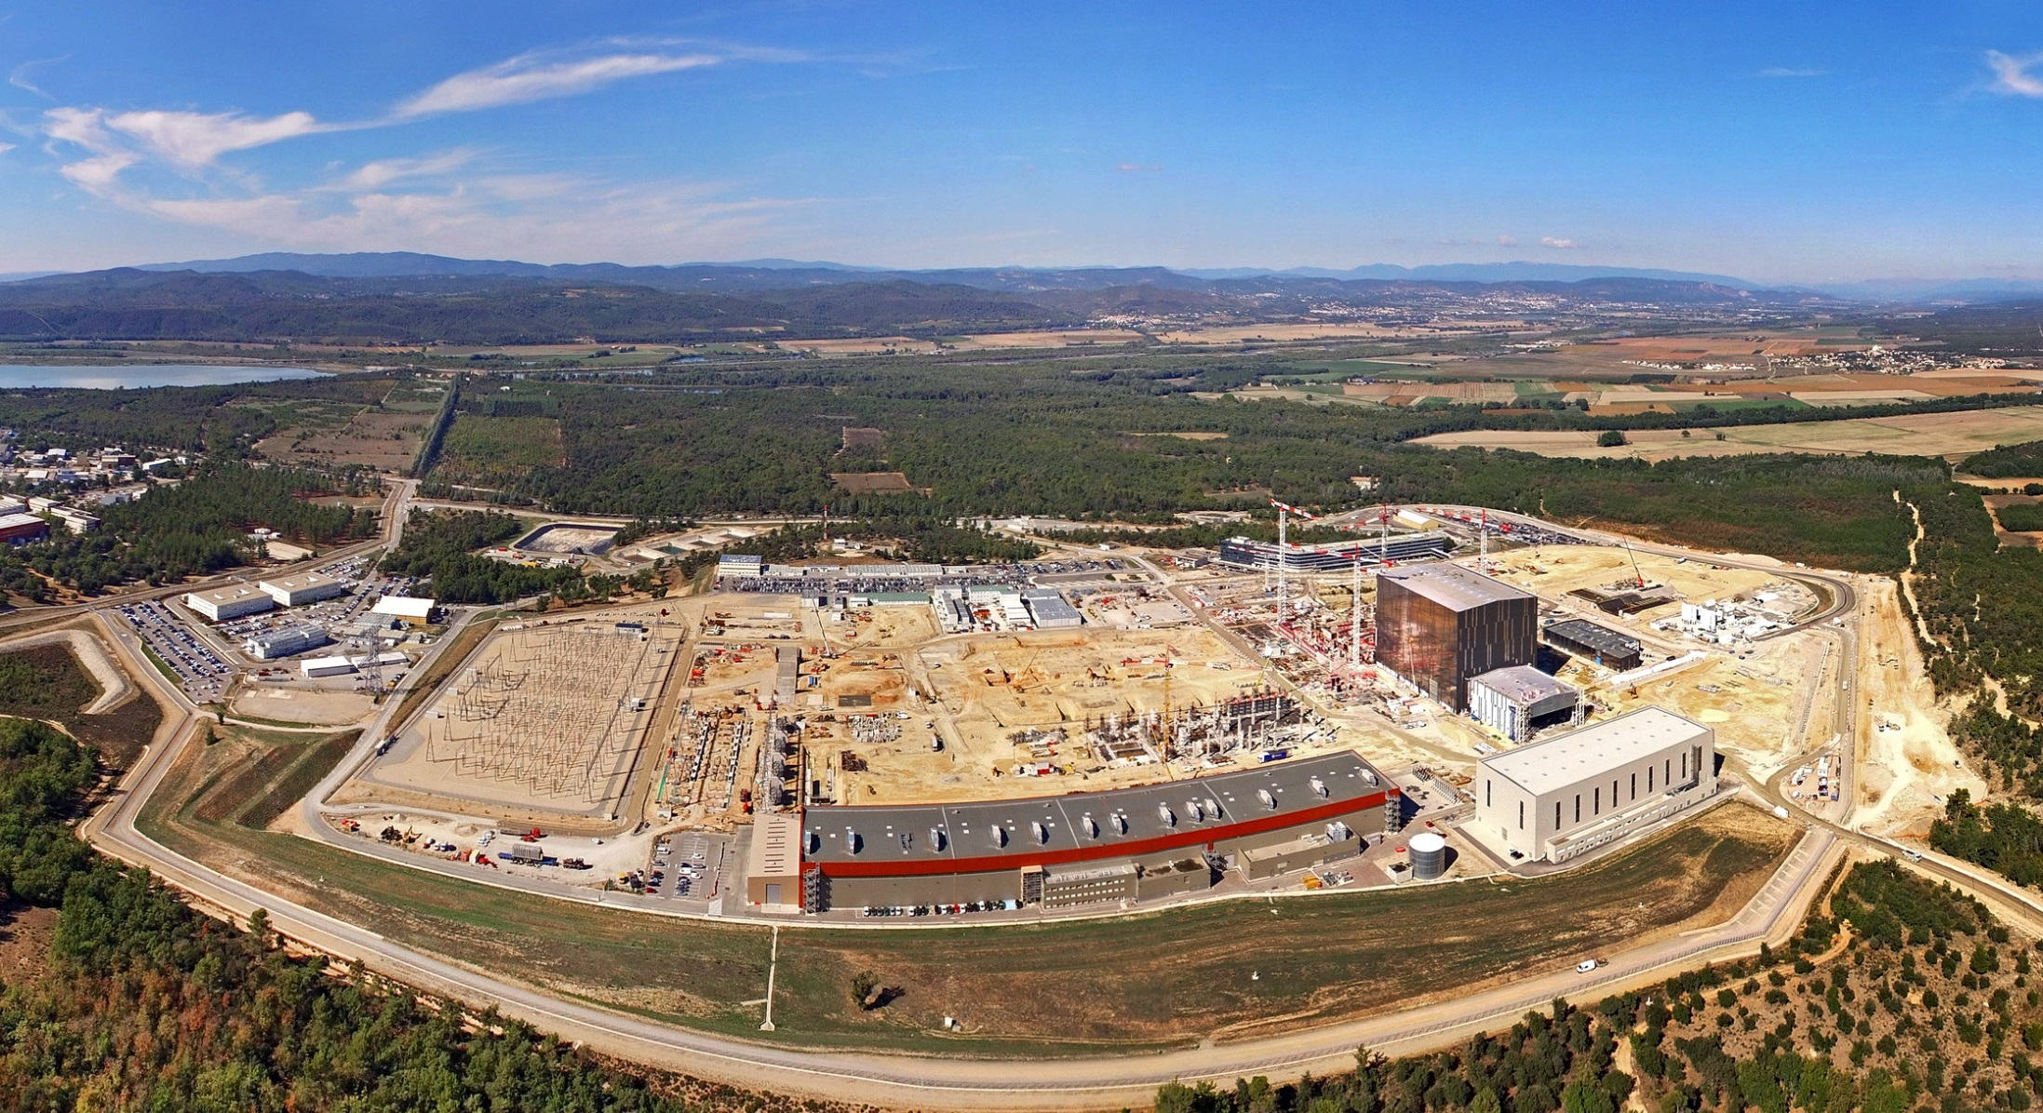
Presentation Overview
Organizational reform
Update on manufacturing and construction
Areas of innovation

Slide 3
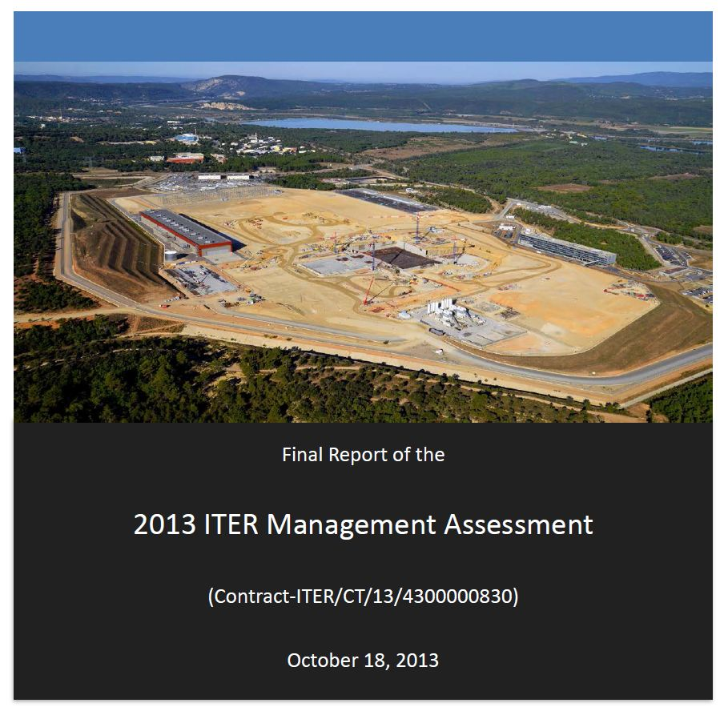
2015: managing the need for change
Action Plan 2015
Set clear priorities and timeline for reform
Reorganized, integrated ITER Central Team with Domestic Agencies
Clear decision processes and accountability
Executive Project Board, Reserve Fund, Project Teams
Finalized and stabilized ITER critical component design
Comprehensive integrated bottom-up review of all activities, systems, structures, and components to build the ITER machine
Developed an optimized resource-loaded schedule for timely, cost-effective construction and operation through D-T plasma. Updated the 2010 Baseline.
Developed and promoted a strong, organization-wide nuclear project culture

Slide 4
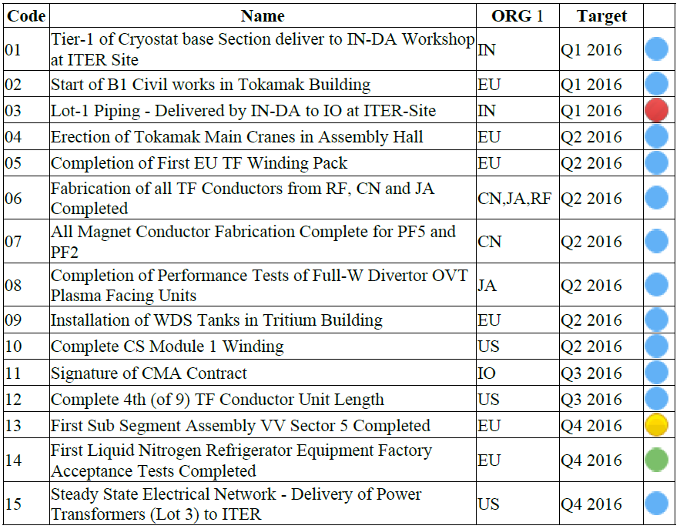
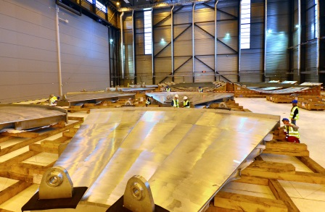
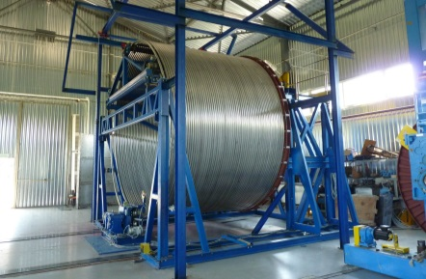
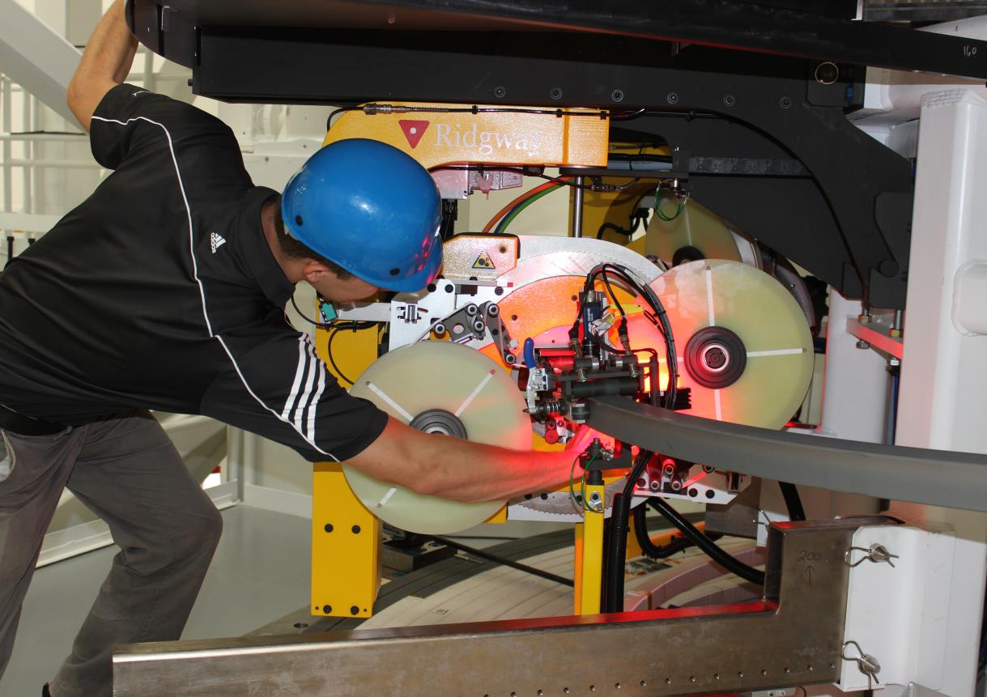
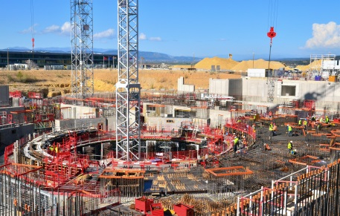
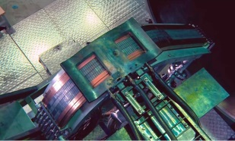
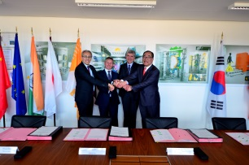
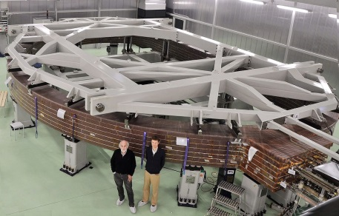
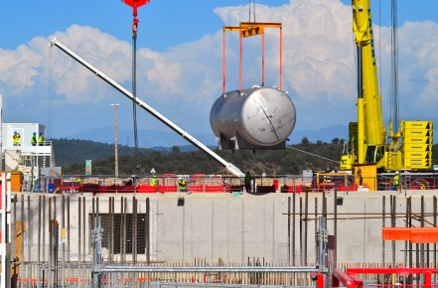
2016: Performance & Follow-through
In November 2015 the ITER Council defined 29 milestones for 2016-2017. 19 milestones set for 2016 were achieved on schedule, on budget. The last one is postponed three months (welding control).
01
06
10
From July 2016 Progress Report
Blue – completed
Green - on schedule
Yellow – delays anticipated
Red – delayed, mitigation needed
02
08
11
...
05
09
Strong performance: meeting demands of external validation while maintaining construction and manufacturing at full pace in accordance with agreed milestones

Slide 5
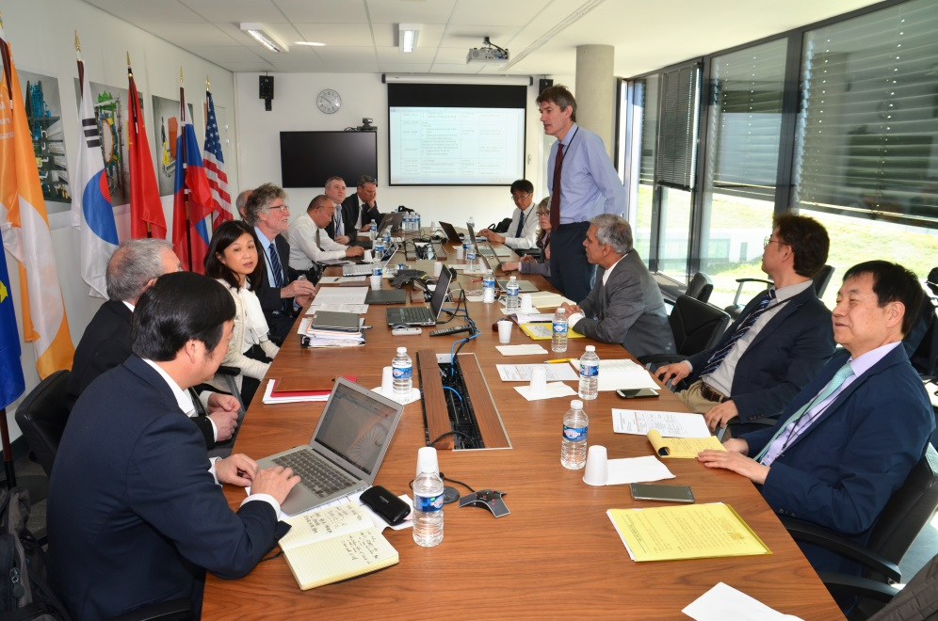
April 2016: intensive, in-depth review by independent expert group declares:
“…substantial improvement in project performance…”
“…high degree of motivation…
“…considerable progress during the past 12 months…”
“…sequence and duration of future activities have been fully and logically mapped in the resource-loaded schedule…”
“…resource estimate is generally complete […] and provides a credible estimate of cost and human resources…”

Slide 6
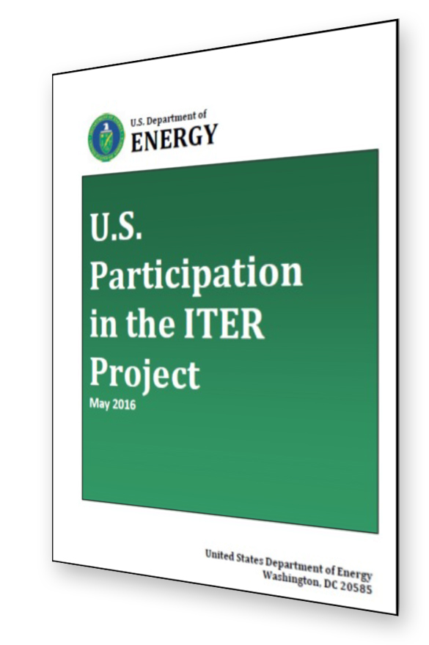
Report to Congress from US Secretary of Energy
“The project appears to be technically achievable, although significant technical and management risks remain.”
“The U.S. ITER in-kind contributions have been designed, constructed and delivered consistent with the key milestones. Four of the twelve U.S. hardware systems are currently in final fabrication.”
“DOE recommends continuing the reforms already underway, implementing additional measures as described in this report, and revisiting this recommendation as part of the FY 2019 budget process (end of 2017 to early 2018).”

Slide 7
A staged approach to DT plasma
Extensive interactions among IO and DAs to finalize revised baseline schedule proposal
Schedule and resource estimates through First Plasma (2025) consistent with Members’ budget constraints
Proposed use of 4-stage approach through Deuterium-Tritium (2035) consistent with Members’ financial and technical constraints

Slide 8
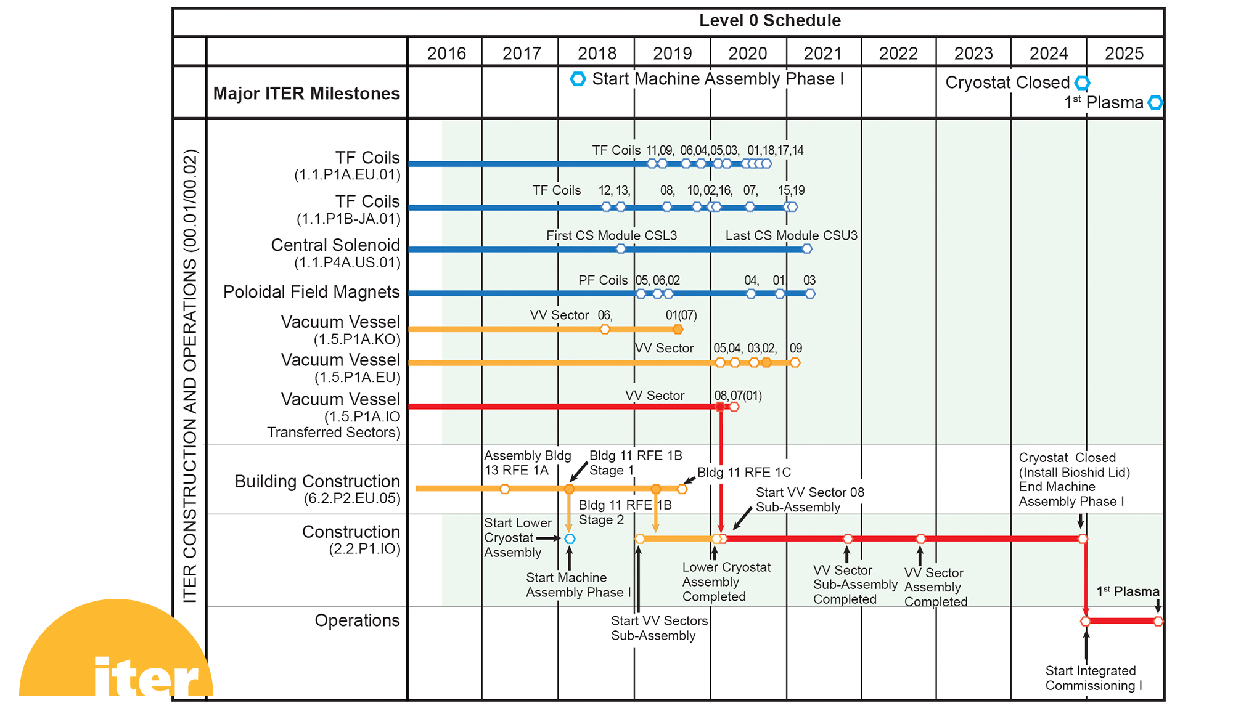
Major assembly milestones

Slide 9
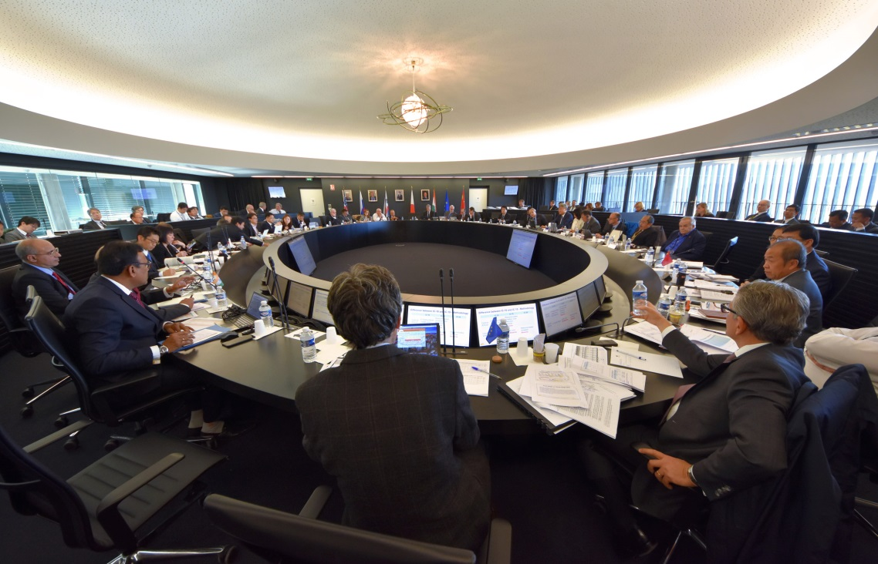
18th & 19th ITER Council endorse updated Schedule
First Plasma in December 2025, first physics experiment in 2028, DT commissioning December 2035.
The updated Schedule is challenging but technically achievable.
It represents the best technically achievable path forward to First Plasma.
Members now have all the elements needed to go through their domestic processes of obtaining approval for the Resource-Loaded Integrated Master Schedule
ITER Council convenes twice a year in June and November at ITER Headquarters

Slide 10
Construction-Management-as-Agent Contract Signed
On 27 June, the ITER Organization signed a 10-year Construction Management-as-Agent (CMA) contract with the MOMENTUM joint venture, to manage and coordinate the assembly and installation of the Tokamak and associated plant systems

Slide 11
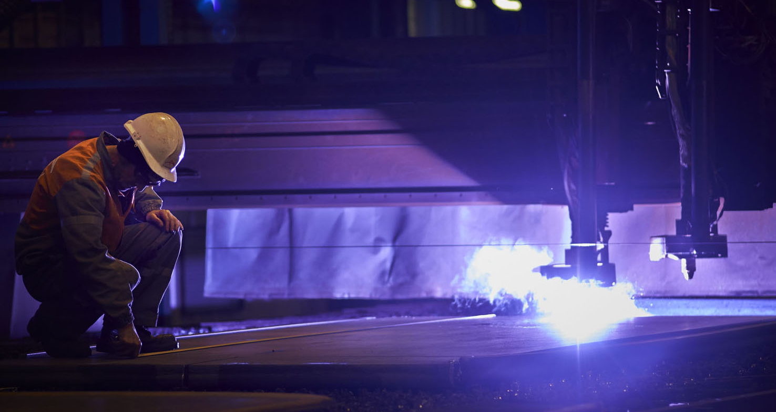
Entering the industrial phase
with highly challenging specifications
Manufacturing of ITER components is taking place at the cutting edge of technology:
Geometrical tolerances measured in millimetres for steel pieces up to 17 m tall weighing several tons
Superconducting power lines cooled to minus 270 degrees Celsius
Plasma facing components to withstand heat flux as large as 20 MW per m²
Cryoplant cooling capacity up to 110 kW at 4.5 K; maximum cumulated liquefaction rate of 12,300 litres/hr
Etc.

Slide 12
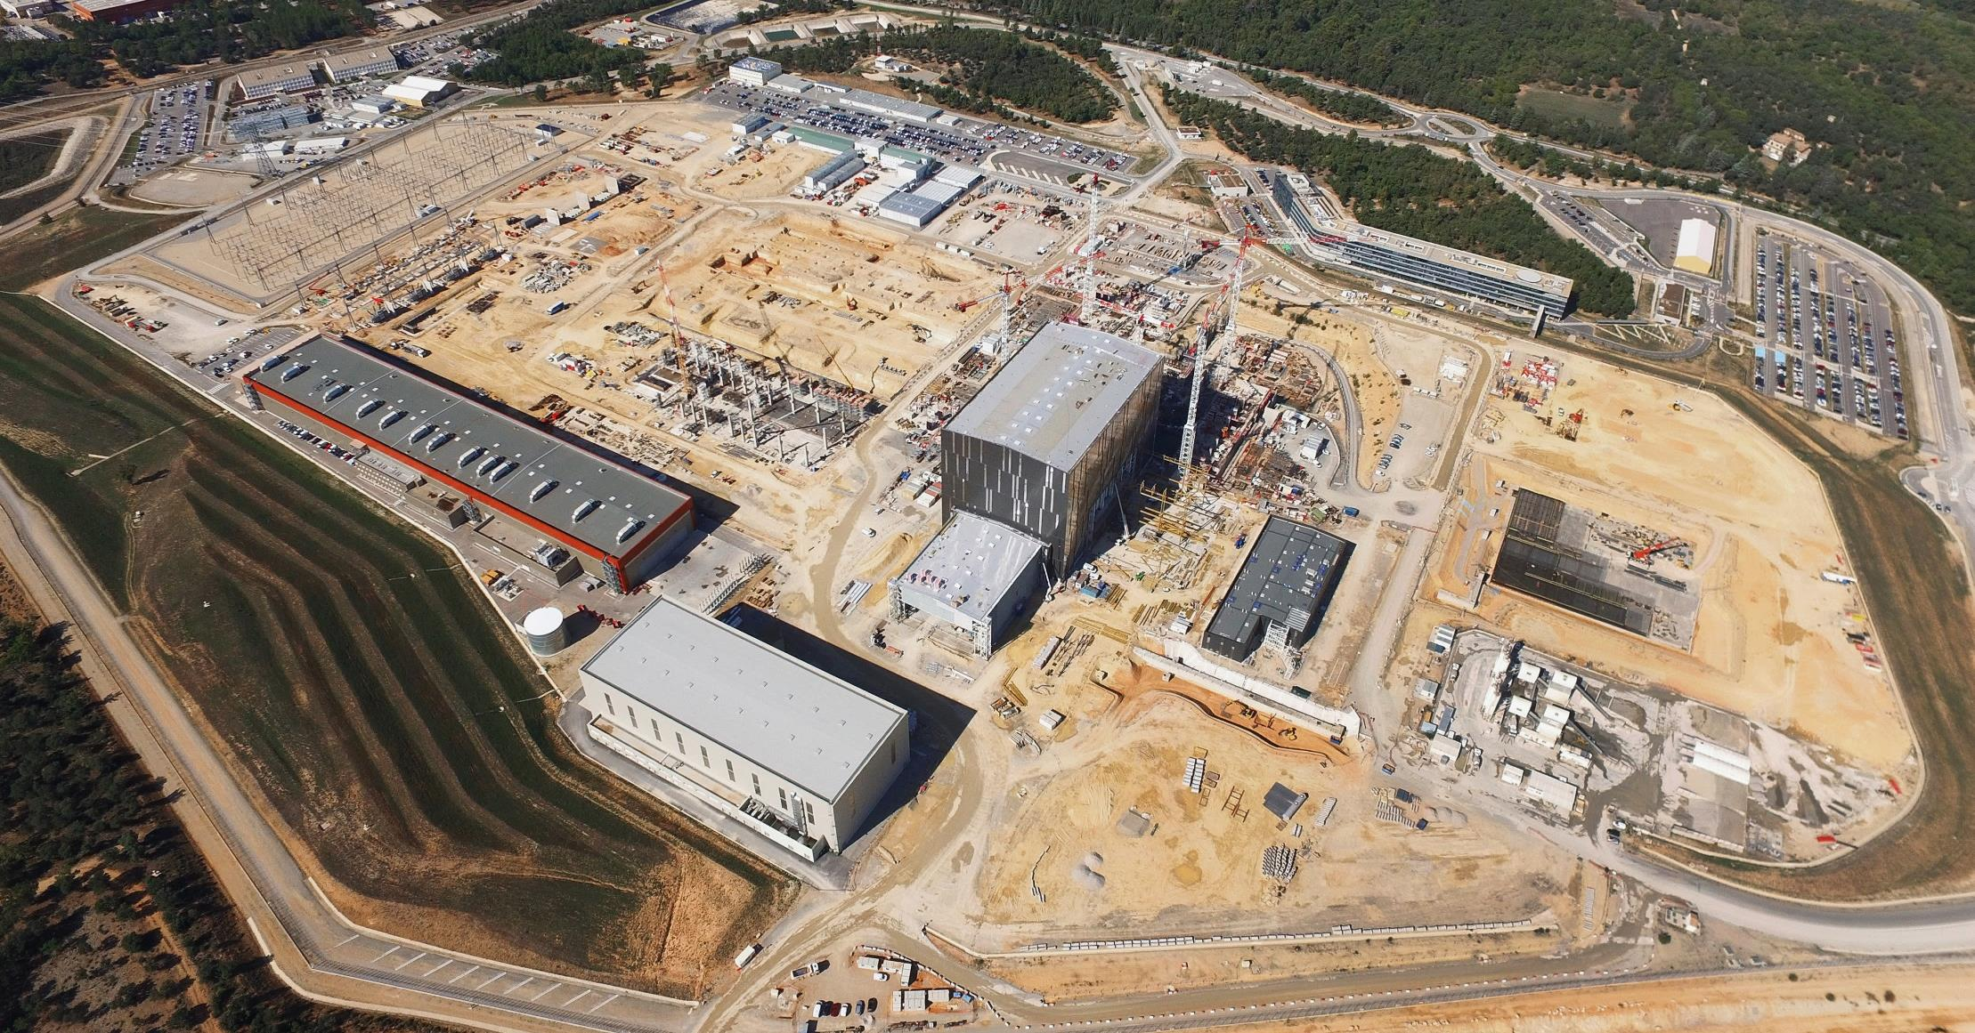
Worksite progress
ITER IO Headquarters
400 kV switchyard
Contractors area
Preparatory works
Magnet Conversion Power
Tokamak Complex
Construction underway
Assembly Hall
Being equipped
Transformers
Preparatory works
Control building
Construction underway
RF Heating
Being equipped
Service Building
PF Coil winding facility
Construction underway
Cooling water system
Cryostat workshop
Construction underway
Cryoplant
Construction underway
Cleaning facility
(October 2016)

Slide 13
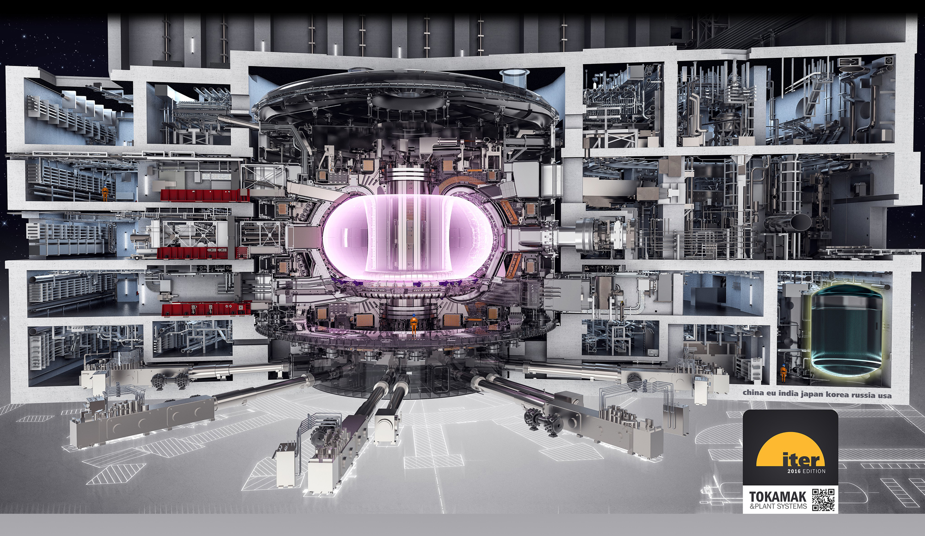
Tokamak Complex

Slide 14
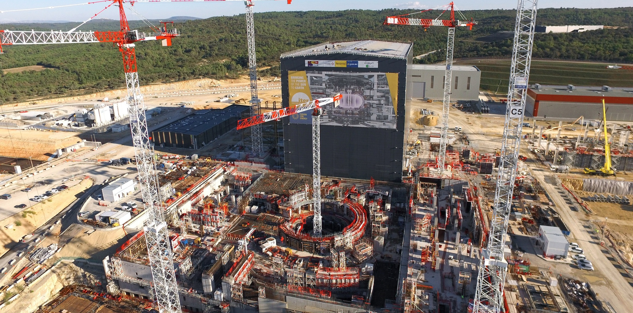
Tokamak Complex
Resting on 493 seismic pads, the 440 000-ton Tokamak Complex comprises 7 levels (2 underground).

Slide 15
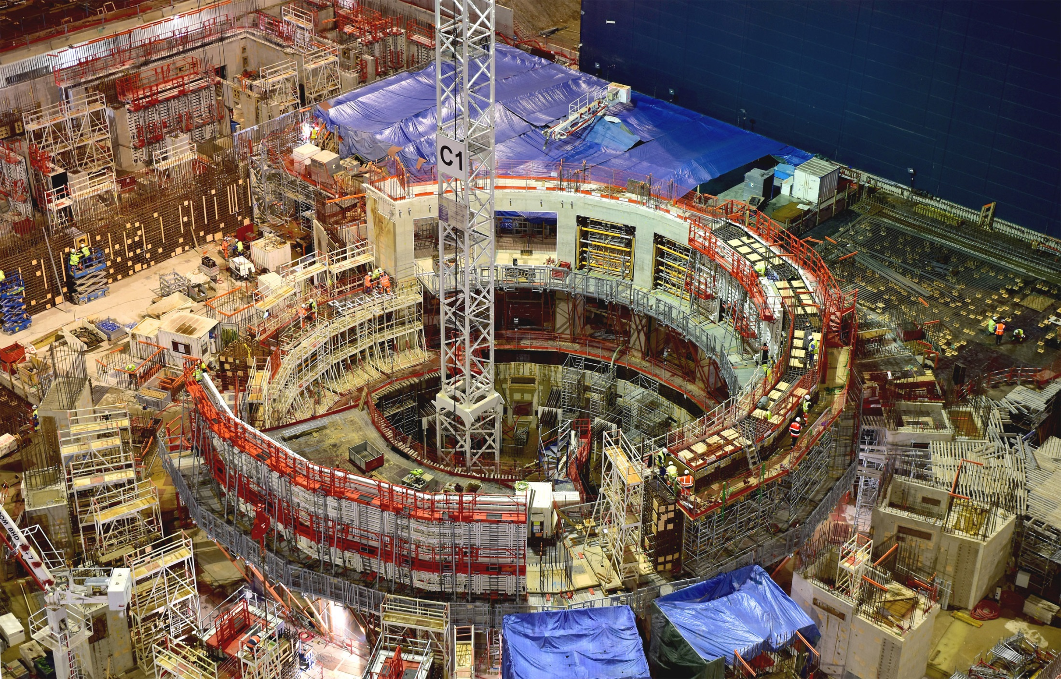
Tokamak Complex
Resting on 493 seismic pads, the 440 000-ton Tokamak Complex comprises 7 levels (2 underground).

Slide 16
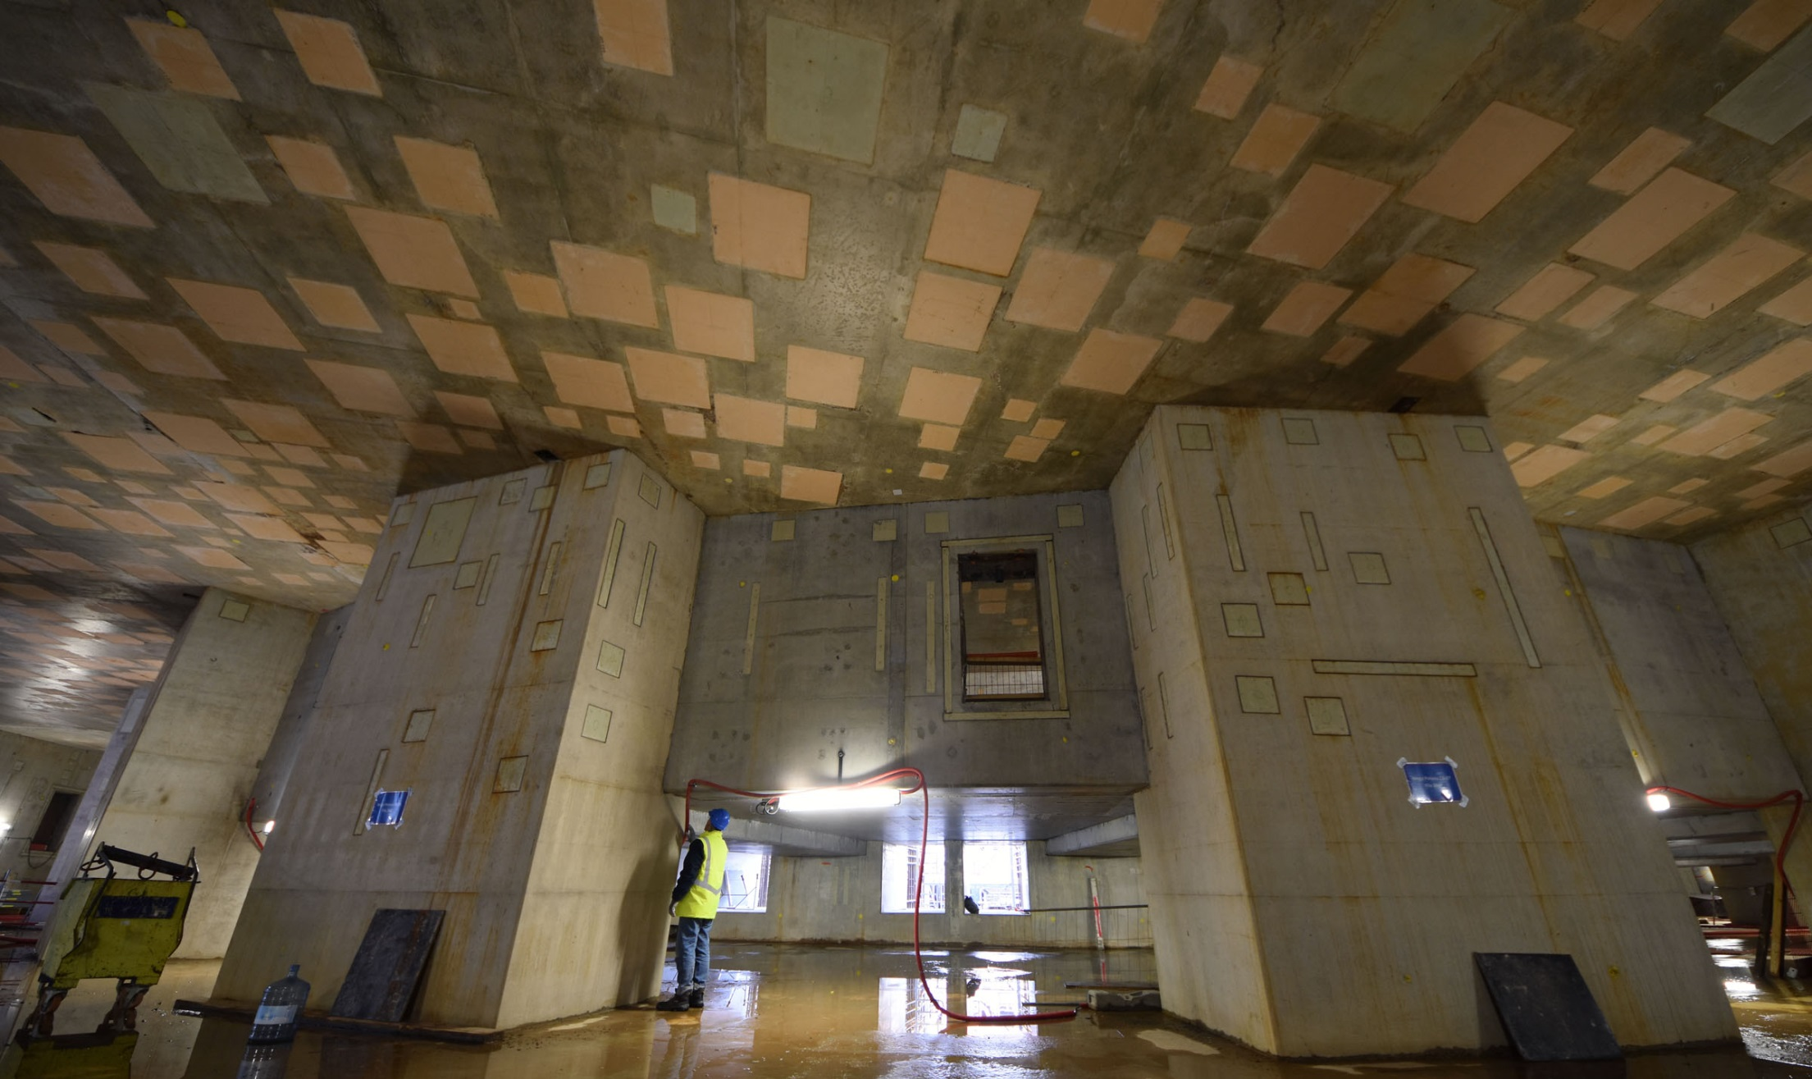
Tokamak Complex
Sub-basement
Resting on 493 seismic pads, the 440 000-ton Tokamak Complex comprises 7 levels (2 underground).

Slide 17
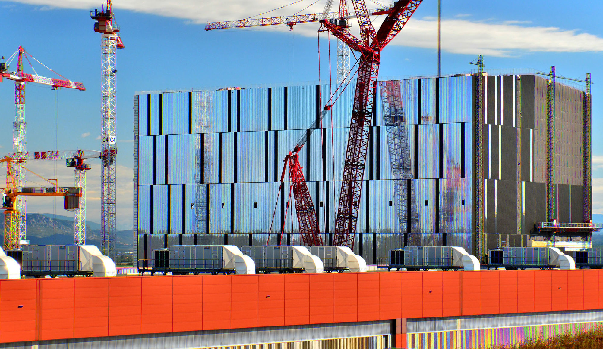
Assembly Hall
Before being integrated in the machine, the components will be prepared and pre-assembled in this 6,000 m2, 60-metre high building. The Assembly Hall is equipped with a double overhead travelling crane with a total lifting capacity of 1,500 tons.

Slide 18
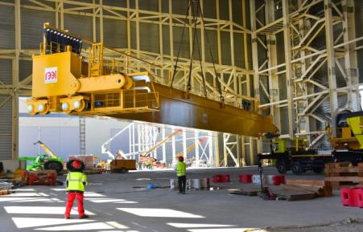
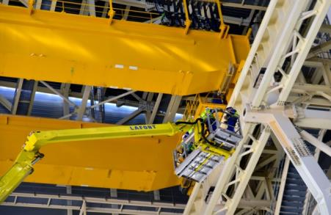
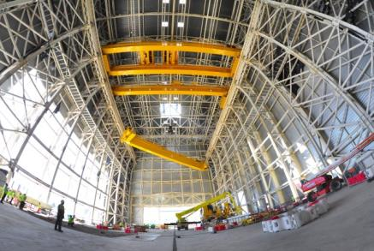
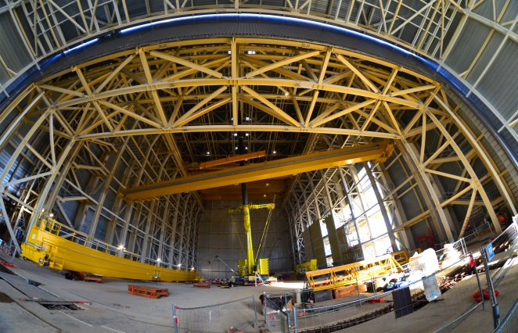
Assembly Hall
43 metres above the building’s basemat the double overhead crane is now installed
On 14 June lifting operations begin.
Each pair of cranes will have a lifting capacity of 750 tons.
On 22 June, the 4 beams and 2 of 4 trolleys (100 t.) are installed.
An auxiliary overhead crane (50 t) was installed on 8 December 2016

Slide 19
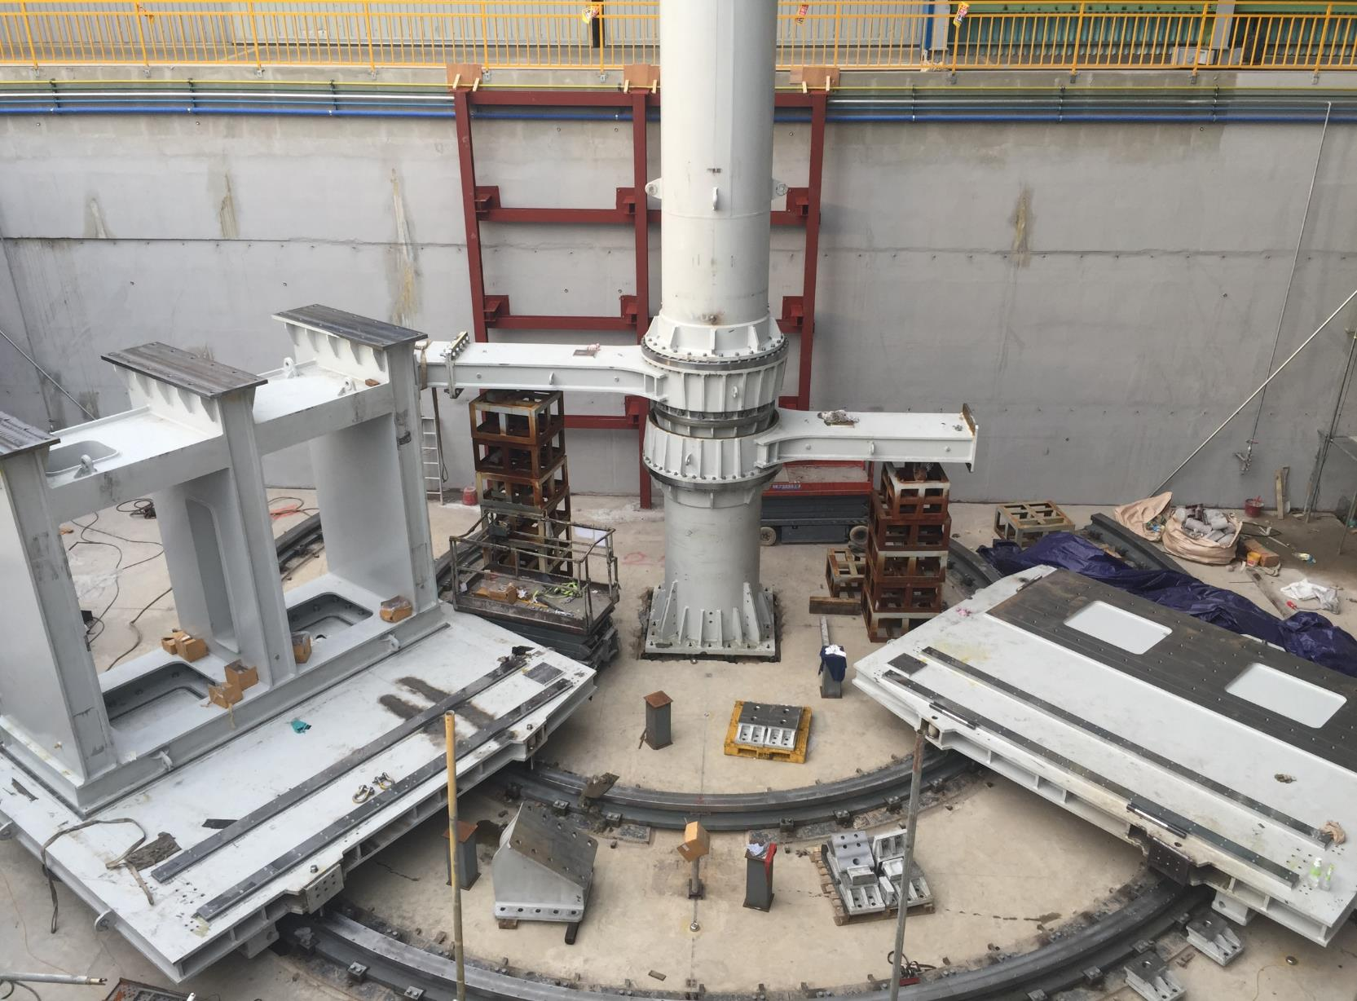
Assembly of SSAT-1 in Factory
Moving unit installation on toroidal rail for rotation (below moving plate)
Hydraulic jack and guide installation for vertical adjustment

Slide 20
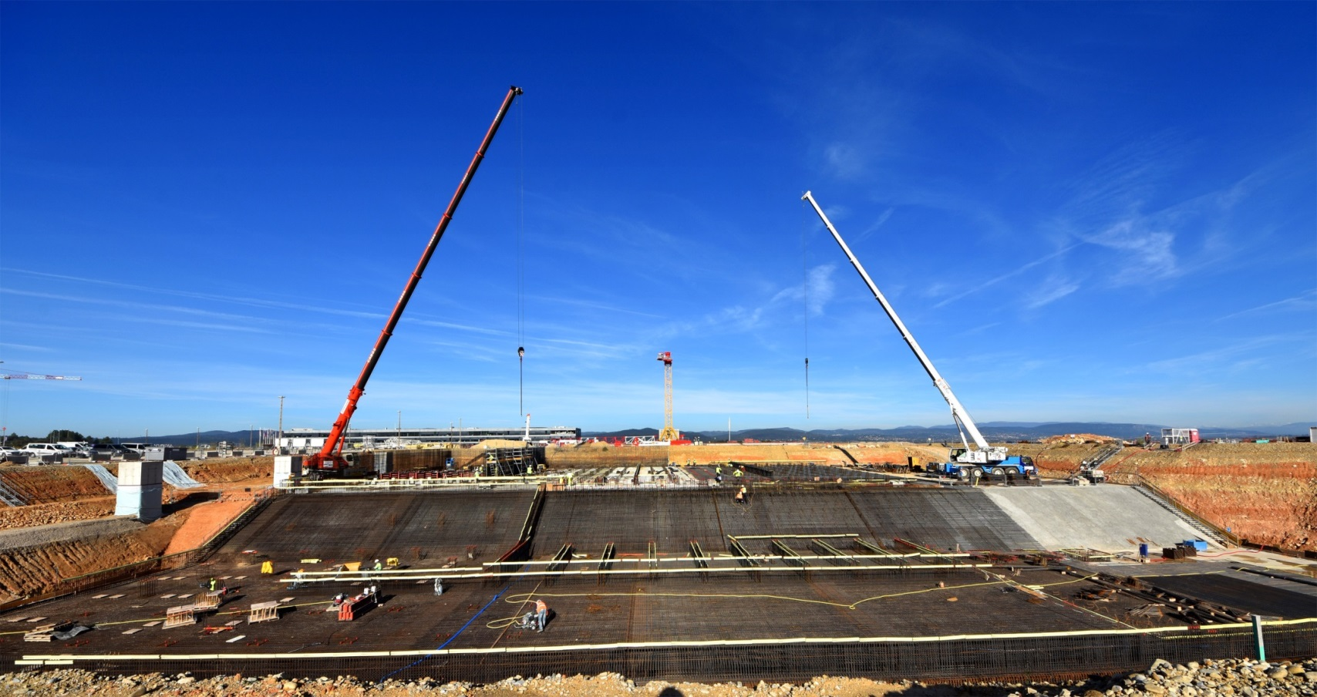
Cooling water systems
ITER power will be partly evacuated by cooling towers (procured by India). Work on the “hot” and “cold” basins’ foundations began in August.

Slide 21
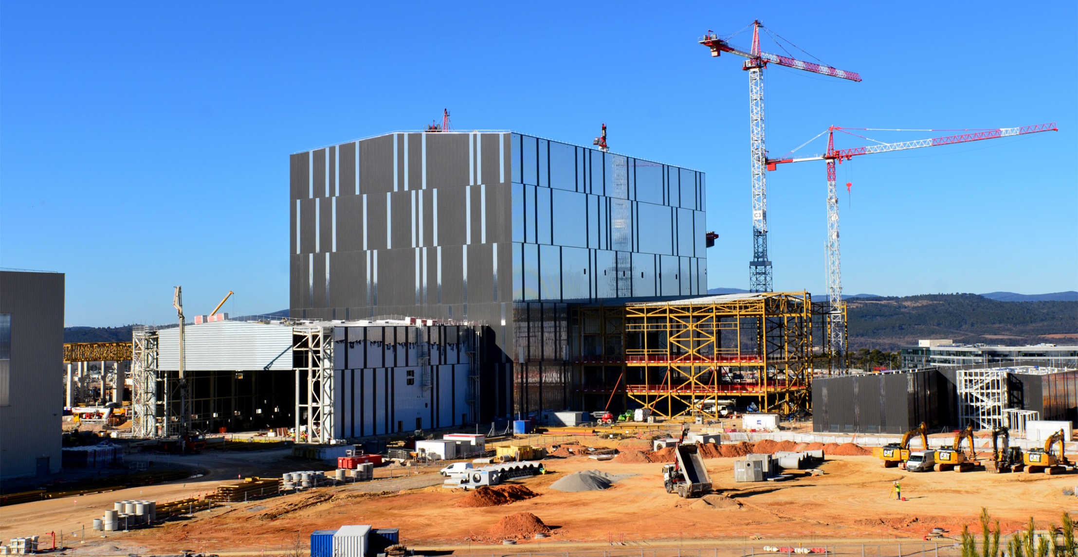
Radiofrequency
heating
Adjacent to the Assembly Hall, the building that will house the plasma heating systems (microwave and radio frequency) is being built.

Slide 22
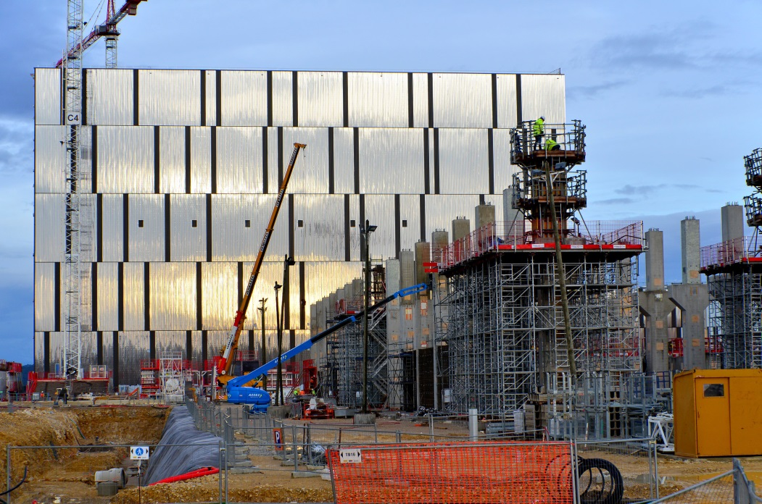
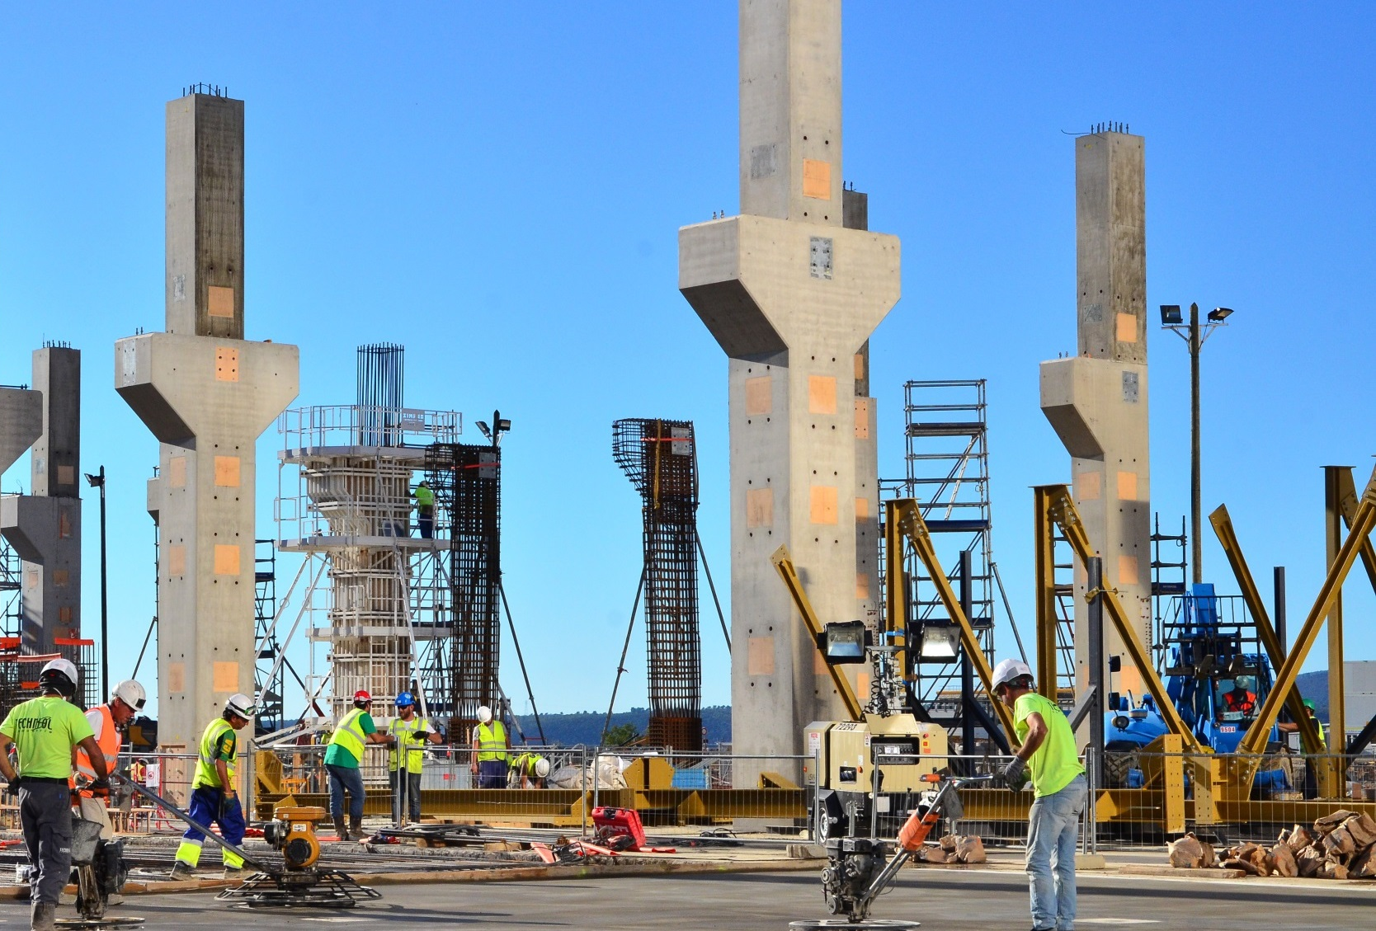
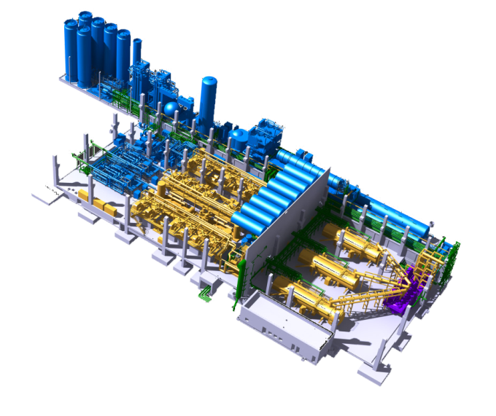
Cryoplant
Foundation works and column construction are ongoing on what will be the largest single platform cryoplant in the world. The ITER Cryoplant will distribute liquid helium and nitrogen to various machine components (supraconducting magnets, thermal shield, cryopumps, etc.).

Slide 23
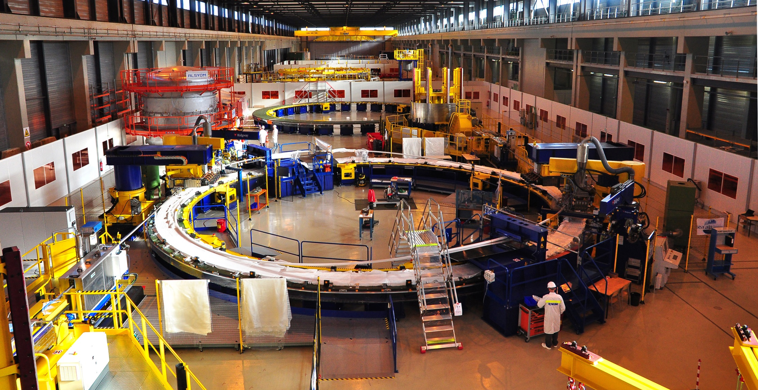
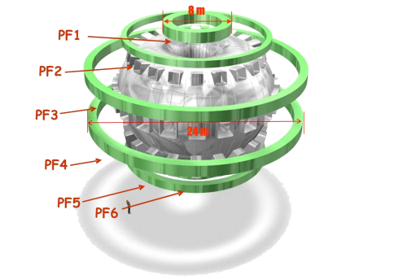
PF Coil winding facility
Too large to be transported by road, four of ITER’s six ring-shaped magnets (the poloidal field coils, 8 to 24 m in diametre) will be assembled by Europe in this 12,000 m² facility. Fabrication of a dummy for PF Coil # 5 (17 m. in diametre) is ongoing.

Slide 24
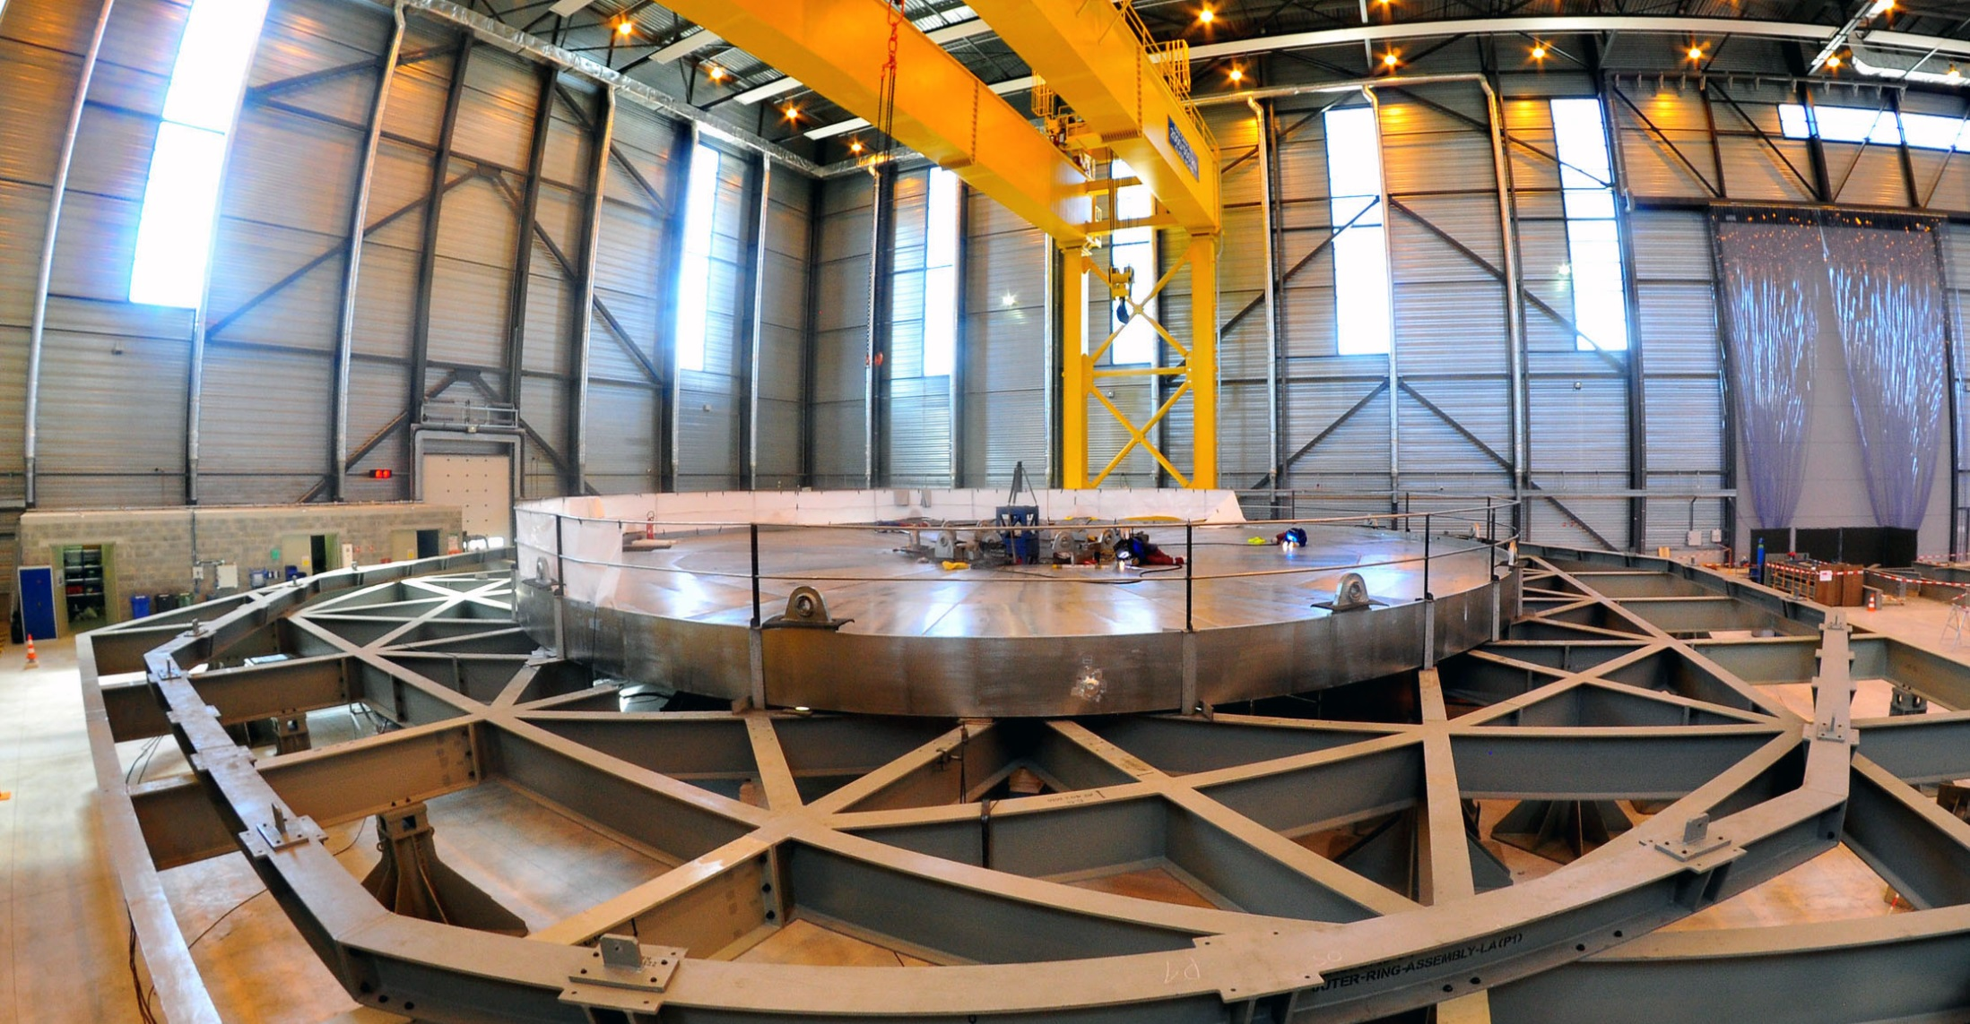
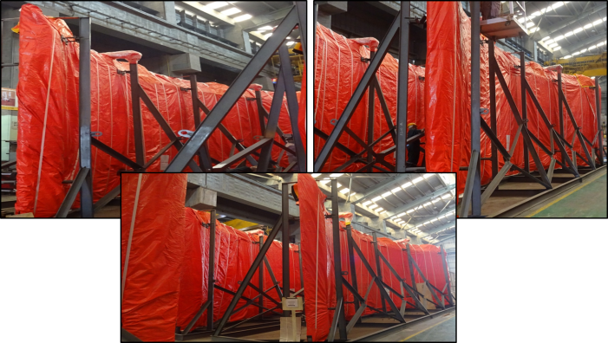
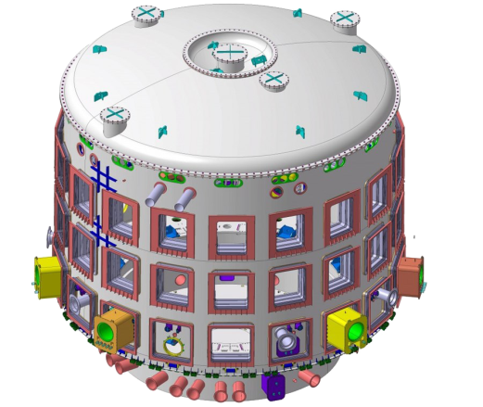
Cryostat workshop
All six sector of LC Tier-1 are packed and ready for shipment
Manufactured in India, the 30 m x 30 m cryostat (the insulating vacuum vessel that encloses the machine) is being assembled and welded on site. Welding operations for the base section (1 250 t.) is complete; verification of welds –helium test and radiography) are ongoing.

Slide 25
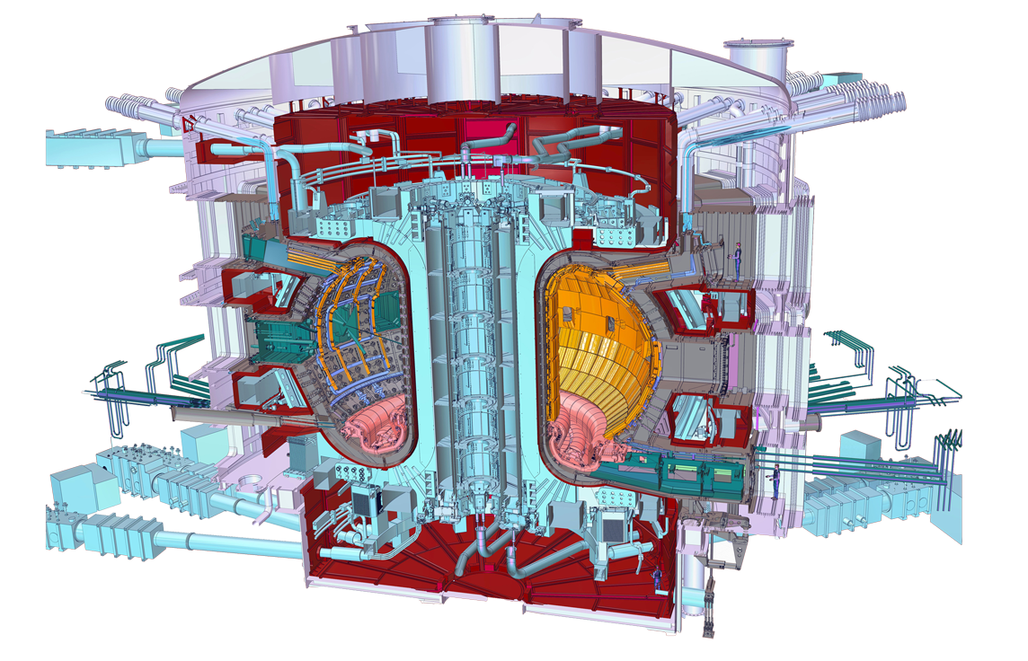
Who manufactures what? The ITER Members share all intellectual property
Cryostat
Feeders (31)
Thermal shield
Toroidal Field coils (18)
Vacuum vessel
Poloidal field coils (6)
Blanket modules
Correction coils (18)
Central solenoid (6)
Divertor

Slide 26
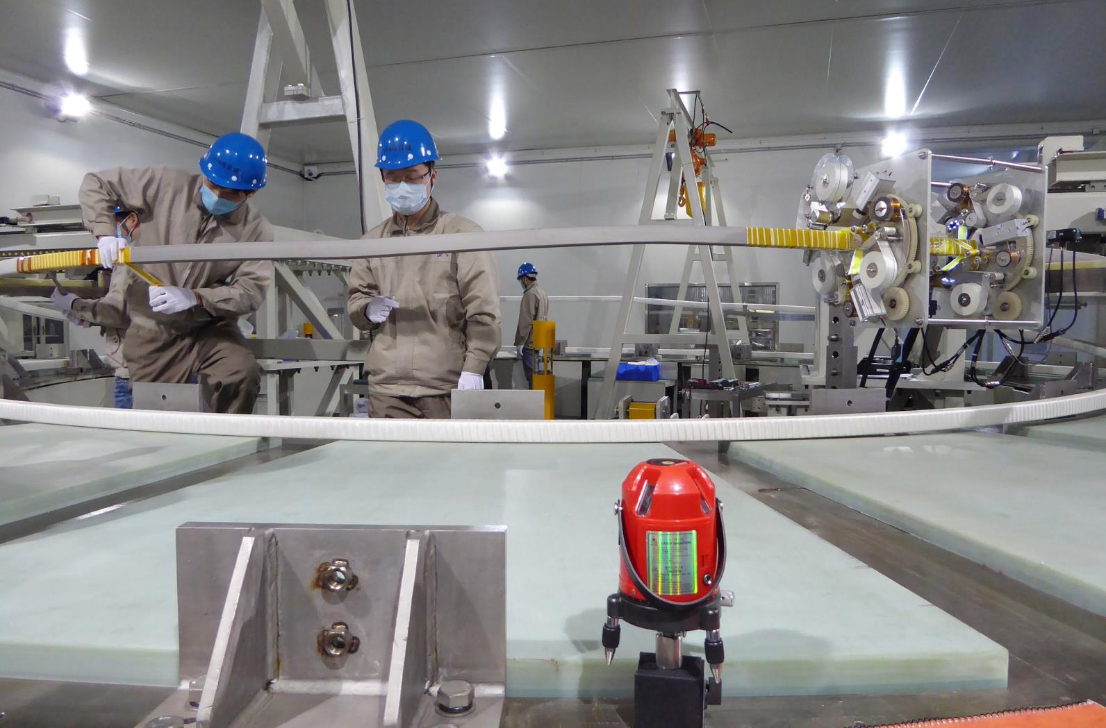
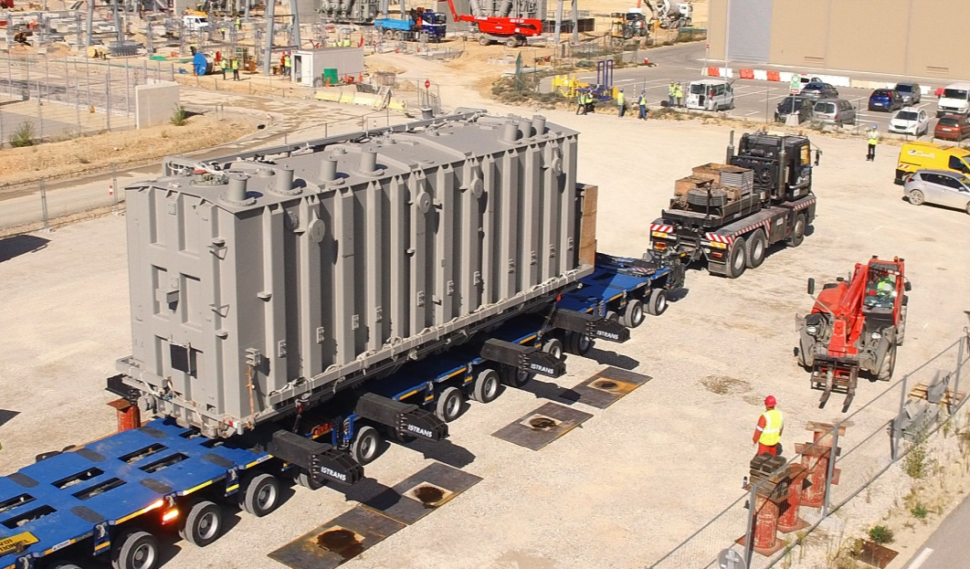
Manufacturing progress
China
Tooling for Poloidal Field coil #6 (350 tons, 10 meters in diameter), is now complete and being commissioned.
The first of three power transformers for the pulsed electrical network is being equipped on site.
Magnet Systems, Power Systems, Blanket, Fuel Cycle, Diagnostics

Slide 27
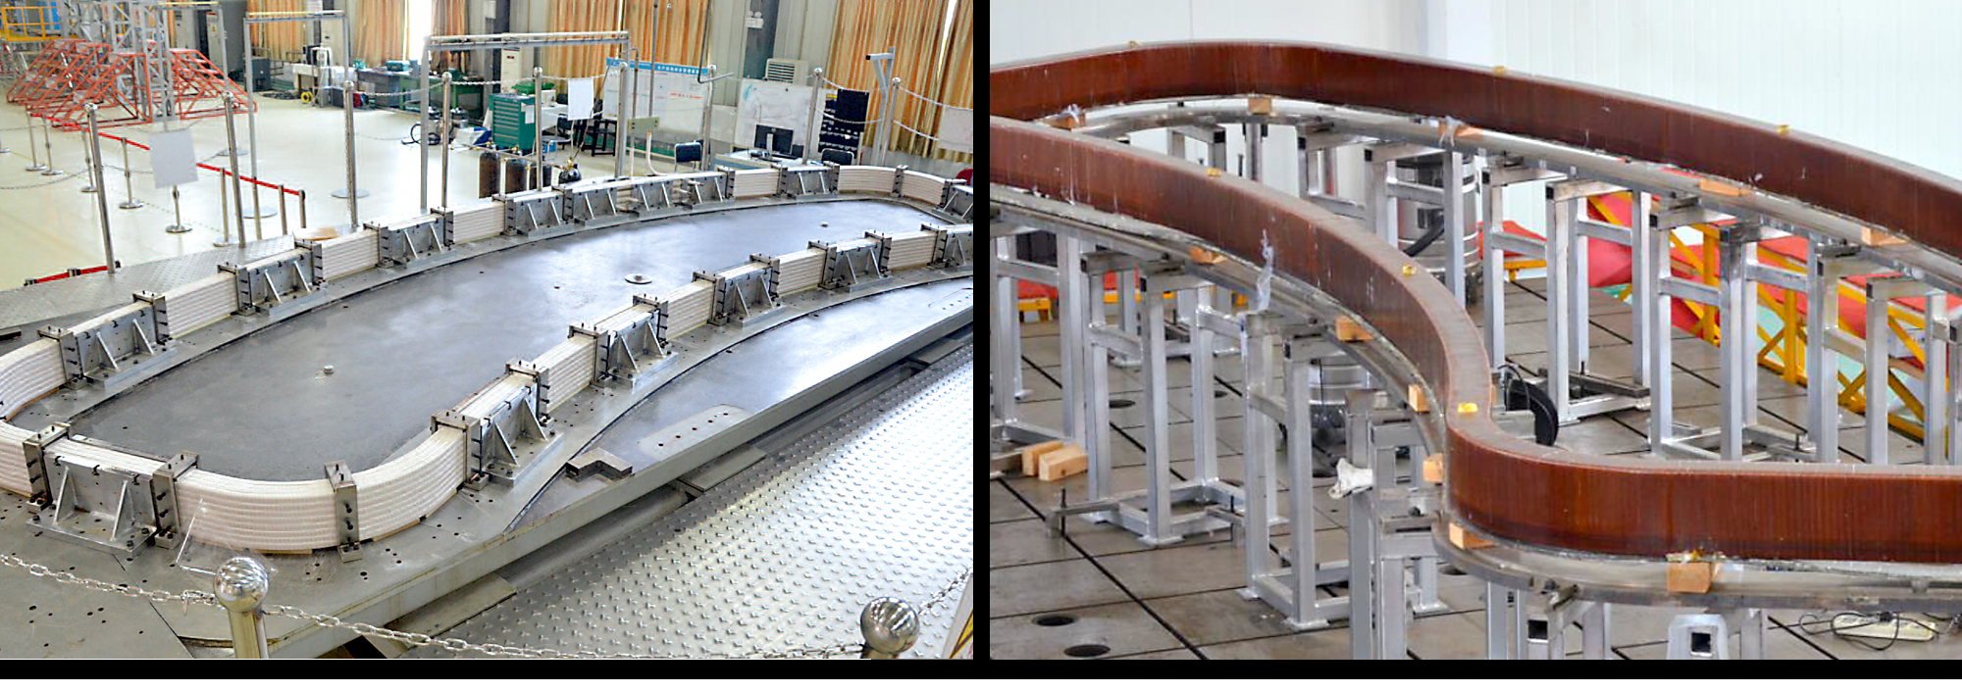
Manufacturing progress
China
At ASIPP, the first-of-series, multiple-pancake bottom correction coil winding is prepped for the wrapping of ground insulation.
Correction coil vacuum pressure impregnation of a dummy double pancake at ASIPP.
Magnet Systems, Power Systems, Blanket, Fuel Cycle, Diagnostics

Slide 28
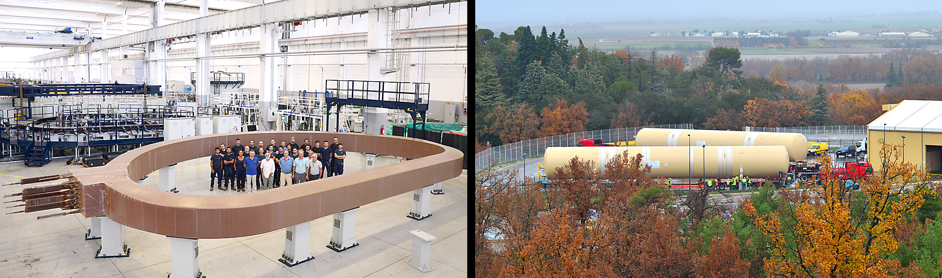
Manufacturing progress
Europe
The first resin impregnated toroidal field coil winding pack was completed at ASG in La Spezia, Italy.
Quench tanks for the ITER cryoplant have been delivered to the site.
Buildings, Magnet Systems, Heating & Current Drive Systems, Vacuum Vessel, Divertor, Blanket, Power Systems, Fuel Cycle, Tritium Plant, Cryoplant, Diagnostics, Radioactive Materials

Slide 29
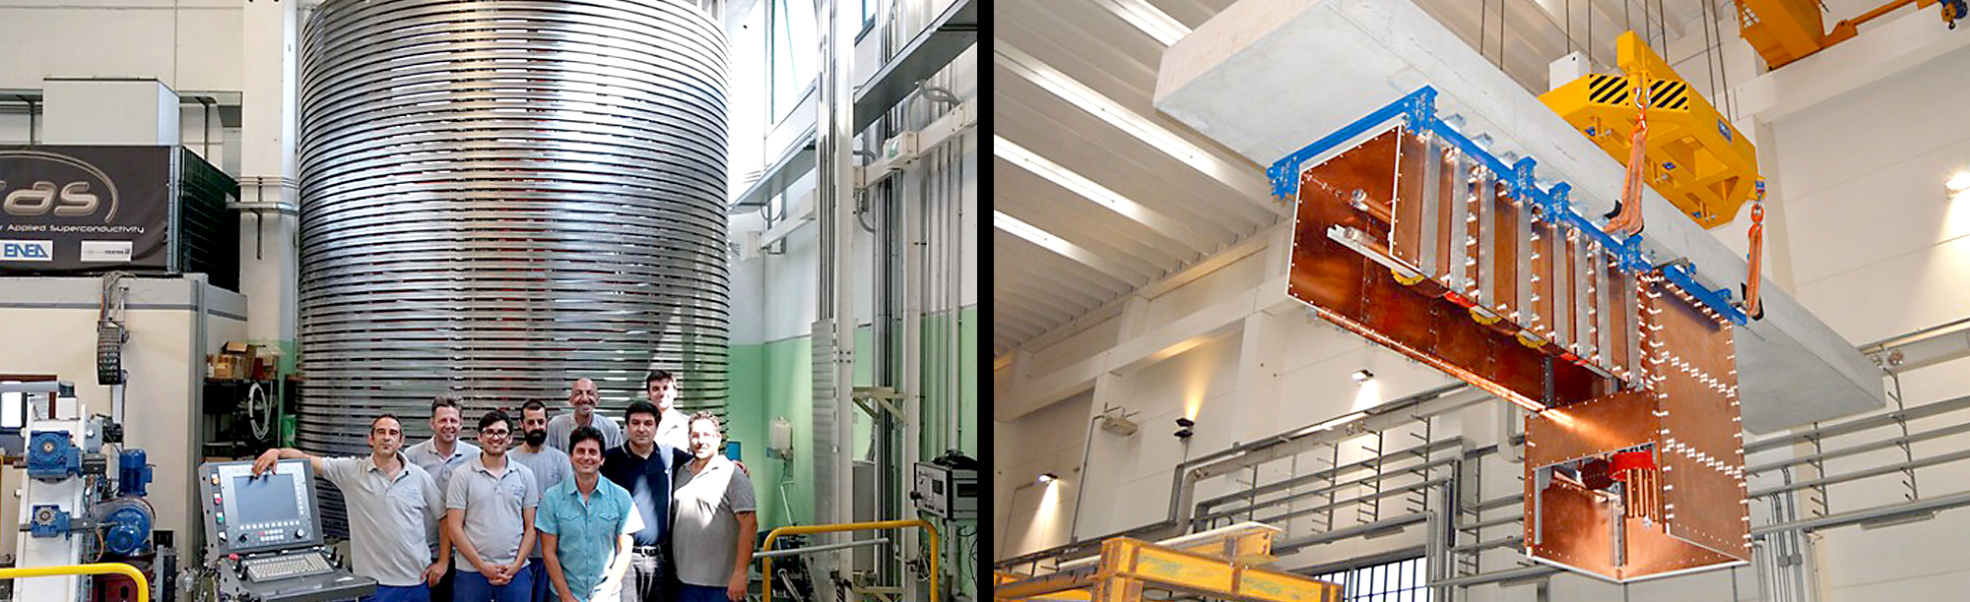
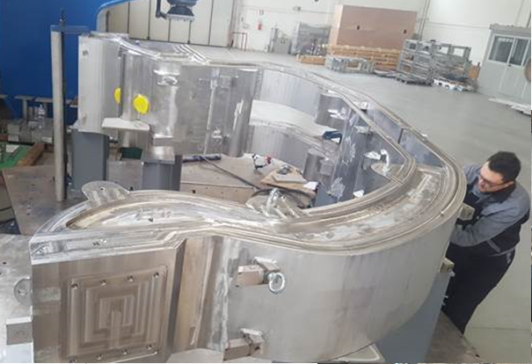
Manufacturing progress
Europe
The manufacturing of the Full-scale Divertor Cassette Body Prototype is well advanced.
Part of the 35m transmission line connected to the SPIDER vessel at the Neutral Beam Testing Facility (NBTF) site in Padua, Italy.
Buildings, Magnet Systems, Heating & Current Drive Systems, Vacuum Vessel, Divertor, Blanket, Power Systems, Fuel Cycle, Tritium Plant, Cryoplant, Diagnostics, Radioactive Materials

Slide 30
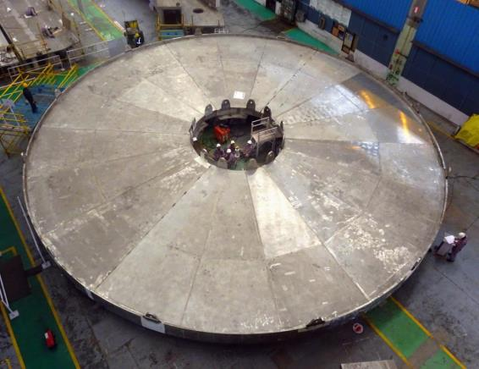
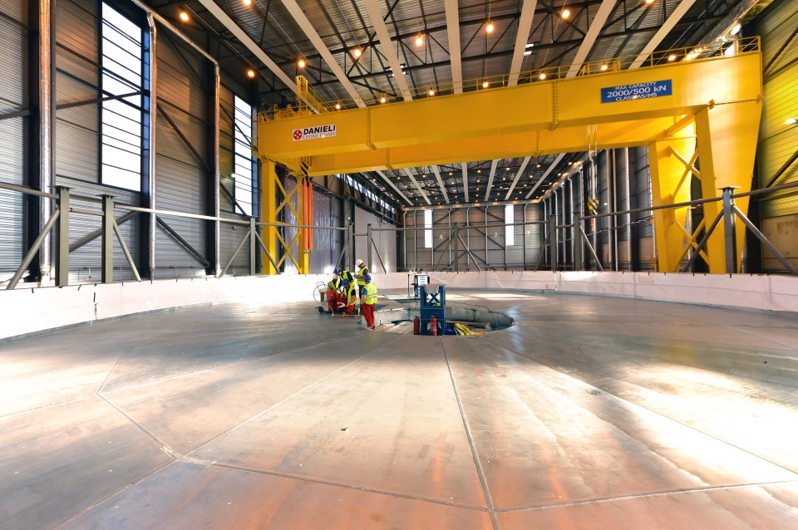
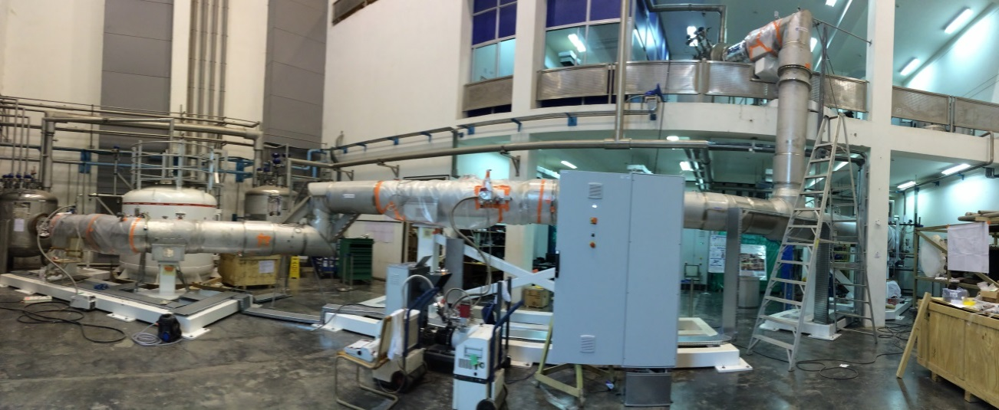
Manufacturing progress
India
India is responsible for fabrication and assembly of the 30 x 30 meter ITER cryostat. The base plates for Tier 1 & 2 have been delivered to ITER.
Prototype Cryoline have been successfully tested at ITER-India.
Cryostat, Cryogenic Systems, Heating and Current Drive Systems, Cooling Water System, Vacuum Vessel, Diagnostics

Slide 31
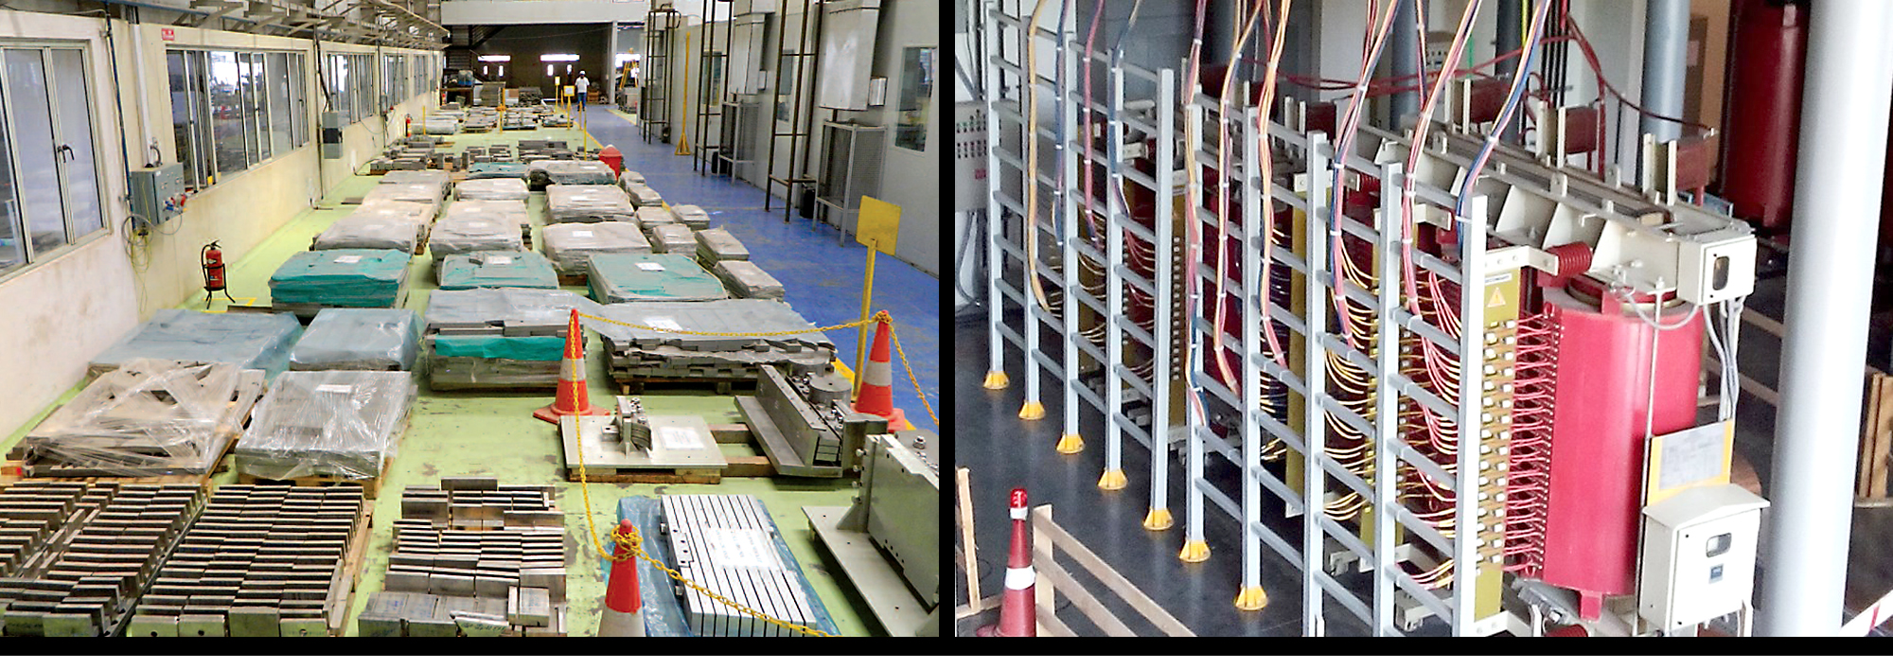
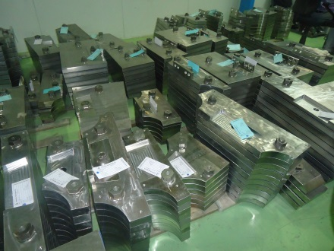
Manufacturing progress
India
Thousands of in-wall shielding pieces have been manufactured, passed factory acceptance, and are being prepared for shipment.
A 3 MW radio frequency high voltage power supply was successfully operated at ITER parameters.
Cryostat, Cryogenic Systems, Heating and Current Drive Systems, Cooling Water System, Vacuum Vessel, Diagnostics
Indian contractor Larsen & Toubro has completed the welding, non-destructive examination and trial assembly of this 30-metre transportation frame/assembly and welding support for the ITER cryostat. It will now be disassembled and shipped in sections to the ITER site.

Slide 32
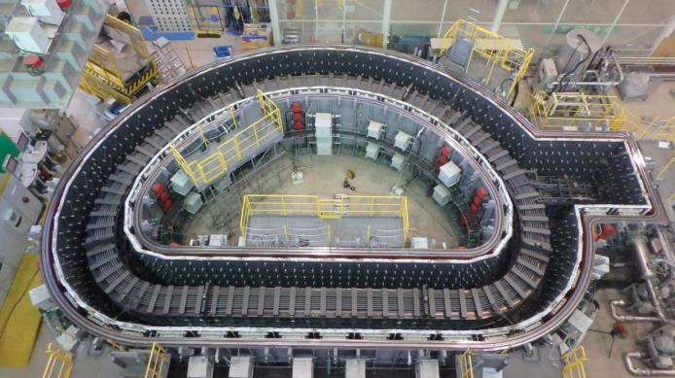
Manufacturing progress
Japan
Toroidal field coil high-temperature treatment to form niobium-tin supraconductor compound.
Connection of segments for the first inboard Toroidal Field Coil structure.
Magnet Systems, Heating & Current Drive Systems, Remote Handling, Divertor, Tritium Plant, Diagnostics

Slide 33
Manufacturing progress
Japan
Series production of central solenoid conductor continues. 28 of 49 conductors have already been shipped to the US.
Assembly tests on the 1 MV bushing at Hitachi for the full-scale ITER neutral beam injector.
Magnet Systems, Heating & Current Drive Systems, Remote Handling, Divertor, Tritium Plant, Diagnostics

Slide 34
Manufacturing progress
Korea
At Hyundai Heavy Industries, welding on the upper section of the inner shell for Sector #6.
Welding operations of the first 800-ton Sector Sub-Assembly Tool, one of 128 purpose-built tools for assembly.
Vacuum Vessel, Blanket, Power Systems, Magnet Systems, Thermal Shield, Assembly Tooling, Tritium Plant, Diagnostics

Slide 35
Manufacturing progress
Korea
At Sam Hong Machinery in Changwon, fabrication is progressing on all nine 40° thermal shield sectors, including outboard welding.
Staff inspects the outboard columns of the giant sector sub-assembly tool at Taekyung Heavy Industries in Changwon.
Vacuum Vessel, Blanket, Power Systems, Magnet Systems, Thermal Shield, Assembly Tooling, Tritium Plant, Diagnostics

Slide 36
Manufacturing progress
Russia
Fabrication and qualification tests of PF1 winding pack stack sample were successfully completed.
Winding of first double pancake for poloidal field coil #1 inside the clean room.
Power Systems, Magnet Systems, Blanket, Divertor, Vacuum Vessel, Diagnostics, Heating & Current Drive Systems

Slide 37
Manufacturing progress
Russia
Russia completed its share of toroidal field conductor in June 2015, marking the end of a 5-year campaign to manufacture 28 production lengths (more than120 tons of material).
Welding of double-wall parts of the Upper Port Stub Extensions #12 and 02 for the vacuum vessel are complete.
Power Systems, Magnet Systems, Blanket, Divertor, Vacuum Vessel, Diagnostics, Heating & Current Drive Systems

Slide 38
Manufacturing progress
USA
General Atomics is fabricating the 1000-ton Central Solenoid (CS). In April 2016, winding of the first CS module was completed.
Module tooling stations are in place and being commissioned, including the heat treatment furnace shown here.
Cooling Water System, Magnet Systems, Diagnostics, Heating & Current Drive Systems, Fuel Cycle, Tritium Plant, Power Systems

Slide 39
Manufacturing progress
USA
The turn insulation station wraps each bar of conductor
with Kapton® fiberglass tape.
The top plate of the central solenoid assembly platform during fabrication at Robatel.
Cooling Water System, Magnet Systems, Diagnostics, Heating & Current Drive Systems, Fuel Cycle, Tritium Plant, Power Systems

Slide 40
Manufacturing progress
USA
Forging of a tie-plate first article. The tie-plates are part of a substantial structural cage surrounding the central solenoid magnet.
After forging, the tie-plates are machined to required specifications.
Cooling Water System, Magnet Systems, Diagnostics, Heating & Current Drive Systems, Fuel Cycle, Tritium Plant, Power Systems

Slide 41
Manufacturing progress
USA
The cryoviscous compressor full-scale prototype was successfully tested at the ORNL Spallation Neutron Source cryo facility.
A roots pump prototype has been successfully tested at ORNL.
Cooling Water System, Magnet Systems, Diagnostics, Heating & Current Drive Systems, Fuel Cycle, Tritium Plant, Power Systems

Slide 42
Manufacturing progress
USA
A blower for cooling transmission lines will be tested on the high-powered ORNL resonant test line.
A radio-frequency discharge system for diagnostic mirror cleaning is in development and testing. [Inset: Electron cyclotron emission prototype developed at General Atomics and tested on DIII-D.]
Cooling Water System, Magnet Systems, Diagnostics, Heating & Current Drive Systems, Fuel Cycle, Tritium Plant, Power Systems

Slide 43
Manufacturing
progress
USA
The US has delivered an array of components for the steady state electrical network and will complete deliveries in 2017.
Cooling Water System, Magnet Systems, Diagnostics, Heating & Current Drive Systems, Fuel Cycle, Tritium Plant, Power Systems

Slide 44
ITER’s Role in the US Fusion Program
From the “Executive Summary”:
“...A burning plasma...is an essential step to reach the goal of fusion power generation....The committee concluded that there is high confidence in the readiness
to proceed with the burning plasma step. The International Thermonuclear Experimental Reactor (ITER), with the United States as a significant partner, was the best choice. Once a commitment to ITER is made, fulfilling it should become the highest priority of the U.S. fusion research program.”
DOE Secretary Moniz’s report to Congress (May 2016)
From the “Message from the Secretary”:
“ITER remains the best candidate today to demonstrate sustained burning plasma, which is a necessary precursor to demonstrating fusion energy power.”
National Research Council (2004)

Slide 45
Coordinating ITER Physics R&D
Emphasis on mobilization of fusion community:
Develop key R&D activities
Support Research Plan development
Prepare for efficient operation
Mechanisms to integrate fusion community into ITER programme:
International Tokamak Physics Activity (ITPA)
IEA TCP on Co-operation on Tokamak Programmes (CTP)
MoUs with fusion facilities and academic institutions
ITER Scientist Fellows’ Network
First ITER Scientist Fellows’ Workshop
ITER HQ, September 2016

Slide 46
Key ITER Physics R&D
Extensive Physics R&D programme in collaboration with international fusion community – critical for addressing remaining design issues and preparing for Operations
Effective disruption management essential to reliable operation
Addressing disruption detection, avoidance and mitigation
International collaboration on development of shattered pellet injector concept for disruption mitigation (IO-CT/ USIPO/ DIII-D/ JET)
ELM control by magnetic perturbations, including spectral requirements and control of divertor heat loads
Optimized approach to Error Field correction
Impact of fuel and impurity transport on plasma performance in ITER
Divertor and PWI studies:
Experimental and simulation studies to support specification of divertor monoblock shaping
Dust production, tritium retention and tritium removal

Slide 47
Engineering innovation : superconductors
200 km, 2,800 tons of superconductors (90% of the total required)
have been manufactured and validated
Six ITER Members—China, Europe, Japan, Korea, Russia and the United States—have been responsible for the production of cable-in-conduit conductors worth a total of EUR 610 million.
The eight-year campaign to produce the superconductors for ITER’s powerful magnet systems is in its final stages.
*Harmonized global standards for production methods, quality controls, testing protocols, etc.
*Groundbreaking work in materials science.
*Largest superconductor procurement in industrial history.

Slide 48
Engineering innovation : gyrotrons
Gyrotron prototype developed by RF-DA.
Gyrotron prototype developed by F4E (EU-DA).
Gyrotron prototype developed by JA-DA.

Slide 49
Engineering innovation: cleaning methods
New cleaning techniques are being developed for ITER first mirrors.

Slide 50
Engineering innovation: vacuum systems
8-tonne machined flange of the first Torus Cryo-pump
Neutral Beam Injection Cryo-pump: 8 meters long, 2.8 meters high
The ITER vacuum system will be one of the largest, most complex vacuum systems ever built: the cryostat, at ~ 8500m3; the torus, at ~1330 m3; the neutral beam injectors at ~180m3 each; plus lower volume systems.
More than 400 vacuum pumps will employ 10 different technologies.
Final design involved new fabrication methods to reduce cost and manufacturing time of cryo-panels and thermal shields within the pumps.
Torus and Cryostat Cryo-pump (1.8 m. diameter)
Dual nozzle prototype at ORNL.

Slide 51
Engineering innovation:
Robotics and remote handling
Due to the massive size of the ITER Tokamak components, as well as the intense neutron flux that will occur during operations, the ITER machine has required the development of cutting-edge robotics and remote handling tools, which will be used in both the assembly and operational phases.
Dual nozzle prototype at ORNL.

Slide 52
Innovation: other areas…
Pellet fueling
& ELM Pacing
Power electronics
High technology filters
Ultrahigh speed signal transmission
(TeraHertz)
Explosive forming
Etc.

Slide 53
ITER is moving forward!

Slide 54
ITER is moving forward!

Slide 55
ITER is moving forward!

Slide 56
Thank you
for your attention
http://www.iter.org

