Slide 2
What is the Fusion Industry Association?
Mission Statement
The Fusion Industry Association supports efforts to accelerate commercially viable fusion research and development. The Association promotes the interests of the fusion industry around the world by advocating for ways to commercialize fusion power on a time-scale that matters.

Slide 3
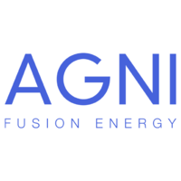
Membership

Slide 4
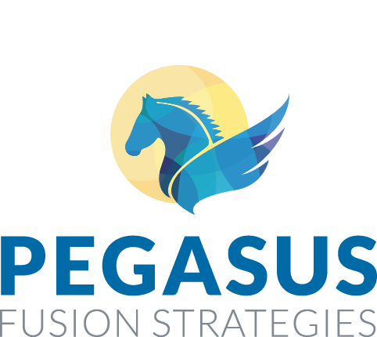
Affiliate Members

Slide 5
Strategy
The Fusion Industry Association has three strategic priorities for accelerating fusion energy:
Partner with Governments for Applied Fusion Research: The private sector should have access to the pathbreaking research that governments have pursued for decades. Likewise, the public sector should be able to benefit from exchanges with private scientists working on fusion.
Drive Financial Support: Sustained financing is needed to accelerate fusion from early-stage research to demonstration levels of energy production. Public-Private Partnerships that include government support can multiply private financial support by reducing risk.
Ensure Regulatory Certainty: Fusion research, development, and deployment should be subject to appropriate regulation when experiments are built and sited.

Slide 6
Principles for a Public-Private Partnership in Fusion Energy
The result of an inclusive, months-long process of discussion and consensus building
Briefed to fusion community stakeholders in September
Submitted to the Department of Energy in October at the request of Undersecretary Dabbar

Slide 7
Principles for a Public-Private Partnership in Fusion Energy
DOE funding for applied research (modeled on GAIN)
Vouchers, grants, awards for companies; expanded technology programs for labs and universities
Flexible administration to seed new ideas, grow promising innovations in technologies/concepts, and support widely-applicable technologies with commercial relevance
DOE and privately funded researchers collaborate on open and publishable topics
Industry experts review research proposals to provide market insight, highlight research areas
DOE capabilities accessible through this program could include:
Experimental and other testing capabilities (e.g. thermal-hydraulic loops, control systems testing, etc.) to achieve faster, more cost-effective development of applied fusion energy technologies
Computational capabilities along with state-of-the-art modeling and simulation tools
Information and data via knowledge & validation center (including ITER designs and technology)
Siting and infrastructure assistance and equipment loans

Slide 8
Principles for a Public-Private Partnership in Fusion Energy
2. Public-private partnership for new U.S.-based capabilities (modeled on NASA COTS / SpaceX and DOE SMR cost-share / NuScale)
DOE leverages private sector creativity to field new U.S.-based capabilities, enabling fusion commercialization and future research access (ex: NASA helped develop, then purchased low-earth orbit access alongside satellite operators vs. owning and operating Space Shuttle lifting satellites)
Government acts as an investor, with a fully authorized pool of funds over a multi-year program
All parties have “skin in the game:” companies are expected to contribute a significant portion
Portfolio approach: Multiple awardees in a competitive process
DOE collaborates on reviews and tiger teams, leveraging full ecosystem toward shared success
Simple application; proposals evaluated on scientific and technical approach and business plan
Performance-based, fixed-price milestone payments in a planned program, negotiated by government program and awardee (different for each company)
Industry responsible for cost overages and hitting milestones, or contract ends
Milestone completion certified by a DOE-appointed external review panel

Slide 9
Plans for 2019
Inspiring Legislation | Working directly with the Administration and Congress to draft and pass supportive legislation and appropriations
Convening Policymakers | Identifying key “Champions” and supporters of the fusion industry, and promoting their work with briefings, hearings, panels, and meetings
Writing Publications | Publishing op-eds, fact-sheets, and “new media” that can educate policymakers and the public in readable, non-scientific language on the prospects and benefits of a fusion industry
Educating “Influencers” | Host events and briefings while participating in key conferences around the country to activate influencers, investors, and supporters who can advance the interests of the fusion industry

Slide 10
Support the FIA Today
www.FusionIndustryAssociation.org
Membership
The Fusion Industry Association is a member-driven educational organization open to private companies striving to develop economically viable commercial fusion power as soon as possible.
Affiliate Membership is open to companies who want to support the FIA and help build a Fusion Energy Ecosystem.
For more information, email Andrew Holland, Director of the FIA at: aholland@FusionIndustryAssociation.org

