Slide 1


DEMO Programme in Europe: lessons learned and future plans
G. Federici
Power Plant Physics and Technology Department
FPA 40th Annual Meeting and Symposium, Dec. 3, 2019, Washington (USA)
The contents of this document cannot be reproduced without prior permission of the authors.

Slide 2

Outline
Context: DEMO in the EU roadmap
  Key messages
  Lessons learnt during the DEMO pre-CD phase
  Lessons learned from ITER
Status: Design choices under study
  Dimensioning process and main design drivers
  DEMO design options
  Prospects: Plans beyond 2020
  To do list

Slide 3

DEMO in the EU Roadmap
EUROPE has recognised early the need for a strategic plan for fusion research going forward.
One of the key objectives is the development of a concept design of a Demonstration Fusion Power Plant to follow ITER
Main goals:
develop realistic technical and operational requirements
develop scientific basis for a feasible design
targeted technology R&D, addressing critical design feasibility performance and integration risks
validate the practice by adopting a Decision Gate Process (DGP)
P_{el}~ 500 MW
T-self sufficient
Plant availability
Tentative timeline:
2020
pre-CDR Gate
2027
CDR Gate
2040
Decision to Construct
DEMO Schedule
2014-2020
Preconceptual Design
2020-2027
Concept Design
2027-2029
CDR
Consolid.
2029-2038
Engineering Design & Site Selection
2038-2040
EDR
Consol
2040-2051
Procurement & Construction
2051-2060
Commissioning & Operations
2014
2025
2029
2033
2035
2037
2039
2060
ITER Schedule
2025-26 First Plasma
2026-2028
2nd Assembly
2028-2030
Pre Fusion Operation 1
2030-2032
3rd Assembly
2032-2034
Pre Fusion Operation 2
2034-35
4th Assembly
2035-2040
High Power Operation
2025
Low Power Operation
(Hydrogen & Helium)
High Power Operation
(Hydrogen & Helium)
2040
Operation with Low Heating
Installation of: ICRH & NB,
ELM control system
First TBM modules
Tritium Plant
High Power Operation
(Deuterium-Tritium)
Installation of: First Wall, Divertor, Neutral Beam Remote Handling, Pellet injector, DMS commissioning
Tritium Plant Commissioning

Slide 4


Key Messages
A more systems-oriented approach brought clarity to several critical design issues, including physics/ technology drivers and constrains
Rationalization of blanket design and R&D strategy, resulting in a change of EU TBM/TBS options to be tested in ITER (replace HCLL with WCLL)
Early attention given to industrial feasibility, costs, nuclear safety and licensing.
A technology maturation plan by embedding industry experience from the beginning Technical oversight by independent (external) experts
Implement a Decision Gate Process (DGP) to assess/ validate progress through Gate Reviews
Refocus the physics R&D for DEMO (experiments/modelling) towards developing an attractive and robust reference plasma scenario (no-ELMs, low disruptivity, etc.)
Training of a number of brilliant young engineers
Expand international collaboration to fill critical technical gaps
Shortage of engineering skills. Inefficient design iterations
Still some misalignments between project needs and strategic interests of some of the Labs. Transitions from a traditional R&D mind-set to a more-system thinking approach

Slide 5
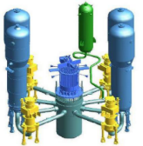
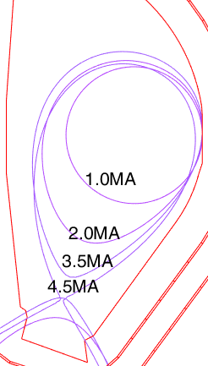
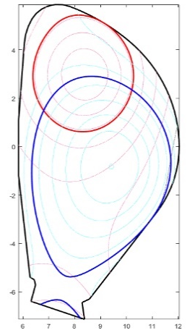
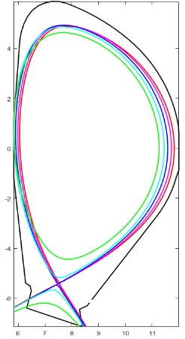
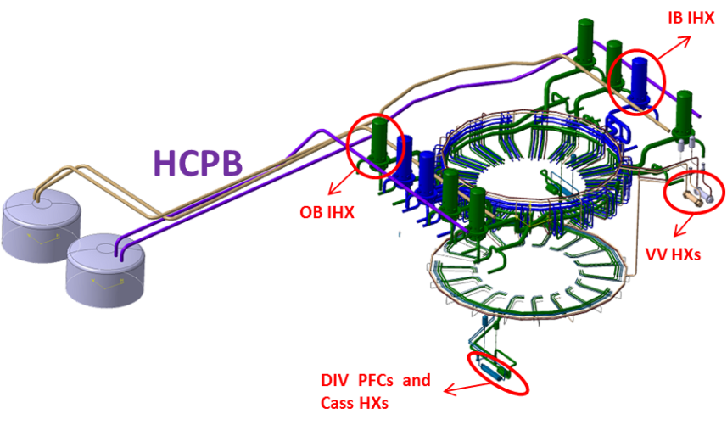
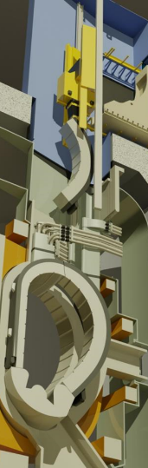
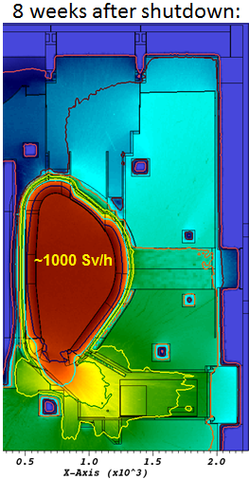

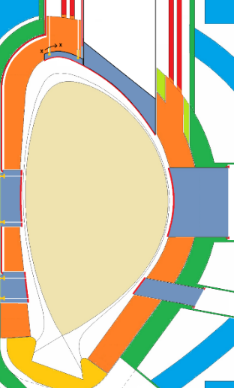

Main lessons learnt during the DEMO pre-CD phase
1) Still large plasma physics uncertainties that impact the design - Off-normal transients are design drivers
2) Integration of multiple design drivers across different systems, e.g., Remote maintenance
3) Many systems interdependencies and interfaces with key nuclear systems: Primary heat transfer system
Ramp-up | VDEs | H-L transition
4 - 6 MW/m² | 0.5 – 2 GJ | 0.5 – 2 GJ
20-40s | TQ: 3-5ms CQ:70-300ms | 1-5s
Blanket Vertical Maintenance: Several poloidal segmentations and pipe routings – tools developed
Main differences: pipe lengths, coolant inventory, HeX surfaces, tritium.
Pressurizer
Steam
generator
Reactor
coolant
pump
24.6 m
14 m
U-VDE
H-L
Reactor
vessel
D-VDE
Dedicated protections required in some areas
 |  | Fission EPR | Blanket He
Coolant loops |  | 4 | 9
Overall pipe length, | km | 0.12 | 4
Coolant inv/loop | m³ | 460 | 1940
Pipe diam | m | 0.780 | 1.197
Volume ESS | m³ | 0 | 6000
IHEX | m² | - | 87290
DEMO first wall

Slide 6
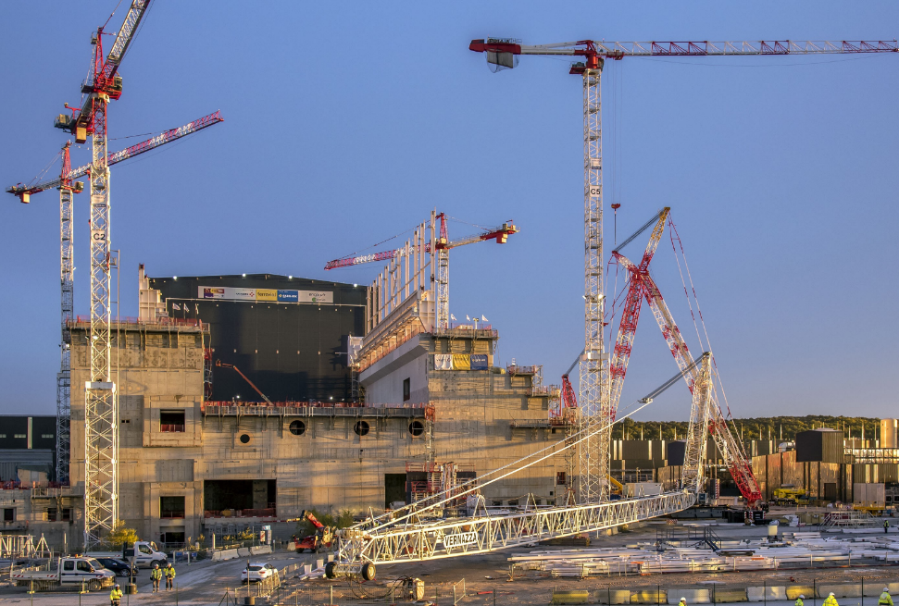
Harnessing the ITER experience
Valuable lessons learnt and technical insights directly informing DEMO tasks
Ad-hoc technical meetings with ITER.
Training of some EEGs in part in ITER IO.
IO (and F4E) experts attend DEMO DRs
Lessons learned from ITER
More attention to thermal transients is required for the design of in-vessel components
Strengthen nuclear design integration and a nuclear safety culture during all the design phases
Many design changes in ITER imposed by regulatory body resulting from more stringent nuclear safety regulations
A robust maintenance plan is a must, with clear provisions to access areas where contamination and or activation could be higher then originally considered
Give sufficient attention to plant layout, including cooling loops, auxiliary systems, etc. Provide sufficient space to integrate all equipments, particularly in tokamak building
Reminder: Important role of the ITER design process during last 30 years to drive progress in fusion R&D
Main topics include:
Tokamak building design/ Plant layout
Systems engineering
Neutron shielding concept
Port plug port integration and RH
In-cryostat maintenance
Thermal shield design/ Design of magnet feeders
VV cooling Loop/ Diagnostics integration

Slide 7
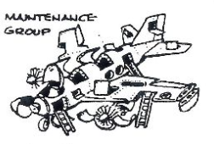


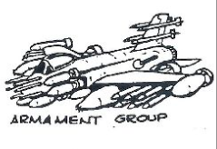
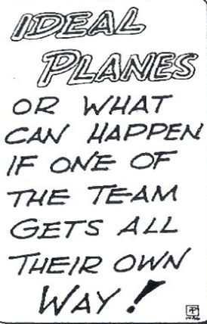
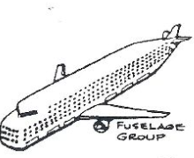
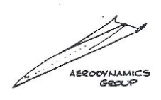
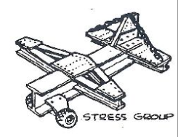
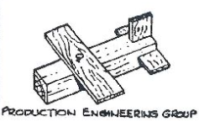
Search for the Optimum Design/ Dimensioning Process
Optimal airplane design from the perspective of engineers of different specialties
Outstanding issues common to any next major facility after ITER
A lot of discussions about making fusion smaller, cheaper, and faster, but there is no magic bullet to solve the integrated design problems. Every time you squeeze somewhere, you make problems worse elsewhere….
By postponing integration, assuming that it restricts innovation, one risks to develop design solutions that cannot be integrated in practice
Fusion is a nuclear technology and as such, it will be assessed with scrutiny by a nuclear regulator
Shielding, RH, safety, licensing considerations play an overwhelming role in the design
Dream Airplanes by C.W. MillerAircraft Design (p. 4),
by L. M. Nicolai and G. E. Carichner, 2010, Reston, VA:
American Institute of Aeronautics and Astronautics.

Slide 8
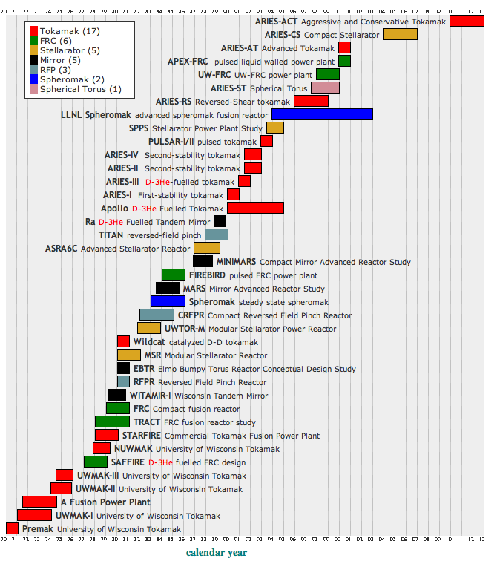
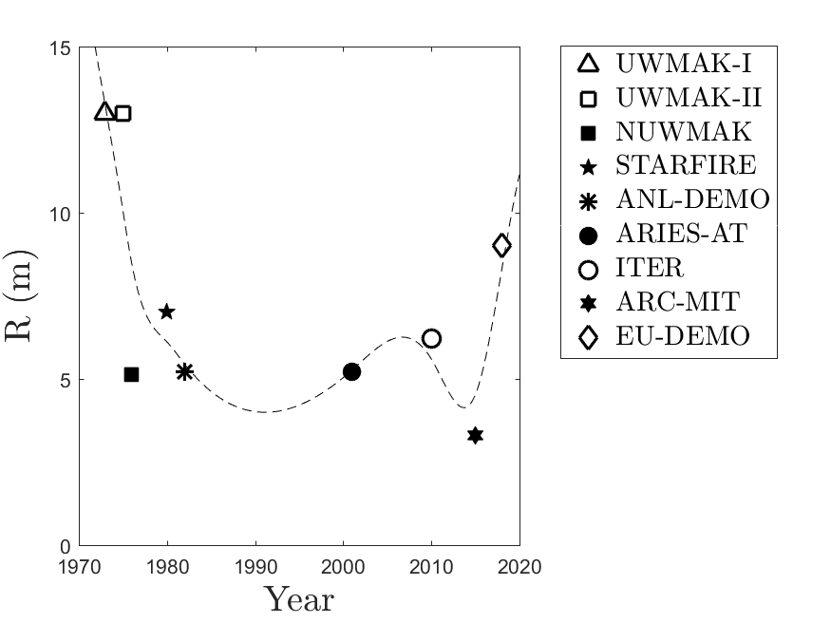
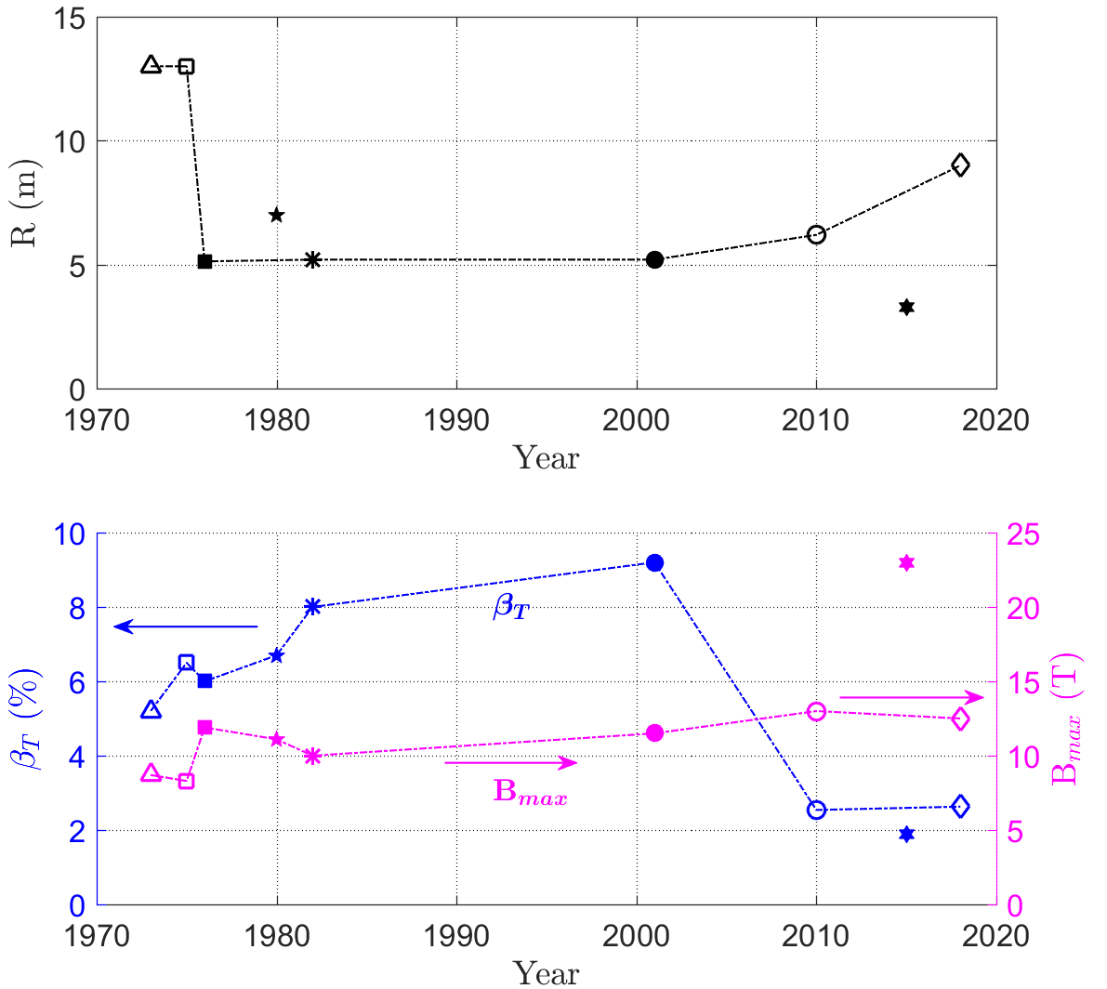
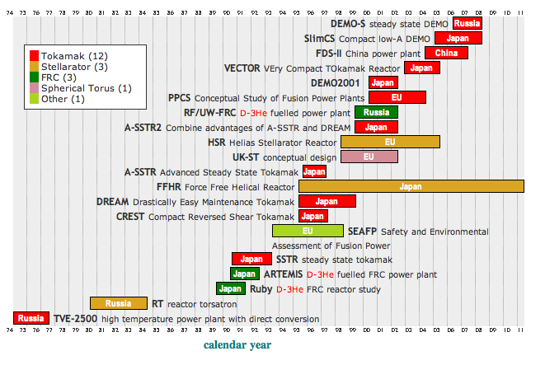
Lesson of the past: many MFE power plant studies:
Caveats
A wealth of interesting information, but:
Very favourable physics and technology assumptions, unrealistic
Divertor problem underestimated or ignored
Lack of thorough nuclear design integration considerations
It is not the first time that we do this
US only
Source: M. Abdou
International

Slide 9
EU DEMO Design Philosophy/ Key Drivers
What matters the most:
A) design point (R and H builds); set of basic parameters to reach a certain performance (i.e., R, a, B_{t}, I_{p}, etc ...)
  readiness of the physics assumptions
  divertor protection
  Stress, forces in the coils, shielding the SC magnets and VV, tritium self sufficiency
  B) from 0D to a technically sound concept design, adopt a 'system based' approach to DEMO to go from 0D to concept technical design.
  plasma equilibrium and vertical stability analyses
  design of in-vessel systems (divertor, limiters) ➔ thermal transients are an important design driver. Limiters to protect thin wall from VDEs; loss of detachments, ELMs mitigation and/or supression
  breeding blanket systems, selection of the coolant and BoP
  In-vessel components RH scheme
  Plasma scenario
  H&CD mix

Slide 10
Limited design space
Divertor remains an important DEMO-size driver
@ Constant Fusion Power - 2 GW DEMO target
M. Siccinio et al 2019 Nucl. Fusion 59 106026
Smaller radius, high field (compact devices)
Larger radius, low field (big devices)
A: unfeasible, below L-H threshold
B: feasible
C: feasible, if more compact magnetic technology were available
D: unfeasible, too high imp. conc. for detachment
E: unfeasible, too high heat flux @ reattachment and too high imp. conc. for detachment
F: unfeasible, too high heat flux @ re-attachment
Too many impurities
H-mode access limit
TF coil limits
Divertor limit
The size of a reactor is limited in terms of R by the impurity concentration to reach detachment [M. Reinke, NF 2017] and in terms of B by the heat flux by re-attachment
More in general, a compact, high field magnet technology would have limited impact on the machine size (see next slide)

Slide 11

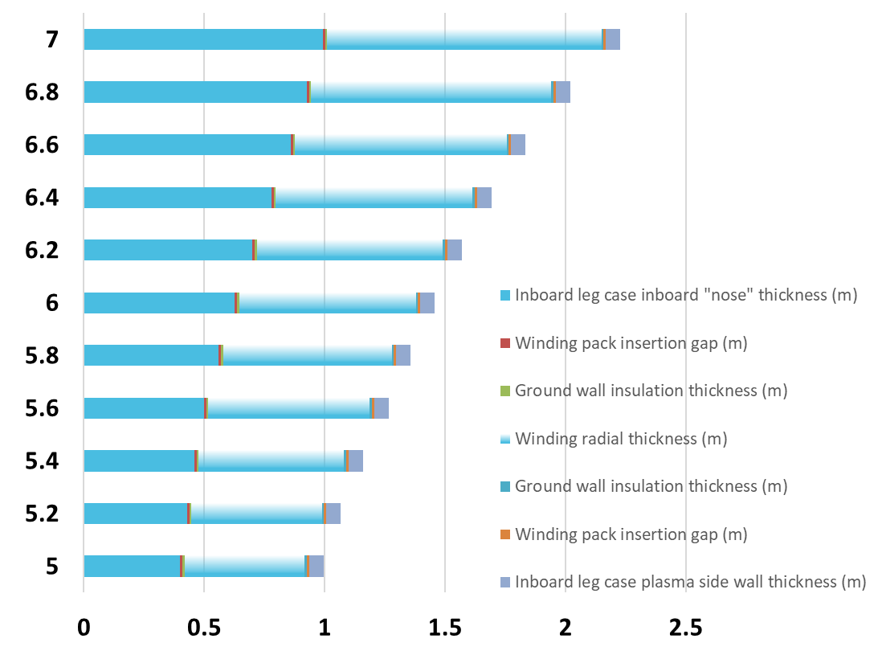
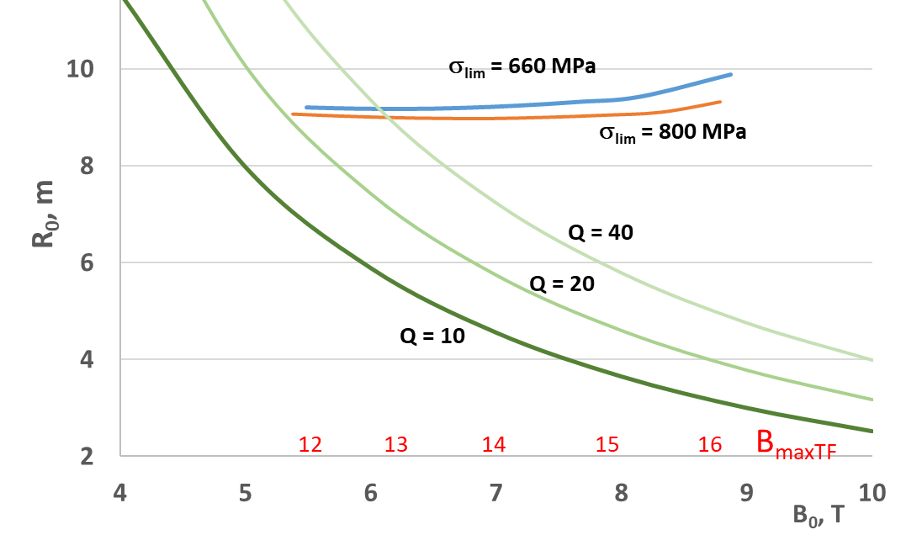
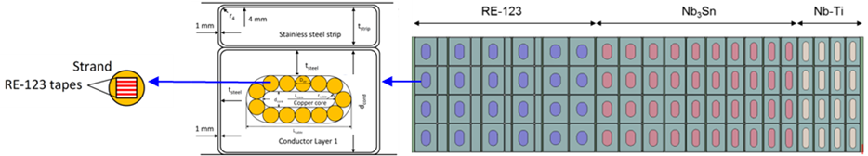
High Field Magnet Technology has limited impact on machine size
*Examples of engineering constraints:
Divertor power handling limits
Stress and forces in the structure of the magnets
Source: R. Kembleton, H. Lux, J. Morris (CCFE)
Calculations with PROCESS for constant fusion | net electric power of 2 | 0.5 GW, and a T breeding device
TF case
SC WP
B_{t,max}
B_{t,0} (T)
With engineering constraints*
R³B⁵ ~constànt
Without engineering constraints
Radial build of the TF coil inboard leg (m)
The max field achievable in TF is limited by the stresses reached in the coils, rather than the superconductor performance.
EU has a strong R&D programme on HTS. We are considering use of HTS for design of an Hybrid CS
G. Federici et al., Nucl. Fusion 59 066013 (2019)
HTS – 18 T
Nb₃Sn
Re-123
NbTi
1 meter
~600 Mpa,
~1000 Mpa,

Slide 12
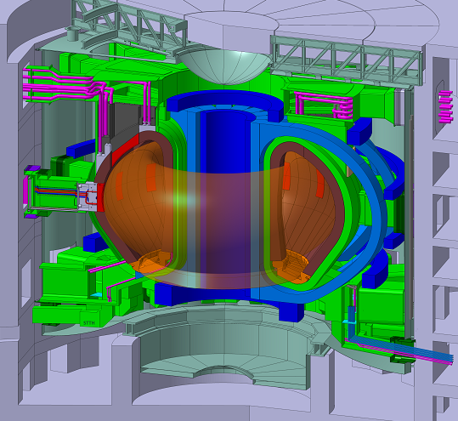


DEMO design points under study
  DEMO 1: a “conservative baseline design” based on expected performance of ITER with reasonable improvements in science and technology.
DEMO-1
2018
flexi-DEMO
  flexi-DEMO: an “optimistic design”, that operates in inductive (pulsed) regime with a greater reliance on auxiliary current drive than DEMO 1, with the possibility to be upgraded to a longer-pulse or steady-state machine if a sufficiently good confinement is achieved.
Parameters
L_{op(ind)}/
H_{op(ss)}
9, 2.9 | R₀, a (m, m) | 8.4, 2.71
3.1 | A | 3.1
5.9 | B_{T},(T) | 5.8
18/ 3.6 | Ip (MA) | 16.6
3.6 | q95 | 4/4.7
1.6, 0.33 | k₉₅ / δ₉₅ | 1.69/0.33
2014 | P_{fus} (MW) | 2000
1.1 | H | 1.13/1.48
37 | f_{bs} (%) | 47/66
50 | P_{aux,ss} (MW) | >100
2 | t_{burn} (hrs) | 1/st.st
500 | P_{e,net} (MW) | 395/399
1.0 | Av_{NWL}(MW/m²) | 1.15
Main design features:
SN H₂O cooled divertor; W PFCs
LTSC magnets (Nb₃Sn), B_{max}~12T
EUROFER as blanket material
VV (AISI316) as 1st confinement
Vertical Blanket maintenance
1st blanket 20 dpa (300appmHe)
2nd blanket 50 dpa,
5 dpa divertor (Cu)
first wall protections
breeding blanket ancillary systems
advanced divertor configurations
vertical blanket segment architecture
power conversion concept
tokamak building and plant systems configuration
direct recirculation pumps
plasma scenario development
Not a fixed design but a “proxy” to identify and resolve crucial design integration problems (KDIIs)
G. Federici et al., (2019) Nucl. Fusion 59 066013 (2019).

Slide 13
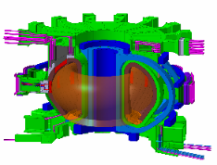
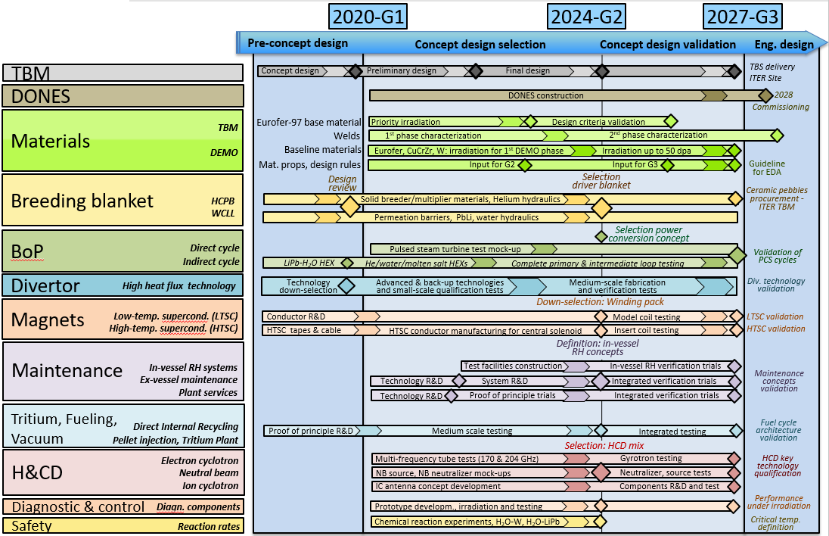
DEMO Technology R&D - Concept Design Phase
Prioritize R&D within a multi-year Technology Maturation Plan (TMP)
Critical technology elements (CTEs) have been identified for all systems
TRAs by Independent Expert Panels, including IO, F4E experts and industry

Slide 14






Industrial
Involvement
International
Collaborations
Collaborations
with F4E
TBM R&D and Qualification activities:
Funct. Matls Development Qualification,
EUROFER97 Qualification and Design Rules,
Predictive Tool Development and Qualification,
Sensors Development and Qualification,
Technologies and Integrated Testing.
Support to TBM Engineering activities:
Design of the WCLL TBM System,
Safety analyses and documentation.
Japan (Broader Approach) IFERC
  joint DEMO Design Activities to address critical DEMO design issues
China:
  DEMO/ CFETR technical meetings
  R&D breeding blanket, HTS, RH
  Russian Federation:
  Fission Reactor Irradiation (BOR60)
  Disruption simulation guns
  LiPb loops
  Korea:
  Discussions about potential collaboration on HCPB TBS (helium-cooled)
  US:
  Fission Reactor Irradiation Experiment HFIR (ORNL)
Fusion Industry
Innovation Forum
System Engineering Training
Design studies BOP/PCS
Project / Program Management
Plant Architect Engineering
Systems Engineering
Cost, risk, safety, RAMI analyses
Plant engineering tools, modelling and simulation
TRL MRL, assessment, etc.
Design for robustness and manufacture
Evaluation phase of tender for a multi-supplier industry framework for Engineering Services to support DEMO and DONES design
Provide a more direct route to industry skills and experience
Nuclear Safety & Licensing
Plant and Systems Design
Plant Control/ Systems/ Operations
Industry Best Practice
We are looking forward to broadening collaboration with US in areas of physics and technology DEMO R&D.

Slide 15


A critical bottleneck: the human factor.
The fusion program is aging rapidly
A first generation of fusion pioneers has left or is leaving the field
Need to find ways to maintain the enthusiasm that has been the pride of the fusion area and that has attracted outstanding people to work in the field
Severe shortage of engineering skills in fusion. We have specialists, but lack designers, ie., people familiar with tokamak/systems design
Unless we continue to attract bright young minds, fusion will surely wither/die
Education and training in fusion must play an important role in each programme
In Europe we are training > 200 PhD (mainly physics) per year and 20 young engineers per year. But many do not stay in fusion
University Programs, and Fusion Laboratories are absolutely vital to sustain the worldwide effort to develop fusion

Slide 16

DEMO priorities beyond 2020
Establish a stronger DEMO Core Team capable of more rapid design cycles for evaluation of design directions
Develop integrated reactor modelling tools to accelerate the design cycle and enable faster assessment and fairer comparison of alternatives
Increase funding for technology R&D to address major risks: breeding blanket, material R&D and qualification; Remote Maintenance, etc.
Continue TRAs by embedding external independent experts (incl IO and F4E) + industry
Improve project management culture
Bring Industry into the design process
Expand training of young engineers from Universities
Refocus the physics R&D for DEMO and strengthen link with the physics community
Consolidate international collaborations to fill critical gaps
Investments from private companies in fusion is welcome news. However, this should not come at the expense of scientific exchange with, and scrutiny by, the rest of the fusion community, under the guise of protection of IP rights
The U.S fusion community should begin a process to develop a strategic plan

Slide 17

Additional Slides →
Worth reading
G. Federici et al., “Overview of the DEMO design-staged approach in Europe”, (2019) Nucl. Fusion 59 066013. https://doi.org/10.1088/1741-4326/ab1178.
M. Siccinio et al, Figure of merit for divertor protection in the preliminary design of the EU-DEMO reactor, 2019 Nucl. Fusion 59 106026, https://doi.org/10.1088/1741-4326/ab3153
G. Federici et al., “An Overview of the EU Breeding Blanket Strategy as integral part of the DEMO design effort”, Fus. Eng. Des. 141 (2019) 30–42, https://doi.org/10.1016/j.fusengdes.2019.01.141.
G. Federici et al., “DEMO Design activity in Europe: progress and updates”, Fus. Eng. Des. 136 (2018) 729–741. https://doi.org/10.1016/j.fusengdes.2018.04.001.
G. Federici et al., “European DEMO design strategy and consequences for materials”, Nucl. Fusion 57 (9), (2017) art. no. 092002, https://doi.org/10.1088/1741-4326/57/9/092002.

Slide 18
DEMO Design Project Phases
The DEMO staged design approach envisages has five project phases. The diagram shows the DEMO and ITER schedules indicating ITER informing links.
G. Federici et al., (2019) Nucl. Fusion 59 066013 (2019

Slide 19
Overview of the DEMO project timeline
The transition from the pre-Concept Design to the Concept Design Phase (CDP) is marked by a Gate (G1) in November 2020, the results of which will have a strong impact on the detailed objectives definition.
Currently, it is assumed that the CDP is divided in two parts: a concept selection phase, followed by a concept verification phase.
An intermediate gate (G2), in the middle of the concept design phase, is presently planned for 2024 to down select the design solution(s) for critical systems.

Slide 20
Overview of the DEMO project timeline
The whole plan is ambitious. In particular, this assumes we are successful in ramping up the resources and there are no adverse surprises along the way...

Slide 21
Key Design Integration Issues (KDIIs)
8 key design integration issues (KDIIs) have been identified as priority issues to be addressed during the pre-conceptual phase until 2020
[See C. Bachmann et al, Key Design Integration Issues addressed in the EU DEMO pre-concept design phase, ISFNT-14, Budapest, 2019]
Distinctive features of KDIIs:
ITER design solution not suitable for DEMO, or ITER does not have these issues.
Bear impact on the plant architecture
Other design integration issues exist and are dealt with outside the KDII context

Slide 22
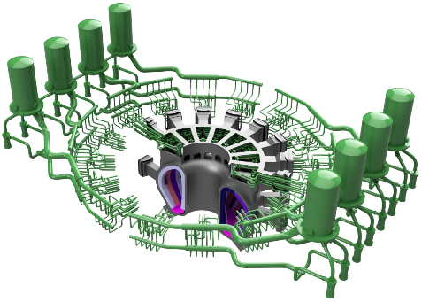
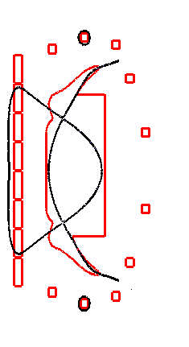
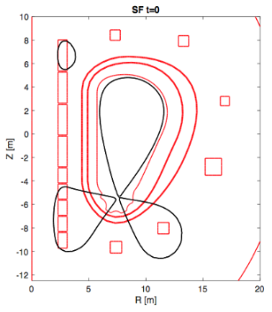
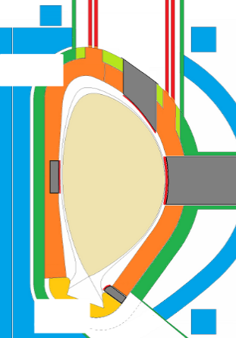
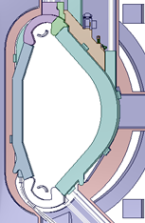
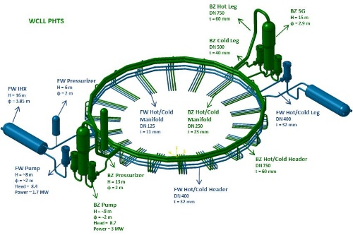
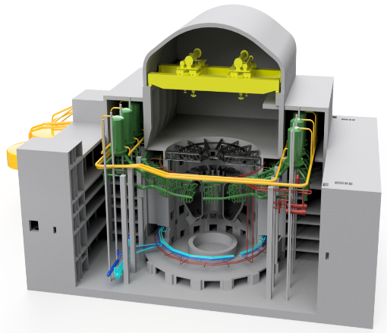
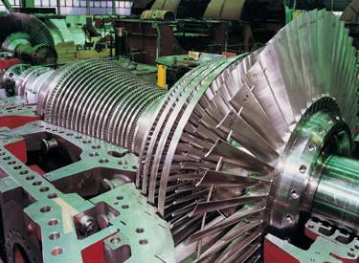
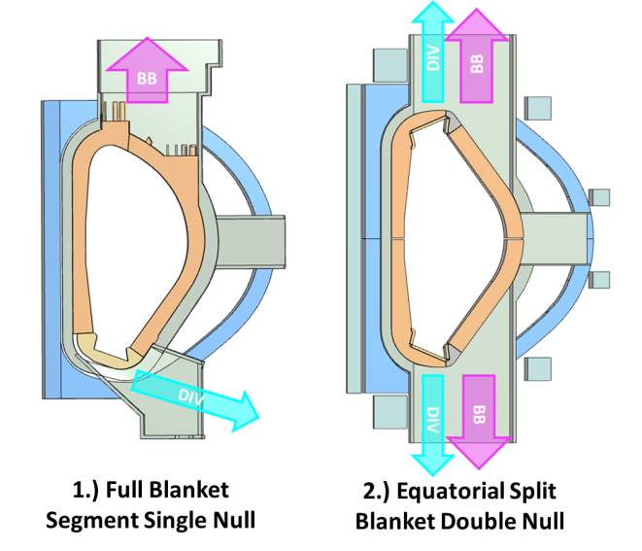


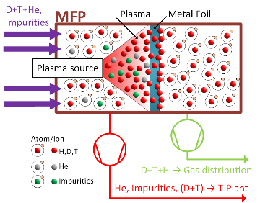
Key Design Integration Issues (KDIIs)
H1 - Wall protection from transients:
Design option with top limiters and DN divertor
H2 - Blanket PHTS and BoP: He and H₂O
H3- Advanced divertors: engineering and design Integration risks
Helium
300-500C, 80 bar
Water
292°C-328°C
150bar
SX
DN-SX
SF
H6 - Design nuclear building concepts
incl. ex-vessel RM
SN with top and eq. limiters
DN
H4 - Blanket Vertical Maintenance:
Several poloidal segmentations and pipe routings investigated
H5 - PCS options, i.e., direct or indirect
Two options: 1) indirect with ESS; 2) direct or very small ESS
H7 - Feasibility of tritium cycle concept with direct recirculation
H8 - Plasma operating scenario and supporting HCD and Diagnostic systems
Divertor: Inter-ELMs loads
Divertor detachment
Loss of detachment
ELMs
Active control
ELM-free scenarios and their consequences

Slide 23
DEMO Plasma Scenario (KDII#8)
Is ELMy H-mode with active ELM suppression a definitely dead option for EU-DEMO?
(…no, but it’s not in a good shape…)
All estimates clearly point out that unmitigated Type I ELMs are not admissible in DEMO.
Also, the “tolerable” ELM-size is virtually zero on long timescales (1 DEMO discharge ~ 700 AUG pulses).
At the moment, no evidence of full ELMs suppression at high divertor density is available.
The research on active ELMs suppression must(and will) continue in support of ITER. In case of success, H-mode remains the best choice for DEMO as well.
…but we must have a plan B (or even a plan A?)…
Mattia Siccinio (EFPW Dec. 2019)

Slide 24
Strengthen the DEMO Core Team
What are the Issues?
What is needed
What is proposed
High degree of complex system interdependencies
Multiple design drivers across different systems
Design dealing with large uncertainties (physics/ technology)
Inefficient design iterations
Shortage of skills in system design, plant architecture and nuclear design integration
Lack of central management and design authority
Design teams work together, but no overarching guide
Operational flexibility
Managerial independence
Evolutionary characters
Technical skills and competence
Rapid design cycle that would allow evaluation of different options for down-selection.
Design authority Strong link with physics Strong link with tech. R&D
Stronger Core Team (CT) capable of more rapid design cycles for evaluation of design directions
Very experienced individuals with technical skills and competence
Provide CT with means to execute tasks in the labs with short response time (WPPMI 100%). Supported by a Configuration Control Board (CCB) Effective way to implement DEMO physics priorities Two legs project organization
TAG recognizes the need and the associated sense of urgency and the benefits of a strong and agile CT to achieve the goals. See outcome TAG subgroup to GA

