Slide 1


Slide 2
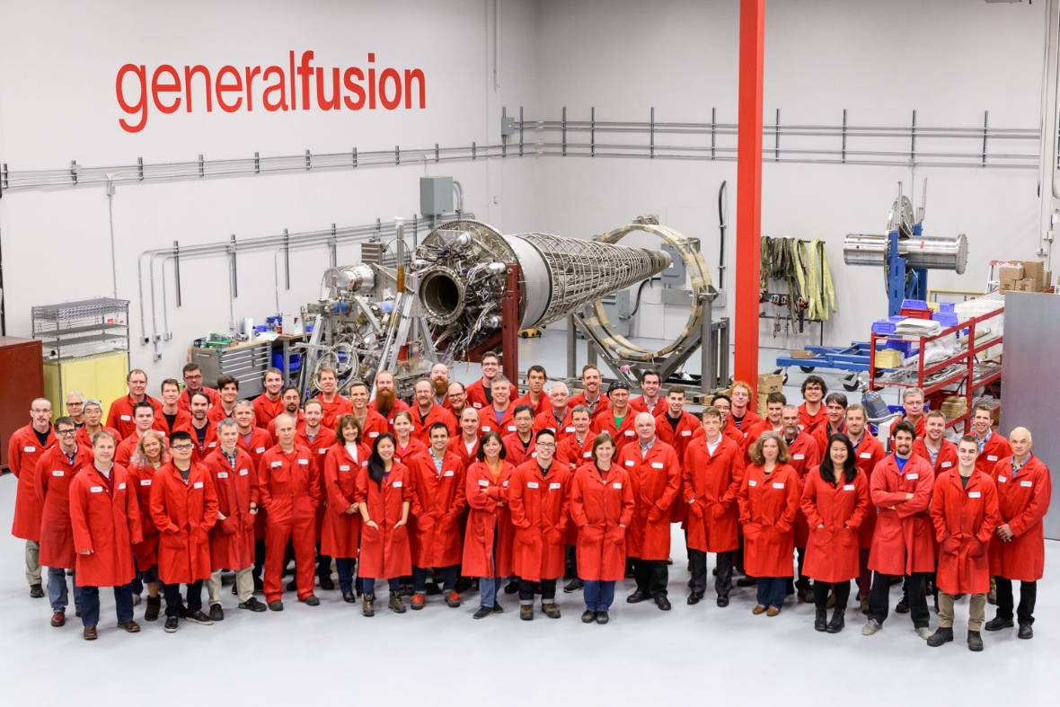

Slide 3
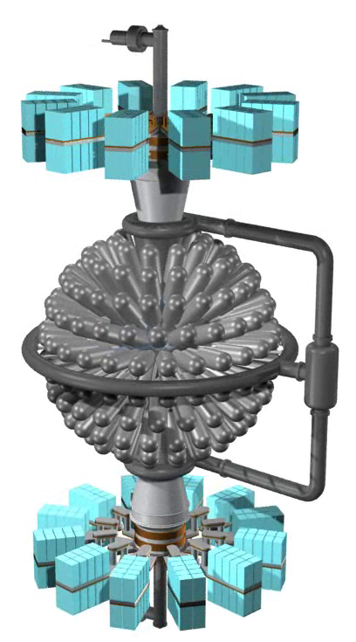
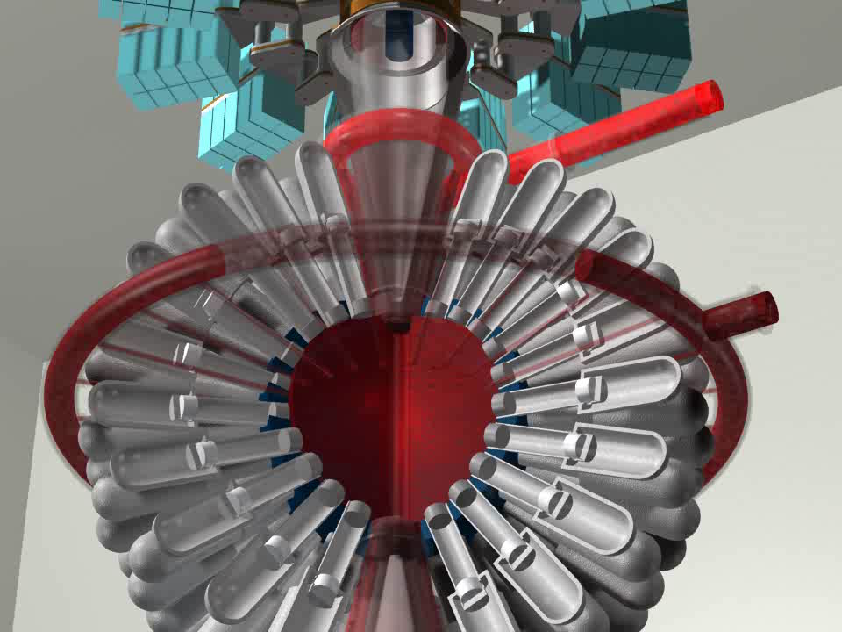
MTF Power Plant Concept

Slide 4
MTF Power Plant Concept
Key Features
Low cost compressed gas driver
Thick liquid metal blanket
  Shields structure
  Extracts heat
  Breeds tritium
Pulsed with plasma-only target

Slide 5
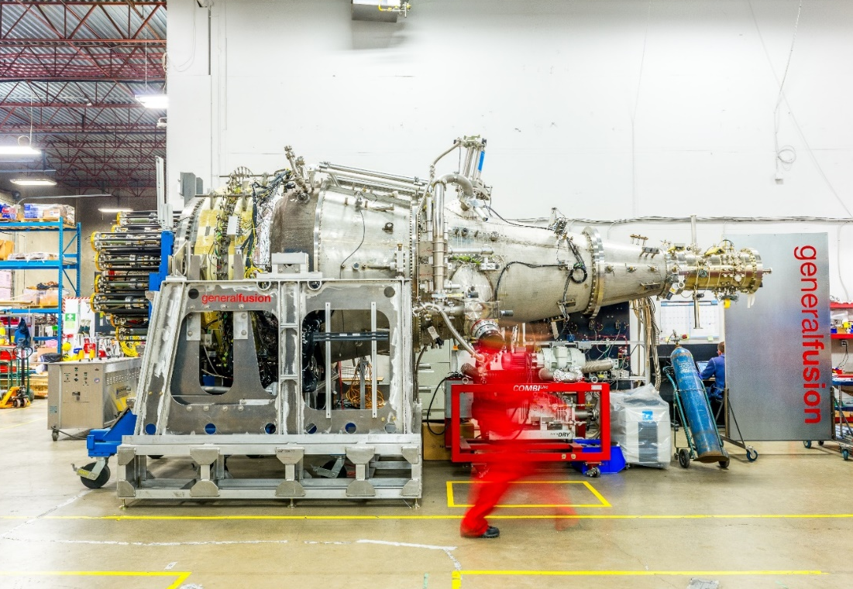

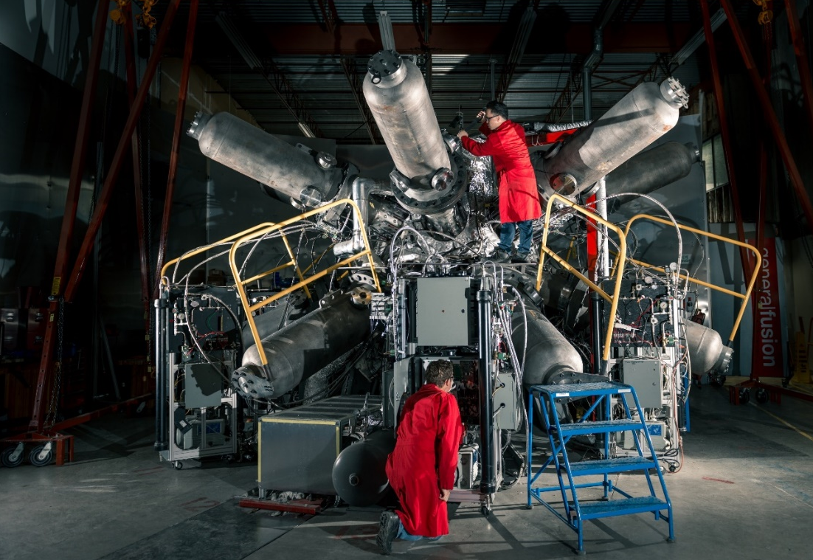
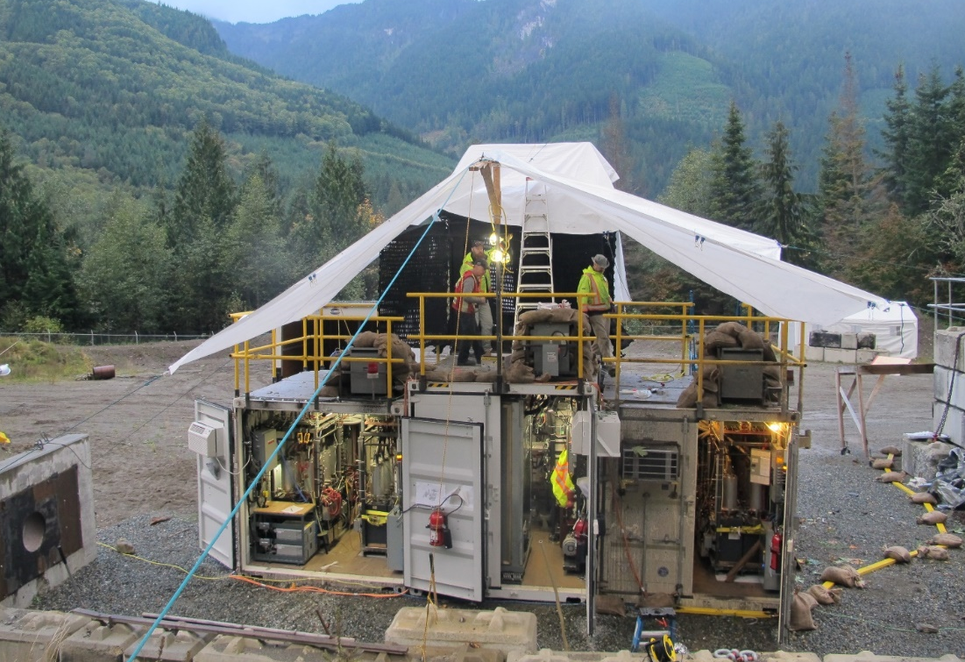


Development Program

Slide 6
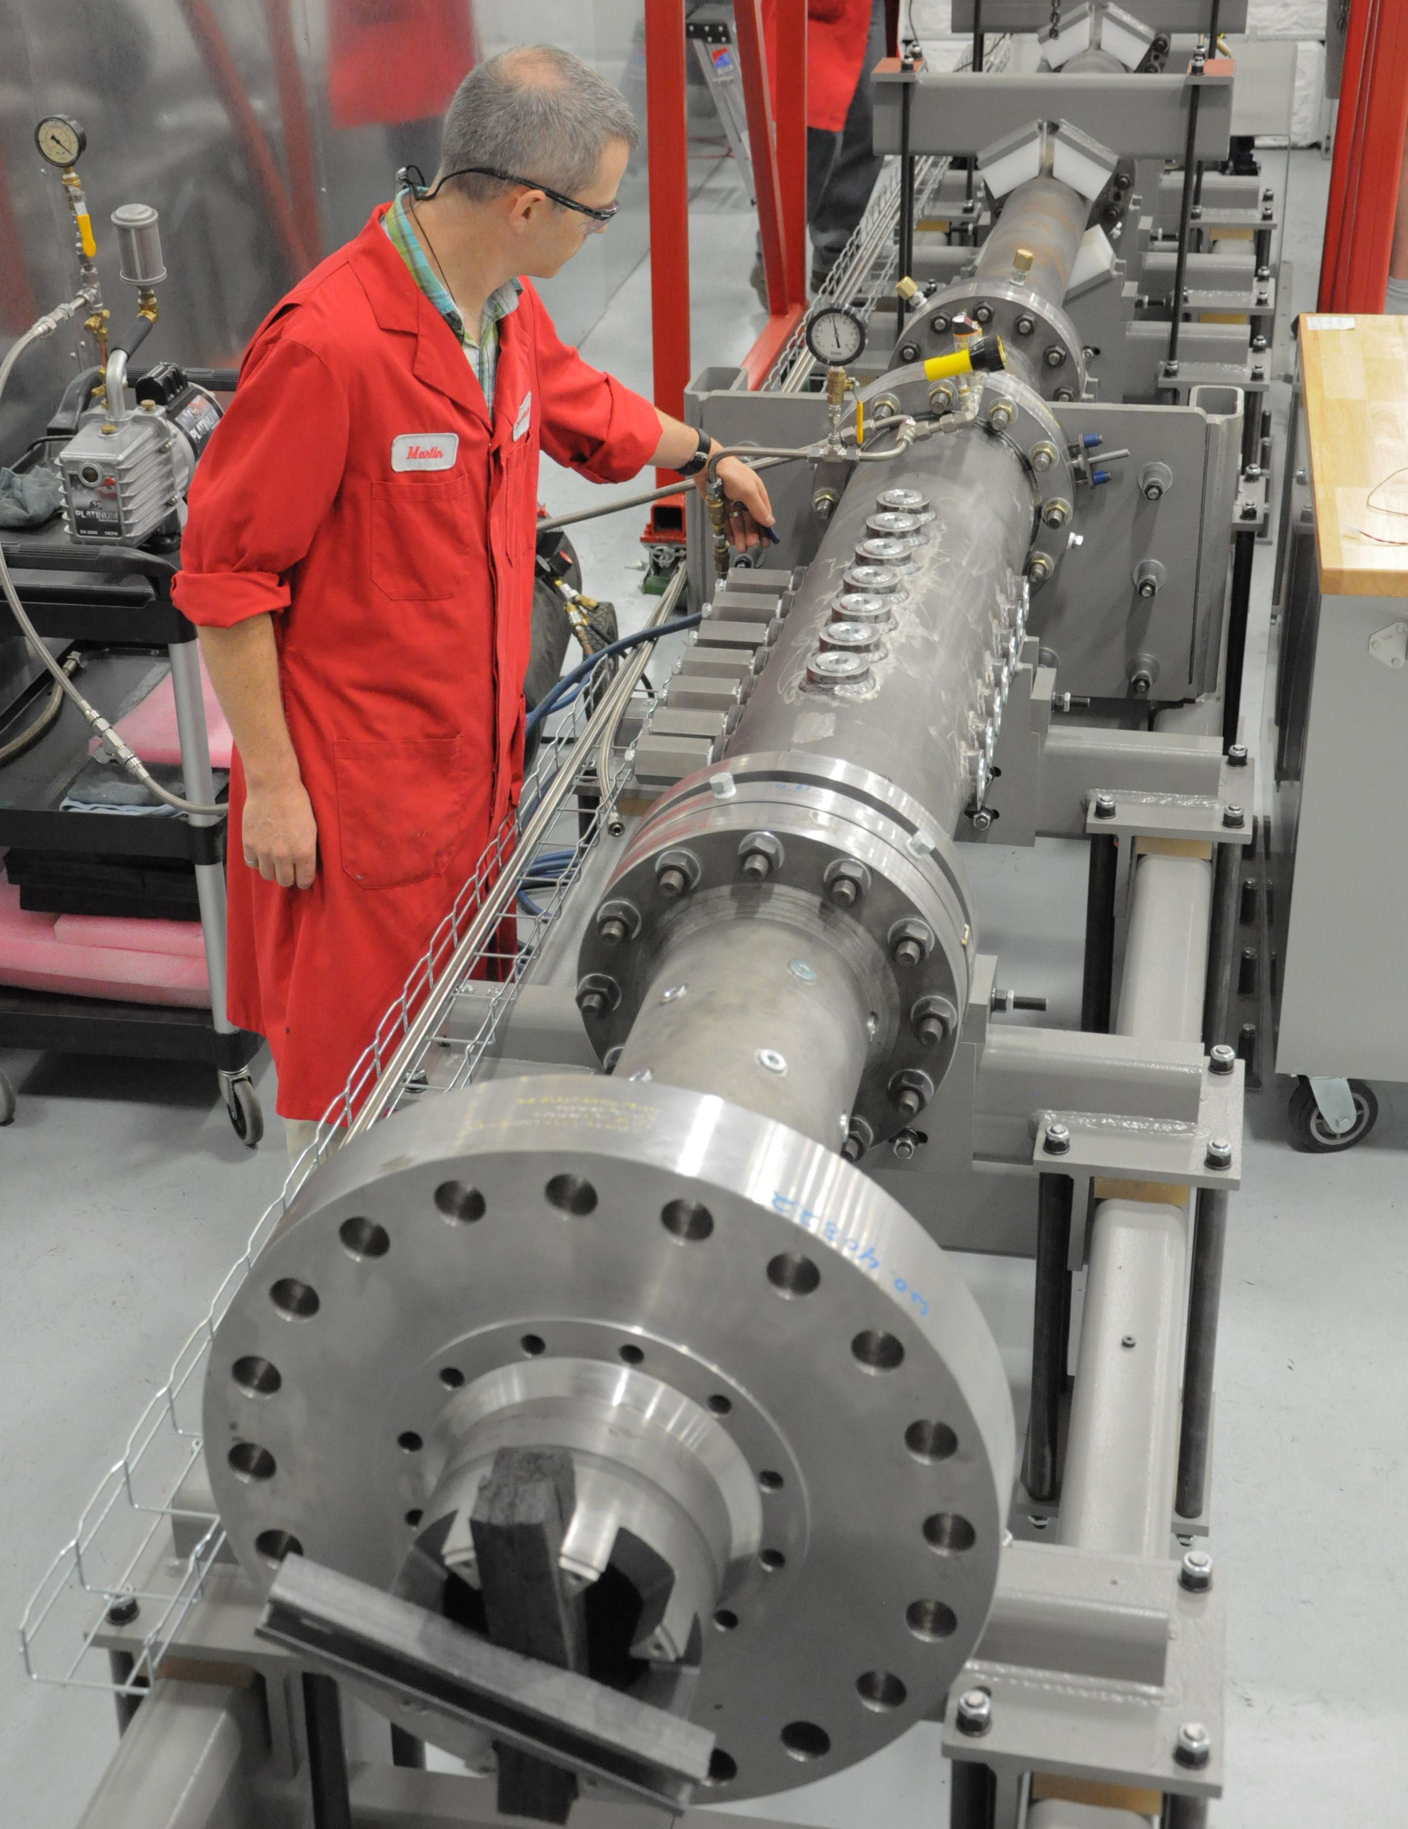
Compression System
New piston design completed and undergoing testing
Much higher drive pressure
New “launch” system
Frictionless servo control and independent position measurement
Technology scalable to large piston arrays

Slide 7
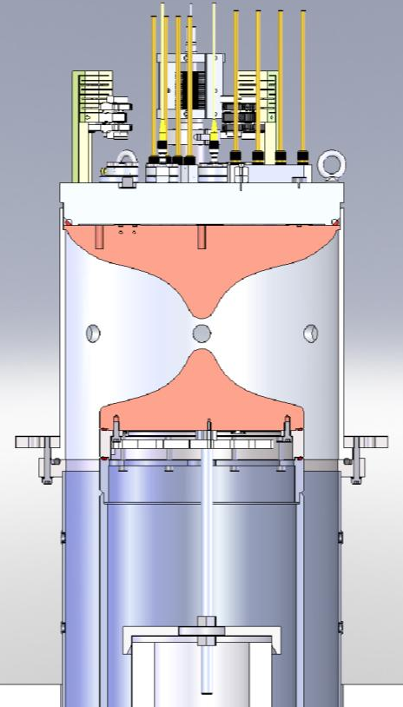
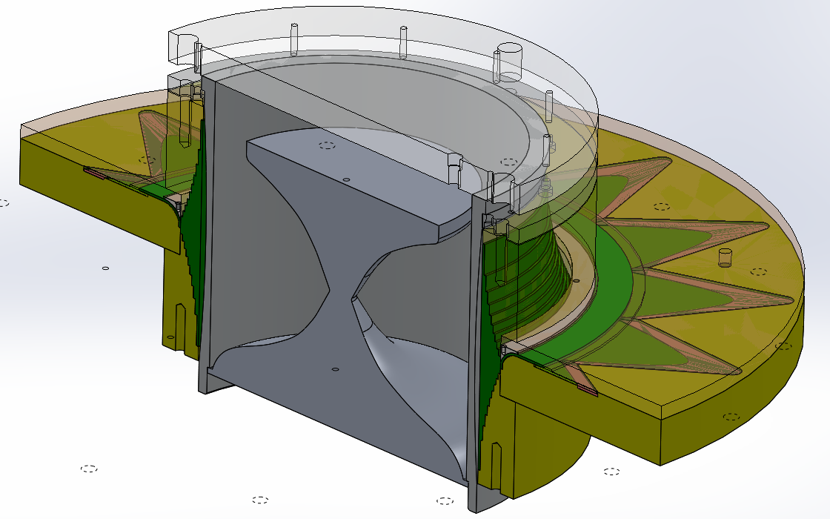
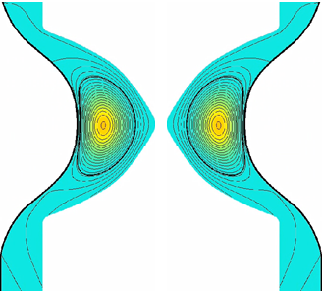
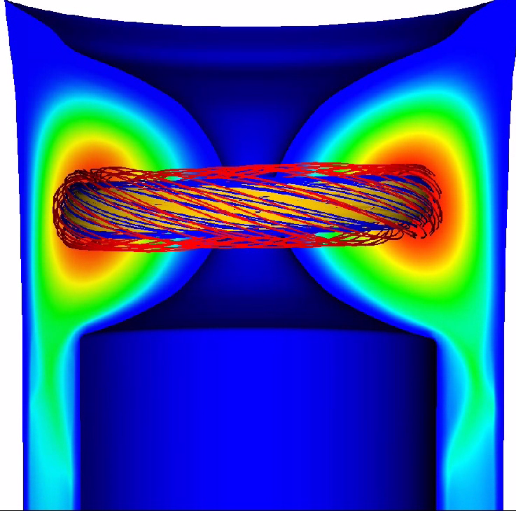
Plasma Injector: Recap to end of 2015
Bad curvature in compression one of the suspects for MHD instabilities in compression
Move to new design with better curvature, self-similar compression geometry

Slide 8
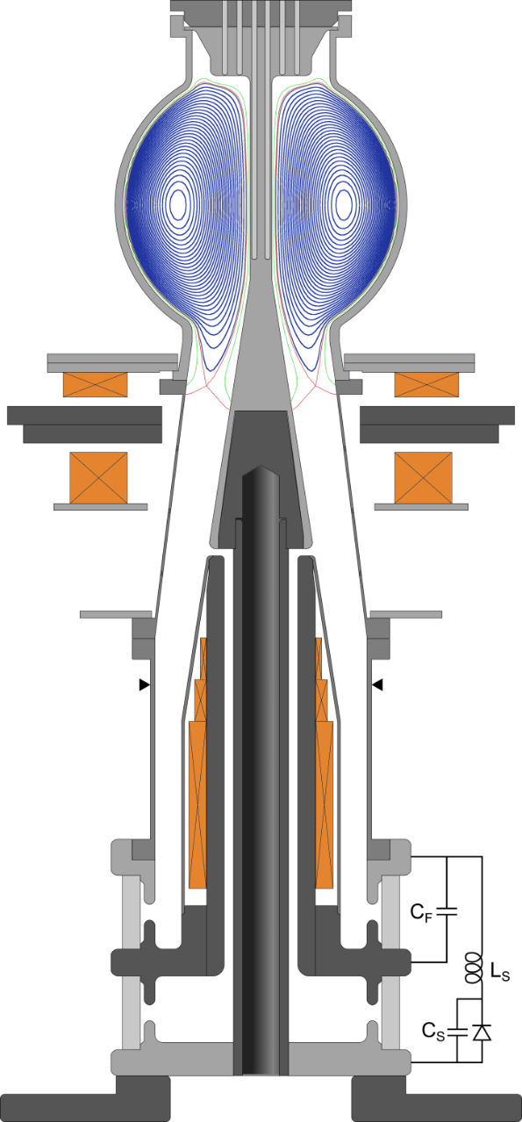
SPECTOR (SPhErical Compact TORoid)
Diagnostic headplate
SPECTOR forms spheromak and spherical tokamak plasmas by coaxial helicity injection into a flux conserver
Major, minor radius R= 12 cm, a = 8 cm
Vessel radius = 19 cm (interior)
Current in axial shaft ≤ 500 kA [crowbarred] creates pre-existing toroidal field before formation plasma
Density range = 5x10¹⁹ to 5x10²⁰ m⁻³
Poloidal Flux in CT = 30 mWb
Toroidal Flux in CT = 35 mWb
Toroidal plasma current = 250 kA
Total magnetic energy in CT = 120 kJ
Aluminum Flux Conserver
Upper
coils
Axial Shaft
Formation electrode
Gas puff valves (8x)
[GF-made piezo]
Main coil
Magnetic steel
Ceramic insulators

Slide 9
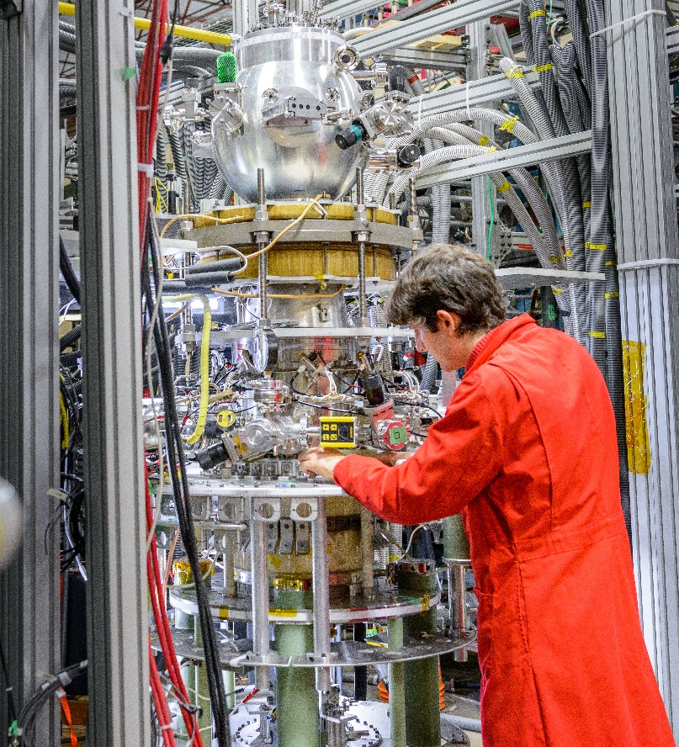
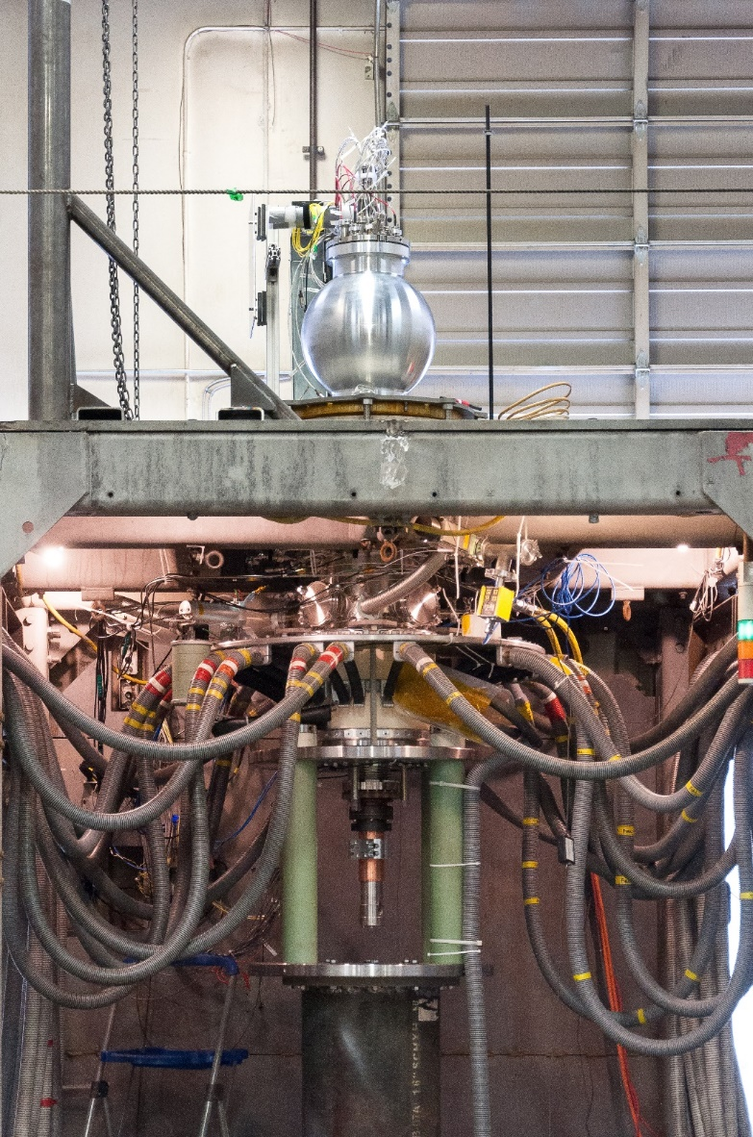
SPECTOR: Lab and Field Variants

Slide 10
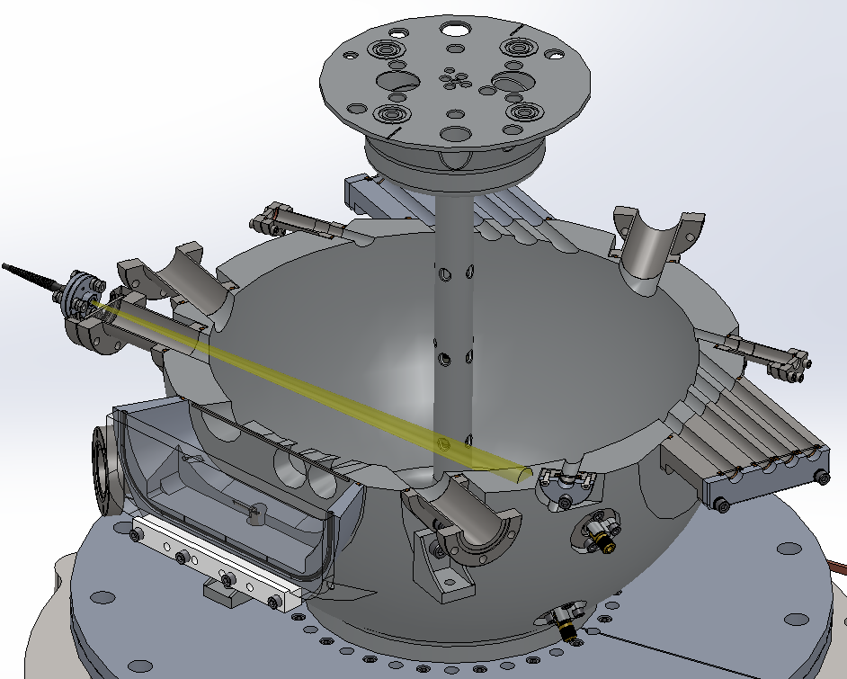
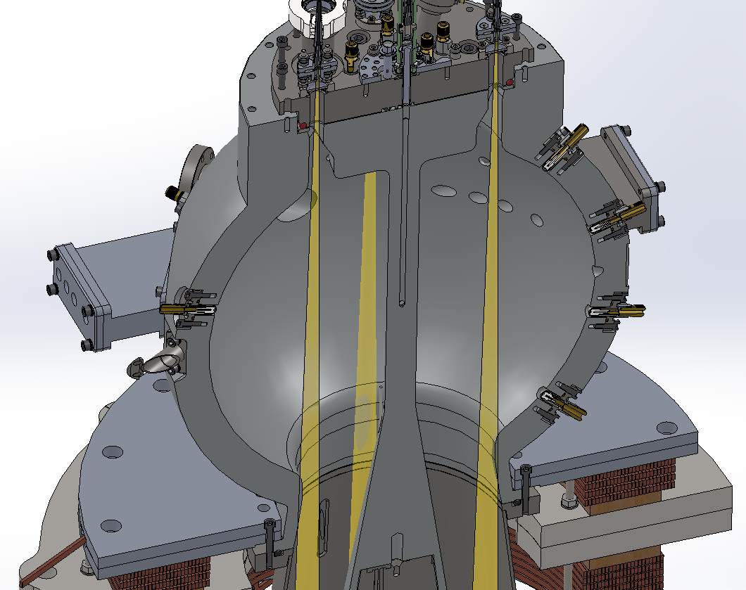
SPECTOR Diagnostics
VUV spectra
Ion Doppler
Thomson Beam
Visible
spectra
Center shaft
B probes
(12 total)
Ion Doppler
Not Shown:
Visible survey spectrometers (x3)
Liquid Scintillator (Gamma + Neutron detector, PSD)
X-ray pinhole camera, with Phantom high speed video
Filtered X-ray photodiodes
IR interferometry
FIR Polarimetry
Visible
Light chords
(4 toroidal positions)
Outer wall B probes
(17 total), measure [Bpol, Btor]

Slide 11
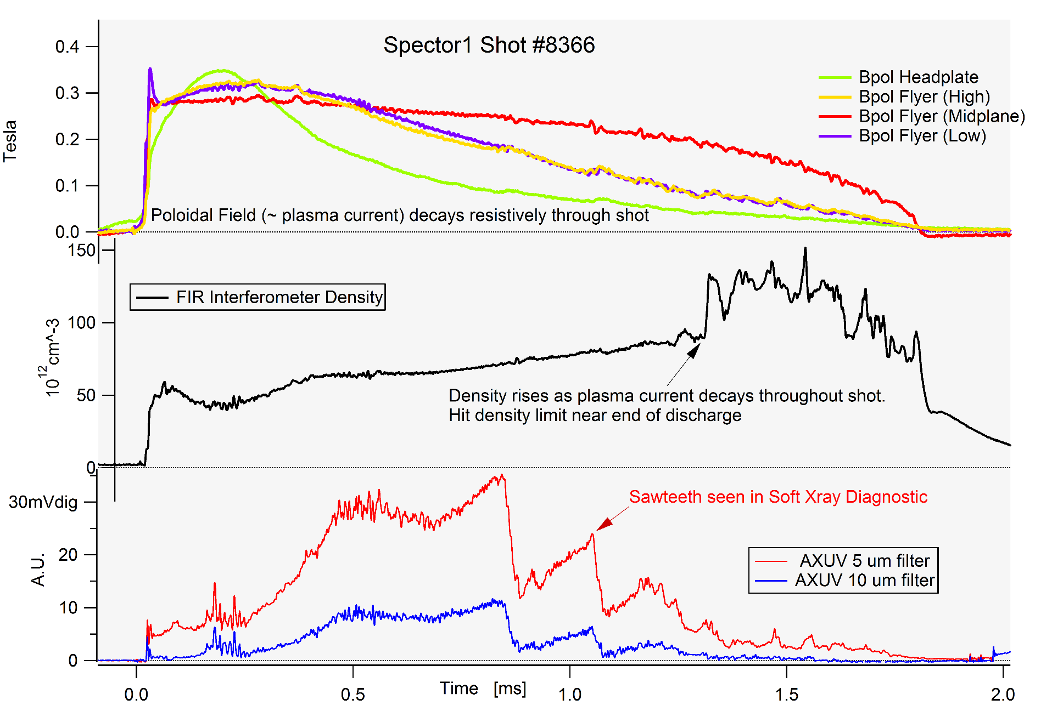
Plasma Lifetimes ~2 ms
Compression Time

Slide 12
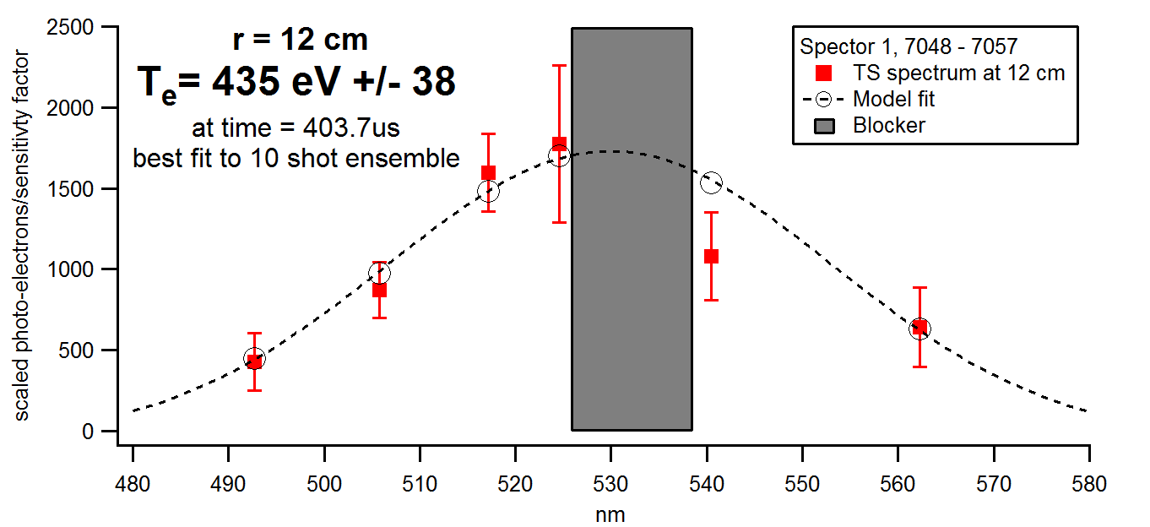
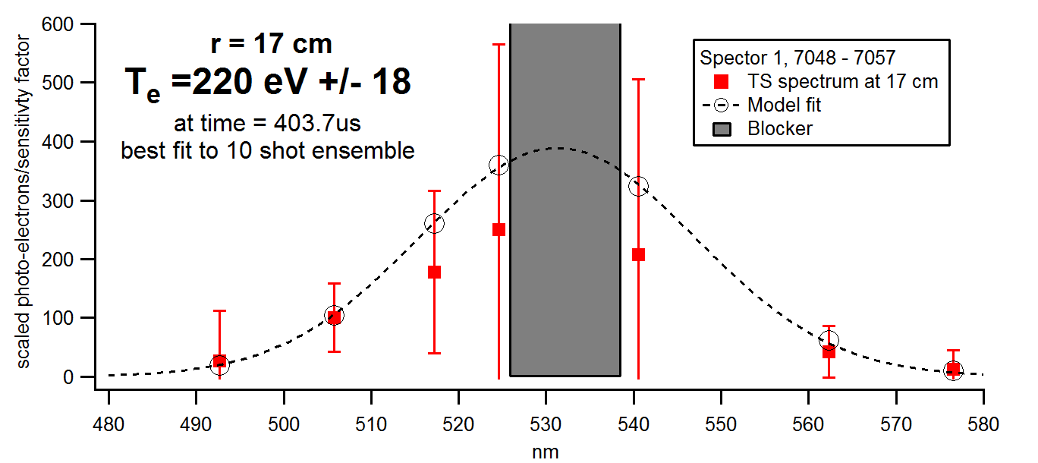
Plasma Temperatures >400 eV

Slide 13
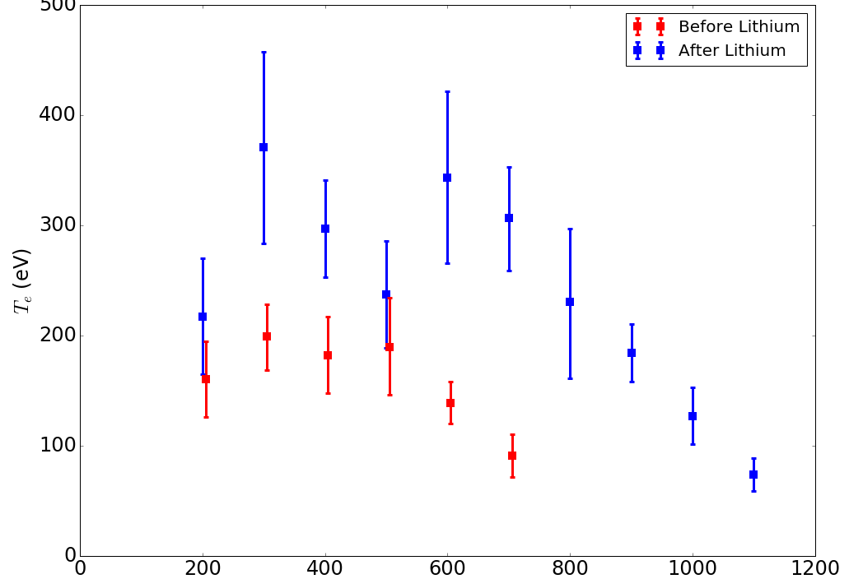
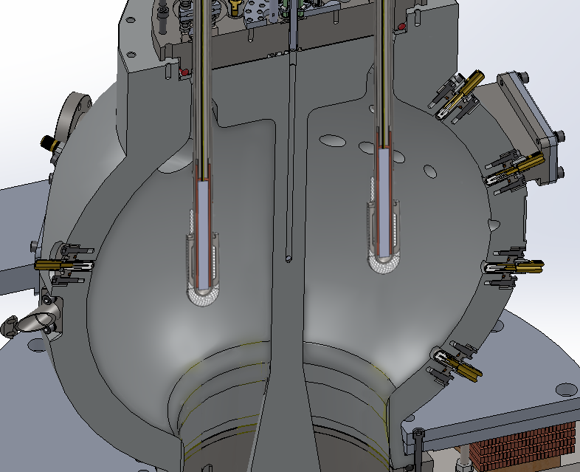

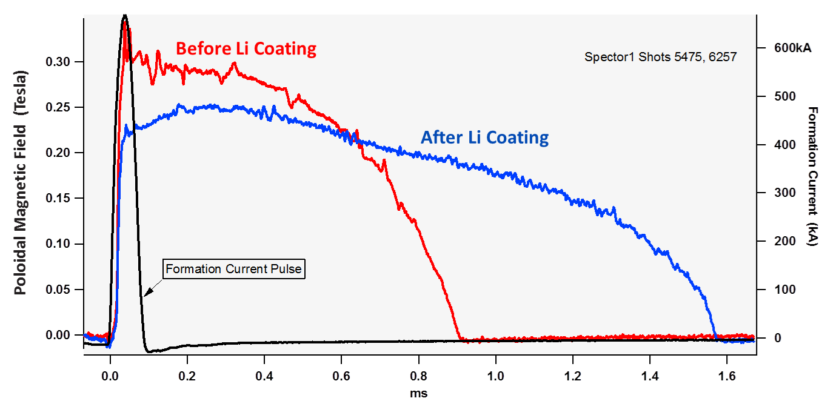
Lithium Gettering

Slide 14
Plasma Compression System

Slide 15
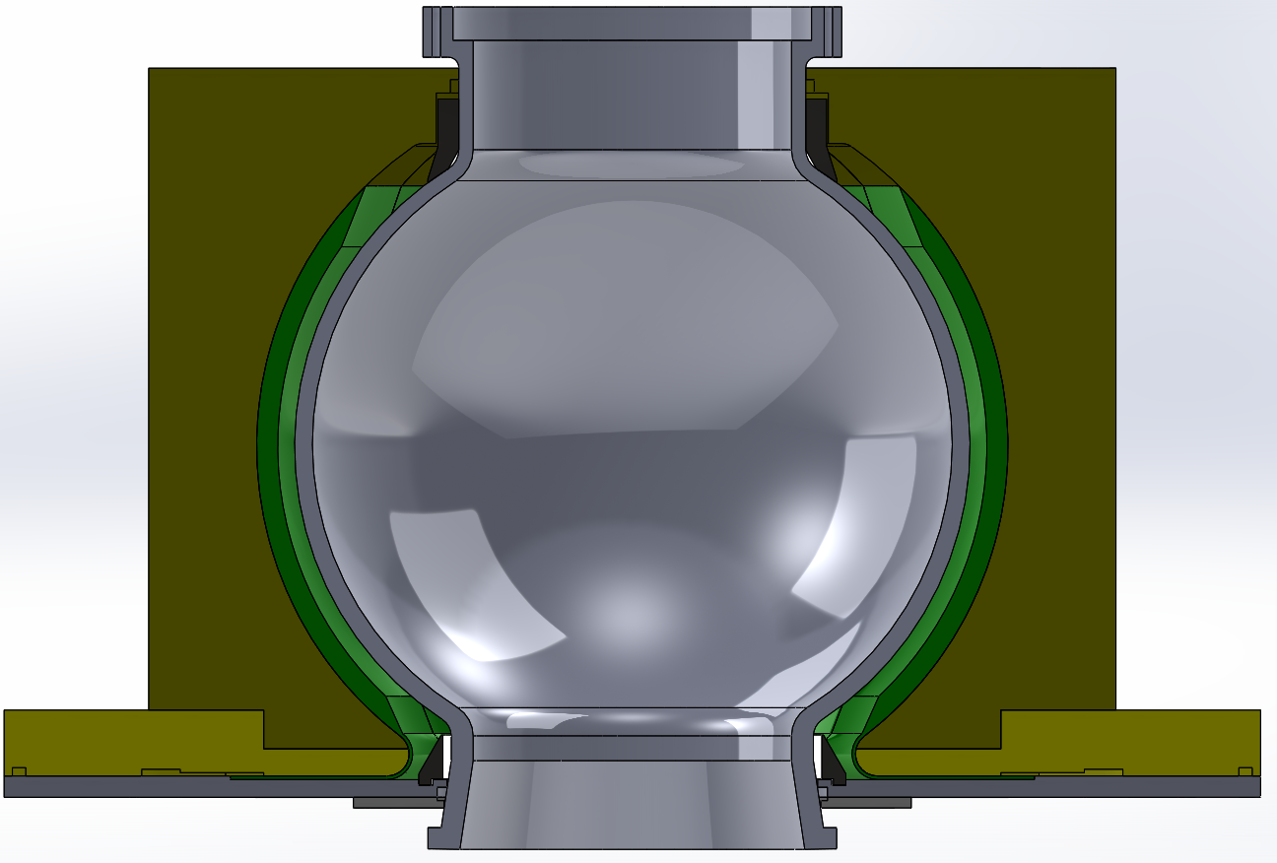
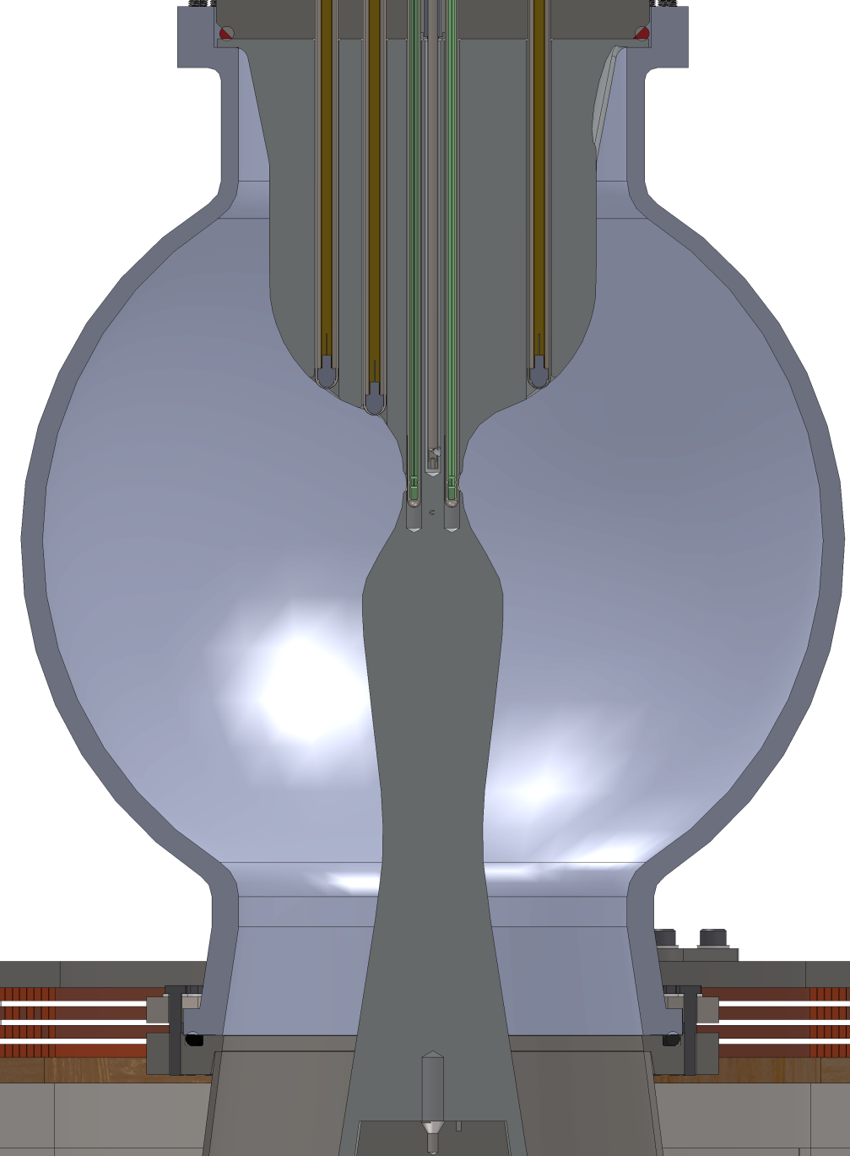
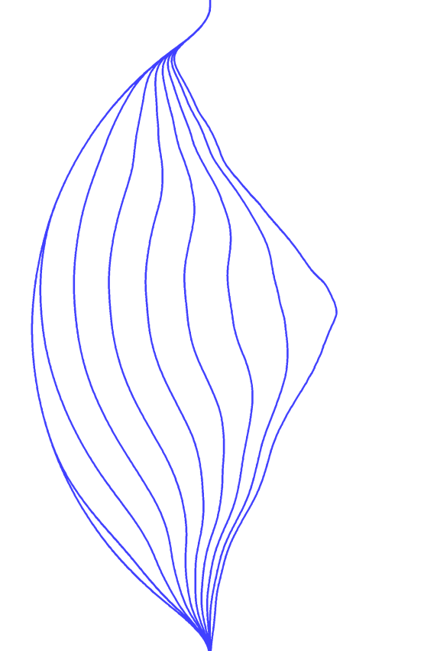
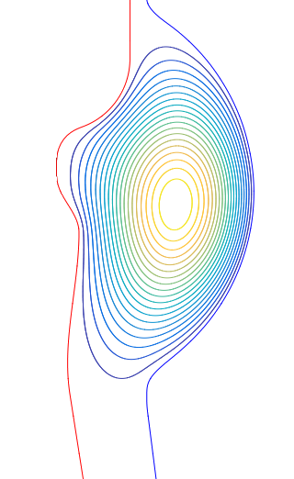
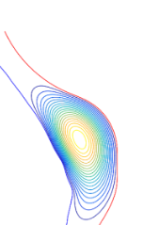
Compression Geometry
Initial Ψ(r,z)
poloidal flux
Wall motion
Final State
38 cm ID
Design achieves ~4:1 radial compression
Good shape until very final stages
Center Shaft

Slide 17
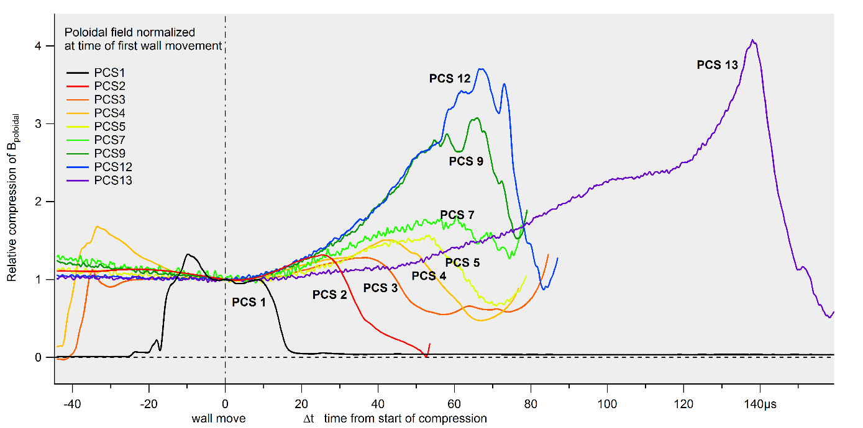
Plasma Compression Results

Slide 18
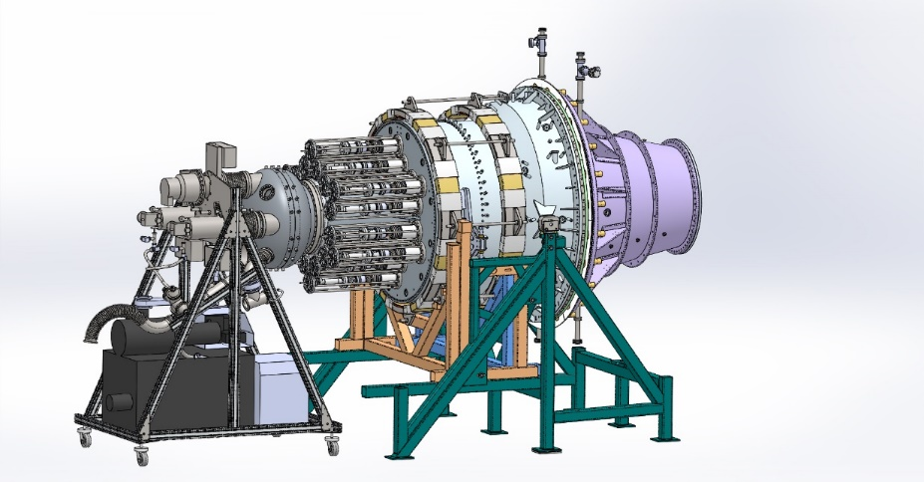
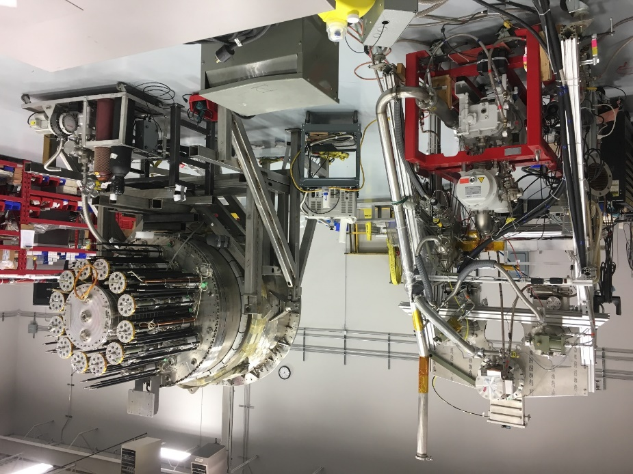
Next Steps
Three plasma compression tests expected in 1H2017
New large injector design being assembled, first plasma this month
Frictionless servo on new piston undergoing testing
Combine it all: detailed design of integrated system in 2017

Slide 19

Aurora
Initiative to migrate all our plasma data to a cloud-based system
Platform for collaboration with outside researchers
Will include some analysis and visualization tools
Will support application of machine learning and “big data” statistical analysis
Launches in first half of 2017

Slide 20
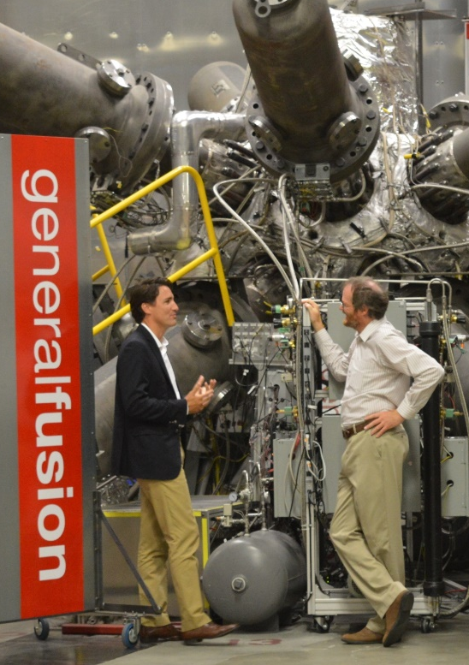


A joint initiative by the Canadian fusion research community
Proposes a staged program, starting with a renewal of research capacity in fusion science and support for domestic and international collaborations
Fusion 2030: Roadmap for Canada

Slide 21





Michael Delage
Chief Technology Officer
michael.delage@generalfusion.com
604-439-3003
106-3680 Bonneville Pl
Burnaby, BC
Canada
www.generalfusion.com
Twitter
@generalfusion
Instagram
@generalfusion
LinkedIn
general-fusion

