Slide 1
Status and Plans on MAST-U
Joe Milnes
For the MAST Upgrade Team
Culham Centre for Fusion Energy
UK Atomic Energy Authority
Fusion Power Associates
37th Annual Meeting and Symposium
Fusion Power Development: An International Venture
13th / 14th December 2016

Slide 2
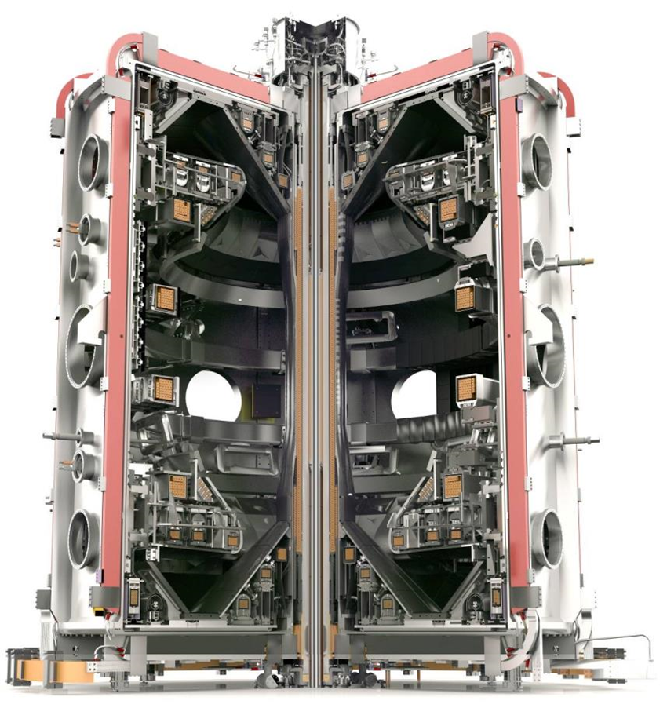
Contents
1) Objectives
2) Timeline
3) Capability
4) Innovation
5) Construction
6) Programme
7) Summary

Slide 3
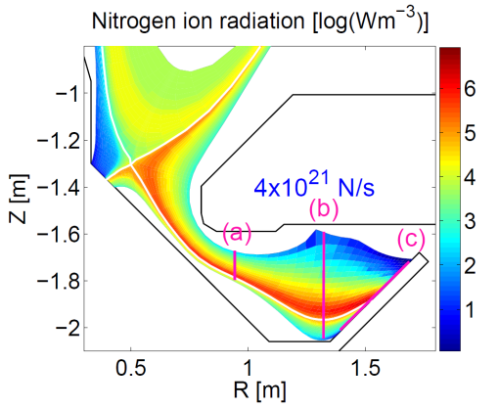
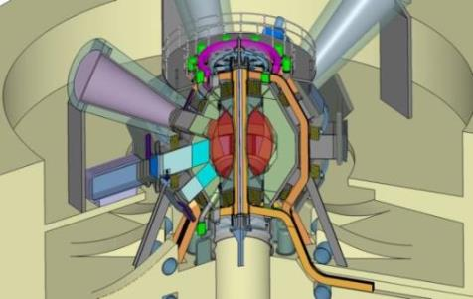
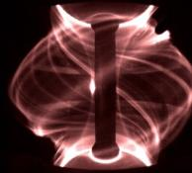
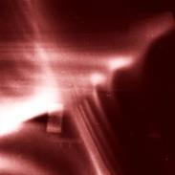
1. Objectives
MAST Upgrade has 3 primary objectives:
Development of novel exhaust concepts
Contribution to the knowledge base for ITER
Feasibility assessment of the spherical tokamak as a fusion Component Test Facility
Ref Havlickova et al
Ref Kirk, Phys Rev Lett, 2012; Harrison, Nucl Fusion, 2014; Chapman, Phys Plasmas 2013
Ref Voss et al
ELMs on MAST
Effect of 3D field on plasma boundary near the X-point

Slide 4
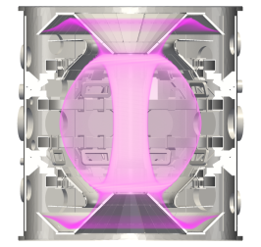
2. Timeline
Conceptual Design
Scheme Design
Detailed Design
Construction
2008
2010
2012
2014
2016
April 2016 First tokamak modules installed in bioshield
Jan 2008 MAST-U + Super-X Divertor, Scoping studies and Conceptual Design started
Oct 2013 MAST Operations finish, Strip out starts
November 2017 First MAST-U Plasma
April 2010 MAST-U Construction Approved
March 2014 MAST-U rebuild underway
February 2017 Pump down
Notes:
4
4
4

Slide 5
3. Capability
Overview
Increased TF
Improved confinement
New Solenoid
Greater I_{p}, pulse duration
19 New PF Coils
Improved shaping
Super-X Divertor
Improved power handling
Off-Axis NBI
Improved profile control

Slide 6
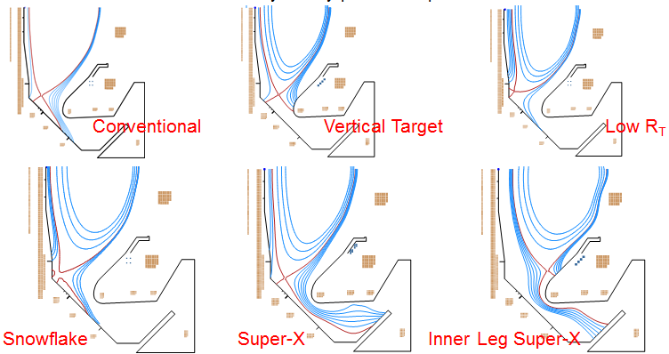
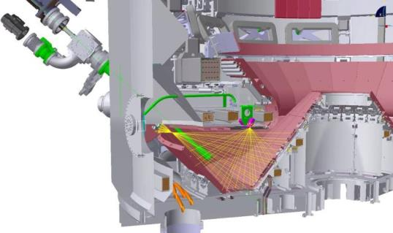
3. Capability
Divertor capability
Highly flexible
8 sets of shaping coils for each divertor
Wide range of strike point locations
Well diagnosed
> 500 Langmuir Probes
> 400 Pick Up coils
Comprehensive Bolometry
Divertor Science Facility (similar to DIMES)
Thomson Scattering
Imaging (visual, spectroscopic, IR)

Slide 7
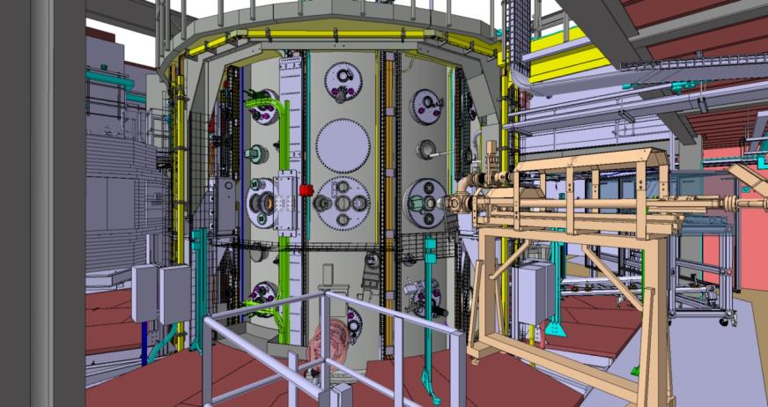
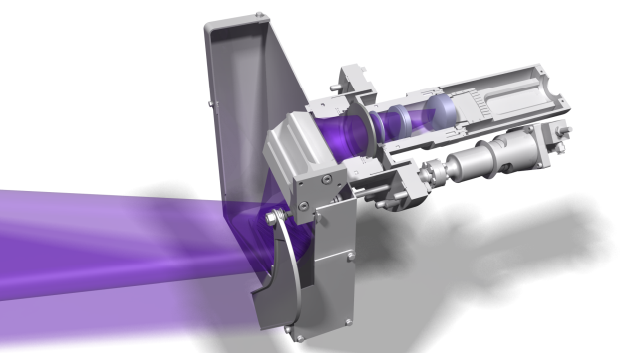
3. Capability
Diagnostic capability
Over 50 systems, including:
Reciprocating probes
Multi-point Thomson Scattering
High resolution beam spectroscopy
Neutron Camera
Microwave diagnostics (Doppler Back Scattering, Synthetic Aperture Microwave Imaging)
Notes:
Image: Charge eXchange Recombination Spectrosopy

Slide 8
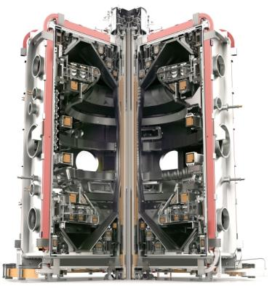
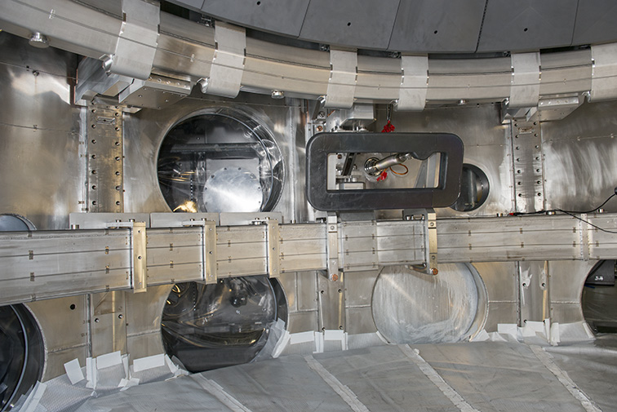
3. Capability
Edge Localised Mode Control
12 ELM coils installed (8 lower, 4 upper)
n = 2 and n = 4 fields
Field strengths comparable with other devices (AUG, DIII-D)

Slide 9
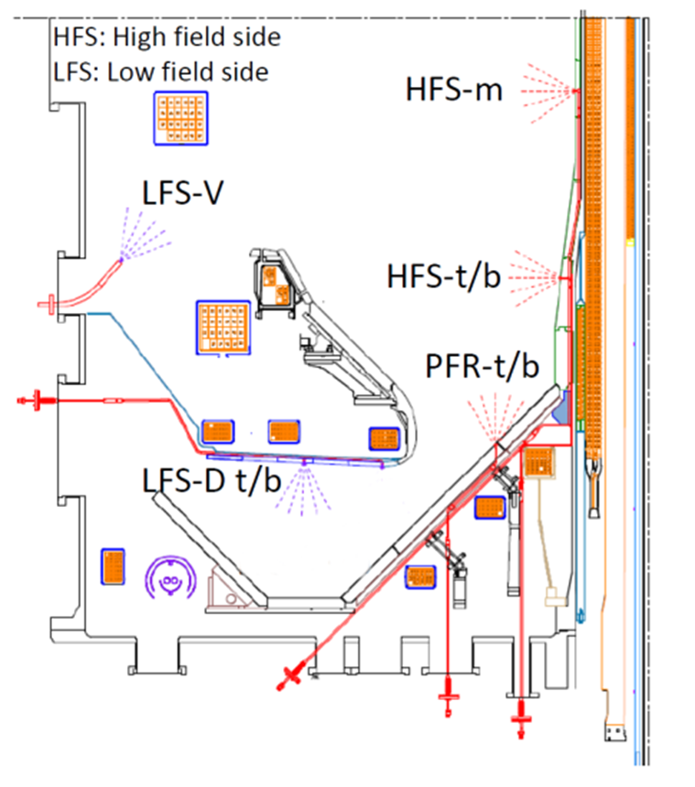
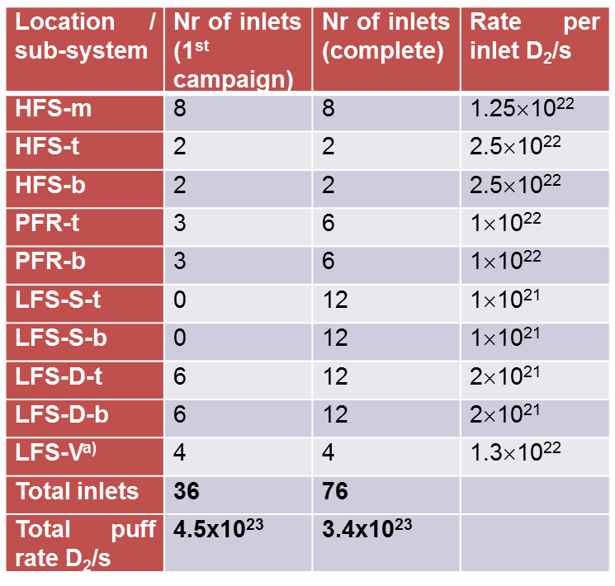
3. Capability
Gas Fuelling capability
Significant capacity
Each location can be used to inject main ion species or impurities
Notes:
For core scope, 50% of PFR-t/b and LFS-D t/b have valves; no valves on LFS-S t/b

Slide 10
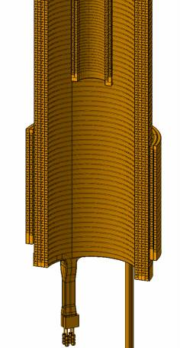
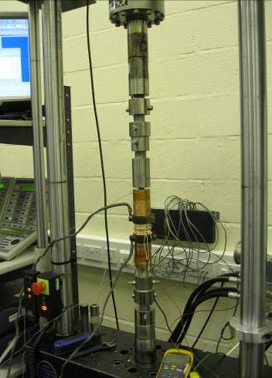
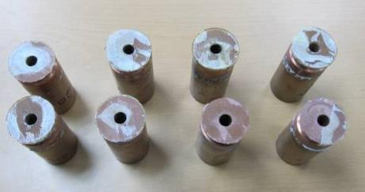
4. Innovation
Cyanate-ester bonding results
Longer pulses:
Challenge:
New Solenoid designed to increase flux swing to 1.6Wb (currently 0.7Wb)
Solution (part 1):
Use of cyanate-ester resin technology to improve strength at higher temperature
Notes:
10
Large R&D programme required to determine optimum bond design, including priming application, surface finish, curing vs semi curing (temp, duration), post-treatment of primed surface
Shear test results shown
Whilst bond strength has been optimised, analysis suggests the original target of 30,000 cycles will not be met so a solenoid is envisaged during the 10 year lifetime of the MAST-U machine.

Slide 11
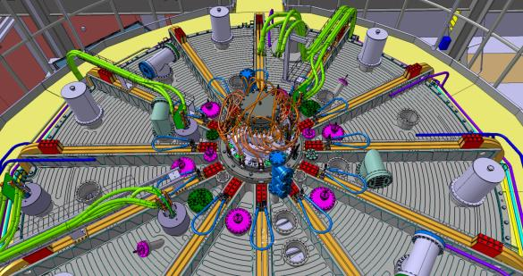
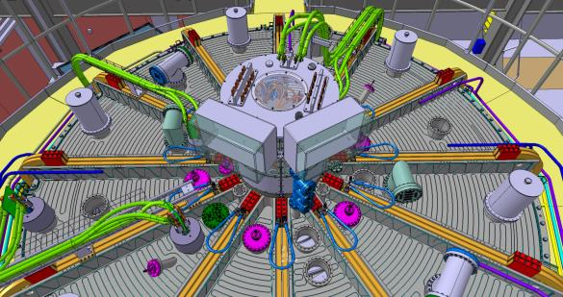
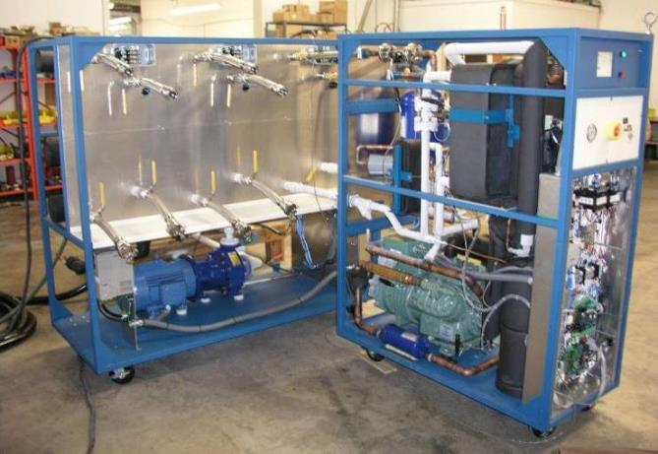
4. Innovation
Dry air enclosure needed for chilling solenoid
Longer pulses:
Challenge:
New Solenoid designed to increase flux swing to 1.6Wb (currently 0.7Wb)
Solution (part 2):
Chiller system using Galden to support thermal demands and longer pulses (running the solenoid from -20ºC to 100ºC)
Chiller System using Galden
Notes:
11
As well as optimising the mechanical strength of the solenoid, the pulse length is further extended via the use of Galden coolant to run the solenoid from -20oC to 140oC, which effectively buys you another 40oC deltaT, maximising the flux swing.
Need a dry air enclosure to avoid condensation and ice build

Slide 12
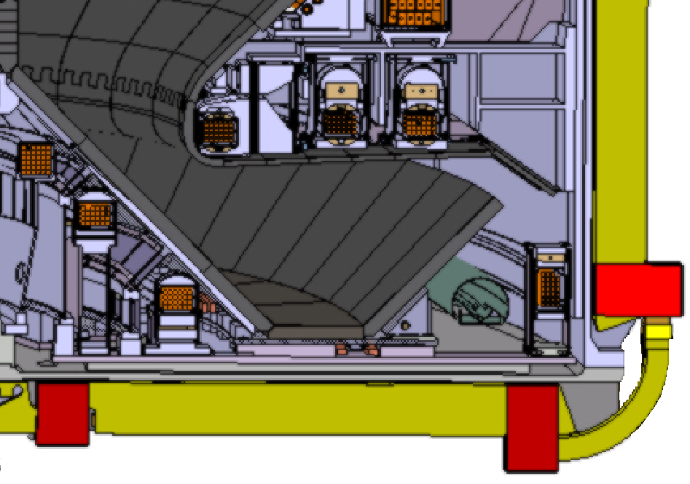
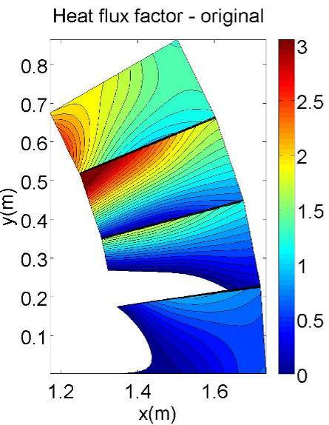
4. Innovation
TF Ripple:
Challenge:
TF ripple leads to factor 3 variation on super-x target
No power flux

Slide 13
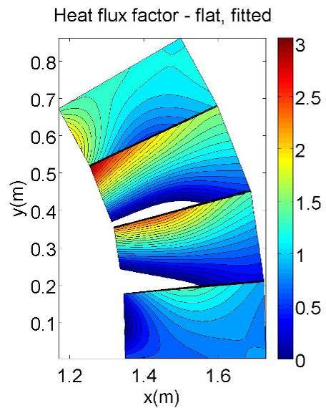
4. Innovation
TF Ripple:
Challenge:
TF ripple leads to factor 3 variation on super-x target
Angling tiles only doesn’t help much.
No power flux

Slide 14
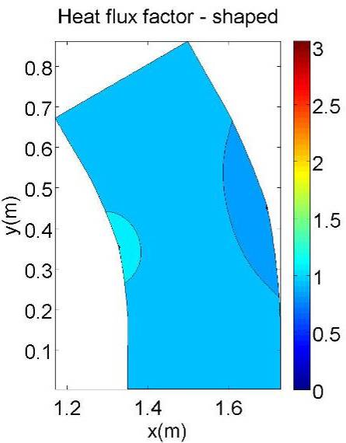
4. Innovation
TF Ripple:
Challenge:
TF ripple leads to factor 3 variation on super-x target
Angling tiles only doesn’t help much.
Solution:
Shaping brings variations within ±6%

Slide 15
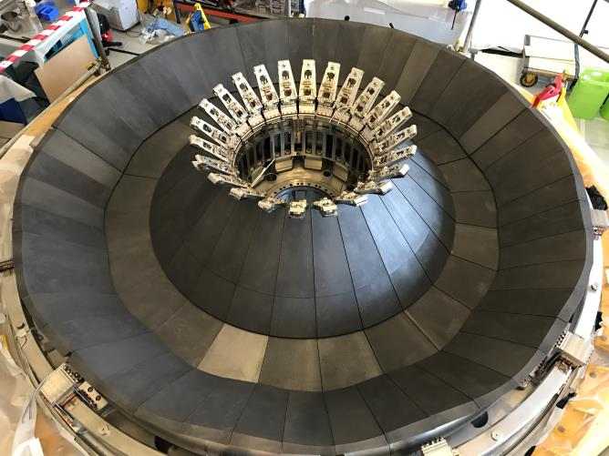
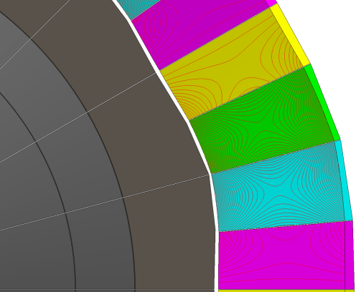
4. Innovation
TF Ripple:
Challenge:
TF ripple leads to factor 3 variation on super-x target
Angling tiles only doesn’t help much.
Solution:
Shaping brings variations within ±6%

Slide 16
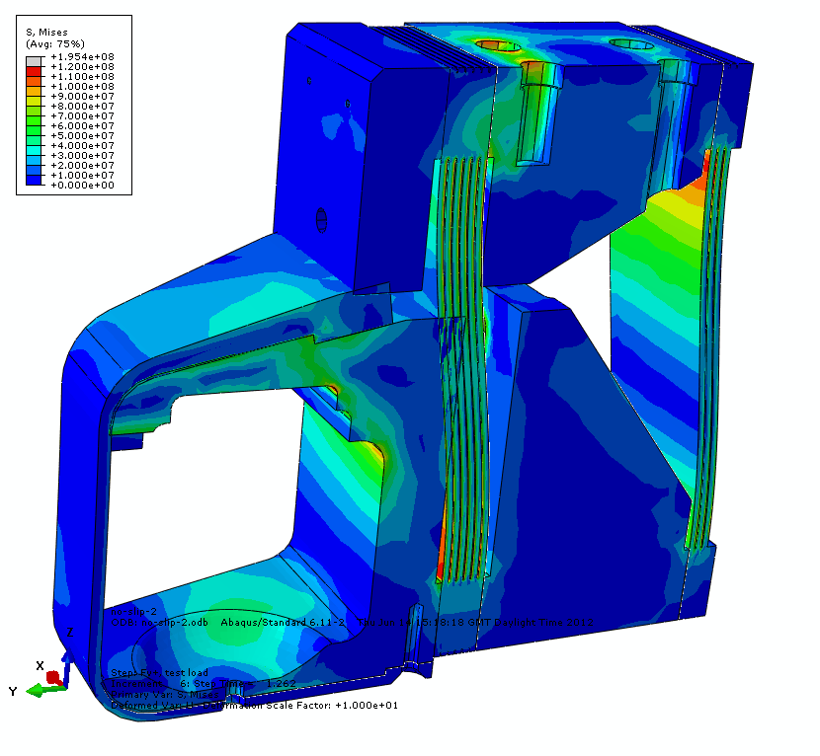
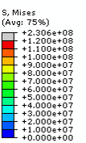
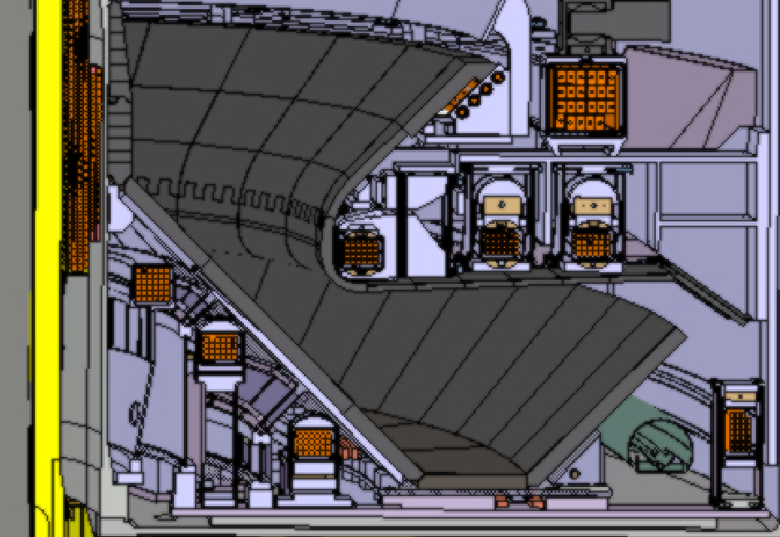
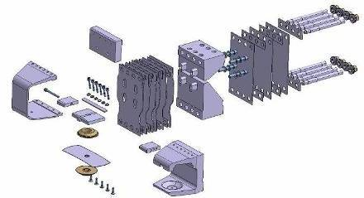
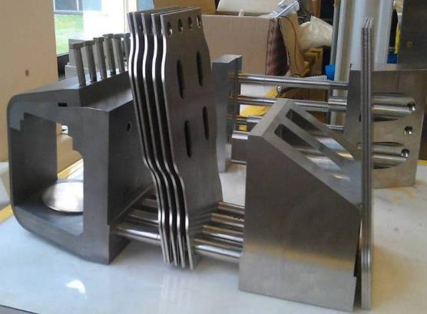
4. Innovation
Challenge:
Forces of several 100kN, differential thermal expansions, limited space
Solution:
Use of lamellae, frictional contact to transmit shear, Wedge / ball support arrangement
Notes:
16
Show where Shear force transmitted
Don’t mention going away from dowels

Slide 17
5. Construction
MAST-U Summary Video
Notes:
17
17
17

Slide 18
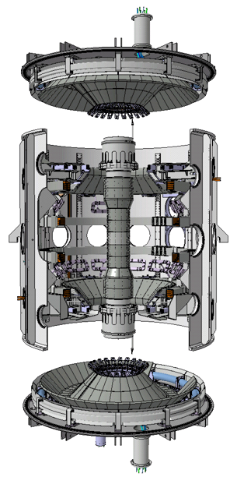
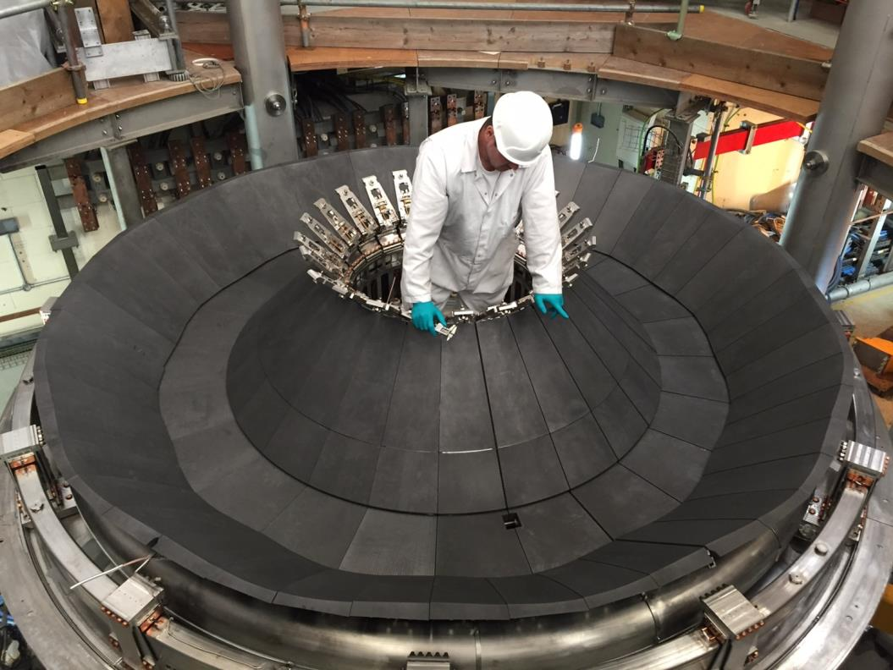
5. Construction
May 2016
Notes:
18
18
18

Slide 19
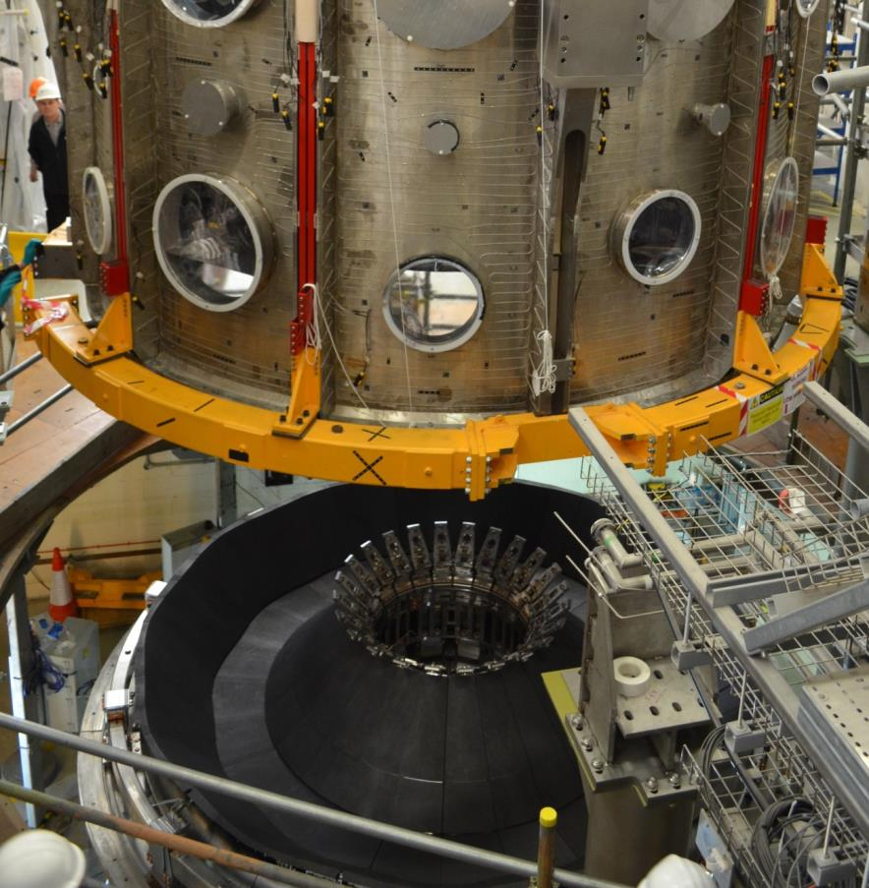
5. Construction
May 2016
Notes:
19
19
19

Slide 20
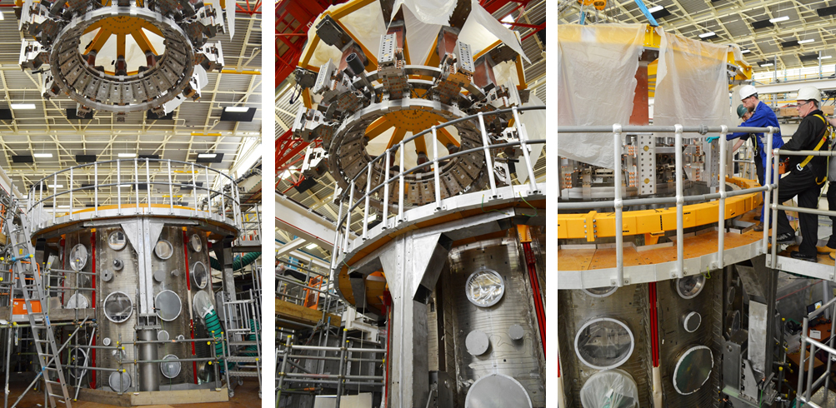
5. Construction
June 2016
Notes:
20
20
20

Slide 21
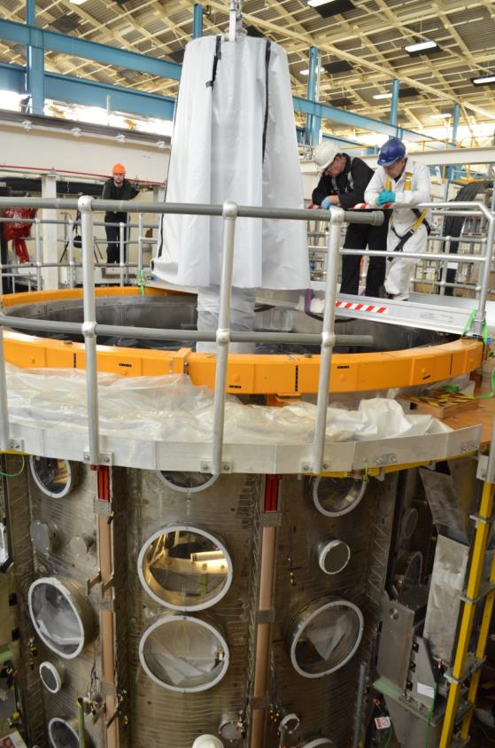
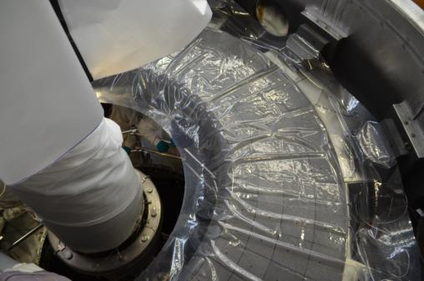
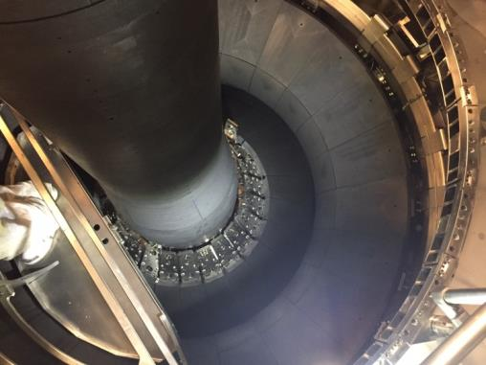
5. Construction
October 2016
Notes:
21
21
21

Slide 22
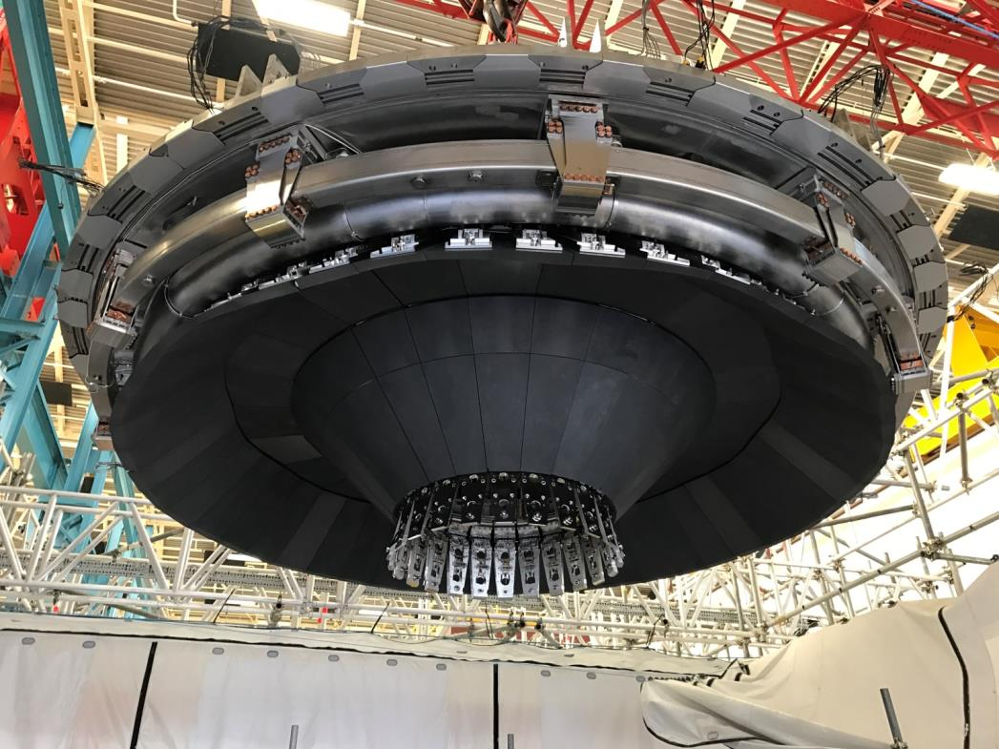
5. Construction
November 2016
Notes:
22
22
22

Slide 23
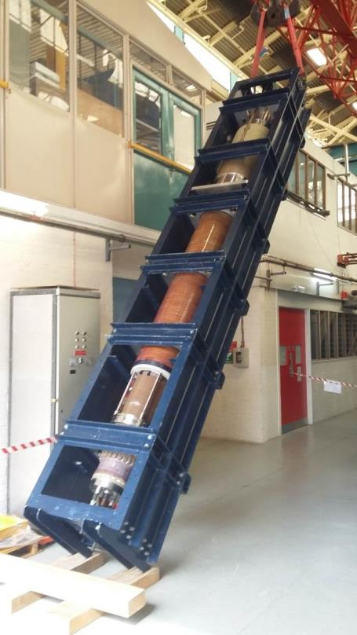
5. Construction
Centre Column installation expected within the next week
Notes:
23

Slide 24
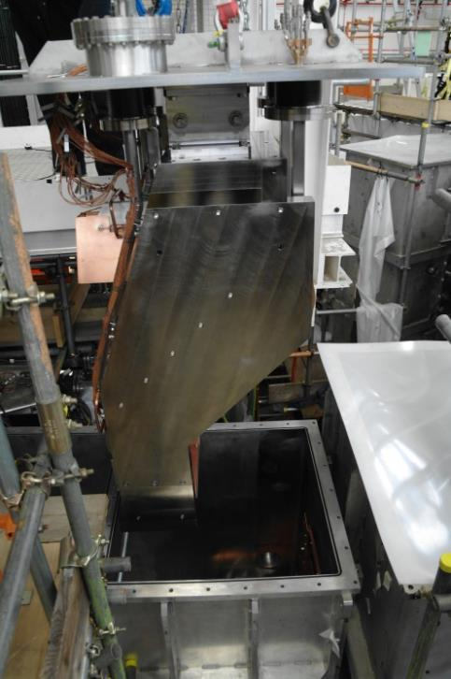
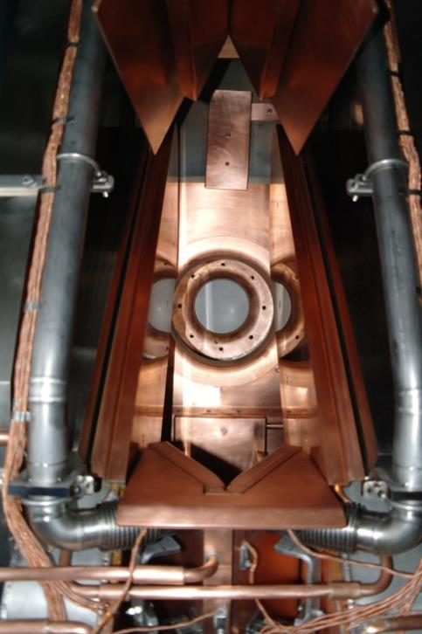
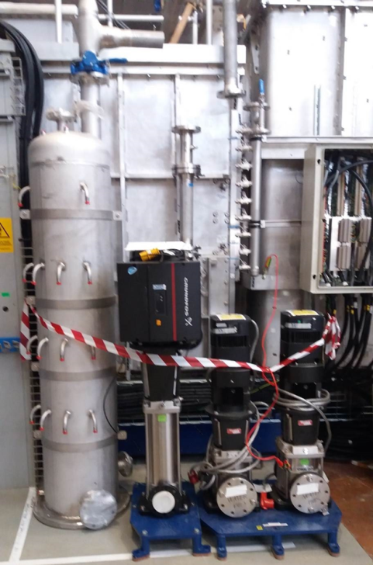
5. Construction
Neutral Beam Heating
NBH systems “Ready for integrated commissioning” expected ~ January 2017
Notes:
24
24
24

Slide 25
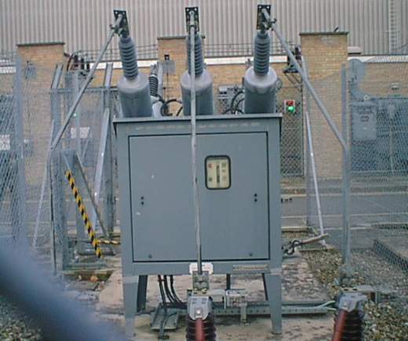
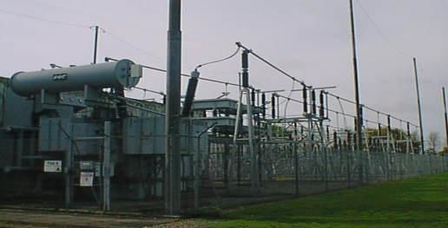
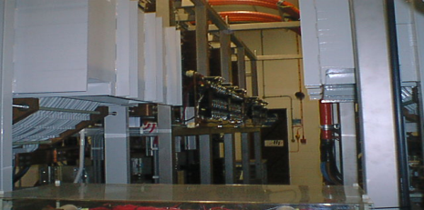
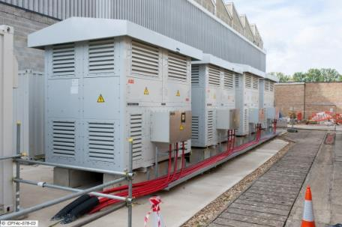
5. Construction
Power Supplies
Divertor Coil Power Supplies
Poloidal Field
Power Supplies
HVPS
LVPS
TF Coil Power Supplies
Solenoid Power Supplies

Slide 26
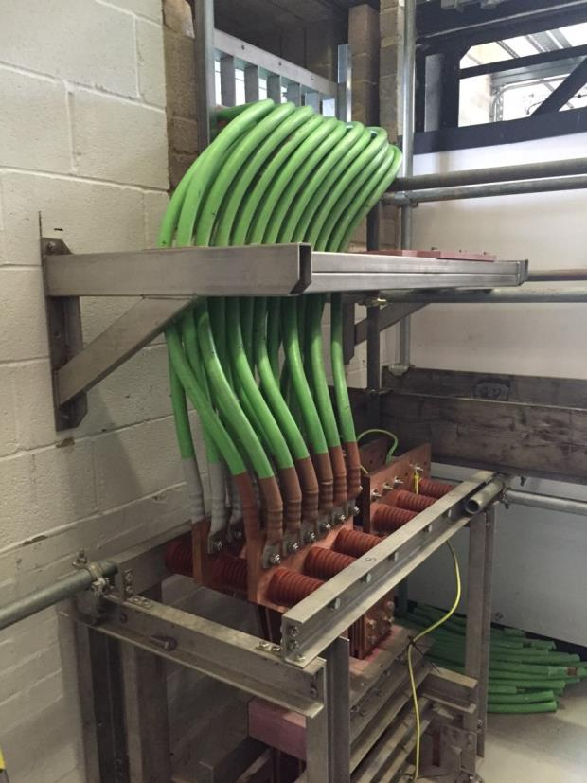
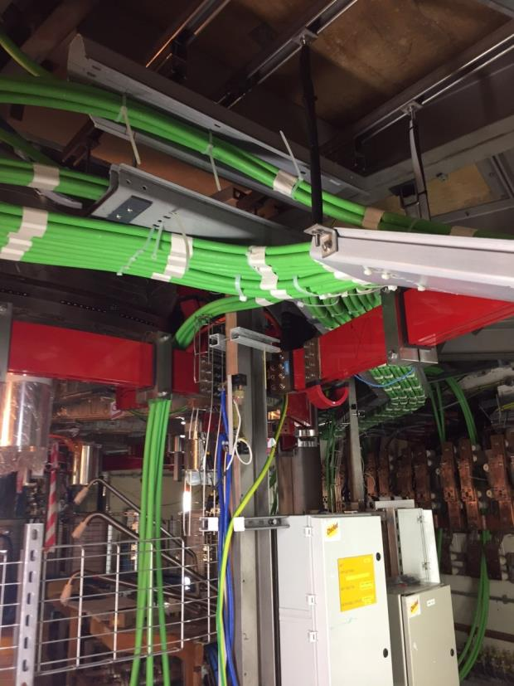
5. Construction
Power Supplies
All power supplies connected to coils expected ~ March 2017
Notes:
26
26
26

Slide 27
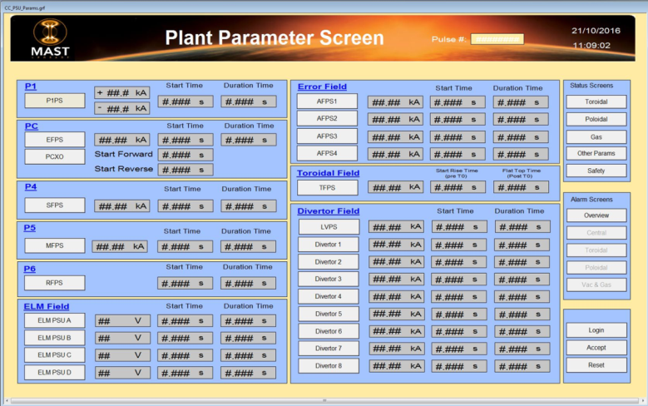
5. Construction
Machine Control
Machine control systems ready to deliver power into coils expected ~ March 2017
Notes:
27

Slide 28
5. Construction
Preparation for integrated commissioning…
MCS
Circuit Breaker
NTM unit
PCS
Machine Protection
RTP
PASS
Z- Controller
RFPS
Datac
Magnetic Transducers
Analogue inputs from PCS

Slide 29
6. Scientific programme
Restart and early phases of machine operation
Conventional
Divertor
Configuration
Super-X
Divertor
Configuration
Plasma
breakdown
Limiter
Configuration
Each of these stages requires several weeks of operation

Slide 30
6. Scientific programme
A Super-X diverted plasma

Slide 31
6. Scientific programme
Key early goals
Improving the understanding of exhaust physics
Closure and connection length
Flux expansion at the divertor targets
Volumetric losses and detachment
Fast ion physics and current drive
Tailoring super-Alfvenic fast ion distribution
High elongation plasmas with reduced fast ion redistribution
Other high-priority ITER, DEMO and CTF needs
RMP ELM control
Pedestal & core turbulence at low collisionality

Slide 32
6. Scientific programme
Collaborations
Following recent EUROfusion call for proposals, 40 proposals were received showing a strong interest from European collaborators
The requested number of pulses was 3 times those available
Shot prioritisation was discussed at the General planning meeting held in November 2016 in Garching at which MAST-U was included for the first time

Slide 33
6. Scientific programme
Collaborations
USA
ORNL: Bolometry
PPPL: plasma control and divertor physics
GA: ELM control
Florida: proton detector
W&M: turbulence imaging
Wisconsin: EMC3 (3-D fluid plasma and kinetic neutral transport code)
UC Irvine: FIDA measurements
UCLA: Doppler Back Scattering
+ a number of other collaborations around the globe

Slide 34
7. Summary
Completion of >90% of the MAST-U Tokamak build has meant that a large number of technical risks are now retired
Current focus is on successful installation of the Centre Column, installation / testing of key services and preparation for the start of integrated commissioning in first half of 2017
Once complete, we expect this device to make significant contributions in the fields of exhaust physics, edge physics, fast ion physics and current drive, and other high-priority ITER, DEMO areas of interest.
There are still many opportunities for collaborations from across the globe to participate in this exciting new facility
Notes:
34
34
34

