Slide 1
Recent DT Cycle Studies Confirm yet again: A Fusion Nuclear Science & Technology Facility is necessary to have credible, practical, and fast pathway to fusion energy Excellent opportunity for Public- Private partnership
Mohamed Abdou
Distinguished Professor of Engineering and Applied Science
Director, Fusion Science and Technology Center, UCLA
https://www.fusion.ucla.edu/
With much appreciation to the many scientists and engineers I have worked with over decades!
Presentation at the FPA Meeting and Symposium 12-7-2022

Slide 2
Introductory Remarks
Fusion, if it works, will be the ultimate energy source for mankind
But the Pace of fusion development has been painfully slow
The reasons for the painful reality that “the time to fusion is 40 years away, and expanding” include:
scientific/technological challenges
Many programmatic, management, leadership, institutional, and other issues involved in the complex fusion energy development – inflexibility in making timely changes in strategy and pathways
Recent comprehensive review of the DT Fuel Cycle studies* confirm again that there is a missing step for developing fusion nuclear components, which is essential to have credible pathway to DT fusion energy. Thus, confirming a conclusion derived in numerous in-depth technical studies over the past 40 years, but never implemented.
This missing step has been called many names: Fusion Nuclear Science Facility (FNSF)/FNSTF/VNS/TDF/CTF. Whatever name you call it, this is the focus of this presentation.
*M. Abdou, M. Riva, A. Ying, C. Day, A. Loarte, L.R. Baylor, P. Humrickhouse, T.F. Fuerst and S.Y. Cho, “Physics and technology considerations for the deuterium-tritium fuel cycle and conditions for tritium fuel self sufficiency“, Nucl. Fusion 61 (2021) 013001 (50pp) Link to article on the IOP Nuclear Fusion Website

Slide 3
Key Challenges/Issues for which progress over the past decades has been frustratingly slow But must be confronted NOW in any serious plan to develop fusion
Lack of External T Supply to provide the large T Startup Inventory required for any major fusion facility
Technology and physics Uncertainties in achieving Tritium Self-Sufficiency
RAMI (Reliability/Availability/Maintainability/Inspectability)
RAMI is the Achilles’ Heel issue for fusion
Complex and new Multiple/synergistic Effects and Interactions Phenomena
These phenomena cannot be synthesized from “separate effects” experiments or modelling
Need to achieve high power density and Blanket High Temperature Operation
The key facility to address these challenges that must be built soon is FNSF.
FNSF (or any name you call it) is a plasma-based facility to learn behavior of Blankets/FW/Divertor in the fusion nuclear environment, learn about multiple/synergistic-effects phenomena, quantify the potential to attain T self-sufficiency, and understand failure modes, rates, effects (RAMI). (and possibly produce excess tritium to supply the Required Start up inventory for DEMO)

Slide 4
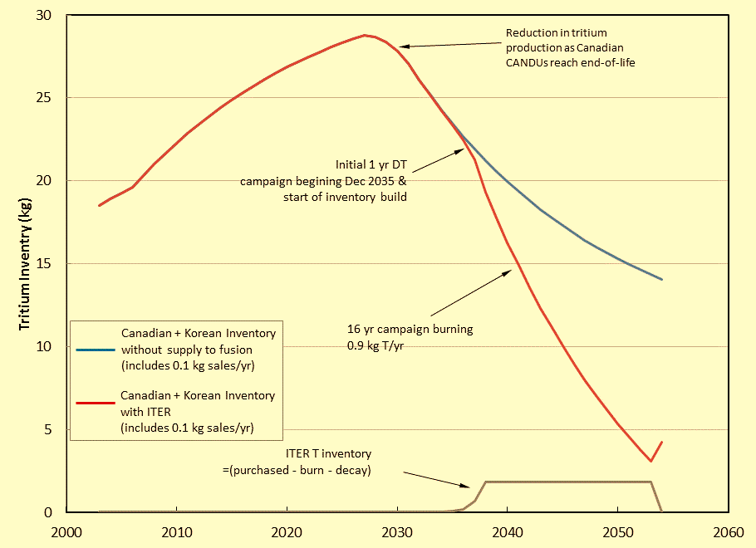
Issue: With ITER DT start in 2036, there will be no external non-fusion supply of tritium left to provide T Startup inventory for any major DT Fusion facility beyond ITER.
The tritium we had at the beginning of ITER design has already decayed!
Tritium decays at 5.47% per year
CANDU Supply
w/o Fusion
Start DT Dec 2035
With ITER:
Burn 0.9 kg/yr for 16 yr

Slide 5
Reliability/Availability/Maintainability/Inspectability (RAMI)
Detailed Analyses show: RAMI is a serious challenge that has major impact on engineering feasibility and economics: anticipated MTBF is hours/days (required is years), and MTTR is 3-4 months (required is days), and availability is very low < 5%
Fundamental reasons:
Location of Blanket/FW/Divertor inside* the vacuum vessel:
low fault tolerance → short MTBF because many failures (e.g. coolant leak) require immediate shutdown, also no redundancy possible.
long MTTR because repair & replacement require breaking “vacuum seal” and many connects/disconnects, and many operations in the limited access space of tokamaks, stellerators, and other “toroidal/closed” configurations
* The decision to put the blanket inside the vacuum vessel is necessary to protect the vacuum vessel, which must be robust and cannot be in high radiation/temperature/stress state facing the plasma.
Large surface area of the first wall results in high failure rate for a given unit failure rate per unit length of piping, welds, and joints → short MTBF
Contrast this to fission reactors:
Can continue operation with ~ 2% of fuel rods with failures (MTBF ~ years)
An entire fuel bundle can be replaced in ~ 2 days (MTTR ~ 2 days).
Fission reactors have been able to achieve 90% availability

Slide 6
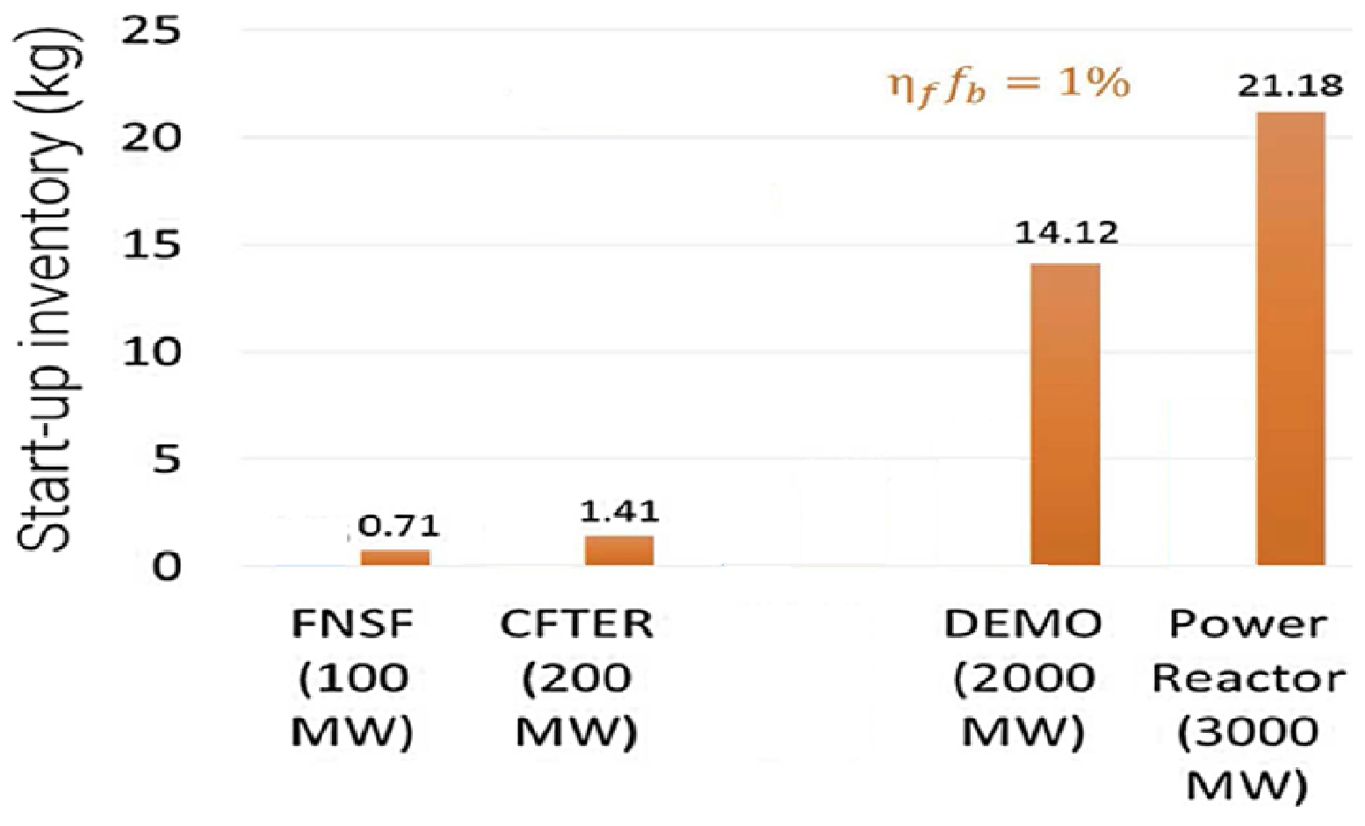
The required T startup inventory for DEMO and power plants is very large even if we assume success of recent physics and technology ideas. No external T supply: First generation of DT fusion devices must have low fusion power (<150 MW) to keep start-up inventory relatively small and obtainable

Slide 7
Alarming findings from Recent DT Fuel Cycle Studies
The underlying fundamental problem that we have now in fusion development is the absence of any DT fusion device in which we can learn about plasma and FNST components performance in the fusion environment.
Therefore, we have to rely on “modeling” to assess the state-of-the art and define R&D requirements. Dynamic modeling of the fuel cycle has been advanced over the past 30 years.
A primary conclusion is that physics and technology state-of-the-art will not enable DEMO and future power plants of providing the required startup inventory, achieving T self-sufficiency, and reasonable pace of entry to market. We quantified goals and defined specific areas and ideas for physics and technology R&D advances. But success cannot be assured, and there is “Missing step(s)” to enable this R&D.
M. Abdou FPA 12-7-2022

Slide 8
“Missing step(s)” without which it seems nearly impossible to have credible pathway to DT fusion energy
The big picture for fusion pathway development that emerges from the detailed analysis of the physics and technology of the DT cycle, including assessment of the state of the art and careful evaluation of the requirements for startup inventory and self sufficiency is that:
A credible pathway must start with a DT plasma-based device that has low fusion power (<150 MW to minimize requirements for external T supply), in which we can learn behavior of Blankets/FW/Divertor in the fusion nuclear environment, discover and understand multiple/synergistic-effects phenomena, quantify the potential to attain T self-sufficiency; and understand failure modes, rates, effects (RAMI).
This first DT fusion device can be called FNSF (or VNS or any name you wish). It should have small size, ≥ 0.5 MW/m² NWL on 10-20m² test area. Only inside the vacuum vessel (FW/Blanket/divertor) need to be prototypical. Plasma should be highly driven, Q ~ 1-3.
Results and experience from this first DT device will tell us much about the viability of current concepts, and whether we need another one or more devices for reliability growth and other physics and technology improvements; and possibly produce excess tritium to supply the required Start up inventory for DEMO.
When the FNSF/VNS device availability approaches ~ 30%, a Demonstration power plant can be built with moderate fusion power (1000-2000MW). Emphasis of DEMO need to be on RAMI & improvement of availability factor to > 50%.
M. Abdou FPA 12-7-2022

Slide 9
Comprehensive FNST studies identified Necessary R&D Stages of Testing FNST components in the fusion nuclear environment prior to DEMO
Non-fusion facilities
FNST Testing in Fusion Facilities
D E M O
Engineering
Feasibility
Engineering Development
Scientific Feasibility
Preparatory R&D
Stage I
Stage II
Stage III
Modeling and experiments in non-fusion facilities
Fluence ~0.3 MW-y/m²
1 - 3 MW-y/m²
> 4 - 6 MW-y/m²
NWL ≥ 0.5 MW/m² Plasma burn > 200 s
1-2 MW/m²
steady state or long burn
COT ~ 1-2 weeks
1-2 MW/m²
steady state or long burn
COT ~ 1-2 weeks
Basic property measurement
Understand issues through modeling and single and multiple-effect experiments
Sub-Modules/Modules
Modules (10-20m² )
Modules/Sectors (20-30m² )
Discover and understand new synergistic phenomena
Establish scientific feasibility of basic functions under prompt responses and under the impact of rapid property changes in early life
Establish engineering feasibility of blankets/PFC/materials (satisfy basic functions & performance, up to 10 to 20% of MTBF and of lifetime)
Show basic RAMI feasibility
RAMI: Failure modes, effects, and rates and mean time to replace/fix components and reliability growth
Verify design and predict availability of FNST components in DEMO
None of the top level technical issues can be resolved before testing in the fusion environment
Notes:
9

Slide 10
Planning the Pathway to DEMO Must Account for Unexpected
Negative Results for Current Blanket/PFC and Confinement Concepts
D E M O
Engineering
Feasibility and Validation
Engineering Development
Scientific Feasibility
And Discovery
Preparatory R&D
III
I
II
Non-Fusion Facilities
Fusion Facility(ies)
FNSF
OR
FNSF-1
FNSF-2
Today, we do not know whether one facility will be sufficient to show scientific feasibility, engineering feasibility, and carry out engineering development
OR if we will need two or more consecutive facilities.
May be multiple FNSF in parallel?! (2 or 3 around the world)
We will not know until we build one!!
Only Laws of nature will tell us regardless of how creative we are. We may even find we must change “direction” (e.g. New Confinement Scheme)
Notes:
10

Slide 11
Staged approach Strategy for FNSF and Design for Breeding Blankets, Structural Materials, PFC & Vacuum Vessel
DD phase has important role: All in-vessel components, e.g. divertor, FW/Blanket performance verification without neutrons before proceeding to the DT Phase
Day 1 Design
Vacuum vessel – low dose environment, proven materials and technology
Inside the VV – all is “experimental.” Understanding failure modes, rates, effects and component maintainability is a crucial FNSF mission.
Structural material – reduced activation ferritic steel for in-vessel components
Base breeding blankets – conservative operating parameters, ferritic steel, 10 dpa design life (acceptable projection, obtain confirming data ~10 dpa & 100 ppm He)
Testing ports – well instrumented, higher performance blanket experiments (also special test module for testing of materials specimens)
After first stage, Upgrade Blanket (and PFC) Design, Bootstrap approach
Extrapolate a factor of 2 (standard in fission, other development), 20 dpa, 200 appm He. Then extrapolate next stage of 40 dpa…
Conclusive results from FNSF (real environment) for testing structural & other materials:
no uncertainty in spectrum or other environmental effects
prototypical responses, e.g. gradients, materials interactions, joints

Slide 12
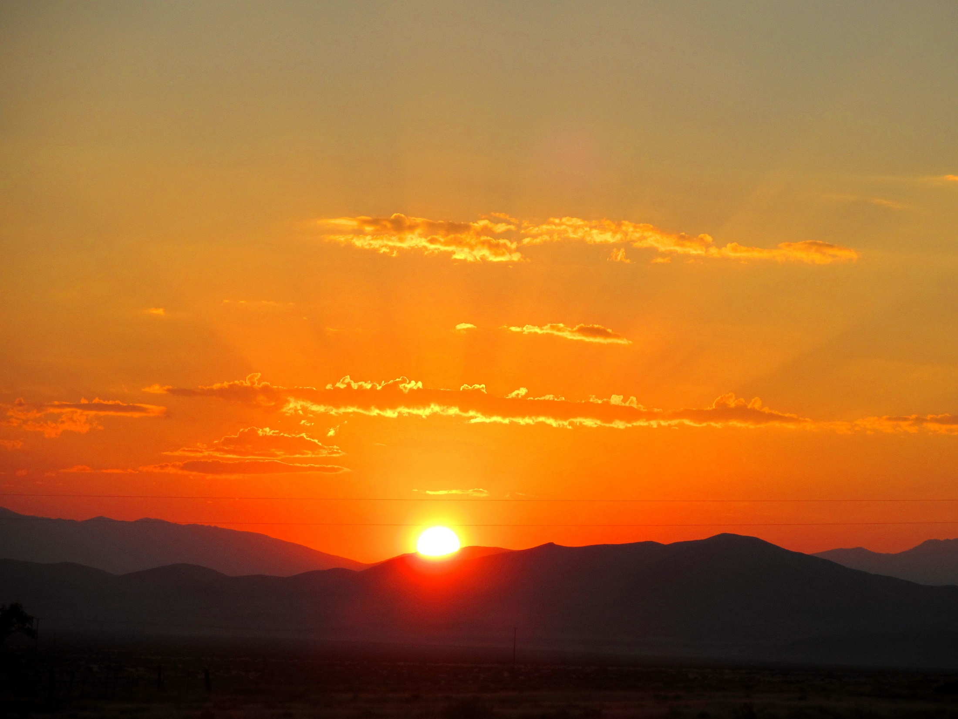
Encouraging signs of initiatives to design and construct the missing FNST facility
BEST in China
FTQP/VNS in Europe
I applaud these initiatives and I wish them speedy progress and steady success.
I also encourage industry and private sector to strongly participate.
M. Abdou FPA 12-7-2022

Slide 13
Thank you!

Slide 14
Selected References
M. Abdou, M. Riva, A. Ying, C. Day, A. Loarte, L.R. Baylor, P. Humrickhouse, T.F. Fuerst and S.Y. Cho, “Physics and technology considerations for the deuterium-tritium fuel cycle and conditions for tritium fuel self sufficiency“, Nucl. Fusion 61 (2021) 013001 (50pp) Link to article on the IOP Nuclear Fusion Website
Abdou, M., Morley, N.B., Smolentsev, S., Ying, A., Malang, S., Rowcliffe, A., Ulrickson, M., “Blanket/First wall challenges and required R&D on the pathway to DEMO“, Fusion Engineering and Design, 100:2-43(2015).
M. Abdou, et al., “Results of an International Study on a High-Volume Plasma-Based Neutron Source for Fusion Blanket Development“, Fusion Technology, 29: 1-57 (1996).
M. Abdou, “A Volumetric Neutron Source for Fusion Nuclear Technology Testing and Development,” Fusion Engineering and Design, 27: 111-153 (1995).
“Challenges and Strategy for Development of FNST: Blanket/FW & Tritium Fuel Cycle”, Presentation at NAS Committee for a Strategic Plan for U.S. Burning Plasma Research, La Jolla, California, February 26, 2018. [PDF] M. Abdou
M. Abdou, “Challenges in the DT Cycle Physics and Technology: T Self Sufficiency and start-up tritium inventories and major impact on defining the R&D pathways to DEMO and beyond”, Invited Lecture at MaPLE-U Inauguration, KIT, Karlsruhe, Germany, October 14, 2022. [PDF]
M. Abdou FPA 12-7-2022

