Slide 1
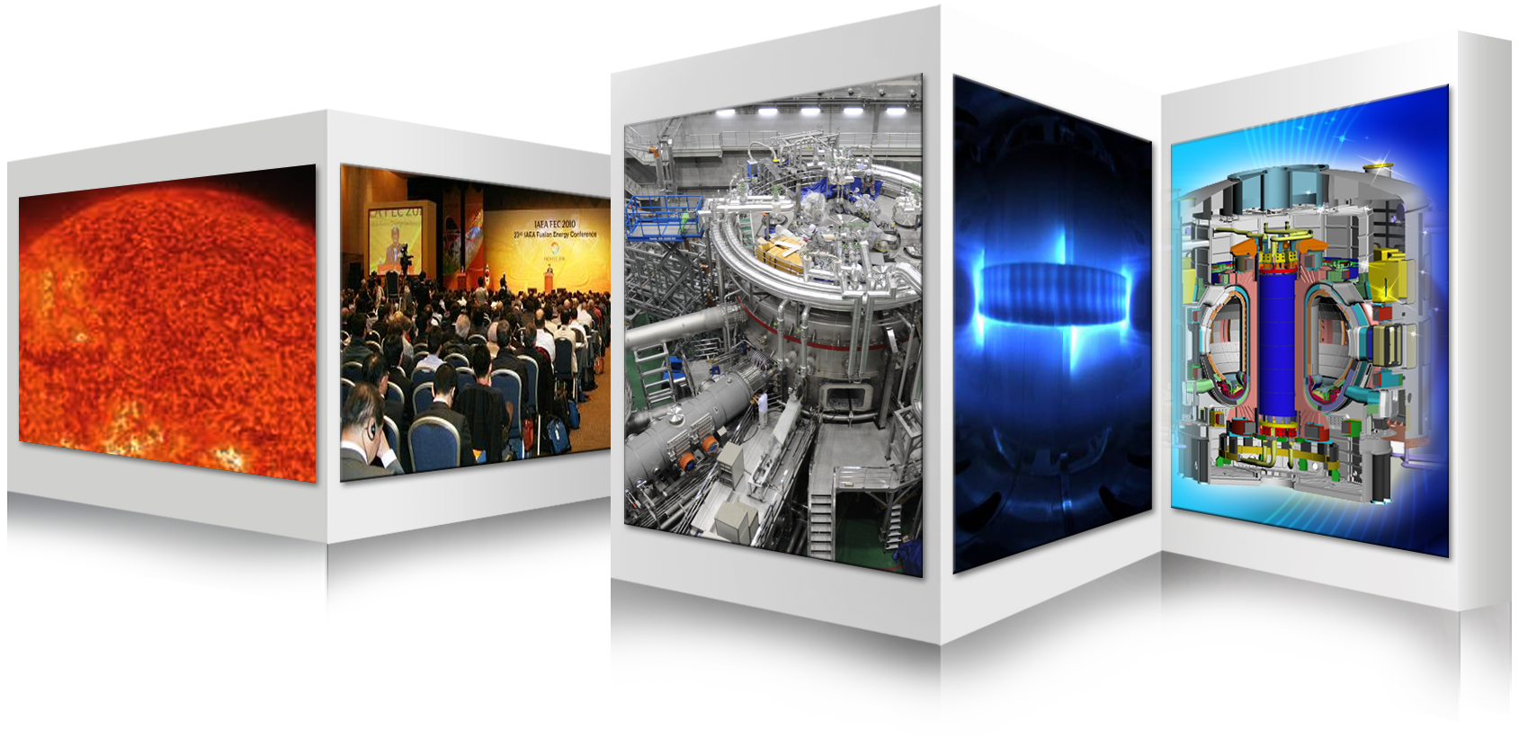
Fusion Energy Development in Korea
Suk Jae YOO
Fusion Power Associates,
43rd Annual Meeting and Symposium,
December 7th – 8th , 2022/
Hybrid (In person and Virtual Remote) Access Meeting
Korea Institute of Fusion Energy

Slide 2
Contents …….
Government Policies for Fusion R&D
Critical Pathway to DEMO
Key Gap Technologies for DEMO
Summary

Slide 3
Governance Framework of Fusion R&D in Korea
“Fusion Energy Development Promotion Act”
MSIT
National Fusion
Energy Committee
Ministry of Science and ICT
KFE
Fusion R&D Programs
Korea Institute of Fusion Energy
Universities
ITER Korea
(KO-DA)
KSTAR
Research Institutes
DEMO R&D
Industries
Plasma R&D
Notes:
This is important recognition from Korean government of the importance for Fusion

Slide 4
Master Plans for Fusion Energy Development
Fusion Energy Development Promotion Act
Article 4 (Establishment of Master Plans to Promote Development of Fusion Energy)
(1) In order to facilitate research and development of fusion energy, the Government shall establish a master plan…
(2) The Minister of Science and ICT shall prepare a master plan every five years in consultation with the heads of relevant central administrative agencies and shall confirm such plan following the deliberation of the National Fusion Energy Committee under Article 6 (1).
Master Plans for Fusion
Energy
Development
1st Master Plan (’07~’11)
Establish the foundation for fusion energy development
2nd Master Plan (’12~’16)
Research and Development on fundamental fusion technologies utilizing KSTAR and ITER
Establish foundation for fusion engineering technology development for demonstration of electricity production
Accelerate development of DEMO core technologies
Strengthen basic research and HR training
Promote social & industry support for fusion energy development
3rd Master Plan (’17~’21)
To lead domestic and international fusion energy development by accelerating core technology development and building strategic foundation
4th Master Plan (’22-’26)
Notes:
This is important recognition from Korean government of the importance for Fusion

Slide 5
Overview of the 4th Master Plan
Vision
To secure a new sustainable national energy with fusion energy development
“To lead domestic and international fusion energy development
by accelerating core technology development and building strategic foundation”
Goal
Achieve KSTAR
experimental goal
Fulfil final stage of
ITER construction
Specify long-term
R&D roadmap
Draft basic direction
for fusion regulation
Establish fusion-specific strategy & regime
Enable & reinforce core technology development
Accelerate technology development through international cooperation
#1
#2
#3
➊ Specify and implement the
Long-term R&D Roadmap
➊ Study high-performance
plasma technology in KSTAR
➊ Secure core technologies
through ITER project
Strategy
&
Task
➋ Establish integrated foundation
for fusion energy regime &
framework
➋ Develop key DEMO technologies
for electricity generation
➋ Reinforce strategical technology
cooperation with major fusion
energy developing countries
➌ Support HR training
and industry ecosystem
Notes:
This is important recognition from Korean government of the importance for Fusion

Slide 6
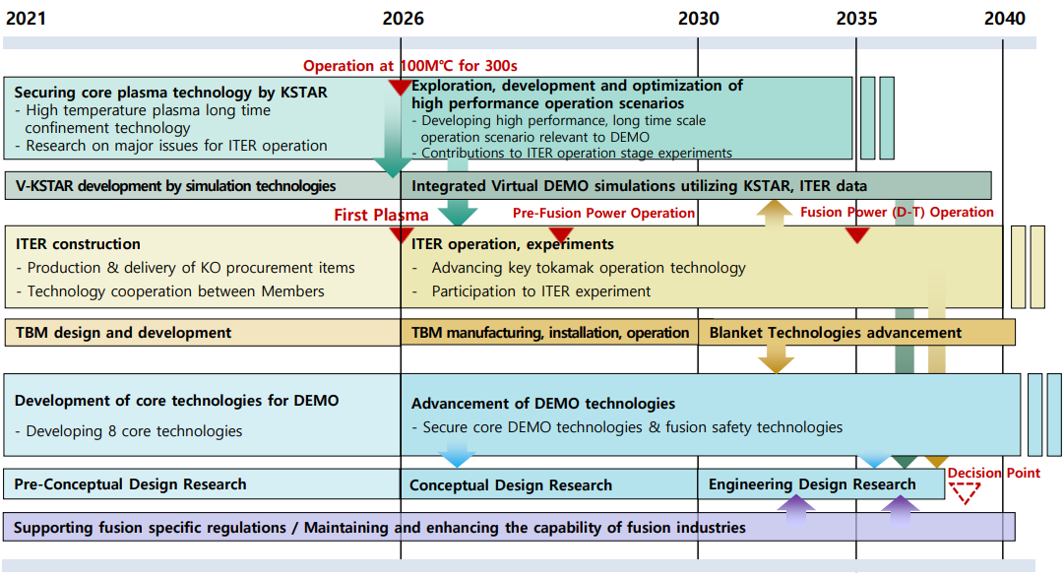
Time Line for Fusion Energy Development
Rolling plan for fusion electricity demonstration by 2050s
* The plan will also be updated every five years with the Master Plan.
4th Master Plan
After confirming ITER achievement (Q=10) in 2035, K-DEMO construction will be decided.
Notes:
This is important recognition from Korean government of the importance for Fusion

Slide 7
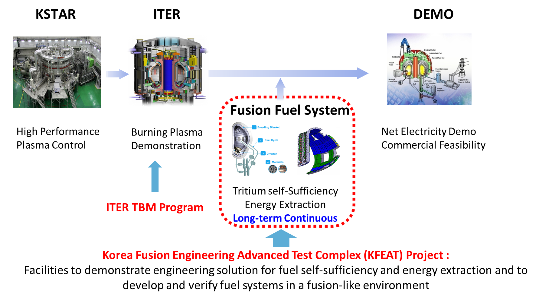
Critical Pathway to DEMO
▶Role of KSTAR: High performance plasma control for steady state operation
Ion temperature over 100 Mil. degrees for longer than 300 s until 2026. High Beta_N (>3.5)
▶ Role of ITER: Burning plasma and engineering experiences
D-T burning until 2038
▶Gap technology between ITER and DEMO, and necessary facilities
Fusion fuel system is the most important gap technology including ITER TBM contributing to DEMO blanket.
R&D infrastructure such as KFEAT is to be established for fusion fuel system technology development.
gap technology
Notes:
This is important recognition from Korean government of the importance for Fusion

Slide 8
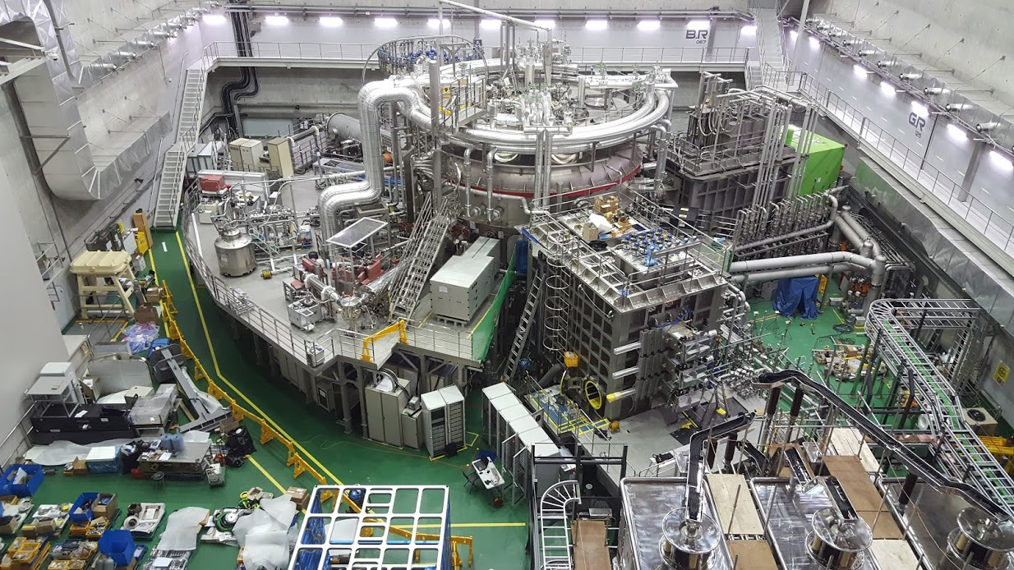
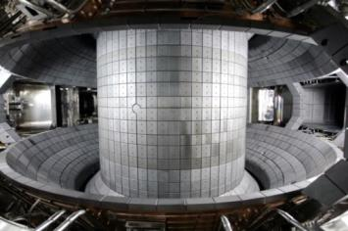
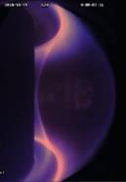
KSTAR Progress in 2022 and Plans for 2023
Korea Superconducting Tokamak Advanced Research
Parameters | Designed | Achieved (~2021)
Major radius, R₀ Minor radius, a Elongation, κ Triangularity, δ Plasma shape Plasma current, I_{P} Toroidal field, B₀ H-mode duration β_{N} Superconductor Heating /CD PFC | 1.8 m 0.5 m 2.0 0.8 DN, SN 2.0 MA 3.5 T 300 s 5.0 Nb₃Sn, NbTi ~ 28 MW C, W | 1.8 m 0.5 m 2.15 0.8 DN, SN 1.2 MA 3.5 T ~ 90 s 4.3 (~ 0.1 s) 3.4 (~ 4 s) 3.0 ( ~ 10 s) Nb₃Sn, NbTi(Pol.#6,7) ~ 15 MW C, (W)
Main body
Height: ca. 10 m
Diameter: ca. 10 m
Notes:
This is important recognition from Korean government of the importance for Fusion

Slide 9
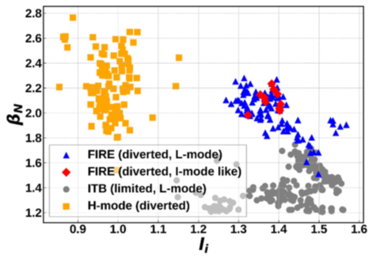
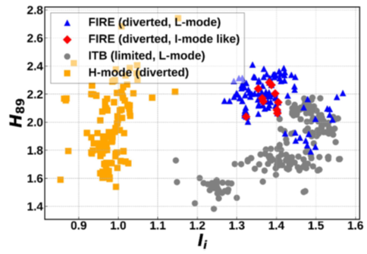
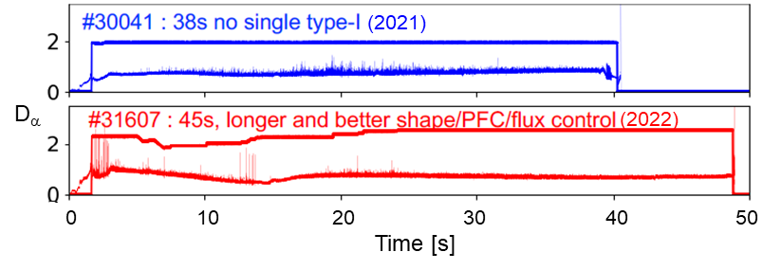
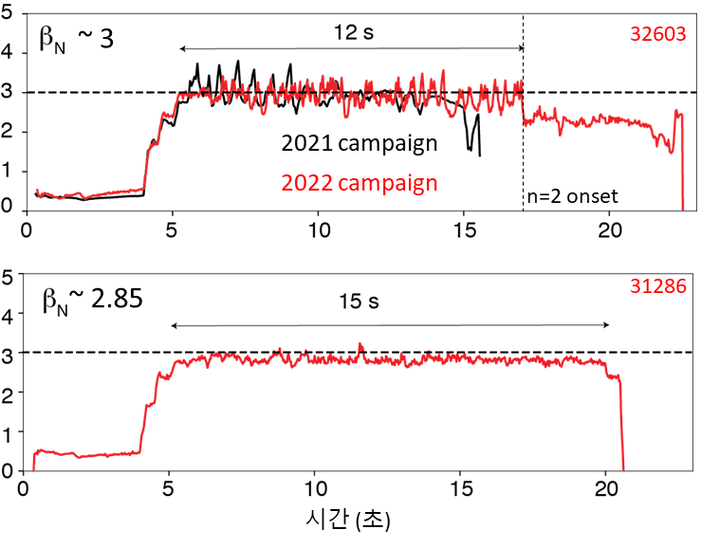
KSTAR Progress in 2022
①
FIRE mode (Nature, 2022)*
- Fast Ion effect on internal transport barrier
Advanced Scenarios for steady state operation
- ① New steady state operation mode (Fast Ion Regulated Enhancement (FIRE) mode)
- ② High beta scenarios based on high internal inductance discharges (~ 15 sec)
Advanced Physics & Engineering
- ③ Long-pulse suppression of the ELMs with Machine Learning and adaptive control with RMP (~45 sec)
③
Long-pulse ELM control
②
* H. Han et al., Nature, v.609, 269 (2022).
High beta discharges
Notes:
This is important recognition from Korean government of the importance for Fusion

Slide 10
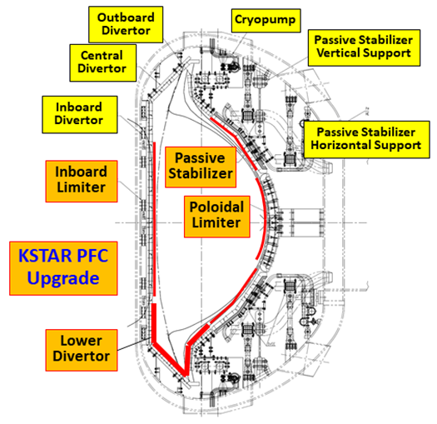
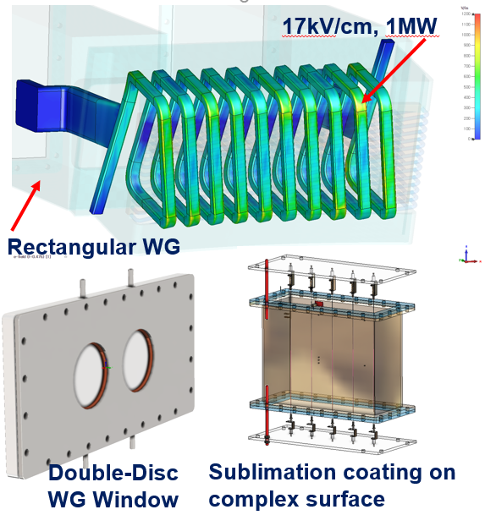
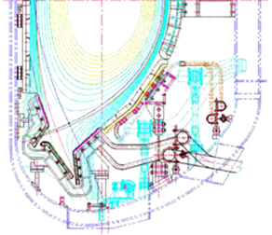
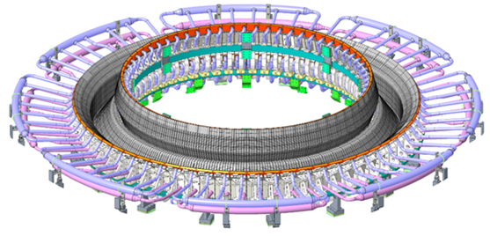
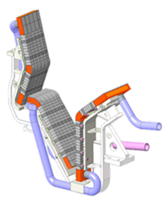
KSTAR Plans for 2023
W divertor upgrade for long pulse operation over 300 s
- ITER-class actively cooled Tungsten monoblock cassette for lower divertor (~August 2023)
Heating & CD upgrade
- NBI 10 MW/ ECH 4 MW
- MW-class Helicon CD (window & antenna upgrade)
Helicon CD upgrade
W monoblock cassette
Notes:
This is important recognition from Korean government of the importance for Fusion

Slide 11
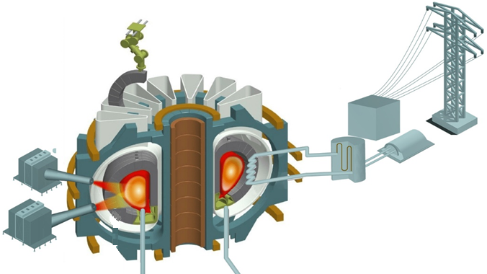
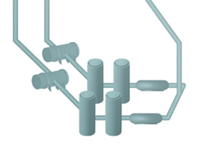
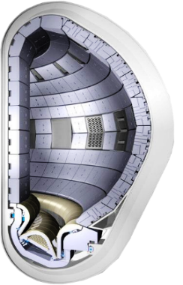
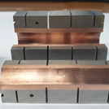
Key Gap Technologies
5
Upgrade of ITER core technology
Energy Conversion
(Electricity or Hydrogen)
1
Plasma Control
BoP
2
Magnet
3
Heating & CD
Safety & Licensing
- Regulatory Framework
Fusion Fuel System
① How different from fission?
② Who will regulate?
③ What will be regulated?
1
Breeding Blanket
Divertor
Fuel Cycle
4
Materials
2
3

Slide 12
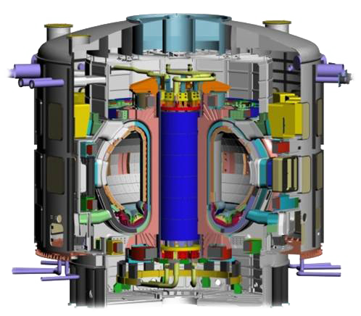
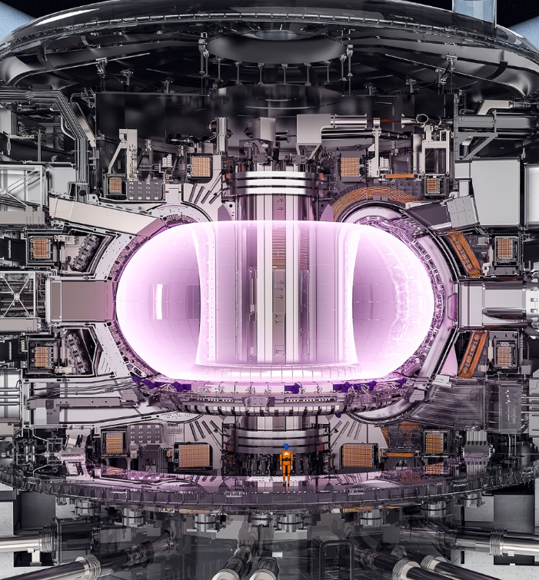
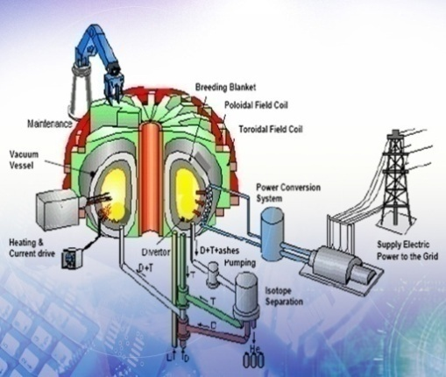
Roadmap based on ITER project
ITER
First Plasma
ITER
Burning Plasma
Electricity
Demonstration
$$≈$$
2020
2025
2030
2035
2038
2040
2050
Secure Gap Technologies btw. ITER and DEMO
Especially Breeding Blanket Technology
Decision/
Construction of DEMO
based on the success of Burning Plasma
Turning point
of Fusion Energy Development
Notes:
This is important recognition from Korean government of the importance for Fusion

Slide 13
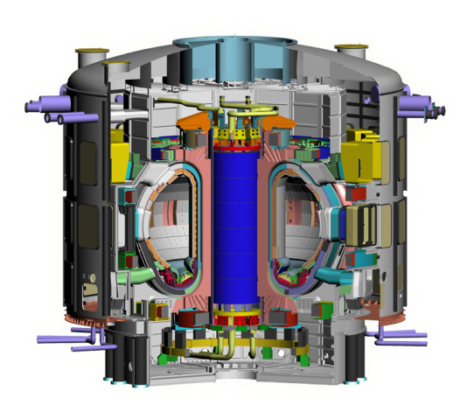
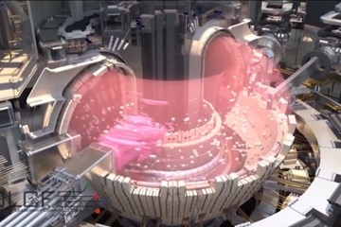
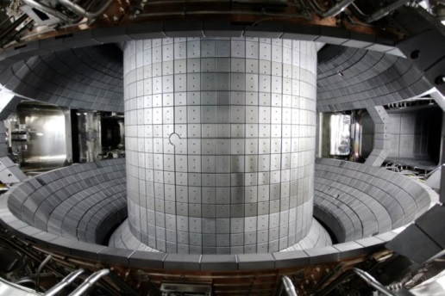
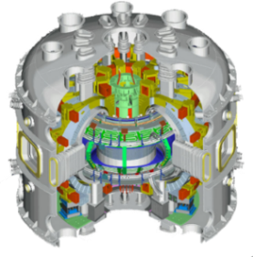
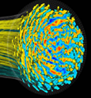
Virtual DEMO
Optimization of DEMO design (simulations), Reduction of construction risks and costs
Virtual KSTAR and ITER can be validated based on KSTAR and ITER experiment data
Virtual DEMO can be extrapolated based on extension of virtual KSTAR and virtual ITER
Decreased uncertainties with high fidelity and accuracy of simulations based on high performance supercomputers
Virtual DEMO
ITER
Performance
KSTAR
Validation
Virtual ITER
Validation
Virtual KSTAR
~ 2027 ~ 2031 ~ 2040
Notes:
This is important recognition from Korean government of the importance for Fusion

Slide 14
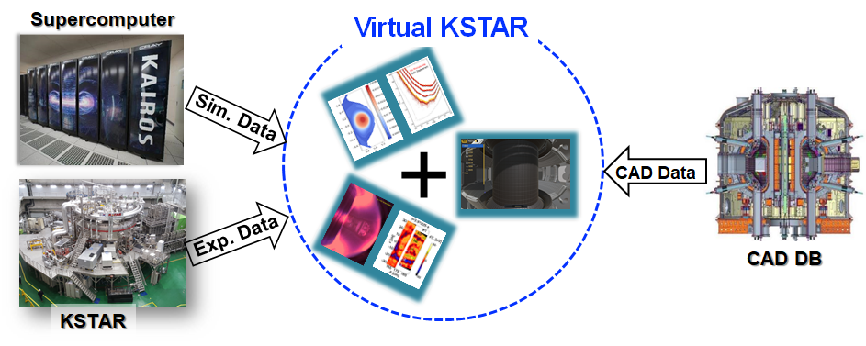
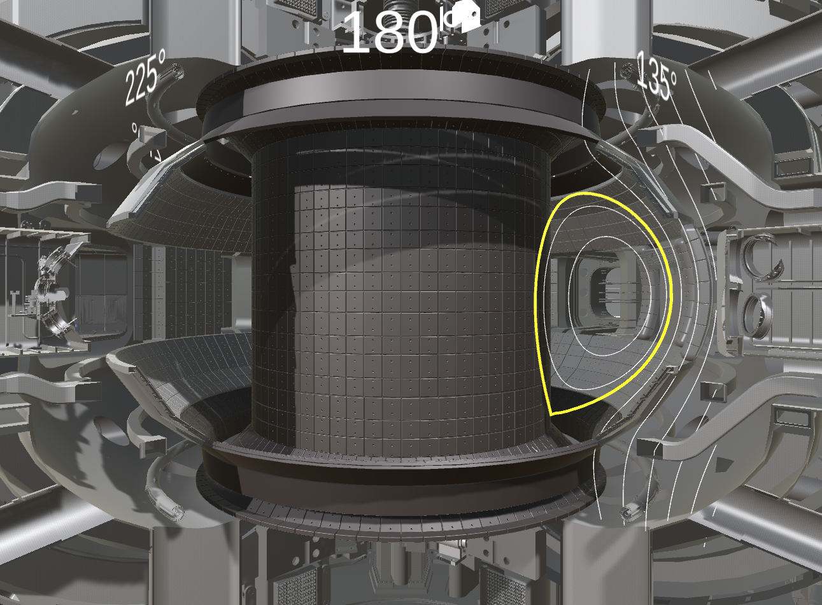
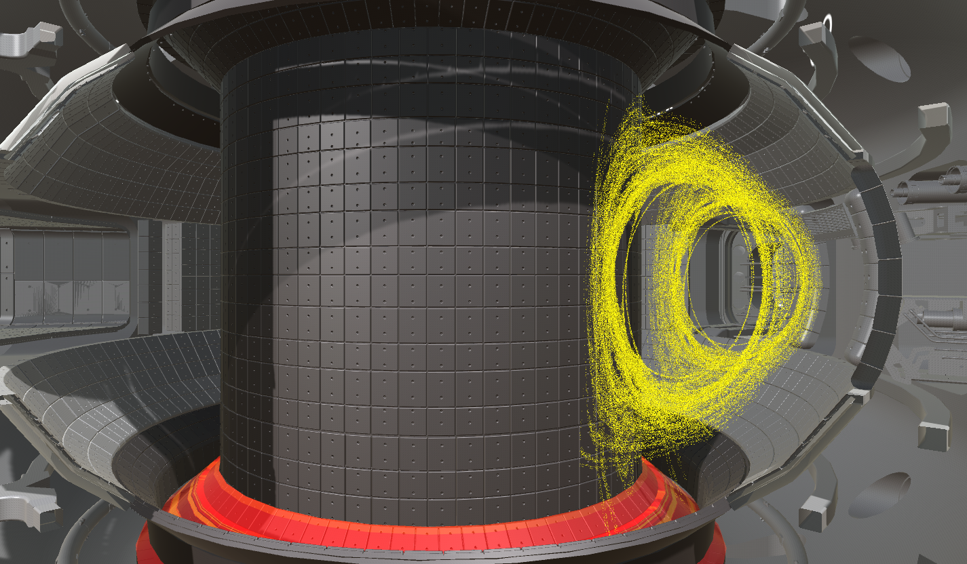
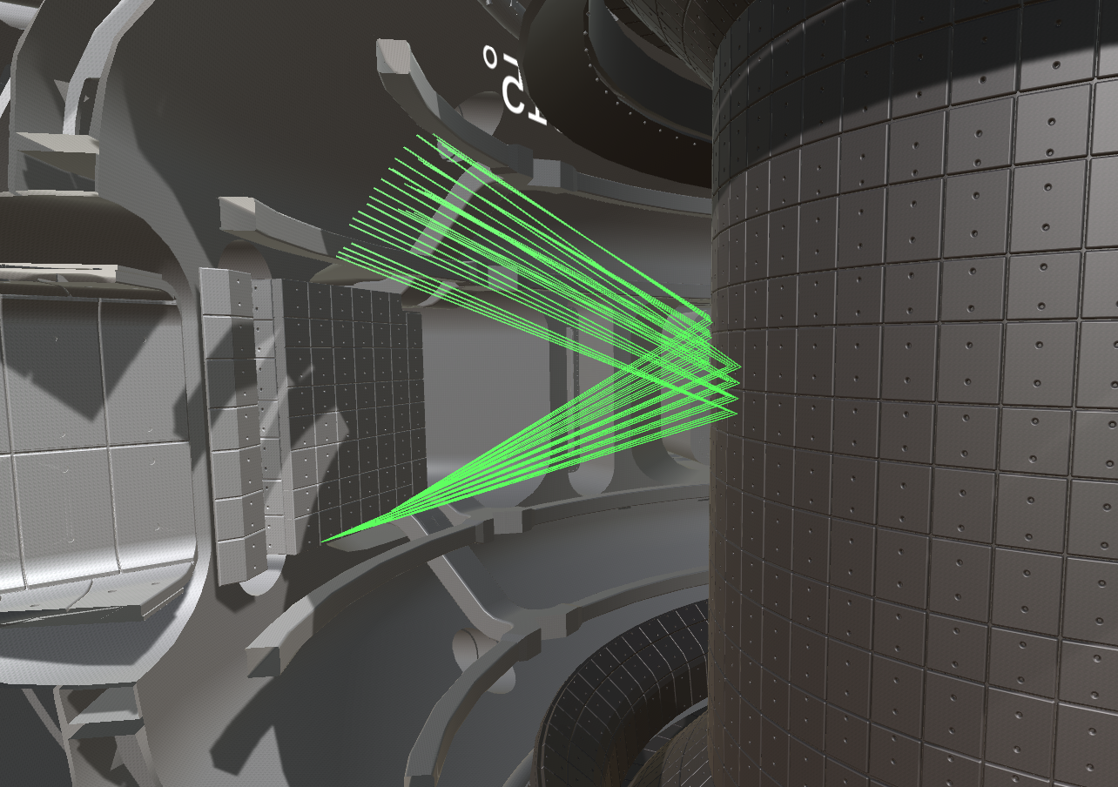
Progress of Virtual KSTAR
Quantitative validation owing to reliable data of the real KSTAR
Precision simulation for quantitative predictive capabilities with KAIROS
Fast virtualization/visualization based on game graphic technology
▶ Virtualization of KSTAR and integrated visualization of fusion data
Monitoring of real time EFIT reconstruction
Post analysis of NBI and RMP simulation results on virtual environment
Interactive analysis of ECH ray tracing
Notes:
This is important recognition from Korean government of the importance for Fusion

Slide 15
Summary
The fusion R&D is expected to be more promoted owing to the 4th master plan of promoting fusion energy R&D launched in 2022
Key technologies for the critical pathway to DEMO
KSTAR can play a major role in developing steady state operation scenarios with the capability of ‘high performance plasma control’
‘Fusion fuel system*’ is the most critical key technology for the pathway to DEMO * Breeding Blanket, Fuel cycle, Divertor, and Fusion Materials
Virtual DEMO* will be helpful for optimization of DEMO design (simulations) and reduction of construction risks and costs
* It could be developed without real DEMO based on the virtual KSTAR and victual ITER
Regulatory framework could accelerate fusion energy progress to DEMO if it would be developed appropriately including unique properties of fusion energy facilities

Slide 16
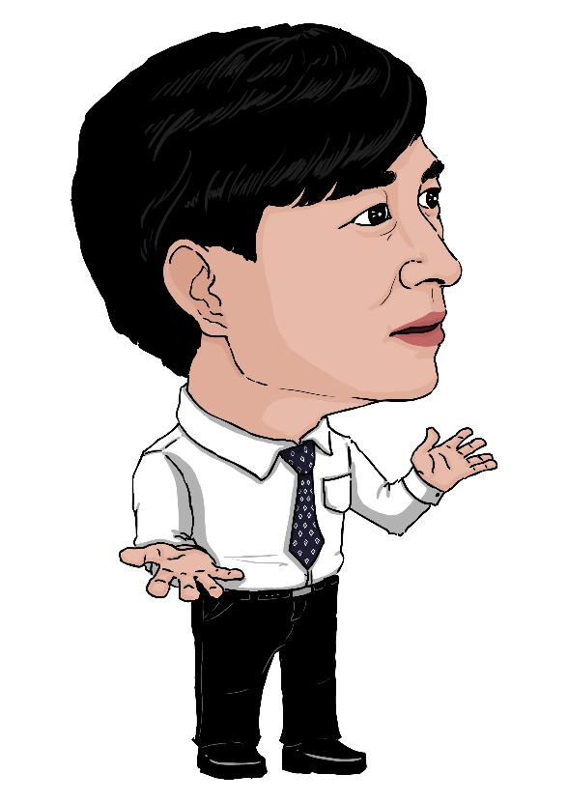
Thank you for your attention !
I hope the recovery of the honor of fusion energy that has been teased with “the Boy Who Cried Wolf” of Aesop’s Fables owing to the success of the ITER burning plasma around 2035.
http://pesstevensone.blogspot.com/2013/08/the-boy-who-cried-wolf.html

