Slide 1
INFUSE Update
https://infuse.ornl.gov
Email: infuse@ornl.gov
URL:
A. Lumsdaine & W. Guttenfelder
Fusion Power Associates
December 8, 2022

Slide 2

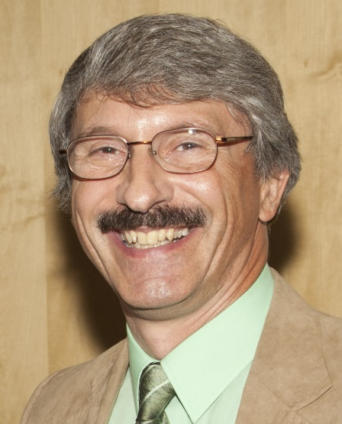
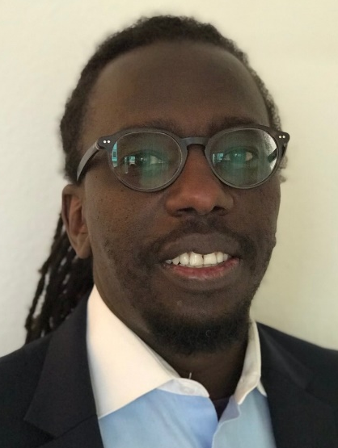




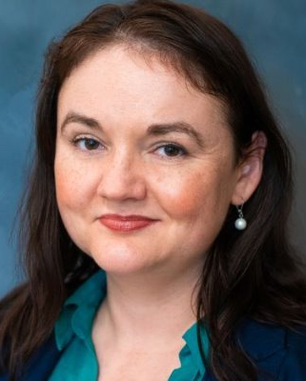
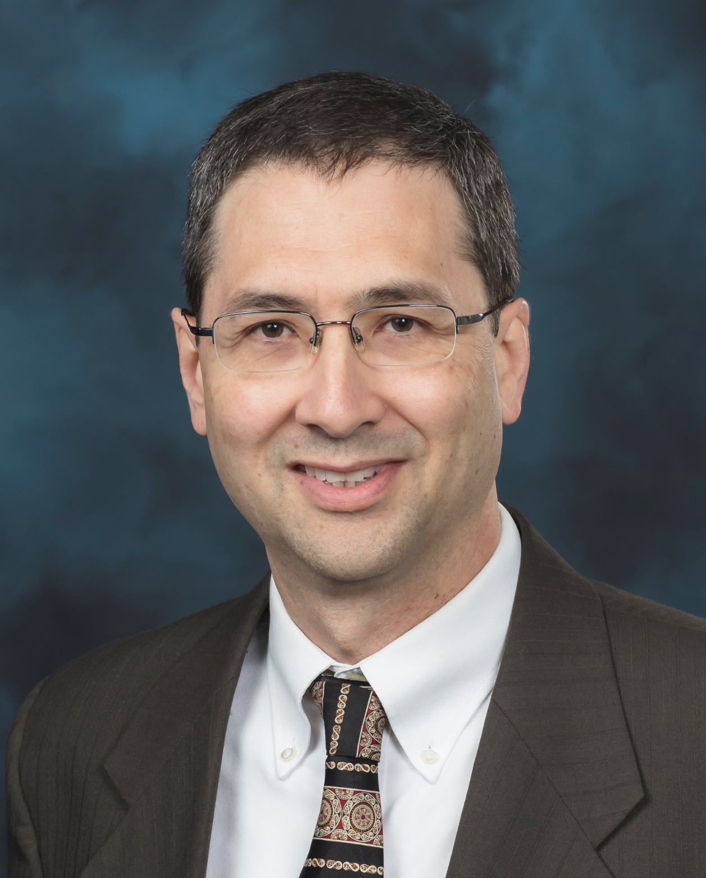
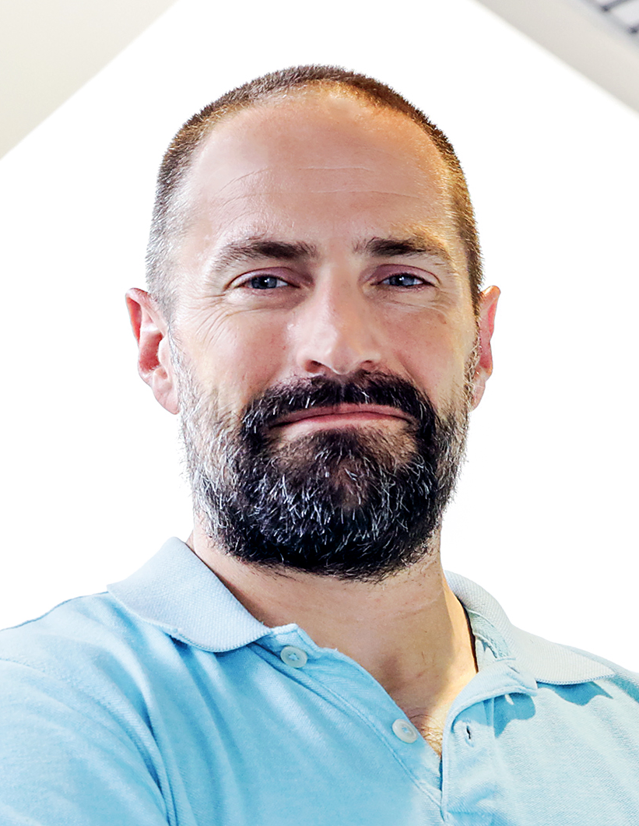
New Leadership
INFUSE Program Manager
INFUSE Director
INFUSE Deputy Director
Thank you to the outgoing leadership team who led the launch of INFUSE and its growth in the last 3+ years!
Daniel Clark
Dennis Youchison
Ahmed Diallo
Welcome the new leadership team who plan to build on the program’s success.
Colleen Nehl
Arnold Lumsdaine
Walter Guttenfelder
Notes:
First – take a moment to thank those who launched INFUSE
Introduce self – worked in all 3 sectors that are involved in program
ME professor ~10 years
Private industry – R&D manager, responsible for NPD for nanotech mfg
13 yrs ORNL in Fusion energy division
(seen the motivational structure of three sectors as an insider)
Success of INFUSE – able to leverage
Introduce Walter – organized this workshop

Slide 3
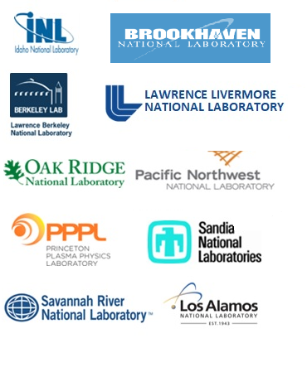
INFUSE Overview
The objective of INFUSE is to provide private-sector fusion companies access to the expertise and facilities of DOE’s national laboratories and (since FY 2022) U.S. academic institutions to overcome critical scientific and technological hurdles in pursuing development of fusion energy.
AWARDS
62 projects funded to date with a total value of $12.4M
Awards were made to 19 private companies partnering with 9 DOE labs and 8 U.S. Universities.
Detailed list:
https://infuse.ornl.gov/wp-content/uploads/2022/07/Cumulative_AwardList_wAbstracts.pdf
PARTICIPATING LABORATORIES
TOPICAL AREAS
Enabling Technologies
Materials Science
Plasma Diagnostics
Modeling and Simulation
Unique Fusion Experimental Capabilities
Notes:
10 primary laboratories participating in fusion
Force multiplier
FY21 – 11 applicants in rounds 2; FY22 – 21 applicants in round 2.

Slide 4
DOE National Labs

Slide 5
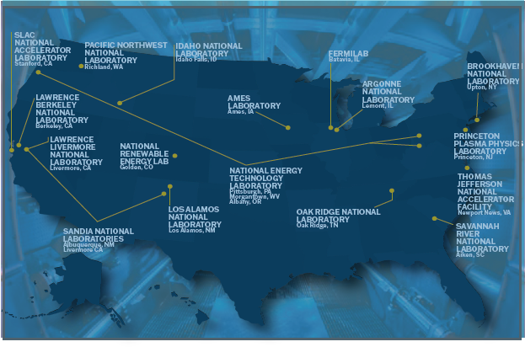
DOE National Labs

Slide 6
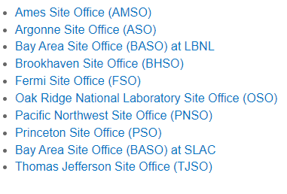
DOE Site Offices – CRADA approvals
SC
NNSA
NNSA HQ – Albuquerque
Field Offices – LANL, LLNL, SNL
Site/Operations Office – SRS/SRNL
Energy
Golden Field Office - NREL
Idaho Operations Office – INL
Multiple Field Offices - NETL
Number of INFUSE POCs will remain at 10
INFUSE will work directly with PIs and SPP officials at the other 7 labs as needed

Slide 7
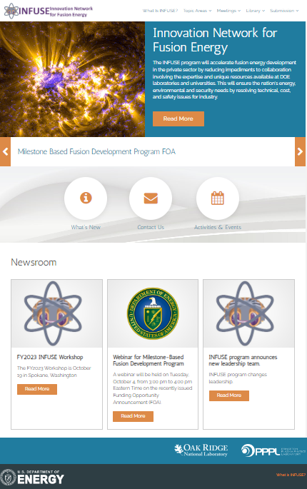
INFUSE Web Site
https://infuse.ornl.gov/
Notes:
This is last year’s schedule

Slide 8
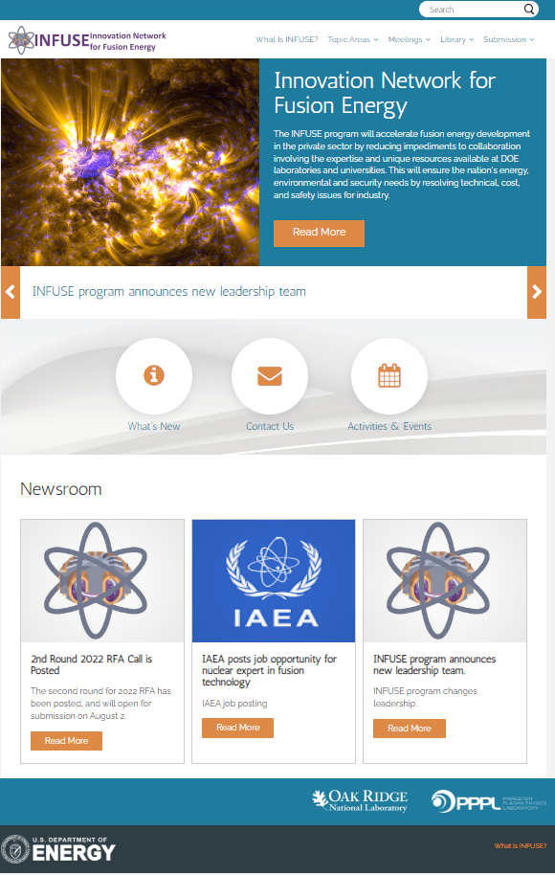
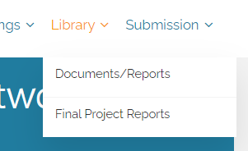
INFUSE Website – Library
The INFUSE Documents/Reports Library (https://infuse.ornl.gov/library/) has many documents and historical information on the program:
Point of Contact information
Frequently Asked Questions (FAQs)
Hints for submitting applications
Previous award summaries
Previous RFAs
Prior year webinar slides
And more . . .
https://infuse.ornl.gov/
Notes:
FAQs have not been updated for this RFQ – will add questions asked here
Previous award summaries are present and up-to-date

Slide 9
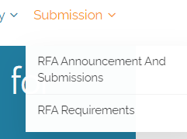
INFUSE Website – RFA and Submission Information
The INFUSE Submission page (https://infuse.ornl.gov/rfa-announcement-and-submission/) has many downloadable resources, Point of Contact information
The INFUSE RFA Call
Standard CRADA
Submission Rules
Etc . . .
It is also the place to start the submission process.

Slide 10
INFUSE Process
Preparation
Phase
Identify priority R&D
Application
Phase
Technical narrative
Award
Phase
Award notification
Agree upon work scope (Record of Discussion)
Budget and cost-share
Supporting Documents
Lab Only: Lab submits Field Work Proposal (FWP) and receives funding
Identify partner institution
Lab Only: CRADA certification
Begin work
University Only: Establish Intellectual Property Management Plan (IPMP) and IPMP certification
University Only: University submits proposal to SC Open Notice
University Only: DOE awards funding via grant/cooperative agreement
Lab Only: Establish standardized CRADA
The process
New in FY 2022
Private Industry
RFA submission
DOE-
INFUSE
IPMP
CRADA
Grant/
Cooperative
Agreement
M&O
Contract/FWP
U.S. Universities
DOE Laboratories
Notes:
CRADA process improving; still complex, time consuming

Slide 11
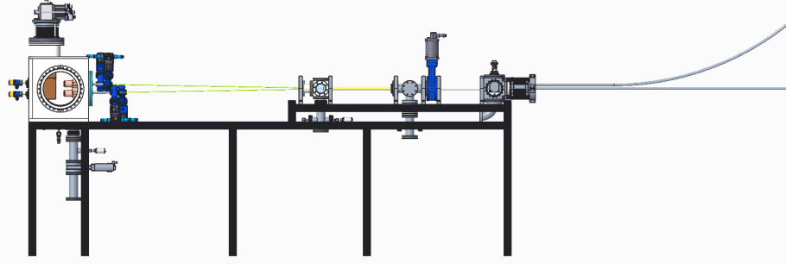
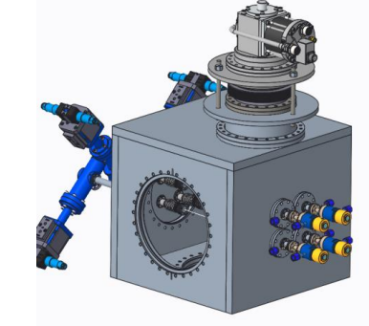
INFUSE as Force Multiplier
A small amount of funding accesses substantial facilities and expertise, and lead to larger public-private collaborations.
Example – award from 2020, “Conceptual design of a tritium pellet injector for the ST40 spherical tokamak”
  Pellet injector design concept successfully completed.
  The company is progressing with a much larger fabricate & test project.
Notes:
Workshop – perhaps with GAIN, ARDP?
Improvements – landscape is different than in 2019
Communicate – get information to you, hear back from you.

Slide 12
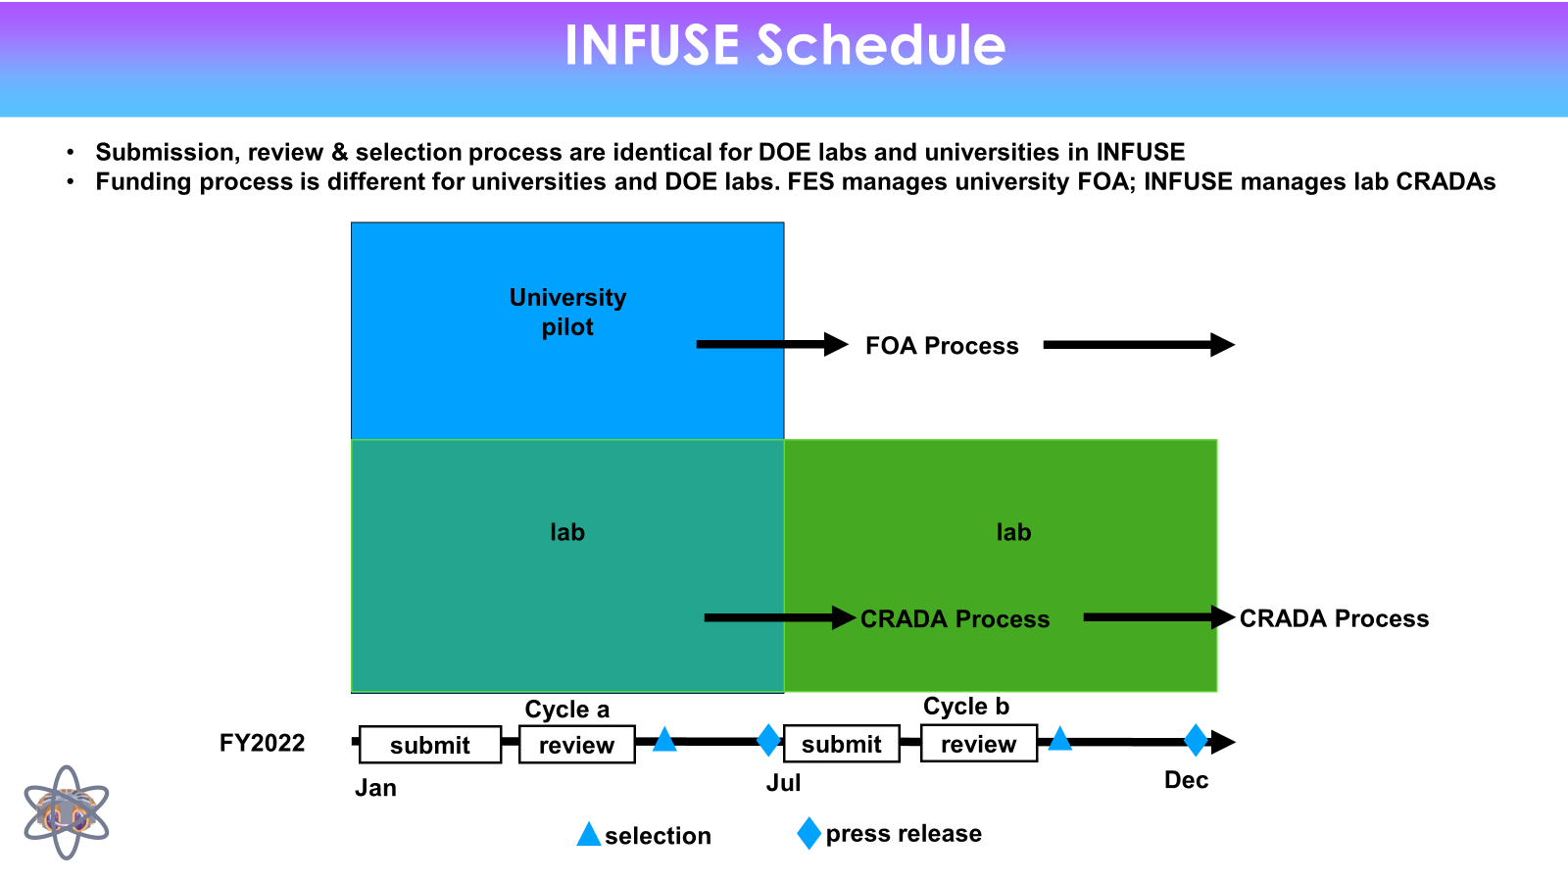

Slide 13
What’s Next? (1)
New awards (for RFA2022b) should be announced in January.
It is expected that the next RFA call will be announced in February.
  Universities will be included as applicants.
  This may be the only RFA call for FY2023.
  The program is currently developing implementation of Promoting Inclusive and Equitable Research (PIER) Plan
Notes:
Workshop – perhaps with GAIN, ARDP?
Improvements – landscape is different than in 2019
Communicate – get information to you, hear back from you.

Slide 14
What’s Next? (2)
A few questions that we are planning to address soon:
  Where, when, and how should we hold the next workshop (typically in Dec.)?
  How can we improve INFUSE (programmatically, procedurally)?
    We are in a different landscape than 2019 – how to respond?
    Submission web site was revamped in 2022, can still improve.
    Review process can be optimized.
  How can we better communicate (tri-directionally)?
    Provide information to companies.
    Received feedback from companies.
    Inform stakeholders how INFUSE is accomplishing its mission
Notes:
Workshop – perhaps with GAIN, ARDP?
Improvements – landscape is different than in 2019
Communicate – get information to you, hear back from you. (including information of company and university capabilities)
Public program; need to communicate with the public (DOE, general public); why necessary with milestone program?

Slide 15
Official Points-of-Contact
Brookhaven National Laboratory (BNL) Kathleen Amm ammk@bnl.gov (631) 344-6150
Idaho National Laboratory (INL) Masashi Shimada masashi.shimada@inl.gov (208) 533-4472
Lawrence Berkeley National Laboratory (LBNL) Steve Gourlay sagourlay@lbl.gov (510) 486-7156
Lawrence Livermore National Laboratory (LLNL) Andris Dimits dimits1@llnl.gov (925) 422-9830
Los Alamos National Laboratory (LANL) John Kline jkline@lanl.gov (505) 667-7062
Oak Ridge National Laboratory (ORNL) Arnold Lumsdaine lumsdainea@ornl.gov (865) 574-0446
Pacific Northwest National Laboratory (PNNL) Wahyu Setyawan wahyu.setyawan@pnnl.gov (509) 371-7692
Princeton Plasma Physics Laboratory (PPPL) Walter Guttenfelder wgutten@pppl.gov (609) 243-2426
Sandia National Laboratories (SNL) Rob Kolasinski rkolasi@sandia.gov (925) 294-2872
Savannah River National Laboratory (SRNL) James Klein james.klein@srnl.doe.gov (803) 507-8549
https://infuse.ornl.gov/wp-content/uploads/2022/07/2022-INFUSE-POC-Panel-Contact-Information_v3.pdf
https://infuse.ornl.gov/national-lab-capabilities/
Notes:
The list changes for a variety of reasons – updates are made on the web page
List of capabilities of labs to partner with are on web site

