Slide 1
The Road Ahead
US ITER Progress and Contributions for US Fusion
Kathy McCarthy
Project Director
Fusion Power Associates Annual Meeting
December 7, 2022

Slide 2
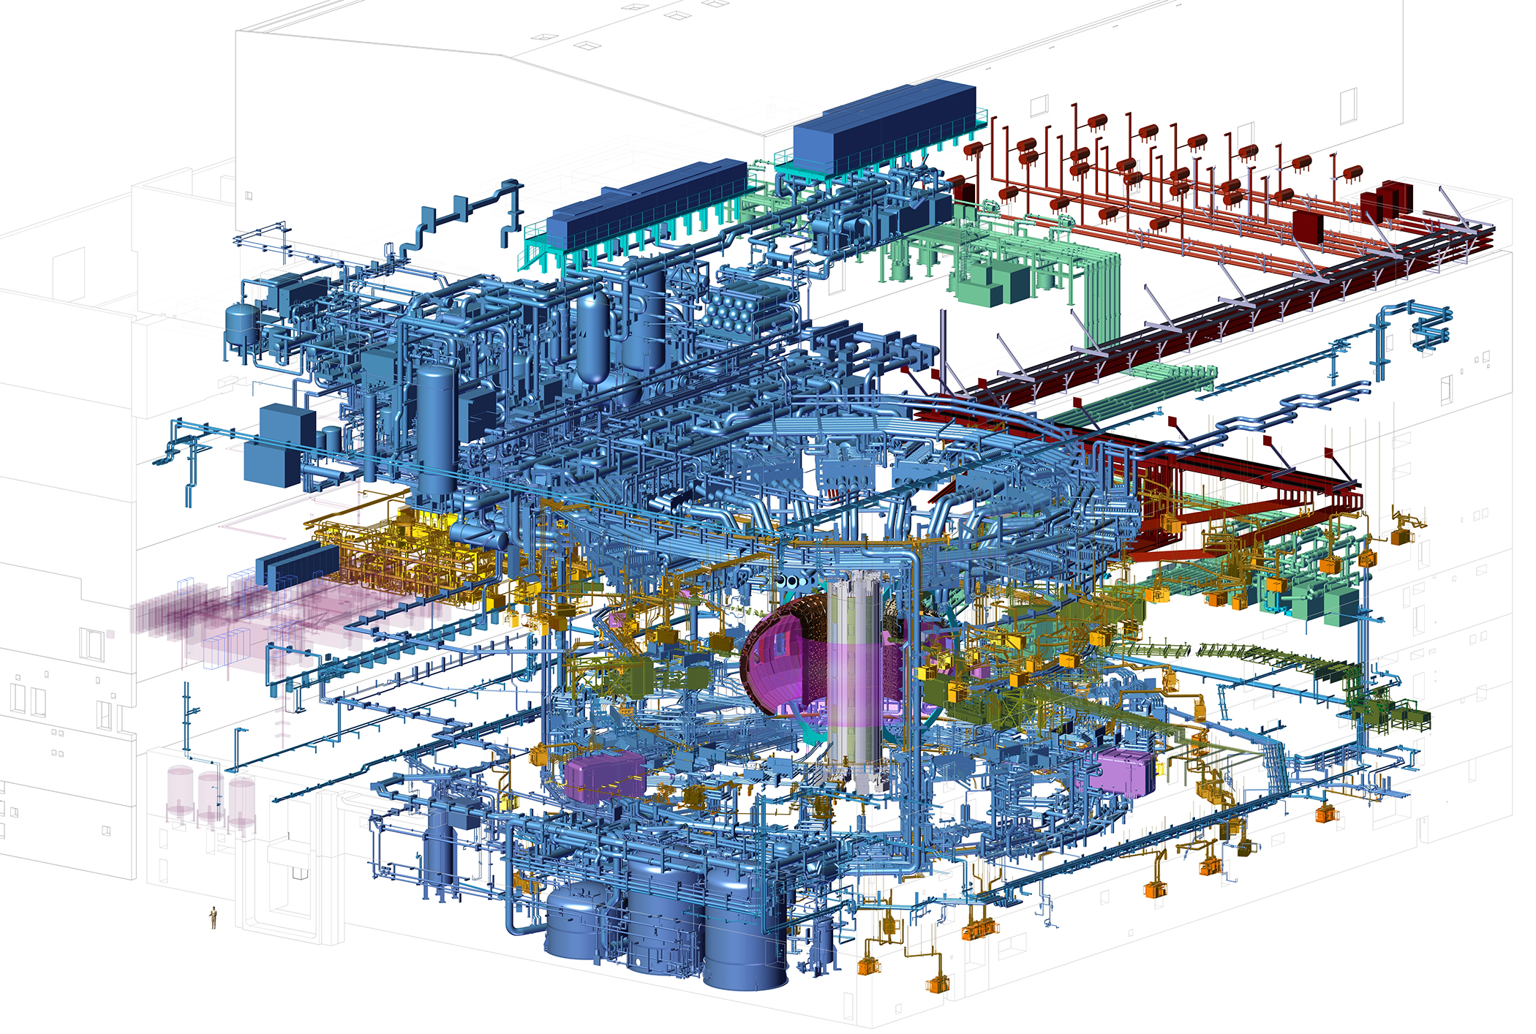
US ITER Hardware Scope US contributes ~9% to construction and receives 100% of ITER science and discovery
Central Solenoid
Electron Cyclotron Heating Transmission Lines
Tokamak Cooling Water System
Vacuum System
Roughing Pumps
Ion Cyclotron Heating Transmission Lines
Toroidal Field Coil Conductor
(US Share 8%)
Tokamak Exhaust Processing System
Steady State Electrical Network
(US Share 75%)
Diagnostics
Port Integration
(US Share 14%)
Instrumentation and Controls
Pellet Injection
Disruption Mitigation

Slide 3
US ITER Hardware Scope US contributes ~9% to construction and receives 100% of ITER science and discovery
Key: Finished • Hardware in fabrication • Prototypes in fabrication • In design
Central Solenoid
Electron Cyclotron Heating Transmission Lines
Tokamak Cooling Water System
Vacuum System
Roughing Pumps
Ion Cyclotron Heating Transmission Lines
Toroidal Field Coil Conductor
(US Share 8%)
Tokamak Exhaust Processing System
Steady State Electrical Network
(US Share 75%)
Diagnostics
Port Integration
(US Share 14%)
Instrumentation and Controls
Pellet Injection
Disruption Mitigation

Slide 4
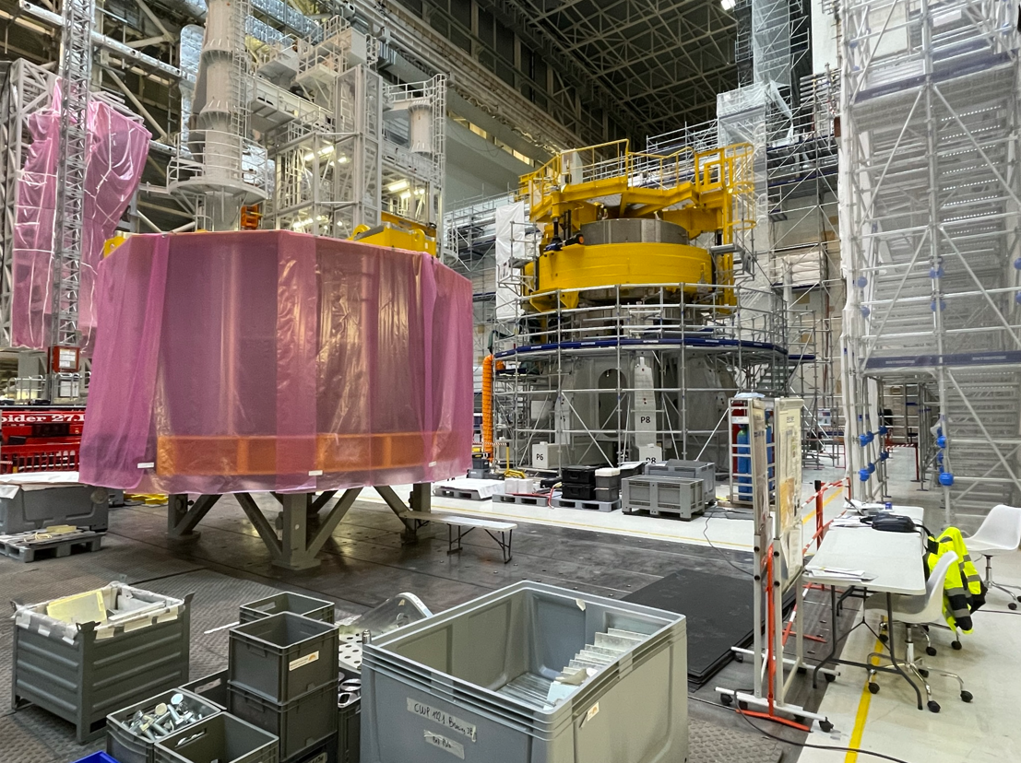
US deliveries for the central solenoid are supporting assembly progress
Module 1 is positioned on the central solenoid stack; bus bars were welded; coax joint is being inspected
Module 2 is being prepared for assembly
Assembly tooling is performing reliably (including lifting fixture)
Central solenoid modules 1 and 2 in the ITER assembly hall. Credit: US ITER

Slide 5
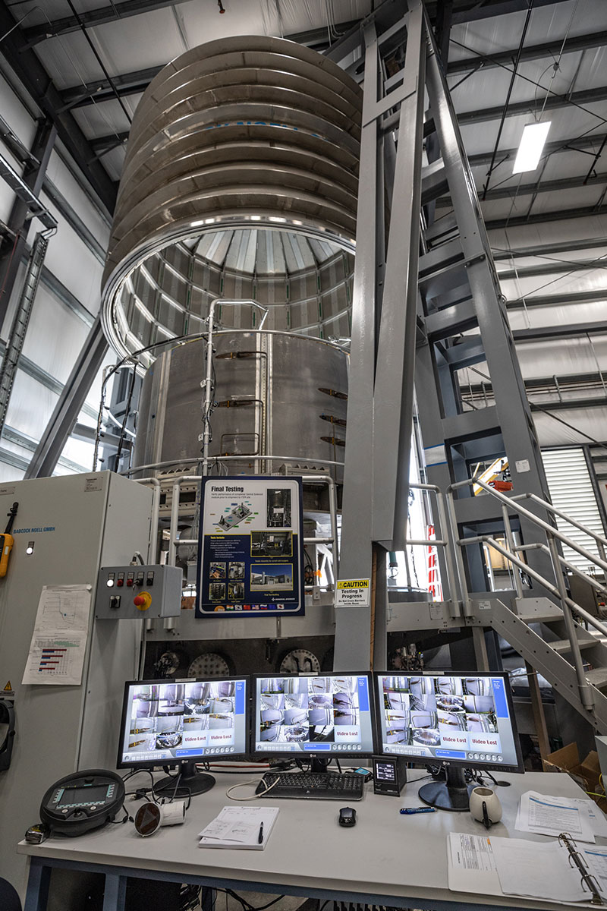
Module 3 challenge is being addressed
Situation: The test facility experienced a Paschen condition during testing earlier this year, impacting the module and test facility
Status:
A qualification and repair plan for Module 3 is in development
Coax joint fabrication is in progress
HiPot, Paschen and Global Leak tests will be repeated after repair is complete
Test facility was assessed and improved; system validation tests were completed to assure readiness for next module
Module 4 is now in testing
Module in test chamber at General Atomics. Credit: GA

Slide 6
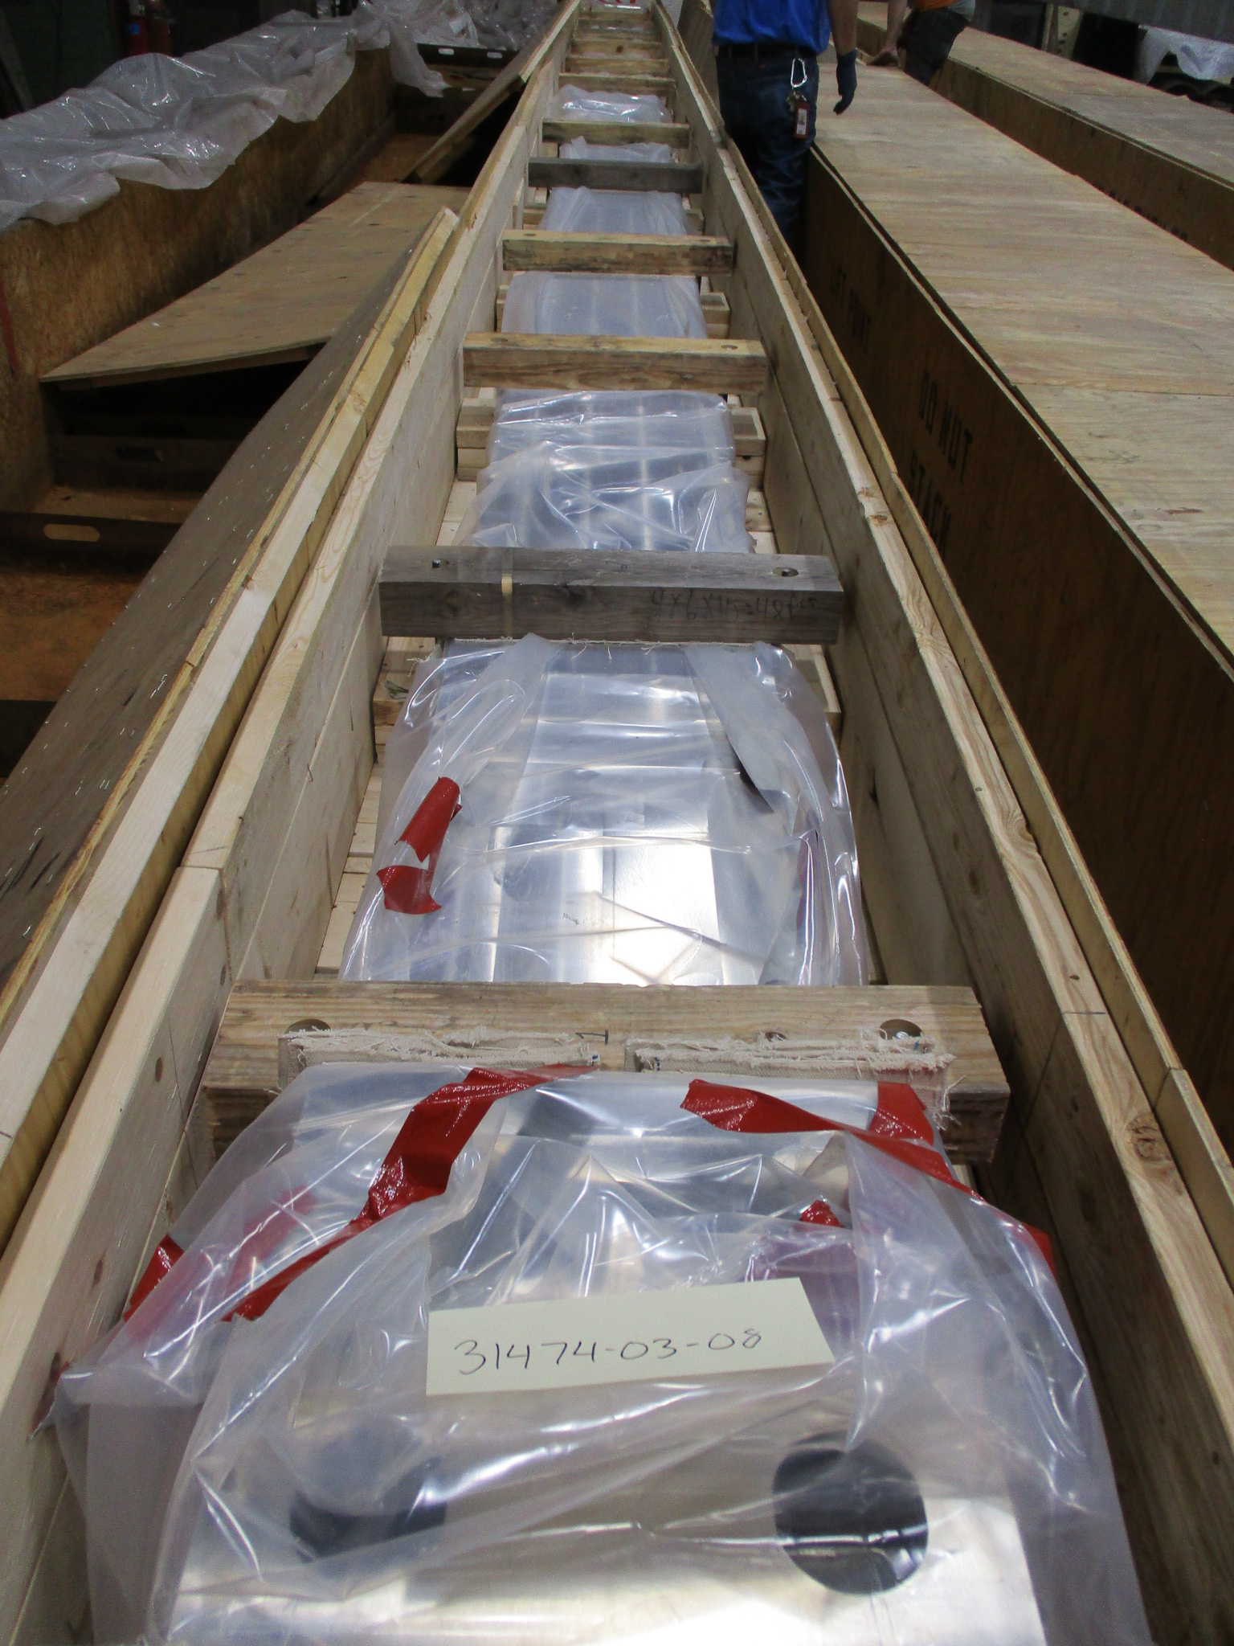
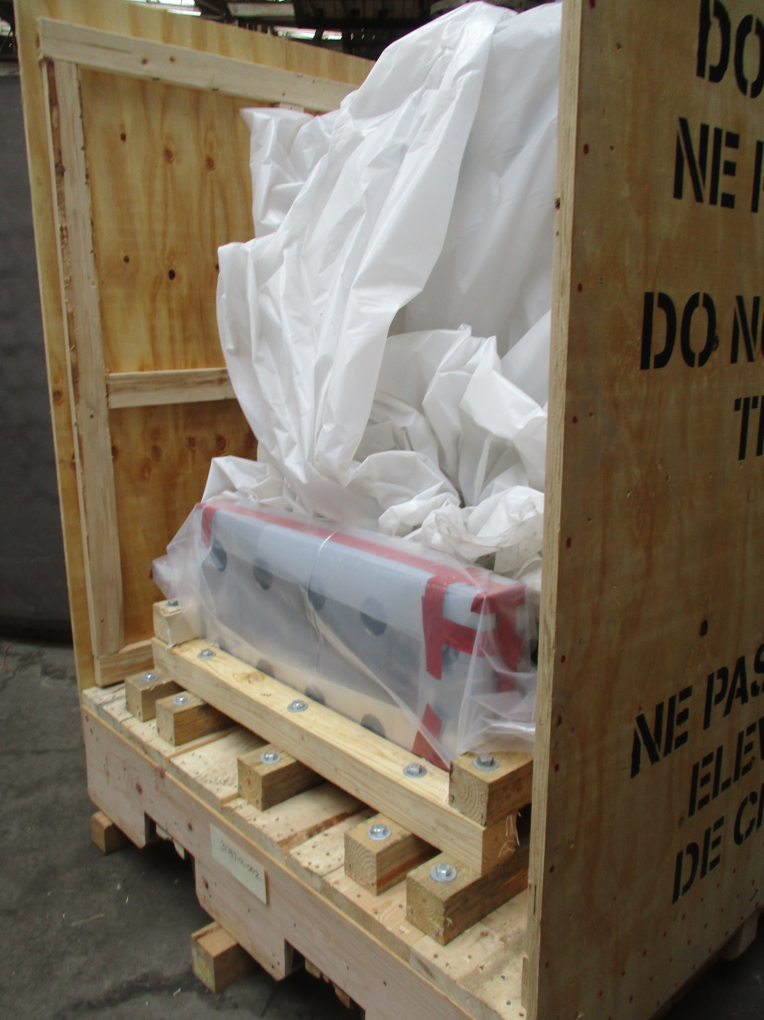
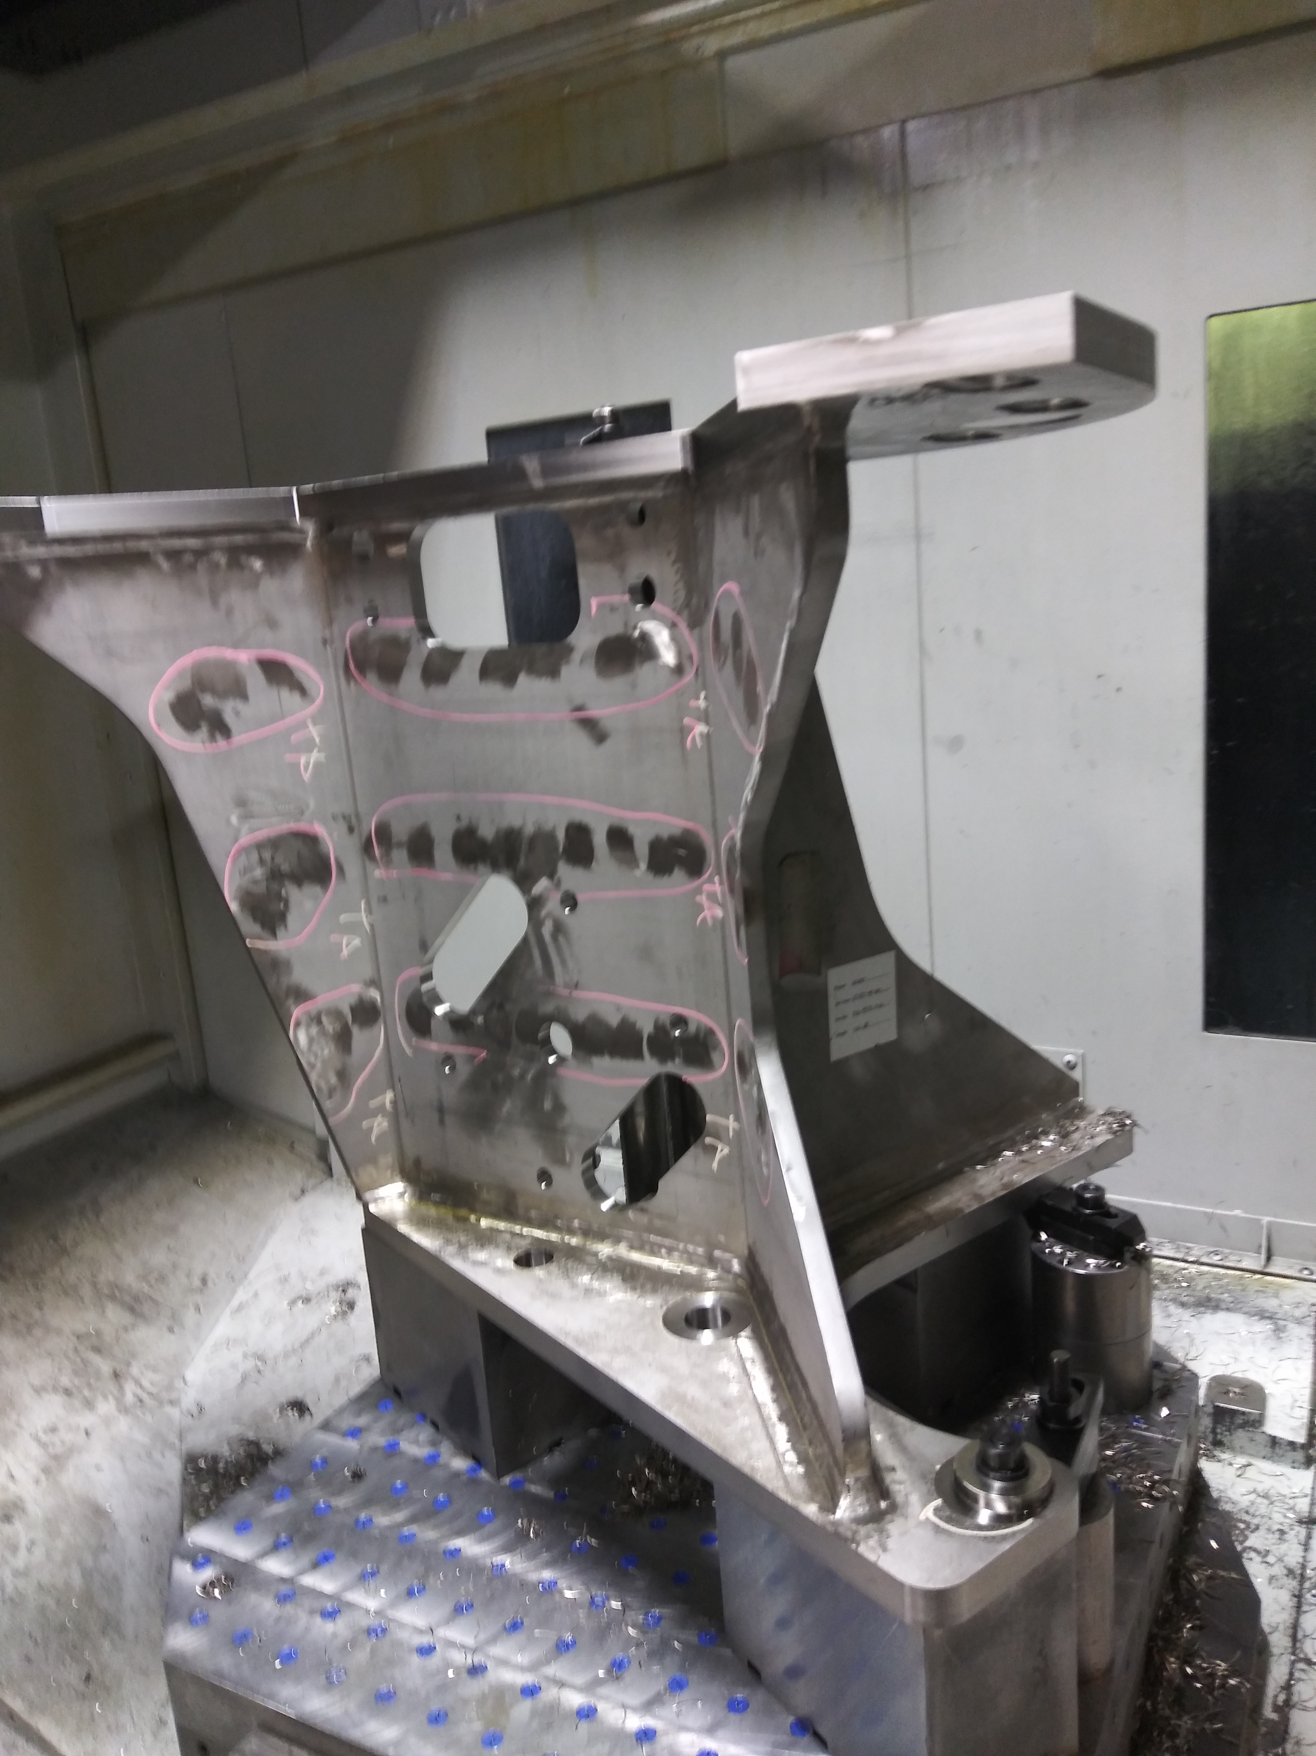
Central Solenoid Structures deliveries will be complete in 2023
Fabrication and deliveries continued in 2022
Tie plates (left) and flex brackets packaged for shipping at Precision Custom Components (PCC) in York, PA. Credit: US ITER
Feeder backet in machining at PCC. Credit: US ITER

Slide 7
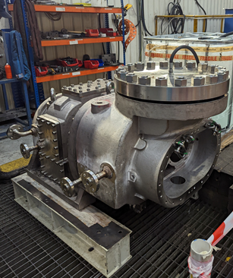
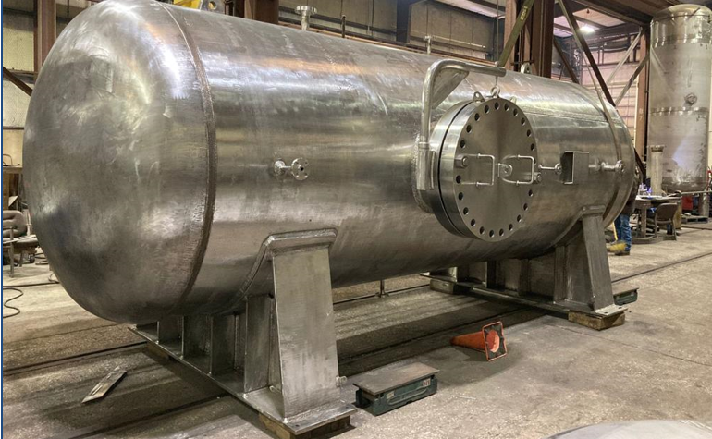
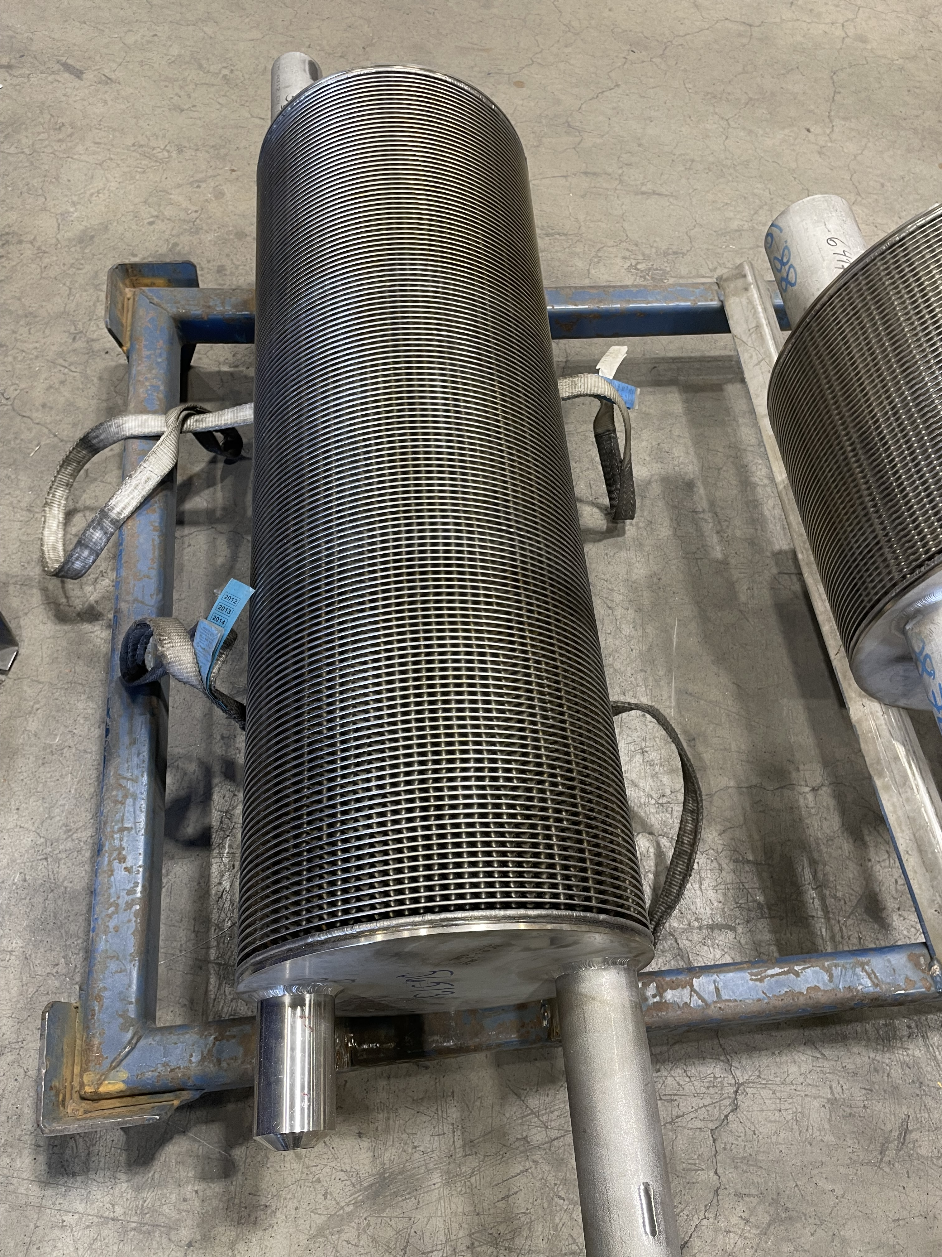
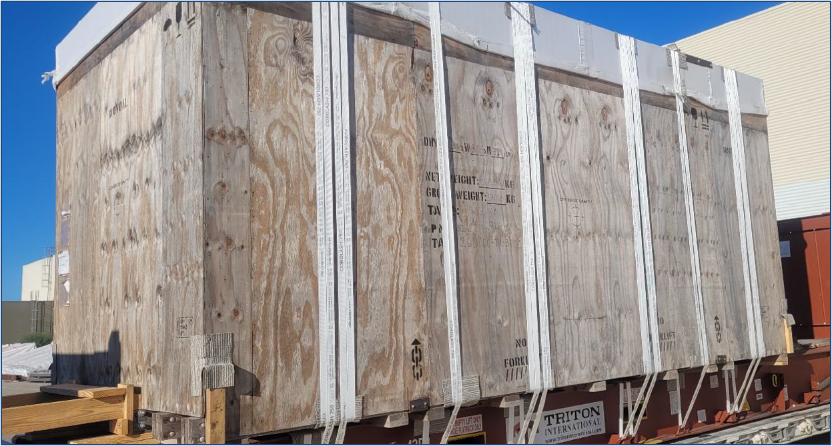
Tokamak Cooling Water System fabrication and deliveries continue
The drying system condenser is in fabrication at Vahterus in Finland
The drying system blowout compressor is in fabrication at Howden in Scotland and is now undergoing hydro testing.
The nitrogen storage tank manufactured by Innoval in Houston, TX has been delivered to the ITER site.
The primary heat transfer system pressurizer is in fabrication at Doosan in South Korea
All photos – Credit: US ITER

Slide 8
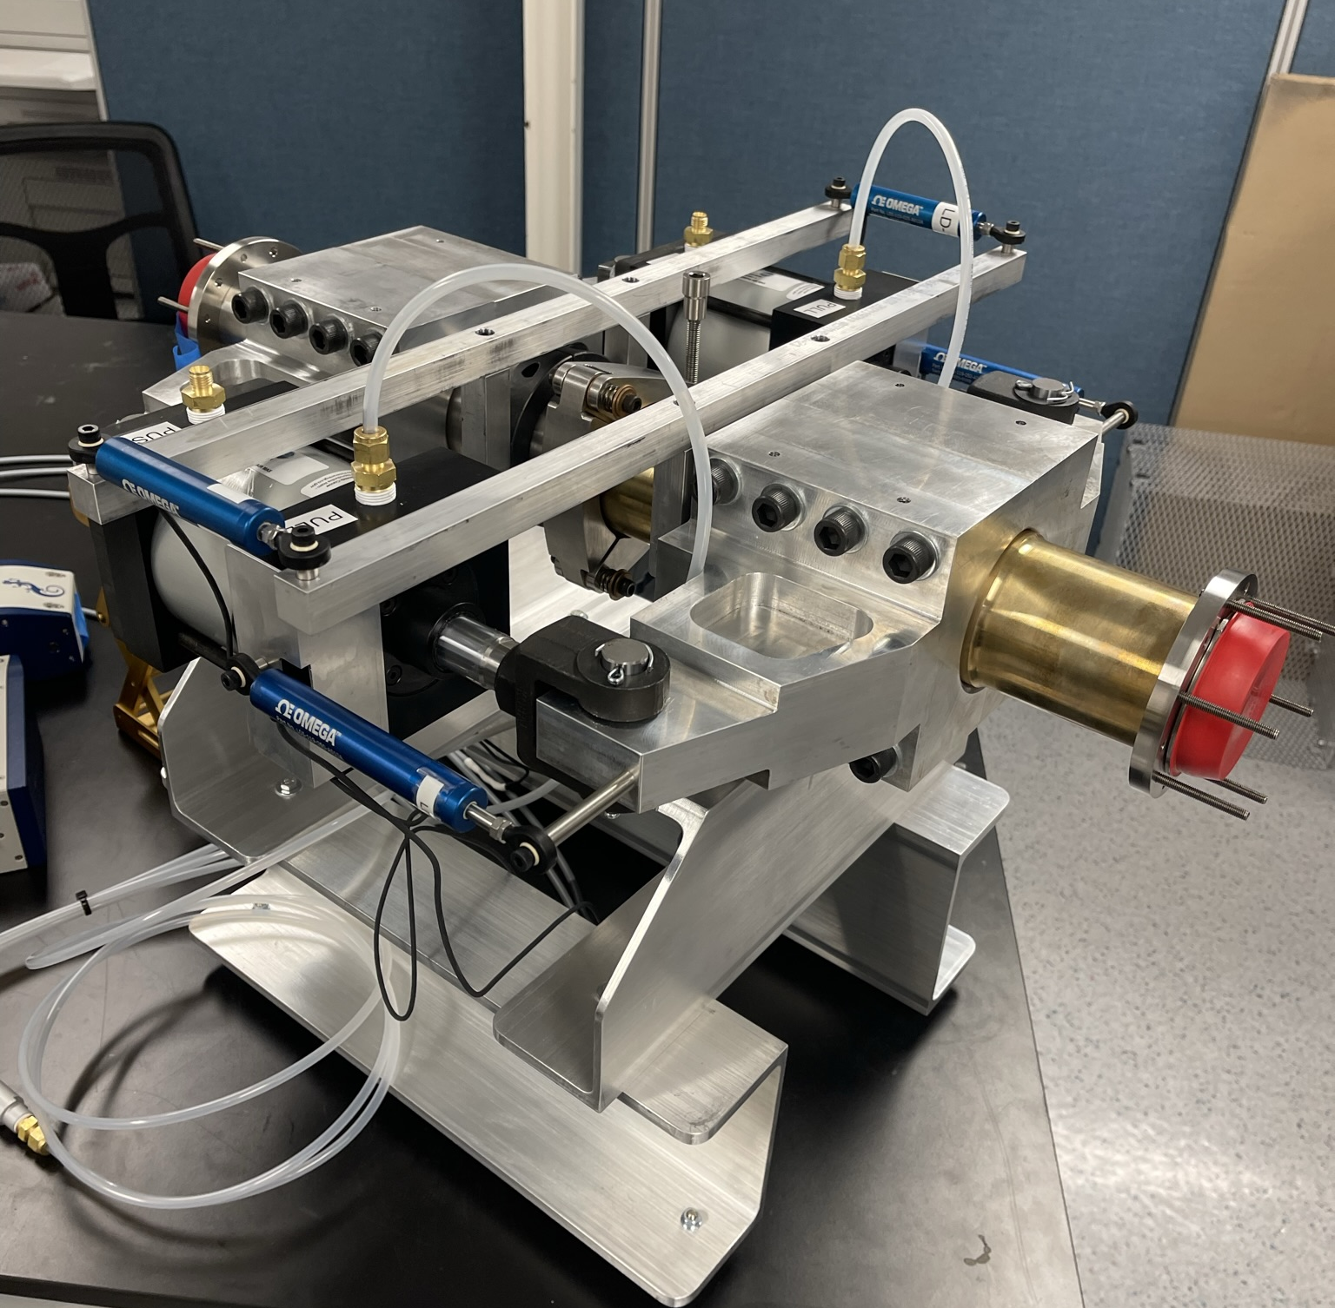
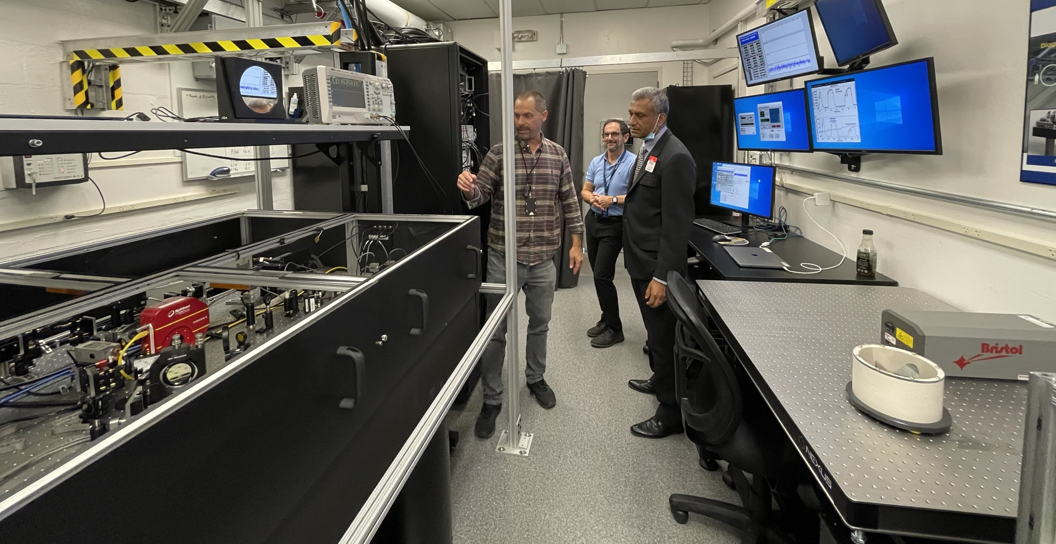
Diagnostic design and manufacturing development is progressing
In addition to 7 diagnostic systems, the US will also provide and integrate 4 diagnostic ports for ITER tenants
Waveguide joint test stand for the low field side reflectometer is assembled and ready for testing at General Atomics. Credit: GA
Optics table and lab for the toroidal interferometer polarimeter (TIP) at General Atomics. Credit: GA

Slide 9
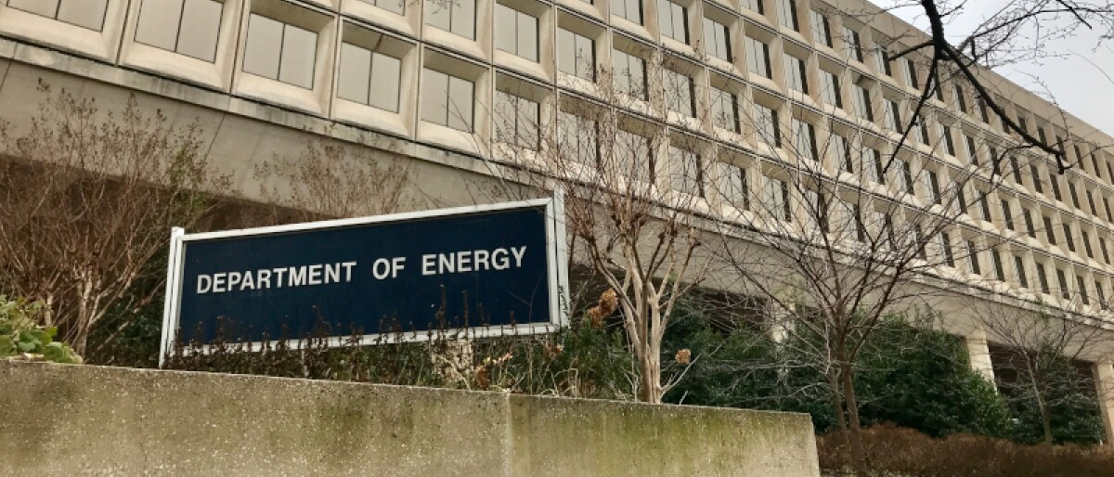
US ITER is preparing to re-baseline, in coordination with DOE guidance and international project needs
Original baseline for Subproject-1 (“First Plasma”) was approved in 2017
Updated baseline will cover all US hardware scope
FPA | December 7, 2022

Slide 10
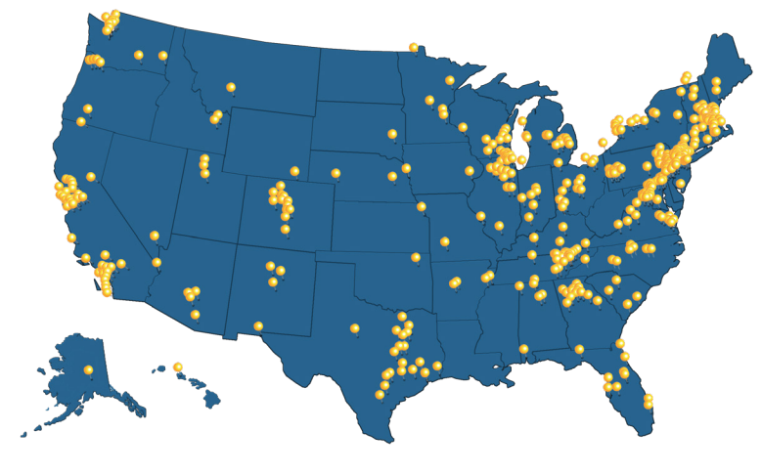
Most US ITER funding remains in the US
>$1.4B
including:
~$900M to industry
~$500M to DOE national laboratories
Data as of October 2022
Notes:
In 46 states plus DC

Slide 11
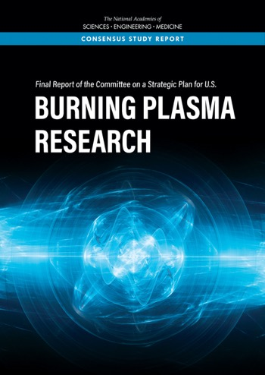
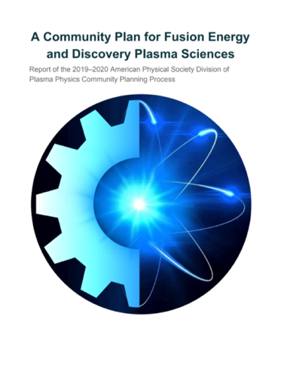
ITER continues to be important for US fusion Parallel activities are being informed by ITER experience
US Fusion Coordinator established (2021)
Milestone-Based Fusion Development Program established (2022)
US research program planning initiated (2022)
Bringing Fusion the U.S. Grid
2019
Policy Development: Regulatory Approaches for fusion energy devices (2020-present)
Fusion Energy Sciences Advisory Committee
2020
2020
2021
DOE Fusion Energy Sciences also supports transfer of US ITER and ITER know-how to support US fusion development, and is preparing a process for US fusion entities
11
FPA | December 7, 2022
Notes:
NASEM Burning Plasma Research (2019): “First, the United States should remain an ITER partner as the most cost-effective way to gain experience with a burning plasma at the scale of a power plant.”
“Second, the United States should start a national program of accompanying research and technology leading to the construction of a compact pilot plant that produces electricity from fusion at the lowest possible capital cost.”
APS Community Plan (2020): “Accelerate the development of the burning plasma physics basis necessary for a fusion pilot plant. Understanding burning plasmas…are critical steps toward achieving fusion energy.”
“The U.S. should sustain full partnership in ITER”
NASEM Bringing Fusion to the U.S. Grid (2021): ITER activities that benefit U.S. industry include:
Tools and strategies for plasma control and performance
Superconducting magnet technologies
Radiation transport analysis
High-powered plasma heating
D-T fuel cycle technologies
Continuous plasma fueling
Fusion materials
Fusion power and particle handling
Burning plasma science / Diagnostics
“The Department of Energy should assure maximum possible access to ITER information for the members of the fusion pilot plant design teams.”

Slide 12
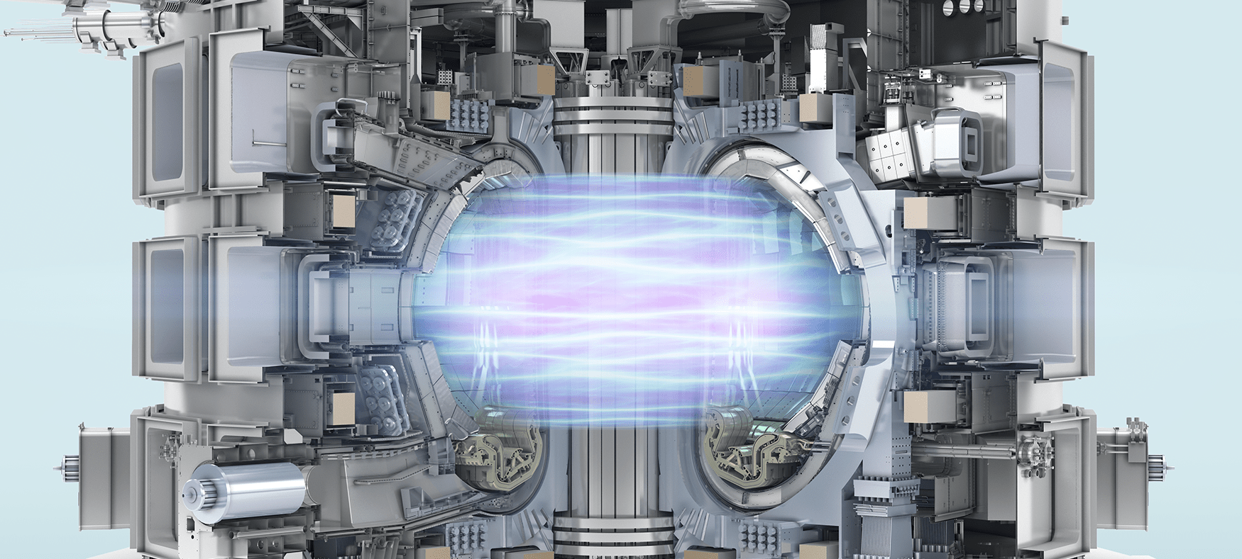
Technical and manufacturing experience from US scope is useful for other fusion systems
ITER demands the design and manufacture of components with tight tolerances that will support safe, reliable performance, including:
Magnet systems
Plasma heating
Fueling and disruption mitigation systems
Diagnostics
Cooling and vacuum systems
US and global industrial capabilities and supply chains continue to develop to meet ITER needs and beyond
Credit: F4E

