Slide 1
Academic research on turbulence and abrupt instability of isotope mixture plasmas in Large Helical Device (LHD)
Executive Director on Science
Katsumi Ida
FUSION POWER ASSOCIATES
43rd Annual Meeting and Symposium
8 December, 2022
15min

Slide 2
Strategy of LHD research
We focused the experiments on basic plasma physics issues for solving future problems of burning plasma as well as current issues in toroidal plasma.
Current issue of toroidal plasma
Turbulent transport study transport improvement
International collaboration
Future issue of burning plasma
basic plasma physics issues
Reduction of the diverter heat load.
turbulence spreading
Alpha-channeling (ion heating by alpha particles.
wave-particle interaction through (inverse) Landau damping at abrupt event
Helium ash exhaust
ion mixing in isotope mixture plasma

Slide 3
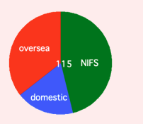
Highlighted topics of recent LHD experiment
LHD experiment
Number of proponents
1/3 of total is international collaborators
1) Turbulent transport study transport improvement
a) LHD-W7X comparison
b) Boron powder injection
c) Isotope effect
2) Turbulence spreading
a) Impact to divertor heat load*
b) Fast turbulence spreading
3) wave-particle interaction through (inverse) Landau dampin a) Mass-dependence of Collisionless energy transfer
→ Isotope effect of Collisionless energy transfer
4) Ion-mixing
a) isotope mixing and prediction for Heliun ash mixing

Slide 4
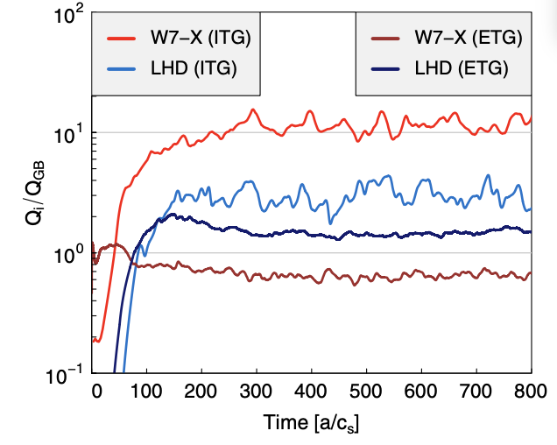
Impact of Magnetic Field Configuration on Suppression of Turbulence
W7-X ITG
LHD ITG
LHD ETG
W7-X ETG
 | LHD | Reason |  | W7X | Reason
Neoclassic Transport | High | Higher eff. helical ripple |  | Low | Orbit optimisation
ETG Turbulence | Low | breaking of streamers |  | Low | breaking of streamers
ITG Turbulence | Low | Stronger ZFs |  | High (except in stability valley) | Weaker ZFs
F. Warmer (Max-Planck-Institut für Plasmaphysik) et. al., Phys Rev Lett 127 (2021) 225001

Slide 5
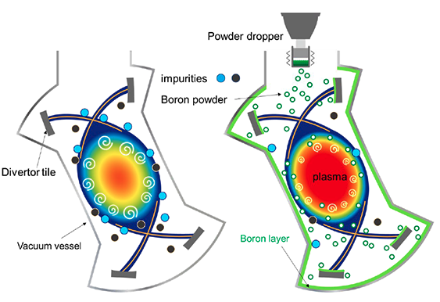
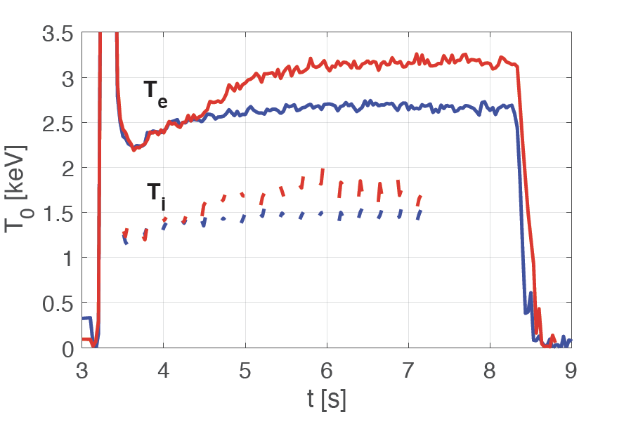
Boron powder injection makes plasma temperature increase
During B powder injection, plasma electron and ion temperatures increase, along with stored energy and confinement time
B powder
Turbulence fluctuation amplitude during injection period is reduced at low frequency (< 100kHz) regime
Reference
POWDER INJECTION
F. Nespoli (PPPL) et al., Nat Phys 18 (2022) 350

Slide 6
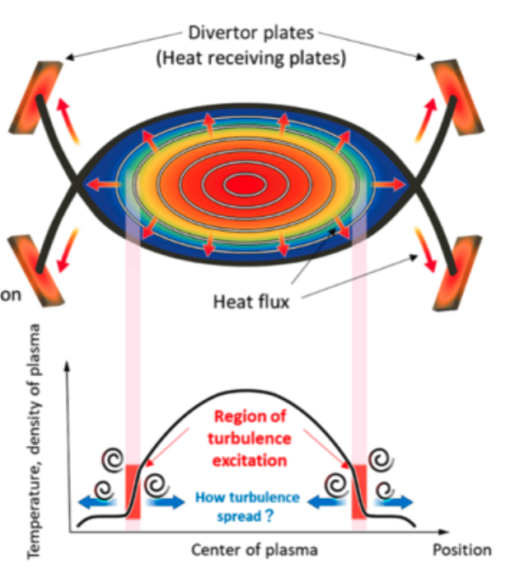
Plasma turbulence spreading by magnetic fluctuation reduces heat load on divertor plate
No magnetic fluctuation
Increase fluctuations
Reduction peak heat load
With magnetic fluctuation
broadening heat load
M. Kobayashi et al., Phys. Rev. Lett. 128, 125001 (2022)

Slide 7
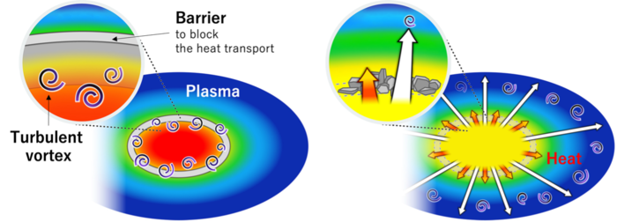
Turbulence and heat movement when a barrier that blocks heat is broken
The heat pulse propagates
at the same speed as that in the theoretical prediction,
whereas the turbulence pulse propagates one order of magnitude faster than that in the prediction.
~1.5 km/s
~10 km/s
The propagation speed of the turbulence pulse is approximately 10 km/s, which is faster than that of the heat pulse propagating at a speed of 1.5 km/s.
N. Kenmochi et al., Sci. Rep. 12, 6979 (2022)

Slide 8
Deformation of ion velocity space is observed by 10kHz charge exchange spectroscopy
A significant increase of kinetic energy of carbon impurity was observed associated with an MHD burst driven by energetic particle-driven instability
The kinetic energy increase is due to the collisionless energy transfer via Landau and time-transit damping accompanied by the deformation (bipolar signature) in ion velocity space from Maxwellian distribution.
First observation of bipolar signature in toroidal plasma in nuclear fusion research!
K.Ida et al, Comm. Physics 5 (2022) 228

Slide 9
Collisionless energy transfer is observed
Energetic particle
(beam ions)
28 kJ
Particle diffusion loss
14 kJ
Inverse Landau damping
Energy transfer rate to carbon is high than that to bulk ion (deuterium)
MHD burst
Landau damping
0.7 kJ (5%)
13 kJ (95%)
Higher efficiency for heavier
Collisionless energy transfer
Carbon impurity
1.5%
Bulk ions
98.5%
Insight of isotope effect of collisionless energy transfer
Collisional energy transfer
Larger gradient
Smaller gradient
Carbon ion
Bulk ion

Slide 10
Ion mixing is observed in the isotope mixture plasma
Although the shape of electron density profile is identical, the hydrogen (H) density profile and Deuterium (D) density significantly vary depending on turbulence state (TEM or ITG).
Similar ion-mixing is expected for Helium-bulk ion
K.Ida et. al., Phys Rev Lett. 124 (2020) 025002
Isotope non-mixing
Isotope mixing

Slide 11
Conclusion
Significant progress in scientific research has been made in experiments on turbulence/transport, magnetic island, energetic particle, spectroscopy, and machine learning based on international and domestic collaborations.
LHD experiments provide the following important observations
1) Reduction of peak heat load on diverter plate by turbulence spreading
2) Mass-dependent collision-less energy transfer via Landau and transit-time damping
3) Relation between ion-mixing and turbulence state
These results give new insights for solving the physics issue of burning plasma, especially diverter heat load, ion-heating by alpha particles, and helium ash exhaust.

Slide 12
List of Press Release on Academic research
December 2, 2021 : F.Warmer, et. al., Impact of Magnetic Field Configuration on Heat Transport in Stellarators and Heliotrons, Phys. Rev. Lett.127 (2021) 225001.
January 28, 2022 : F. Nespoli et. al., Observation of a reduced-turbulence regime with boron powder injection in a stellarator, Nat. Phys. 18 (2022) 350.
March 3, 2022 : T.Kobayashi, et. al., Self-Sustained Divertor Oscillation Driven by Magnetic Island Dynamics in Torus Plasma, Phys. Rev. Lett.128 (2022) 085001.
April 5, 2022 : M.Kobayashi, et. al., Turbulence Spreading into an Edge Stochastic Magnetic Layer Induced by Magnetic Fluctuation and Its Impact on Divertor Heat Load, Phys. Rev. Lett.128 (2022) 125001.
April 28, 2022 : T.Kobayashi, et. al., Hydrogen isotope effect on self‑organized electron internal transport barrier criticality and role of radial electric field in toroidal plasmas, Sci. Rep. 12 (2022) 5507.
May 19, 2022 : N.Kenmochi, et al., Preceding propagation of turbulence pulses at avalanche events in a magnetically confined, Plasma, Sci. Rep. 12 (2022) 6979.
September 28 2022 : K.Ida et. al., Direct observation of mass-dependent collisionless energy transfer via Landau and transit-time damping, Comm. Phys. 5 (2022) 228.

Slide 13
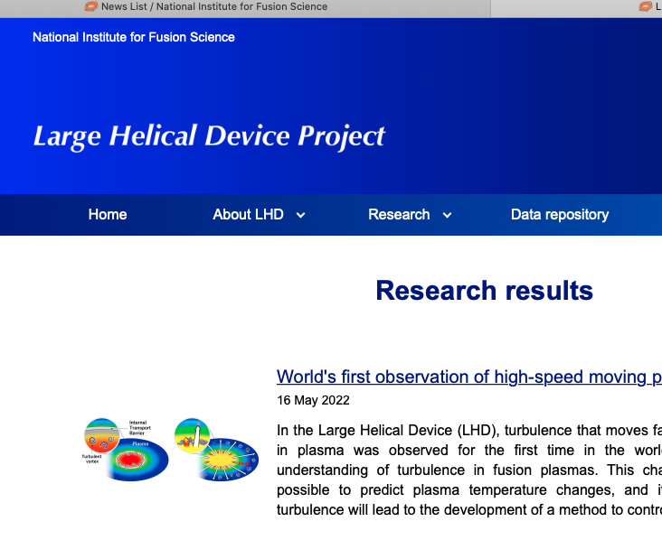
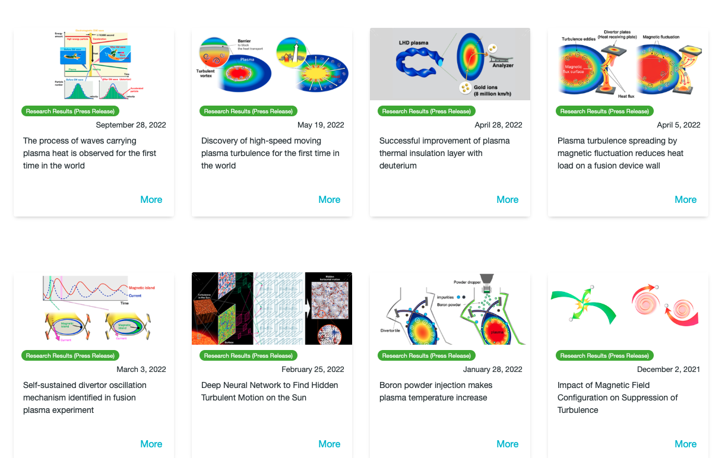
For more details, please visit the following page
LHD experimental results
https://www-lhd.nifs.ac.jp/pub/Science_en.html
Press release
https://www.nifs.ac.jp/en/news/index_list.html

