Slide 1
The Road Ahead for Sandia’s pulsed power program
Daniel Sinars
Sandia Program Executive, Office of Experimental Sciences
Director, Pulsed Power Sciences Center
Fusion Power Associates Meeting
December 7-8, 2022
SAND2022-6293 C

Slide 2
Our planning in the Pulsed Power Sciences Center encompasses five major workflows for this decade
Deliver on Z into 2030s
Pu Production Science
Pegpost
Hostile
Mitigation
Pegpost
60 MA Power Flow
X-ray & ICF target scaling
Weapon Science for ‘25 pegpost
Enhanced integrated testing
Pu production pegpost
…
SNM load path
Outputs opacity
…
…
Sustain Z
into 2030s
Fluid systems
Data Acq.
MITL cleaning
Flash Lamps
Marx Cap.
Replacement
HVAC
Screen Boxes
Crane Mod.
Calibration Systems
Adaptive Optics
Humidity Control
SF6 Mod.
Digitizers
Advance NGPP process
CD0
AoA
CD1
CD4
Conceptual Design
Full System Title 1 Design
CD2
CD3
Final Design
Construction
Mature PP technologies
Vulcan flashover test bed
Center section conceptual design
3D Power Flow Design Tools
AMM (module)
Advanced insulator stack
Automated Refurb Prototypes
SF6 Free technology
Industry partnerships
…
…
…
Complete Scorpius/ECSE
Integrated Test Stand Ready
Complete Injector Commissioning
Complete Full Scale at ITS
CD 2/3
CD4
…
…
…
2022
2026
2030
~2035

Slide 3

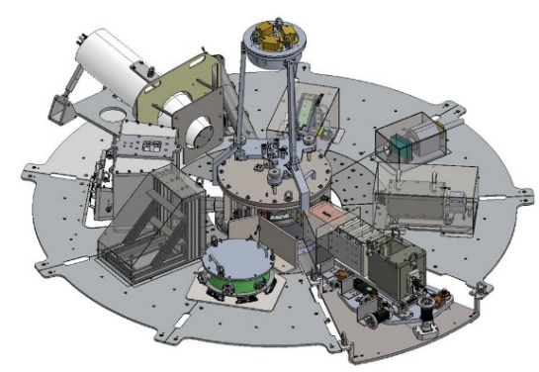














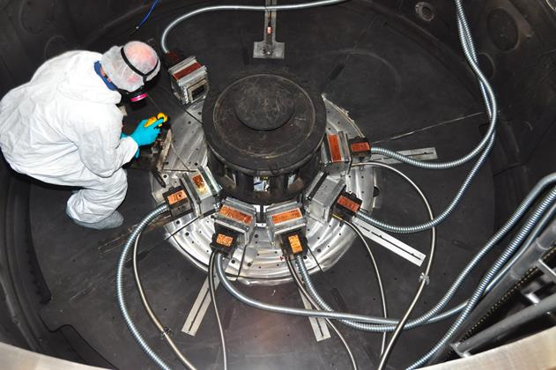
We have a capability development road map for the next decade on Z that will enable innovative HED science
Advanced fusion platforms & diagnostics
2023
2025
2027-30
Assess 25 MA power-flow
Outputs opacity
Refined High-Yield Requirements
Innovative MDD assessment
Z-NIF Opacity Comparison
Assess 60 MA power-flow
Enhanced Integrated Testing
Mission Priority
Objective
3D MIF Modeling
SNM Diffraction
NGPP Tech Mat
Thermo-nuclear Burn
Realize and apply magnetic- direct-drive fusion platforms for stockpile applications
X-ray diffraction, pre-heating, etc.
Material Properties
Be a world leader in multi-Mbar material and opacity science for the stockpile
Survivability
Realize the world’s brightest x-ray and fast neutron environments for weapon survivability
Pulsed-Power
Be the world leader in pulsed-power science and technologies for key national security applications.
Advanced radiation science platforms
Plutonium Production Science
High-pressure SNM (tiny stripline)
Fusion-Fission on Z
Plasma Transport Requirements
Advanced Insulator Technology
Pre-heated SNM
Fast-neutron Effects
Vulcan Operational
Multi-physics xMHD models
Fluid-kinetic MDD target models
Engineering Materials Assessment
Warm x-ray scaling
NGPP Module
2022
2024
2026

Slide 4
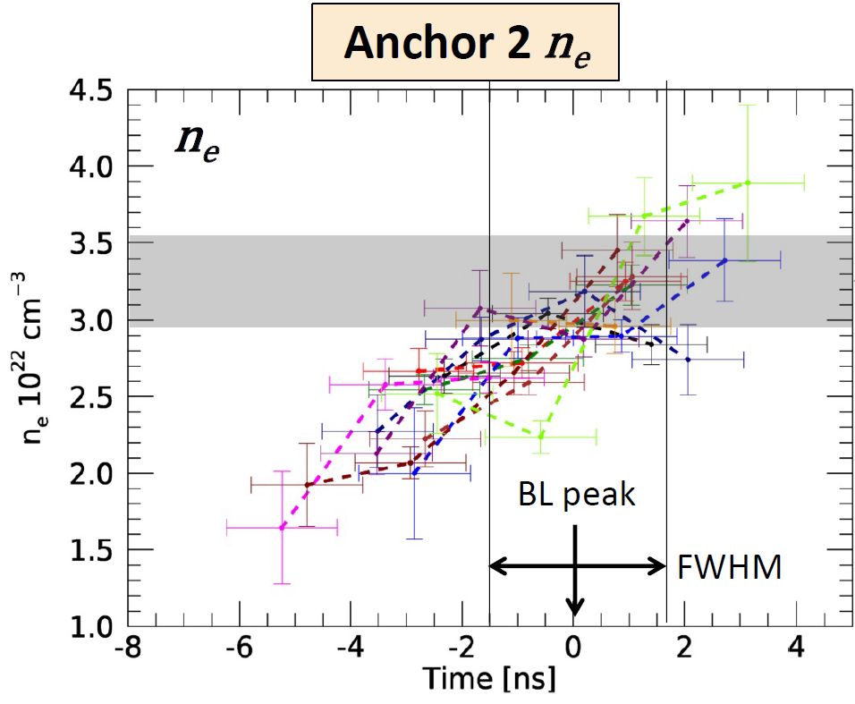
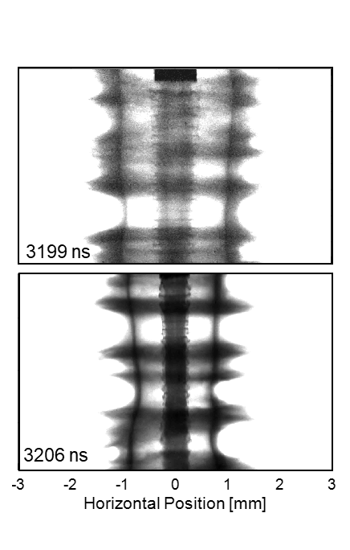
Sandia’s assessment science and ICF efforts will continue delivering high-value scientific capabilities and data for the stewardship program
Material Properties
Priorities: Deliver on commitments for national Pu, opacity science, and instability efforts
FY22 Highlights: Pu aging on war reserve samples, x-ray diffraction on Z, and time-gated opacity
Thermonuclear Burn
Priorities: Evolve magnetic direct drive effort toward high yield
FY22 Highlights: >20% Tritium fills for precise stagnation diagnostics, similarity scaling plan for MagLIF, cylindrical instability experiments, and ML enabled data analysis of key fusion metrics
Survivability
Priorities: Support rad effects for stockpile options, optimize x-ray sources on Z, and understand source scaling to higher-current facilities
FY22 Highlights: Demonstrated brightest x-ray sources yet while supporting deliverables
Pulsed Power Science
Priorities: Develop new pulsed-power technologies and advance the science of power flow
FY22 Highlights: Demonstrated efficient power flow at NGPP-like field strengths and completed design and construction of Vulcan
Time-dependent opacity
Guillaume Loisel
APS DPP 2022 invited talk
Radiographic series of highly multimode RMI growth in converging geometry.

Slide 5
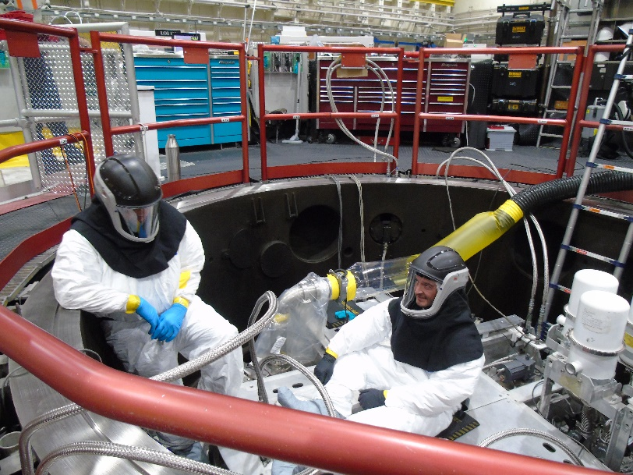
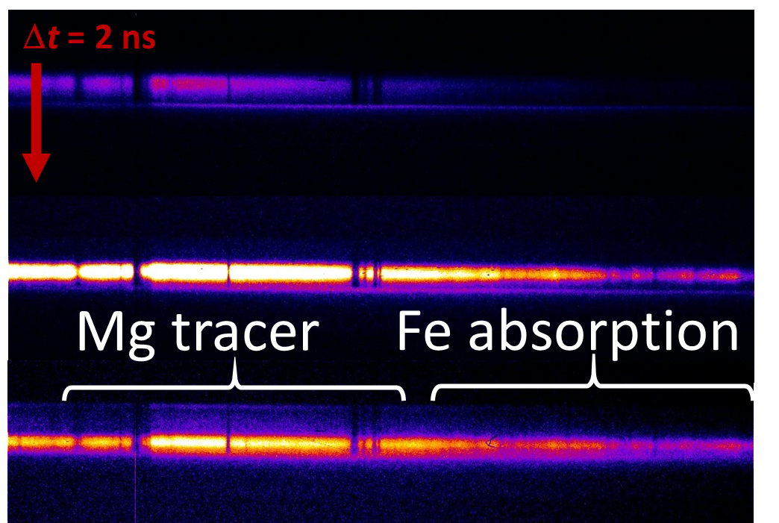
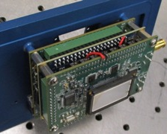
In FY23, the Material Properties area will deliver high impact data on plutonium compressibility to address aging and production as well as data for fundamental weapon science
Z will, in partnership with LANL, execute and analyze multiple plutonium experiments on weapon-relevant loading trajectories to help quantify aging effects and support pit production decisions
  Two “Production Science” experiments successfully executed in Q1 FY23
  Pu Aging experiment
Advance the National Opacity Program
  Compare measured opacities on Z and NIF and compare with modern theoretical calculations
  Calculate time-integrated opacities expected on Z given measured evolution of plasma conditions (shown below)
  Measure time-resolved iron opacity at Z
Pu Production Science experiments October 2022
Time
Sandia hCMOS
Ultrafast X-ray Imager

Slide 6
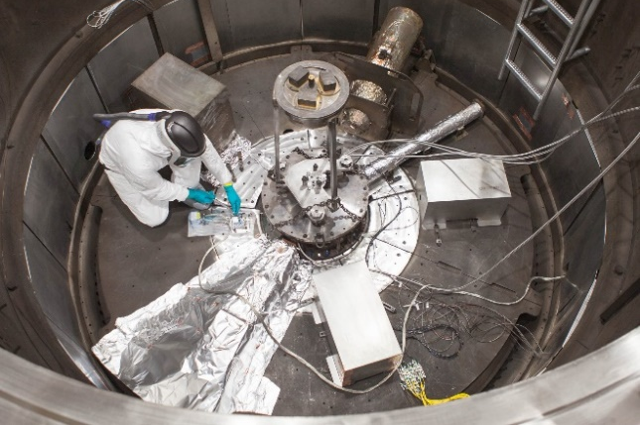
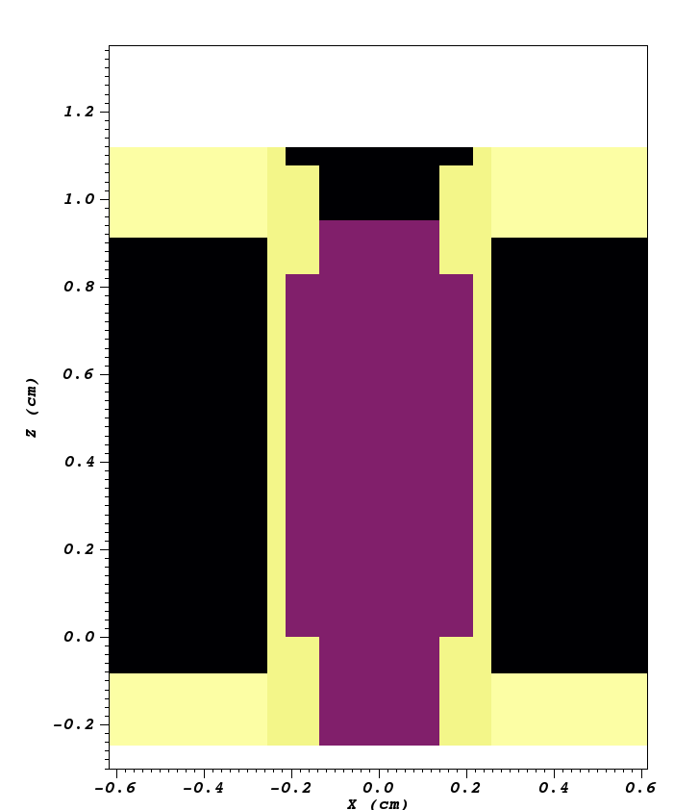
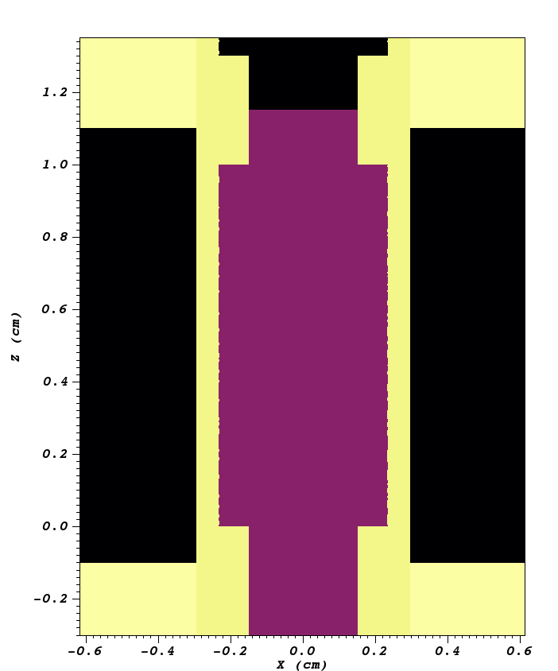
In FY23, the Thermonuclear Burn area will advance our understanding of Magnetic Direct Drive towards volume burn and high yield
Tritium on Z
Improve quantification of stagnation conditions to inform scaling path to high yield
Commission first precision neutron-time-flight diagnostic to distinguish between ion temperature and residual motion
Improve x-ray-spectroscopy-based temperature and density inferences
Increased frequency of tritium experiments for DT-based diagnostics
Test the similarity scaling framework for MagLIF
Systematically scale the target geometry and input conditions (axial magnetic field, preheat, fuel density) across a range of currents on Z
Study the impact of 3D effects on MagLIF simulations at Z & NGPP scales
14 MA
21 MA
Target design for 14 and 21 MA shots with overlay of x-ray
self-emission images.

Slide 7
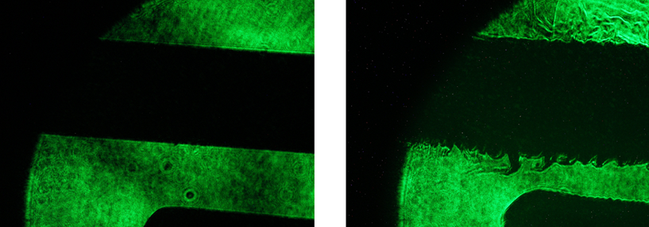

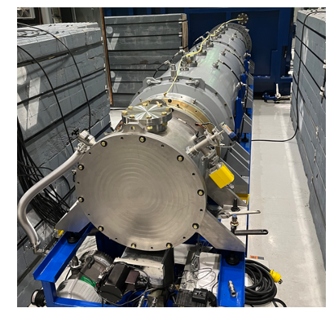
In FY23, the Pulsed-Power area will continue to mature our understanding of the physics and technology required to reach 60 MA
Complete an assessment of power flow physics and key physics phenomenon for power flow at 20 MA
  Continue to acquire data on power flow at NGPP-like field strengths
  Acquire data on other key power flow phenomenon for model validation
  Assess both CHICAGO and EMPIRE simulation tools
Advance pulsed power designs and technology maturation for NGPP
  Employ Vulcan to make progress in vacuum insulator flashover physics and improve performance
  Begin designs for an advanced Marx module prototype
  Assess a collaboration with First Light Fusion to increase the rate of progress on pulsed power technology at scale
Pre-shot
Near peak current
Power flow plasma shadowgraphy on Mykonos
plasma instabilities in dense cathode plasma layer
Vulcan 5 MV flashover test stand ready for tests

Slide 8
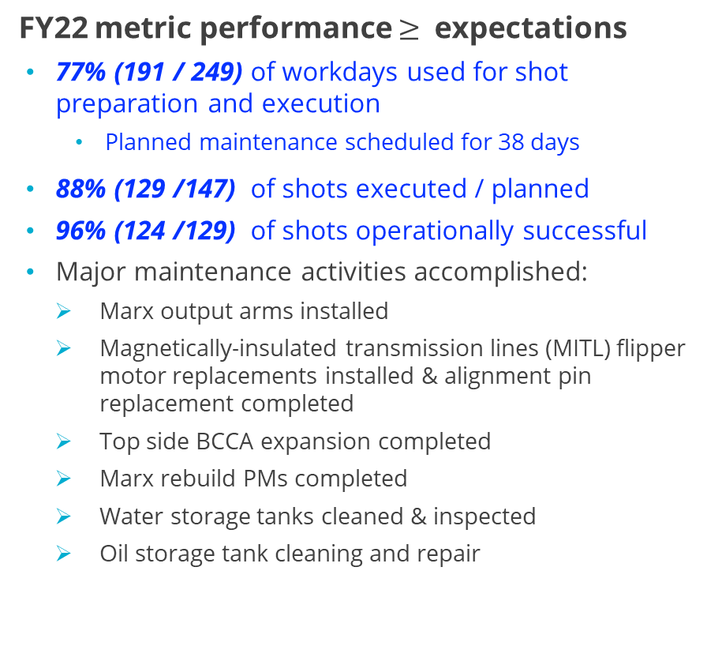
Key improvements in FY22 enabled a return to full operations tempo on Z with potential for productivity increases over past performance
FY22 metric performance $≥$ expectations
77% (191 / 249) of workdays used for shot preparation and execution
  Planned maintenance scheduled for 38 days
88% (129 /147) of shots executed / planned
96% (124 /129) of shots operationally successful
Major maintenance activities accomplished:
  Marx output arms installed
  Magnetically-insulated transmission lines (MITL) flipper motor replacements installed & alignment pin replacement completed
  Top side BCCA expansion completed
  Marx rebuild PMs completed
  Water storage tanks cleaned & inspected
  Oil storage tank cleaning and repair
Major activities / improvements implemented:
Converted to a limited 2-shift operations model
Hired Team Leads for core day & evening ops. teams
Introduced operational readiness reviews
Adopted scheduling flexible work time at the end of the facility week
Increased facility time to allow for adoption of facility systems pre-shot testing (MTG charge and holds)
Planning activities improved efficiency of special configuration shots
  5- to 4-day turnaround reduced SNM shot timelines
  2 tritium shots executed in a single week
We expect FY23 to also have a high shot rate
8

Slide 9
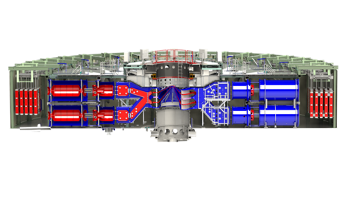
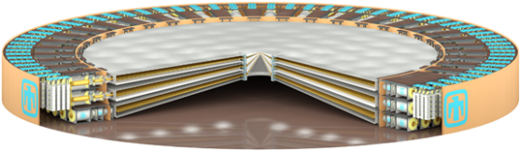
NGPP will address long-standing capability gaps and provide needed agility and flexibility for the next phase of stockpile modernization/ replacement
Z (2 MJ, 85TW)
NGPP will:
  Unambiguously answer what is required for a high yield pulsed power capability
  Provide capability to study nuclear dominated weapon processes and significantly reduce extrapolation to real weapon conditions and surrogacy issues
  Provide experimental capability to simulate high-fidelity warm x-ray and 14MeV neutron environments with large (sub-system, system) components
  Fill gaps in ability to experimentally measure properties of strategic materials at certain weapon conditions
  Help the US advance the state-of-the-art in laboratory pulsed power technologies
NGPP Concept (10-20 MJ, 600-700TW)
Parameter | Example NGPP Option | Z
Diameter | 300’ | 108’
Marxes | 75 @ 2400 kJ (180 MJ) | 36 @ 600 kJ (22 MJ)
Capacitors | 13,500 @ 2.95 µF | 2,160 @ 2.65 µF
Power at Stack | 602 TW | 85 TW
Forward Energy at Stack | 54 MJ (short pulse) | 6 MJ (short pulse)

Slide 10
Our planning in the Pulsed Power Sciences Center encompasses five major workflows for this decade
Deliver on Z into 2030s
Pu Production Science
Pegpost
Hostile
Mitigation
Pegpost
60 MA Power Flow
X-ray & ICF target scaling
Weapon Science for ‘25 pegpost
Enhanced integrated testing
Pu production pegpost
…
SNM load path
Outputs opacity
…
…
Sustain Z
into 2030s
Fluid systems
Data Acq.
MITL cleaning
Flash Lamps
Marx Cap.
Replacement
HVAC
Screen Boxes
Crane Mod.
Calibration Systems
Adaptive Optics
Humidity Control
SF6 Mod.
Digitizers
Advance NGPP process
CD0
AoA
CD1
CD4
Conceptual Design
Full System Title 1 Design
CD2
CD3
Final Design
Construction
Mature PP technologies
Vulcan flashover test bed
Center section conceptual design
3D Power Flow Design Tools
AMM (module)
Advanced insulator stack
Automated Refurb Prototypes
SF6 Free technology
Industry partnerships
…
…
…
Complete Scorpius/ECSE
Integrated Test Stand Ready
Complete Injector Commissioning
Complete Full Scale at ITS
CD 2/3
CD4
…
…
…
2022
2026
2030
~2035

Slide 11
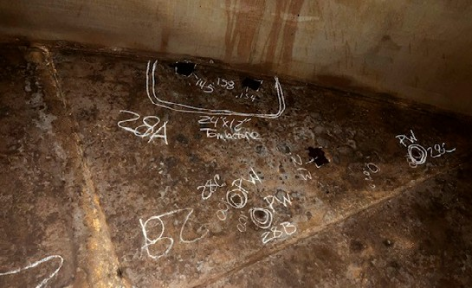
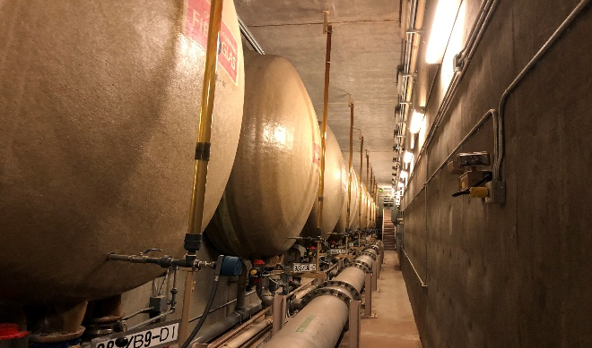
Sandia’s pulsed power program is continuing to make progress on Z while preparing for the future
Deliver on Z into 2030s
Sustain Z into 2030s
Advanced fusion platforms & diagnostics
Oil Tank Cleaning & Repair
Water Tank Cleaning, Valves
Advance Next-Gen Pulsed Power Process
Mature PP technologies
New 5 MV Vulcan flashover test stand completed
NGPP Concept (10-20 MJ, 600-700TW)
Z (2 MJ, 85TW)

