Slide 1
FUSION POWER ASSOCIATES
BOARD OF DIRECTORS
Recognizes
JAMES VAN DAM
for your
OUTSTANDING LEADERSHIP
of the
U.S. Fusion Energy Sciences Program

Slide 2
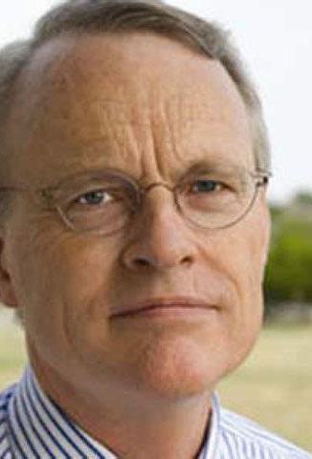
Jim’s Leadership Contributions Are Extensive
Moved from the Institute for Advanced Studies to Institute for Fusion Studies (UT-Austin) with M. Rosenbluth in 1980
Associate Director, 1986-2003
Co-Authored 3 chapters in the 1999 ITER Physics Basis.
IFS Director, 2003-2011
Co-Chair of U.S.-Japan Joint Institute for Fusion Theory, 2002-2011
USBPO Director and Chief Scientist for the US IPO, 2007-2011.
Served on (and Chaired) Program Advisory Committees for C-Mod, NIFS, DIII-D, IFTS, KSTAR, IPP
DOE FES Research Division Director, 2011-2017
Acting AD and Associate Director of Science, FES, 2017-2022

Slide 3
US Community Leadership
”…During the last five years, your steady hand and influence has brought the fusion community together to produce three truly remarkable (and totally unimaginable a few years earlier) reports for US fusion research…”

Slide 4
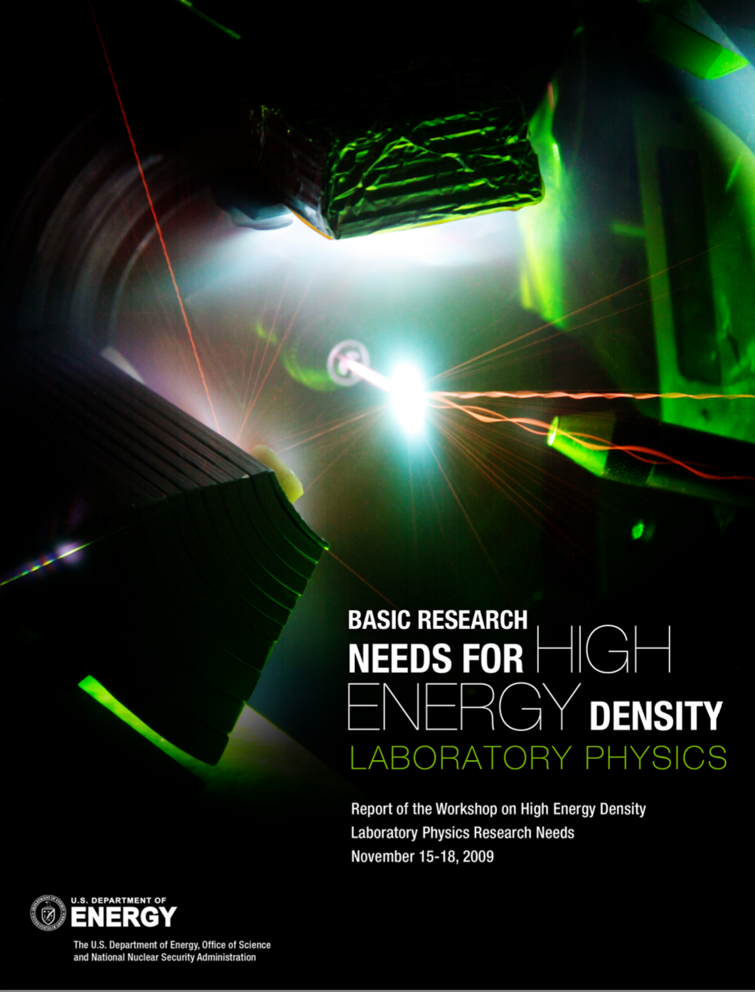
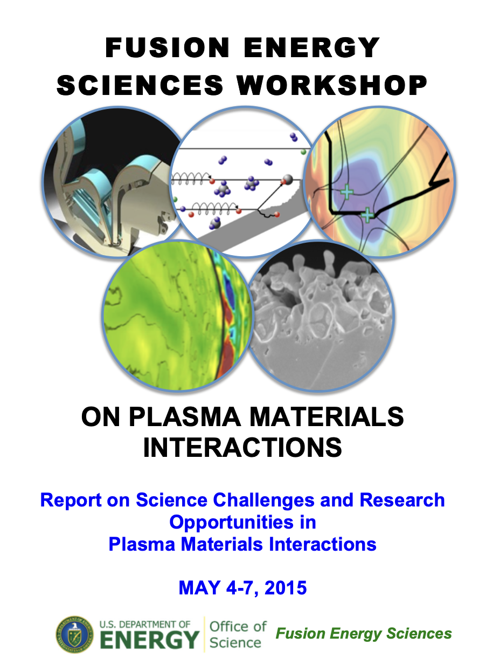
Research Program Leadership
“…you have quietly and effectively implemented a large range of FESAC recommendations, including initiatives on fusion simulation, boundary/material science, and transient control as well as launched new programs in high energy density plasma science and public-private partnerships.”

Slide 5
ITER Support
“…the US ITER program is now solidly funded by Congress, the project is delivering on its milestones and a ITER Research Needs workshop is now reaching completion.”
Testimony to US House Science Committee, 2017

Slide 6
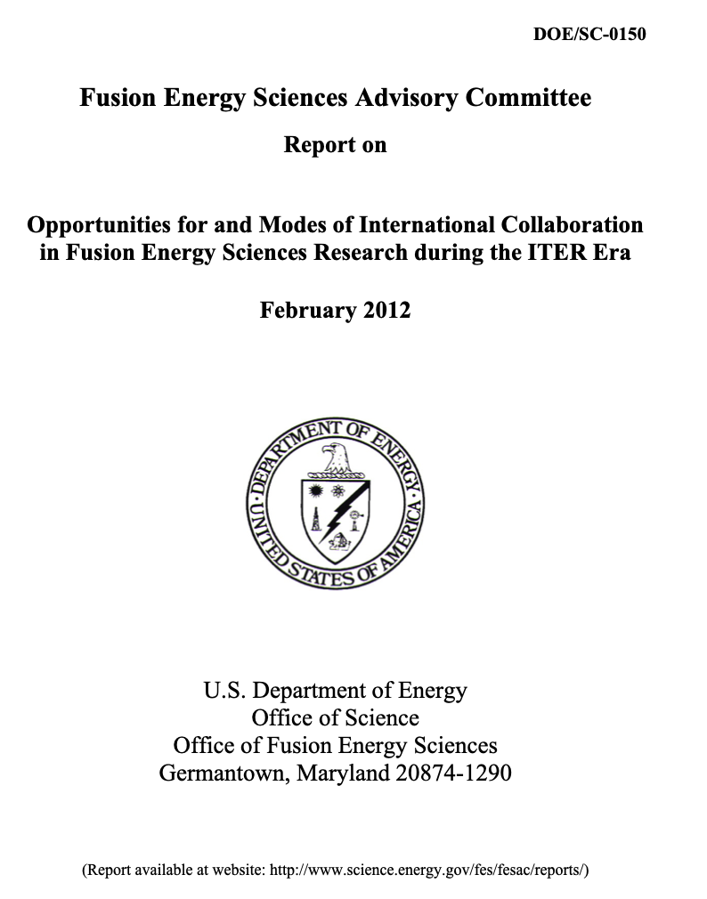
International Collaboration
“You are a fusion leader with a global view and broad visions…have promoted extensive international cooperation between the United States and other countries.”

Slide 7
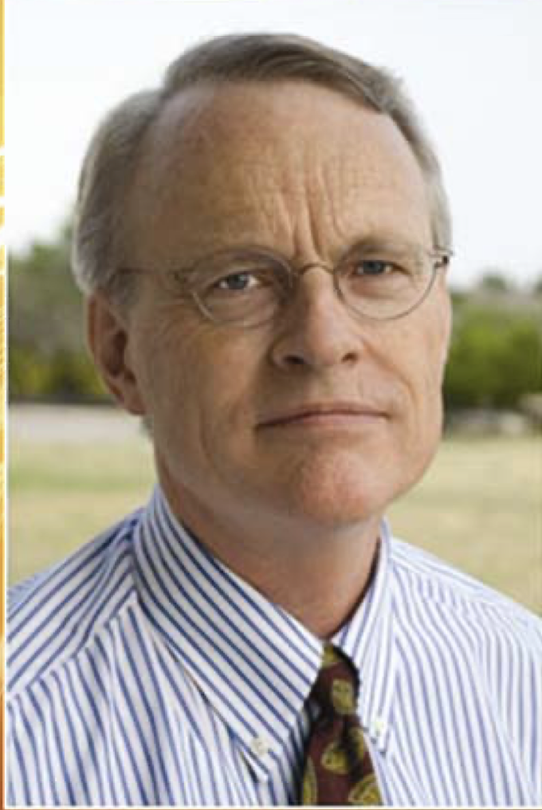
Personal Commitment to Good
“You are also liked and respected as a man of integrity and empathy”

Slide 8
Thank you for a Job Well Done!!!
“You are also liked and respected as a man of integrity and empathy”
Your leadership has and will continue to shape us for years to come.

