Slide 1
Wisconsin HTS Axisymmetric Mirror
flow-shear stabilized compact mirror path to fusion
Cary Forest^{1,12}, Jay Anderson^{1,12}, Jim Anderson⁴, Oscar Anderson¹, Ted Biewer⁷, Tim Bohn¹, Mike Brown¹¹, Mirela Cengher⁴, Mike Clark¹, Jan Egedal¹, Doug Endrizzi¹, Gennady Fiksel¹⁰, Kieran Furlong¹², Manaure Francisquez⁸, Ammar Hakim⁸, Bob Harvey⁵, Mykola Ialovega¹, Mi Joung¹³, Jeremiah Kirch¹, Grant Kristofek², Xavier Navarro-Gonzalez¹, Ben Lindley^{1,12}, John Lohr⁴, Ari Le⁶, Vladimir Mirnov¹, Bob Mumgaard², Jessica Hoffman¹, Ethan Peterson³, Yuri Petrov⁵, Jon Pizzo¹, Steve Oliva¹, Charlie Moeller⁴, Kunal Sanwalka¹, Oliver Schmitz^{1,12}, Mary Severson¹, Bhuvana Srinivasan⁹, Benjamin Terranova¹, Danah Velez¹, John Wallace¹, Blake Wetherton⁶, Dennis Whyte³, Mason Yu¹
1 University of Wisconsin-Madison
2 Commonwealth Fusion Systems
3 MIT
4 General Atomics
5 CompxCo
6 LANL
7 ORNL
8 PPPL
9 Virginia Tech
10 University of Michigan
11 Swarthmore College
12 Realta Fusion
13 KSTAR NFRI
COMPX

Slide 2
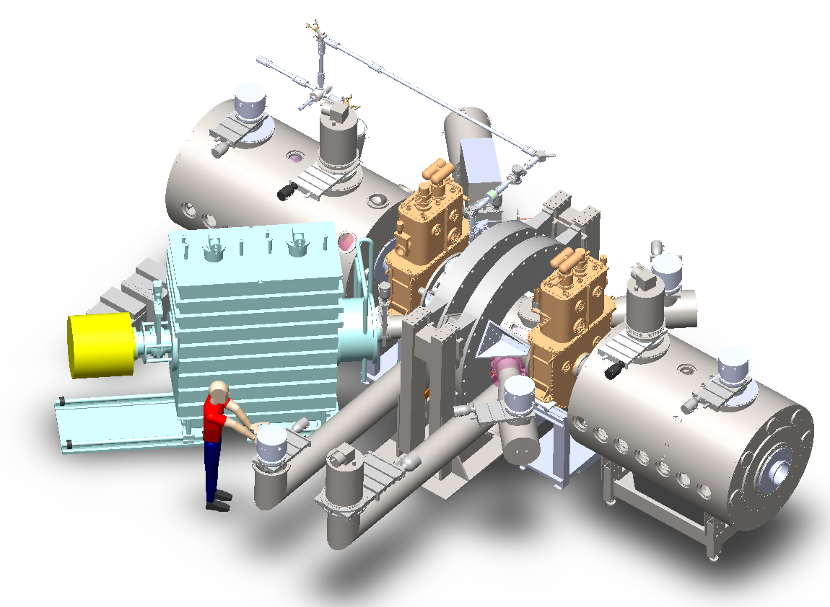
WHAM is a ARPA-E funded and aims to prototype the ATM end plug
Physics Missions:
Confine MHD stable, high Te plasma in axisymmetric mirror
demonstrate shear-flow stabilization of Interchange combined with electron heating and expander confinement
create high plasma pressure allowed by strong magnetic field
sloshing ion stabilization of DCLC
Demonstrate novel in-situ ion acceleration
combine radio-frequency heating with neutral beam fueling
show confinement benefit of high energy ions
Technology Missions: (intertwined with physics goals)
Build REBCO HTS mirror reactor magnets
build and operate 17 T, 5.5 cm bore HTS coils
design 25 T, 50 cm integrated end plug for WHAM++, Hammir
Demonstrate advanced particle handling techniques
Novel non-evaporable tantalum getters
test advanced plasma facing components
$$B_{M}=17T,R_{M}=20$$
$$L=4m,a=12cm$$
Additional ARPA-E directives:
Refine reactor concept
low cost/length central cell solution
neutronics analysis for shielding
Develop commercialization plan

Slide 3
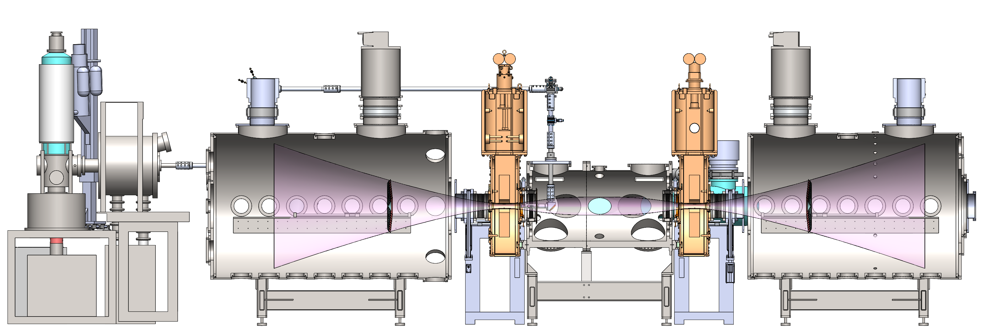
Vacuum vessel under assembly
April
12” CF GATE VALVES (2)
STATUS: RECEIVED Order Placed:
ETA:
COST: $13,633
CRYO PUMPS
STATUS: ORDERED 3 Order Placed: 12/13/2021
ETA: 16 week, 4/13/2022
COST: $116,573
April
CUSTOM ADAPTER FLANGES
STATUS: ORDERED
Order Placed: Pending, 8/2022
ETA: 30 weeks
COST: $21,960
CENTRAL CELL
STATUS: ORDERED
Order Placed: 7/19/2021
ETA: 16 week, Feb. 2022
COST: $101,250
Includes all mating flanges
ECH WAVEGUIDE
STATUS: RECEIVED
Order Placed: 8/18/2021
ETA: 28 weeks, April. 2022
COST: $247,465
TURBO PUMPS
STATUS: ORDERED 2
Order Placed: 1/19/2021
ETA: 12 weeks, 3/19/2022
COST: $36,318
2021
May
Aug 22
Sept.
August
END CELLS (2)
STATUS: ORDERED
Order Placed: 5/27/2021
ETA: 16 week, Feb. 2022
COST: $64,550
May
Oct 22
TO BE DESIGNED
-CFS Magnet stands
-NBI Beam Dumps
-ECH Launcher
CHAMBER STANDS (3)
STATUS: RECEIVED
Order Placed:
COST: ESTIMATE = $12,000
NBI STAND and POSITIONER
STATUS: FINALIZING DESIGN
Order Placed: Pending
COST: ESTIMATE = $12,000
STABILIZATION RINGS
STATUS: RFB
Order Placed: Pending
ETA: End of July
COST: TBD
CUSTOM BELLOWS
STATUS: RFB
Order Placed: Pending
ETA: 16 weeks
COST: Estimate $15,000
CUSTOM PUMPING DUCT
STATUS: Finalize Design
Order Placed: Pending
ETA: 12 weeks
COST: Estimate $15,000
Nov 22
Dec 22
Jan 23
2021
July
Nov 22
Nov 22
June
* Order Placed = PO leaving the building

Slide 4
WHAM is now under construction at the Physical Sciences Lab of the University of Wisconsin: 1st plasma Q2 2023
December 1, 2020

Slide 5
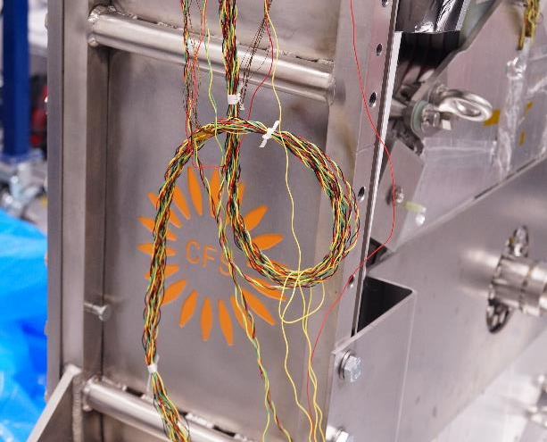
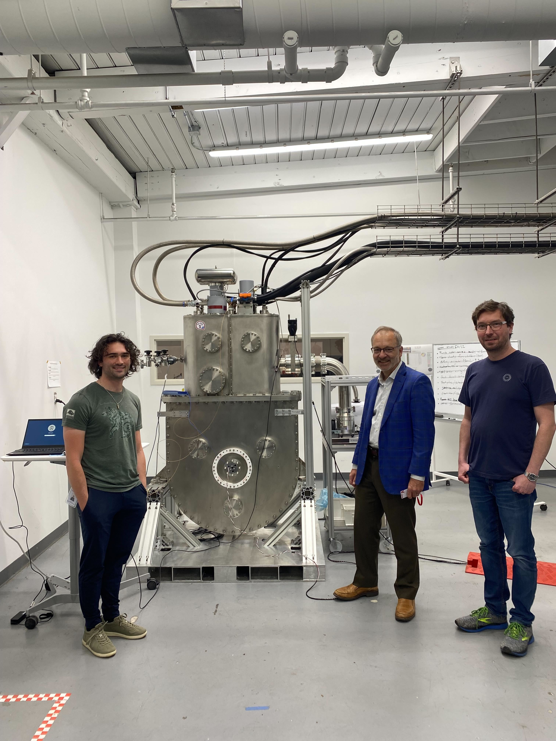
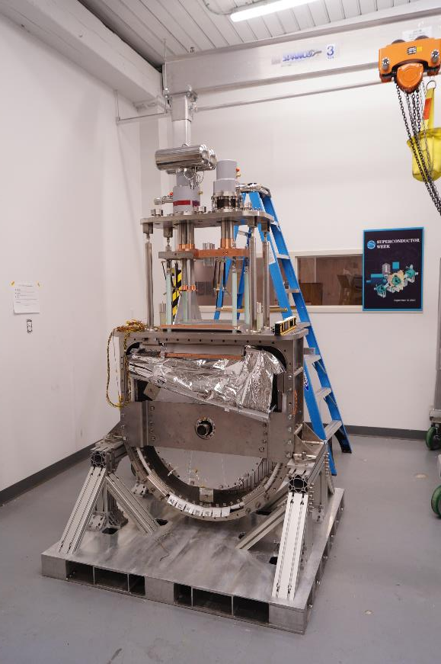
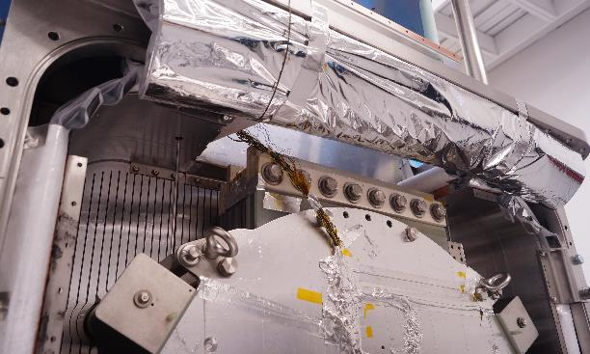
WHAM magnet specifications (Thing 1 tested successfully to 16.5 T)
Stored energy | 3.2 | MJ
Magnetic field at center | 17 | T
Maximum magnetic field | 20 | T
Operating current | 2000 | A
Inner diameter | 0.05 | m
Outer diameter, WP | 0.7 | m
Thickness | 0.15 | m
Height | 2.1 | m
Winding pack mass | 500 | kg
Magnet mass | 1500 | kg
Operating temperature | 20 | K

Slide 6
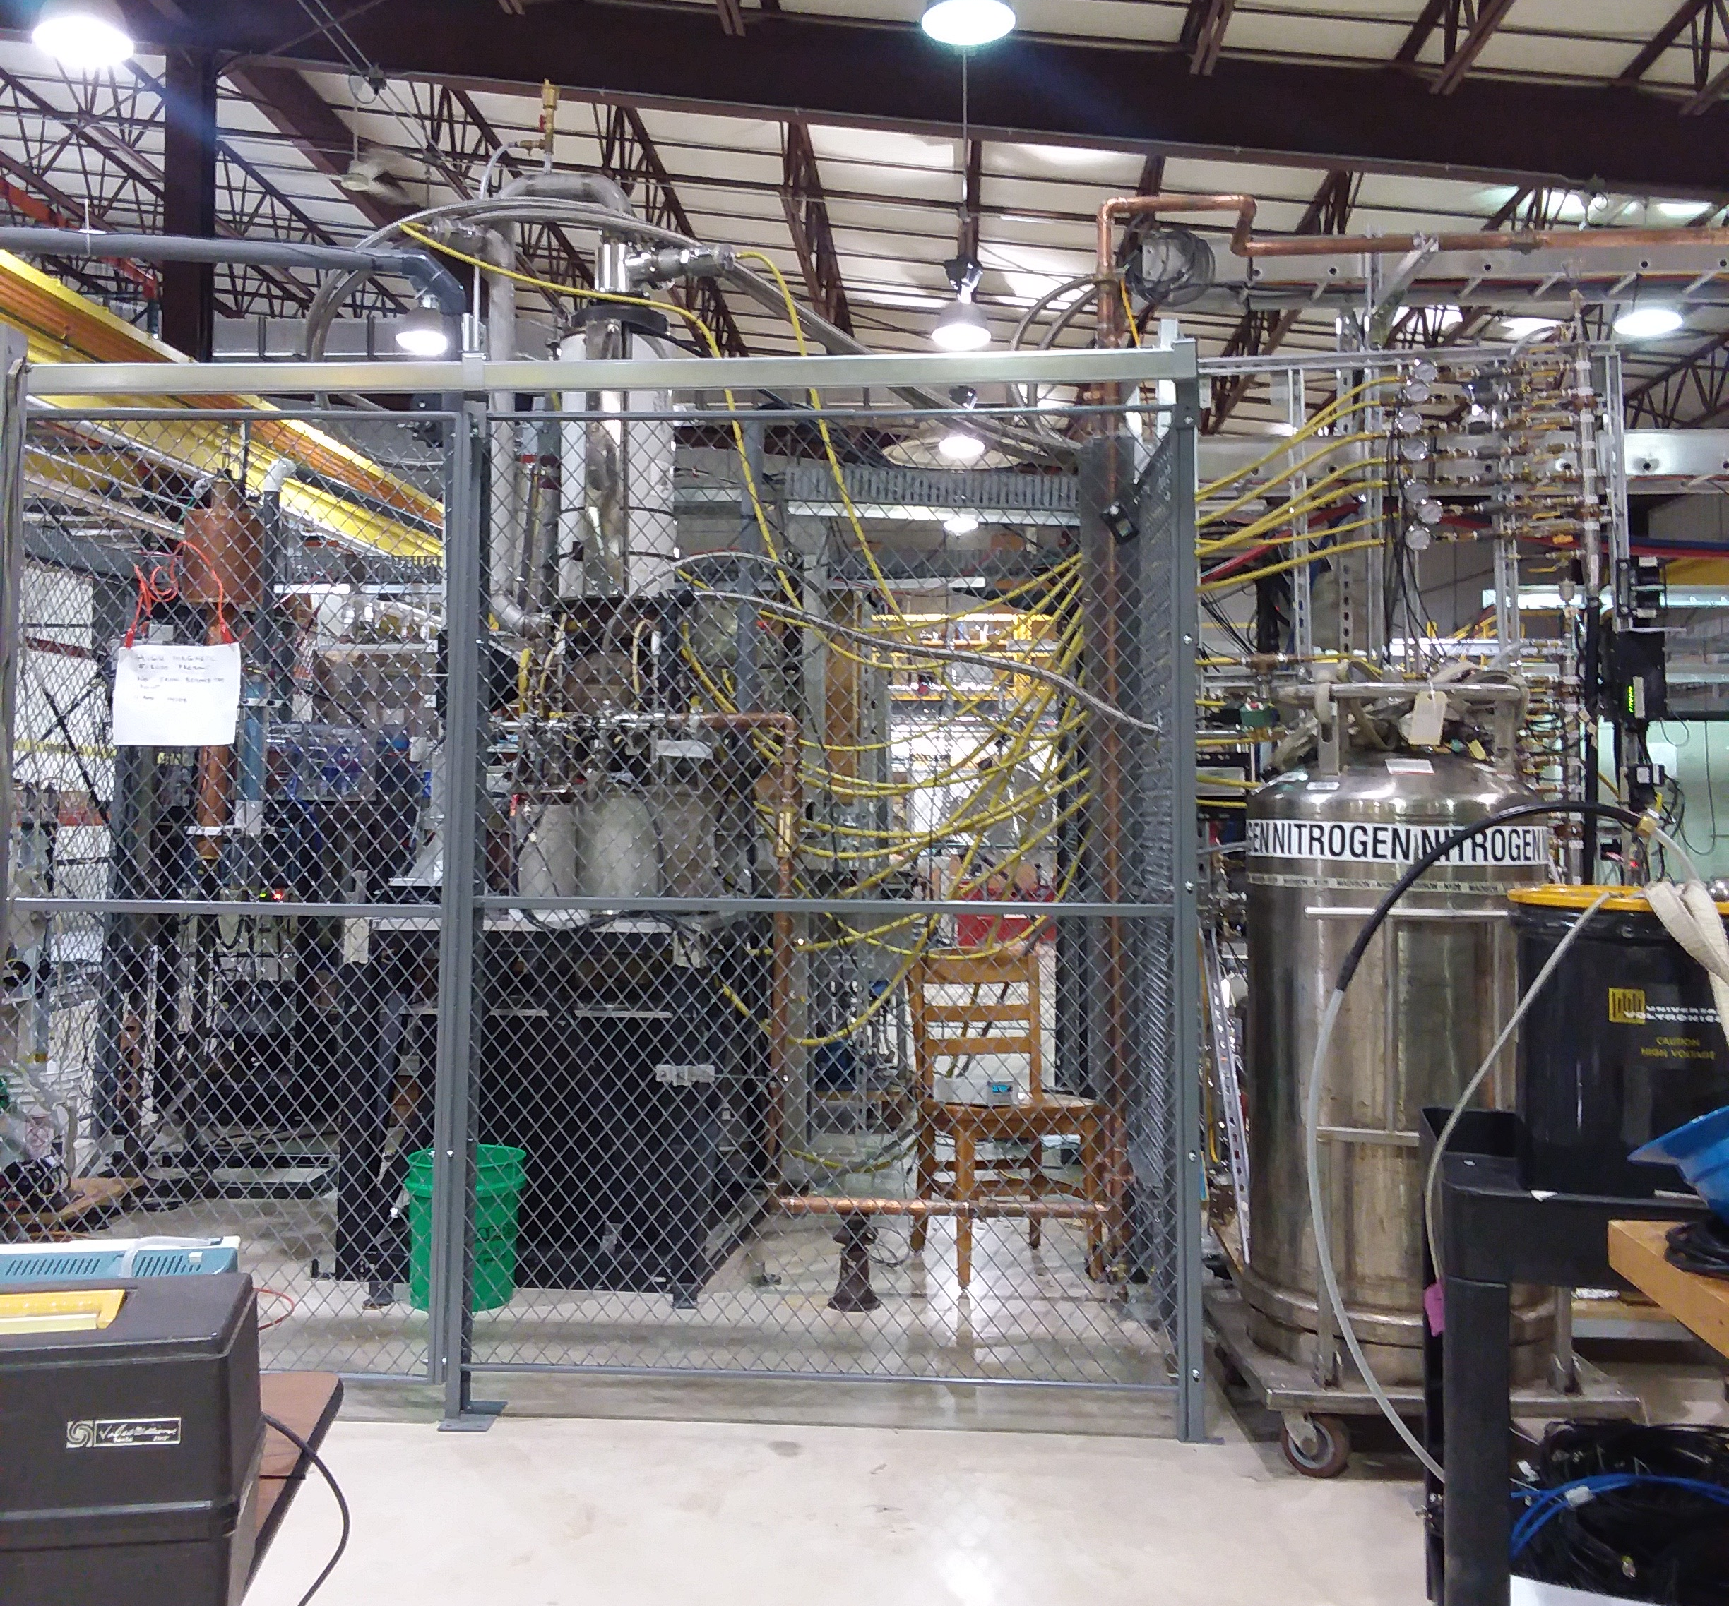
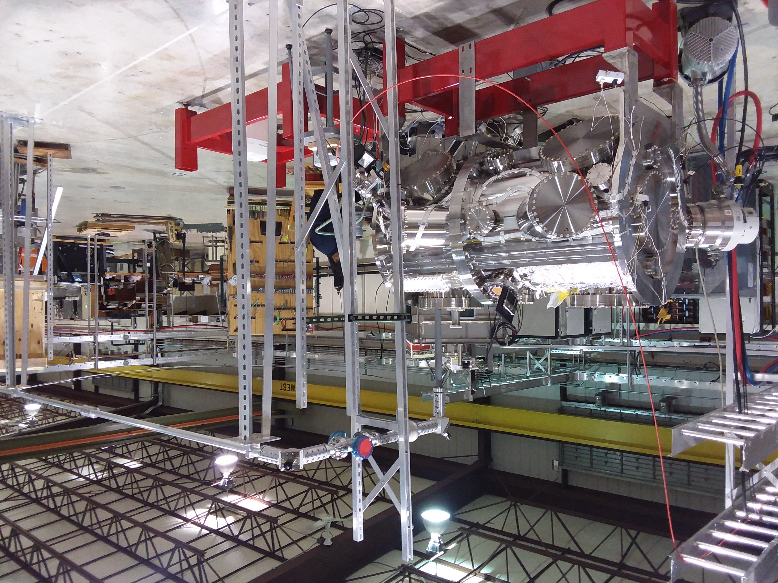
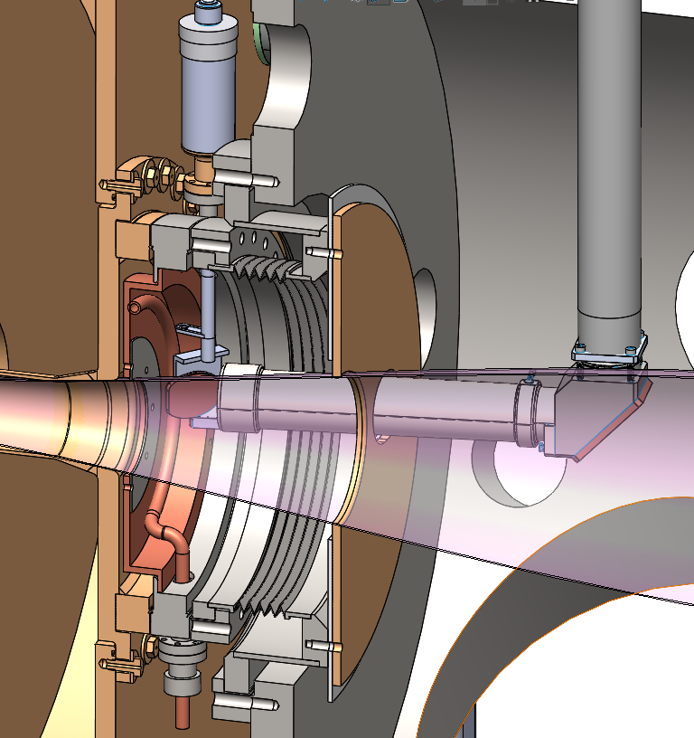
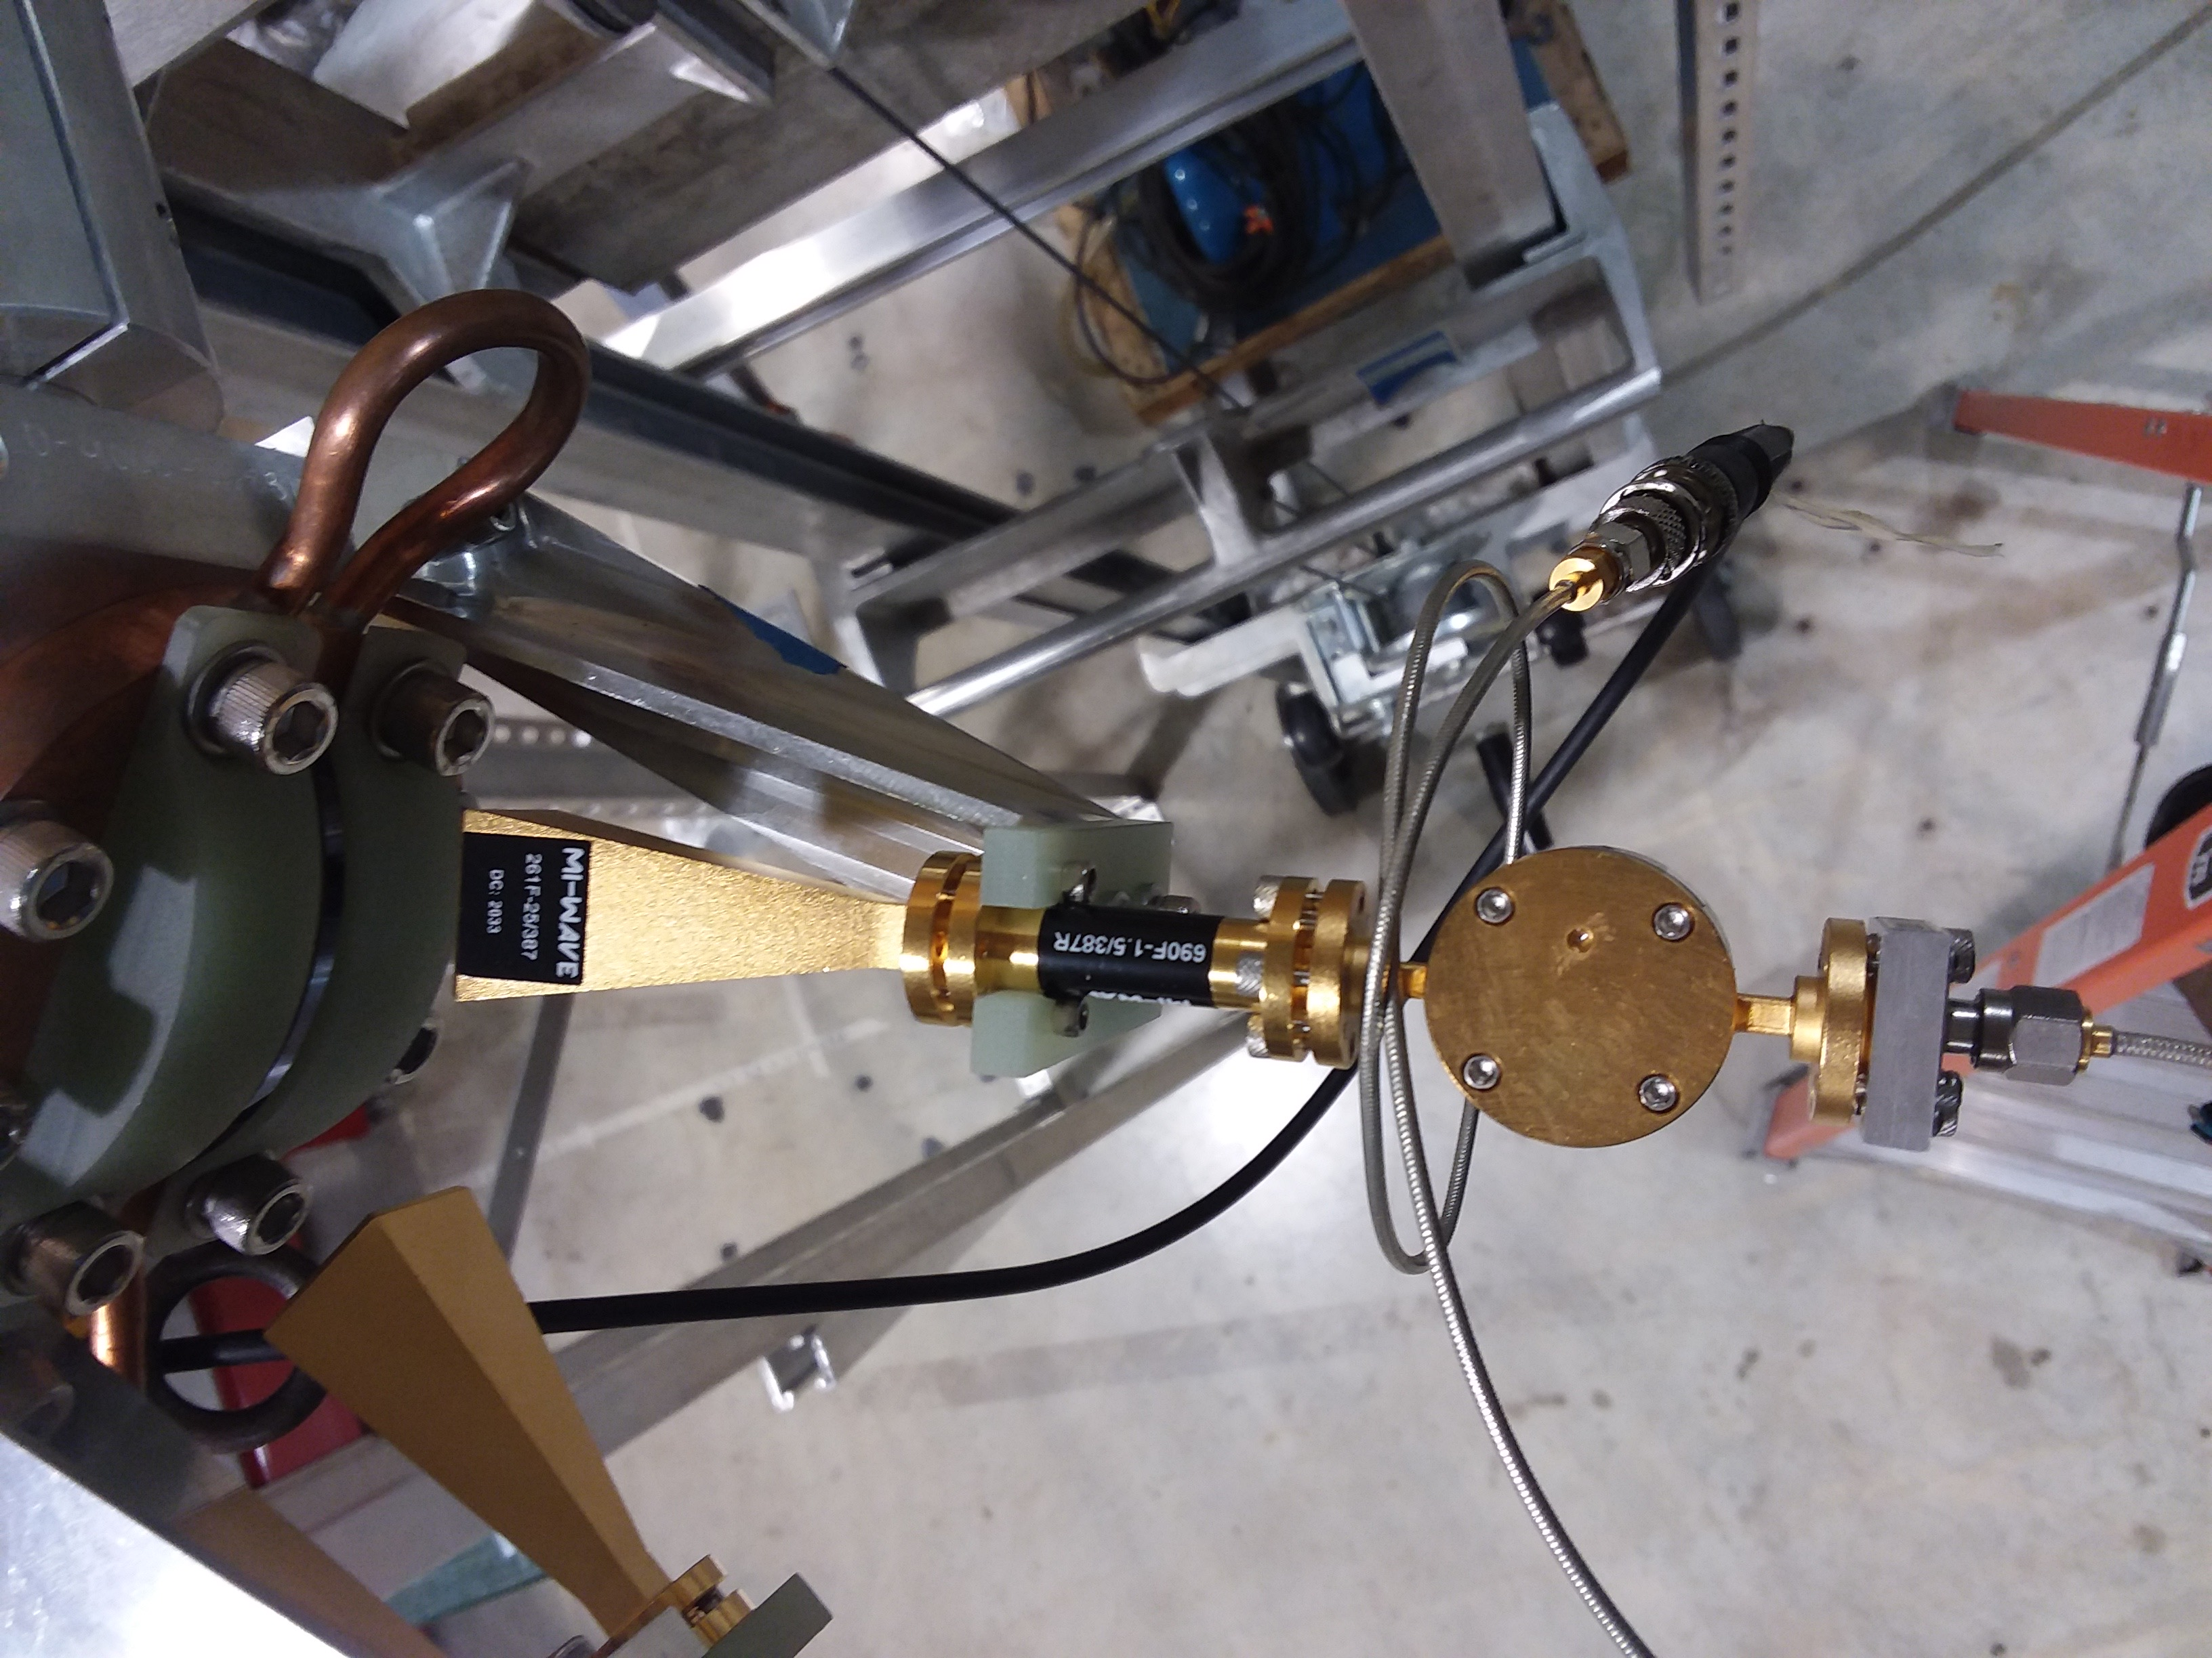
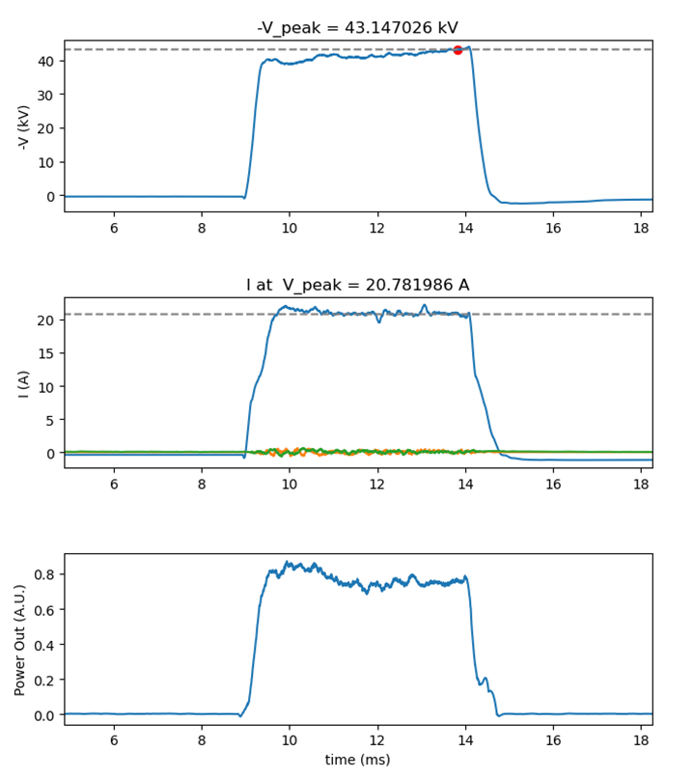
ECH: gyrotron operational; transition line installed; launcher arriving in Q1 2023; power optimization underway
transmission line
launcher: In fabrication.
Boris testing: power output at 65 kV, 22 A

Slide 7
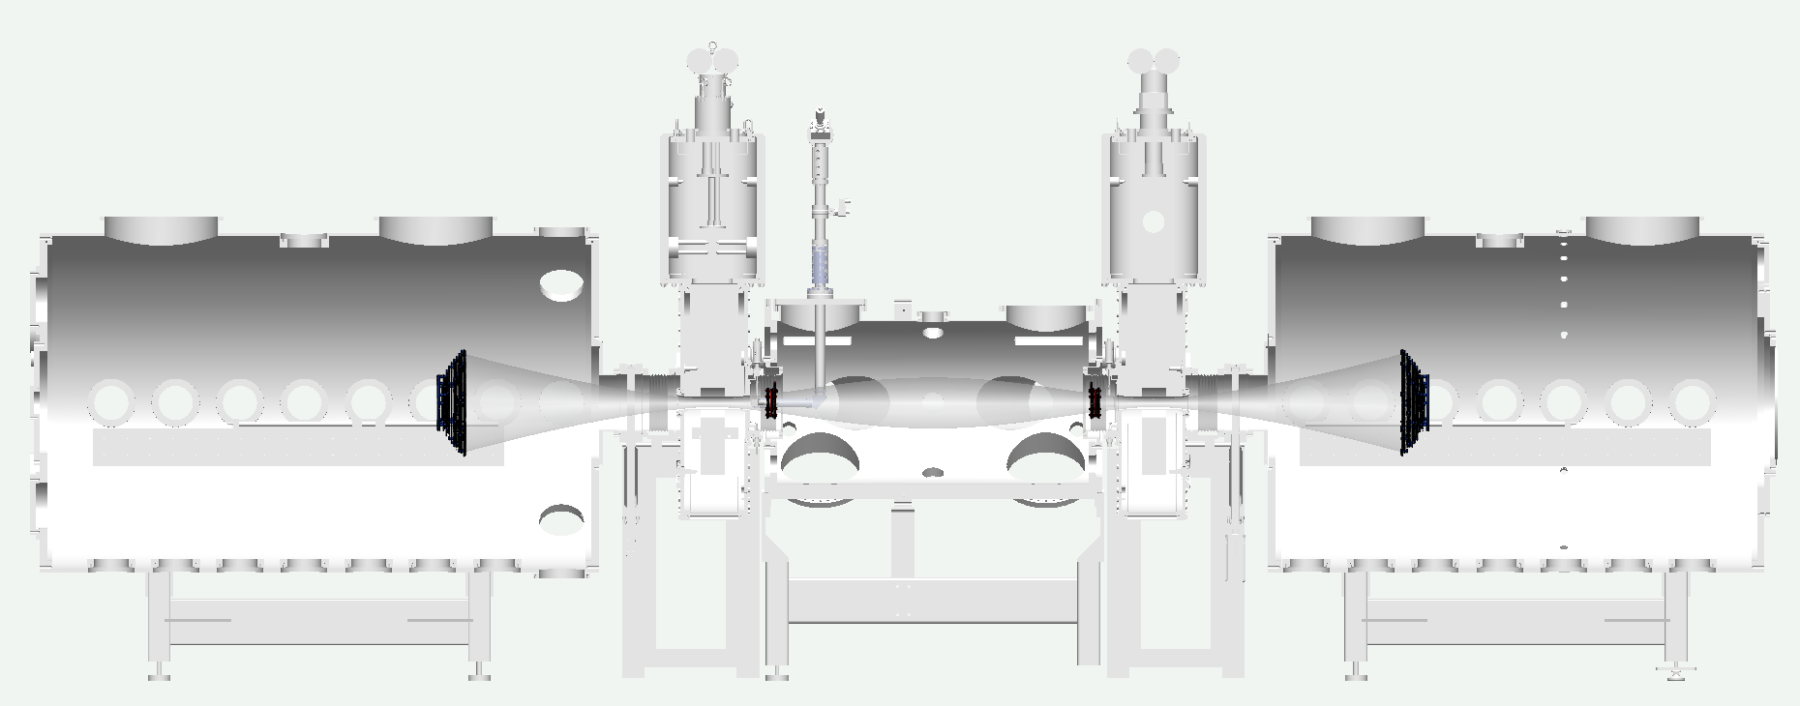
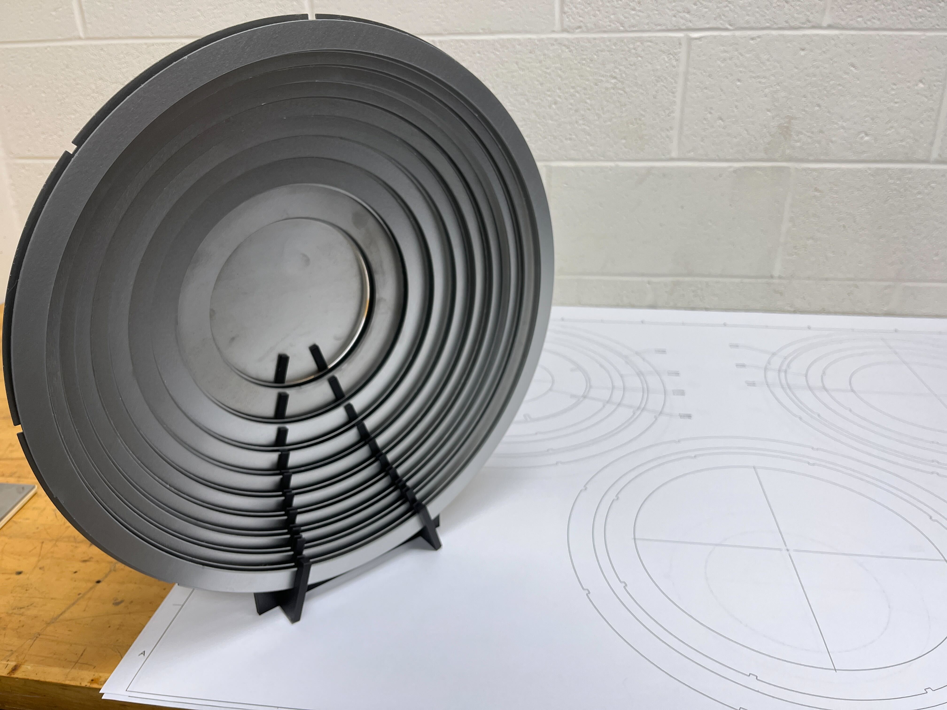
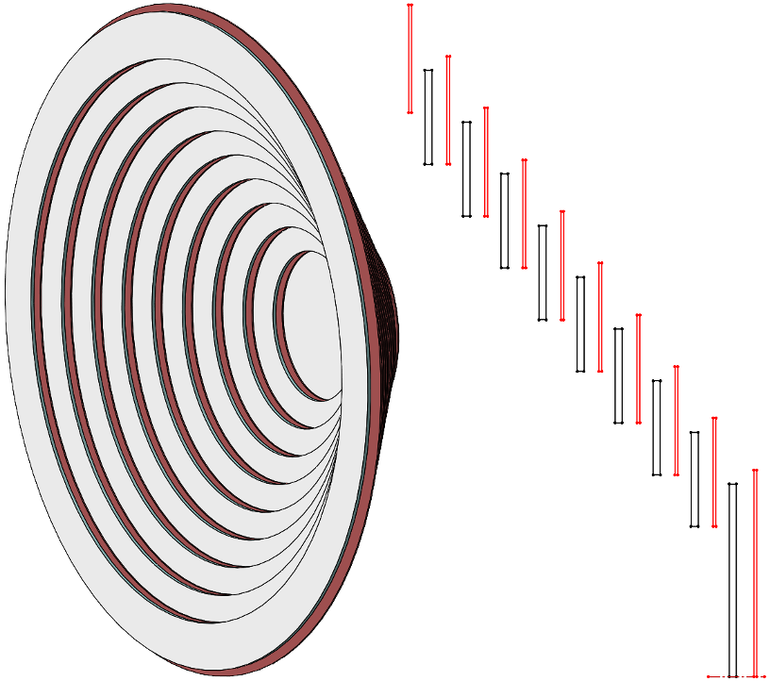
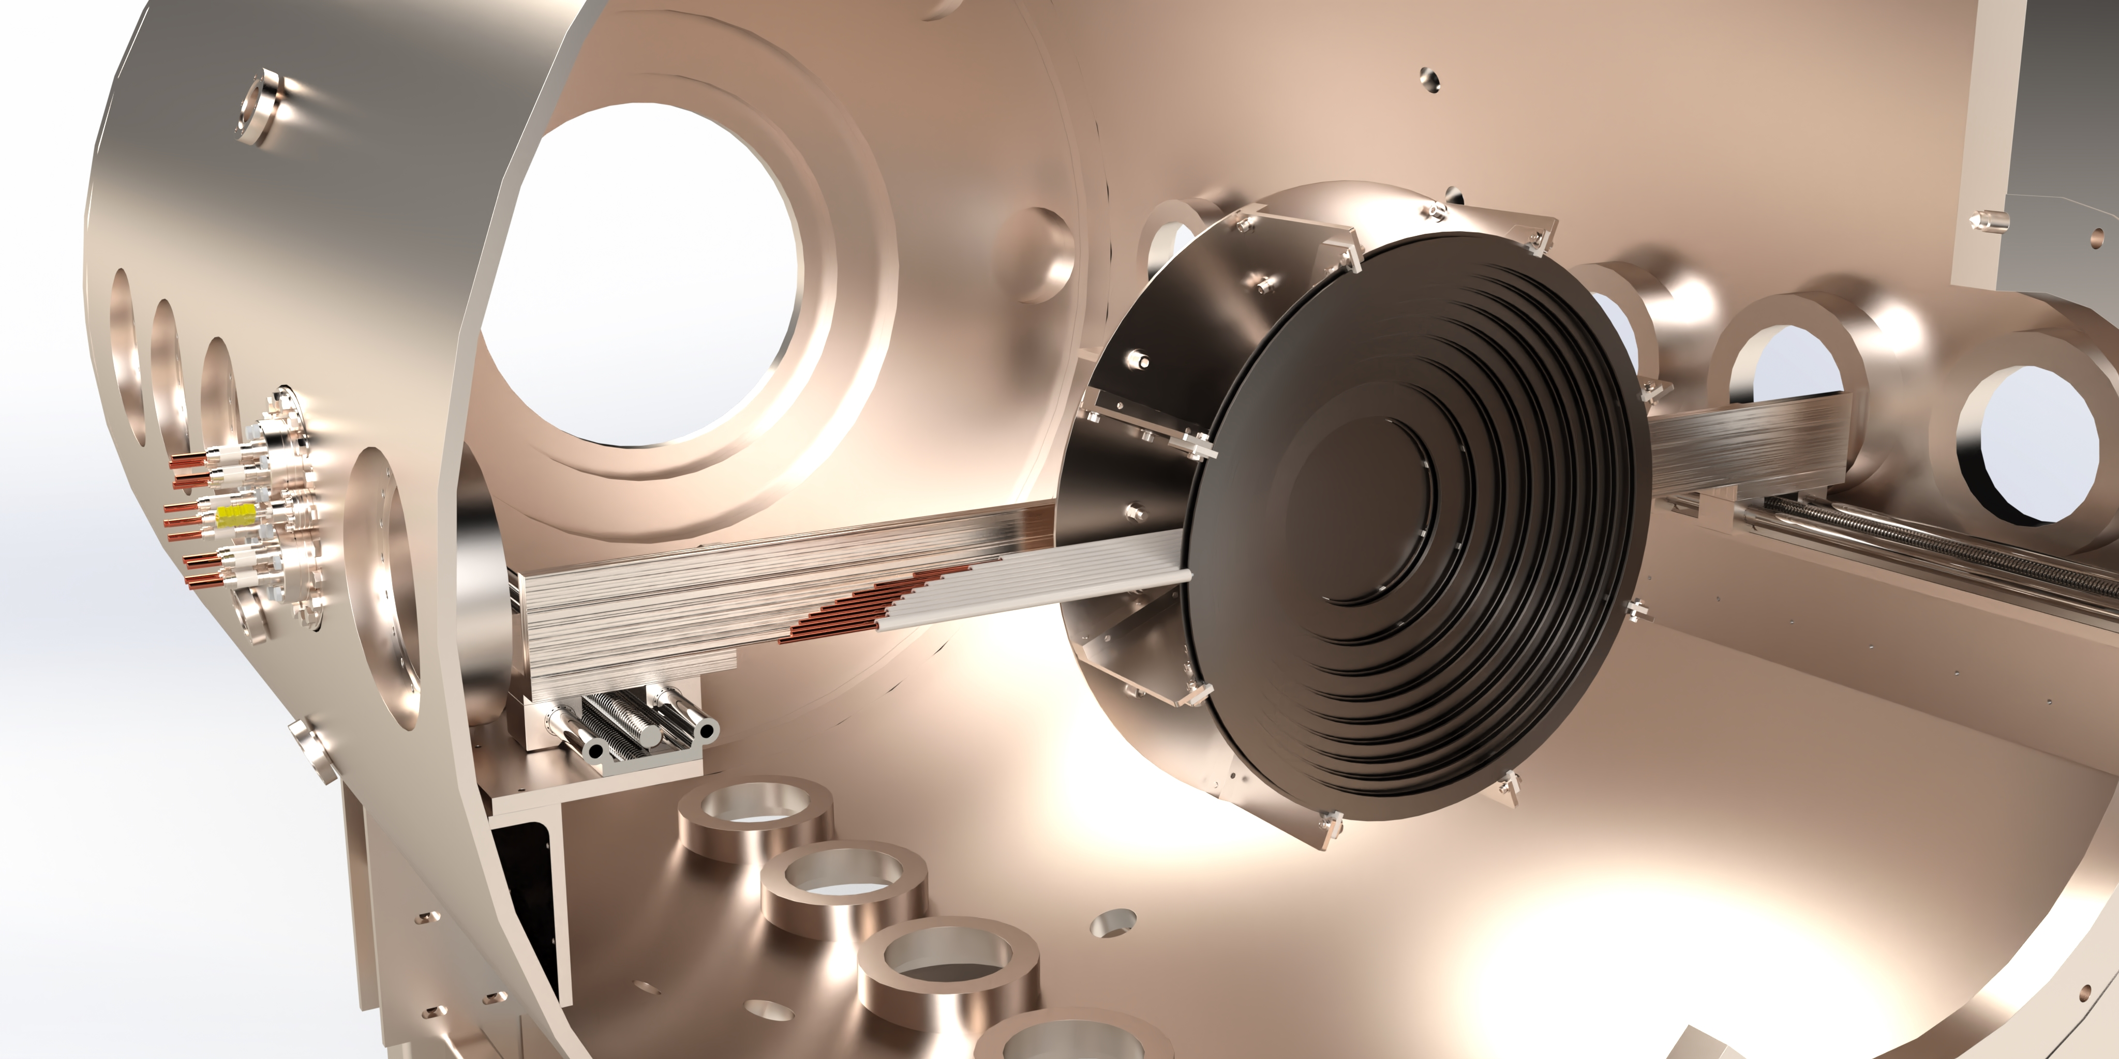
Shear-Flow Stabilized Axisymmetric Mirror uses biased limiters and
ambipolar potential profile control for m=1 stability
Positive bias on ring limiter in confinement zone;
Grounded outer rings, negatively biased central rings in expander
Experience at GDT: biased rings on field lines that intercept vessel must be protected by floating ring.
Open System 2021 meeting: TAE reports biasing adjacent rings without arcing.

Slide 8
simpler, cheaper, faster
Realta Fusion’s compact high-field magnetic mirror technology is the lowest capital, least complex path to commercially competitive fusion energy.
We are focused on Plant #1 for industrial process heat.

Slide 9
Founding Team
Kieran Furlong, MBA
Experienced start-up operator and venture capital investor. Chemical engineer with background in high temperature process catalysis (ICI, Johnson Matthey) and climate-tech. Stanford MBA.
Cary Forest, PhD
Leading plasma physics and fusion innovator with industry (general atomics) and academic background. Heads Wisconsin plasma physics lab. U.Wisconsin Professor, Princeton PhD, Fellow of American Physical Society.
Ben Lindley, PhD
Industry-experienced researcher (Jacobs) and now a faculty member at U.Wisconsin, Ben played a key role in the development of software and calculation methodologies for the analysis of boiling water reactors, sodium-cooled fast reactors, and molten salt reactors.
Jay Anderson, PhD
a highly accomplished and world-recognized researcher in fusion plasma physics. Specialties include auxiliary plasma heating and stability, Jay addresses the critical scientific issues facing the magnetic mirror fusion reactor.
Oliver Schmitz, PhD
Expert on high temperature fusion plasma & wall material interactions. U.Wisconsin Professor & Dean of Research, ITER Science Fellow.

Slide 10
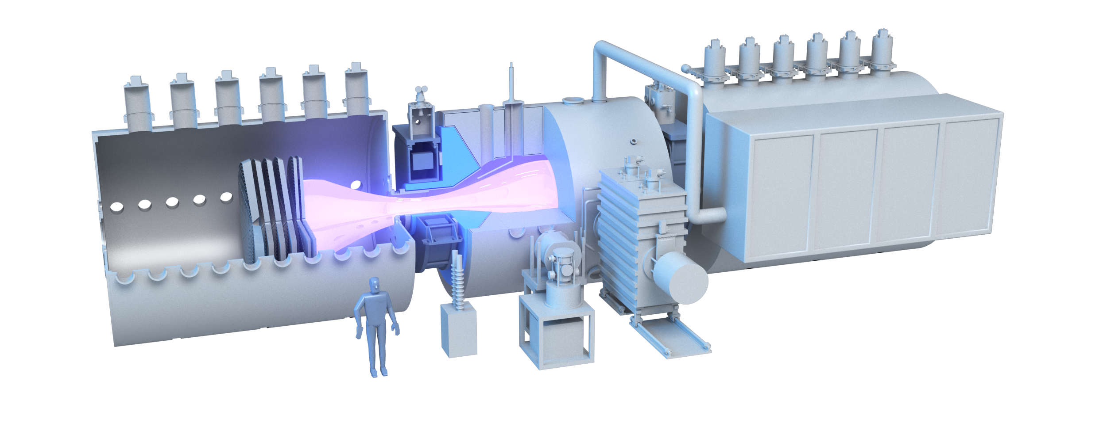
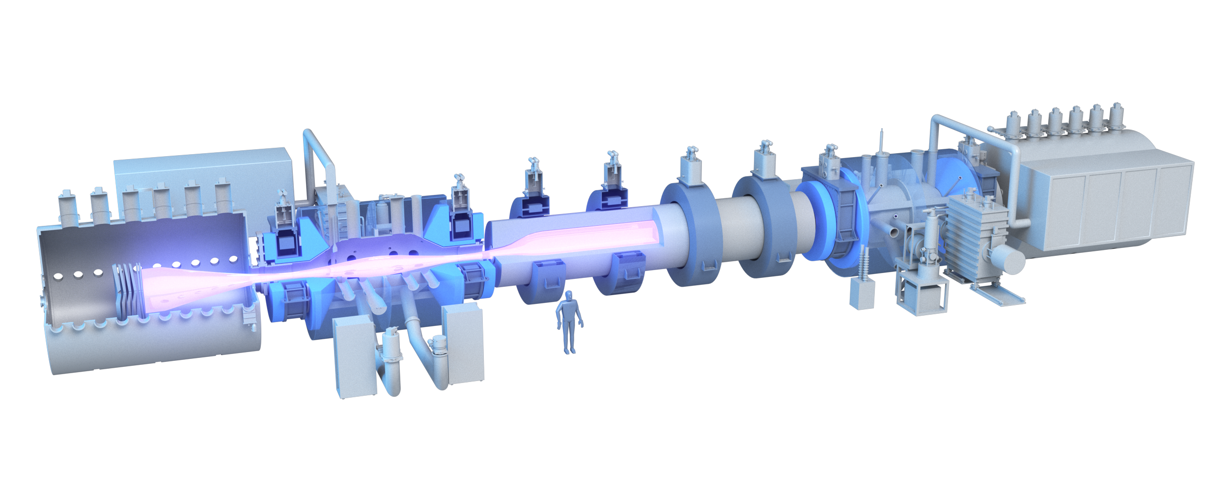
2020 2024 2028 2032 2036
WHAM 1.0
WHAM++ Qequiv~1 (dd) short pulse
WHAM++ Q~1 (dt) steady-state
WHAM++ high Bp (go/no go)
Industrial Heat & Power
HAMMir (2 x WHAM++, central cell)
HTS
MHD stable, Confinement
rf ion acceleration
direct conversion
Initial independent estimated cost of thermal energy <$7/mmBtu
steady-state
blanket testing
dt fuel cycle demonstration
CoP>1 in steady-state
Large size (with core and edge)
component and materials testing
Qsci,equiv~1
rf spinup to MeV ions for tandem endplugs
Path to
Commercial Scale
First-of-Kind plant
process heat with industrial partner
Q>10 ca. 300 MWt

Slide 11
Aspirational WHAM++
large expansion for stability and electron confinement
High Temperature blanket (PbLi, or He cooled ceramics)
WHAM ++
BM=25 T, B0=2.5 (5) T, a = 0.5 m
P=2-5 MW (>120 keV NBI) CW and DT
Q ~ 1 (2-5 MW of fusion power)
RM=15 at $β$=0.5
WHAM+
-full power, short pulse performance verification of end plug in deuterium
-test direct energy conversion boost to Q~2-3
-cost driven by ca. $50M of Rebco tape
WHAM++
steady-state operation with dt
VNS for high temperature blanket testing
direct energy conversion
with axisymmetric ferromagnetic venetian blind
High Field (25 T) REBCO
magnets for end plugs
100 keV neutral beam
injection into end plugs for fueling
tungsten carbide magnet shielding
large diameter, beta stabilized (min B) with conducting walls and neutrally opaque plasma

Slide 12
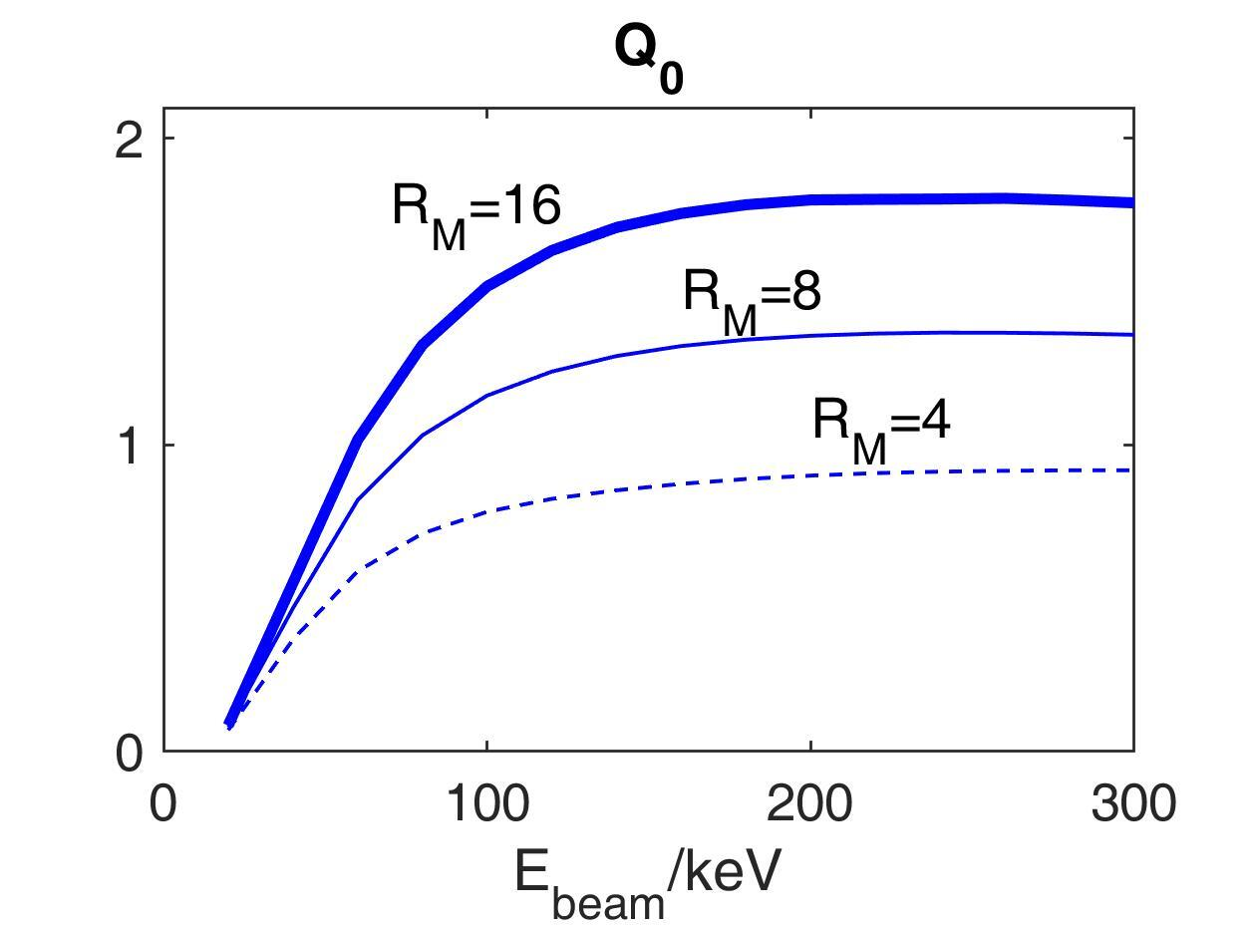
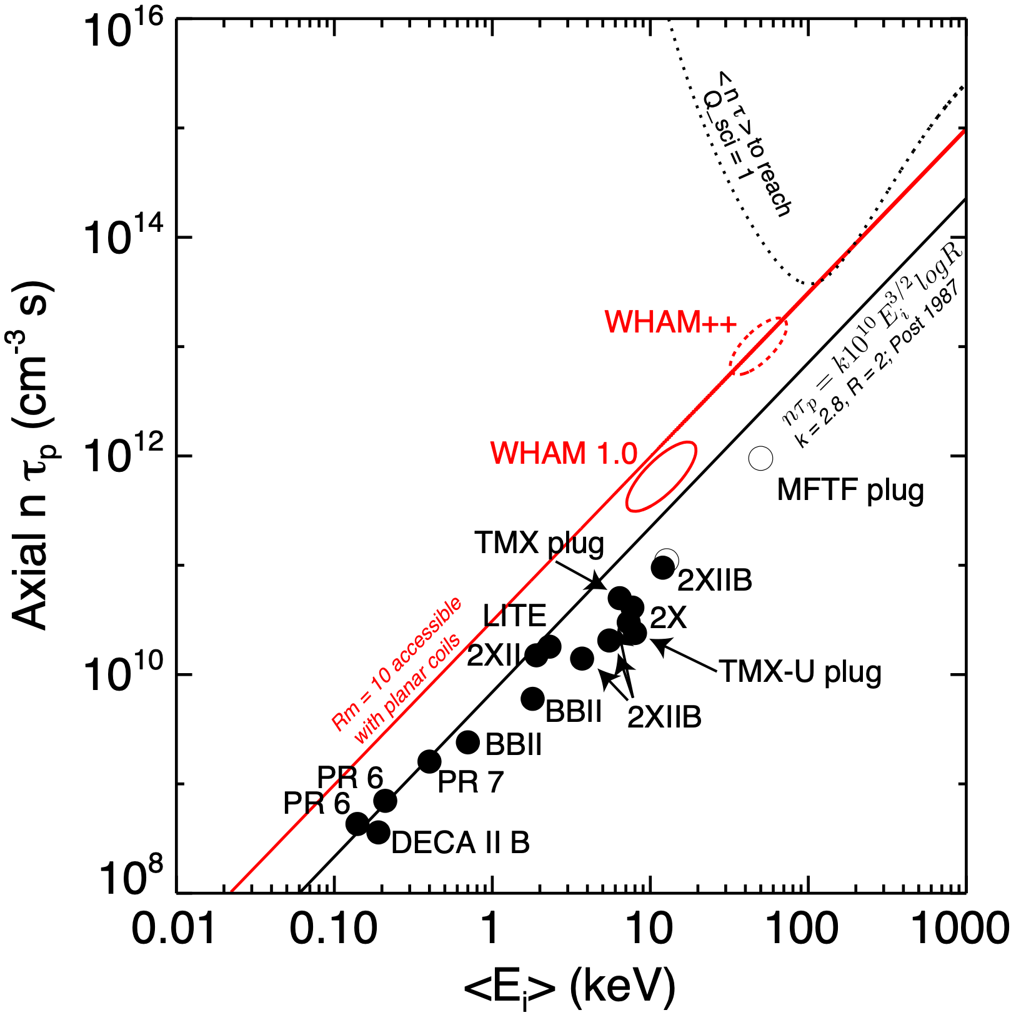
Increasing mirror ratio ($2→10$), increasing beam energy (25 keV $→$120 keV), puts mirror in $Q∼1$ territory for classical confinement
Fokker Planck calculations
Optimizes around $E_{b}∼\text{100 keV}$
Independent of plasma parameters, size or B
actual scale set by combination of minimum density for beam ionization, length for FLR stabilization, min a/rho; B set by beta
$$τ_{p}=0.00028\frac{E_{b,keV}^{3/2}}{n_{20}}\log_{10}R_{M}\text{sec}$$
Tandem
Endplug
Rm = 10
WHAM++
$$P_{nbi}=I_{b}E_{b}=\frac{enV}{τ_{P}}E_{b}∼\frac{{10}^{20}}{3}\frac{n_{20}^{2}}{E_{b,100keV}^{1/2}\log_{10}R_{M}}V\frac{MeV}{sec}$$
$$P_{fus}=\frac{1}{4}⟨σv⟩n^{2}E_{fusion}V∼5×{10}^{19}n_{20}^{2}V\frac{MeV}{sec}\text{for}T_{i}∼\text{100 keV}$$
Rm = 2
$$Q≡\frac{P_{fusion}}{P_{nbi}}∝⟨σv⟩E_{b}^{1/2}\log_{10}R_{M}∼1.3E_{b,100keV}^{1/2}\log_{10}R_{M}$$
Egedal, J., Endrizzi, D., Forest, C. B. & Fowler, T. K. Fusion by beam ions in a low collisionality, high mirror ratio magnetic mirror. Nucl Fusion 62, 126053 (2022).

Slide 13
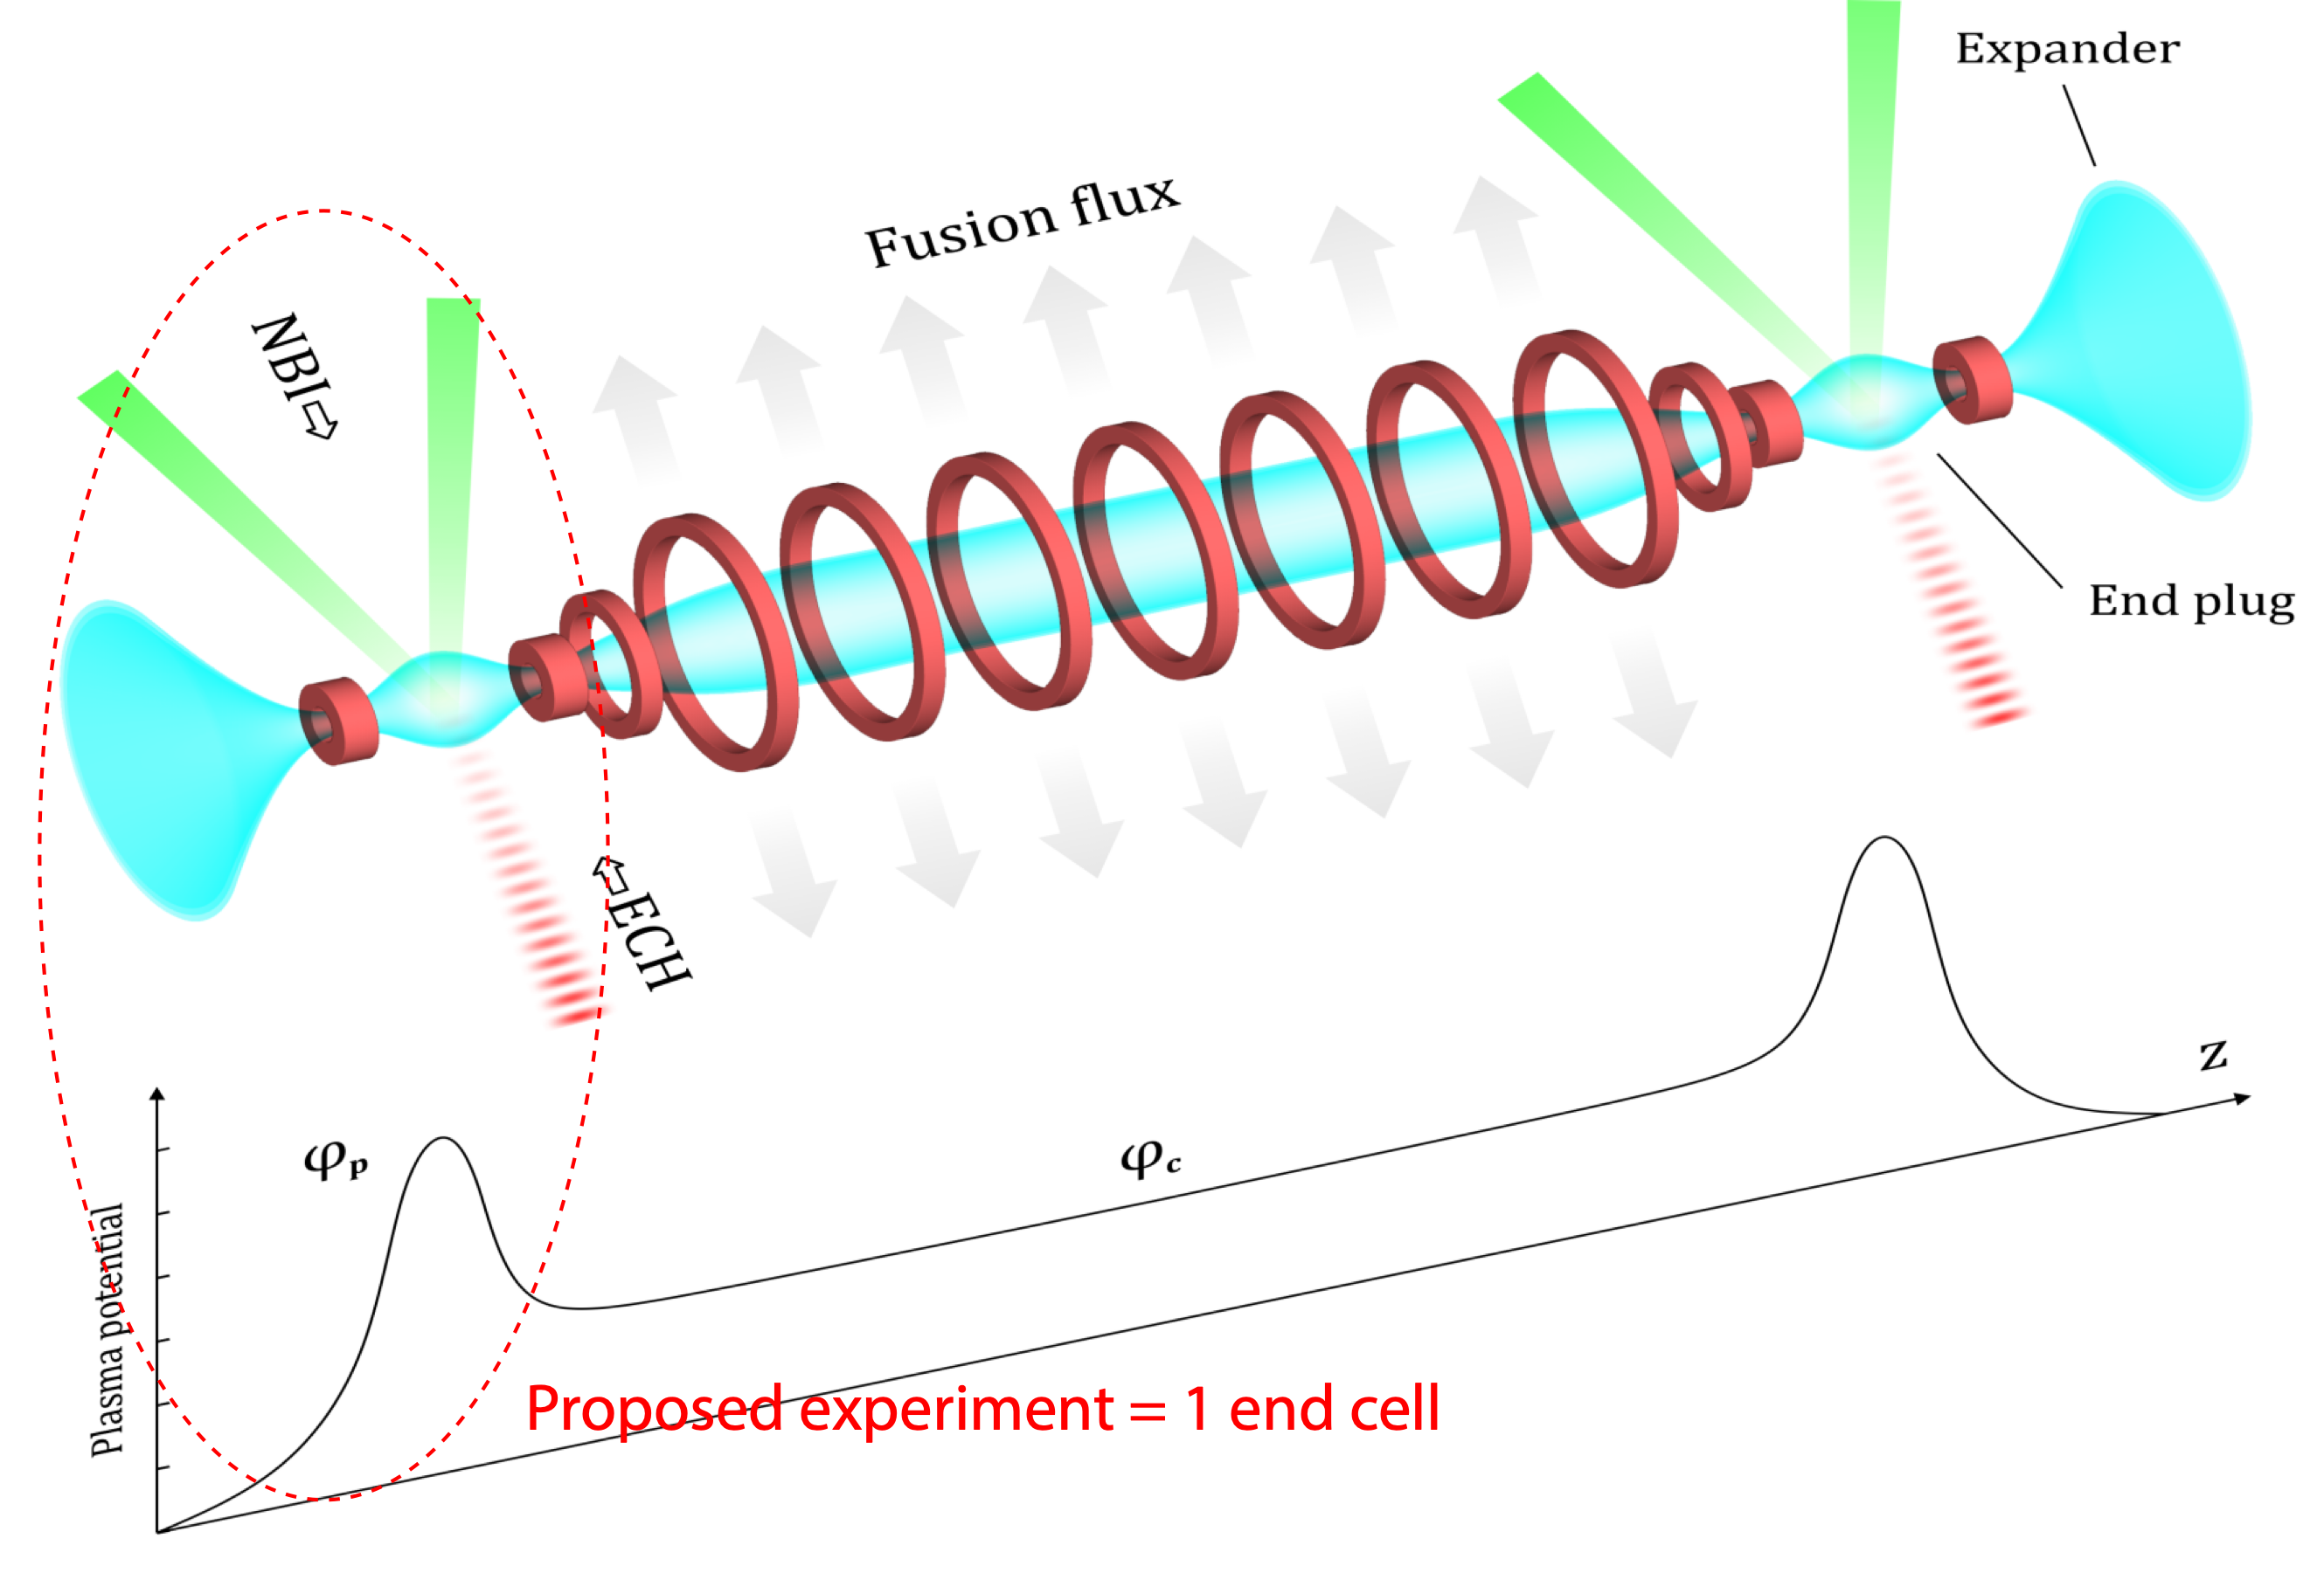
axisymmetric tandem uses very high energy hydrogen ions (800 keV) in end plugs to confine thermal central cell plasma
Four species to consider:
High density plug
High Te plug electrons
Central cell electrons
Central cell thermal ions
Confined by:
high energy ions
ambipolar potential associated with fast plug ions
Pastukhov factor
Confined by potential of expander
Electrostatically confined by end plug potential $τ_{i}∼τ_{ii}lnR_{M}Φ_{i}/T_{ic}e^{{Φ_{i}}/{T_{ic}}}$
$Φ_{i}=Φ_{p}-Φ_{c}=T_{ep}ln(n_{p}/n_{c})$
T. K. Fowler, R. W. Moir, and T. C. Simonen, A New Simpler Way to Obtain High Fusion Power Gain in Tandem Mirrors, Nucl Fusion 57, 056014 (2017).

Slide 14
High-Field Axisymmetric Magnetic Mirror Reactor (HAMMiR)
The lowest capital and least complex fusion reactor suitably scaled for industrial use
Simpler, cheaper, faster - provides advantages both in development/scale-up and commercial deployment
High pressure non-thermal end plug plasma w/ feedback
Lower pressure thermonuclear
Central Cell Plasma
Simple, efficient PbLi to harness
energy and breed tritium
Radio frequency (120Mhz) acceleration of end plug ions to ~800keV
Expanding exhaust plasma for stability, electron thermal confinement, power handling & direct energy conversion
High field (~20T) REBCO magnets
for end plugs
Low field (<2T) MRI-class magnets for central cell
Microwave heating (170GHz) of electrons to control radial transport
100keV neutral beam injection into end plugs
for fueling.

