Slide 1
SRNL Support for Current and Future Fusion Pilot Plants
Fusion Power Associates 44th Annual Meeting - December 2023
Dave Babineau and Brenda L. Garcia-Diaz
SRNL-RP-2023-01474
FPA Meeting, Dec 20, 2023, Washington, DC

Slide 2
Fuel Cycle Support and Timelines to Fusion Plants
NASEM
Define Fuel Cycle Reqs. & Demo.
Fuel Cycle TRL 5-6
Fuel Cycle TRL 7
Fuel Cycle TRL 9
Q_{e}>1
50 MW & >3hr
TBR > 1
50 MW & Env. Cycle
Materials Durability Testing
ITER
First Plasma
TEP Delivery
D-T Ops Start
Long Burn
Q=10
Milestone Program
Conceptual Design Completion
Fuel Cycle Design Lock-in
FPP Tech Maturation
FPP Operation
Fuel Cycle R&D
FPP Tech Development
FOAK & Next Gen Tech Development
FOAK Tech Maturation
Next Gen Tech Development
SRNL is focusing in the short term on FPP design activities because of the decadal vision
Working with DOE and companies through PPP programs to help advance technologies
After lock-in of FPP fuel cycle designs, will shift to technology maturation and research for future fuel cycles
SRNL is also looking ahead to the long term to understand the needs to get to FOAK and Next Gen devices
SRNL is collaborating on community planning through the Fuel Cycle & Blanket workshop and other workshops (Fusion Materials, IFE BRN)
SRNL is researching advanced fuel cycle technologies through multiple programs with FES, ARPA-E, and leveraging NNSA programs
SRNL is planning research facilities that can support fuel cycle research for the next 30 years or more

Slide 3
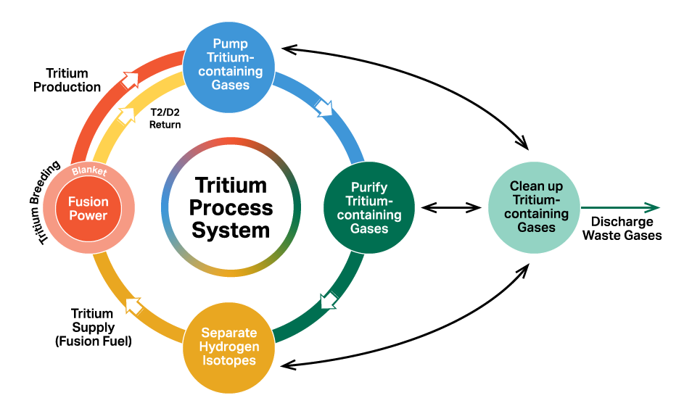
Six Fuel Cycle Research Topics (Based on FESAC, NASEM, Decadal Vision, FC/B Workshops)
Process Modeling, Process Control, & Simulation – Define models to advance & optimize system design, monitor operation, control the process and simulate performance during normal and off-normal operation
Tritium Inventory Reduction & Improved Process Technologies – Improve tritium processing (including development methods of internal recycling) to reduce the inventory needed and lower the radioactive source term.
Isotope Supply, Tritium Breeding, and Tritium Extraction – Define tritium/isotope supply source and processing, ensure tritium breeding ratio can be achieved, and minimize captive inventory
Tritium Confinement to Reduce Emissions and Tritium Effects on Materials – Develop advanced tritium wetted materials and confinement barriers; understand and mitigate tritium retention and permeation; and improve tritium removal and recovery from secondary/tertiary confinements and effluent streams
Tritium Accountability and Tritium Analytical/Diagnostic Capabilities – Develop rapid, high-accuracy/precise accountability measurement instruments and techniques to measure tritium and account for it in different parts of the system
Fusion Waste, Regulation, Non-Proliferation, Community Engagement – Support the development of regulations for fusion related to tritium, non-proliferation, and waste. Improve material selection and tritium decontamination to support waste disposal and the safety basis.

Slide 4
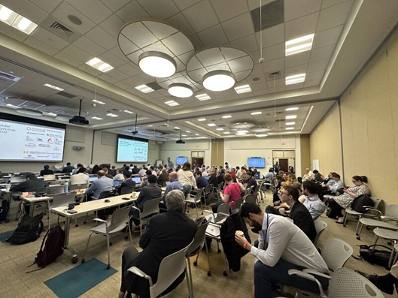
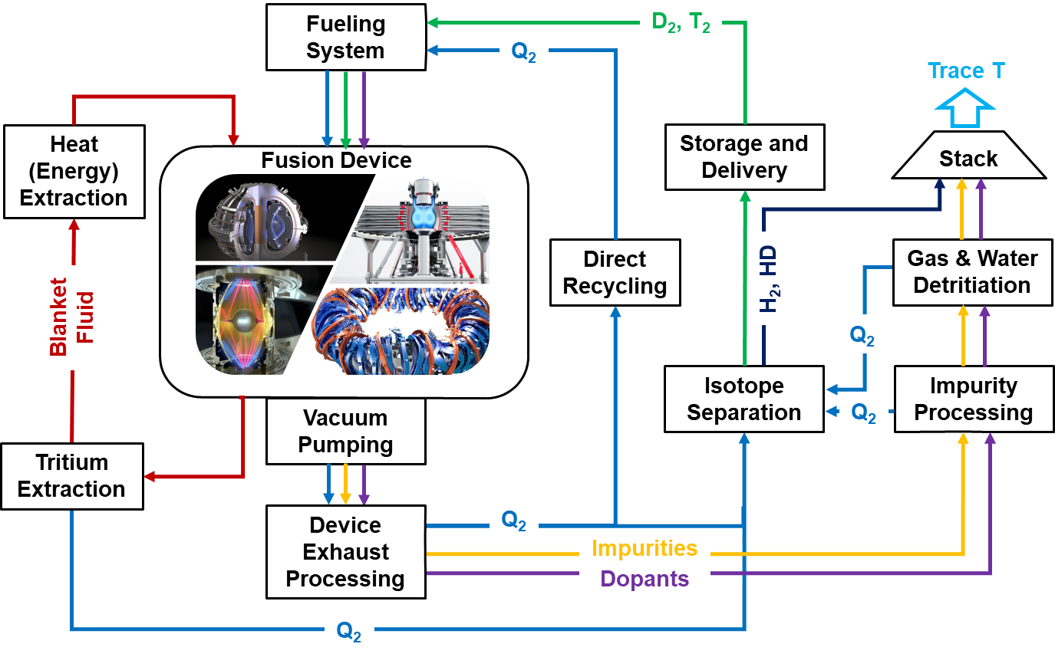
2023 Fuel Cycle & Blanket Workshops
Conducted workshops with community on fuel cycle and blanket needs
Virtual Workshops – May 2 and 4, 2023
In-person Workshops @ EPRI – May 22-25, 2023
SRNL co-hosted workshop with community members
Industry: Commonwealth Fusion Systems, Realta Fusion, Type One Energy
Education: MIT
Workshops were similar to FPNS, IFE, and Materials workshops
Defined infrastructure needs for the fuel cycle
Defined critical technology needs to be addressed
Identified enduring scientific missions for facilities after fusion pilot plant operation
Creating research objectives to guide technology development
Drafting a roadmap for fuel cycle and blanket technology development
In-person Fuel Cycle and Blanket Workshops held at EPRI in Charlotte.
Preliminary block diagram of an FPP-class tritium handling system (utilizing the ARC power plant being developed by CFS as an example to start discussion).

Slide 5
Summary of Tritium R&D Facility and Technology Needs for Fusion (work in progress)
Initial Estimated Size and Tritium Testing Capacity of a Tritium R&D Facility Needed for Fusion (still in discussion among workshop team members)
Tritium Inventory & Space Needs: Sufficient tritium and space needed to work on multiple components and systems simultaneously
Timeframe: Likely needed by 2028 or 2029 to support the “Bold Decadal Vision for Fusion Commercialization”, but can assist past that time as well
Testing Scale: Allow for Full Scale (up to 10 - 100 SLPM) that would be typical for fusion pilot plant facilities
Key Space Features:
Flexibility to allow testing of multiple technologies or subsystems that can be moved in and out.
Ability to divide and partition tritium inventory between tests on different components or subsystems.
Access for companies and researchers that are participating in the Milestone Program or other DOE programs
Inventory, facility size and scale of testing could be limited if budget or delivery time dictates
May limit effectiveness or scope of testing
Technologies and Testing Needs Summary
Pellet Fueling (MFE) and Target Fueling (IFE)
Vacuum Pumping Solutions
Direct Internal Recycling Solutions
Isotope Separation Systems
Water Detritiation and Waste Detritiation
Recycling, Regeneration, and Reuse of Tritiated Materials
Tritium Accountancy Systems
Tritium Permeation Barriers
Tritium Extraction from All Blanket Types
Tritium Properties in Blanket and Other Materials

Slide 6
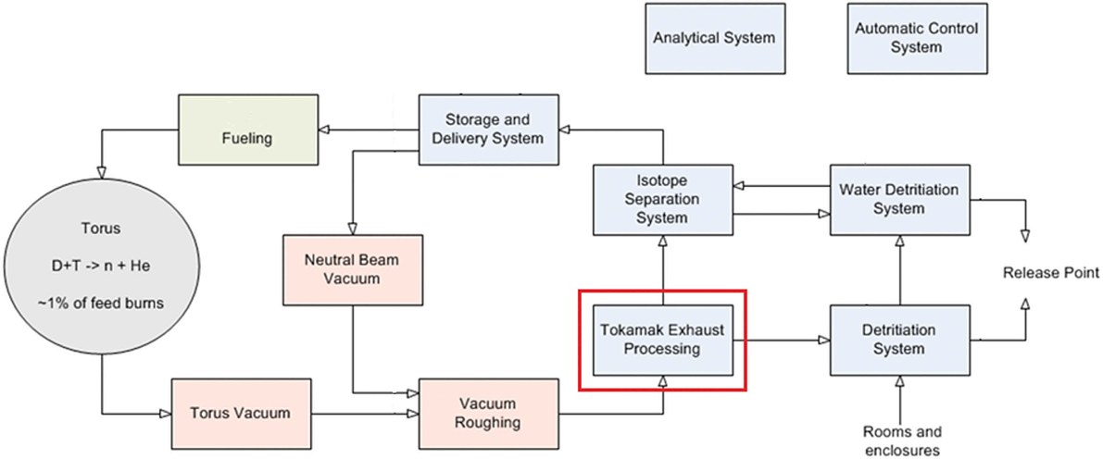
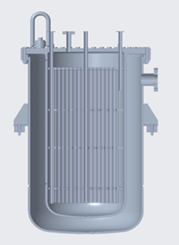
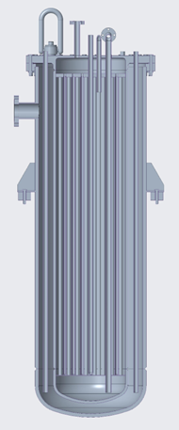
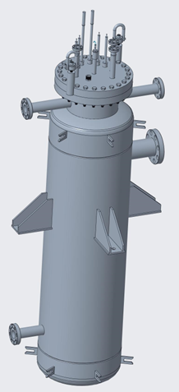
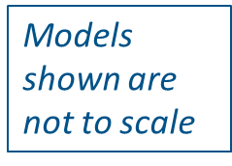
ITER Tokamak Exhaust Processing (TEP) System
SRNL is leading the design, qualification, manufacture, factory acceptance testing and delivery of the TEP System
Status of Design
TEP Final Design is subdivided into 2 parts
Design Phase 1 completed in September 2022
Design Phase 2 scheduled to conclude in FY2025, with Final Design Review closed at the end of FY2025
Prototype procurements for ITER scale chemical process components ongoing
diffuser, palladium membrane reactor, catalyst beds, cryo and ambient sieve beds w/ jacket
Status of Procurement
Procurement baseline estimate is complete

Slide 7
SRNL Support for Milestone Awardees
Modeling/Simulation/Accountancy & Materials
Fusion Pilot Plant Support
Waste Disposal
Regulation
Community Engagement
SRNL is working with commercial companies through Public-Private Partnerships including the Milestone Program to help develop solutions for the fuel cycle, blanket, and materials.
SRNL was part of proposals from 6 of 8 Milestone Awardees and has had discussions on supporting pilot plant efforts from other fusion companies both inside and outside the milestone program
HyPOR Loop
Vacuum/ Cryopumps
Mol. Sieves Beds
Isotope Separation (TCAP, 2D Sieving)
Hydride Beds
Electrochemical Extraction
Redox Control / Tritium Extraction
Permeators
PMRs
Fusion Energy Fuel Cycle

Slide 8
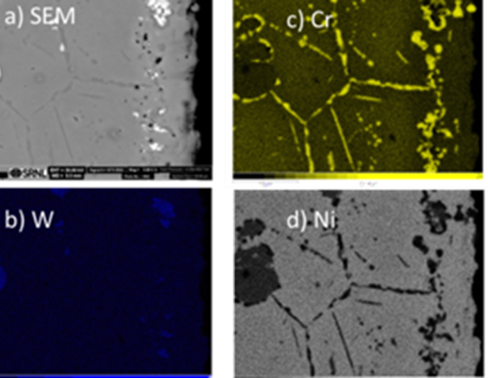
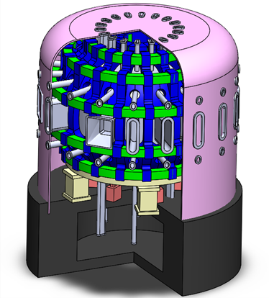
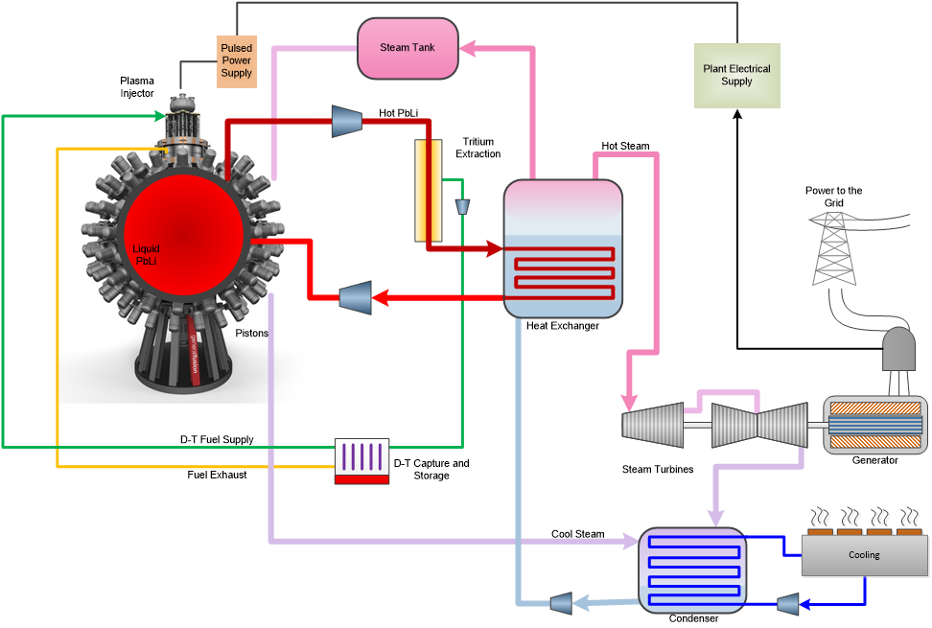
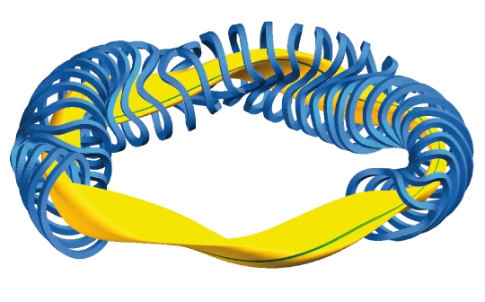
Partnering with Industry through INFUSE CRADA projects
Active Redox Control of Molten Salts For Fusion Blankets
Fuel Cycle and Tritium Plant Model for Fusion Pilot Plant
Demonstrate corrosion mitigation using redox control coupled with electrochemical potential measurements
Develop reduced and detailed models form a fusion pilot plant fuel cycle that can be utilized for integration into overall fusion pilot plant models
Tritium Fuel Cycle Modelling and Optimization to Enable Fusion Pilot Plant Development
Li Compatibility of Electrode Materials for Electrolysis
Efficient Tritium Extraction From Liquid Lithium
Advance the Direct LiT Electrolysis concept by adapting it for use with lithium blanket systems in the Stellarex design and improve methods
Quantify and streamline tritium processing in a commercial pilot plant to enable fusion pilot plant development to deliver clean, safe, and on-demand fusion power at industrial scale
Quantify and improve mechanical durability of electrodes for Direct LiT Electrolysis and adapt technology to UNITY Loop

Slide 9
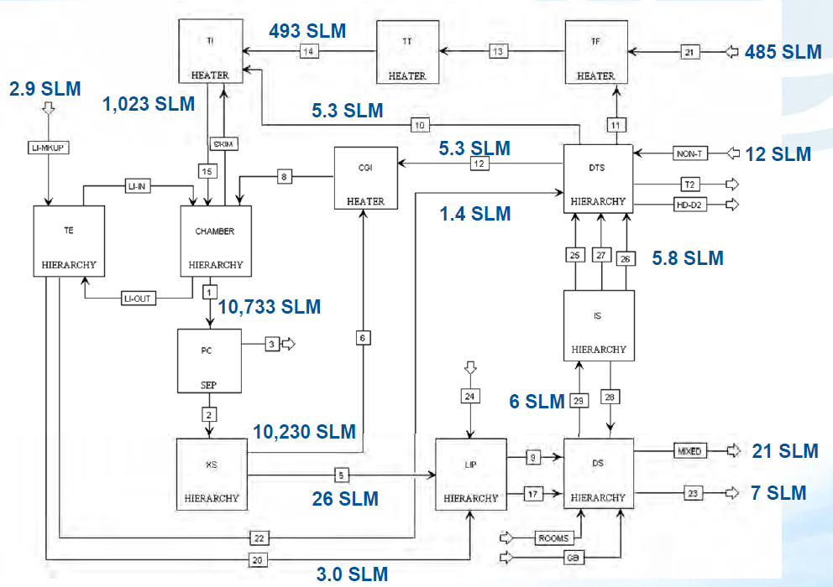
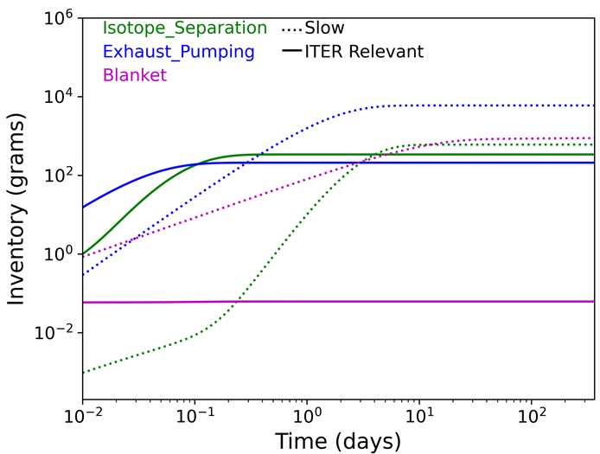
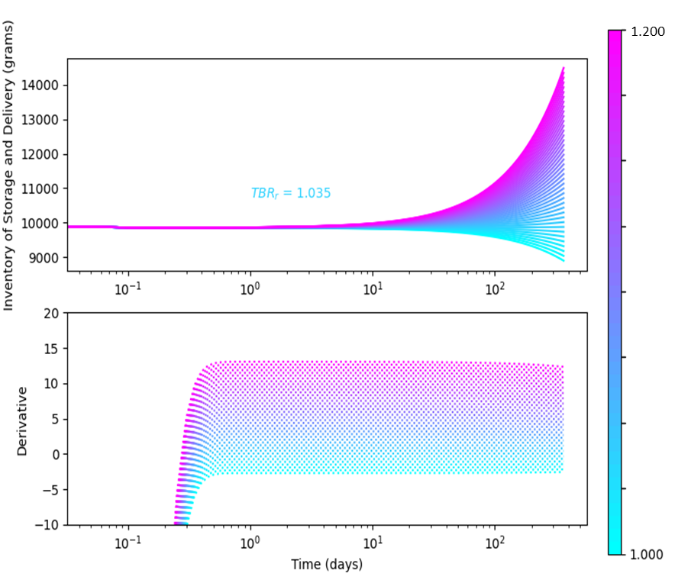
System Modeling, Process Control, & Simulation
The Fuel Cycle Discrete-Time Model RHINO
Fuel Cycle Simulations using ASPEN
Inertial Fusion Engine Aspen Plus® fuel cycle simulation
Inventory per Subsystem
Required TBR
Reduced Hydrogen INventory & Optimization (RHINO) Model is a discrete-time model based on processing times to calculate inventory
RHINO has been shown to support inventory reduction studies and real-time accountancy
Fuel Cycle throughputs and compositions determine system requirements
System design uses engineering models requiring bulk material properties like viscosity, heats of adsorption/vaporization, interaction parameters, etc
Start-Up-Inventory = Required-For-Fueling + Process-losses + In-Process-Active-Inventory + Operation-Inefficiencies + Buffer
Start-Up-Inventory is device specific and varies significantly depending on burn, fueling efficiency, and recycling efficiency.
Notes:
-- The efforts for System Modeling, Process Control, & Simulation
-- SRNL actively works in the areas of Automation Modeling, using Machine Learning/Artificial Intelligence to tackle materials, cyber-physical inspection, and material inspection
-- Efforts in automation also include supply chain optimization for the movement of tritium through our facilit

Slide 10
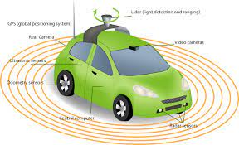
The Development of a Real-Time Accountancy Open Framework for Fusion Energy*
Sensor Measurements
AI/ML Advanced Algorithms
Research Impact
The successful completion of this project would support the development of and provide an implementation example of real-time tritium accountancy for a continuously operating Commercial Fusion Devices and similar plants.
System Model
Demonstrated Proof-of-Concept capability of the Kalman Filter (KF) for real-time accountancy *
Simulated sensor error was reduced from 60% to near 0.001%
Couple sensor measurements and computational modeling with advanced AI/ML algorithms to develop a real-time tritium accountancy framework
*Research to be performed as part of an SC Early Career Award from Dr. Holly Flynn
1.) Flynn, H. B., and George Larsen. "Investigating the application of Kalman Filters for real-time accountancy in fusion fuel cycles." Fusion Engineering and Design 176 (2022): 113037.

Slide 11
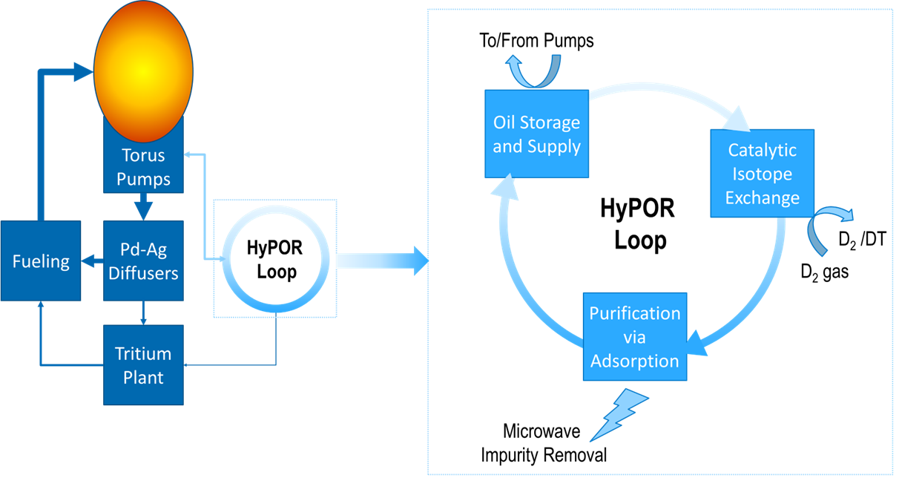
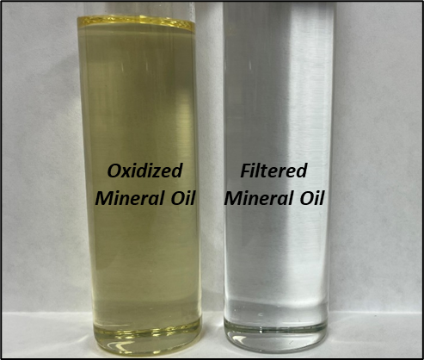
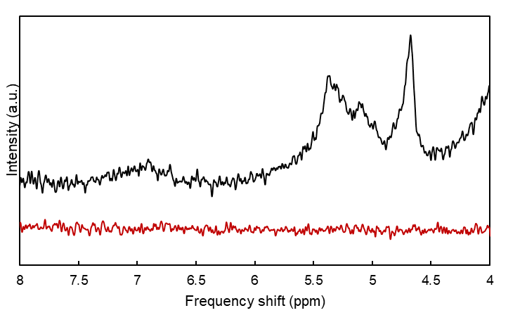
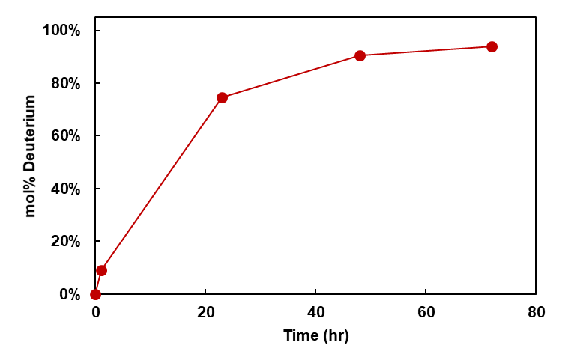
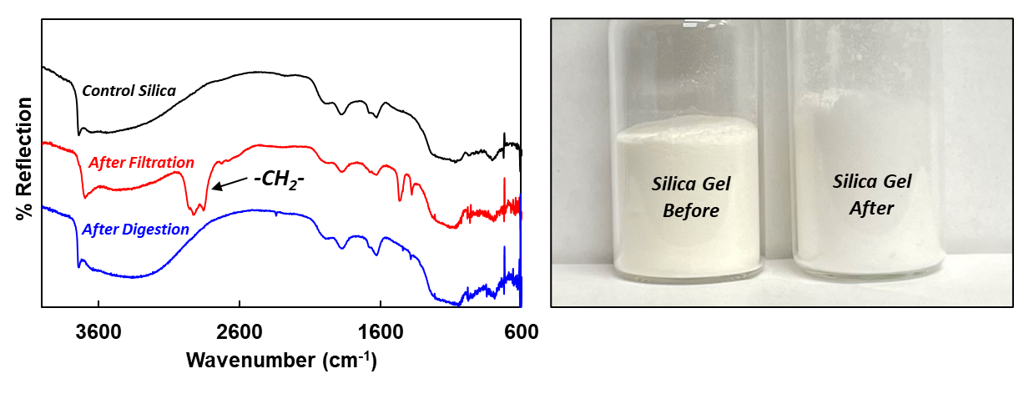
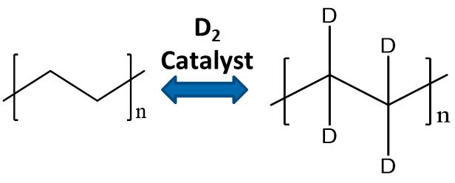
HyPOR Loop Development for Pump Oil Detritiation (ARPA-E/FES GAMOW Project)
HyPOR Loop in a Fusion Fuel Cycle
Oxidized Oil Adsorption by Silica Gel
NMR spectra of mineral oil before and after removal of oxidized species
Isotopic Exchange in Oil
Regeneration of Silica Gel
Diffuse reflectance FTIR spectra of silica gel before and after the removal of oxidized mineral oil species.
Silica gel before and after EM thermocatalytic digestion of oxidized mineral oil species.

Slide 12
Summary
SRNL is working to enable a fusion pilot plant through all of the activities discussed here and many others not discussed in this presentation.

Slide 13
Questions?

