Slide 1
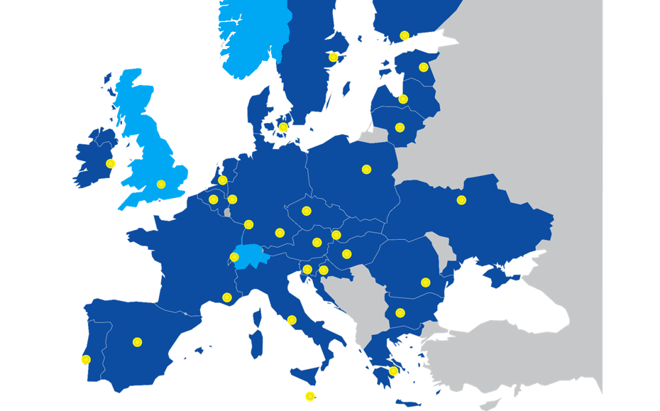
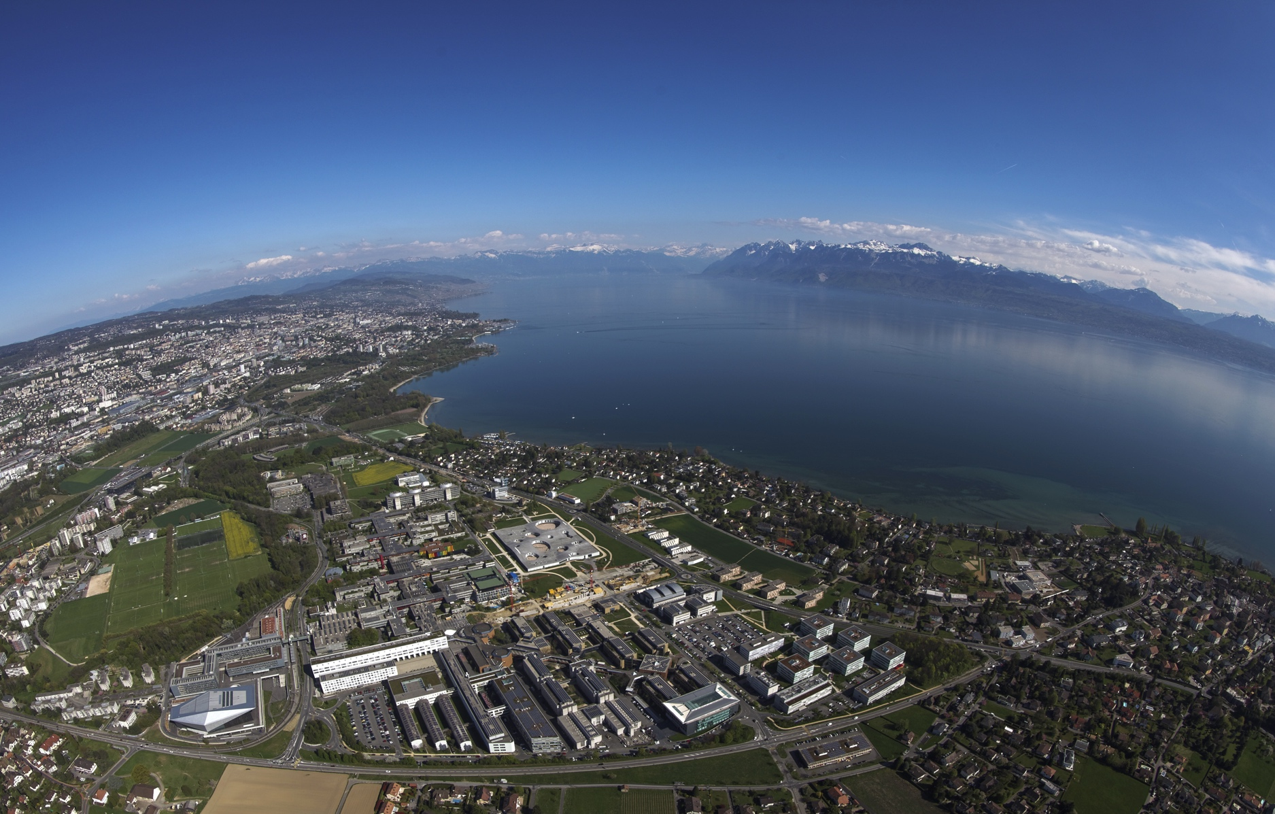

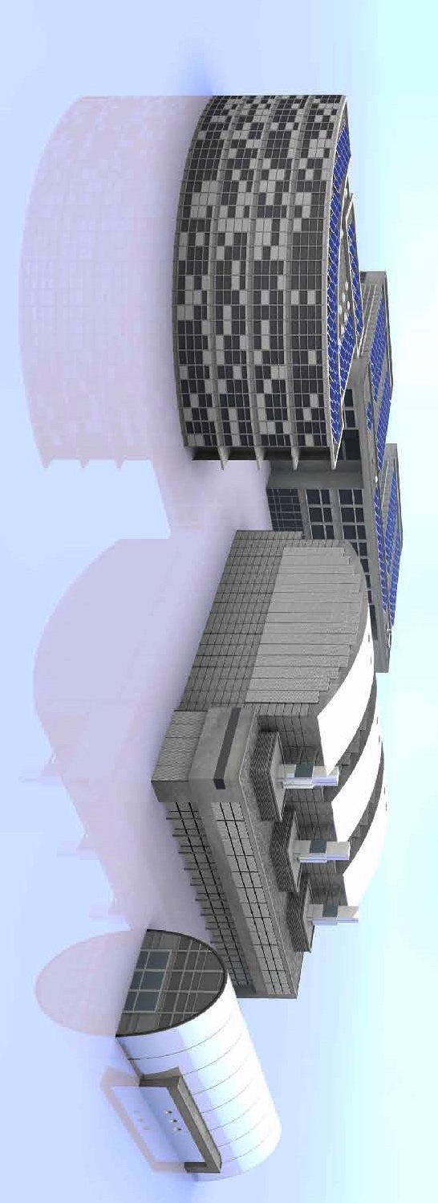
A revised Roadmap towards DEMO and FPP
Ambrogio Fasoli
EPFL - Swiss Plasma Center

Slide 2
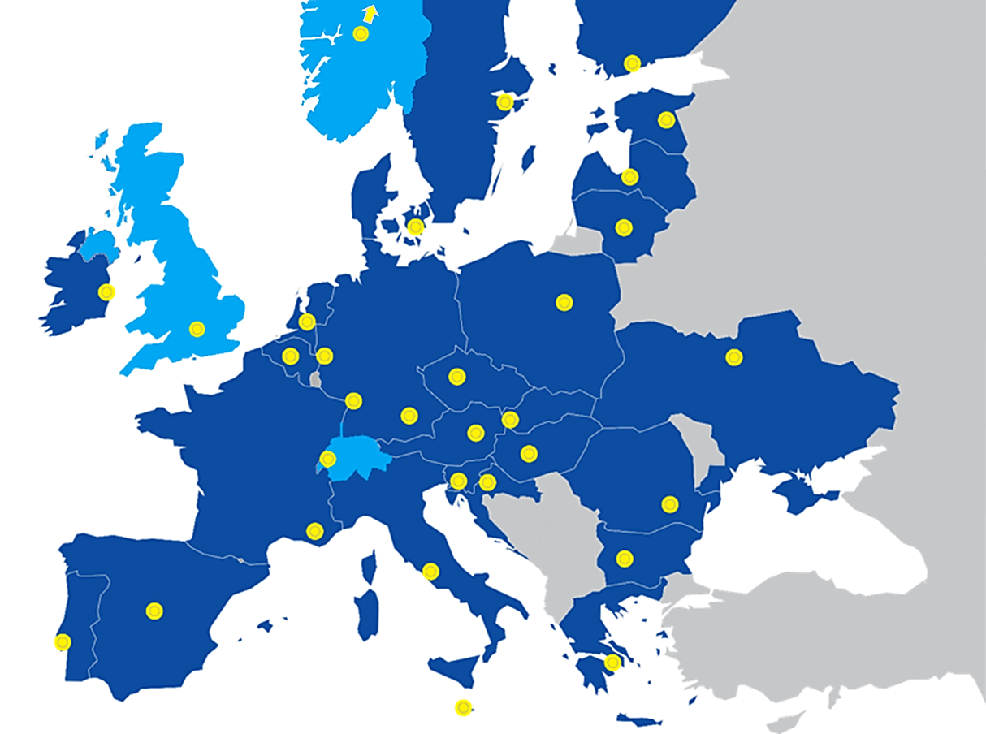
The EUROfusion Consortium
EUROfusion integrates R&D in
fusion science and technology
29
31
164
800
4000
Countries
Research Institutions
Universities
MSc & PhD students
Fusion Researchers & Support Staff

Slide 3


R&D program follows European Fusion Roadmap
Short-term
Medium-term
Long-term
Research on present and planned facilities, analysis and modelling
ITER
First plasma
Full performance
Commence
construction
Fusion Power Plants
Consistent
concept
Electricity
production
DEMO
Material research facilities IFMIF/DONES
Stellarator as fusion plant?
Lower cost through concept improvements and innovations
Milestone
Resource allocation in H2020

Slide 4
R&D program follows European Fusion Roadmap
Short-term
Medium-term
Long-term
Research on present and planned facilities, analysis and modelling
ITER
First plasma
Full performance
Commence
construction
Fusion Power Plants
Consistent
concept
Electricity
production
DEMO
Material research facilities IFMIF/DONES
Stellarator as fusion plant?
Lower cost through concept improvements and innovations
Milestone
Present resource allocation

Slide 5
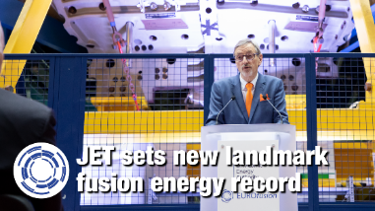
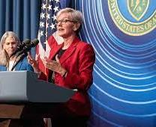
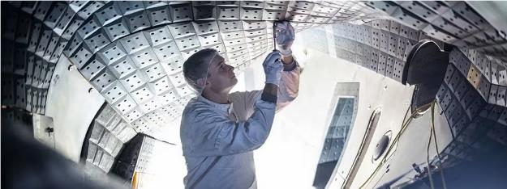

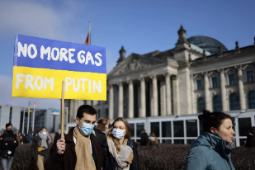
Why the revision ?
Interest in fusion has grown enormously thanks to
  Public fusion research successes at JET, NIF, W7-X and Medium-Sized Tokamaks, ITER assembly
  Realization that baseload electricity power plants are essential for energy transition & security
Industries and private investors are now part of the fusion effort

Slide 6

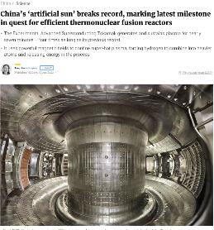
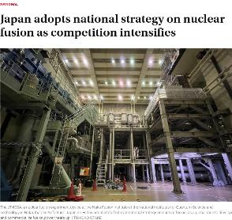
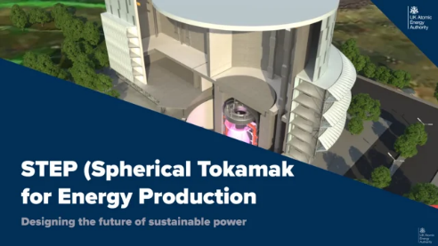
Why the revision?
We must maintain European leadership and technological competitiveness and our attractiveness for the young talents, hence proceed rapidly to demonstrating the commercial feasibility of fusion energy

Slide 7
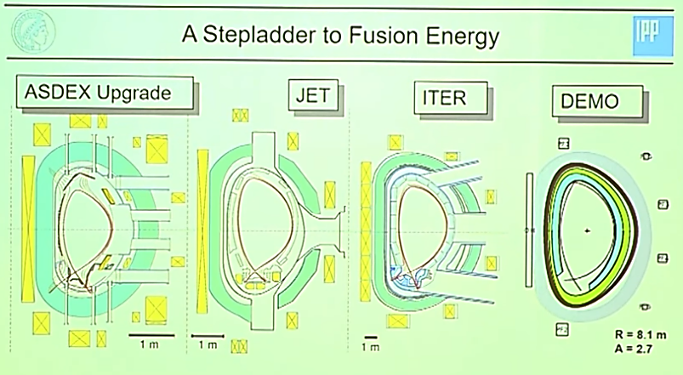

Why the revision?
The Roadmap contains all the linked elements of a reactor-oriented program but is based on a sequential JET-ITER-DEMO approach and on assumptions that are no longer valid

Slide 8
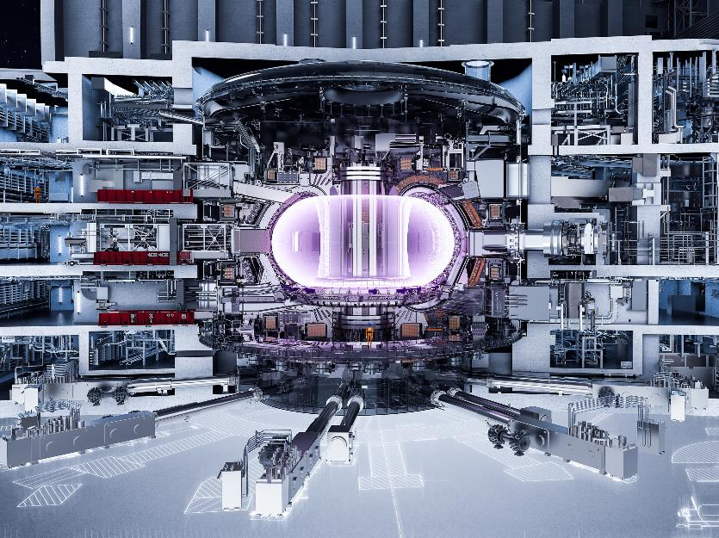
Why the revision?
Delays have impacted ITER…
  …and JT-60SA, IFMIF-DONES and DTT
Unique and valuable lessons learned from every stage of the ITER project can and must be integrated into the Roadmap

Slide 9
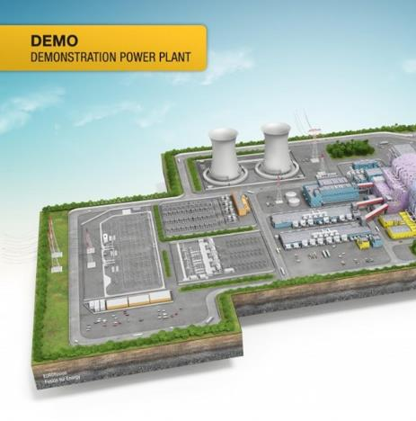
Main elements of the ongoing Roadmap revision
  Definition of the DEMO step
  Focus R&D on remaining gaps
  Parallelization of ITER and DEMO activities
  Measures to accelerate the DEMO and FPP programs
  Public-Private-Partnerships
These points are in addition to the specific activities for the ITER project, which remain central

Slide 10
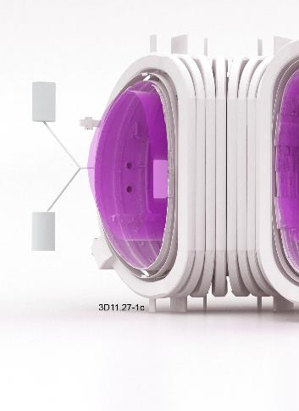
Definition of the DEMO step: high level goals
Demonstration of performance of key technologies with tolerable failure rates to achieve adequate levels of availability, and integration
  Net electricity output to grid ~ 300-500MW
  Self-sufficient fuel cycle: supply T for itself & to start a new plant
  Robust plasma operation scenario and power-exhaust system
  Demonstration of intrinsic safety and tolerable impact of waste
  Maintenance systems that ensure plant availability and accessibility
Tokamak configuration
Target: start operations / commissioning ~20 years after kick off

Slide 11
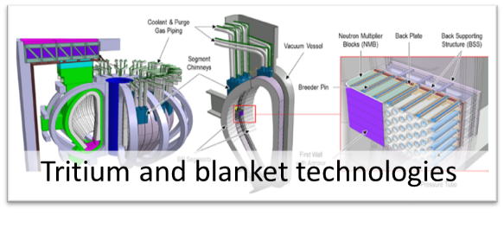
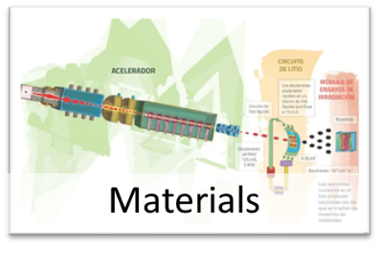
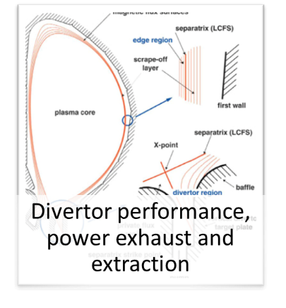
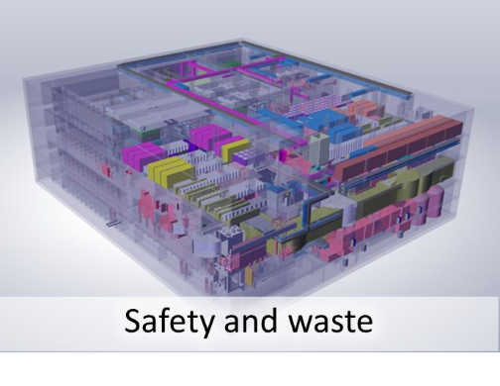
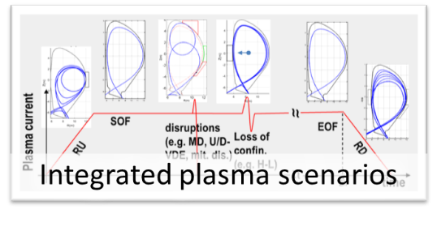

Gaps to be addressed
Notes:
+ theory and numerical simulations

Slide 12
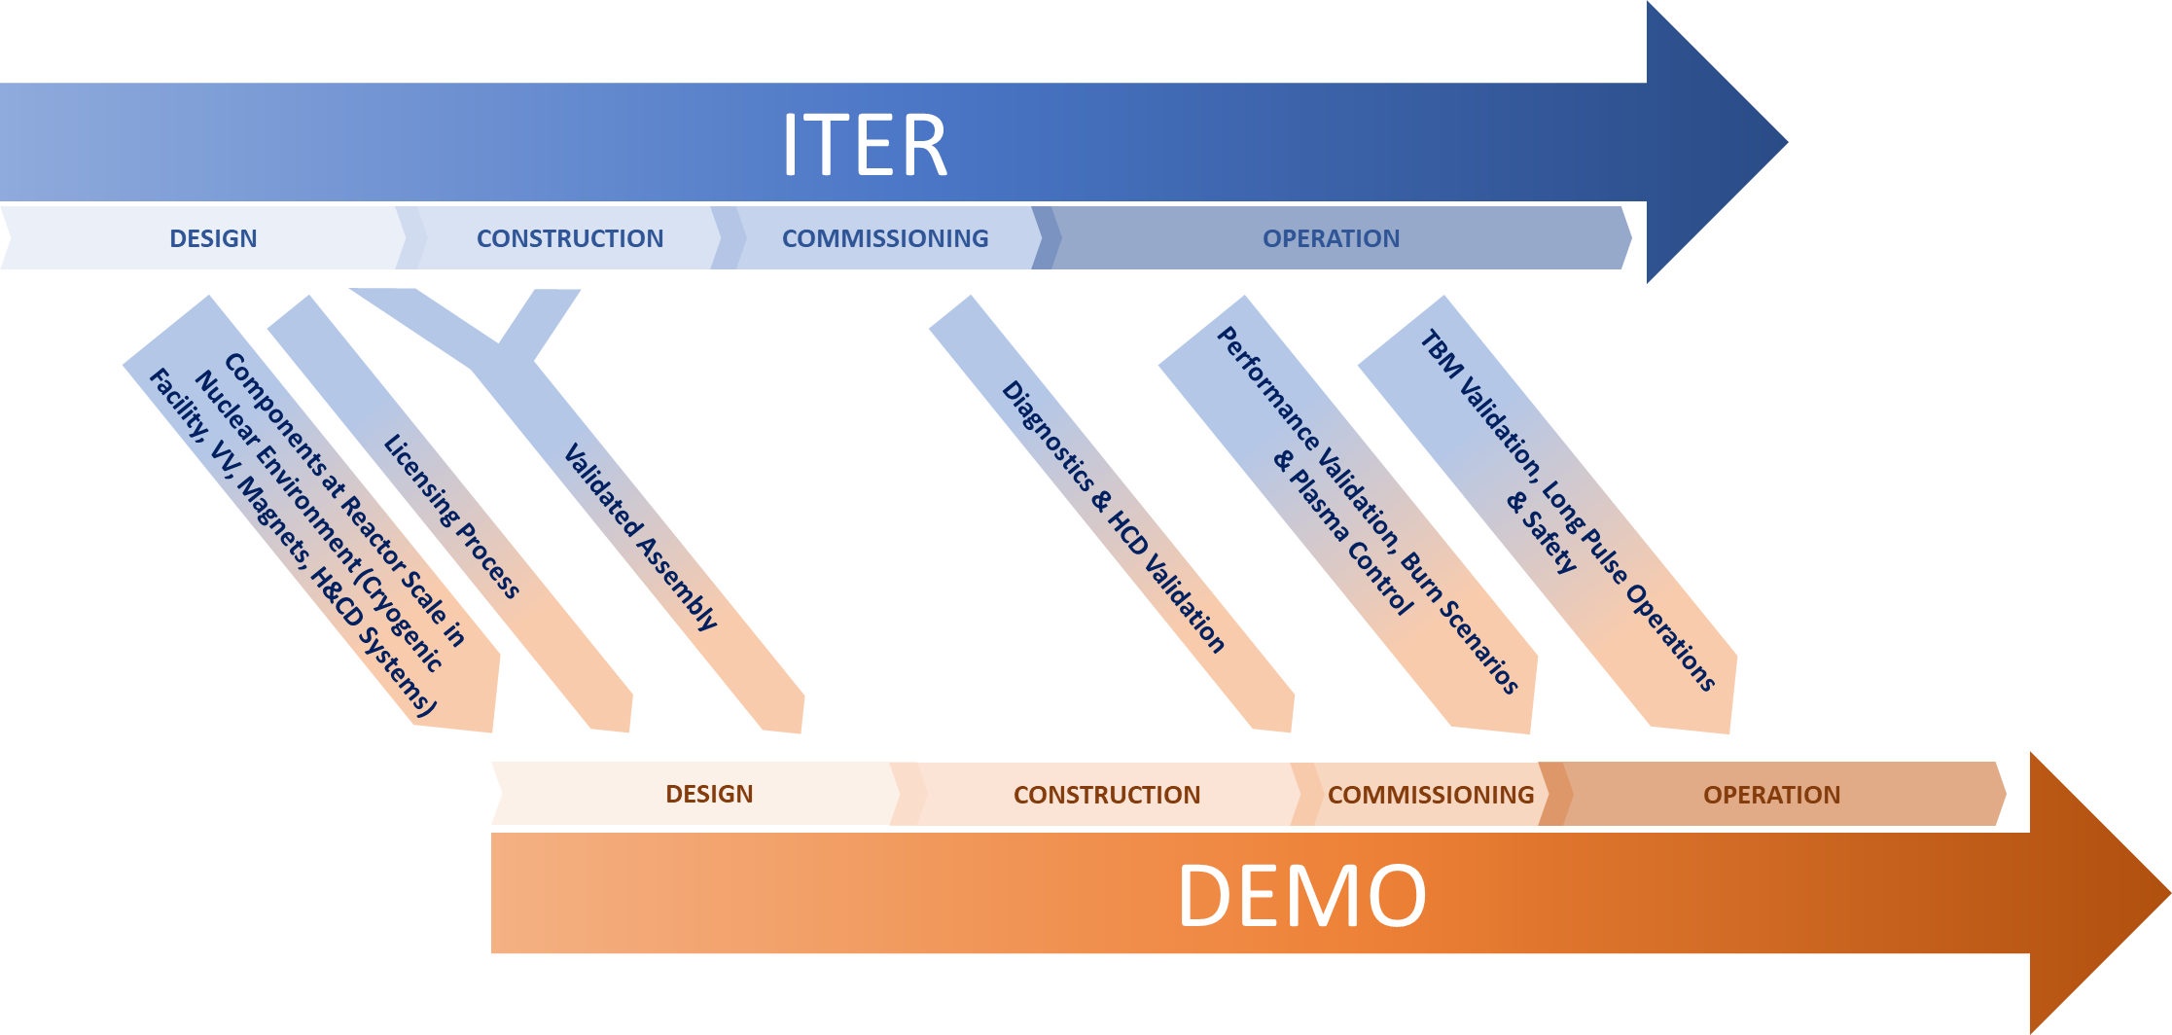
A more synergetic approach to DEMO and ITER

Slide 13
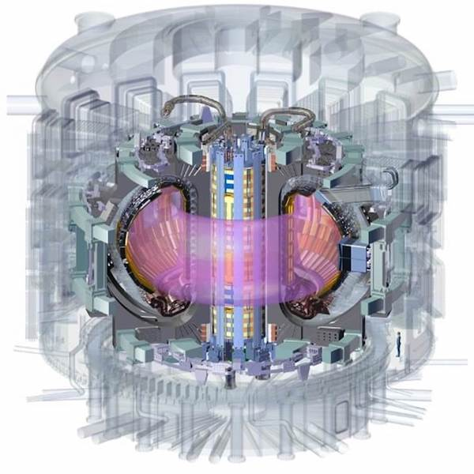
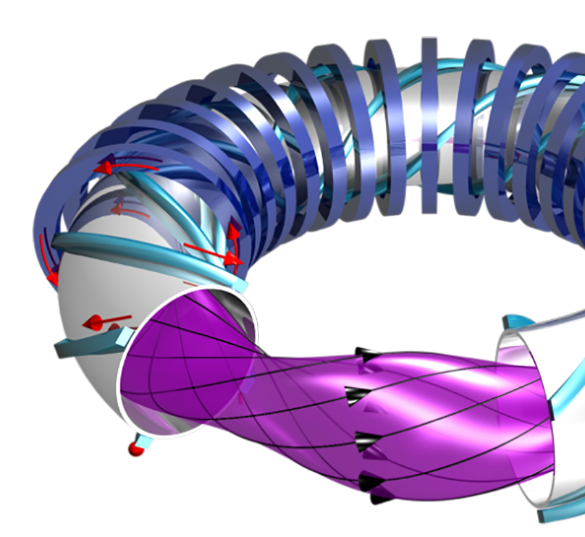
Measures to accelerate the FPP program beyond DEMO
Dedicated test facilities to qualify technologies for FPPs that will be different from DEMO
Investigations to increase attractiveness of FPPs
  Stellarator FPP design studies
  HTS magnets
  Advanced structural materials
  Alternatives to water as primary coolant
Source: ITER
Source: IPP

Slide 14

Public-Private Partnerships
DEMO will be built within an industrial framework, utilizing fully industrial practices
Private efforts, though not necessarily extensible to FPPs, are characterized by risk-tolerance, technology focus, agility and speed
We need to combine industrial and entrepreneurial approaches with the extensive know-how, and the ambitious yet realistic vision of public-funded European fusion program

Slide 15

Public-Private Partnerships
Collaborative approach involving joint leadership, a combination of public and private-owned IP, agile procurement processes similar to those of the private sector, yet compatible with EU industry development
A key issue is how to develop capability and capacity in supply chains, especially in areas that are not stimulated by ITER procurement
  Technology challenges program, within PPPs, e.g. on blankets and related T system, materials, superconducting magnets - crucial design and cost drivers for DEMO and FPPs
Notes:
ex Lithium management and possibly Li-6 enrichment, large-scale deployment of microwave heating and current drive systems from plug to plasma, fabrication of blanket,

Slide 16
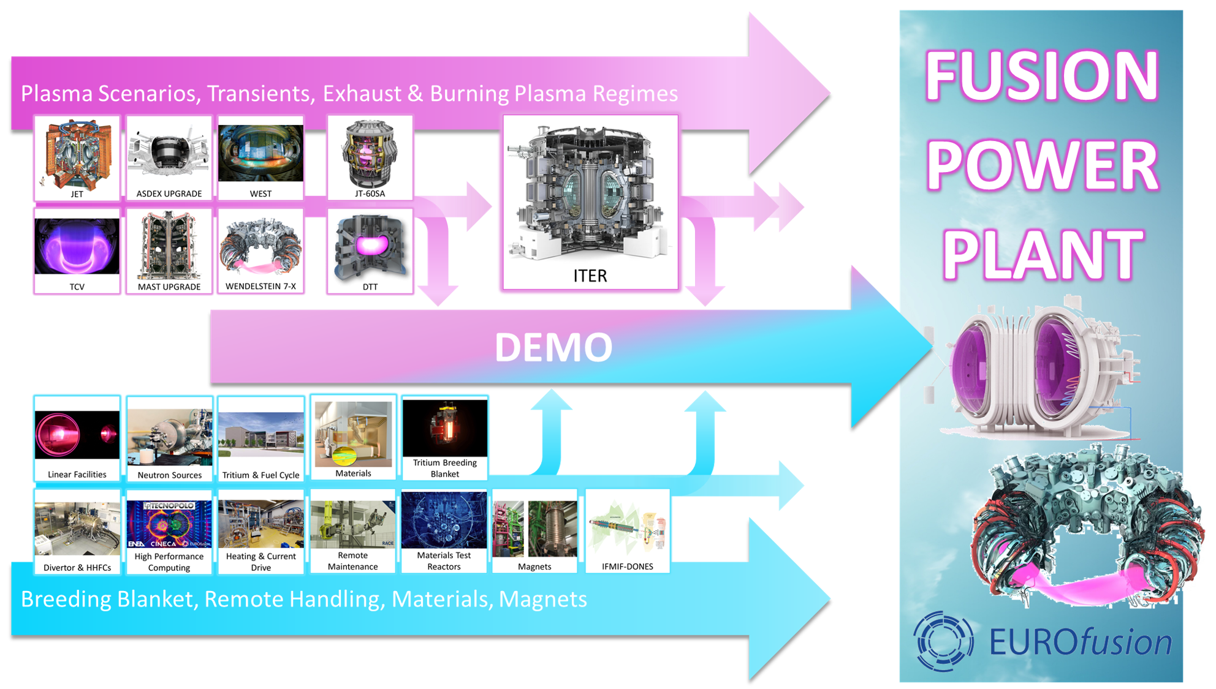
Proposed revised approach to the Roadmap

