Slide 1
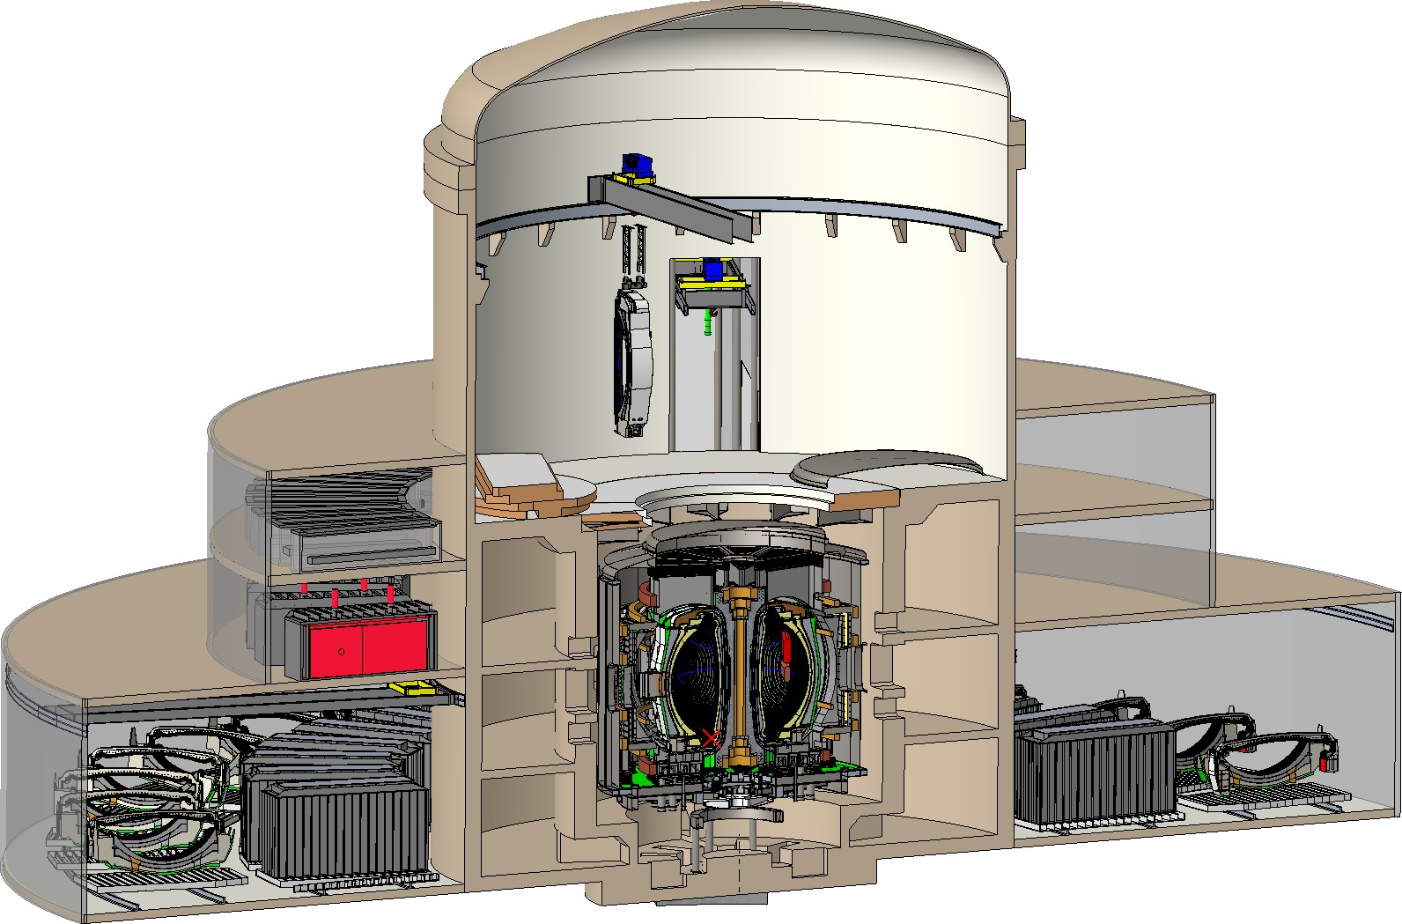
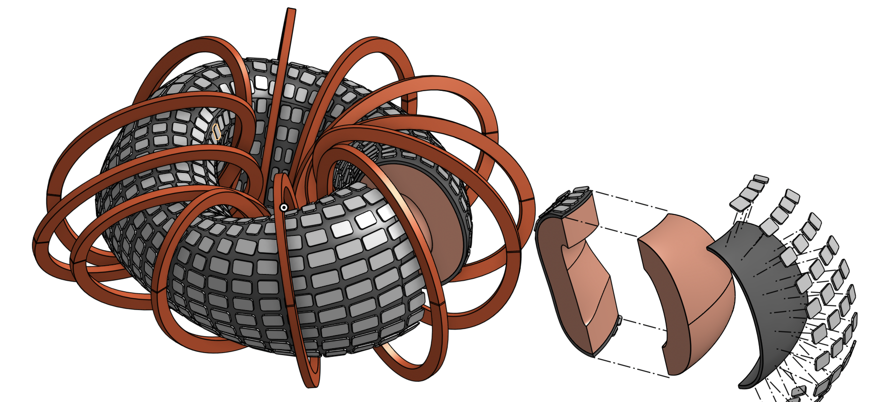
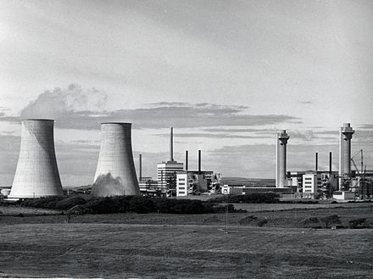
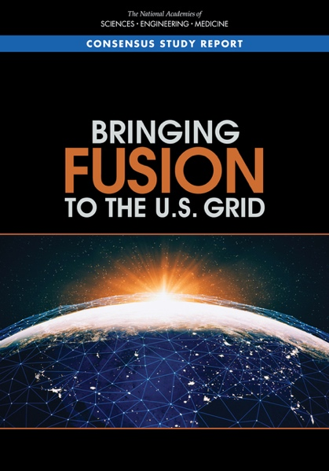

Getting to a Pilot Plant
Steve Cowley Princeton Plasma Physics Lab
NASEM: Bringing Fusion to the U.S. Grid. “the Department of Energy and the private sector should produce net electricity in a fusion plant in the United States in the 2035-2040 timeframe.”

Slide 2
Two simple propositions today
Uncomfortable truth: We do not know enough plasma physics to deliver fusion. Confinement innovation is needed. The better the plasma performance the easier the engineering.
We cannot sell a fusion plant without thorough lifetime testing of the nuclear components (blankets etc.) with realistic neutron fluxes and fluences (FNSF mission).
  Early delivery of fusion requires this be done in a/the Pilot Plant along with the net electricity mission.
  Pilot Plant must therefore be designed to be highly maintainable and flexible.
  I would argue that a Pilot Plant needs to be a low-risk robust machine that does not require engineering miracles.

Slide 3
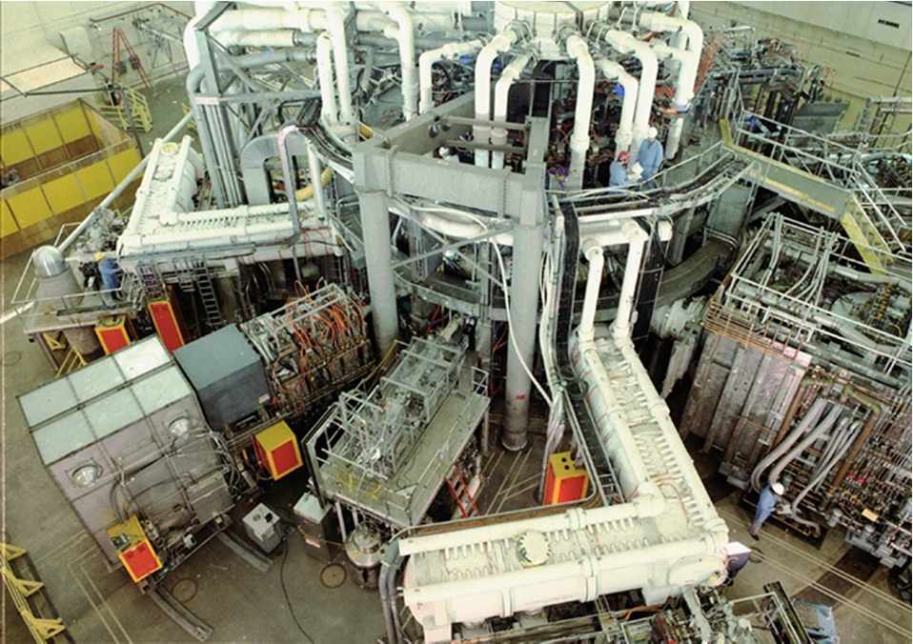
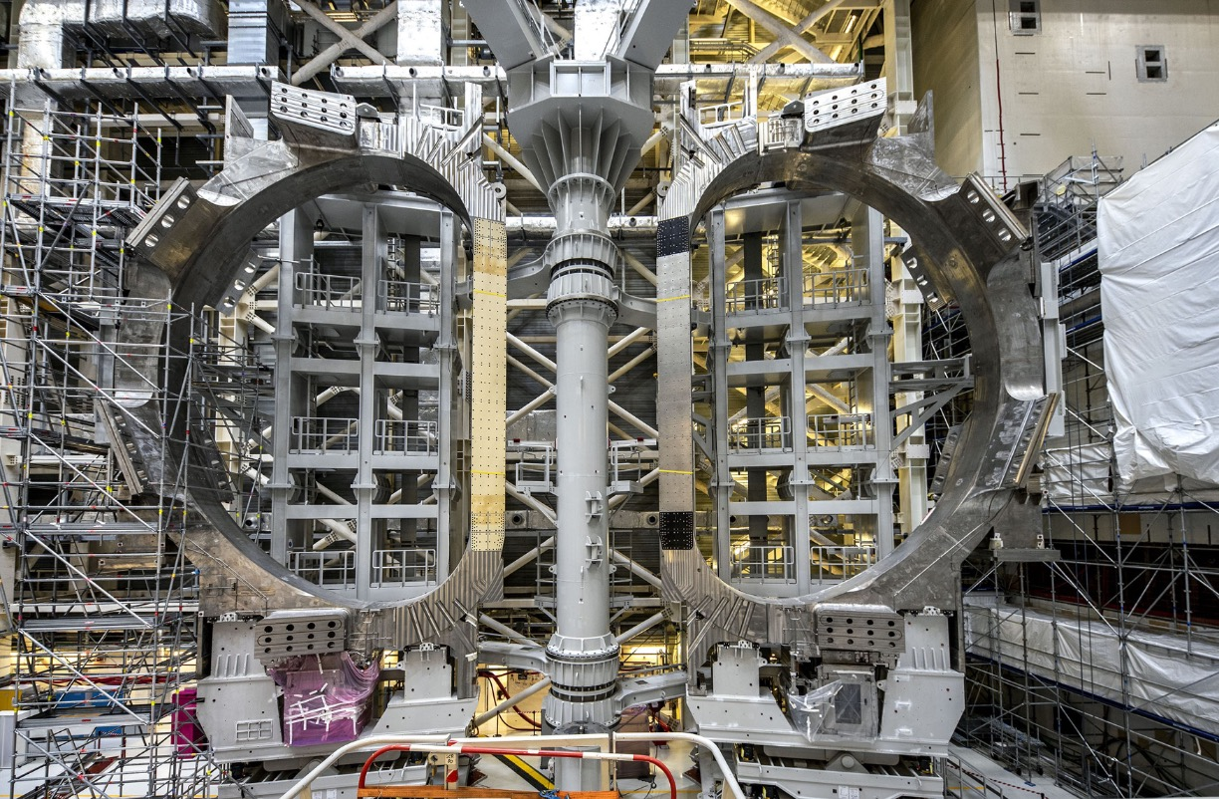
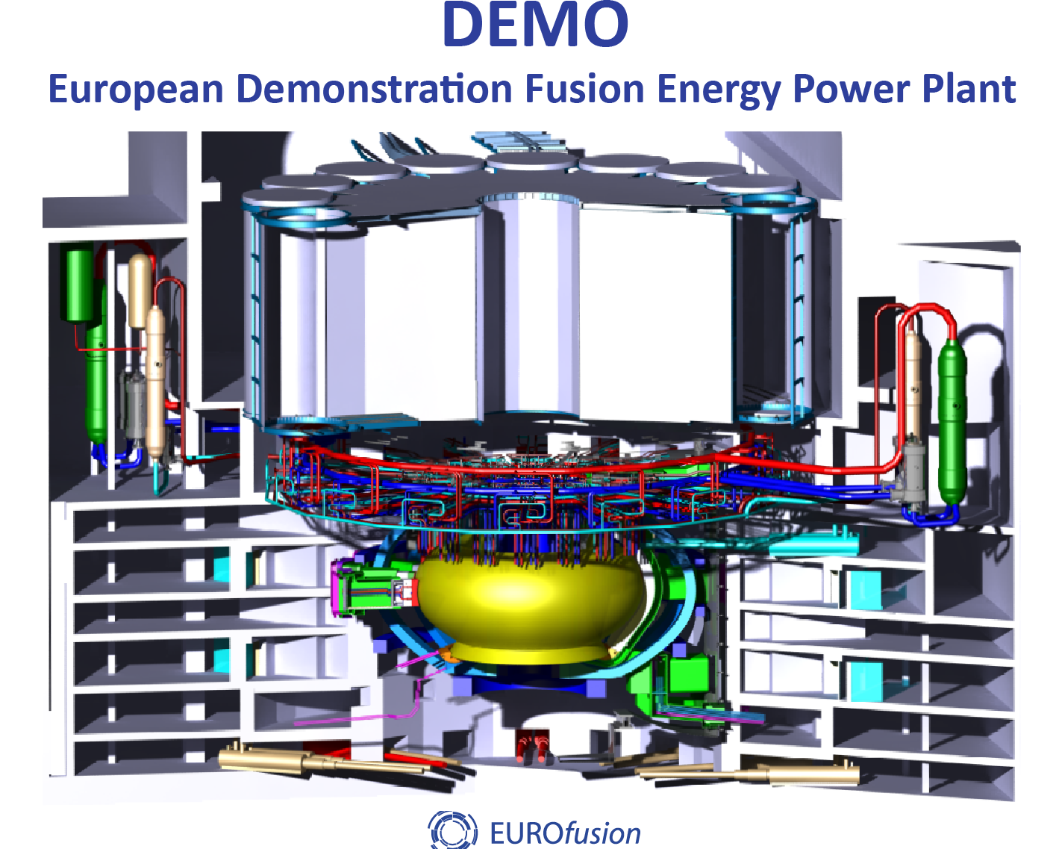
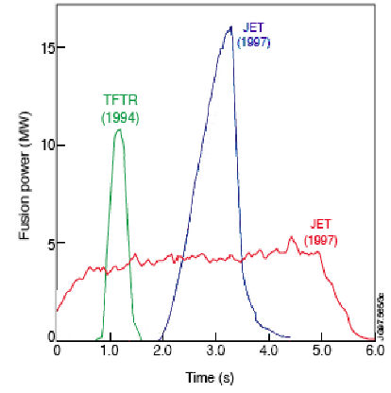
We need innovation if we want commercial fusion
| First the “main line” fusion is possible but ….
TFTR – fusion conditions 1994
ITER – fusion burn 2035?
DEMO – fusion electricity 2045?
The EU DEMO is the logical conclusion of the conventional tokamak line. Unfortunately:
It is technically challenged – particularly power handling is not “solved.”
1
It is very large and estimated to be very expensive.
2

Slide 4
The Standard Model of the Tokamak
Ignition (sustained burn) requires (gyro-Bohm ~“ITER scaling”):
“H” is the confinement enhancement fudge factor.
Total power output – essentially independent of size when ignited
SELF SIMILAR SCALING AT CONSTANT GAIN, ”H” AND SHAPE
ITER: R= 6.2m, B = 5.3T BR^{3/4} = 20.8
MIT + COMMONWEALTH FUSION SYSTEMS
SPARC: R = 1.78m B = 12.5T BR^{3/4} = 19.2
2

Slide 5
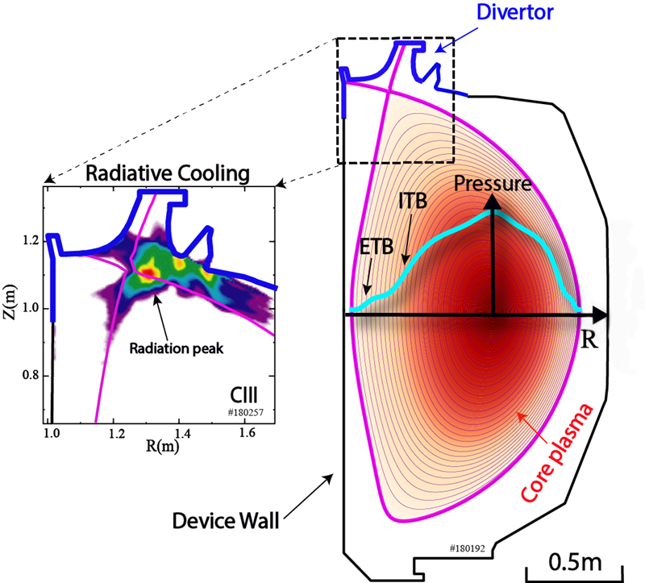
A central problem -- Plasma Exhaust
At plasma edge plasma flows along
Scrapeoff layer to divertor
Power per unit area of divertor = heat load
Radiation is proportional to plasma
Density squared.
STELLARATOR?
Notes:
Glib statement – wanted now.
Required late century – transition technologies.
National Climate assessment.

Slide 6
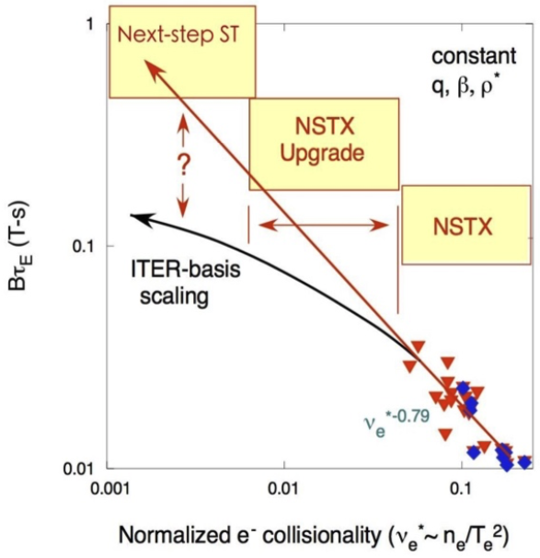
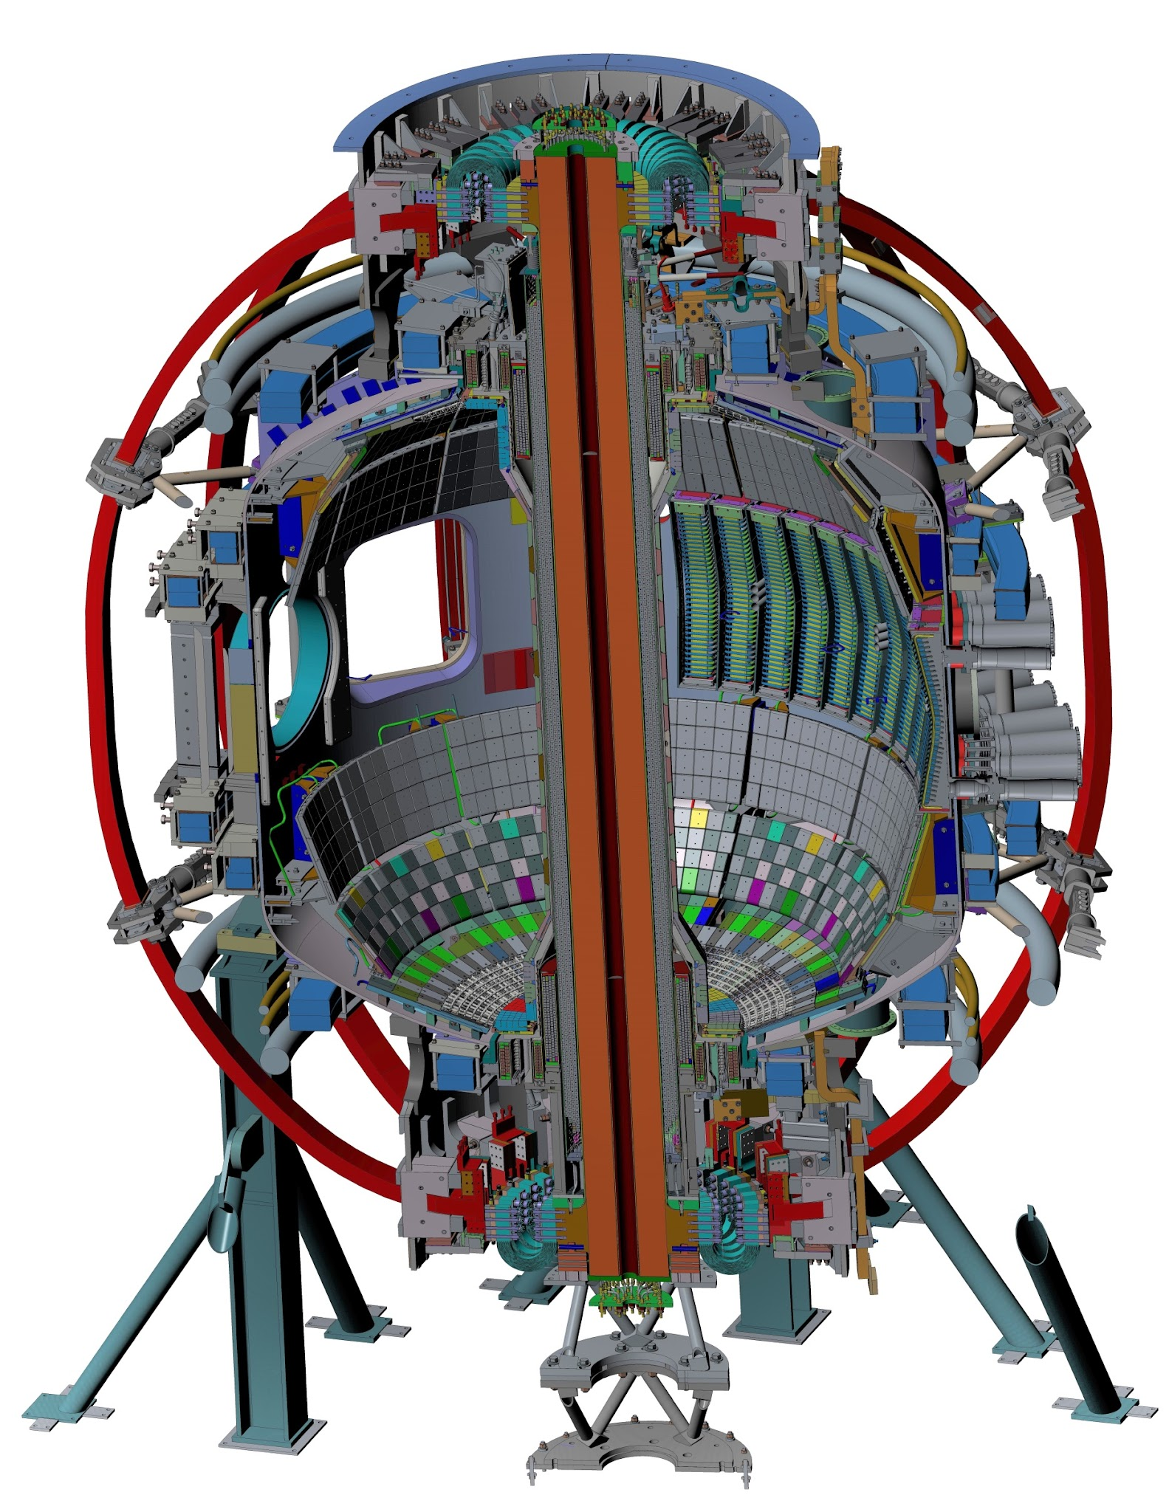
NSTX-U will study confinement trends at Fusion conditions
Enhancement is roughly
equivalent to H=2. If this
is correct then the ST is a
Low-cost route to a Pilot
Plant.
85% Complete

Slide 7
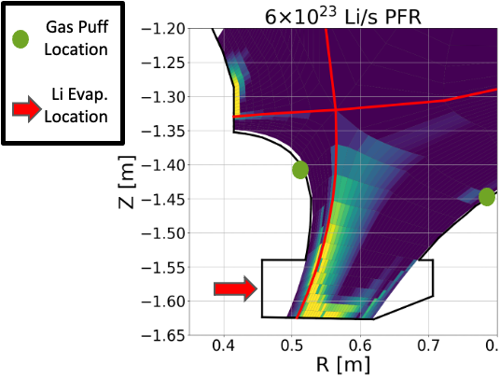
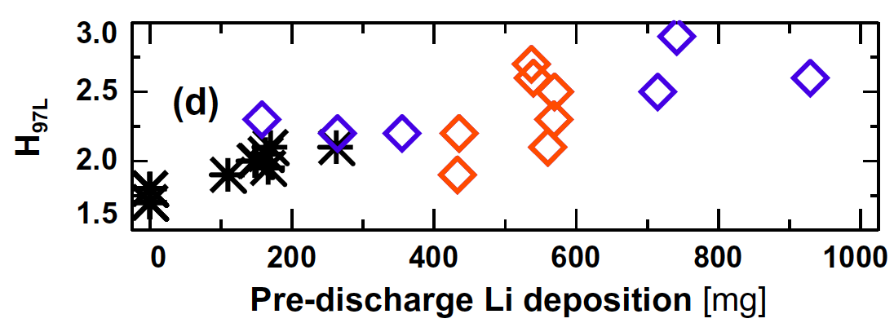
NSTX-U will pivot toward heat and particle flux control with liquid Li PFCs after fulfilling the core physics mission
q_{peak} = 92 MW/m²
(No Li, no gas puff)
NSTX-U can purposefully achieve q⊥ ~100 MW/m² for future PFC tests
R&D ongoing to develop a Lithium Vapor Box
  Heat flux of ~ 92 MW/m² can be reduced to 7 MW/m² with low core contamination
  Synergistic with R&D for Private Companies through Milestone-based Program
Li PFCs also reduce recycling and increase τ_{E}
  Attractive core-edge integrated design for STs!
  NSTX-U data needed to extend to lower ν*
q_{peak}=7 MW/m²
Normalized τ_{E}
(NSTX data)

Slide 8
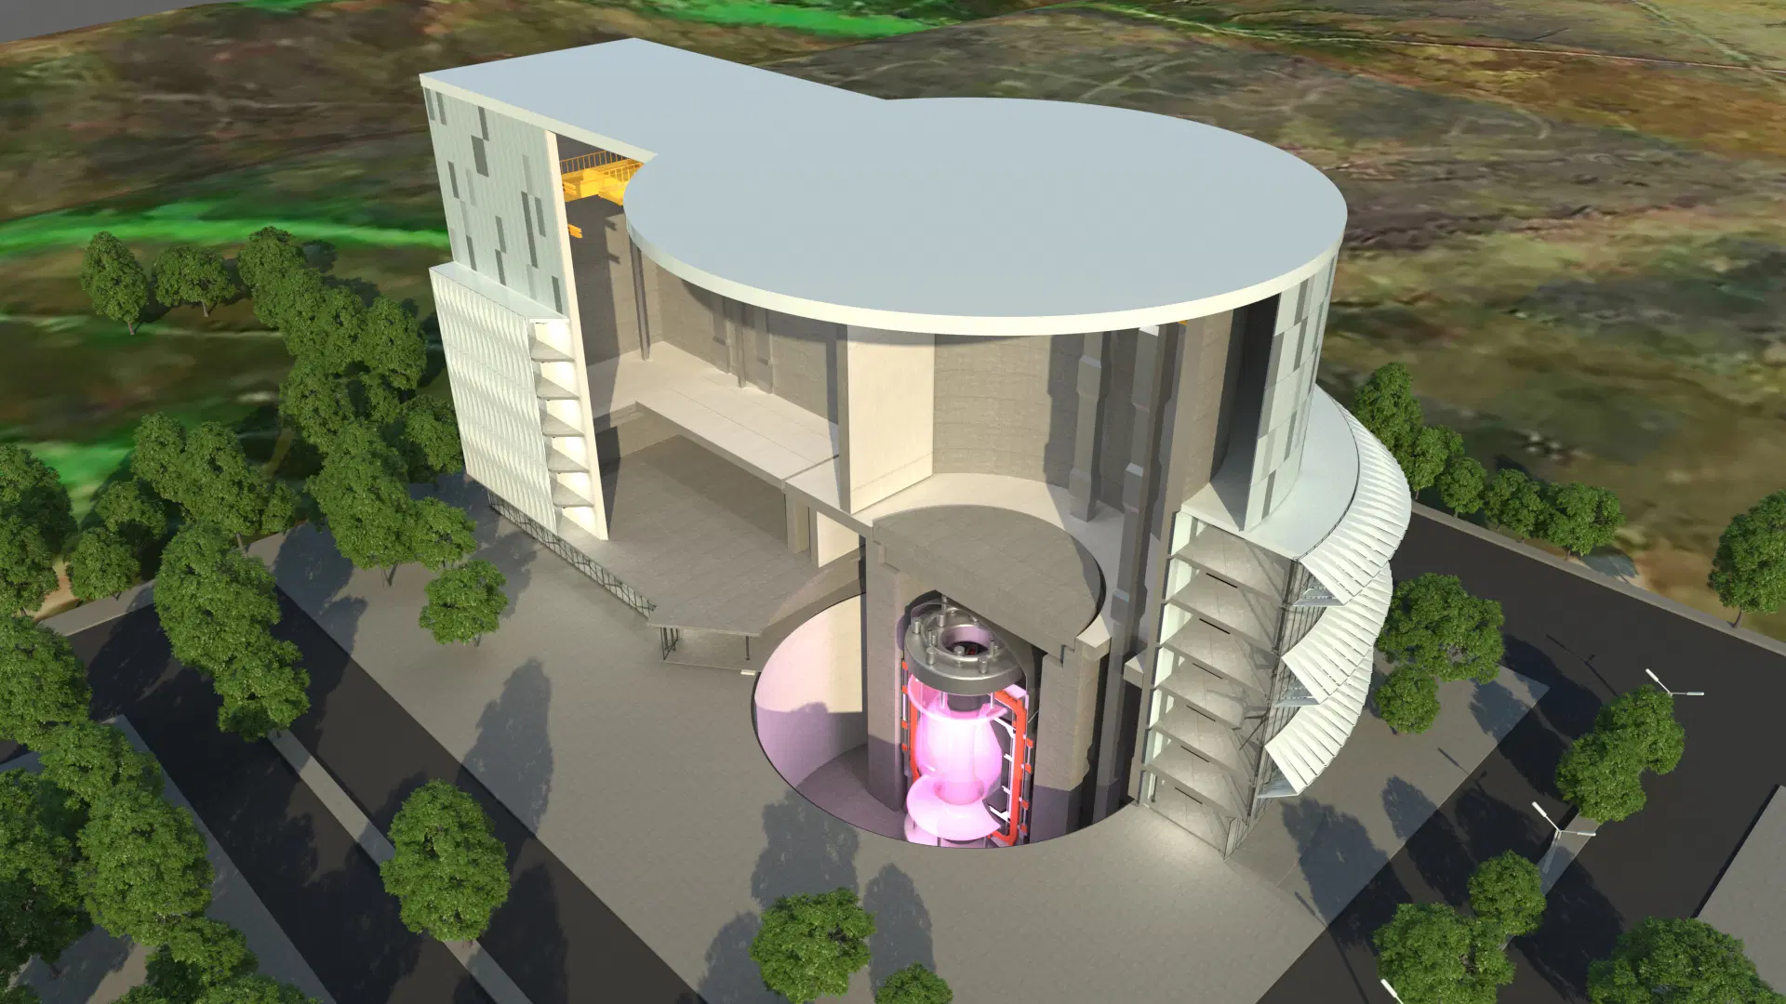
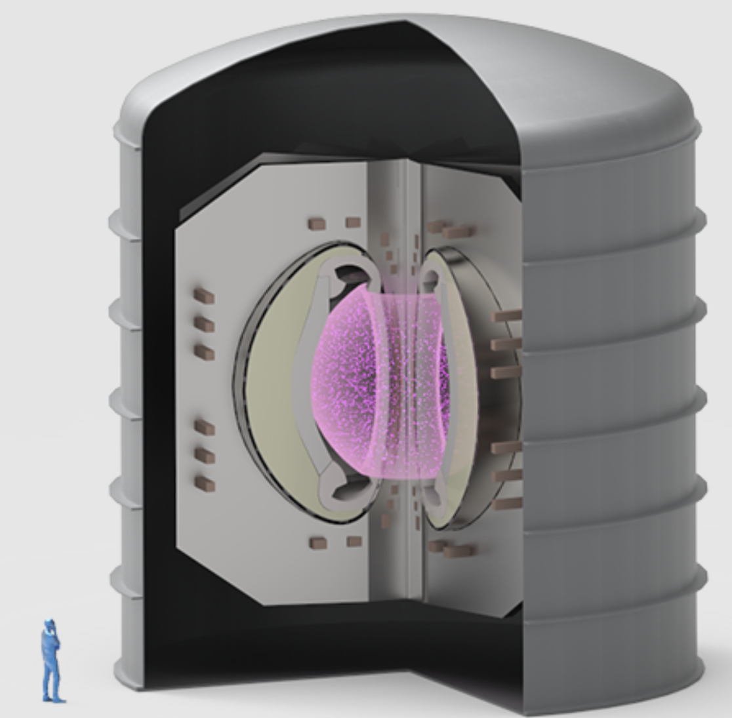
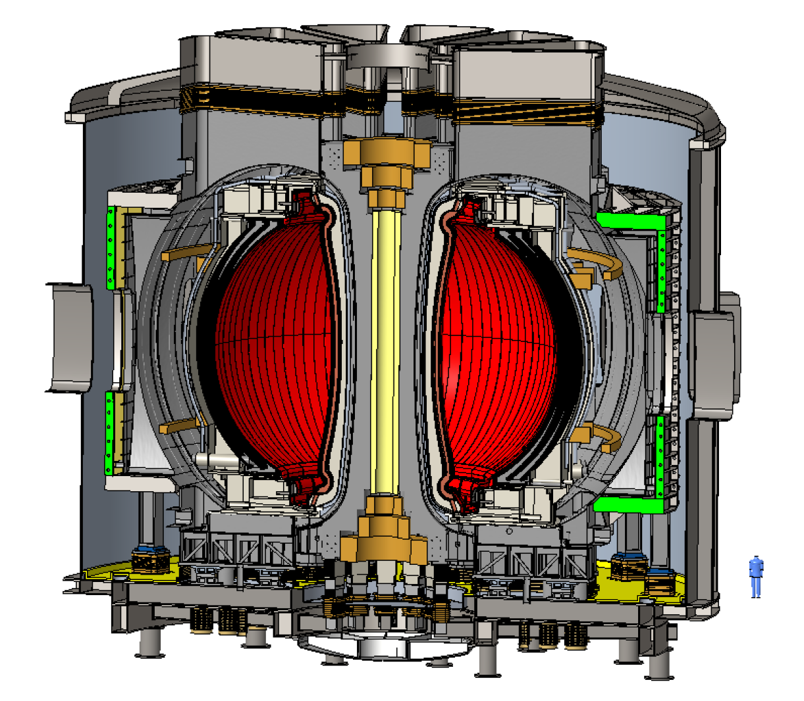
Bold decadal vision (BDV): STs make attractive pilot plants and NSTX-U is an essential step.
Spherical Tokamak for Energy Production (STEP) – UKAEA
  Need confinement and stability results from NSTX-U.
ST-HTS - Tokamak Energy, Ltd
ST-E1 - Tokamak Energy, Ltd
  Part of the Milestone program.
  Need core-edge integration with liquid Li PFCs from NSTX-U.
ST Advanced Reactor (STAR) led by PPPL - understand reactor potential of low-A / ST
  Menard (2016, 2019, 2022) found attractive A~2 operating point for compact, steady-state Pilot Plant,
    Need NSTX-U data to determine if projections hold.

Slide 9
Neutron Wall Loading
Peak Neutron Flux (from scaling EU DEMO)
Field in tesla
Rule of thumb 1MW/m² for a full power year => 10DPA
How much DPA before material must be replaced?
20DPA makes material scientists nervous. We need DONES to know.
EU Demo wall lifetime (to 20 DPA) could be 1 full power year
High Field devices will be a few months
Notes:
Glib statement – wanted now.
Required late century – transition technologies.
National Climate assessment.

Slide 10
The case for low power density
Tokamak | KEY PARAMETERS | DIVERTOR HEAT LOAD | RADIATIVE FRACTION | WALL LIFETIME | AVERAGE CURRENT DENSITY
EU DEMO | B=5.9T R= 9m BR^{3/4}=30 H=1 | P_{D} >100MW/m² | 1 | 1-2 FULL POWER YEARS TO 20DPA | 3.37MA/m²
HIGH FIELD | B=12.5T R=3.2m BR^{3/4}=30 H=1 | ~5.7 P_{D} | 2(f_{GW})² | 1.5-3 FULL POWER MONTHS TO 20DPA | 53MA/m²
LOW FIELD | B=3T R=21m BR^{3/4}=30 H=1 | ~0.2 P_{D} | 0.5(f_{GW})² STELLARATOR? | 6-12 FULL POWER YEARS TO 20DPA | 0.6MA/m²

Slide 11
Early Fusion
If we want fusion soon we need to get to a Pilot Plant soon.
  Need innovation to get to a low-cost solution.
  Need to focus on high maintainability and low engineering risk.

Slide 12
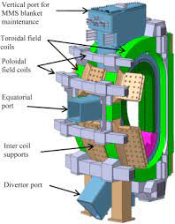
Maintenance. How easy is it to replace the wall and blanket?
We may have to replace the wall and blanket components after they have been damaged by radiation and plasma. We may have to consider these components consumables.
Unfortunately, it is hard to get inside the coils and cryostat. One measure of the space and accessibility for replacement is the average current density through the hole in the middle.
Small current density is good – lots of space!
Notes:
Glib statement – wanted now.
Required late century – transition technologies.
National Climate assessment.

