Slide 1
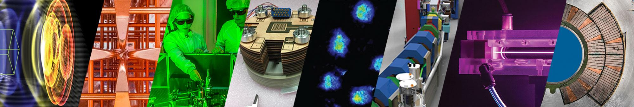
Jean-Luc Vay, LBNL
Fusion Power Associates, 44th annual meeting and symposium Dec 19-20, 2023
Fusion Energy Science & Technologies at Berkeley Lab
for future pilot plants
The work is supported by the U.S. Department of Energy, Office of Science, Fusion Energy Sciences, SciDAC and ARPA-E,
under Contract No. DE-AC02-05CH11231.

Slide 2
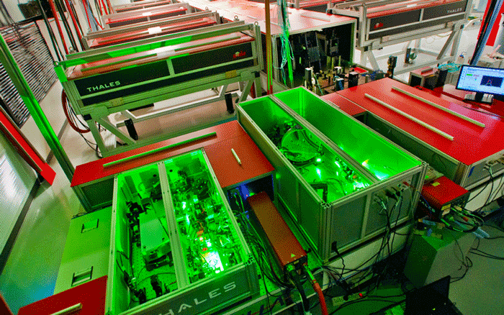
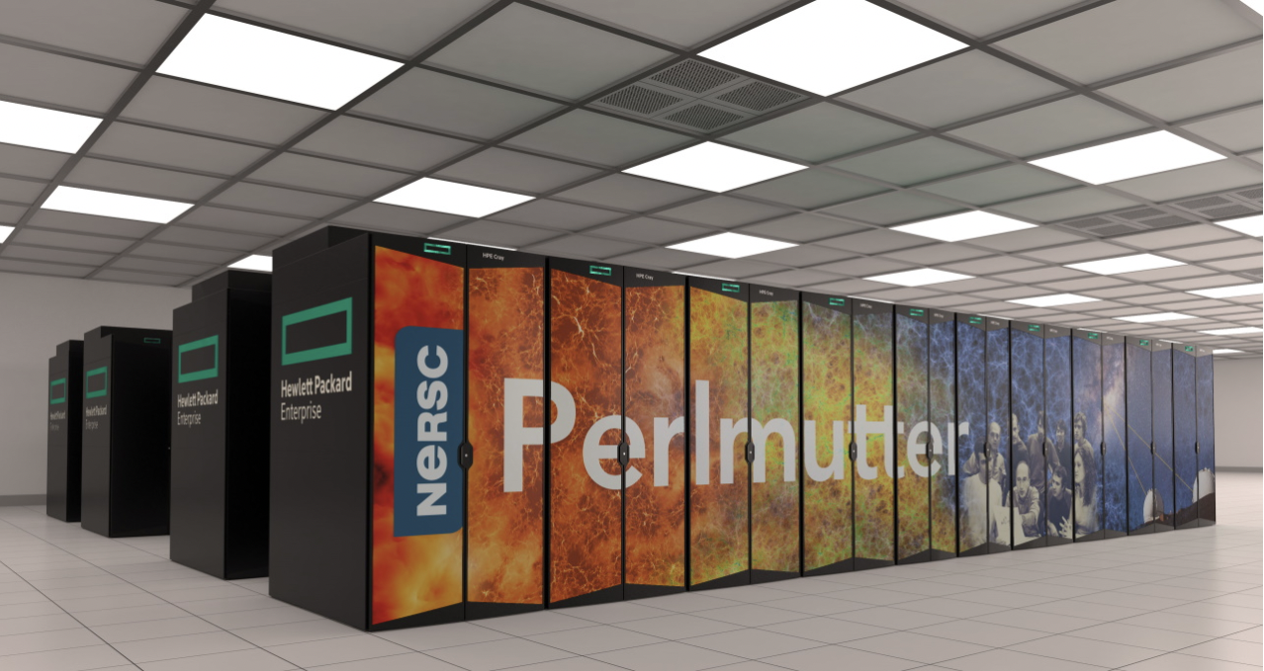
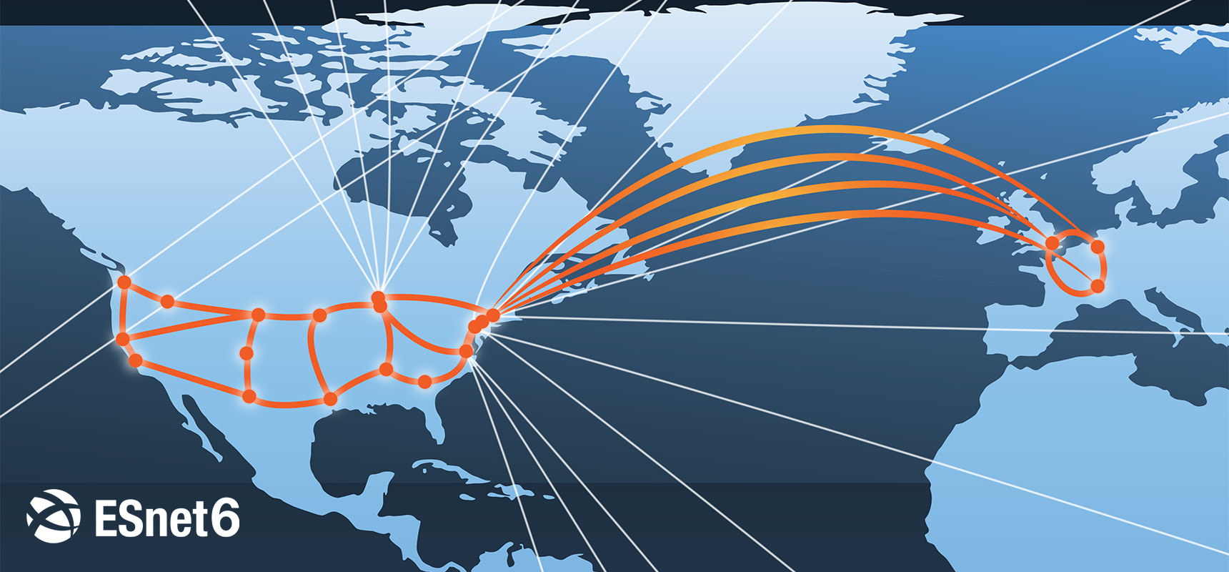
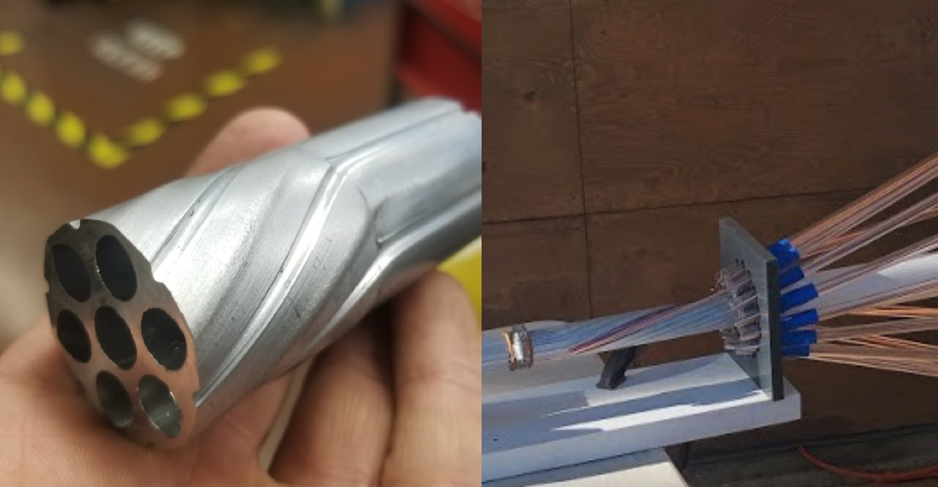
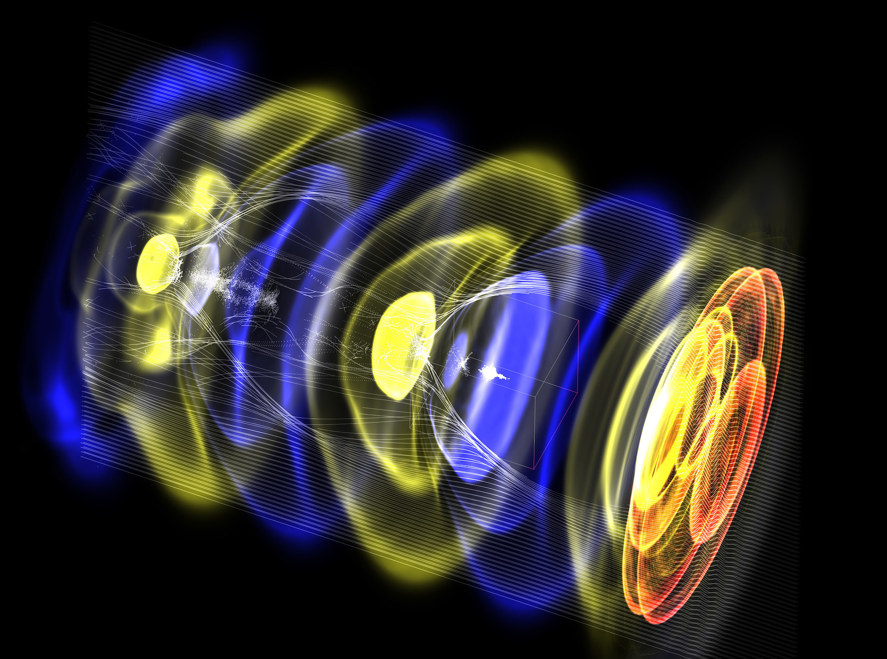
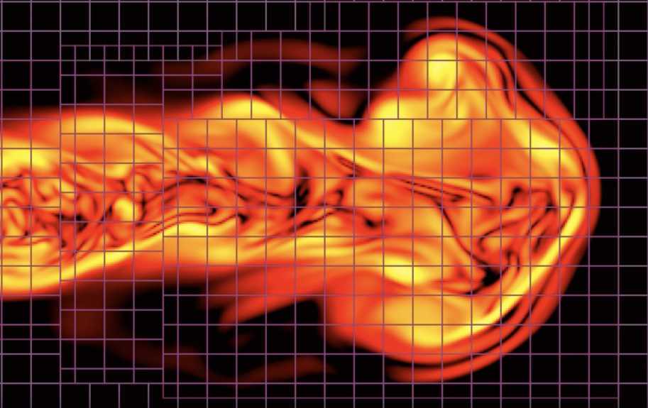
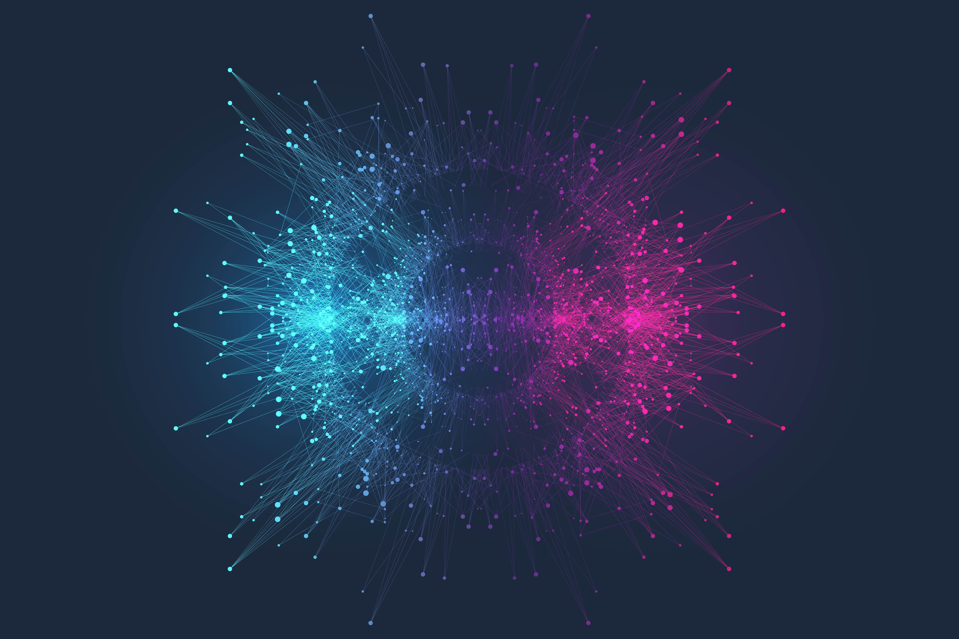

Research environment for fusion at LBNL
Physical Sciences
Computing Sciences
Magnets
Lasers
Supercomputers
Fast networks
Superconducting
magnet program
BELLA Center
NERSC
ESnet
Beams
Simulations
Applied maths & comput. sc.
Data science, AI/ML
Fusion science &
ion beam tech.
Advanced modeling
App. Math & Comp. Research Division
Scientific Data Div.

Slide 3
Research environment for fusion at LBNL
Physical Sciences
Computing Sciences
Magnets
Lasers
Supercomputers
Fast networks
Superconducting
magnet program
BELLA Center
NERSC
ESnet
Beams
Simulations
Applied maths & comput. sc.
Data science, AI/ML
Fusion science &
ion beam tech.
Advanced modeling
App. Math & Comp. Research Division
Scientific Data Div.

Slide 4
High Field Magnet Leadership for Compact Fusion Plants
Magnetic field strength is key to fusion reactor size: High Temperature Superconductors (HTS) have potential for 2x field
LBNL leads the High Energy Physics US Magnet Development Program → leverage for fusion
  Started: FES Test Facility Dipole + commercial partnerships (Commonwealth, General Atomics, TypeOne Energy…)
Understand and mitigate the degradation in HTS fusion cables
Design and develop technologies for robust fusion magnet systems
Enable the next FES facility
FES Magnet Program @ LBNL
Advanced diagnostics
Cable and magnet R&D
Enabling R&D
Demountable joints
Radiation effects
Vision:
Leverage Berkeley Lab’s expertise and experience to deliver on the FES Long Range Plan for fusion power
https://bcmt.lbl.gov/
Contact: SOPrestemon@lbl.gov
Other emerging needs, e.g., system-level protection

Slide 5
Research environment for fusion at LBNL
Physical Sciences
Computing Sciences
Magnets
Lasers
Supercomputers
Fast networks
Superconducting
magnet program
BELLA Center
NERSC
ESnet
Beams
Simulations
Applied maths & comput. sc.
Data science, AI/ML
Fusion science &
ion beam tech.
Advanced modeling
App. Math & Comp. Research Division
Scientific Data Div.

Slide 6
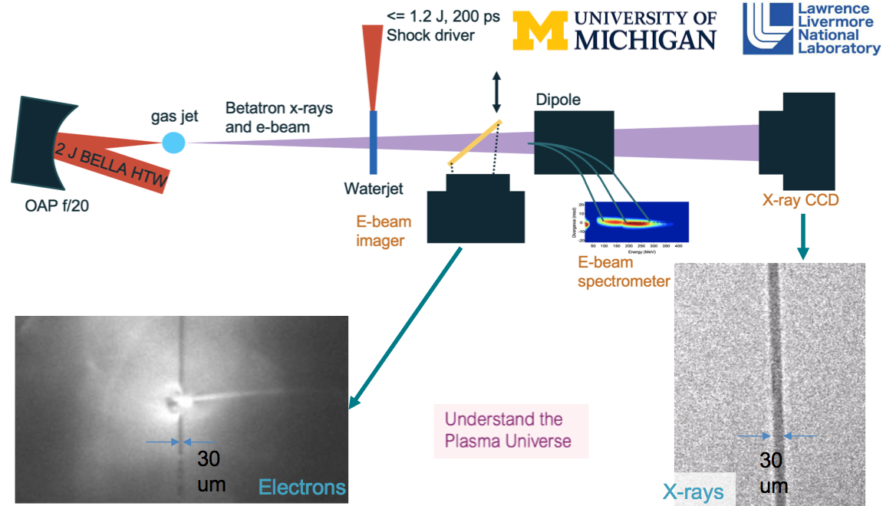
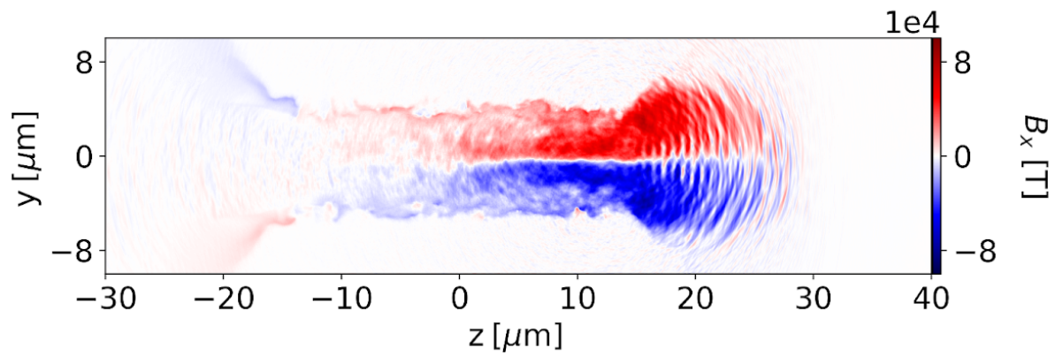
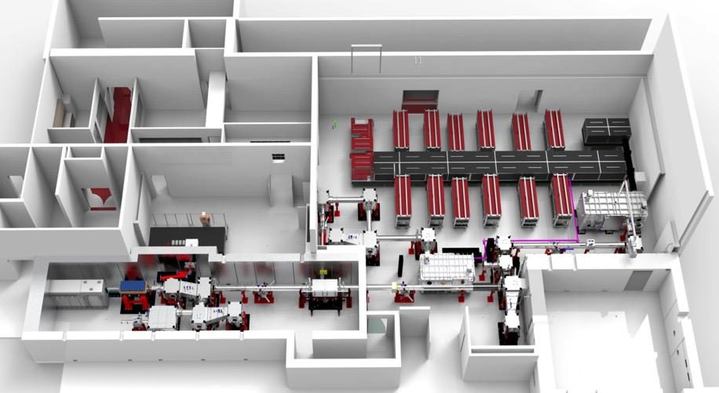
Ultra-intense Lasers and Ion Beams for Inertial Fusion Energy
Inertial fusion requires high gain
  Precision physics – diagnostics
  Fast ignition – particle beam ignitors can reduce driver energy requirements and increase gain
LaserNetUS & user programs at 1 Hz BELLA lasers can advance solutions
  Precision particle and photon sources and hydrodynamic measurements at high repetition rate
  Multi 10 MeV, intense ion beam pulses at our new FES short focal length, ultra-high intensity, high contrast beamline
Precision photon source probes & hydrodynamics
BELLA iP2 for laser
ion acceleration
Sahel Hakimi, et al., “Laser–solid interaction studies enabled by the iP2 BELLA PW”, Phys. Plasmas 29, 083102 (2022)
L. Obst-Huebl, et al., “High power commissioning of BELLA iP2 up to 17 J”, Proc. of SPIE Vol. 12583 (2023).
Contact: EHEsarey@lbl.gov
Notes:
Talking points: basically the bullet points on the left, with the most important message being that “short pulse/midscale laser facilities like those in LaserNetUS can contribute to inertial fusion research by enabling research of HEDP with ultra-fast particle/radiation sources for diagnostics and heating/ignition”

Slide 7
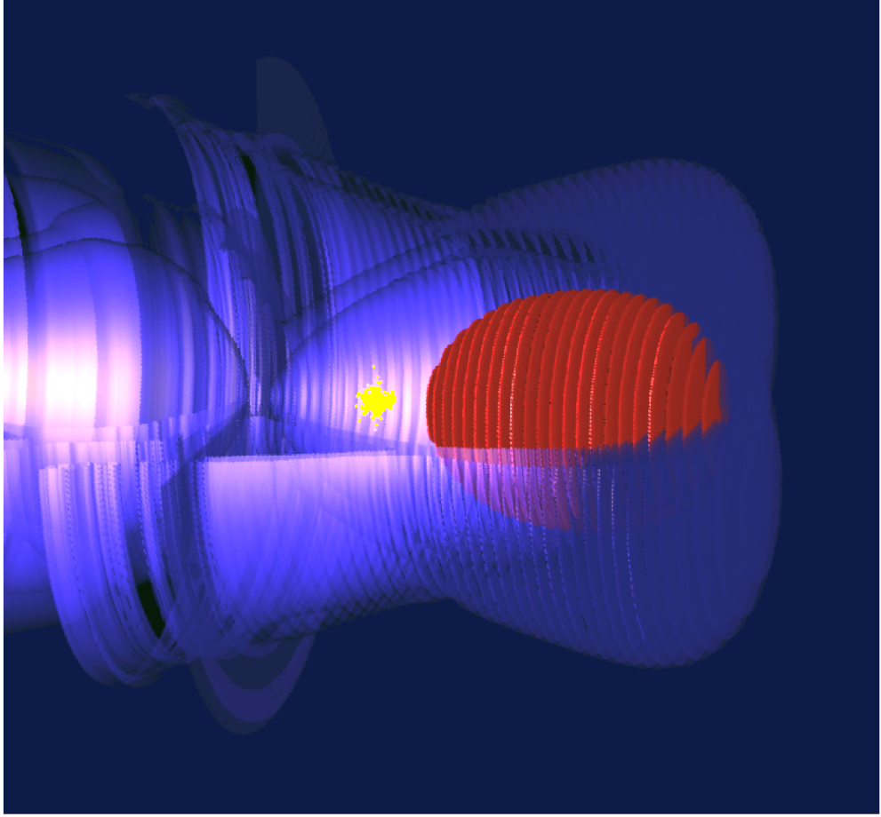
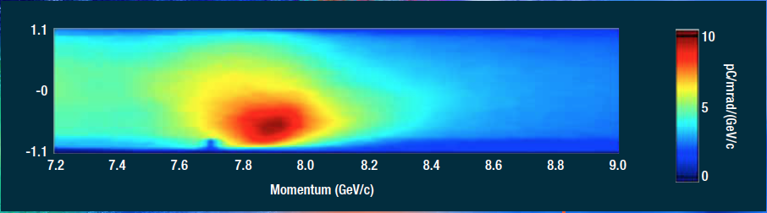

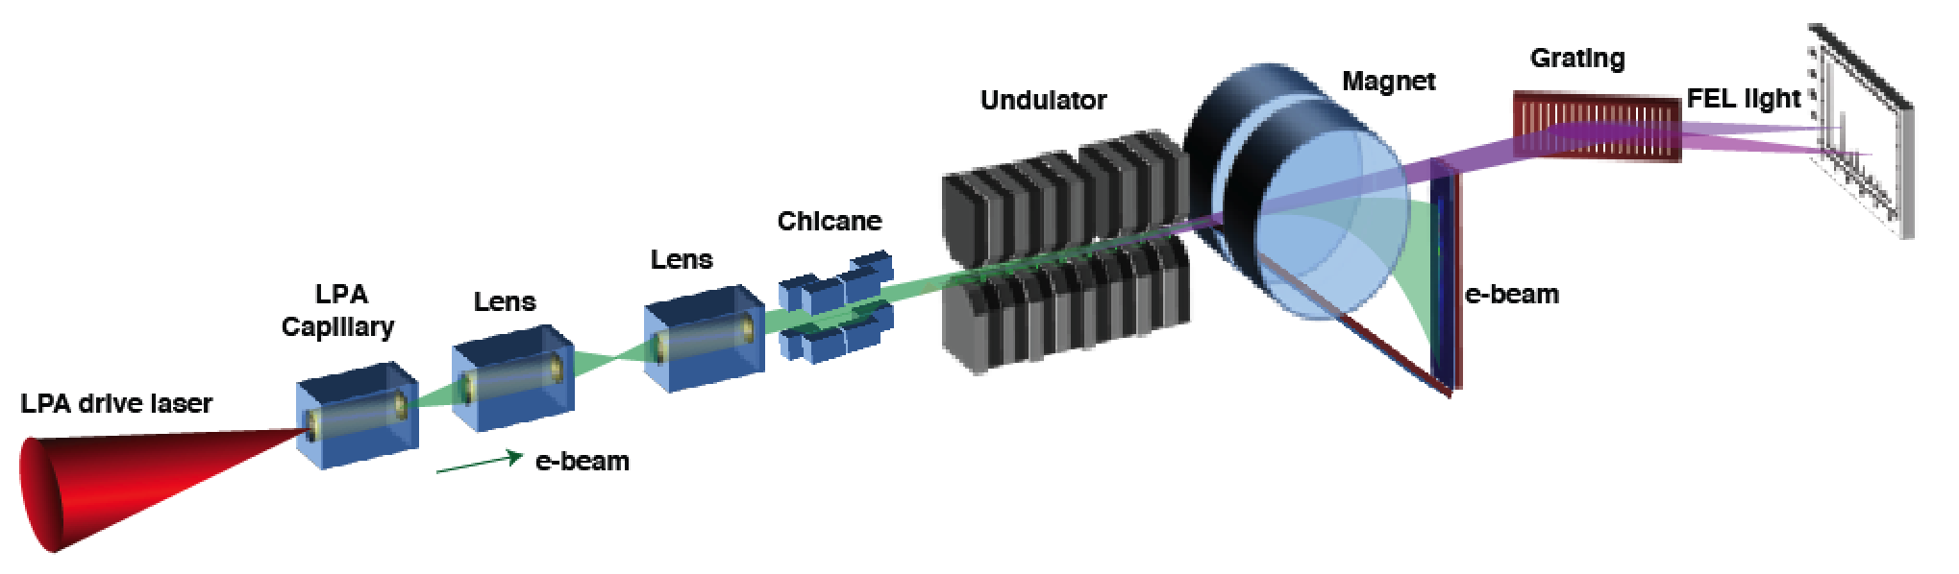
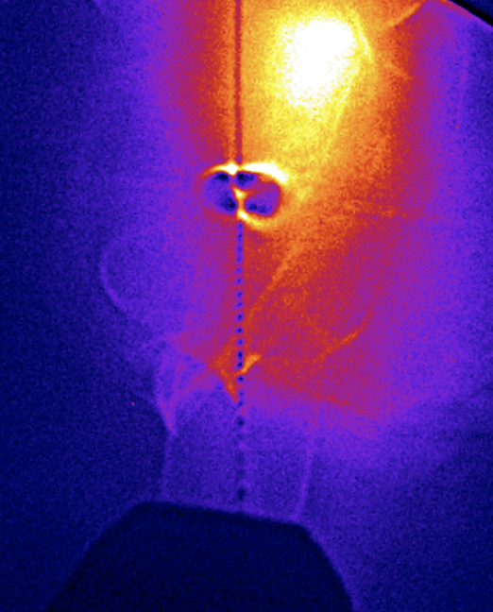
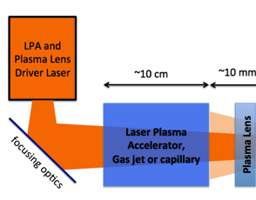
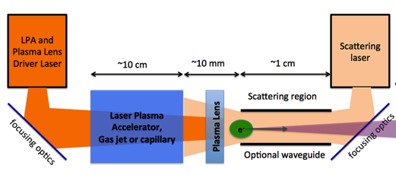

Ultrafast probes from laser-plasma sources of particles and photons
can be developed at the BELLA Center
Laser plasma acceleration of electrons
  Intrinsically short (10 fs), up to 10 GeV
Betatron radiation
  Transverse electron oscillations
  Broadband width incoherent hard x-rays
LPA-driven Free Electron Laser
  Soft x-rays (path to keV) – Coherent imaging
Thomson scattering
  Scatter laser off LPA e-beam
  Narrow bandwidth MeV photons F. Albert @ LLNL)
Electron and ion beam probes
  Laser-synched fs particle probes
  Dynamics in high-density plasmas
2019: 8 GeV record
🡪 Laser
e-bunch 🡪
in a 20 cm plasma
🡪 Plasma wave
~1cm
~1cm
~1cm
LPA
Decel.
Decel.
section
Mononergetic Thomson photons🡪
Electron probe of plasma expansion
e⁻ accel.
Contact: EHEsarey@lbl.gov
Notes:
This slide goes deeper into the point from the previous slide of using LPA sources as compact probes for HEDP/IDE plasmas. Probably no need to go through every bullet point but the important message is: “High repetition rate particle/radiation probes produced with mid-scale laser facilities help explore the (sometimes not well understood) physics taking place in fusion plasmas. IFE relevant platforms like NIF, OMEGA and LMJ have short pulse platforms installed at the facility (ARC, EP etc.) that can already be adapted for these purposes. The development of these particle and radiation probes and the corresponding detectors can be performed at midscale facilities as are available through LaserNetUS.”

Slide 8
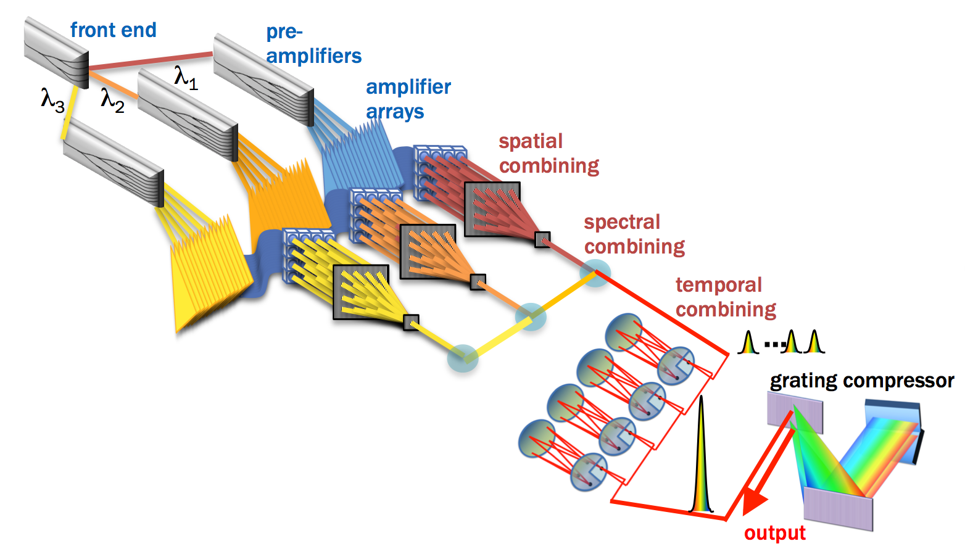
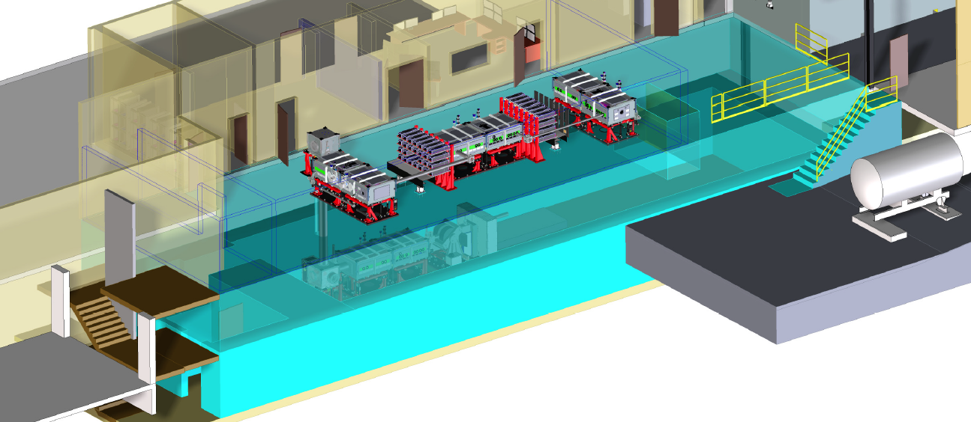
Development of efficient Laser Drivers for Inertial Fusion
IFE requires drivers at 10s of percent efficiency
  But current laser drivers < 1% (flash lamps)
High efficiency laser technology program
  Leverages our development of lasers for particle accelerators
  Diode pumping, fiber combination, paths to ≥30%
The combination of fibers offers efficient driver options
for IFE
The proposed kBELLA
high average power laser
Contact: EHEsarey@lbl.gov
Notes:
Talking points: basically the bullet points on the slide.

Slide 9
Research environment for fusion at LBNL
Physical Sciences
Computing Sciences
Magnets
Lasers
Supercomputers
Fast networks
Superconducting
magnet program
BELLA Center
NERSC
ESnet
Beams
Simulations
Applied maths & comput. sc.
Data science, AI/ML
Fusion science &
ion beam tech.
Advanced modeling
App. Math & Comp. Research Division
Scientific Data Div.

Slide 10
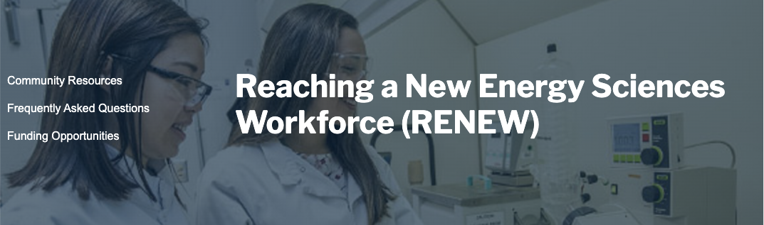
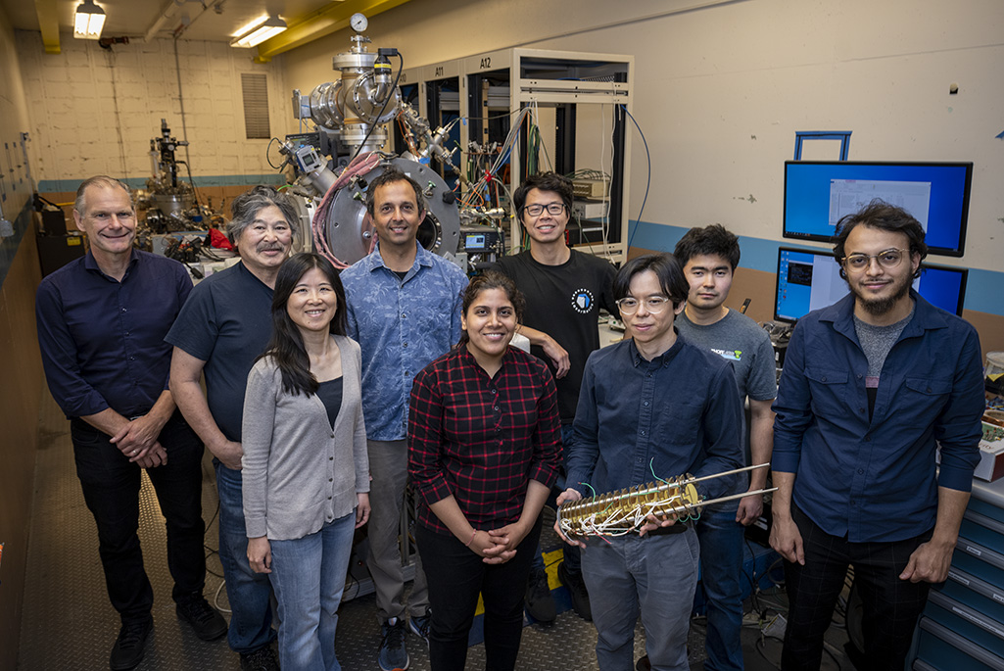
RENEW – fusion workforce development with lasers and ion beams for materials and qubit studies
RENEW project start co. Alice Koniges, University of Hawaii, Manoa, connecting simulations with experiments for high energy density science, materials and qubit synthesis far from equilibrium
Great integration with LaserNetUS beamtimes and FES support of quantum information science
https://newscenter.lbl.gov/2023/08/22/advances-in-quantum-emitters-mark-progress-toward-a-quantum-internet/
Redjem, W., Zhiyenbayev, Y., Qarony, W. et al. All-silicon quantum light source by embedding an atomic emissive center in a nanophotonic cavity. Nat Commun 14, 3321 (2023). https://doi.org/10.1038/s41467-023-38559-6
Redjem, W., Amsellem, A.J., Allen, F.I. et al. Defect engineering of silicon with ion pulses from laser acceleration. Commun Mater 4, 22 (2023). https://doi.org/10.1038/s43246-023-00349-4
Contact: t_schenkel@lbl.gov

Slide 11
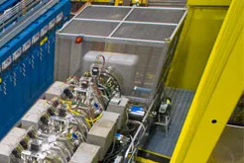
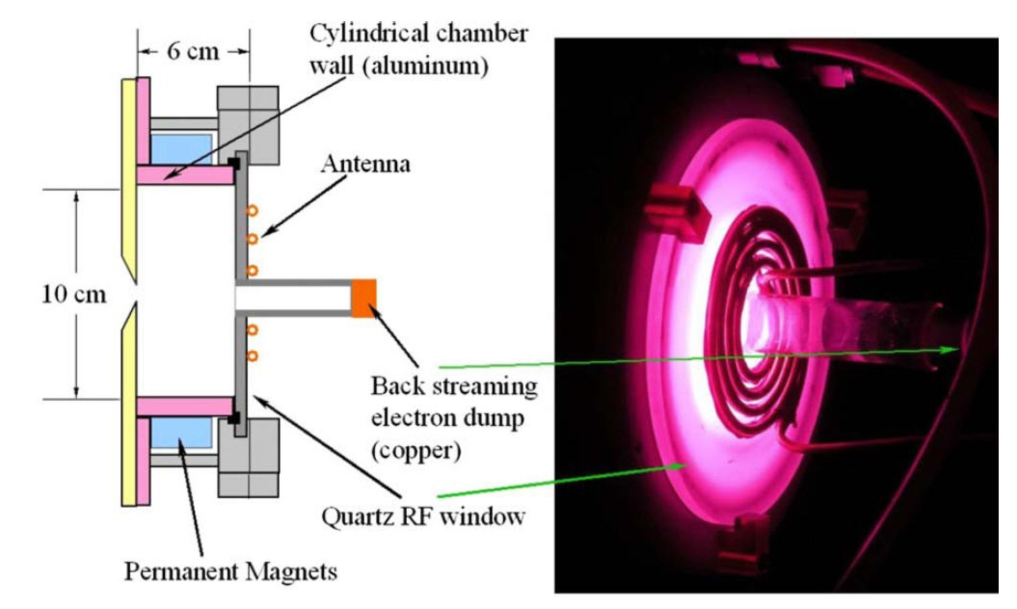
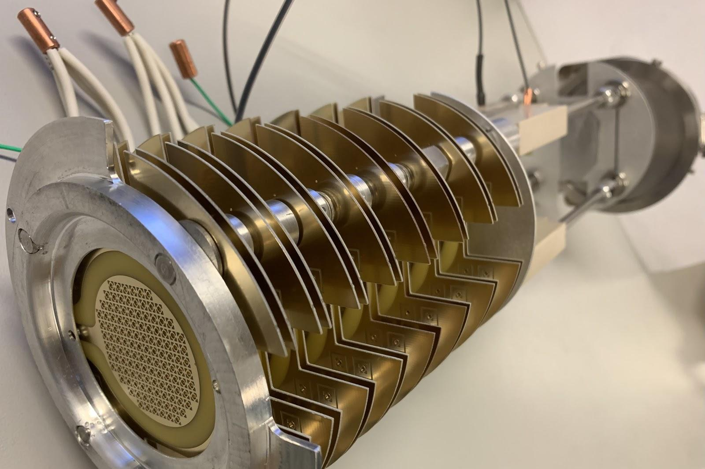
Development of neutral beam injectors for the burning plasma era
150 kV injector with R&D ion beamline
Past: Berkeley Lab has developed ion beams and neutral beam injectors for plasma heating back in the 1980s
Today, we are active in the development of high-power ion beams (positive and negative)
Looking forward:
  Need for efficient neutral beam injectors in fusion
    ➔ for plasma heating & control in the burning plasma era
  Opportunities for new private-public partnerships and collaborations ➔ Emerging partnership with REALTA Fusion, …
RF driven
hydrogen ion source
with external antenna
Compact RF ion linac can accelerate ions to 150 keV
in ~100 parallel beams using a stack of low cost wafers
[Q. Ji, et. al., Rev. Sci. Instr. 92, 103301 (2021)]
Contact: t_schenkel@lbl.gov

Slide 12
Research environment for fusion at LBNL
Physical Sciences
Computing Sciences
Magnets
Lasers
Supercomputers
Fast networks
Superconducting
magnet program
BELLA Center
NERSC
ESnet
Beams
Simulations
Applied maths & comput. sc.
Data science, AI/ML
Fusion science &
ion beam tech.
Advanced modeling
App. Math & Comp. Research Division
Scientific Data Div.

Slide 13


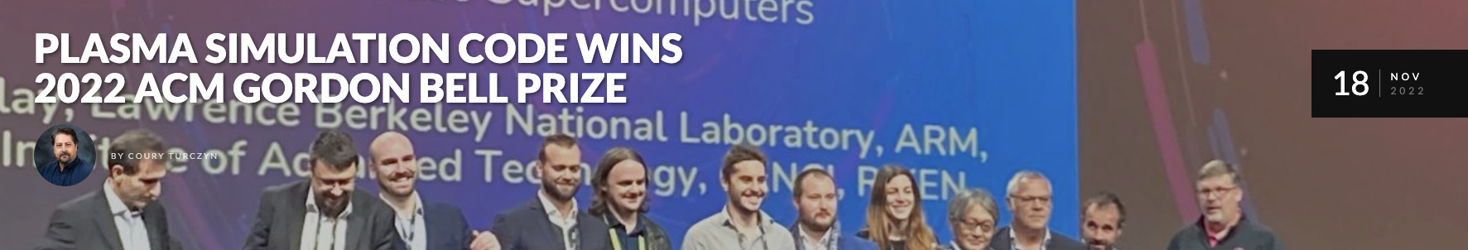
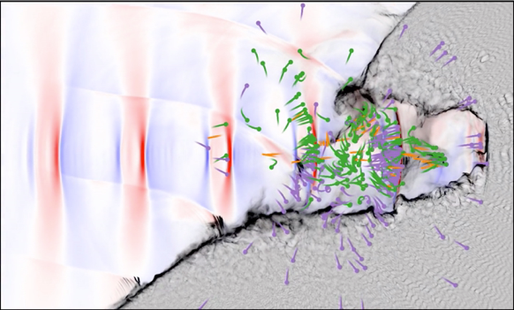


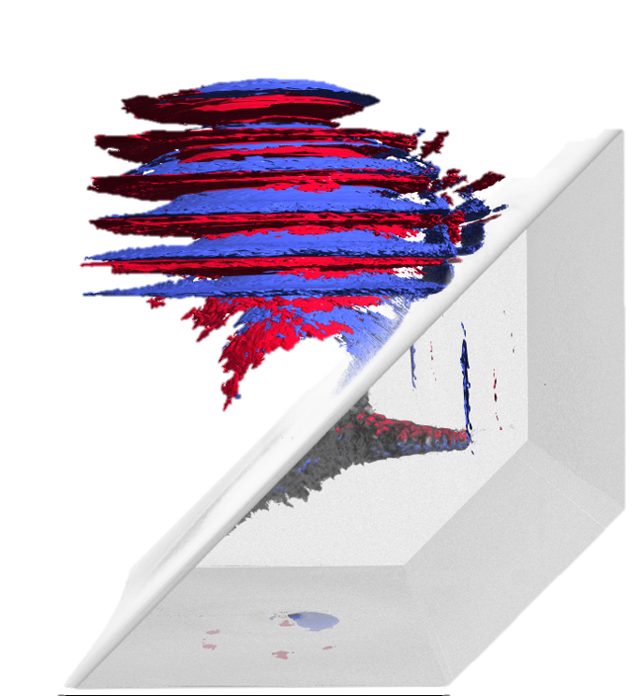

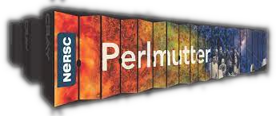
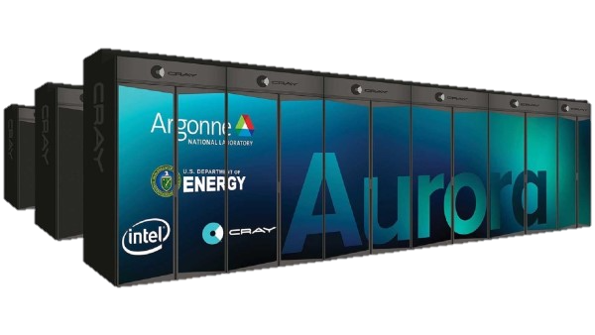
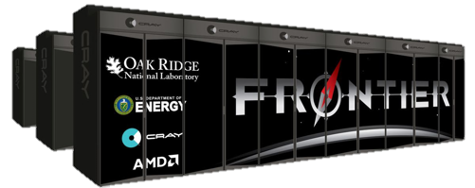



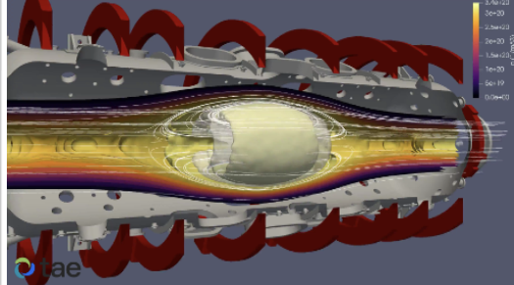






WarpX is our flagship code
for fusion and plasma physics modeling
Many fusion-relevant features in WarpX
WarpX is an advanced Particle-In-Cell code
Winner of the 2022
Gordon Bell Prize
Fully open-source & documented
github.com/ECP-WarpX/WarpX
warpx.readthedocs.io
Runs on largest CPU or GPU-based supercomputers, as well as on single-user laptops or desktops
Developed by international team of contributors
Full support for laser-plasma interactions
Monte-Carlo modules for:
  fusion reactions
  Coulomb collisions
  ionization physics
  …
Support for arbitrarily-shaped
metallic boundaries
(e.g., from STL files)
Python interface allows
full customization by
users
Top500
#12
#2
#1
Contact: jlvay@lbl.gov

Slide 14

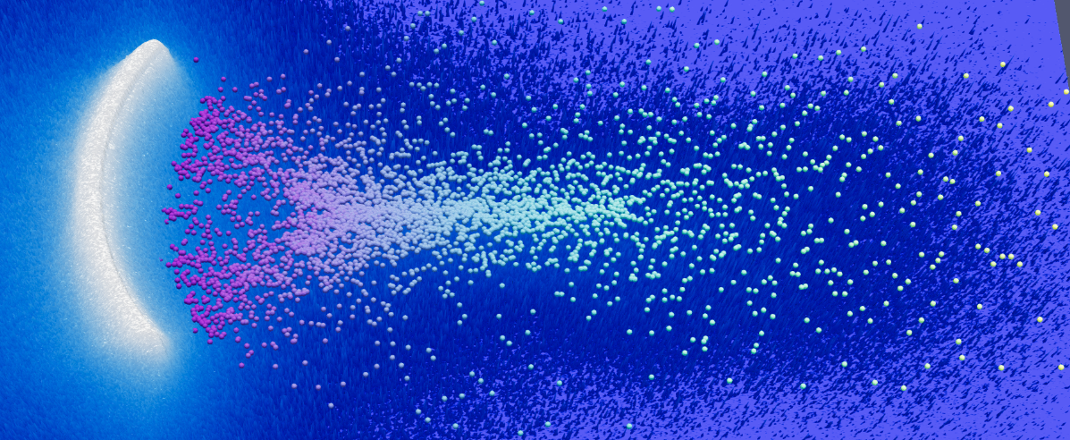
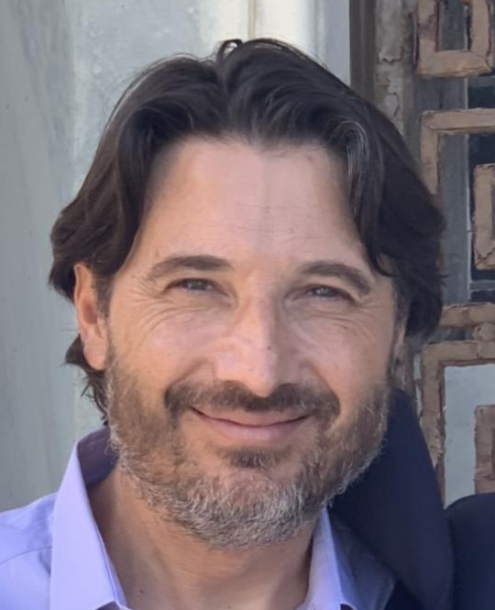
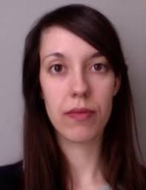
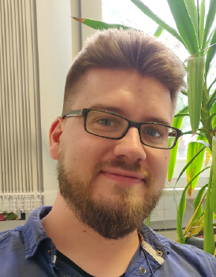
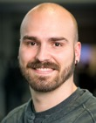
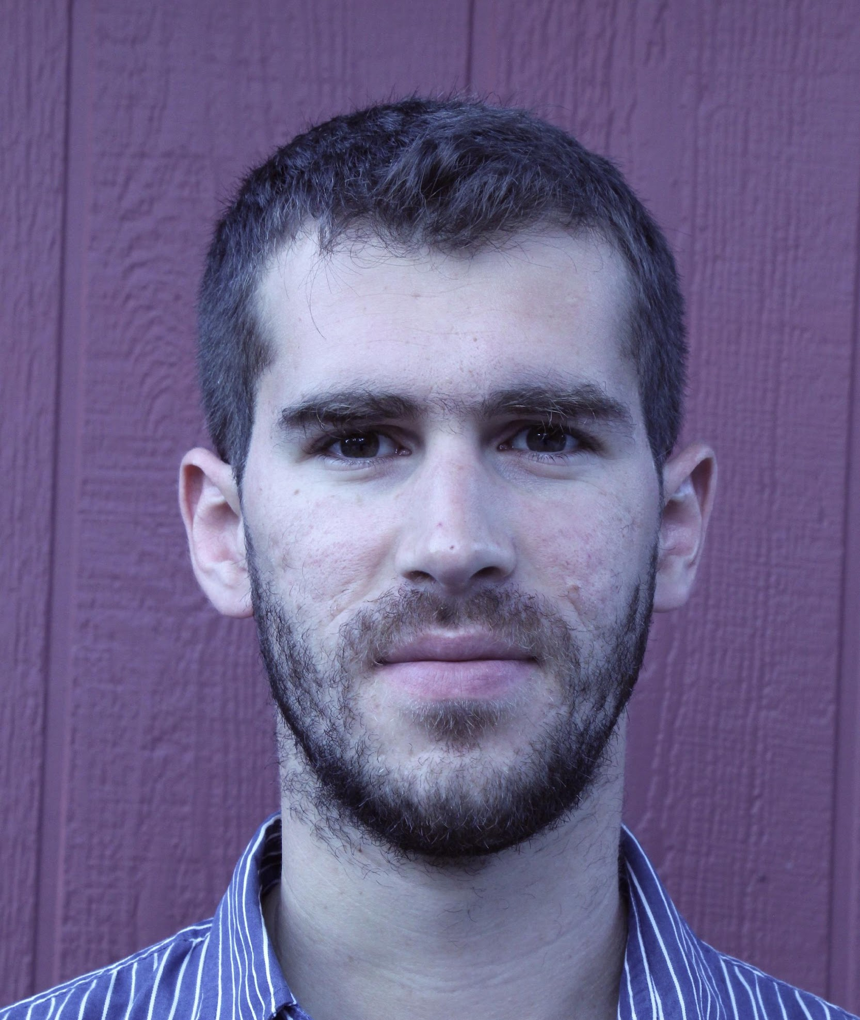
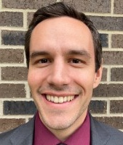


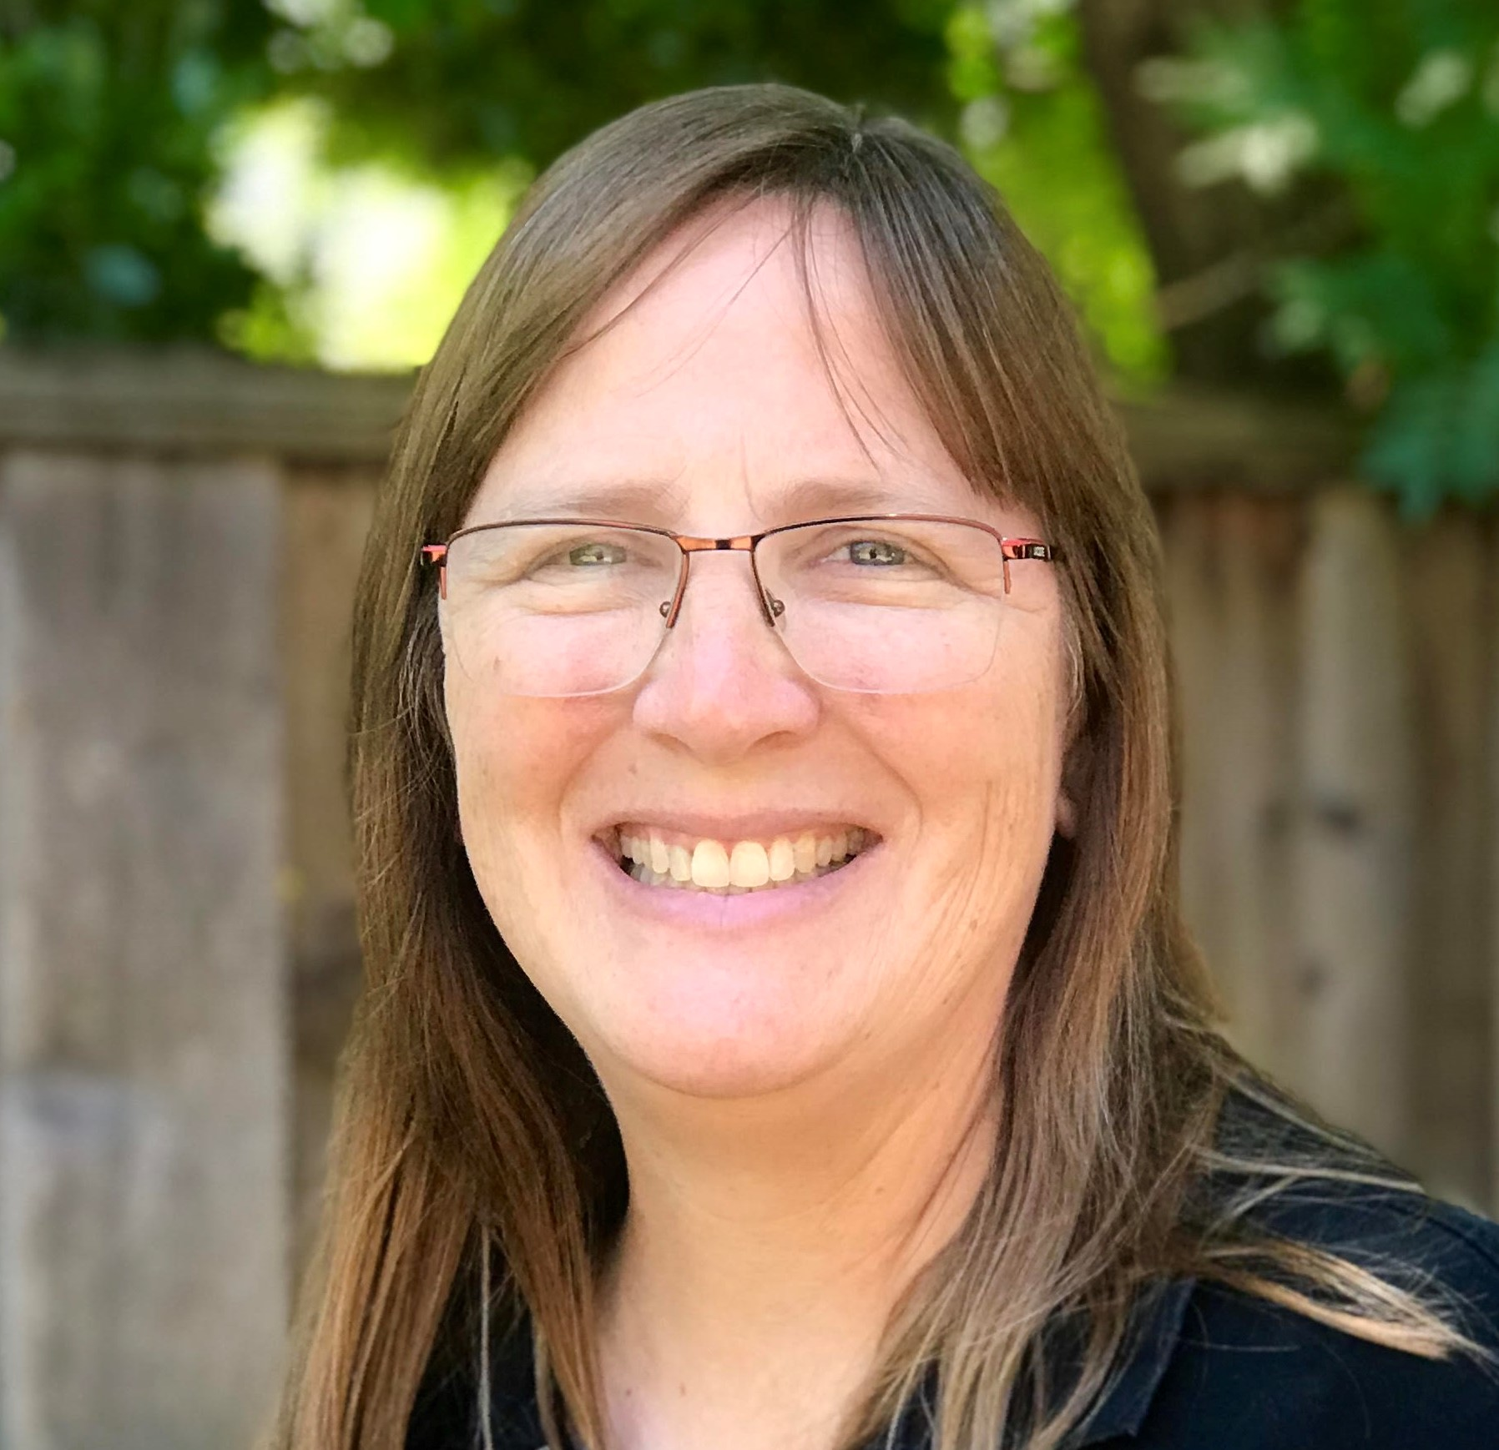









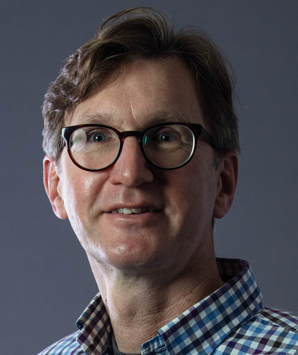
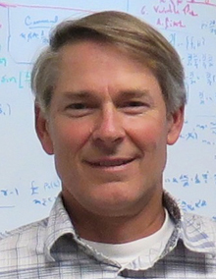


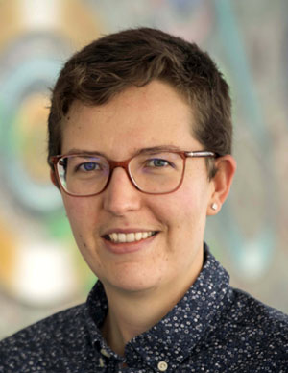
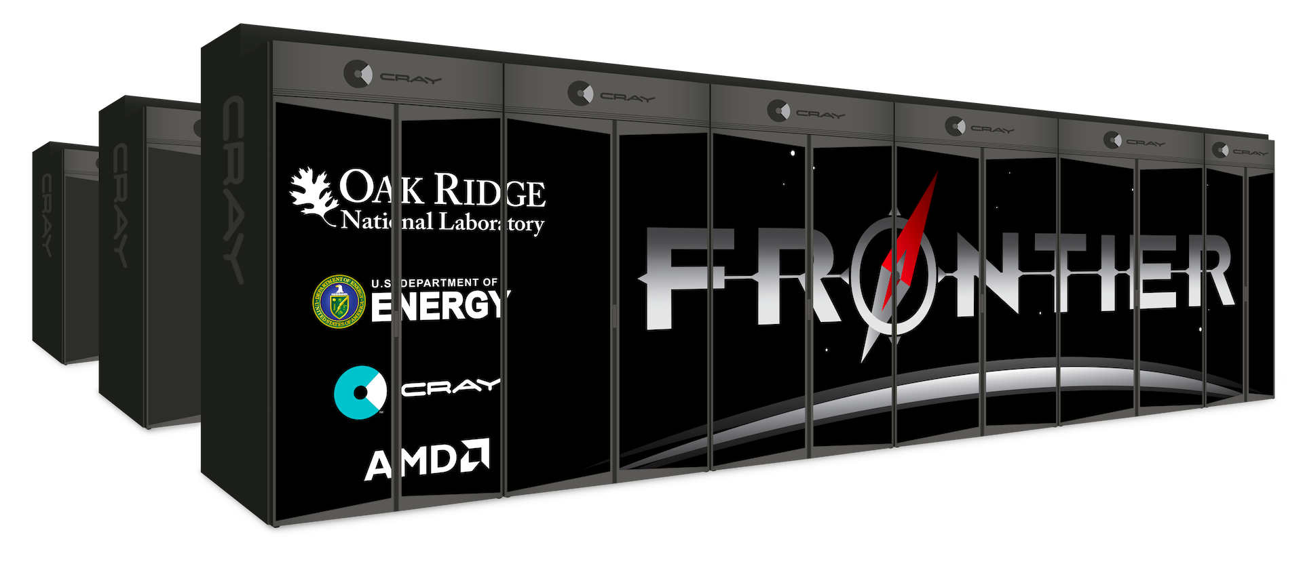

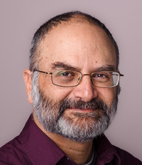
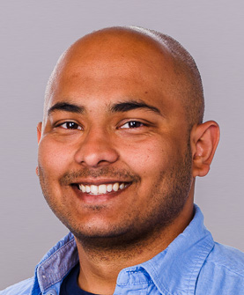

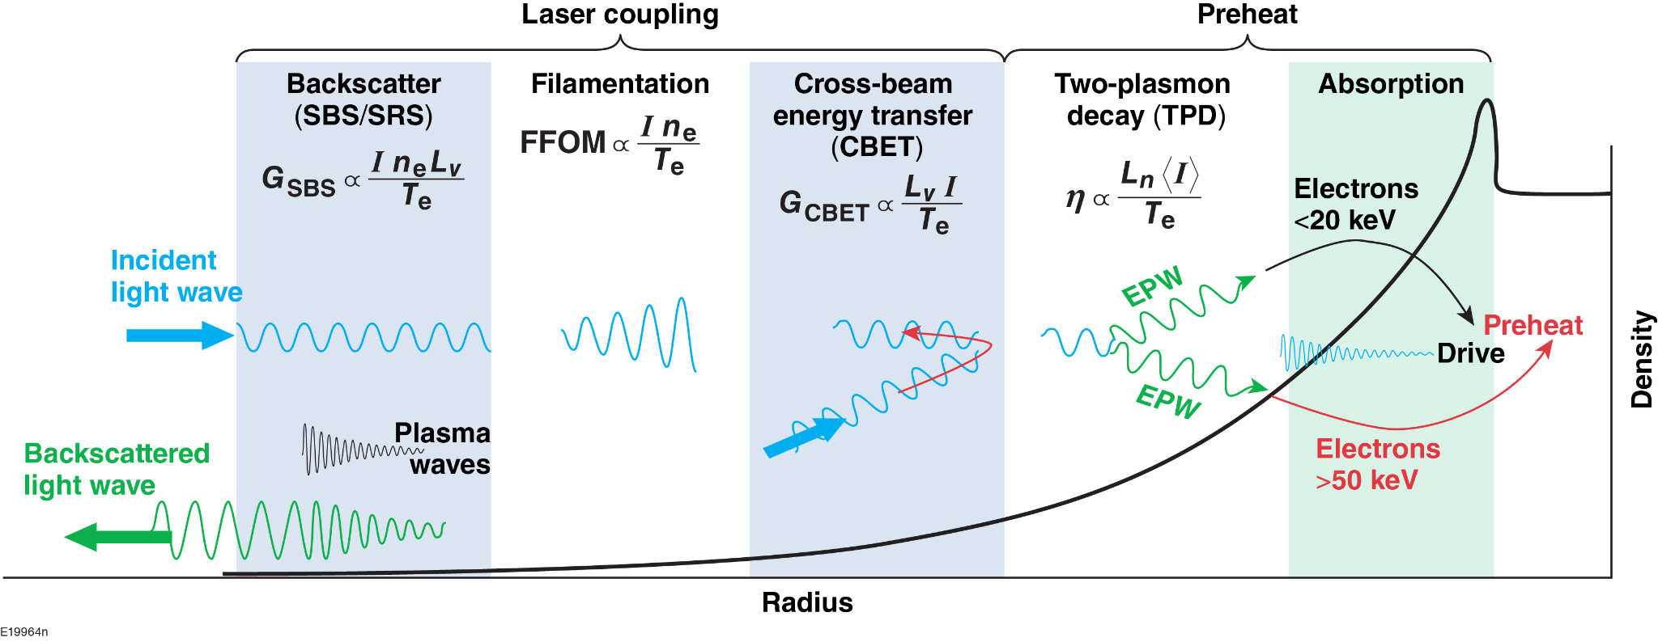
Kinetic IFE Simulations at Multiscale with Exascale Technologies
K I S M E T
PIC algorithms & WarpX Code, Plasma Modeling
AMReX, Solvers
Target Surface & Hotspot
Physics, Implicit Solvers
Low Density Plasma Physics,
Laser Absorption & Transport
Data Visualization & Analysis
Four Physics Thrusts
  low-density plasma physics
  laser absorption & transport
  target surface
  hotspot physics
Thrusts
Two Computational Thrusts
  Particle-In-Cell algorithms & WarpX
  Scalable data visualization & analysis
Contact: jlvay@lbl.gov

Slide 15
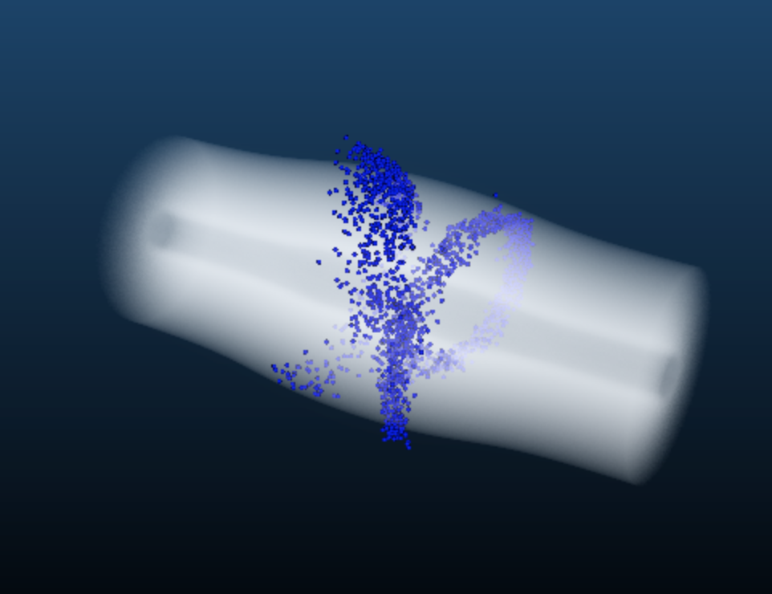
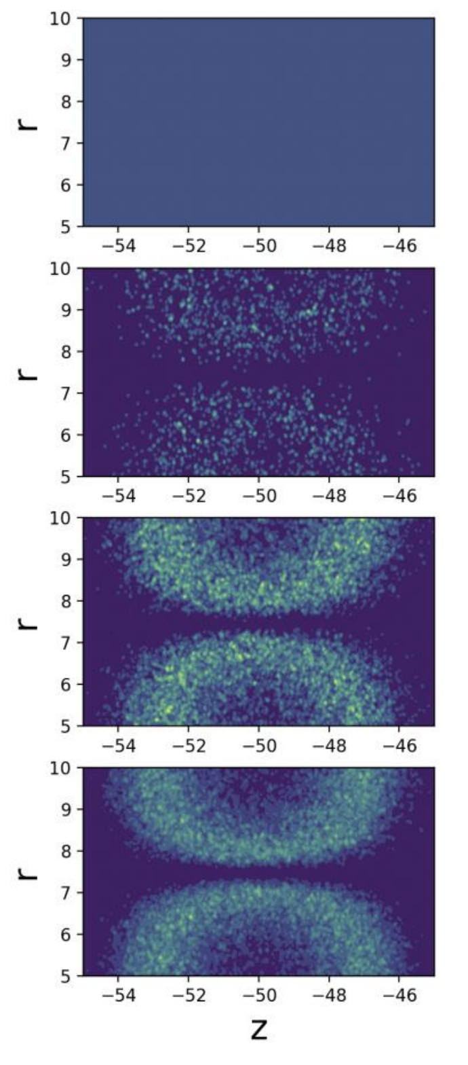
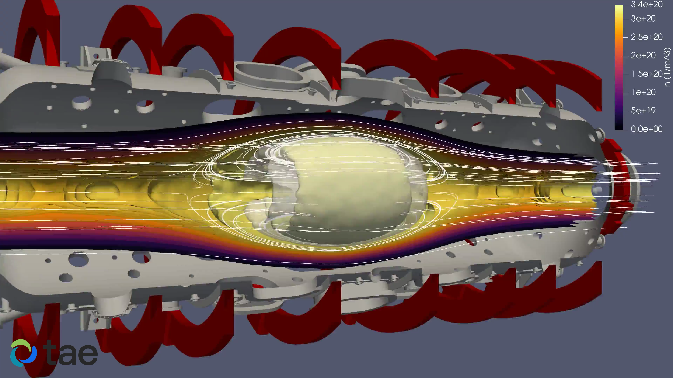
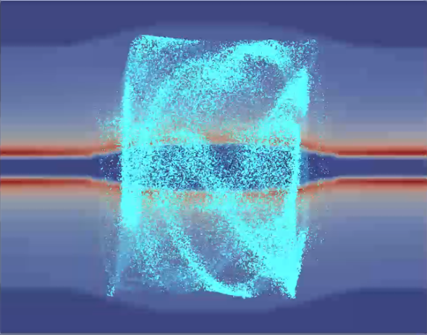

WarpX is also used (and developed) by private fusion companies
Example of hypothetical FRC disruption simulation using the extended WarpX
NERSC Perlmutter
multi-A100 simulations
10⁹ particles, 10⁶ cells, 10⁵ steps ➔ ~1 day time to solution
Modeling of a z-pinch plasma source with WarpX:
simulating electron density over 1ns shows how the early onset of breakdown may look
using a background neutral gas profile from a CFD calculation
Modeling of Orbitrap with WarpX
T=0
T=0.66ns
T=0.33ns
T=1ns
Contact: jlvay@lbl.gov

Slide 16
Research environment for fusion at LBNL
Physical Sciences
Computing Sciences
Magnets
Lasers
Supercomputers
Fast networks
Superconducting
magnet program
BELLA Center
NERSC
ESnet
Beams
Simulations
Applied maths & comput. sc.
Data science, AI/ML
Fusion science &
ion beam tech.
Advanced modeling
App. Math & Comp. Research Division
Scientific Data Div.

Slide 17





LDRD “Toward Superfacilities for High Energy Density
and Inertial Fusion Energy Science”
Bella iP2 – 1Hz
Physical Sciences
Computing Sciences
Lasers
Supercomputers
Fast networks
BELLA Center
NERSC
ESnet
Automated feedback
Simulations
Applied maths & comput. sc.
Data science, AI/ML
Advanced modeling
App. Math & Comp. Research Division
Scientific Data Div.
with AI/ML

Slide 18
Conclusion
Physical Sciences
Computing Sciences
Magnets
Lasers
Supercomputers
Fast networks
LBNL is ramping up its efforts in Fusion research along several areas with unique facilities and workforce
  Magnets, lasers, particle beams, advanced modeling, AI/ML, supercomputing, fast networks, superfacilities, …
Looking forward to our participation toward Fusion demos, pilot &
production power plants.
Superconducting
magnet program
BELLA Center
NERSC
ESnet
Beams
Simulations
Applied maths & comput. sc.
Data science, AI/ML
Fusion science &
ion beam tech.
Advanced modeling
App. Math & Comp. Research Division
Scientific Data Div.

Slide 19


Thank you! Questions?
Thank you! Questions?
jlvay@lbl.gov

