Slide 1

Focused Energy roadmap for Inertial Fusion Energy
Pravesh Patel, Scientific Director
43rd Annual Meeting, Fusion Power Associates
December 7-8, 2022

Slide 2
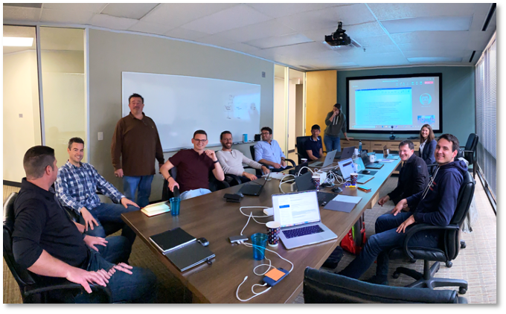
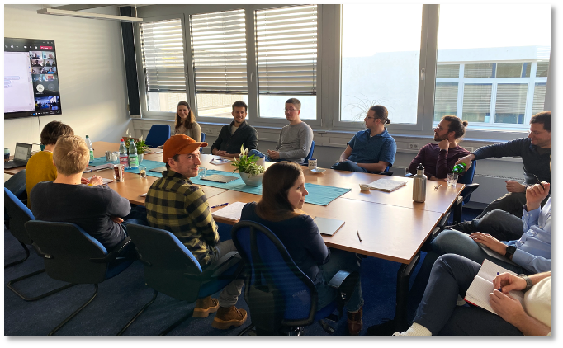

Focused Energy was founded in July 2021 with the goal to develop an IFE fusion pilot plant by the late 2030’s
FE is a U.S. company based in Austin, TX, with a subsidary in Darmstadt, Germany
We have grown to a team of 50 employees in the first 15 months
Notes:
US company based in Austin with a subsidiary in Germany based in Darmstadt

Slide 3
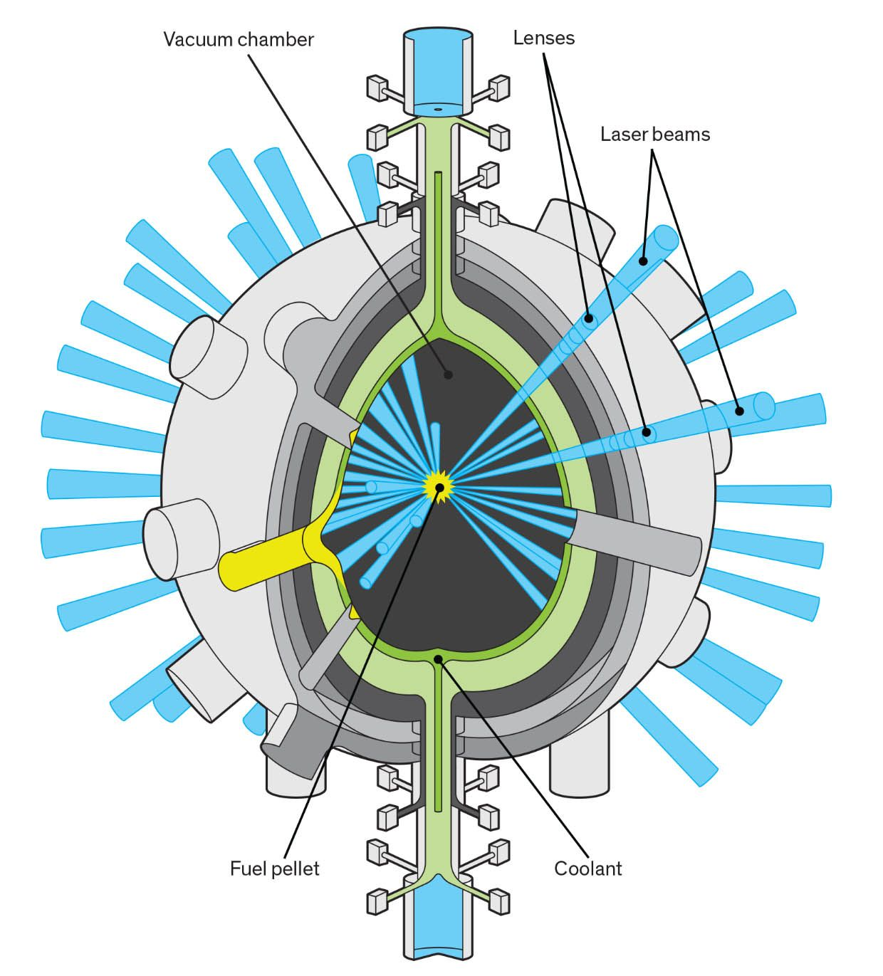
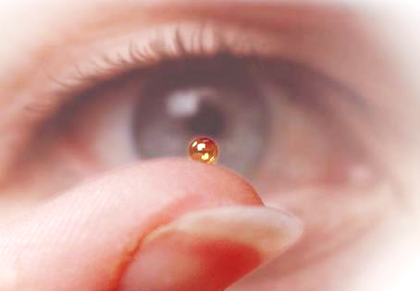
Our approach is based on laser-driven IFE
DT fuel pellet
Illustration: Chris Philpot
In IFE, a high-power laser is used to compress and ignite tiny pellets of DT fuel at the center of a reaction chamber at repetition rates of ~10 Hz

Slide 4
IFE has a number of features that make it attractive for a fusion pilot plant
No active plasma confinement needed
No active shutdown mechanism needed
First wall material challenges are simplified by large physical distance between the plasma and wall
Low tritium start-up and on-site inventory, and possibility of T-lean fuel
Highly modular system (separated laser beams, separated targets) is good for RAMI, and upgradability
Laser-driven IFE also leverages multi-billion-dollar investments by DOE over 50 years in inertial confinement fusion science and laser technology

Slide 5


These investments led, in 2021, to the first laboratory demonstration of ignition, and a Lawson parameter>1
1.38 MJ
1.38 MJ
$$\frac{d2T}{dt2}>0$$
$$\frac{dT}{dt}>0$$
A. Zylstra et al., Nature 601, 542 (2022)
H. Abu-Shawareb et al., PRL 129, 075001 (2022)
P. Patel et al., Phys. Plasmas 27, 050901 (2020)
Notes:
Those investments led to a break through achievement last year

Slide 6
An IFE-based FPP has several key S&T requirements
Target design with a gain, G>100, demonstrating robust, repeatable performance
Diode-pumped laser system operating at 10 Hz with high efficiency, and low production and maintenance costs
Target mass manufacturing and automated assembly and delivery at low cost
Target injection system operating at 10 Hz in a reactor environment
Reactor chamber, first wall, and plasma facing components design compatible with pulsed neutron, ion, and x-ray source spectrum
Tritium fuel cycle and minimization of on-site inventory
Notes:
We will focus on the first, how to produce high gain, in a robust, repeatable manner

Slide 7
An IFE-based FPP has several key S&T requirements
Target design with a gain, G>100, demonstrating robust, repeatable performance
Diode-pumped laser system operating at 10 Hz with high efficiency, and low production and maintenance costs
Target mass manufacturing and automated assembly and delivery at low cost
Target injection system operating at 10 Hz in a reactor environment
Reactor chamber, first wall, and plasma facing components design compatible with pulsed neutron, ion, and x-ray source spectrum
Tritium fuel cycle and minimization of on-site inventory
Notes:
We will focus on the first, how to produce high gain, in a robust, repeatable manner

Slide 8
The mechanism by which ICF can achieve high fusion gain is hot-spot ignition
For ignition and efficient burn you need:
T > 5 keV (fusion power > radiation loss)
ρR > 2-3 g/cm² (burn-up fraction of >20-30%)
DT fuel
(T, ρ, R)

Slide 9
The mechanism by which ICF can achieve high fusion gain is hot-spot ignition
For ignition and efficient burn you need:
T > 5 keV (fusion power > radiation loss)
ρR > 2-3 g/cm² (burn-up fraction of >20-30%)
DT fuel
If you take 200 µg DT:
Heating it to 5 keV would require 120 kJ energy
But, you only need to heat a small region of fuel (ρR~0.3 g/cm²), corresponding to ~10 µg, or 5 kJ energy
Alpha-heating will then bootstrap the temperature in this region to >20 keV, launching a propagating burnwave into the rest of the fuel.
Hence, the term hot-spot ignition—from just 5 kJ of energy in the hot spot you can produce 10’s of MJ of fusion energy
(T, ρ, R)

Slide 10
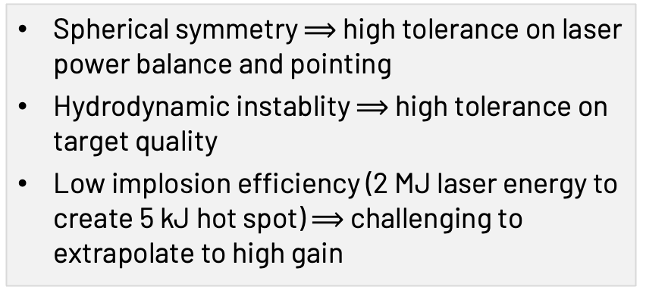
Conventional method for ignition is central hot-spot
Central hot-spot ignition
Thin shell, high convergence, high vel. implosion to simultaneously achieve high ρR & T
fuel
hot
spot
Spherical symmetry $⟹$ high tolerance on laser power balance and pointing
Hydrodynamic instablity $⟹$ high tolerance on target quality
Low implosion efficiency (2 MJ laser energy to create 5 kJ hot spot) $⟹$ challenging to extrapolate to high gain
Notes:
FI has been extensively studied for 20 years, but

Slide 11
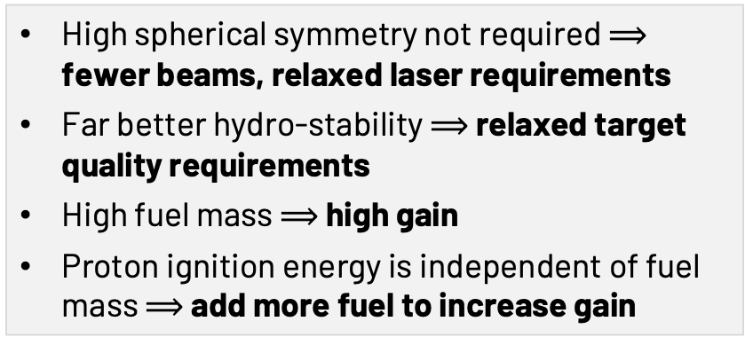
But you don’t need to ignite from the center…
Central hot-spot ignition
Proton fast ignition
Thin shell, high convergence, high vel. implosion to simultaneously achieve high ρR & T
High mass, thick shell at low conv. for high ρR
External heat source for high T
fuel
fuel
hot
spot
hot
spot
Laser-generated proton beam
Spherical symmetry $⟹$ high tolerance on laser power balance and pointing
Hydrodynamic instablity $⟹$ high tolerance on target quality
Low implosion efficiency (2 MJ laser energy to create 5 kJ hot spot) $⟹$ challenging to extrapolate to high gain
High spherical symmetry not required $⟹$ fewer beams, relaxed laser requirements
Far better hydro-stability $⟹$ relaxed target quality requirements
High fuel mass $⟹$ high gain
Proton ignition energy is independent of fuel mass $⟹$ add more fuel to increase gain
M. Tabak et al., Phys. Plasmas 1, 1626 (1994)
Notes:
FI has been extensively studied for 20 years, but

Slide 12
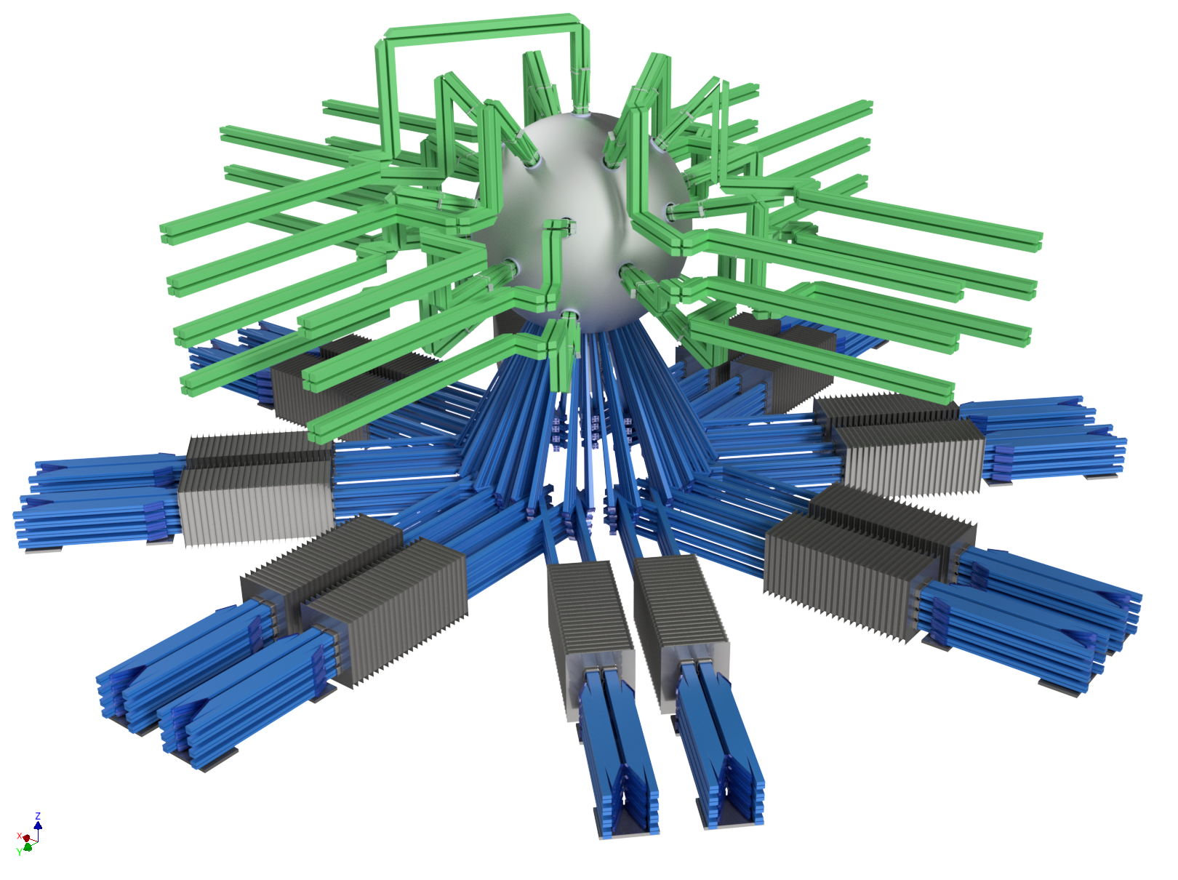
Our most important milestone on the path to an FPP is to demonstrate scientific energy gain through PFI
Super-NOVA
400-600 kJ 2ω LP laser (100 beams, 25 quads)
150 kJ 1ω SP laser (100 beams)

Slide 13
Our most important milestone on the path to an FPP is to demonstrate scientific energy gain through PFI
Super-NOVA
400-600 kJ 2ω LP laser (100 beams, 25 quads)
Key technology advancements
Liquid-cooled amplifiers capable of firing one shot every 3 minutes
DT wetted foam targets
Automated robotic target assembly, delivery, insertion
Automated data analysis, interpretation, and feedback to optimize performance
Super-NOVA will be a NIF-like ignition facility capable of >100 experiments a day — will vastly accelerate rate of progress in target design & optimization
150 kJ 1ω SP laser (100 beams)

Slide 14
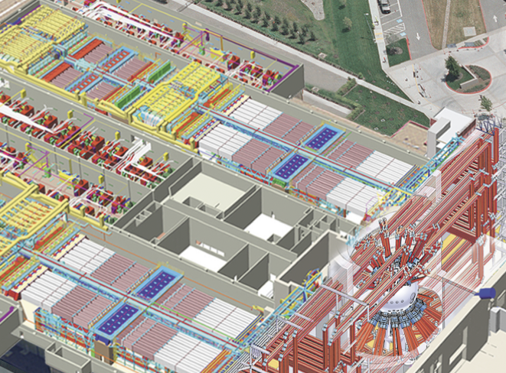
We believe this is the right facility as a stepping stone to an IFE fusion power plant
National Ignition Facility
IFE
Fusion Power Plant (QUASAR)
1-2 shots a day
100 shots a day
10 Hz
DT beta layering
DT foam
DT foam
Manual targets
Automated target systems
Automated target injection

Slide 15
pravesh.patel@focused-energy.world

