Slide 1
FUSION POWER ASSOCIATES
43RD Annual Meeting and Symposium
Office of Experimental Sciences, Defense Programs
National Nuclear Security Administration
Dr. Sarah L. Nelson* (Presented by Dr. Jeffrey Quintenz)
Director, Office of Experimental Sciences (OES)
December 7, 2022
* sarah.nelson@nnsa.doe.gov, (202) 586-8833

Slide 2
The NNSA Mission
NNSA Priorities
Maintain the safety, security, and effectiveness of the nation’s nuclear deterrent
Reduce global nuclear security threats and strengthen the nuclear enterprise
Provide safe and effective integrated nuclear propulsion systems for the U.S. Navy
Strengthen key science, technology, and engineering capabilities
Modernize the national security infrastructure
DOE Mission
To ensure America’s security and prosperity by addressing its energy, environmental, and nuclear challenges through transformative science and technology solutions
Notes:
Point out the role of big DOE

Slide 3
The NNSA Office of Experimental Science delivers the world-class scientific data, facilities, and expertise required support the modern nuclear stockpile
Science
Computer Simulation
Inertial Confinement Fusion
Technology Maturation
Engineering
RDT&E
For maintaining the effectiveness of the nuclear weapons stockpile, providing a technical basis for the annual assessment, developing modernization options, and quantifying the effects of aging on the stockpile
VISION: A world-class scientific enterprise for stockpile stewardship that creates and applies 21st century science capabilities to anticipate and address existing and emergent stockpile needs, and thwart unforeseen threats
MISSION: Ensure a resilient US nuclear deterrence posture by delivering world-class data, facilities, and expertise required to undergird the effectiveness and responsiveness of the modern stockpile
Office of
Experimental
Sciences
Notes:
OES provides the data needed for the NNSA national security mission described previously.

Slide 4
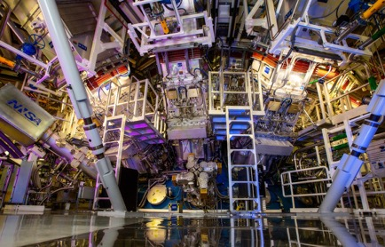
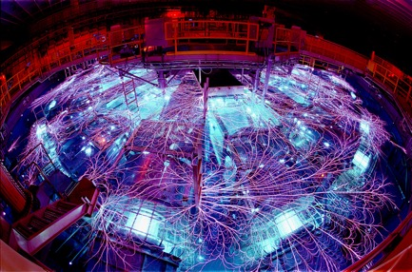
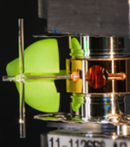

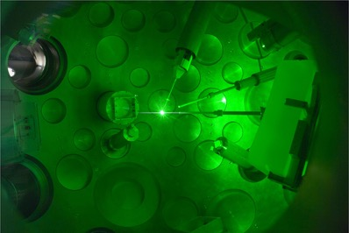
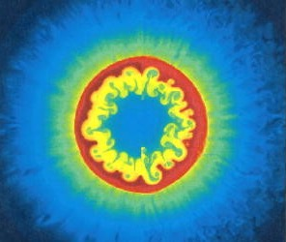
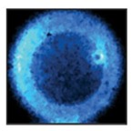
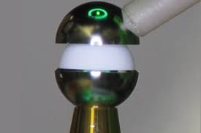
Achieving a burning plasma is a priority for the NNSA
NIF, Laser Indirect Drive
Z, Magnetic Direct Drive
Omega, Laser Direct Drive
LANL, HED and ICF physics investigations
General Atomics, Targets
Notes:
Each of the three NNSA science and engineering national labs are actively working on ICF, as are partners at LLE and GA.
This is a priority activity for the NNSA. We intentionally approach it using different techniques, because each has its own unique benefits and challenges.

Slide 5
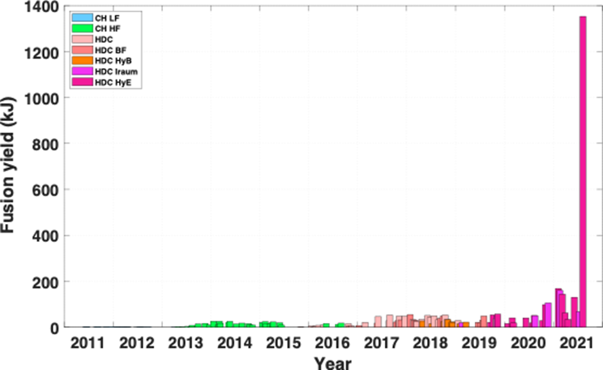
NIF August 8, 2021 experiment – a major leap forward
- increased interest in Inertial Fusion Energy (IFE)
HyE/Iraum (1.35 MJ)
Increased coupling
and compression
Understanding
degradations
Better targets
Reduced LPI
Reduced fill tube
Diamond ablator
Improved symmetry
HyE/Iraum
(100+ kJ)
Improved stability
NIC
(2.5 kJ)
High-foot
(25 kJ)
HDC/BF
(55 kJ)
Notes:
I’m not just being optimistic saying that we’re closer than ever before. We have the data to prove it.
We’ll hear more about this from the scientists involved in this shot, so I won’t go into any technical detail here, beyond to say that is a great success made possible by years of hard work and perseverance.

Slide 6
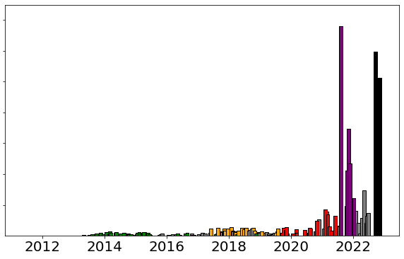
On August 8, 2021, we entered a new performance and physics regime putting us on the threshold of ignition
Achieving such yields required a concerted long-term effort to improve our:
Target quality
Laser accuracy
Diagnostic capabilities
Design
Repeat attempts had yields in the 0.4-0.8MJ range
Applying our wide suite of diagnostics, we have improved our understanding of this new regime
Improved understanding has led design refinements that have achieved 1.2MJ and 1.0MJ yields in 2 recent experiments
1.4
N210808
1.2
N220919
1.0
N221107
Fusion energy [MJ]
0.8
0.6
0.4
0.2
0.0

Slide 7
NNSA ICF program benefits IFE development while maintaining the primacy of its Stockpile Stewardship mission
The fusion output goal for the ICF program is high yield (>100 megajoules)
Inertial Fusion Energy (IFE) requires net energy gain and high-repetition rate in addition to high yield
NNSA supports OFES research into IFE in areas of dual benefit
Workforces for both ICF and IFE programs have complementary and often overlapping expertise requirements
There are areas of potential sensitivity or concern including export control and non-proliferation
Achieving the ICF goal is on the path to IFE

Slide 8
While there are clear differences in the mission, there are some technologies are of interest to both stewardship and IFE priorities
Stockpile Science
Fusion Energy
Precision laser & current delivery
High efficiency drivers
Technology: High rep-rate lasers, & pulsed power
Final optics & recyclable transmission lines
Static target alignment
Engaging and tracking moving targets
Target metrology
Target mass production
Target fabrication with SSP materials
Target Physics Diagnostics
Tritium processing & breeding
Target physics modeling
Chamber hardening for radiation and shock
DOE-NNSA funded
DOE-SC / ARPA-E funded
Not currently funded
Economics
Machine Learning & Cognitive Simulations
Systems engineering

Slide 9
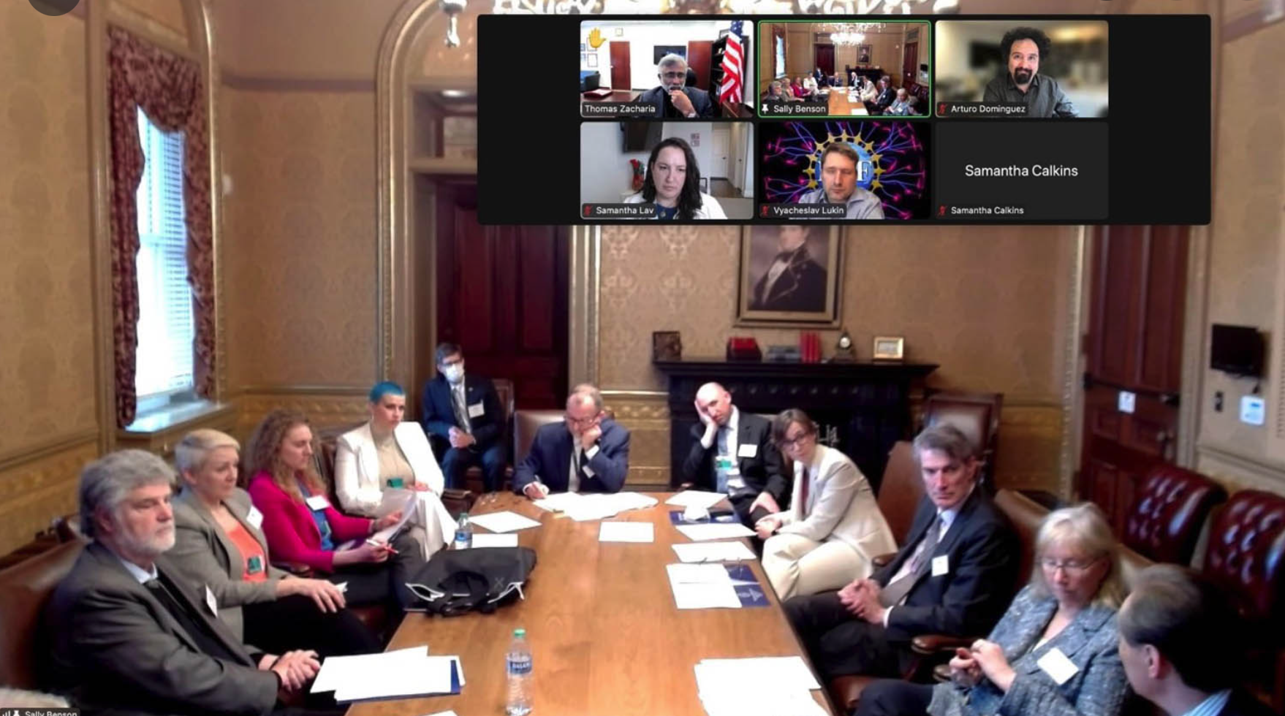
The Pursuit of Inertial Fusion Energy
The NNSA is part of the Department of Energy effort to realize the promise of Inertial Fusion Energy.
The long-standing inertial confinement fusion (ICF) mission of the NNSA means we have significant expertise in many of the technical aspects of IFE, including:
  Diagnostics,
  Modeling and simulation,
  Target fabrication,
  many others…
Members of the NNSA participated in the White House Summit on Developing a Bold Decadal Vision for Commercial Fusion Energy (March 2022) and continue to work with the DOE “cross-cut teams.”
Notes:
Introduction
Highlight that national security is the NNSA mission (from https://www.energy.gov/nnsa/about-nnsa)

Slide 10
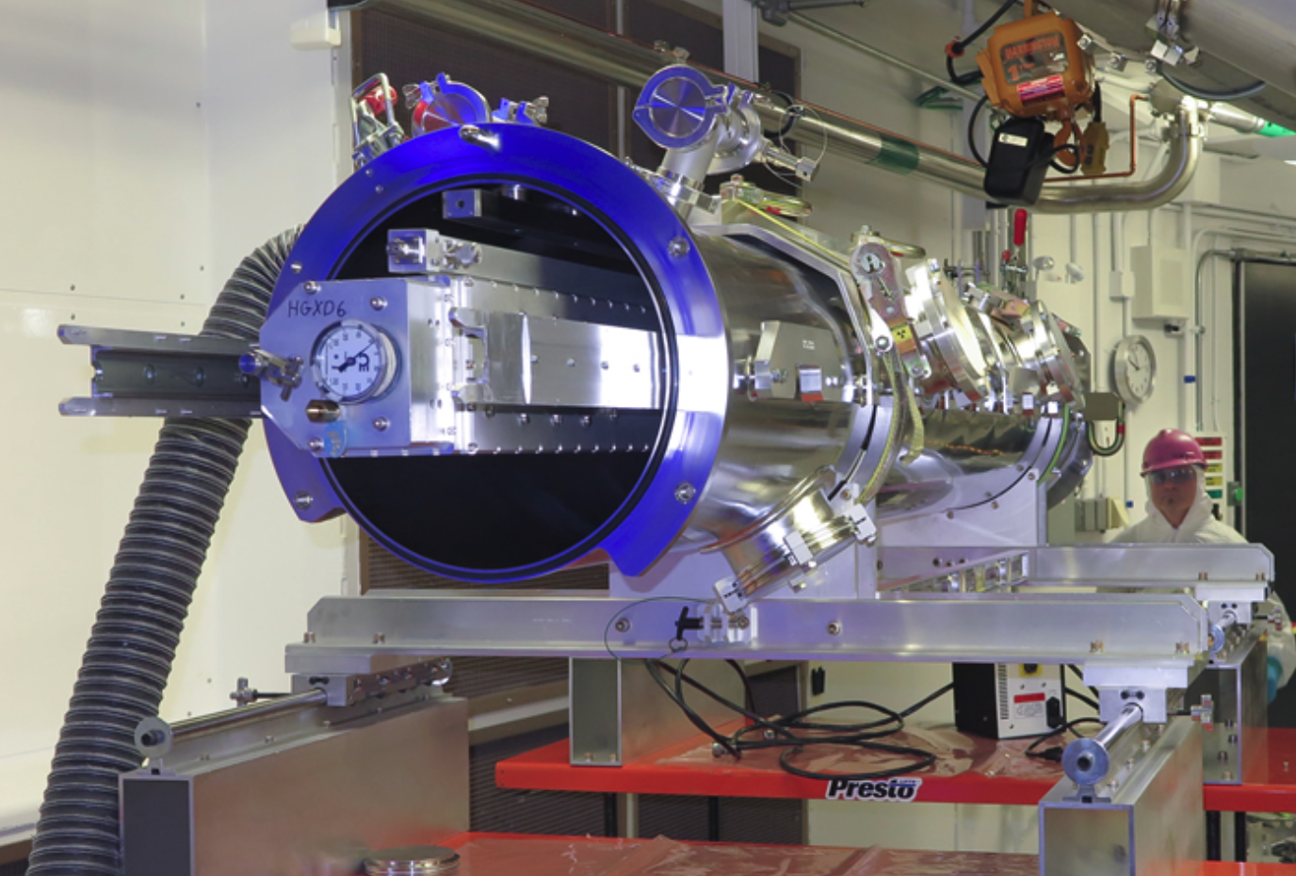
The Pursuit of Inertial Fusion Energy
Through the DOE “cross-cut teams” activities we are identifying places where our existing efforts, including diagnostic development and simulation and modeling, can contribute to the IFE effort.
However:
The NNSA does not have a mission (or funding) to pursue energy production.
The hardened gated x-ray detector (HGXD) is a fundamental diagnostic to measure x-ray emissions from the core of an ICF capsule. The HGXD is hardened against radiation damage for use in high-yield experiments. Credit: NIF; James Pryatel.
Notes:
Introduction
Highlight that national security is the NNSA mission (from https://www.energy.gov/nnsa/about-nnsa)

Slide 11
Questions?

Slide 12
Backup Slides

Slide 13
Some of the different needs of SSP vs IFE

Slide 14
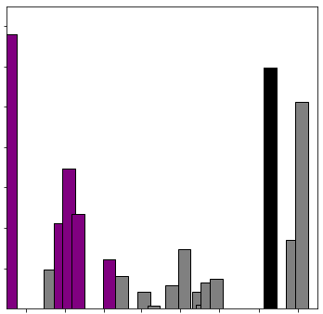
The “more stable design” path has produced two additional experiments yielding over a megajoule
1.5
N210808
1.35MJ yield: 1.9MJ of laser energy and standard thickness
1.2MJ yield: 2.05 MJ of laser energy and +6μm thicker capsule
  Higher laser energy and thicker targets provide a path to increased energy and less sensitivity to capsule fuel mix
1.0MJ yield: 1.9MJ of laser energy and a denser capsule
  Denser capsule increases dwell time at highest pressures
N220919
N221107
1.0
Fusion energy [MJ]
Repeats
0.5
0.0
The first experiment with higher quality target capsules is scheduled for February, 2023
Aug.
2021
Jan.
2022
Oct.
2022

