Slide 1
The Strategic Dimensions of the Fusion Energy Challenge
Dr. Florentino PORTERO

Slide 2
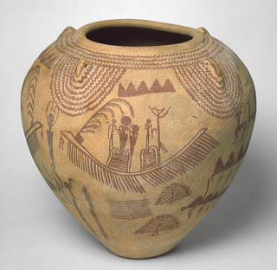
Neolithic Revolution (10000 BC-....)
Egyptian ceramic pot (3400 BC)

Slide 3
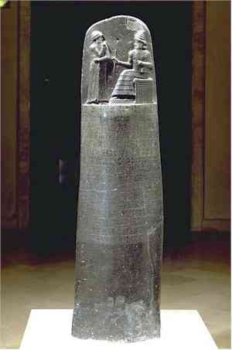
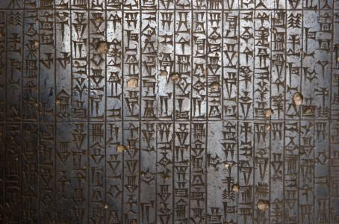
Code of Hammurabi (1754 BC)

Slide 4
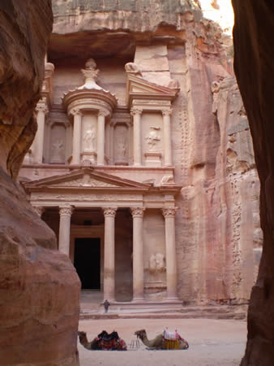
Petra (capital of the
Nabataeans since 312 BC)
The Treasury, 1st c AD

Slide 5
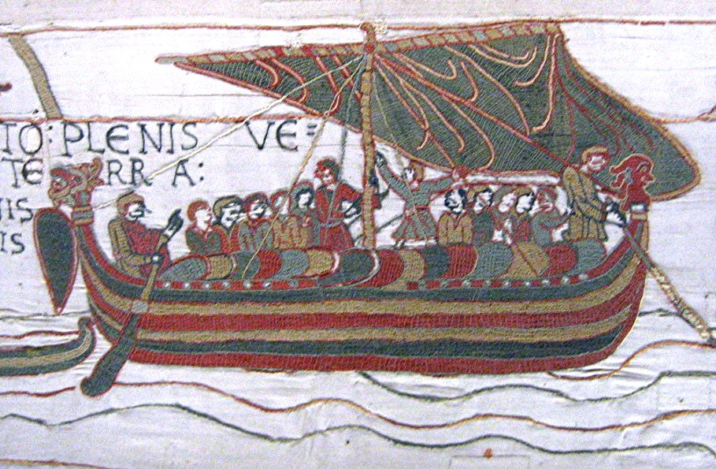
Wind Power. Bayeux Tapestry (1070 A.D.)

Slide 6
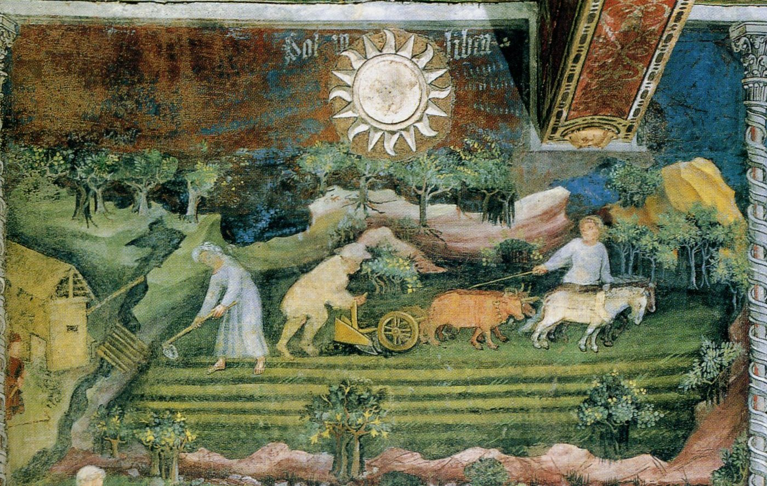
Animal Power (Ciclo dei mesi. Maestro Wenceslao, c. 1400. Trento)

Slide 7
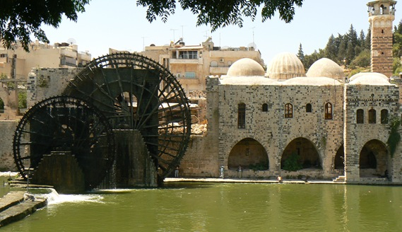
Water power (Noria of Hama, Syria, Ayyubid period XII-XIII c)

Slide 8
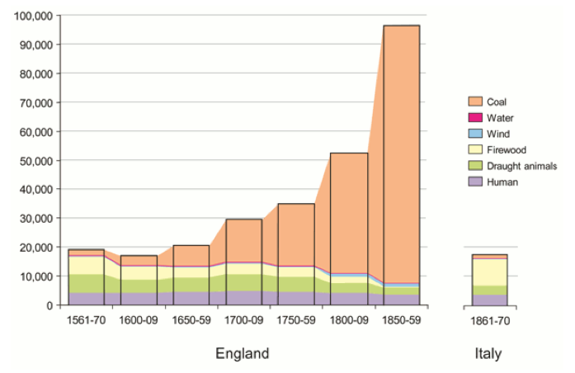
England’s shift to coal as its primary energy source

Slide 9
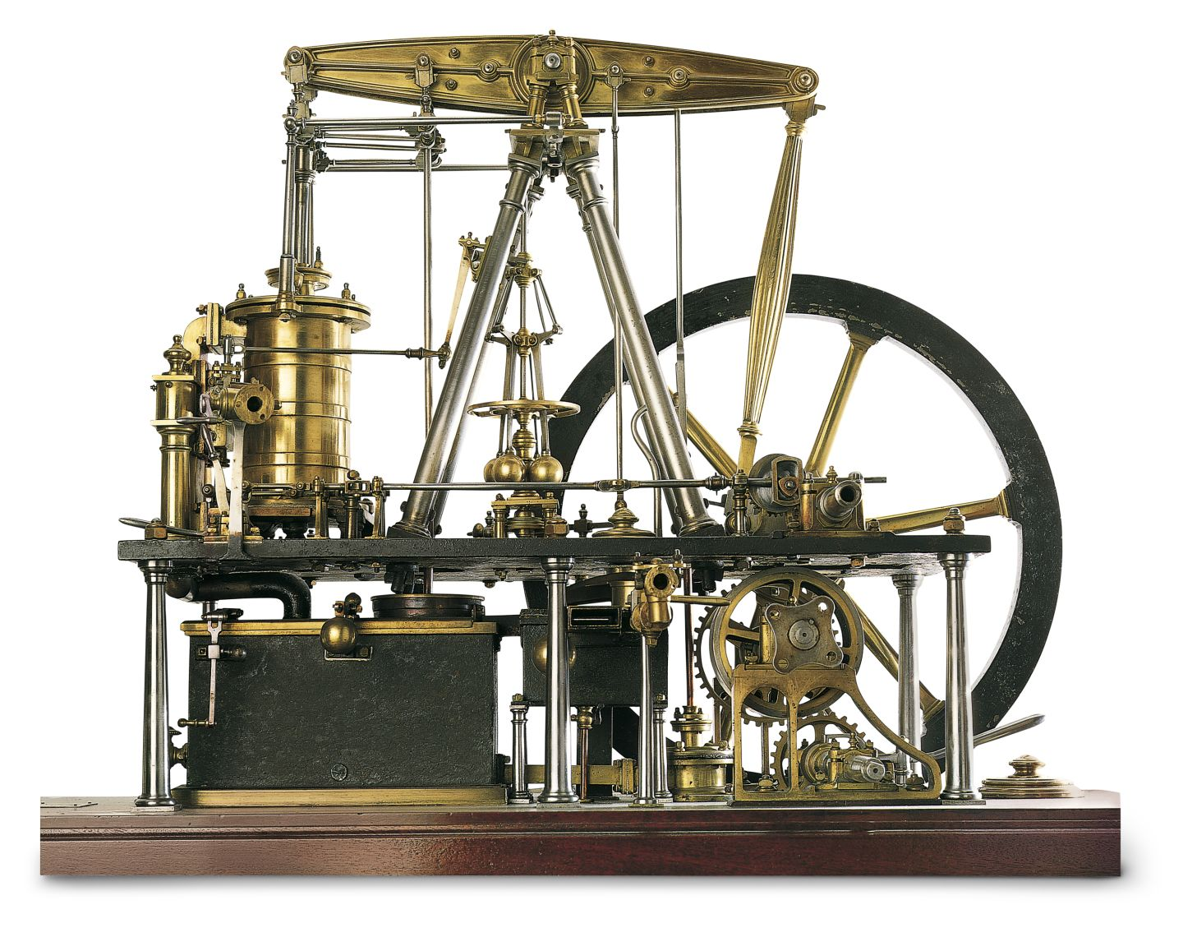
Watt’s Steam Engine (1774)

Slide 10
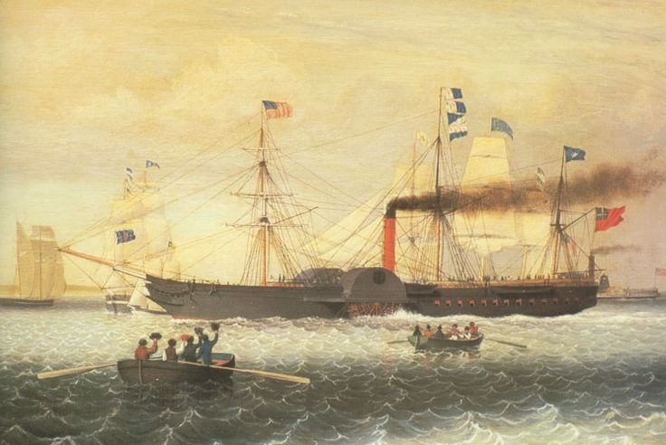
The Paddle Steamer “Britannia” (1840)

Slide 11
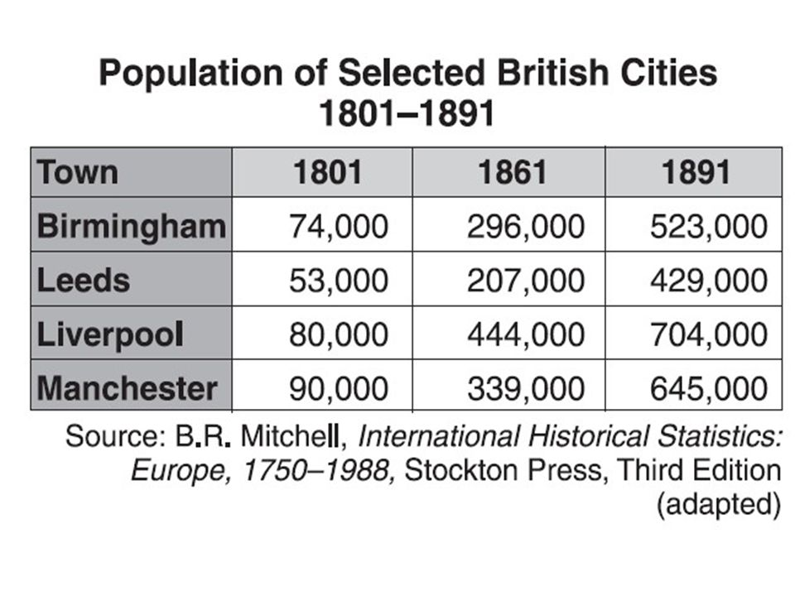

Slide 12
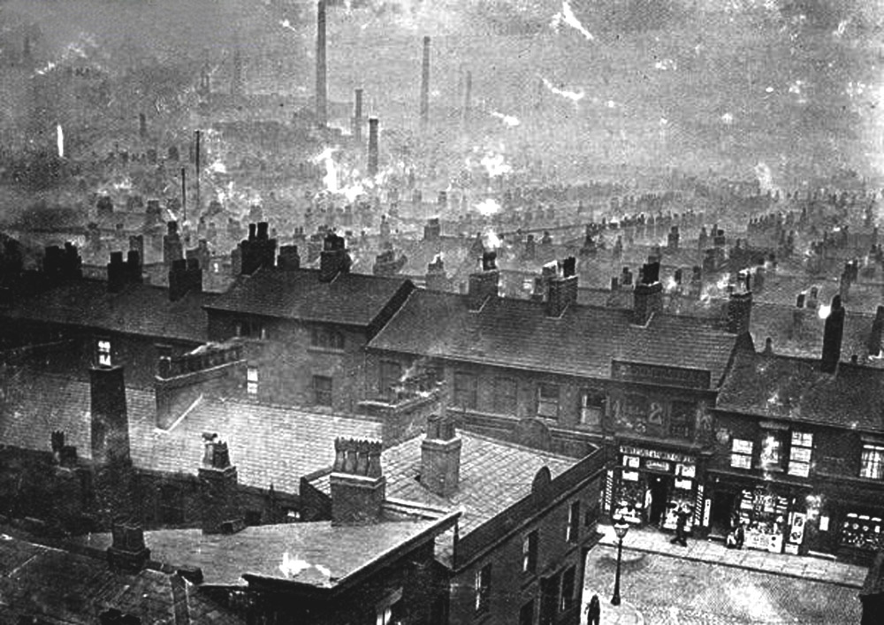
Manchester (1870)

Slide 13
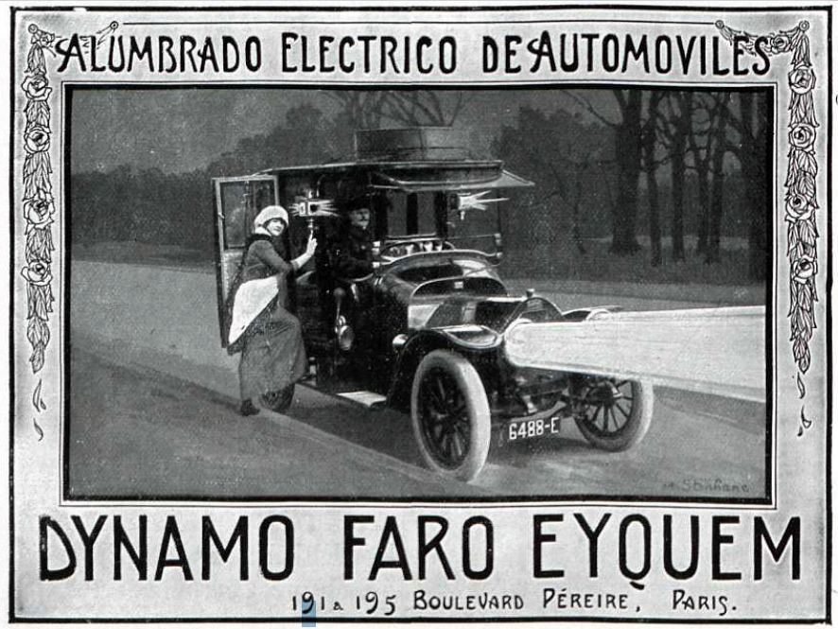

Slide 14
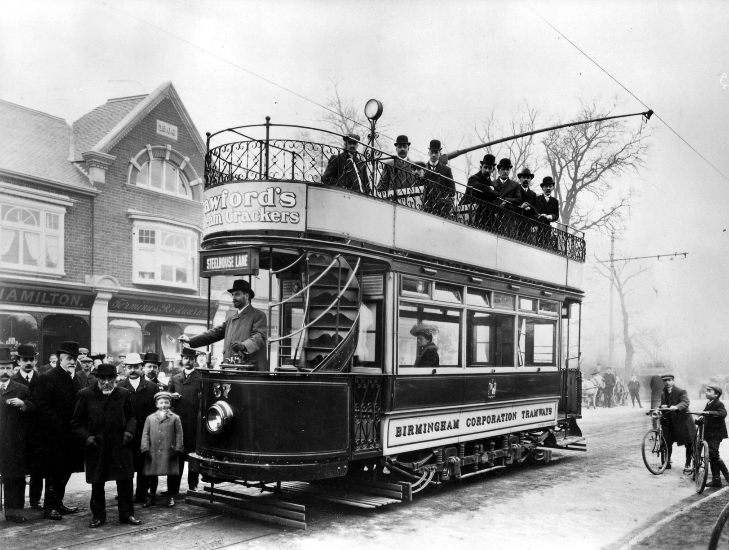
1907

Slide 15
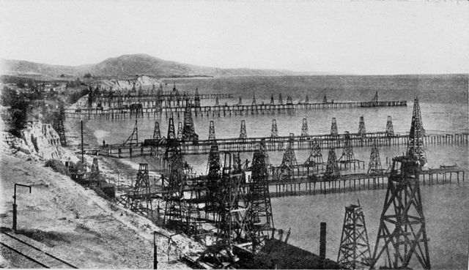
California’s first offshore oil wells (Summerland Field before 1906)

Slide 16
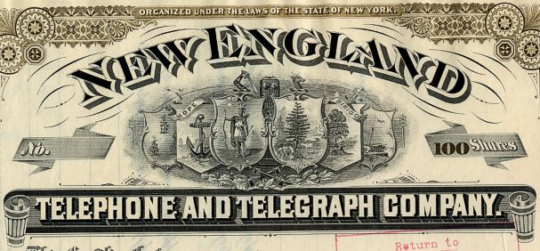

Slide 17
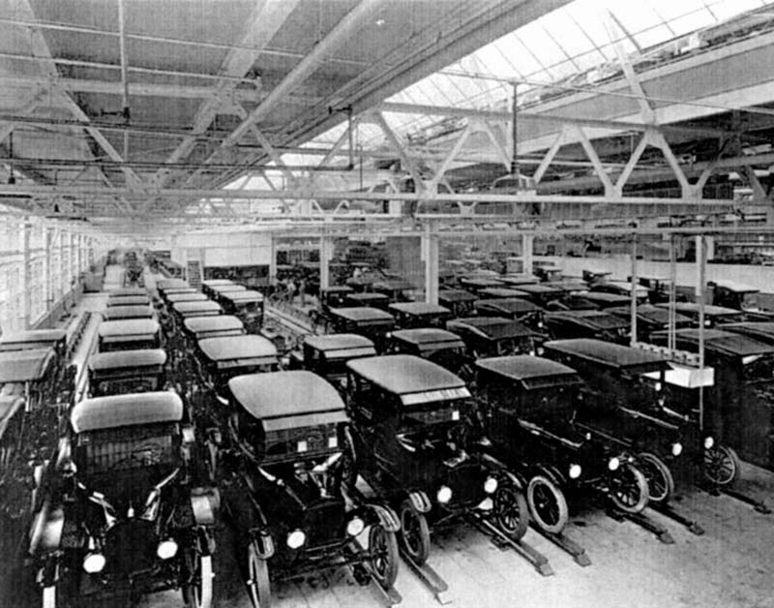
A Ford T
factory

Slide 18
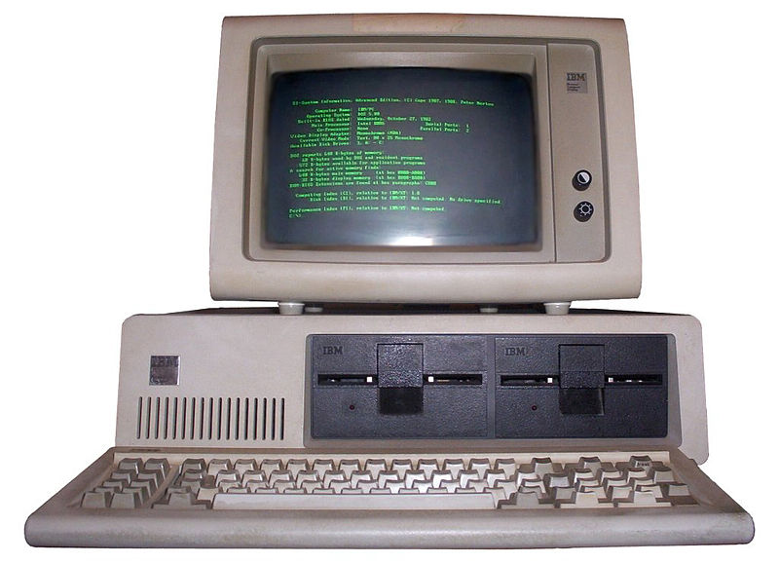

Slide 19
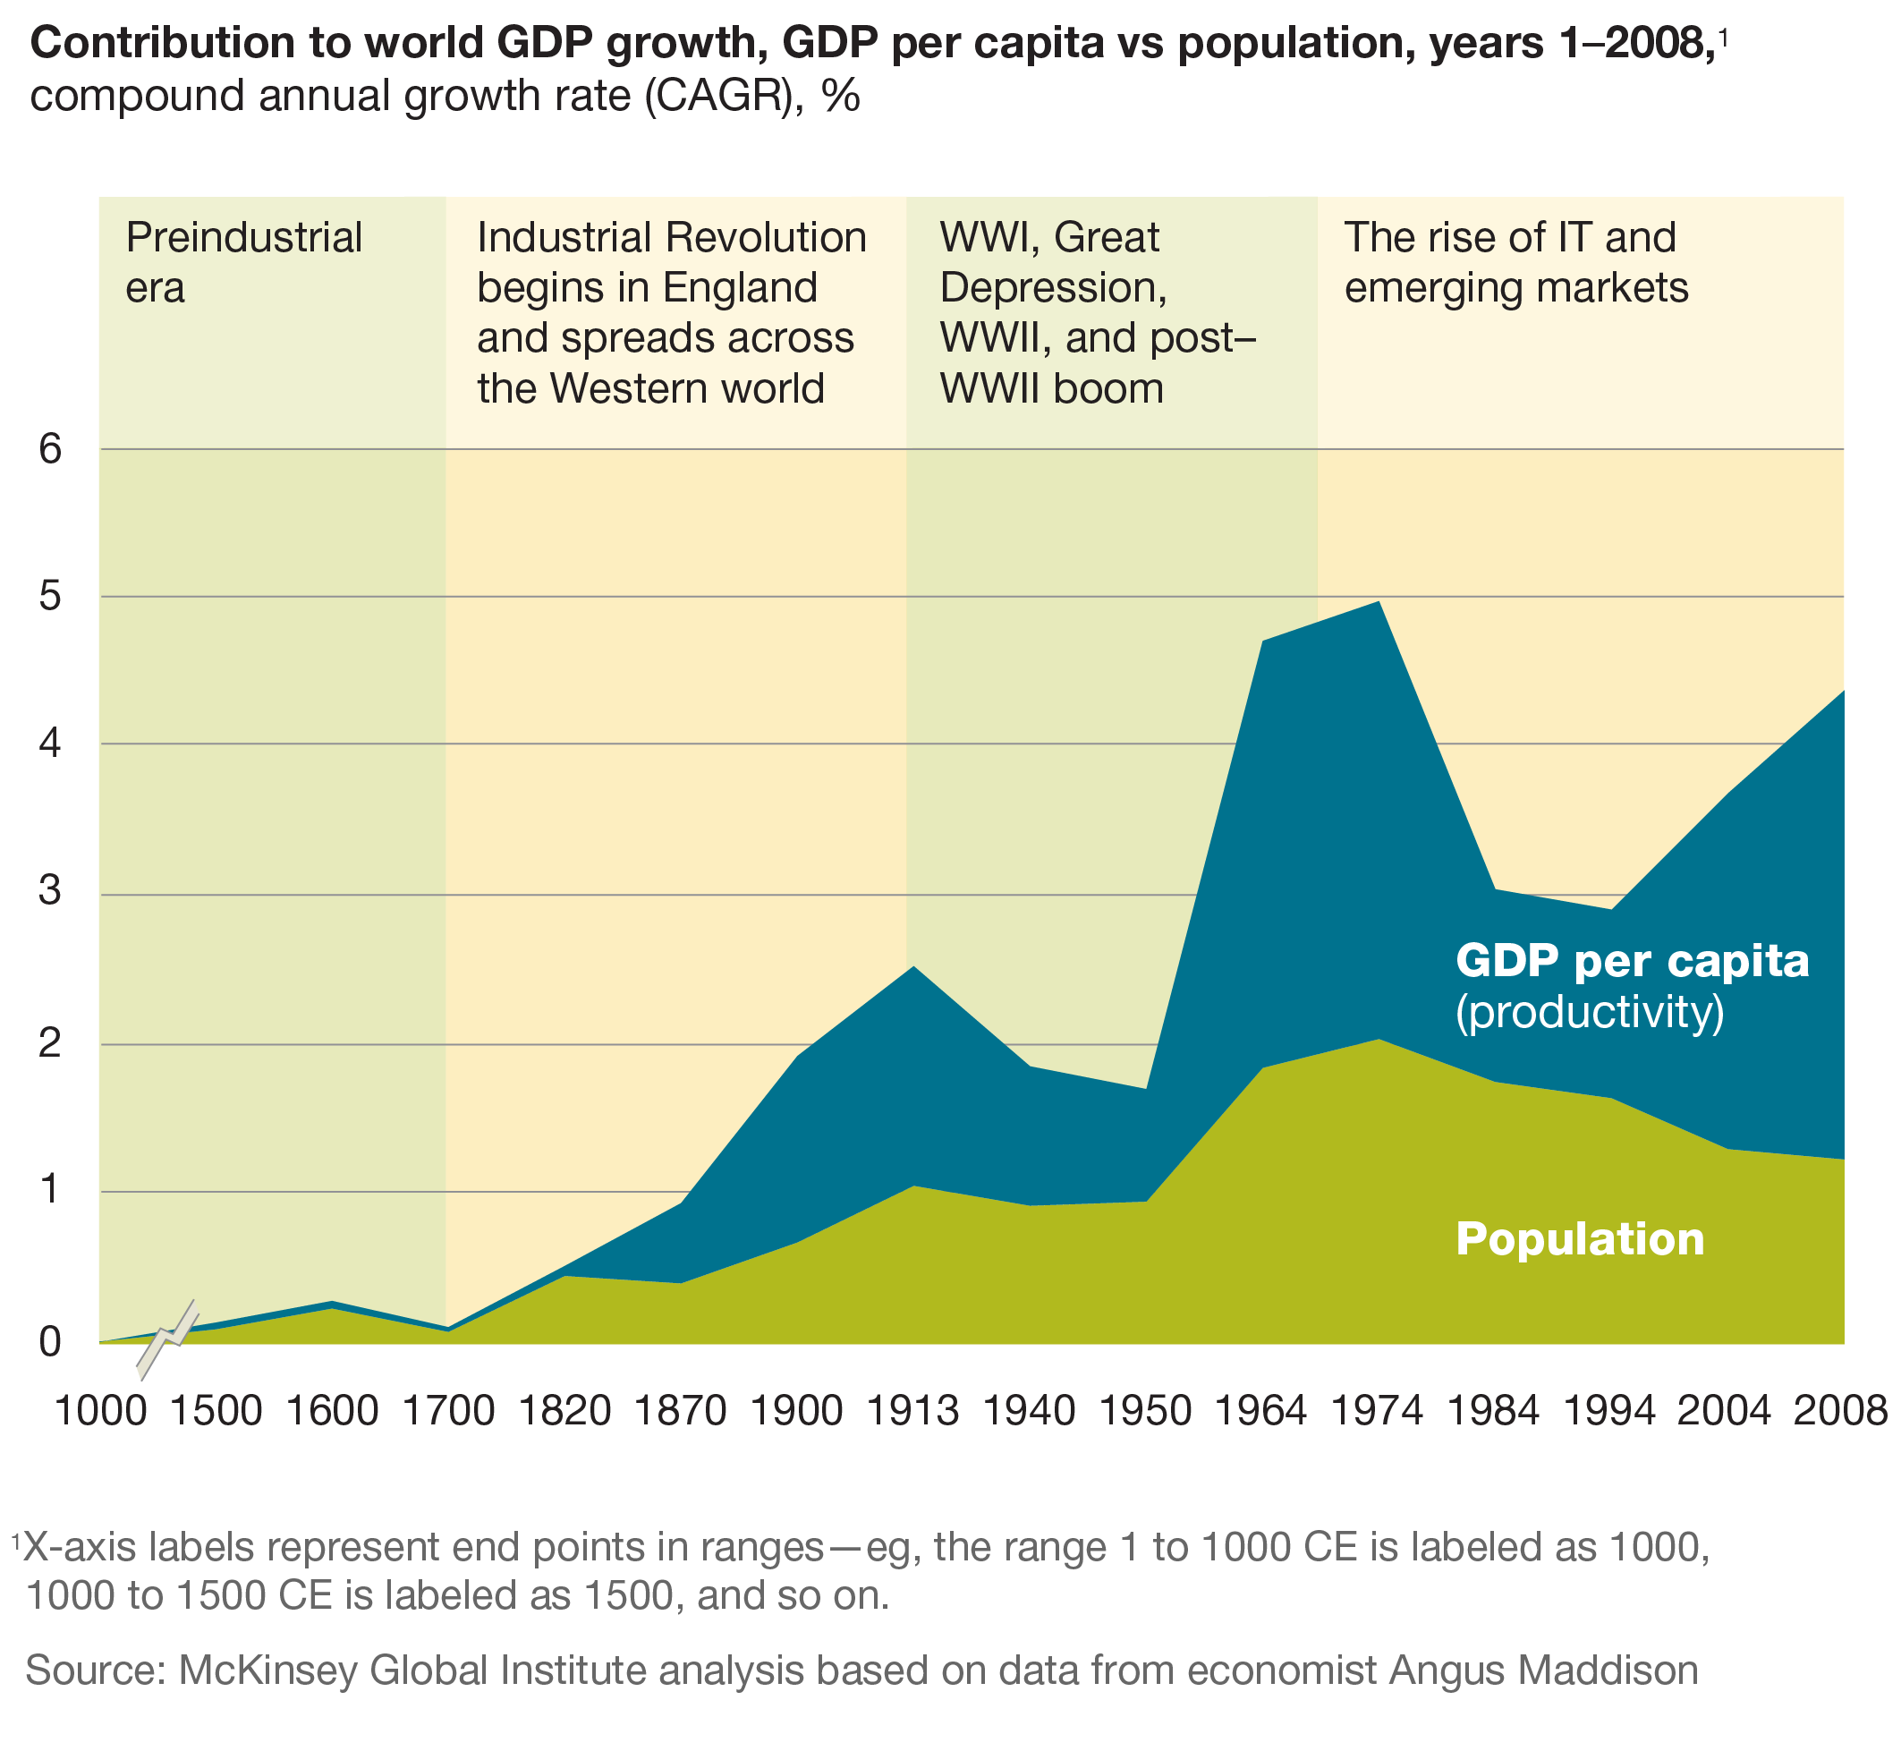

Slide 20
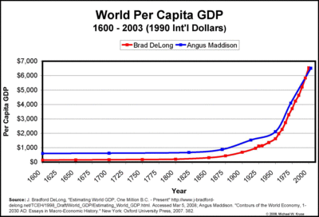

Slide 21
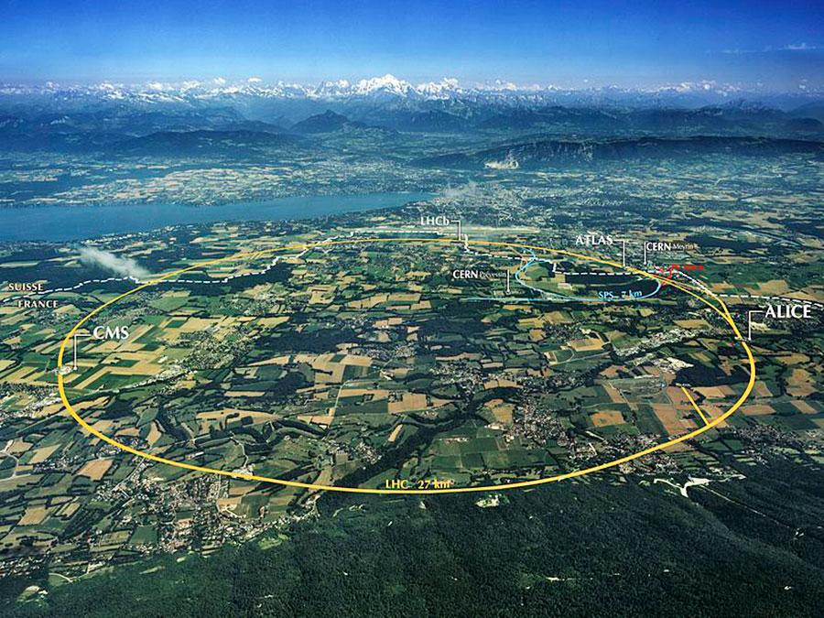

Slide 22
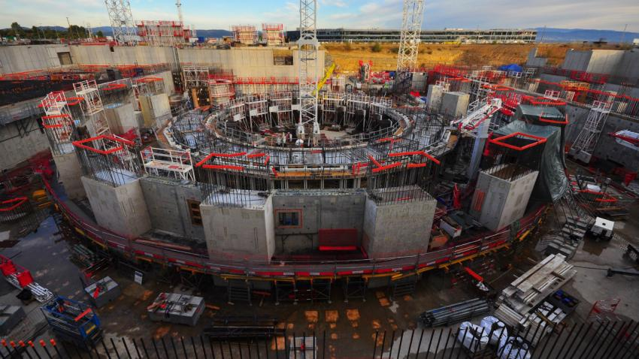

Slide 23
Conclusions
The consumption of energy is increasing, therefore clean sources of energies are required to keep the progress
Realization of fusion as energy source would imply a new revolution for the mankind and could fulfil part of those needs
It is an obligation of governments and society to provide the necessary tools to researcher and engineers to achieve Fusion as a source of energy
You, as Fusion experts, have the opportunity of transform the history of the mankind towards a new era!

