Slide 1
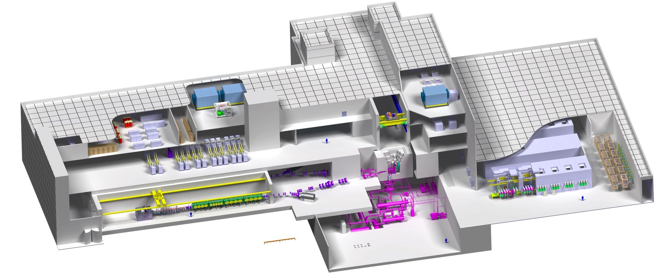
IFMIF
the neutron source for the Fusion Program
J. Knaster, R. Heidinger and S. O’hira
on behalf of IFMIF/EVEDA team
Electric Power Supply
Industrial HVAC
Nuclear HVAC
Access Cell
PIE Detritiation Process
Beam Dump
Post Irradiation Examination
Wally
RF Modules
SRF Linac
Li Loop
Test Cell
Injector
RFQ
0
10m
IAEA Fusion Energy Conference
Kyoto
October 2016

Slide 2
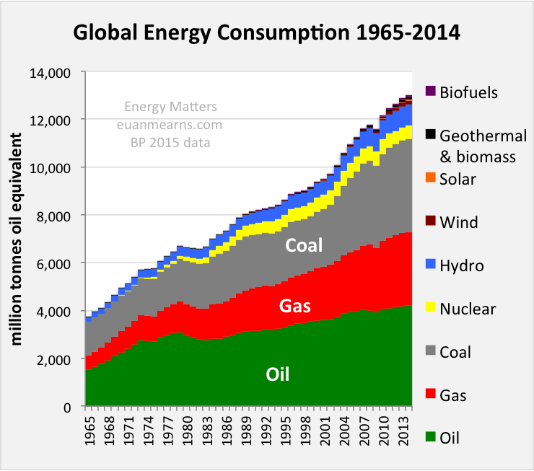
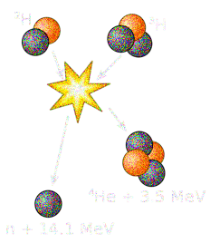
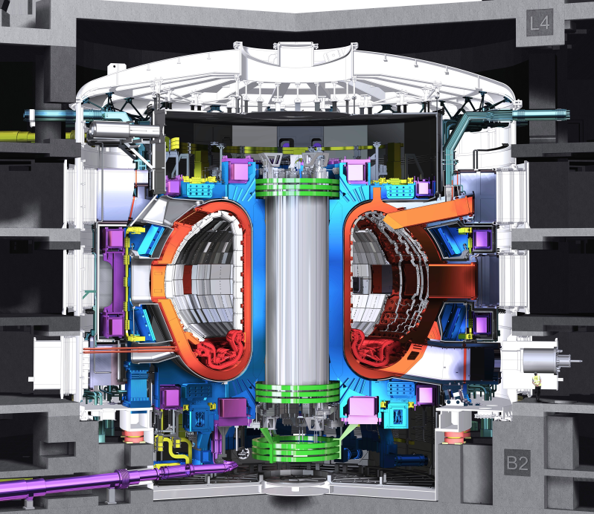
Nuclear Fusion
the potential energy solution for humankind
The first wall
of the reactor vessel shall
absorb 14.1 MeV neutrons
product of DT reactions
ITER first wall will present
3 < dpa at the end of its operational life
In a Fusion power plant
~15 dpa per year of operation
Two transmutation reactions become critical
⁵⁶Fe(n,α)⁵³Cr
and
⁵⁶Fe(n, p)⁵⁶Mn
with n threshold energies at 2.9 and 0.9 MeV
ITER
Blanket
Divertor
Where is
Wally?

Slide 3
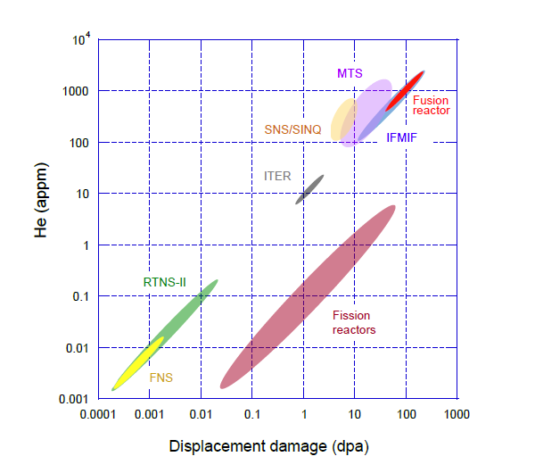
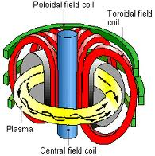

Unique features of fusion materials
Structural Fusion materials are to withstand the combination of
High fluxes (and fluences)
10¹⁸ n/m²s
Cyclic stresses
Δσ > 100 MPa
(Maxwell stresses)
Thermal loads
>10 MW/m²
(critical in W based divertor)
He&H generation
~12 appm He/dpa
Neither fission reactors (0.3 He/dpa) nor spallation sources (>50 He/dpa)
give needed answers

Slide 4
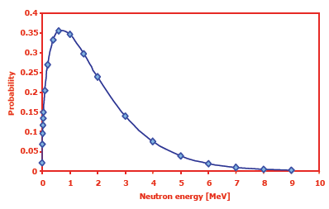
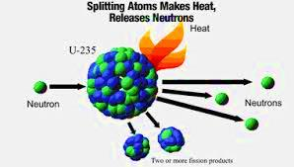
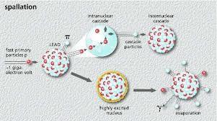
Available neutron sources
Fission reactors n average energy <2 MeV
Spallation sources present a wide spectrum
with tails reaching impacting particle energy
~20 n per reaction
and are pulsed
Watt
Distribution
(fission n spectrum)
No efficient
p⁺ or α-particle generation
Fission
Spallation

Slide 5
Uncertainties (many) present
A 2 GW DEMO will reach ITER’s expected degradation damage
in a couple of months operating at full power
We need data
from all possible sources
from fission reactors
from spallation sources
from ion implantation
from a 14 MeV neutron source
Radiation-induced
degradation
Expected behavior
tbc in a Li(d,xn)
Thanks
to Tanigawa-san
Known degradation
under fission neutrons
Guess of
Fusion neutrons
From ions impl. & spallation
fusion oriented experiments
3
30
dpa
ITER
~ 2 years
DEMO Operation
Fusion relevant neutron sources are indispensable

Slide 6
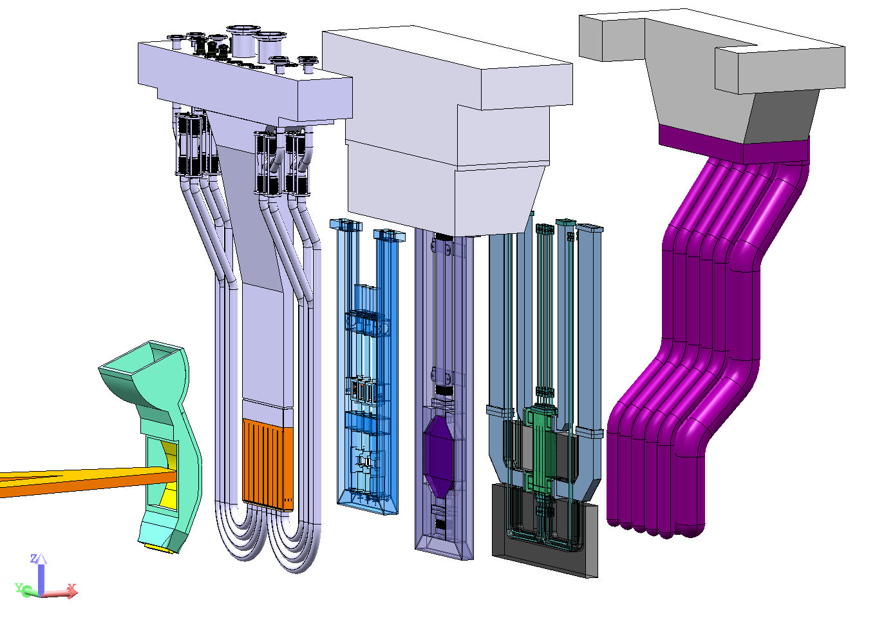
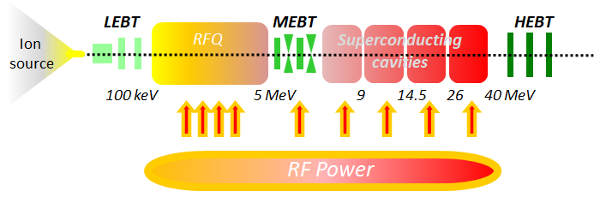


Four decades of work towards a Li(d,xn) facility
A worldwide R&D and design work
has continuously been in place since the ‘70s
FMIT (80s in the US) – ESNIT (90s in Japan)
IFMIF for last 20 years
Initially as a US, RF, JP & EU collaboration up to 2007
Lithium
loop
P. Grand et al., An intense Li(d,n) neutron radiation test facility for controlled thermonuclear reactor materials testing, Nuclear Technology, Vol 29, p. 327 (1976)
Li(d,xn)
Test
Facility
Neutron
E_{n} ~ 0.4E_{d}
Accelerator Facility
R. Serber, The Production of High Energy Neutrons by Stripping, Phys. Rev. Vol. 72, No 1 (1947)
Target Facility

Slide 7
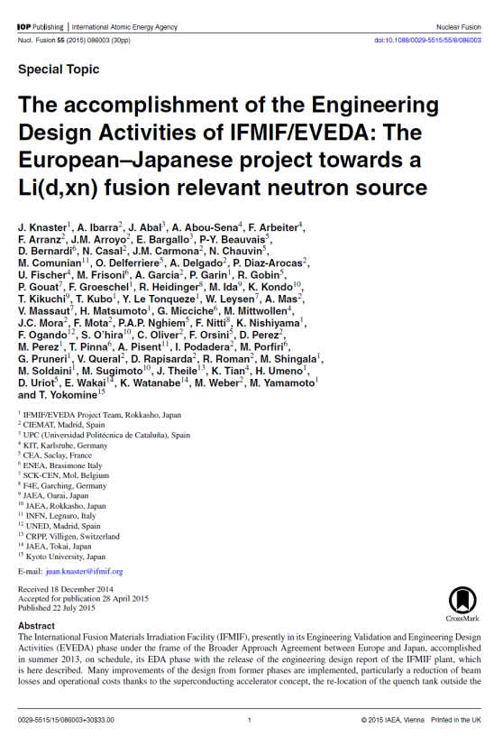
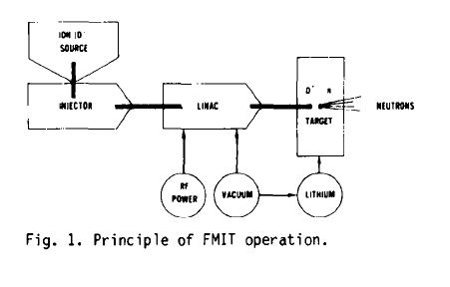
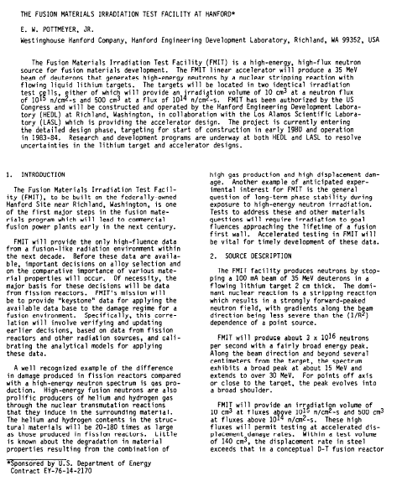
Four decades of work towards a Li(d,xn) facility
IFMIF
FMIT
E.W. Pottmeyer Jr., The Fusion Material Irradiation Facility at Handford, Journal of Nuclear Materials 85 & 86 (1979) 463-465
J. Knaster et al, The accomplishment of the Engineering Design Activities of IFMIF/EVEDA: The European–Japanese project towards a Li(d,xn) fusion relevant neutron source, Nuclear Fusion 55 (2015) 086003

Slide 8
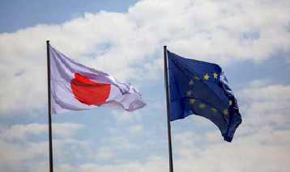

























IFMIF/EVEDA
IFMIF
International Fusion Materials Irradiation Facility
EVEDA
Engineering Validation & Engineering Design Activities
…to produce an integrated engineering design of IFMIF and the data necessary for future decisions on the construction, operation, exploitation and decommissioning of IFMIF, and to validate continuous and stable operation of each IFMIF subsystem
Signed in February 2007
Framed by the Broader Approach Agreement
Osaka University
Nagoya University
Tohoku University
Tokyo University
Kyushu University
Hachinohe Institute of Technology
Hachinohe National College of technology

Slide 9
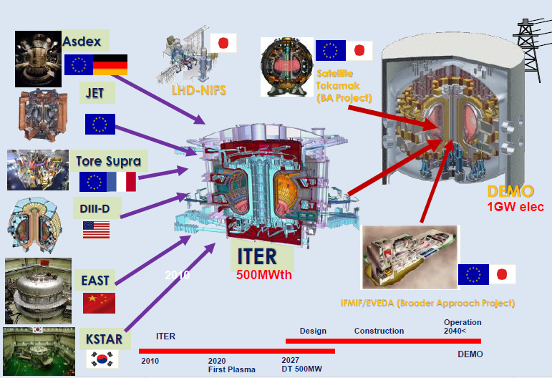
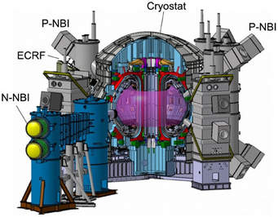

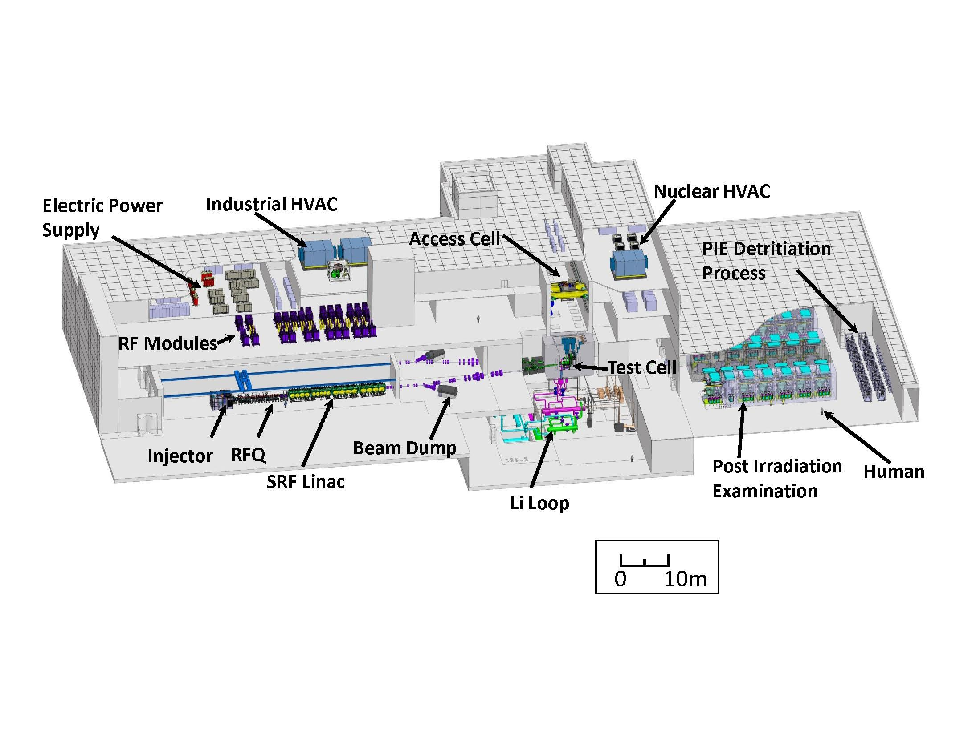

DEMO
JT-60SA
IFERC
IFMIF/EVEDA
JT60
The Broader Approach Agreement
since 2007

Slide 10
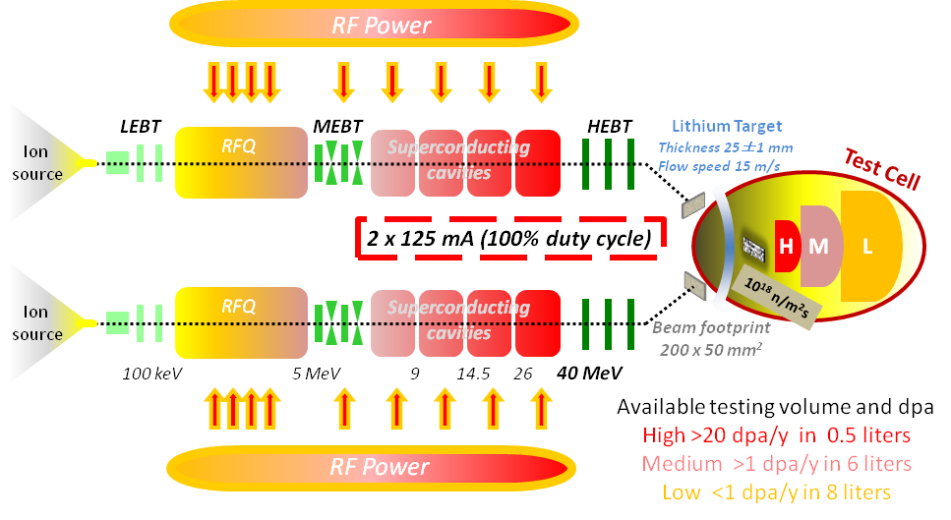
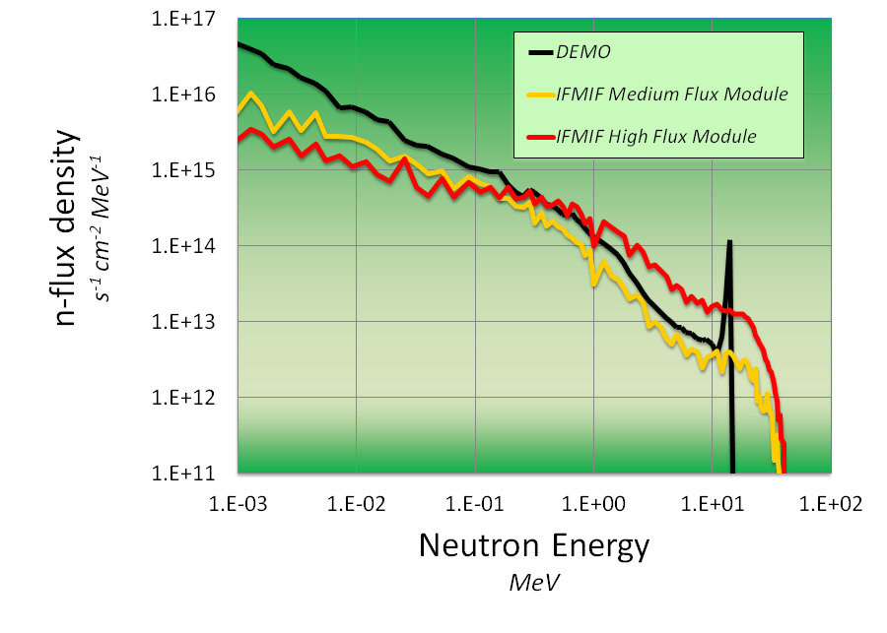
IFMIF concept
Two concurrent
125 mA CW deuterons beam
at 40 MeV
impact with
a beam footprint of 200 x 50 mm²
on a liquid Li screen
flowing at 15 m/s
A flux of neutrons of ~10¹⁸ m⁻²s⁻¹
is generated in the forward direction
with a broad peak at
14 MeV
and irradiate three regions
>20 dpa/y in 0.5 liters
>1 dpa/y in 6 liters
<1 dpa/y in 8 liters
14 MeV
Availability of facility >70%
~40 MeV
Notes:
IFMIF will generate a neutron flux with a broad peak at 14 MeV by Li(d,xn) nuclear reactions thanks to two parallel deuteron accelerators colliding in a liquid Li screen with a footprint of 20 cm x 5 cm. The energy of the beam (40 MeV) and the current of the parallel accelerators (2 x 125 mA) have been tuned to maximize the neutrons flux (10¹⁸ m⁻²s⁻¹) to get irradiation conditions comparable to those in the first wall of a fusion reactor in a volume of 0.5 l that will house around small 1000 specimens

Slide 11
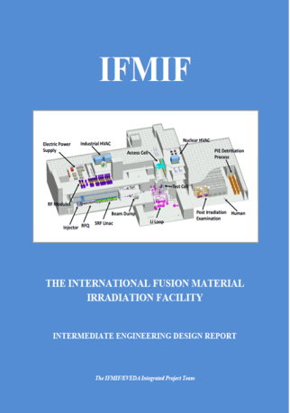
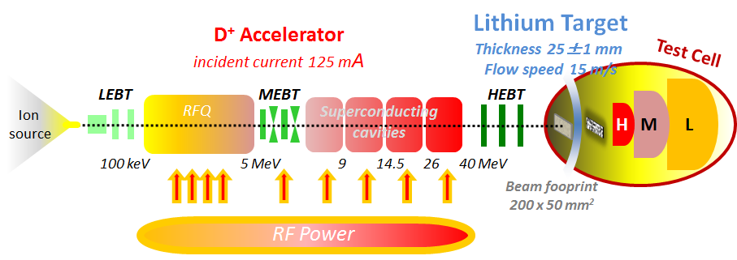
EVEDA = EDA + EVA Phases
Engineering Design Activities – EDA phase
Validation Activities – EVA phase
Successfully delivered on schedule
J. Knaster et al, The accomplishment of the Engineering Design Activities of IFMIF/EVEDA: The European–Japanese project towards a Li(d,xn) fusion relevant neutron source, Nuclear Fusion 55 (2015) 086003
Electric Power Supply
Industrial HVAC
Nuclear HVAC
Access Cell
PIE Detritiation Process
Test Cell
RF Modules
Beam Dump
Post Irradiation Examination
Human
SRF Linac
Li Loop
Injector
RFQ
0
10m
J. Knaster et al., IFMIF: overview of the validation activities, Nuclear Fusion 53 (2013) 116001

Slide 12
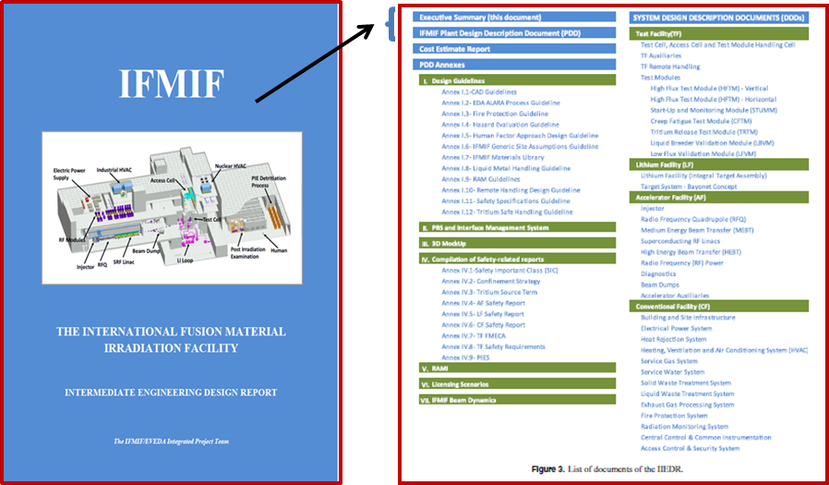
Engineering Design Activities (EDA) Phase
It includes
>100 technical reports
interfaces with thorough 3D models, licensing scenarios,
RAMI analysis, nuclear safety studies, beam dynamics,
35 Detail Design Description documents of all sub-systems
and cost&schedule

Slide 13
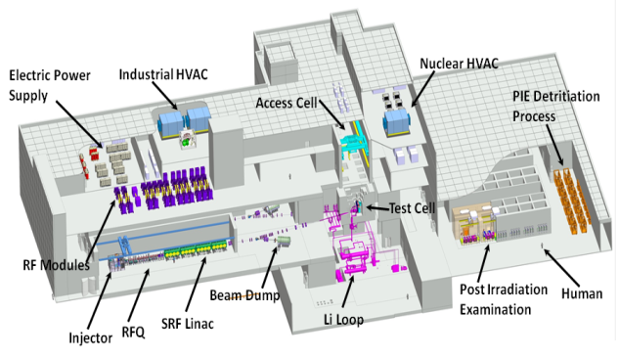
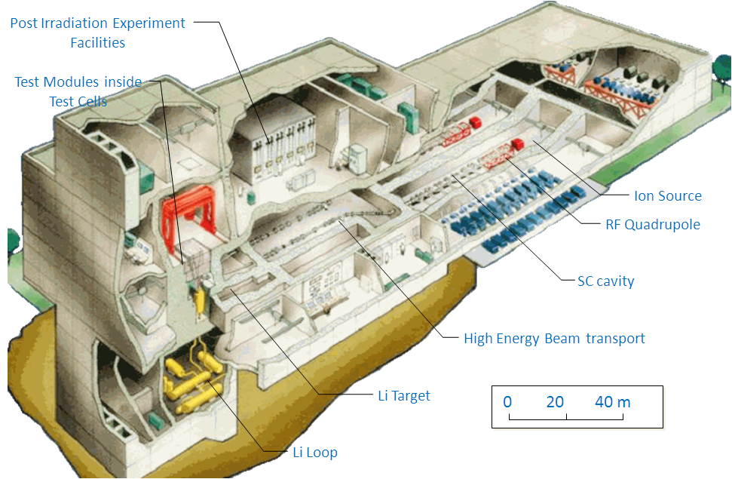
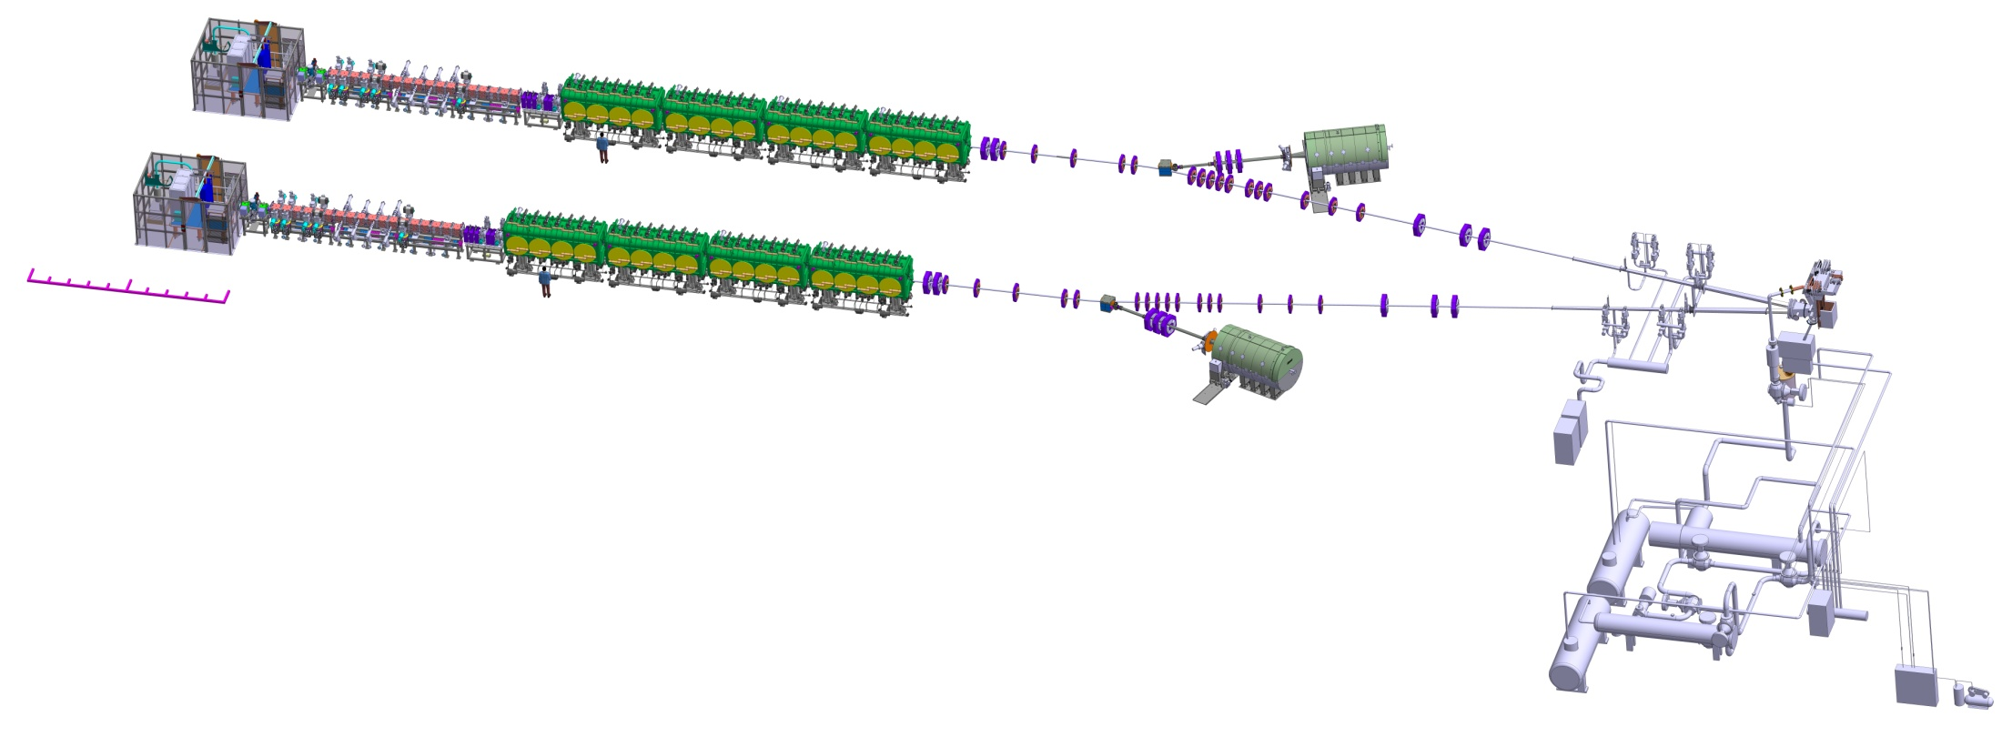
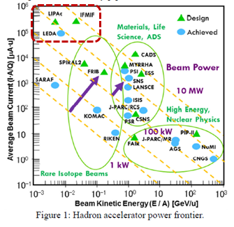
EVA Phase – Accelerator Facility
Deuteron beams 2 x 125 mA in CW
40 MeV energy
2 x 5 MW beam power
J. WEI et al., The very high intensity future, IPAC 2014, Dresde

Slide 14
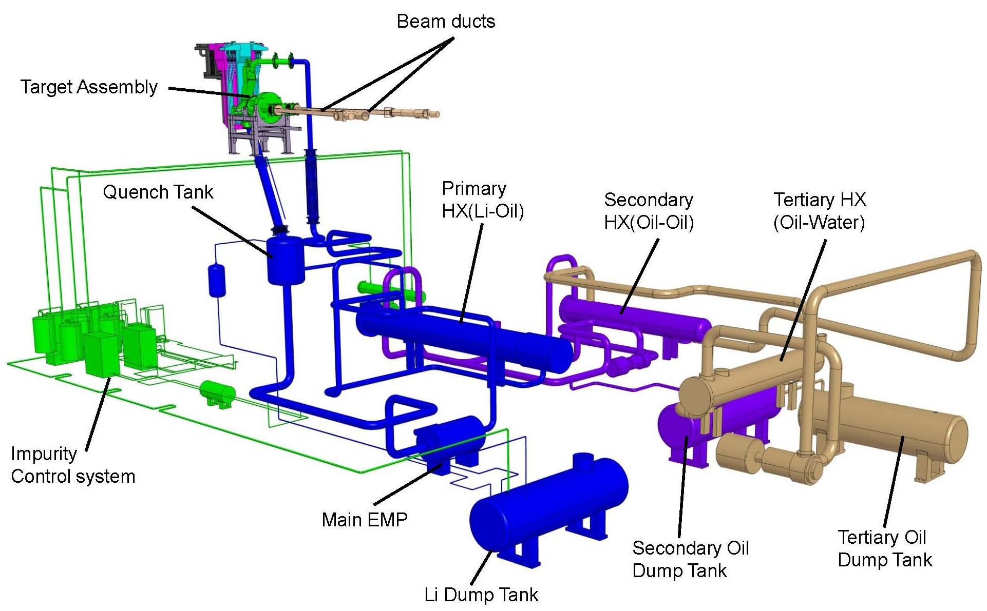


EVA Phase – Target Facility
Lithium jet
at 250 C
Flow speed 15 m/s
Thickness 25±1 mm
D⁺ Accelerator
incident current 125 mA
LEBT
MEBT
HEBT
L
Ion
source
RFQ
Superconducting
cavities
M
H
100 keV 5 MeV 9 14.5 26 40 MeV
RF Power

Slide 15
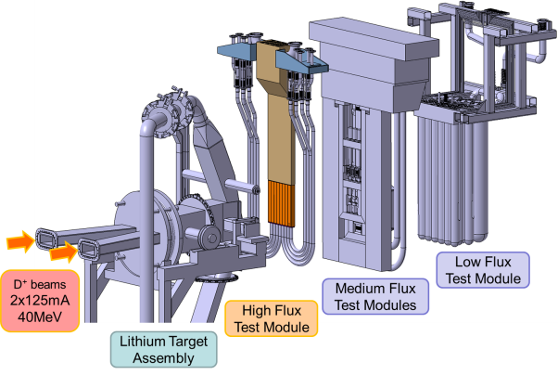
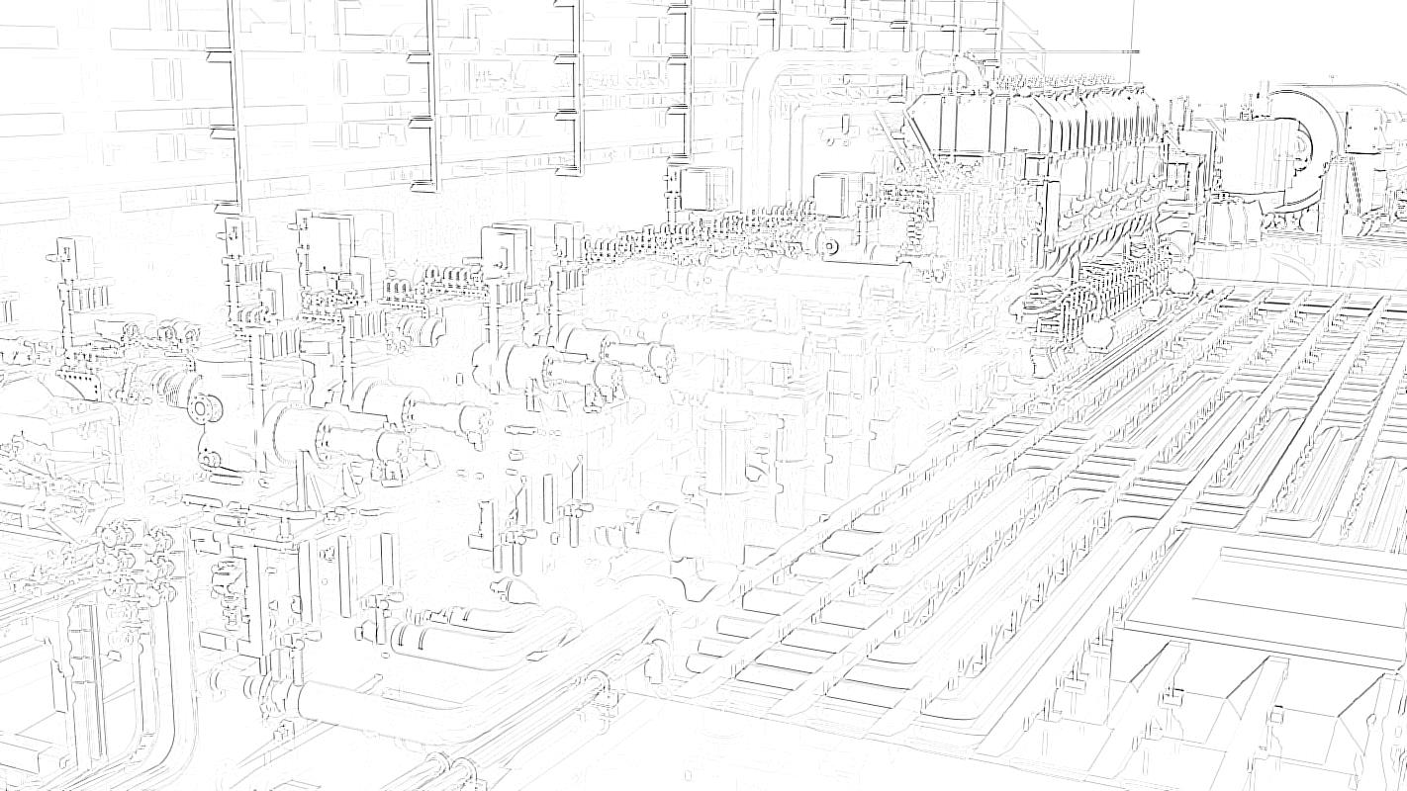

EVA Phase – Test facility
HFTM
20 dpa/y in 500 cm³
12 x 80 small specimens
independently cooled
within +/3% T
Test Cell
LEBT
MEBT
HEBT
L
Ion
source
RFQ
Superconducting
cavities
M
H
100 keV 5 MeV 9 14.5 26 40 MeV
RF Power

Slide 16
The validation activities covered
a very wide range
There is no time to cover the full scope
in this talk
I will focus on identifying those historical main technological challenges
and explain how EVEDA has addressed them
J. Knaster et al., IFMIF: overview of the validation activities, Nuclear Fusion 53 (2013) 116001

Slide 17
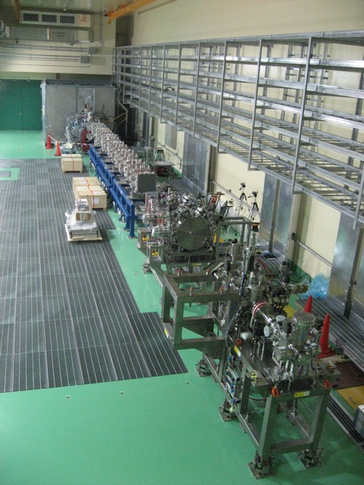
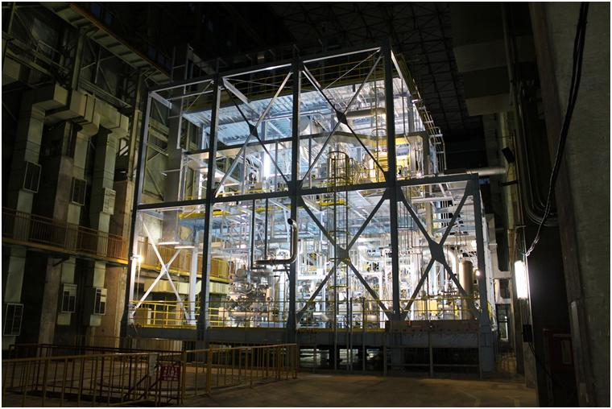
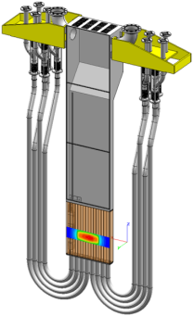
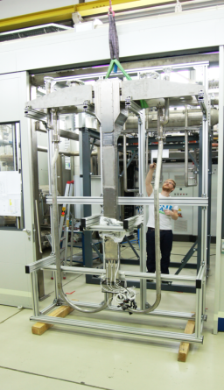
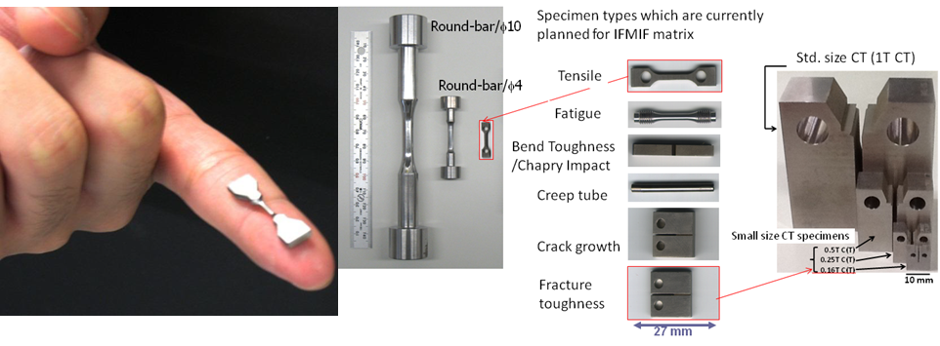
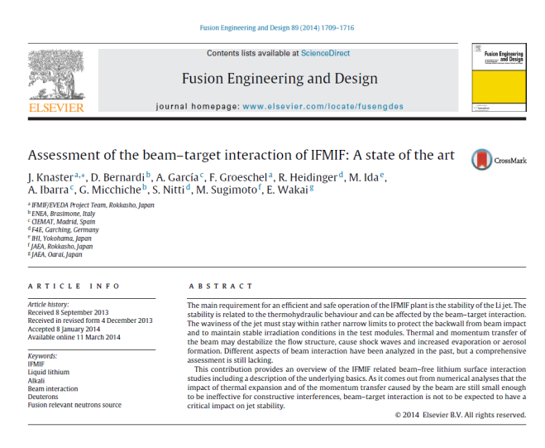
Five major historical technical concerns addressed
in IFMIF/EVEDA
1st concern: D⁺ accelerator of 125 mA CW at 40 MeV
D⁺ prototype accelerator of 125 mA CW at 9 MeV in Rokkasho
2nd concern: Stable flow of lithium at required performance
Full scale prototype of Li facility in Oarai
3rd concern: Irradiated capsules allowing independent cooling
High Flux Test Module prototype in KIT
4th concern: Small Specimens Test Techniques
Shape validation for pending specimens in Japanese Univers.
5th concern: 2 x 5 MW beam vs target interaction
Suitable concave backplate design assessed
Oarai
Rokkasho
Karlsruhe

Slide 18
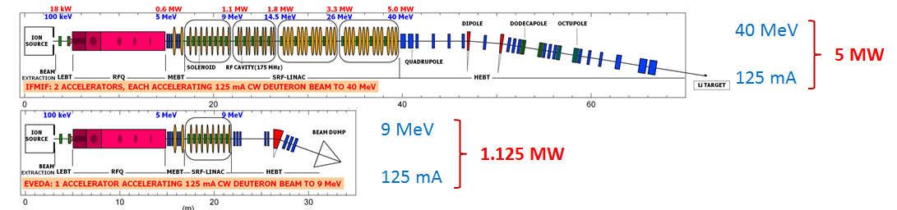
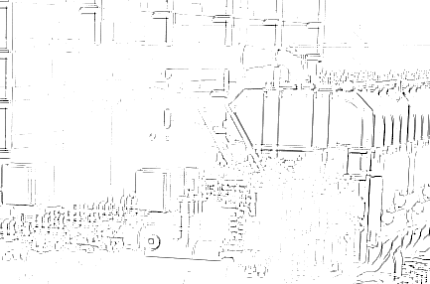


1st concern: D+ accelerator of 125 mA CW
IFMIF
LIPAc
Small in size but
big in performance

Slide 19
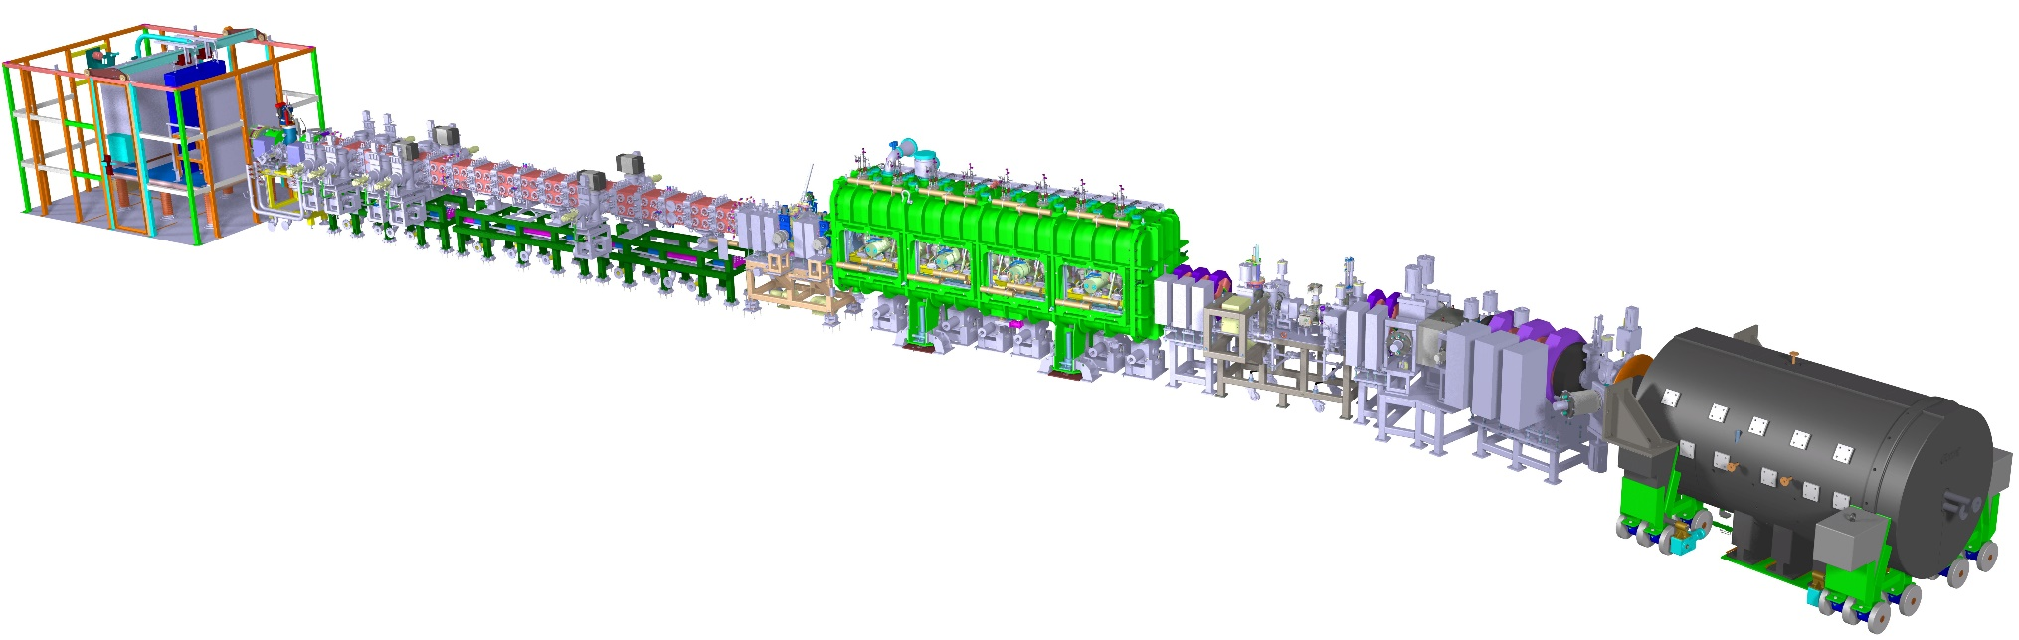



EVA Phase – Accelerator Facility
Equipment designed
and constructed in Europe
Installed and commissioned in Rokkasho
★
Rokkasho
Injector + LEBT
CEA Saclay
RFQ
INFN Legnaro
QST
MEBT
CIEMAT Madrid
SRF Linac
CEA Saclay
CIEMAT Madrid
HEBT
CIEMAT Madrid
BD
CIEMAT Madrid
Diagnostics
CEA Saclay
CIEMAT Madrid
Cryoplant
CEA Saclay
36 m
RF Power
CIEMAT Madrid
CEA Saclay
SCK Mol
Building
Auxiliary System
Control system
Installation
QST

Slide 20
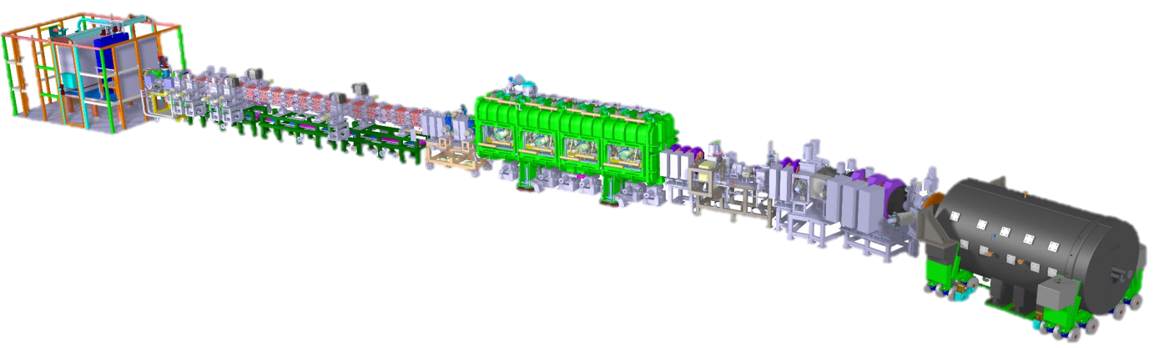
1st concern: D+ accelerator of 125 mA CW
LIPAc is very ambitious
World’s highest current linac
World’s top H⁺&D⁺ injector performance
World’s longest RFQ
World’s record of light hadrons current through SC cavities
World’s highest beam perveance
The accelerator
of records
P. Cara et al., The Linear IFMIF Prototype Accelerator (LIPAc) design development under the European-Japanese collaboration, IPAC 2106 - Busan
MPT/P5-13
A. Kasugai et al., Progress on the Development of Linear IFMIF Prototype Accelerator and the Beam Commissioning

Slide 21
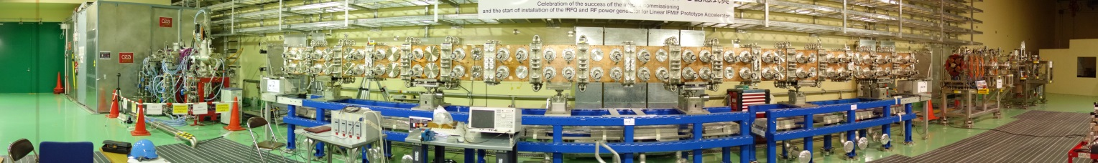
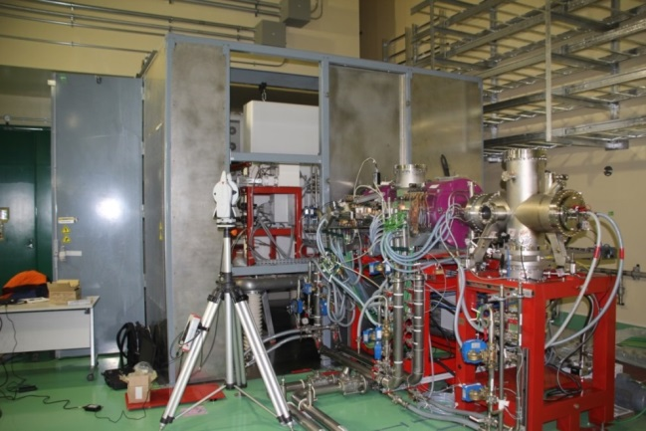
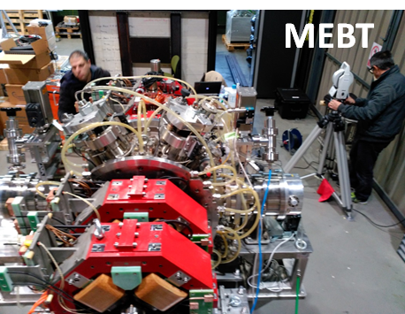
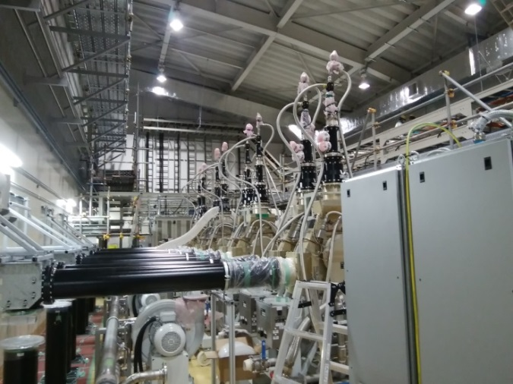
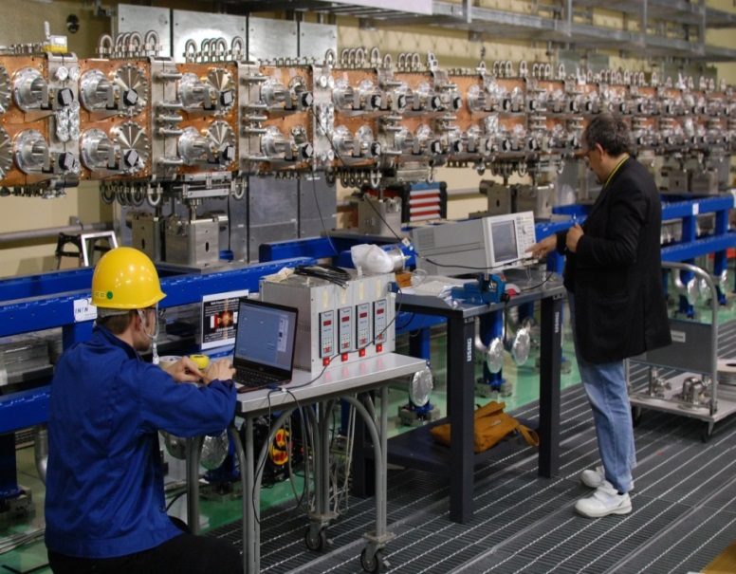
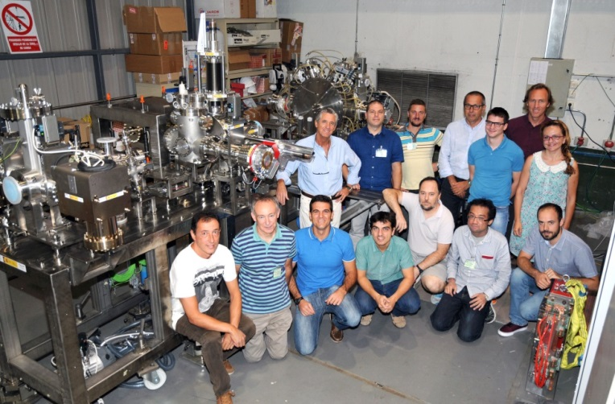


Rokkasho Fusion Institute
MPT/P5-13
A. Kasugai et al., Progress on the Development of Linear IFMIF Prototype Accelerator and the Beam Commissioning
Ion source + LEBT
D-plate
RFQ RF Power
RF Power
9.8 m long RFQ
during bead pulling exercise
May 2016
Diagnostic Plate
Are we technologically ready for such accelerator?

Slide 22
Evolution of accelerators technology since FMIT
W.D. Cornelius, CW operation of the FMIT RFQ accelerator, Nucl. Instr. Meth. Phys. Res. B10/l1 (1985) 859-863
The 1st attempt to run a RFQ in CW was in Los Alamos (LANL)
for FMIT accelerator validation exercise
The ‘beam halo’ was discovered the rough way
Beam quality injected in RFQ was poor
ECR approach was technologically validated for H⁺ in Chalk River
LANL successfully operated LEDA
100 mA in CW at 6.7 MeV
with a dual electrodes capacitive/inductive part cooling RFQ tuning
and unraveled beam halo physics the following years
Alvarez type accelerating structure (DTL)
for beam energies within 0.2<β<0.6
is a difficult challenge for high currents in CW
the feasibility of superconducting resonators for low-β
was demonstrated in LANL in 2002
Operation of superconducting HWR cavities in CW
SARAF has operated 176 MHz HWR cavities in CW in 2010
T. Taylor and J.S.C. Wills, A high-current low-emittance dc ECR proton source, Nucl. Instr. Meth. Phys. Res. A309, (1991)
80s
90s
L.M. Young et al., High power operations of LEDA, LINAC 2000, Monterey
1999
2001
C.K. Allen et al., Beam-Halo Measurements in High-Current Proton Beams, Phys. Rev. Lett. 89, Number 21, 18 Nov. 2002
M. Kelly, Superconducting Radio-Frequency Cavities for Low-Beta Particle Accelerators, Reviews of Accelerator Science and Technology 5:185 (2012)
2001
T. Tajima, et al., Evaluation and Testing of a Low-β Spoke Resonator, PAC 2001, Chicago
2010
J. Knaster and Y. Okumura, Accelerators for fusion materials testing, Reviews of Accelerator Science and Technology 8, 115142 (2015)
D. Berkovits et al., Operational experience and Future goals of the SARAF proton/deuteron linac, LINAC 2012, Tel-Aviv
LIPAc implements best possible technologies

Slide 23
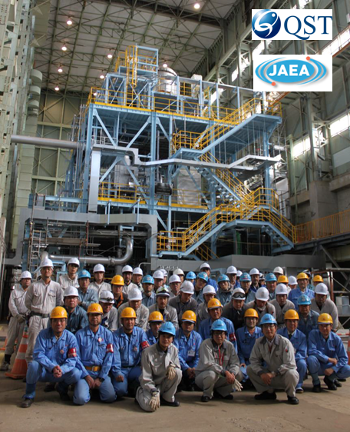
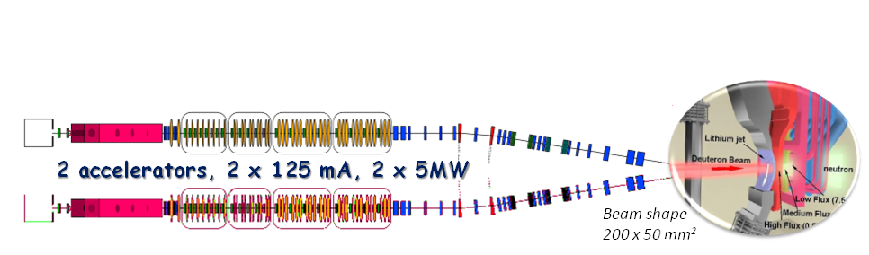
2nd concern: Stable flow of lithium at required performance
The mandate was challenging
the demonstration
of the flow operational conditions of IFMIF lithium target
Lithium temperature at 250 °C
Flow speed at 15 m/s
Stable flow with +/- 1 mm amplitude
10⁻³ Pa on free surface
Long term operation stability
Free surface interferometry diagnostics
Feasibility of Impurities in lithium <10 ppm
Operated until October 2014
Kondo, H. et al. Validation of IFMIF liquid Li target for IFMIF/EVEDA Project, Fusion Eng. Des. 9697, 117122 (2015)

Slide 24
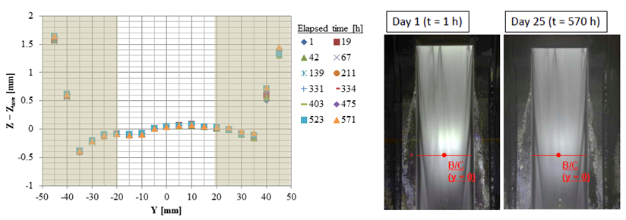

2nd concern: Stable flow of lithium at required performance
The result of 25 days
continuous operation (24 h/day)
MPT/P5-41
F. Arbeiter et al.,
The Accomplishments of Lithium Target and Test Facility Validation Activities in the IFMIF/EVEDA Phase
MPT/P5-11
H. Kondo et al.,
Validation of Liquid Lithium Target Stability for Intense Neutron Source
Long term flow stability demonstrated

Slide 25
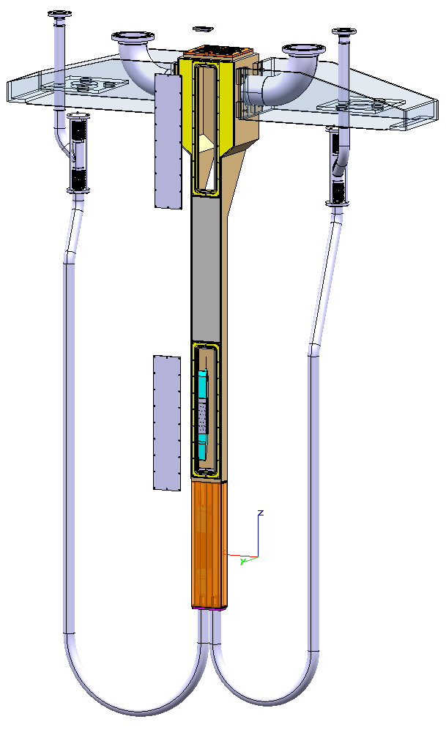



3th concern: Irradiated capsules allowing independent cooling
HELOKA
HFTM-Double Compartment
MPT/P5-41
F. Arbeiter et al.,
The Accomplishments of Lithium Target and Test Facility Validation Activities in the IFMIF/EVEDA Phase
Target T uniformity of specimens demonstrated
Arbeiter, F. et al. Design description and validation results for the IFMIF HighFlux Test Module as outcome of the EVEDA phase, Nuclear Materials and Energy (2016)

Slide 26




4th concern: Small Specimens Test Techniques
Small specimens
are neither exclusive of fusion
nor a new technology
Under EVEDA intense work has been developed on
Fatigue
Fracture toughness
Crack growth rate

Slide 27





4th concern: Small Specimens Test Techniques
12 capsules within beam footprint
x2 sets of 40-45 spec/capsule
within 3% ΔT/capsule
Thermalized with NaK
8 compartment
4 central directly irradiated
80-90 specimens/capsule
Specimen filling in hot cell

Slide 28



4th concern: Small Specimens Test Techniques
Master Curve for ferritic steels under
ASTM E1921 did not work
an adaptation is being studied
Fatigue matches standard specimens
MPT/P5-25
E. Wakai et al., Small Specimen Test Technology Develop. towards Design of Fusion DEMO Reactors and Future Direction Plan
IAEA’s Coordinated Research Project launched
‘Towards standardization of SSTT for Fusion applications’
Notes:
The purpose of the Creep Fatigue Test Module (CFTM) in IFMIF is to perform creep fatigue experiments under intense neutron irradiation. A CFTM prototype has been built and extensively tested at Villigen. The final CFTM will consist of three parallel load controlled single testing machines (STM), mounted on a frame. The three testing machines will operate independently with +/-12.5 kN load with controlled speed ranging between 1 μm/s and 80 μm/s. The complete CFTM will be installed in the medium flux area of IFMIF test cell and will be exposed to intense radiation fields, including both neutron and gamma fields. The heat absorbed by the different parts of the module will be extracted by means of a helium gas (coolant) passing through independent cooling channels.
Due to the limited irradiation volume available in the test modules, small specimen test technique (SSTT) is being developed under IFMIF/EVEDA frame by various Japanese universities (College of Hachinohe, Kyoto University and Tohoku University) and institutions (NIFS) under the coordination of JAEA . The understanding fracture mechanics of irradiated specimens as well as fatigue behavior in the irradiated materials of the first wall in the fusion reactor vessel is essential.
Two types of fatigue specimens were tested with a perfect match for the round bar type in the range of interest . Further tests are needed to understand a slight deviation from the expected hysteresis behaviour.
Transition fracture toughness has been measured with ¼CT-specimens aiming at the definition of Master Curve (MC) following ASTM E1921 ‘Determination of Reference Temperature, To, for Ferritic Steels in the Transition Range’. Results indicate that the correlation developed for ferritic steels cannot be exactly applied. A new correlation has been proposed, but further tests are needed to statistically secure it.
It is to be noted that Charpy tests for miniaturized specimens is already covered by ASTM E1253 ‘Reconstitution of Irradiated Charpy-Sized Specimens’.
The crack growth rate through environmental assisted cracking and stress corrosion cracking has been assessed for RAFM by Hachinohe College with no significant difference observed with the data accumulated with austenitic steels.

Slide 29




5th concern: Beam – Li target interaction
Y. Momozaki et al., Proton beam-on-liquid lithium stripper film experiment,
J. Radioanal Nucl. Chem. (2015)
Design of the Li target implements
the lessons learnt
throughout 30 years of studies
Bragg’s peak in Li of 40 MeV at 19 mm
25 mm thick screen +/-1 mm perturbations
Power density of 1 GW/m² (beam footprint maximized)
~x10 lower than FMIT
Concave back plate leads to kPa centrifugal pressures
Maximum pressure waves amplitudes of 32 Pa
15 m/s liquid Li speed evacuate the beam power
V_{max} = 0.5 m/s of wave pressure prevents resonances
Italics fonts
results achieved
Temperature profile along channel[K]
J. Knaster et al., Assessment of the beam-target interaction of IFMIF: state of the art, Fusion Engineering and Design 89 (2014) 1709–1716

Slide 30



Do we need IFMIF?
Possibly not
one only accelerator suffices
to cope with present DEMO expected performance
A sensitivity analysis with involved parameters
has been carried out
F. Mota et al., Sensitivity of IFMIF-DONES irradiation characteristics to different design parameters, Nuclear Fusion (2016)
>20 dpa/fpy

Slide 31


Conclusions
The EDA Phase was successfully accomplished on schedule
IFMIF nominal flow operational conditions of liquid lithium
have been validated
IFMIF HFTM specs
have been validated
LIPAc commissioning is advancing in Rokkasho
125 mA in CW 40 MeV deuteron accelerator
is nowadays at hand of technology
The on-going success of IFMIF/EVEDA
allows us to expect counting next decade
with a Li(d,xn) fusion relevant neutron source
adapted to fusion community needs
for a marginal cost of a fusion reactor

Slide 32

Thanks to the EU-JA IFMIF team
(and all people involved in former phases/projects)
for their resilient enthusiasm
crucial for the present success of the program

