Slide 1
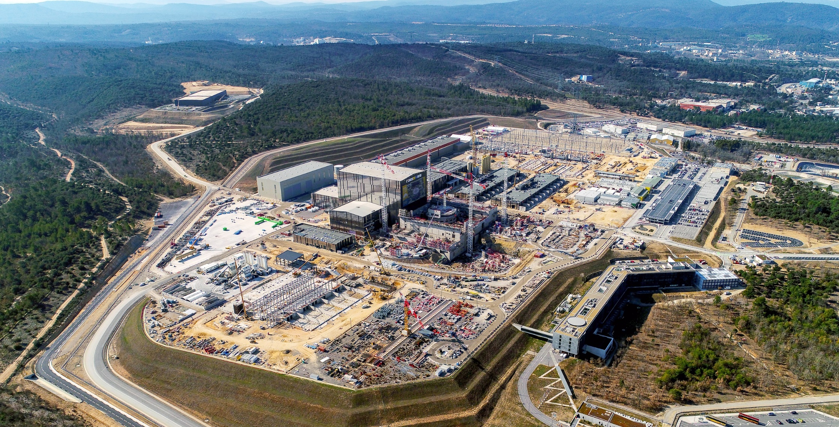
Fusion Technology Contributions of ITER
Hans-H. ALTFELD, Project Control Office, ITER Organization

Slide 2
Disclaimer:
The views and opinions expressed herein do not necessarily reflect those of the ITER Organization

Slide 3

Learnings from ITER
Already learned
Requirements
Challenges
To be learned
TODAY
2035

Slide 4
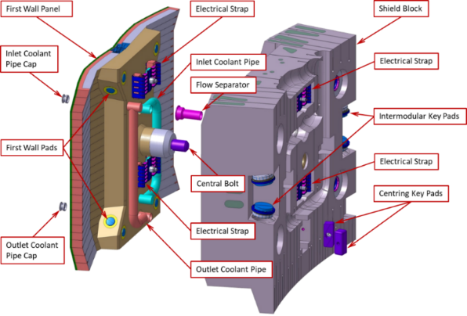
Plasma Facing Components (I)
Learnings from ITER Blanket System:
A beryllium-to-copper joining technology capable to withstand the cyclic heat fluxes associated with pulsing of the plasma.
Validation of welding and machining operations.
Demonstration of tolerance requirements’ achievement.
Qualification of proper fixations, allowing for thermal expansion and providing a path for halo currents.
Validation of effective blanket cooling circuits and flow control.
A blanket system for the next generation fusion reactor will learn from the ITER Blanket System, but will in addition have to cope with:
  Higher temperature coolant and materials
  Higher allowable neutron fluxes
440 Blanket Modules cooled by water at 70 C and 4 MPa at the inlet and up to 140 C at the outlet.
316 L stainless steel is used as structural material, and BE and CuCrZr as armor and heat sink, respectively for the first wall.
Technology R&D

Slide 5
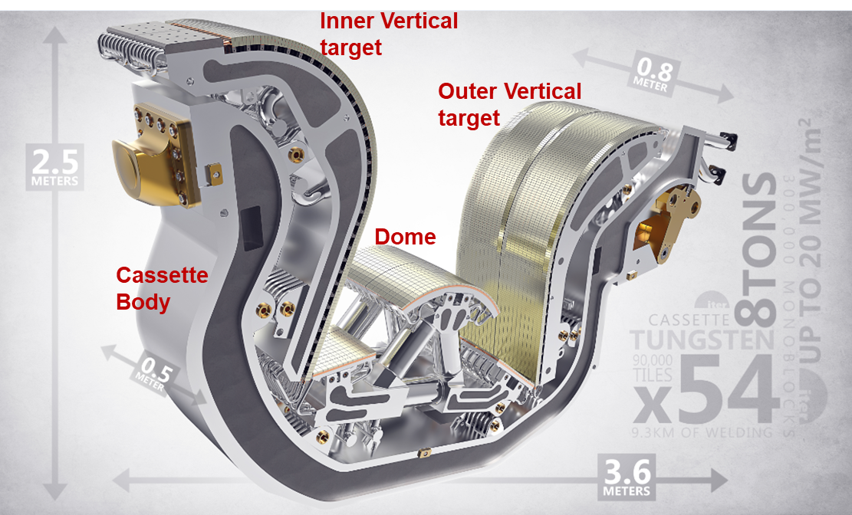
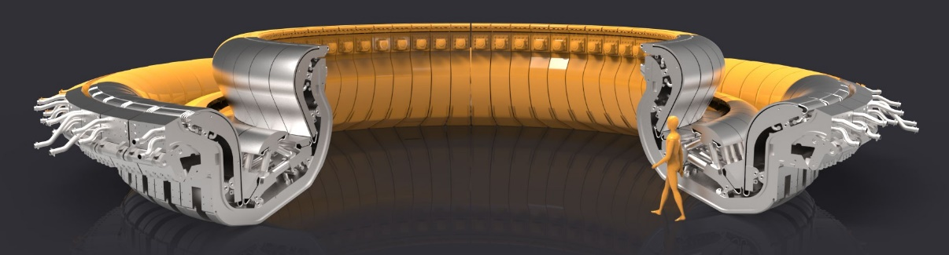
Plasma Facing Components (II)
Learnings from ITER Divertor:
A tungsten-to-copper joining technology capable to withstand the cyclic heat fluxes associated with pulsing of the plasma.
Validation of welding and machining operations.
Fully qualified divertor.
Technology R&D

Slide 6
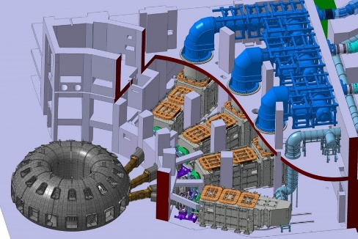
Heating Systems (I)
Learnings from Neutral Beam Injector (NBI):
Validation of negatively-charged ion source to achieve 3-4 times higher speed required compared to previous systems
A NBI for the next generation fusion reactor will learn from all ITER NBI, but will in addition have to launch R&D for:
  Plasma or photo neutralizer concepts to increase efficiency of the injectors
  Operation at lower gas source pressures
  Development of alternatives to caesiated sources
  Management of neutron fluxes through the NB ports
There is space for three neutral beam injectors on ITER (two will be installed first, with space for a third if the operational program requires it). At right, a smaller bay will receive the diagnostic neutral beam.
Technology R&D

Slide 7
Heating Systems (II)
Learnings from Electron Cyclotron Resonance Heating (ECRH):
Demonstration of 1 MW sources at 50% electrical efficiency
Qualified diamond technology for microwave windows
Improved transmission line component design
Development of waveguide transmission codes for accurate modelling of distortions, misalignments
An ECRH for the next generation fusion reactor will learn from ITER ECRH, but will in addition have to launch R&D for:
  Generation of high power sources ˜1.5MW with ≥60% electrical efficiencies
Technology R&D

Slide 8
Heating Systems (III)
Learnings from Ion Cyclotron Resonance Heating (ICRH):
Qualification of a reliable set of transmitters
Qualification of RF windows transmitting multi-MW power and providing confinement
An ICRH for the next generation fusion reactor will learn from ITER ICRH, but will in addition have to launch R&D for:
  High power RF sources in the range of 3 to 4MW
  High power coaxial windows
  Antenna resilience to coupling changes
ICRH System
Technology R&D

Slide 9
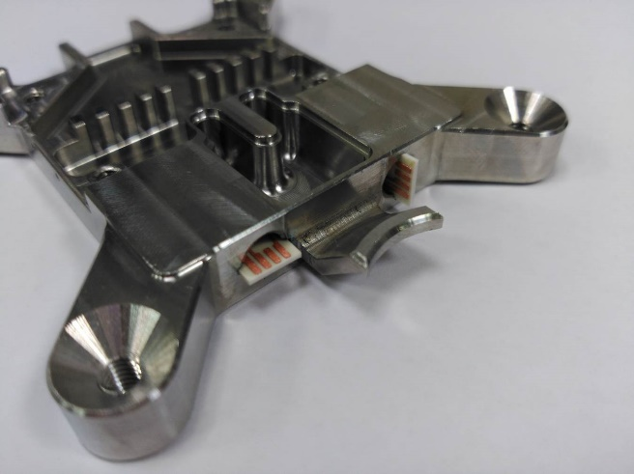
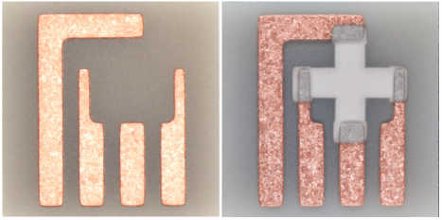
Diagnostics
Learnings from Diagnostics:
Development of many different and non-replaceable types of diagnostics systems (Rogowski coils, flux loops, inductive sensors, Hall sensors, fiber optic current sensors, etc.) for nuclear fusion applications, surviving and operating reliably in a highly demanding environment in terms of thermal, particle and neutron fluxes, ambient temperatures, electromagnetic loads and pulse duration
Example 1: Pair of bismuth Hall sensors to measure local poloidal field components
Tested to all in-cryostat normal and accidental conditions (irradiation, bake-out, accidental loss of cryogenic coolant) and magnetic field up to +/-7 T
On-board thermocouple - recalibrated in-situ using embedded indium capsule
Now in manufacture.
Example 2: significantly deteriorated
Molybdenum mirror being recovered to high quality
First mirrors are subject to deposits and erosion due to many factors
Ex-situ maintenance requires too long shut down times
In situ maintenance: RF applied to mirror => cleaning discharge successfully demonstrated for ITER
Images: Courtesy of USDA/PPPL/TNO/University of Basel
Technology R&D

Slide 10
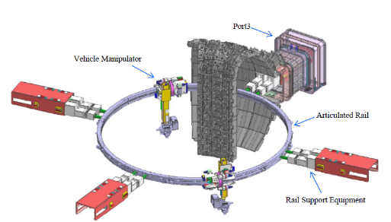
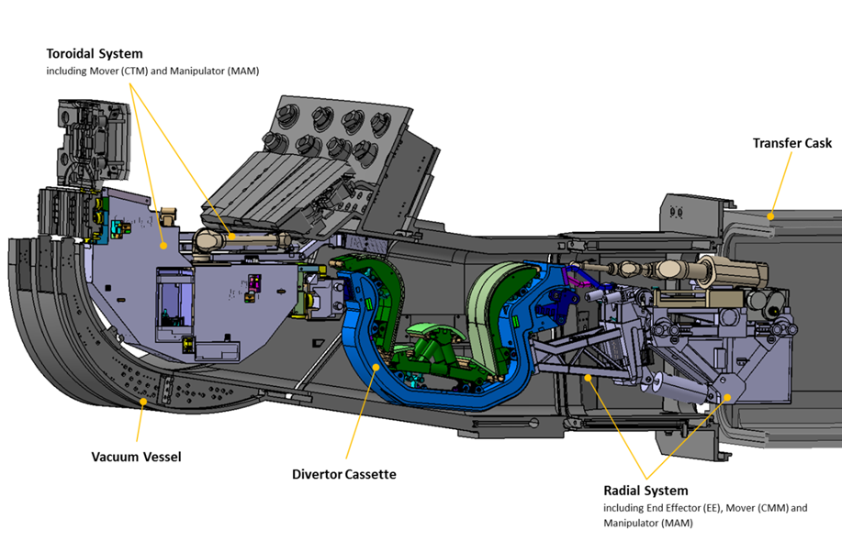
Remote Handling
Learnings from Blanket Remote Handling System:
Qualification of 4.5t shield block replacements with mm insertion tolerance while exposed to ~5MGy (requiring radiation hard actuators, sensors, cabling)
Learnings from Divertor Remote Handling System:
Qualification of 9t divertor cassette replacements with only 10mm clearances to manoeuvre in access ports
Qualification of manipulator operations within port duct, cutting/ welding of divertor pipes
Learnings from Cask and Plug Remote Handling System:
Qualification of transport of activated and contaminated components between Tokamak building and Hot Cell Complex
Technology R&D

Slide 11
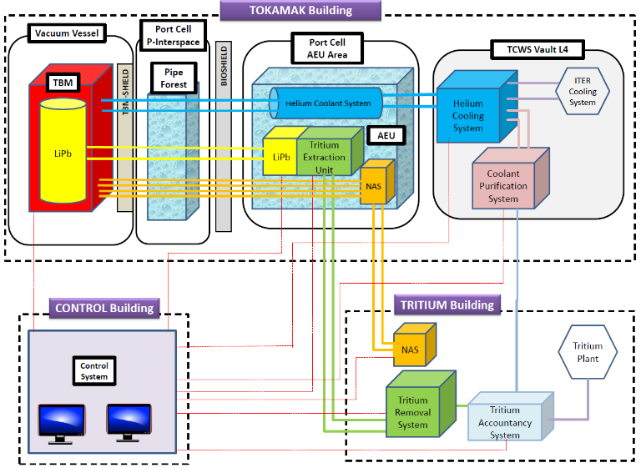
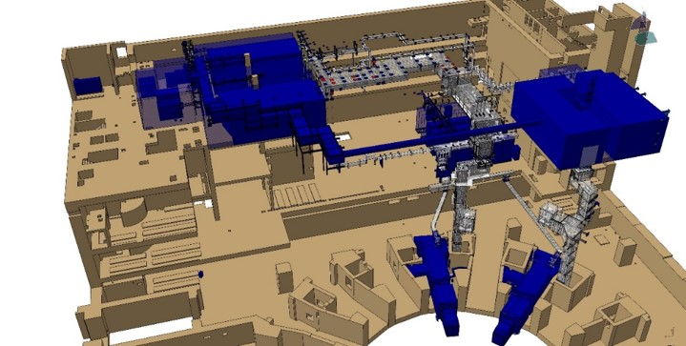
Tritium Breeding
Learnings from Test Blanket Systems (TBS):
Demonstration that tritium can be produced in the blanket and extracted from the blanket at a rate equal to tritium consumption in the plasma plus losses caused by radioactive decay from tritium inventories in reactor components.
Demonstration that heat be extracted from the blanket, simultaneously with tritium breeding, at temperatures which are sufficiently high for efficient electricity generation.
Example of Helium Cooled / LiPb Test Blanket System in ITER
AEU: Ancillary Equipment Unit
NAS: Neutron Activation System
Test Blanket Systems
Technology R&D

Slide 12
Tritium Handling
Learnings from Tritium handling:
Qualification of Tokamak leak localization and repair methods
Rapid/online measurement of Gas composition (e.g. for isotope separation control)
Dealing with Tritium in water (cooling, detritiation system) and on surfaces
Fuel processing and effluent detritiation in the presence of hydrocarbons, ammonia, halogens, and fire gases
Qualification of larger capacity tritium circulation pumps
Technology R&D

Slide 13
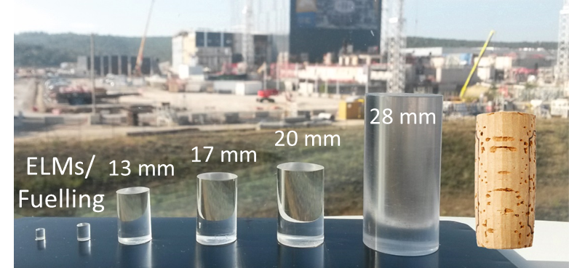
Plasma Disruption Mitigation
Learnings from Disruption Mitigation System (DMS) via Shattered Pellet Injection (SPI):
Validation of capability to quickly dissipate thermal and magnetic energy and to prevent runaway electron formation
Demonstration of
  reliable and uniform pellet formation and release
  control of variability in size distribution of shards from the shatter of the pellet
Minimization of the variability of timing of the pellet
Courtesy: M. Lehnen
Pellet sizes for disruption mitigation
Technology R&D

Slide 14
Other Technology R&D
Development of High Voltage Coil Insulation for magnets:
  Higher fluence levels (10MGy or 10²² neutrons/m²) than at ITER require improved insulation material
  Cynate ester proposed in 2002 as possible improvement, but expensive
  Cynate Ester – Epoxy blend investigated, 40% CE identified as acceptable up to 4*10²² neutrons/m²
Forming of High Strength Structural Metals
Tolerance Management
High Temperature Superconductive Cables
New Generation Fast Discharge Units
Solid State based Switching Network Units
Technology R&D

Slide 15
Other Learnings
Industrial Aspects
Civil Works
Assembly and Installation
Nuclear and regulatory requirements
Operations (in particular off-normal and dynamic ones)
Project Governance
see Back-UP
Technology R&D

Slide 16
Conclusions
Important technology information will be obtained from design, fabrication and operation of ITER systems as well as R&D performed using ITER as a platform (such as TBM).
The nuclear nature of ITER and future fusion reactors drive many design, development, operations and maintenance aspects (such as licensing aspects, remote handling, rad-hard electronics, radwaste management, etc).
ITER is now servings as the first instance of a power-producing fusion nuclear facility, pioneering both, the regulatory process and providing insights into fusion safety and regulation.
Some important industrial lessons learned should be considered for future build of fusion reactors.
ITER sets the precedence for development of codes and standards for nuclear fusion power plants of the future.

Slide 17

Acknowledgements
The presenter acknowledges the contributions from colleagues at the ITER Organization
Some of the information presented here is based on
  Campbell, D.J., Akiyama, T., Barnsley, R. et al. J Fusion Energy (2019) 38: 11.
  https://doi.org/10.1007/s10894-018-0187-9

Slide 18
THANK YOU!

Slide 19
BACK-UP

Slide 20
Industrial Aspects (I)
Innovations in Installation Activities:
  To organize the civil structures as structural modules fully prefabricated in the workshop (out of site) as currently done for fission reactors in AP1000 and EPRs.
  On-site to only perform the filling of concrete into the structural module and connection among modules
Implementation of Mechanical Modules:
  To study the lay out and the installation sequence at the level of conceptual design implementing exclusively mechanical modules fully integrated of mechanical / electrical and I&C systems assuring full prefabrication and FAT in the workshop
  To study properly the on-site integration processes identifying the make-up lines to be connected among interfacing mechanical modules as well as the anchorage configuration to structural modules
  To assure an installation sequence and integrated connections harmonically with structural modules’ assembly, with in many cases the mechanical modules being part of the structural ones.
Industrial Aspects

Slide 21
Industrial Aspects (II)
Early Pre-commissioning:
  Move as much as possible pre-commissioning tests into workshops to protect the field commissioning time schedule
Securing Industrial Base:
  Maintain technological and industrial know-how over long periods until next fusion reactor is a challenge
  Secured supply for some key raw materials is not a given (eg Nb alloys)
New Manufacturing Concepts:
  Today, Vacuum Vessels are made up of welded steel structures where it is extremely difficult to maintain tight tolerance requirements (because of component size and material behavior under weld)
  As a major innovation to avoid these problems and to have faster manufacturing times it is proposed to launch an R&D program to investigate the use of 3D printing to manufacture Vacuum Vessels.
Industrial Aspects

Slide 22
Industrial Aspects (III)
Project Management and Systems Engineering:
  Must be fully and consistently applied from the onset – this is a challenge in a science-dominated environment
  A realistic cost and schedule estimate is key to planning and execution
  Risk management is a unifying theme for a project that guides decision-making from early design to installation: design decisions must seek to minimize risk
  Particular challenges identified at ITER are:
    Design to cost
    Design to manufacturability / constructability / maintainability / decommissioning
    Difficulty to generate an integrated EVM due to the specific ITER governance
    Adherence to pass/fail criteria at gate reviews
    Interface Management
    Configuration Management
    Requirements Management
Industrial Aspects

Slide 23
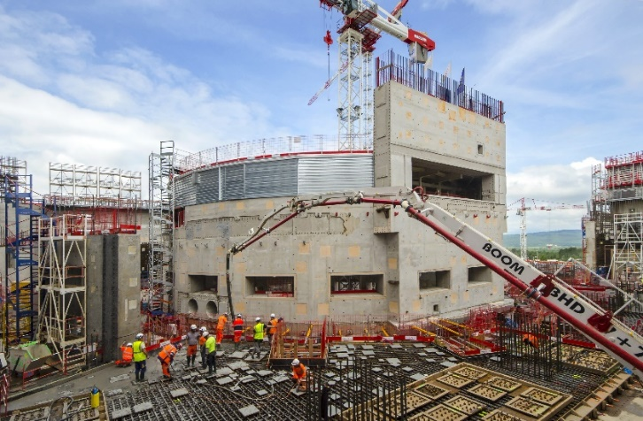
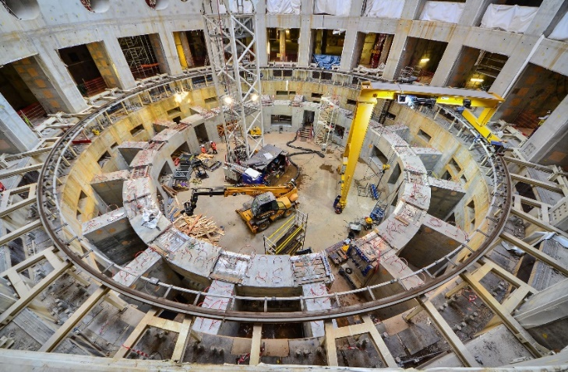
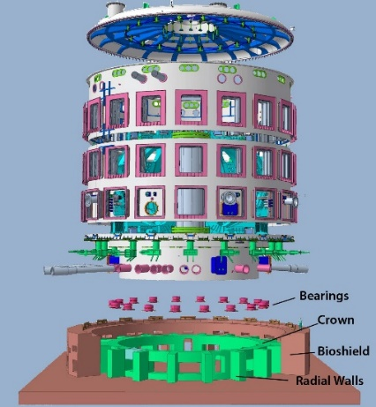
Learnings from Civil Works
Major technology issues already addressed at ITER:
  Specific designs for high density borated concrete for Tokamak Complex biological shield,
  Specific concrete mixes for self compacting high density concrete for Tokamak Complex areas with very high reinforcement,
  Specific large high load bearing, spherical bearings to support the complete Tokamak.
Learnings from Civil Works

Slide 24
Learnings from Assembly & Installation
Major technology issues already addressed at ITER:
  VV welding NG TIG with large use of new technologies: remote inspection and modelling,
  UT Qualification for Stainless as alternative to RT, applies to VV, Cryostat and thin-walled pipes,
  Metrology provides measurement networks with lower uncertainty to align large components to millimeter tolerances,
  Manufacture and design for feeders, thermal shield, silver coating. In-stu repair process,
  In-kind contribution model. DA manufacturing on-site and shared manufacturing.
  Transversal Engineering Requirements for: Common Mode Failure, Missile Impact etc.
  Radiation map and needs for shielding: Fusion vs Fission.
  Openings/Penetration design for confinement,
  Captive components in a Staged Approach,
  Fire protection safety requirement,
  Cable Management,
  Embedded Plates Arrangement,
  Interference Requirements,
  Propagation of Defined Requirements,
FOAK Configuration management,
Learnings from Assembly & Installation

Slide 25
Learnings from Assembly & Installation
Major technology issues to be addressed at ITER:
  Be handling, storage, transport and control,
  Ventilation and Clean Conditions for Assembly temperature and clean conditions control,
  4D planning, developing approach to use of standard 4D modelling software,
  RH technologies, in particular metrology systems suitable to high-radiation environment,
  More flexibility for cable penetration design with sleeves,
  Proper planning of the installation activities based on the design maturity of the system,
  Galleries designed as a single fire sector: requires extensive fire wrapping,
  Avoid redesigning the systems for reducing cabling or find alternative routing etc.
  Embedded plates: Greater flexibility for late design updates,
  Identification and definition of all interfaces at early stage, not at construction execution,
  Fusion requirements must be defined and propagated from constructor to regulator,
  Implement and customize CM program from initial stages of planning, FEED.
  FDR, ensure proper development in an integrated approach,
  develop specific to Fission rules, principles.
Learnings from Assembly & Installation

Slide 26
Nuclear Aspects (I)
General:
  ITER is the first fusion device to go through the process of nuclear licensing. There is massive learnings from this for a fusion community largely not confronted with nuclear regulatory requirements.
  ITER safety related (protection important) systems and components being qualified for normal and accidental conditions, including fusion specific environments (e.g. electro-magnetic loads)
  Nuclear safety control system complying with the international nuclear standards requirements for the highest classification (class 1 system as per IEC 61513)
  Most nuclear safety I&C functions are devoted to the confinement by protecting the barriers and operating the isolation valves and the detritiation system
  The selected technologies have undergone rigorous qualification, including product, environmental, EMC, seismic and functional qualification
  However, all selected I&C technologies are commercial off-the-shelf
Nuclear Aspects
Notes:
I&C: Instrumentation and Control

Slide 27
Nuclear Aspects (II)
Nuclear Pressure Equipment (NPE):
  The ITER Vacuum Vessel (VV) is a NPE by French Order
  ITER, as VV manufacturer, must demonstrate that the applicable Essential Safety Requirements and radioprotection requirements are satisfied
    First use of NPE Codes RCC-MR to design/manufacture/assemble/operate a Fusion machine. An Agreed Notified Body (by the French Safety Authorities) is contracted by ITER to evaluate the NPE conformity of the VV with these requirements.
    VV in-service inspection (imposed by NPE) required compensatory measures due to closed structure
    Combined Acceptance Tests for Fusion components & NPEs:
  Guidelines development including a complete description of all tests to be performed and the sequence (at factory and on-site after delivery), to validate the requirements specified for the VV components
Nuclear Aspects

Slide 28
Nuclear Aspects (III)
Nuclear Shielding:
  Challenging trade-off between a compact design to minimize cost and the need to provide sufficient space allocation margin to maintain adequate shielding as the final design progresses as changes to be done in the final design stage and even more so in the early fabrication stage have much larger implications on interfacing systems as well as larger cost and schedule impact.
  ITER will provide better understanding of the accuracy of analytical neutronics predictions when applied to such a complex geometry as a fusion reactor.
Nuclear Requirements Understanding and Cascade:
  In the case of ITER, French regulatory requirements have to be cascaded to its global supply chain, which makes their understanding a challenge.
Nuclear Aspects

Slide 29
Learnings from Operations
ITER operation will help clarify the actual pulsed heat loads on components due to off-normal or dynamic events such as:
  vertical displacement events (VDE)
  H-mode to L-mode transitions
  disruptions
  uncontrolled EMLs,
  runaway electrons.
A refined categorization of these heat loads including realistic frequency rates is needed, akin to that of EM loads during disruption events. ITER will help provide this.
ITER will also document the localisation probability of thermal damage on the armor due to these events.
This would help development of a realistic action plan (such as repair plan and spare strategy) for a next generation fusion device.
Learnings from Operations

