Slide 1


IFE Program in Japan
FIREX-NEO project - for IFE target design with a FI scheme
J-EPoCH project - for High-repetition high-power laser development toward an IFE reactor
HYPERION project - for fast-track strategy of laser fusion energy
Keisuke SHIGEMORI (for Ryosuke KODAMA)
Institute of Laser Engineering, Osaka University
1
Notes:
Three projects are for target design, laser development and fast track strategy.
However, budgets have not yet been approved for all plans for any of the projects.

Slide 2
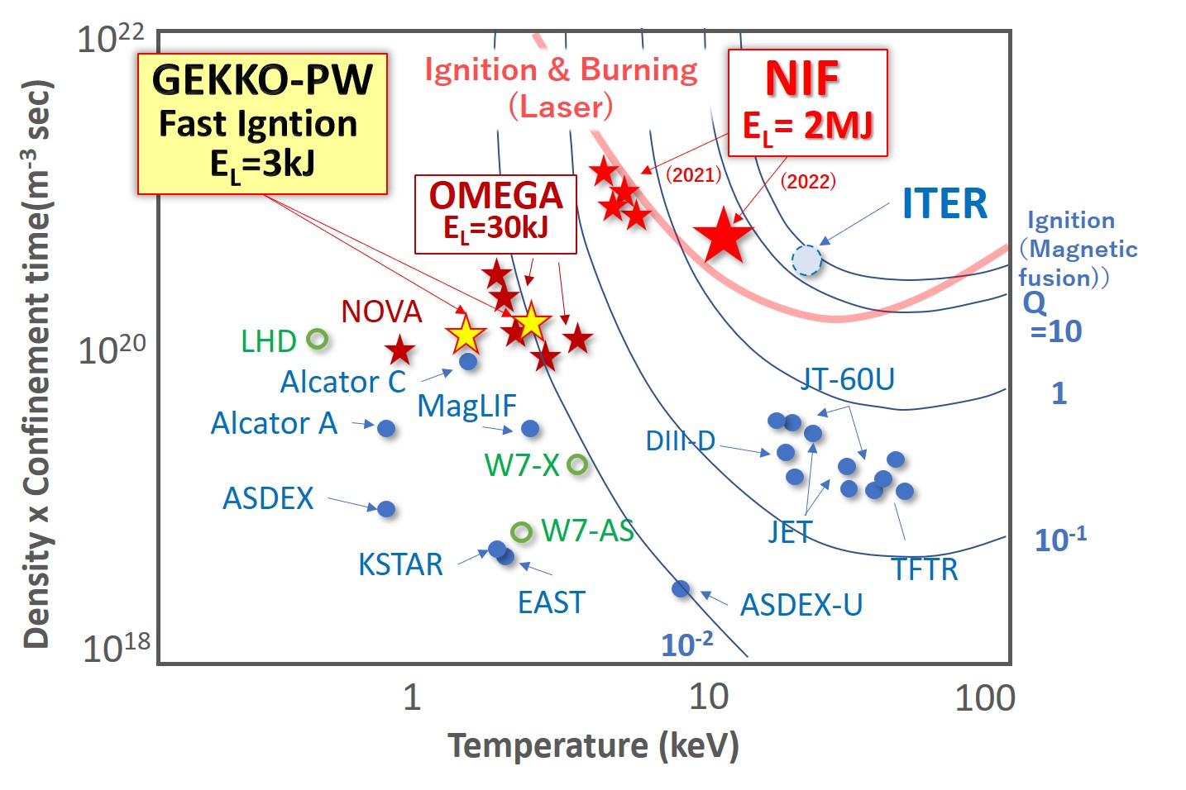
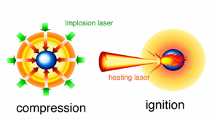
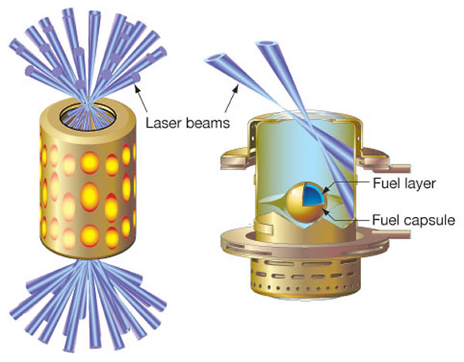

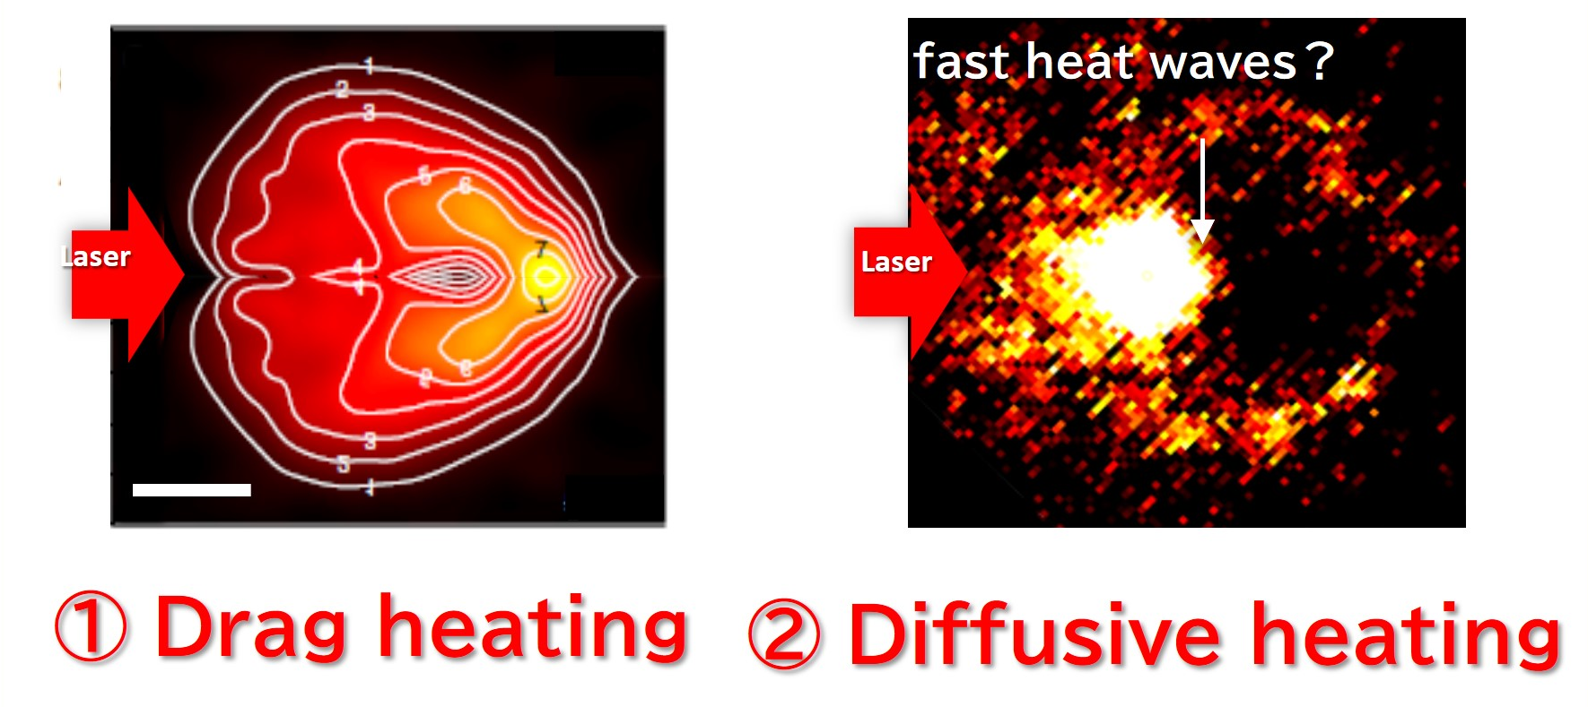
A reactor target designs, based on detailed research results over the past almost three decades
Fast Ignition
Indirect &
Central ignition
K Matsuo, et al., Phys. Rev. Lett. 124, (2020) 035001
In 2020, 2 Peta Pa was achieved at about one-tenth the energy of the central ignition scheme, demonstrating the high efficiency of the fast ignition scheme and a deep understanding of the physics.
Energy coupled to the core is ~200kJ from 2MJ laser
Fusion yield is ~ 3MJ (Fuel burning rate ~10%) on 2022 and 3.88MJ on 2023.
Based on the detailed understanding of the physics of FI obtained over the past nearly 3 decades, reactor targets can be designed.
Solid or low aspect sphere without a cone
Implosion laser energy (2ω): 200kJ
Heating laser energy (ω): 50~100kJ
Target fusion yield
~ 30MJ (gain 100)
The fusion yield will be ~ 40MJ (gain 10) in a decade (plan)
2
Notes:
In 2020, 2 Peta Pa was achieved at about one-tenth the energy of the central ignition scheme, demonstrating the high efficiency of the fast ignition scheme and a deep understanding of the physics.
Based on the detailed understanding of the physics of FI obtained over the past nearly 3 decades, reactor targets can be designed now.
Then, we can expect fusion yield of about more than 30MJ with a gain of 100 using solid sphere fuel and a total laser energy of less than 300 kJ.

Slide 3
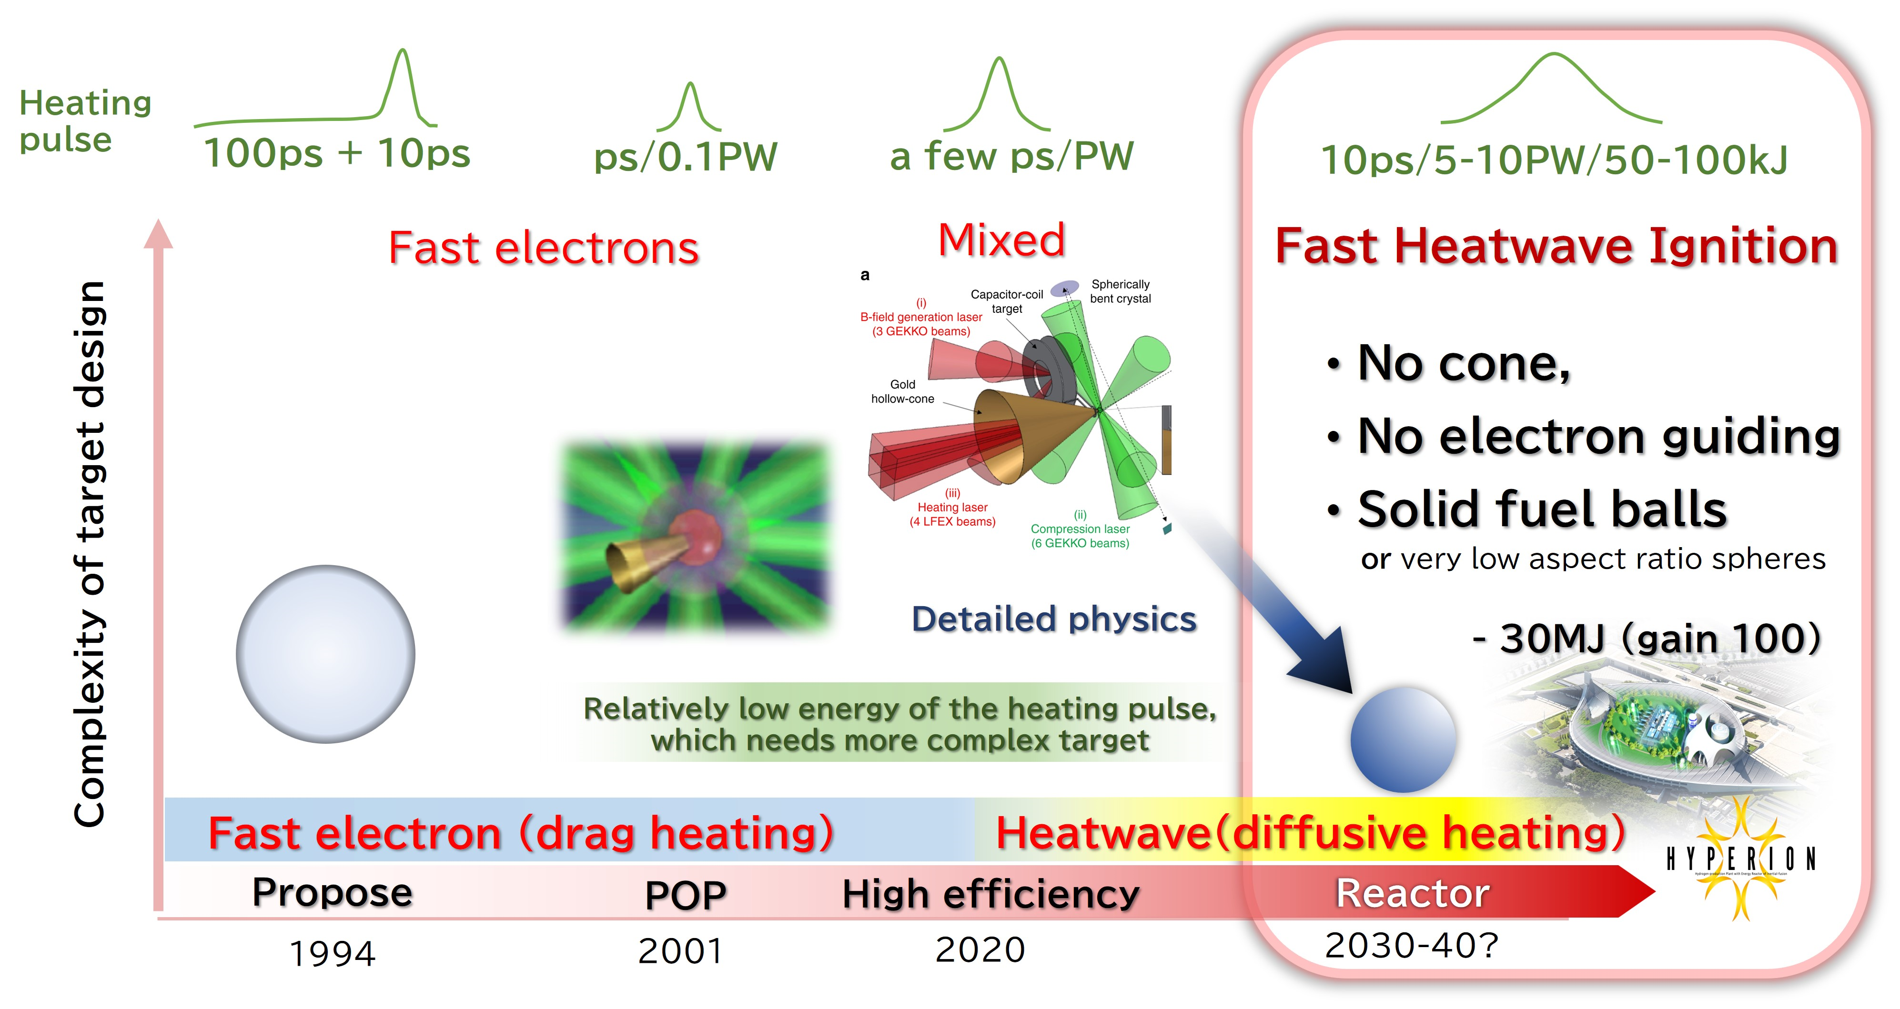
History and Evolution of Fast Ignition Target Design
At the beginning, a spherical shell implosion and fast electron heating by short pulse laser was proposed and the POP was experimentally made.
In the experiments under much smaller laser energies than the reactor size, the targets became more and more complex to study the details of the fast ignition scheme.
This allowed us to understand the details of the stable implosion and efficient heating, and to find that the target for the reactor would be very simple due to the different heating mechanisms from the original.
+ α heating
3
Notes:
This is a history of fast ignition target designs.
At the beginning, a spherical shell implosion and fast electron heating by short pulse laser was proposed and the POP was experimentally made.
In the experiments under much smaller laser energies than the reactor size, the targets became more and more complex to study the details of the fast ignition scheme.
This allowed us to understand the details of the stable implosion and efficient heating, and to find that the target for the reactor would be very simple due to the different heating mechanisms from the original.
No cone and no external magnetic field since the primary heating is by fast heat waves,

Slide 4
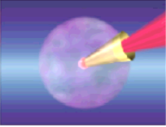
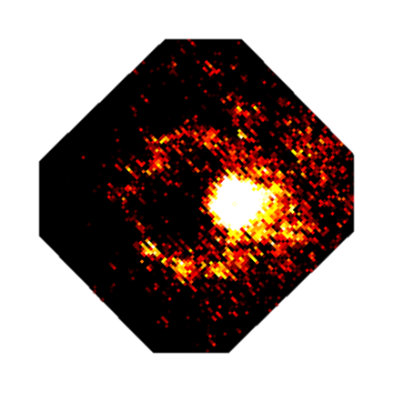
Mechanism of Fast Heating of the Imploded Core
It was initially thought that direct drag heating by fast electrons would dominate.
0
Experiment
Thermal front
Shockwave
Heatwave
fast heat waves？
②
Heating
laser pulse
Laser
Laser
Fast electron
①
① Drag heating
② Diffusive heating
K Matsuo, et al., Phys. Rev. Lett. 124, (2020) 035001
However, experimental results using kJ-psec laser, showed the importance of diffusive heating along with fast electrons.
4
Notes:
the heating mechanism.
it was initially thought that direct drag heating by fast electrons would dominate.
However, experimental results using kJ-psec lase, showed the importance of diffusion heating along with fast electrons.

Slide 5
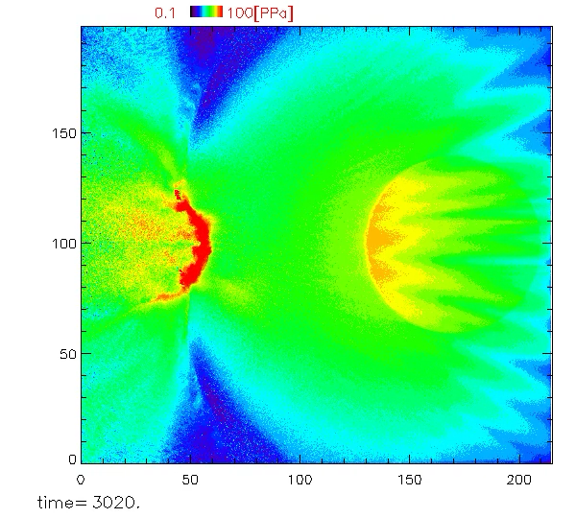
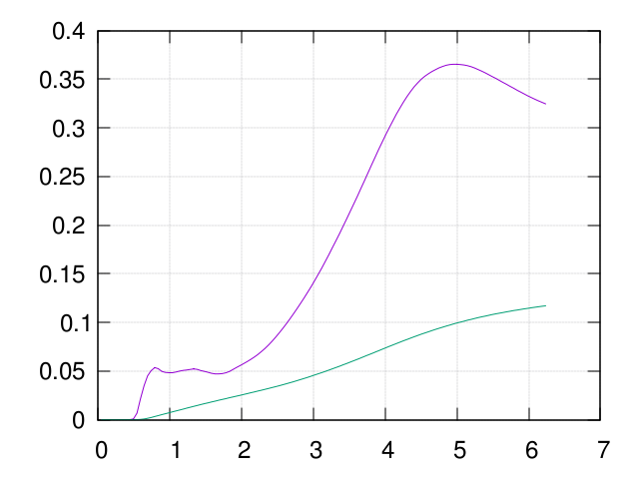
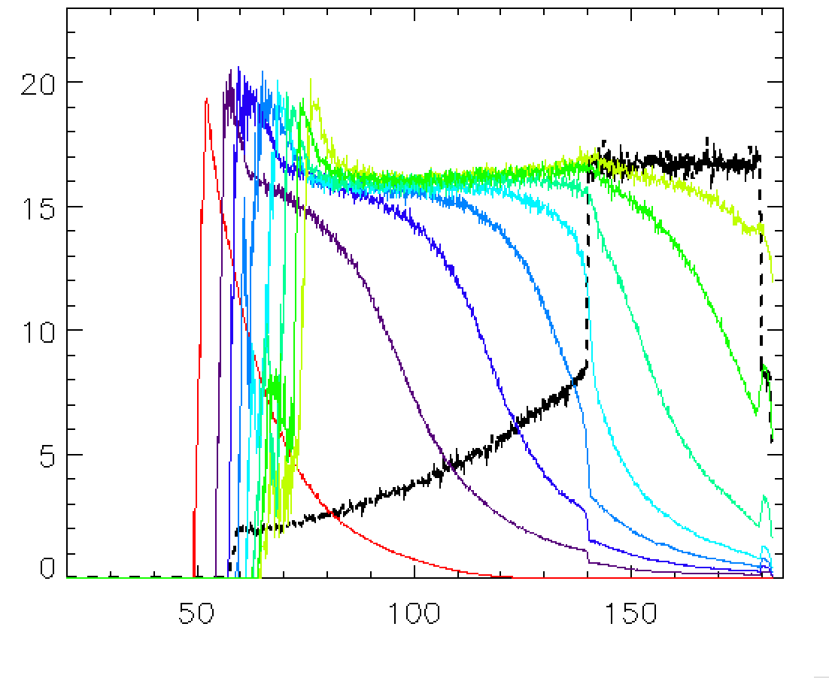

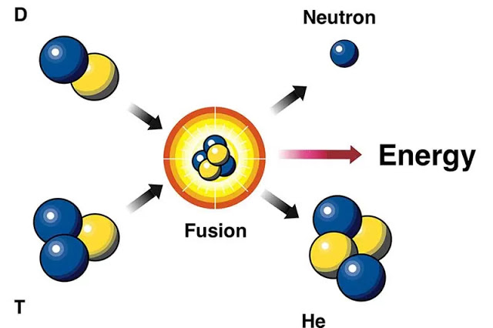

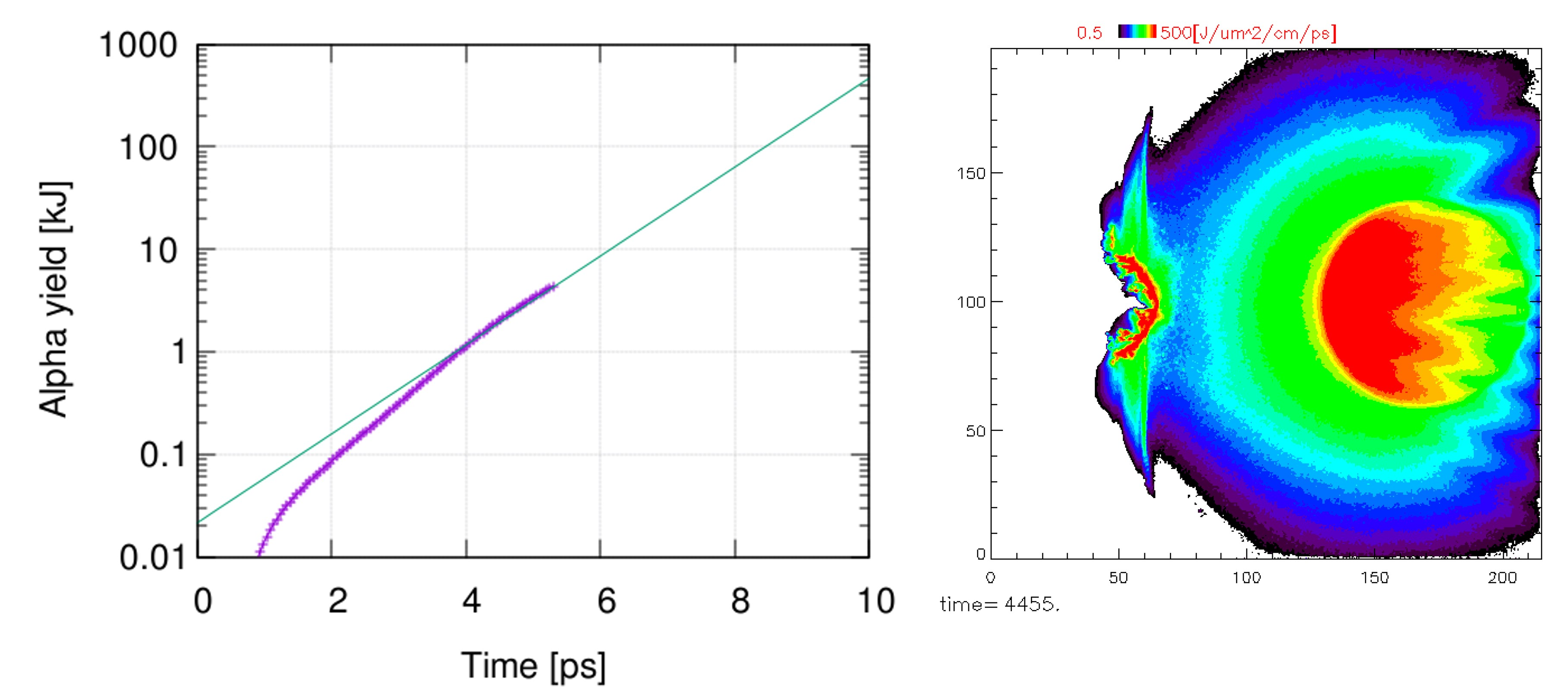



Heating mechanism in the reactor will be different from the original idea of the fast ignition
Heatwave speed: v_{heat}~0.1c
Simulation prediction
20
20
③
Boost-up heating
10
Achieving high energy coupling over 30%
Te[keV]
10
ρ[g/cm³]
laser
density
0
x[μm]
0
Thermal front
②
Diffusive heating
Laser hole-boring
Shockwave
Heatwave
Nonlocal heat transport
②
Heating
laser pulse
Fast electron
①
①
Drag heating
α-particle
Self magnetic field
③
α yield: 5.5kJ/ps > Radiation loss:3kJ/ps
Fast Heatwave heating & α-particle heating will achieve fusion gains of over 50 with a 50kJ heating laser & 200kJ implosion laser pulse.
5
Notes:
According to simulation, Heating mechanism in the reactor would be different from the original idea of the fast ignition
Fast Heatwave & a-particle heating will achieve fusion gains of over 50 with a 50kJ heating laser & 200kJ implosion laser pulse.

Slide 6
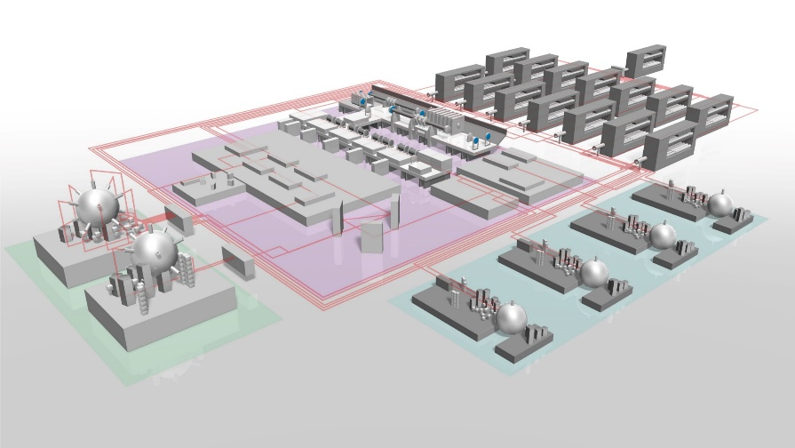
J-EPoCH Project
-Japanese Establishment for Power-laser Community Harvest-
The project will develop a high-repetition, high-power laser that will open a new stage of IFE research.
6

Slide 7
Based on the 10kW development, the J-EPoCH, consisting of MW-class lasers will be a technological reality within 10 years.
Big Data for deeply understanding of fusion plasmas
Start of reactor engineering with repetitive fusion reaction
A. Iwamoto and R. Kodama, Nucl. Fusion 61, 116075 (2021)
On the laser development we need strategy for the reactor from a viewpoint of back casting,
FY
Considering the actual stable pulsed operation of laser fusion reactors, the laser specifications should be several to 10 times greater than the normal operation for the reactor, i.e., 10Hz laser development is not enough for the actual reactor operation .
After more than 30 years of development of high repetition rate high power lasers, the average output power has exceeded kW and is about to reach 10 kW.
7
Notes:
We are now developing a large scale of high repetition laser system J-EPOCH.
After more than 30 years of development of high repetition rate high power lasers, the average output power has exceeded kW and is about to reach 10 kW.
Based on these developments, the J-EPoCH consisting of MW-class lasers will be a technological reality within 10 years.
With this system, we can expect Big Data for deeply understanding of fusion plasmas and Start of reactor engineering with repetitive fusion reaction.
On the development of laser system, we need Strategy for the reactor from a view point of back casting,
Considering the actual stable pulsed operation of laser fusion reactors, the laser specifications should be several to 10 times greater than the normal operation for the reactor, i.e., 10Hz laser development is not enough for the actual reactor operation .

Slide 8
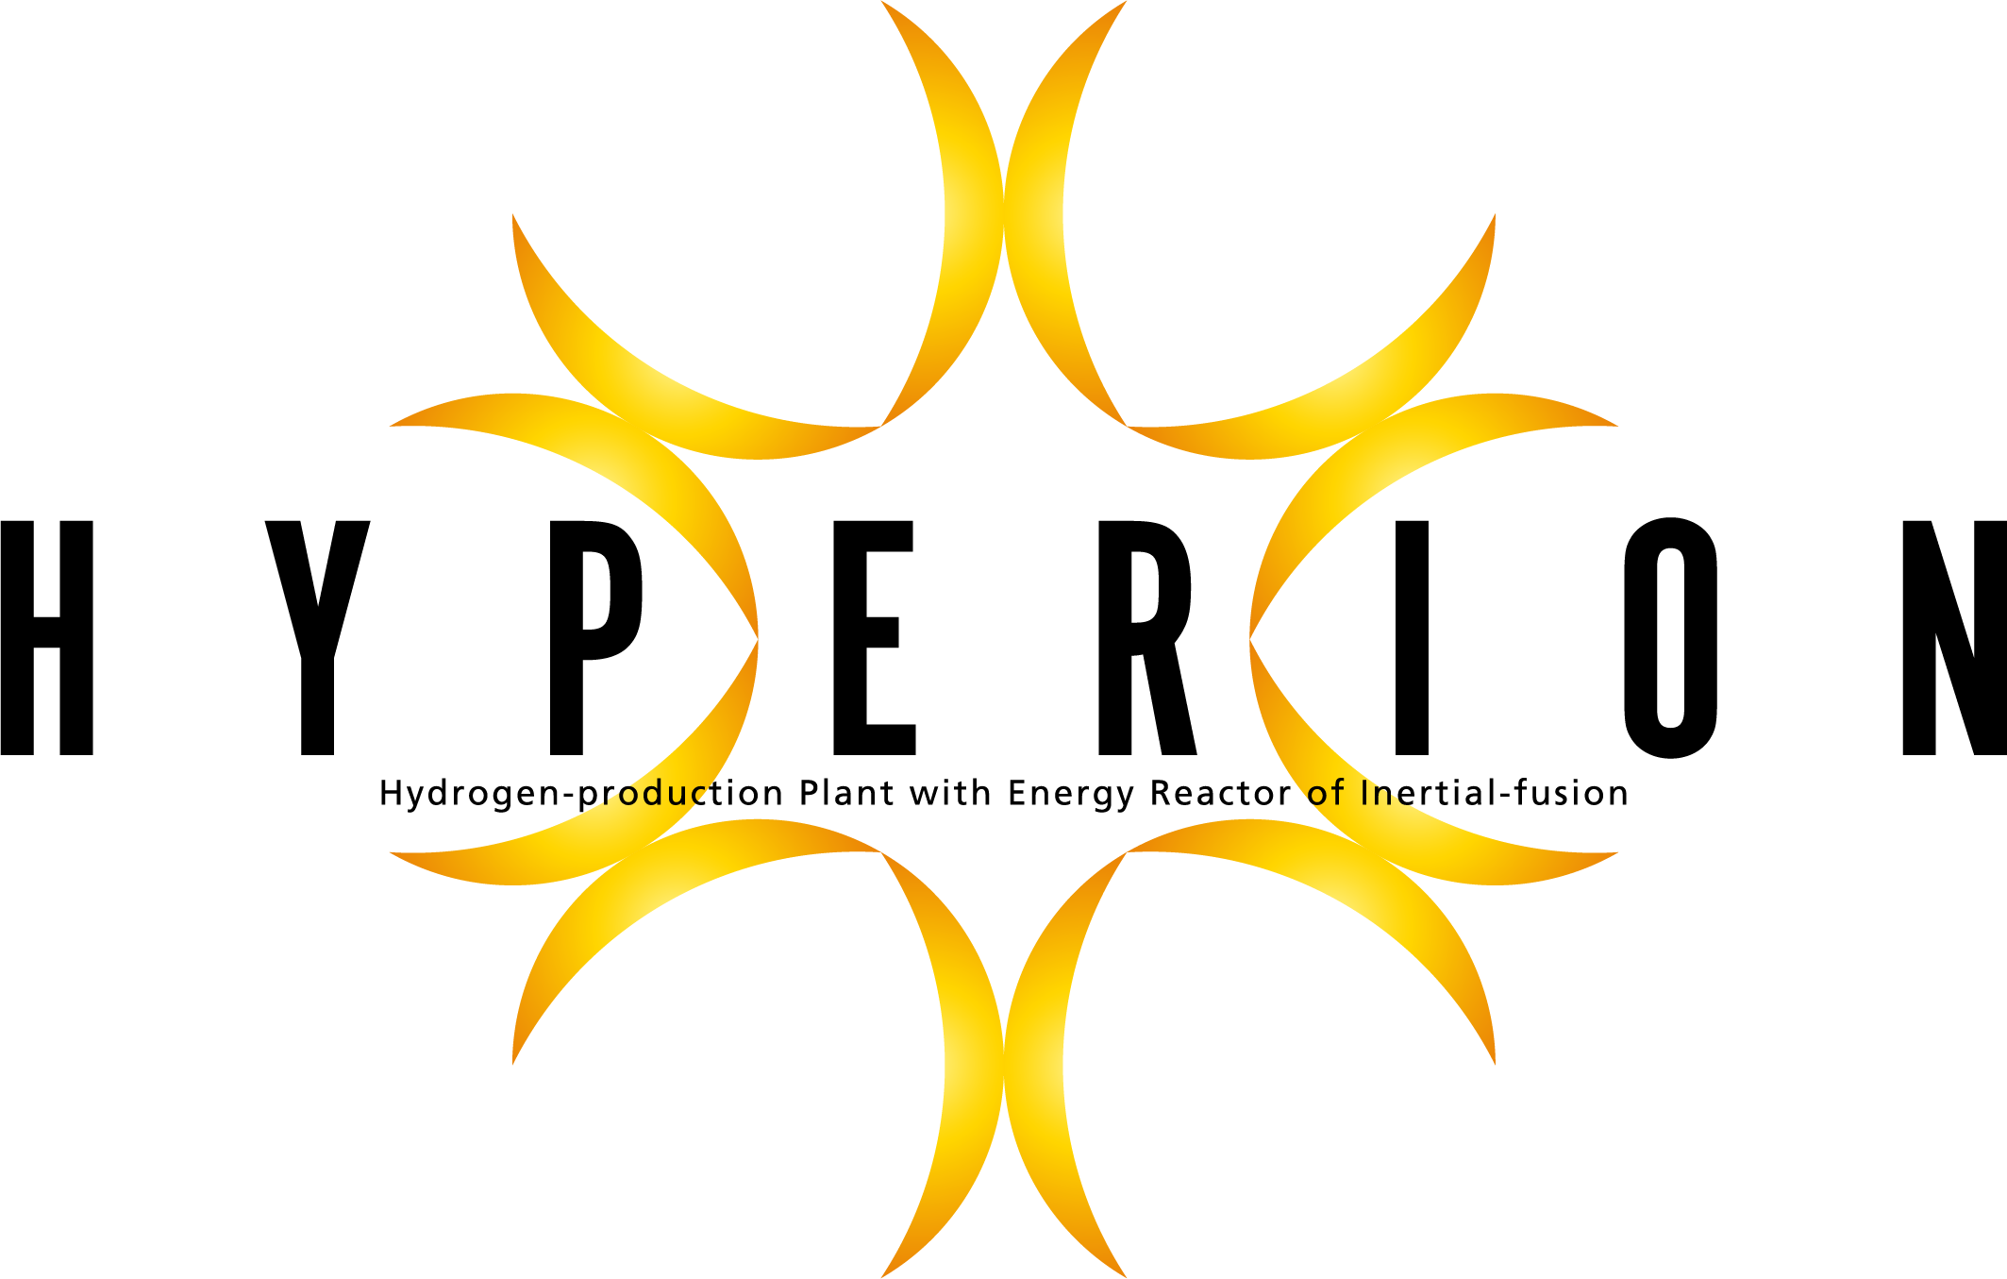
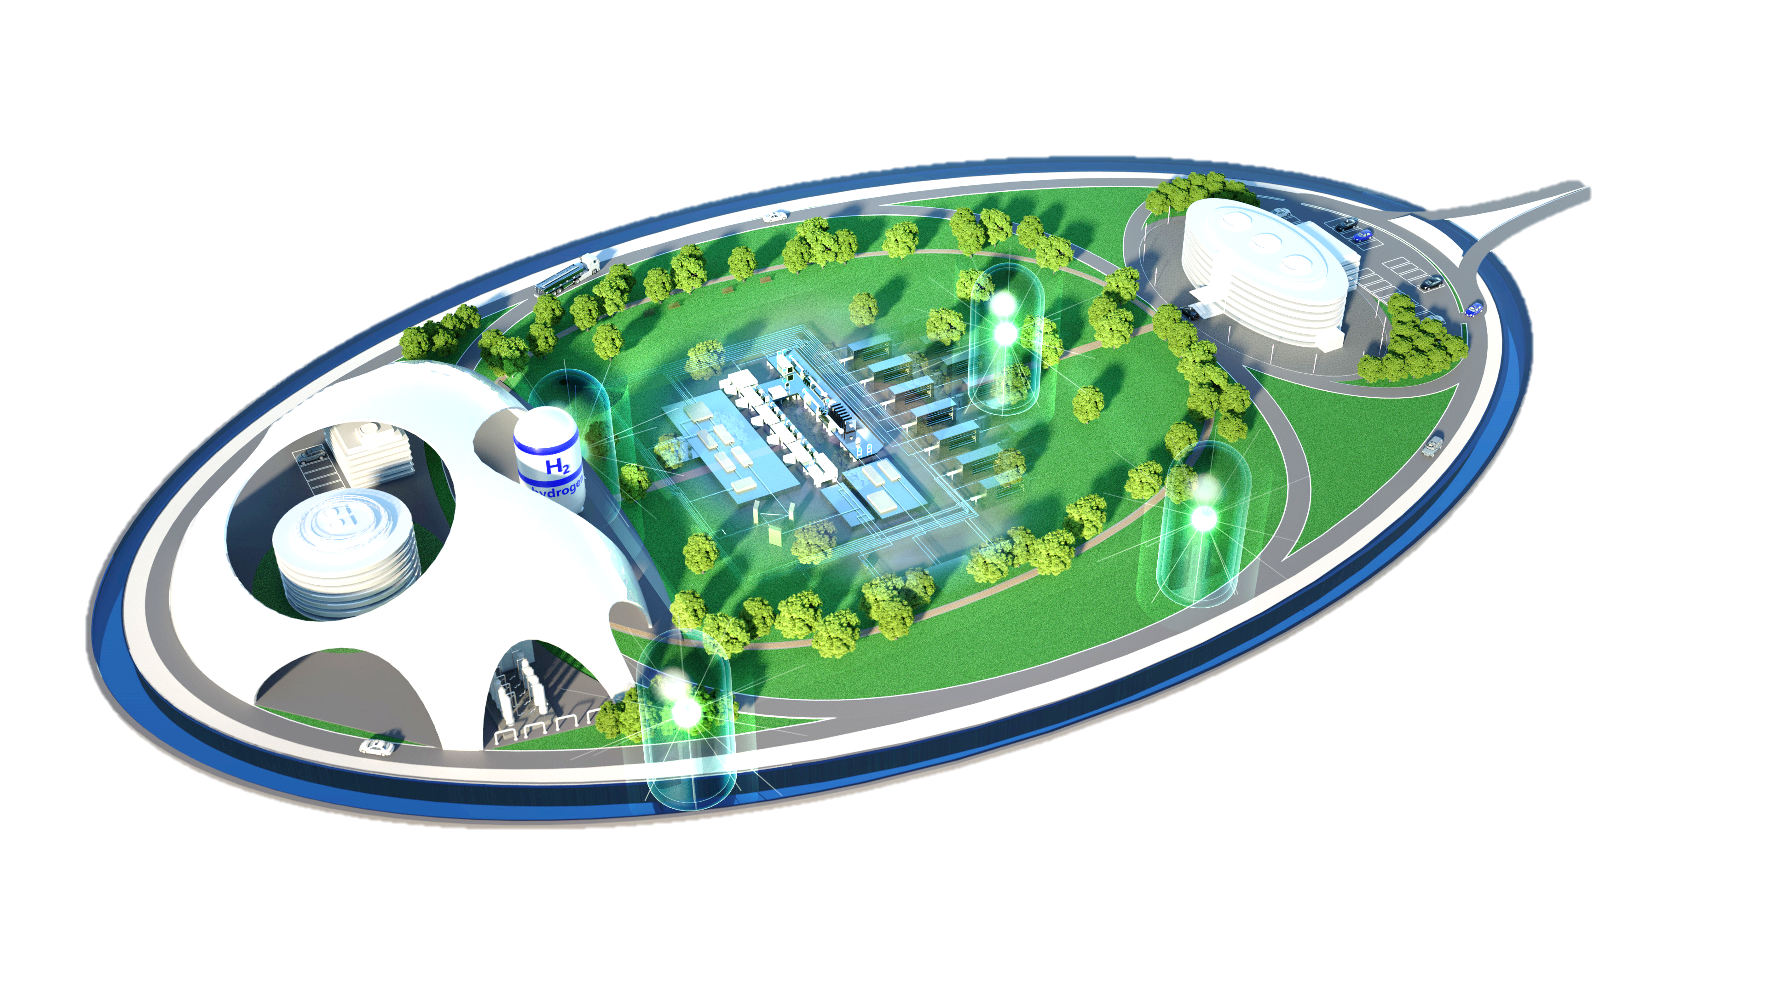
HYPERION Project
-HYdrogen-production Plant with Energy Reactor of Inertial-fusiON-
This project is a fast-track strategy for making fusion energy available to humanity at an early opportunity.
8

Slide 9
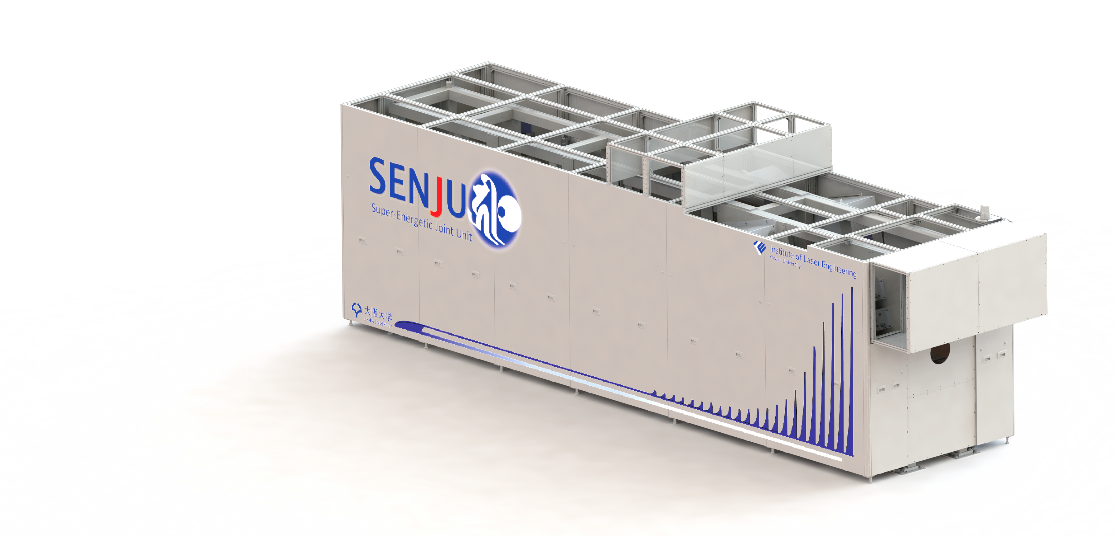
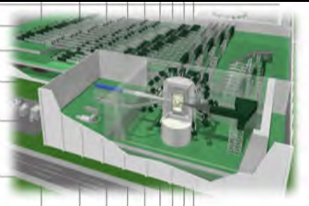
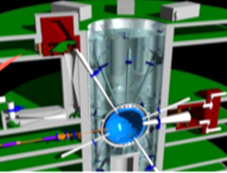
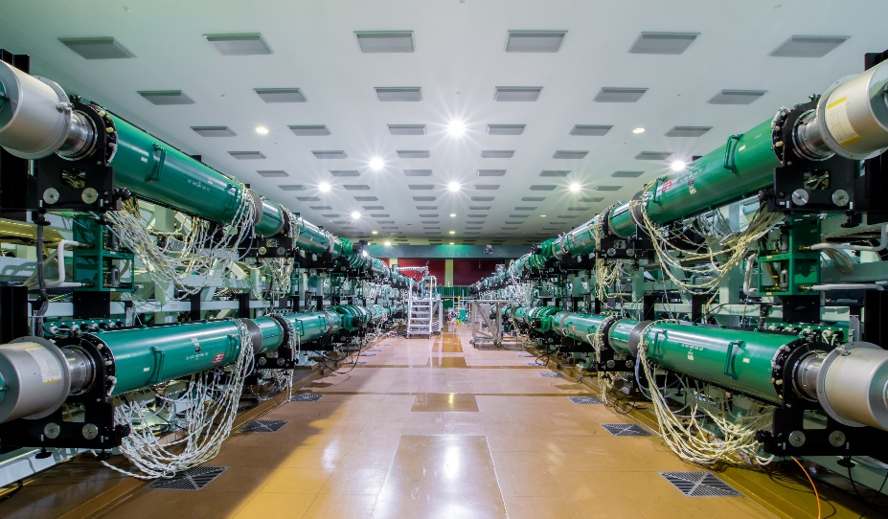
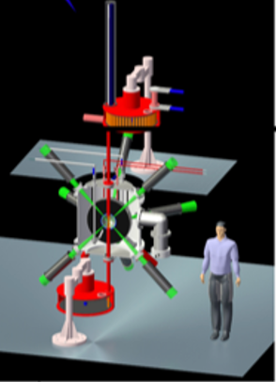
Conventional strategy for a fast-ignition fusion reactor
2023
2030
2040
2050
SENJU
J-EPoCH
LIFT
KOYO-F
(module）
（Multi purpose）
(Test reactor）
(commercial test reactor)
100Hz/10０J Laser
Test facility of the high repetition laser
1-100Hz/10kJ Laser
Sub-critical reactor
Too late
for carbon neutral 2050
0.６MJ/1-16Hz/MW
Small test reactor for power generation.
Optimization of burning fusion plasma
Electricity output:100-400MW (1-4 Hz/reactor x 4)
Grid connection test
Steady-state electricity supply
Demonstration of Generation of Electric Power
Data-driven analysis of fusion plasmas for the optimization
Single-shot base achievements
Demonstration of highly efficient fusion based on a fast ignition system
International collaborations
A commercial test reactor KOYO-F will be after 2050 taking account of the reality of power generation or difficulties in the grid connection.
9
Notes:
This is a conventional strategy for a fast-ignition fusion reactor,
Around 2040, LIFT is established as a test reactor, and a commercia test reactor KOYO-F will be after 2050 taking account of the reality of power generation or difficulties in the grid connection.
However, This plan is too late for carbon neutral 2050

Slide 10

A new fast-track strategy: HYPERION
that moves away from the traditional strategy of fusion only power generation to introduce hydrogen production using the fusion heat source.
HYPERION : Hydrogen-production Plant with Energy Reactor of Inertial-fusion
2023
2030
２０４０～2050
SENJU
J-EPoCH
HYPERION
（Test reactor –
Commercial Reactor）
(module）
（Multi purpose）
compact fusion reactor (30-50MJ X 4 units)
1-100Hz/10kJ Laser
Sub-critical reactor
100Hz/10０J Laser
Test facility of the high repetition laser
Demonstration of Generation of Electric Power and Clean H2
Data-driven analysis of fusion plasmas for the optimization
MW laser
0.3-0.5ＭＪ
Consumer
Single-shot base achievements
Taking account of the difficulties in actual grid connection, HYPERION can function as both a test reactor for power generation and a commercial reactor for clean hydrogen production,
To realize of the HYPERION accelerate the development of key technologies and human resources with J-EPoCH
Demonstration of highly efficient fusion based on a fast ignition system
International collaborations
10
Notes:
This is a new fast-track strategy: HYPERION that moves away from the traditional strategy of fusion only power generation to introduce hydrogen production using the heat from fusion reactions.
Taking account of the difficulties in actual grid connection, the HYPERION can function as both a test reactor for power generation and a commercial reactor for clean hydrogen production.
Then, By 2050, we will be able to use fusion energy in our daily lives.

Slide 11
Conclusion
Back-casting Prospect Necessary for IFE Realization
Target design should be simpler.
Considering the actual stable pulsed operation of laser fusion reactors, the lasers system should be developed to be above a few 10 Hz and below MJ.
We should consider realistic strategy that does not turn away from the practical difficulties in grid connection in order to realize fusion energy utilization by 2050.
11
Notes:
Let me show my conclusion.
After the ignition at LLNL, we need now to have Back-casting Perspective, which is Necessary for IFE Realization.
Target design should be simpler.
Considering the actual stable pulsed operation of laser fusion reactors,
the lasers system should be developed to be above a few 10 Hz and below MJ.
We should consider realistic strategy that does not turn away from the practical difficulties in grid connection in order to realize fusion energy utilization by 2050.

