Slide 1
The EU Fusion programme in support to ITER
Presented by Xavier Litaudon on behalf of EUROfusion

Slide 2
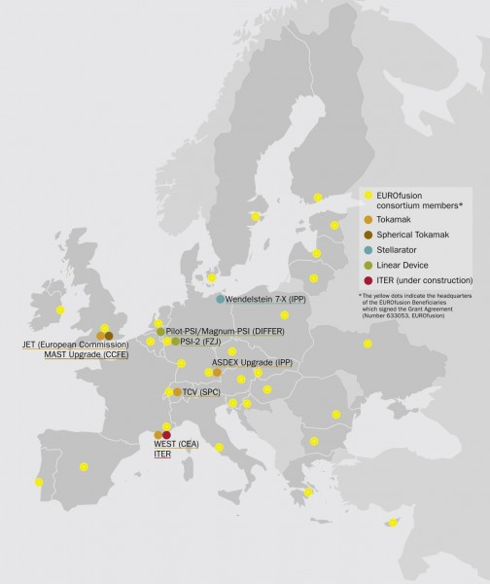



EUROfusion coordinates R&D in fusion research
30 Research Units from 26 EU countries plus Switzerland + Ukraine from Jan. 2017 working together to achieve the goal of the Fusion Roadmap
the EU Domestic Agency for ITER: Focus on procurements

Slide 3
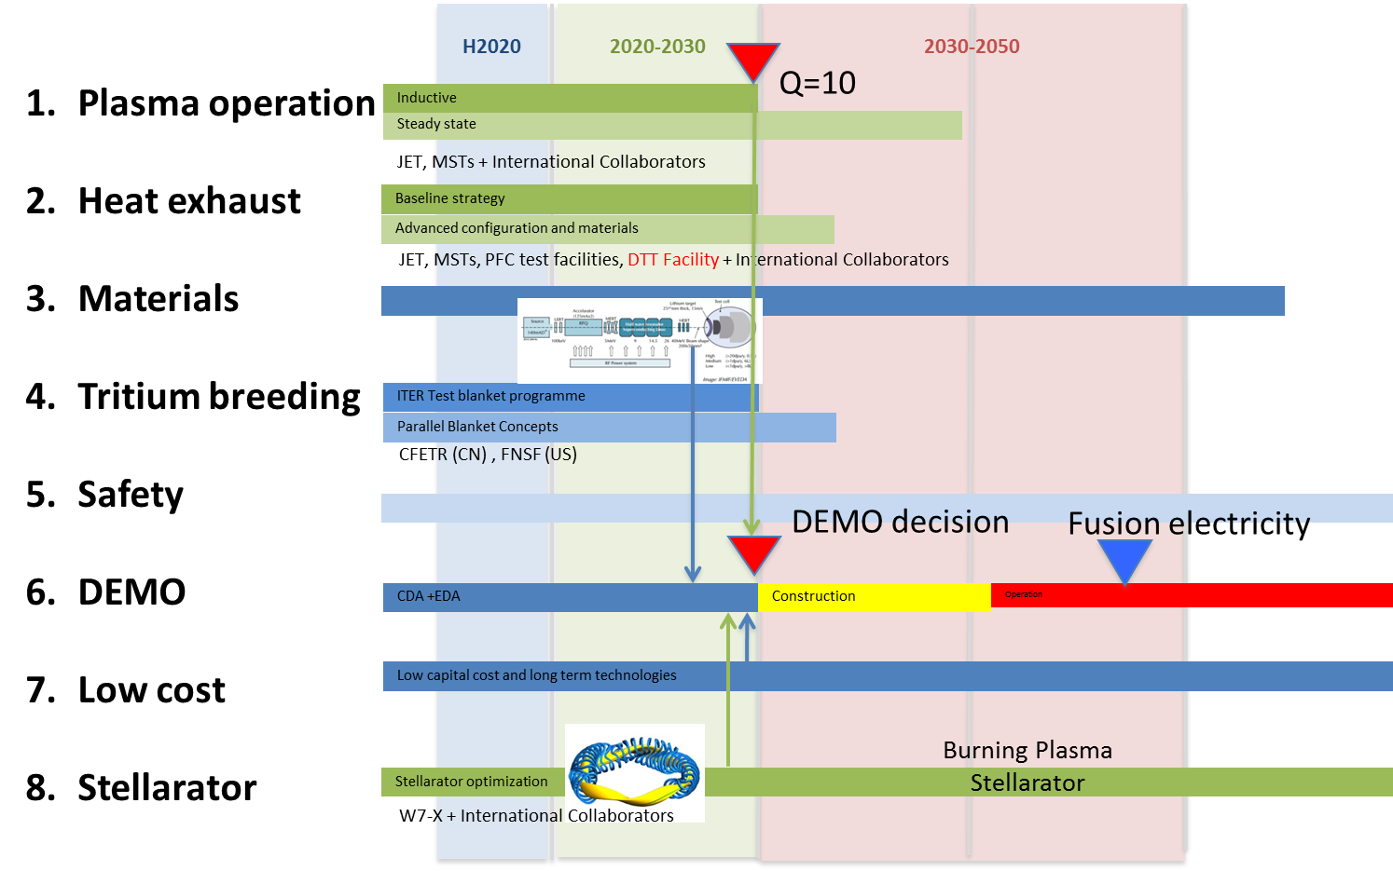
2012 EU Roadmap to the realisation of fusion energy
Joint EU programme with clear goal
Avoids open-ended R&D
ITER: the key facility & critical path
DEMO construction after ITER Q=10 and a single step to a commercial fusion power plant
2017: roadmap evolution with revised ITER schedule

Slide 4
2017 EU Roadmap ‘evolution’ not ‘revolution’ …
Two documents high level documents in preparation
EU Top-Level roadmap to be endorsed by EUROfusion General Assembly (GA) and the F4E Governing Board
Fusion Research roadmap to be endorsed by EUROfusion GA
The main changes:
New ITER Baseline Schedule and revised ITER Research Plan (Missions 1, 2)
Future of JET and decision to not internationalise JET (Missions 1, 2)
Revised JT-60SA Research Plan (Missions 1, 2)
EUROfusion decisions on Plasma Exhaust strategy including the Italian Divertor Test Tokamak facility (Mission 2)
6-7 years delay for construction/ Exploitation of Early Neutron Source IFMIF-DONES for material testing (Mission 3)
Explore possibility for a EU modelling centre (s) (all Missions)

Slide 5

2017 EU Top Roadmap Overview
Input from research on present facilities, analysis and modelling
High level milestone
Science & Technology Basis for first FPPs
ITER
First plasma
Full performance
Consistent
Concept
Commence
Construction
Electricity
Production
DEMO
Pre conceptual design
Conceptual design
Engineering design
Materials
DONES
IFMIF
Concept improvements and innovations → Lower cost
Back-up strategy: Stellarator
Stellarator viable
for an FPP?
Short term
Medium term
Long term

Slide 6
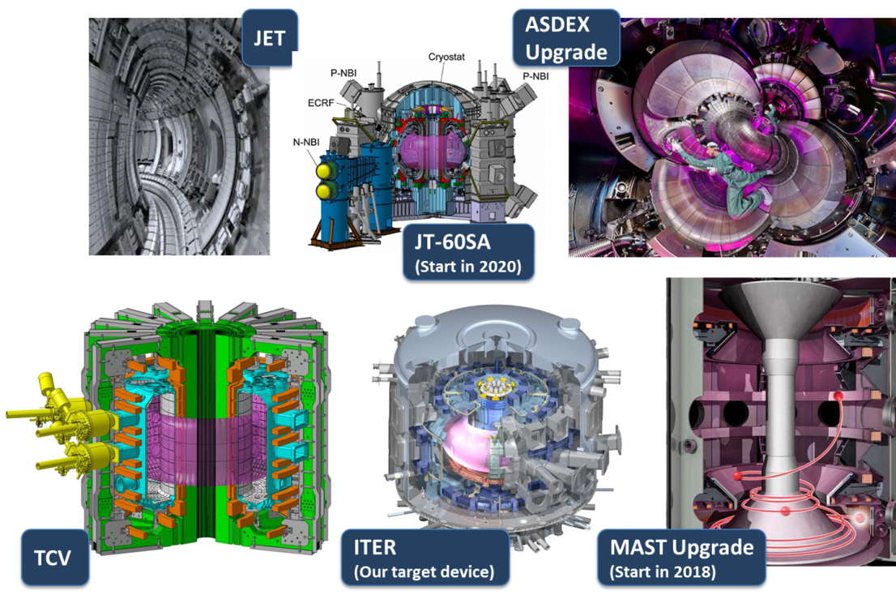
Mission 1 – Plasma Regimes of operation

Slide 7
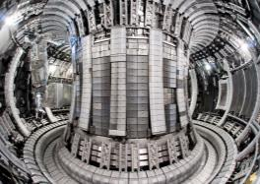
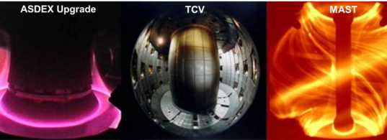
JET and MST 2018 Top Objectives: Step-ladder approach for ITER and DEMO
JET
Coordinated MST programme
in 3 EU devices
Prepare scenarios for fusion performance and alpha particle physics.
Determine the isotopes dependence of H-mode physics, SOL conditions and fuel retention.
Quantify the efficacy of Shattered Pellet Injection vs Massive Gas Injection on runaway electron and disruption energy dissipation and extrapolate to ITER
Demonstrate the compatibility of small, no/suppressed ELM regimes for ITER and DEMO
Develop and characterize conventional and alternative divertor configurations for ITER and DEMO
Develop/characterize methods to predict and avoid disruptions as well as control/mitigate runaway electrons and demonstrate their portability.

Slide 8
JET preparation for D-T
Focused campaigns on high power (34MW NBI) scenarios preparation for D-T
Demonstrate stationary high fusion power and scenario integration relevant to ITER
Separate effects of fuel mass (isotope experiment) from the fusion effect (D-T experiment)
ITER physics issues: e.g. disruption / runaway mitigation SPI, isotope physics
2018/2019: Last D-D campaigns for D-T preparation and use of SPI system
Isotope Experiments
D-T Experiment 2
Start of D-D campaign end of April
rigid shift of the campaign maintaining the number of sessions unchanged

Slide 9
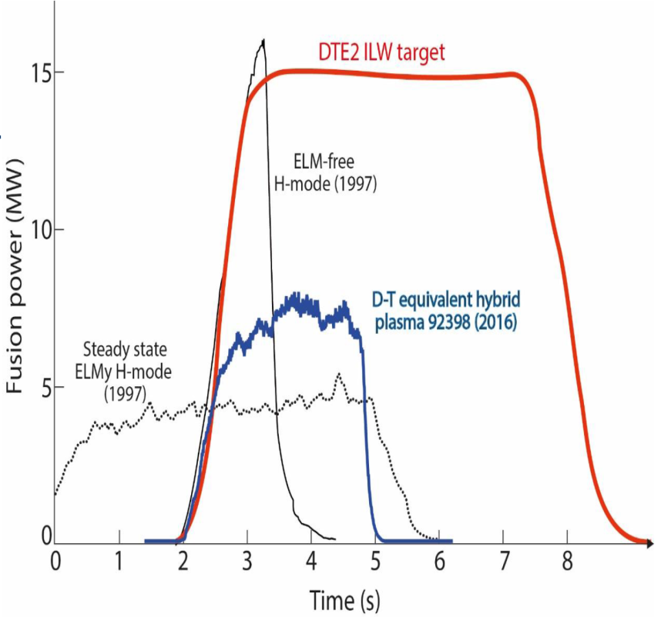
JET D-T operation with ITER Like Wall
Plasma Wall Interaction
ITER scenarios
Isotope effect
T-cycle
fuelling, retention, migration, recovery, dust
α−particle physics
Fusion technology
calibration, materials under 14MeV neutrons, code validation
[Mantsinen EPS Conf. 2017]

Slide 10
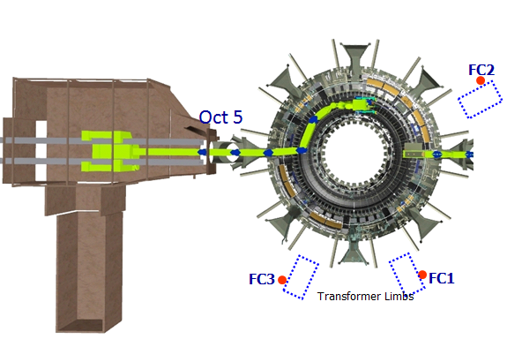
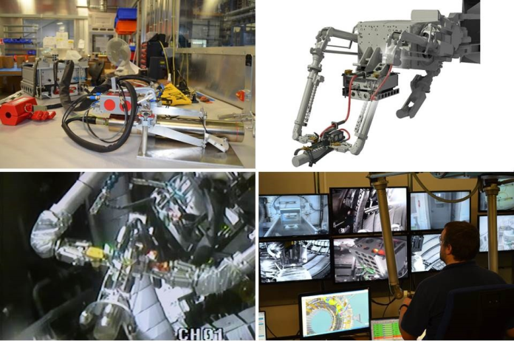
D-T Fusion power measurement procedure for JET and ITER
14 MeV diagnostic neutron calibration at JET
3 Fission chambers and 1 Activation system
Diagnostic calibration with 14MeV neutron source deployed by remote handling
early 2017 !
7 EUROfusion lab. + JET and ITER CT
Analysis to be finalised in 2018
Validation of neutronics codes for ITER

Slide 11
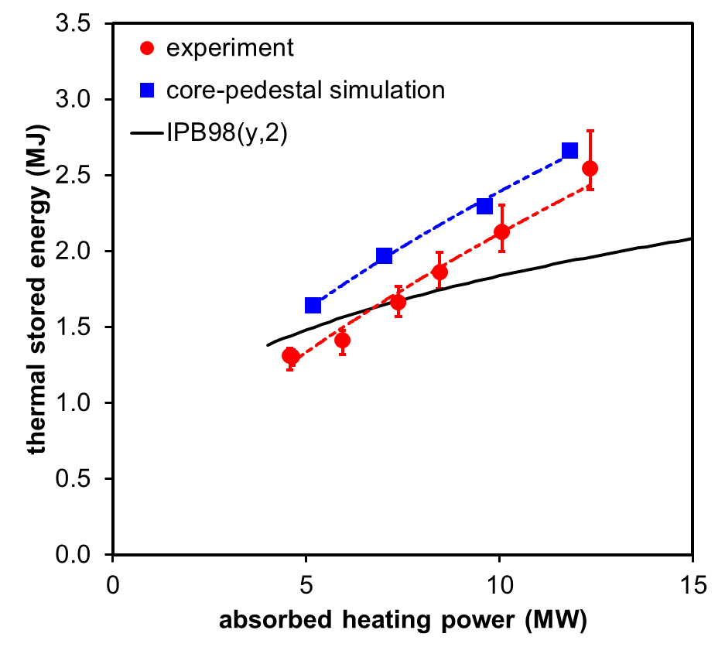
Pedestal and core performance
Core-pedestal interdependence can affect scaling for ITER
[Challis et al NF 2015]
Coupled Core-pedestal modelling to reproduce the beta / power scaling
The observed Ne-Te pedestal shift in AUG* and JET** needs to be included for predictive fusion performance
JET power scan 1.4MA/1.7T
[*Dunne et al PPFC 2016, Wolfrum 2017]
[**Stefanikova et al EPS 2016, Frassinetti et al PPCF 2016]
[Snyder et al NF (2007) also describes ‘Virtuous cycle’ ]
[Meneghini PoP 2016, self-consistent core pedestal modelling DIII-D & ITER : TGLF & EPED]

Slide 12
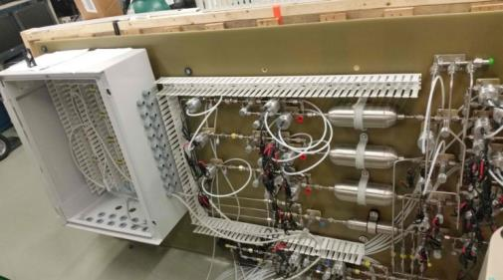

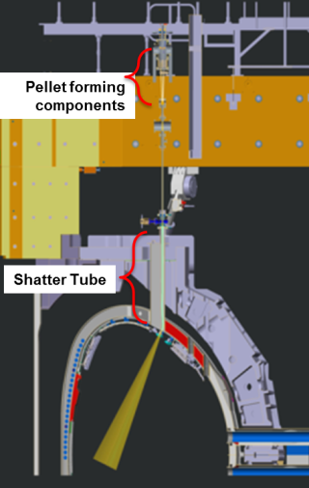
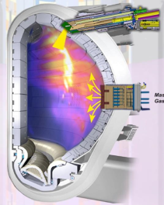


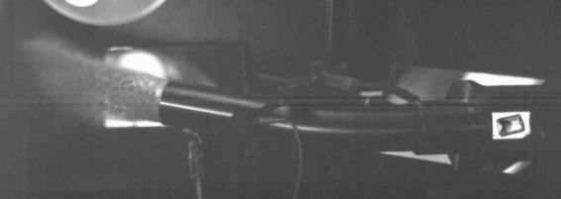


Disruption Mitigation Studies for ITER
Operate Disruption Mitigation Systems as on ITER
Impact ITER-DMS design:
Runaway electron dissipation
Thermal load mitigation
MGI vs SPI, comparison to ASDEX-U and DIII-D
Extrapolation towards ITER
Operation during D-D and H-H
Independent firing of three barrels
pellets of varying sizes
SPI on JET under international collaboration
SPI build at ORNL

Slide 13
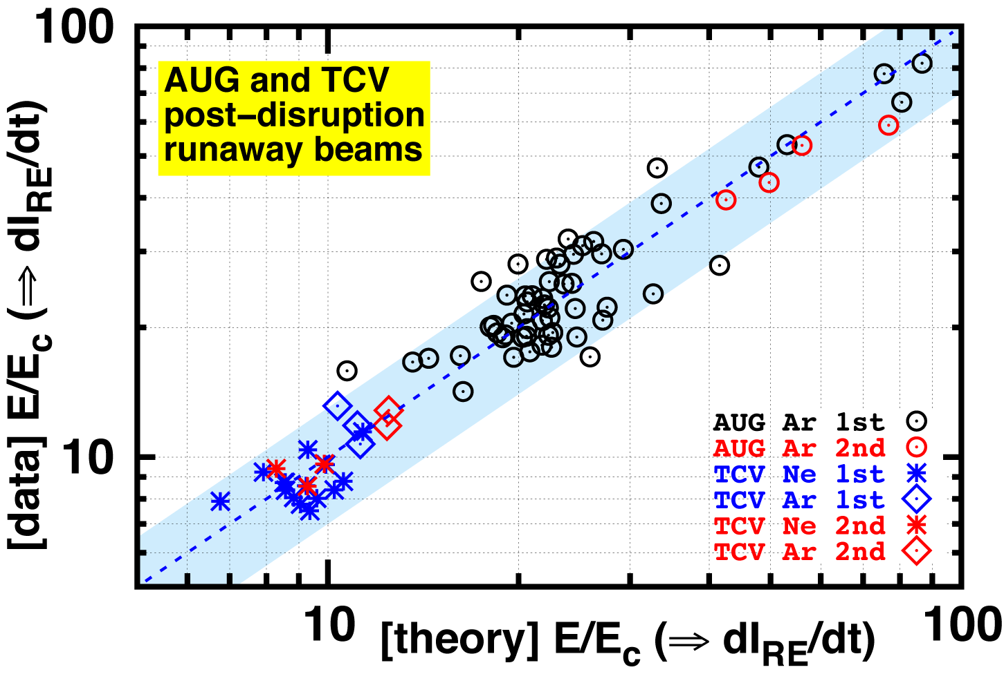


MST programme on disruption and no-ELMs physics
Disruption/ runaway
optimisation and portability of methods for disruption avoidance
Pre-disruption modelling
Disruption avoidance via ECRH and magnetic perturbations
Control, mitigate, simulate runaway electrons
[G. Papp et. al. 2017, ]
Compatibility of small, no- or suppressed ELM regimes with ITER and DEMO requirements
Assess applicability of type-I ELM suppression by Resonant Magnetic Perturbations to ITER:
operational space (density/collisionality, plasma shape, rotation)
predictive modelling capability
Characterise no-ELM regimes operating space at low collisionality
Extrapolate small ELM regimes at high density

Slide 14
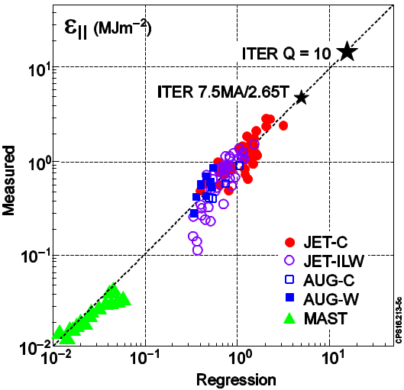



ELM Divertor Heat Load Scaling to ITER
Multi-machines scaling type-I ELM energy flux // B
[Eich et al 2017 ]
Proportional to machine size and pedestal pressure
Trade-off performance vs material limits ?
[Sieglin et al Nuc Fus 2017]
JOREK
“mitigated” ELMs follows the same scaling
Scaling and ITER extrapolation agree with JOREK MHD simulation
[S. Pamela et al FEC 2016 TH/8-2]
[EU Medium Size Tokamaks Overview by Meyer et al 2017 Nucl Fusion ]
Notes:
Parallel energy = time integral of heat-flux

Slide 15
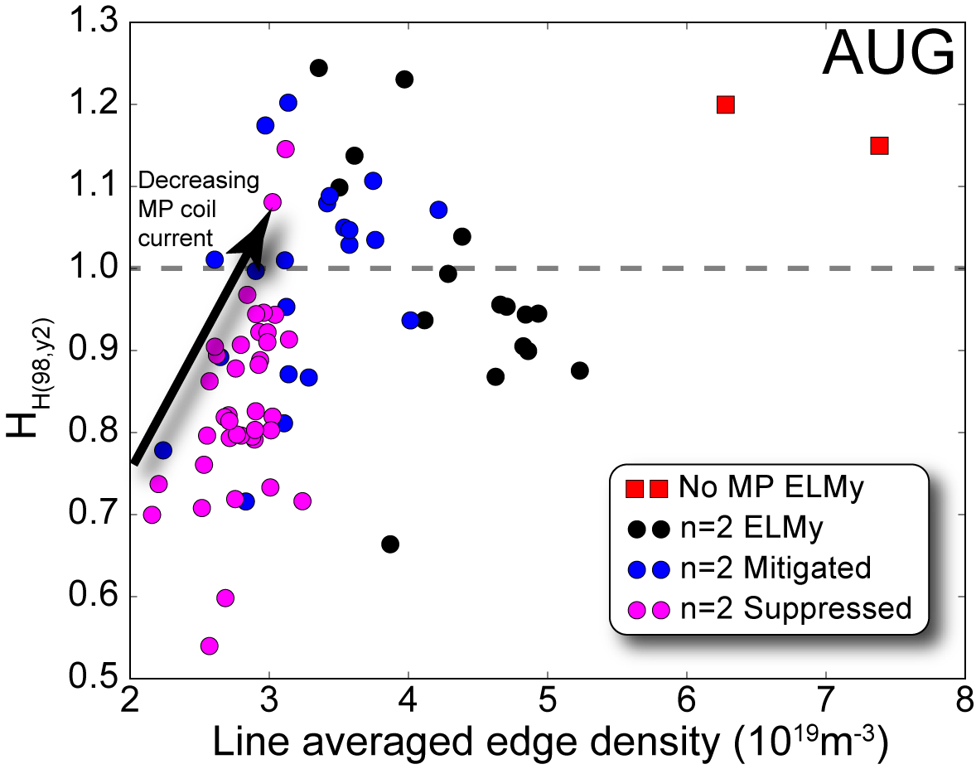

ELM suppression achieved at low collisionality on AUG with high confinement
Triangularity as key ingredient to access ELM suppression
High confinement during suppressed and mitigated phases
ITPA/PEP-38
[W. Suttrop 44th EPS 2017, Belfast, Northern Ireland sub. to PRL]
[R. Nazikian 26th IAEA FEC 2016]

Slide 16
EUROfusion database
EUROfusion Project has been set-up for JET , MST and Stellarator databases
IMAS as the basis of a common EUROfusion database infrastructure
Physics variable definitions
Database workflow development
4 EUROfusion database
Disruptions, Confinement (~600 JET ILW data), Pedestal, Stellarator
IMAS implemented on JET cluster and used for the disruption database: to be extended to the other databases
Then EU contribution to the ITPA database

Slide 17
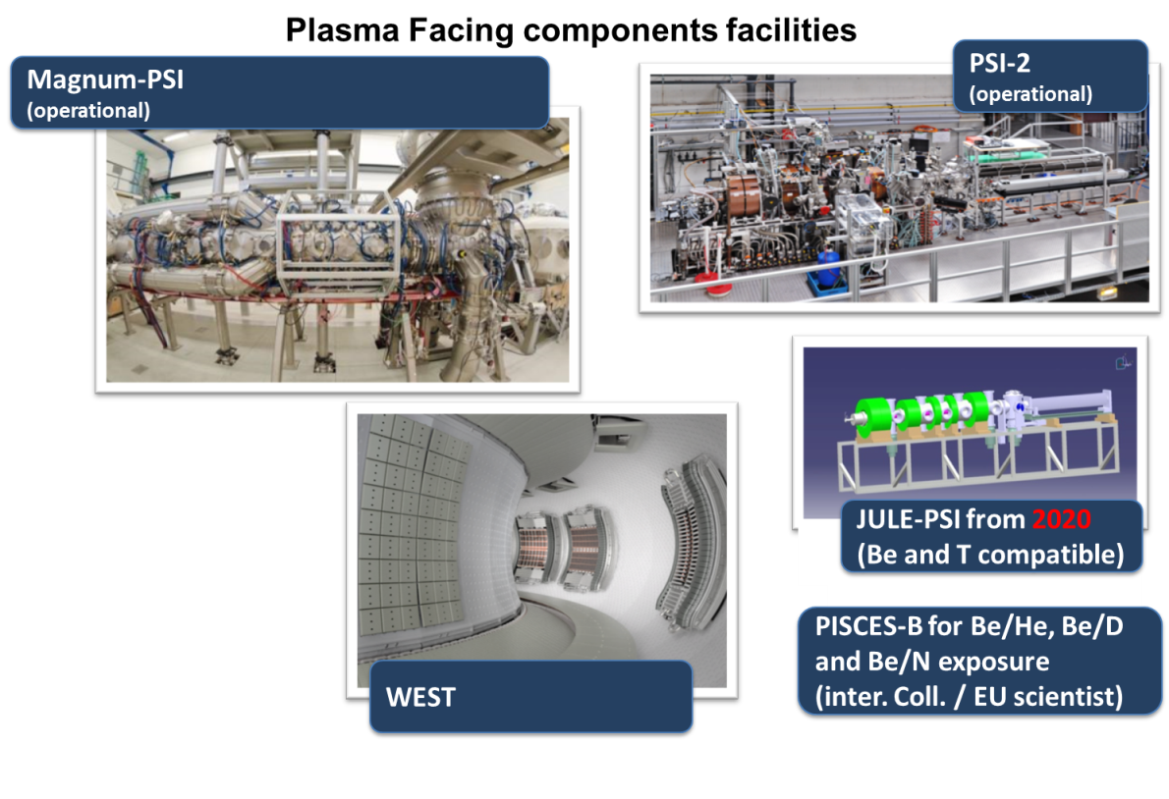
Mission 2 – Heat exhaust systems

Slide 18
Overview of the latest 2017 update
Agreement of PEX upgrade strategy within EUROfusion
AUG, MAST-U, TCV, WEST, Hot cell at FZJ upgrades
report on the “Assessment of the DEMO compatibility of alternative plasma exhaust solutions” released in 2017
none of the assessed configurations (X, Super-X and Snowflake divertors) has an obvious show-stopper, but they all come at greater costs
decision to down select alternatives postponed to 2023-2024 with inputs from the proposed upgrades on MST facilities
Divertor Test Tokamak facility starts as an Italian project
Design provides adequate flexibility for EUROfusion to fund the project by 2022-23 (event driven by MST results)
EUROfusion project will focus on DEMO relevance of Alternative Divertor configurations
A new Project on Liquid Metal Divertor for DEMO

Slide 19
MST on conventional and alternative divertor configurations for ITER or DEMO
Develop and characterize conventional and alternative divertor configurations for ITER or DEMO
Develop detachment control (using the X-point radiator, standard diagnostics)
Compare radiative detachment and detachment control to alternative scenarios
characterisation of alternative configuration with respect to seeded operation
comparison of key physics mechanisms in similar alternative divertor configurations (e.g super-X) in TCV and MAST-U
Benchmark codes to predict ITER and DEMO detachment
Modelling of alternative configuration to prepare MST upgrades
Code validation on existing experiments
First experimental campaign in MAST-U in 2018
wide range of alternative divertor configurations including the Super-X
first plasma, then first diverted plasma and first attempt at Super-X, and a period of scenario development

Slide 20
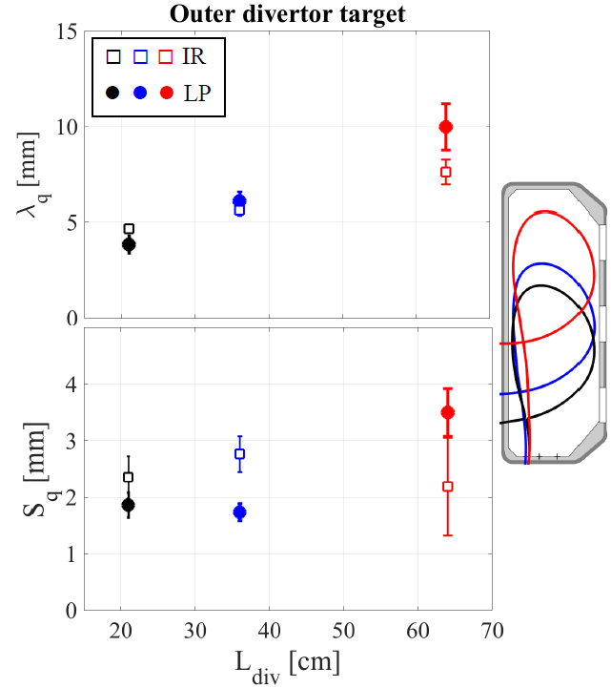

Impact of the plasma geometry on divertor power exhaust and SOL physics
Increase of poloidal leg length L_{div} leads to an increase in λ_{q} (despite constant B_{pol})
Diffusive SOL simulations fail to capture this effect
SOL simulation with asymmetric turbulent is required to capture this behaviour
TCV
[A. Gallo et al. PPCF (2017) in press]
[R. Maurizio et al. , subm. to Nucl. Fusion]

Slide 21
PFC activities in support of JT-60SA and ITER
R&D on wall conditioning for ITER
ITER divertor tungsten monoblock “lifetime” replication experiments
exposure of water-cooled monoblock mock-ups to high fluence at MAGNUM-PSI
Extend tests for W-coating tiles for JT-60SA
2017 focus on heat loads, but in 2018 the same rigorous process on retention and erosion: long pulse operation !
Synergy with R&D for W7X
WEST project will focus on actively cooled ITER mono-block testing in a plasma environment
Delay in the 2017 campaign (no sustained plasma and campaign to restart end of October 2017)
He campaign in 2018 with EUROfusion participation
He embrittlement, W nanostructures formation and retention etc

Slide 22
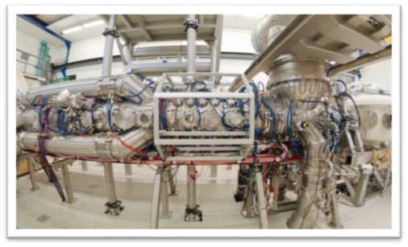
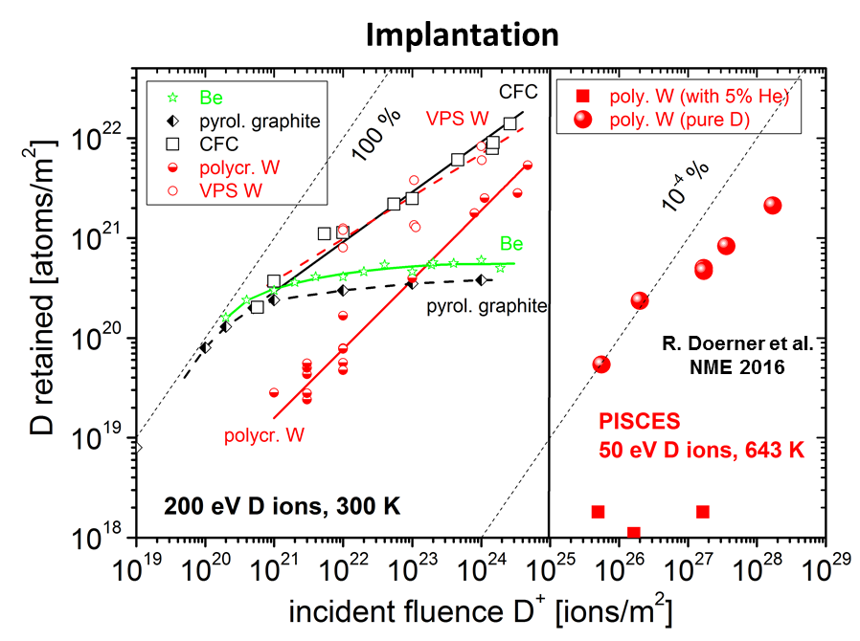
Tungsten divertor components lifetime experiments in MAGNUM-PSI
Study power handling, fuel retention and erosion of ITER-grade W at large (ITER) fluence exposition and high heat flux
Phase I: steady state in 2018
H plasma ~ 5x10²⁸D/m² at 10MW/m²
He plasma ~ 5x10²⁸ D/m² at 14MW/m²
D plasma ~5x10³⁰ D/m² at 23MW/m²
D+He plasma ~5x10³⁰ (0.9D+0.1He)/m² at 23MW/m²
Phase II: steady-state + transients in 2019
MAGNUM

Slide 23
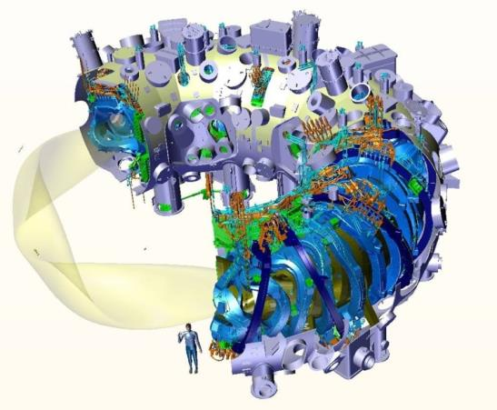
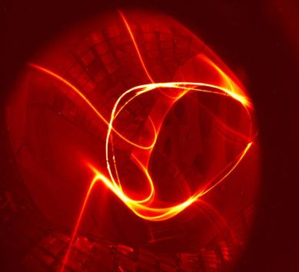
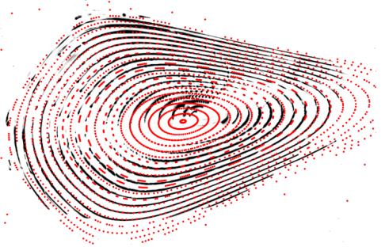
Mission 8: Stellarator
Experimental demonstration
of closed flux surfaces
© M. Otte, IPP

Slide 24
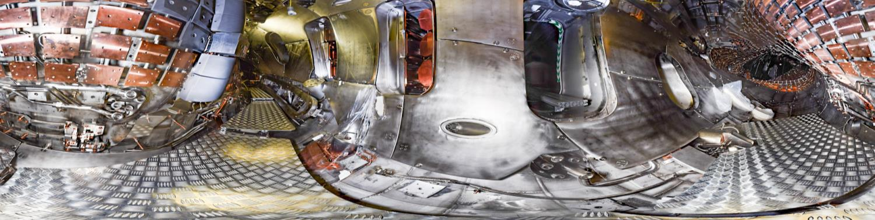
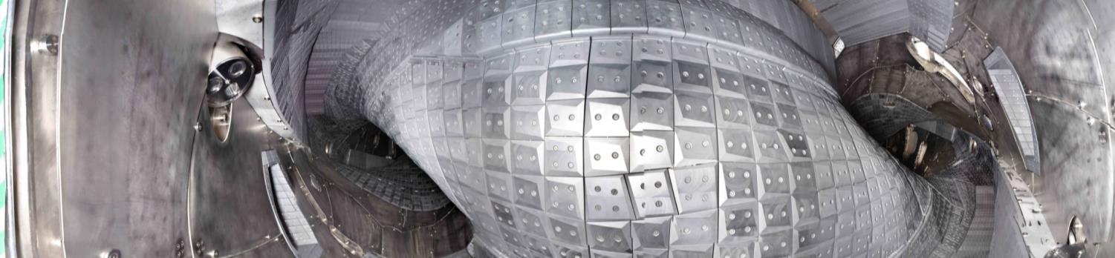
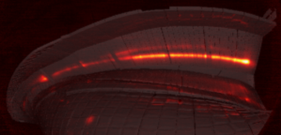
Status W7-X
OP1.1 (2015/16)
W7-X operates with an uncooled graphite divertor
Campaign (Op1.2(A)) until Dec. 8th.

Slide 25
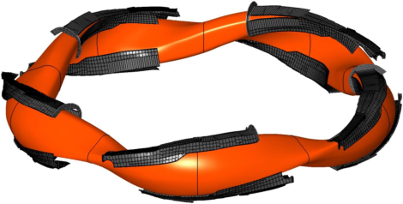
Scientific exploitation of W7-X and 3D-code validation with a diverted plasma
Uncooled graphite test divertor unit
Save divertor operation established in 3 configurations
Improved heating systems (NBI, ICRH, ECRH) fuelling (pellet) and diagnostics capabilities
Demonstrate operation (2018) at high heating power (8MW/10s) and long-pulse operation (1MW/ 1minute) on W7-X
Prepare investigations on fast particle confinement in W7-X
Synergy with Tokamak activity further developed
Save ECRH operation and protection for stray/reflected radiation
Plasma Facing Components
Edge modelling with 3-D effects included
Fast ions physics and ICRH scenarios
PROCESS development

Slide 26
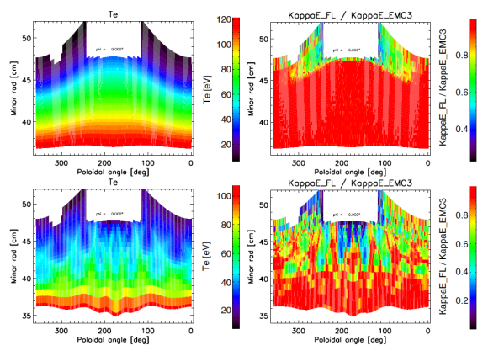
3D Edge Transport Studies for Stellarator (M8) and ITER (M1,2)
Key issue for ITER: divertor power loading in dissipative regimes with ELM suppression by magnetic perturbations.
EMC3-Eirene is the 3D modelling tool in the EU
Extra effort for code development and validation on current devices
Long standing issue is absence of volume recombination in the code.
Improved treatment of impurities and radiation
In present state can only access sheath limited and high recycling conditions for ITER
Account for impurities and divertor dissipation, including 3D effects (ripple and RMPs)
plasma & geometry description
example: Calculations for 3D Dynamic Ergodic Divertor at TEXTOR [D. Harting, D. Reiter, Y. Feng et al. CPC 48, 2008]

Slide 27
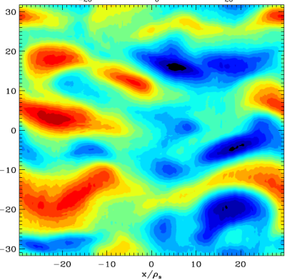
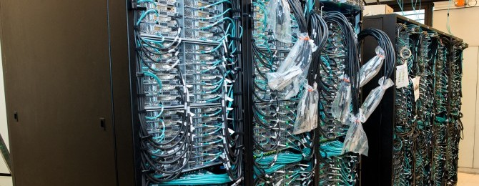
First principles & integrated modelling in support of M1, M2 and M8

Slide 28

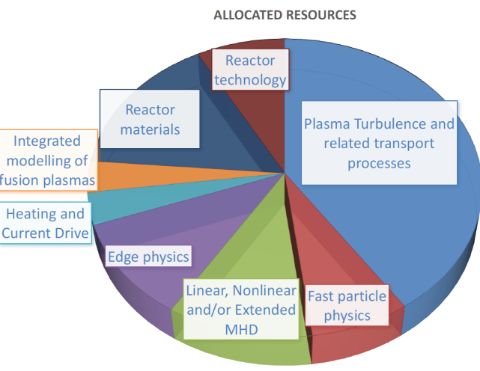
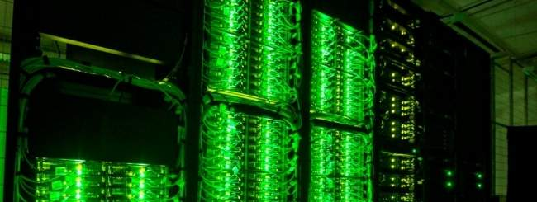
EUROfusion High Performance Computer Marconi-Fusion
EUROfusion HPC Marconi-Fusion available since mid 2016
Performance 1 to 3.3 times HELIOS
August 2017: 1 Pflops A1 partition to the much larger 5 Pflops A3 partition
Gateway for integrated modelling transferred to Marconi-Fusion
Second cycle of projects selected end of July 2017
High Level Support Team effort is critical to take advantage of the HPC capabilities (codes optimisation for new architecture)
Allocated resources
HPC Marconi-Fusion in Italy/Bologna) CINECA

Slide 29
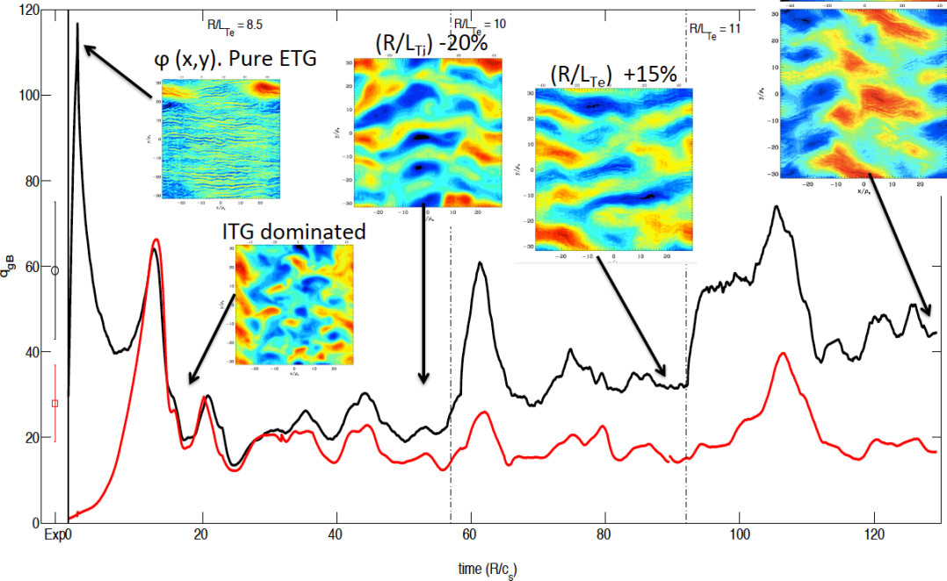
Multi-scales Gyro-Kinetic simulations of heat transport in JET
Multi-scales ITG/ETG gyro-kinetic simulations (GENE) show the importance of ETG turbulence to reproduce electron transport
Results relevant for future ITER simulations
Normalised Heat flux
Electron
Exp
Ion
Normalised time
8. x 10⁶ CPUh on HELIOS continuing on Marconi-Fusion
[N. Bonanomi et al sub. to PRL]

Slide 30
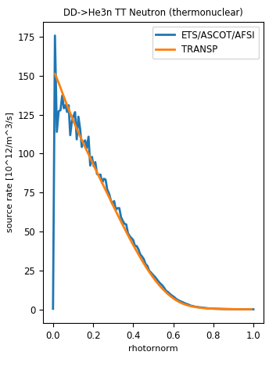
EU Transport Solver (ETS) benchmarked against TRANSP and future exploitation
JET #92416 t=5.750
TRANSP: 92416Q05
Installation of ETS on JET cluster and on the new Gateway
Ongoing benchmark (interpretative) against TRANSP
Next step in 2018-2019:
ETS exploitation on attractive scientific cases with ETS added values
Modelling of ICRH heating schemes in mixed species plasmas
NTM time dependent modelling in JET scenarios
DD-thermal fusion reaction rate

Slide 31
ITER Integrated Analysis and Modelling Suite (IMAS)
2018: a new Task Force within WP-Code Development with the aim of expediting (one year) the convergence of EU workflows to IMAS
Demonstration of a core plasma workflow in IMAS (end of 2018) but with minimal elements, so physics exploitation in 2019
EU-MHD stability workflow in IMAS ready
EUROfusion databases for JET, MST using IMAS infrastructure
Coordinated projects with JET and MST
Equilibrium reconstruction
Profile data for transport simulations
Steering Committee between EUROfusion and ITER-IO
to ensure high level coordination on IMAS development between EUROfusion and ITER-CT

Slide 32
Conclusion [1/2]: Overview of EUROfusion facilities operation in 2018

Slide 33
Conclusion [2/2]
A challenging and fascinating 2018 programme which requires high level of EU programme coordination
Ongoing selection of the new EU members of ITPA groups
Launch new projects in the field of Plasma Exhausts
Evolution of the EU Fusion roadmap
A strong focus to support ITER operation while laying out the foundation of DEMO design
Prepare the extension of the ‘2014-2018’ EU Commission Grant for 2019-2020 within Horizon 2020 (2014-2020)
Start preparing the fusion research grant for the next Framework Programme 9 (FP9).

Slide 34
EU participation in the ITPA topical Group
At the 16th meeting of the General Assembly of EUROfusion (December 2016), it was decided membership of European representatives in the various ITPA Topical Groups will be limited in time to six years
‘Old’ members will gradually step down in ‘17, ‘18 and ’19
ITPA TG chairs or/and EU members have been contacted to optimise the rotation schedule
2017 EU call for new ITPA topical Group members
With focus on specific competences that are needed
Deadline to reply 31 October 2017
Replies to the call under analysis by the EU ITPA CC members who will make a proposal to the next EUROfusion GA meeting

Slide 35
Back-up

Slide 36
D-T Equivalent fusion power
‘Baseline’ performance exceeds previous projections:
extension of H₉₈~1 domain to higher plasma current
development of T_{i}>T_{e} conditions in plasma core
Equivalent D-T fusion power at constant power is similar for both ‘baseline’ & ‘hybrid:
P_{fusion}~7.2MW (assuming E_{beam} achieved in 2016 )
P_{fusion}~8.1MW (assuming full E_{D}=125keV & E_{T}=118keV)
Extrapolation at higher power (40MW), different current/field
0-D and physics model : validation ongoing
Coupled Core / pedestal modelling
JETTO Bohm-gyroBohm + EUROped
Quasilinear GK core + scaling for pedestal: CRONOS/JETTO TGLF + Cordey’s scaling for pedestal pressure
Ranging from 10–14 MW when no credit is taken for isotope or alpha particle effect
[Challis , Garcia et al]

Slide 37
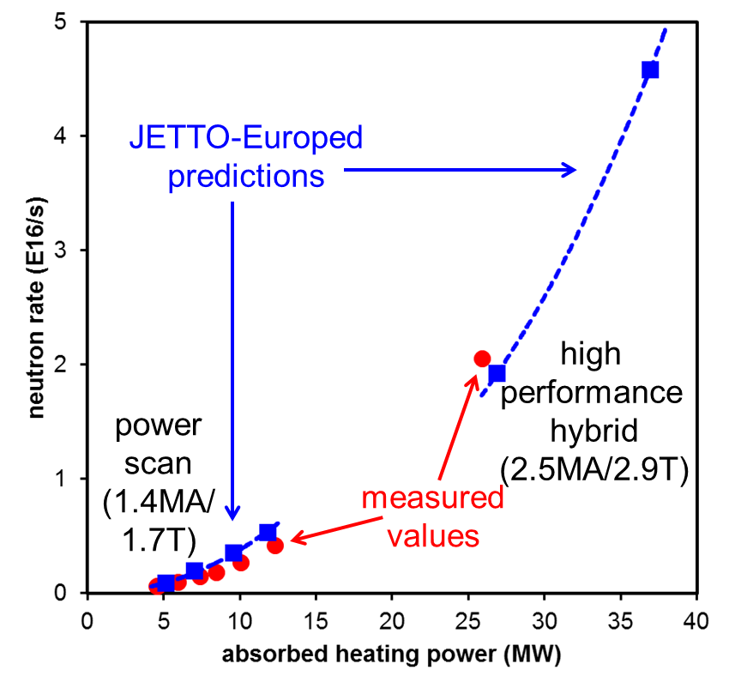
P_{fusion} extrapolated to full power
Modelling consistent with measured neutron rate
Prediction at 38MW at 2.5 MA/2.9 T
P_{fus} ~12.6 MW
Important uncertainties
Impurity ?
ICRF+NBI synergy
Rotation ?
…
alpha effects synergy effects not included
[Challis, Garzotti & Saarelma]

Slide 38
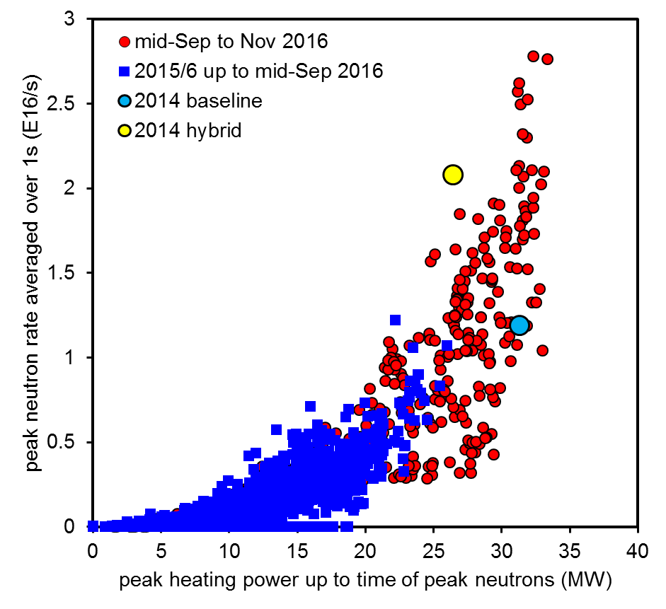
High plasma performance at high power
Neutron rate vs Power
2016 high power operation
‘gap’ has been reduced between best achieved performance and goals for JET DT experiments
Similar fusion power (7-8 MW) achieved in ‘baseline’ and ‘hybrid’ experiments
[Challis et al ]

Slide 39
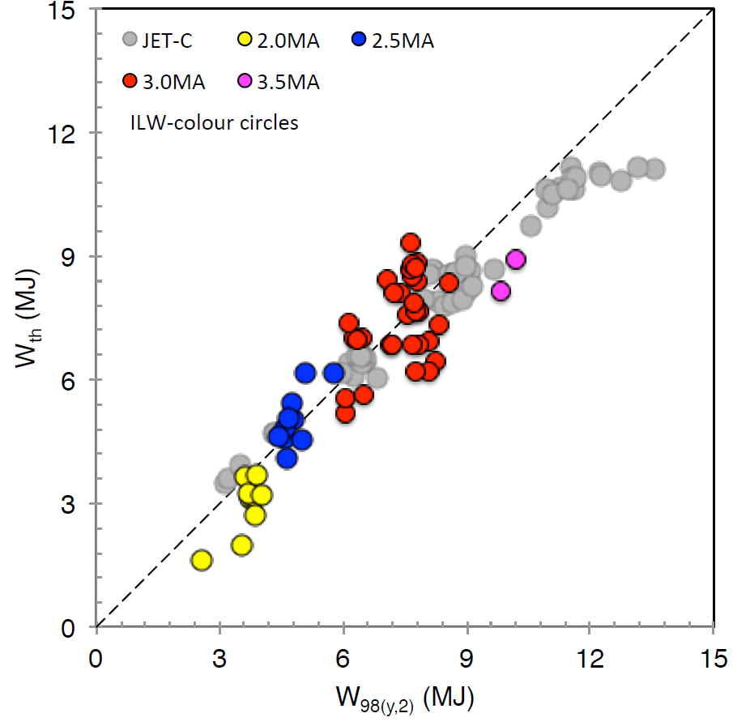
Latest progress: ITER Baseline Operation at ≈30MW 3MA/2.7T
2018/19
Objective
[β_{N}>1.8]
[Nunes et al 2017 ]

Slide 40
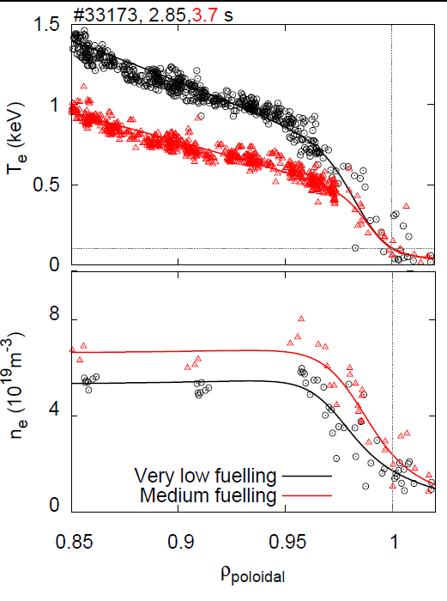


Impact of wall materials and seeding gases on the pedestal and on core plasma performance
Outward shift of density profile degrades pedestal top
Nitrogen seeding can partially reversed this effect (AUG)
JET-ILW tends to have larger relative shift than JET-C
8
JET-C
6
JET-ILW
Normalised pedestal pressure, α
4
2
Low δ, ν∗∼0.1-0.35
0
2
0
1
3
Pedestal density shift (% ψ)
[Dunne et al PPFC 2016, Wolfrum 2017]
[Stefanikova et al EPS 2016, Frassinetti et al PPCF 2016]

Slide 41
JET schedule up to 2020
Clean-up
JET campaign sequence 2017-2020 (with tritium and DTE2 in 2019/2020):
Pre-DT shutdown in 2017 followed by 4 month restart phase.
High power deuterium operation in 2018.
Isotope studies using hydrogen, tritium and deuterium in 2018-2019.
(0.1e21 14MeV neutron budget assuming 1% D in TT and 1% T in DD campaigns)
DTE2 phase with >1.55e21 14 MeV neutron budget (DTE1 neutron budget 0.3e21)
Put JET in a safe state following the DTE2 (~6 months in 2020)
[Short maintenance periods only during 2018-19 – no planned shutdowns]

Slide 42
Overview of programme proposed by JET TFLs
 | C38 D (176) | C39 D,H (50) | C40 T (63) | C41 T-H, H, H-D (54) | C42 D (57)
Objective 1: 12 experiments (132=45%) DT scenarios Scenario building blocks | 28+28+8 29 | 0+0+0 7 | 10+10+3 9
Objective 2: 19 Experiments (98=34%) L-H transition Neutrals & pedestal Transport & confinement Detachment & Density limit Retention & migration Clean-up & isotope monitoring | 2 14 15 4 6 0 | 4 2 2 0 3 15 | 3 7 15 4 2 0
Objective 3: 6 experiments (33=11%) Disruption Run-aways | 14 8 | 3 8 | 0 0
Other JET & ITER physics : 8 experiments (28=10%) | 19 | 3 | 6
TOTALs | 172 | 47 | 69 | 61 | 81
Back-up experiments: 13 experiments | 12 | 4 | 3 | 2 | 1
Sessions attributed here are provisional only

Slide 43

First experimental campaign in Wendelstein 7-X with diveror configuration (OP1.2a)
Three magnetic configurations have been commissioned and plasma discharges run.
They feature two different divertor configurations (based on the 5/5 and 5/4 edge island structure) and different effective ripple and expected bootstrap currents.
The 1/1 resonant error fields have been measured with flux surface imaging and the correcting trim coil settings determined (figure).
Save divertor operation has been established in the three configurations what enabled to run >8MJ (ECRH energy input) discharges.
Strike line on the horizontal targets of one of the divertor modules. [A. Ali, P. Drewelow, M.W. Jakubowski, V. Moncada, H. Niemann, F. Pisano, A. Puig Sitjes ]
Flux surface measurements compared to field line tracing for the FTM configuration with 1/1 helical shift of the axis. [S. Bozhenkov, M. Otte et al.]

Slide 44
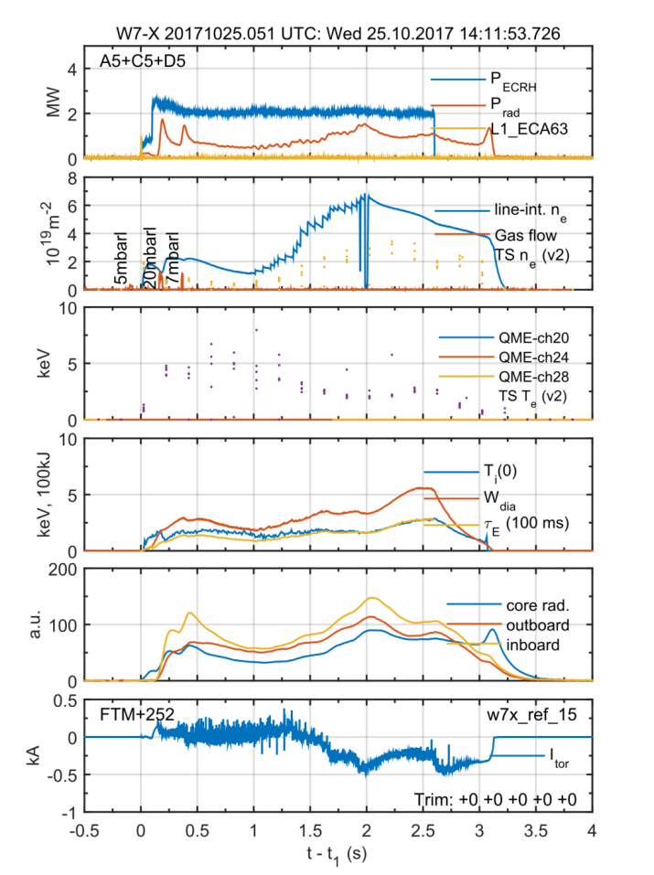
First experimental campaign in Wendelstein 7-X with diveror configuration (OP1.2a)
The extension of the operational space relies on helium operation, allowing for a more stable and reproducible plasma density evolution.
Hydrogen discharges with
6e19 m⁻³ averaged density
0.7 MJ energy content and
0.25 s energy confinement time
3 keV central ion temperatures (similar to electron’s).
These were achieved in transient conditions. Density feed-back schemes are at present being commissioned.
Pellet system (LFS and HFS) and 10 gyrotrons (~8MW) commissioned.
Pellet injection

Slide 45
M1, 2, and 8 : Contribution to the success of ITER

Slide 46
Main IPH ‘expected‘ impact for ITER [1/2]
Disruption mitigation:
comparison between MGI vs SPI, model validation and extrapolation to ITER
runaway electrons mitigation modelling (ER project)
Development of disruption avoidance scheme via ECRH/ECCD on MST
Tritium retention monitoring system for ITER
LIBS retention monitoring system and demonstration in tokamak environment
Demonstration of the viability of the LIBS system for tracking tritium-rich areas in ITER
Fast ion Lost Detectors
Conceptual FILD design for ITER (ITER-IO, EUROfusion)
Conceptual Design as part of EUROfusion JT-60SA diagnostic contributions
Advance Isotope physics:
confinement, L- H threshold, density limit, SOL, fuel retention, PSI process
Development ITER scenarios on JET and MST, including radiative scenario on MST
Approach ITER collisionality, rho-star, beta on JET
Extend scenarios with low torque inputs (MST) including MHD stability analysis
Validation on JET/MST of Core and pedestal integrated modelling for ITER Q=10 (ER project)
Advance ICRH scenarios for ITER
Finalisation of Neutron calibration procedure for ITER

Slide 47
Main IPH ‘expected‘ impact for ITER [2/2]
Investigation on confinement (pedestal ) reduction with metallic wall:
ne-Te pedestal shift, cause difference W vs C wall ?, transport vs MHD limitation
PSI with ITER material mix including associated modelling
Test actively cooled ITER mono-block in linear devices and in a plasma environment
DUST characterisation and modelling in JET , MST and linear devices
Investigate the plasma cleaning of mirrors by RF-assisted method
Deployment of IMAS
Demonstration of core plasma workflow in IMAS
EU tokamak database for ITER extrapolation
Deployment and validation of IMAS on MST, WEST , JET
Validation of ITER modelling tools
SOLPS-ITER, neutronics codes, MEMOS-3D code for melting, W redeposition, JOREK for disruption modelling
R&D on ECRH Protection
R&D Wall conditioning (recently also including Ukraine)
ECWC, ICWC, GDC

