Slide 1
Particle Physics Project Prioritization Panel (P5) Strategic Planning
March 2019
Andrew J. Lankford University of California, Irvine

Slide 2
Acknowlegements & Thank you’s
Michael Cooke (DOE HEP)
Provided invaluable support to P5 throughout the process
Prepared the slides upon which this presentation is based
Steven Ritz (UCSC, P5 Chair)
Provided skillful and intrepid leadership
Provided the content of many of today’s slides
Continued leadership of community follow-up
The P5 Panel
Wisdom and devotion
DOE HEP and NSF PHY
Guidance and trust

Slide 3
Introduction

Slide 4

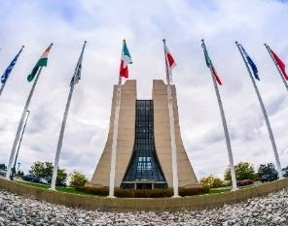
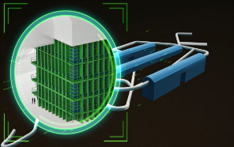
U.S. Strategy in High Energy Physics
The global vision presented in the 2014 Particle Physics Project Prioritization Panel (P5) report is the culmination of years of effort by the U.S. particle physics community
2012 – 2013: Scientific community organized year-long planning exercise (“Snowmass”)
2013 – 2014: U.S. High Energy Physics Advisory Panel convened P5 to develop a plan to be executed over a ten-year timescale in the context of a 20-year global vision for the field
P5 report enables discovery science with a balanced program that deeply intertwines U.S. efforts with international partners
U.S. particle physics community strongly supports strategy
U.S. Administration has supported implementing the P5 strategy through each President’s Budget Request
U.S. Congress has supported implementing the P5 strategy through the language and funding levels in appropriations bills
International community recognizes strategy through global partnerships

Slide 5
Strategic Plan for U.S. Particle Physics
Charge: A strategic plan, executable over 10 years, in the context of a 20-year global vision
US community has come together to make a plan.
Driven by the science
Meets fiscal constraints
Considers the global context
Resolves key issues for the field
Provides a continuous flow of results while making essential investments for the future

Slide 6
Preparing for P5

Slide 7
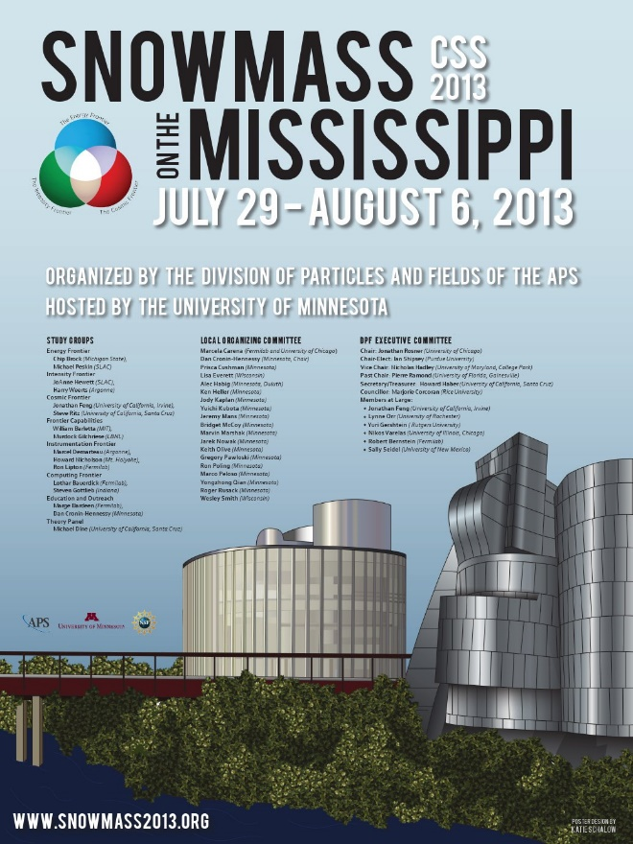
Snowmass Community Process
Organized by The Division of Particles and Fields of the American Physical Society
Designed to address the questions the particle physics community wishes to answer over the next two decades and methods to answer them
Did not prioritize activities; aim was to ask and answer hard questions
Supported inter-frontier discussions to ensure addressing the cross-cutting nature of the physics
Subgroups: Intensity Frontier; Energy Frontier; Cosmic Frontier; Theory; Accelerator Capabilities; Underground Laboratory Capabilities; Instrumentation; Computing; Communication, Education, and Outreach
Produced 358 page resource book that conveyed the health and diversity of the U.S. program in a global context
http://www.slac.stanford.edu/econf/C1307292/
Timeline:
Planning began in 2011
Community Planning Meeting at Fermilab, Oct 11-13, 2012
Preparatory meetings held by subgroups during 2012-13
Final meeting held at U Minnesota, July 29 - Aug 6, 2013

Slide 8
Snowmass / P5 Interface
These topics were suggested to the community as guidance for Snowmass reports and white papers:
What are the most compelling science questions in HEP that can be addressed in the next 10 to 20 years and why
What are the primary experimental approaches that can be used to address them? Are they likely to answer the question(s) in a “definitive” manner or will follow-on experiments be needed?
What are the “hard questions” (science, technical, cost…) that a given experiment or facility needs to answer to respond to perceived limitations in its proposal?
P5 built on the investment in the Snowmass process and outcomes.
P5 used the Snowmass reports and white papers as its starting point for prioritization.
Community input & interaction did not stop with Snowmass.

Slide 9
P5 Charge

Slide 10
P5 Charge Summary 1
Develop an updated strategic plan for U.S. high energy physics that can be executed over a 10 year timescale, in the context of a 20-year global vision for the field
Relevant considerations:
More stringent budgets than were considered by previous P5
Recent discovery of Higgs boson
Observation of large rates of neutrino mixing
Fuller understanding of physics to be explored at LHC
Global coordination required to realize proposed major new scientific milestones

Slide 11
P5 Charge Summary 2
Consider appropriate balance of small, mid-scale, and large experiments
Articulate scientific opportunities which can and cannot be pursued and overall level of support needed in HEP research to achieve scenarios
Provide detailed perspective on whether and how the pursuit of major international partnerships might fit into the program in each scenario
Effectively communicate the excitement, impact, and vitality of high-energy physics that can be shared with non-scientific audiences

Slide 12
P5 Budget Scenarios
P5 considered 10-year HEP budget scenarios within a 20-year vision for the global field
Scenario A was the lowest constrained budget scenario
Scenario B was a slightly higher constrained budget
Scenario C was unconstrained, but prioritized list of specific activities

Slide 13
Forming P5

Slide 14
Constituting the P5 panel
Careful choice of chair
Criteria: experienced, strong committee leader; familiar w/ P5 process; not perceived to be conflicted wrt critical decisions to be made
Careful choice of panel
Called for nominations so as not to overlook any excellent candidates
Good community response: ~800 nominations for ~400 individuals
Consulted widely, including with agencies
Scientifically respected, broad view of field, perceived as fair and unbiased
Composition intended to cover range of expertise and roughly reflect demographics of field
Broadly representative wrt to subfield, geography and gender
Strong international representation (2 each Europe and Japan)
Focus on leaders of strategic planning and on leaders familiar with U.S. program
P5 panel was charged with representing the interests of the field, not of their subfield or institution.

Slide 15
P5 Panel Members
P5 included mix of Laboratory and University, U.S. and international scientists, with complementary expertise
Steve Ritz, chair University of California, Santa Cruz
Hiroaki Aihara University of Tokyo
Martin Breidenbach SLAC National Accelerator Laboratory
Bob Cousins University of California, Los Angeles
André de Gouvêa Northwestern University
Marcel Demarteau Argonne National Laboratory
Scott Dodelson Fermi National Accelerator Laboratory and University of Chicago
Jonathan L. Feng University of California, Irvine
Bonnie Fleming Yale University
Fabiola Gianotti European Organization for Nuclear Research (CERN)
Francis Halzen University of Wisconsin-Madison
JoAnne Hewett SLAC National Accelerator Laboratory
Wim Leemans Lawrence Berkeley National Laboratory
Joe Lykken Fermi National Accelerator Laboratory
Dan McKinsey Yale University
Lia Merminga TRIUMF
Toshinori Mori University of Tokyo
Tatsuya Nakada Swiss Federal Institute of Technology in Lausanne (EPFL)
Steve Peggs Brookhaven National Laboratory
Saul Perlmutter University of California, Berkeley
Kevin Pitts University of Illinois at Urbana‑Champaign
Kate Scholberg Duke University
Rick van Kooten Indiana University
Mark Wise California Institute of Technology
Andy Lankford, ex officio University of California, Irvine

Slide 16
P5 Process & Meetings

Slide 17
P5 Process and Meetings 1
The P5 process had several components, all of which were designed with community engagement in mind:
A website was maintained, with information, frequent news, meetings, and a submissions portal with a public archive.
There were three large public meetings. All talks were posted online.
There were three physical town halls and three virtual town halls. The virtual town halls were particularly effective for hearing younger voices.
A special effort was made to reach out to younger colleagues, with emails to Snowmass Young mailing lists and to PIs urging them to inform their students and post-docs about the process, and a Twitter feed.

Slide 18
P5 Process and Meetings 2
Experiment/activity input:
Each of the major activities considered was given a standard form to fill in, with cost profiles and FTE estimates for each phase of the project (R&D, construction, operations), separated by funding agency, along with information about project level of maturity, contingency, etc.
From these, and agency inputs, detailed spreadsheets were developed and used to support the budget exercises.
Community input via three P5 Workshops:
Fermi National Accelerator Laboratory, Nov. 2–4, 2013
Topics: Snowmass Inputs, International Context, Accelerator-based neutrino program, non-accelerator neutrino program, Town Hall
SLAC National Accelerator Laboratory, Dec. 2–4, 2013
Topics: Dark Matter, Theory, Computing, Science Connections, International Context: Astroparticle Physics Planning in Europe, Cosmic Surveys: Dark Energy and CMB, HE Cosmic Particles and Additional Topics, Town Hall
Brookhaven National Laboratory, Dec. 15–18, 2013
Topics: LHC Upgrades, ILC, Fermilab Proton Accelerator Complex and Opportunities, Proton-driven Rare processes/Precision Experiments, Young Physicists Forum, HE Vision Machines, Town Hall, Accelerator R&D, Instrumentation R&D

Slide 19
P5 Process and Meetings 3
P5 Panel Meetings:
The panel worked by consensus.
There were full-panel phone calls approximately weekly throughout the process, as well as many subgroups to work on tasks in parallel.
The panel had additional face-to-face meetings on the following dates in 2014:
12–14 January, 21–24 February, 5–8 April, and 29–30 April.
Panel attendance was remarkably good.
All panel discussions had both agency attendance and P5 “alone time”. Agency program managers only attended first three large meetings.
P5 discussions were held confidential until report rollout.

Slide 20
P5 Process and Meetings 4
Peer-review:
The would-be final version of report was sent out confidentially to about half a dozen distinguished scientists.
Yielded quite useful feedback regarding clarity and compelling-ness of the report
Led to a complete reorganization of report
First two chapters were self-contained, with Ch. 2 presenting all recommendations. (20 pp)
Ch. 3 & 4 presented science drivers and broader impacts. (30 pp)
HEPAP interactions:
There were HEPAP presentations and discussions in September 2013, December 2013, March 2014, and May 2014.
Preliminary comments were presented and discussed at the March meeting, and the Report was presented, discussed, and approved at the May 2014 HEPAP meeting.

Slide 21
Context – Changes since previous P5
Scientific:
Higgs discovered; relatively low Higgs mass
An important neutrino mixing parameter measured; relatively large value
Three Nobel Prizes: CKM, Higgs, Dark Energy; demonstrates importance of diversity of topic and scale
Programmatic:
DUSEL didn’t succeed, SURF cont’d; JDEM didn’t succeed
Tevatron & B-factory operations ended
Budgets lower than anticipated
International cooperation continues to be successful

Slide 22
Criteria (I): Overall Program Optimization
• Science-driven big picture: where we want to go and how to get there.
• Prioritized portfolio for discovery and exploration.
• International context and optimization:
– Pursue the most important opportunities wherever they are, and host world-leading facilities that attract the worldwide scientific community.
– Reliable partnerships are essential.
– Duplication only when significant value added or when competition helps propel us in important directions. When competing, be clearly leading in key ways.
• Health of the field, sustained productivity:
– Maintain a stream of results while investing in facilities and future capabilities => a balance of project scales.
– Maintain and develop critical technical and scientific expertise and infrastructure to enable future discoveries.
– a guideline: total expenditures on projects around 20-25% of total budget; research fraction >~40% for both project data analysis and blue-sky research to explore unplanned new directions.

Slide 23
Criteria (II): Projects
• Science first: how does it address key questions in particle physics?
• Discovery space. How might it change the direction of the field, and what is the value of null results?
• When is it absolutely needed, and how does it fit into the larger picture? What does the experiment add that is unique, is it definitive, and/or where might it lead? Are there alternatives?
• Cost vs value.
– Is the scope well defined and does it match the physics case? For multidisciplinary/agency projects, does the support match the distribution of science?
– One main measurement or a preponderance of interesting possible results? Solid result(s) expected or possibly marginal?
– At what cost/schedule/capability changes does the priority change?
• Take into account previous prioritization and existing commitments. What are the impacts of changes in direction?
• Is the project feasible as proposed? Technical, cost, schedule risks.
• Is U.S.particle physics leadership, or participation, critical, and how?
• What are the other benefits of the project?

Slide 24
Contents of the P5 Report

Slide 25
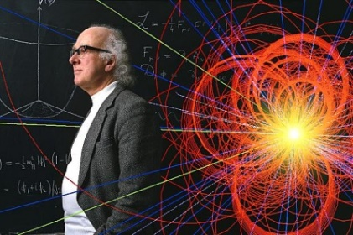


P5: High Energy Physics Overview
Particle physics is a highly successful, discovery-driven science.
It explores the fundamental constituents of matter and energy, and it reveals the profound connections underlying everything we see, including the smallest and the largest structures in the Universe
Earlier investments have been rewarded with recent fundamental discoveries, and upcoming opportunities will push into new territory
Particle physics is global.
To address the most pressing scientific questions and maintain its status as a global leader, the U.S. must both host a unique, world-class facility and be a partner on the highest priority facilities hosted elsewhere
Our community has made difficult choices.
The updated strategy in the May 2014 Particle Physics Project Prioritization Panel (P5) report recommends investments in the best opportunities, chosen from a large number of excellent options, in order to have the biggest impact and make the most efficient use of resources over the coming decade

Slide 26



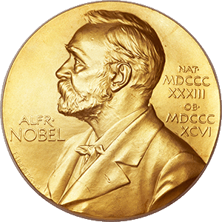



P5: Science Drivers of Particle Physics
P5 distilled the 11 groups of physics questions from Snowmass into 5 compelling lines of inquiry that show great promise for discovery over the next 10 to 20 years:
Use the Higgs boson as a new tool for discovery.
Pursue the physics associated with neutrino mass.
Identify the new physics of dark matter.
Understand cosmic acceleration: dark energy and inflation.
Explore the unknown: new particles, interactions, and physical principles
*2013
*2015
*2011
* Since 2011, three of the five science drivers have been lines of inquiry recognized with Nobel Prizes

Slide 27
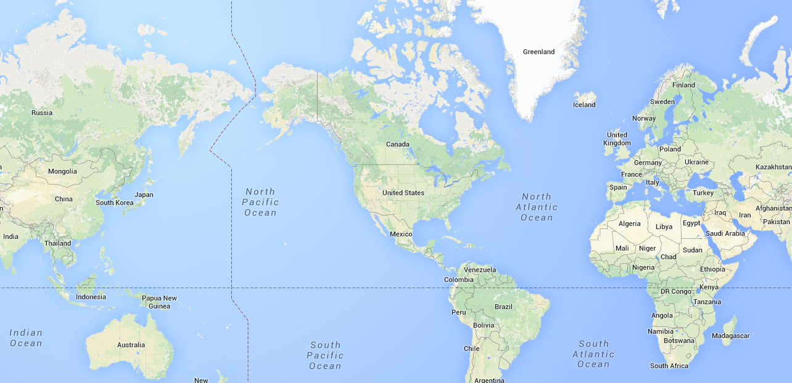
P5: Particle Physics Is a Global Field
From Chapter 1 of the P5 Report
“The scientific program required to address all of the most compelling questions of the field is beyond the finances and the technical expertise of any one nation or region.”
“The capability to address these questions in a comprehensive manner is within reach of a cooperative global program.”
Japan
International Linear Collider
Fermilab
Long-Baseline Neutrino Facility
CERN
Large Hadron Collider

Slide 28
P5: Particle Physics Is a Global Field II
“The United States and major players in other regions can together address the full breadth of the field’s most urgent scientific questions if each hosts a unique world-class facility at home and partners in high-priority facilities hosted elsewhere.”
“Strong foundations of international cooperation exist, with the Large Hadron Collider (LHC) at CERN serving as an example of a successful large international science project.”
“The field is at a juncture where the major players each plan to host one of the large projects most needed by the worldwide scientific community.”

Slide 29

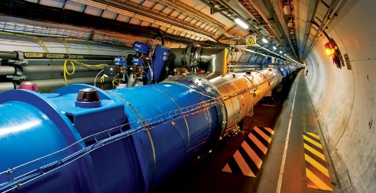
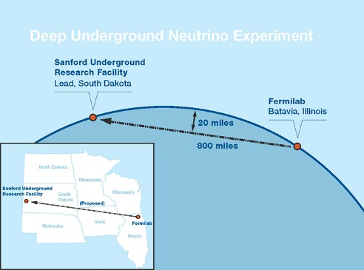
P5:Particle Physics is a Global Field III
P5 identified two highest-priority large international projects:
Continue strong collaboration in the Large Hadron Collider at CERN, including the High-Luminosity LHC accelerator and detector upgrades.
Develop a world-leading neutrino program with U.S.-hosted Long-Baseline Neutrino Facility/Deep Underground Neutrino Experiment as the centerpiece.
A 3rd large project, large-scale involvement in the International Linear Collider in Japan, could not be pursued due to budgetary constraints.
Notes:
The broad, inclusive prioritization process and strategic planning with heavy community involvement provided the basis for moving ahead with LBNF/DUNE.

Slide 30
An important change in direction: LBNE → LBNF
P5 recognized that the Long Baseline Neutrino Experiment, which was supported in the 2008 P5 report and had reached CD-1, would not meet the science goals identified by the community and informed by recent neutrino oscillation measurements.
From the P5 report:
The minimum requirements to proceed are the identified capability to reach an exposure of at least 120 kt*MW*yr by the 2035 timeframe, the far detector situated underground with cavern space for expansion to at least 40 kt LAr fiducial volume, and 1.2 MW beam power upgradable to multi-megawatt power. The experiment should have the demonstrated capability to search for supernova (SN) bursts and for proton decay, providing a significant improvement in discovery sensitivity over current searches for the proton lifetime.
These minimum requirements are not met by the current LBNE project’s CD-1 minimum scope.
A more ambitious long-baseline neutrino facility has also been urged by the Snowmass community study and in expressions of interest from physicists in other regions. To address even the minimum requirements specified above, the expertise and resources of the international neutrino community are needed. A change in approach is therefore required.
Recommendation 13: Form a new international collaboration to design and execute a highly capable Long-Baseline Neutrino Facility (LBNF) hosted by the U.S. To proceed, a project plan and identified resources must exist to meet the minimum requirements in the text. LBNF is the highest-priority large project in its timeframe.

Slide 31
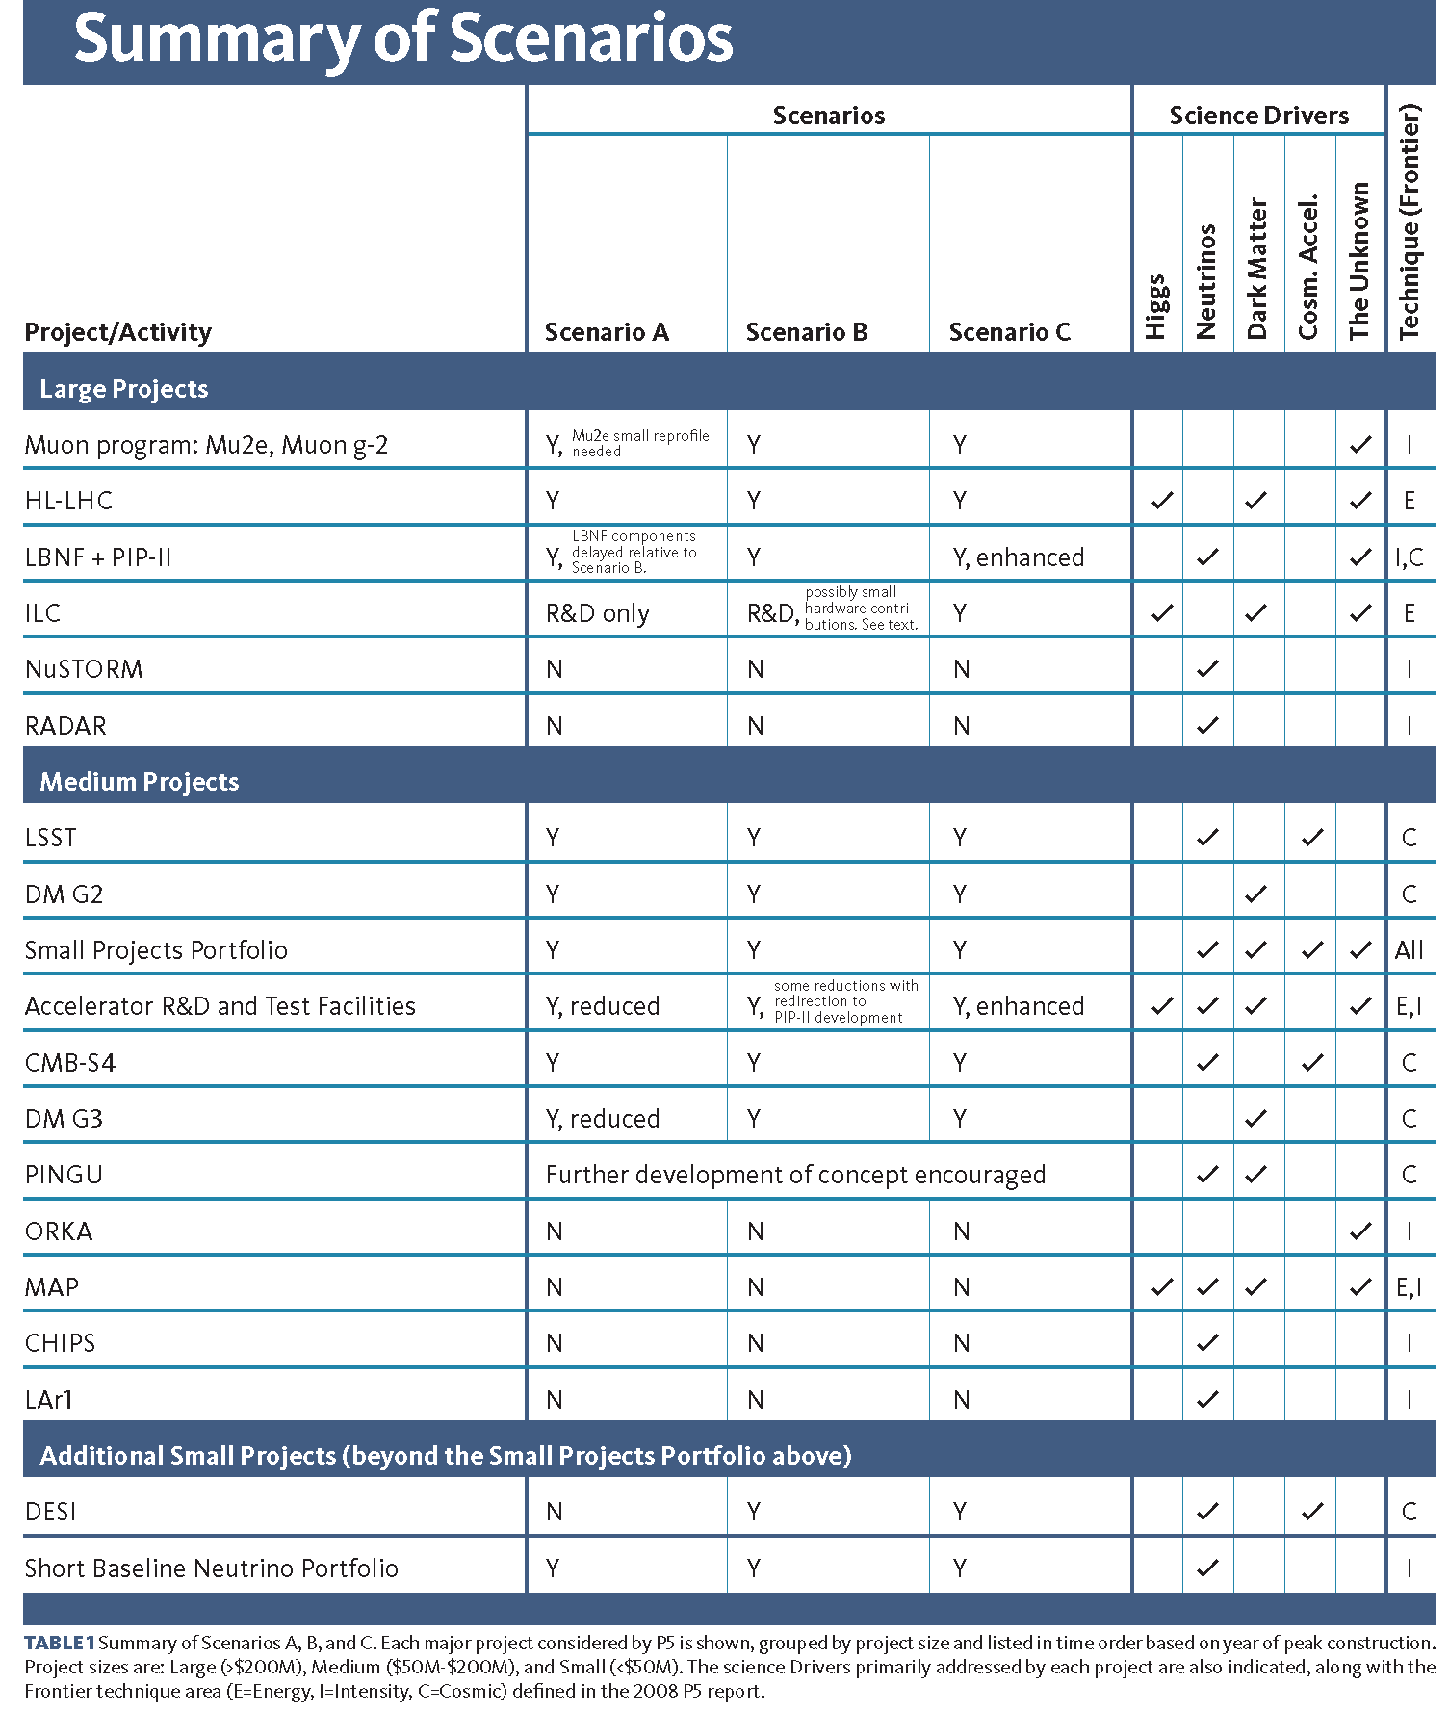
P5 Project Priorities
Not all projects presented to P5 through the Snowmass process were selected to move forward
Some ongoing programs were ramped down (MAP)
Many proposed projects were turned down

Slide 32
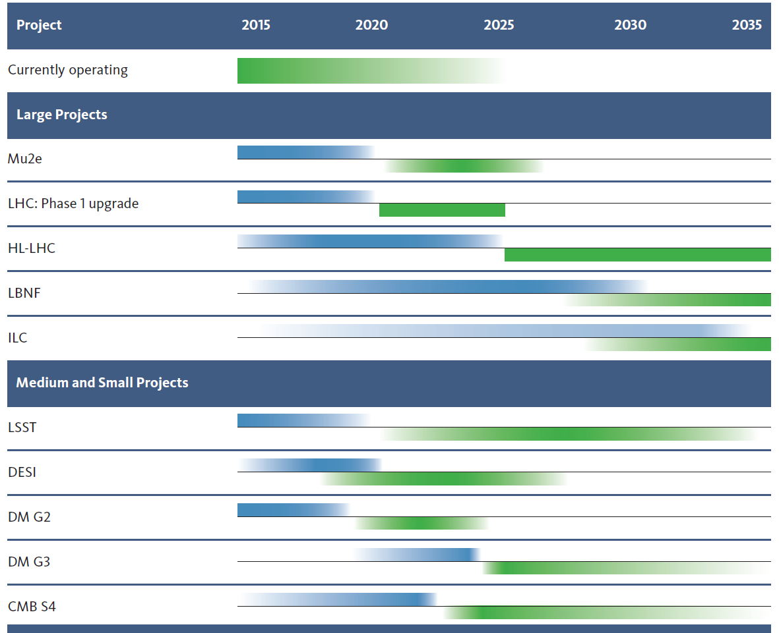
P5 Construction and Physics Timeline
Panel made difficult decisions
Many projects were not recommended
Final timeline balanced project size and projected science output
Ensure scientific return on investment and stable research career path

Slide 33
Significant Changes in Direction - 1
Increase investment in construction.
In constrained scenarios, this implies increased fraction of budget toward construction.
Reformulate the long-baseline neutrino program as an internationally designed and funded program, with Fermilab as host.
Upgrade the Fermilab proton accelerator complex to produce the world’s most powerful neutrino beam
redirecting Project-X activities & some existing accelerator R&D
Proceed immediately with a broad second-generation (G2) dark matter direct detection program.
Invest at level significantly above that called for in 2012 joint agency announcement.

Slide 34
Significant Changes in Direction - 2
Provide increased particle physics funding of CMB research & projects,
as part of the core particle physics program, in context of multiagency partnerships.
Re-align activities in accelerator R&D, which is critical to enabling future discoveries, based on new physics information and long-term needs.
Reassess the Muon Accelerator Program (MAP), and consult with international partners on the early termination of MICE.
In the general accelerator R&D program, focus on outcomes and capabilities that will dramatically improve cost effectiveness for mid- and far-term accelerators.

Slide 35
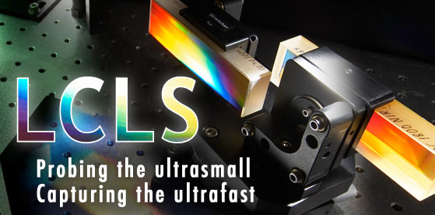
P5: Benefits and Broader Impacts
From the P5 report:
Particle physics shares with other basic sciences the need to innovate, invent, and develop technologies to carry out its mission to explore the nature of matter, energy, space and time.
Advanced particle accelerators, cutting-edge particle detectors, and sophisticated computing techniques are the hallmarks of particle physics research.
This dedicated research has benefited tremendously from progress in other areas of science to advance the current state of technology for particle physics.
In return, developments within the particle physics community have enabled basic scientific research and applications in numerous other areas.
Research in particle physics inspires young people to engage with science.
This broad, connected scientific enterprise provides tremendous benefits to society as a whole.
BGO crystals & PET industry
Quantum Field Theory & Atomic (AMO) Physics
GEANT & space industry

Slide 36
Rolling Out the P5 Report

Slide 37
The End Game: Rolling out the Report
P5 Report was presented publicly & approved by HEPAP in May 2014.
All ready at the time of the May HEPAP meeting:
• International partner consultations
• Draft versions of 1-page overview and talking points
• Press release and web features ready to go
Followed quickly by:
Community: Virtual Town Hall, emails, news items, briefings by phone and talks/discussions at universities and labs, and conferences
Briefing decision makers as requested
Continued talks/discussions at community meetings, universities, and labs, international committees

Slide 38
Strategic Plan for U.S. Particle Physics
Charge: A strategic plan, executable over 10 years, in the context of a 20-year global vision
US community has come together to make a plan.
Driven by the science
Meets fiscal constraints
Considers the global context
Resolves key issues for the field
Provides a continuous flow of results while making essential investments for the future

Slide 40
Rolling out the report
Roll out in Washington: Good reception
From Secretary of Energy to DOE Office of HEP
Executive Office of the President
Office of Management & Budget (OMB) & Office of Science & Technology Policy (OSTP)
FY16 budget in preparation
Congress (relevant committees of both House and Senate)
Common Washington questions: International collaboration, MAP
Roll out in community: Good reception
HEPAP, Virtual Town Hall, conferences & workshops
APS Physics Policy Committee
Laboratory Directors
Influential physics leaders
Common community questions:
Internationalization of neutrino program, Muon Accelerator Program (MAP), impact on research groups, prospects for future machines in US.
International community

Slide 41
Community & Public Response to P5
U.S. particle physics community enthusiastically supports the new plan.
2,331 community members signed a letter of support to DOE and NSF (organized by DPF)
Major news outlets reported on the recommendations.
Most science publications pointed out that the top priority outlined in the P5 report is the continued participation in the LHC experiments and its upgrades
Often focused on the proposed construction of a billion-dollar-plus Long-Baseline Neutrino Facility, a project that hadn’t received much media attention in the past
An Associated Press article on the report and the proposed LBNF was carried in more than 270 media outlets worldwide

Slide 42
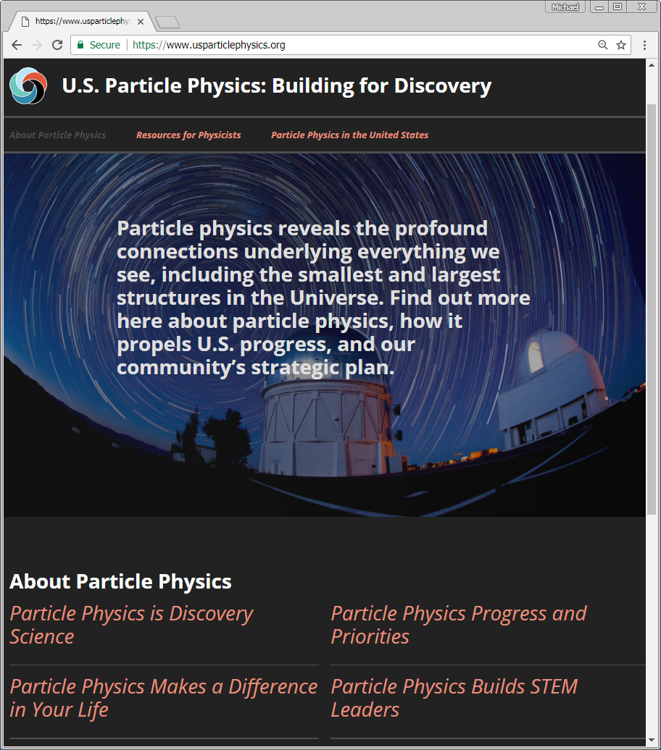
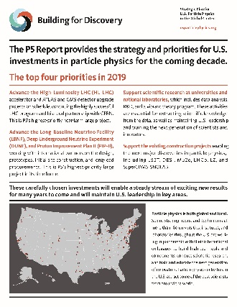
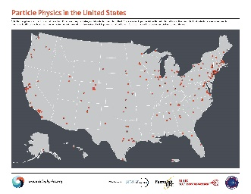
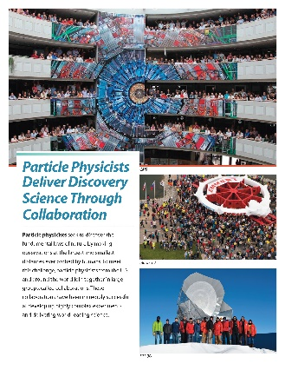
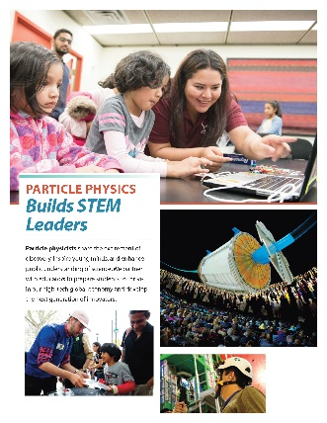
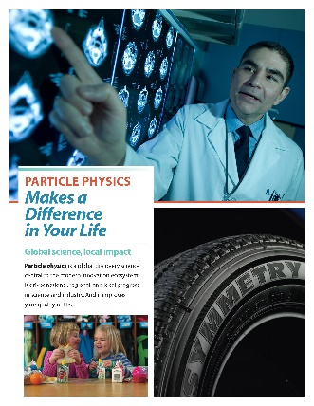
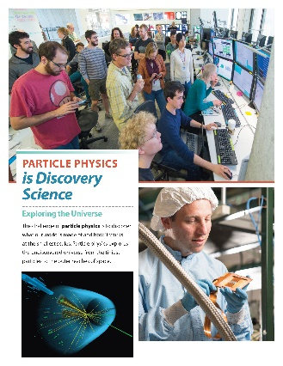
Continuing Communications
Community groups and Steve Ritz (P5 chair) produce and regularly update community materials on usparticlephysics.org
Coordinated effort of DPF Executive Committee, Fermilab Users’ Executive Committee, SLAC Users Organization, and U.S. LHC Users Association
Material includes a one-sheet on “Progress and Priorities” regarding implementation of the P5 strategy
Top priorities, recent results, program advances, looking forward

Slide 43
Important Impacts of the P5 Report

Slide 44
U.S. Congress Supports P5 Strategy
FY 2019 Senate Energy and Water Development Appropriations Report:
“The Committee recommends $1,010,000,000 for High Energy Physics. The Committee strongly supports the Department’s efforts to advance the recommendations of the Particle Physics Project Prioritization Panel Report [P5], which established clear priorities for the domestic particle physics program…”
“Four years into executing the P5, the Committee commends the Office of Science and the high energy physics community for achieving significant accomplishments and meeting the milestones and goals set forth in the strategic plan…”

Slide 45
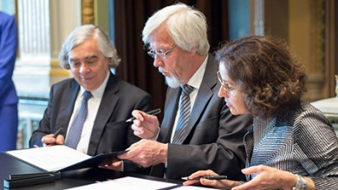
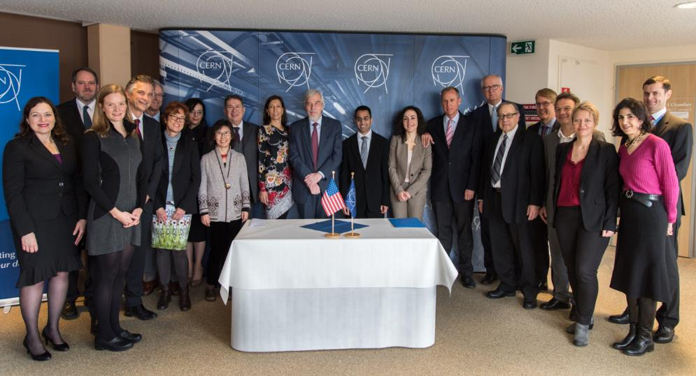
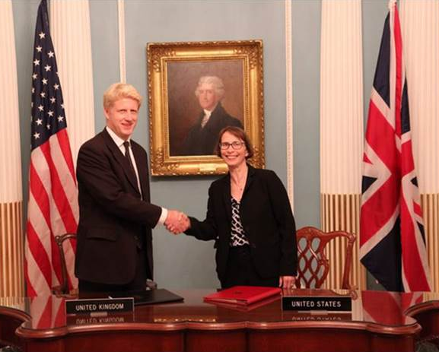
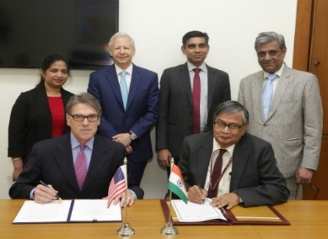
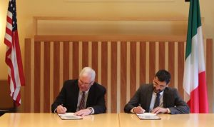
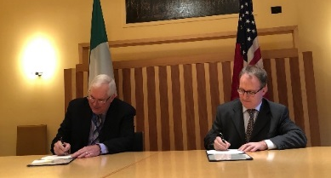
Growing International Partnerships
CERN is an important partner with DOE through cooperative agreements signed in 2015 and 2017
UK-U.S. Science and Technology Agreement signed Sep. 20, 2017
Major project under this agreement is UK investment in LBNF/DUNE/PIP-II program
DOE and DAE-India Project Annex II on Neutrino Research signed April 16, 2018
Expands accelerator science collaboration with India to include the science for neutrinos
DOE and Italian Ministry of Education, Universities and Research agreements on neutrinos and accelerators
Agreement under an umbrella agreement on neutrino science collaboration signed June 28, 2018
Annex agreement for PIP-II accelerator signed Dec. 4, 2018
Statements of Interest each from CEA and CNRS (France), expressing interest in U.S.-hosted Neutrino Program, signed December 2018
Close coordination by DOE with U.S. Government agencies, including the State Department, on establishing cooperative agreements
Actively pursuing engagements with other potential global partners to advance particle physics program
CERN
UK
India
Italy

Slide 46
Why is 2014 P5 Report Successful?

Slide 47
Generally Important to Success
The report addresses different audiences.
HEP community, DOE HEP & SC, OMB, Congress
The report presented a strategic plan, a well-balanced, scientifically compelling program, not strictly a prioritization of projects.
What are some generally important points?
Community support
Credible panel
Strongly prioritized the science case as the deciding factor
Restructuring of LBNF/DUNE into a scientifically strong project
Presentation of report and articulation of rationales strengthened by peer-review.
Report provided rationale of prioritization
Communicating the report (P5 Chair S. Ritz was important here)

Slide 48
Additionally key to HEP Community
What else was important to the HEP community?
Snowmass process built community buy-in.
Understood as important from the NP experience
Particularly the large final meeting
P5 built on the investment in Snowmass process and outcomes
But was not constrained by them
Open to input, transparent process, communication channels throughout process
Public meetings, town halls, further input, communications.
Restructuring of LBNF/DUNE into a scientifically strong project

Slide 49
Additionally key to Administration & Congress
What else was important to DOE HEP and SC?
Credible panel that devoted itself to the task, and held itself to a high standard; panel represented the field not special interests
Realistic, implementable plan (hard work on realistic budgets, made difficult choices)
Addressed perceptions and concerns of officials
Support of HEPAP, DPF, and Community
What else is important to Congress?
Consistent, coherent message
Progress on ongoing medium-scale projects as large-scale projects started
International aspect
Sustained community support
Ongoing communication of the P5 strategic plan

Slide 50



Slide 51
Timeline for Updating the U.S. Strategy
The May 2014 P5 report was successful because it was well informed by the science community, including information from:
2010 New Worlds, New Horizons in Astronomy and Astrophysics
2012 Report of the Subcommittee on Future Projects of High Energy Physics (Japan)
2013 European Strategy for Particle Physics Report
2013 U.S. Particle Physics Community-driven “Snowmass” process
The timeline of processes that impact strategic planning is:
2018-20: New NAS Astronomy and Astrophysics Decadal Survey
2019: Japan position on ILC
2019: Start of European Strategy for Particle Physics process
2020: Release of updated European Strategy for Particle Physics
2020: Earliest opportunity for National Science Board to approve obligating MREFC for HL-LHC
From a DOE perspective, the earliest that new “Snowmass,” NAS Elementary Particle Physics Decadal Survey, and P5 processes could begin is 2020
Relative timing of Snowmass, P5, and NAS EPP Decadal survey to be determined
Enables receiving new P5 recommendations in time to inform the FY 2024/25 budget
U.S. community encouraged to work with international collaborators in developing other regional plans with a global vision for particle physics

Slide 54

The Science Drivers
P5 distilled the 11 groups of physics questions from Snowmass into 5 compelling lines of inquiry that show great promise for discovery over the next 10 to 20 years.
The Science Drivers:
Use the Higgs boson as a new tool for discovery.
Pursue the physics associated with neutrino mass.
Identify the new physics of dark matter.
Understand cosmic acceleration: dark energy and inflation.
Explore the unknown: new particles, interactions, and physical principles.
The Drivers are deliberately not prioritized because they are intertwined, probably more deeply than currently understood.
A selected set of different experimental approaches that reinforce each other is required. Projects are prioritized.
The vision for addressing each of the Drivers using a selected set of experiments is given in the report, along with their approximate timescales and how they fit together.
Recommendation 2: Pursue a program to address the 5 science Drivers.

Slide 55
P5 Panel Perspective
This is a challenging time for particle physics. The science is deeply exciting and its endeavors have been extremely successful, yet funding in the U.S. is declining in real terms. The report offers important opportunities for U.S. investment in science, prioritized under the tightly constrained budget scenarios in the Charge.
We had the responsibility to make the tough choices for a world-class program under each of these scenarios, which we have done. At the same time, we felt the responsibility to aspire to an even bolder future.
Wondrous projects that address profound questions inspire and invigorate far beyond their specific fields, and they lay the foundations for next-century technologies we can only begin to imagine. Particle physics is an excellent candidate for such investments.
With foundations set by decades of hard work and support, U.S. particle physics is poised to move forward into a new era of discovery.
More generally, we strongly affirm the essential importance of fundamental research in all areas of science.
Our field is ready to move forward.

