Slide 1

GA MFE: Accelerating Fusion Energy Development through International Collaboration
By
Mickey R. Wade
Presented at
Fusion Power Associates
37th Annual Meeting
and Symposium
December 13 – 14, 2016

Slide 2
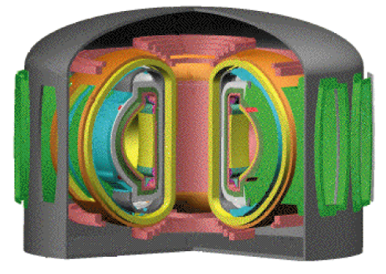


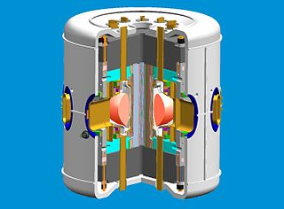
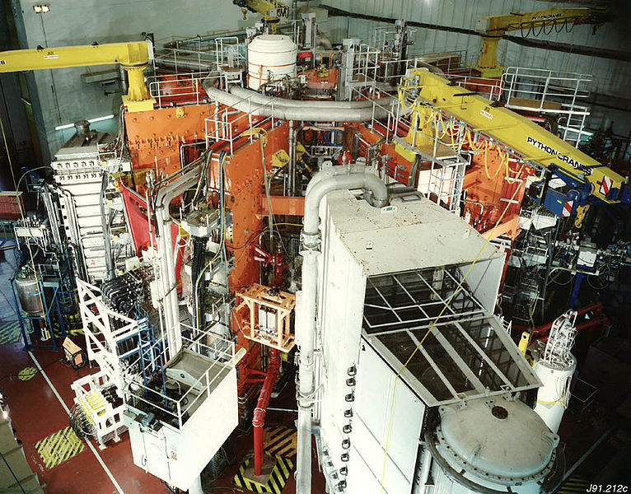
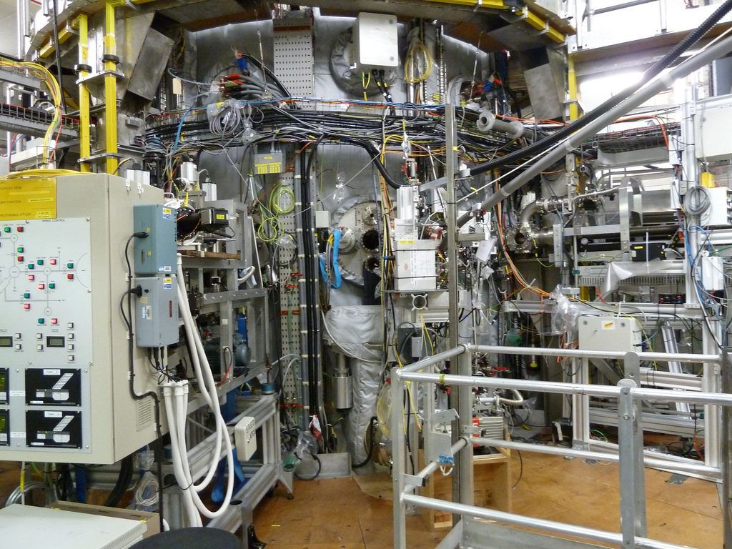
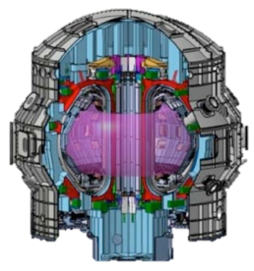

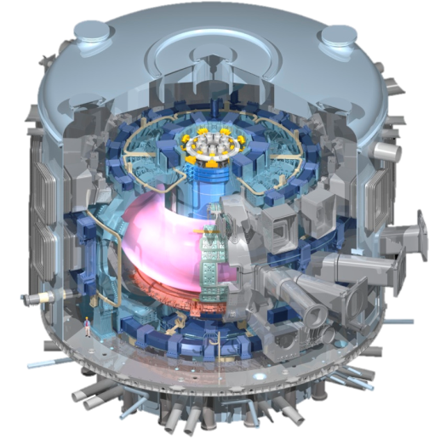
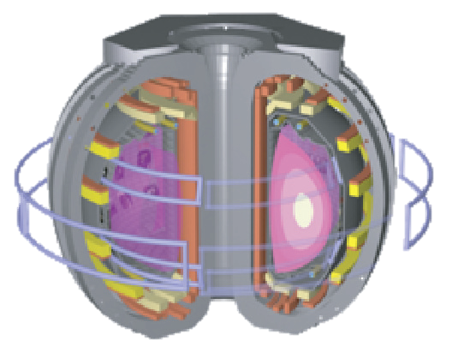
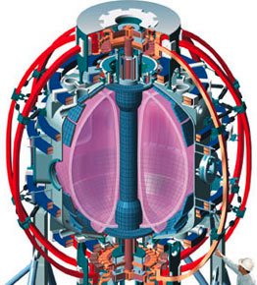
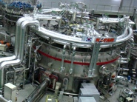
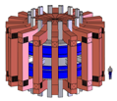
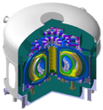
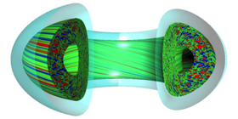
GA Leverages International Partnerships to Accelerate Achievement of Key Milestones for Fusion Energy
Provide physics basis for ITER success
Deliver high technology components
Experiments Worldwide
Power plant
C-Mod
JET
MAST
ASDEX-U
JT-60SA
FNSF
Test components in fusion environment
DIII-D
NSTX
TCV
SST-1
EAST
KSTAR
ITER
CFETR
Theory and Computation
Notes:
From ASIPP Sept 18, 2013

Slide 3
Outline of Talk
GA Guiding Principles for International Collaboration
History of GA International collaboration
Examples of DIII-D and GA Theory Research Enhanced by International Collaboration
GA/ASIPP collaboration
ITER activities
Summary

Slide 4
Mission and Guiding Principles for
GA MFE International Collaborations
Mission:
  GA MFE: To accelerate the realization of fusion energy through development of optimized physics and technology solutions in collaboration with our US and international partners
  DIII-D: To establish the physics basis for the optimization of the tokamak approach to fusion energy
Guiding Principles for International Collaboration:
  Ensure progress on the critical next step in fusion
  research, a burning plasma → make sure ITER succeeds
  Target R&D areas with potential for improved solutions beyond ITER
  Develop collaborations that provide mutual benefit to all partners
  Develop joint teams of senior and junior staff from all parties
  → ensure buy-in, enthusiasm, and leadership
  Take advantage of remote collaboration tools

Slide 5
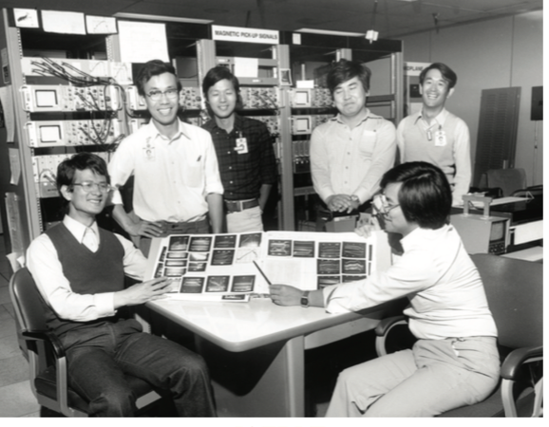
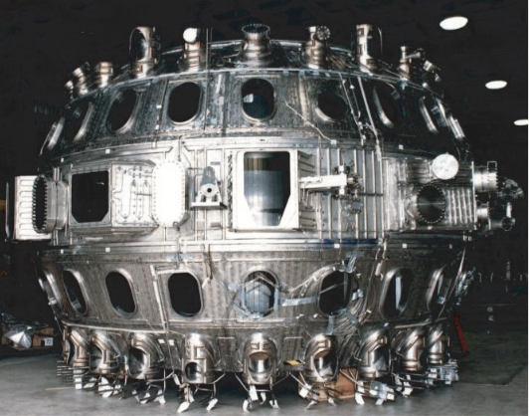
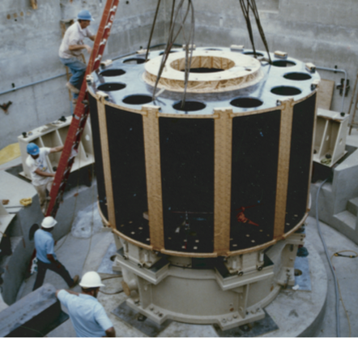
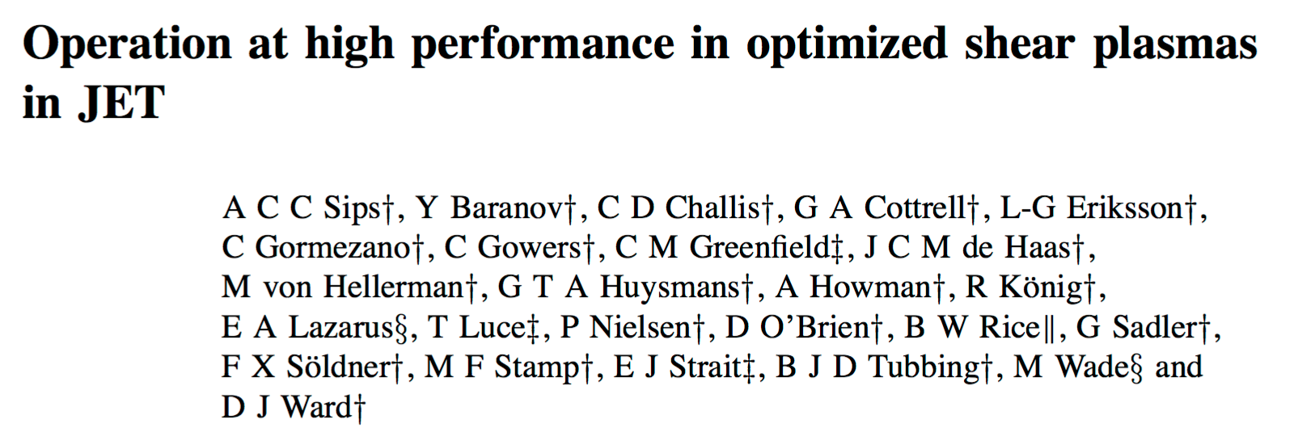
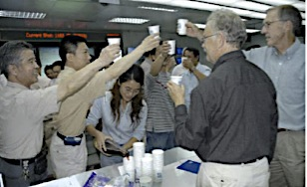
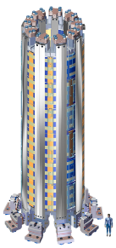
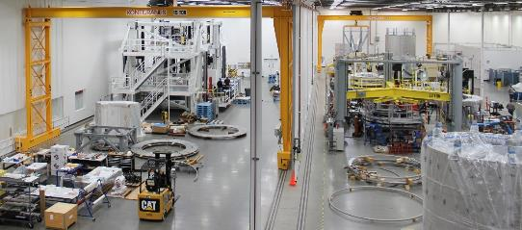
General Atomics and DIII-D Has Long Embraced and Pursued International Collaboration
In 1979, GA and JAERI initiated a joint collaboration that is still vibrant today
In 1990s, JET DT optimized shear campaign motivated and enabled by scoping experiments on DIII-D
  Joint JET/DIII-D team carried out DT experiments
In 2004, collaboration initiated with ASIPP
to exchange hardware/personnel between EAST and DIII-D
GA and DIII-D has provided strong
support of ITER in a variety of areas
  Physics basis, Research Plan, Advisory Committees, Engineering solutions, Hardware, and Diagnostics
Vessel and Motor Generator (Toshiba)
JAERI Team
PPCF 40 (1998) 1171
Chinese and U.S. scientists celebrate first plasma shot on EAST
ITER Central Solenoid Facility

Slide 6
DIII-D Program’s Foundation is an Integrated Team with Diverse Expertise and Common Interests
594 Users
33 Countries
94 Institutions
67 Grad Student Users
53 Post Doc Users

Slide 7
DIII-D Program’s Foundation is an Integrated Team with Diverse Expertise and Common Interests
594 Users
33 Countries
94 Institutions
67 Grad Student Users
53 Post Doc Users
~ 50 International
Partners

Slide 8
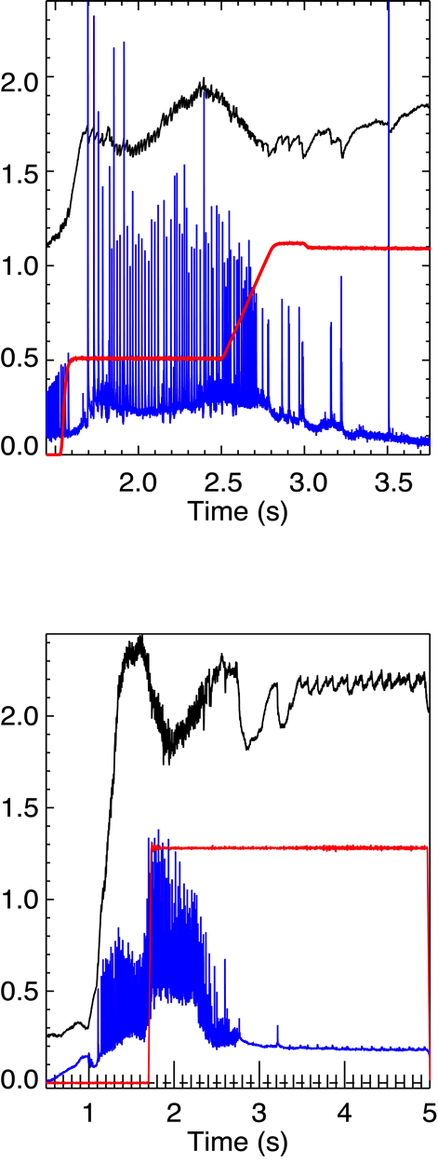
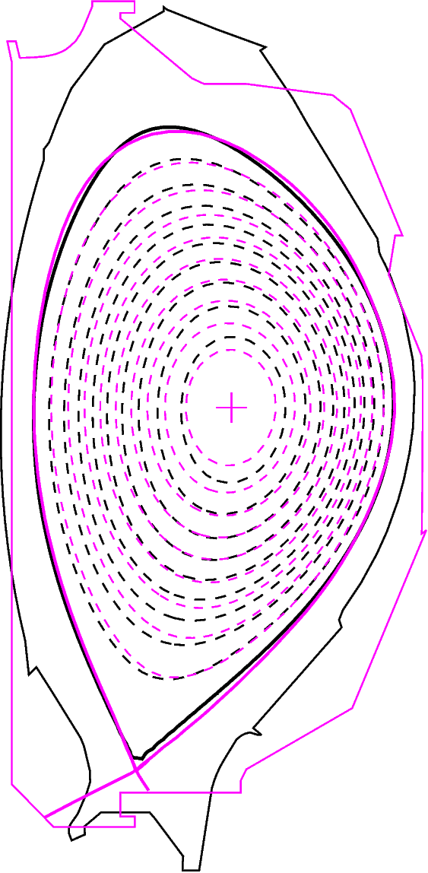
ITPA Joint Experiments Provide a Mechanism for Increasing Confidence in the ITER Design Basis
DIII-D n=3 RMP
Shape overlay
DIII-D/AUG
• Example: RMP ELM Suppression
• Result on DIII-D suggested lower collisionality and increased shaping on AUG is key
• Follow on experiment on AUG achieved ELM suppression
• Encouraging result for ITER
164361
β_{N}
δ≈0.3
I(kA)
Dα
AUG n=2 RMP
33353
β_{N}
Post-deadline presentation at 2016 IAEA Fusion Energy Conference
(Nazikian, PPPL)
I(kA)
Dα
Notes:
D3D program is focused on critical needs for the future… LIST – ITER SUCCESS…. PATH BEYOND ITER
We have organized our presentation of the ENTIRE d3d program in suport of these goals.
MARRIES

Slide 9
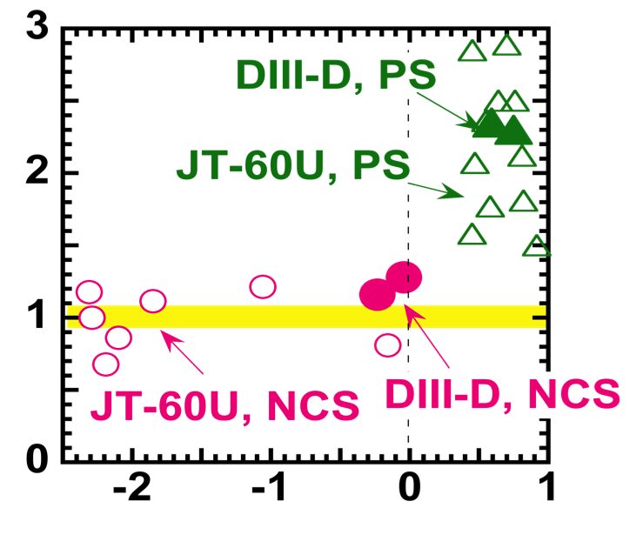
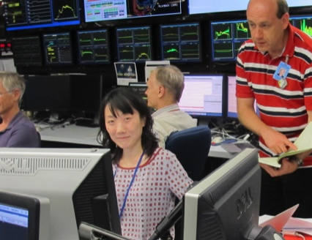
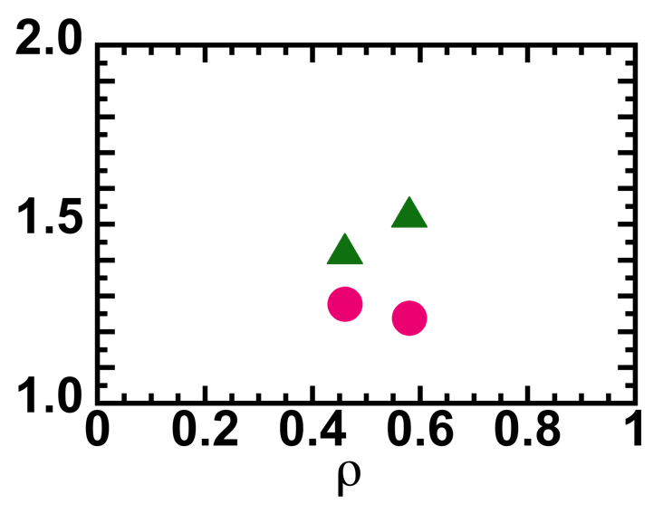
ITPA Joint Experiments Provide Foundation for Pursuing Common Interests With International Partners
Transport analysis of JT-60U data indicated that effect of ECH was much smaller in plasmas with negative central shear
ITPA joint experiment on DIII-D confirmed JT-60U findings and provided new data
Invited talk at 2016 IAEA Fusion Energy Conference
  Given by JT-60U author
  M. Yoshida
Change in χ_{i} with ECH
magnetic shear
Change in density
fluctuations with T_{e}/T_{i}
Σ ñ _{{High Te/Ti}}
Σ ñ _{{Low Te/Ti}}
PS
Provides basis for vibrant collaboration on exploiting JT-60SA to extend physics basis of Advanced Tokamak
NCS

Slide 10
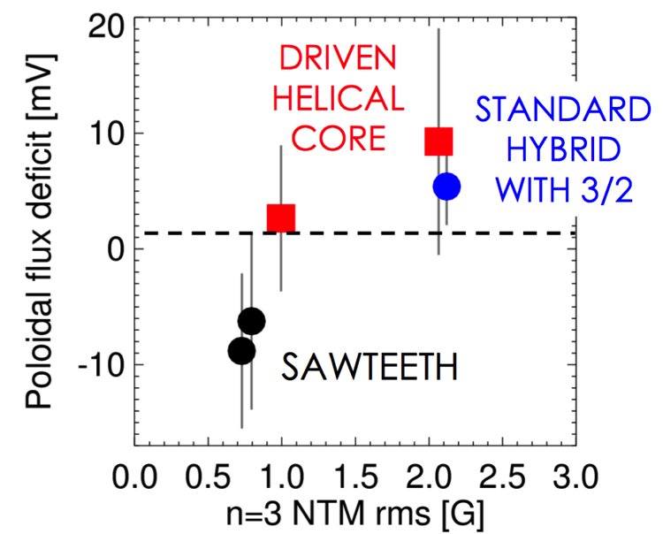
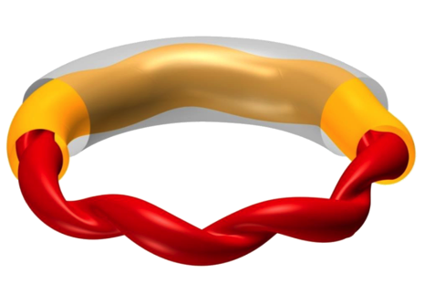
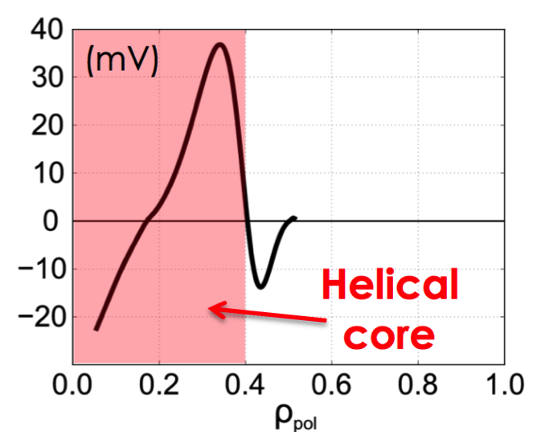
Expertise of International Groups Has Enabled DIII-D to Better Address Important Physics Phenomena
Example: Flux pumping in hybrid discharges
Helical RFP in FTU has many of the same traits
  MHD dynamo redistributes current non-resistively
Applying same models tested on FTU to DIII-D reveal similar flux pumping
DIII-D
FTU
DIII-D
Effective Loop Voltage
Due to dynamo
Experimental time provided through the Torkil Jensen Award for DIII-D Innovative Experiments

Slide 11
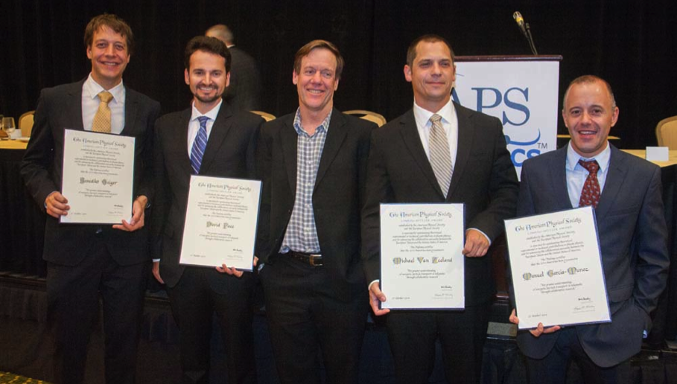
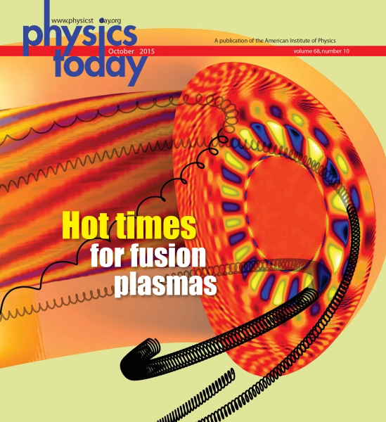
International Collaboration Has Enabled
Award-Winning Research by Early Career Staff
Example: DIII-D and ASDEX-Upgrade
scientists teamed together to greatly enhance understanding of energetic particles in fusion plasmas
Awarded the 2014 Landau-Spitzer
Prize
  "For greater understanding of energetic particle transport in tokamaks through collaborative research."
Delivered world-class diagnostic and analysis capabilities to both devices
  Now routinely used throughout the world

Slide 12
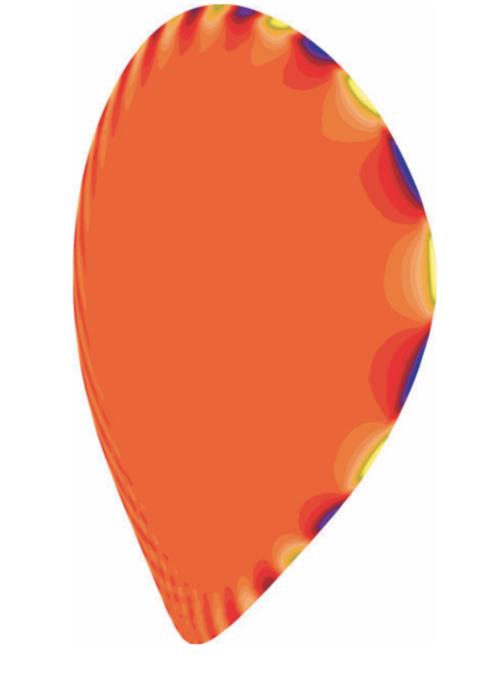
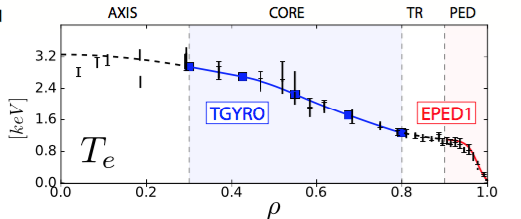
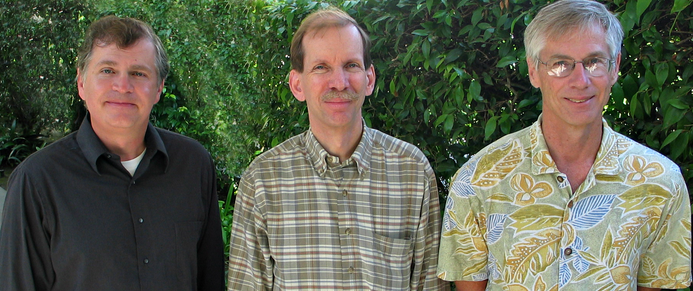
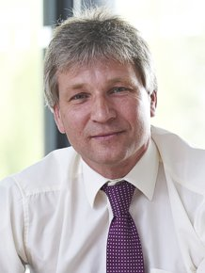
Key Theoretical Developments Also Energized through International Partnerships
Eigenmode structure
From ELITE (n = 6)
EPED Model
Example: Edge stability code ELITE developed via GA partnership with Culham and U. York*
Provided basis for predicting pedestal width AND height …
… which can then be used to predict performance in ITER
* Early development of ELITE and accompanying physics basis awarded 2013 APS-DPP John
Dawson Excellence in Plasma
Physics prize
Prediction of full
profile in ITER-similar
DIII-D plasma
Snyder
(GA Theory)
J. Ferron
(DIII-D)
T. Osborne
(DIII-D)
H. Wilson
(U. York)

Slide 13
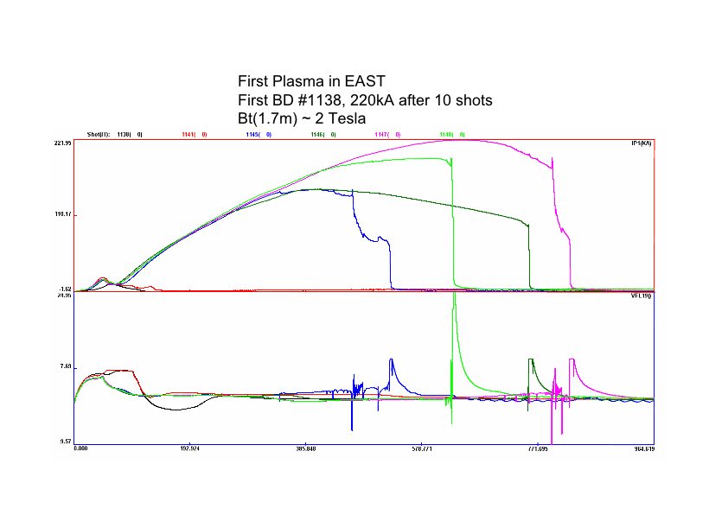
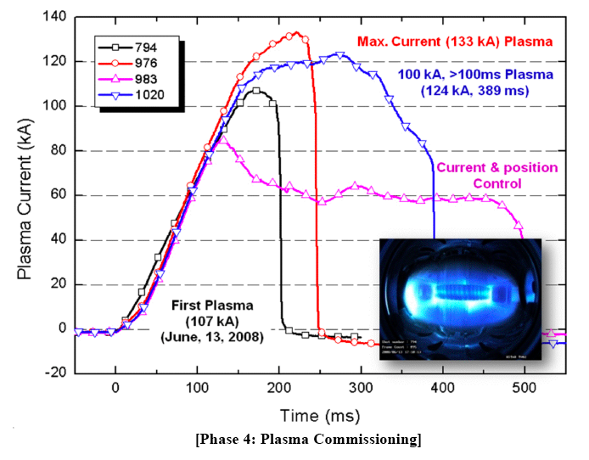
Plasma Control Collaborations with EAST & KSTAR
Enabled Rapid First Plasma Development … and More
EAST first plasma obtained within
3 days of first attempts
  1.8 s discharges obtained in first few months
Similar experience on KSTAR
Enabled opportunity to expand control capabilities to superconducting devices in preparation for ITER
Ongoing activities between DIII-D, EAST, and KSTAR are exploiting commonality to expand control capabilities
EAST
KSTAR

Slide 14
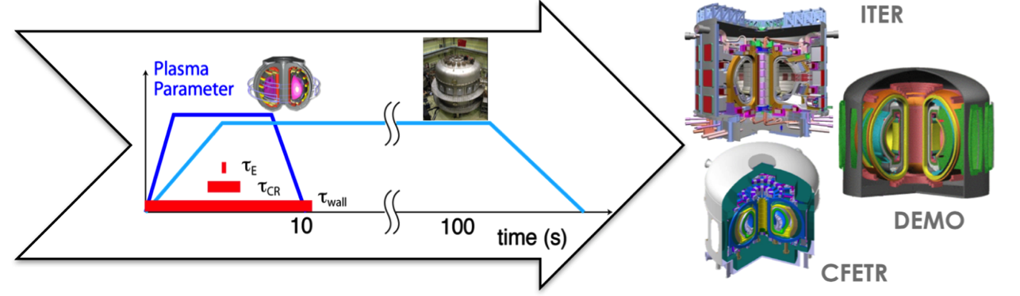
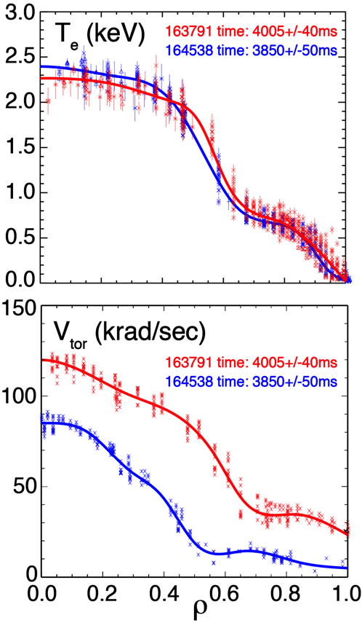
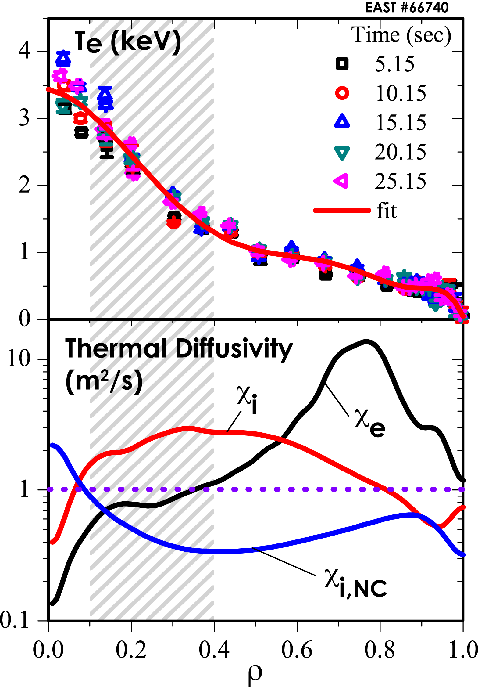
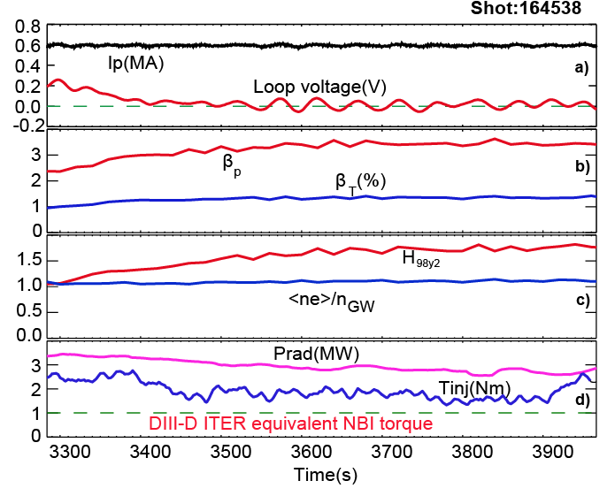
DIII-D/EAST Collaboration Leverages Each Facility’s Unique Capabilities to Develop Results of Mutual Interest
DIII-D/EAST Long-Pulse Initiative: Extend high performance discharges developed on DIII-D to true steady-state in EAST
DIII-D developed low Torque, fully non-inductive, high β_{p} discharge
  ITB sustained even at low rotation
Preliminary EAST experiments
  show ITB formation at low rotation

Slide 15
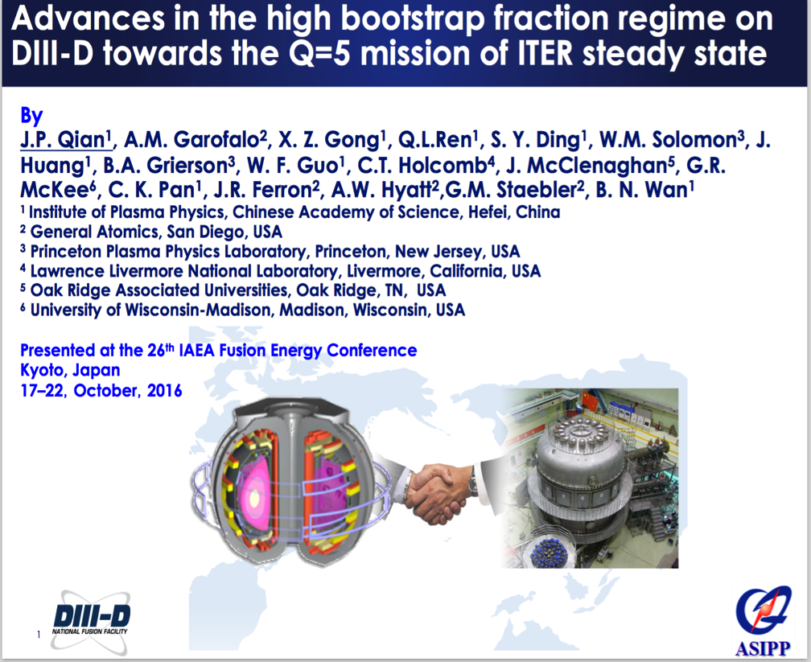
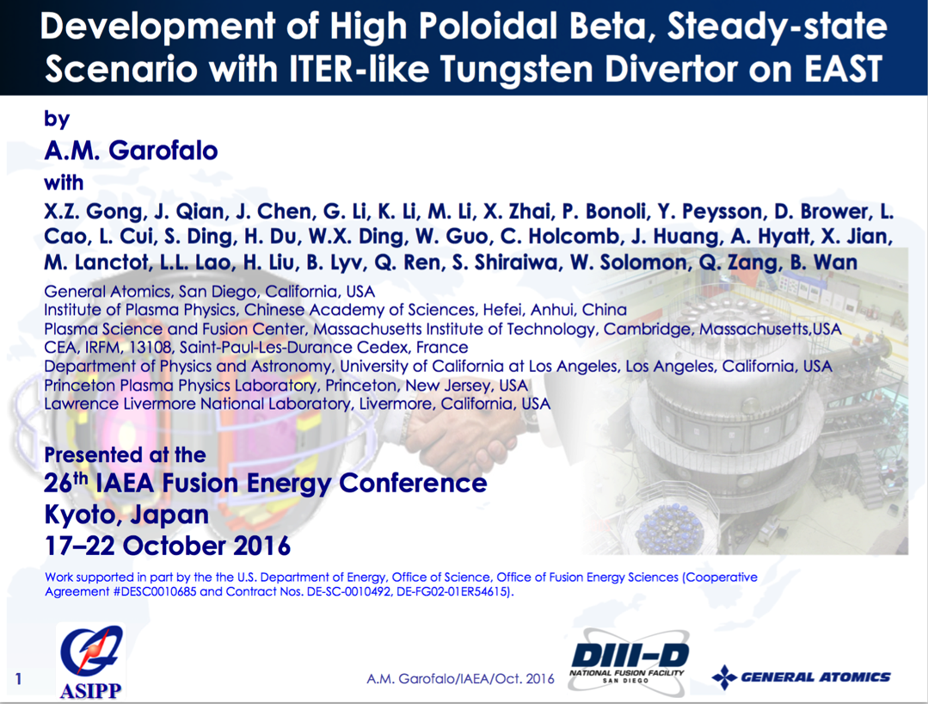
DIII-D/EAST Collaboration Leverages Each Facility’s Unique Capabilities to Develop Results of Mutual Interest
DIII-D/EAST Long-Pulse Initiative: Extend high performance discharges developed on DIII-D to true steady-state in EAST
Progress evidenced by two invited talks at 2016 IAEA Fusion Energy Conference (speaker from collaborating institution)

Slide 16
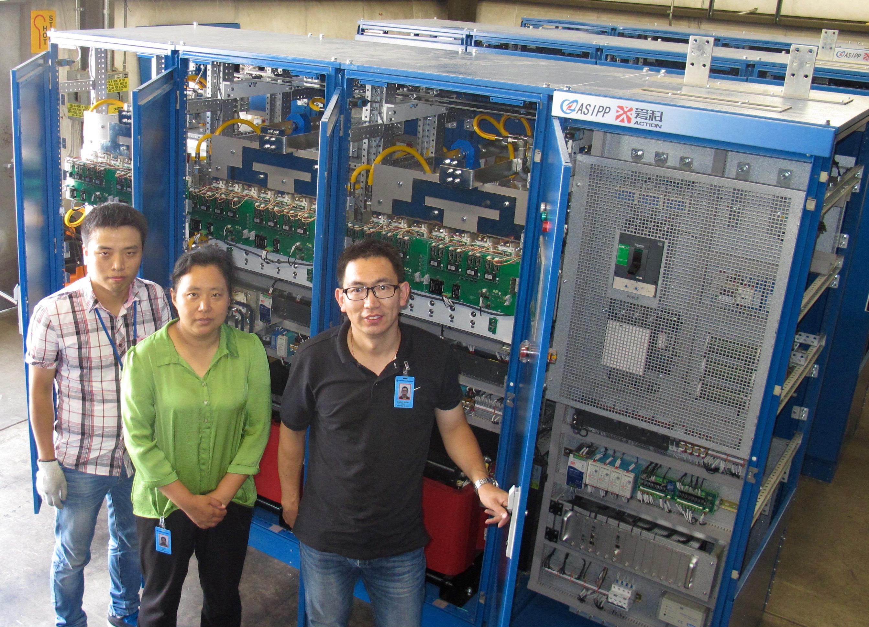
GA/ASIPP Resource and Personnel Exchange
Structured to Ensure Mutual Benefit
DIII-D → EAST | EAST→ DIII-D
Plasma control system (hardware, software, and assistance) → Rapid development of 1st EAST plasma | Lower divertor ring plate → Cost-efficient new divertor for DIII-D
Designed divertor cryopump and 3D coils → Rapid deployment of enabling tools | 138 kV transformers → Longer pulse, higher power
Dedicated several DIII-D run days to EAST scenario development → Efficient path to steady-state operation | “Super Supply” →Multi-n 3D fields, 2D shape control
* Table is representative, not exhaustive

Slide 17
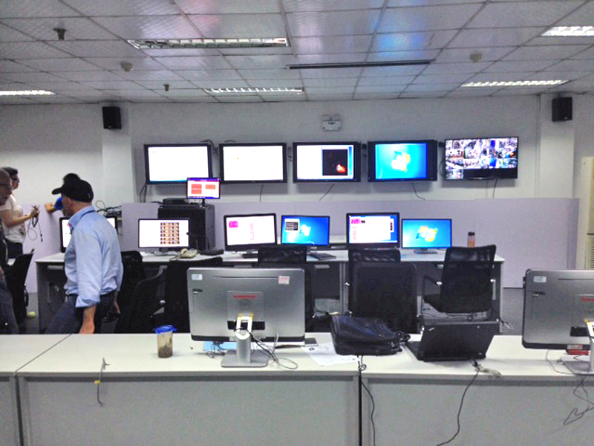
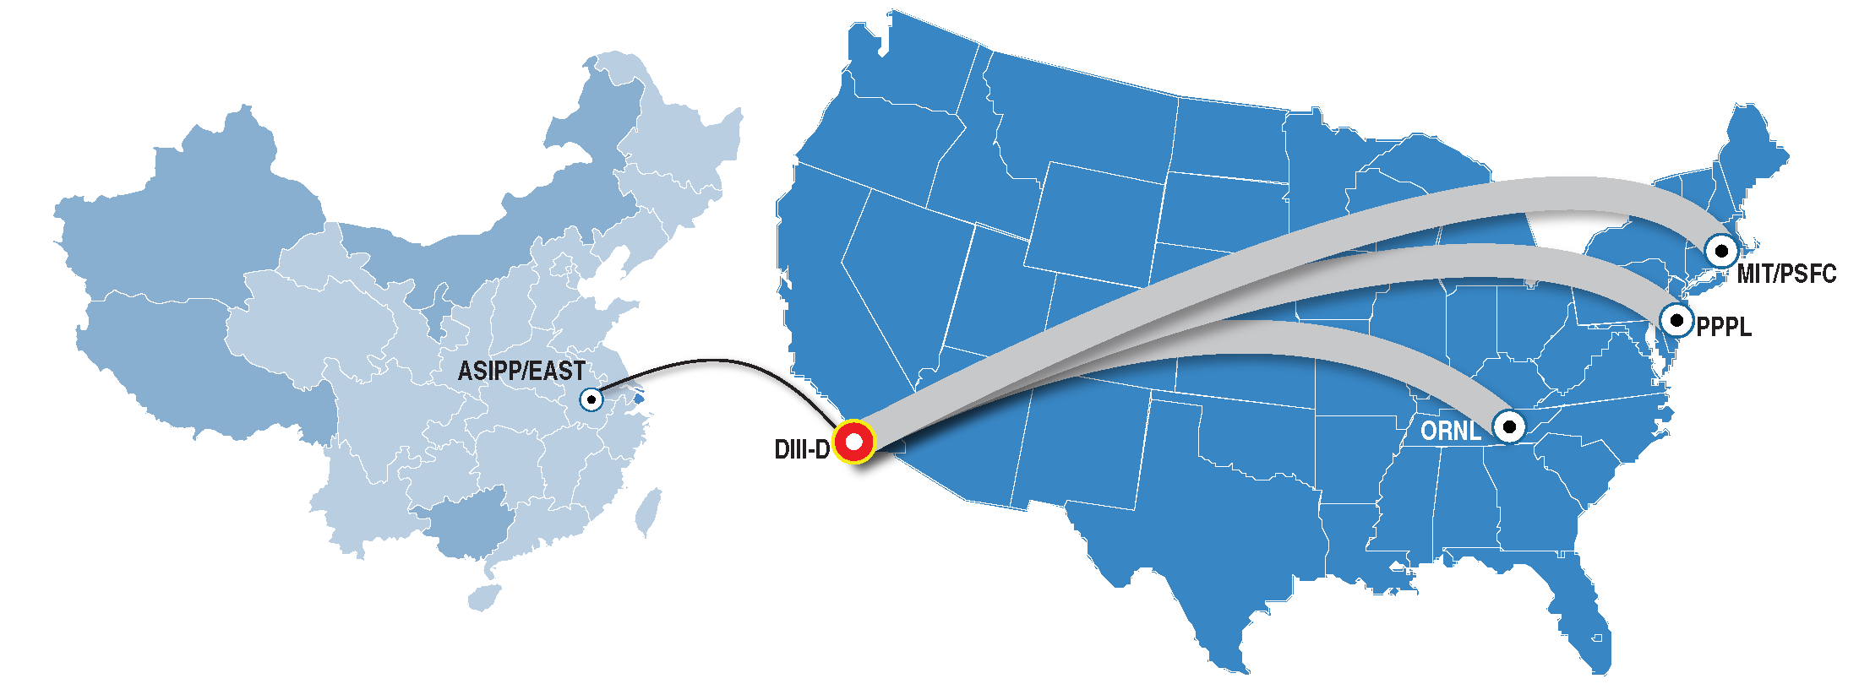
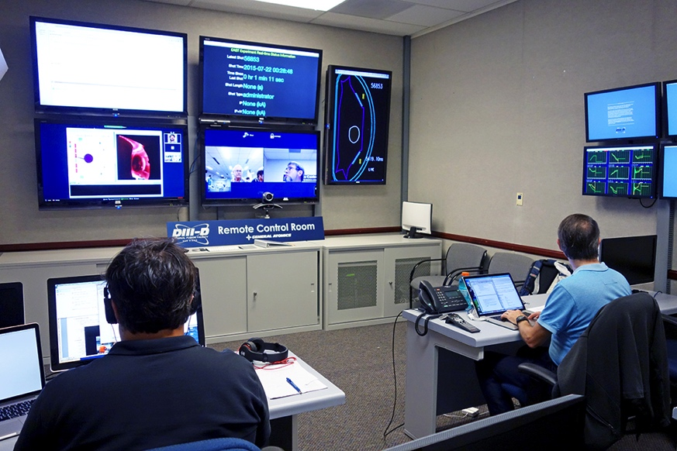
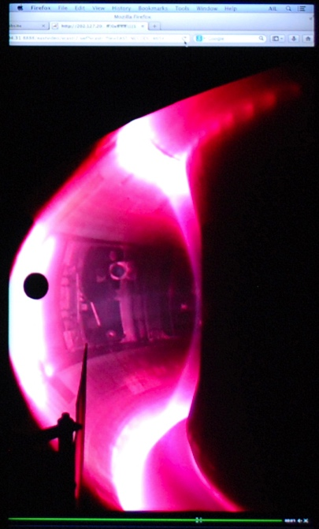
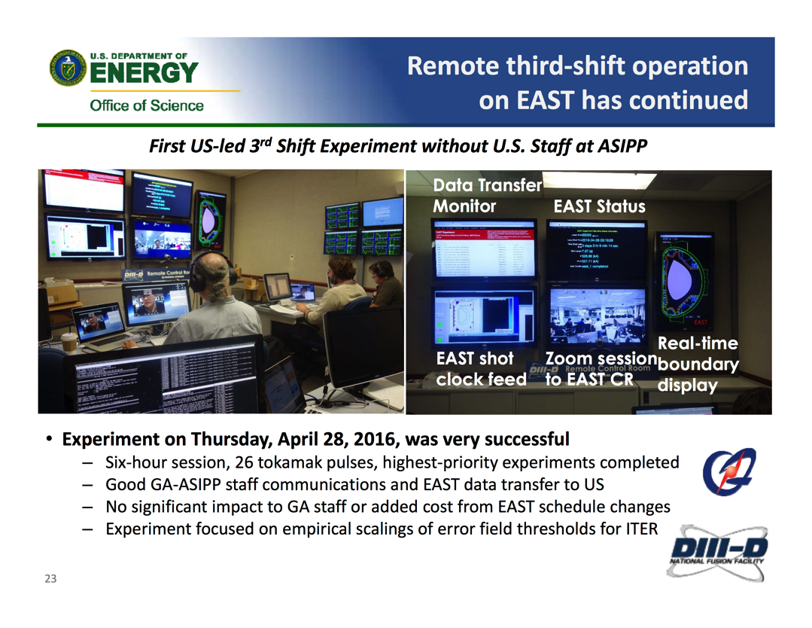
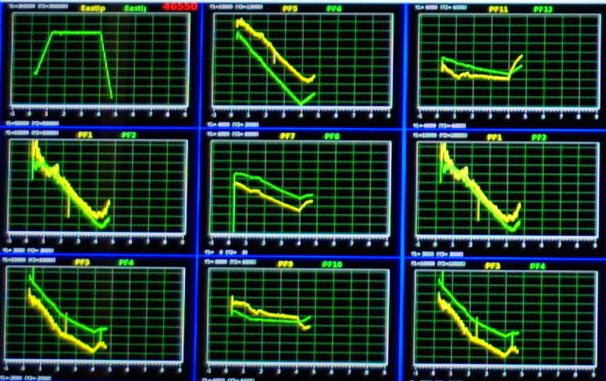
High-speed Telecommunication Has Transformed the Nature of Participation in International Experiments
EAST Control Room
Realtime displays
(during shot)
DIII-D Control Room
Between-shot
data display
GA contributed to data transfer improvements in China
Enabled successful 3rd shift operations with GA/DIII-D personnel running experiment from San Diego

Slide 18
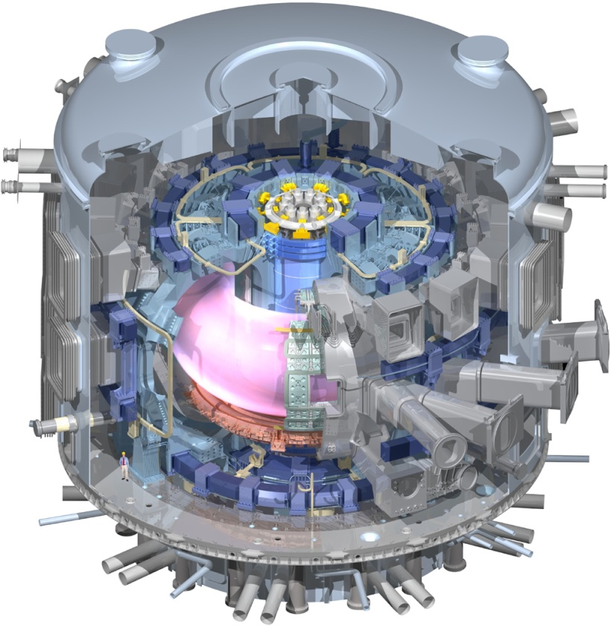
International Collaboration is Essential to Constructing, Preparing For, and Exploiting ITER
ITER
C-Mod
JET
MAST
ASDEX-U
JT-60SA
Exploitation
DIII-D
NSTX
TCV
SST-1
EAST
KSTAR
Realization
Physics Basis
Q = 10
Burning Plasma
ITPA Joint Experiments
Component
Manufacturing
First Plasma
ITER Research Plan
Diagnostics
ITER Assembly
Design Issues
Plasma Control
Remote Collaboratory
Operating Scenarios
Plasma Simulation
Interpretive Models
Validated Modeling

Slide 19
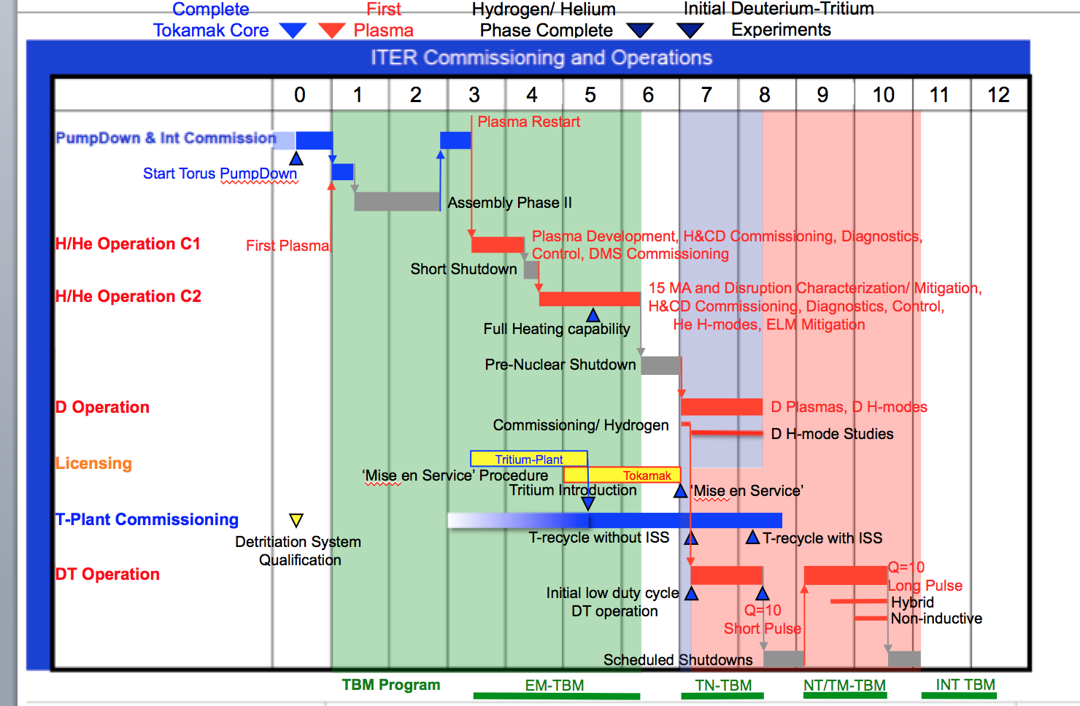

GA and DIII-D Personnel Are Heavily Engaged in Preparing for ITER Research
Provide expertise to key technical
and management activities:
  ITER Research Plan
  ITER STAC & MAC
Resolve key issues identified by ITER
team and world community
  ELM control
  Disruption mitigation
Complete large number of ITPA joint experiments in collaboration with international partners
Develop ITER plasma control and diagnostics in collaboration with
ITER IO, USIPO, and international partners
ITER Research
Plan
Year | # of ITPA Expt’s
2016 | 26
2015 | 18
2014 | 27
2013 | 30
2012 | 31
ITER Toroidal
Interferometer/Polarimeter

Slide 20



General Atomics Works with International Partners to Manufacture the ITER Central Solenoid
Nb₃Sn CICC Conductor supplied by JAEA in
900 m lengths
7 modules wound, cured, insulated, and tested at GA
6 of these assembled at ITER (1 spare)
Delivered to
GA
Delivered to
Cadarache
Completed module weighs 250,000 pounds has 560 turns (4 miles of conductor)
Design and manufacturing assisted via discussions with Koreans, Japanese, Italians, Chinese
ITER Central Solenoid

Slide 21



Collaboration between GA and ASIPP for ITER CS Final Test System Feeder
CS Feeder system designed and built at ASIPP based on ITER feeders
Testing of feeders performed at ASIPP with GA assistance
Installation performed at GA as collaboration
Operational testing with balance of CS Final Test System performed by joint GA/ASIPP team
Feeder under test at ASIPP
Test chamber and feeder installed at GA

Slide 22


Paschen Test Experience on W7-X Leveraged for ITER CS Final Test
Babcock Noel (BNG) performed many of the Paschen test for W7-X coils
BNG performed early insulation design verification tests for CS coil
GA and BNG collaborated on design of final test chamber
BNG provided integrated final test chamber system including 48 camera system to monitor
for Paschen
breakdown
Camera frame system to provide full coverage of CS coil during Paschen testing
Final Test Chamber System as installed at GA

Slide 23
Summary
GA has a long history of international collaborations that:
  Resolve key issues on the path to fusion energy
  Take advantage of unique capabilities or resources provided by our partners
  Provide mutual benefit to all partners
  Engage research staff in cutting edge science and technology
GA is committed to the earliest realization of fusion energy possible and believes that international collaboration are essential in accelerating the timetable for achieving
key milestones in this quest.

