Slide 1
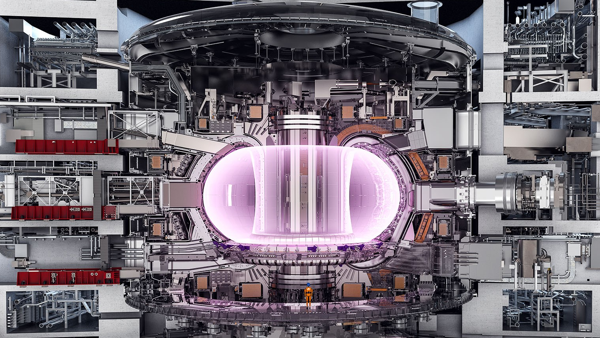
Expectations for ITER in the 2020’s
T.C. Luce
Director, Science and Operations Department
Chief Scientist
ITER Organization

Slide 2
The 2020’s Will See ITER Come to Life
To use an obvious cliché, we have ‘great’ expectations for the ITER Project in the 2020’s
Some high points:
2020: Begin tokamak assembly; begin cryoplant commissioning
2022: Torus completion
2024: Cryostat closure
2025: First Plasma
2026: Begin installation of in-vessel components
2028: Begin commissioning of control and protection systems with plasma operation up to 7.5 MA (maybe 10 MA)

Slide 3
Roadmap for this Talk
Present highlights of the plans for:
Component fabrication
Site construction and assembly
System commissioning
Research program
… using present status as an indicator of the progress in maintaining the schedule

Slide 4
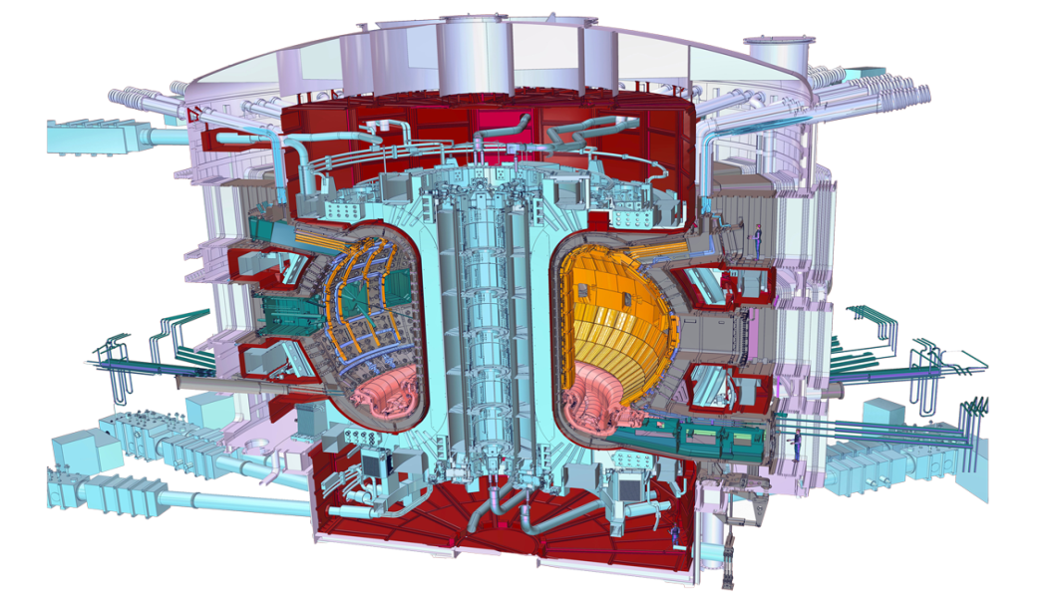



Who manufactures what? The ITER Members share all intellectual property
Cryostat
Feeders (31)
Thermal shield
Toroidal Field coils (18)
Vacuum vessel
Poloidal field coils (6)
Blanket modules
Correction coils (18)
Central solenoid (6)
Divertor

Slide 5
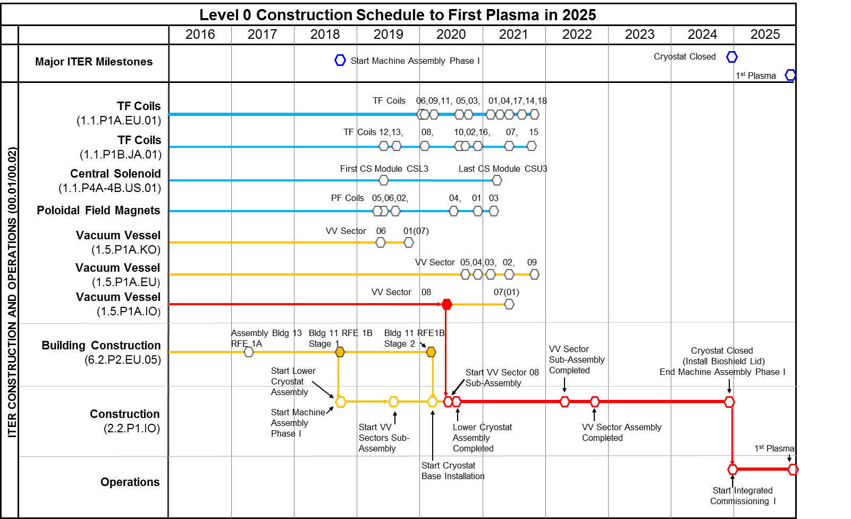
Major Component Fabrication Milestones
Key components begin to arrive in 2019:
TF coils
CS coils
PF coils
VV sectors
Cryostat (base/lower cylinder on site now)

Slide 6

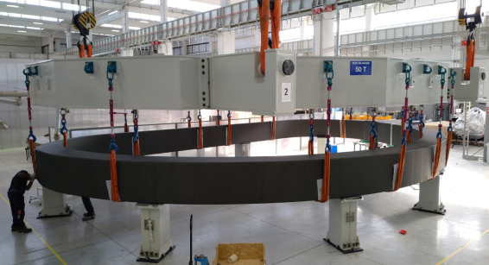
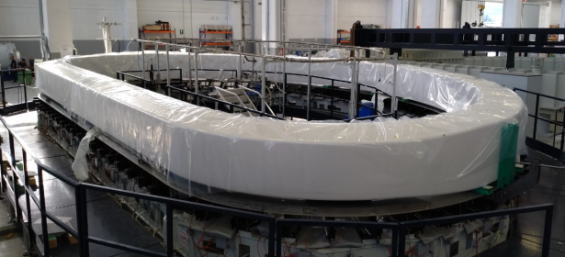
Manufacturing of Winding Packs for Toroidal Field Coils
EU
70 Double Pancakes (DP) to build:
Winding of 70 DP completed ⇨100%
70 Radial Plates completed ⇨100%
H.T and insertion of 70 DPs completed ⇨100%
Cover plates welding of 70 DPs completed ⇨100%
65 DPs impregnated & completed ⇨ 93%
10 Winding Packs (WP) to build:
Stacking of 8 WPs completed ⇨80%
Ground insulation of 7 WPs completed ⇨70%
VPI of 5 WPs completed ⇨50%
Final assembly & test of 4 WPs completed ⇨40%
Delivery of 3 WPs completed ⇨30%
5th WP after VPI. Ready for final assembly.
Production optimized to match the delivery of TFCS by JA-DA (to avoid expensive storage of WPs)
6th WP preparation prior to VPI

Slide 7
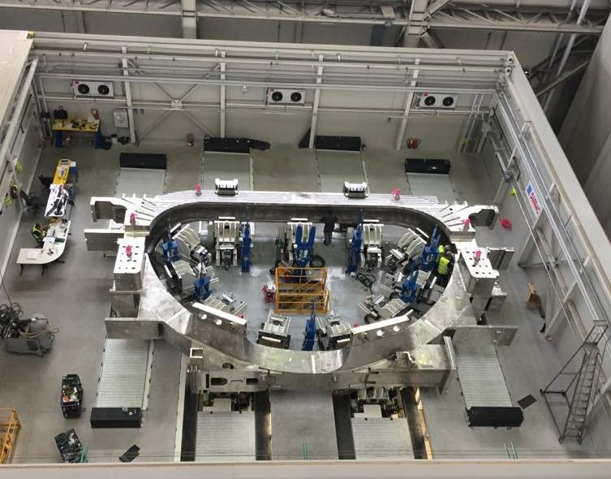
Insertion of Winding Pack (WP) into Coil Cases for Toroidal Field Coils
EU
3 WPs at SIMIC premises:
1st cold tested and ready for insertion.
2nd cold tested and preparation for insertion ongoing.
3rd preliminary test before cold test starting imminently.
2 TF Coil Cases delivered by JA-DA at SIMIC premises:
1st released for Insertion.
2nd acceptance tests on-going.
Assembly rigs tested with 1st TF Coil Case – insertion dry run

Slide 8
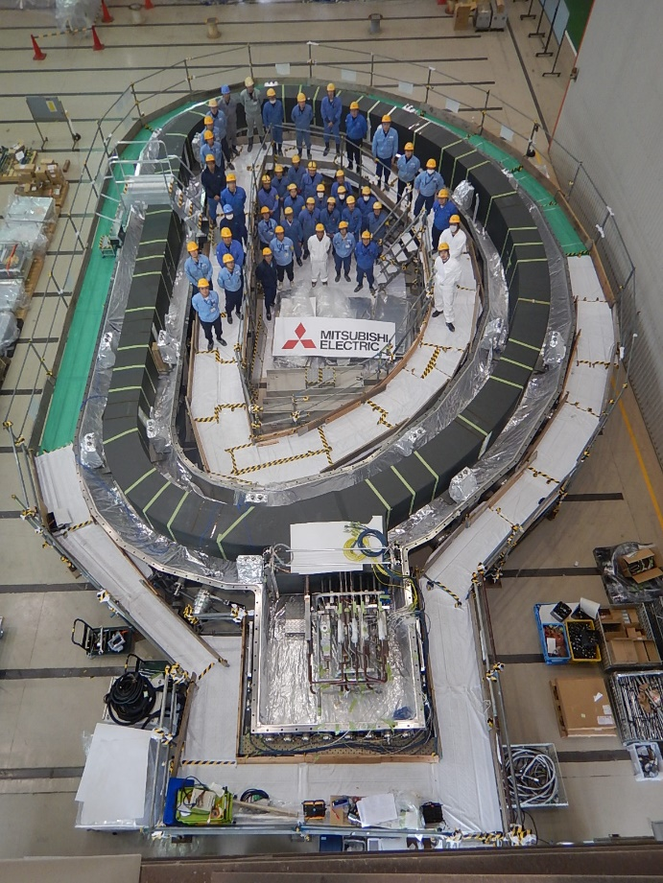
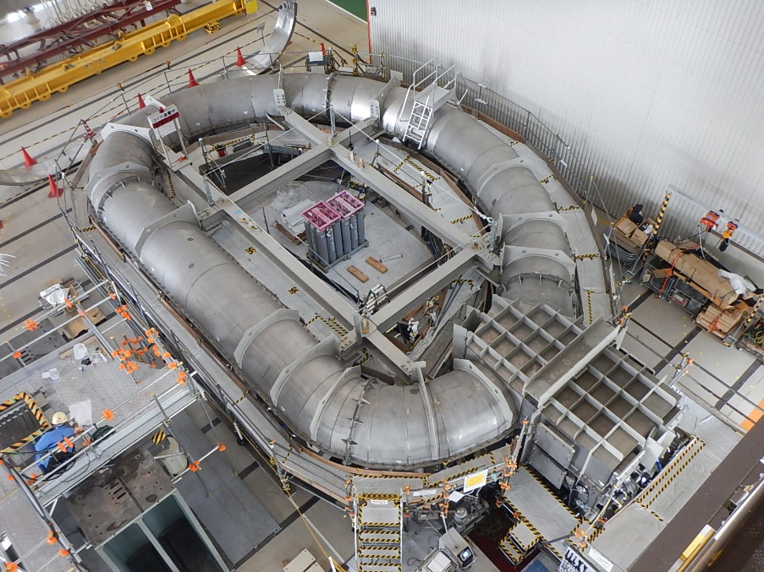
TF Coil Winding Pack (WP), Cold Test Started
Status of TF Coil Winding
1st winding pack:
The cold test ongoing.
2nd winding pack:
Impregnation completed, and cooling pipe assembly ongoing.
3rd winding pack:
Double pancake (DP) stacking, WP insulation, joint between DPs completed. WP impregnation ongoing.
4th, 5th winding packs:
Cover plate (CP) welding, DP insulation, DP impregnation ongoing.
6th winding pack:
Radial plate fabrication, transfer, conductor insulation and CP welding ongoing.
The first winding pack (WP) has been installed inside Cryostat for its cold test at 80K. The cold tests are in progress at Mitsubishi Electric Corporation in Futami. The winding pack is to be inserted into TF coil structures to form TF Coil #12.

Slide 9

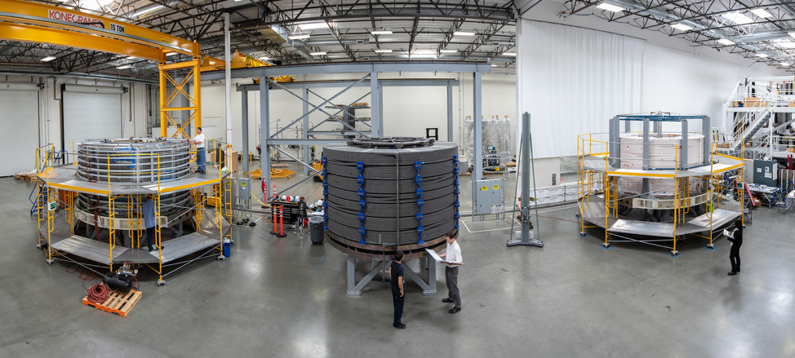
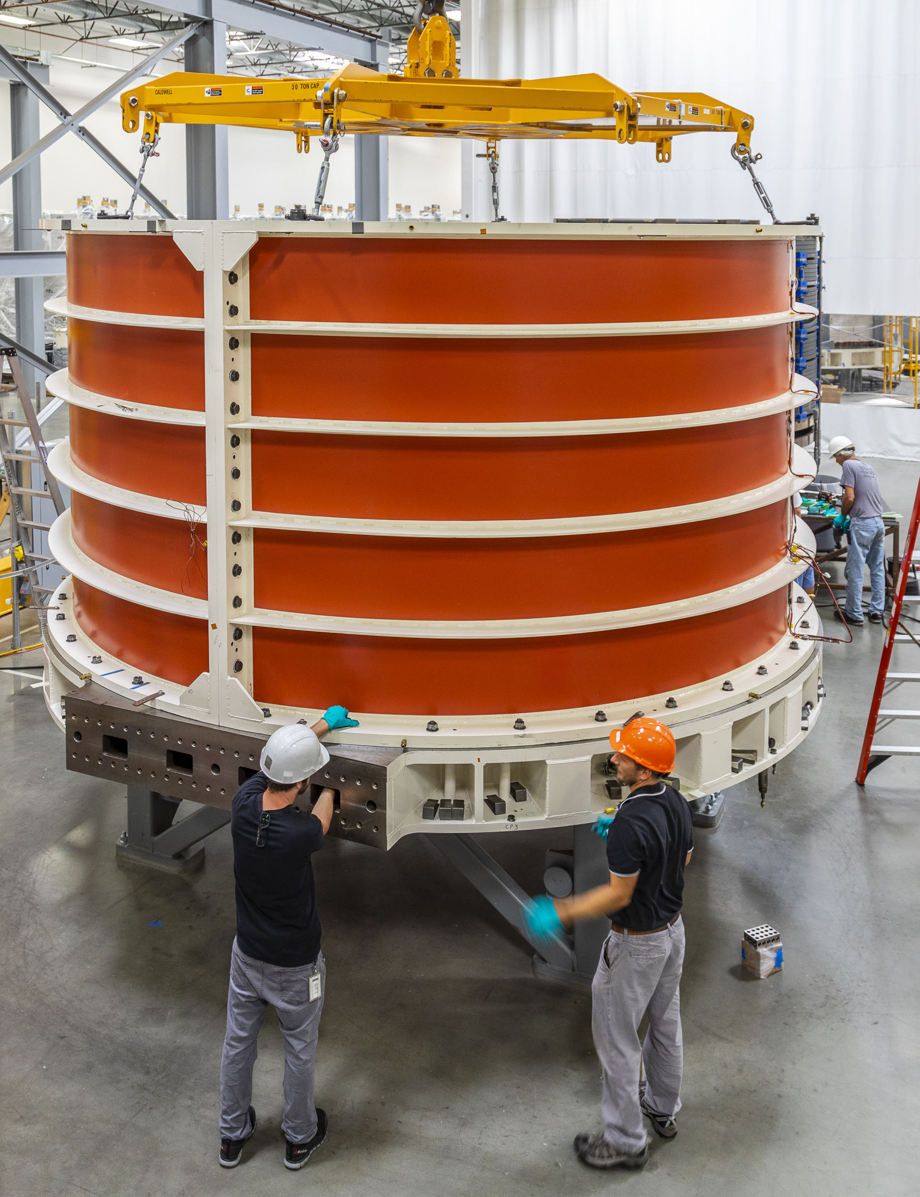
5 of 7 Central Solenoid Modules in Fabrication
Work stations at General Atomics, from left: Preparation for vacuum pressure impregnation, post-heat treatment, ground insulation, and turn insulation.
A sleeve is placed over Module 1 in preparation for vacuum pressure impregnation.

Slide 10
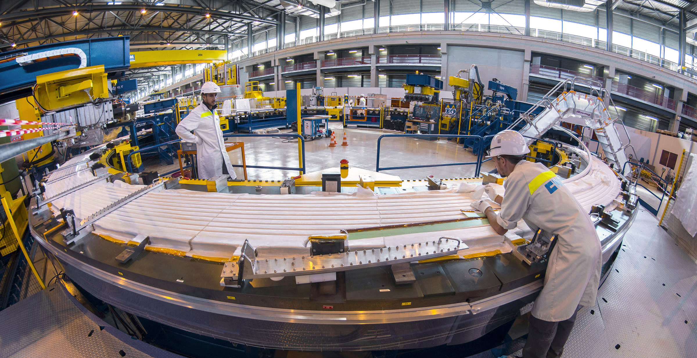
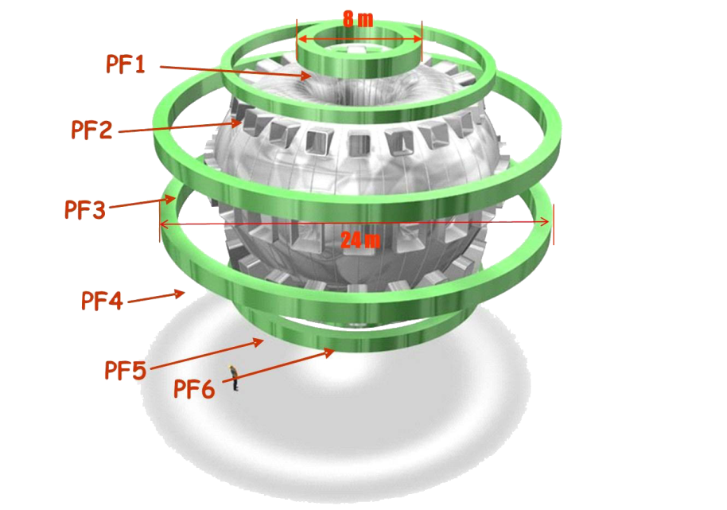
PF Coil winding facility
Too large to be transported by road, four of ITER’s six poloidal field coils, 8 to 24 m in diametre) will be assembled by Europe in this 12,000 m² facility.

Slide 11
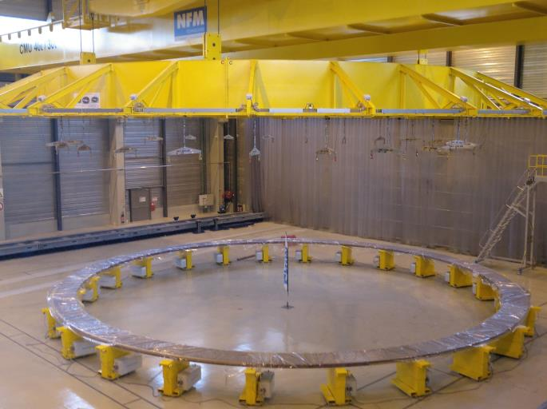
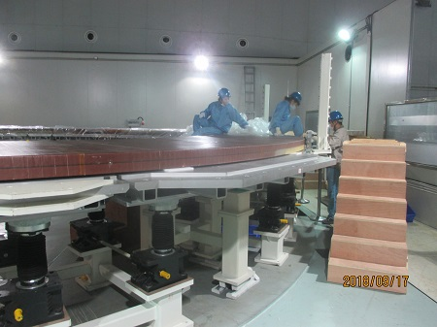
Poloidal Field Coils Production
EU
Cadarache: Production of the Double Pancakes is well underway for PF5 (6 wound, 2 impregnated, 2 preparing for impregnation). Installation of the Cold Test Facility in progress;
ASIPP (CN): Production of the Double Pancakes almost completed for PF6 (9 wound-all completed, 8 impregnated, the last one preparing for impregnation). Stacking of the DPs has started.
PF5 – DP7 impregnated in Cadarache
PF6 – Stacking of DPs started in ASIPP

Slide 12

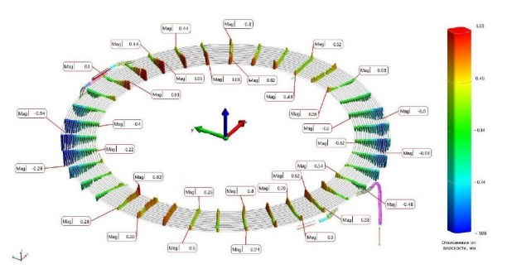
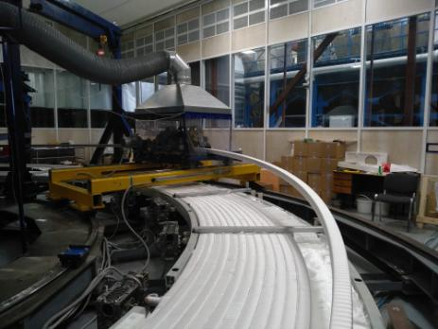
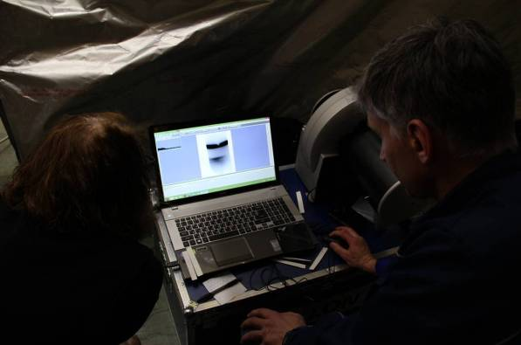
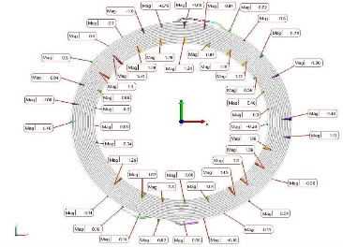
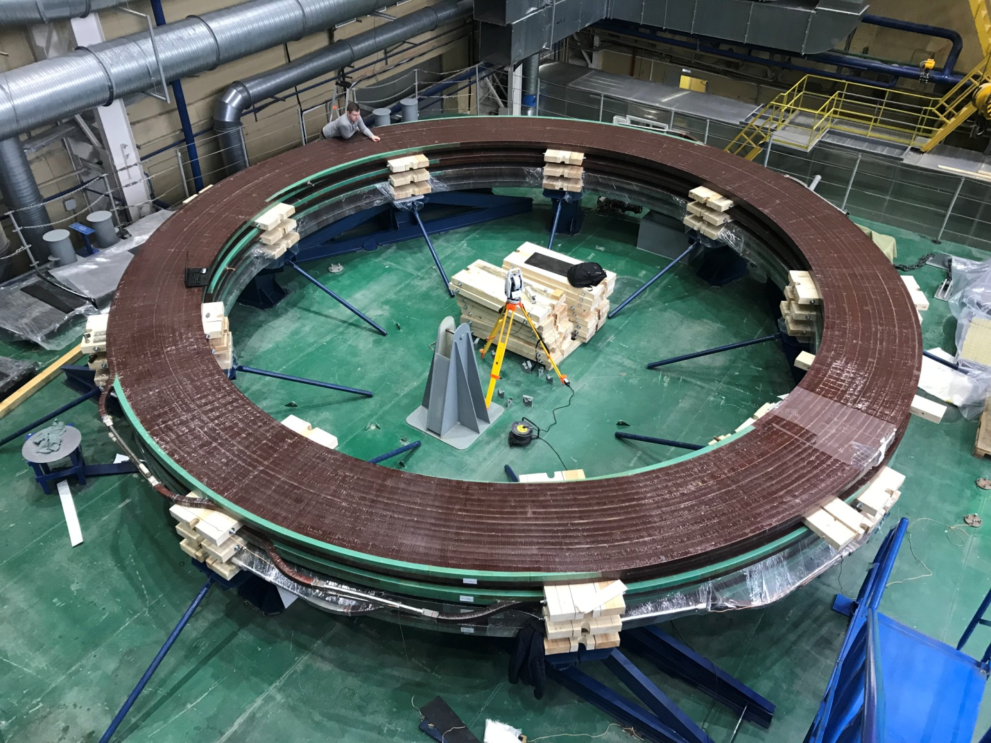
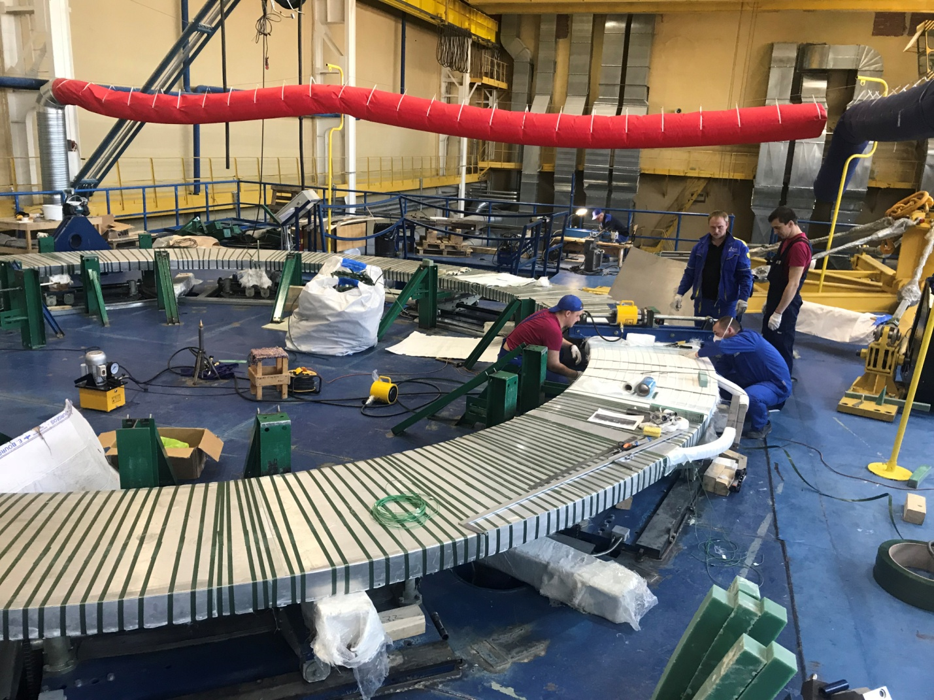
Current Progress PF1 Coil
Radiographic test of DP06 welded helium inlet
Upper layer winding of Double Pancake (DP) #7
Measured diagram of DP 07 flatness
Conductor Termination Bending
Diagram of radius measurement of DP 07
Fabrication of PF-1 Double Pancakes on schedule
DP 04 after Vacuum Pressure Impregnation

Slide 13
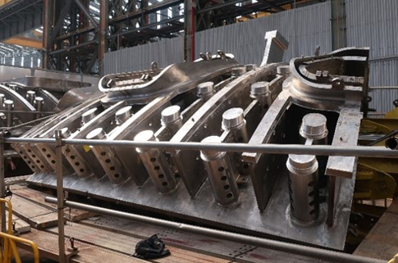
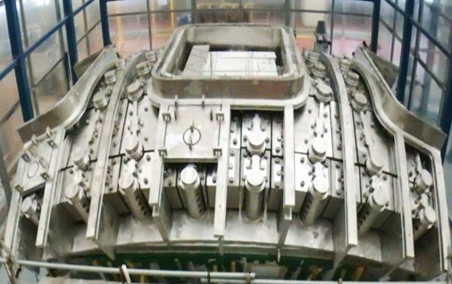
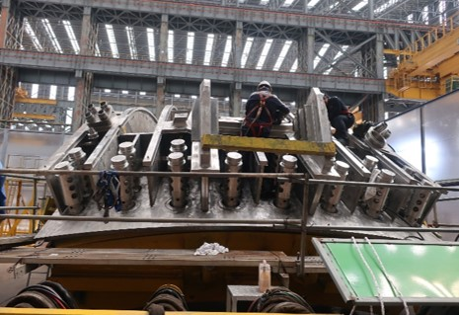
Progress of Vacuum Vessel (VV)
Manufacture of VV Sectors by HHI is ongoing in order to ensure First Plasma in December 2025, but with many technical challenges;
Manufacturing progress of the first Sector #6 is 82.8% (end of Aug 2018). Sector 7 is 64%, Sector 8 is 42% and Sector 1 is 25%.
Poloidal Segment #2 (PS2): T-rib, Flexible Support Housing (FSH) and In-Wall Shielding Support Rib (IWS SR) Assembly
Poloidal Segment #3 (PS3): Completion of In-Wall Shielding Block Assembly
Poloidal Segment #4 (PS4): T-rib, FSH and IWS SR Assembly

Slide 14
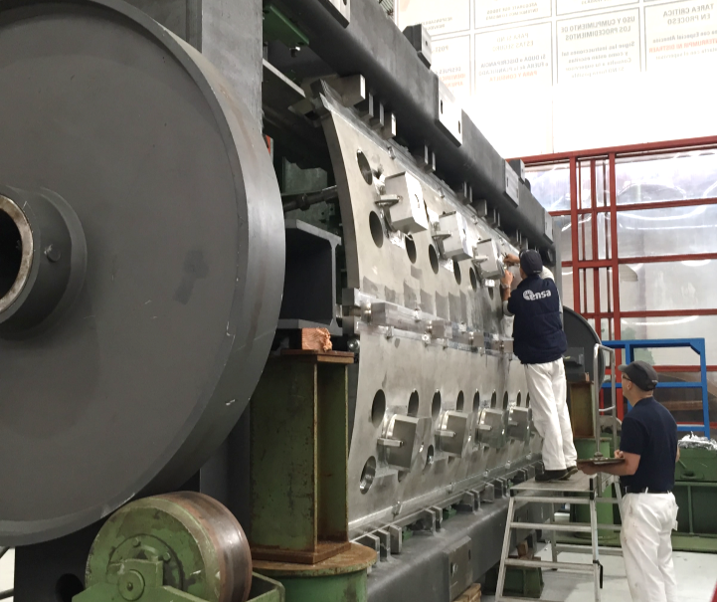
EU
Vacuum Vessel
Significant increase of manufacturing capacity involving seven European welding industries;
Manufacturing rate increasing steadily, but still below expectation for some sectors;
Status of segments manufacturing as of August 2018 [compared to March 2018].
VV Sector 5: | 61% | [58]
VV Sector 4: | 59% | [50]
VV Sector 3: | 53% | [26]
VV Sector 2: | 50% | [15]
VV Sector 9: | 46% | [11]
PS1 Intermodular keys and T-ribs preparation at ENSA (SP) for Electron Beam Welding at Probeam (GE)
New cooperative approach, EU and KO DAs
With AMW and HHI industries meeting in Monfalcone, September 2018

Slide 15
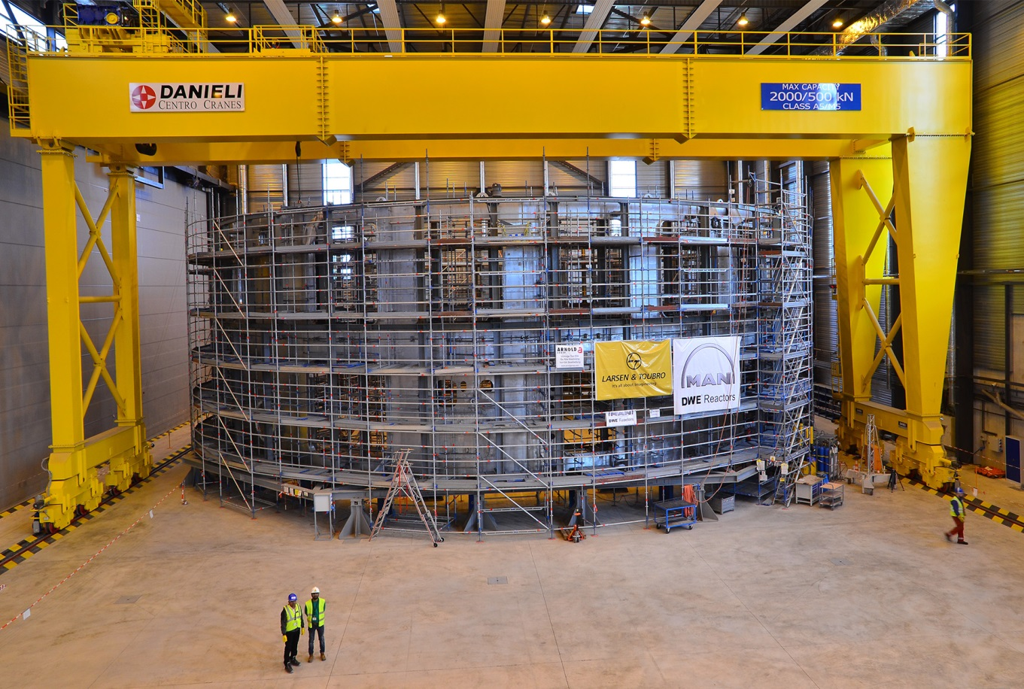
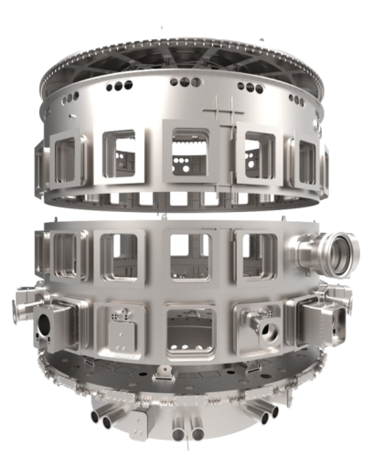
Cryostat Workshop (ITER Site)
Lid
Upper cylinder
Lower cylinder
Base section
Manufactured in India, the 30 m x 30 m cryostat is being assembled and welded on site.

Slide 16
Building Construction and Assembly

Slide 17
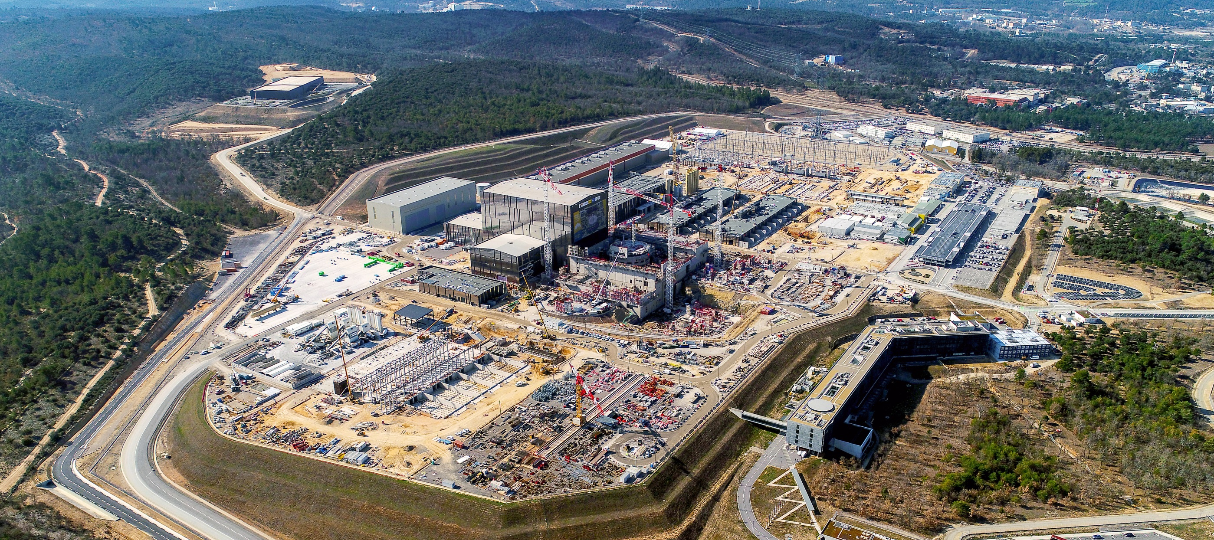
Overview of the ITER Worksite

Slide 18
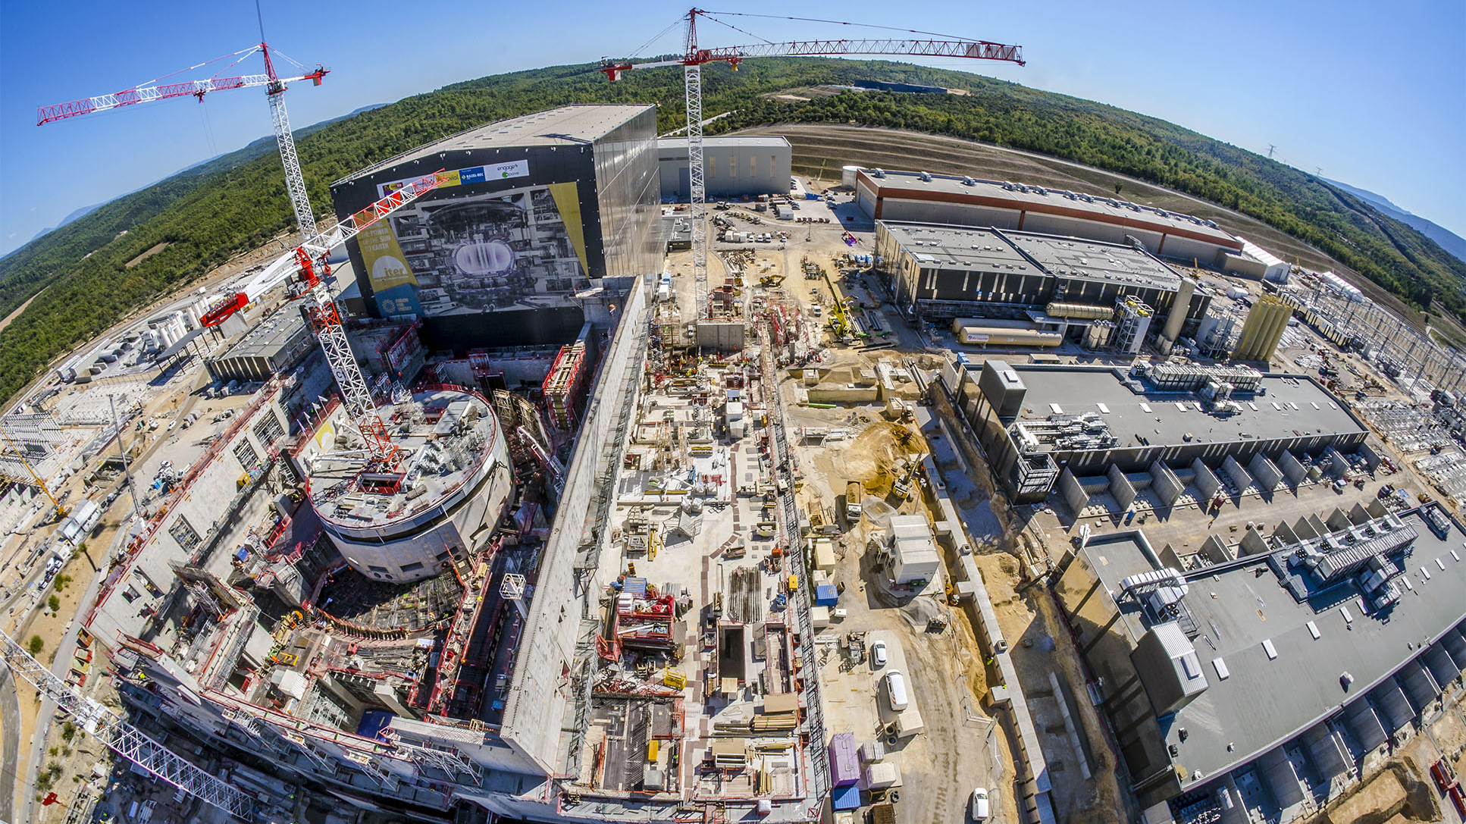
Worksite progress
Assembly Hall
Cryostat Workshop
PF Coil Winding Facility
Radiofrequency Heating
Cryoplant
Service Bldg.
Cooling System
400 kV Switchyard
~ Machine axis
Tritium Bdg.
Diagnostics Bdg.
Bioshield
Magnet Power Conversions Bdgs.
Tokamak Bdg.
4 October 2018

Slide 19
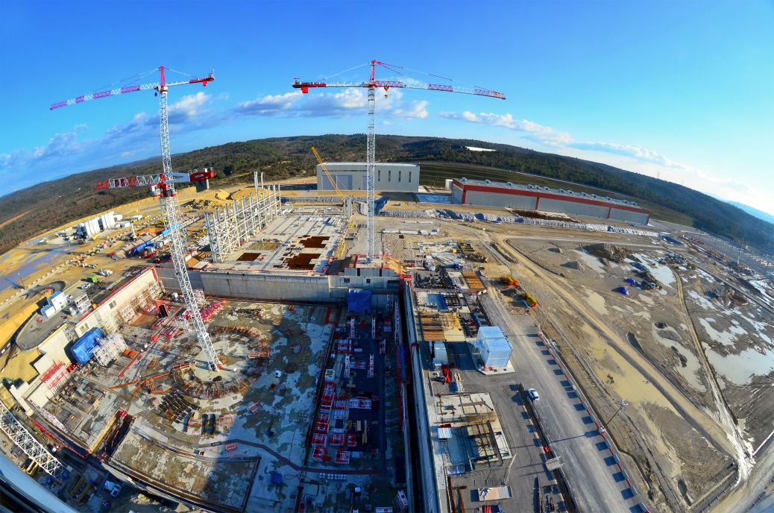
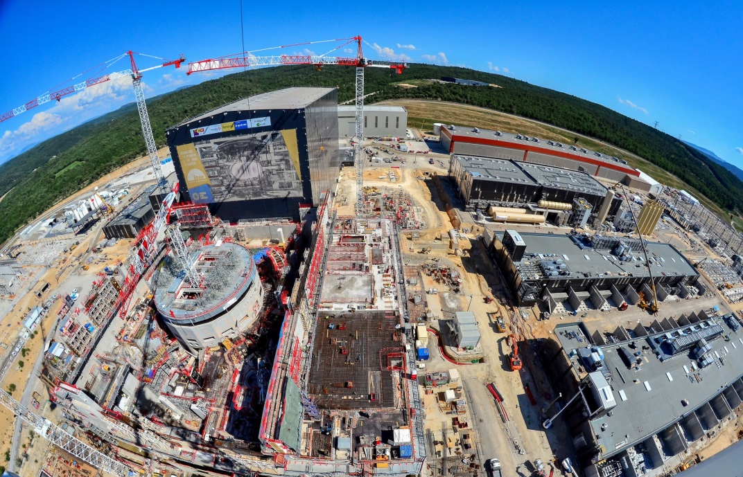
Rapid Progress Is Being Made in Building Construction
View in Feb. 2015:
View in July 2018:

Slide 20
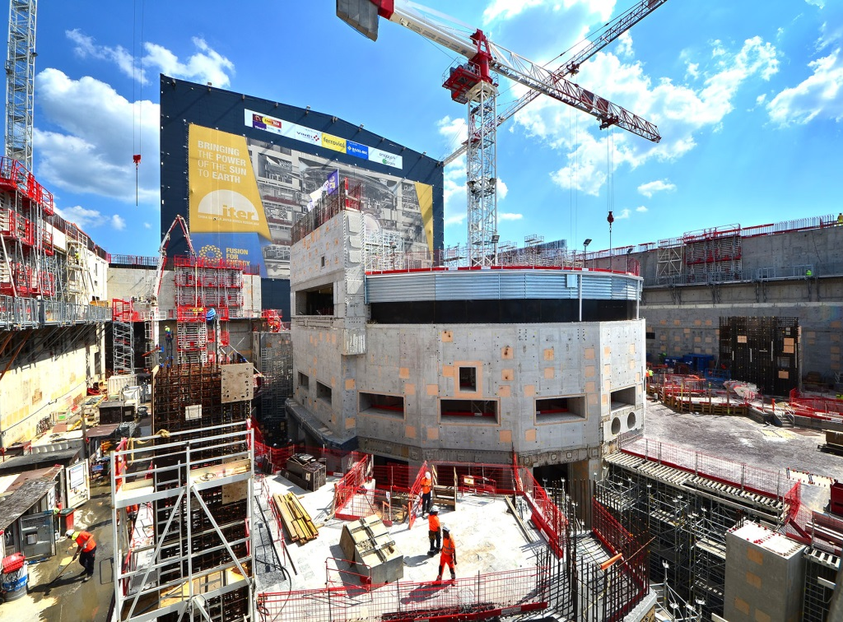
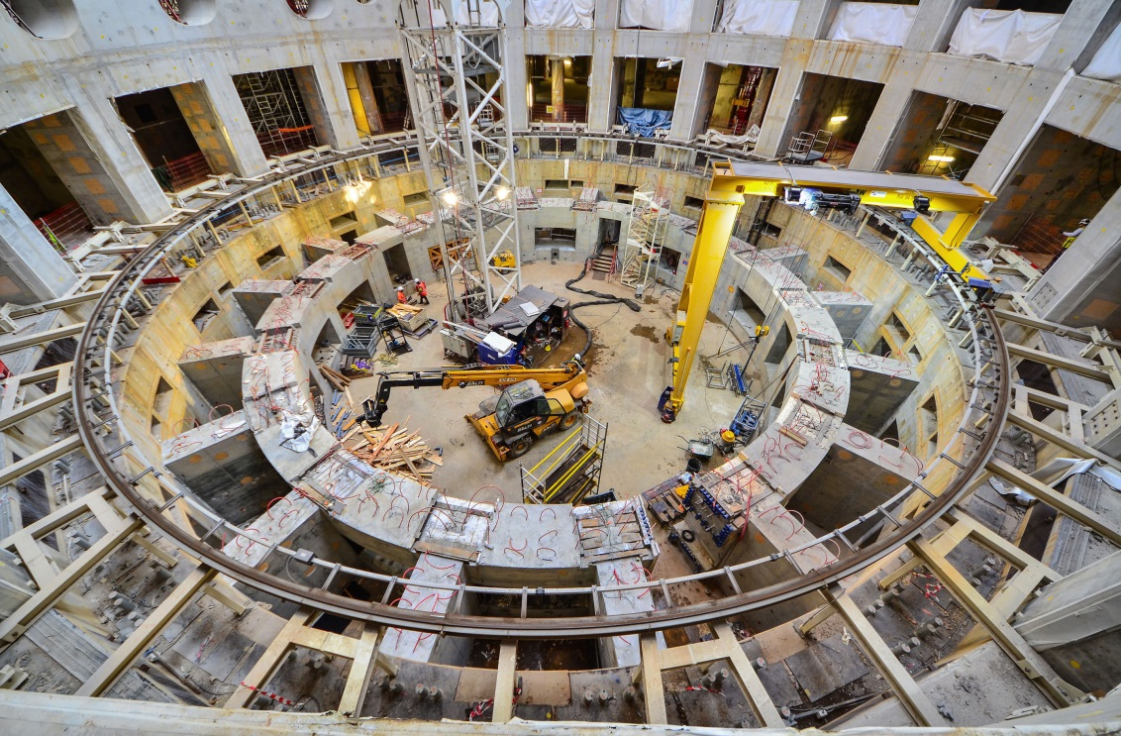
Tokamak Complex
The bioshield (left) is now finalized. The high-resistance concrete-and-steel structure (the “Crown”) that will support the combined mass of tokamak + cryostat (23 000 tonnes) is in the last stages of completion (right). Signed agreement has been reached with EU and their contractors with a firm commitment to deliver the tokamak building for assembly work in March 2020.

Slide 21
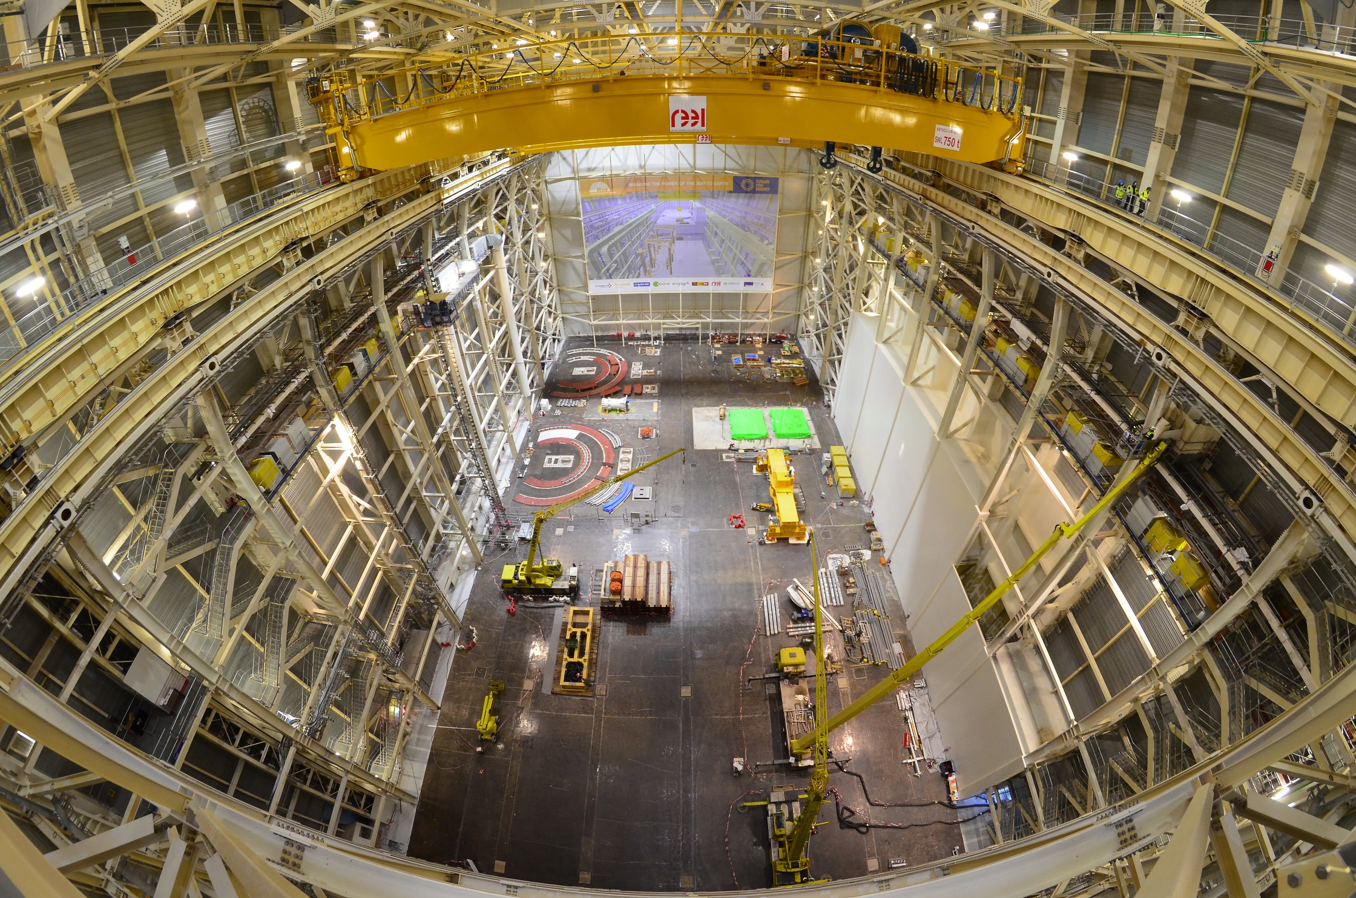
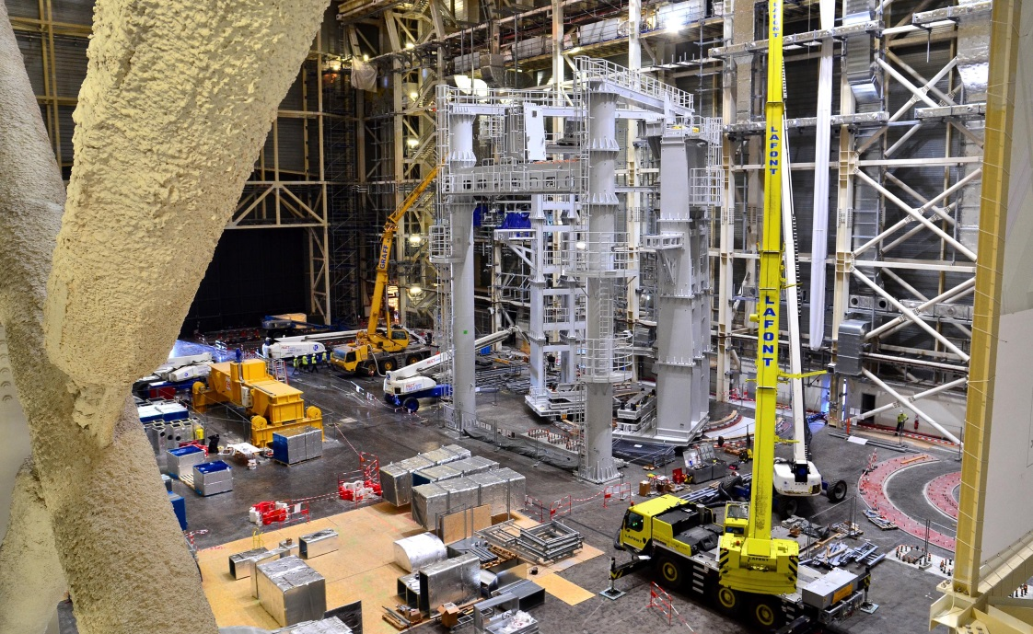
Assembly Building
Before integration into the machine, components will be prepared and assembled in this 6,000 m², 60 m high building. The Assembly Hall is equipped with a double overhead travelling crane with a lifting capacity of 1,500 t. Load tests, both static and dynamic (1,875 – 1,650 t), were finalized in December 2017. To the right, the installation of the sub-assembly tool (SSAT-1) is nearly complete.

Slide 22

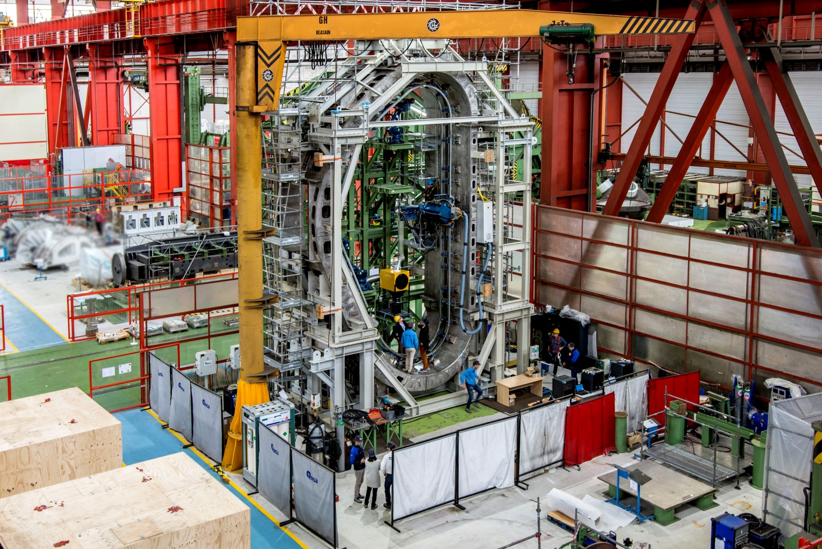
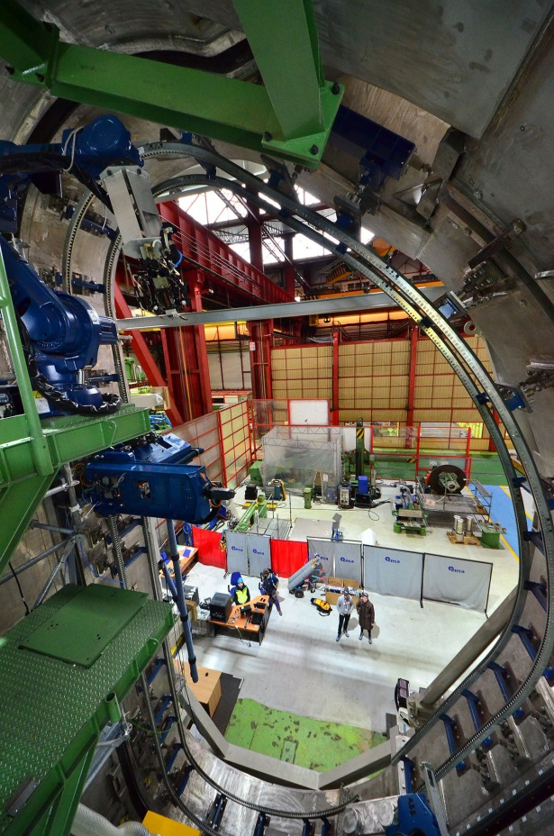
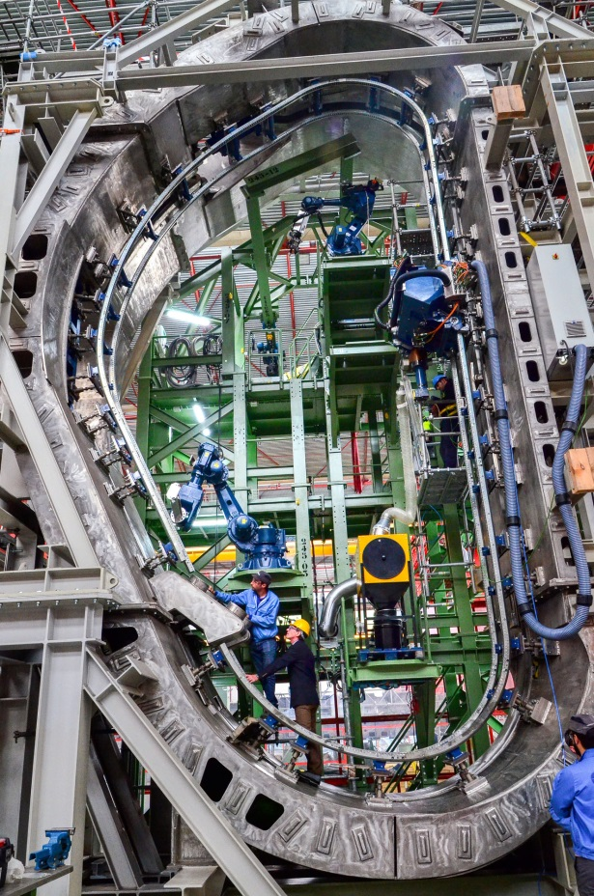
EU
Vacuum Vessel Mock-up and Welding Tools
Welding tools and procedures for the VV assembly are being tested on a real-size mock-up at ENSA, Spain

Slide 23
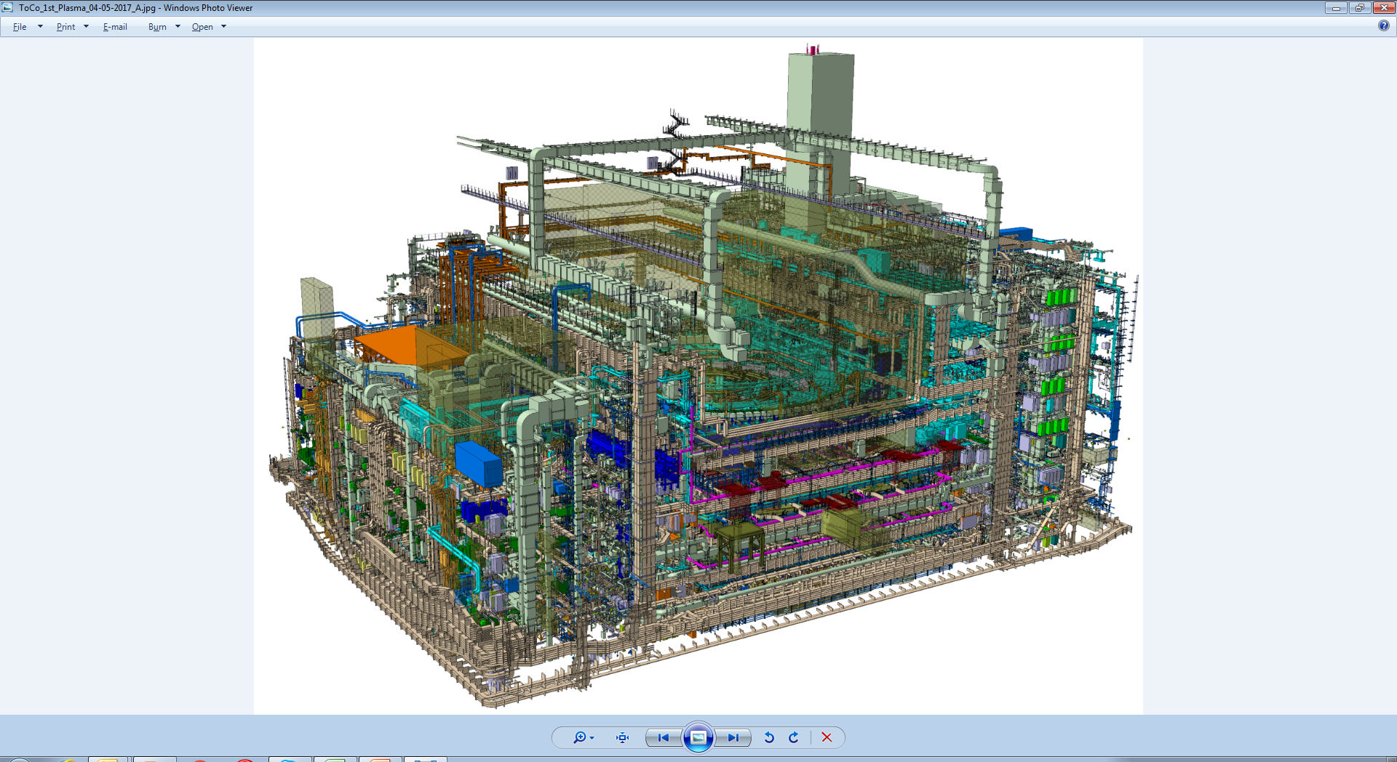
Challenges of Assembly
Revised construction strategy endorsed by ITER Council
Allows more flexibility to deal with delivery timing
Regulatory hold point in 2020
Significant integration issues for installation of services in the tokamak building

Slide 24
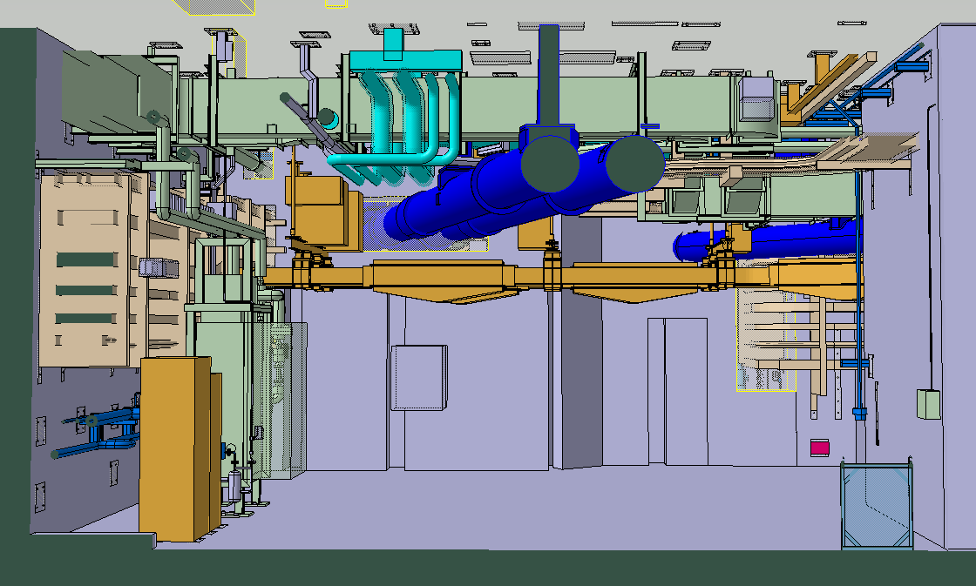
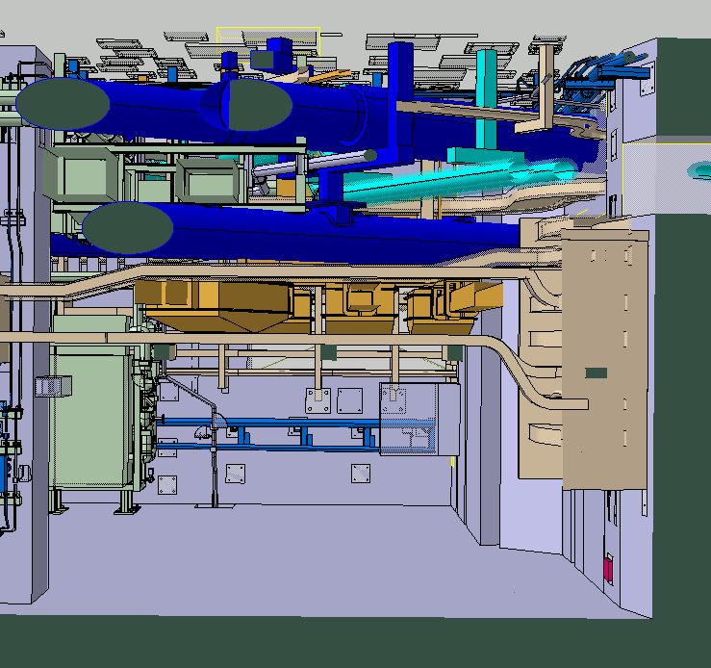
Co-Activities in Tokamak Complex - B2 Level NW Corner
Section A-A
Section B-B
CCWS
HVAC
CHWS
TF Cryolines
CS Cryoline
Cable Trays
BusBar
T&C Cryolines
BusBar
Sequence of Installation: Top to Bottom
HVAC & Cable Trays → TB04 Contract
CCWS/CHWS → TCC1 Contract
T&C Cryolines→ MPL Contract
BusBar→ BusBar Contract
Sequence of Installation:
TF Cryolines→ MPL Contract
CS Cryolines→ MPL Contract
CCWS/CHWS → TCC1 Contract
HVAC→ TB04 Contract
BusBar→ BusBar Contract
Cables Trays→ TB04 Contract

Slide 25
System Commissioning
Master system commissioning schedule developed and will continue to be refined
Progression of systems to be brought into service:
Steady-state Electric (enters operation Jan. 2019)
Coil power supply connection to French grid (Q1 2019)
Demineralized water/compressed gases (starts 1st half 2019)
Cooling water (starts 1st half 2019)
Cryogenic plant (starts 1st half 2020—ITER Council milestone)
Coil power supplies (end 2021)
First ECH subsystems (end 2021)

Slide 26
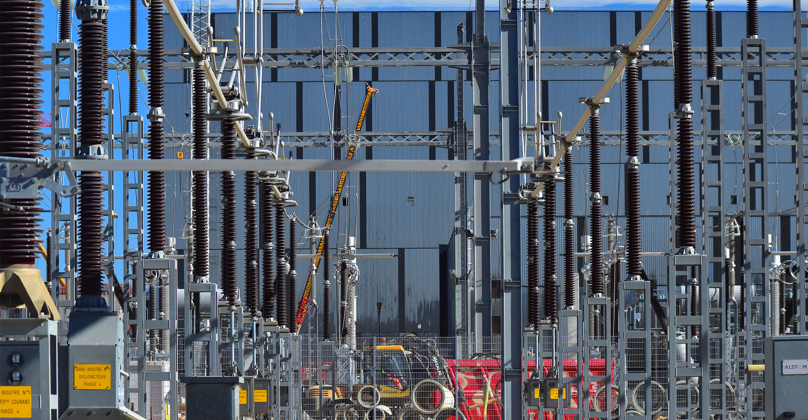
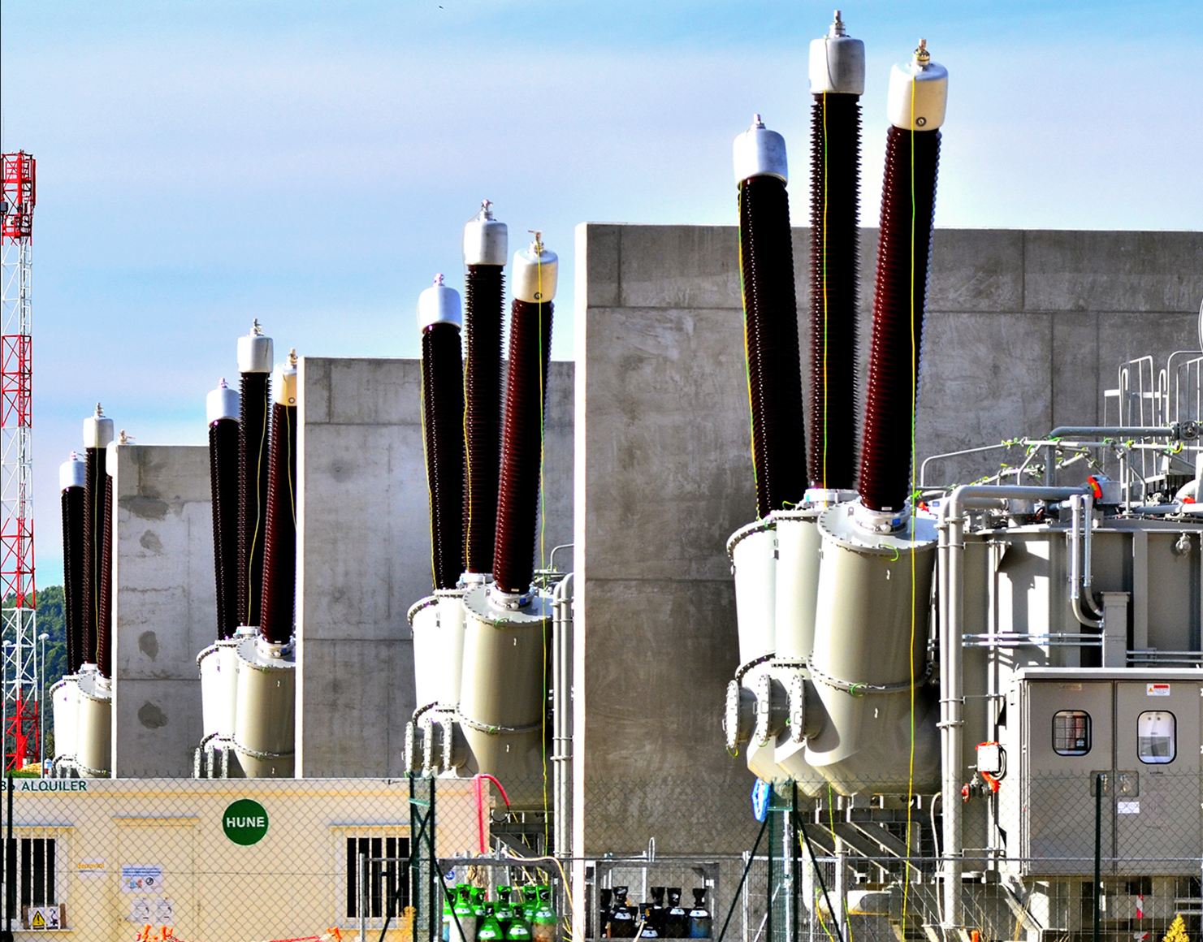
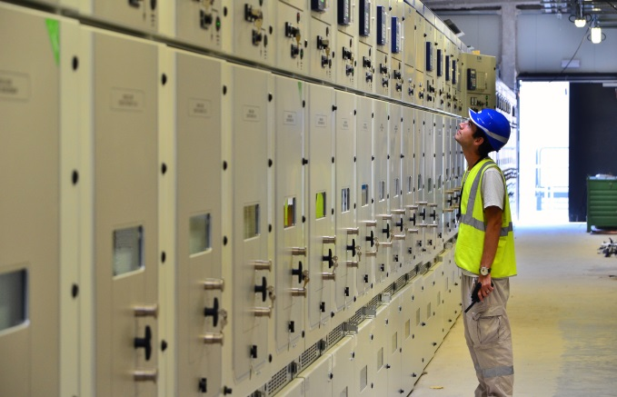
Electrical Network Being Commissioned
The connection of the 400 kV switchyard to the French grid was successfully established on 17-18 Sept. 2018. Full operations to supply site power now planned for January 2019.

Slide 27
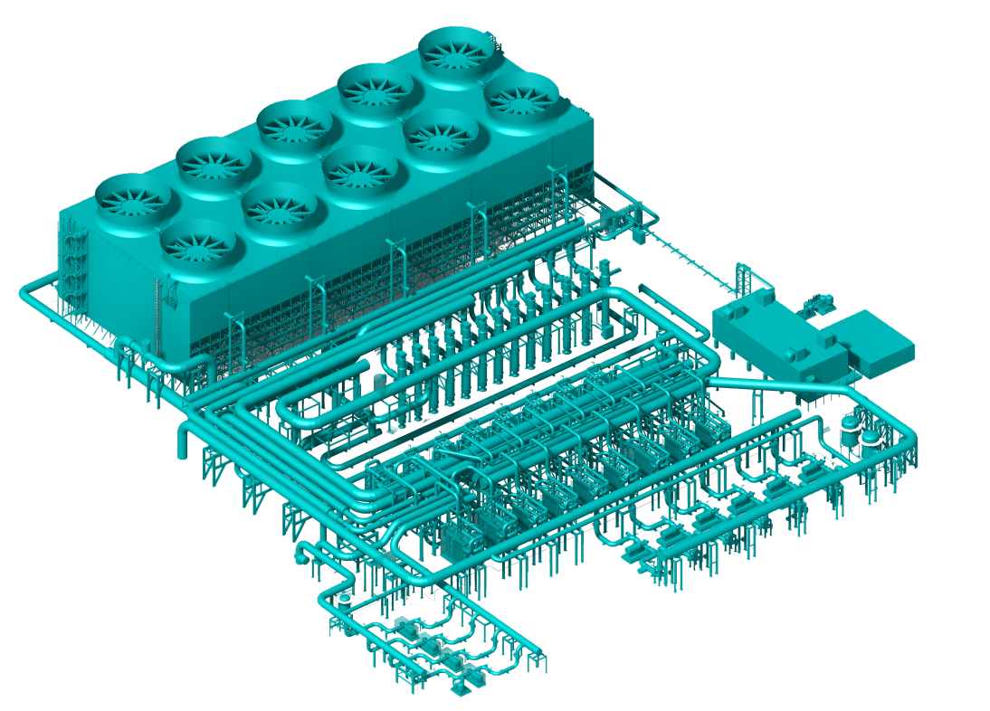
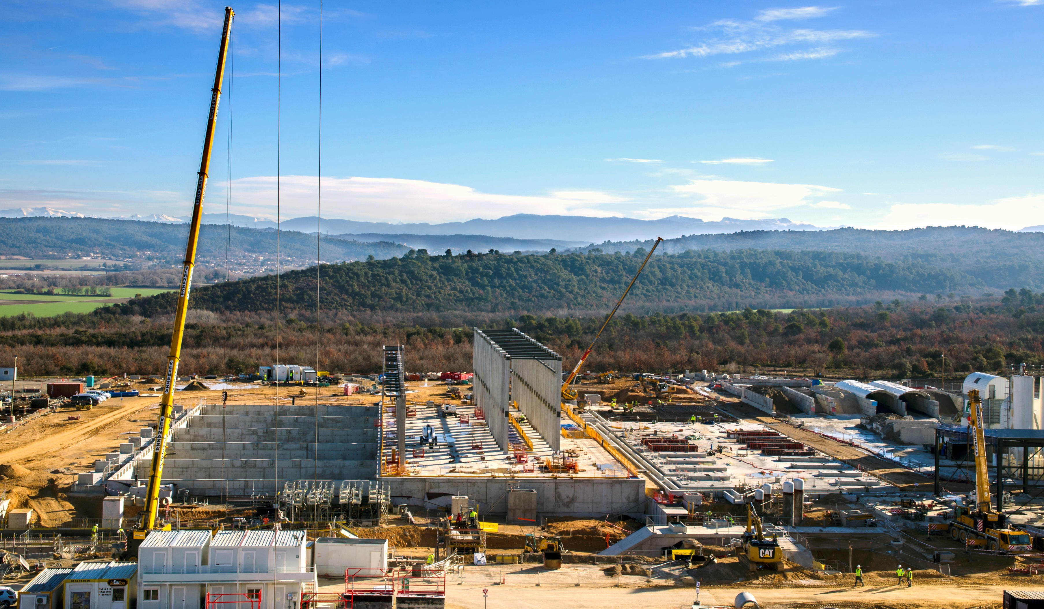
Cooling Water System Is Being Prepared for Operation

Slide 28
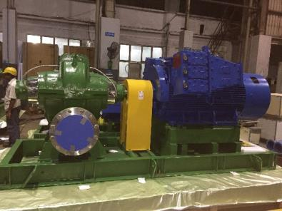
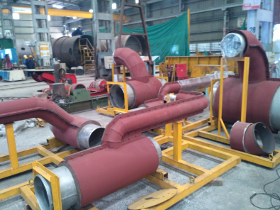
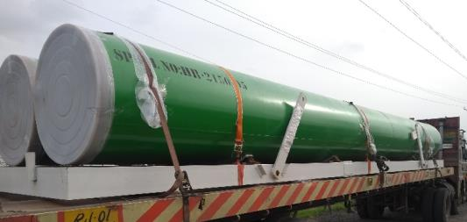
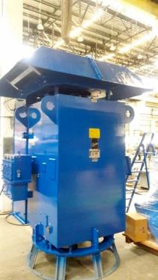
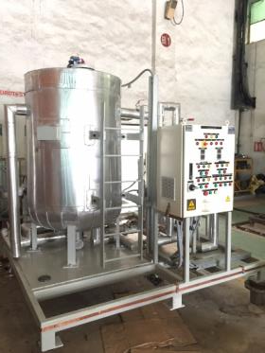
Progress of Cooling Water System
Horizontal Pumps
Pipe Modules
Component Cooling Water System (CCWS), Chilled Water System (CHWS), Heat Rejection System (HRS) Manufacturing and shipment progress
Spools 50%
Supports 60%
Equipment 70%
Electrical 50%
I&C 90%
Vertical Turbine Pump Motor
Chemical Dosing System

Slide 29

Cryogenic System Is Critical For Proper Operation
Nearly 25 tons of liquid helium at 4 K will circulate in the ITER installation during operation.

Slide 30


Cryoplant Construction Progressing
The ITER Cryoplant will be the largest single platform cryo-facility in the world. It will distribute liquid helium to various machine components (superconducting magnets, thermal shield, cryopumps, etc.). Installation of 11 helium and nitrogen tanks is now complete.
The installation of helium compressor skids on concrete pads was completed earlier this year. They will supply the cold boxes with gaseous helium at 21.8 bars and eventually provide the necessary gas flow for the supercritical helium cooling needs of the Tokamak.

Slide 31

Major Challenges for System Commissioning
Systems must operate for client services while still being extended in construction (e.g., cooling water)
Site networks (electrical, gas, waste water, fire protection, etc.) are not complete at first
Main control building is not available for installation until mid-2022

Slide 32
Updated ITER Research Plan

Slide 33

A “Staged Approach” to Full Operating Capacity
PFPO-2
PFPO-1
FP/EO
FPO
Extensive interactions among the ITER Organization and Domestic Agencies to finalize revised baseline schedule (2015-6)
Schedule estimates through First Plasma (2025) up to DT operation (2035) consistent with Members’ budget and technical constraints
Required a new ITER Research Plan (completed in 2017)

Slide 34

Release of ITER Research Plan as ITER Technical Report
Written by IO staff and experts from ITER Members’ fusion institutions and DAs; recommended to ITER Council by STAC
ITER Research Plan made publicly available as ITER Technical Report ITR-18-003 for first time since ITER Organization established
Intended to be a ‘living document’ by working with the fusion community on details of experimental plans to achieve project’s goals and to define the supporting R&D required

Slide 35
Integrated/Engineering Commissioning
Three key phases are envisioned in this period of operations:
Integrated commissioning (2025)
Basic plant systems, magnets (to half current), 1/3 EC heating system, magnetic diagnostics calibrated, basic controls functional, as demonstrated by …
First Plasma!
100 kA, 100 ms is the milestone
Engineering Commissioning (1st half 2026)
Tests of magnets to full current
Measurements of |B| surfaces to locate the first wall properly, if suitable method is found

Slide 36
First Pre-Fusion Power Operating Phase (PFPO-I)
100% of final configuration
Main deliverables:
Demonstration of basic shape control (diverted plasmas up to 7.5 MA)
Commissioning of wall protection systems
Commissioning and validation of disruption mitigation system
Commissioning of EC system (20 MW, >100 s)
Measure heat loads
Tokamak
Plant
H&CD
Control
Physics
Note: this is ‘pre-fusion power’ because the working gas is either hydrogen or helium for low neutron generation

Slide 37

Disruption Physics and Mitigation
Disruption mitigation is needed early in PFPO-I
Validity of scaling projections for the mitigation will be immediately known
Operation at full field will be done in PFPO-I specifically to test the scaling of runaway generation with B

Slide 38


Disruption Mitigation
Disruption mitigation scenarios must be found which mitigate thermal and EM loads but at the same time avoid runaway electrons
Task Force formed to carry out design validation and engineering studies
IO will be responsible for implementation
28 mm
20 mm
17 mm
13 mm

Slide 39
Operations/Plasma Control System
Key R&D contribution is validation of control models being used to assess the PCS, for example:
Shape control development
Wall protection schemes--heat flux control
Fueling control
Termination scenarios under ITER relevant control constraints (control of l_{i}, H-L transition, density, ELMs, detachment)
Simultaneous integration of control schemes:
Actuator sharing: e.g. NTM and current density profile control
Study of the interaction between different control schemes (e.g. between density control and detachment control)

Slide 40
Second Pre-Fusion Power Operating Phase (PFPO-2)
100% of final configuration
Main deliverables:
Operation at 15 MA
Validation of disruption mitigation system
Commissioning of full heating power to >100 s
Operation in H mode
Demonstration of heat flux control in the divertor
Tokamak
Plant
H&CD
Control
Physics

Slide 41




Handling Heat and Particle Flux
ITER transients
The challenge is not small!
The consequences of failing to protect in-vessel components are big—components are actively cooled (water) and replacement time is months
Re-entry
vehicle
Ariane 5/
Vulcain 2
HWR
Power load [MW/m²]
~1 <10 85 2000
Arc welding
Rolls Royce Trent 900
ITER steady-state

Slide 42


Long Pulse Operation May Be Possible
Options for long-pulse operation in PFPO-II phase developed:
7.5 MA H-modes offers the possibility of very long pulses
Achievable flat top durations for varying pre-magnetization current
Flattop duration (s)
I_{p} (MA)
Main limit to exploitation may be system commissioning time to long pulse operation: e.g. H&CD, fuelling, PCS etc.

Slide 43
Fusion Power Operating Phases
100% of final configuration
Main deliverables:
Commission tritium plant; license facility
500 MW fusion power, Q=10, 300-500 s
Q=5 in-principle steady-state operation
Explore technology of tritium breeding
Tokamak
Plant
H&CD
Control
Physics

Slide 44

Estimate of Available Experimental Time
Two-week cycle: 12 days experiments/2 days maintenance
Two-year campaign cycle (from FPO-1) → ~415 days of experiments
Incorporating RAMI analysis for availability and conservative approach to disruption mitigation/recovery → ~13 pulses/day in 2 shift operation

Slide 45
ITER R&D Needs
From the ITER Research Plan, a list of R&D needs (mostly physics) is being compiled and classified into the following categories:
1: Major impact on design or IRP
2: Could modify design or IRP strategy significantly
3: Leads to design or IRP optimization
Goal is to complete internal review and release to the Members’ fusion communities before the ITPA CC/IEA CTP discussions in January 2019

Slide 46
Preliminary Category 1 R&D Needs
Topics presently under discussion as category 1:
DMS
Shard size, impurity composition for runaway avoidance (PFPO-I)
Runaway dissipation (PFPO-I)
Multiple injection (PFPO-I)
Multiple location (PFPO-I)
Alternative delivery scheme to SPI (PFPO-I)
Alternative to gas injection (PFPO-II)
Laser induced desorption of tritium (FPO)
Single crystal mirror testing (PFPO-I)
Helium H-mode characterization (PFPO-II)
Mixed H/He H-mode threshold (PFPO-II)
EC wall conditioning (PFPO-I)

Slide 47
Strategic Directions
ITER strongly supports (requires?) thriving domestic fusion programs in the Members:
Conducting R&D in support of ITER operation
Training staff for ITER operation and research
Preparing the Member fusion communities to digest ITER results for the next steps toward fusion energy
ITER will only ‘succeed’ if there is something following ITER on a path to fusion energy
Significant investments in technology required for fusion are needed to anticipate any potential next step

Slide 48
Challenges Ahead Until Construction Completion
ITER Organization, Domestic Agencies and suppliers working as a team with a strong project culture
Strict respect by suppliers for quality and safety requirements
Strict respect by all stakeholders for the schedule requirements, in particular for the required delivery dates for materials and equipment on the ITER site
Reliable and fully integrated assembly/construction sequences on ITER site
Contracting with high-performing and experienced companies for the assembly activities in the Tokamak Complex
Setting in place a well-suited organization in charge of commissioning
Setting in place a well-suited organization to conceive and execute the progressive take-over of the machine, ultimately for its operation and maintenance
Timely, reliable availability of the planned and committed resources from the seven ITER Members

Slide 49

ITER Will Be The First Look At Burning Plasma

