Slide 1
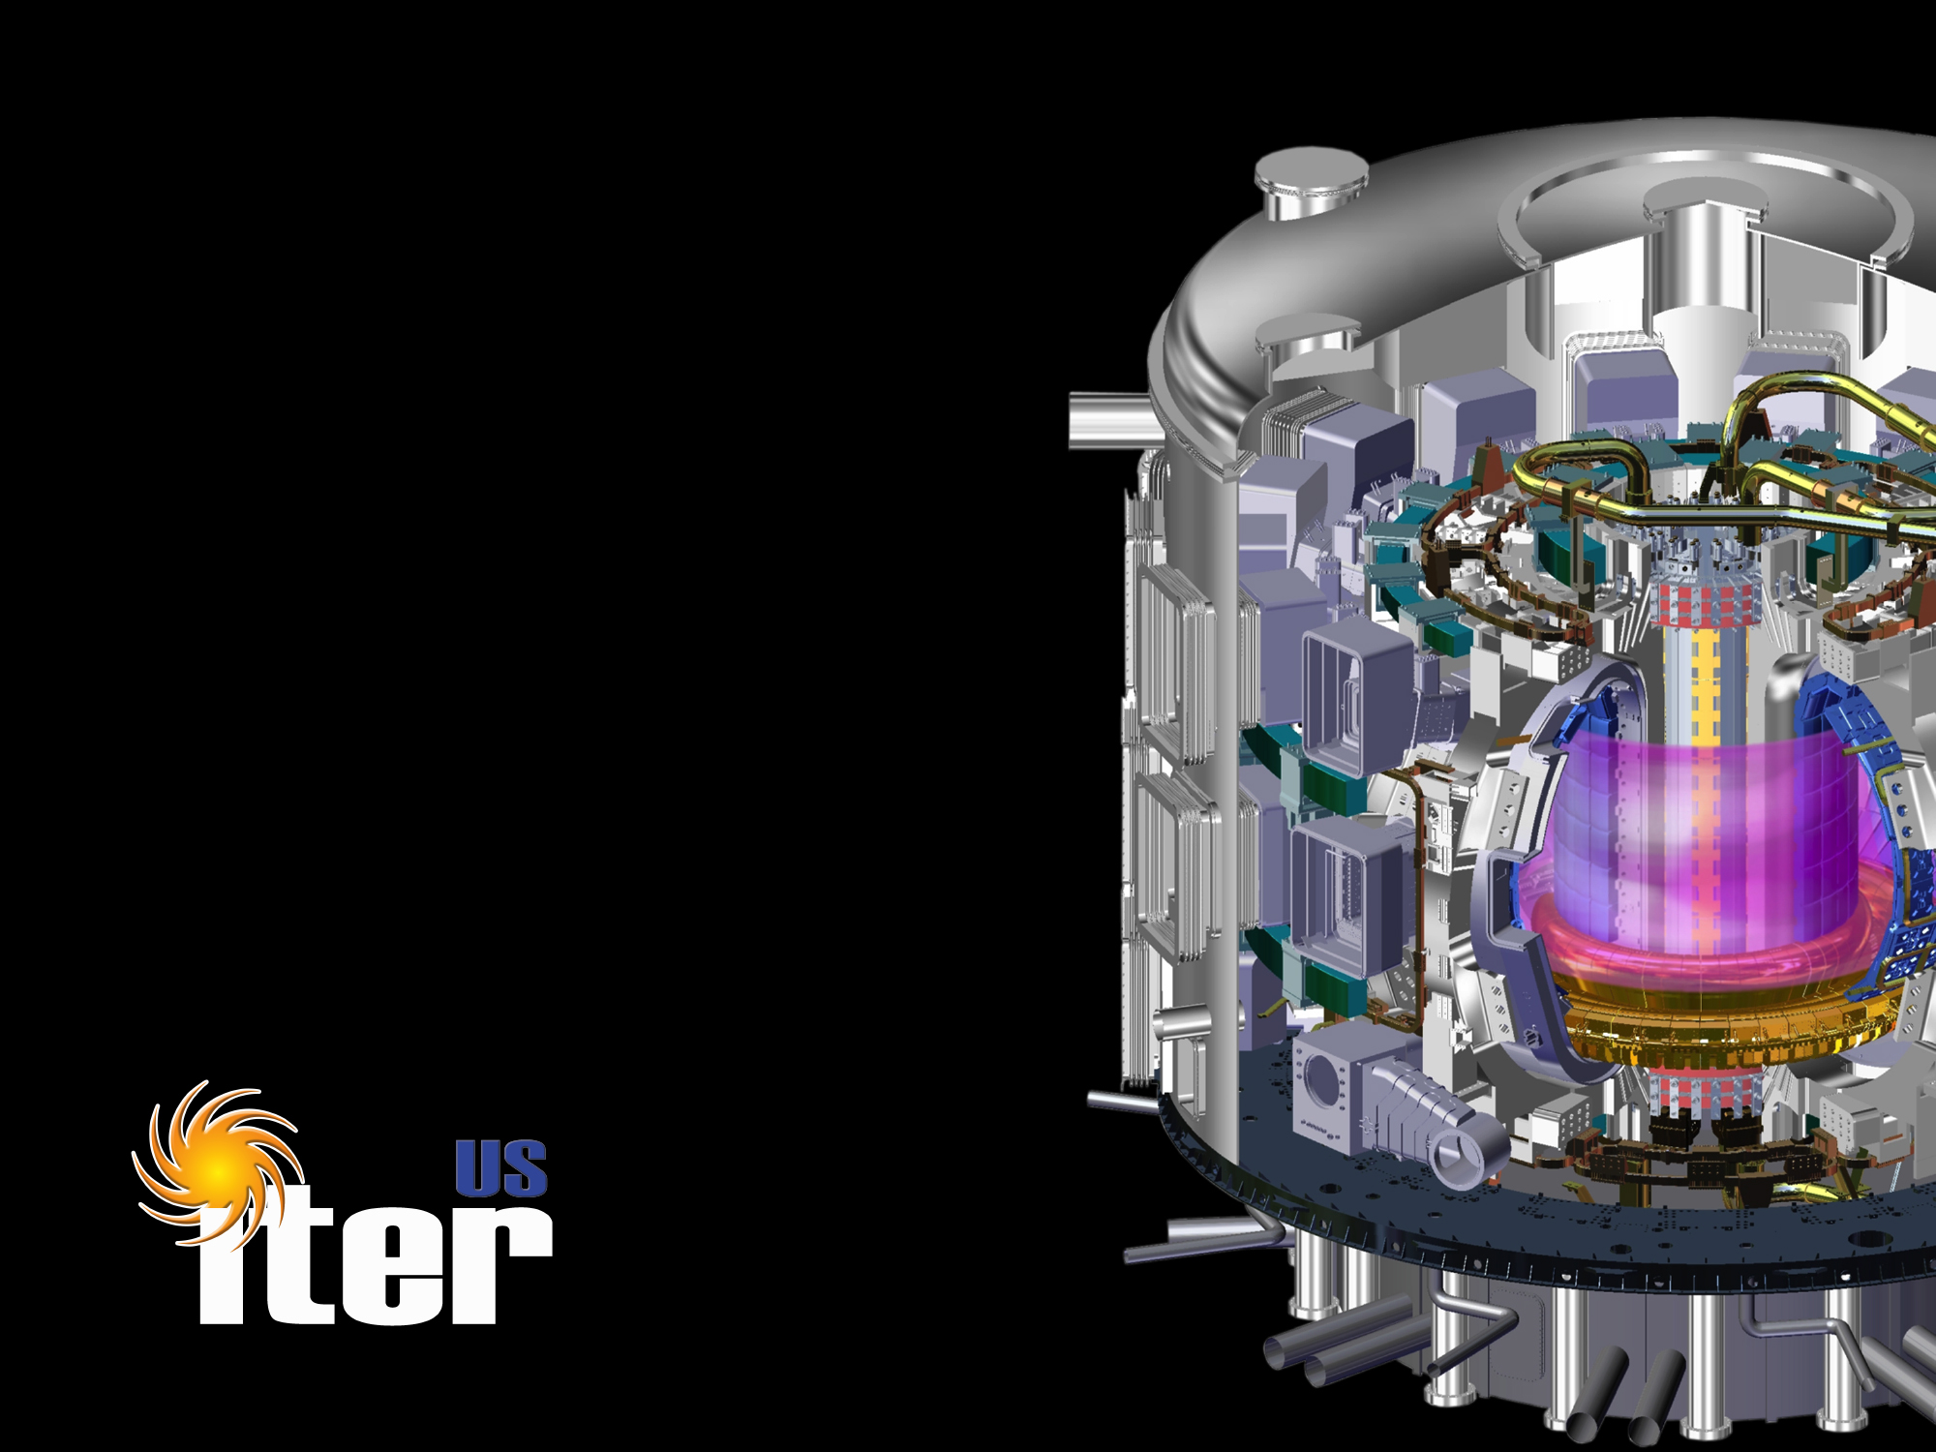
US ITER Progress
Ned R. Sauthoff
Director, US ITER Project Office
Fusion Power Associates
December 5, 2018

Slide 2
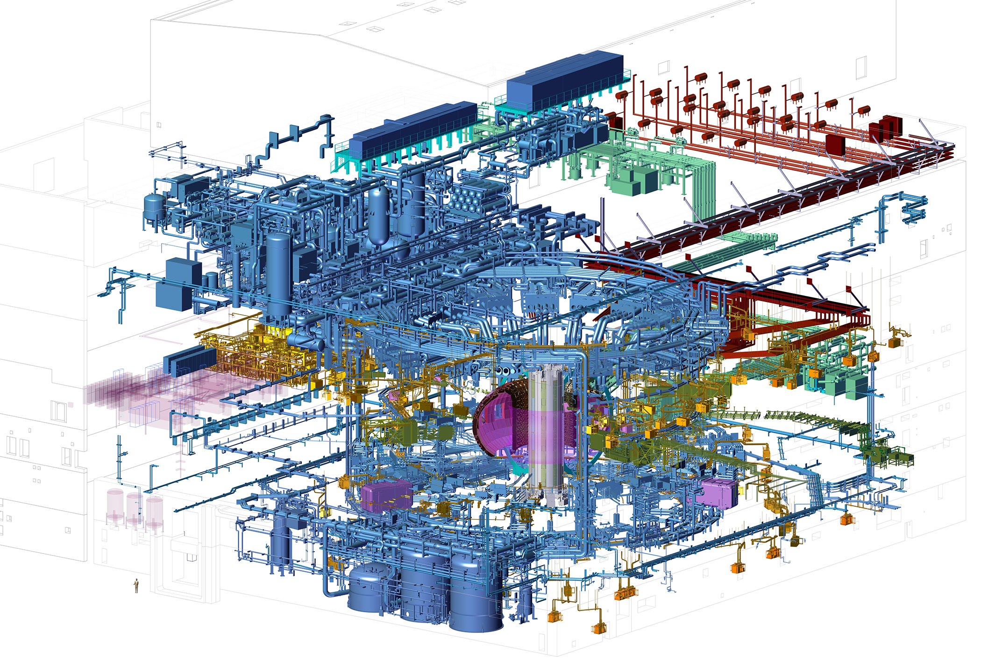
Full US Hardware Scope
Key: Finished • Hardware in fabrication • Prototypes in fabrication • In design
Central Solenoid
Electron Cyclotron Heating Transmission Lines
Tokamak Cooling Water System
Ion Cyclotron Heating Transmission Lines
Vacuum System &
Roughing Pumps
Steady State Electrical Network
(US Share 75%)
COMPLETE
Tokamak Exhaust Processing System
Toroidal Field Coil Conductor
(US Share 8%)
COMPLETE
Pellet Injection
Disruption Mitigation
(up to a capped value)
Diagnostics
(US Share 14%)
12-5-2018

Slide 3
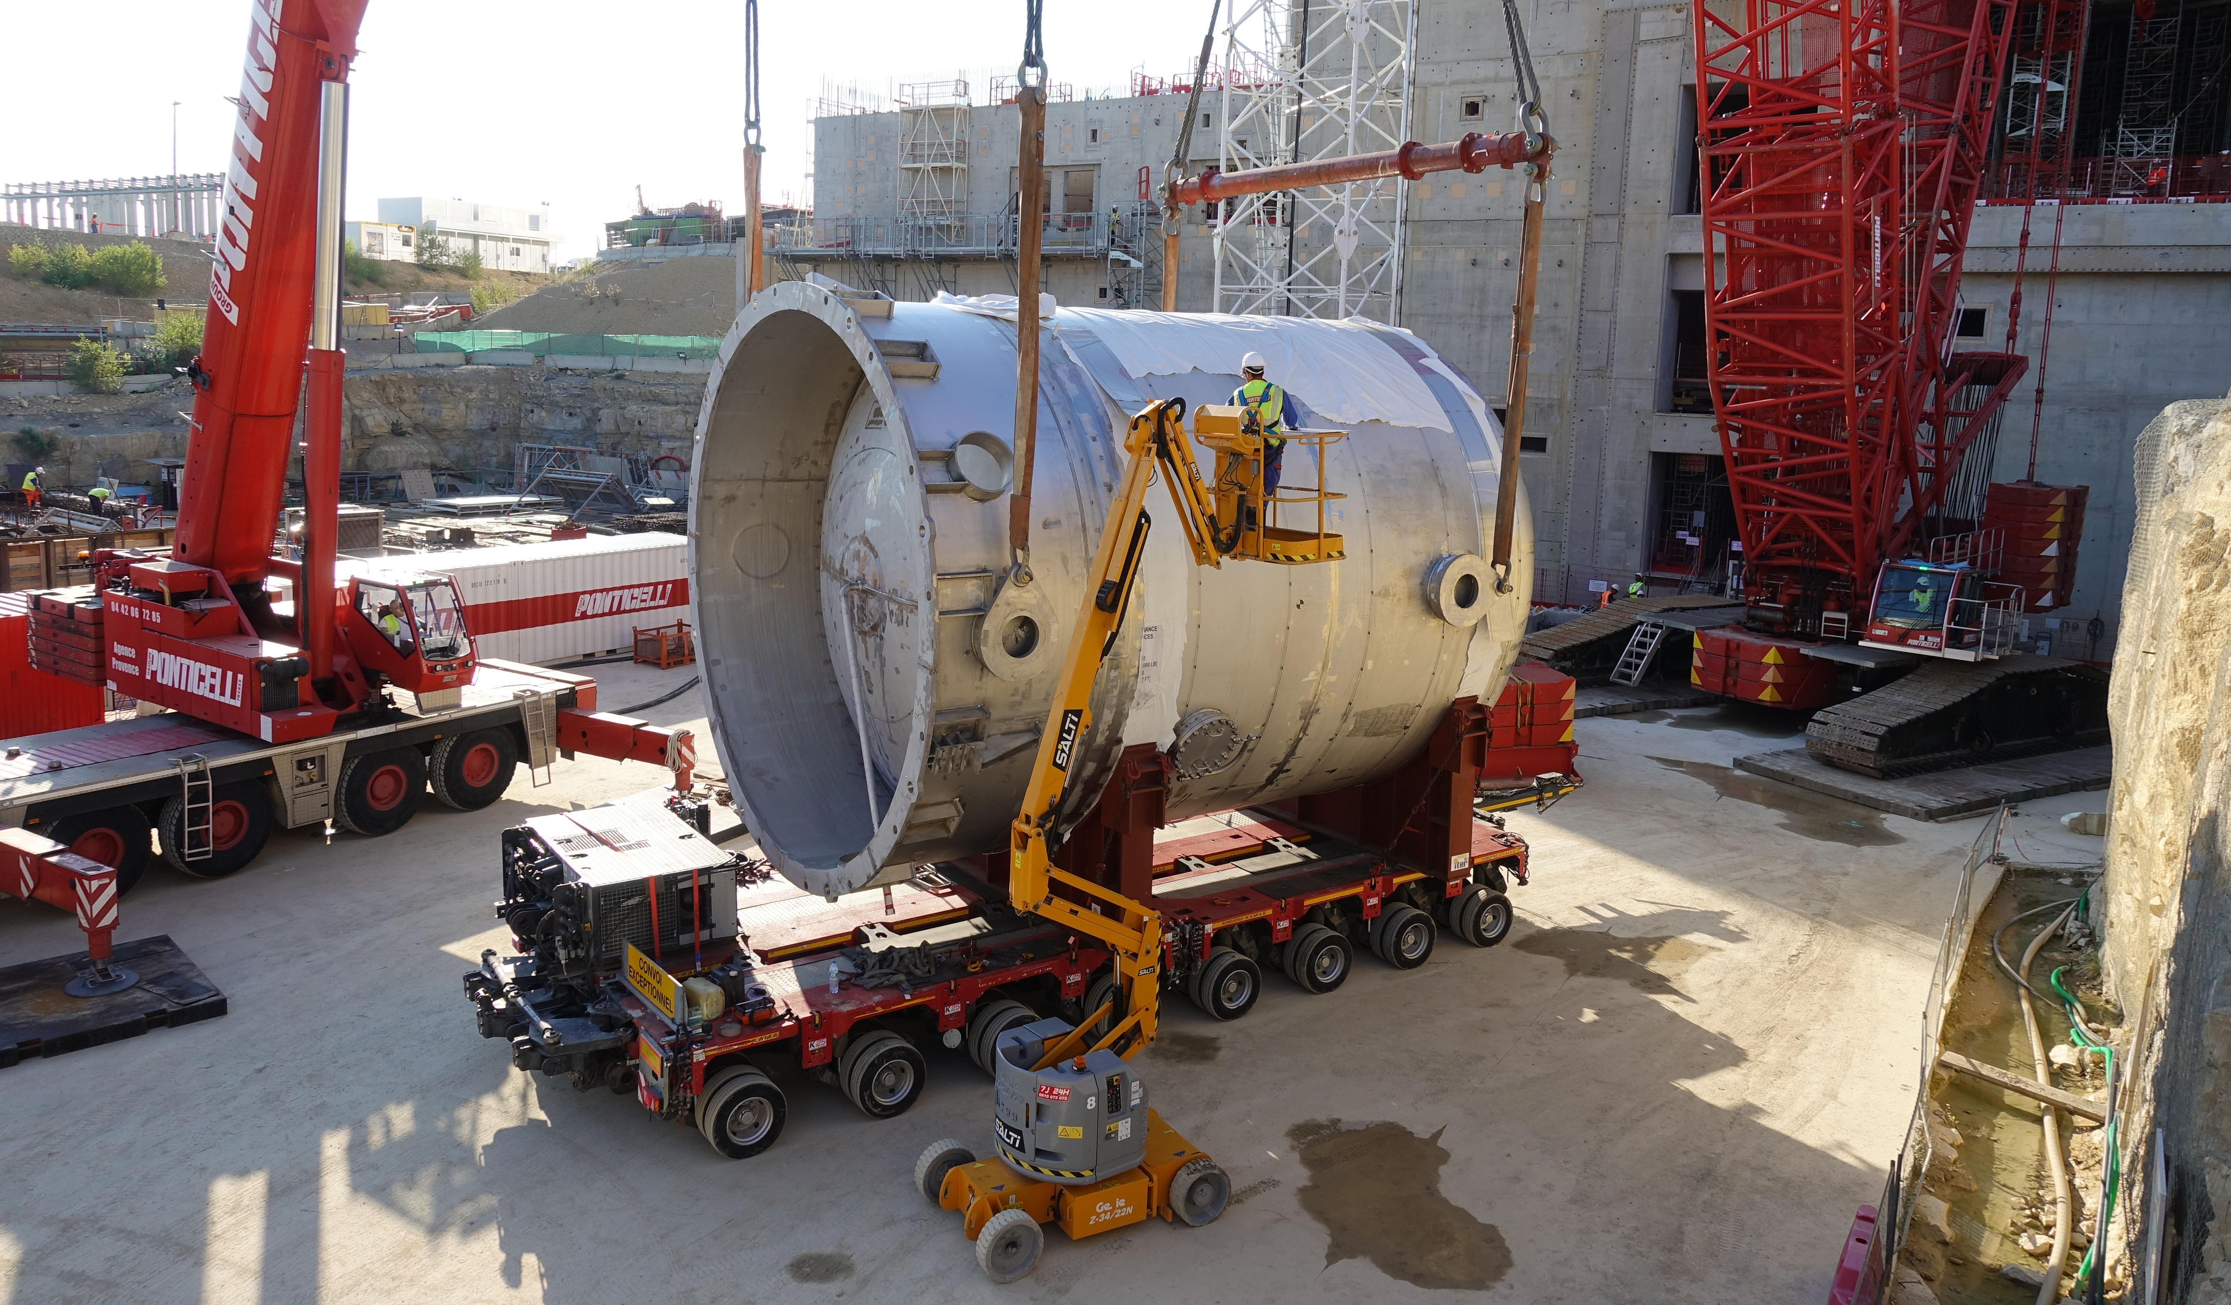
First US Components Installed in Tokamak Complex
One of the three drain tanks for the Tokamak Cooling Water System installed in the tokamak complex in August 2018. The remaining two tanks will be installed later in the construction sequence. Photo: ITER Organization
12-5-2018

Slide 4
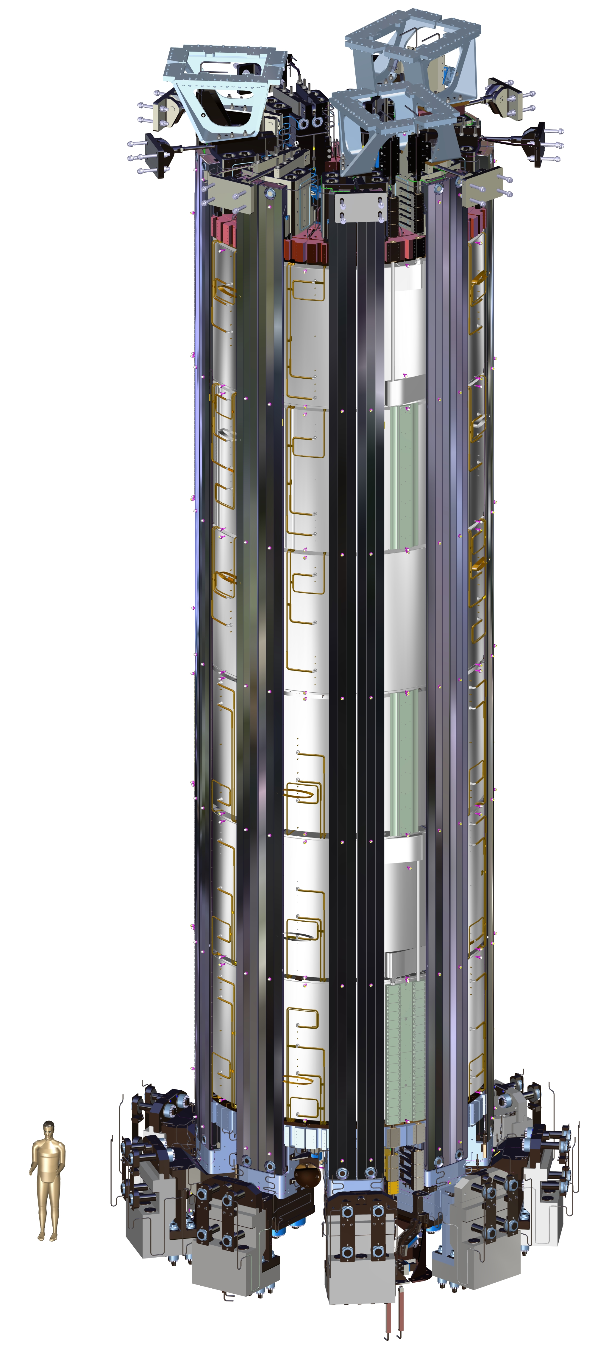
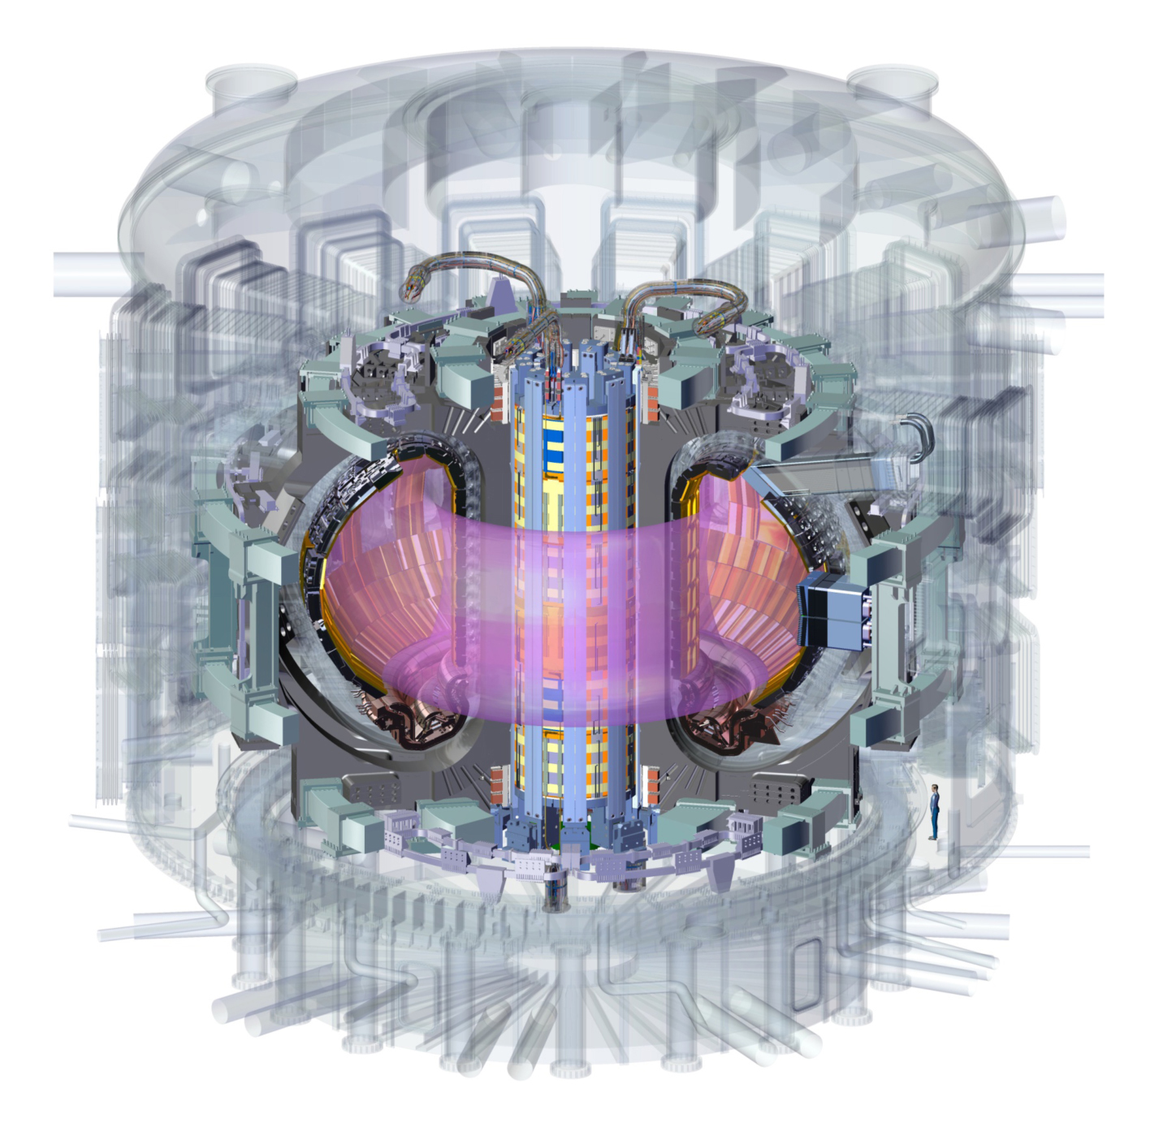
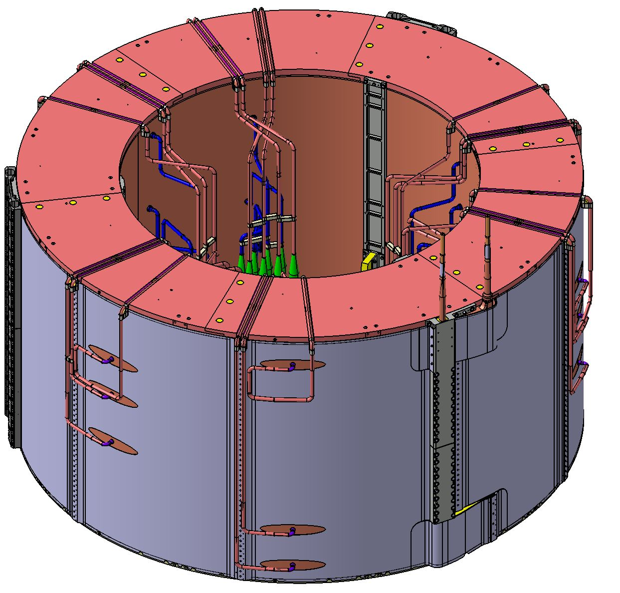
Spotlight: Central Solenoid Progress
7 coil packs (including 1 spare)
Height: 18 m
Diameter: 4.13 m
Total Weight: 1000 t
Peak Field Strength: 13.1 T
Stored Energy Capacity: 5.5 GJ
Operating Voltage: 14 kV
Operating Current: 45 kA
Stored Energy Capacity: 5.5 GJ
Single Coil Pack (module)
5800 m of conductor | 110 t
12-5-2018

Slide 5
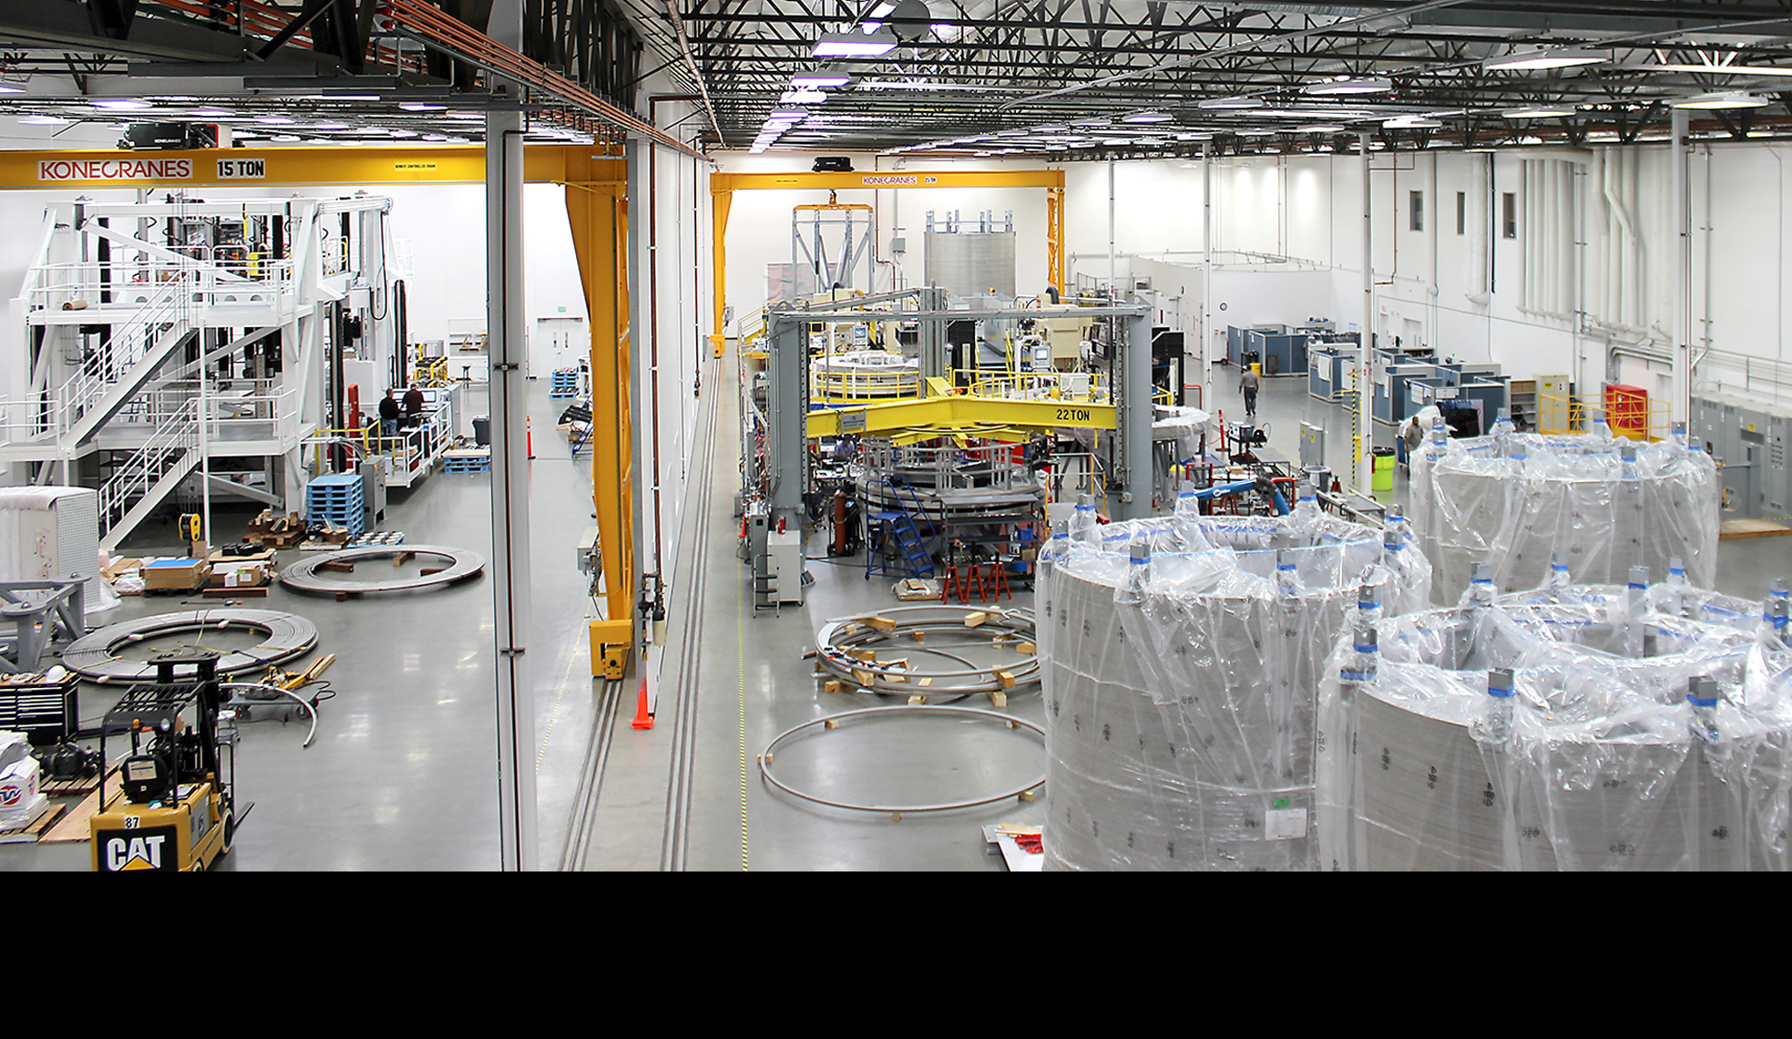
Central Solenoid Module Fabrication
Serial module fabrication is underway at General Atomics’ 64,000 ft² Magnet Technologies Center. The facility includes 10 work stations.
12-5-2018
Notes:
US industry is fabricating a first-of-a-kind 1,000–metric ton, 13-meter tall, 13-tesla central solenoid electromagnet (the “heartbeat” of ITER). A new manufacturing facility has been developed at General Atomics in Poway, CA with ten high tech workstations, including a 4K test station for magnet testing. Industrial partners have developed new techniques to fabricate large-scale components to ITER requirements.
Key contributors:
Modules: General Atomics (Poway, CA), Cryogenic Materials, Inc. (Boulder, CO)
Structural support components: Precision Custom Components (York, PA), Major Tool & Major (Indianapolis, IN), Superbolt (Carnegie, PA), Petersen, Inc. (Ogden, UT), Hamill Manufacturing, G&G Steel (Russellville, AL), Martinez & Turek, Inc. (Rialto, CA), Cryomagnetics (Oak Ridge, TN)

Slide 6
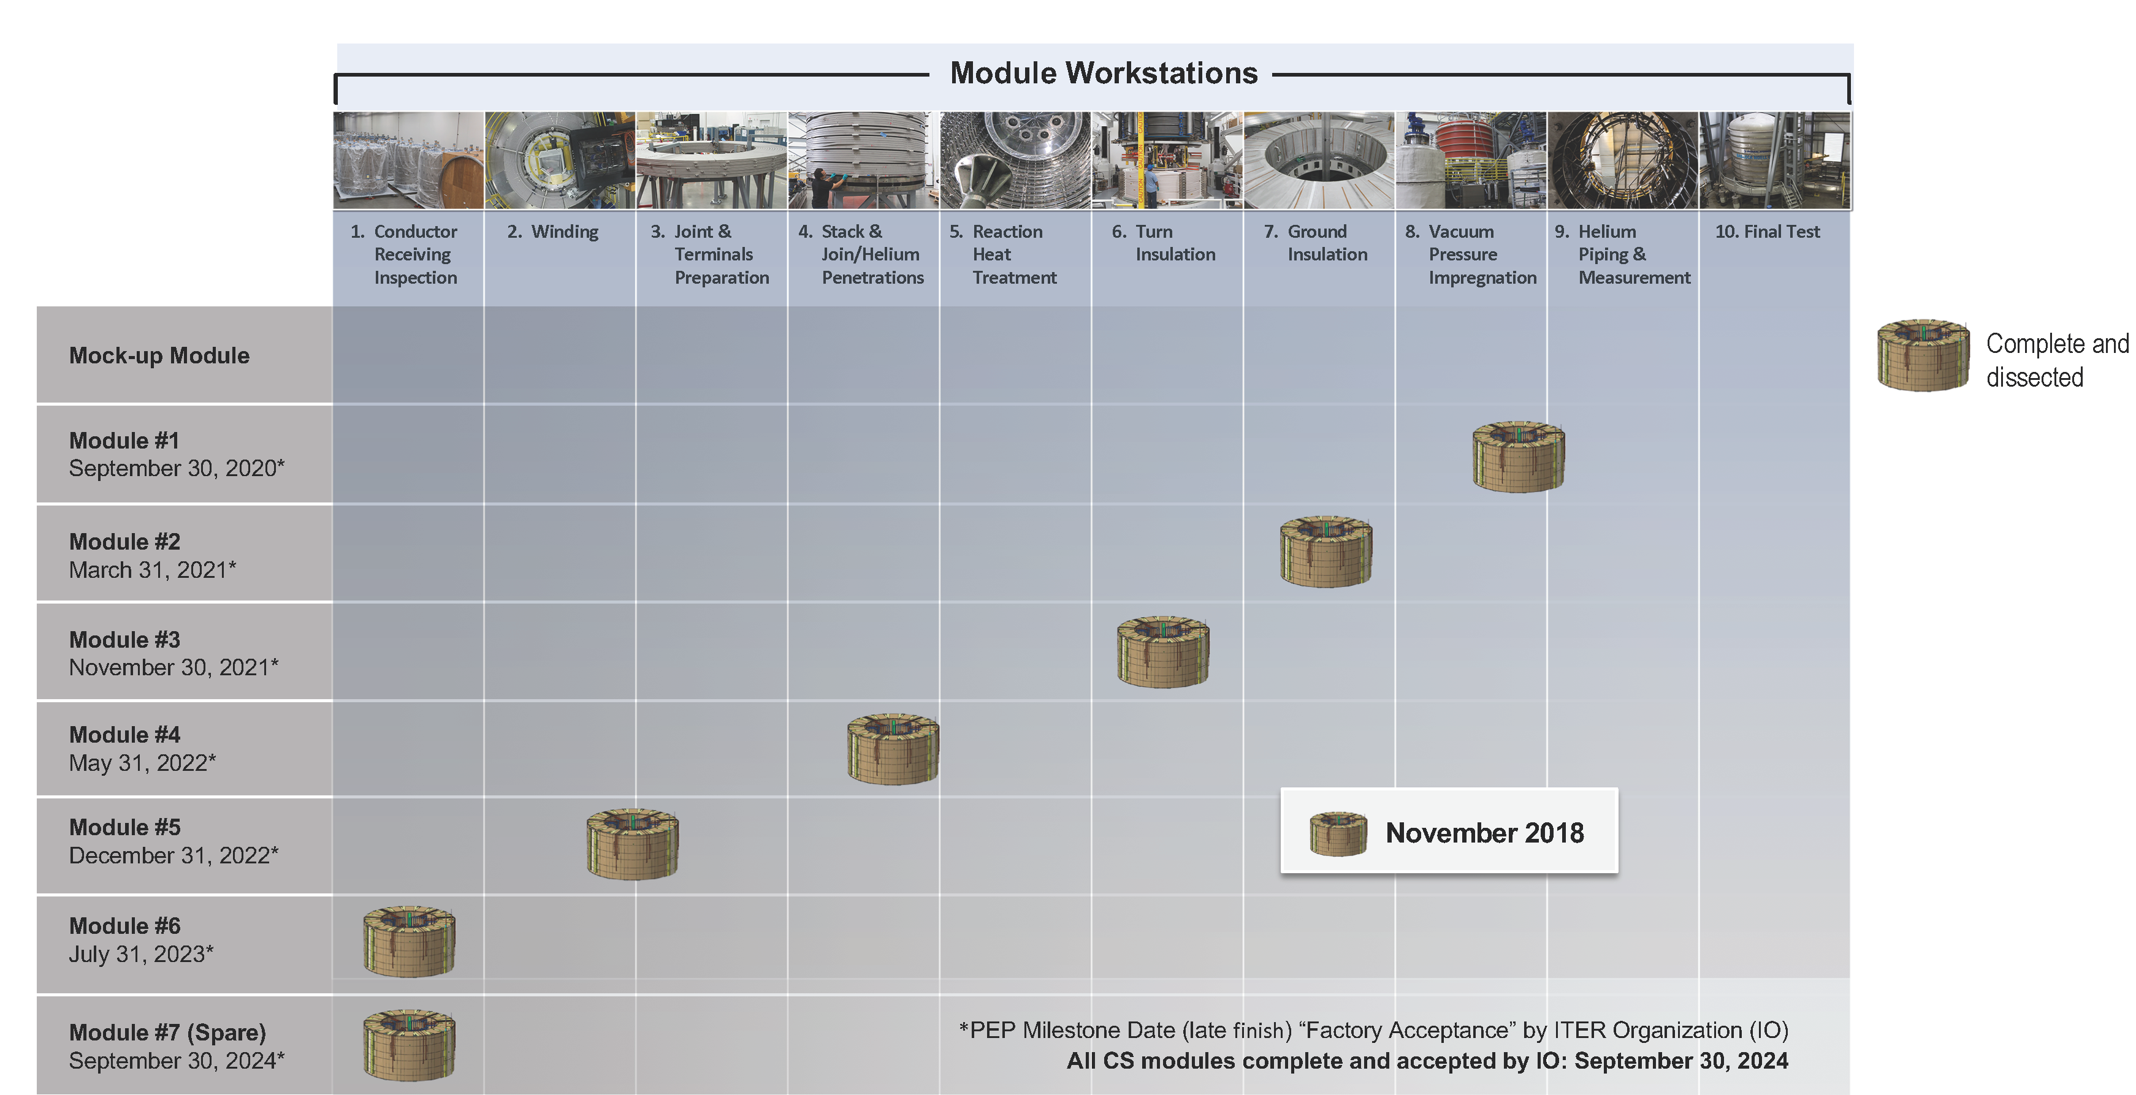
US Hardware
Central Solenoid Module Fabrication Progressing
12-5-2018

Slide 7
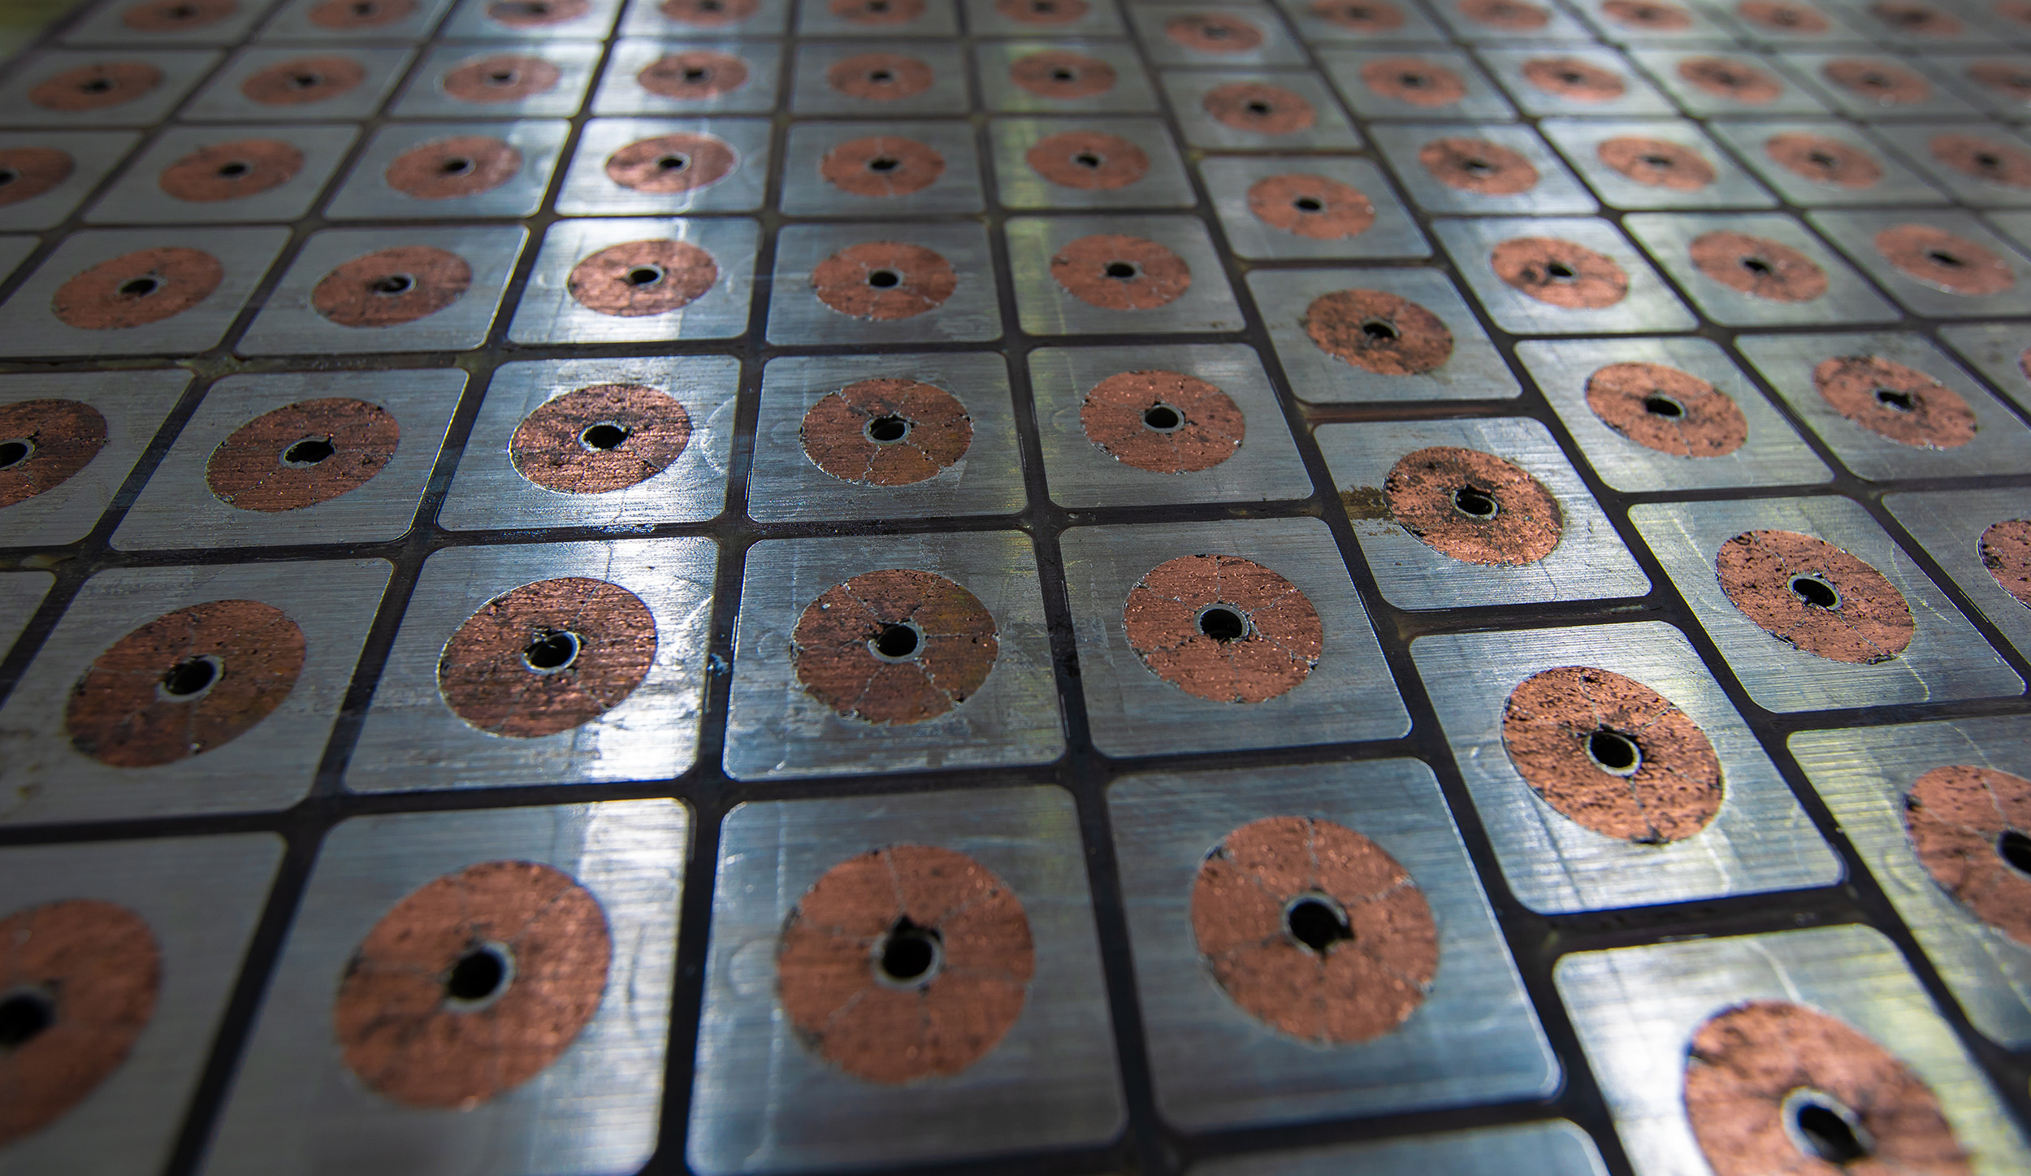
Mock-up Coil Complete
12-5-2018

Slide 8
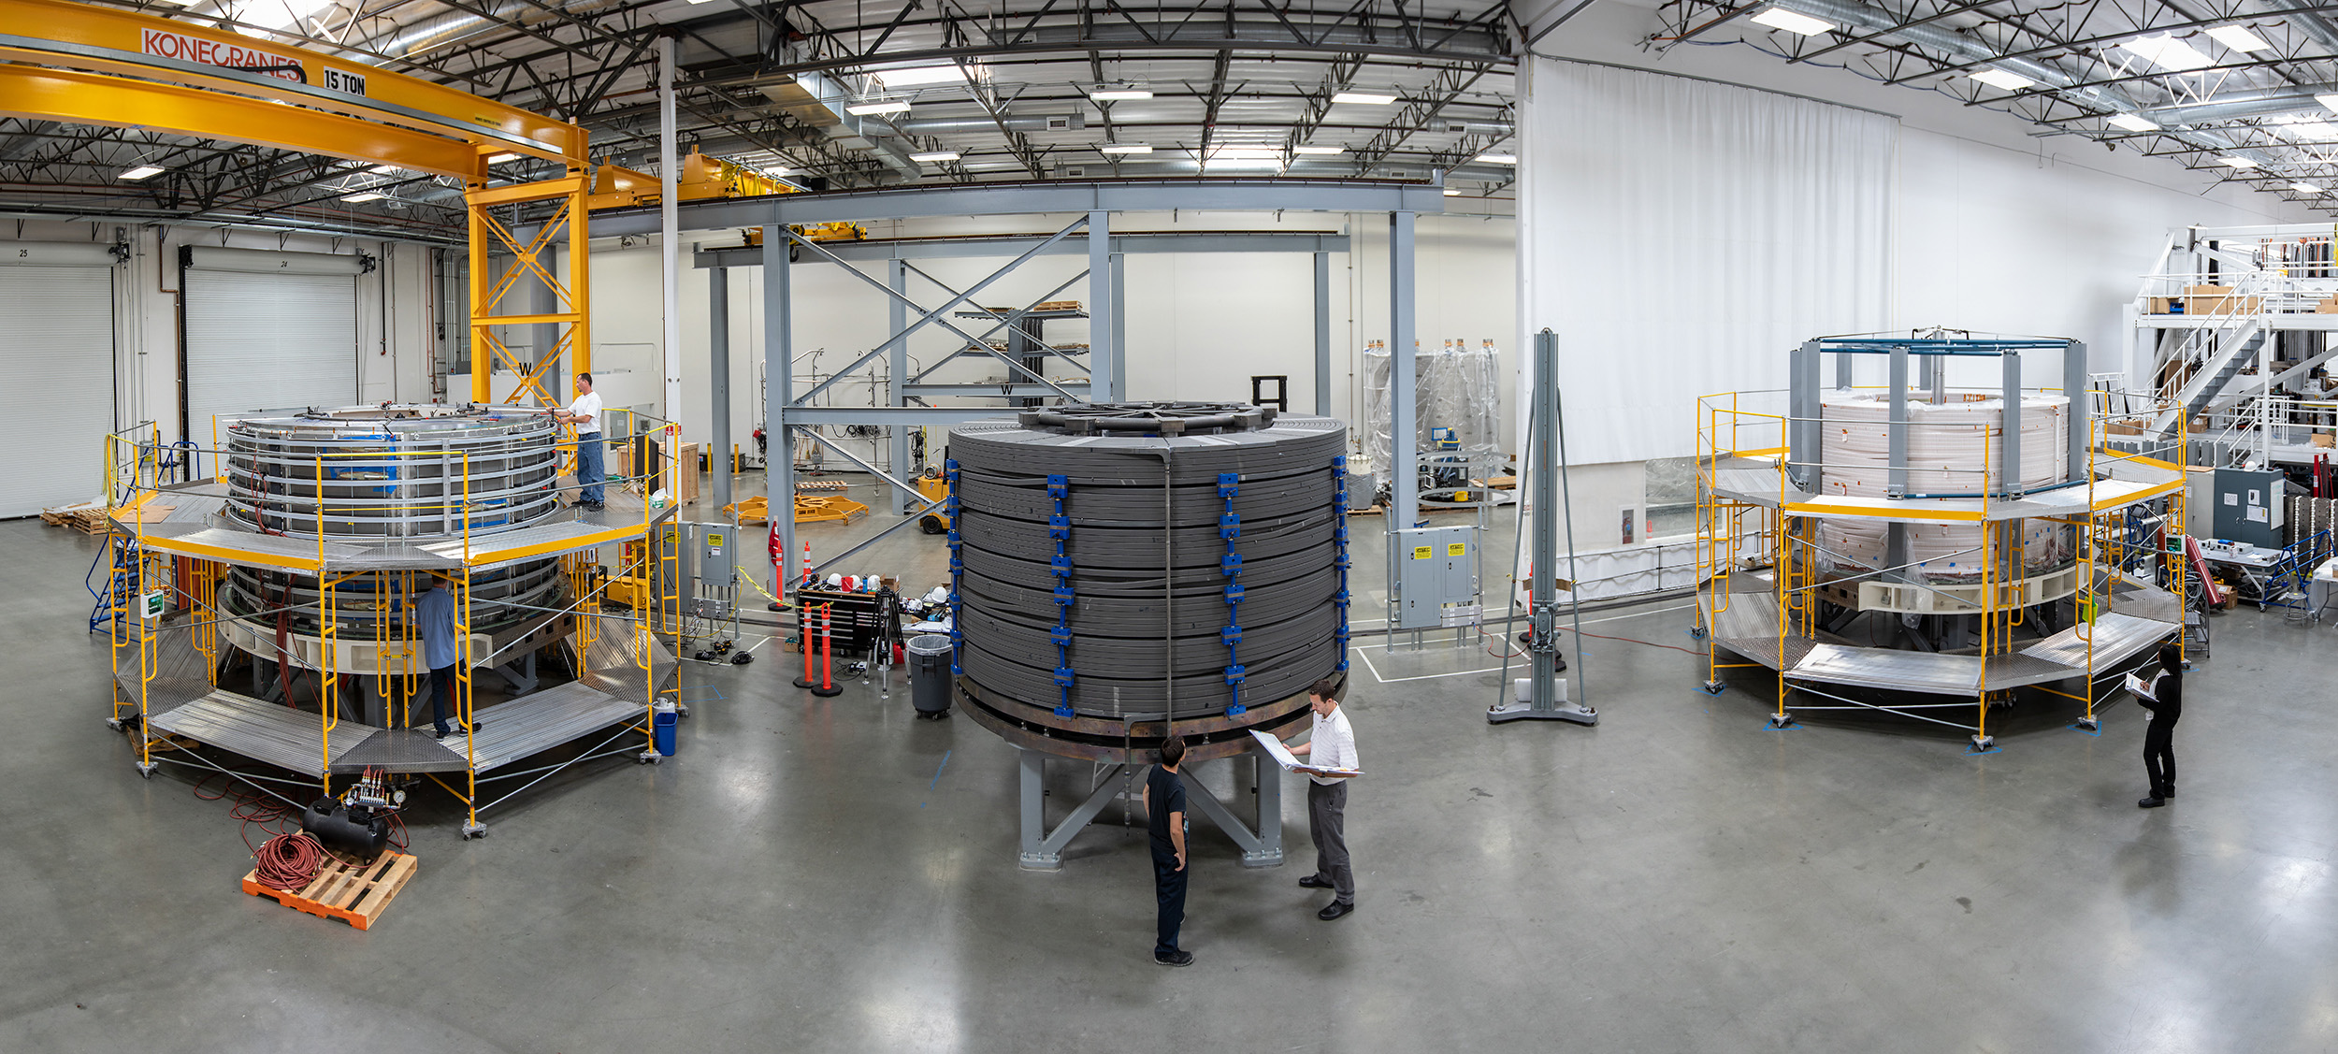
Serial Module Fabrication is Underway
Left: Module in preparation for vacuum pressure impregnation.
Middle: Module after heat treatment before transfer to turn insulation.
Right: Module in preparation for ground insulation after turn insulation.
Photos: GA
12-5-2018

Slide 9
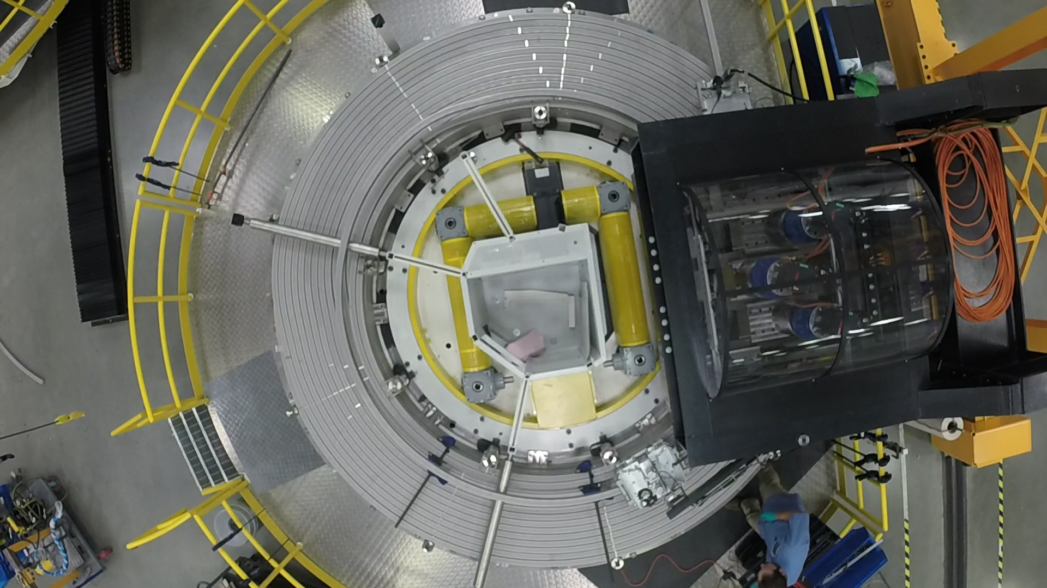
Winding
Module 5 is completing winding.
Photo: GA
12-5-2018

Slide 10
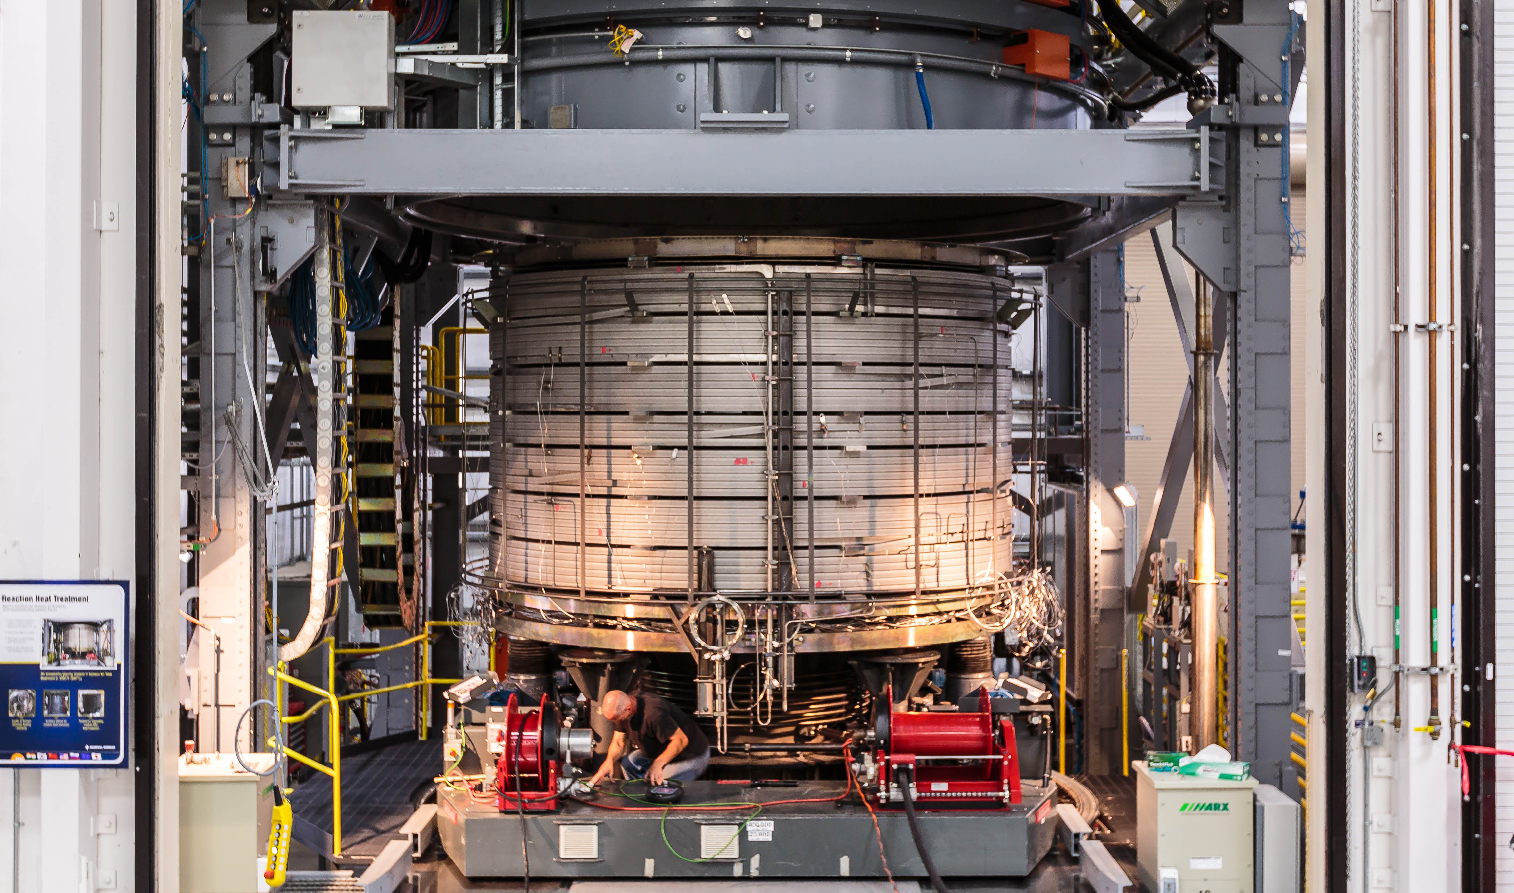
Heat Treatment
Module 4 is preparing for heat treatment.
Photo: GA
12-5-2018

Slide 11
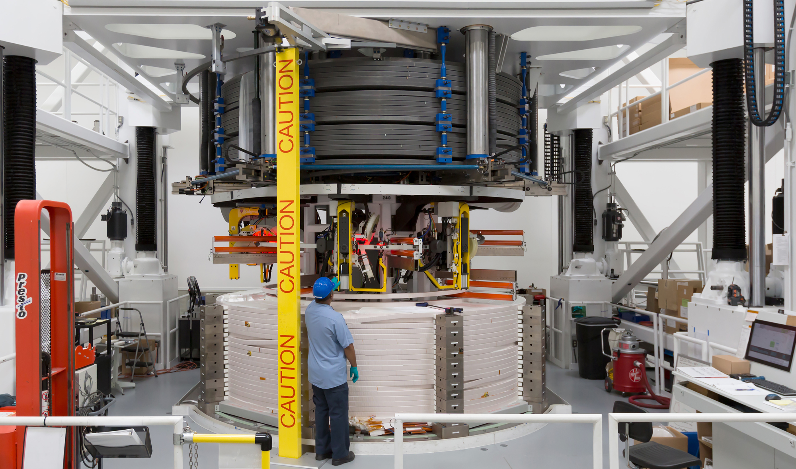
Turn Insulation
Module 3 is in turn insulation.
Photo: GA
12-5-2018

Slide 12
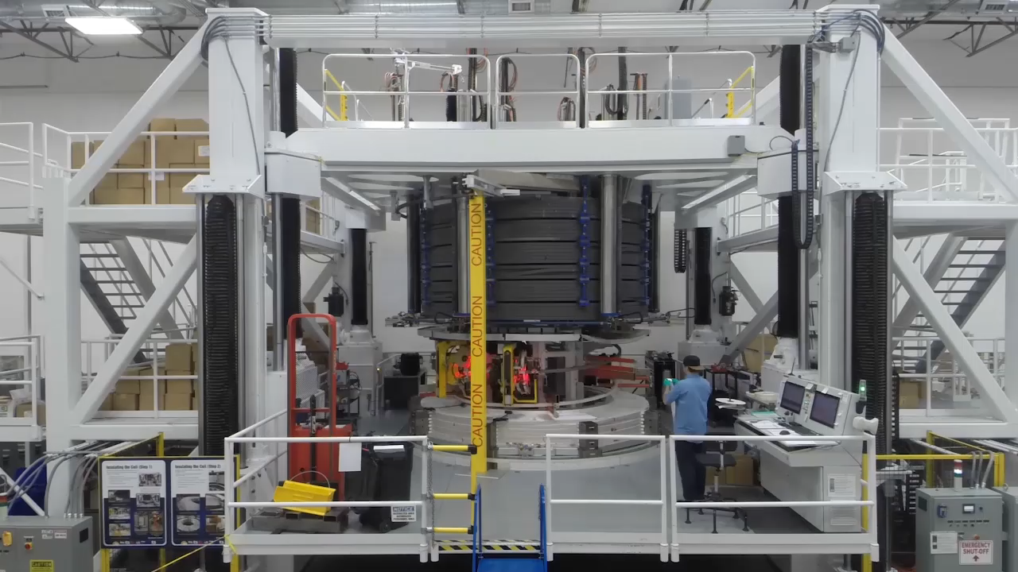
Turn Insulation in Action
12-5-2018

Slide 13
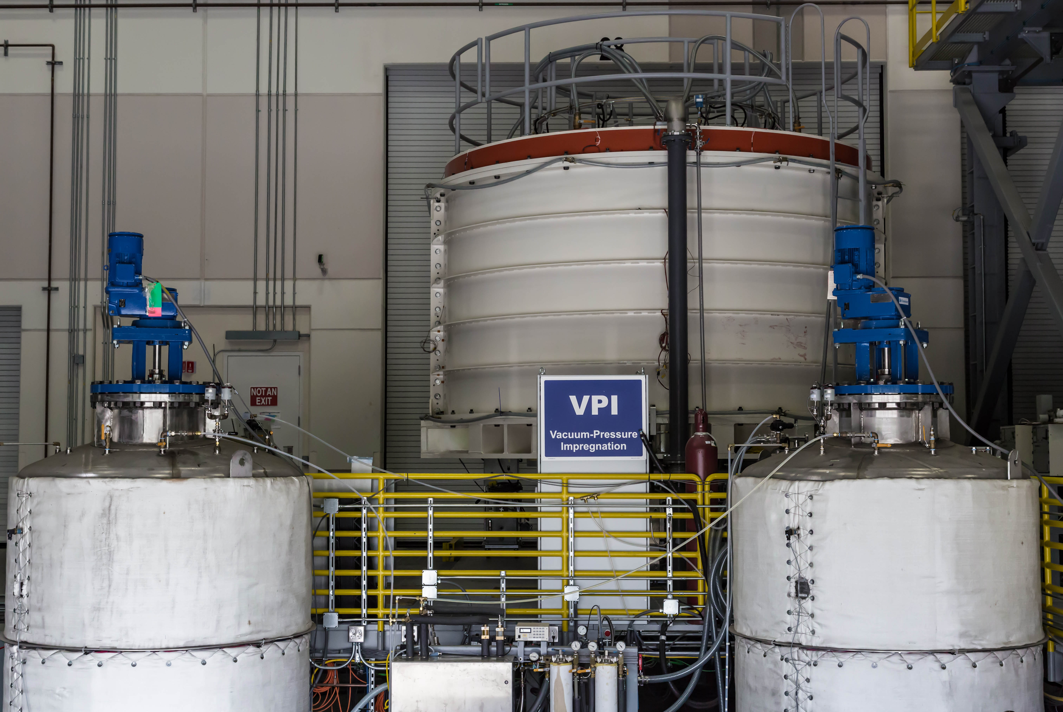
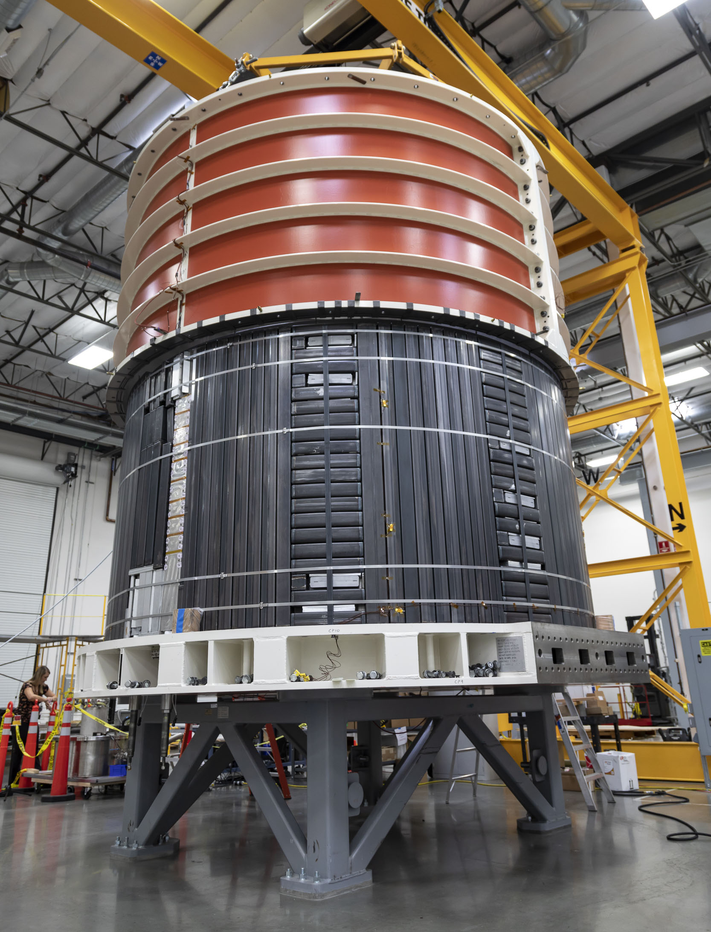
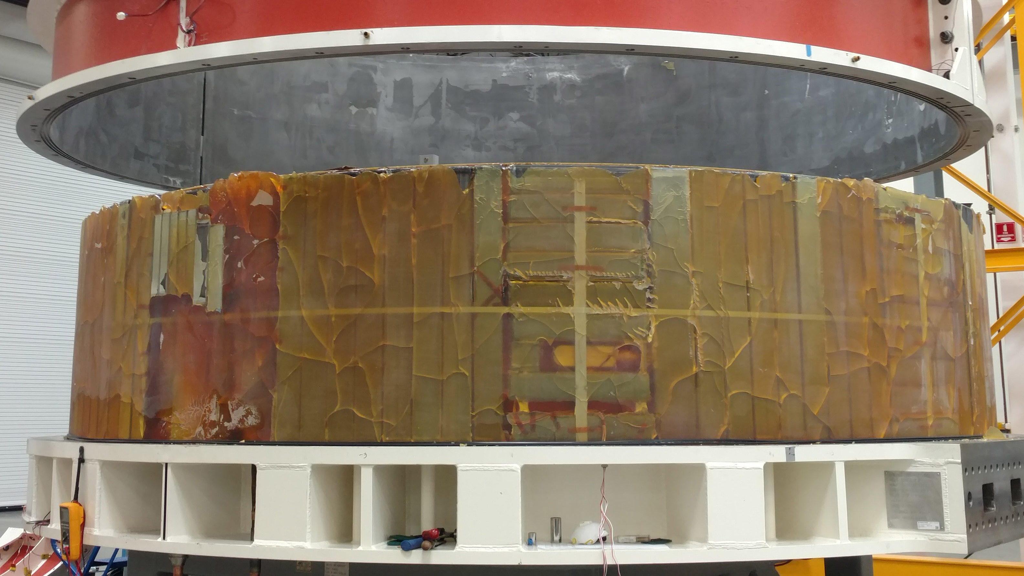
Vacuum Pressure Impregnation of Module 1 is Complete
VPI station with resin tanks
Photo: GA
Mock-up module after VPI.
Photo: GA
Module 1 was sleeved before VPI.
Photo: GA
12-5-2018

Slide 14
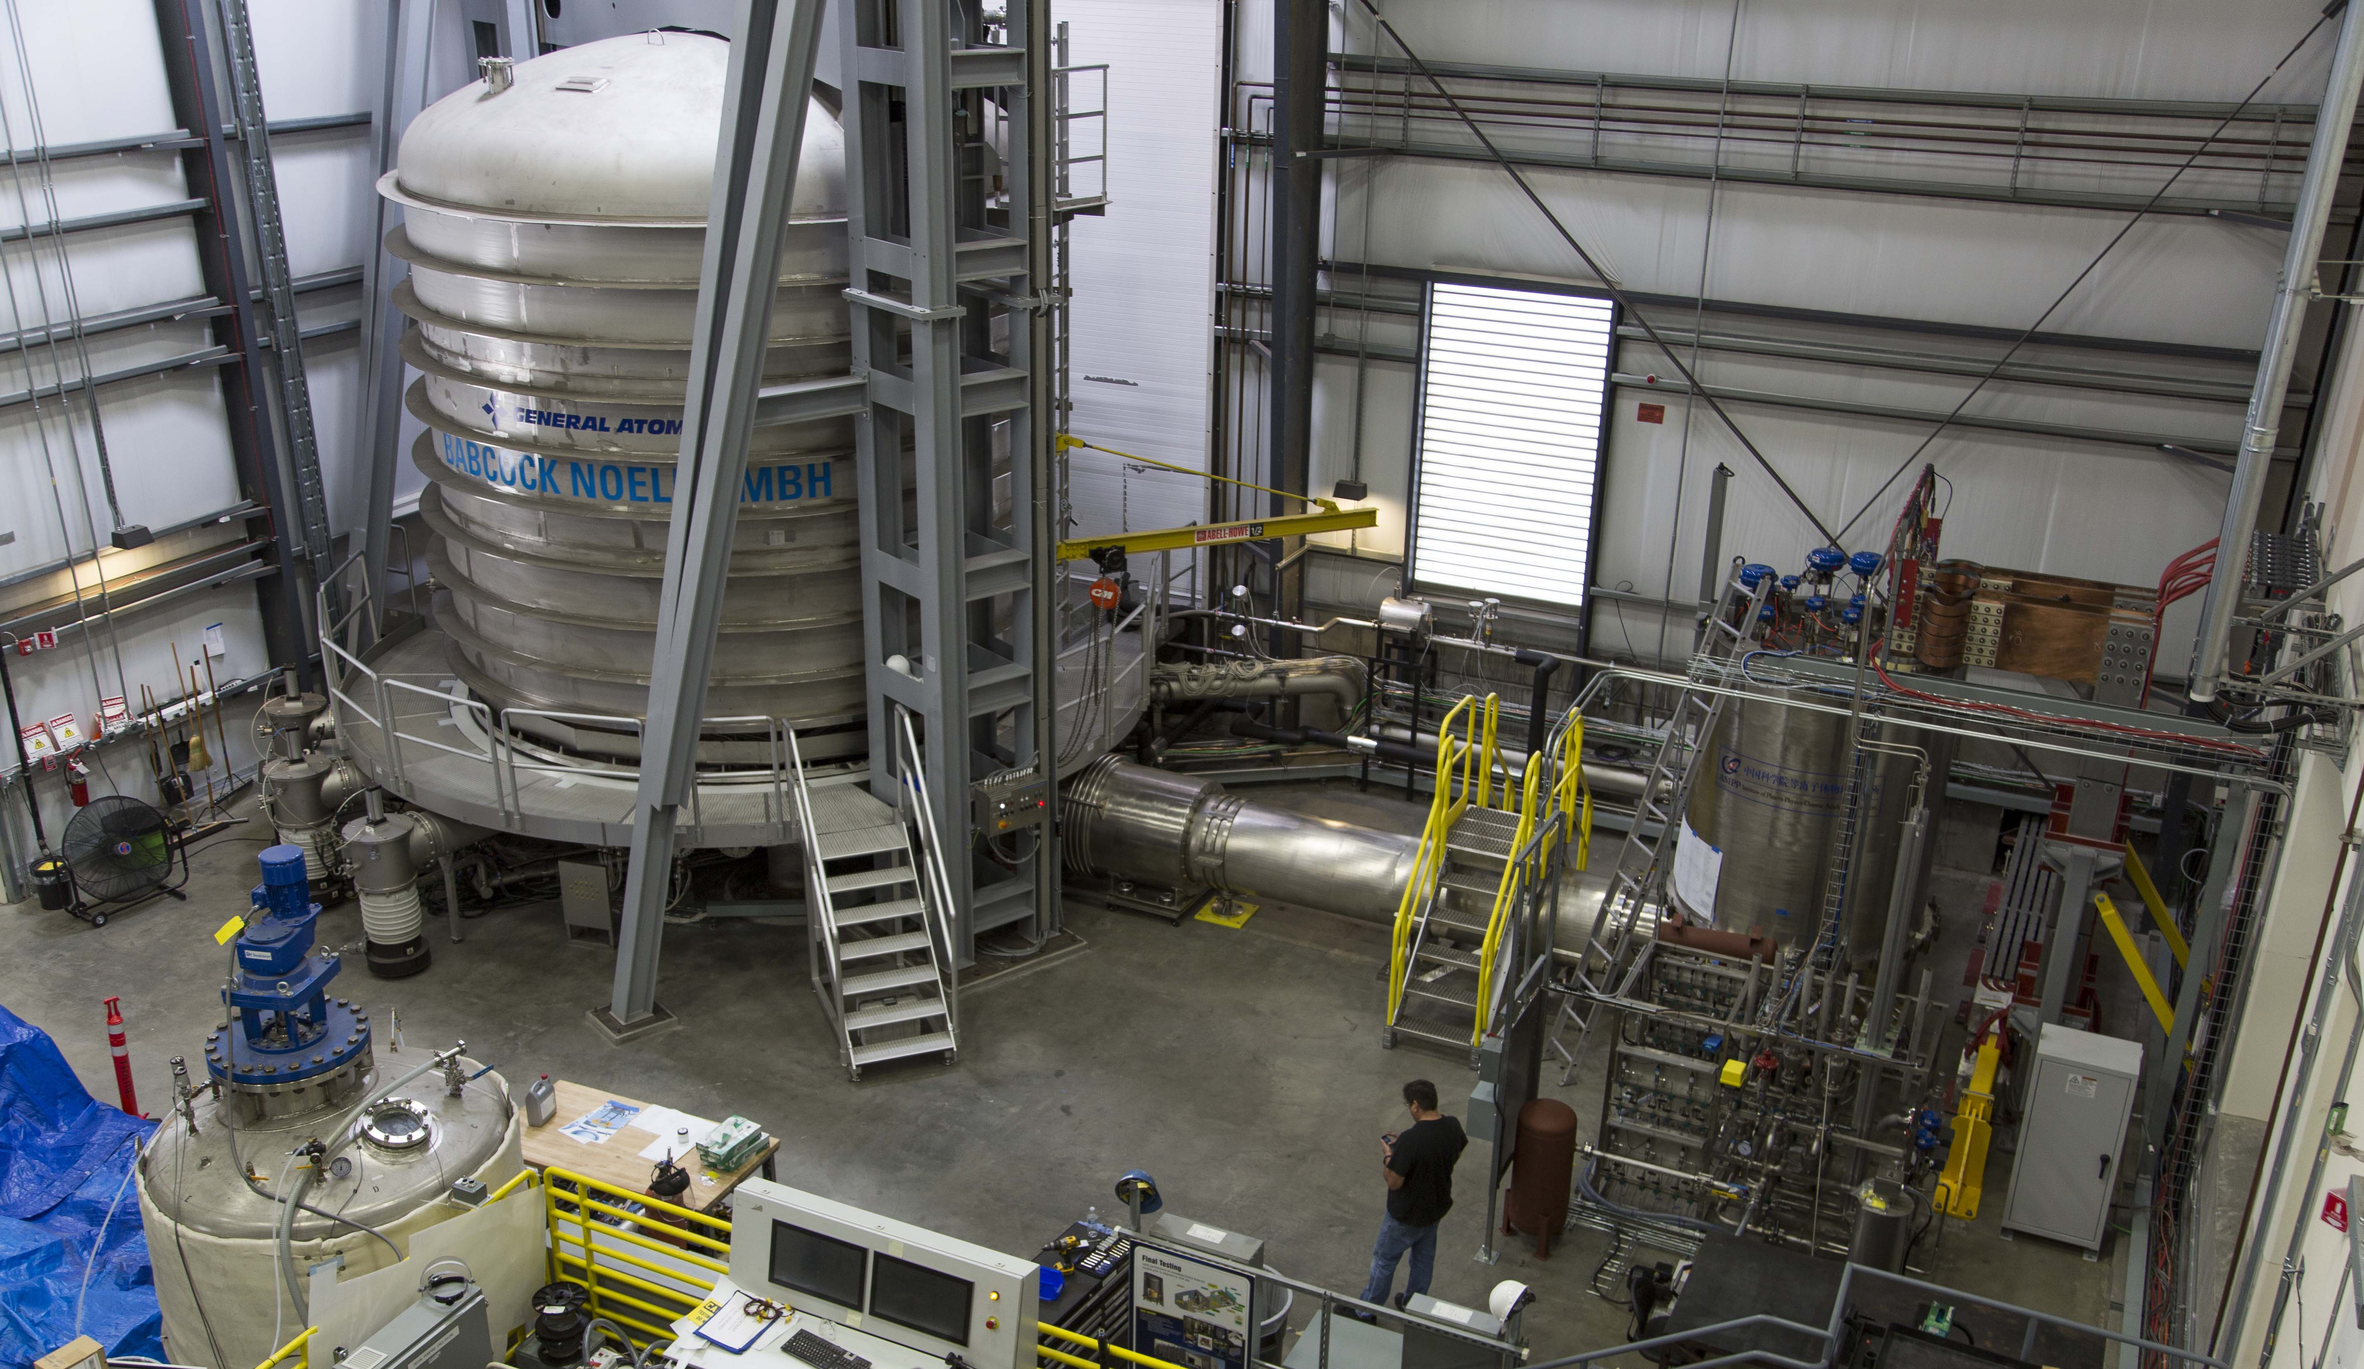
Final Test
Each module will be tested at 30 kV and 50kA (at 4K)
Photo: GA
12-5-2018

Slide 15
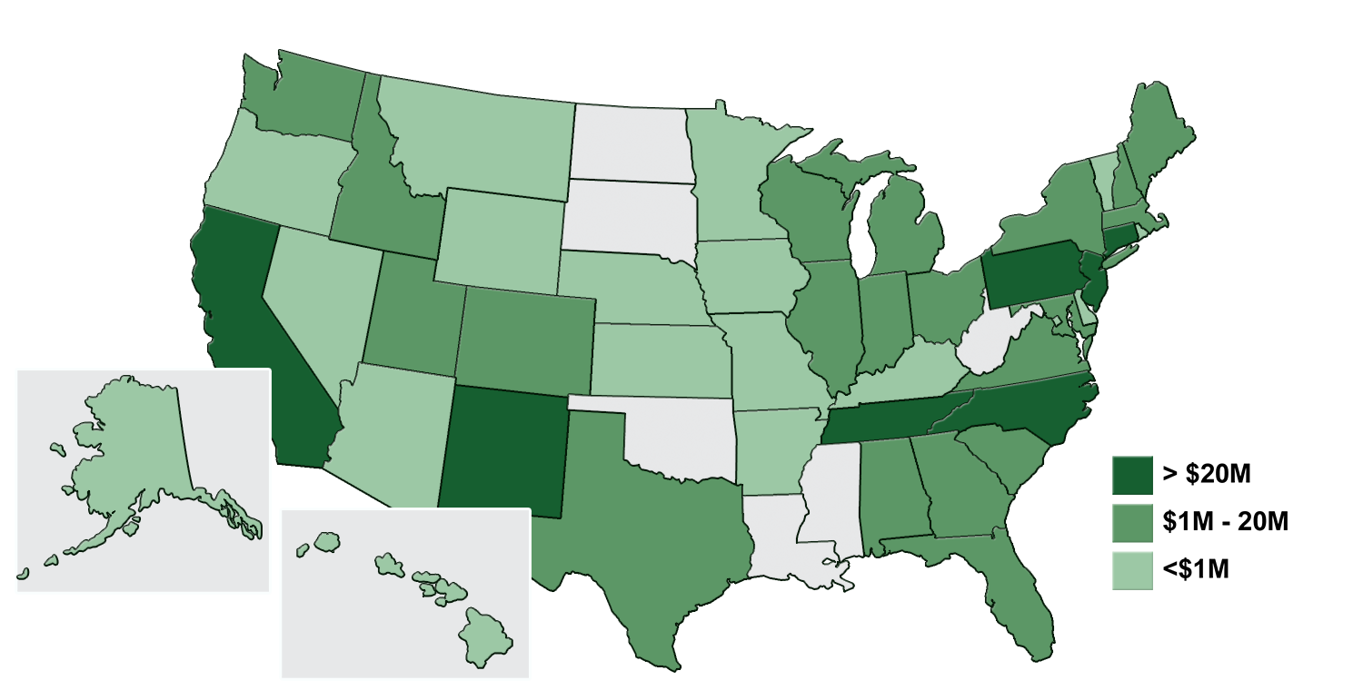
>80% of US ITER Funding Remains in the US
As of September 2018, over $1B has been awarded to US industry and universities, and obligated to DOE national laboratories in 44 states plus the District of Columbia.
12-5-2018

Slide 16
US Industries, Universities and National Laboratories are Engaged
General Atomics, San Diego, CA
AREVA Federal Services, LLC, Charlotte, NC
Luvata Waterbury, Inc., Waterbury, CT
Precision Custom Components, York, PA
Oxford Superconducting Technology, Carteret, NJ
Transfair, Sea Tac, WA
High Performance Magnetics, Tallahassee, FL
Schneider Electric, Palatine, IL
Robatel Technologies, Roanoke, VA
Petersen, Inc., Ogden, UT
Superbolt, Carnegie, PA
Hyundai Corporation, Houston, TX
New England Wire Technologies, Lisbon, NH
Transproject, Houston, TX
Robatel Technologies LLC, Roanoke, VA
Hamill Manufacturing, Traford, PA
Major Tool & Machine, Inc., Indianapolis, IN
Mega Industries, LLC, Gorham, ME
Dielectric Communications, Raymond, ME
Siemen’s Industry, Inc., Wendall, NC
Eaton Corporation, Cleveland, OH
G&G Steel, Russellville, AL
Massachusetts Institute of Technology
University of Texas at Austin
University of Tennessee
Florida State University
University of Wisconsin at Madison
University of California Los Angeles
University of Michigan
University of California San Diego
Columbia University
Washington State University
Indiana University
Oak Ridge National Laboratory
Princeton Plasma Physics Laboratory
Sandia National Laboratory
Savannah River National Laboratory
Los Alamos National Laboratory
Lawrence Livermore National Laboratory
Idaho National Laboratory
Fermi National Laboratory
Argonne National Laboratory
Lawrence Berkeley National Laboratory
.edu
.com
.gov
12-5-2018

Slide 17
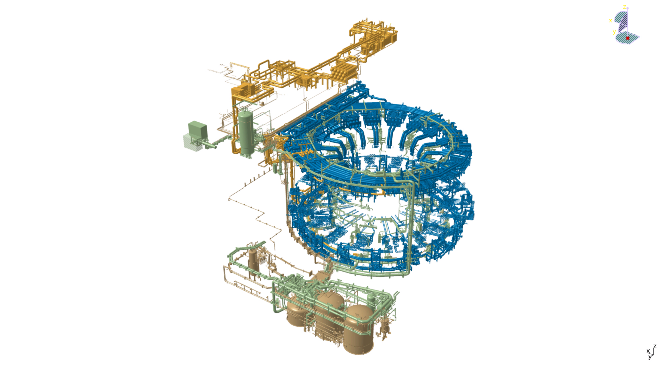
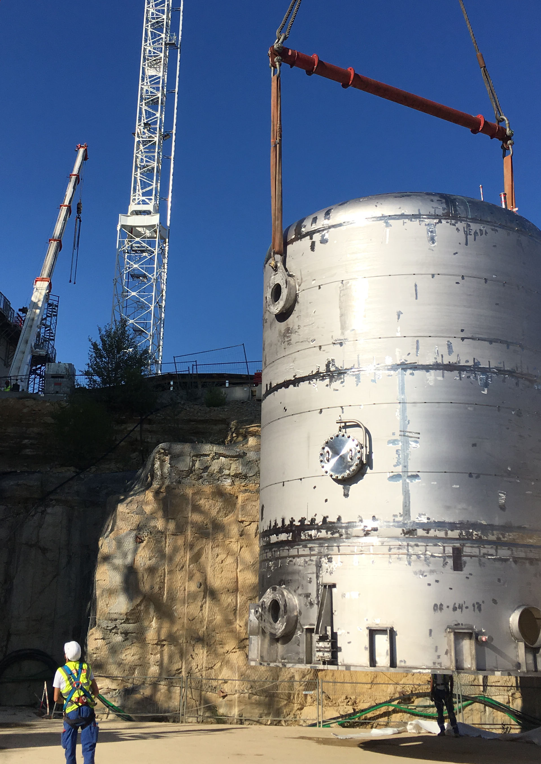
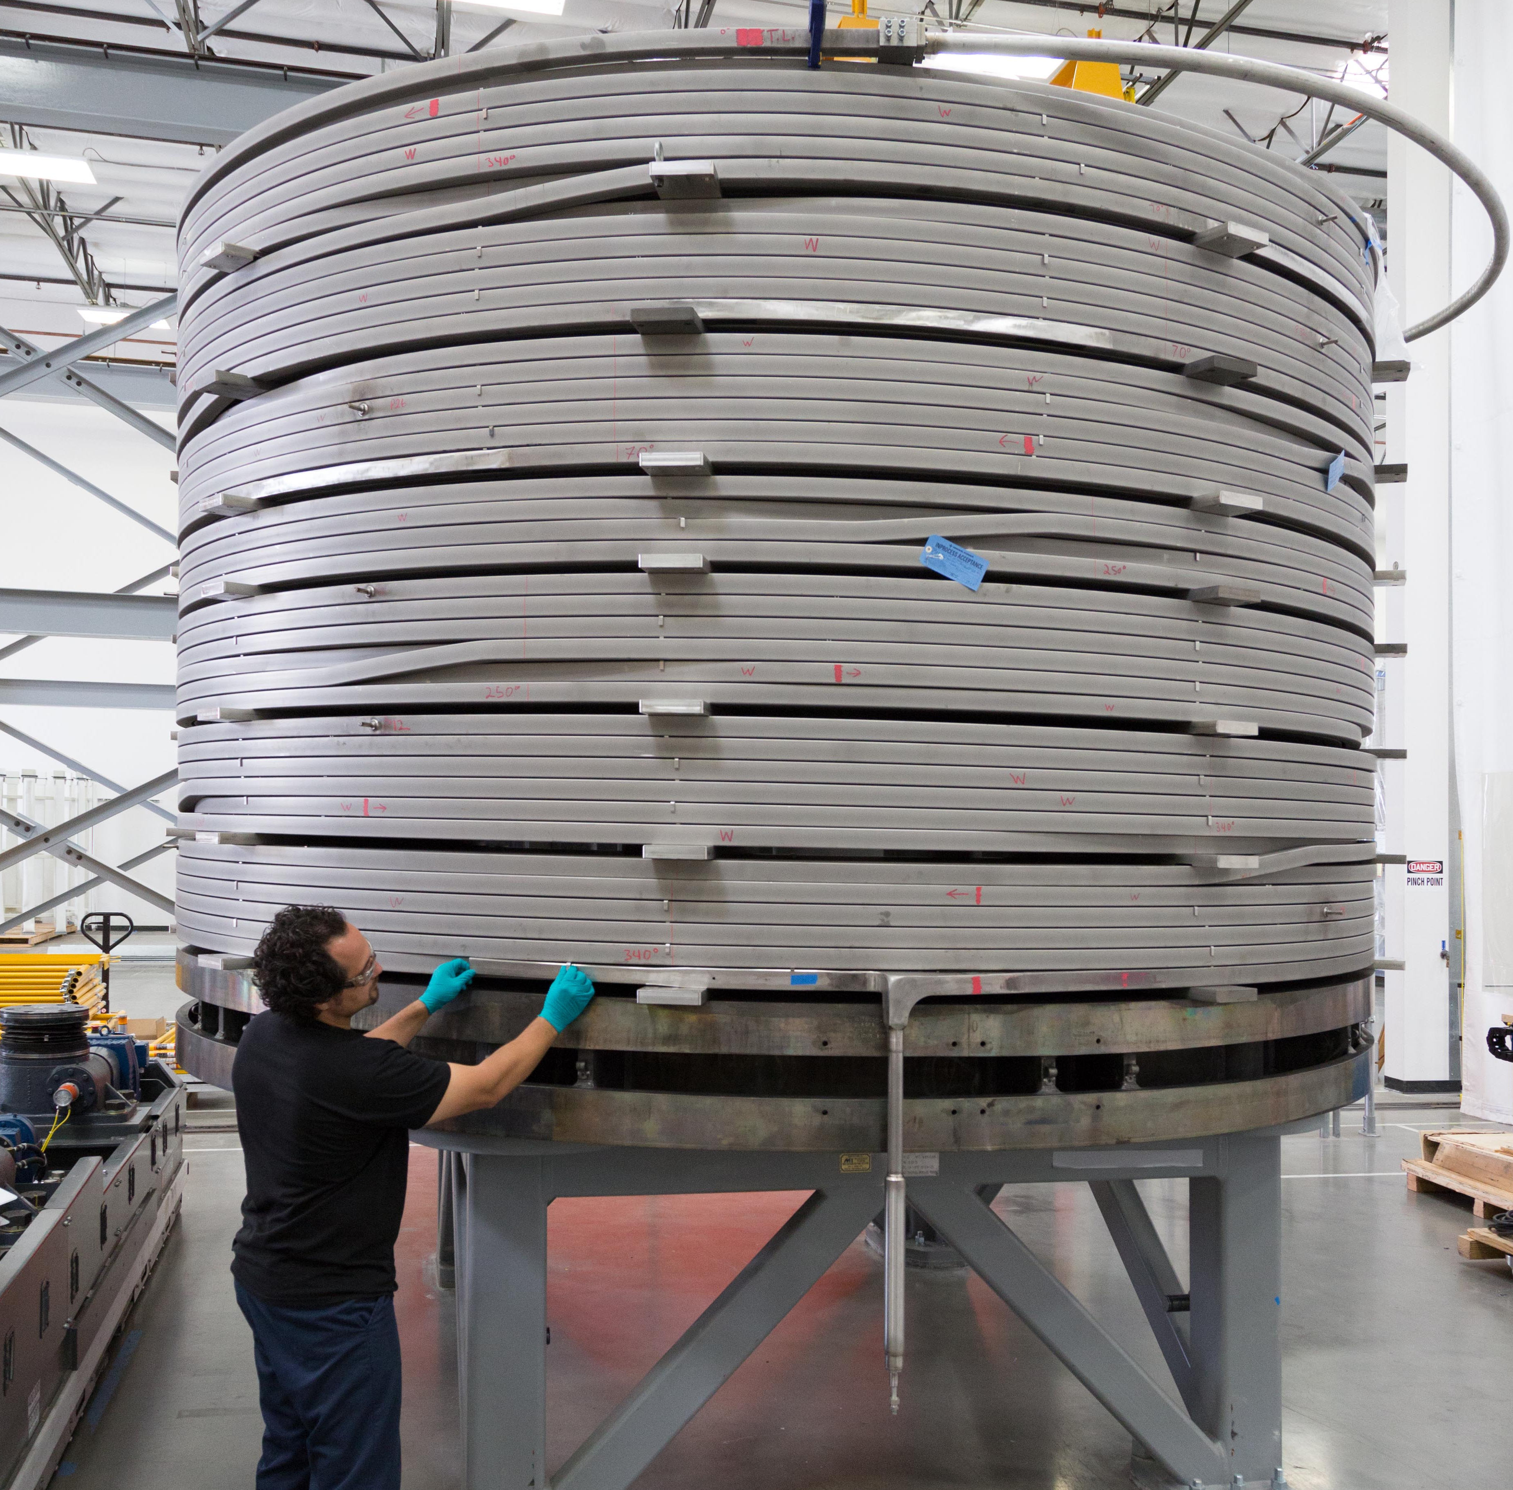
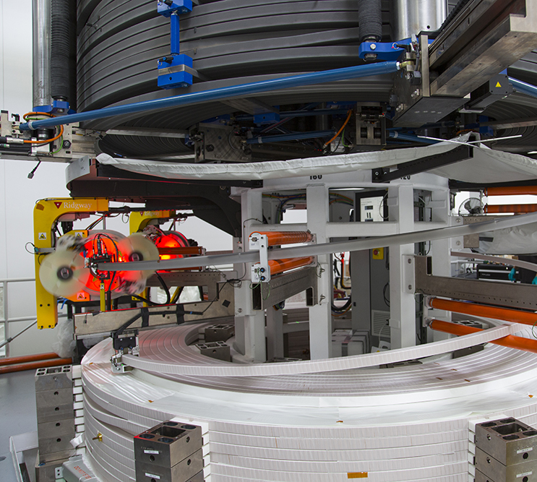
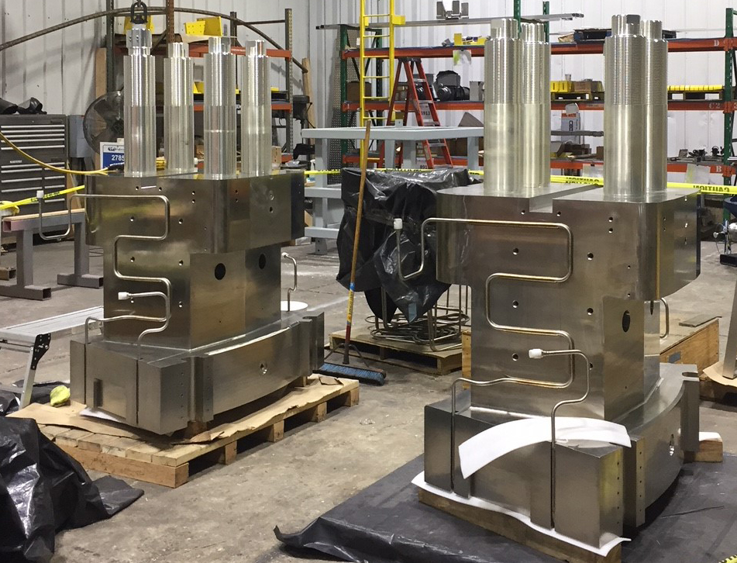
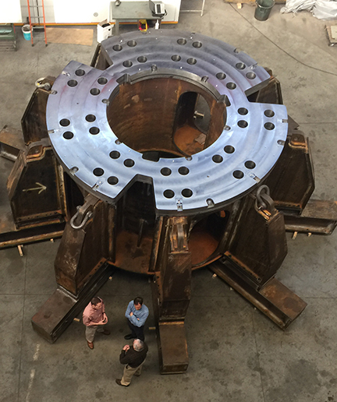
Summary
US ITER is progressing on priority systems, as identified by the international ITER project.
US ITER seeks to maximize US progress toward achievement of the international schedule.
12-5-2018

