Slide 1
Fusion Power Associates
40TH ANNUAL MEETING
Fusion Energy: Perspectives and Planning
Dec.3-4,2019 Grand Hyatt Washington
Chief Fusioneer Satoshi Konishi

Slide 2

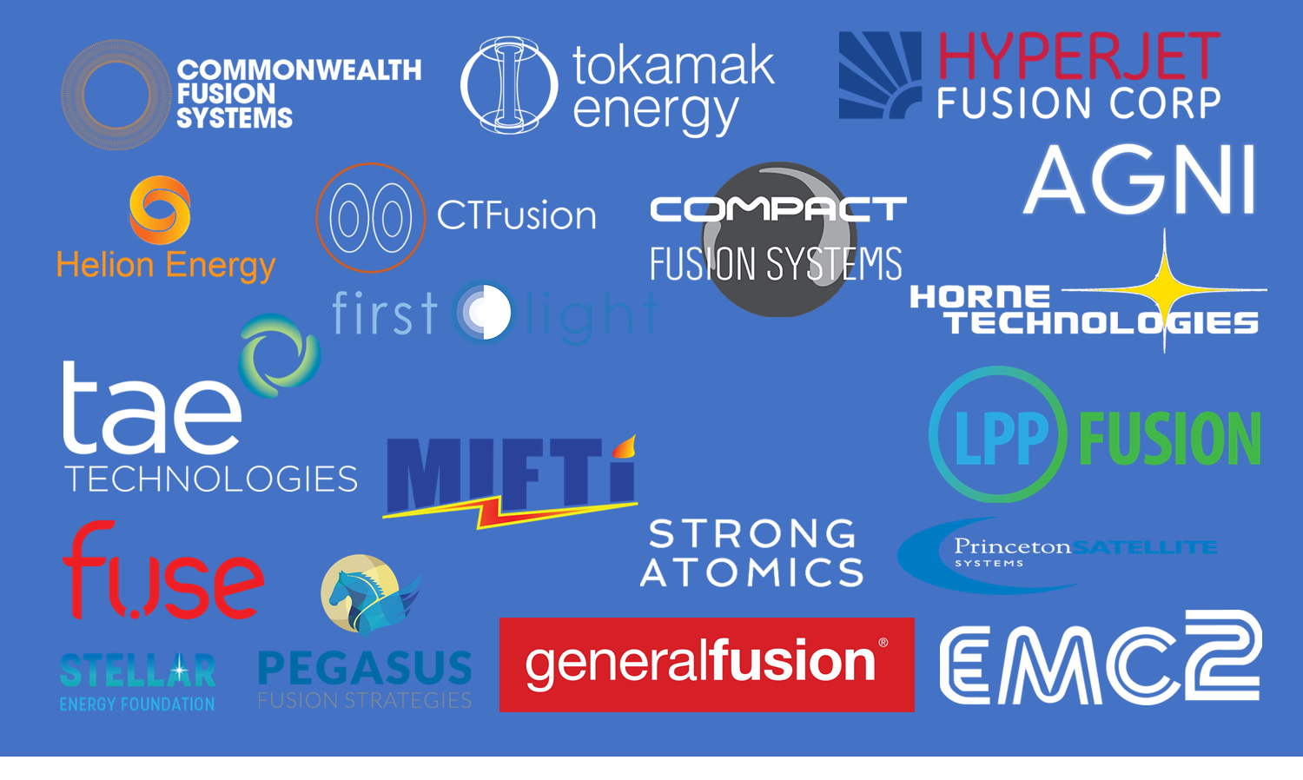
What We will Provide
Fusion Power Associates 40th annual meeting 2019
Kyoto Fusioneering Ltd. was founded in 2019 to provide B2B technical assistance for fusion challengers.
Private Fusion Developers are physics driven.
However their investors expect clear and compelling demonstration
- How fusion makes money?
We can provide
-blanket
-reactor components
-fuel cycle
-BoP
-reactor engineering
-plant design
-economic assessment
-strategy planning…

Slide 3
Fusion Market Perspectives
Fusion Power Associates 40th annual meeting 2019
Carbon budget of post-Paris agreement age will run out after 2040, if majority of the countries would be honest.
Carbon Removal is more critical than fossil fuels.
While Clean electricity can be supplied various options,
very few Alternative Fuel are known.
Further, Carbon Isolation is more serious, precious
Resource for future...
Electricity may be sold, but cheap.
Grid Parity/Stability, Alternative Fuel, and
Ultimate Disposal of Carbon have stronger demands.
Fusion may provide a solution for this issue.

Slide 4
Carbon Budget (by IEA)
Fusion Power Associates 40th annual meeting 2019
Carbon budget of post-Paris agrll run out after 2040,
What we will run out is not fossil resource,but carbon budget.
CCS resource is more critical than fossil fuels.
“Negative Carbon” will be
Most precious energy resource beyond 2040.
Oil and coal canont be sold not because of high price, but High penalty.
Fusion can provide alternative
CCS technology

Slide 5
Value of the electricity (California duck)
Fusion Power Associates 40th annual meeting 2019
Fig. Change of electricity demand in a sunny day
California Independent
System OperatorCAISO)
In the deregulated market,
Price of electricity varies.
Due to large share of renewable,
electricity market price drops in
day time.
Instability of grid (frequency
change and outage) is
Serious when share of
Renewable increased.
Value of the electricity (even clean base load) can be negative.
→Fusion Electricity may not recover investments!

Slide 6
Stranded Assets
Fusion Power Associates 40th annual meeting 2019
“Divestment” from carbon to technology is happening.
・Fossil resources become “stranded” because they cannot be sold
・Many of the large scale long terminvestment (bond)in the world, particularly pension fund is highly dependent on fossil assets
・Value of the fossil assets drops under low carbon economy

Slide 7
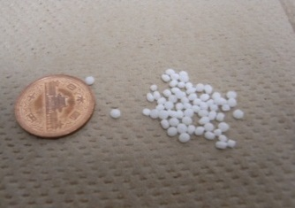

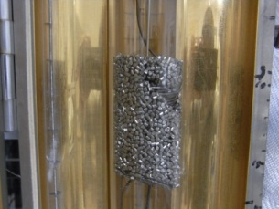
Chemistry of biomass conversion
Fusion Power Associates 40th annual meeting 2019
16MJ
External Heat，900℃
Biomass
(1kg)
8.2MJ
+
H₂O
H₂,CO
24.2MJ
Biomass gasification
cellulose：（C₆H₁₀O₅）_{n/6}+ n/6H₂O → nH₂ + nCO – 136n [kJ]
lignin: (CH_{1.4}O_{0.3})n + 0.7nH₂O → 1.4nH₂ + nCO –136n[kJ]
hydrogen
Shift Reaction
CO + H₂O ⇔ H₂ + CO₂ + 32 [kJ]
Fischer-Tropsch reaction
Carbon Neutral
2H₂ + CO → -CH₂- + H₂O + 160 [kJ]
8.1MJ
diesel(hydrocarbon)
Heat for generation
Carbon free oil 0.5 liter
15.6MJ
Notes:
こちらが、それぞれセルロース、リグニンの代表的な元素組成のCHO比から想定される水蒸気と反応した理想的なガス化を示す式です。
一方、このときに起こると考えられる代表的な平行反応には。これらの反応式が示すようにメタンを生成する反応や、一酸化炭素と水蒸気から水素と二酸化炭素を生成するシフト反応があります。簡略化のために炭素２個以上の反応は考慮していません。
こちらが本研究で用いる、パラメータである水素生成率、炭素分解率の定義式です。水素生成率は、全ての反応が理想的に上式で起こったときの水素生成量を100%とし、実際の生成量より求めます。炭素分解率は、バイオマスのもつ炭素原子数が一酸化炭素、二酸化炭素、メタンの炭素ガスにどれぐらい分解されたかを示します。
(0:55)

Slide 8
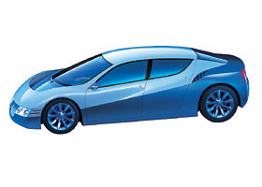

  Why fuels?
Fusion Power Associates 40th annual meeting 2019
Market 3 times larger than electricity
・Carbon-free fuels required
Substitute fewer than electricity source
・Competition in electricity market is tough
・Future fuel use
－ Fuel cells , automobile
－ aircrafts, ships
・Grid parity/stability
Dispersed electricity system
－ Cogeneration
－ Fuel cell,
－ micro gas turbine
(could be other synthetic fuels)
Automobile
Aircraft
25
Electricity
20
Solid Fuel
Liquid Fuel
15
Gaseous Fuel
Energy demand(GTOE)
10
5
0
2000
2020
2040
2060
2080
2100
Year
Example of Outlook of Global Energy

Slide 9
Fusion Energy Balance
Fusion Power Associates 40th annual meeting 2019
Fusion
Energy
Multiplication
fusion energy
P_{d}
Biomass
Chemical
energy
Driver
Energy
P_{d}
Net plant energy output(fuel)
Blanket
Output
Q =
Conversion
Efficiency
η 2.0~2.7
Generation
Efficiency
η ~0.33
◯Large energy gain Q (>20) needed for DEMO because of poor
generation efficiency.
○If fusion plant is used for fuel production, fusion energy is
fully converted to output, adding to chemical energy from
biomass.
required energy multiplication Q could be as low as 3!!

Slide 10
Relaxed Lawson criterion and efficiency η
Fusion Power Associates 40th annual meeting 2019
10
22
◯High Plasma Q not required
・Positive plant energy balance
・larger energy efficiency
Electricity
generation
Ｑ＝20，
η_{e}＝0.33
10
21
Net plant energy output
DEMO
ｎτ
10
20
ITER
6
Practical energy generation
Larger than electricity
biofuel
Ｑ＝５，
η_{ｆ}＝２．７
10
Break-even
Ｑ＝１，η＝１
10
19
◯Low Q plasma can be competitive
・possible marketing as oil fuel
・earlier introduction
・easier plasma requirements
○smaller plant→
Ｑ＞５，Ｒ<5 m is sufficient!
-0.6
Negative power
10
18
1
10
100
Ｔ（ｋｅｖ）
Fusion Target is easier
By “Hybrid Effect”.

Slide 11
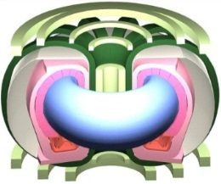
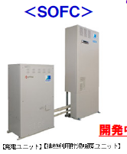
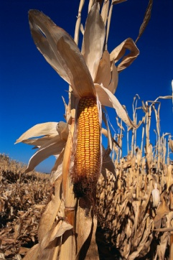

Fusion-Biomass energy flow
Fusion Power Associates 40th annual meeting 2019
Grid Stability
Start-up and
driving
Fuel Cell
Local
Electricity
FUSION
Process heat
Residential heat
“apparent”
energy multiplication
Grid
Electricity
Fuel Cell
Gasification reactor
H2+CO
BIOMASS
Fischer Tropsch process
Liquid
Fuel

Slide 12
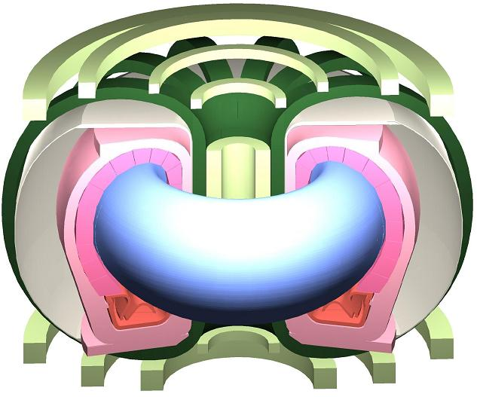
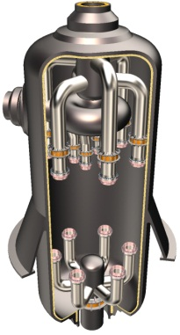

Biomass Hybrid fusion plant
Fusion Power Associates 40th annual meeting 2019
Biomass:180t/h
cellulose：（C₆H₁₀O₅）_{n/6}+ n/6H₂O
→ nH₂ + nCO – 136n [kJ]
P_{f} 320MW
IHX
Fischer-Tropsch reaction
2H₂ + CO → -CH₂- + H₂O + 160 [kJ]
R_{p}=5.2m
Diesel:90kl/h
Liquid blanket
~760MW eq.
P_{n} ~0.5MW/m²
Fusion reactor smaller than ITER with same physics
Used for endo-thermic reaction for bio-fuel production
Energy output larger than pure fusion.
Notes:
We have proposed the Fusion-biomass hybrid reactor for fuel production.
The characteristic of this reactor are small major radius and neutron wall load.
In this concept, fusion power is used for biomass gasification for hydrogen or fuel production.
To achieve high efficiency of biomass gasification, high temperature extraction over 900 degree C is required.

Slide 13
Carbon negative energy system
Fusion Power Associates 40th annual meeting 2019
CO₂
1 GW electricity equivalent
Solar energy
photosynthesis
Fusion
3GW heat
440M$/y assuming
5 cent/kwh
Biomass
C, H₂O, H₂
Cellulose/lignin：
(CH_{1.6}O_{0.6})n = nC+0.4nH₂+0.6n H₂O-451n kJ
Hydrogen fuel
Charcoal
Carbon stored as solid charcoal at ambient temperature and pressure
2.5Mt/ycarbon=9.3MtCO₂/y
Emission reduction credit
450M$/y assuming 50$/tonCO₂
→Fusion has unlimited market chance of “negative carbon” by abundant energy.
100,000 unit-operation year of 3GW fusion plant market.(7.4 TtonCO2 to solidify)
Notes:
こちらが、それぞれセルロース、リグニンの代表的な元素組成のCHO比から想定される水蒸気と反応した理想的なガス化を示す式です。
一方、このときに起こると考えられる代表的な平行反応には。これらの反応式が示すようにメタンを生成する反応や、一酸化炭素と水蒸気から水素と二酸化炭素を生成するシフト反応があります。簡略化のために炭素２個以上の反応は考慮していません。
こちらが本研究で用いる、パラメータである水素生成率、炭素分解率の定義式です。水素生成率は、全ての反応が理想的に上式で起こったときの水素生成量を100%とし、実際の生成量より求めます。炭素分解率は、バイオマスのもつ炭素原子数が一酸化炭素、二酸化炭素、メタンの炭素ガスにどれぐらい分解されたかを示します。
(0:55)

Slide 14
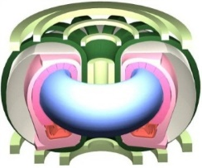
BECCS:biomass +CCS for CO₂ isolation
Fusion Power Associates 40th annual meeting 2019
CO2 absoption
and sequestration by photosynthesis
Regular CCS:
Biomass combustion
Followed by
Energy supply
Charcoal
storage
Limited site, capacity and stability
Unlimited site,
Capacity
From ：Mollersten, Biomass and Bioenergy 25(2003)273-285

Slide 15




Sustainable world with fusion-biomass
Fusion Power Associates 40th annual meeting 2019
Restoration of
Environment,
Forest and
farmland
irrigation
forests
farm
Woody biomass
Desalination of
Sea water
waste：
CO2
absorption
heat
biomass
(CxHyOz)n
heat
waste
Atmosphere CO2
Capture and reduction
Fusion plant
Grid parity
Electricity
And
stabilization
熱
charcoal
Carbon sequestration
gasification
PV
Returning the carbon from air to coal mines.
Electricity
In future grid
FC
Bio-fuels
Notes:
以上のセルロース、リグニンの吸熱分解実験の結果を用いて、産業廃棄物である木くずの年間排出量596万トンを処理することを目的に、熱交換型反応器の概要設計を行いました。木くずはセルロース７０％、リグニン３０％でなるものとしました。
設計時に用いるガス化パラメータとして、吸熱量と反応時間がありますが、これらについて本研究のデータを用いました。
コチラの図は、実験で得られたパラメータをもとに必要な物質収支、熱供給量、反応時間を満たすように設計した装置の概念です。
バイオマスは細かく粉砕して反応器上部より投入し、水蒸気も同じ流路を上から下に流通します。
一方、伝熱管に反応器下部から上部へと熱媒体を向流で流し、バイオマスへと熱伝達を行い、ガス化を行います。高温ガス炉、または高温の核融合炉を想定して熱媒体はヘリウムと仮定し、伝熱管材料はSiC複合材としました。
こちらが反応器断面の一部になります。このように内径１７ｍｍ、外径２０ｍｍの伝熱管が密に配置され全長は１０ｍ、総本数は29500本となっています。反応熱による吸熱量が大きいために設計上は熱供給が一番厳しい条件になりました。

Slide 16
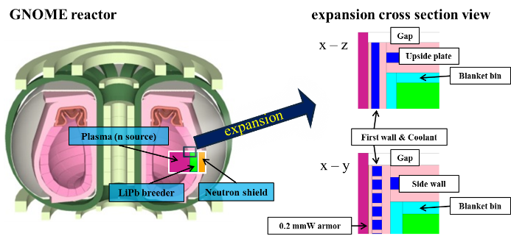
Blanket neutronics
Fusion Power Associates 40th annual meeting 2019
>> Monte Carlo neutron transport code, MCNP-5.14
>> FENDL-2.1
>> Toroidal (y-axis) – 48 cm
>> Poloidal (z-axis)– 166 cm
→Armor・first wall・configuration of modules are considered・
>> 1st wall（F82H・SiC）
>> coolants（water・He）
>> natural LiPb +Be, enriched LiPb
Investigated a possibility of LiPb without enrichment.
Notes:
ここからはArmor材・第一壁材料・モジュール間ギャップ・冷却領域・ブランケット側壁・増殖材種類まで考慮し、
多様なパラメータがトリチウム生成に与える影響を明らかにするため、具体化されたブランケットデザインを用いて核解析を行いました。
主な比較パラメータは第一壁の種類・冷却材の種類・増殖材の種類となります。

Slide 17
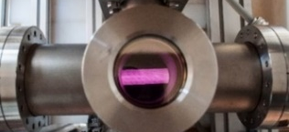
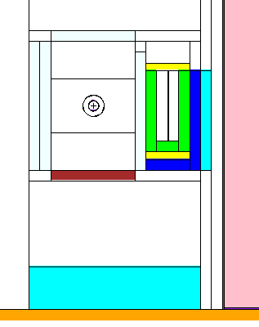
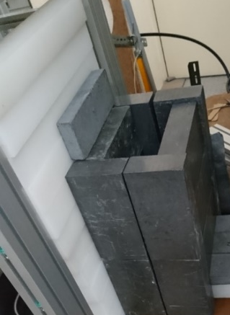
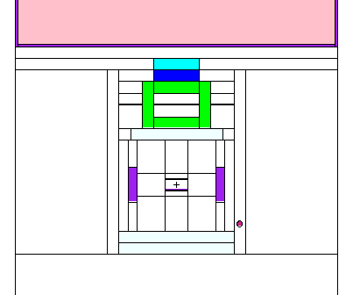
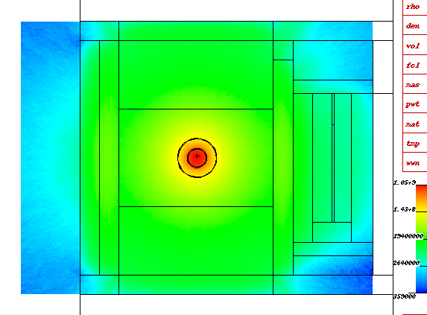
neutronics experiment
Fusion Power Associates 40th annual meeting 2019
blanket assembly and small neutron source for transport measurement for actual measurement of tritium self sufficiency
Neutron IP
PE
Entron
Source
LiPb
Pb
PE
PE
C
z
Boronized PE
1×10⁹
source
1×10⁸
³He detector
y
2×10⁷
3×10⁶
NS
y
4×10⁵
PE
Borate water
鉛
鉛
x
PE
PE
鉛

Slide 18
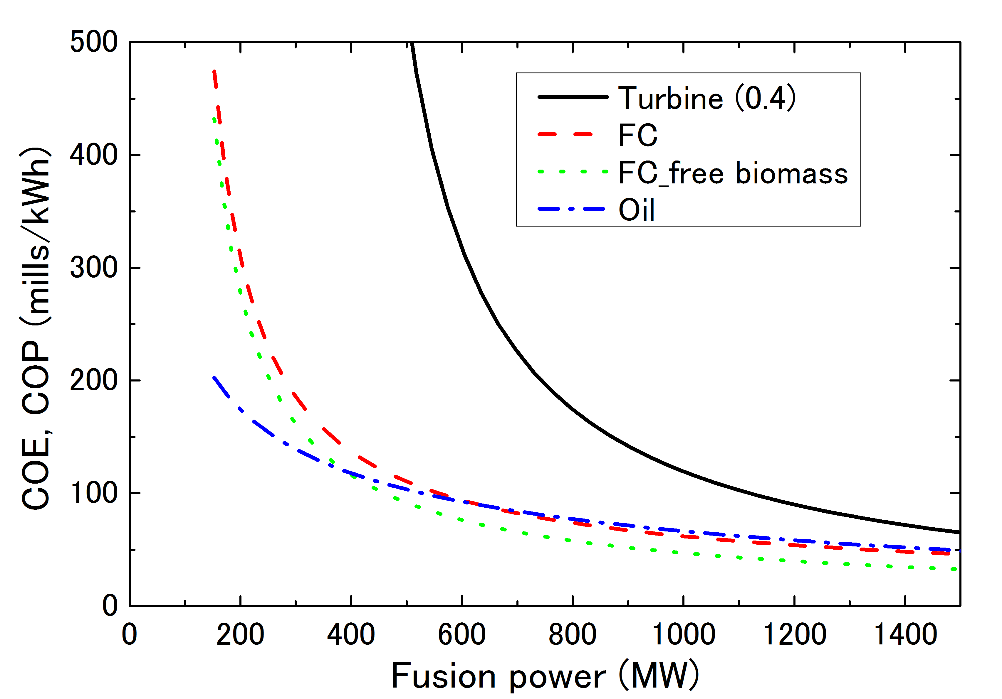
Cost analysis of energy plant
Fusion Power Associates 40th annual meeting 2019
  Fusion electricity by fuel cells
FT plant case, P_{CD} is supplied by 100 mills/kWh
FCs
Turbine
Oil
  For smaller reactor, Fuel cell is more efficient

Slide 19
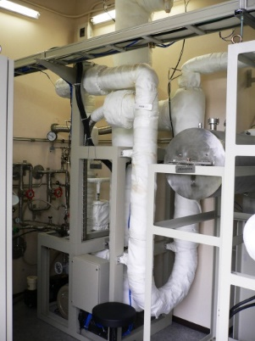
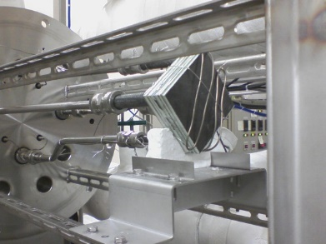
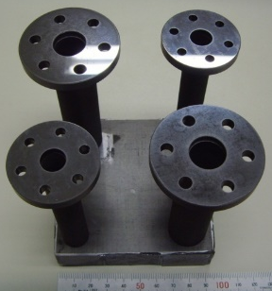
Energy utilization study
Fusion Power Associates 40th annual meeting 2019
LiPb-SiC heat exchanger development
High temperature heat exchanger made of ceramics desired.
Hydrogen production needs special isolation between
primary and secondary coolants.
→IHX transfers heat but prevent
tritium permeation between
primary LiPb or He and secondary.
Expansion
tank
heater
SiC tube
T
Test section2
９００℃
T
T
economizer
７００℃
P
cooler
F
T
IHX
module
T
～200℃
T
Gas
Chromato-graph
ＥＭＰ
heater
９００℃
７００℃
Test vessel
T
T
P
GC
T
Test section3
hygrometer
Test section1
F
MSB
SiC compact IHX test model
Primary loop
Zr
Dump tank
Secondary loop
GC
.
10kw heat exchanger demonstrated with PbLi/He at 1000 ℃
Notes:
The model of Japan is outlined in the flowing.
Nuclear fusion plant in Japan will be located in coastal area, but NORMTRI assumes that nuclear fusion plant is located in the inland area. In addition, Japanese food culture is different from European food culture. Principal food of Japan is rice but in Europe it is wheat or potato.
So, the sea section was brought into NORMTRI to consider effect of the sea. And, rice compartment was added because rice grows in rice paddy which is covered with water unlike normal agricultural field.

Slide 20
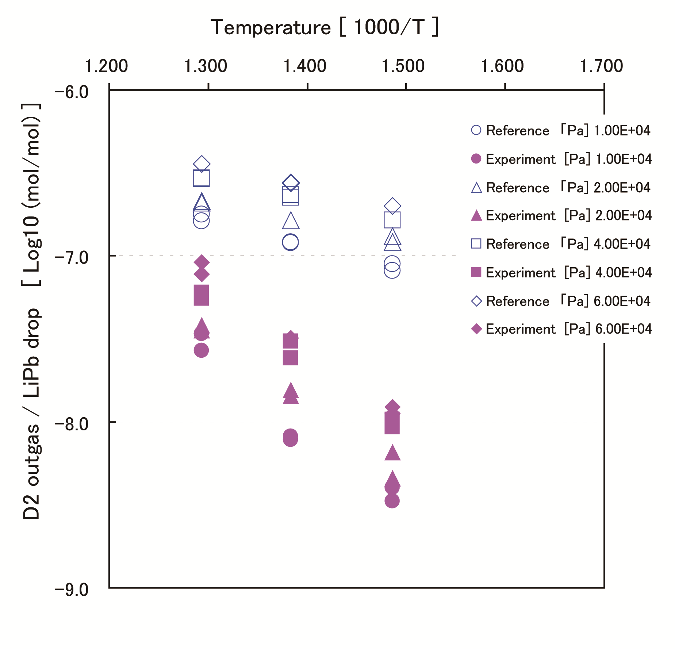
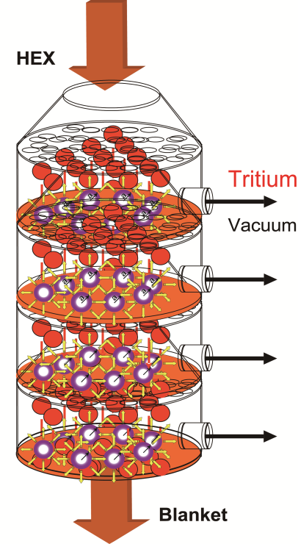
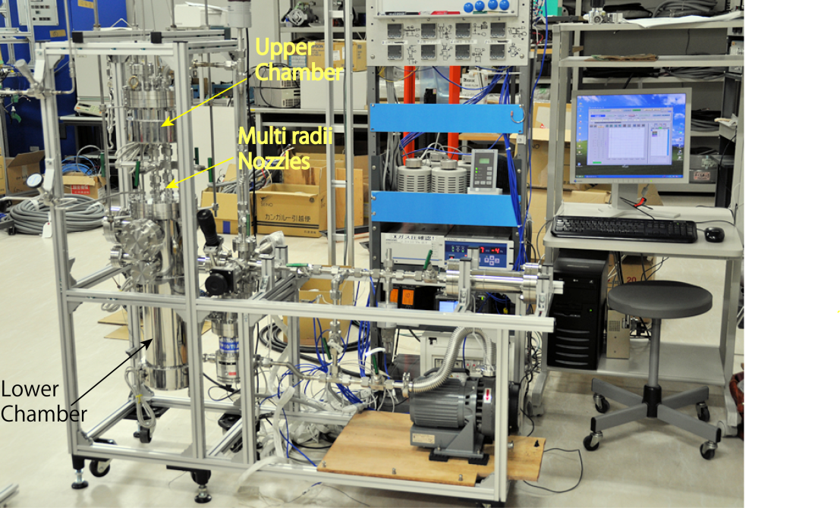
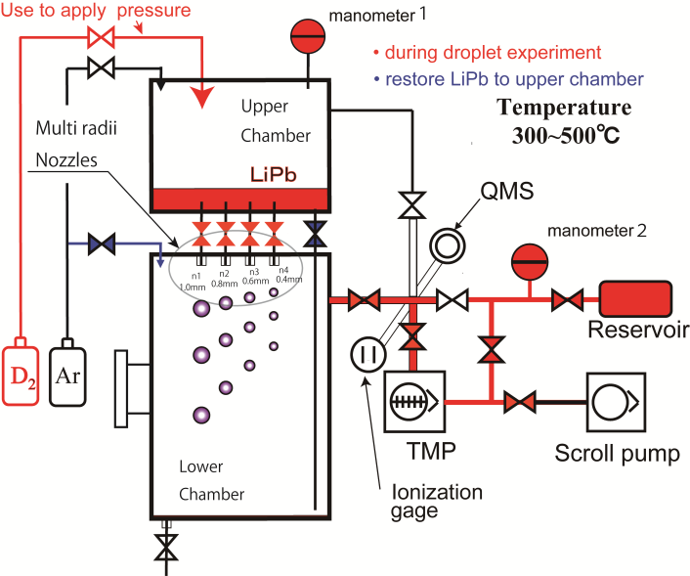
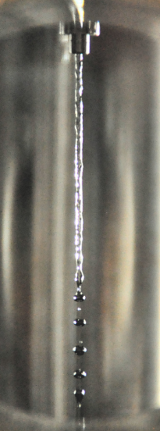
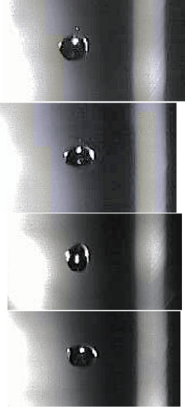
Extraction of tritium from liquid metal
Fusion Power Associates 40th annual meeting 2019
Tritium extraction from LiPb by vacuum sieve tray is developed.

Slide 21
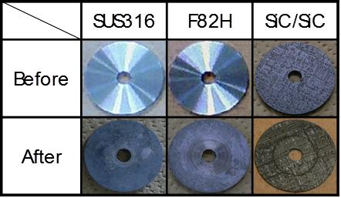
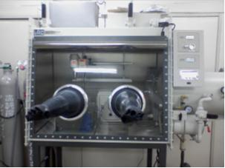
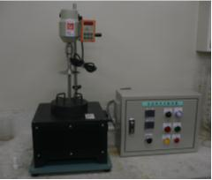
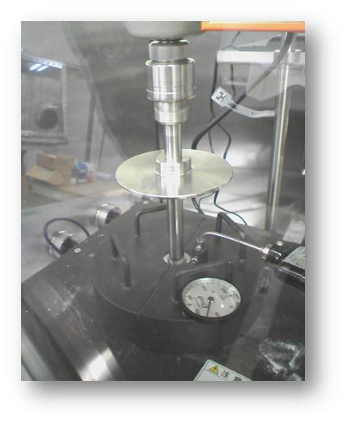
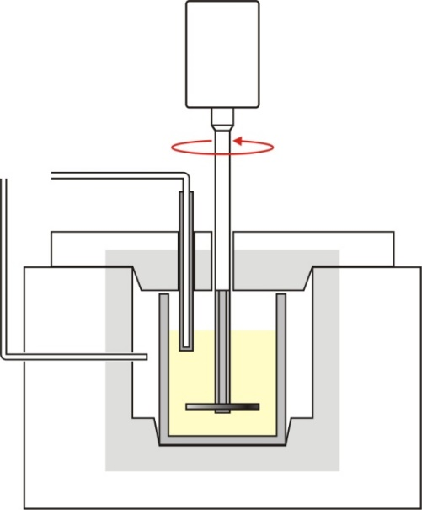
Material compatibility assessment
Fusion Power Associates 40th annual meeting 2019
LiPb/SiC/RAFM Compatibility study
Electric Motor
Mo TC protection tube
Thermocouple
Mo Support bar
Mo Support bar guide
Electric Furnace
Specimen
Liquid LiPb or Na
Mo Crucible

Slide 22
Modelling of Fuel System for self sufficiency
Fusion Power Associates 40th annual meeting 2019
（described with Stella）
[D-D]×0.5
[D-D]×TBR_{DD}
Decay & Leak
Breeding
Blanket
N_{bk}
Plasma/VV
N_{p}
Exchange Reaction,
Accumulate and saturate
Dead inventory
[D-T]
[D-T]×TBR_{DT}
Decay
(τ_{p}=20s)
Dead inventory
(τ_{bk}=1.73 × 10⁵)
Accumulate continuously,
(Same as decay)
$$N_{fs}/τ_{fs}$$
Fuel clean up
N_{ex}
Decay & Leak
Decay & Leak
Decay
(τ_{fs}=1800s)
(τ_{fu}=1200s)
Return from 2ndary loops
Decay & Leak
Decay & Leak
Fueling & Storage
N_{fu}
Isotope separation system
N_{is}
Dead inventory
Dead inventory
Decay
(τ_{is}=1800s)
Decay

Slide 23
Conclusion
Fusion Power Associates 40th annual meeting 2019
Kyoto Fusioneering assists fusion challengers through
engineering solutions for the energy demonstration.
We provide not only device or design, but integrated consultation to assist efficient power demonstration.
Through the development, transfer of skills and experience from senior to young generation is intended.
Open Innovation by the combination of various industry and research facilities (some reused) are expected.
Kyoto Fusioneering proposes fusion technology options
responding to future energy/environmental needs.

