Slide 1
Progress toward scaling to inertial fusion energy conditions
Dr. Daniel Sinars, Director of the Pulsed Power Sciences Center at Sandia National Laboratories
Fusion Power Associates | December 3, 2019

Slide 2
These are exciting times to be working in pulsed power fusion research
It may be possible to achieve close to scientific fusion breakeven on the Z pulsed power facility
  ~100 kJ DT-equivalent yields may be possible in next few years
  This is approximately the energy in the fusion fuel, based on simulations
We have substantially improved our understanding of Magnetized Liner Inertial Fusion plasmas
We have previously scaled MagLIF downward 1000x in energy to the Omega laser facility
We are now scaling the concept upward on Z by increasing the magnetization and current
We are laying the groundwork for a next step in pulsed power sometime after 2030
  The 26 MA, 80 TW Z facility will celebrate 35 years of Z-pinch operation in 2030
  Opportunity to build a >60 MA, >800 TW facility capable of coupling ~10 MJ to fusion targets by ~2032
  Such a facility would allow a direct scale-up of MagLIF targets on Z to conditions for gas-burning (volume) ignition at multi-MJ yields
  It would also be big enough to test ice-burning, high-gain MagLIF targets

Slide 3
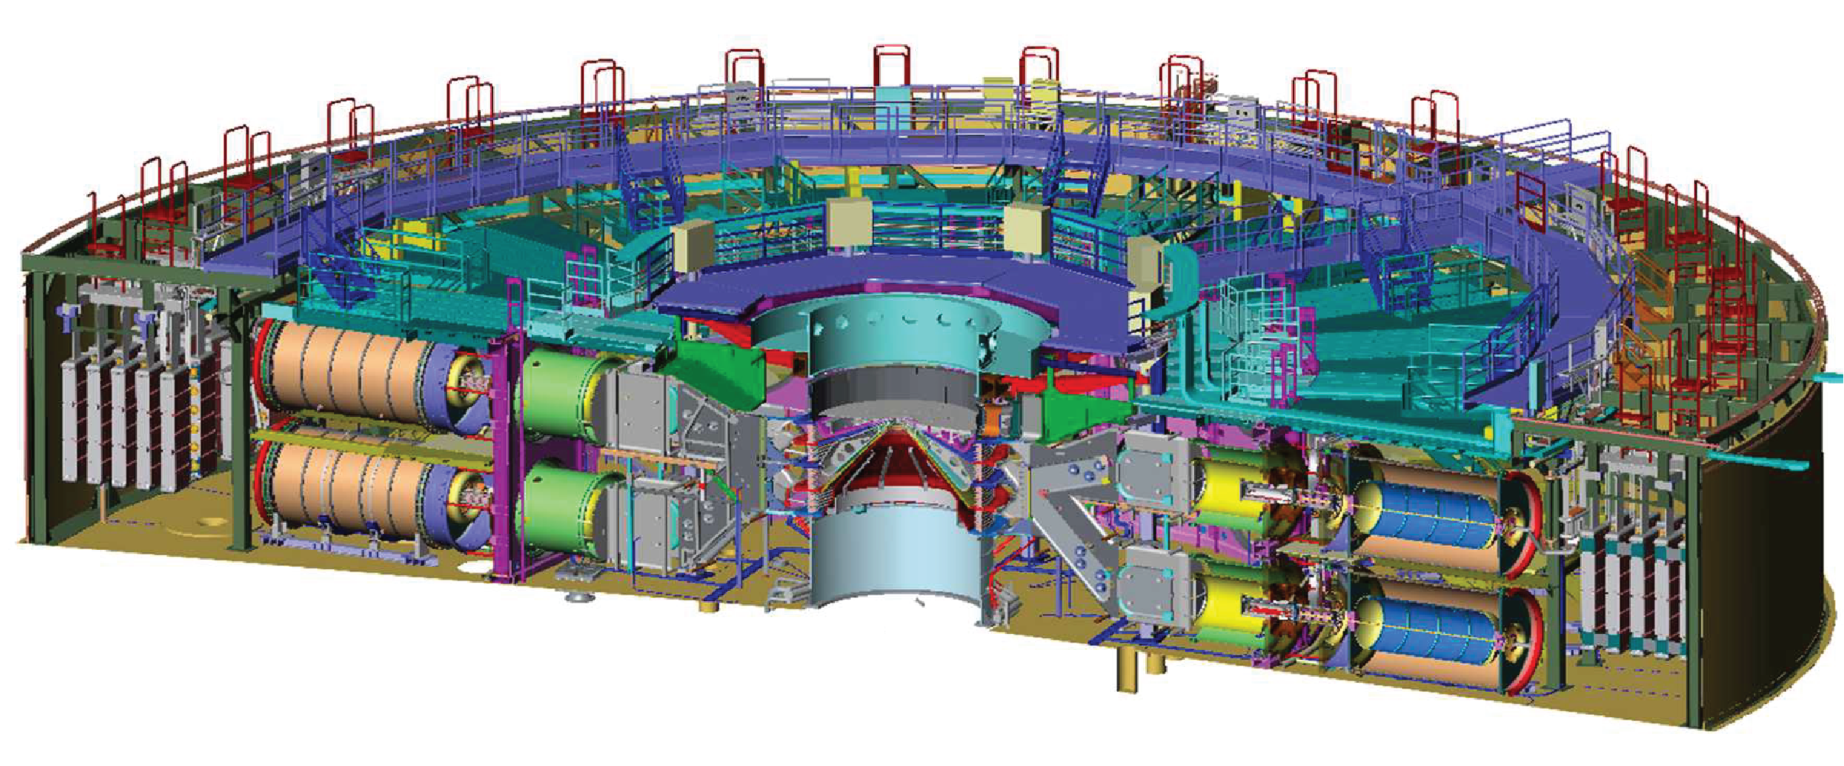
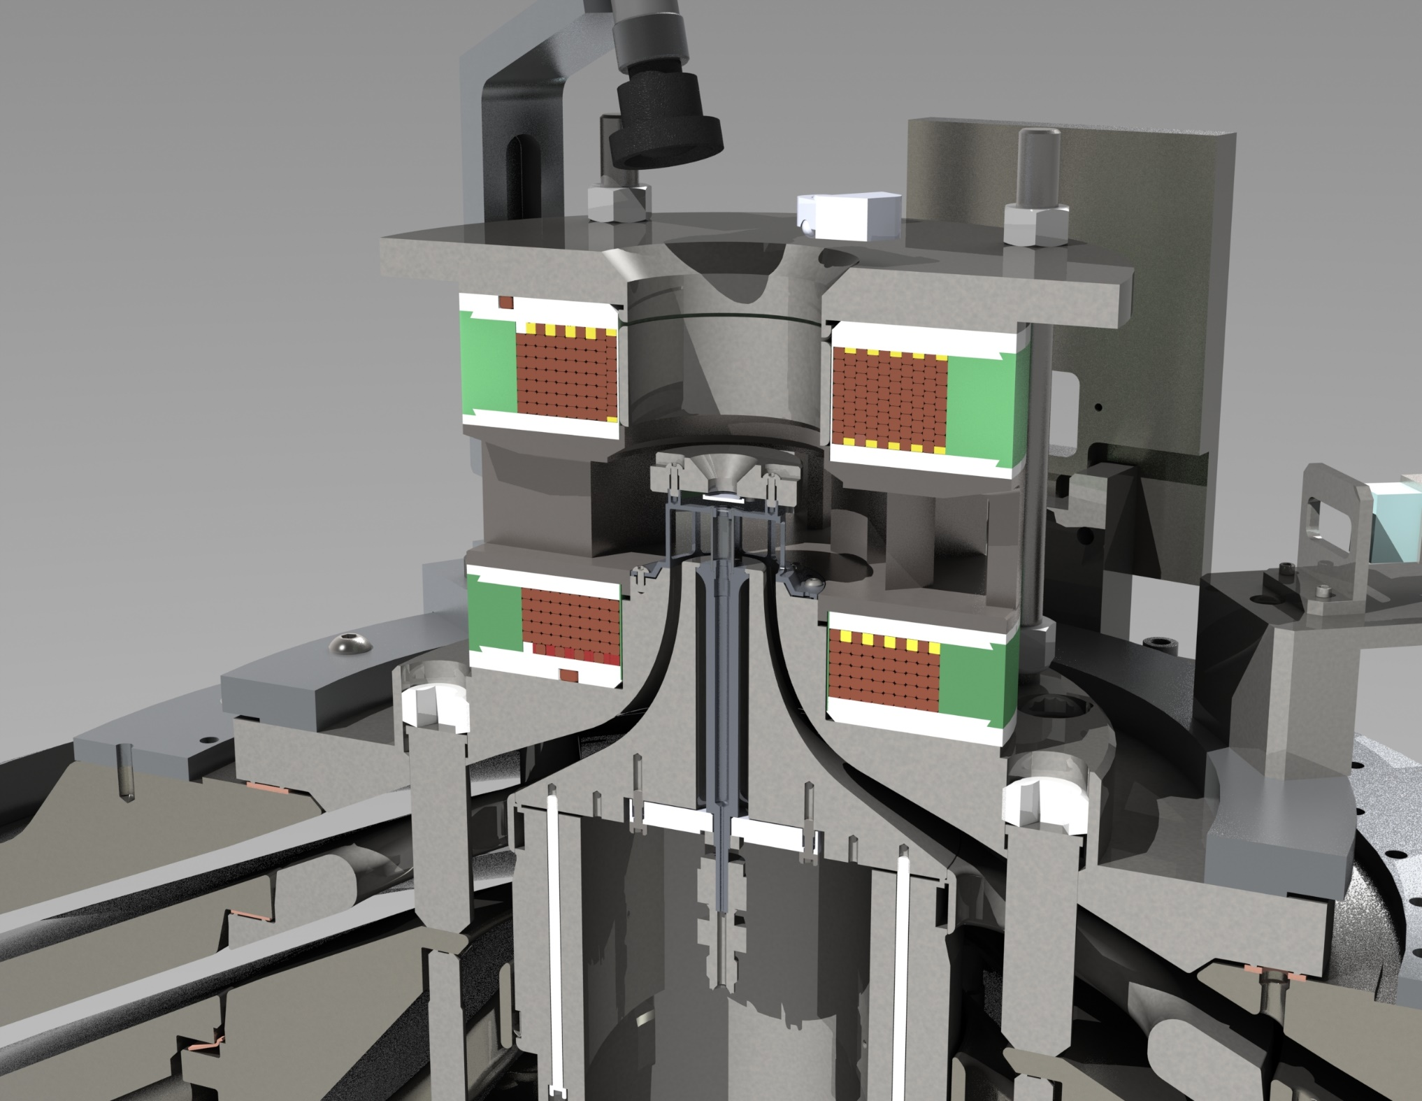
Z compresses energy in space and time to generate fusion conditions at its center
Marx Generator
(22 MJ Stored)
Pulse Forming
Storage Section
Center
Section
Load Hardware & Target
Z today couples several MJ out of 22 MJ stored to the load hardware region at the machine center.
80 TW, 26 MA
Electrical

Slide 4
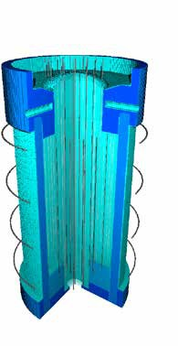
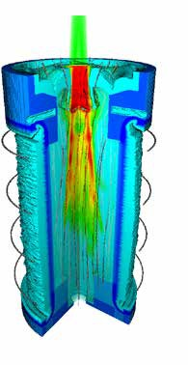
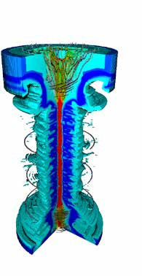


Magnetized Liner Inertial Fusion (MagLIF) is a magneto-inertial fusion (MIF) concept
Relies on three components to produce fusion conditions at stagnation
=
Magnetization
Suppress radial thermal conduction losses
Enable slow implosion with thick target walls
Preheat
Ionize fuel to lock in B-field
Increase adiabat to limit required convergence
Implosion
PdV work to heat fuel
Flux compression to amplify B-field
Stagnation
Several keV temperatures
Several kT B-field to trap charged fusion products
S.A. Slutz et al., Phys. Plasmas (2010); A.B. Sefkow et al., Phys. Plasmas (2014); S.A. Slutz et al., Phys. Plasmas (2018).

Slide 5
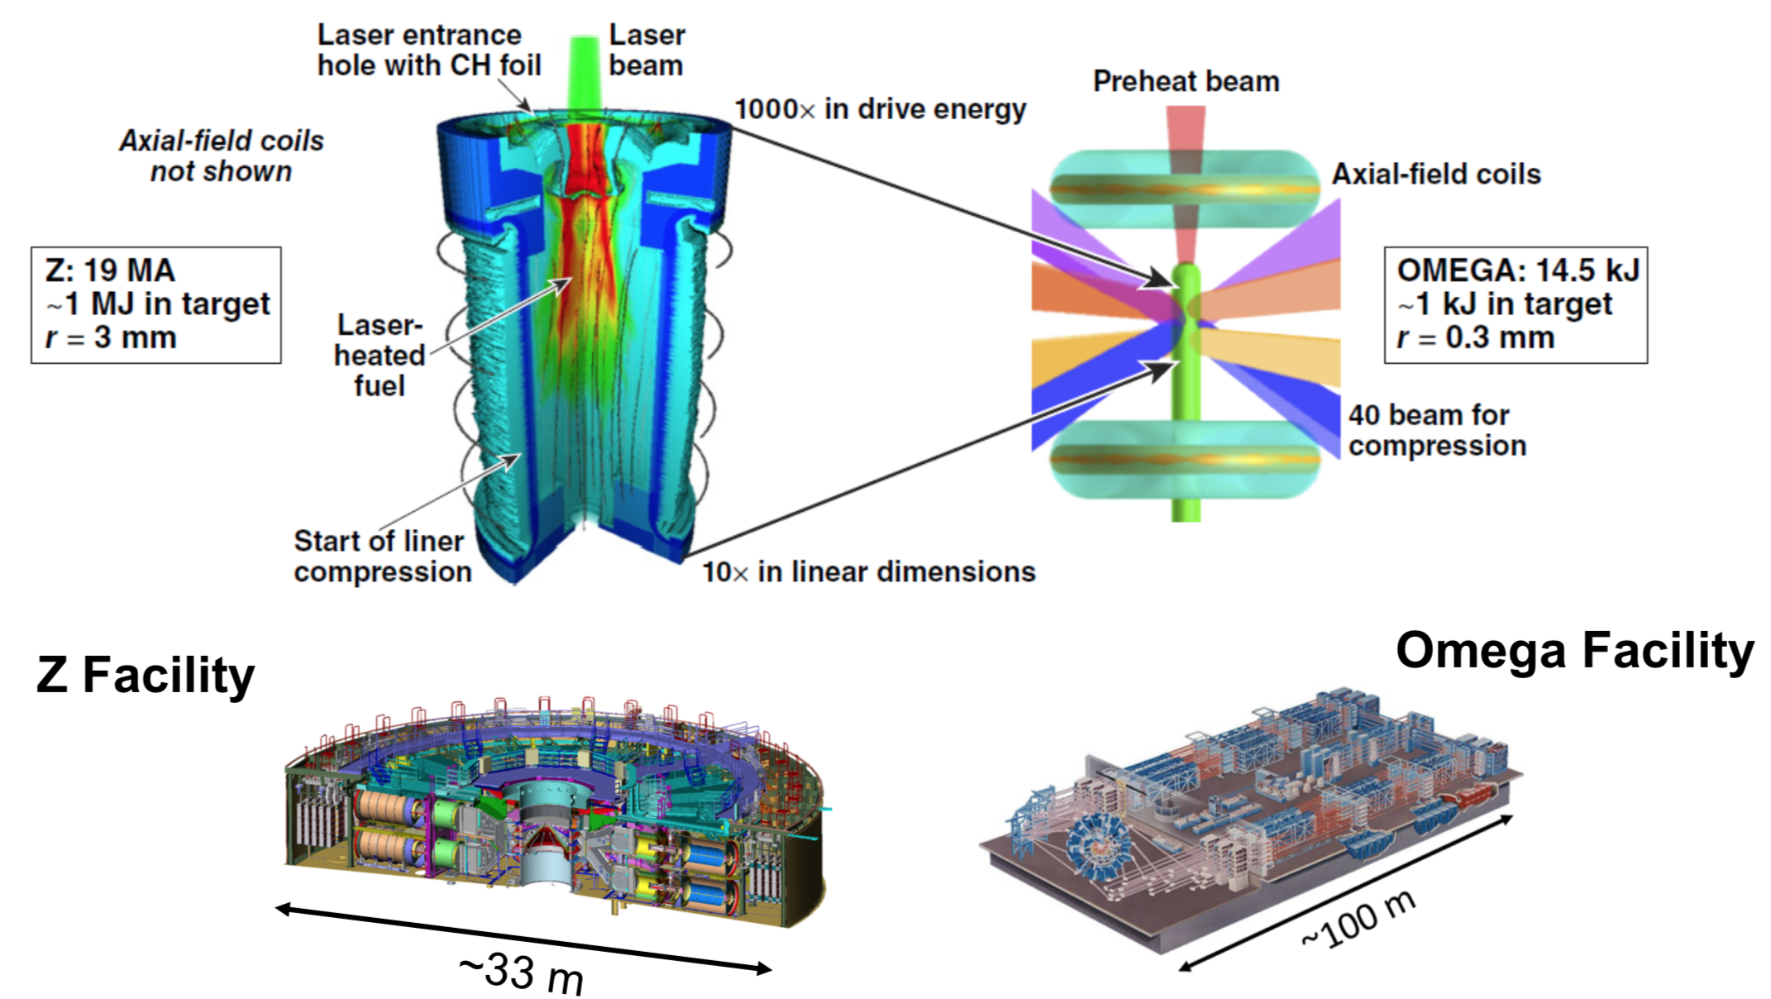


MagLIF has been demonstrated to work well over a range of 1000x in energy
J.R. Davies et al., Phys. Plasmas (2017); D.H. Barnak et al., Phys. Plasmas (2017).

Slide 6
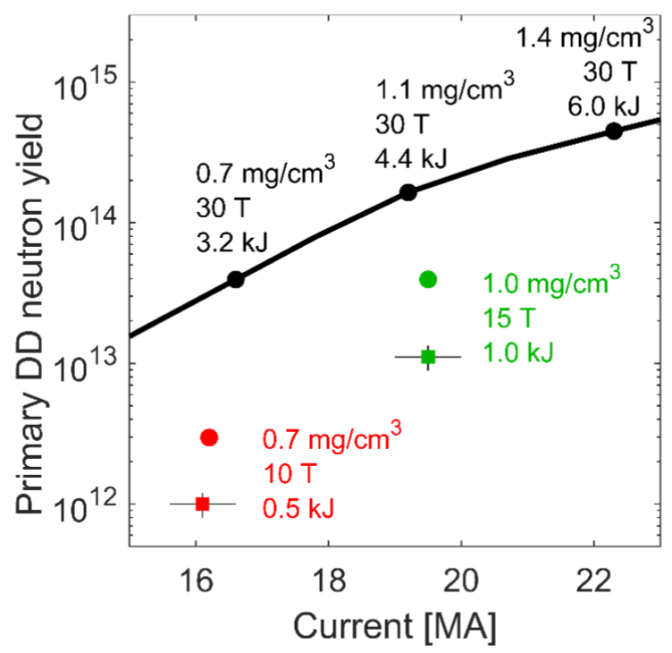
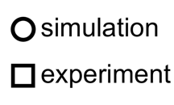
We have made substantial progress over the past five years in understanding MagLIF plasmas, and in beginning to scale MagLIF to higher yields
Optimized yield curve
2019
2014
M.R. Gomez, S.A. Slutz, C.A. Jennings et al., manuscript under preparation (2019).

Slide 7
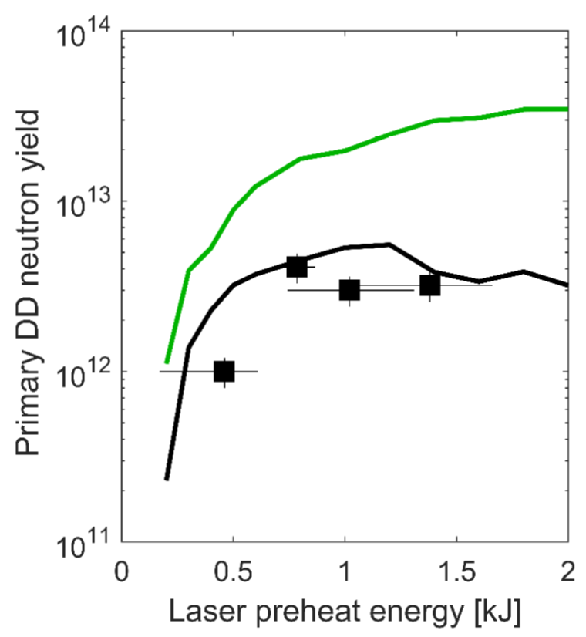
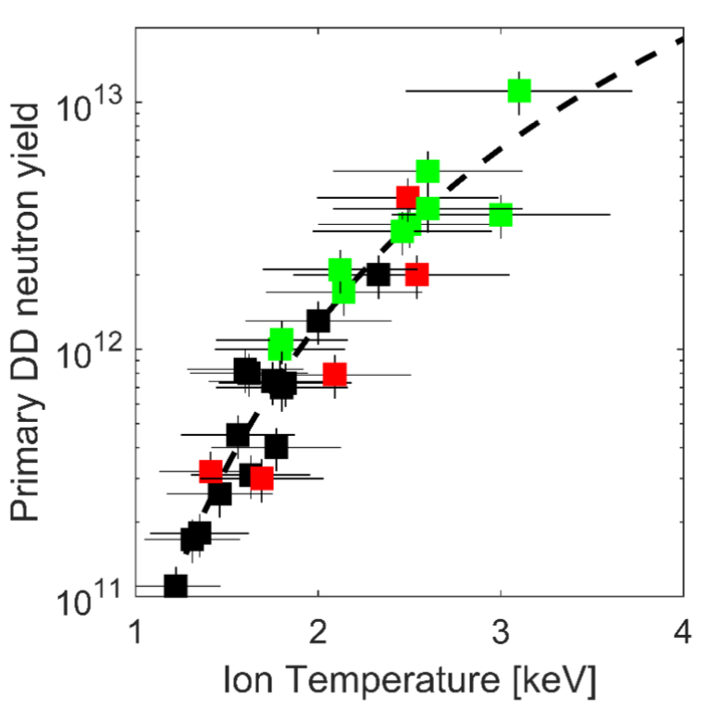
We have a better understanding of the importance of magnetization, fuel preheat, and sources of mix on the performance of MagLIF targets
Yield vs preheat energy trend as expected
Nernst effect non-negligible
Yield scales as expected for thermonuclear fusion
Laser entrance hole mix a factor
30 T
10 T
High-Z washer
Poor laser pulse shape
Low-Z washer;
Extended laser prepulse
Data at 0.7 mg/cc, 16 MA, 10 T
M.R. Gomez, S.A. Slutz, C.A. Jennings et al., manuscript under preparation (2019).

Slide 8
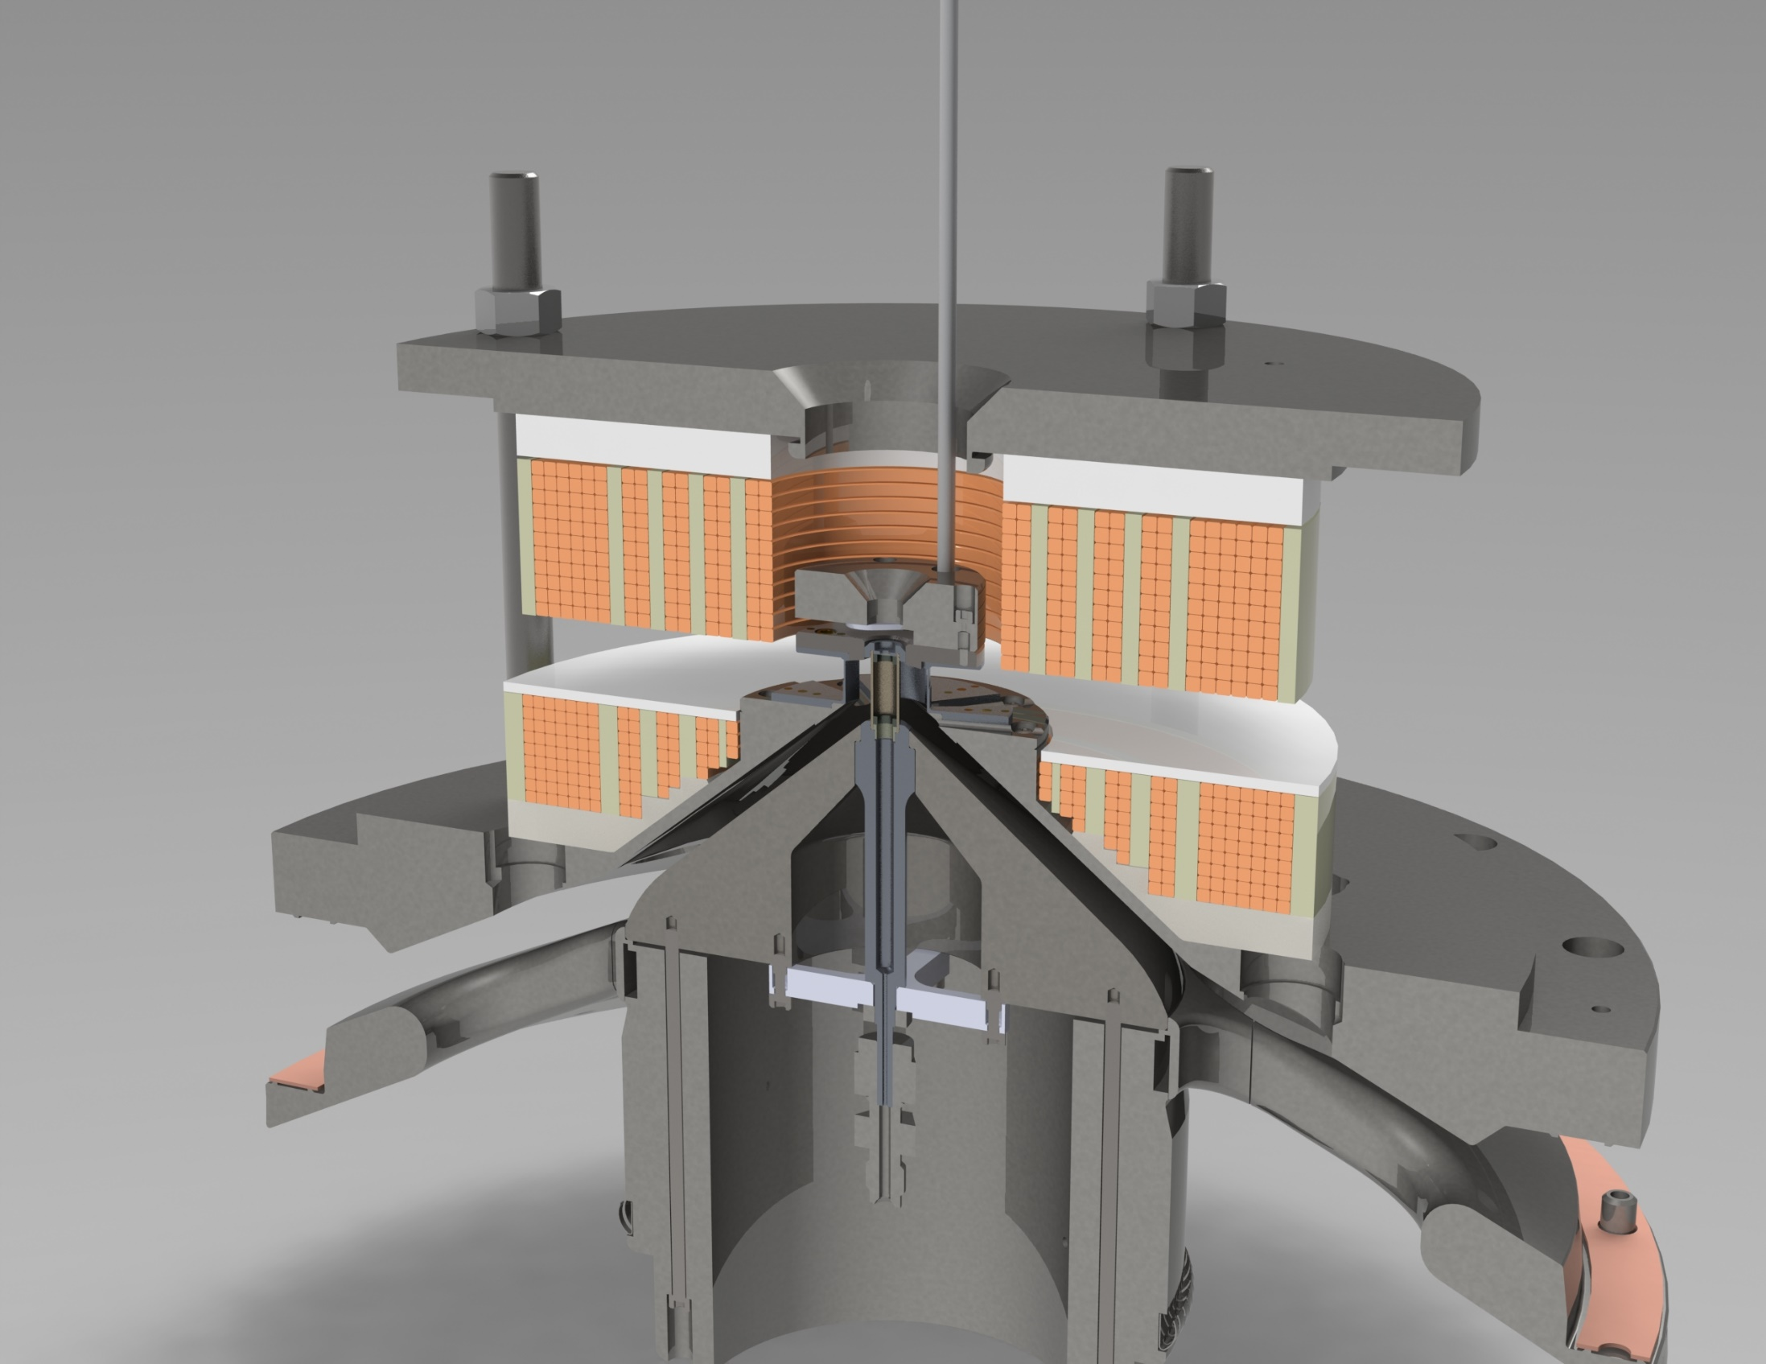
We will continue to test MagLIF scaling through further increases in magnetization, preheat, and drive current
MagLIF
ca. 2014
7-10 T
MagLIF
ca. 2021
25-30 T
We are working to demonstrate 20-25 T, 2-4 kJ, 20-21 MA in the next 2 years
S. A. Slutz, et al., Phys. Plasmas (2018); Invited APS-DPP talk by M. Gomez GI3.00004.
Notes:
We are working towards a FY20 milestone requiring >20 T, >2 kJ, and >20 MA
2022 goal is relatively straight forward given our present capabilities and planned upgrades

Slide 9
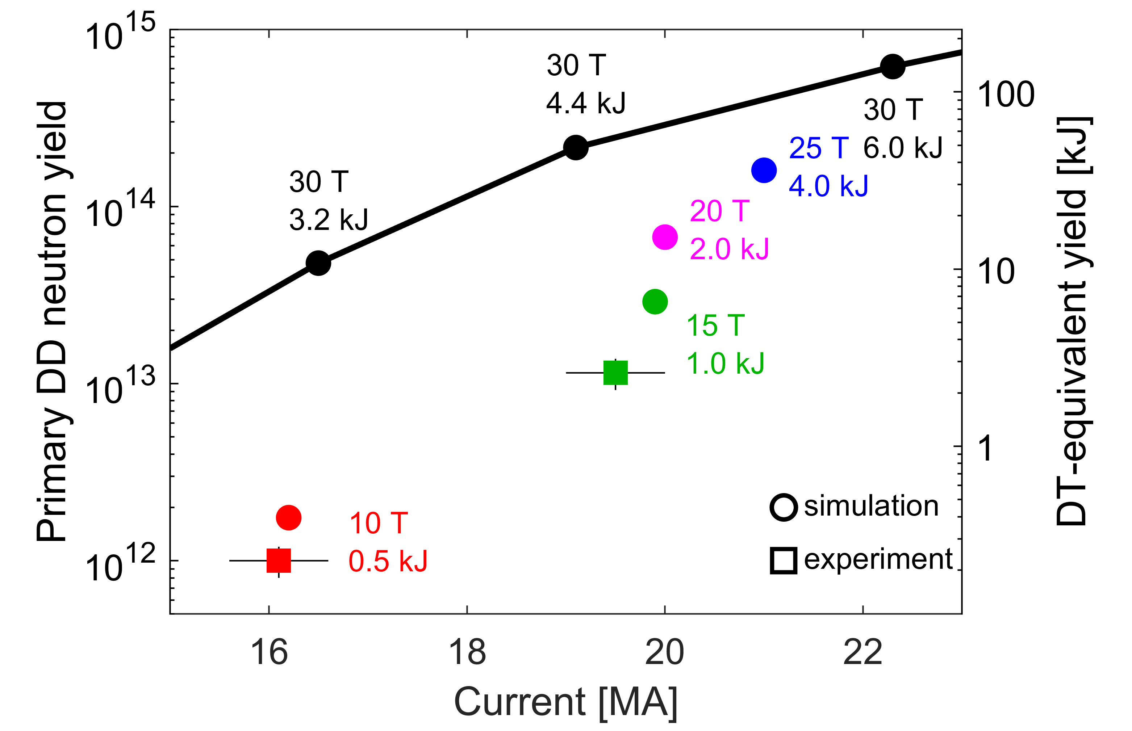
We will continue to test MagLIF scaling through further increases in magnetization, preheat, and drive current; 10s of kJ DT-equivalent yield possible in next 2 years
We are working to demonstrate 20-25 T, 2-4 kJ, 20-21 MA in the next 2 years
S. A. Slutz, et al., Phys. Plasmas (2018); Invited APS-DPP talk by M. Gomez GI3.00004.
Notes:
We are working towards a FY20 milestone requiring >20 T, >2 kJ, and >20 MA
2022 goal is relatively straight forward given our present capabilities and planned upgrades

Slide 10
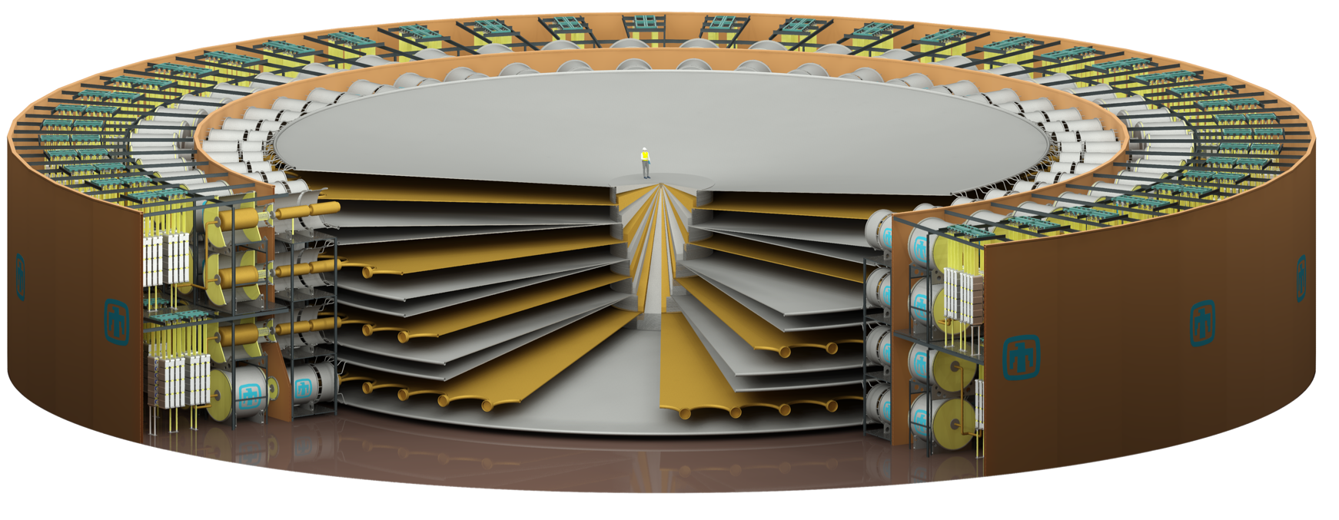
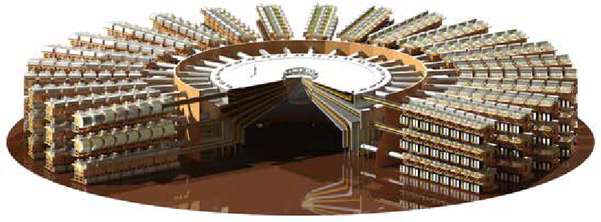
Sandia has proposed a next generation pulsed power facility to the NNSA
World’s most powerful warm x-ray and fast fusion neutron source
(hostile nuclear survivability)
Enabling capability for high energy density physics
(nuclear explosive package certification)
It would attract and test tomorrow’s stewards of pulsed power and fusion research
It would provide a venue for scientific and technical innovation for national security
It would demonstrate inertial fusion energy target concepts at relevant scales
Proposed project start date ~2025
Proposed project completion date ~2032
Z will celebrate ~35 years of z-pinch physics in 2030, with some parts of infrastructure ~45 years old.
Sandia is evaluating pulsed power architectures
~3x diameter of Z today
Delivers 800-1000 TW of electrical energy
Couples ~10 MJ to fusion targets
Requires new operations concepts to reduce manual labor and potential worker hazards
Notes:
- While most of the pulsed power hardware for Z was refurbished in 2006, the majority of the building and surrounding infrastructure is >35 years old today.
There are increasingly large benefits for Sandia’s stockpile stewardship role relative to high energy density physics if yields in the 1-1000 megajoule (MJ) range can be achieved.
Z continues to lack state-of-the-art nuclear fusion diagnostics like those present on the National Ignition Facility or the Omega laser. National investments to port some of these technologies into the Z environment would improve the credibility of the target fusion scaling.
in its current configuration

Slide 11
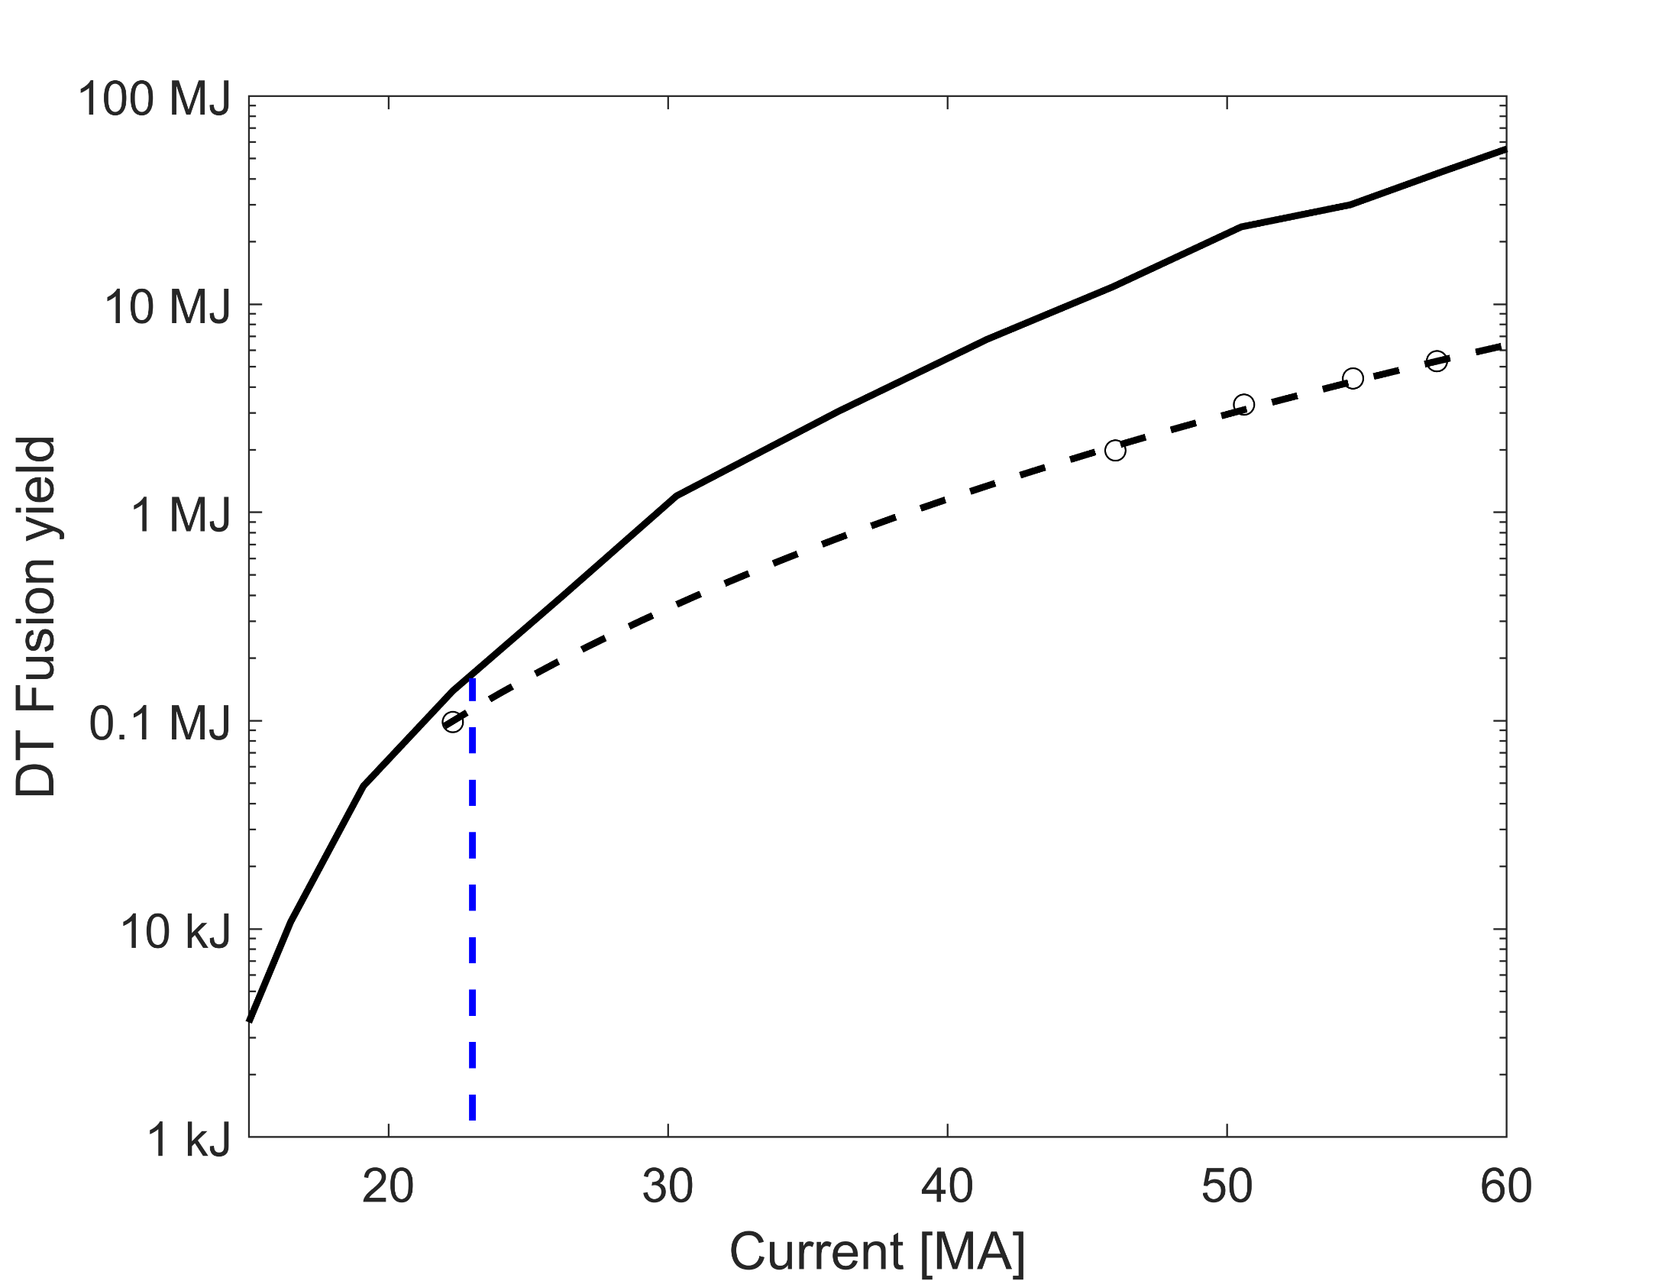
Achieving close to 100 kJ (DT-equivalent) yield on Z with MagLIF would improve the credibility of scaling to multi-MJ fusion yields on a future facility
2D clean simulated MagLIF performance
At >60 MA, MagLIF appears capable of >10 MJ yields
Most credible scaling is for gas (volume) burning targets; ice-burning targets may be capable of higher gains*
Program of work on Z, NIF, and Omega continues to address scaling physics
  3D Effects
  Mix
  Magnetization
  Implosions
LASNEX optimized
No alpha
Z
Future facility
S. A. Slutz et al., Phys. Plasmas (2018); * Slutz & Vesey, Phys. Rev. Lett. (2012).

Slide 12
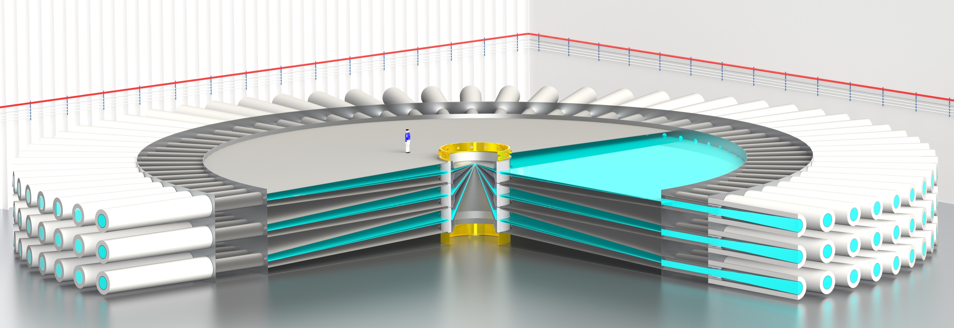
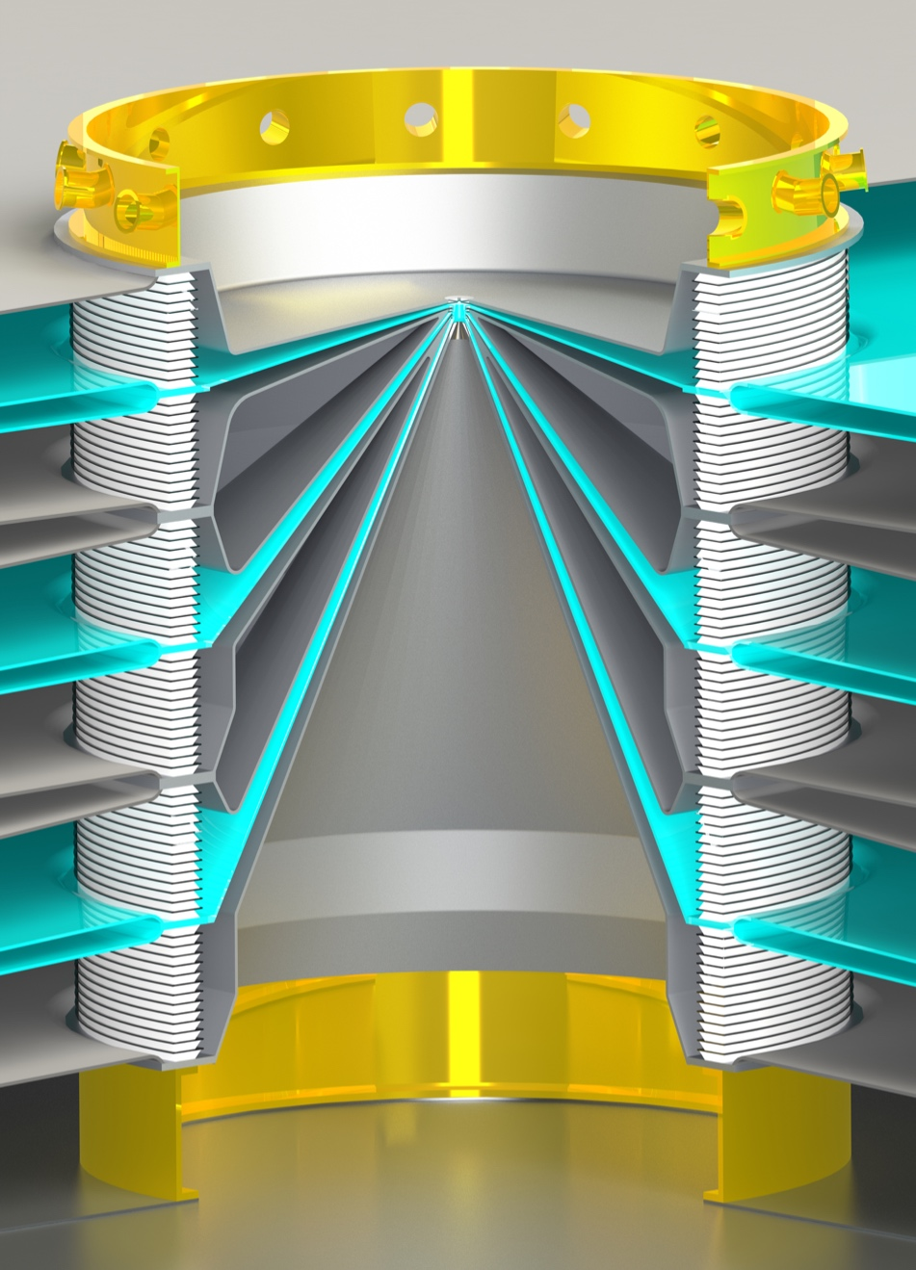
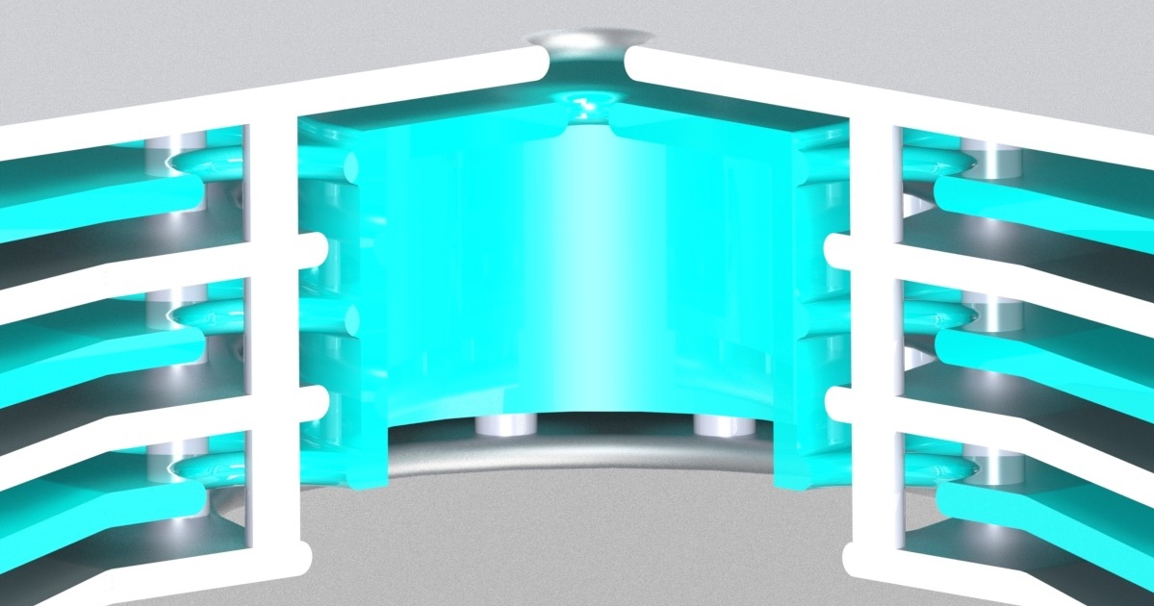
We are investing in driver-target coupling physics, which spans a rich intermediate-density regime of plasma physics
~1 PW
9 MJ electrical
How do plasmas form from surfaces?
How well insulated are the gaps during the current pulse?

Slide 13
We are investing in driver-target coupling physics, which spans a rich intermediate-density regime of plasma physics
Section of a “vacuum” transmission line
Anode: heated ohmically, by electrons, neg. ions?, radiation
10²³
Anode-contaminant plasma (~2 eV)
10¹⁶⁻¹⁹
~1 PW
9 MJ electrical
electrons launched by upstream MITLs (~MeV)
B~100 T
E~10 MV/cm
ions emitted by the anode plasma (~MeV)
10¹¹⁻¹⁴
electrons emitted by the cathode (~100 keV)
Cathode-contaminant plasma (~2 eV)
10¹⁶⁻¹⁹
How do plasmas form from surfaces?
How well insulated are the gaps during the current pulse?
Cathode: heated via breakdown, ohmically, by ions, radiation
10²³
Multi-scale and non-neutral plasmas crossing PIC and Continuum regimes

Slide 14

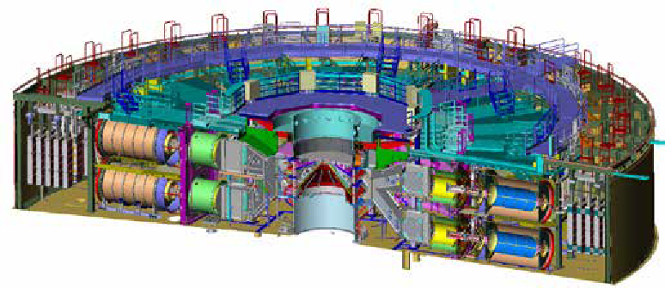
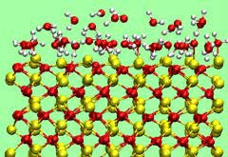
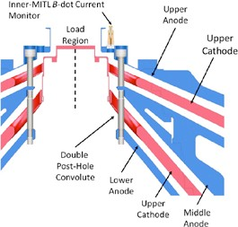
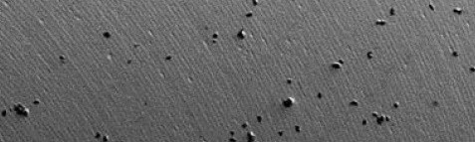
We are using internal laboratory funding to conduct a range of basic to applied power flow physics research
Pulsed Power Facility (1 – 50 meter)
Basic
Basic Science:
Surface desorption physics
Multi-scale simulation of a plasma expanding into vacuum
Use-inspired:
Hybrid fluid/particle-in-cell algorithm development
Applied:
3D double post hole Z convolute simulation
Combined power flow and target simulations
Atomistic Effects (10 – 100 nm)
Use-Inspired
Power Flow
Geometry (1 – 20 cm)
Applied
Electrode / Plasma Morphology (10 – 100 µm)

Slide 15
These are exciting times to be working in pulsed power fusion research
It may be possible to achieve close to scientific fusion breakeven on the Z pulsed power facility
  ~100 kJ DT-equivalent yields may be possible in next few years
  This is approximately the energy in the fusion fuel, based on simulations
We have substantially improved our understanding of Magnetized Liner Inertial Fusion plasmas
We have previously scaled MagLIF downward 1000x in energy to the Omega laser facility
We are now scaling the concept upward on Z by increasing the magnetization and current
We are laying the groundwork for a next step in pulsed power sometime after 2030
  The 26 MA, 80 TW Z facility will celebrate 35 years of Z-pinch operation in 2030
  Opportunity to build a >60 MA, >800 TW facility capable of coupling ~10 MJ to fusion targets by ~2032
  Such a facility would allow a direct scale-up of MagLIF targets on Z to conditions for gas-burning (volume) ignition at multi-MJ yields
  It would also be big enough to test ice-burning, high-gain MagLIF targets

Slide 16
BACKUP SLIDES

Slide 17
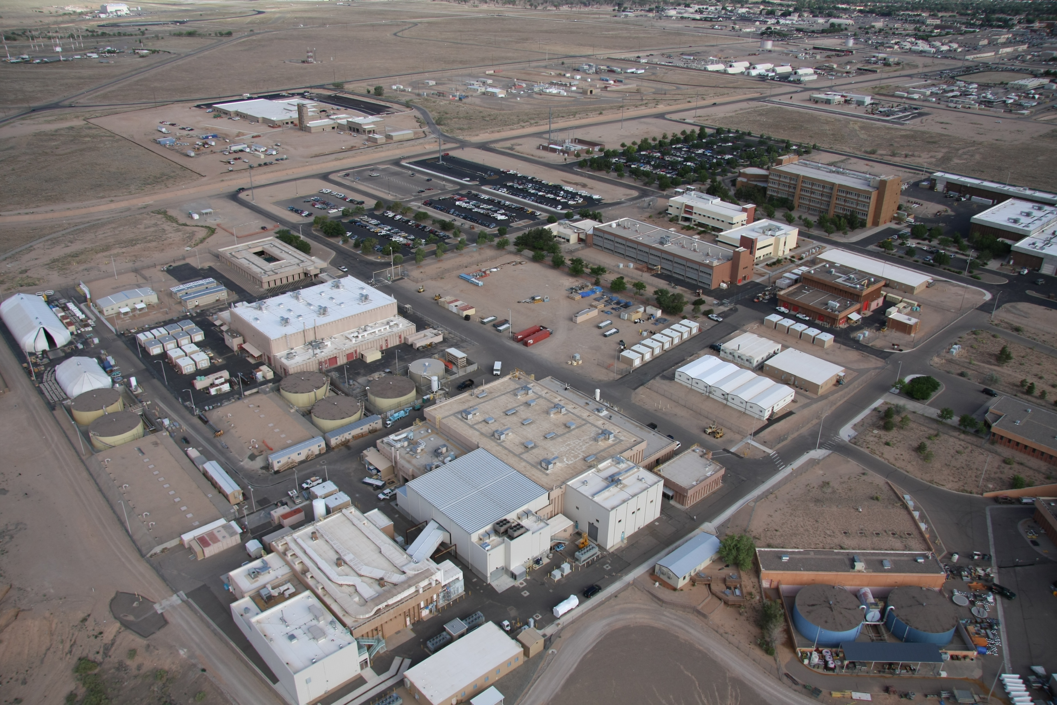
The Z facility is supported by the multi-kJ Z-Beamlet & Z-Petawatt lasers, which can also be operated independently

Slide 18
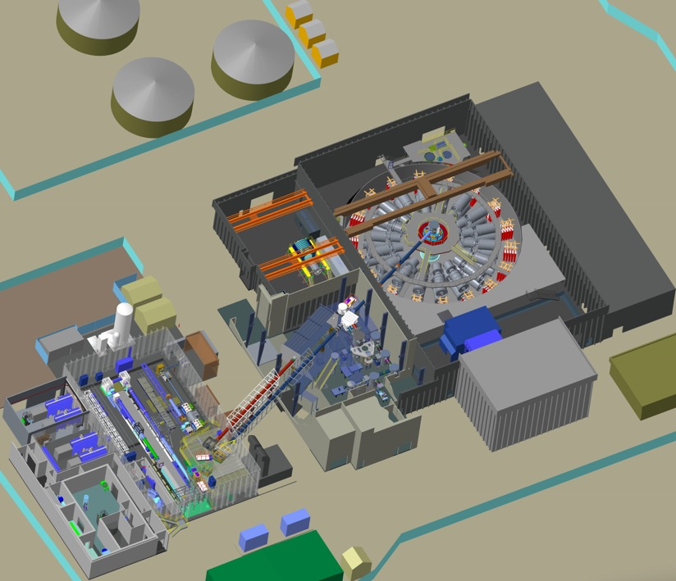
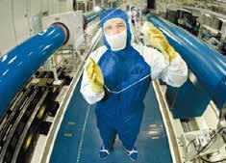
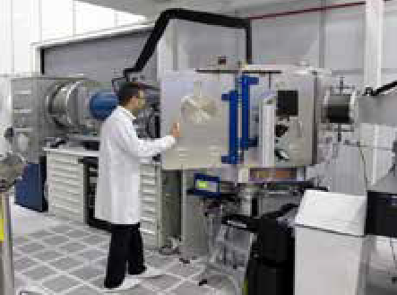
The Z facility is supported by the multi-kJ Z-Beamlet & Z-Petawatt lasers, which can also be operated independently
Z Machine
Pulsed Power Development
Area
Z-Beamlet
Laser
Target Chambers
P.K. Rambo et al., Applied Optics 44 (2005); P. Rambo et al., Proc. SPIE 10014 (2016).

Slide 19
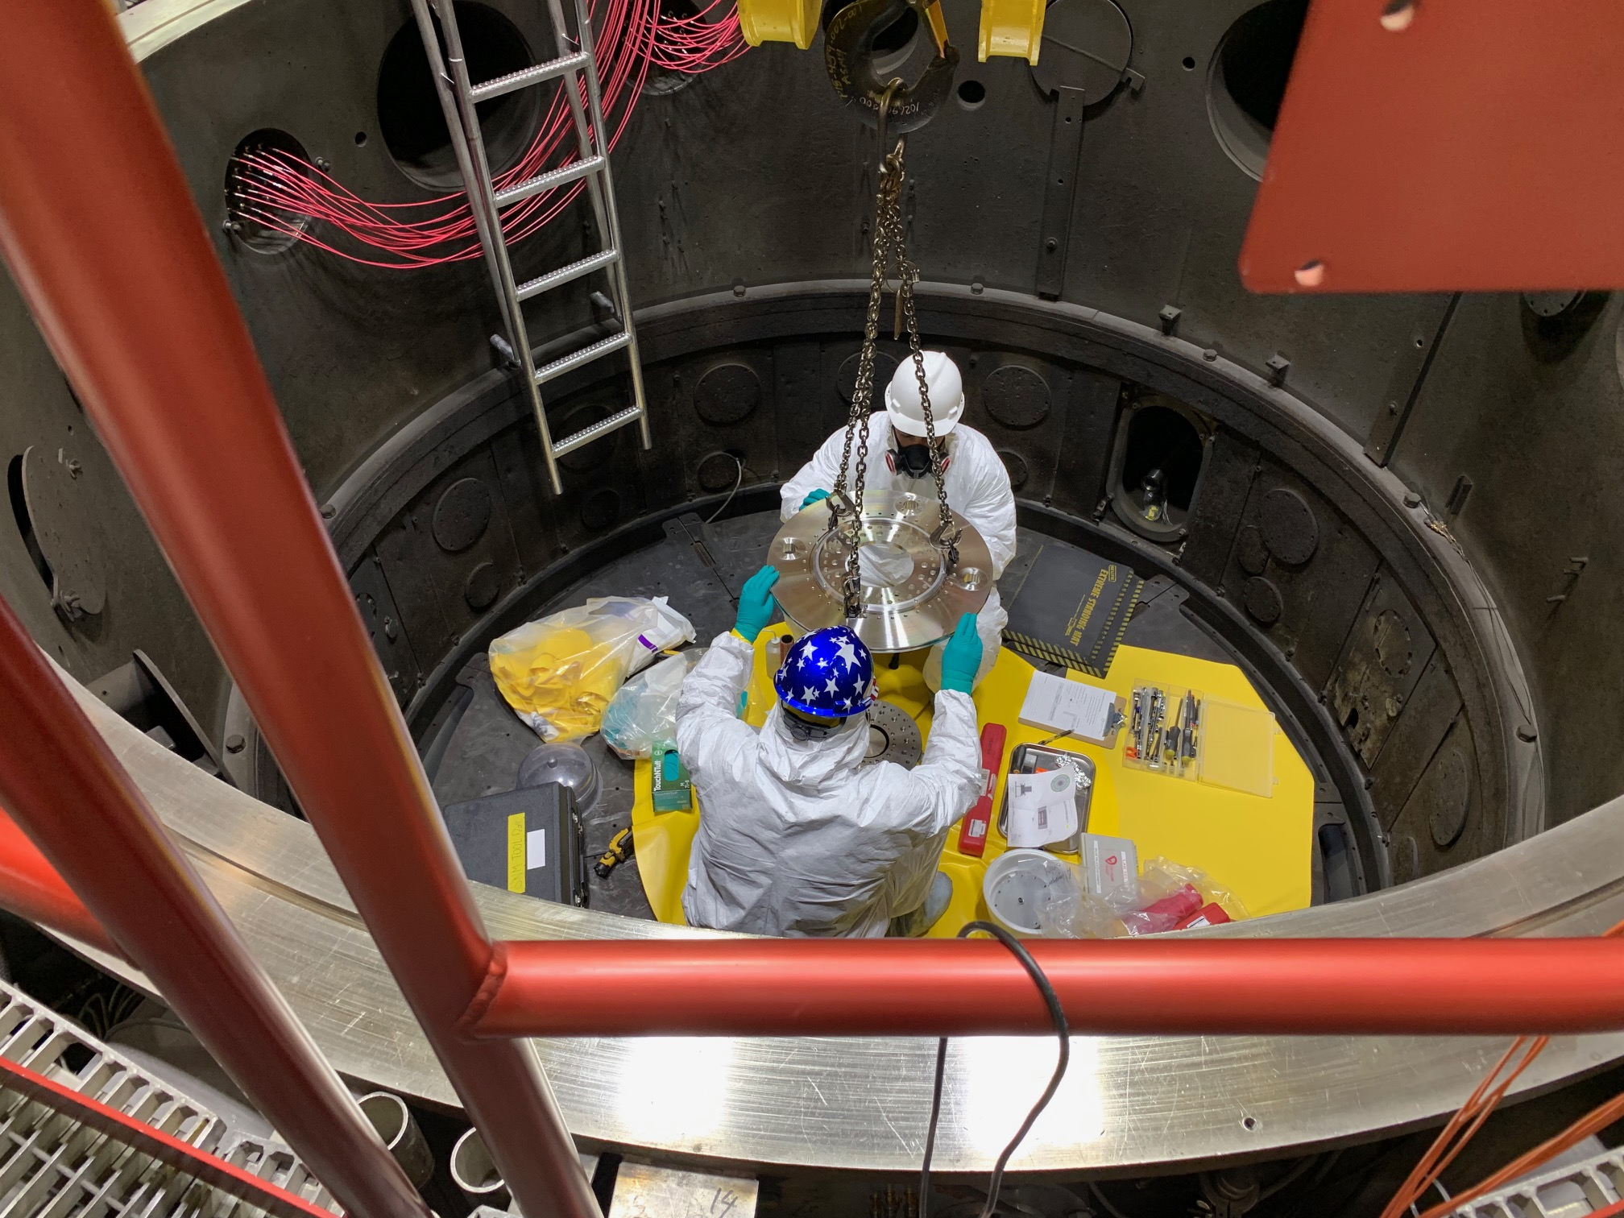
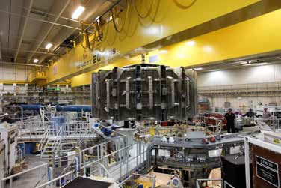
Workers on Z fire ~150 shots per year under challenging working conditions
Center
Section
80 TW, 26 MA
Electrical

Slide 20
MagLIF is a Magneto-Inertial Fusion (MIF) concept
Relies on three components to produce fusion conditions at stagnation
Use-Inspired
without B_{z}
with B_{z}
6-10 mm
Magnetization: 10-30T at t=0
  Reduces electron heat loss during implosion
  Traps charged particles at stagnation
Liner
DD Fuel
random
helical
Magnetization
Suppress radial thermal conduction losses
Enable slow implosion with thick target walls
S.A. Slutz et al., Phys. Plasmas (2010); A.B. Sefkow et al., Phys. Plasmas (2014); S.A. Slutz et al., Phys. Plasmas (2018).

Slide 21
MagLIF is a Magneto-Inertial Fusion (MIF) concept
Relies on three components to produce fusion conditions at stagnation
Use-Inspired
Laser preheat: 100-200 eV
  Uses Z-Beamlet Laser (other heating methods possible)
  Relax convergence requirement
  CR=R_{initial}/R_{final}= 120 → 20-40
Magnetization
Suppress radial thermal conduction losses
Enable slow implosion with thick target walls
Preheat
Ionize fuel to lock in B-field
Increase adiabat to limit required convergence
S.A. Slutz et al., Phys. Plasmas (2010); A.B. Sefkow et al., Phys. Plasmas (2014); S.A. Slutz et al., Phys. Plasmas (2018).

Slide 22
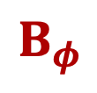
MagLIF is a Magneto-Inertial Fusion (MIF) concept
Relies on three components to produce fusion conditions at stagnation
$$B_{φ}$$
Use-Inspired
Magnetically Driven Implosion
  “Only” ~100 km/s
  (vs. ~380 km/s on NIF)
  B-field amplified to >10,000 T
Current, I
JxB
JxB
Magnetization
Suppress radial thermal conduction losses
Enable slow implosion with thick target walls
Preheat
Ionize fuel to lock in B-field
Increase adiabat to limit required convergence
Implosion
PdV work to heat fuel
Flux compression to amplify B-field
S.A. Slutz et al., Phys. Plasmas (2010); A.B. Sefkow et al., Phys. Plasmas (2014); S.A. Slutz et al., Phys. Plasmas (2018).

Slide 23
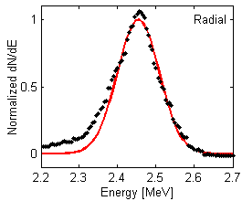
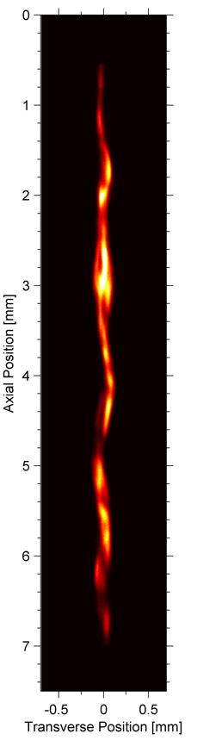
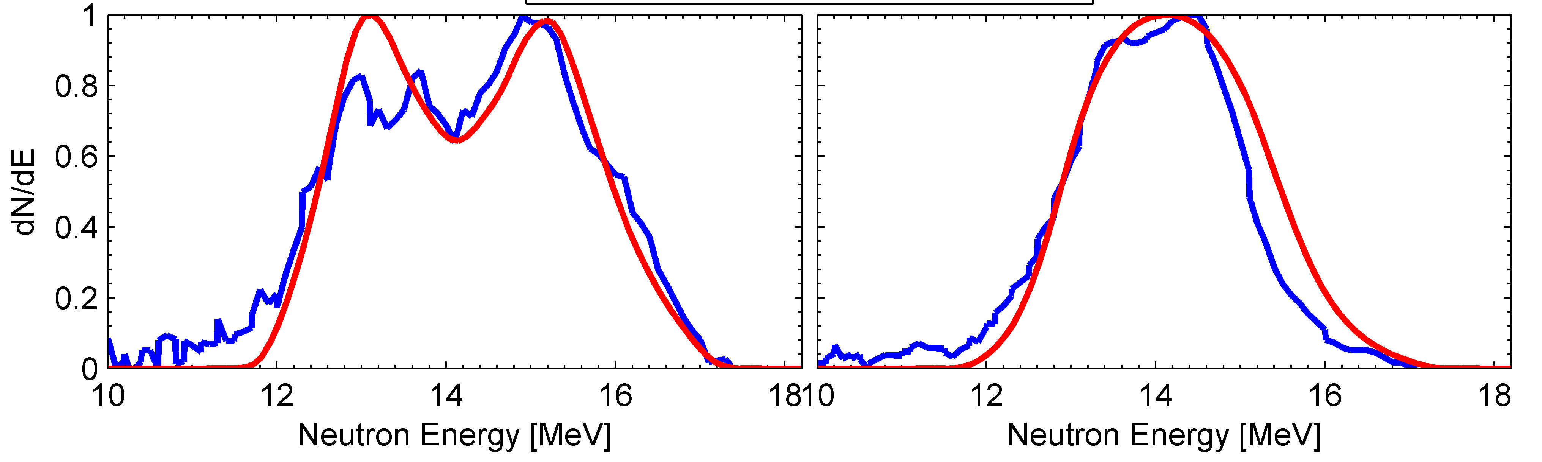
MagLIF allowed us to demonstrate the key tenets of magneto-inertial fusion
In a target that would not produce significant yield without both heating and magnetization
Use-Inspired
Thermonuclear neutron generation with
fusion-relevant ion temperatures (2-3 keV)
High aspect ratio fuel column at CR > 30
Highly magnetized fuel at stagnation (>0.3 MG-cm)
Exp.
Model
Exp.
Model
Axial Radial
Secondary DT Neutron Spectra
M.R. Gomez et al., Phys Rev Lett (2014); P.F. Schmit et al., Phys Rev Lett (2014).

Slide 24
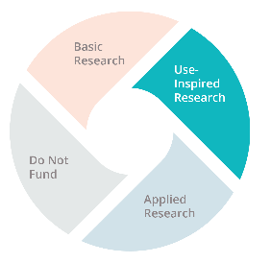
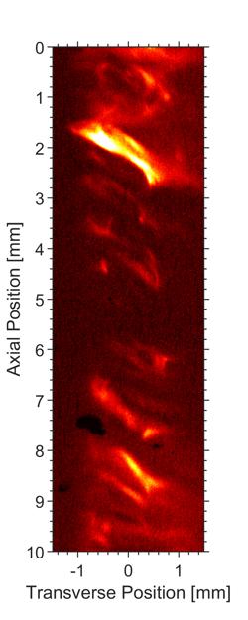
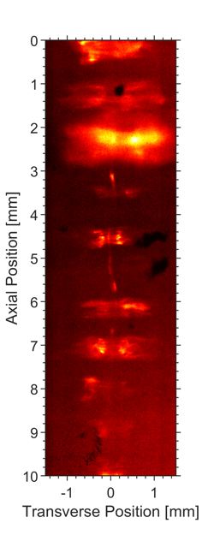
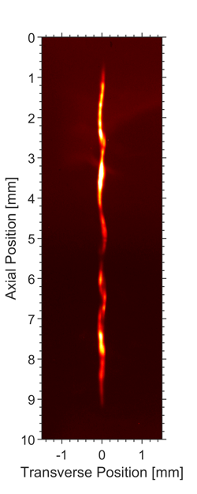
Maglif Allowed us to demonstrate the key tenets of magneto-inertial fusion
In a target that would not produce significant yield without both heating and magnetizations
10 T B-field
No laser preheat
1x10¹⁰ DD neutrons
No B-field
1 kJ laser preheat
4x10¹⁰ DD neutrons
10 T B-field
1 kJ laser preheat
3x10¹² DD neutrons
Strong emission from fuel column
Emission from exterior of liner
Weak emission from fuel column
M.R. Gomez et al., Phys Rev Lett 113, 155003 (2014); P.F. Schmit et al., Phys Rev Lett 113, 155004 (2014).

Slide 25
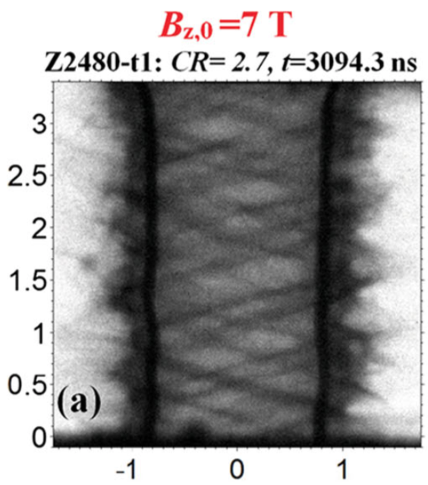

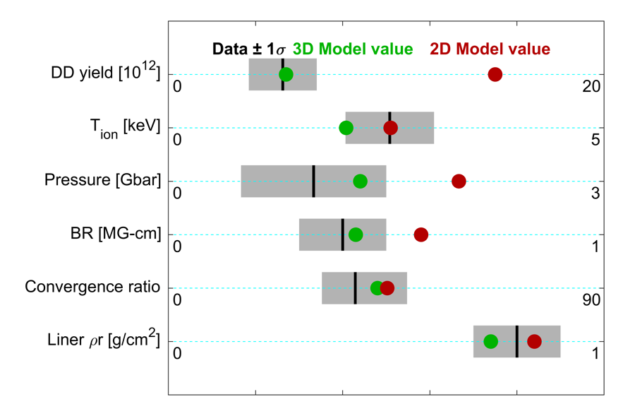
The addition of the axial magnetic field results in a helical MRT instability structure during implosion and a helical stagnation
Use-Inspired
Sim
Exp
0°
90°
T.J. Awe et al., Phys. Rev. Lett. (2013).
3D HYDRA simulations appear to do a better job of matching the key observables than 2D

