Slide 1
Latest from UKAEA
Joe Milnes
JET Operating Contract Senior Manager
FPA Annual Meeting 3rd / 4th December 2019

Slide 2
UKAEA approach
Strong
International
Partnerships
Ambitious
Domestic
Program
Facilities and
infrastructure
to deliver
Notes:
1) Strong international partnerships (JET, ITER, Eurofusion....) - much work being done on these in the face of Brexit - commitment from UKAEA to maintain participation
2) Substantial domestic programme - now £220M for STEP adds to the MAST programme
3) Facilities and infrastructure to deliver - the new facilities (H3AT etc.) Plus the £184M for buildings, training etc.
UK government announced an £184M investment to upgrade the Culham site.
Culham is on track to be at the heart of a world-leading fusion cluster, in which national labs, companies and universities work together on the big challenges of delivering fusion energy
The funding will develop and upgrade the facilities at Culham and enable new apprentice training programmes. It will upgrade buildings and IT infrastructure, including a new innovation centre, an expanded robotics test facility and accommodation for commercial fusion companies.
The intention is to create an environment in which innovation and collaboration between UKAEA’s national programmes and companies will thrive.
UKAEA will provide access to the specialist facilities at Culham for fusion businesses and academic researches to use – enabling access to capabilities not easily found anywhere else.

Slide 3

JET Status and Plans
Clean-up & D reference pulses
Deuterium-Tritium Experiments
Tritium (Isotope) Experiments
Protium (Isotope) Experiments
Tritium Commissioning
Preparation for high performance DT
Deuterium (Isotope) Experiments
Integrated plasma-wall solutions for ITER
High priority ITER issues (disruption mitigation)
Maintenance

Slide 4
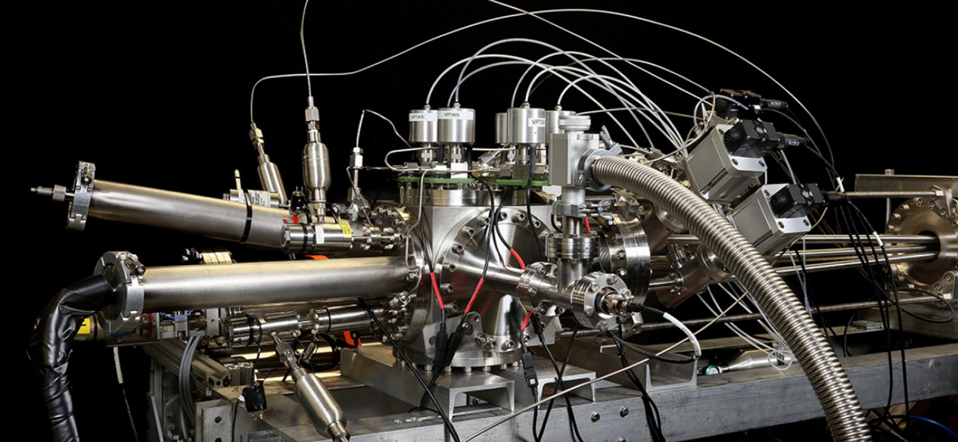
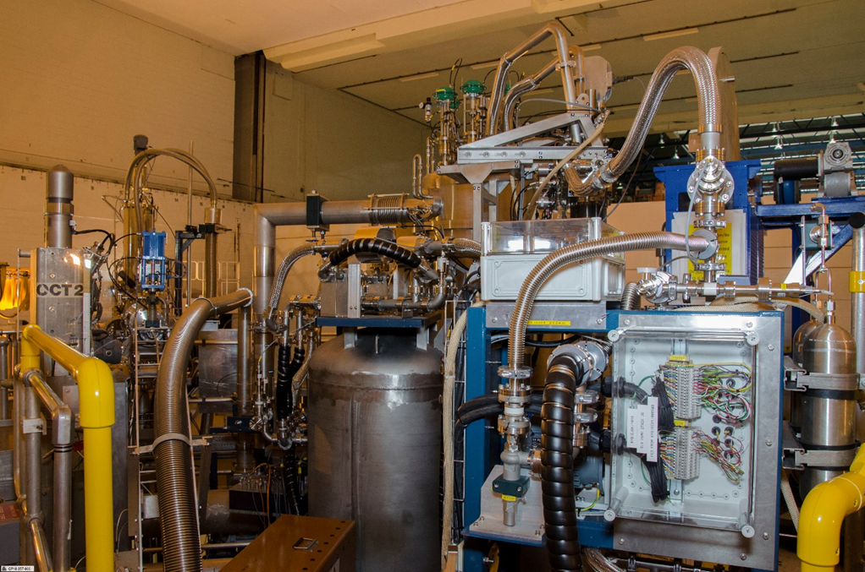

JET Status and Plans
Shattered Pellet Injection is ITER’s preferred method for mitigating:
Thermal & electromagnetic loads due to disruptions
Impact damage due to runaway electron beams
SPI installed on JET
Notes:
A large amount of data has already been collected for ITER with dedicated JET experiments
Successful SPI commissioning and operation on JET
The results are preliminary and will require detailed analysis (experiments last week)
Run-away suppression with shattered pellet have been demonstrated at JET on a controlled RE beam
Unexpected result with the 12mm D2 shattered leading to suppression of fast electrons:
beam current increases to 0.8 MA, HXR and neutrons drop, then the beam disappears in a few ms without any localized impact. (similar to some DIII-D observations)
Thermal load mitigated with SPI and analysis of mitigation of radiation asymmetry

Slide 5
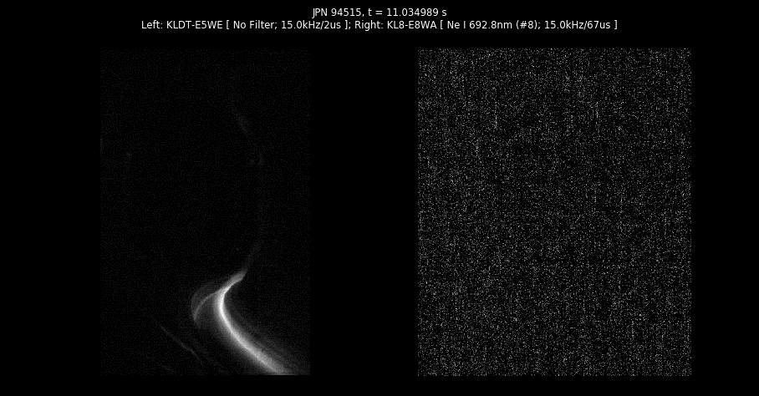
JET Status and Plans
Shattered Pellet Injection is ITER’s preferred method for mitigating:
Thermal & electromagnetic loads due to disruptions
Impact damage due to runaway electron beams
Notes:
A large amount of data has already been collected for ITER with dedicated JET experiments
Successful SPI commissioning and operation on JET
The results are preliminary and will require detailed analysis (experiments last week)
Run-away suppression with shattered pellet have been demonstrated at JET on a controlled RE beam
Unexpected result with the 12mm D2 shattered leading to suppression of fast electrons:
beam current increases to 0.8 MA, HXR and neutrons drop, then the beam disappears in a few ms without any localized impact. (similar to some DIII-D observations)
Thermal load mitigated with SPI and analysis of mitigation of radiation asymmetry

Slide 6
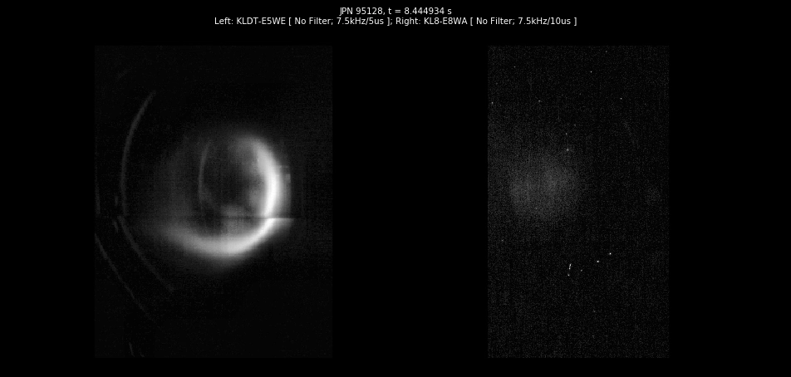
JET Status and Plans
Shattered Pellet Injection is ITER’s preferred method for mitigating:
Thermal & electromagnetic loads due to disruptions
Impact damage due to runaway electron beams
Notes:
A large amount of data has already been collected for ITER with dedicated JET experiments
Successful SPI commissioning and operation on JET
The results are preliminary and will require detailed analysis (experiments last week)
Run-away suppression with shattered pellet have been demonstrated at JET on a controlled RE beam
Unexpected result with the 12mm D2 shattered leading to suppression of fast electrons:
beam current increases to 0.8 MA, HXR and neutrons drop, then the beam disappears in a few ms without any localized impact. (similar to some DIII-D observations)
Thermal load mitigated with SPI and analysis of mitigation of radiation asymmetry

Slide 7
JET Status and Plans
Clean-up & D reference pulses
Deuterium-Tritium Experiments
Tritium (Isotope) Experiments
Protium (Isotope) Experiments
Tritium Commissioning
Preparation for high performance DT
Deuterium (Isotope) Experiments
Integrated plasma-wall solutions for ITER
High priority ITER issues (disruption mitigation)
Maintenance

Slide 8
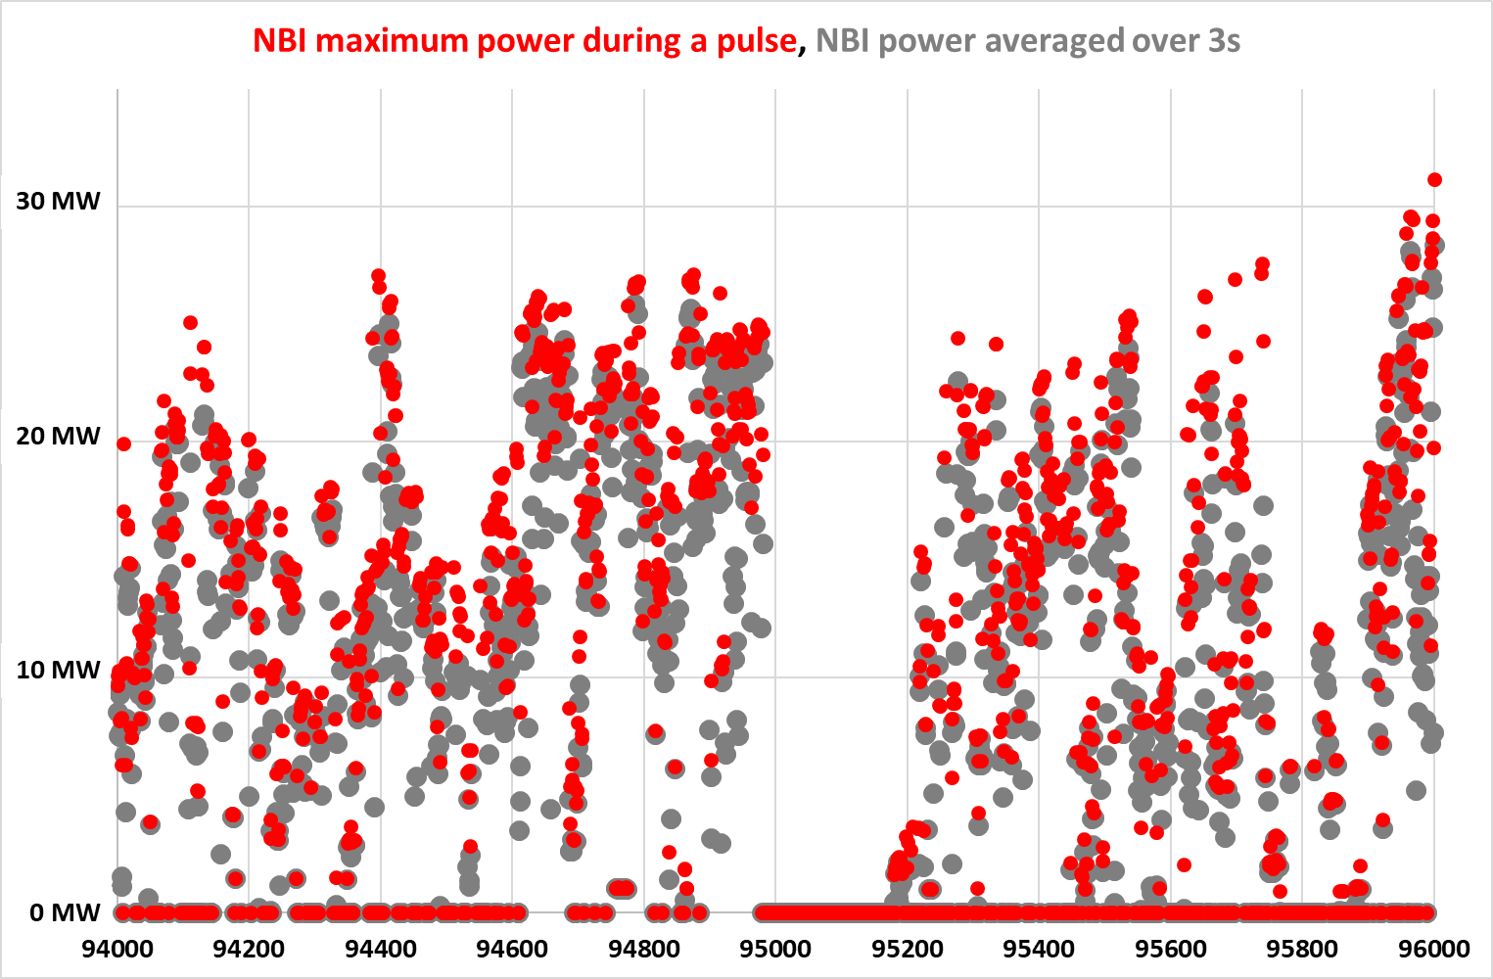
JET Status and Plans
High Input Power to Maximise Fusion Yield is Now Becoming Available
Peak power up to 31.2MW
Averaged over 3s up to 28.4MW
ICRH is available at 5-6 MW in H-mode
August 2019
Sept/Oct 2019
DT rehearsal PINI’s ASYNC

Slide 9
JET Status and Plans
DT Performance Projections:
19
15
11
7
3
CRONOS-TGFL & JINTRAC-QUALIKIZ: filled symbols
JINTRAC-BGB-EUROped: open symbols
CRONOS-CDBM: Stars
Taking into account additional effects:
Isotope effects
Alpha power contribution
Consistent core-pedestal modelling
Uncertainty in P_{FUS} reflects use of different plasma current and bootstrap models
P_{FUS} (MW)
Hybrid
ITB
Baseline
20 30 40 50
P_{IN} (MW)

Slide 10
JET Status and Plans
SPI, RH, mirrors, diagnostics
ready
AGHS ready for N₂
Programme elements ~fixed
DTE2: With 14 MeV neutron budget of 3x10²⁰ (~10 pulses at 10-15MW/5s)
ITER disruption studies:
with 2nd SPI
ITER like operations
Seeding with ILW, q₉₅~3
He for ITER (H-mode, ILW)
Contingency for Seeding
DTE3 & T removal:
N₂ seeding, LIDS
Budget: 13x10²⁰ 14MeV
6-month shutdown:
SPI2
ITER mirrors
Diagnostics (14 MeV, radiation)
Take samples from ILW
Put JET in safe-state:
Remove ITER mirrors
LIBS
Diagnostic calibrations
Take samples from ILW

Slide 11
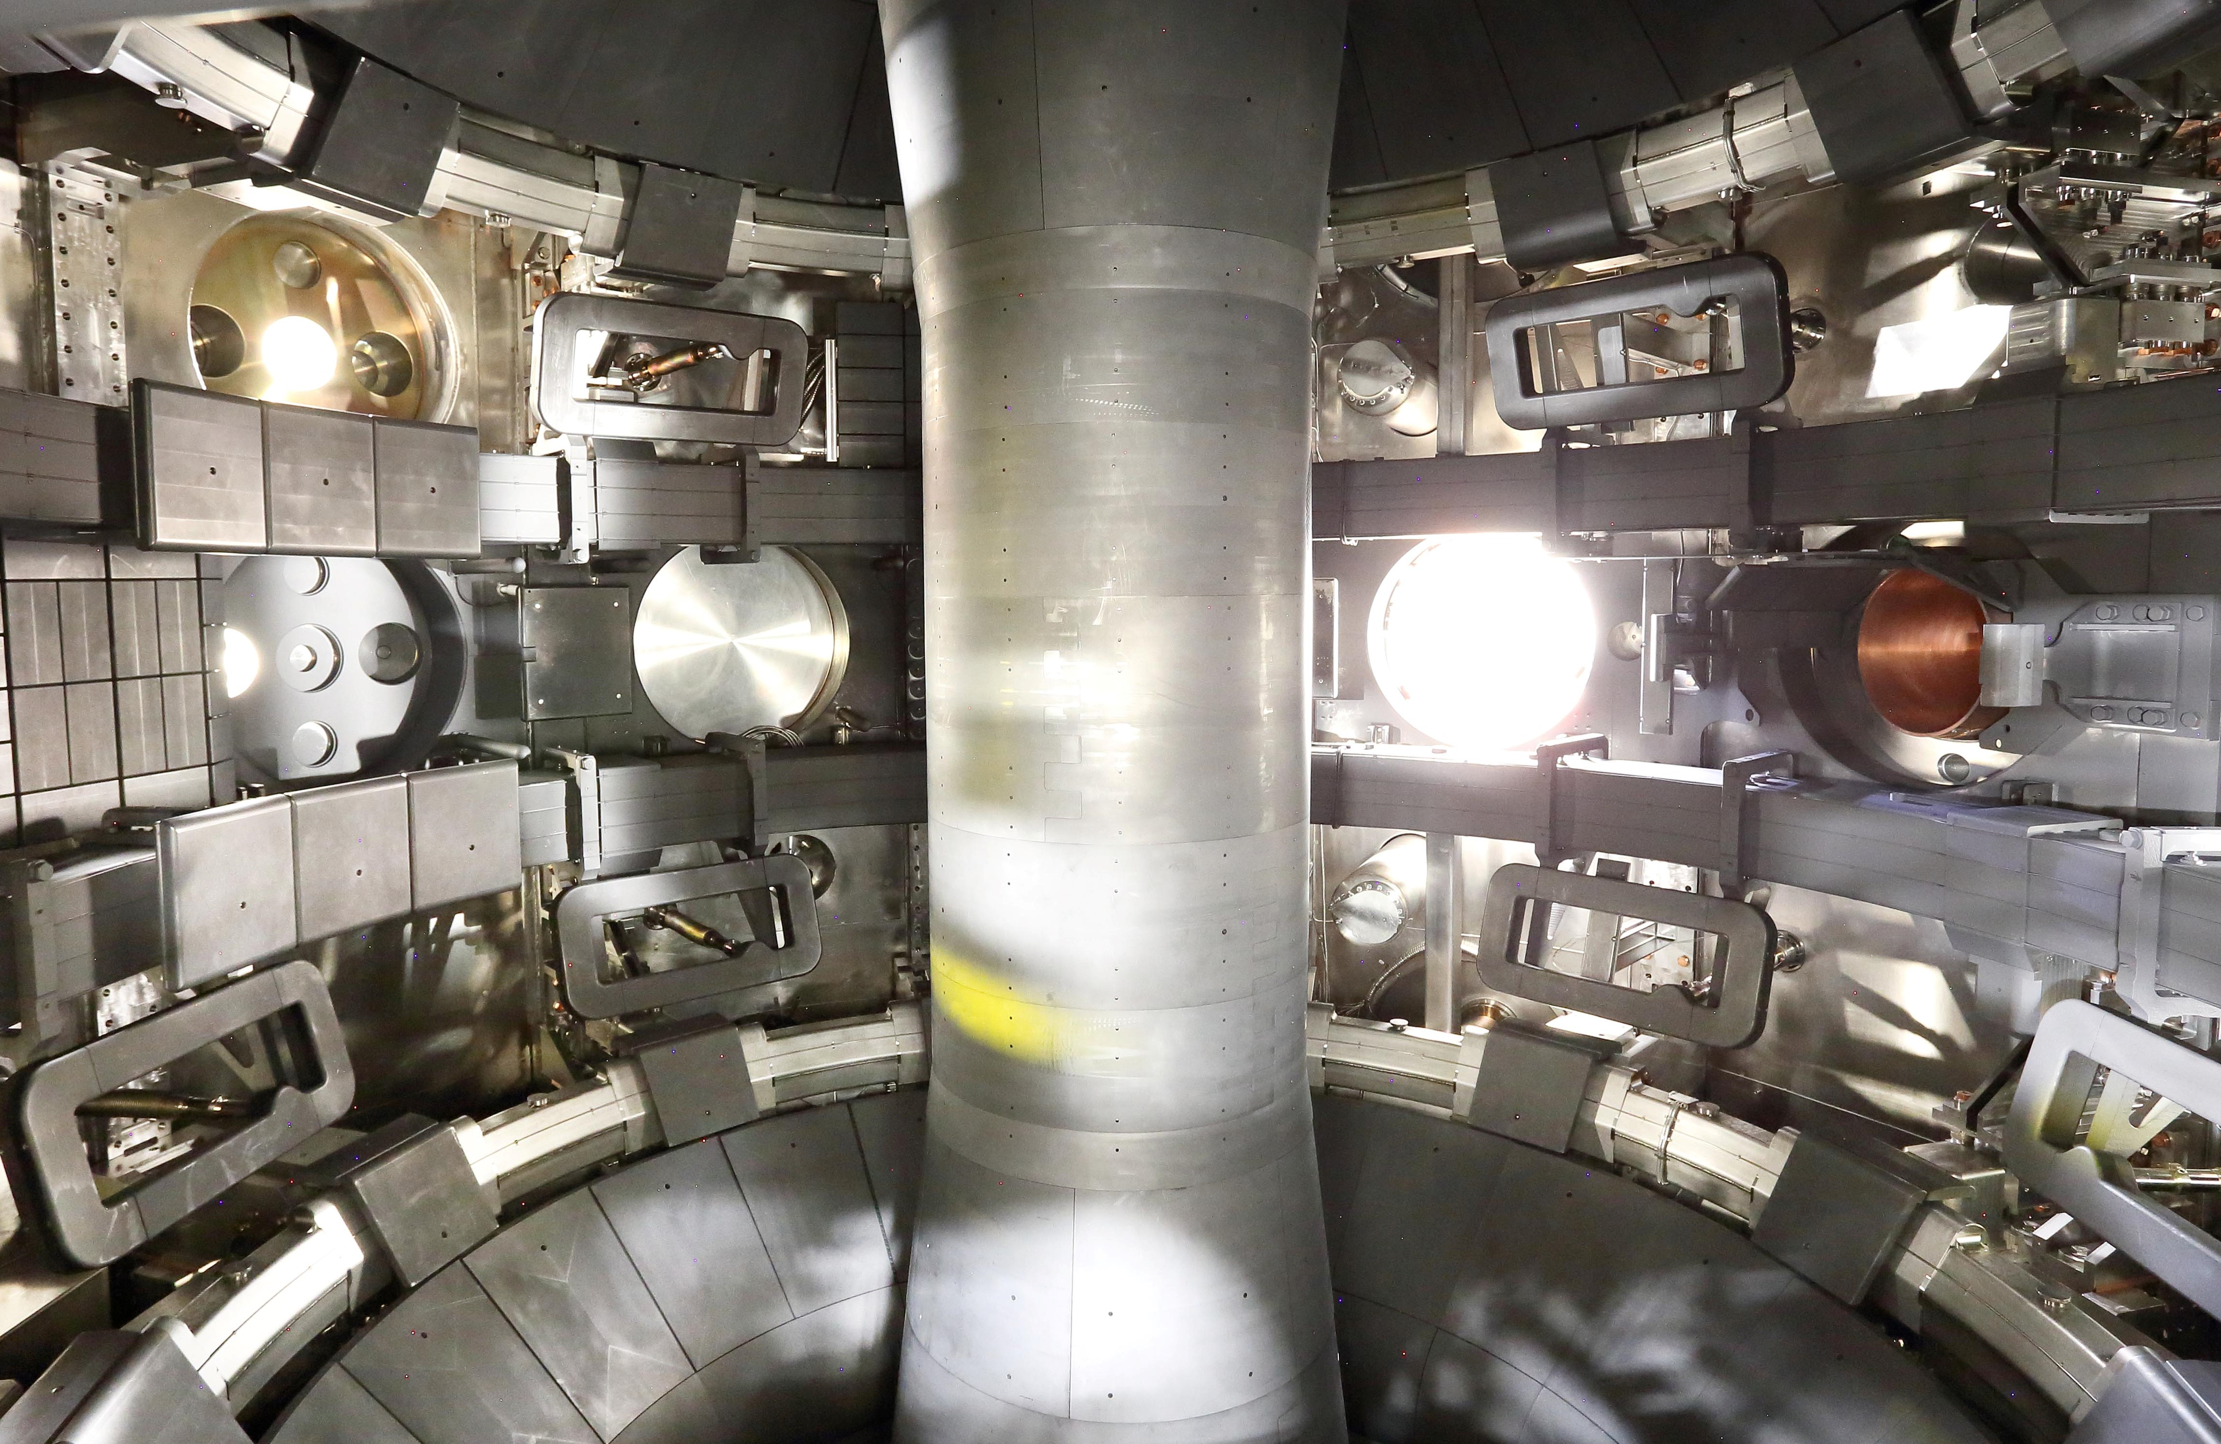
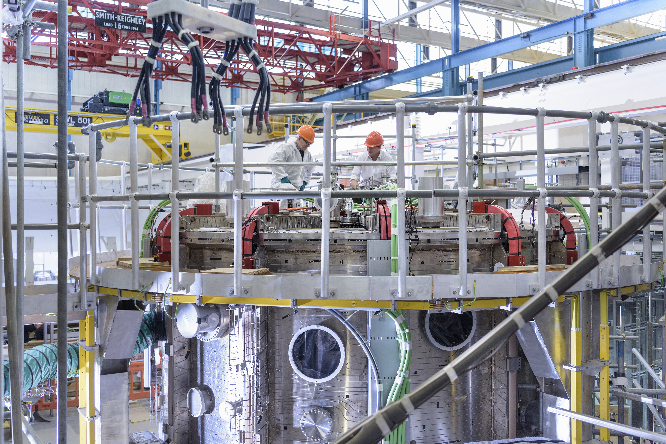
Compact Tokamak – MAST Upgrade
Commissioning of power supplies and coils underway
First plasma early 2020
Physics campaigns mid 2020.

Slide 12
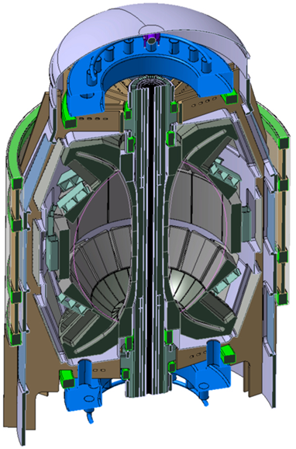
Compact Tokamak – STEP
UKAEA funded £220M for the five year conceptual design phase.
Net electricity production
Tritium self-sufficiency
Robotic maintenance
Decadal pilot plant lifetime
Design work split into distinct work packages
UKAEA now seeking collaboration from academic and industrial partners.
Notes:
We are beginning a conceptual design for an ST reactor – must produce
net electricity, aiming for T self-sufficiency, and materials, availability etc
which scale to an economic power plant
Programme is a tight collaboration between UKAEA and UK industry and
academia. UK government have provided £20M to begin this work
Will retain a strong role in EU-DEMO. Large overlap between the two
programmes

Slide 13
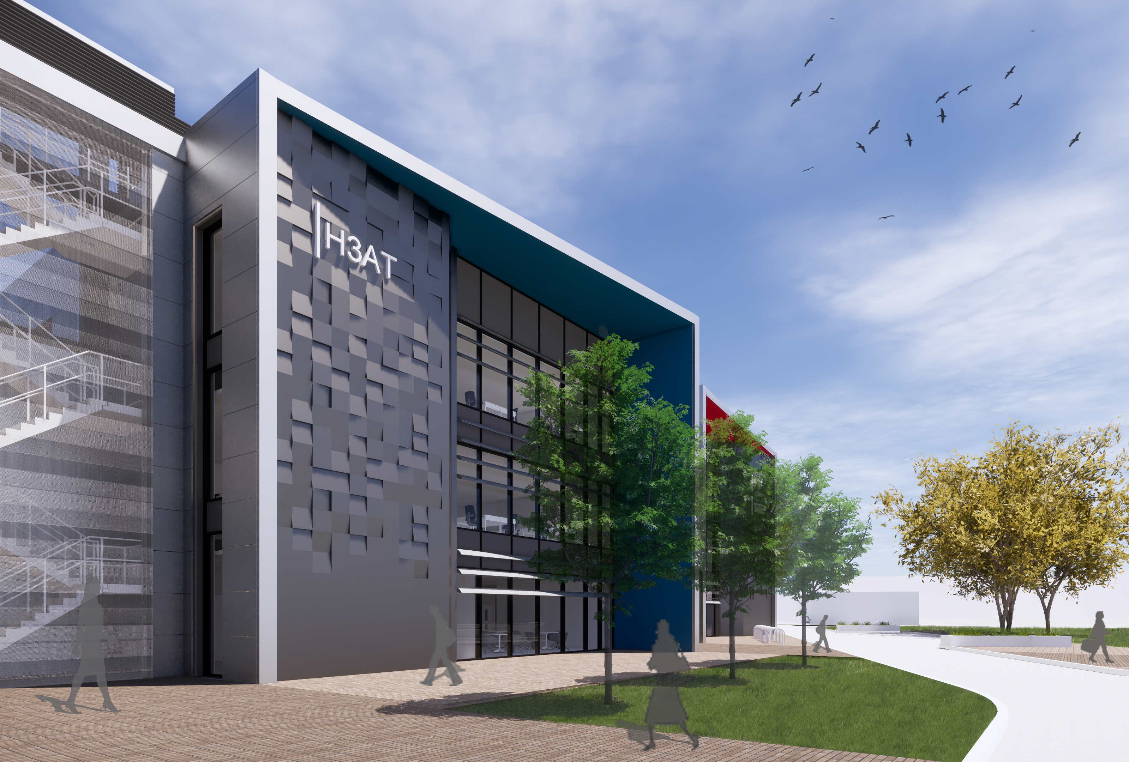
Tritium facility – H3AT
A £40M state of the art tritium facility
Up to 100g T2 inventory.
1/20th scale ITER like tritium fuel cycle system able to operate in closed loop.
Uranium bed storage and delivery, Impurity Separation, Cryogenic Distillation, Air and Water Detritiation Systems.
Fuel cycle feeds flexible test cells/gloveboxes
Also tritium wet chemistry, solid waste detritiation and C-14 laboratory .

Slide 14
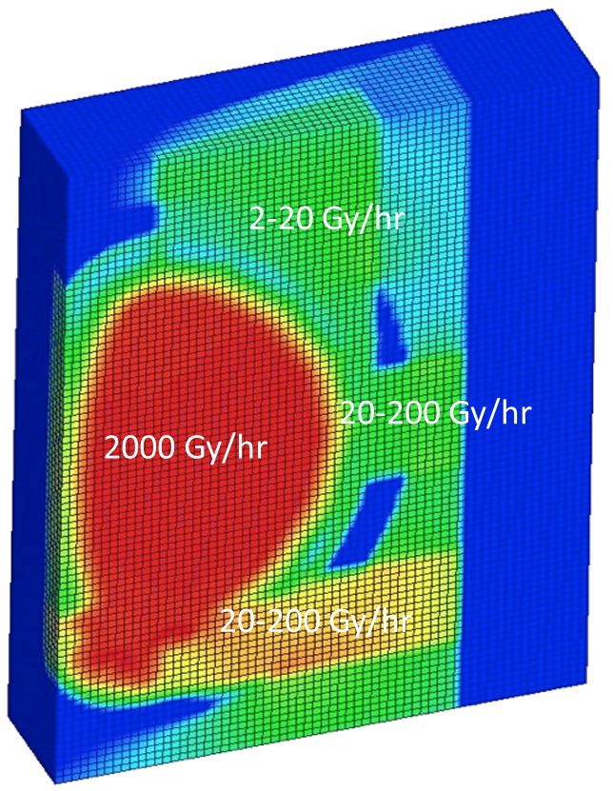

Remote Handling
Remote Applications in Challenging Environments – RACE:
~160 FTE engineers
>40 projects
>100 industrial collaborators
13 university partners
£345M robotics collaborative R&D
RACE: £15M activity pa (OpEx)
Extreme levels of radiation in a fusion reactor (that’s the idea!)
Current designs mean routine in-vessel operations: for refuelling and maintenance
Radiation levels mean zero manned entry into large parts of the plant
The plant must be designed for remote operation and maintenance

Slide 15
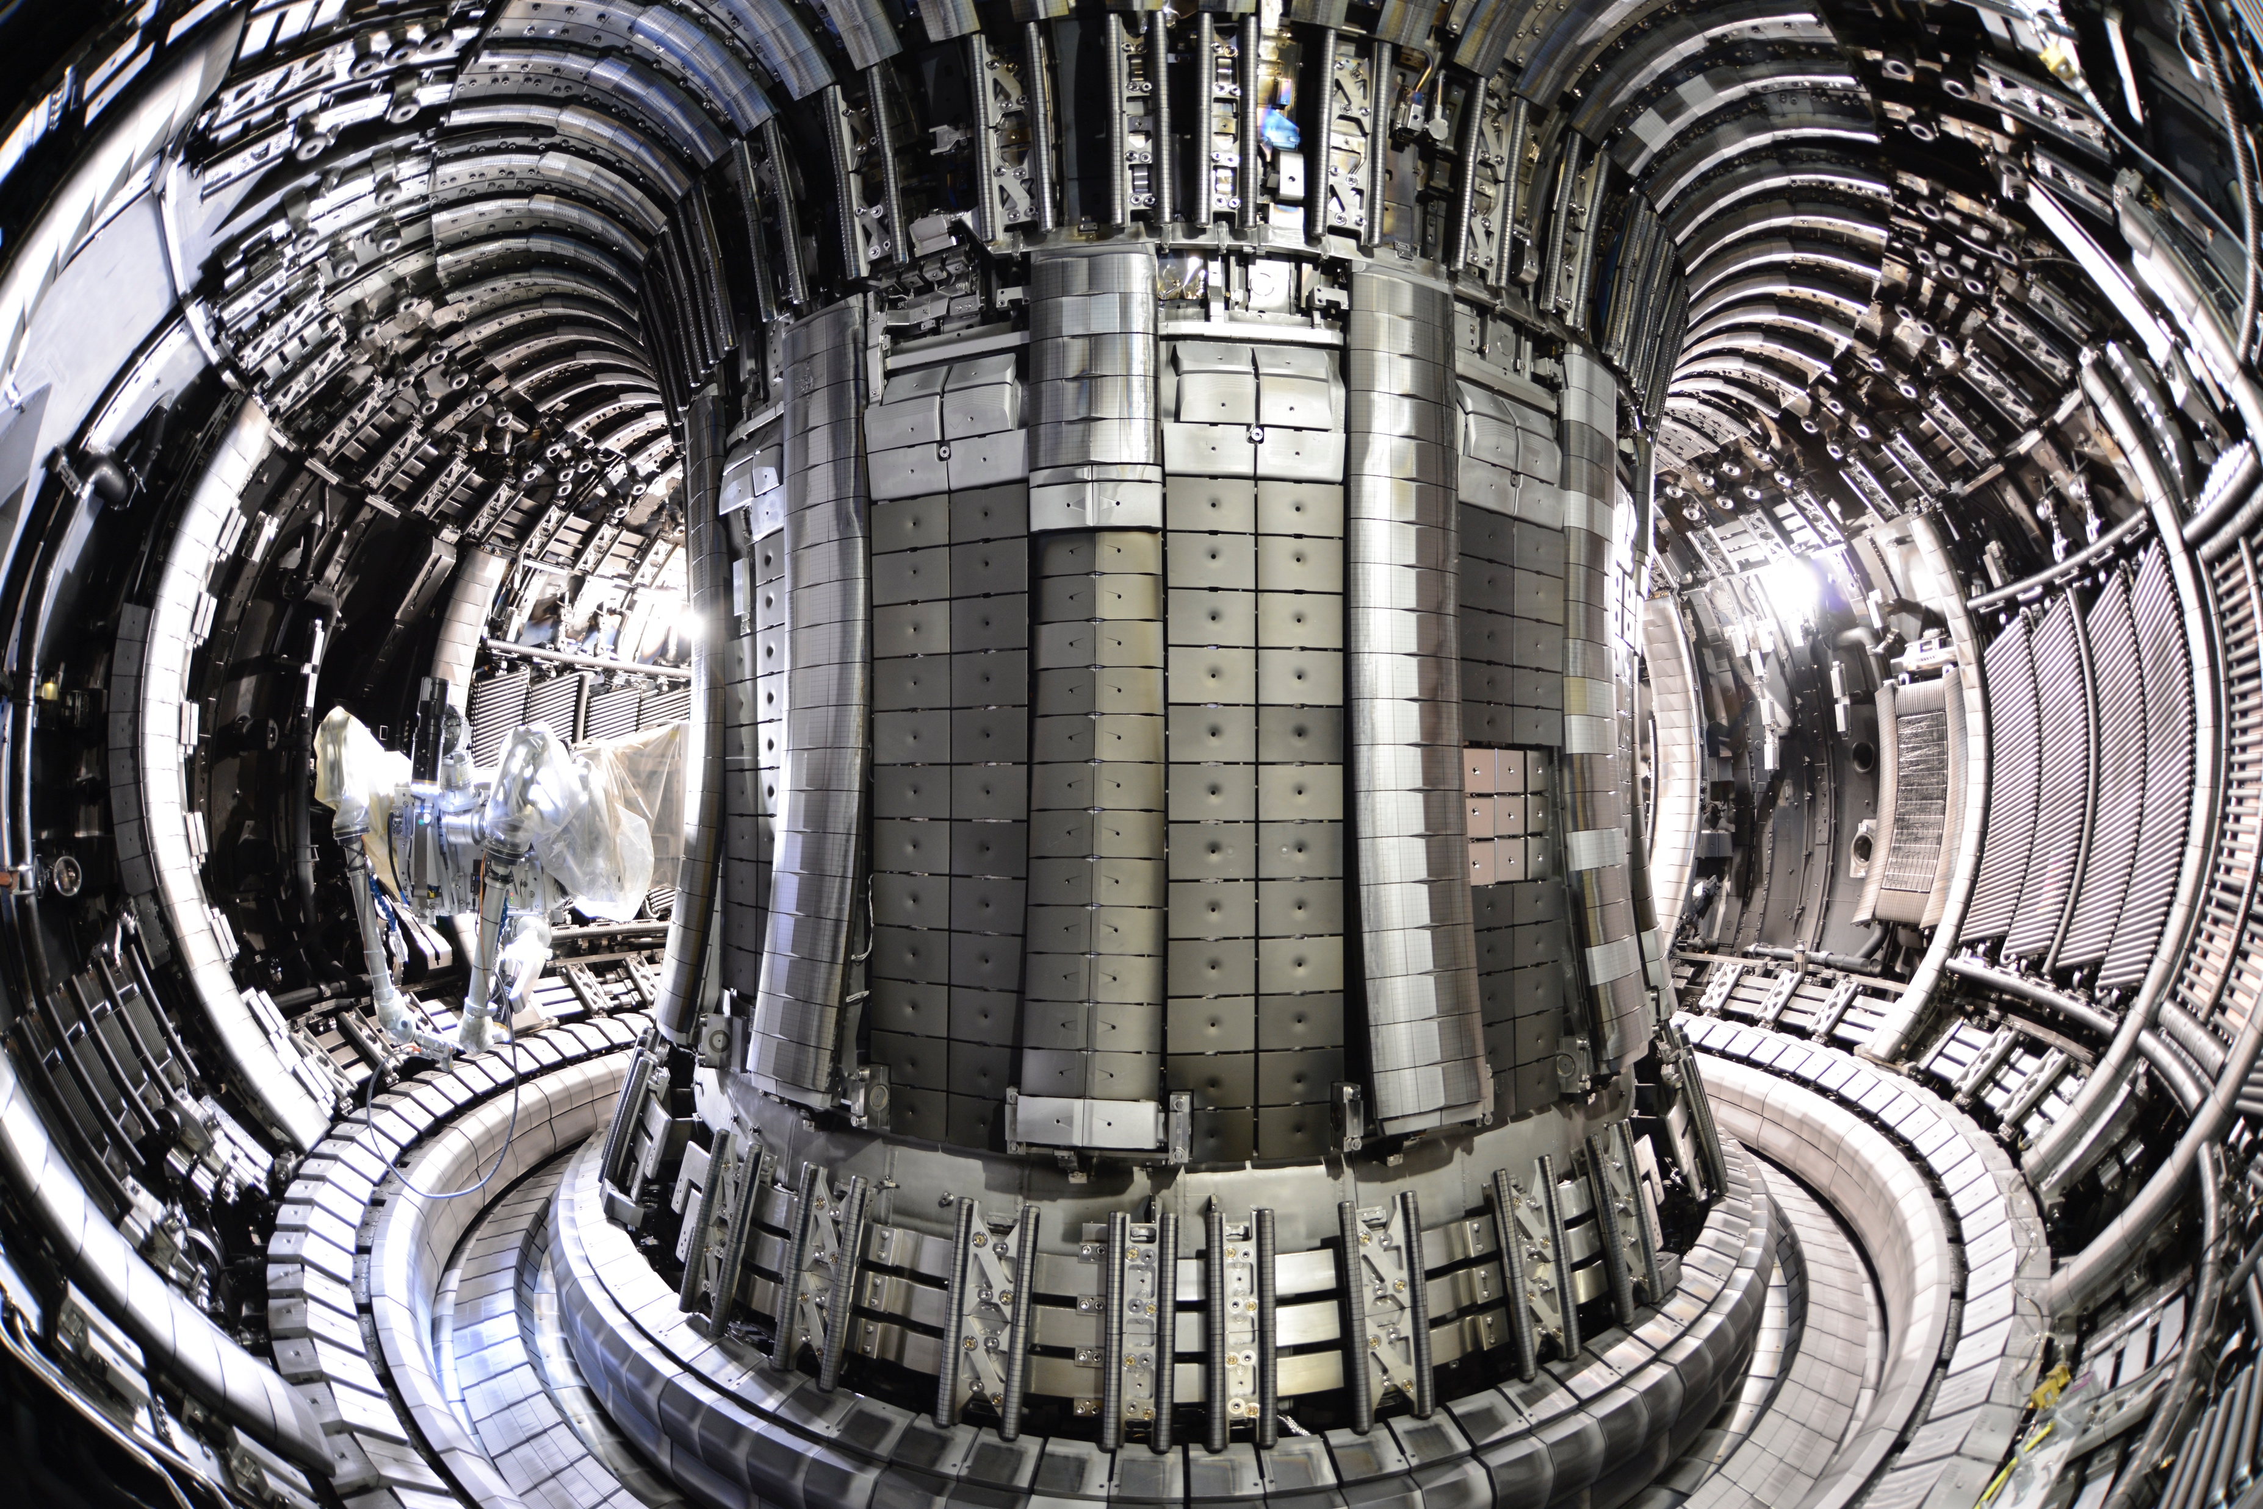
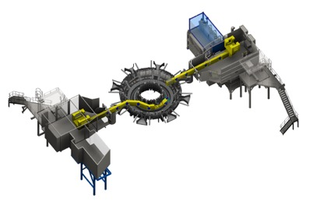
Remote Handling
Decommissioning liabilities:
Fukushima Daiichi - £80B ~$2B pa
US - $564B ~$6B pa
UK - £99-225B ~£3B pa
Contracts:
VNS (UK) inspection arm functional mock-up at RACE
NDF/TEPCO intelligent customer “The role of mock-ups for long term remote operations”
3x RACE/TEPCO workshops
2x TEPCO secondments
JET to Fukushima Daiichi…

Slide 16
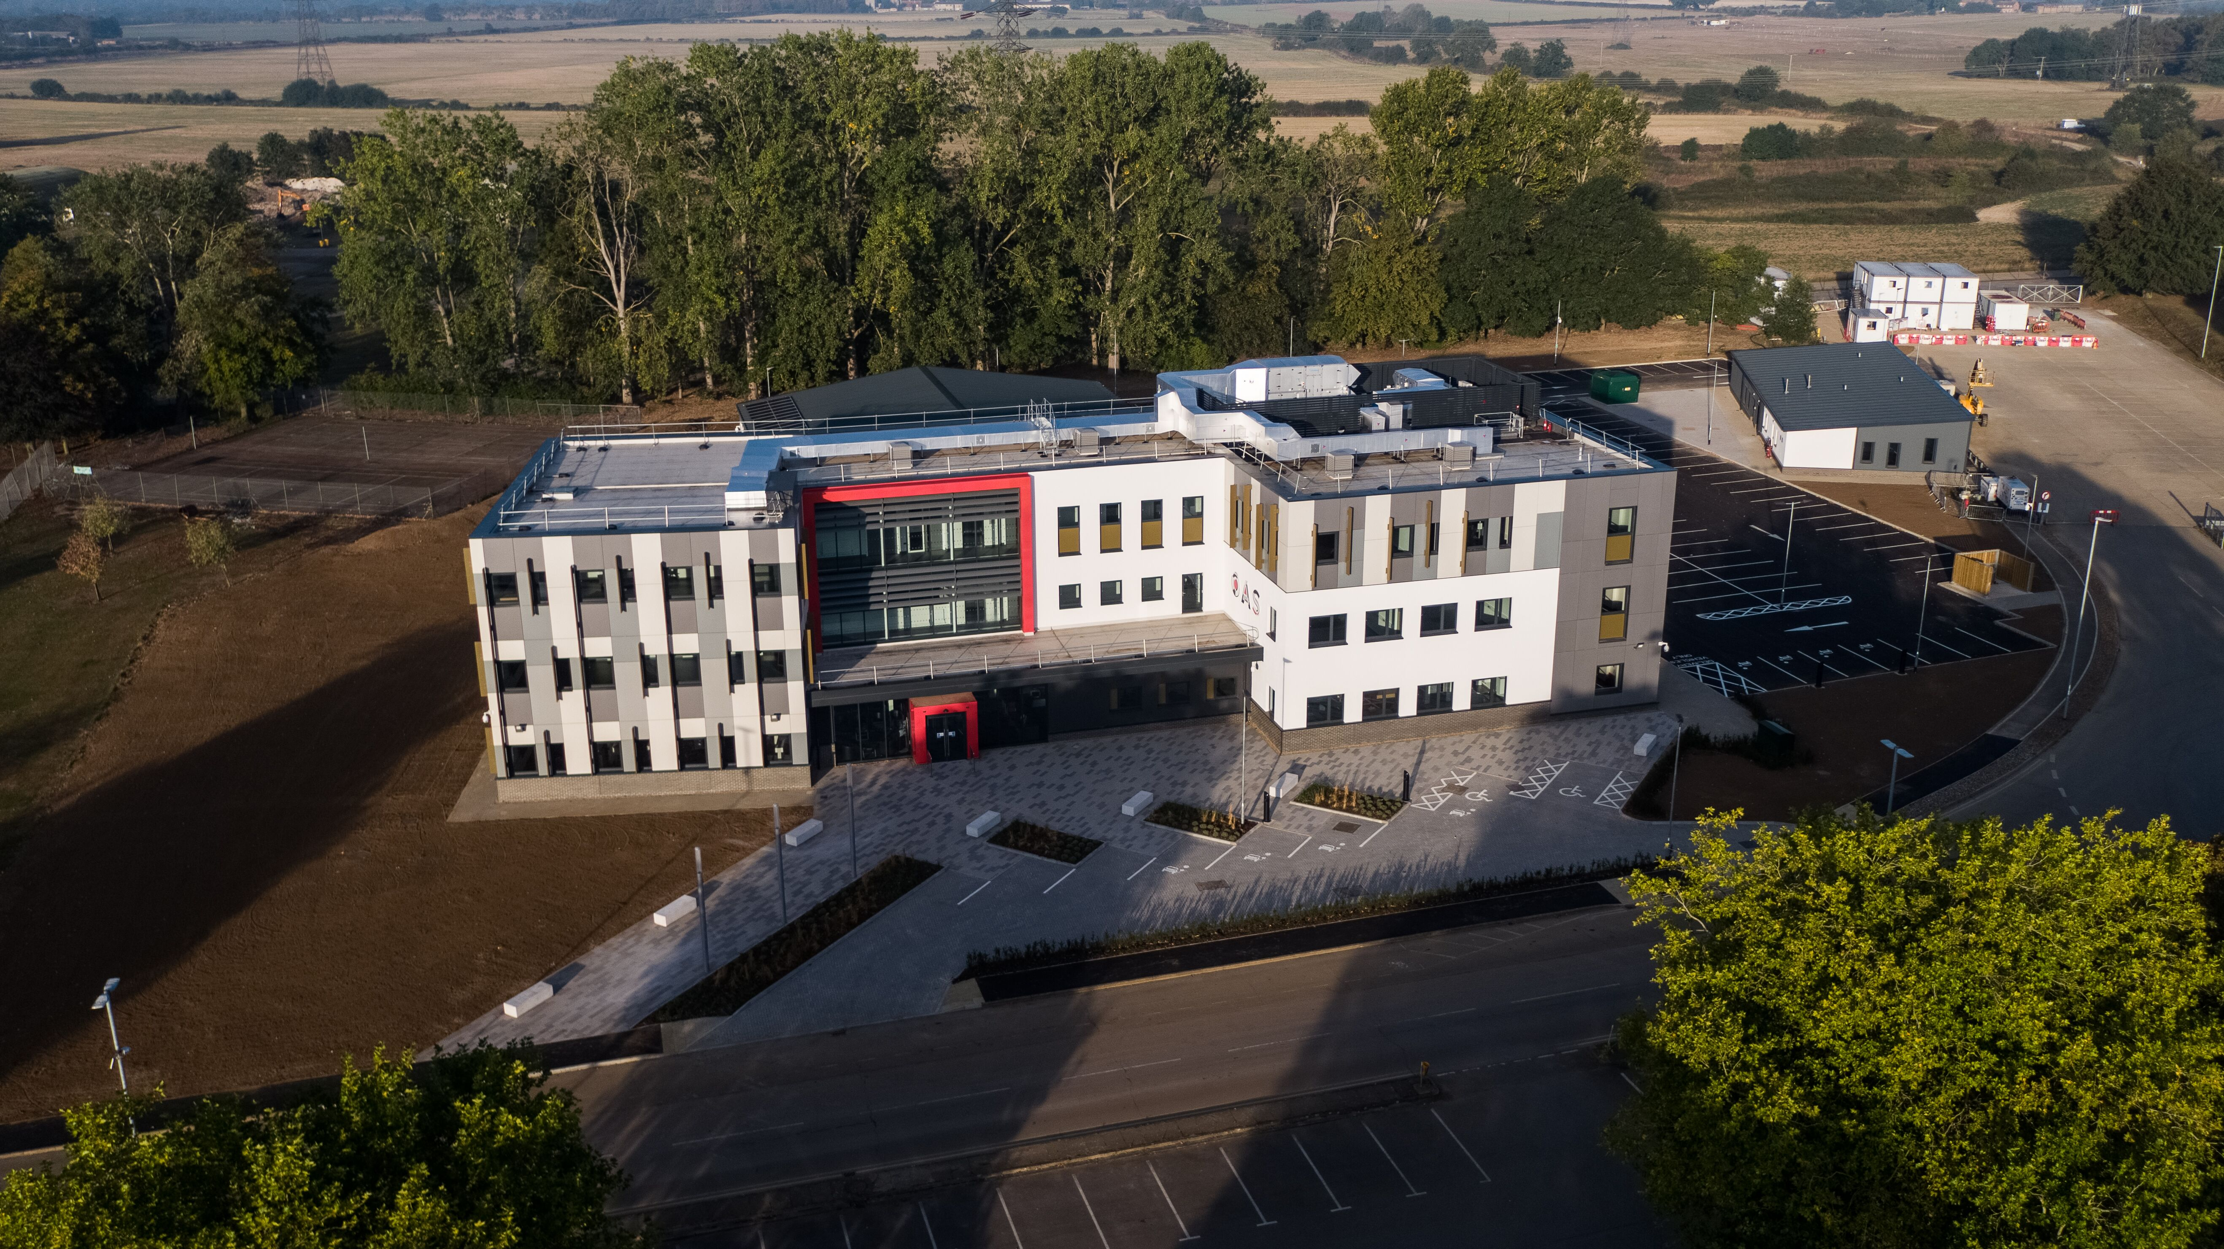
Training
Oxfordshire Advanced Skills centre
Opened 1 year ahead of schedule
Capacity to train 140 apprentices per year
Plans for further expansion

Slide 17
Conclusions
UKAEA’s approach is focussed on maintaining and growing strong international partnerships while in parallel taking on an ambitious domestic programme.
The UK government’s support is evident in the £220M investment in STEP and a further £184M for facilities to support the domestic and internal programmes.
UKAEA’s key focus is to grow at the pace required and form the partnerships required with labs, industry and academia to deliver this.

Slide 18
Additional slides

Slide 19
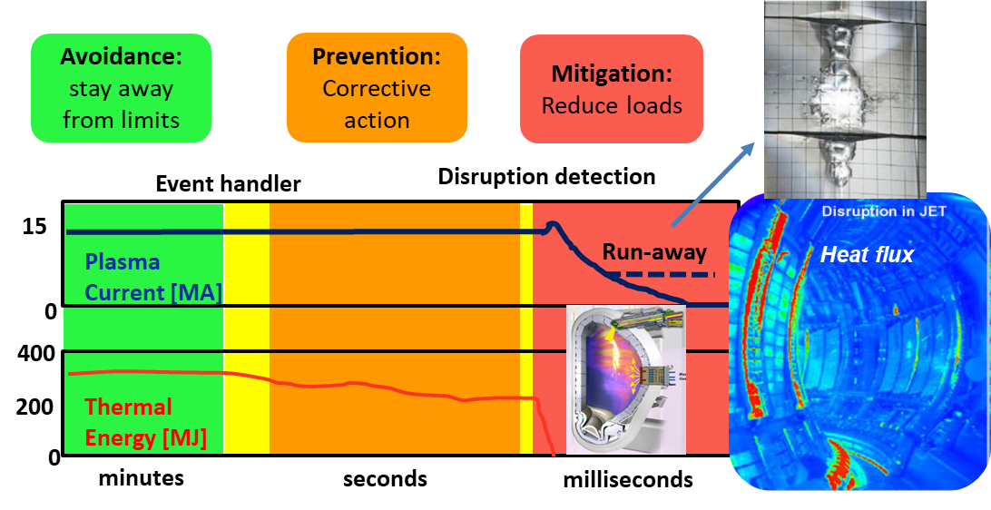
Integrated Programme on Disruption
Avoidance, Prediction and Mitigation:
Multi-machines programme on JET, JT-60SA, MSTs

