Slide 1




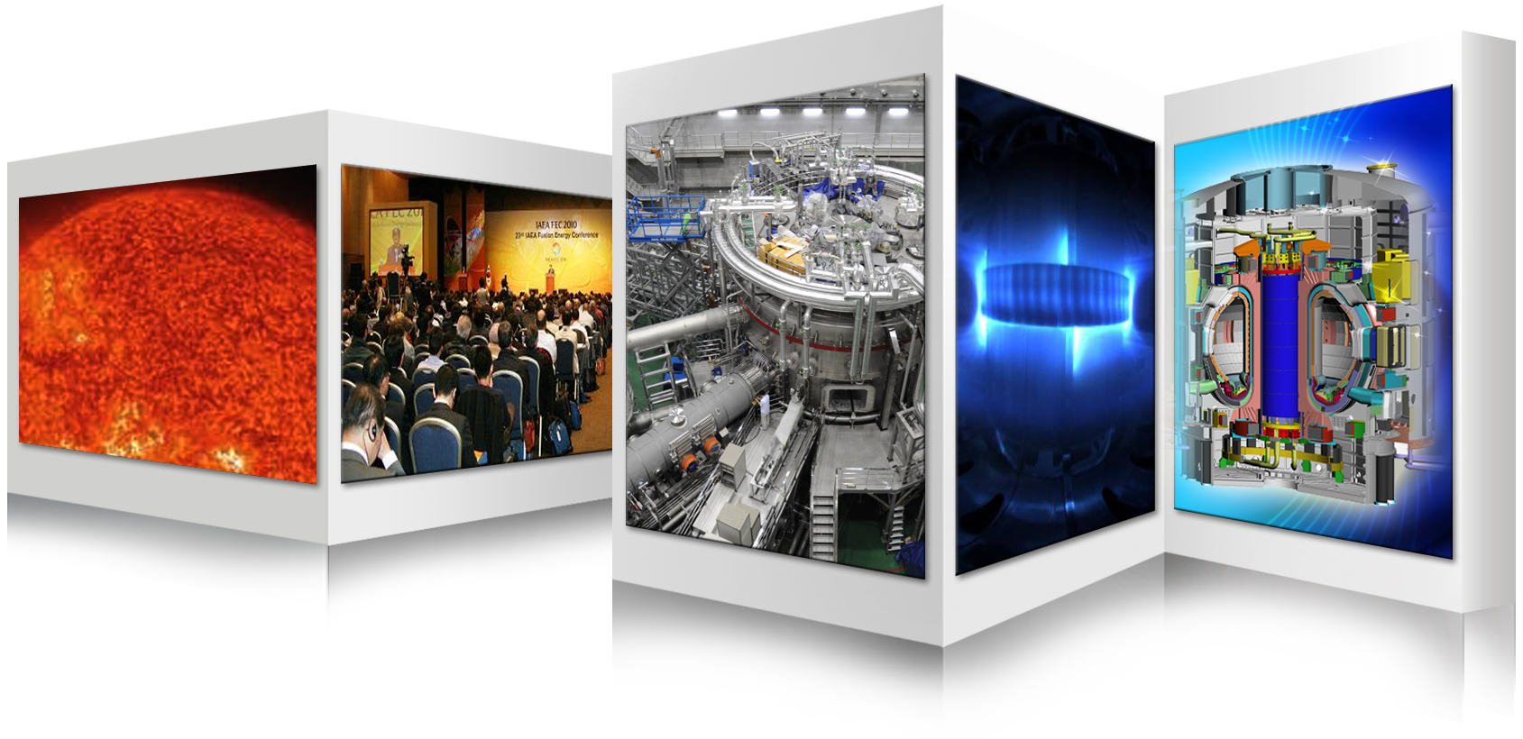

Perspectives and Planning on Fusion Energy Development in Korea
Suk Jae YOO
Fusion Power Associates,
40th Annual Meeting and Symposium,
December 3rd , 2019/Washington DC, USA
On behalf of National Fusion Research Institute and Korea Fusion Research Groups

Slide 2
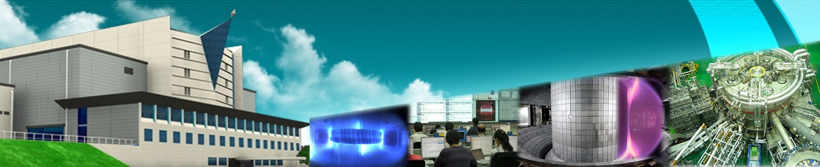
Contents …….
Korea Fusion R&D Program
K-DEMO Strategies
Approach via Virtual DEMO
KSTAR role for Virtual DEMO Approach
Summary

Slide 3
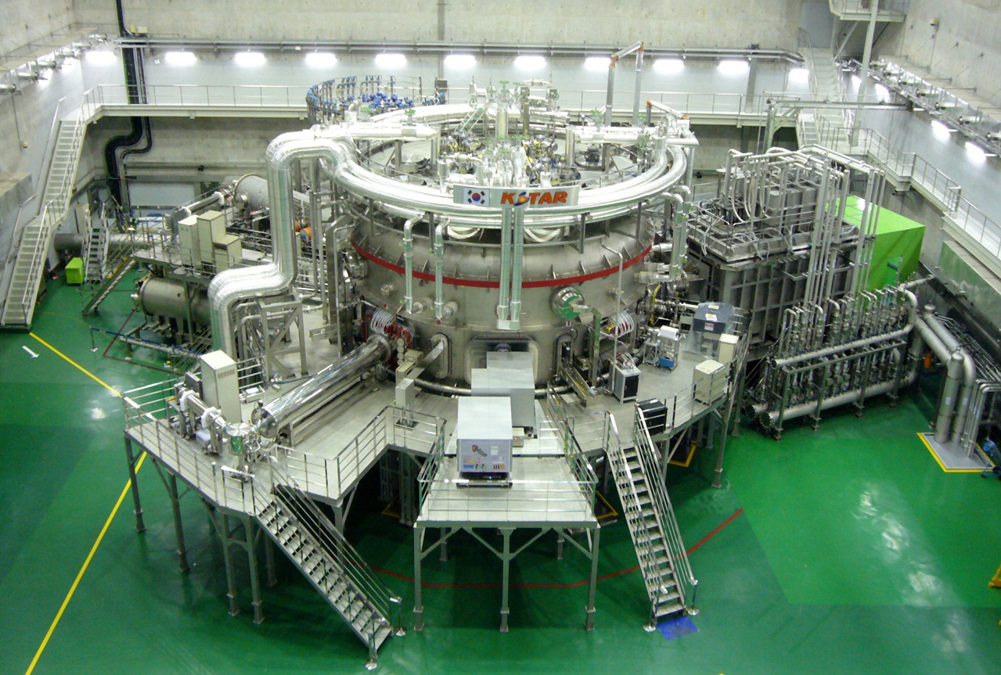
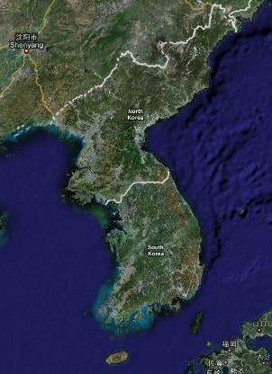
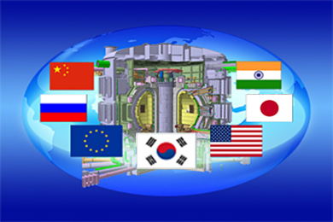
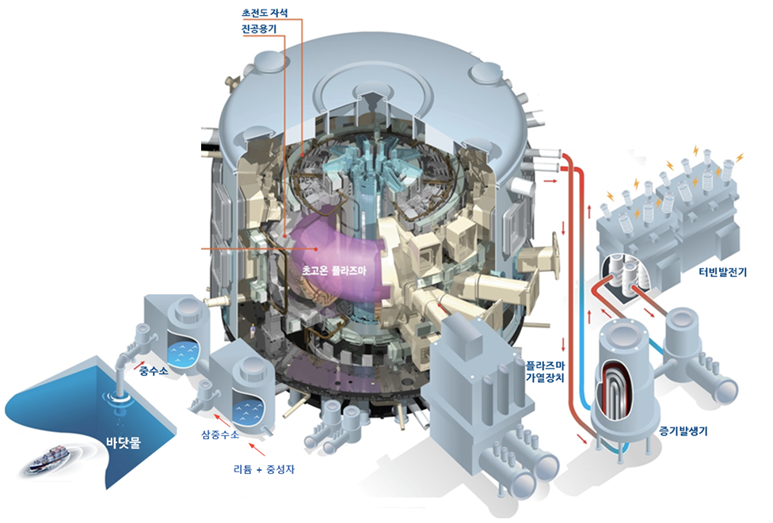
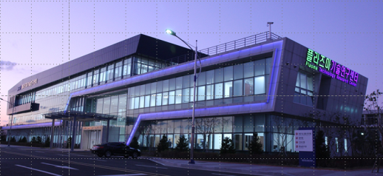
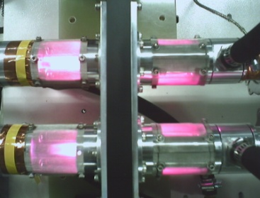
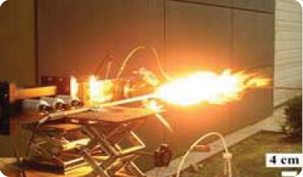
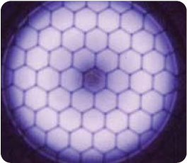
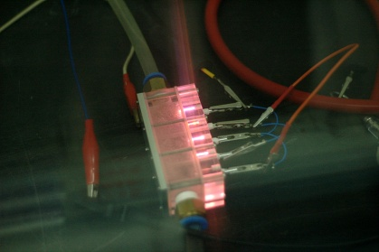
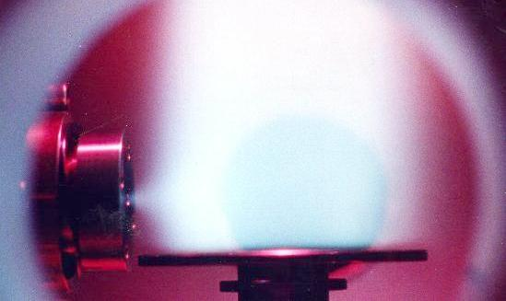
National Fusion Research Institute (NFRI)
KSTAR*
Nuclear Fusion
and Plasma science
ITER**
K-DEMO
Seoul
* Korean Superconducting Tokamak Advanced Research
** International Thermonuclear Experimental Research
Daejeon
Plasma Technology
and Applications
Gunsan
Jeju
Plasma Technology Research Center

Slide 4
Basic Plan of Korea Fusion Energy R&D
Fusion Energy Development Promotion Law (Dec. 2006)
Basic plan for the development and promotion of fusion energy (Aug. 2007)
Phase
Phase 1 (’07~’11)
Phase 2 (’12~’26)
Phase 3 (’27~’41)
Policy Goal
Establishment of a foundation
for fusion energy development
Development of Core Technology for DEMO
Acquirement of construction capability of fusion power plants
Basic Directions
Acquisition of operating technology for the KSTAR
Participation in the international joint construction of ITER
Establishment of a system for the development of fusion reactor engineering technology
High-performance plasma operation in KSTAR for preparations for the ITER Operation
Completion of ITER and acquisition of core technology
Development of core technology for the design of DEMO
DEMO design, construction, and demonstration of electricity production
Undertaking of a key role in ITER operations
Completion of reactor core and system design of the fusion power reactor
Commercialization of fusion technology
Basic Promotion Plan
Basic Promotion Plan 1 (’07~‘11)
Basic promotion plan 2 (‘12~‘16)
Basic promotion plan 3 (‘17~‘21)
Basic promotion plan 4 (‘22~‘26)
Basic promotion plan 5 (‘27~‘31)
Basic promotion plan 6 (‘32~‘36)
Basic promotion plan 7 (‘37~‘41)
Policy Goal for Plan 3
Establishment of foundation for fusion engineering technology development for demonstrating electricity production
Primary
Strategy for Plan 3
Acceleration for development of DEMO core technology
Strengthening of basic research in fusion and manpower fostering system
Broadening the base of support for fusion energy development

Slide 5

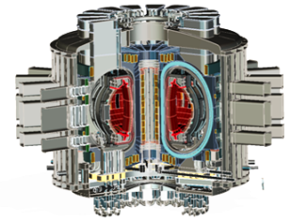
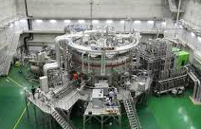
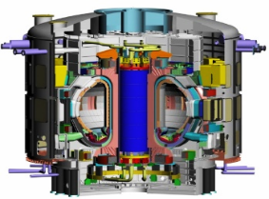

A Roadmap toward K-DEMO
Basic R&D
KSTAR
DEMO
D-T
Burning
ITER
Fusion Technology R&D
Fusion Technology R&D 1
Fusion Technology R&D 2

Slide 6
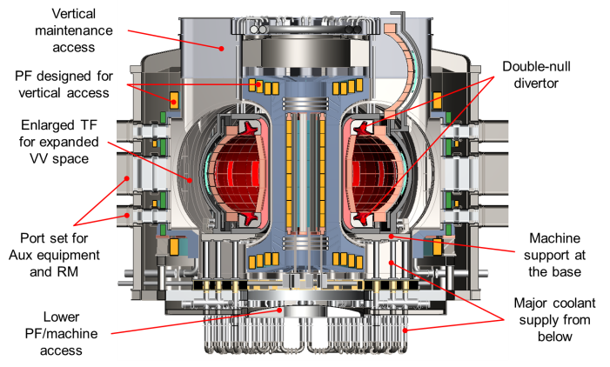
K-DEMO Design: A Basic Concept
Demonstrate both electricity generation and commercial feasibility
Main Parameters
R = 6.8 m / a = 2.1 m
B₀ = 7.0~7.4 T / B-peak = 16 T
elongation = 1.8
triangularity = 0.625
Plasma current > 12 MA
Te > 20 keV
Other Feature
Double-null & Single-null configuration
Vertical Maintenance
Total H&CD Power = 80~120 MW
P-fusion = 2200~3000 MW
P-net > 400 MWe at Stage II
Number of Coils : 16 TF, 8 CS, 12 PF

Slide 7
K-DEMO Strategies
Strategy 1: Direct K-DEMO Approach
- Demonstrate both electricity generation and commercial feasibility
- Totally new engineering design of K-DEMO
- Net electricity generation > 400 MWe
⇒ Would be a great burden of national program with budget and engineering
Strategy 2: Virtual DEMO Approach
- Demonstrate performance of K-DEMO design virtually
- The construction of demonstration reactor is left to the market forces
- KSTAR and ITER will be used as a test bed for K-DEMO design
⇒ Need to pursue Fusion Reactor Engineering Test Facility as a priority

Slide 8
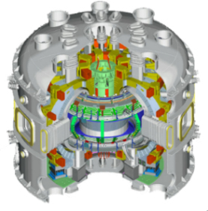
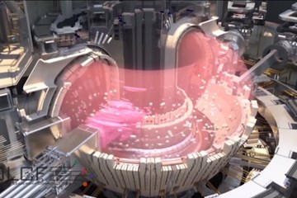
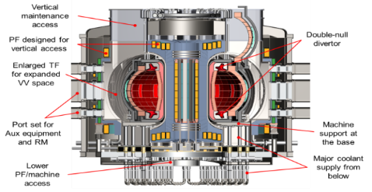
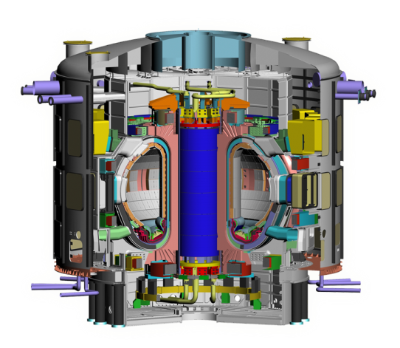
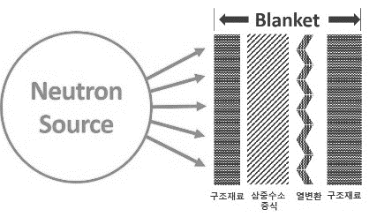
Virtual DEMO: Bridges the present (KSTAR, ITER) and the future (K-DEMO)
Validated simulations with data provided by KSTAR, ITER and Blanket facilities
Integrated simulations of engineering components (Blanket, BOP, licensing etc)
Optimization of K-DEMO simulations, Reduced risks and construction costs
Virtual DEMO
K-DEMO
High Performance
Plasma Data
Optimization
Reduced costs
KSTAR
Burning Plasma Data
Licensing, System integration
Tritium
Heat exchange
Materials
Basic Fusion R&D Program
ITER
Blanket R&D Facility

Slide 9
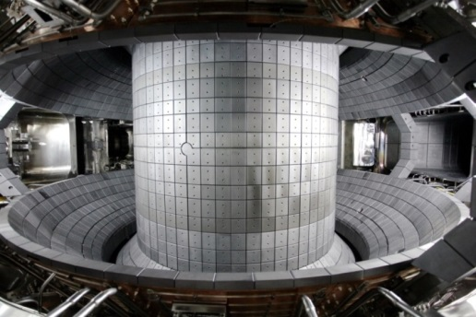
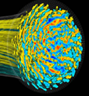


V. KSTAR extended through V. ITER up to Virtual DEMO
Virtual DEMO validation can be made well based on KSTAR, ITER data
☞ Simulations validated with KSTAR, ITER experiments
Decreased uncertainties with high fidelity and accuracy of simulations
☞ Reduced risks and construction costs by validated simulations
Virtual DEMO
ITER
K-DEMO
Predictions,
Design,
Fusion
Performance
KSTAR
Validation
Virtual ITER
Validation
Virtual KSTAR
Devices, Operations

Slide 10
Virtual DEMO R&D Roadmap
V-DEMO incorporates both physical and engineering components of fusion power plants
V-Tokamak is focused on predictions and uncertainty reduction of fusion reaction physics
V-BBS integrates Blanket and BOP simulations for engineering designs
1 phase (‘20 ~ ’25)
2 phase (‘26 ~ ’30)
3 phase (’31 ~ ‘35)
4 phase (‘36 ~ ‘40)
V-Tokamak
Fusion plasma simulations
Burning plasma simulations
Burning plasma simulation validations
V-BBS
Integrated system design codes development
Blanket simulations development
Blanket simulations validations
Integrated simulators development and engineering code management
V-DEMO
Virtual KSTAR
Virtual ITER
V-Tokamak &
V-BBS
V-DEMO
V-DEMO Validation
K-DEMO Design
Licensing supports
Resources
~ 1.0 petaflops
HP CPU clusters
~ 5.0 petaflops
HP CPU clusters, GPUs
~ 50.0 petaflops
HP CPU clusters, GPUs
~ Exascale
HP CPU clusters, GPUs

Slide 11
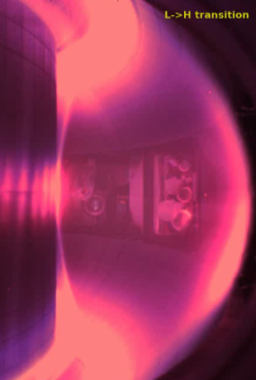
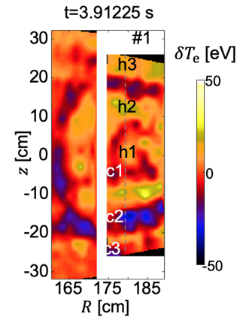
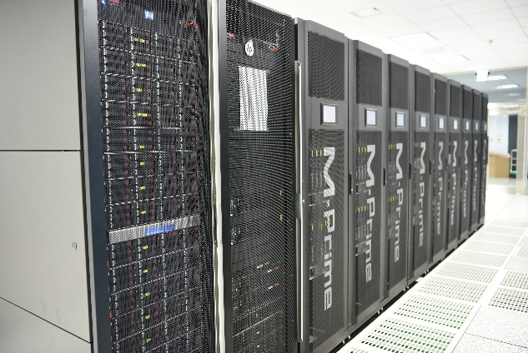
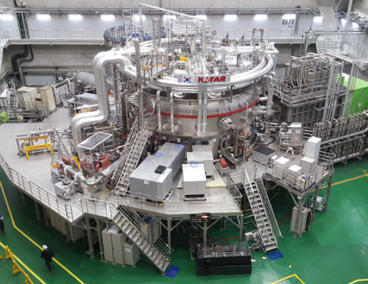
Virtual KSTAR is the First Step toward Virtual DEMO
Quantitative validation owing to reliable data of the real KSTAR
Precision simulation for quantitative predictive capabilities
Large-scale high precision simulation development
Peta-flops Super-parallel supercomputing techniques
Efficient simulations with reduced models
Data analysis and validation with big data techniques
Validation
Exploration
Supercomputer
KSTAR

Slide 12
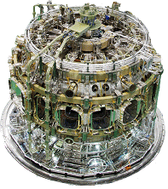
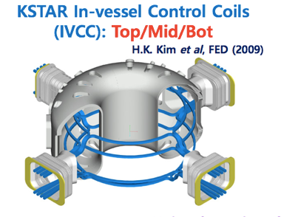
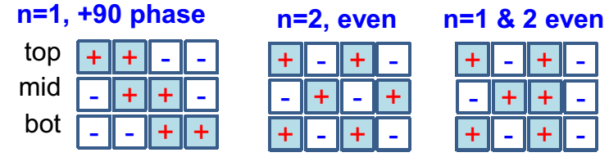
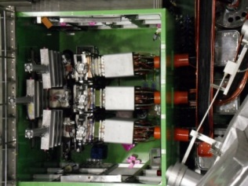
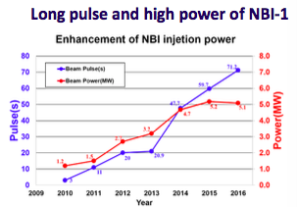
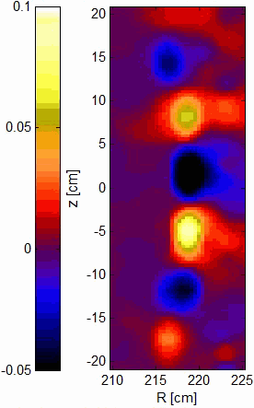
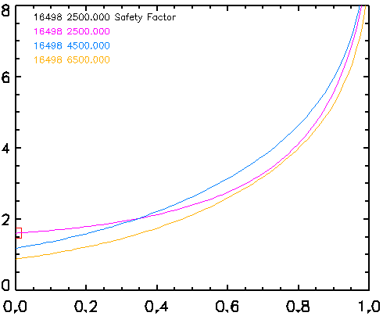
KSTAR has unique hardware advantages for high validation capabilities of virtual tokamaks
▶ SC magnet technology
Lowest error field (𝛿B/B₀~1x10⁻⁵)
Lowest toroidal ripple (~0.01 %)
▶ ITER relevant In-vessel coils
Uniquely top/middle/bottom coils
Reliable ELM-crash suppression
▶ steady-state heating & CD
Long pulse NBI and ECCD
2nd NBI system is under construction
▶ Advanced diagnostic systems
Profile and 2D imaging diagnostics
Domestic and int’l collaborations
ECEI
Image bolometer
MSE
#16498
2500 ms (w/ ITB)
4500 ms (w/o ITB H-mode)
6500 ms (w/o ITB L-mode)
q
psi_n

Slide 13
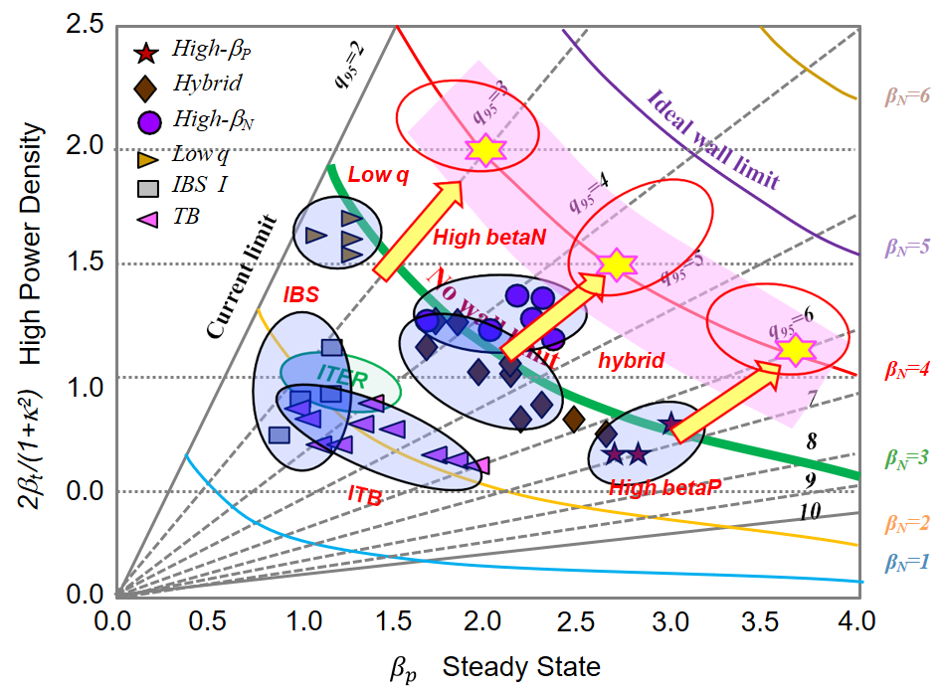
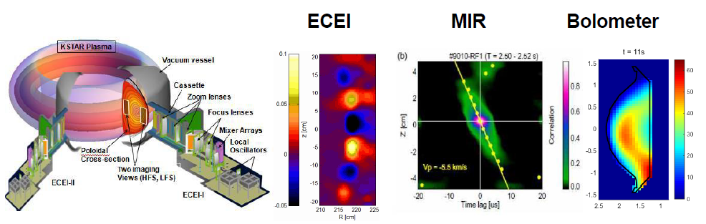
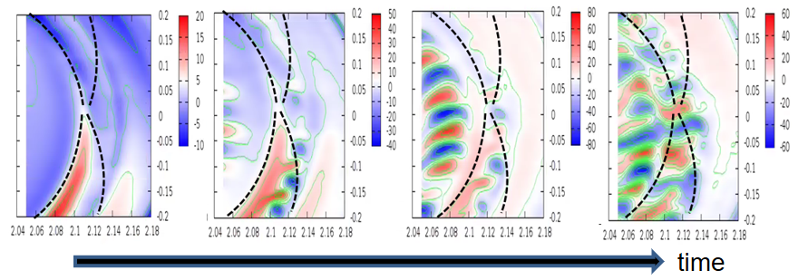
KSTAR has been well developed in operation for
exploration of new operation modes
Progressive achievement of H-Mode long-pulse operation
☞ up to 300 s
Reliable operation for development of new high performance modes
☞ Efficient exploration of unknown modes by simulation predictions
High quality imaging diagnostics
☞ Simulation validation and numerical model development
Plasma turbulence observations by imaging techniques
K-DEMO scenario development by KSTAR
Plasma turbulence simulations with supercomputers

Slide 14
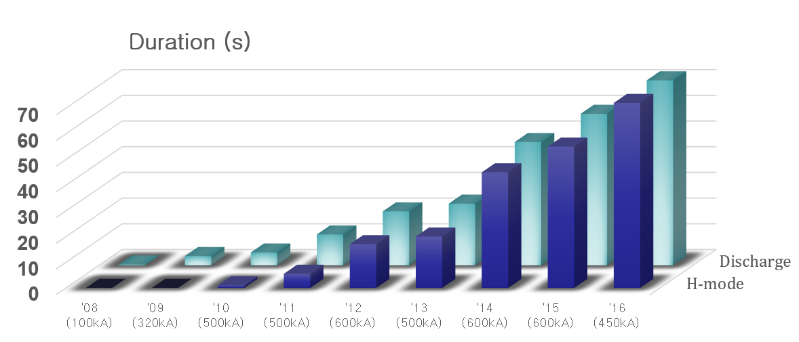
H-Mode long-pulse operation in KSTAR
20 s (2013) → 48 s (2014) → 70 s (2016) → 90 s (2018)
300 s (2025)
(sec)
90
80
(Sustaining time)
‘18
(Year)

Slide 15
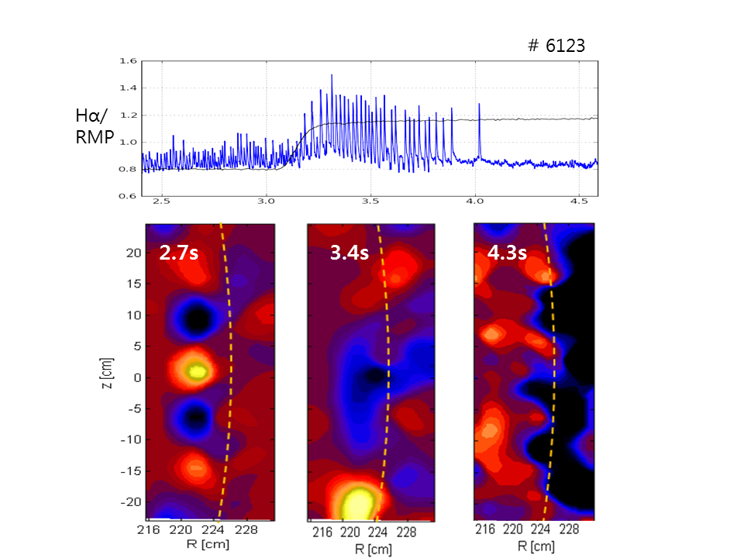
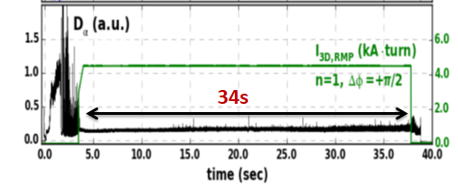
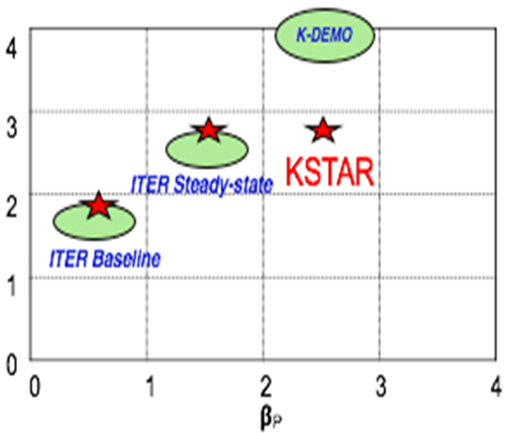
Experiments of advanced operation modes by KSTAR
▶ Active ELM suppression
▶ Advanced operation modes
• Internal transport barrier (ITB) > 7 s
• High beta operation (β_{P} > 3.0) > 3 s
2011
# 6123
ITB mode
2017
# 18726
High beta in 2017

Slide 16
Upgrade plan of KSTAR for higher beta and steady-state operation
2008
2017
Long-pulse H-mode research
Long pulse H-mode (>70s)
ELM research & control (>30s)
Alternative operation modes (ITB, low q, ..)
First plasma
(ECH 84 GHz)
Long-pulse H-mode
(NBI~5.5 MW)
(ECH~1 MW)
2017
2021
Advanced scenario & MHD research
Stable high beta operation
(β_{N} >3.0, T_{ion} ~ 10 keV)
Advanced mode develop.
(hybrid, ITB, low q)
MHD & disruption control
Heating upgrade
(NBI~12 MW)
(ECH~6 MW)
2021
2025 ~
Steady-state & reactor mode research
Tungsten divertor & active cooling
Advanced current drive under test
(HFS LHCD & Helicon CD)
Steady-state operation (~300s)
Divertor upgrade
(Tungsten divertor)
(Detached divertor)
(Diagnostics)
Advanced current drive
(LHCD~4 MW)
(Helicon CD~4 MW)

Slide 17
Fusion Neutron Irradiation Data
The Fusion Neutron Irradiation Data are crucial toward the virtual DEMO together with the data of KSTAR and ITER
⇒ We are considering various types of fusion neutron sources such as beam-target
sources, volumetric ones, and even a new fission experimental reactor
Tritium
Breeding
Tritium
Fuel Cycle
Neutron
Irradiation
Facility
Neutron
Energy
Conversion
Structure
Material

Slide 18
Summary
We are going to take a virtual DEMO into consideration for planning the K-DEMO
The virtual DEMO will be much more helpful to optimize the engineering design with uncertainties reduced and accelerate the construction of K-DEMO.
A virtual KSTAR will be the first step toward the virtual DEMO
We will be able to make a good benchmarking of the virtual KSTAR by using the real KSTAR and explore new operating modes of the real KSTAR by using virtual KSTAR, vice versa.
The virtual KSTAR can be easily and reliably extended to a virtual ITER by using the data of the ITER operations.
And then the virtual ITER can also be easily and reliably extended to a virtual DEMO with the experimental data of breeding blankets.
Fusion Engineering Test Facility equipped with a high flux fusion neutron source is crucial for the experimental data of breeding blankets,
We are now making a planning of the fusion engineering test facility with considering several types of fusion neutron sources.

Slide 19


Thank you for your attention !
Around 2035, owing to the success of ITER burning, I hope the recovery of
the honor of fusion energy that has been teased with “the Boy Who Cried Wolf” of Aesop’s Fables
http://pesstevensone.blogspot.com/2013/08/the-boy-who-cried-wolf.html

Slide 20
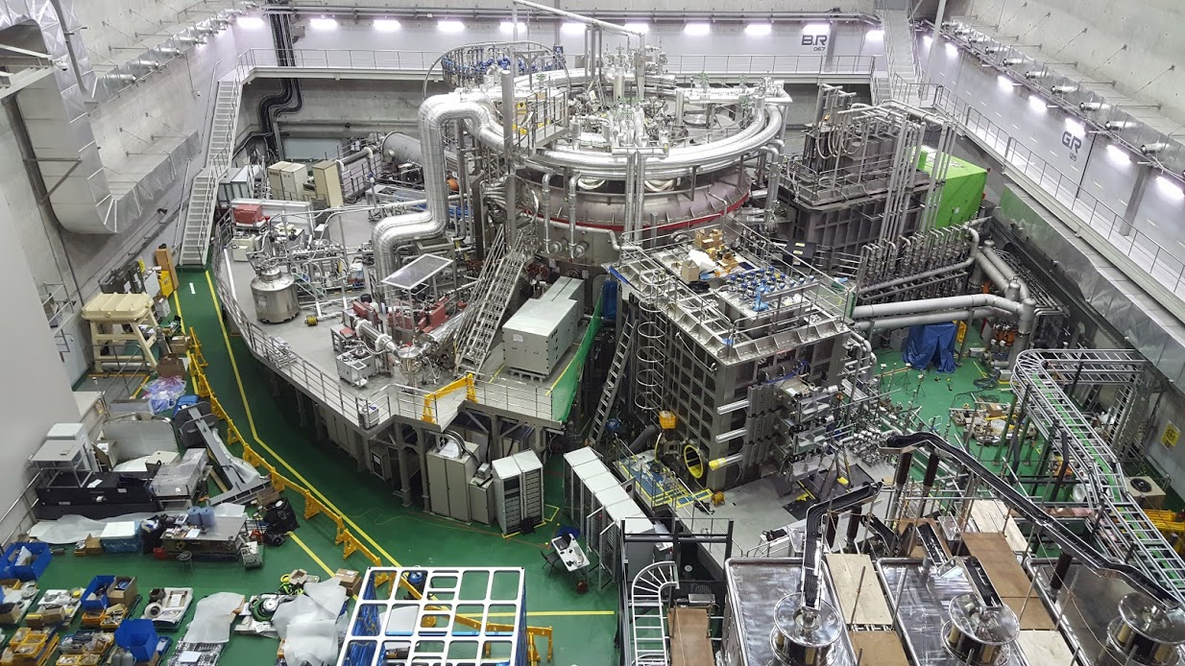
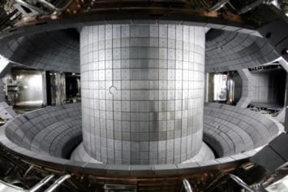
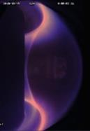
KSTAR (Korea superconducting Tokamak Advanced Research)
Main body
Height: ca. 10 m
Diameter: ca. 10 m
Parameters | Designed | Achieved (~2017)
Major radius, R₀ Minor radius, a Elongation, κ Triangularity, δ Plasma shape Plasma current, I_{P} Toroidal field, B₀ H-mode duration β_{N} Superconductor Heating /CD PFC | 1.8 m 0.5 m 2.0 0.8 DN, SN 2.0 MA 3.5 T 300 s 5.0 Nb₃Sn, NbTi ~ 28 MW C, W | 1.8 m 0.5 m 2.15 0.8 DN, SN 1.0 MA 3.5 T 73 s 4.3 Nb₃Sn, NbTi ~ 10 MW C, W

