Slide 1
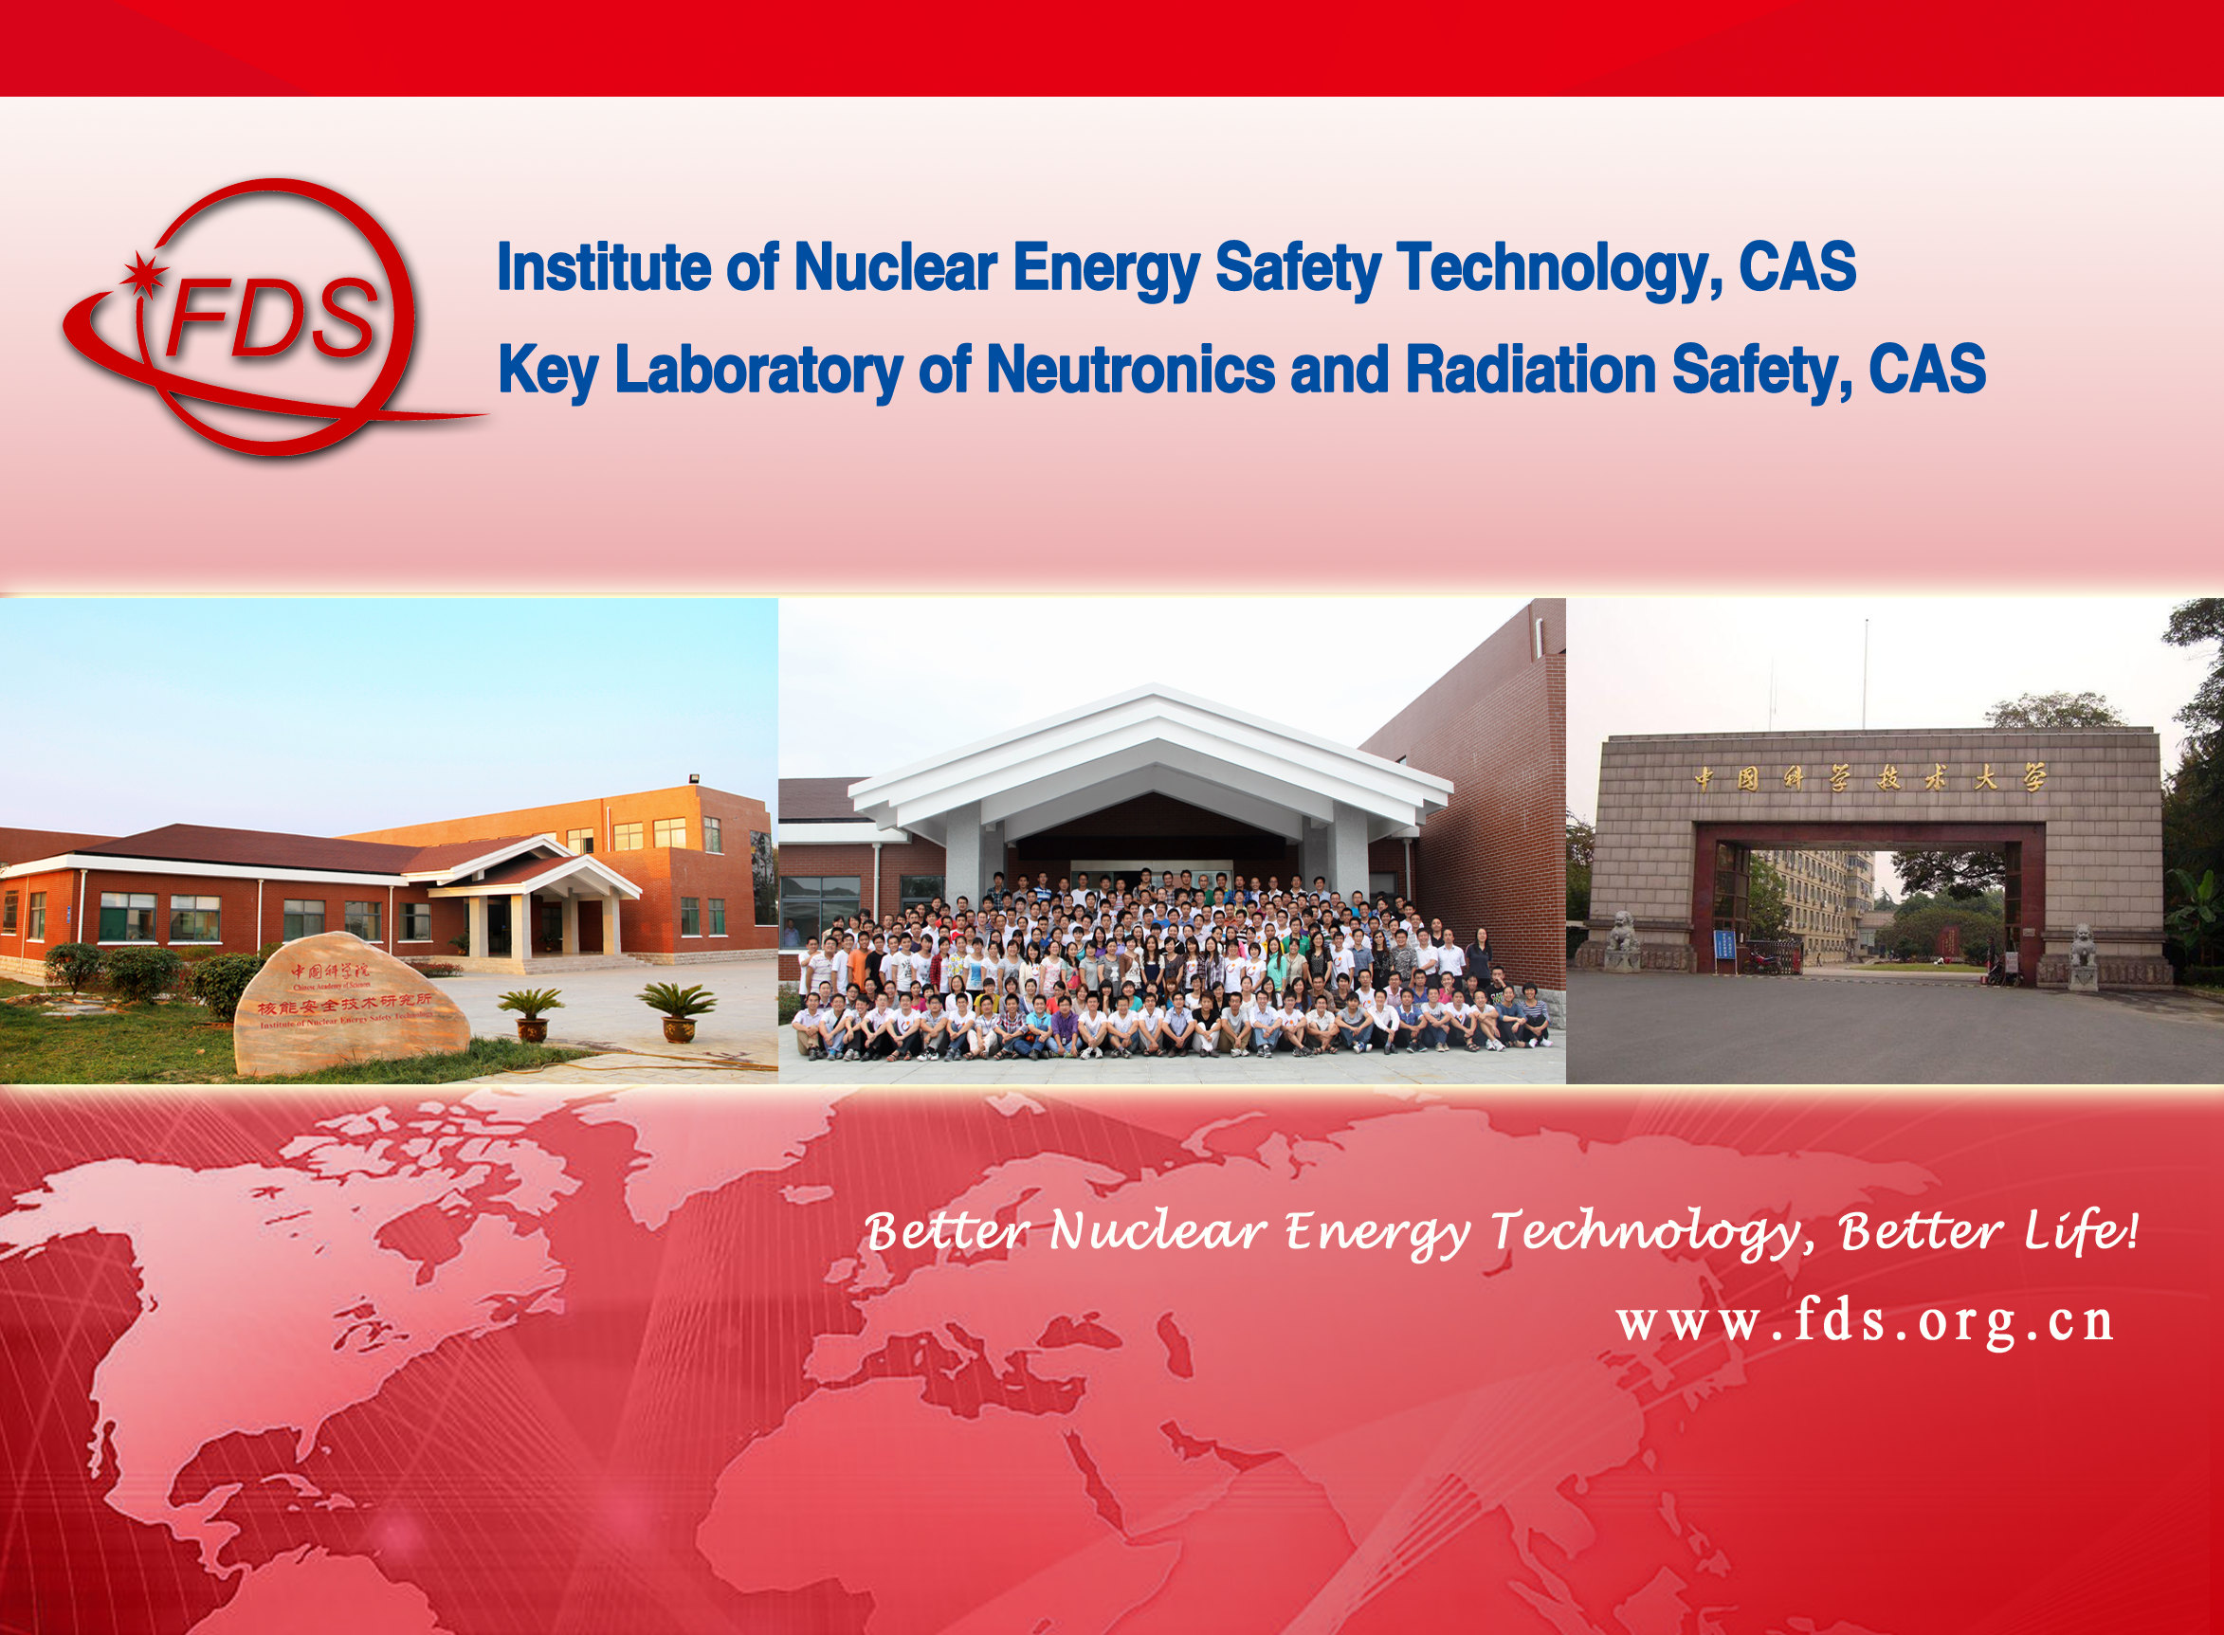

Slide 2
Fusion R&D Activities at INEST·FDS Team
Presented by Yican Wu
Contributed by FDS Team
Key Laboratory of Neutronics and Radiation Safety
Institute of Nuclear Energy Safety Technology (INEST)
Chinese Academy of Sciences
www.fds.org.cn
Notes:
Good Morning everyone. I am Zhibin Chen from INEST*FDS Team. On behalf of Prof. Yican Wu who unfortunately cannot make here today because of travel formality, I will make the presentation titled “Fusion R&D Activities at INEST·FDS Team”.

Slide 3
Institute of Nuclear Energy Safety Technology ( INEST )
ASIPP
Plasma Technology
ASIPP
FDS Team
FDS
Team
Fusion Nuclear
Technology & Material
Fusion
INEST
USTC
Nuclear Engineering（fusion & fission）
Fission
FDS Team – Joint Research Team
on Advanced Nuclear Energy
Notes:
INEST is abbreviated from Institute of Nuclear Energy Safety Technology, Chinese Academy of Sciences. Its foundation come from the FDS team affiliated with both ASIPP and USTC. After its foundation, the part of fusion nuclear technology and material in ASIPP and the part of nuclear engineering go to INEST. Now the FDS team is a little bit bigger concept than INEST, which is the joint research team on advanced nuclear energy.

Slide 4
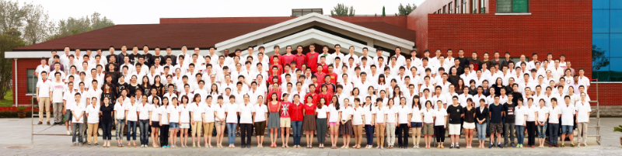
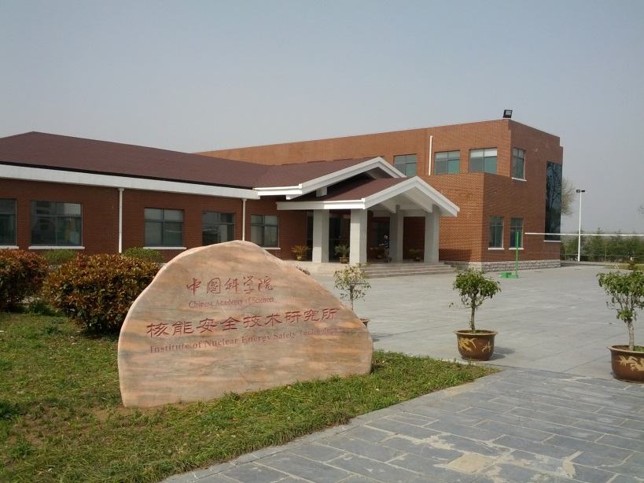
Institute of Nuclear Energy Safety Technology, Chinese Academy of Sciences ( INEST, CAS )
Key programs:
Strategic Priority Research Program of the Chinese Academy of Sciences
ITER Related International and Domestic Program
Nuclear Energy and Safety Techonlogy Innovation Program
10 Divisions， 400 Staff + 100 Students
~500 members
Four Main Research Projects:
1. Physics and Safety of Nuclear Energy
2. Lead-based reactors
3. Fusion nuclear technology and materials
4. Nuclear technology and applications
The major professional/fundamental research basis for nuclear energy safety technology in China to promote the efficient and safe application of nuclear energy.
Notes:
INEST now has around 500 members with the average age of around 30.
We are mainly involved with 3 key programs not only in fusion reactor but also fission reactor, including Strategic Priority Research Program of the Chinese Academy of Sciences, ITER Related International and Domestic Program, and Nuclear Energy and Safety Techonlogy Innovation Program
We are doing four main research projects, such as XXX. In fact, INEST is the major professional/fundamental research basis for nuclear energy safety technology in China to promote the efficient and safe application of nuclear energy.

Slide 5
Outline
Introduction
Research Progress
Cooperation
Summary

Slide 6
Main Fusion Concepts Developed in China
Fusion TEST Reactor
（Multi-Functional eXperimental Reactor abbreviated as MFX）
Hybrid Test Reactor: CAEP-EM, FDS-MFX (-GDT/-ST), FEB, ...
Fusion Test Reactor: CFETR (-CDT/-SDT)…
Fusion DEMO Reactor
Hybrid DEMO Reactor: FDS-SFB, FDTR
Fusion DEMO Reactor: C-DEMO, HCCB-DEMO
Fusion POWER Plant
Fusion Power Plants: FDS-II, FDS-III, FDS-ST…
Others
* Currently Active in Down line
* Blue by FDS team
Notes:
In China, there are many different fusion concepts developed, such as the hybrid test reactor of CAEP-EM and FDS-MFX, the fusion test reactor of CFETR, the hybrid DEMO reactor of FDS-SFB, the fusion DEMO reactor of C-DEMO and HCCB-DEMO, the fusion power plants of FDS series, and so on. A lot of discussions are present in China regarding the future fusion device beyond ITER, and it is still waiting for the approval of the government for the next step.

Slide 7
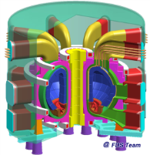
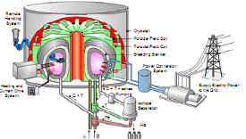
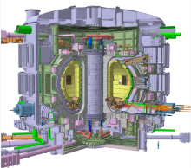
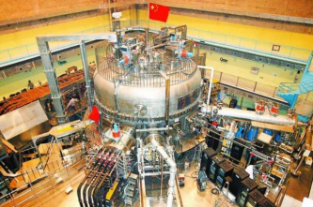
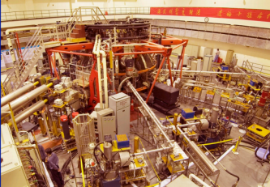
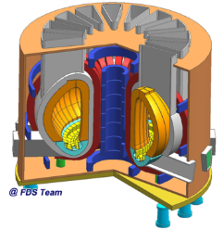
Proposed Roadmap of Fusion Nuclear Technology and Safety in China
Now
2020
2030
2040?
2050?
DEMO
FFP
ITER
Integrated Fusion Engineering Test Reactor
（ CFETR/MFX/GDT, etc.)
1. Nucl. Design & Safety 2. FNS
3. Blanket and coolant Tech. 4. RAFM Steel ...
Hybrid Reactor
Fusion Nuclear Technology and Safety
Notes:
And more about fusion research in China, I would like to show a proposed roadmap of fusion nuclear technology and safety in China till construction of FPP.
This blue line shows the normal way to FPP like most county’s proposal. But in China, we may propose something different like the yellow line.
we may construct our own testing reactor, there are many different concepts proposed: CFETR is one of optional concepts developed recently, and actually we have some other multi-functional testing reactor concepts as options developed in parallel. Before FPP, we may have options of pure fusion DEMO or Hybrid reactor.
In the development of the proposed engineering test reactor, and we think fusion nuclear technology and safety will play the increasing important role, such as the R&D on nuclear design and nuclear safety, fusion neutron source, blanket and coolant technology, RAFM steel, etc.
Again there are still many discussions in order to get a converged roadmap of fusion development in China, but this situation does not influence we can work practically on fusion technology development, with strong support of government.

Slide 8
INEST Continuously Supported by National Programs
on Fusion Research
MOST: Domestic Fusion R&D Program
Program of International S&T Cooperation
CAS: Knowledge Innovation Program
NSFC: National Natural Science Foundation of China
Notes:
Our fusion research has been continuously supported by national programs, including
MOST: Domestic Fusion R&D Program
Program of International S&T Cooperation
CAS: Knowledge Innovation Program
NSFC: National Natural Science Foundation of China

Slide 9
Outline
Introduction
Research Progress
Reactor/Blanket Concepts
Neutronics Simulation/Experiment
Material and Blanket Fabrication
Coolant Testing Facilities
Cooperation
Summary

Slide 10
Reactor/Blanket Concepts

Slide 11
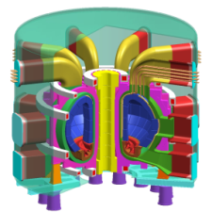
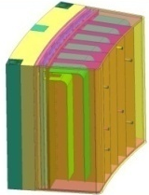
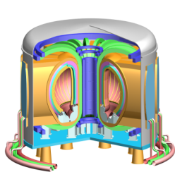
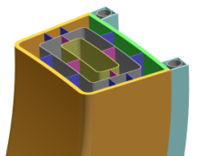
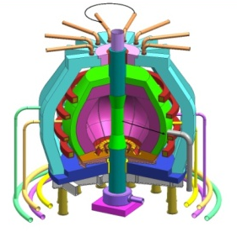
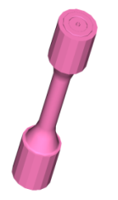
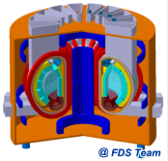
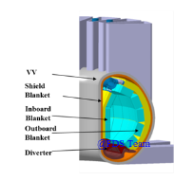
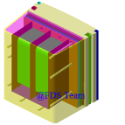
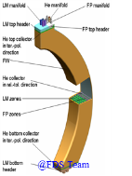

FDS Series Fusion Reactors & Blankets Conceptual Design
Fusion POWER Plant FDS-II: Fusion Power Reactor for high-efficiency electricity generation FDS-III: High Temperature Fusion Reactor for advanced applications, e.g. hydrogen production FDS-ST: Spherical Tokamak-based Reactor for exploiting and assessing innovative concepts FDS-NTT: Negative Triangularity Tokamak Reactor for exploiting innovative concepts to handle power Fusion DEMO Reactor Hybrid DEMO Reactor: FDS-SFB for spent fuel burner (energy production, fuel breeding, waste transmutation ) Fusion DEMO Reactor: C-DEMO Fusion TEST Reactor Test Reactor: FDS-MFX (RT/-GDT/-ST) （Multi-Functional eXperimental Reactor abbreviated as MFX）
FDS-II
700ºC
DLL/SLL
FDS-III
1000ºC
HTL
FDS-ST
450ºC
CCP
FDS-MFX
Notes:
We have performed conceptual designs of FDS series fusion reactors and blankets. We have developed the concepts of fusion power plants, such as the FDS-II fusion power reactor, FDS-III high temperature fusion reactor, and FDS-ST spherical Tokamak-based reactor. We have developed the hybrid demo reactor concepts of FDS-SFB for spent fuel burner, and fusion demo reactor concepts of C-DEMO. We also developed the fusion test reactor concept of FDS-MFX.

Slide 12
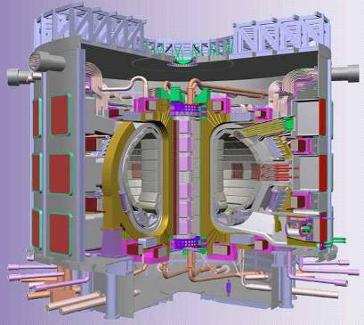
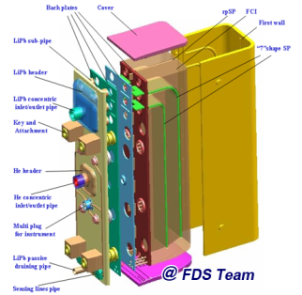


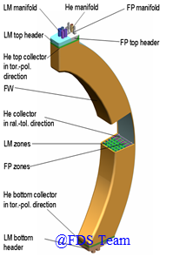
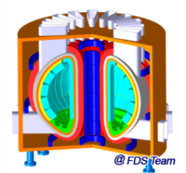
DFLL-TBM Dual Function Lithium Lead liquid breeder TBM
Test
TBM
ITER
SLL/DLL
HTL
DCB/DWT
MFX
Structural Materials: CLAM/ODS
Insulation/Anti-erosion/Anti-permeation coating: Al-based Coating / SiC insert
Tritium Breeder/Neutron Multiplier: PbLi
Coolant: He or He/PbLi
TBM for Testing:
SLL mode at the early stage
- PbLi: 1mm/s, 450℃
DLL mode at the late stage
- PbLi: ~10mm/s, ~700 ℃
- FCI: SiC
Notes:
12
As you may know, INEST is responsible for the development of Dual function lithium lead liquid breeder DFLL TBM, which has been supported by CN MOST. This TBM has two modes, including SLL mode with PbLi speed of 1mm/s, and DLL mode with PbLi speed of 10mm/s. The structure material is CLAM with the SiC as the FCI. Besides, INEST is also responsible for safety and structure material for the development of HCCB TBM in China.

Slide 13
Neutronics Simulation/Experiment
Notes:
The first subsection is related to “Neutronics Simulation/Experiment”.

Slide 14
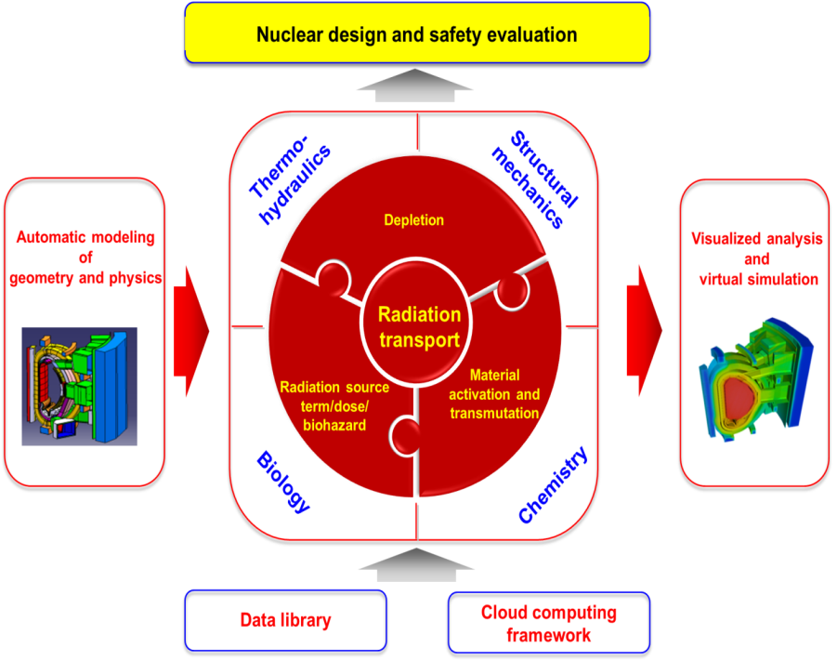
Super Monte Carlo Program for Nuclear and Radiation Simulation SuperMC
Multi-functional, intelligent, accurate & precise simulation software
Publicly distributed in OECD/NEA Software Data Bank
Notes:
This is the functional architecture of SuperMC. It is designed to support the design and safety assessment of nuclear systems featuring high fidelity simulation capability and intelligent operation.
This picture shows the functional architecture of SuperMC by taking the radiation transport calculation as the core and including the calculation of isotope depletion, radiation source term/dose/biohazard, material activation and nuclide transmutation, etc. We also plan to integrate the multi-physics coupling calculation related to thermo-hydraulics, structural mechanics, radiation biology, corrosion chemistry etc.
CAD-based pre-processing interface and visualization-based post-processing interface are two powerful advantages.
The system can be run based on the internet with cloud computing framework.

Slide 15
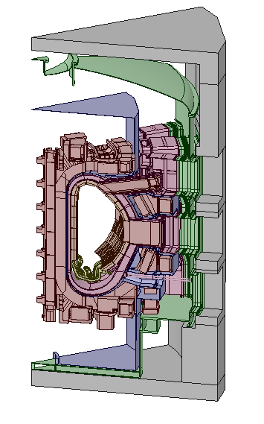
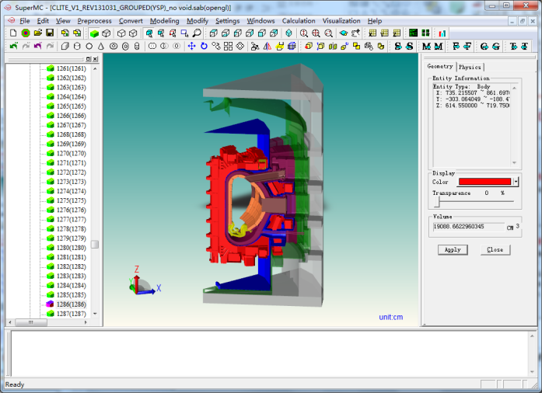



CAD/Imaged-based Modeling
Accurate automatic conversion between CAD/Image and MC simulation model
Integrated whole model interactive modeling (geometry material, source, tally, etc)
Creating CAD model without the help of other commercial CAD software
SuperMC
(direct calculation)
CAD model
autoCAD, CATIA, UG…
Other MC
MCNP
TRIPOLI
Geant4
FLUKA
……
Image model
CT / MRI / segmented images…
Accurate automatic modeling

Slide 16

Efficient Radiation Transport Calculation
Source sampling
Geometry processing acceleration method based on particle location prejudgment
Advanced intelligent adaptive variance reduction
Adaptive variance reduction based on weight window smoothing
Global weight window generator (GWWG)
Uniform fission site method(UFS)
Hybrid MC and deterministic methods with transition region
Cell geometry multi-tree based method for massive tallies
Other acceleration: source convergence, union energy grid, etc.
Transport length sampling
Nuclear reaction process
Physical statistics
Notes:
For transport calculation of particles, we have developed serials of novel methods which cover the main processes of transport simulation. Such as the geometry processing acceleration method based on particle location anticipation, advanced intelligent adaptive variance reduction, hybrid MC and deterministic method with transition region, Cell geometry multi-tree based method for scoring massive tallies and so on.

Slide 17
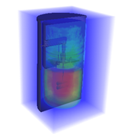
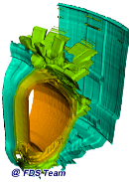
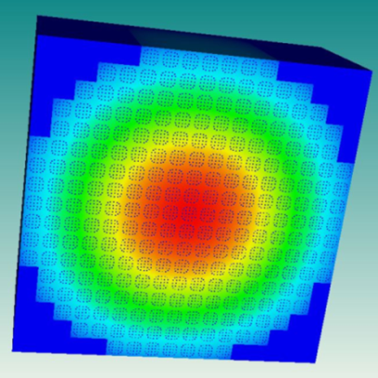
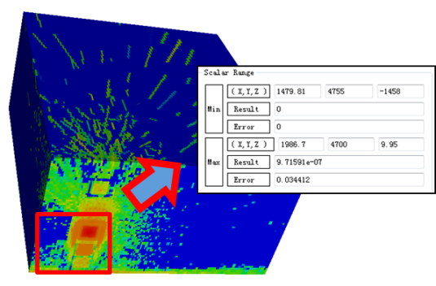
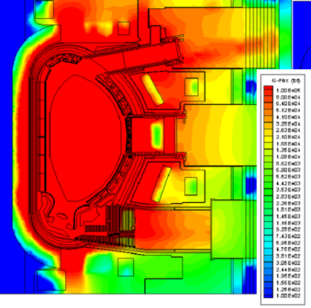
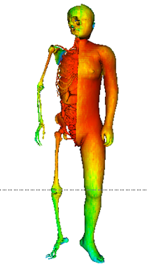
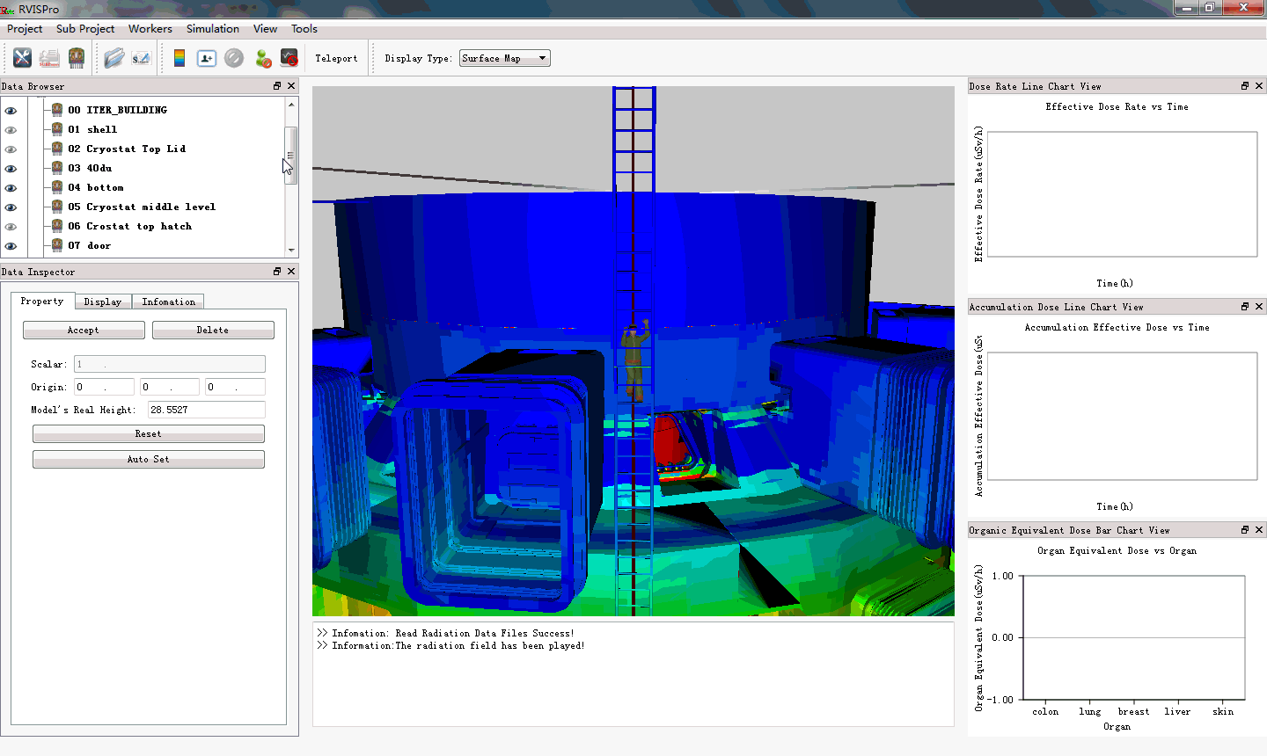
Multi-D Visualization Analysis
Surface rendering
Volume rendering
Iso-surface
Data extract
Visualization mixed with geometries
Rad-Human
Virtual-reality based simulation
Visualization for multiple codes: MCNP、TORT、FISPACT …
Notes:
已更新

Slide 18
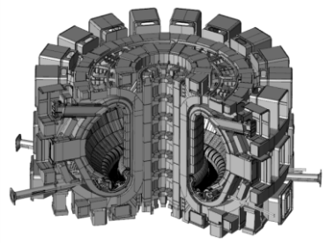
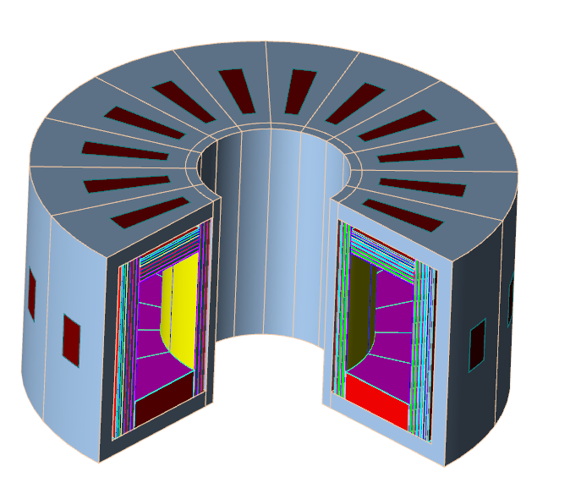
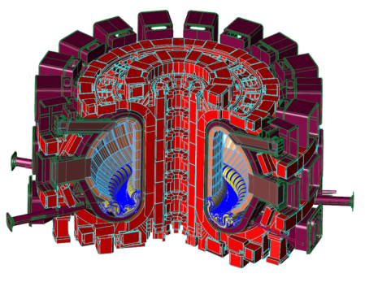
Development of ITER Neutronics Reference Model
Regular modelling
(approximate)
Irregular modelling
(accurate)
ITER CAD model
（140,000 entities）
973 entities
140,000 entities
~16 person-year
~ 10 minutes
Increase of efficiency by factor of 1000+

Slide 19
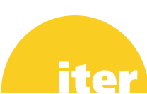

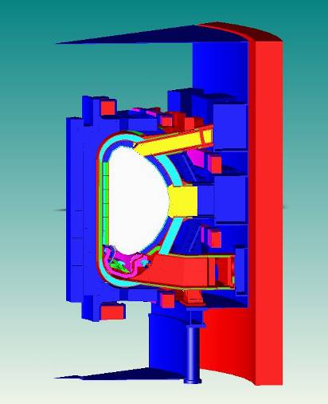
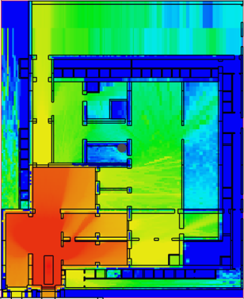
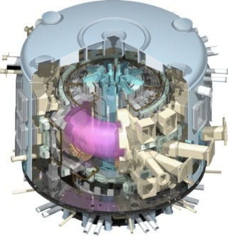
List of China-ITER Neutronics Tasks
Task 2003 : Upper Port Shielding Analysis
Task 2004 : Update of Basic MCNP Model for ITER and Extension of Data Library
Task 2005: Testing and Application of a CAD/MCNP Interface Program for
ITER Neutronics Design Calculations
Task 2009 : A : Creating Neutronics Model of ITER Building
B : Gamma Dose Map in Building during Cask Movements
C: Activation of the ITER Cooling Water
D : Neutronics of the Bio-shield Plug
Task 2012: A : Production of CAD Neutronics Models for ITER
B : Radiation Transport in ITER buildings
Task 2013: A: Radiological calculation for port cell doors
B: Virtual-reality simulation for ITER PF4 coils maintenance
Task 2015: Shielding Analysis of Bio-shield Plugs in B1 of ITER
Task 2016: Production of Activation Data Handbook for ITER Neutronics
ITER Building Model
ITER Neutronics Model
Radiation Map in Hotcell
ITER Tokamak Machine
Notes:
With support from ITER project and domestic fusion program, we have finished several neutronics tasks since the year 2003. Last year, we have performed a new task: shielding analysis of bio-shield plugs in ITER building.

Slide 20
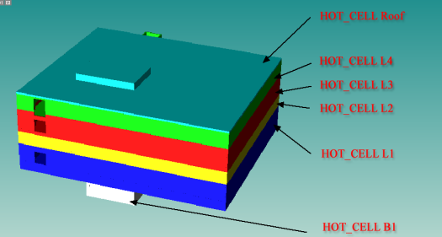
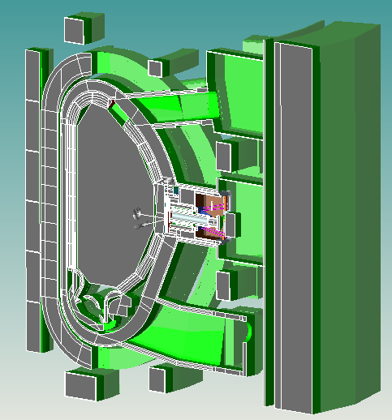
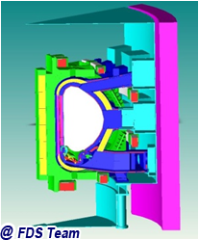
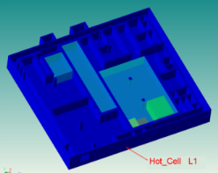
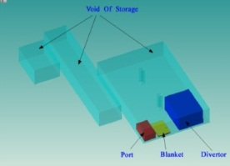
List of Other Country ITER Neutronics Tasks
Supported by FDS Team
Task 2006 :
（JAEA）
Task 2007:
(JAEA)
Task 2010 :
(CEA)
Required Thickness for the Ceiling Slab of Hot Cell Repair Room from Radiation Shielding Point of View
Nuclear analysis of the port limiter and neutron flux monitor in the equatorial port
Development of Monte Carlo automatic modeling functions of MCAM for TRIPOLI-ITER application
ITER Hot Cell
Port Limiter
SuperMC/MCAM for TRIPOLI-ITER
Notes:
Port Limiter

Slide 21
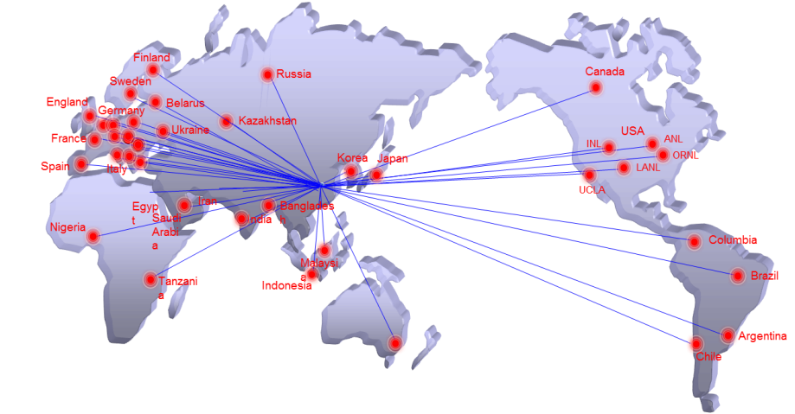
SuperMC widely used in 800+ institutions in 50+ nations and 30+ major international nuclear projects

Slide 22
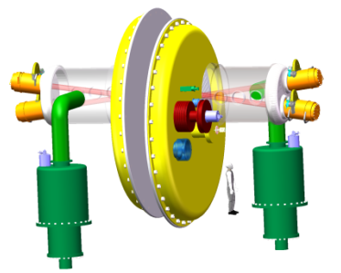
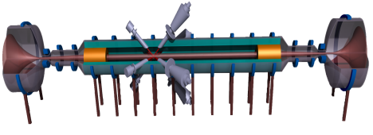
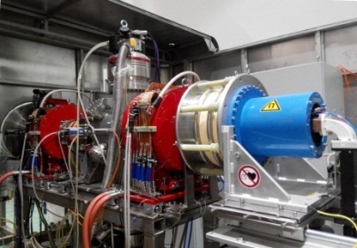
Roadmap of Fusion Neutron Sources
>10¹⁸ n/s
10¹⁵-10¹⁶ n/s
10¹²-10¹³ n/s
HINEG-III
Volumetric Fusion Neutron Source:( e.g. GDT-VFNS )
HINEG-II
High Intensity Steady Neutron Source
HINEG-I
Steady and Pulse Dual-Mode Neutron Source
Multi-Physics Coupling Test
Neutrons, Ions, Heat, Magnetic Field…
High Volume Nuclear Heat Deposition
Service Performance Integration Test
Materials Irradiation
Neutronics Performance Test
Activation, Tritium breed, Radiation shielding…
Nuclear Technology Application
Nuclear Data
Methods and Software
Radiation Protection
Basic Research
on Neutronics
Research on Nuclear
Technology and Safety
Integration Test of Components Nuclear Performance
Notes:
Here I would like to show the proposed roadmap of fusion neutron source in China. The D-T fusion neutron source with the neutron intensity of 10¹²-10¹³n/s (like HINEG-I) has been constructed for basic research on nuclear data, neutronic physics, radiation protection. The relative high neutron intensity of 10¹⁵-10¹⁶n/s (like HINEG-II) is needed to conduct the research on material radiation, neutronics performance test, and nuclear technology application. Volumetric fusion neutron source (like HINEG-VFNS) is proposed to be built with the neutron intensity of more than 10¹⁸ n/s to perform the integration test of component.

Slide 23
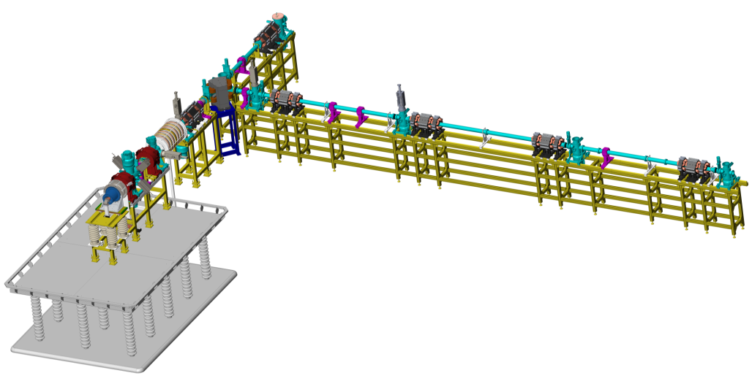
Overview of HINEG-I
Switching Magnet
Accelerator tube
Quadrupole Magnet
Pulse Beamline
1.5 ns
Steady Beamline
10¹²⁻¹³n/s
Ion Source
Applications:
Steady Beam: V&V of neutronic method and software, etc.
Pulse Beam: Nuclear data measurement, etc.
Fusion neutrons with yield up to 10¹²n/s have been generated

Slide 24




HINEG-I Main Sub-systems
Ion Source and Low Energy Beam Transportation
Steady Beam Line
Pulse Beam Line
Control Room

Slide 25




FDS-0—Fusion Driven Subcritical Reactor/Blanket
Neutronics Performance of Hybrid Reactor
Accelerator-based
Neutron Source
(HINEG-I)
Zero Power Reactor Facility
(CLEAR-0)
Hybrid Test Facility
(FDS-0)
Objective：Validation of Nuclear Design and Control Technology for Hybrid System （ADS/FDS）
V&V of methods, software and data library for reactor design and analysis
Validation of breeding/ shielding/ fission blanket design scheme
Validation of Measurement and Control Technology
Notes:
The CLEAR-0 can be coupled with HINEG-I. The coupled system called FDS-0 or ADS-0. It may be read as Fusion-Driven Zero-Power Sub-critical System or Accelerator-Driven Zero-Power Sub-critical System.
FDS-O can play an important role in the development of lead-based hybrid nuclear systems such as physics validation of the ADS-CLEAR series reactor and the FDS series fusion and hybrid reactors.

Slide 26

Preliminary Scheme of HINEG-II
Neutron yield：10¹⁵-10¹⁶ n/s
Conceptual Design Option
Key Technology of HINEG-II
Ultra-High Power Rotating Target
High Heat Flux (100kW/cm²)
Removal Technology
Ion Accelerator
Ampere Level Ion Source &
Accelerator Technology
R&D for key components of HINEG-II is on-going
Notes:
Here is the general scheme of HINEG-II, mainly consisting of two beams with the rotating target. The key technologies mainly include Ultra-High Power Rotating Tritium Target, High Heat Flux (50 kW/cm²)
Removal Technology, High Intensity (170mA/400keV) Ion Accelerator Technology, Tritium Relevant Technology. R&D for key components of HINEG-II is on-going.

Slide 27


Optional Conceptual Design of HINEG-III
Support Project：IAEA Coordinated Research Project F1.30.15 (2012-2016)
International Cooperation：8 countries (12 institutions) currently involved
GDT-VFNS: Fusion Materials and Component Testing facility
GDT-Hybrid: Fusion-Fission Hybrid System
GDT-VFNS
GDT-Hybrid
The pre-conceptual design of HINEG-III has been finished
Notes:
Meanwhile, a high flux volumetric fusion neutron source, HINEG-VFNS is under development. HINEG-VFNS would focus on integrated test of fusion reactor components. And the neutron with intensity of 10 to 18n/s together with the complex environment of ions, heat and magnetism would provide multi-physics test for reactor component, which would be essential in the establishment of fusion industry standards.
FDS Team have proposed two scheme of volumetric fusion neutron source based on the gas dynamic trap to be Fusion Materials and Component Testing facility and Fusion-Fission Hybrid System. Currently, the pre-conceptual design of HINEG-VFNS has been finished with the financial support of IAEA Coordinated Research Project and widely international cooperation.

Slide 28



Series Neutronics Experiments on HINEG
Neutronics theory and software verifcation:
MC Method Validation for New Physics Theory
Simulation Technique for Verifying New Physics Problem
Reactor criticality safety, New material activating radiation, etc.
Measurement and validation of nuclear data
Nuclear Data Evaluation and Validation
Neutron multiplication, new-type nuclear fuel , etc.
Nuclear Data Measurement:
Materials’ service properties and life, shielding and activation
Neutronics Properties of Materials Evaluation
Neutronics performance of blanket/reactor
Experiment for DFLL (Dual Function Lithium-Lead) TBM
Fusion Driven Subcritical Reactor/Blanket
Mechanism of materials irradiation damage
First Wall/Structural Materials of Fusion Reactor
Other nuclear technology applications
DFLL
Bubbles and defects
Notes:
A series of Neutronics Experiments were scheduled at both the self-owned faculties and cooperated platforms to concentrate on the following categories.
First, to verify the neutronics theory and program especially for the new physics in advanced nuclear systems, such as the neutron multiplication cross section of new materials, and new type of nuclear fuel.
Second, to validate the nuclear data especially for the materials' service properties, shielding and activation properties, and these data can be used to evaluating the neutronics properties of material.
Third, to study the neutronics performance of blanket used in advanced nuclear systems including the fusion reactors and Fusion driven subcritical reactors.
Fourth, to investigate the mechanism of radiation damage of materials used in the first wall and as structural materials in fusion reactors.
Besides, nuclear technology applications researches are also scheduled.

Slide 29
Material and Blanket Fabrication

Slide 30


Development of Structure Materials for Advanced Reactor
CLAM (China Low Activation Martensitic steel)
Nominal composition: 9Cr-1.5W-0.2V-0.15Ta-0.45Mn-0.1C
~6.4 ton smelting with good control of main composition
High-dose neutron irradiation experiments
(Spallation source ~ 21dpa) (High Flux Engineering Test Reactor ~2dpa)
Plates
Rectangular tube
~ 6 ton ingot during forging
creep test ~10000hrs
2.5dpa neturon Irradiation
Nuclear Reactor Material Database (NRMD)
Properties of CLAM steel is comparable with Eurofer97 and F82H
CLAM steel selected as the candidate structural material for CN ITER TBM
Notes:
30
30
After years of development, a structure steel for advanced reactor named China Low Activation Martensitic steel (CLAM) have been developed. More than 100 heats from 5kg to 6t were fabricated, and many experiments and tests have been achieved, such as high dose neutron irradiation experiments, creep test.
Properties of CLAM steel is comparable with Eurofer97 and F82H, and have been selected as the candidate structural material for CN ITER TBM.

Slide 31





CLAM Steel Fabrication
F D S
F D S
Forging billet
F D S
F D S
F D S
Plate：7600mm × 1570mm×14mm
Plate：2500mm × 1570mm×52mm
Large scale fabrication with uniform mechanical properties
Notes:
31
31

Slide 32



Neutron Irradiation of CLAM Steel
Up to 3 dpa, which meets the life-long irradiation dose in ITER
Smaller irradiation hardening
Lower DBTT shift
Up to the irradiation dose of DEMO（~21dpa）
Smaller irradiation hardening
Comparable elongation
Irradiation properties of CLAM are similar to those of the other RAFMs.

Slide 33
Compatibility with Liquid Heavy Metal
DRAGON Loop in INEST
PICOLO Loop in KIT
Compared with JLF-1
（Corrosion rate is 1/3 of JLF-1）
Compared with EUROFER
Corrosion rate lower than EUROFER）
PbLi corrosion tests：>10,000 hr, ( 480℃ + 0.08m/s，550℃ + 0.10m/s)
CLAM shows better corrosion resistance in PbLi

Slide 34




Fabrication of TBM by Welding
Welding Techniques
HIP diffusion welding
EB welding
TIG welding
Welding filler
1/3 scale DFLL-TBM mockup fabricated by welding

Slide 35
Coolant Testing Facilities
Notes:
Now we move to the subsection of heavy liquid experimental loop.

Slide 36

Multi-functional Liquid PbLi Loop (DRAGON-IV)
for Coolant Technology
Experimental functions
Material compatibility
MHD effect
Flow and heat transfer behavior
Purification technology of HLM
Main parameters
Max. temperature: 800℃
Max. magnetic field: 2T
Max. Flow rate: 2m/s
More than 800hrs corrosion test for CLAM under magnetic field has been conducted.
Testing results suggested that the MHD pressure drop under 2.03T and 0.2m/s of PbLi in the test section is about 70kpa, which agrees well the calculation ones.

Slide 37

Dual Coolant Thermal Hydraulic Experimental Loop DRAGON-V
I. Platform for Fusion Blanket Technology
To support the engineering design verification of DEMO blanket with the parameters covering the requirements of ITER-TBM and China DEMO.
Experimental functions
MHD effect
Heat transfer
Material corrosion under magnetic field
Main parameters
Max. temperature: 1100℃
Max. magnetic field: 5T
Max. flow rate of PbLi: 40kg/s
Helium pressure: 10.5MPa

Slide 38

Dual Coolant Thermal Hydraulic Experimental Loop DRAGON-V
II. Platform for Accident Evolution and Verification
Experimental functions
Vapor explosion of lead-based alloys contacting with water
Steam bubble transportation monitoring
In-box LOCA
Heat-exchanger technique validation
Main parameters
Temperature : 200~550℃
Max Pressure of the vessel: ~25MPa
Lead-based alloys inventory: ~3t

Slide 39
Outline
Introduction
Research Progress
Cooperation
Summary
Notes:
Now we move to section of Cooperation.

Slide 40


“Joint Research Center for Fusion Nuclear Safety”
Led by INEST
Topics：
Fusion safety assessment methodology & radioactive source analysis
Thermo-hydraulics in fusion reactor
Blanket structure safety & reliability analysis
Radiation protection technology for fusion reactor
Tritium safety technology of fusion reactor
Environmental influence of fusion radiation
Combining the domestic efforts to perform systematic studies on fusion nuclear safety
Notes:
Joint research centre for fusion nuclear safety has been founded at INEST, supported by INEST, SWIP, CAEP, SCU, etc. This is to combine the national efforts to perform systematic studies on fusion nuclear safety

Slide 41

China ITER TBM Program
Leading the R&D of CN DFLL TBM (Liquid Breeder)
In Charge of CN HCCB TBM ( Solid Breeder) on
Structure Materials, Safety Technology, etc.
PD phase of CN HCCB TBM Program officially started at 2016

Slide 42


International Cooperation on Fusion
Nuclear Technology and Safety
IEA-ESEFP ExCo Chair
IEA-NTFR ExCo Vice-Chair
ExCo Members from：
McMaster University, Canada
MOST, China（INEST being the representative ）
EC, Europe
JAEA, Japan
NFRI, Korea
RF-FAAE, Russia
DOE, USA
……
2015 IEA ESEFP ExCo Meeting
2015 IEA NTFR ExCo Meeting
Establishment of safety assessment methodology and safe design guideline
Notes:
INEST joined the IEA-ESEFP and IEA-NTFR technology Cooperation programmes as the representative institution of MOST China. Now as the institution serving the ExCo chair and ExCo vice chair, INEST is actively push forward the International Cooperation on Fusion Nuclear Technology and Safety.

Slide 43


Promoting Research on Fusion Safety Assessment and Regulatory
(Safety concept, safety approach, safety design, licensing, et al )
A joint paper has been published in nature energy
1st International Workshop on ESEFP has been organized by INEST
( 50 participants from 12 countries, including former DDG of IO )
International consensus presented in ISFNT-12 as the plenary presentation
on fusion safety
Notes:
For example, INEST has organized and hosted the 1st International Workshop on ESEFP to promote research on fusion safety assessment and regulatory, such as safety concept, safety approach, safety design, licensing, et al. International consensus has been presented in ISFNT-12 as the plenary presentation on fusion safety, and in principle accepted for the publication in Nature Energy.

Slide 44
Summary
In the field of fusion research, INEST concentrates on the Nuclear Technology and Safety, which is regarded as the key to finally realize the fusion as the ultimate energy source.
INEST has performed a series of research on neutronics theory and Software (i.e. SuperMC) for advanced nuclear system, and developed HINEG neutron source, CLAM steel and DRAGON loop, etc.
INEST is always open to domestic & international Cooperation.
Notes:
Here is the summary.
In the field of fusion research, INEST concentrates on the nuclear technology, in particular related to safety technology, fusion concepts, nuclear software development, etc.
INEST is always open to domestic & international Cooperation (e.g. SuperMC, HINEG, CLAM, DRAGON), as it is indeed the key to finally realize the fusion as the ultimate energy source.

Slide 45

Thanks for Your Attention ！
Looking forward to Your Visit ！
Website: www.fds.org.cn
E-mail: contact@fds.org.cn
Notes:
With that, thanks for your attention.

