Slide 1
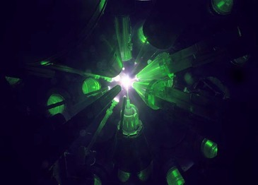
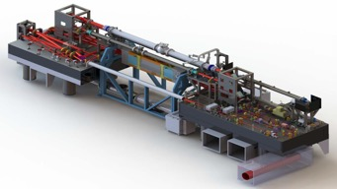
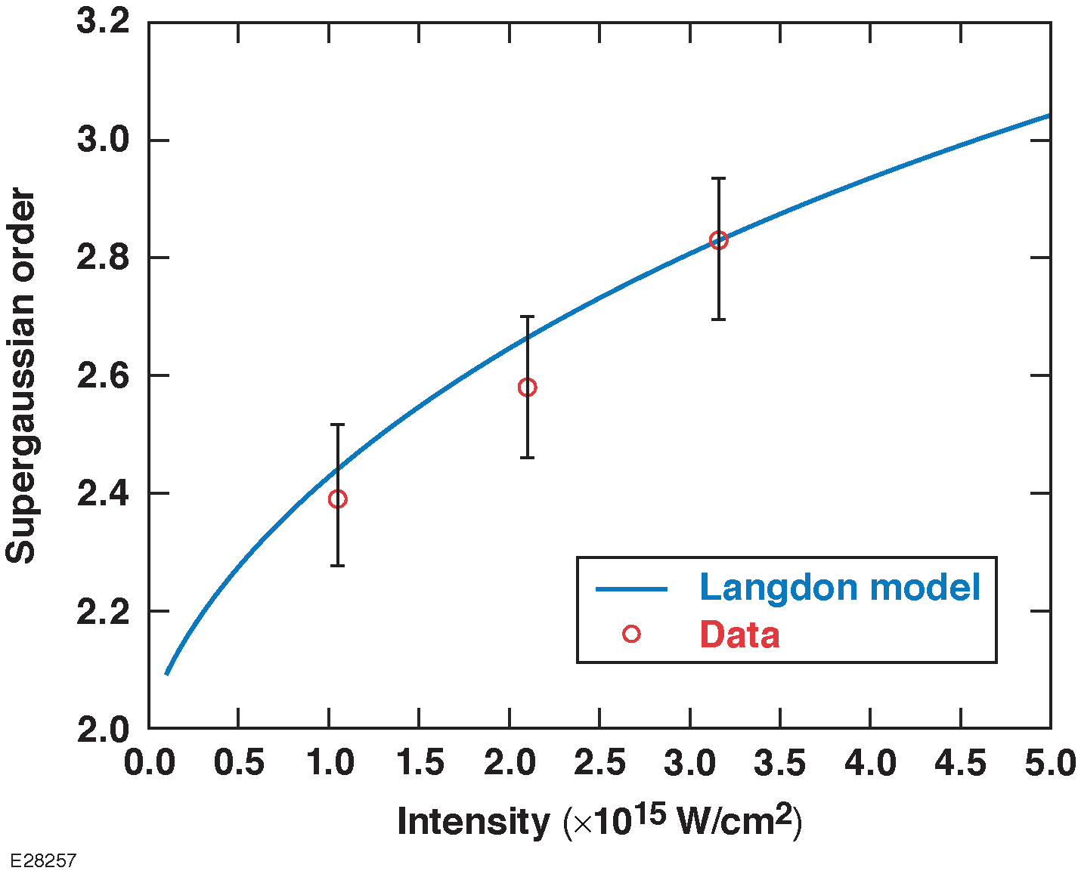
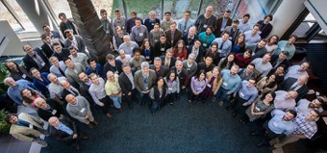
Laboratory for Laser Energetics (LLE) Update
Non-Maxwellian EDF
Dr. E. M. Campbell, Director
University of Rochester
Laboratory for Laser Energetics
41st Annual Fusion Power Associates Meeting
December 16, 2020

Slide 2
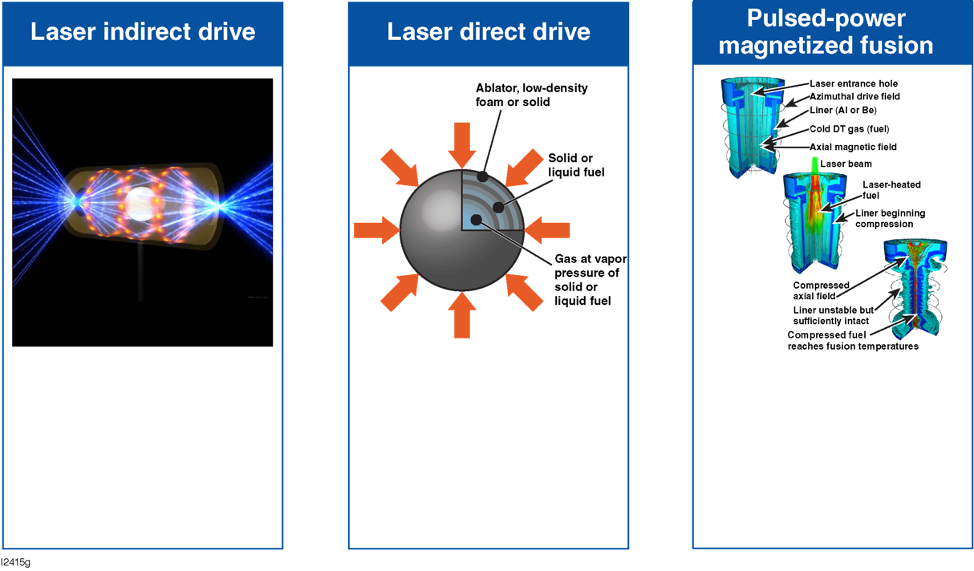
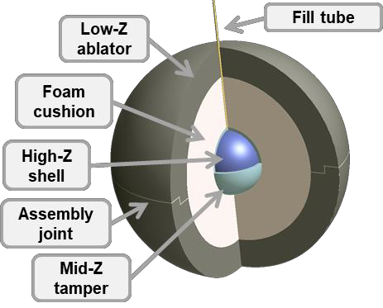
An advantage of ICF: There are multiple approaches to MJ and greater fusion yields in the laboratory
Multiple shell capsules (direct and indirect drive)
LLNL lead laboratory
(LANL)
Facility
NIF
  OMEGA
LLE lead laboratory
(NRL,LLNL, LANL)
Facility
Omega
  NIF
  NIKE
SNL lead laboratory
(LLNL, LANL, LLE)
Facility
Z
  Omega
  NIF
Innovative variations exist within each approach (e.g., shock ignition, B fields).

Slide 3
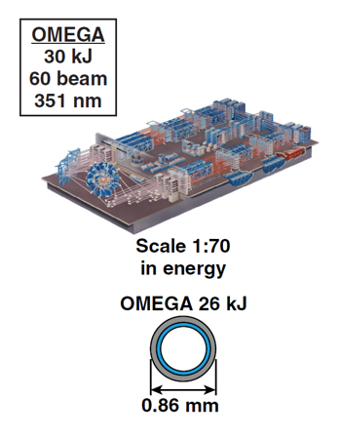
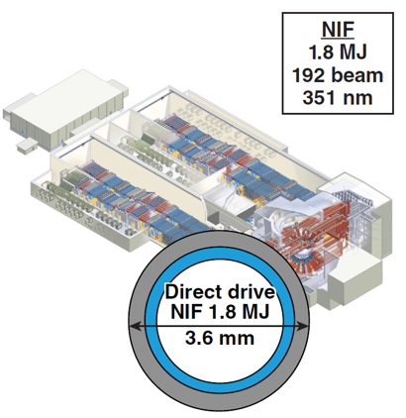
Laser-direct-drive research is executed at both the Omega and the NIF facilities; the ability to conduct research at both facilities is a key component of LDD strategy
OMEGA implosions
Spherical (optimized)
Polar
NIF implosions
Polar drive
4$×$ in scale
~(E_{NIF}/E_{Ω} )^{1/3}
Laser coupling, hydro scaling, preheat, imprint, limited Implosions at the MJ scale
Laser coupling, preheat, imprint, and hydrodynamically scaled implosions

Slide 4
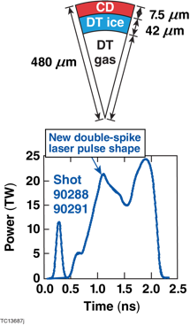
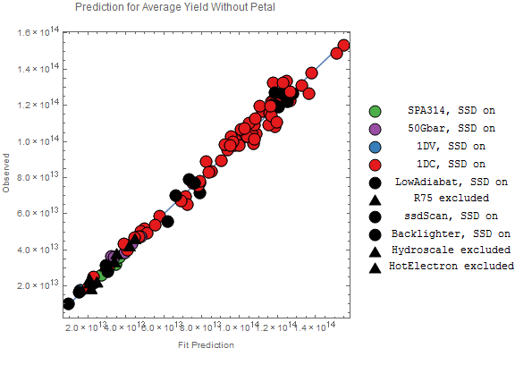
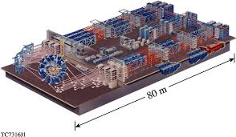
Predictive Machine Learning Model has been developed exploiting the shot rate and diagnostics (3-D) on OMEGA
Fusion Yield
(>160 experiments)
Experiments
Model Prediction

Slide 5
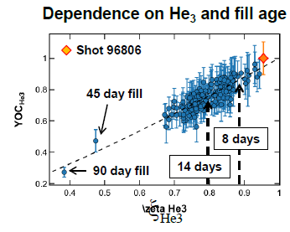
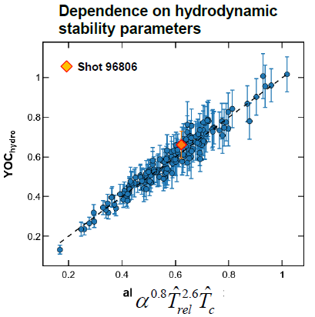
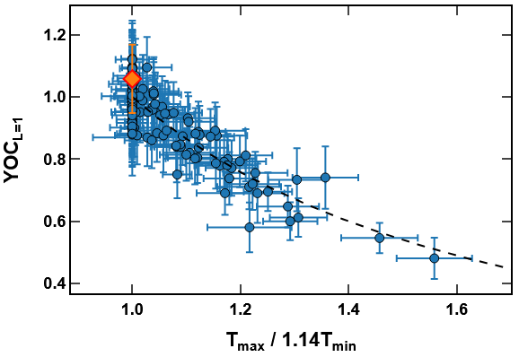
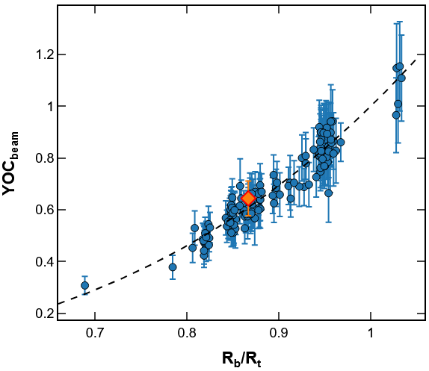
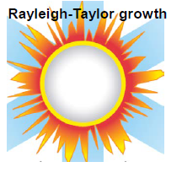
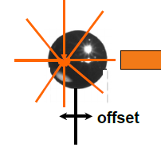
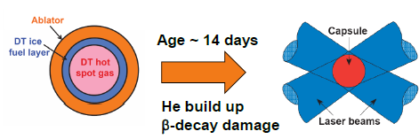
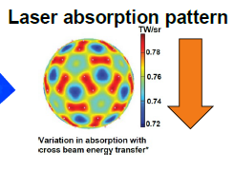
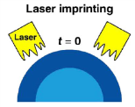
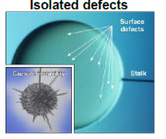
Exploiting machine learning, 3-D diagnostics, and data mapping; Omega cryogenic implosions are developing models and quantifying and developing mitigation strategies for mechanisms that degrade performance
Dependence on laser beam to target size
Dependence on the L=1 mode
ξ_{He3}
A. Lees, invited talk APS DPP 2020

Slide 6
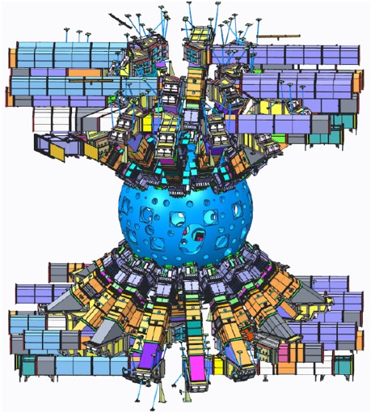
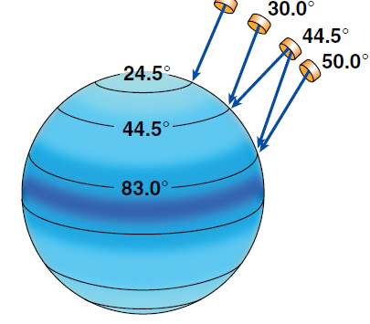
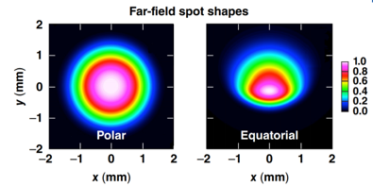
To reduce the impact to the facility and maintain the present capability for LID on NIF, LDD implosions are executed in the “polar drive” configuration; PDD will be an increasing focus of LDD research
NIF polar drive
Advantages of polar drive
  Innovative targets (e.g., B fields)
  Reactor flexibility (IFE)
  Reduced impact on present NIF
PDD phase plates
NIF pointing for polar direct drive
LLNL and LLE are developing a “phased approach” strategy to improve PDD on NIF.

Slide 7
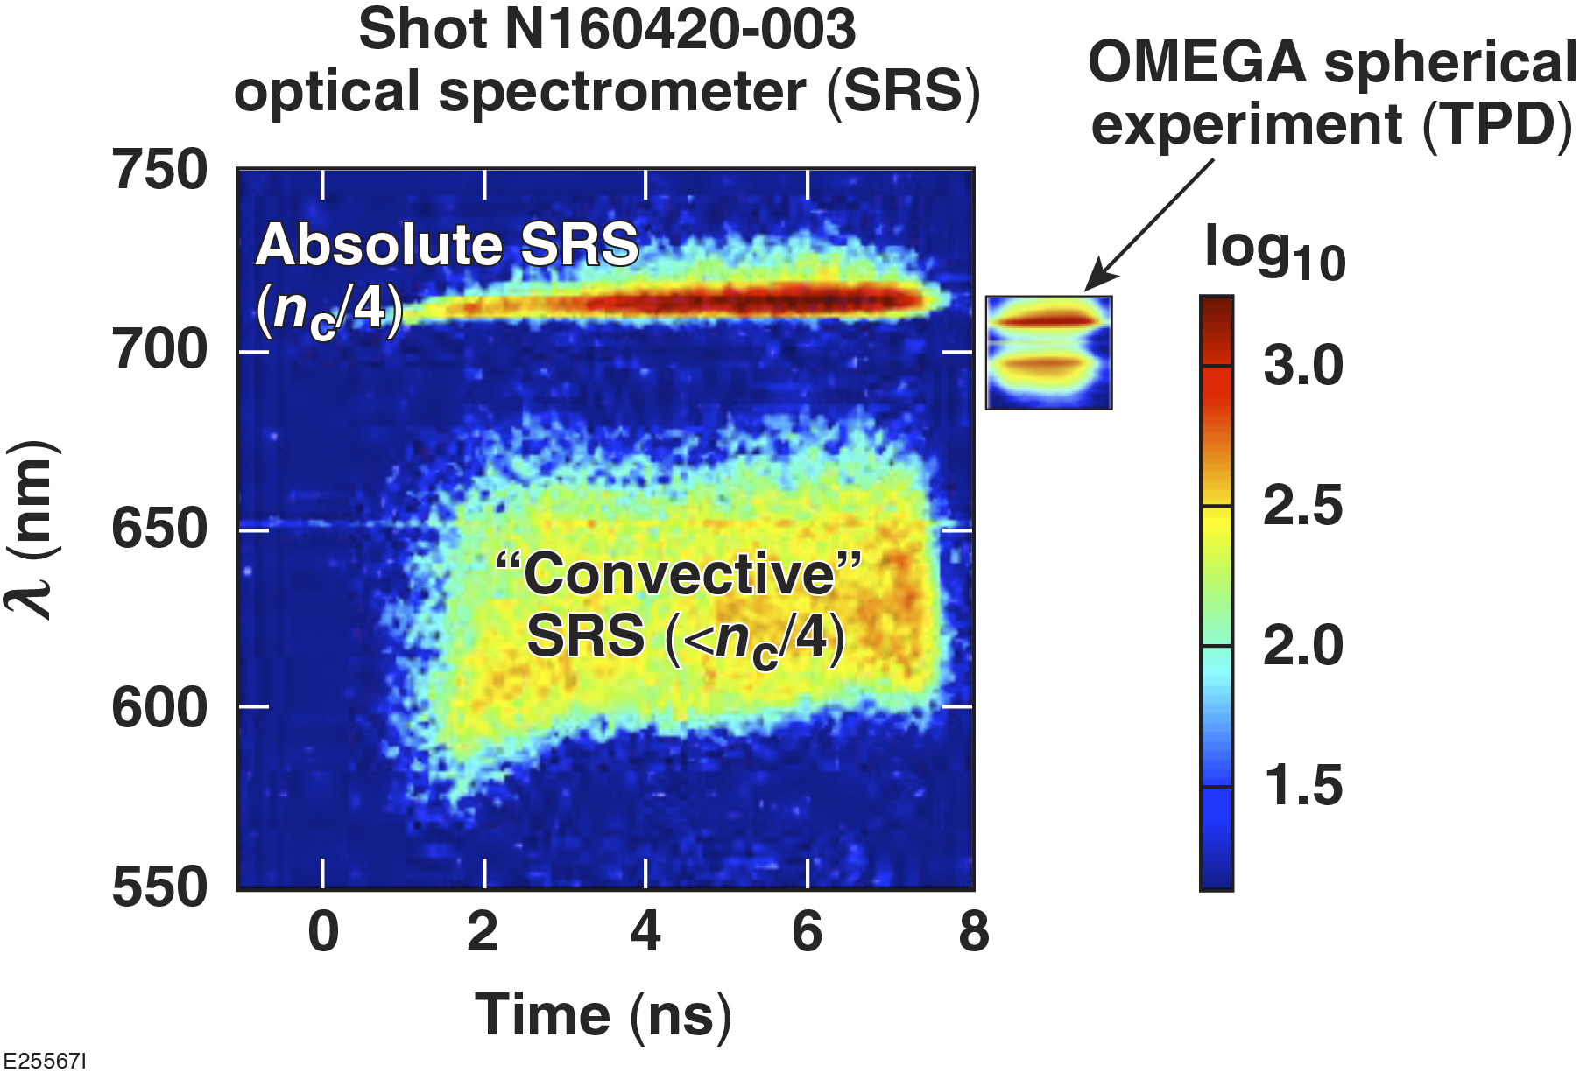
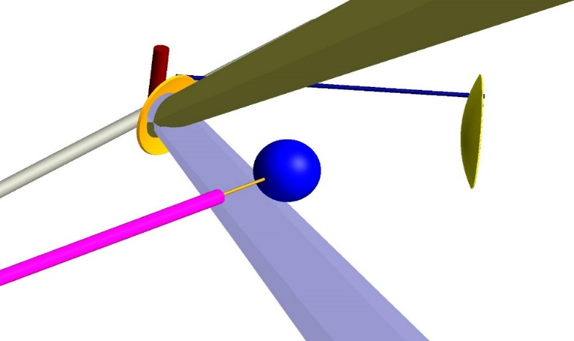
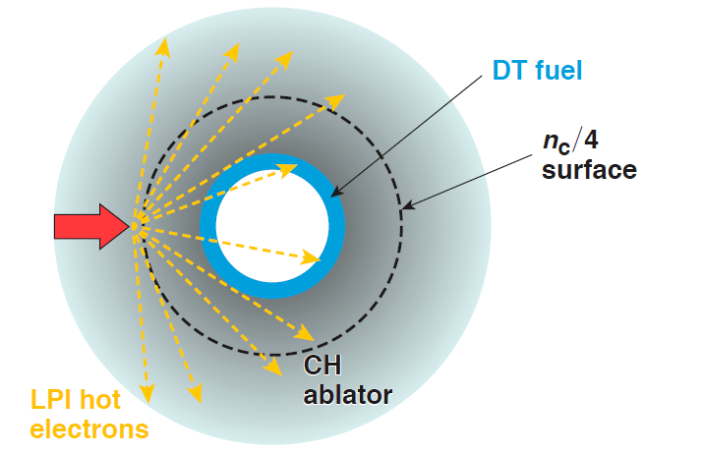
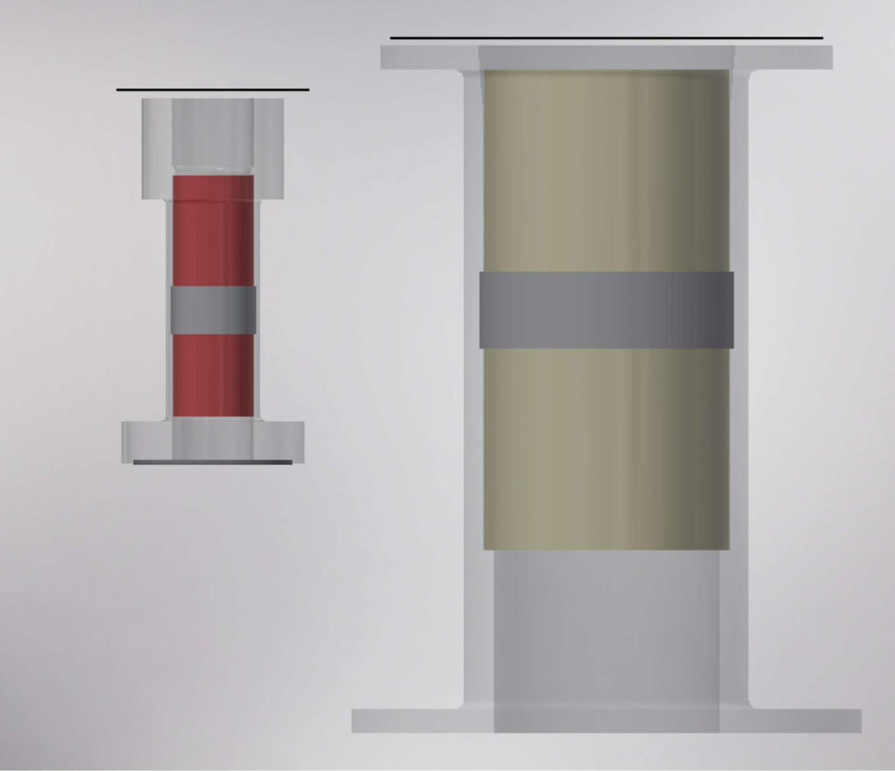
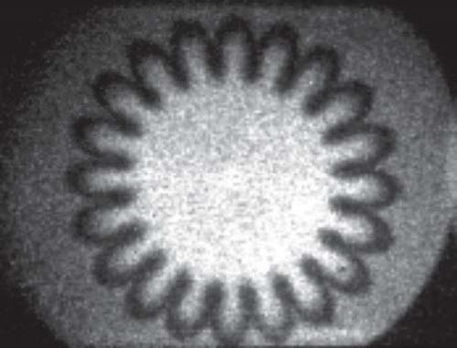
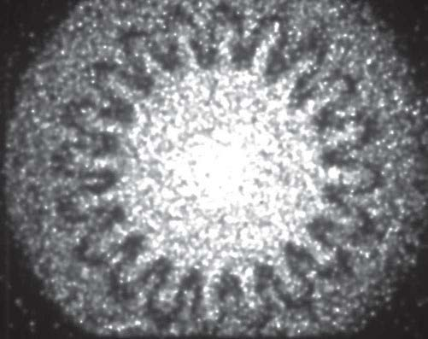
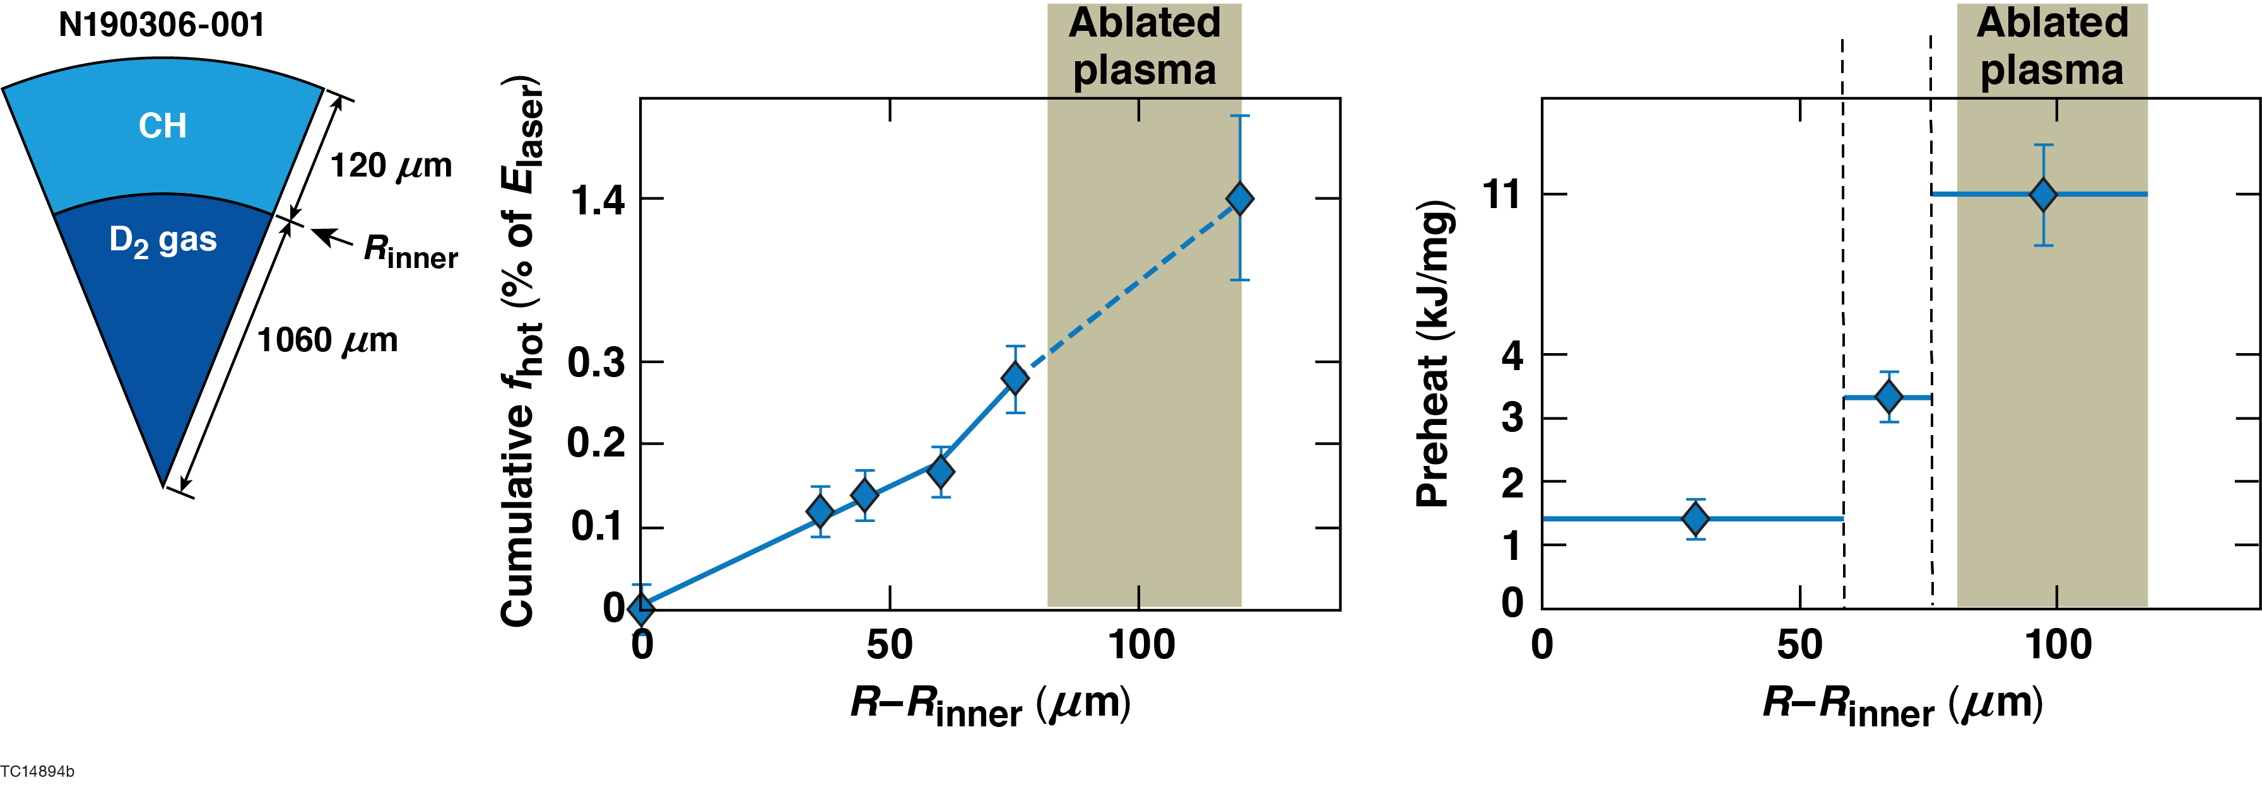
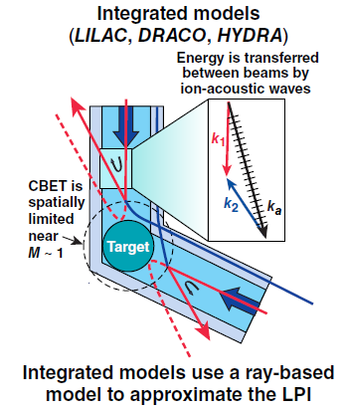
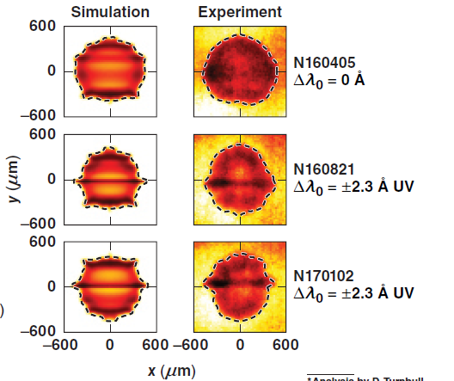
LDD research on NIF enables laser-target coupling, hydrodynamics, LPI to be conducted at megajoule energy scale (~60x and 15x energy and power from Omega)
Laser-target coupling
Hydrodynamic instabilities¹
Laser-plasma instabilities
Hot electrons
Cu Back-lighter foil
Au shield for DIM-90-124
OMEGA
Solid sphere driven by 184 beams
CBET
NIF
¹LANL led effort

Slide 8
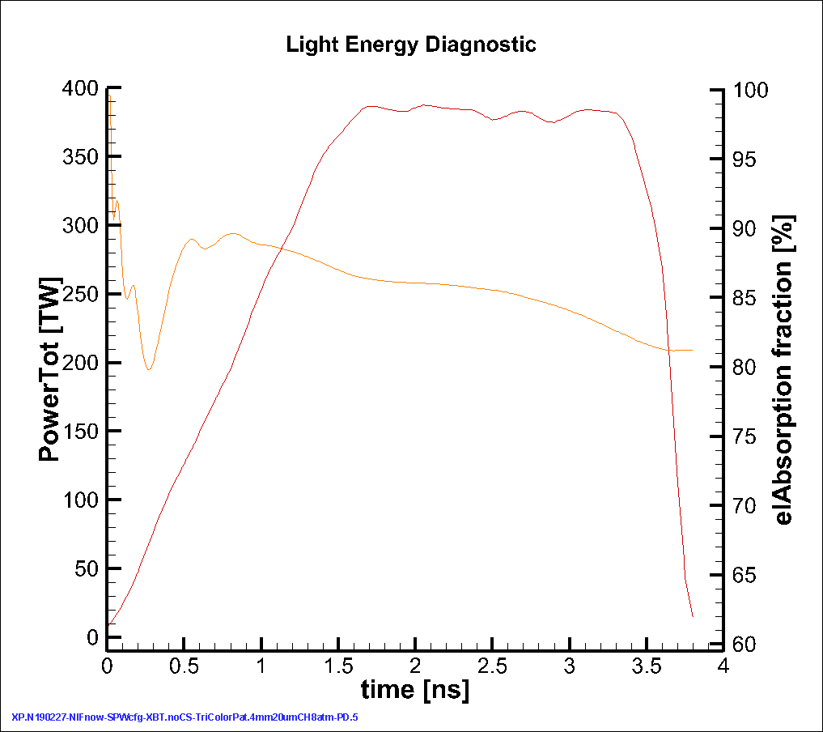
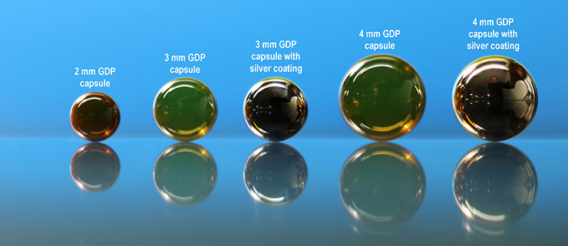
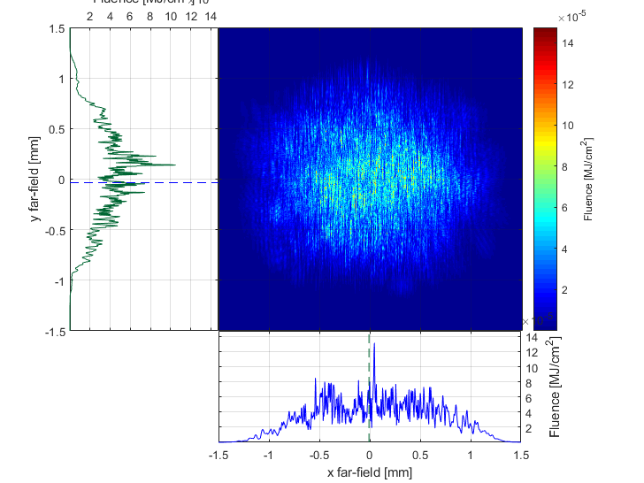
Polar direct drive implosions with present NIF have achieved fusion yields >10¹⁶ and are well modeled by 2-D simulations with cross-beam energy transfer and nonlocal electron thermal conduction
+
Fusion Yield (10¹⁵)
3 to 4 mm diameter gas capsules
NIF Power
(Energy~1MJ)
Present NIF capabilities limit implosions to low convergence (~7 to 10)
New phase plates
Improved beam quality

Slide 9
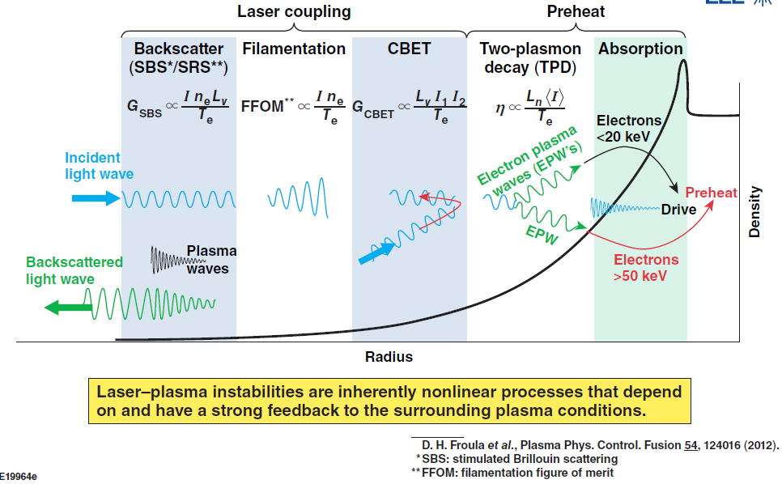
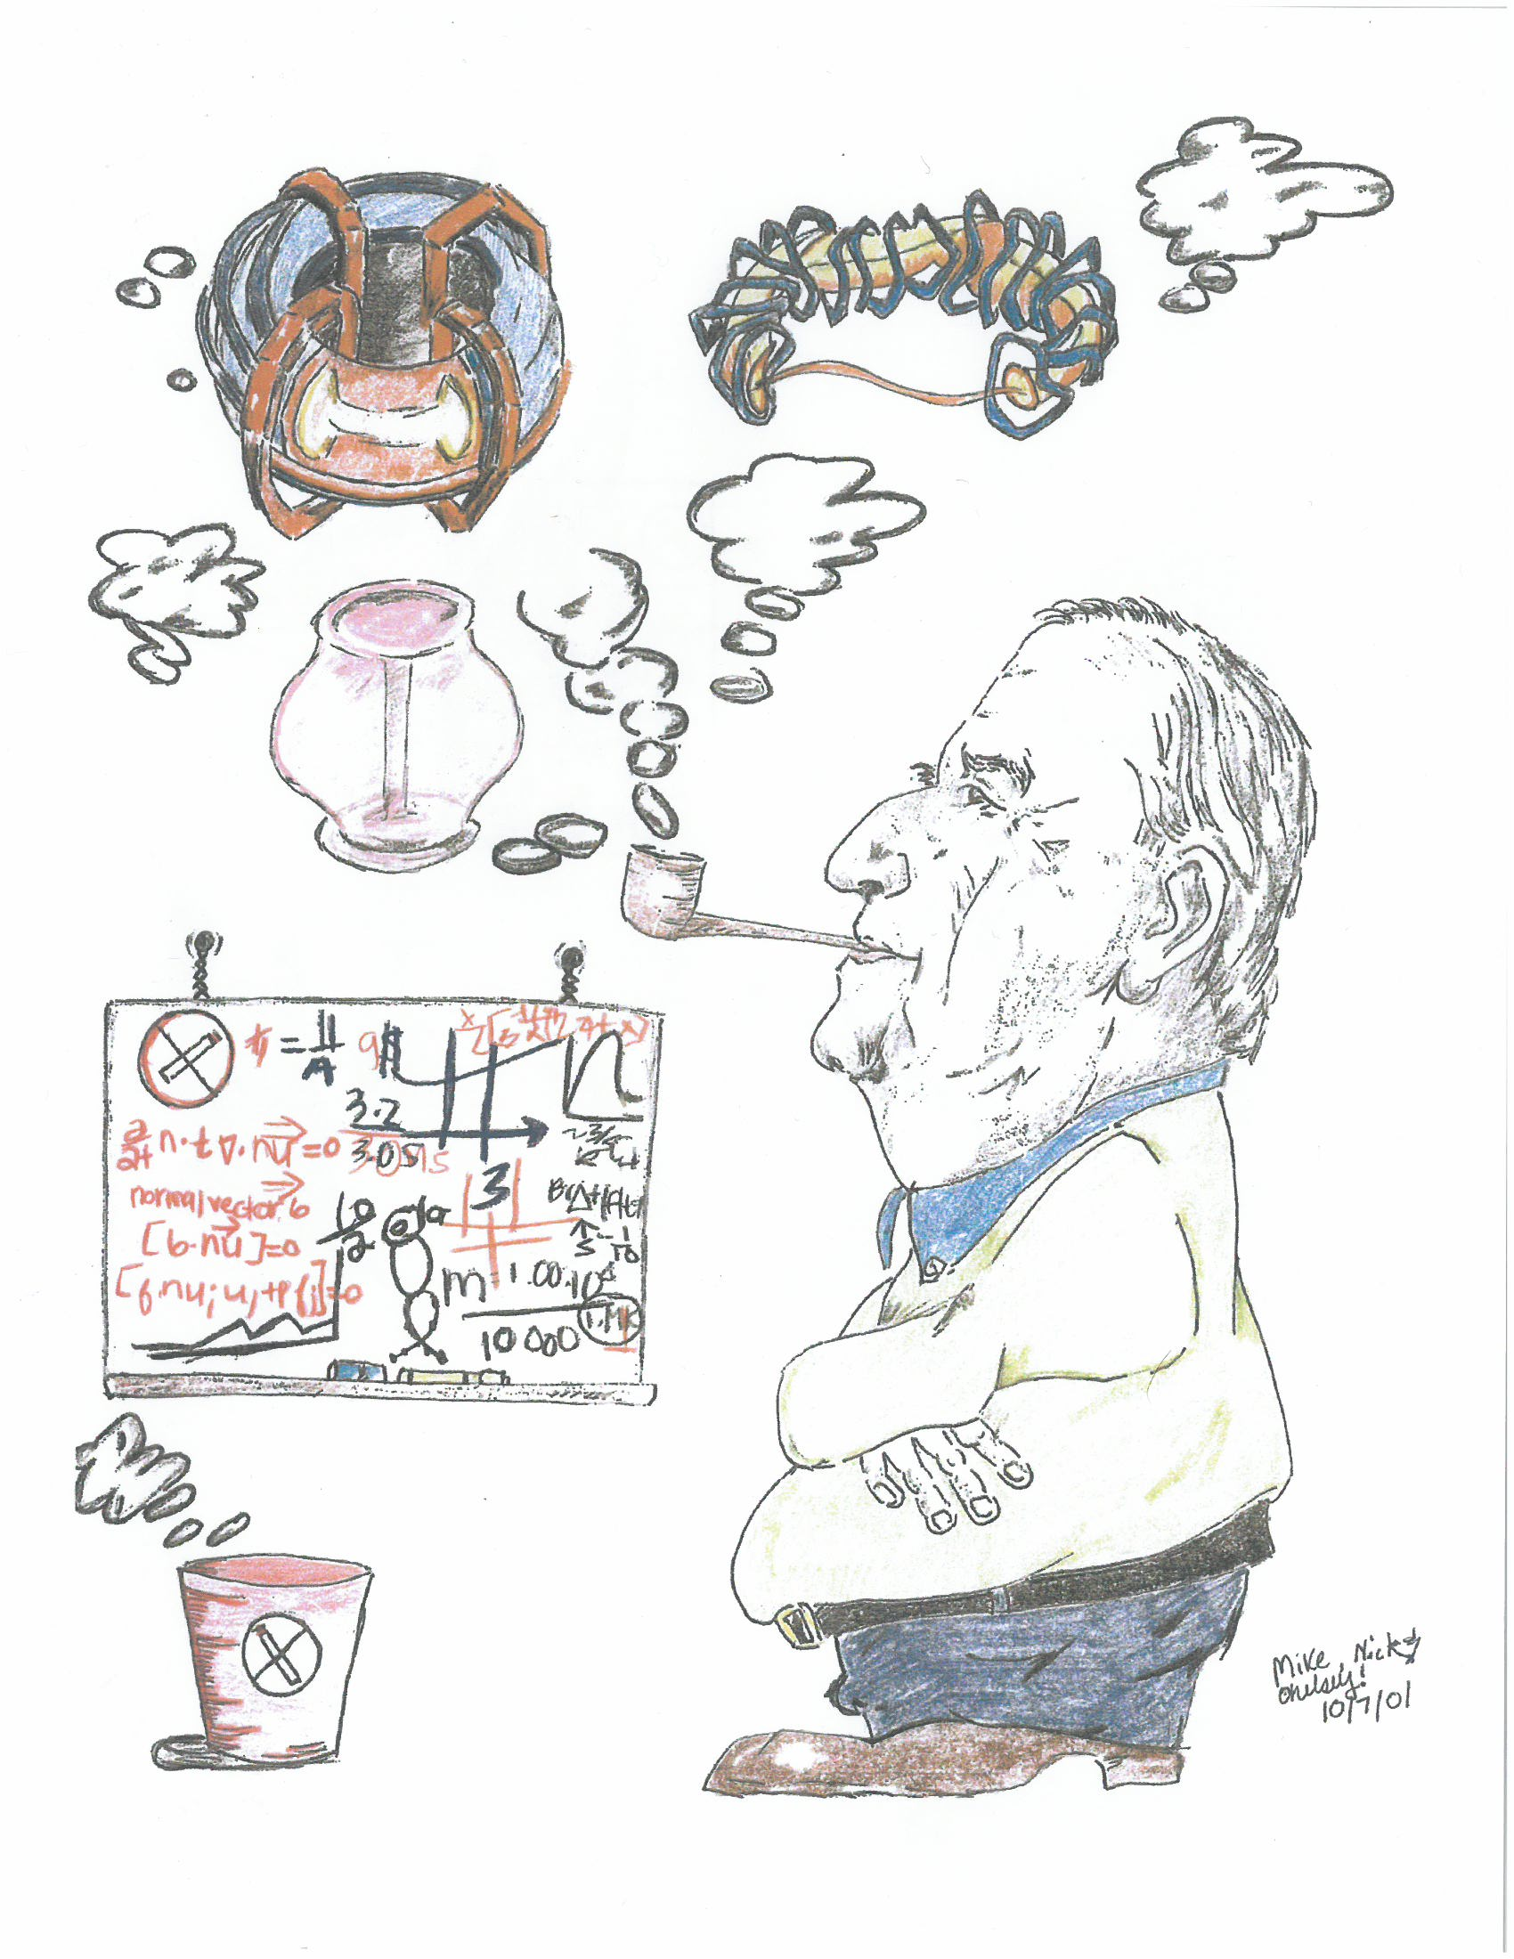
The physics and mitigation of laser-driven plasma instabilities are a major focus of research at UR/LLE
Research focus
Diagnostics
Modeling and simulations
Experimental platforms
4th Generation laser S&T

Slide 10
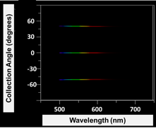
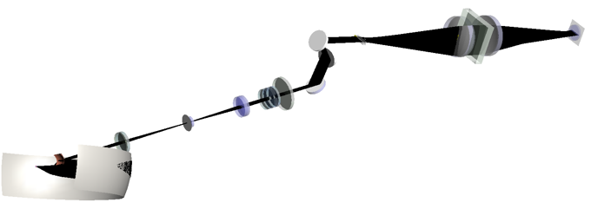
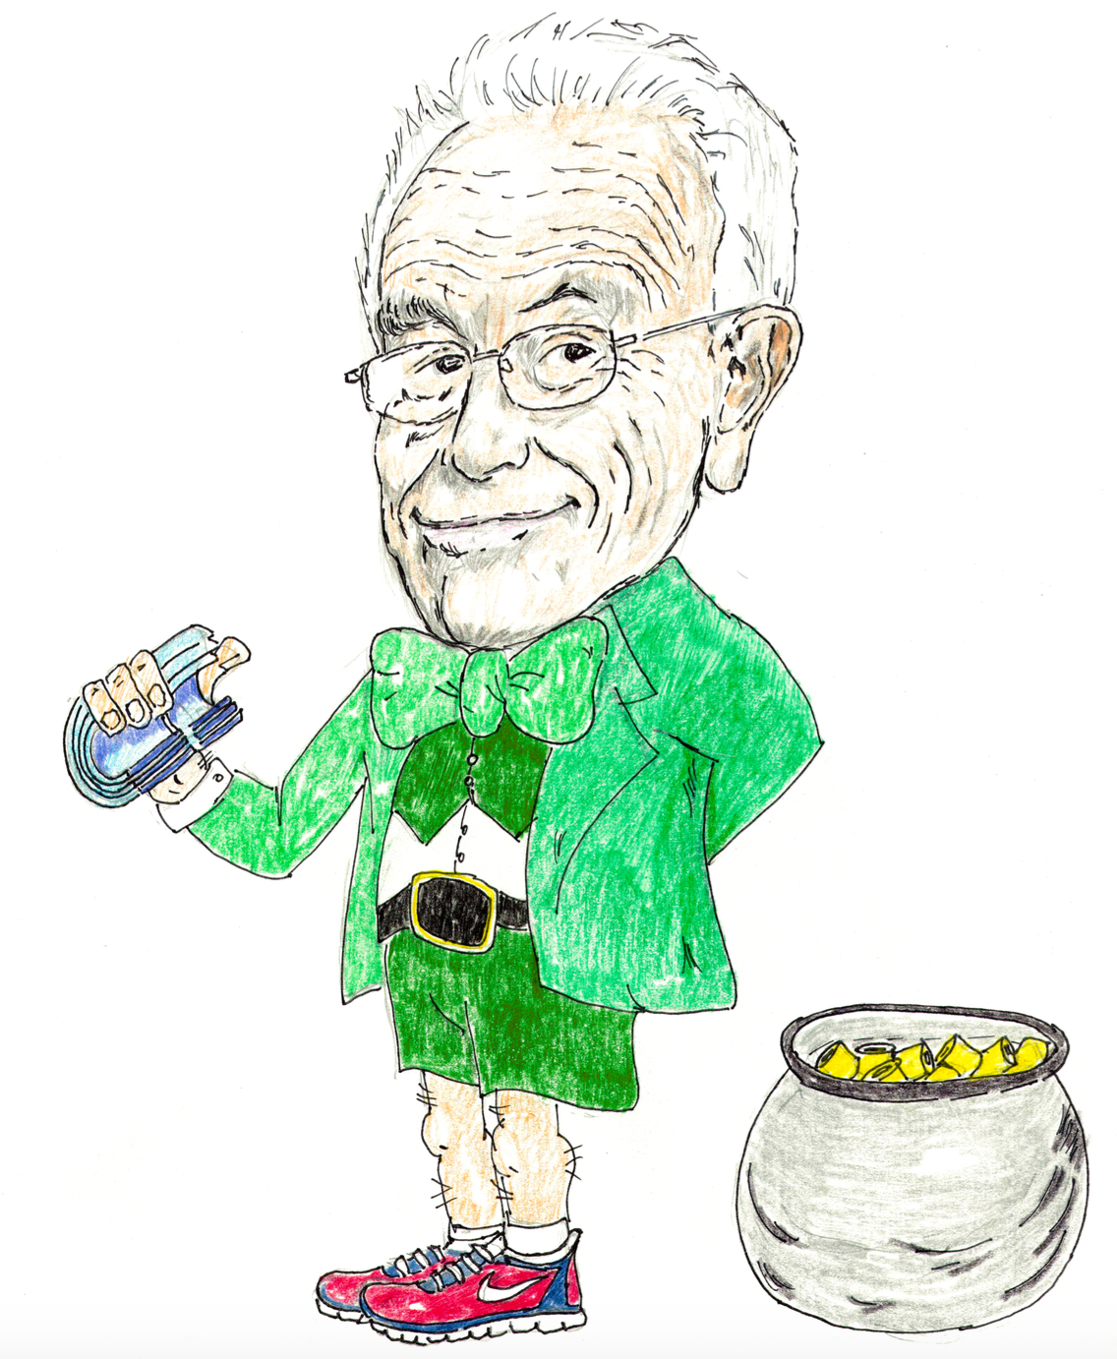
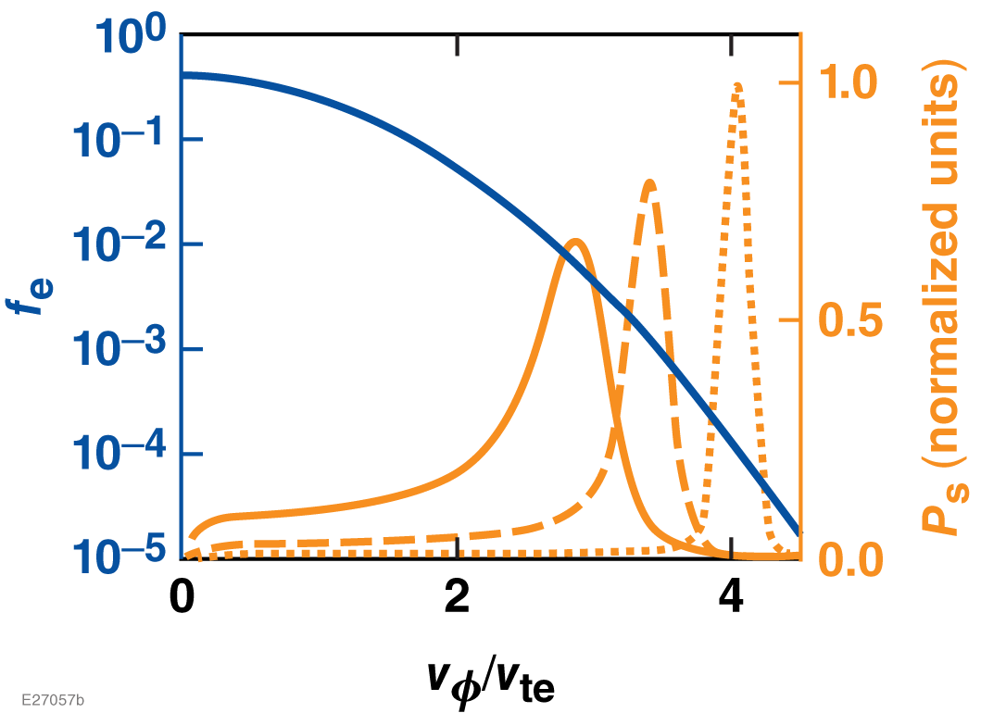
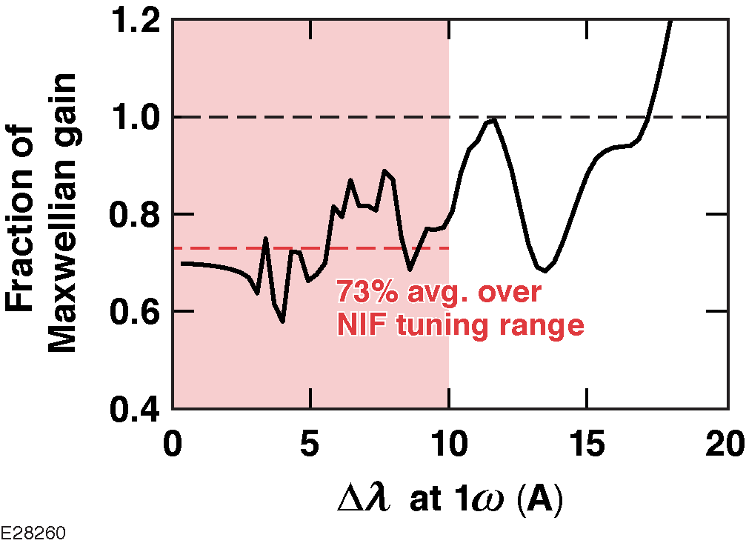
Diagnostics: Multi-angle Thomson scattering to measure electron distribution function (EDF) in laser plasmas
Non-Maxwellian EDF
120º k-resolved Thomson scattering
Omega
I love this!
Maxweillian
θ₃
θ₁
θ₂
CBET understanding (NIF)
Impact
Laser-plasma interaction physics (LPI)
Electron thermal transport
Radiation physics
Each scattering angle (120 measurements) probes a different part of the distribution function

Slide 11
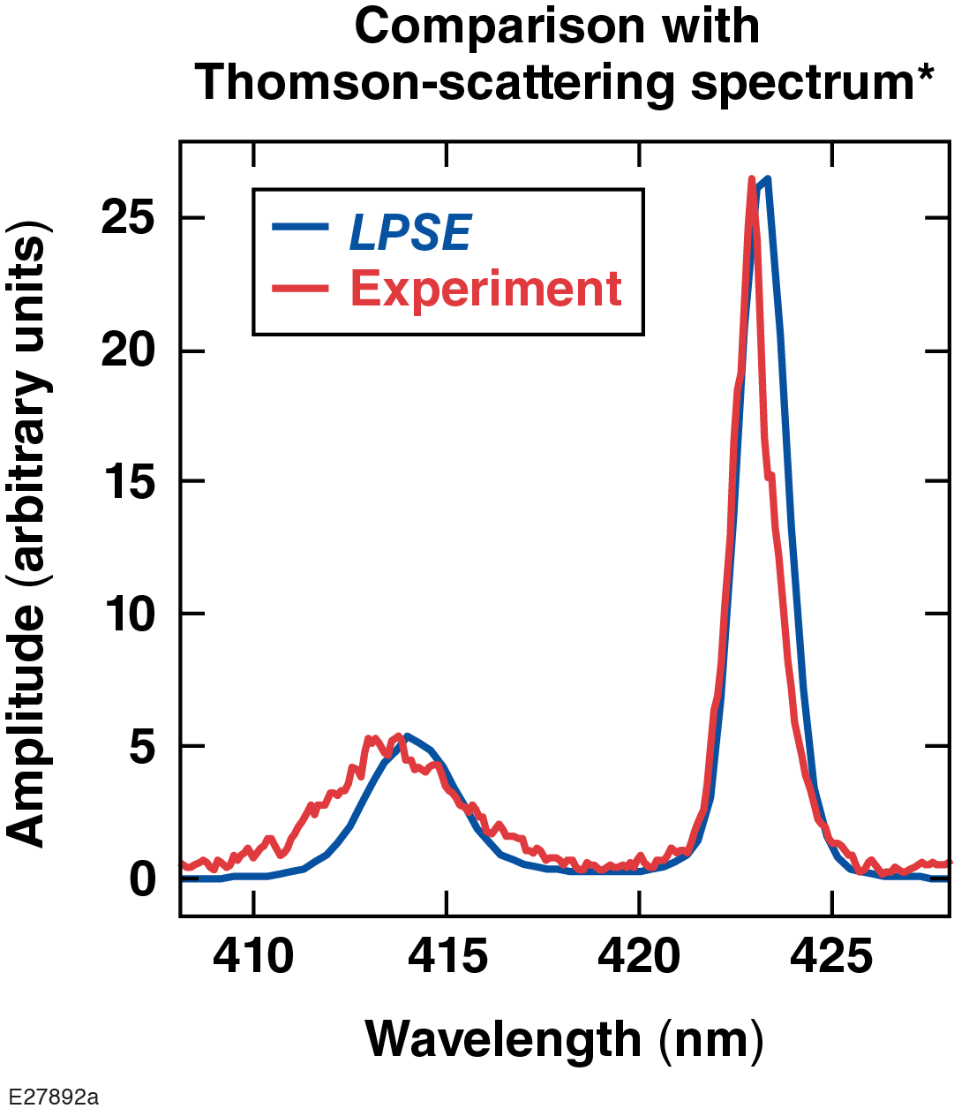
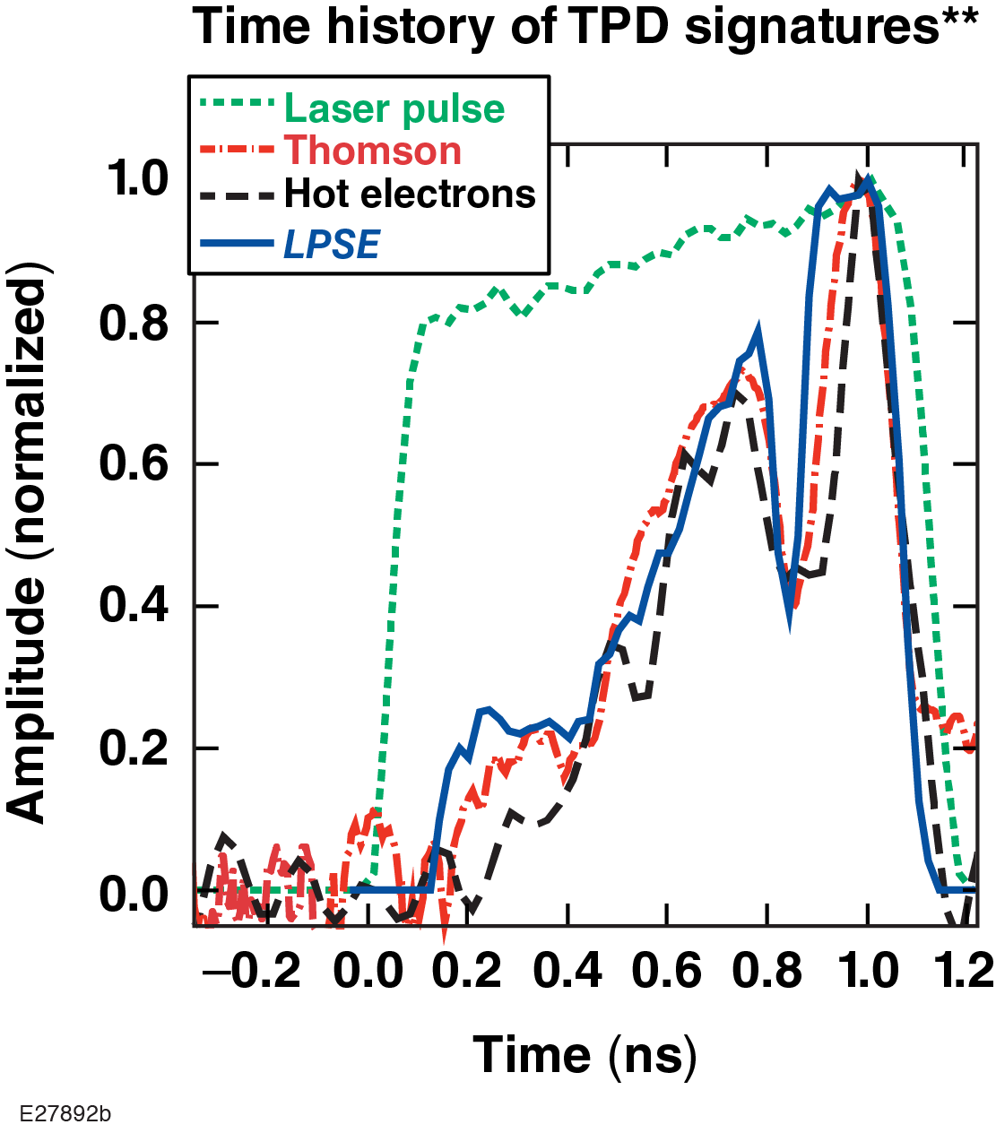
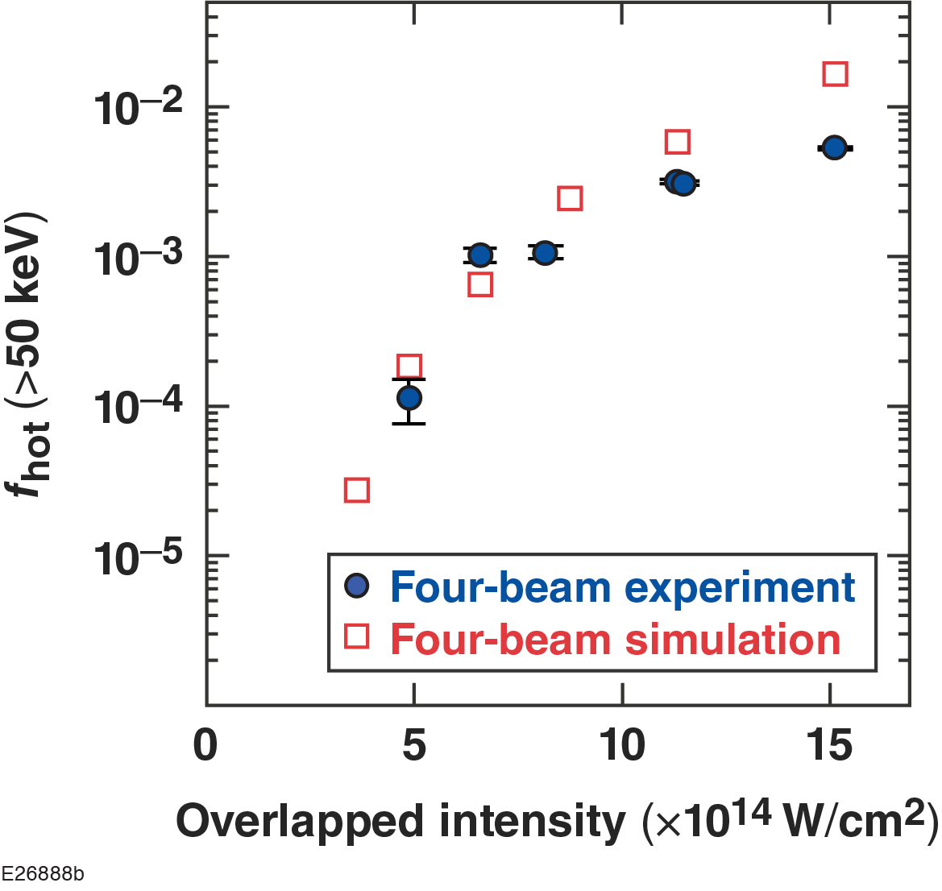
Simulation and Modeling: LPSE solves 3-D vector wave equations (speckle, polarization, bandwidth, no paraxial approximation) with physics of CBET, 2ω_{pe}, SRS, and hot electron production
Hot electrons generated by TPD
TPD pump depletion
(since implemented)
LPSE predicts the measured, turbulent spectrum of TPD driven plasma waves
The LPSE spectrum agrees with Thomson scattering over the entire pulse duration
The hot electron fraction predicted by LPSE matches that inferred from x-ray data
LPSE is a community code with users at LLE, NRL, Alberta, RAL and CELIA.
*R. Follett, Phys. Plasmas 24, 102134 (2017).

Slide 12
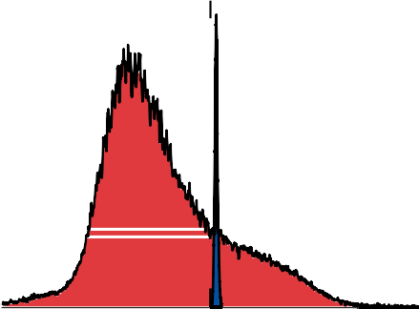
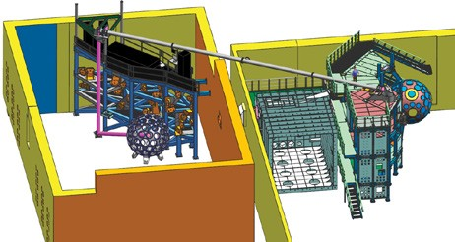

Platform: Combining OMEGA and OMEGA EP, a multiwavelength LPI platform with independent plasma formation and interaction beam has been developed for focused experiments and will be extended in the future for FLUX
Kinematic steering mirror
Shield walls
Vacuum tube for
t
Spectral density
(arbitrary units)
OPA’s
Novel tunable system
OMEGA EP OPA
δλ= 3 nm
UV beam transpor
0.8
Nd:glass regenerative amplifier
0.4
OMEGA EP
target chamber
Insertable mirror
To port P9
0.0
950
1050
Wavelength (nm)
1150
OMEGA
target chamber
Flexible experimental configurations
B55 ^{TBD} B52
^{k}55 ^{k}52
LPI Platform
OMEGA
  pump beams
  Plasma forming
    Gas jets
    Capsules (implosion)
OMEGA EP
  tunable seed beam
TBD
Pump laser
k_{p}
^{k}plasma wave
^{k}IAW ^{k}IAW
^{k}39
^{k}23
k_{s}
k_{s}
k_{s}
B39 B23
Seed laser
Calorimeter T-OPA Calorimeter
^{k}IAW ^{k}IAW
T-OPA
Backscattering geometry Single-beam measurements
Backscattering geometry Three- to six-beam measurements
Forward-scattering geometry Three- to six-beam measurements
I2682
36

Slide 13
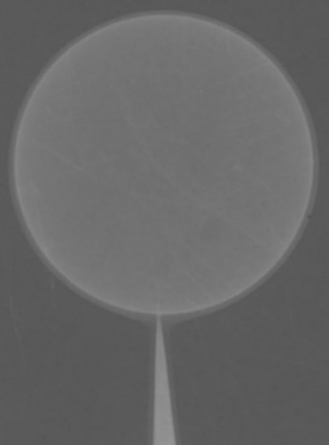
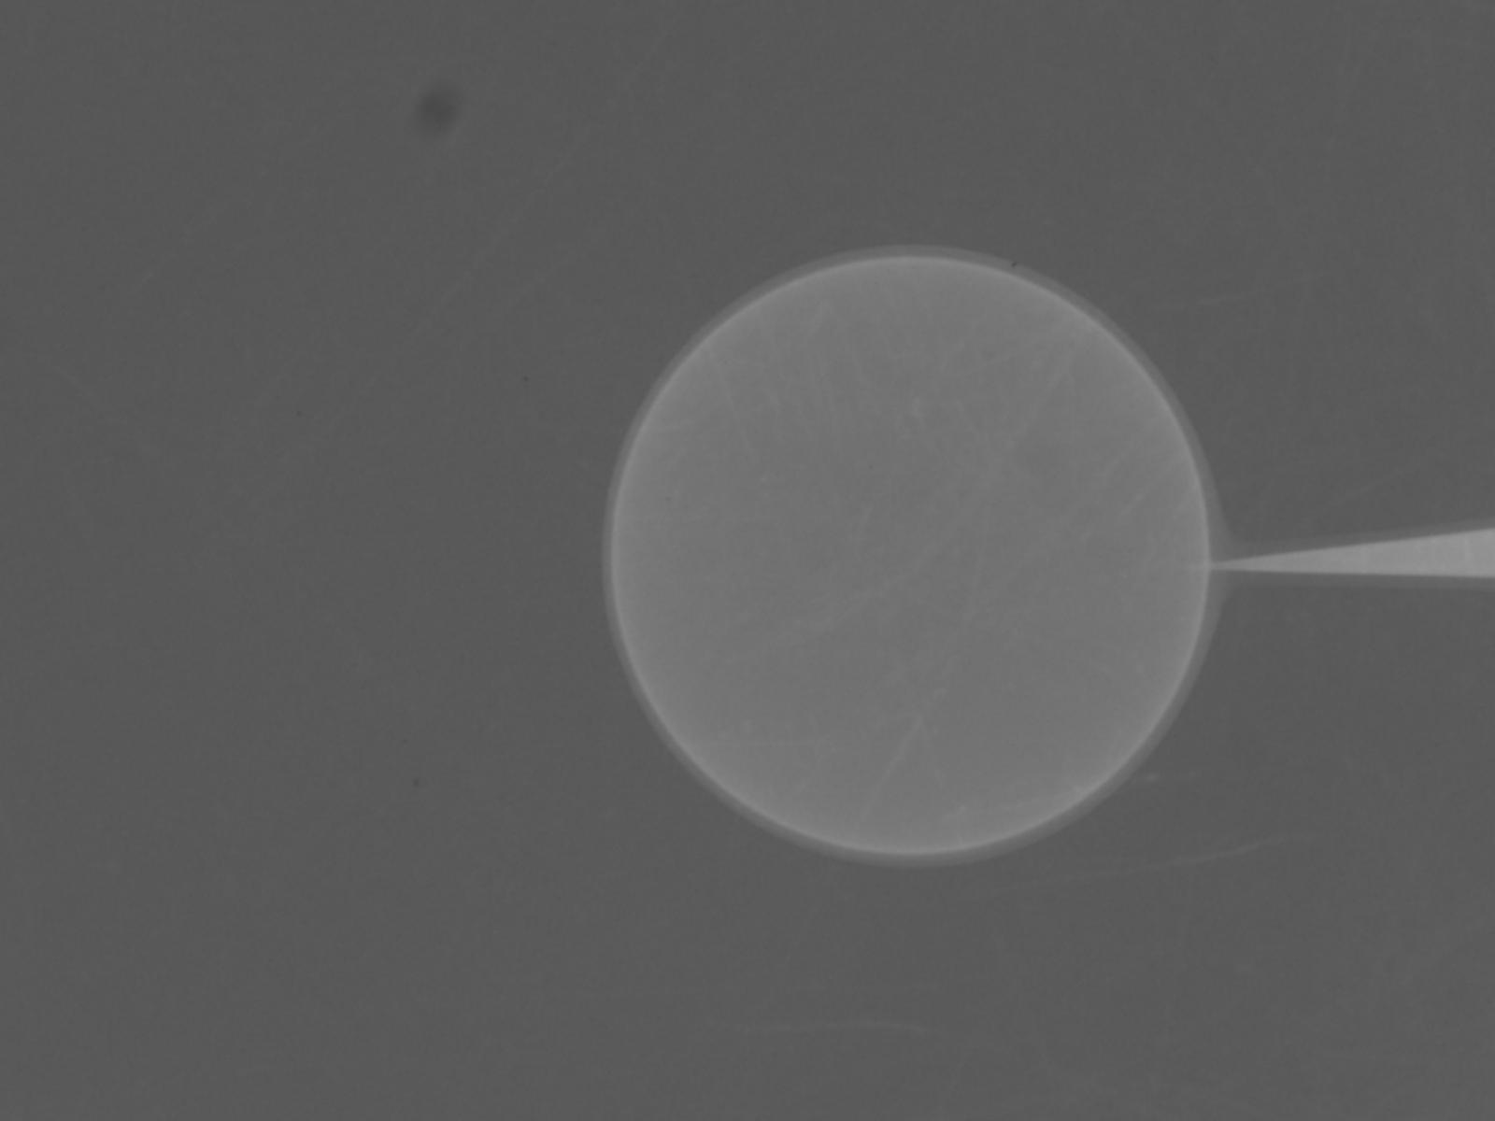

The ICF program must continue to encourage innovation (design) and take advantage of the “additive manufacturing” revolution for target fabrication
Multiple shells
Coated targets for imprint reduction
Dynamic shell¹
~5 -10 μm CH shell
Wetted foam
Liquid DT
Liquid DT
100
10
Power (TW)
0
50
100
150
200
250
Time (ns)
Lower Ignition temperature
  Radiation trapping, tamping
Reduced LPI concern (I_{peak}~ 2-4 x10¹⁴ W/cm²)
  Lower Implosion velocity and convergence
Volume ignition and low-modest gain
Target simplicity
Fuel uniformity
Control of density in central region
  High gain @ convergence <20
Control of shell velocity and ablated mass with pulse shaping
  Foams
  High-Z coating
¹Funded by BETHE ARPA-E Program

Slide 14



A conversation at LLNL in 1960
Edward. I think we can do fusion with this new invention, lasers!
I agree! And Jon Zuegel will tell you tomorrow
Not if plasma physics gets in the way!
“LPI free” drivers would significantly expand parameter space and may enable IFE required gains at MJ scale energies.

Slide 15

Summary: LDD remains an attractive ICF approach for achieving ignition/gain in the Laboratory
LDD research is conducted on OMEGA and NIF
  The ability to conduct and model experiments over a factor of ~50 energy, 15 in power, and 4 in scale significantly reduces the risk for projecting ignition on MJ facilities (NIF)
  The Community has made significant progress
    Implosion physics
      Data-driven statistical predictive model
      3-D diagnostics and systematic experiments
      High yield (high adiabat, convergence ~ 7 to 10) polar drive gas implosions modeled with DRACO
      Polar cryogenic implosions on OMEGA
      Innovative target designs/concepts (supported by ARPA-E)
    LPI
      Quantitative physics of CBET with wavelength detuning
        TOP9
        NIF
      Similar hot electron preheat (~1J/μg) in cold fuel layer for both OMEGA and NIF
      Outstanding diagnostics and laser platform
      FLUX (supported by both NNSA and FES)
I like the BETHE Program!
LDD research over the next five years will reduce the risk and specify requirements for NIF to achieve a burning plasma and MJ fusion yields in the Laboratory.

Slide 16





Near term impacts of ICF: EUV lithography (13.5 nm radiation) was enabled by advanced x-ray diagnostics and laser-plasma physics developed by the ICF Program
N. Petta
IPA (UR)
ICF Target Fabrication
Assistant Director for Microelectronics,
DOD Undersecretary for R&E
TWINSCAN NXE EUV lithography systems
EUV Source was developed and is manufactured
in San Diego (CYMER)
7 nm node (Logic and DRAM markets)
Shipments 30 (2019), 18 (2018), 11 (2017)
$120M/system
Development underway for 3 nm node Logic
New Apple iPhone has 8 billion transitors (EUV produced!)
Mike Farrell (GA) built
Beta EUV source
Extreme-ultraviolet (EUV) prototype
(LLNL, SNL, LBNL)

