Slide 1
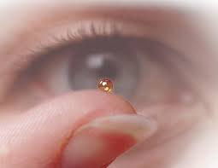
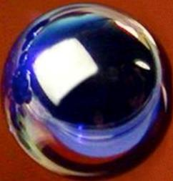
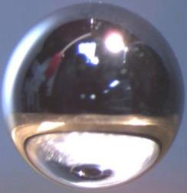
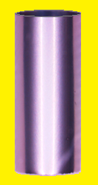
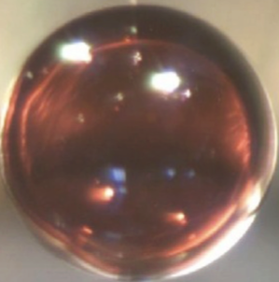
Targets, at the Center of ICF Experiments and Research
Presented at
41ST ANNUAL FUSION POWER ASSOCIATES MEETING
Virtual/Remote Meeting
By
Mike Farrell
Inertial Fusion Technology Division
December 16-17, 2020
HDC
Be
CH
Cr/W
W/Be
Be

Slide 2
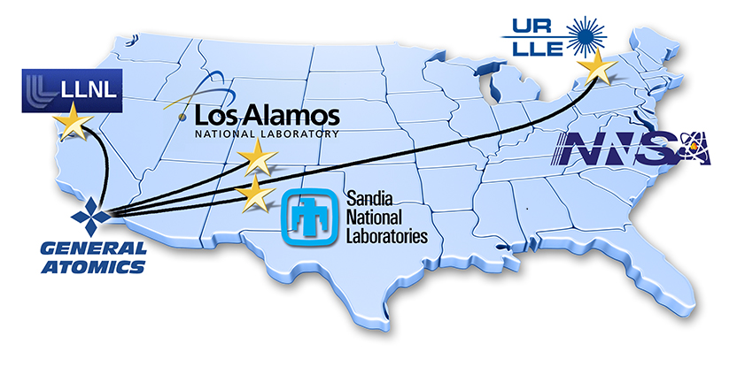
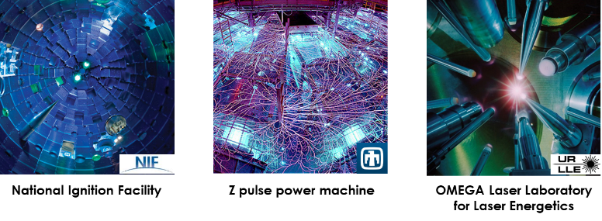
Advances in ICF Drivers, Simulations, & Diagnostics
Need to be Matched by Advances in Targets Manufacture and Metrology
“Focus” is on the target
Recent advances for indirect drive
The increasingly complex direct drive capsule
Applying knowhow to MagLIF targets
Additive manufacturing for smaller facilities
Rep-rated research efforts
~15,000 targets for experiments at

Slide 3
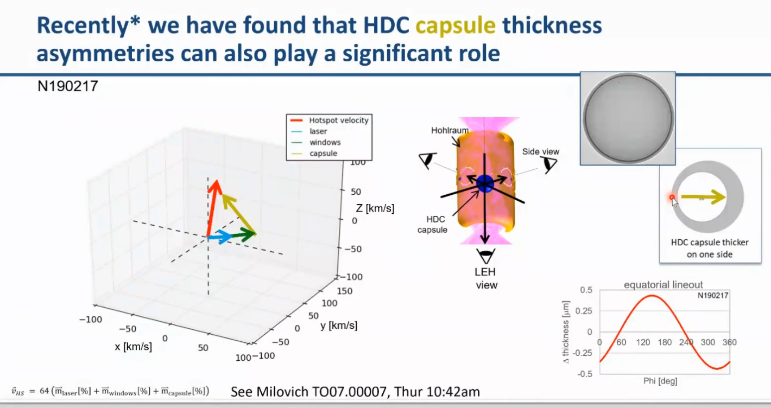
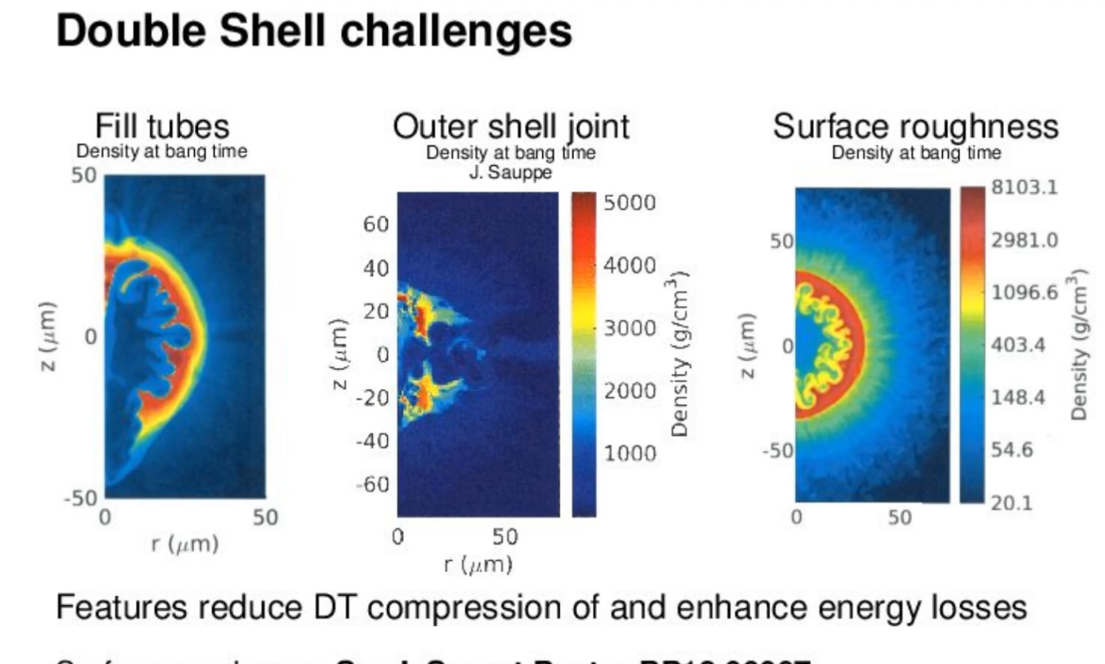
After Recent Facility and Diagnostic Improvements
Focus is Now on the Target
2020 JASON & APS DPP talks spoke to observed and simulated target related concerns
Instability seeds & growth
Edwards (LLNL): JASON Summer talk
Shell spherical variations
Casey (LLNL): APS talk
Engineered features
LANL: Invited APS talk

Slide 4
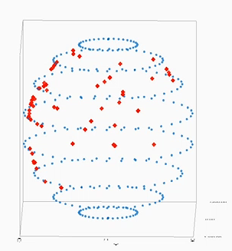
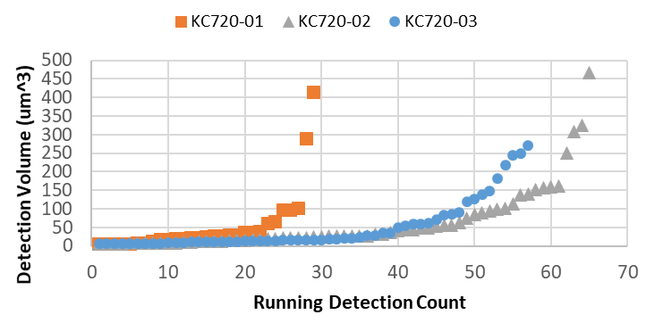
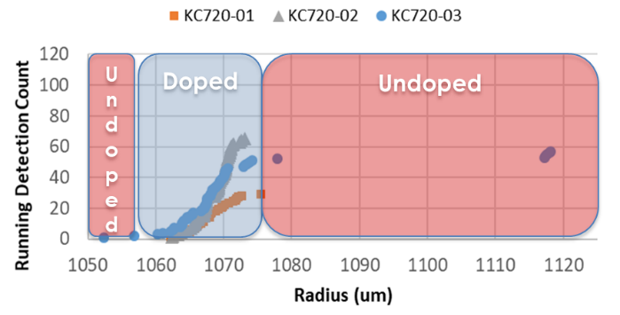
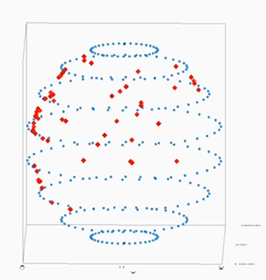
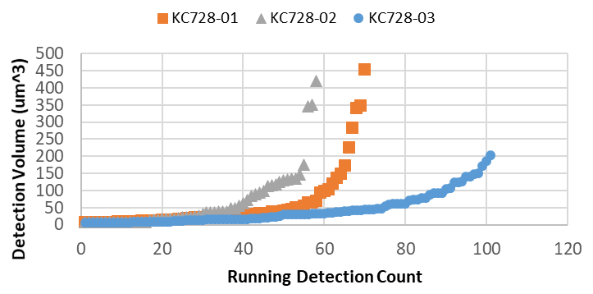
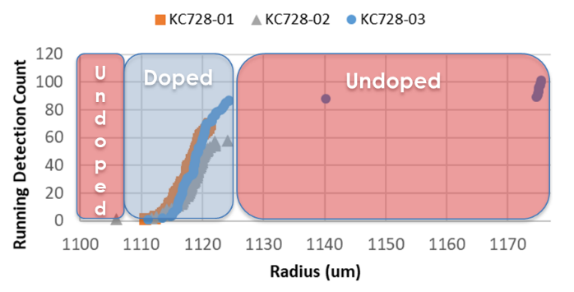
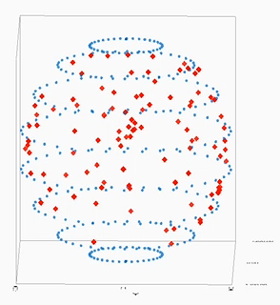
Target Metrology is Providing Increasingly Detailed Information Shell-by-Shell
(Thereby informing both the simulations as well as the fabrication process)
Multiple Perspectives
Defect specific
Location within shell wall
3D position
# of Defects
Shell Wall
Volume, Type, Composition
Local Location
Global Location

Slide 5

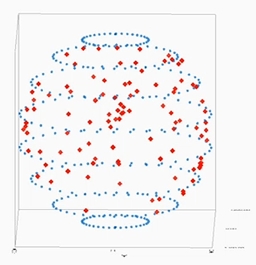
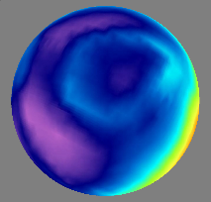
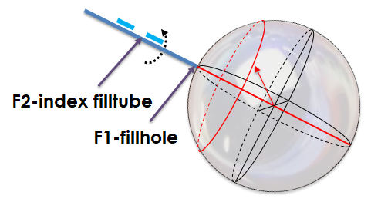
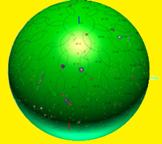
Assembling a Tiny Three Dimensional Puzzle
Spherical figure
Surface roughness
Thickness variation
Wall homogeneity
  Composition
  Voids
  Inclusions
Known orientation
at shot time
The Objective
The Metrology
Spherical (3D) TARGET DATA is increasingly important to physics understanding
Correlating data with fiducials enables known positioning of shell imperfections

Slide 6
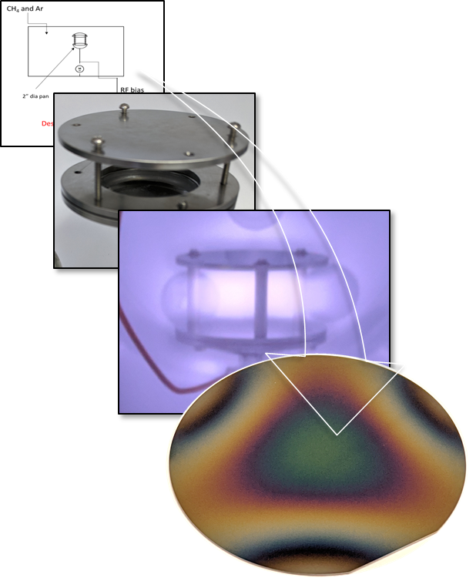
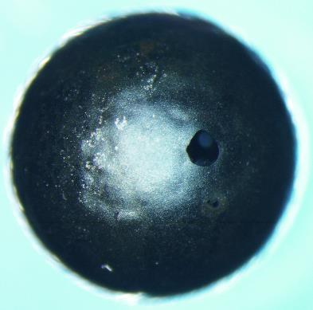
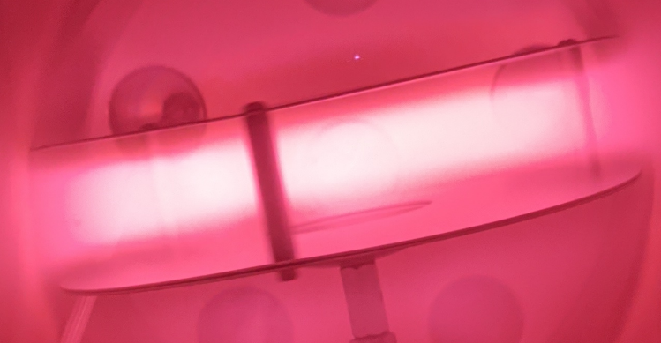
Research into Amorphous Ablator Materials is occurring at GA & LLNL
(Eliminate crystalline microstructure inherent High Density Carbon & Be shells)
Planar DLC coating R&D
Proof-of-principle DLC/GDP shell
Prototype rotating apparatus constructed for DLC capsule fab
Commercially
available stationary
coating
Rotating Hollow Cathode
coating apparatus developed for shells
~undesirable quality, but demonstrates feasibility
* Amorphous Carbon = sp³ phase = Diamond-Like-Carbon (DLC)

Slide 7
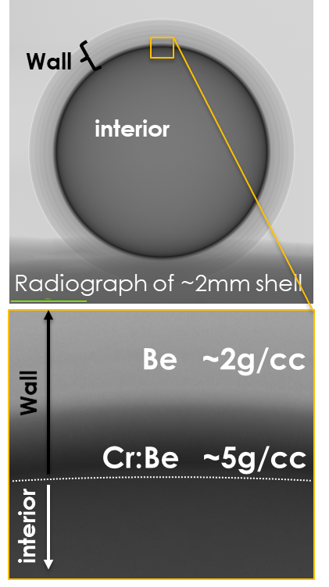
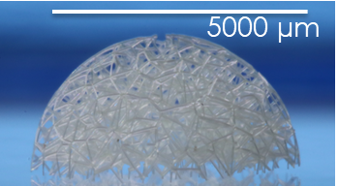
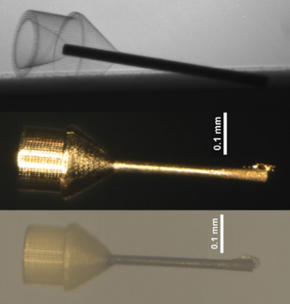
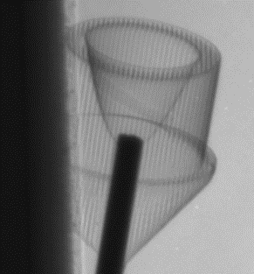
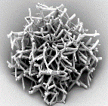
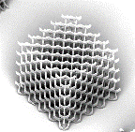
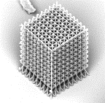
Other R&D Supporting Laser Indirect Drive
Gradient Density
Metal Shells
Additive Manufacturing for Selected Applications
(Improving feature size)
(Avoid glues by printing directly on objects)
2019
80X
2020
Double Shell
cushion
CPC cone based
MeV & Gamma Backlighters

Slide 8
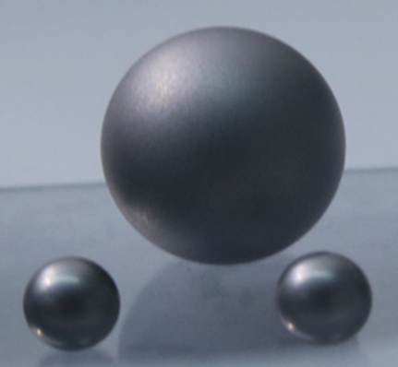
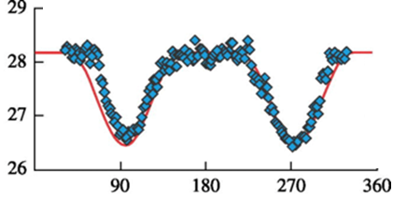
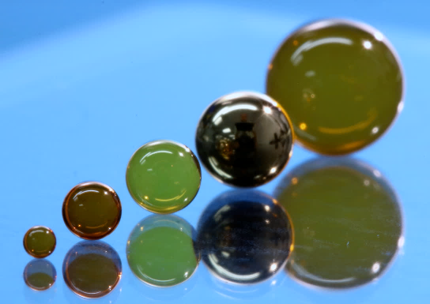

Using Larger, Shimmed and Soon-to-be Foam Covered Shells on NIF for Laser Direct Drive ICF and Neutron Sources
Be
~5.0 mm
~1-2 µm shimming the shell wall
(correcting sym. for NIF’s polar config.)
Shell Thickness as a function of angle
CH
~5.0 mm
~2.0 mm
~0.9 mm
Scaling Shells
(Increased fuel load; Triple Shell scale)
Exterior Conformal CH Foam Coating s (~15 mg/cc)
(Laser Imprint mitigation, Double Shell cushion)

Slide 9
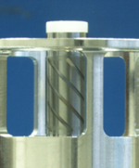
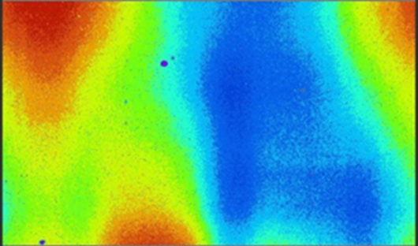
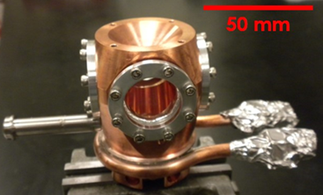
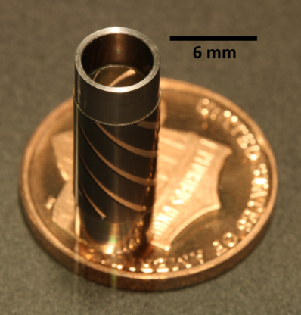
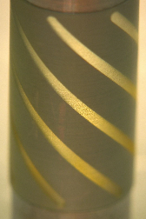
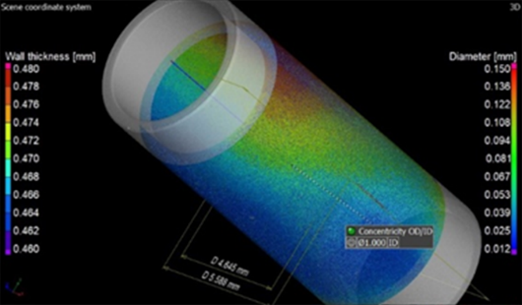
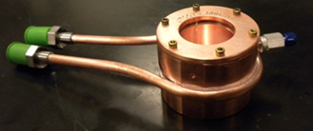
Applying Target Fab and Metrology Knowhow to Novel
Cylindrical & Magnetized Liner Inertial Fusion (MagLIF) Targets
Auto Magnetizing Target
(Improved B-field application)
Cryogenic Gas Cells
(Laser Pre-Heat)
Improving Characterization
(Implosion Simulation & Stability)

Slide 10
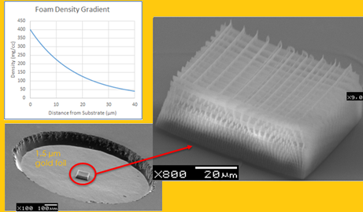
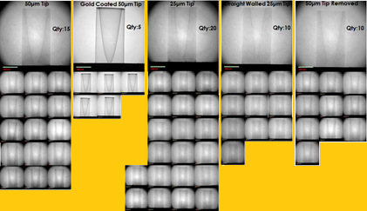
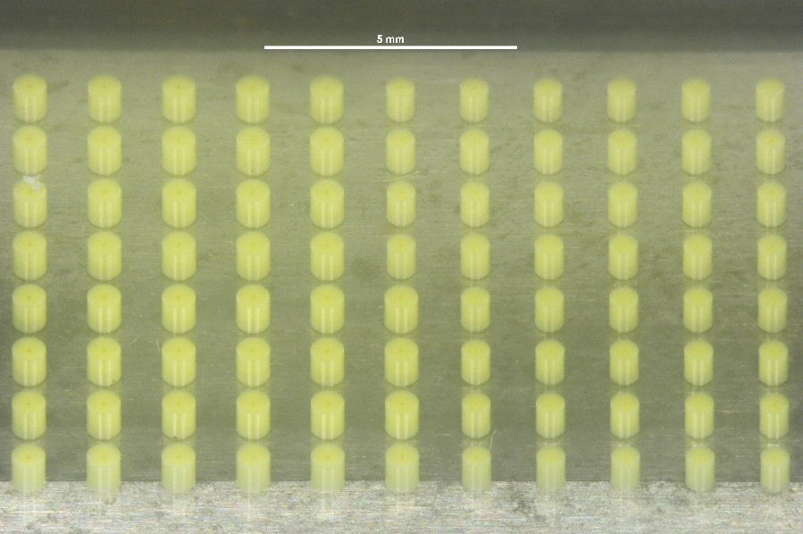
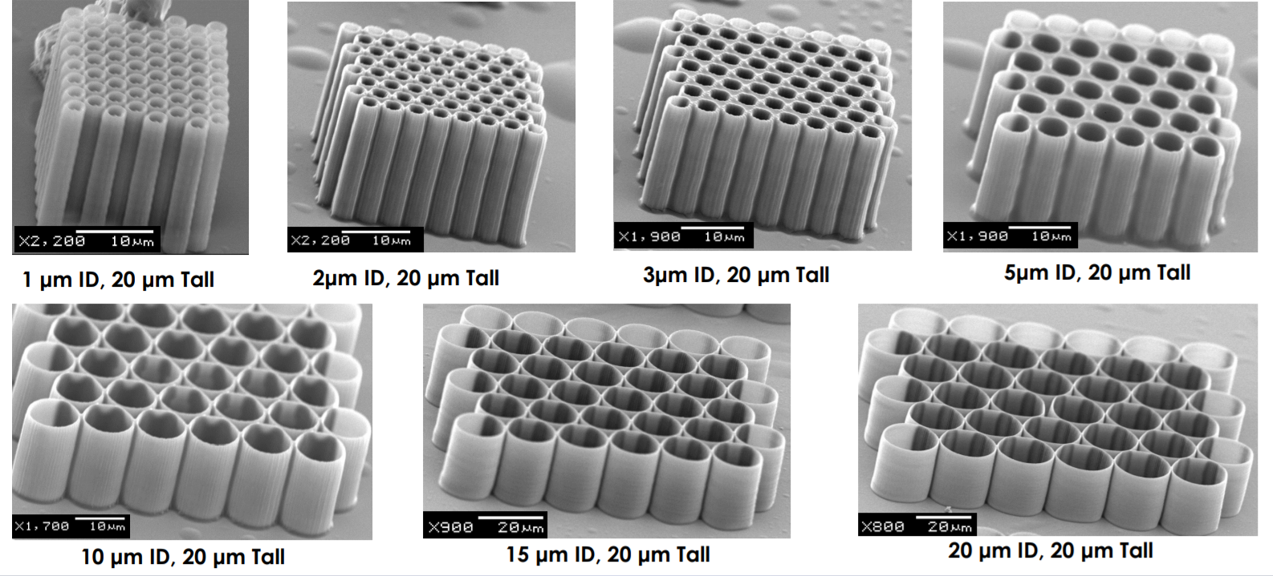
Increasing Use of Additively Manufactured Targets thru LaserNetUS
(Enabling efficient design variation studies)
Focusing cone design variations
Gradient Density Foam
Microtubes: probing ion generation

Slide 11
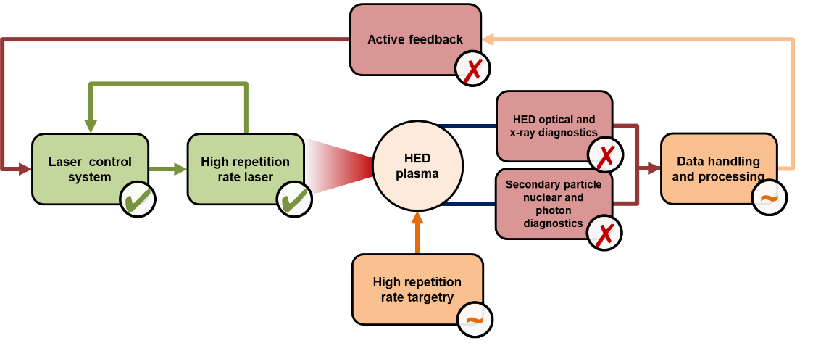
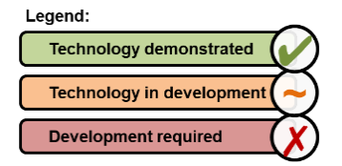
Developing a Facility to Support
Control systems, Target fielding, and Diagnostics Research
GALADRIEL: GA LAboratory for Developing Rep-rated Instrumentation and Experiments with Lasers:
Anticipate future needs as HED research on rep-rate facilities (~0.1-10Hz)
Apply MFE knowhow: a) managing large data sets 2) active feedback control

Slide 12
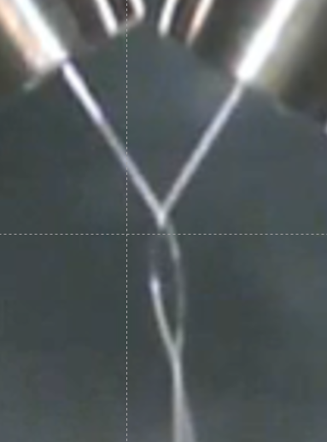
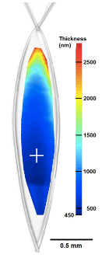
Developing Rep-rated Target System(s) Using GALADRIEL
Develop a liquid-leaf system to continuously create thin (<1𝛍m) films for proton generation
  Test designs for proton production
Demo robust ~MeV-proton generation
  Rep-rated spectroscopy, beam monitoring
  ~ps imaging of laser-liquid interaction
  Fast-analysis tools & feedback to laser system
Liquid-leaf Apparatus
Morrison et al, NJP 20 (2018)

Slide 13
In Conclusion
Focus is turning to the target
Advances in drivers, simulations, and diagnostics need to be matched by advances in target fabrication, target metrology, and final assembly
A Partner in Science-Based Stockpile Stewardship and ICF Research for Three Decades
HDC
Be
CH
Cr/W
W/Be
Be

