Slide 1
Magneto-Inertial Fusion:
A Promising Path Toward Burning Plasmas in the Laboratory
Daniel B. Sinars
Sandia National Laboratories
Fusion Power Associates| December 16, 2020
Credit to Paul Schmit (Sandia) for slides from his 2020 APS-DPP plenary talk

Slide 2
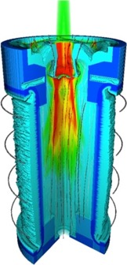
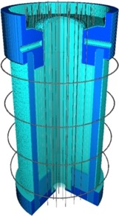
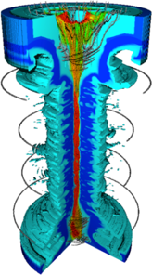
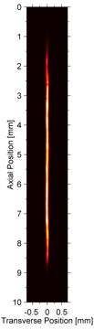
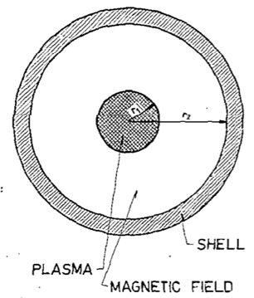
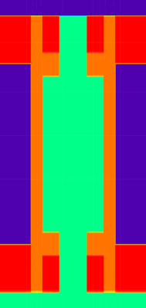
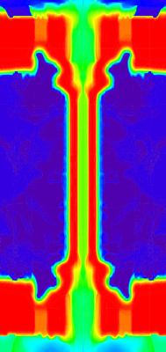
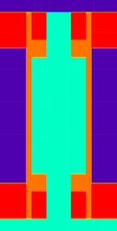
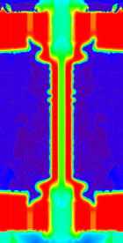


The thrill of discovery is thriving in modern magneto-inertial fusion (MIF) research
The benefits of magnetizing inertially confined fusion fuel have been understood for ~60 years.
Magneto-inertial fusion scheme, ca. 1962 (Linhart et al.)
Magnetize
Preheat
Compress
Magnetized Liner Inertial Fusion (MagLIF) has demonstrated the fundamental principles of MIF and is an engine of discovery in the field.
51 MA peak current
22 MA peak current
MIF represents a promising path toward burning plasmas in the lab, with well-characterized benefits/risks and rich opportunities for collaboration.
3 mm
$$Y_{DT}=0.13 MJ$$
$$Y_{DT}=13 MJ$$

Slide 3
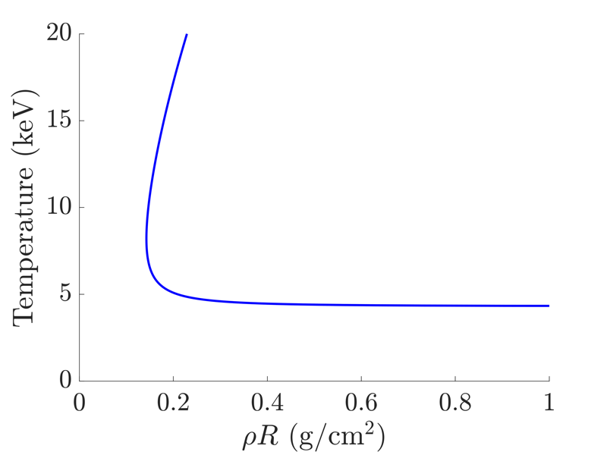









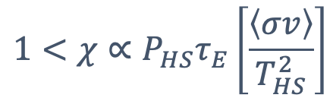

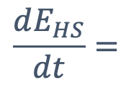
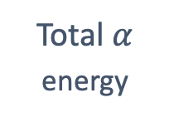


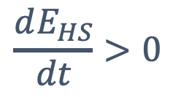

Burning ICF plasmas must satisfy a few important criteria
2
Hot spot self-heating criteria
$$α$$
Conduction cooled
Hot spot
$$\frac{dE_{HS}}{dt}>0$$
1
$$α$$
$${δR}_{sh}$$
$$T_{HS}≳4.3 \text{keV}$$
$$α$$
$$α$$
1
2
$${\left(ρR\right)}_{HS}≳0.2 \text{g}\text{/}{\text{cm}}^{2}$$
$$R_{HS}$$
Radiation cooled
Tamper
3
$χ>1$ (Lawson)
1
2
3
Energy reproduction (Lawson):
Total $α$
energy
Hot spot
energy
$$\frac{dE_{HS}}{dt}=$$
Alpha
heating
Radiation
losses
Conduction
losses
$$>$$
$$−$$
$$−$$
Positive energy balance
$$1<χ∝P_{HS}τ_{E}\left[\frac{\left\langle σv\right\rangle }{T_{HS}^{2}}\right]$$
$$∝{\left(ρδR\right)}_{sh}^{1/2}{\left(ρRT^{3}\right)}_{HS}^{1/2}$$
Atzeni & Meyer-ter-Vehn (2004)
Betti et al., POP 17, 058102 (2010)

Slide 4
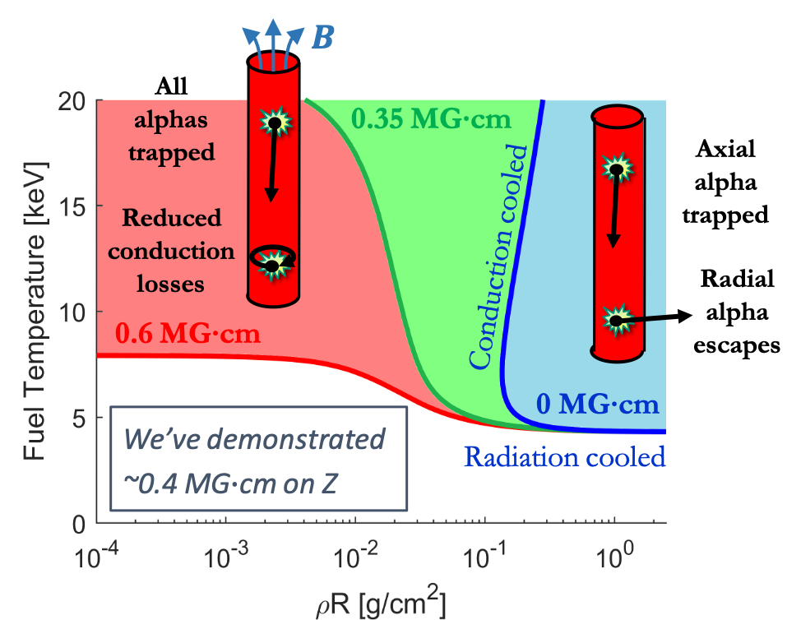
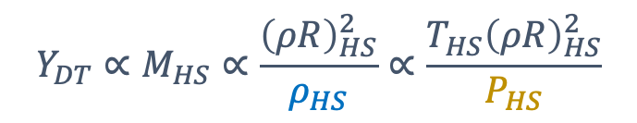
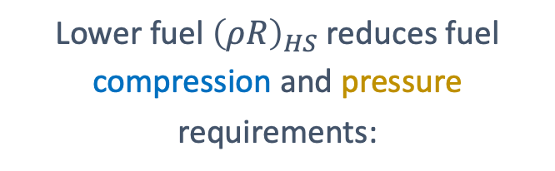
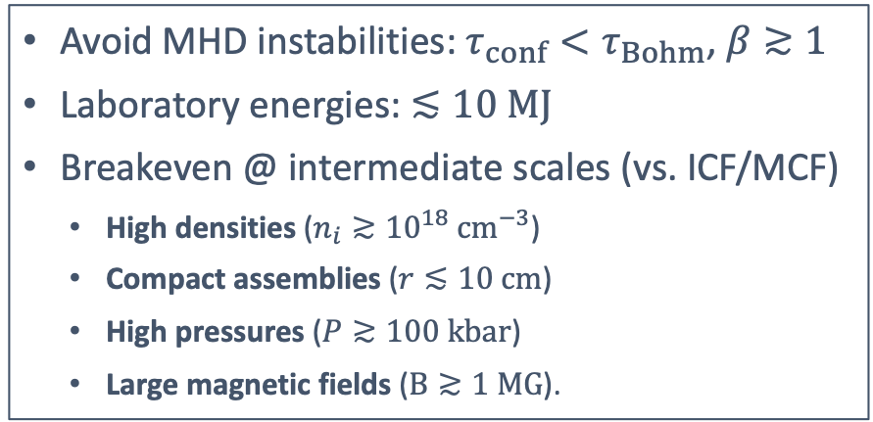
Magnetic fields open the door to a broader range of new paths to achieve fusion
Consider an axially magnetized, cylindrical hot spot:
Lower fuel ${\left(ρR\right)}_{HS}$ reduces fuel compression and pressure requirements:
Traditional ICF approaches
$$Y_{DT}∝M_{HS}∝\frac{{\left(ρR\right)}_{HS}^{2}}{ρ_{HS}}∝\frac{T_{HS}{\left(ρR\right)}_{HS}^{2}}{P_{HS}}$$
How do we access these new plasma states?
General MIF problem statement:
Avoid MHD instabilities: $τ_{conf}<τ_{Bohm}$, $β≳1$
Laboratory energies: $≲10 MJ$
Breakeven @ intermediate scales (vs. ICF/MCF)
  High densities ($n_{i}≳{10}^{18} {cm}^{−3}$)
  Compact assemblies ($r≲10 cm$)
  High pressures ($P≳100 kbar$)
  Large magnetic fields ($B≳1 MG$).
Plasma preparation
Linhart (1970)
Lindemuth/Siemon (2009)
Lindemuth (2017)
Implosion (pulsed)
Basko et al., Nucl. Fusion 40, 59 (2000)
Schmit et al., PRL 113, 155004 (2014)
Knapp et al., POP 22, 056312 (2015)

Slide 5
Sandia’s Z Pulsed Power Facility
The Earth’s largest pulsed power machine:
An engine of discovery for fundamental, HED, and fusion science!
Z Building

Slide 6
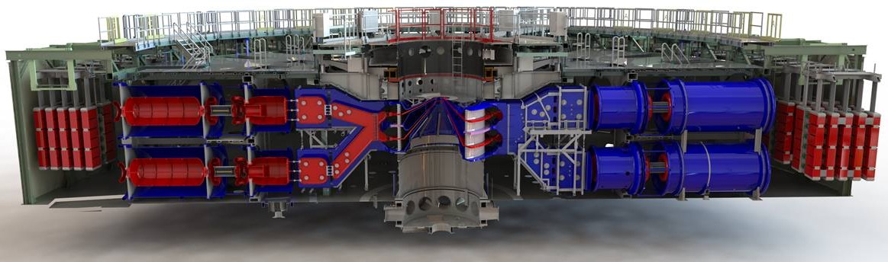
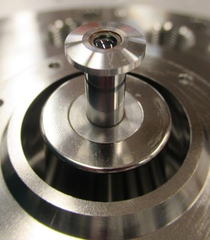
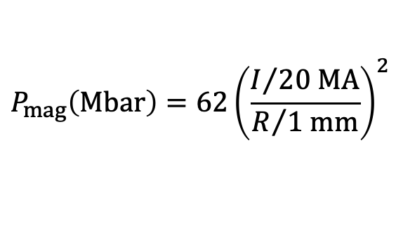
Z compresses energy in space and time to generate extreme dynamical forces
Z Pulsed Power Facility
Magnetically Driven Implosion
$$P_{mag}\left(Mbar\right)=62{\left(\frac{I/{20 MA}}{R/{1 mm}}\right)}^{2}$$
Diameter = 33 meters
Anode
Beryllium liner (MagLIF)
Diameter = 6 mm
drive
current
I
Cathode
R
Peak electrical current ~ 20 MA
Rise time ~ 100 nanoseconds
~7 Mbar → >100 Mbar during expt.
Notes:
”focusing of electrical energy onto the target”. 8 Mbar initial pressure for R = (5.58/2) mm and I = 20 MA

Slide 7
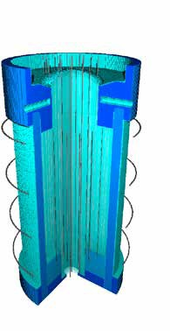
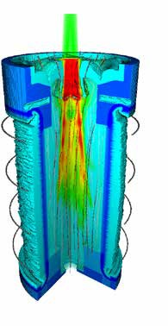
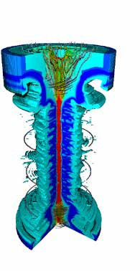
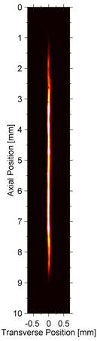

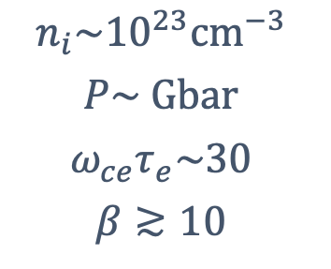
MagLIF is a concept enabling the study of all aspects of Magneto-Inertial Fusion
Relies on three components to produce fusion conditions at stagnation
$$n_{i}\sim {10}^{23}{cm}^{−3}$$
$$P\sim Gbar$$
$$ω_{ce}τ_{e}\sim 30$$
$$β≳10$$
=
Magnetization
Suppress radial thermal conduction losses
Enables slow, stable liner implosions
Preheat
Pressurize fuel for ~adiabatic compression
Limit convergence needed to reach multi-keV
Implosion
~Adiabatic PdV work
Flux compression to amplify B-field
Stagnation
Several keV plasma temperatures
Several kT B-field to trap charged fusion products
S.A. Slutz et al., Phys. Plasmas (2010); A.B. Sefkow et al., Phys. Plasmas (2014); S.A. Slutz et al., Phys. Plasmas (2018).

Slide 8
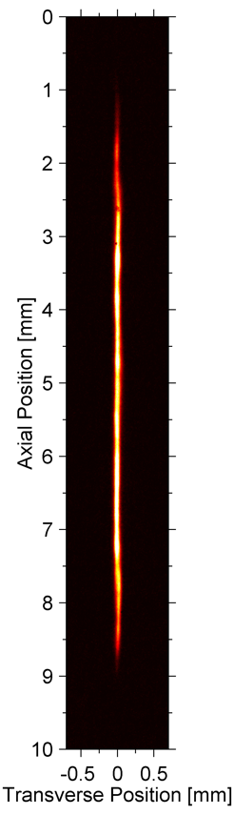
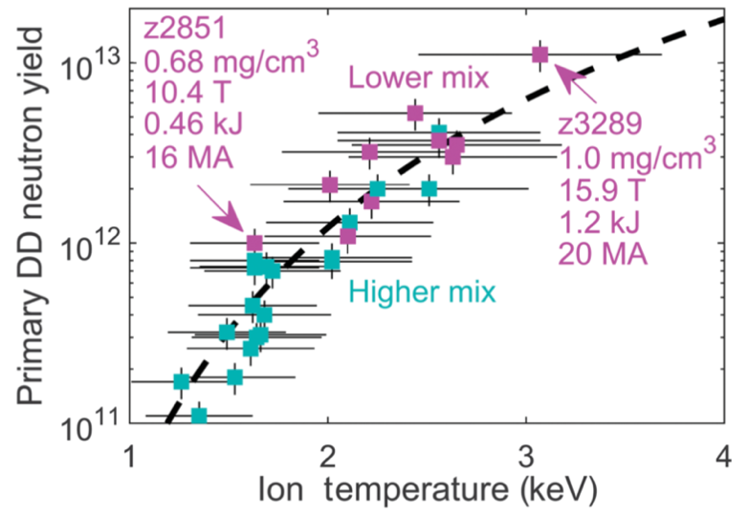
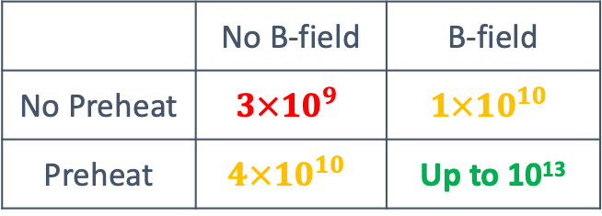

MagLIF experiments have demonstrated the fundamental principles of MIF
Thermonuclear neutrons, multi-keV temperatures from high aspect-ratio, cylindrical fuel assemblies.
Hallmark of MIF: significant fusion only when both the laser preheat and magnetization stages are present.
DD neutron yields
$$∝{\left\langle σv\right\rangle }_{DD}$$
 | No B-field | B-field
No Preheat | $$3×{10}^{9}$$ | $$1×{10}^{10}$$
Preheat | $$4×{10}^{10}$$ | Up to 10¹³
Gomez et al., PRL 113, 155003 (2014)
Gomez et al., PRL 125, 155002 (2020)

Slide 9
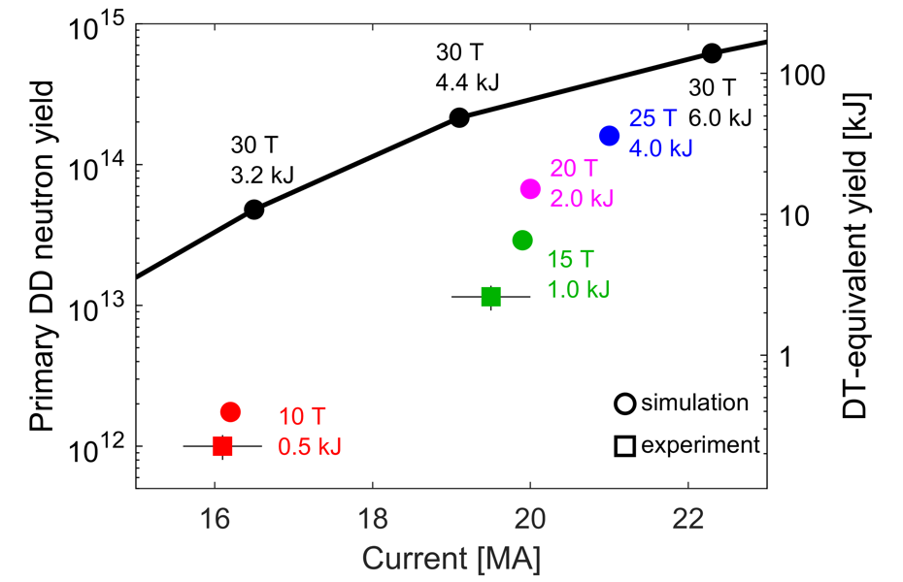
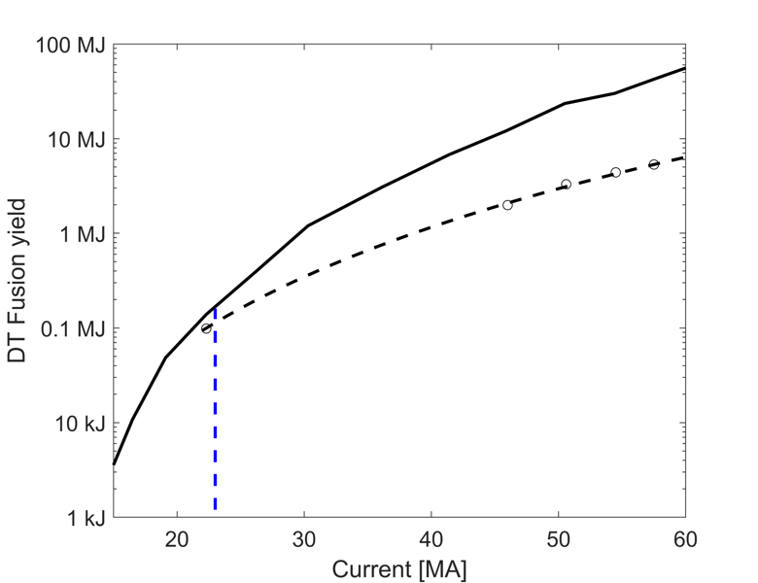

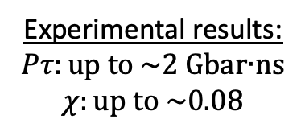
Forward-looking performance/scaling question: Where are we going?
Two major thrusts:
1 Improve baseline performance
2 Mature understanding of scaling
LASNEX optimized
Volume burn
2D LASNEX, optimized
No alpha
Experimental results:
$$Pτ:\text{up} \text{to} \text{\sim 2 }\text{Gbar}\text{∙}\text{ns}$$
$$χ:\text{up} \text{to}\text{ \sim 0.08}$$
Z
Future facility
We are working to demonstrate 20-25 T, 2-4 kJ, 20-21 MA in the next 2 years
Question: What physics risks could prevent us from reaching these conditions?
Slutz et al., POP 23, 022702 (2016)
Slutz et al., POP 25, 112706 (2018)
Notes:
Ptau values from Pat Knapp’s aggregate analysis, found at: Macintosh HD/Users/pfschmi/Desktop/Talks/APS-DPP 2020/Source material/Knapp Bayesian/maglif_ptau_Tburn.csv

Slide 10
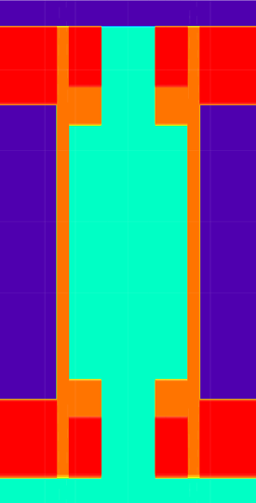
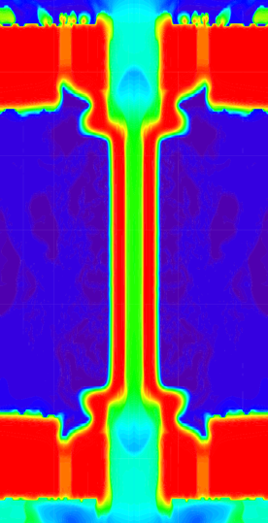
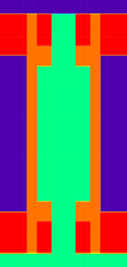
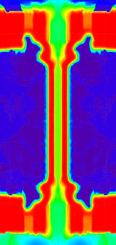

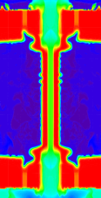
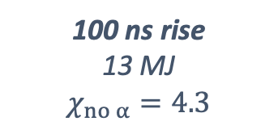
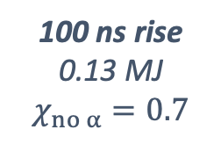

Many unique paths to reach higher performance while balancing physics risks
52 MA,
25 T, 54 kJ preheat
Baseline case
51 MA,
25 T, 33 kJ preheat
Scaling up preserves/improves:
Liner trajectory
MRT susceptibility (IFAR)
Mix kinematics
Most/all energy losses
Most transport processes
22 MA,
25 T, 4 kJ preheat
2.4x
2.4x
1.4x
1.4x
3 mm
100 ns rise
0.13 MJ
$$χ_{no α}=0.7$$
100 ns rise
13 MJ
$$χ_{no α}=4.3$$
240 ns rise
25 MJ
$$χ_{no α}=4.0$$
Implosion-time conserving
Schmit & Ruiz, POP 27, 062707 (2020)
Pressure-velocity conserving (Euler scaling)
Notes:
For the ITC-r case, ion conduction losses get a bit worse (unmagnetized losses ~I_max). For the PVC-t case, radiation losses get a bit worse (~I_max).
For the ITC-r case, the initial liner aspect ratio is ~3.6. The baseline and PVC-t cases are AR=6. In a dimensionless sense, the ITC-r case is 72% thicker than the other cases.

Slide 11
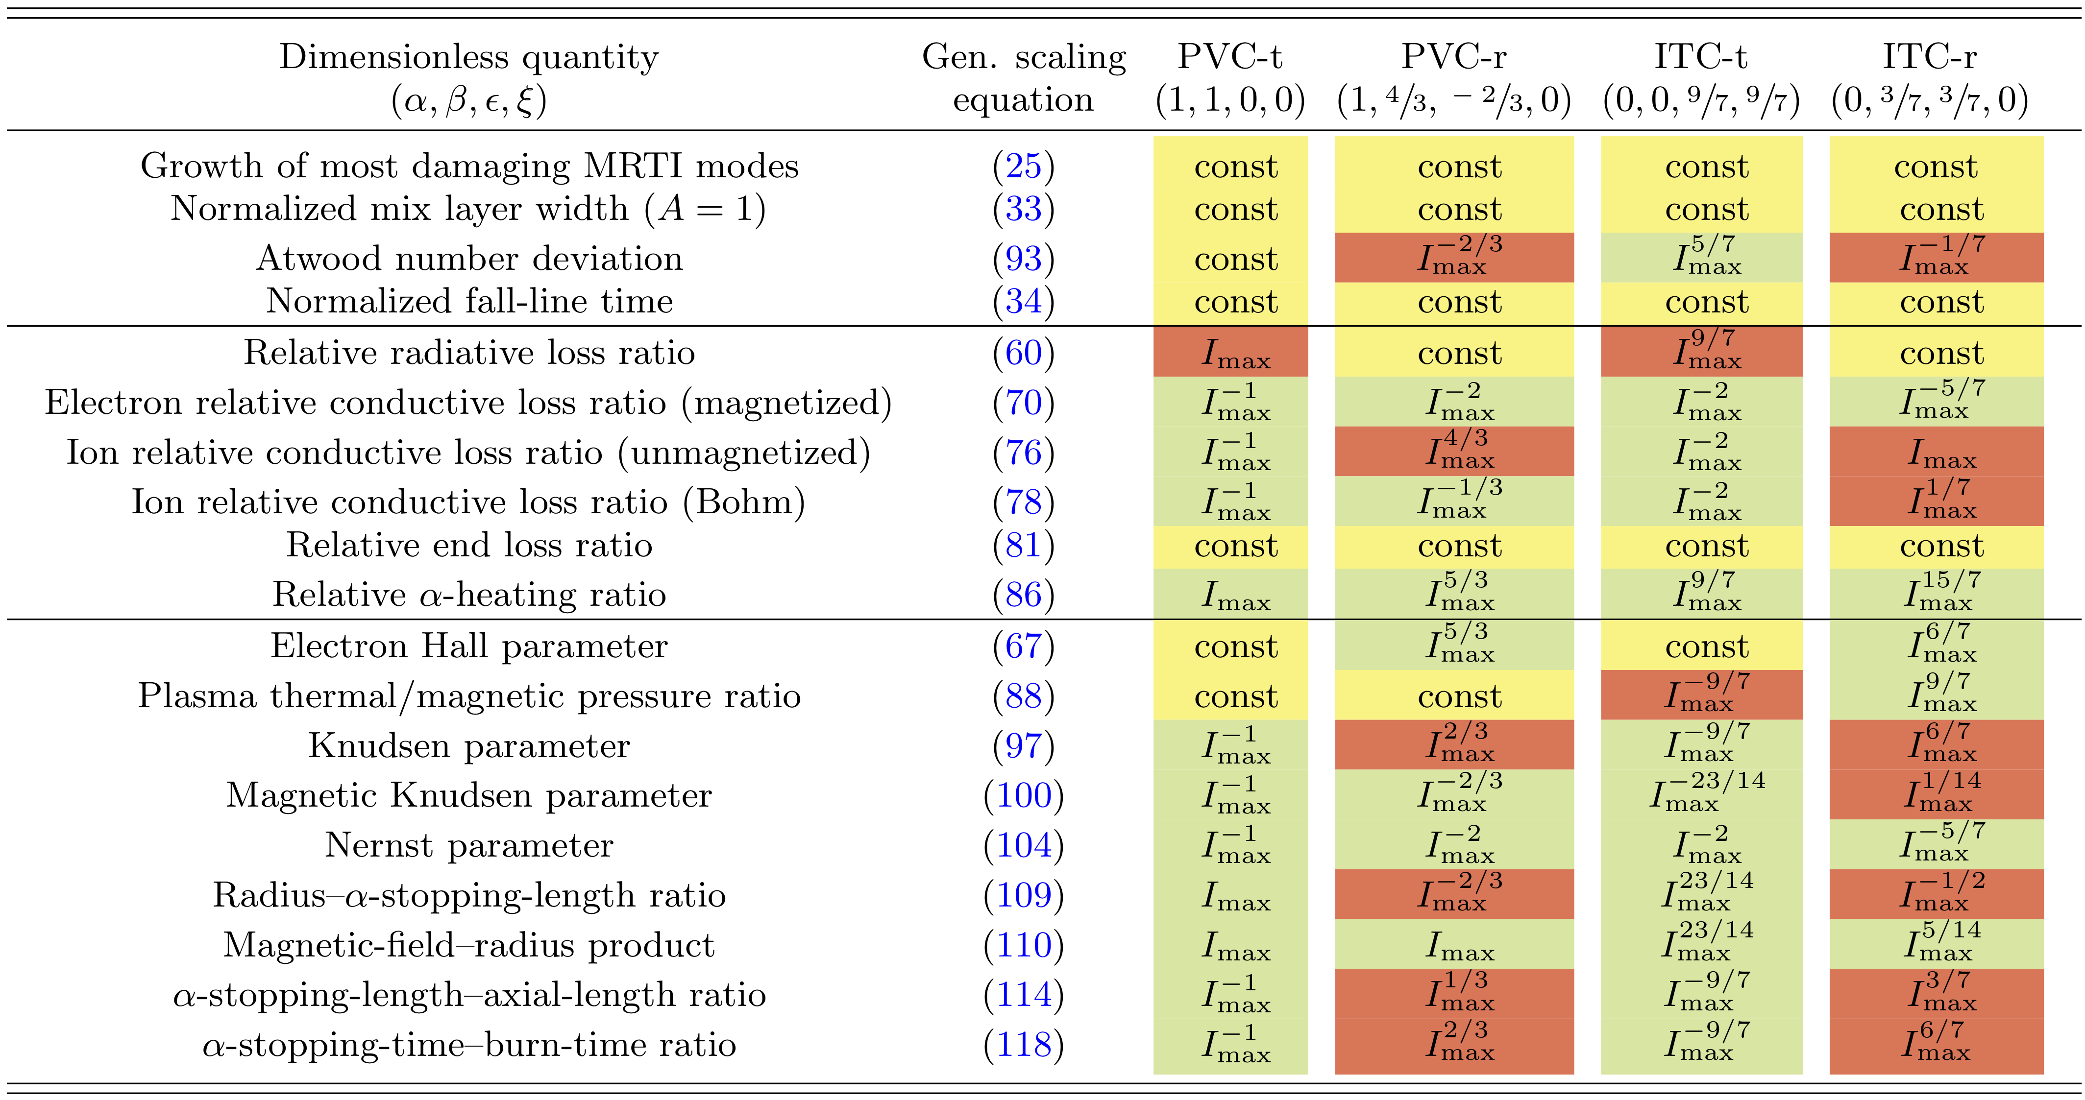
2020 scaling paper illustrates physics tradeoffs with different scaling choices
Pressure-velocity conserving paths
Implosion-time conserving paths
Physics scaling trends with increasing current
Favorable
Neutral
Unfavorable
Schmit & Ruiz, POP 27, 062707 (2020)

Slide 12
The thrill of discovery is thriving in modern magneto-inertial fusion (MIF) research
The benefits of magnetizing inertially confined fusion fuel have been understood for ~60 years.
Magneto-inertial fusion scheme, ca. 1962 (Linhart et al.)
Magnetize
Preheat
Compress
Magnetized Liner Inertial Fusion (MagLIF) has demonstrated the fundamental principles of MIF and is an engine of discovery in the field.
51 MA peak current
22 MA peak current
MIF represents a promising path toward burning plasmas in the lab, with well-characterized benefits/risks and rich opportunities for collaboration.
3 mm
$$Y_{DT}=0.13 MJ$$
$$Y_{DT}=13 MJ$$

