Slide 1
Fusion Research in Europe Horizon EUROfusion (‘21-’27)
Tony Donné
Programme Manager EUROfusion
FPA meeting | 15 December 2021

Slide 2

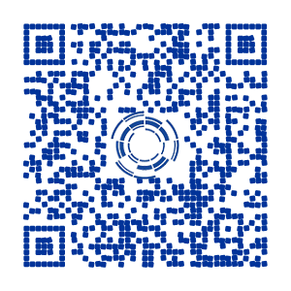
European Fusion Roadmap
Short-term
Medium-term
Long-term
Research on present and planned facilities, analysis and modelling
ITER
First plasma
Full performance
Commence
construction
Fusion Power Plants
Consistent
concept
Electricity
production
DEMO
Material research facilities IFMIF/DONES
Stellarator as fusion plant?
Lower cost through concept improvements and innovations
Milestone
Horizon EUROfusion

Slide 3
DEMO schedule critically depends on ITER

Slide 4
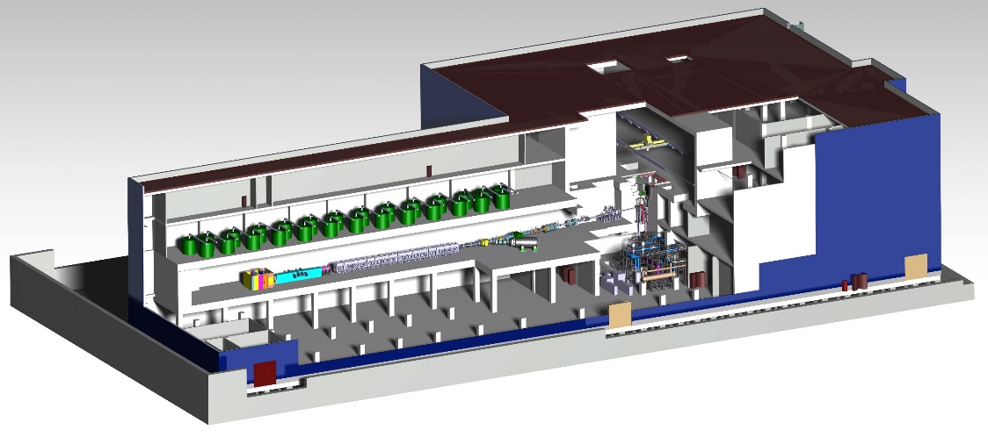
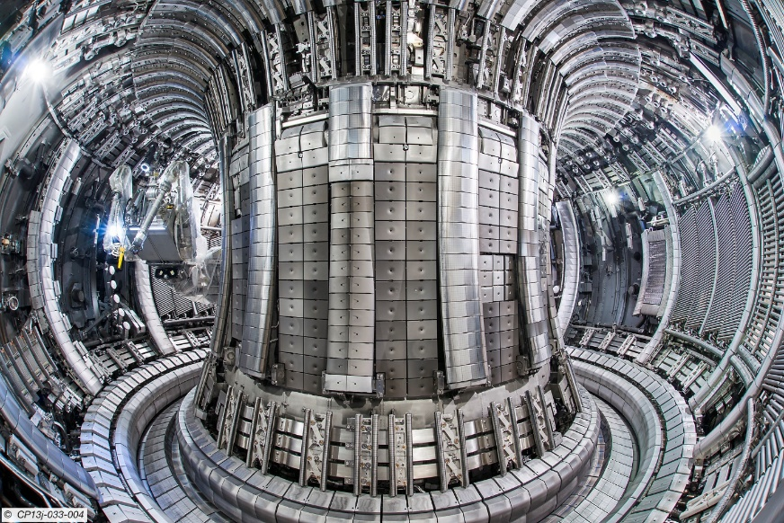
Horizon Europe an exciting period
2021
DT operation of JET
© CIEMAT
© EUROfusion

Slide 5
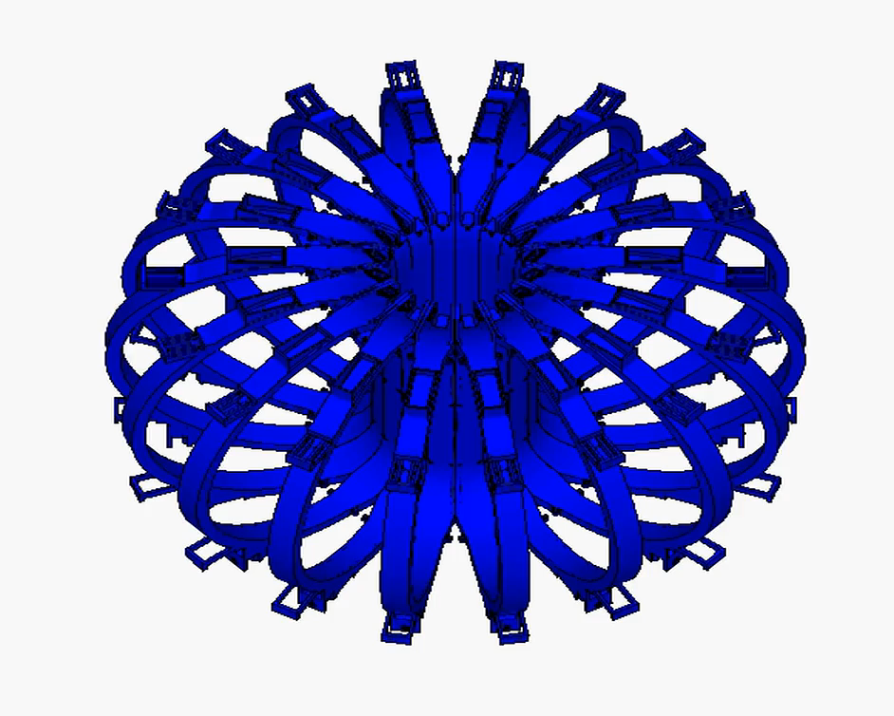
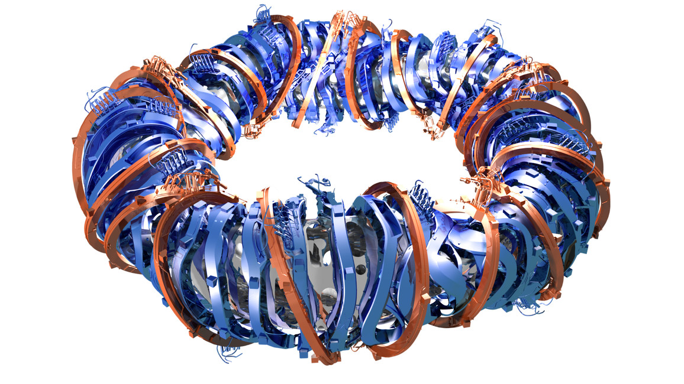
Horizon Europe an exciting period
2021
DT operation of JET
2022
JT-60SA first plasma
Start IFMIF-DONES construction
Start W7-X with actively cooled divertor
© CIEMAT
© IPP
© QST, Japan

Slide 6
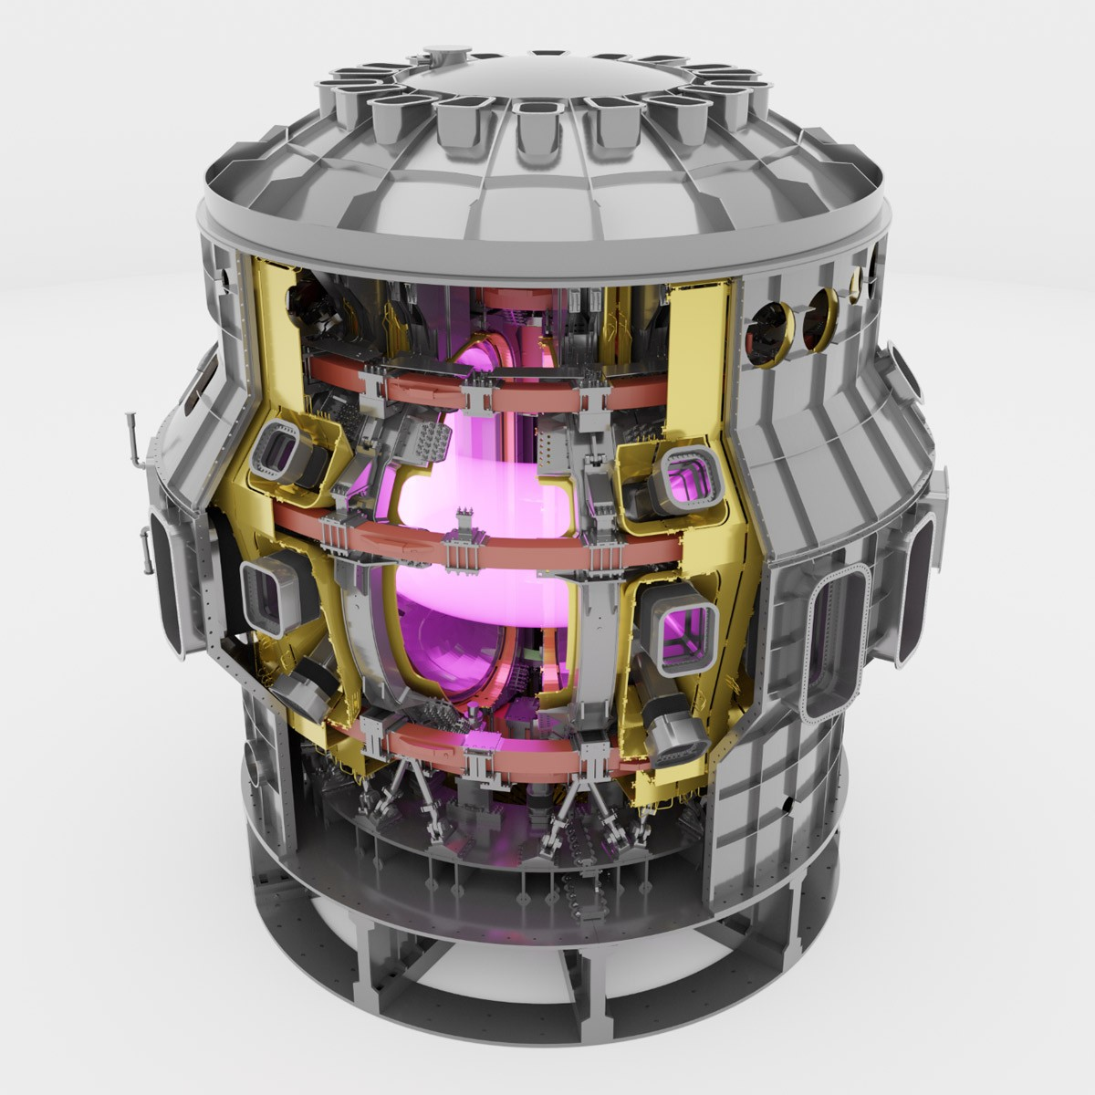
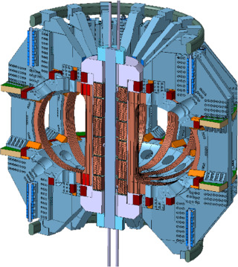
Horizon Europe an exciting period
2021
DT operation of JET
2022
JT-60SA first plasma
Start IFMIF-DONES construction
Start W7-X with actively cooled divertor
2023
European Facility Review
First full physics campaign JT-60SA (>’24)
First COMPASS-U plasma
© F4E
© IPP.CR

Slide 7
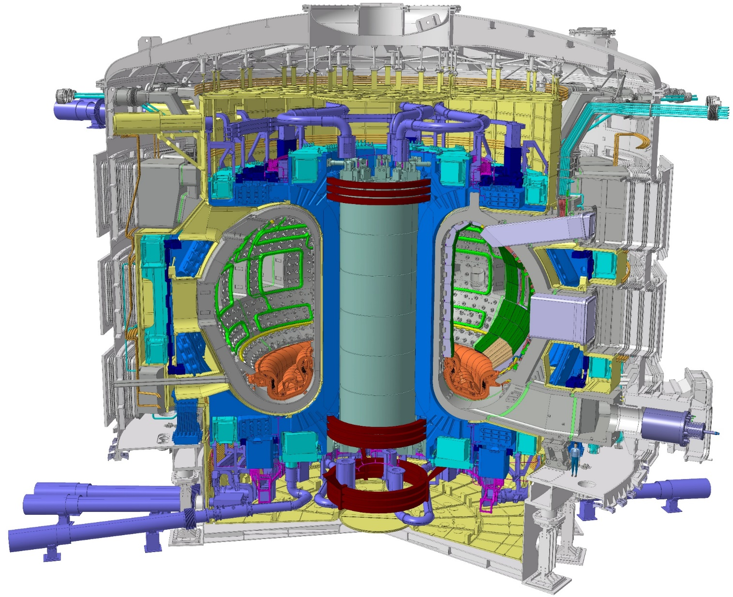
Horizon Europe an exciting period
2021
DT operation of JET
2022
JT-60SA first plasma
Start IFMIF-DONES construction
Start W7-X with actively cooled divertor
2023
European Facility Review
First full physics campaign JT-60SA (->’24)
First COMPASS-U plasma
2025
First ITER plasma
© ITER

Slide 8
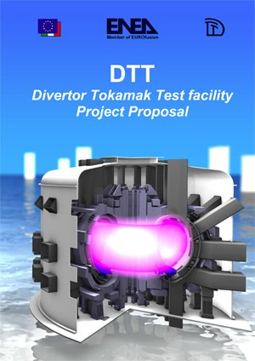
Horizon Europe an exciting period
2021
DT operation of JET
2022
JT-60SA first plasma
Start IFMIF-DONES construction
Start W7-X with actively cooled divertor
2023
European Facility Review
First full physics campaign JT-60SA(->’24)
First COMPASS-U plasma
2025
First ITER plasma
2026
First DTT plasma
© ENEA

Slide 9
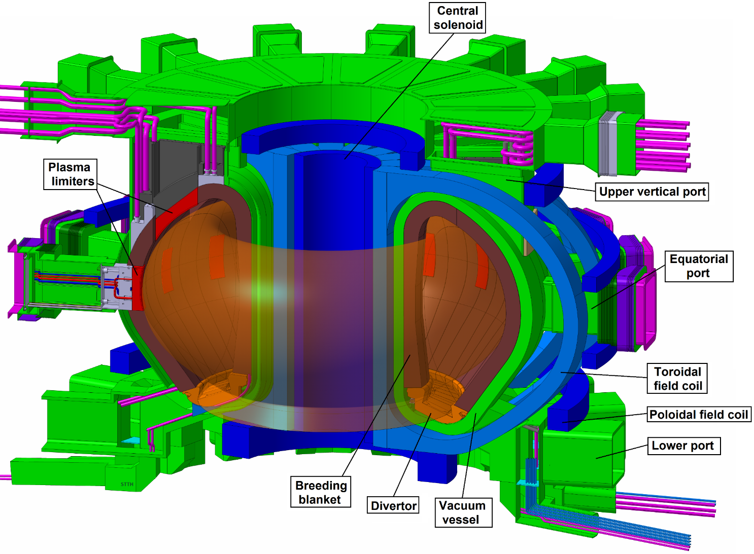
Horizon Europe an exciting period
2021
DT operation of JET
2022
JT-60SA first plasma
Start IFMIF-DONES construction
Start W7-X with actively cooled divertor
2023
European Facility Review
First full physics campaign JT-60SA (->’24)
First COMPASS-U plasma
2025
First ITER plasma
2026
First DTT plasma
© EUROfusion
2027
Finalisation DEMO Conceptual Design

Slide 10
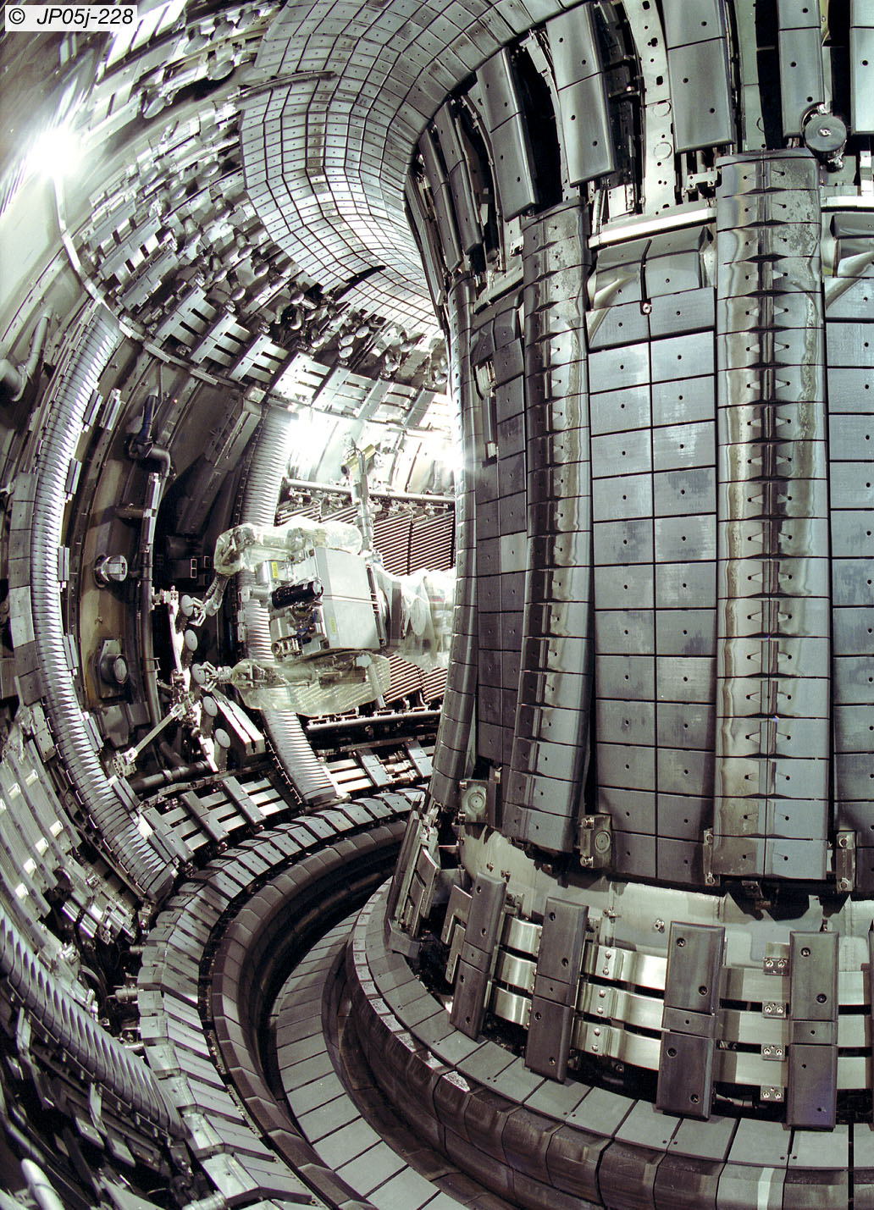
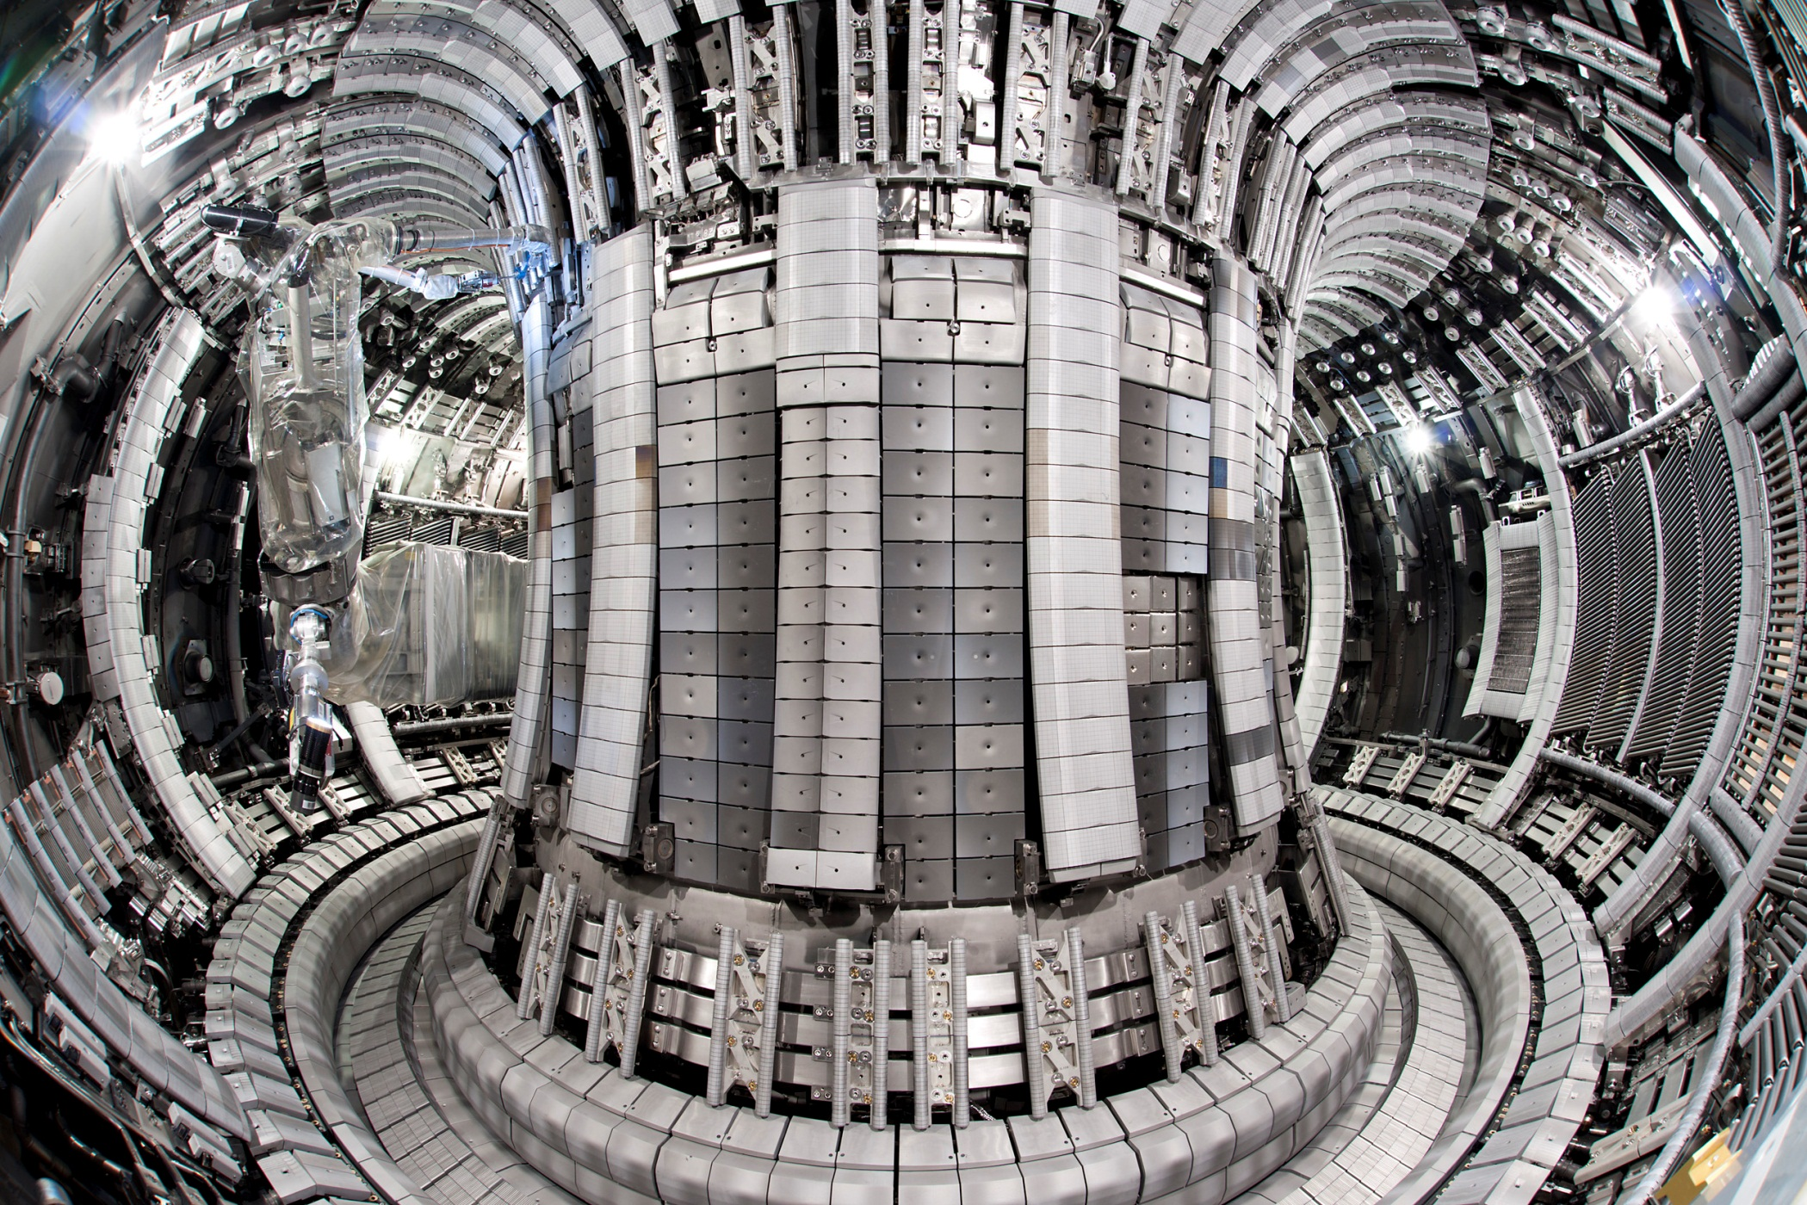
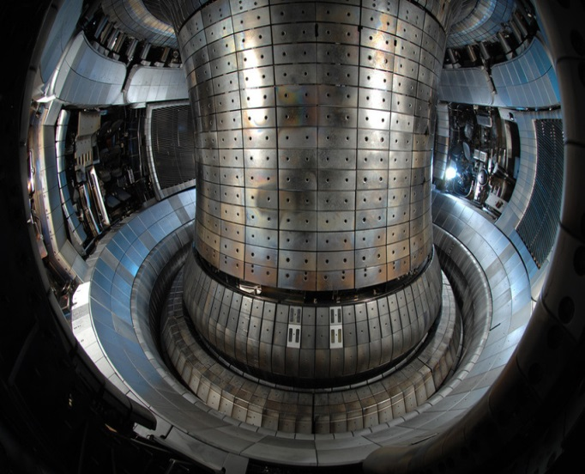
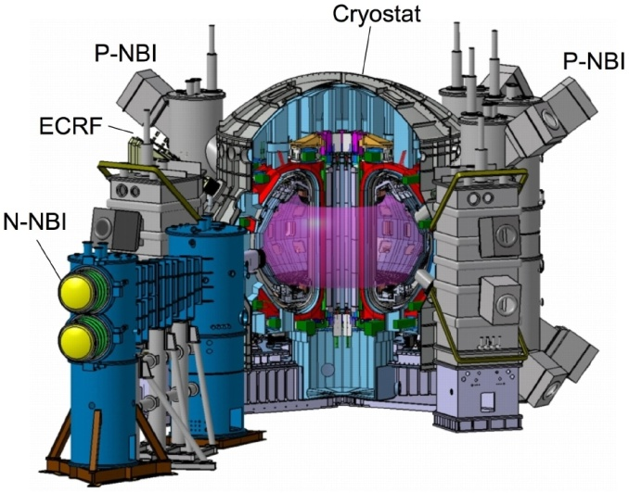
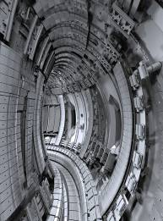
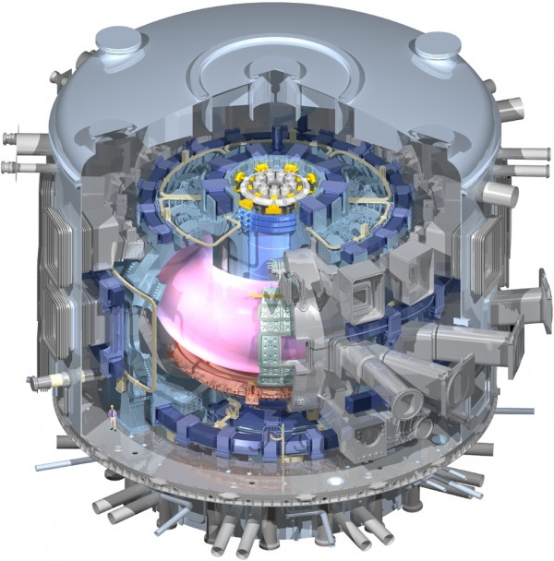
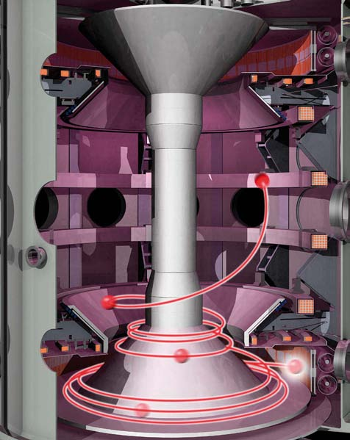
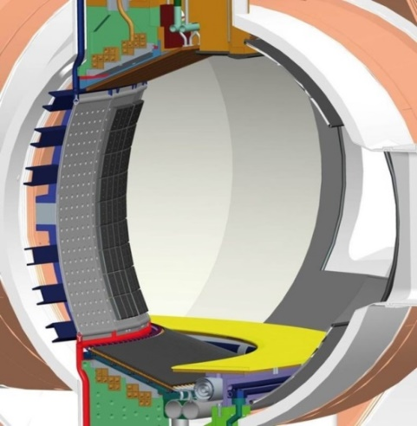
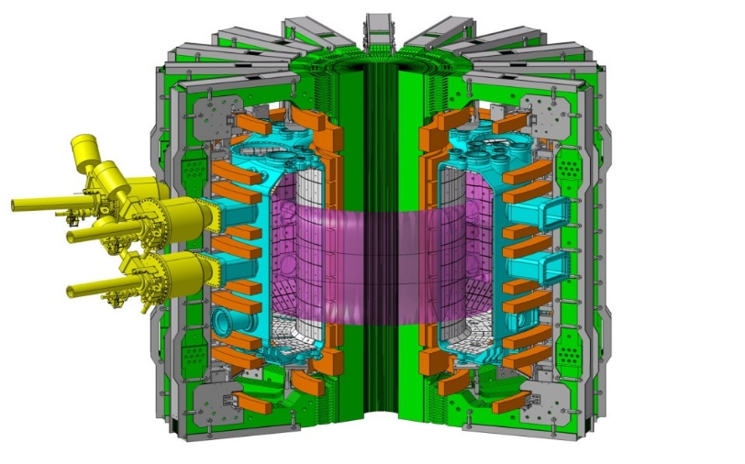
Eight Roadmap Missions – Mission 1
JET-C
until October 2009
JET-ITER-Like Wall
since May 2011
JET, UK
JT-60SA, JA
(Start in 2022)
ASDEX Upgrade, Munich, DE
ITER
(Our target device)
TCV, CH
WEST, FR
MAST Upgrade, UK

Slide 11
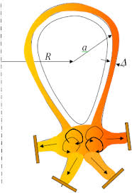
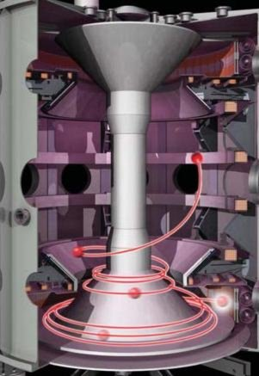
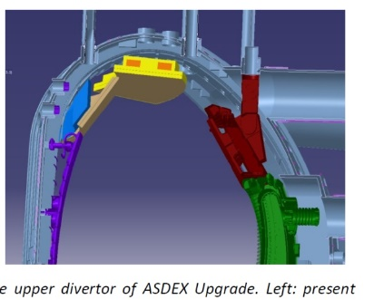
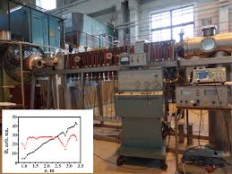
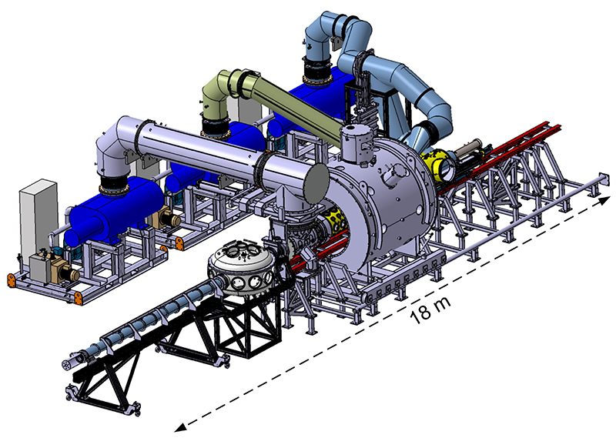


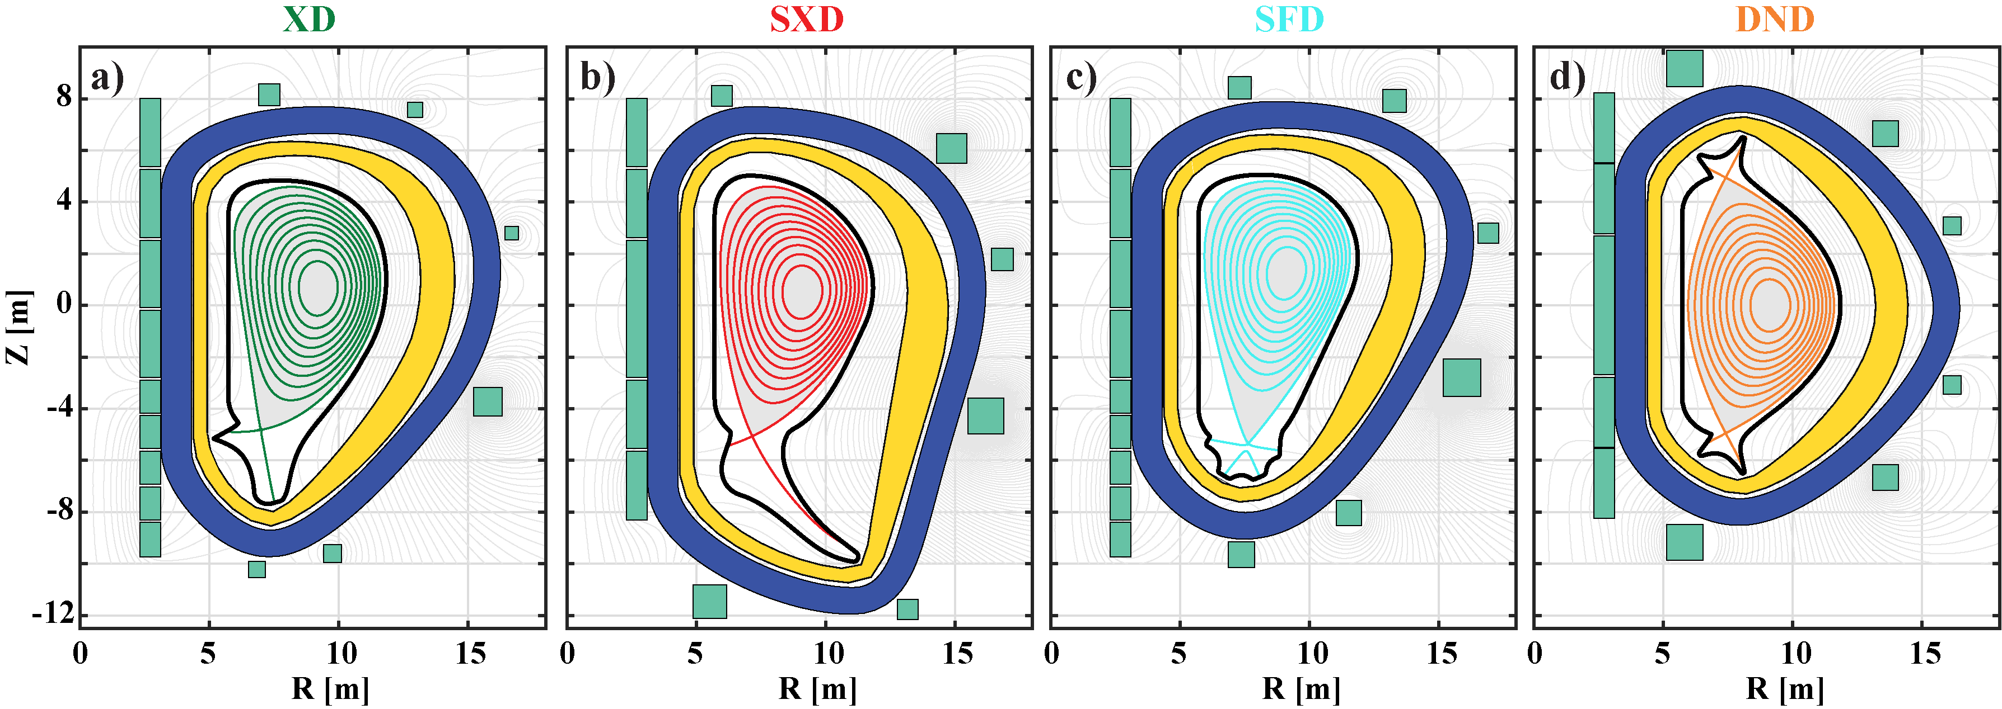
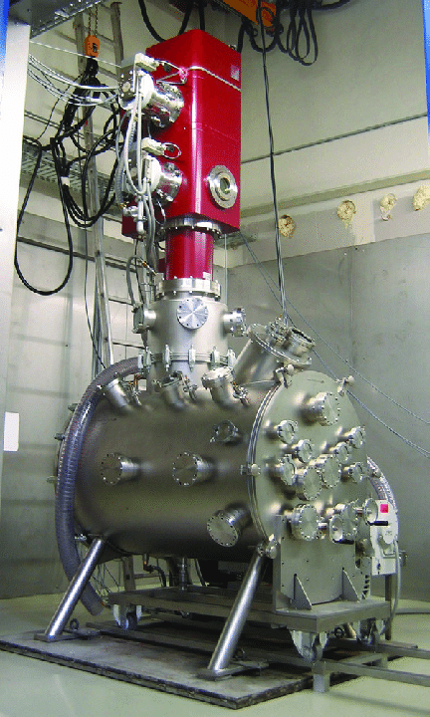
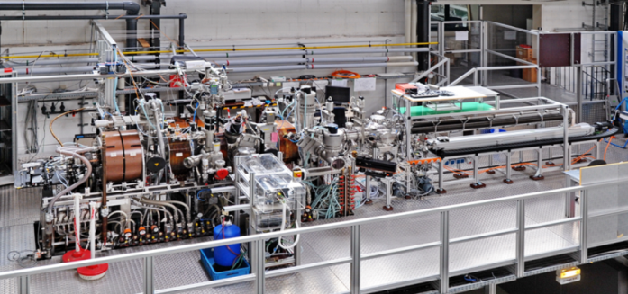

Eight Roadmap Missions – Mission 2

Slide 12
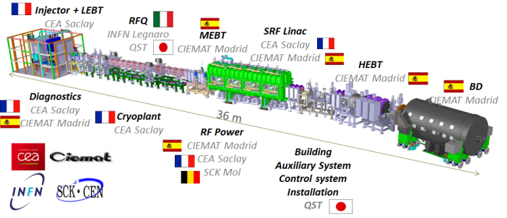
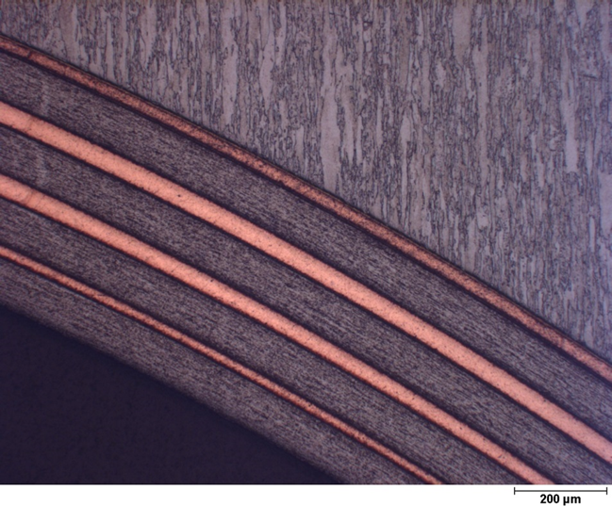
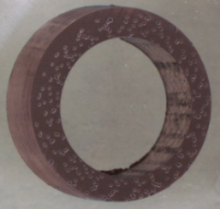
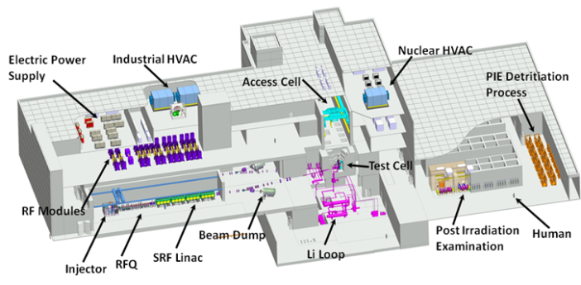
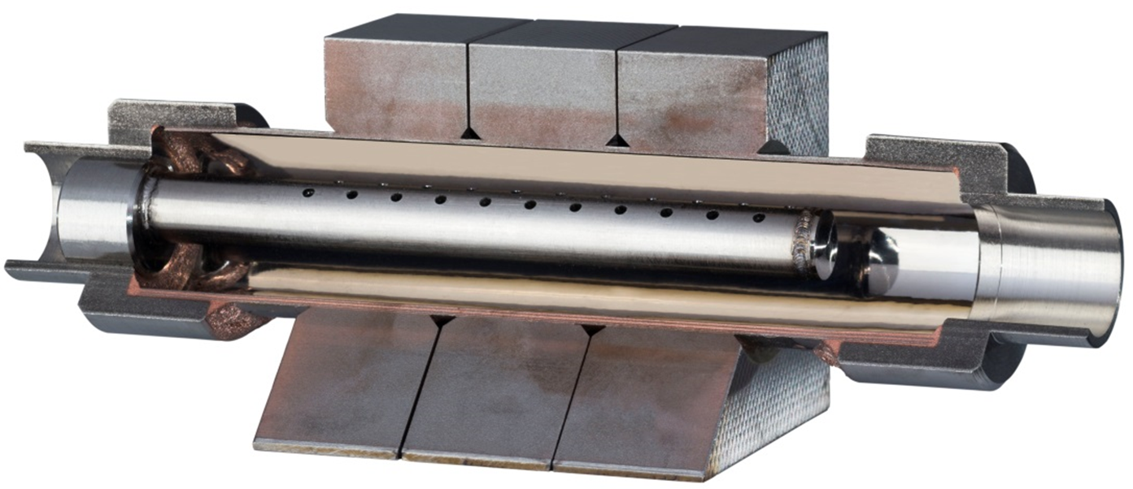
Eight Roadmap Missions – Mission 3
IFMIF-EVEDA
IFMIF-DONES

Slide 13
Eight Roadmap Missions – Mission 3
Challenges and opportunities
Embrittlement and operating temperature of steels esp.
Functional materials (breeding, coatings etc)
Activation: decay heat, waste, recycling
Design rules and licensing with sparse data (esp. 14MeV)
Basic approach:
EUROFER97, tungsten, CuCrZr for in-vessel structures
Use MTRs, advanced analysis and modelling for design rules (20dpa, ~2fpy)
IFMIF-DONES for validation and >20dpa
Alternate & advanced materials, composites: back-up/improved
Model multi-scale problem

Slide 14
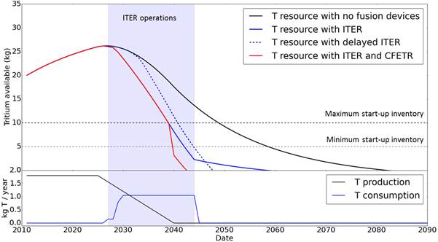
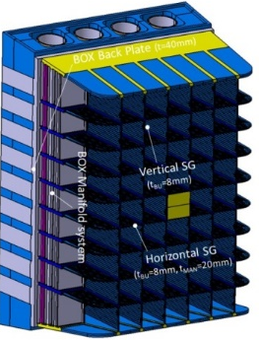
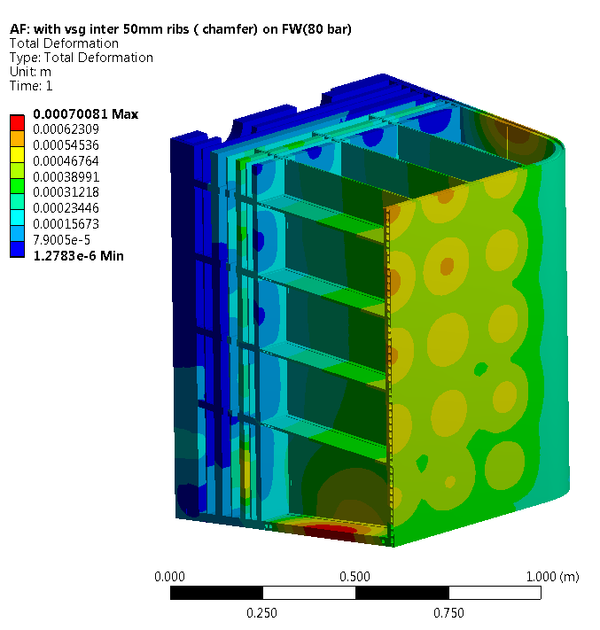

Eight Roadmap Missions – Mission 4

Slide 15
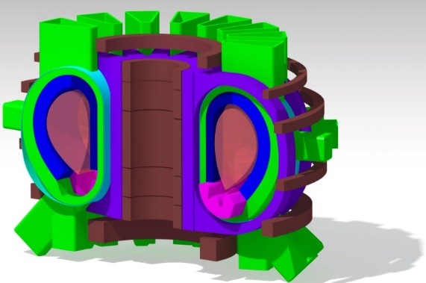
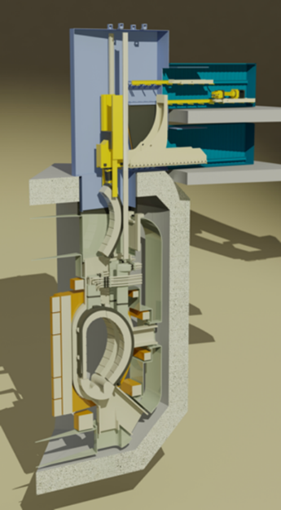
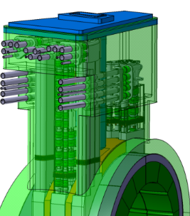
Eight Roadmap Missions – Mission 5-6

Slide 16
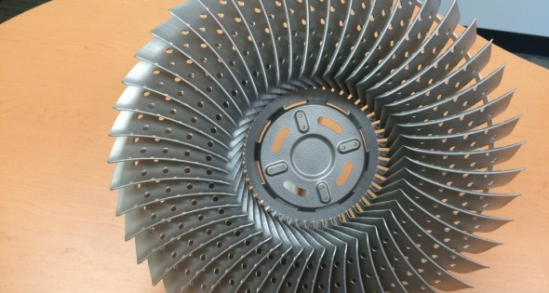
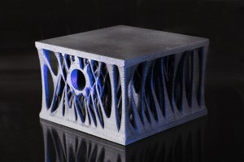
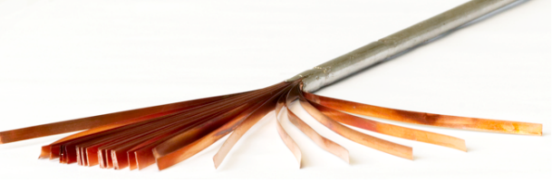
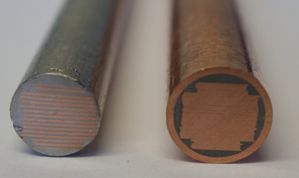

Eight Roadmap Missions – Mission 7

Slide 17
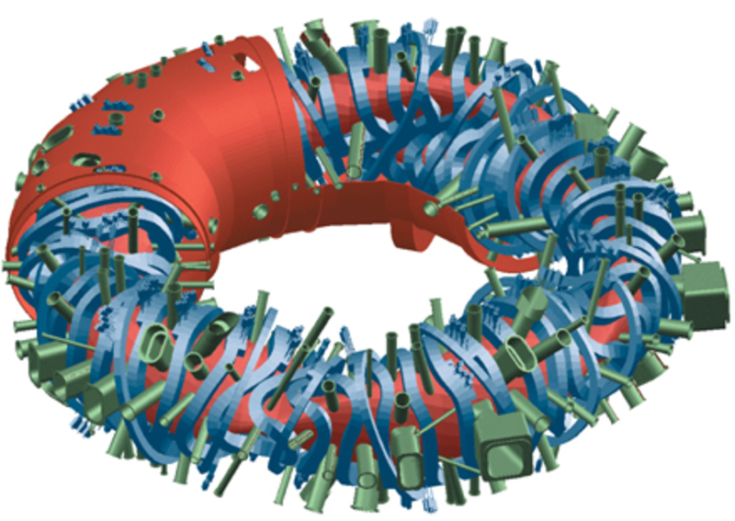
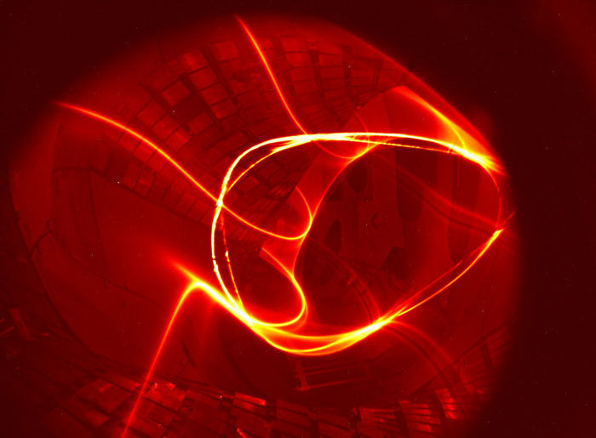
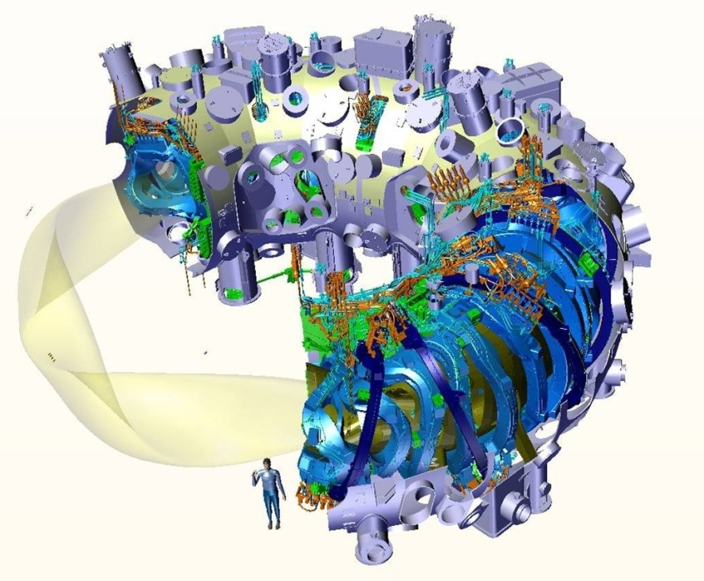

Eight Roadmap Missions – Mission 8

Slide 18


Mission 1 and 2: Tokamak devices
JET, UK
ASDEX Upgrade, Munich, DE
JT-60SA, JA
(Start in 2022)
COMPASS-U
(Start in 2023)
ITER
(Our target device)
TCV, CH
WEST, FR
MAST Upgrade, UK

Slide 19
EUROfusion Theory and Advanced Simulation Coordination
E-TASC Scientific Board
M2, M8 Pedestal-SOL, exhaust, PWI
M3 Materials,neutronics
M1, M8 Core-pedestal
TSVV Tasks
M4-M7 Engineering
Code integration, integrated modelling, and control (IMAS…)
Advanced Computing Hubs
Code development and deployment on HPC
HPC & mid-range facilities
Data analysis (incl. AI) and management
EUROfusion “standard codes” for ITER operation and DEMO design
Validated models for ITER & DEMO
[X. Litaudon]

Slide 20
Primary objectives for Mission 1 in Horizon Europe
Plasma Regimes of Operation
M1.1 Demonstrate and qualify MHD-stable high-performance operation with metallic plasma facing components for ITER and DEMO;
M1.2 Enhance the physics understanding in order to control the operation of burning plasmas in ITER and DEMO;
M1.3 Develop integrated scenarios with controllers for long pulse, ultimately steady-state, operation for ITER and DEMO.

Slide 21
Primary objectives for Mission 2 in Horizon Europe
Heat Exhaust Systems
M2.1 Detachment control for ITER, DEMO baseline and HELIAS (the helical-axis advanced stellarator line)operation;
M2.2 Prepare efficient Plasma Facing Components (PFC) operation for ITER, DEMO and HELIAS;
M2.3 Investigate alternative innovative divertor geometries for DEMO;
M2.4 Develop a liquid-metal based divertor solution for DEMO.

Slide 22
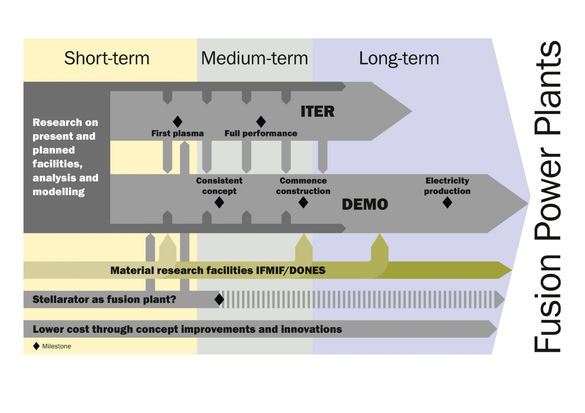
Mission 3 : Neutron-Resilient Materials

Slide 23
Primary objectives for Mission 3 in Horizon Europe
Develop Neutron-Resilient Materials
M3.1 Support finalisation of the IFMIF-DONES design and construction;
M3.2 Implementation of a neutron irradiation programme in suitable material test reactors for DEMO relevant conditions. This includes post irradiation experiments to interpret the results and measure resulting material property changes;
M3.3 Implementation of the data in the Material Property Handbook and as appendices to Codes & Standards (RCC MRx...), and development of DEMO specific design rules for radiation loaded components;
M3.4 Development and characterisation of advanced materials towards industrial manufacturing, and industrial fabrication of baseline materials and their qualification as well as the qualification of joining technologies, in particular with regard to high heat flux performance and fusion neutron irradiation induced property changes;
M3.5 Materials modelling and experimental validation.

Slide 24
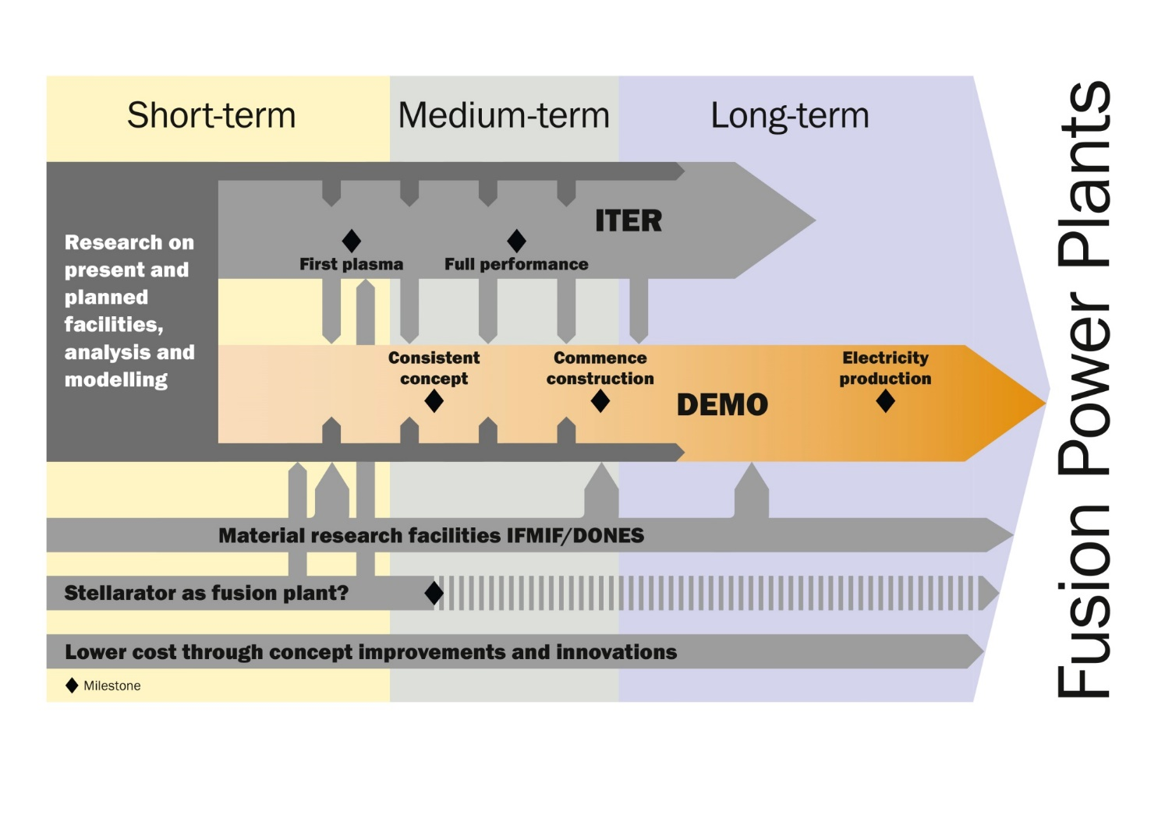
Mission 4 – 6: Tritium breeding, Safety, DEMO Design

Slide 25
Primary objectives for Mission 4 in Horizon Europe
Ensure tritium self-sufficiency
M4.1 Advance the technology maturity of the most attractive blanket concepts (i.e., WCLL, HCPB) for ITER TBM and DEMO, in particular for breeders, multipliers, high-temperature high-pressure coolants technologies, tritium permeation and corrosion barriers, liquid metal magneto-hydrodynamics and manufacturing technologies;
M4.2 Validate (design and R&D) of the fuel cycle architecture and its underlying elements;
M4.3 Validate the tritium containment control strategy;
M4.4 Understand the future availability of tritium and evaluate the impact of limited resources on the timeline of DEMO and develop mitigations

Slide 26
Primary objectives for Mission 5 in Horizon Europe
Implementation of the intrinsic safety features of fusion
M5.1 Definition of DEMO safety approach to licensing regulatory requirements;
M5.2 Integration of safety analyses and demonstration of safety margins in the design;
M5.3 Development and maintenance of processes and tools that enable DEMO safety assessments;
M5.4 Preliminary Safety Report for the DEMO Conceptual Design (including Decommissioning Plan).

Slide 27
Primary objectives for Mission 6 in Horizon Europe
Conceptual DEMO design
M6.1 Develop the necessary scientific basis (physics and technology) for a feasible and sound conceptual plant design;
M6.2 Bring critical technologies for DEMO to adequate maturity;
M6.3 Establish a structured and traceable conceptual baseline design that provides an integrated solution, meeting the Stakeholders requirements with sufficient margin.

Slide 28
Establish Technology Hubs
enable best use of relevant existing and new technology facilities.
foster collaboration, integration among the laboratories, and training.
offset the risk of concentration of specific technological skills in only one lab in favour of more distributed knowledge and capabilities.
increase the visibility of the involved laboratories.

Slide 29
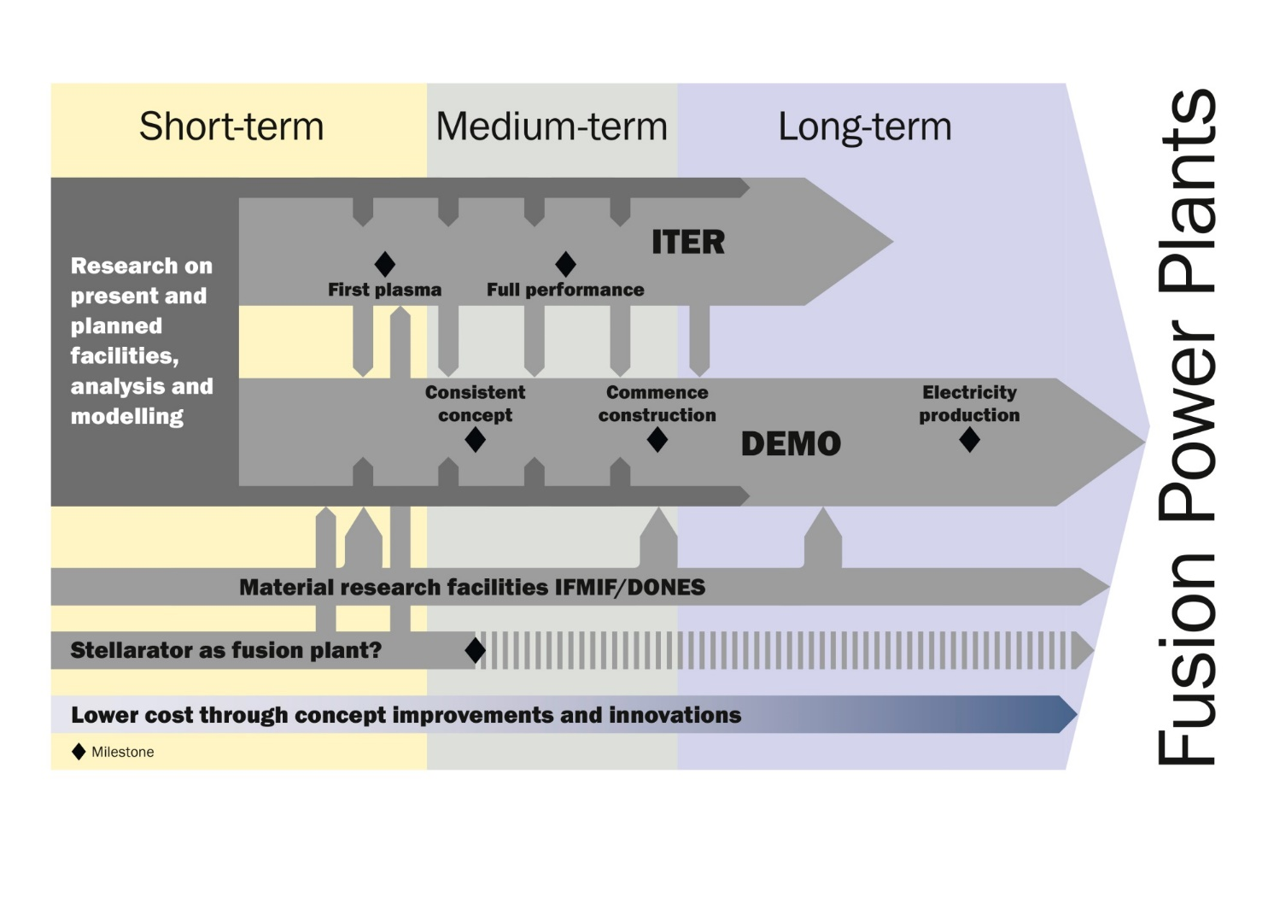
Mission 7 : Cost of Electricity

Slide 30
Primary objectives for Mission 7 in Horizon Europe
M7.1 Development and maturation of potential technologies for fusion, including advanced divertor, blanket, plasma heating, and magnet options which may improve performance and electrical efficiency;
M7.2 Identification of additional research requirements needed to support the concepts developed in M7.1;
M7.3 Development of novel materials and manufacturing techniques to support the requirements of fusion technology on a large scale;
M7.4 Improvement of fusion plant conceptual development tools (including for stellarators) so that a range of future options can be explored and the consequences of improved physics or technology can be investigated;
M7.5 Investigation of market opportunities and challenges for fusion, including electricity generation, hydrogen production, and chemistry process heat.

Slide 31
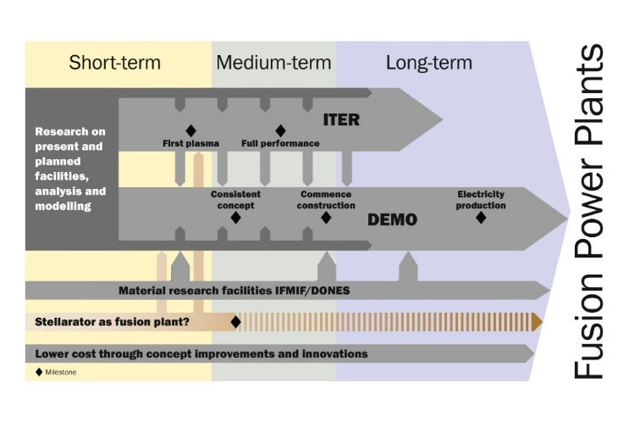
Mission 8 - Stellarators
Opportunities and challenges
current-less stellarators: no disruptions, intrinsically steady state
Large physical size of helias power plants
Complex construction (remote maintenance?)
Actions (examples)
Full active cooling of W7-X: steady state high power plasmas
Theory + experiment for burning plasma scenarios
Develop pre-conceptual DEMO/FPP-class design

Slide 32
Primary objectives for Mission 8 in Horizon Europe
Stellarator
M8.1 Qualification of HELIAS optimised stellarator operation and reactor-like operation based on W7-X results and outcome;
M8.2 Theory development and validation for the prediction of stellarator optimisation;
M8.3 Advancement of specific stellarator engineering and technology in preparation of a next-step device.

Slide 33
Take home message
A challenging plan has been developed for Horizon Europe which is fully aligned with the European fusion roadmap
Together we will make the future!

Slide 34
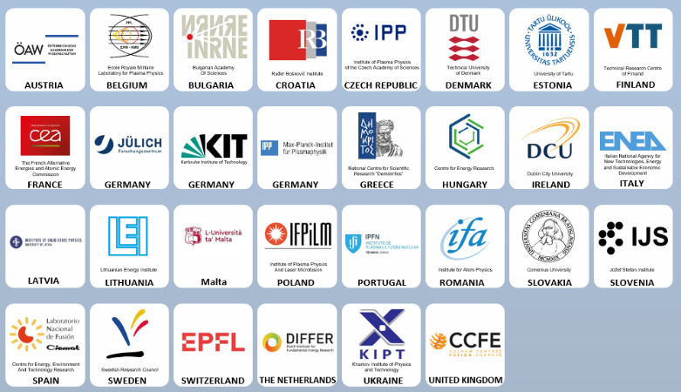
EUROfusion –30 Beneficiaries in 28 countries

