Slide 1

ORNL’s Role in Enabling an Aggressive Path to Fusion Energy
By
Mickey Wade
Director, ORNL Fusion Energy Division
42nd Fusion Power Associates Annual Meeting
December 15-16, 2021

Slide 2
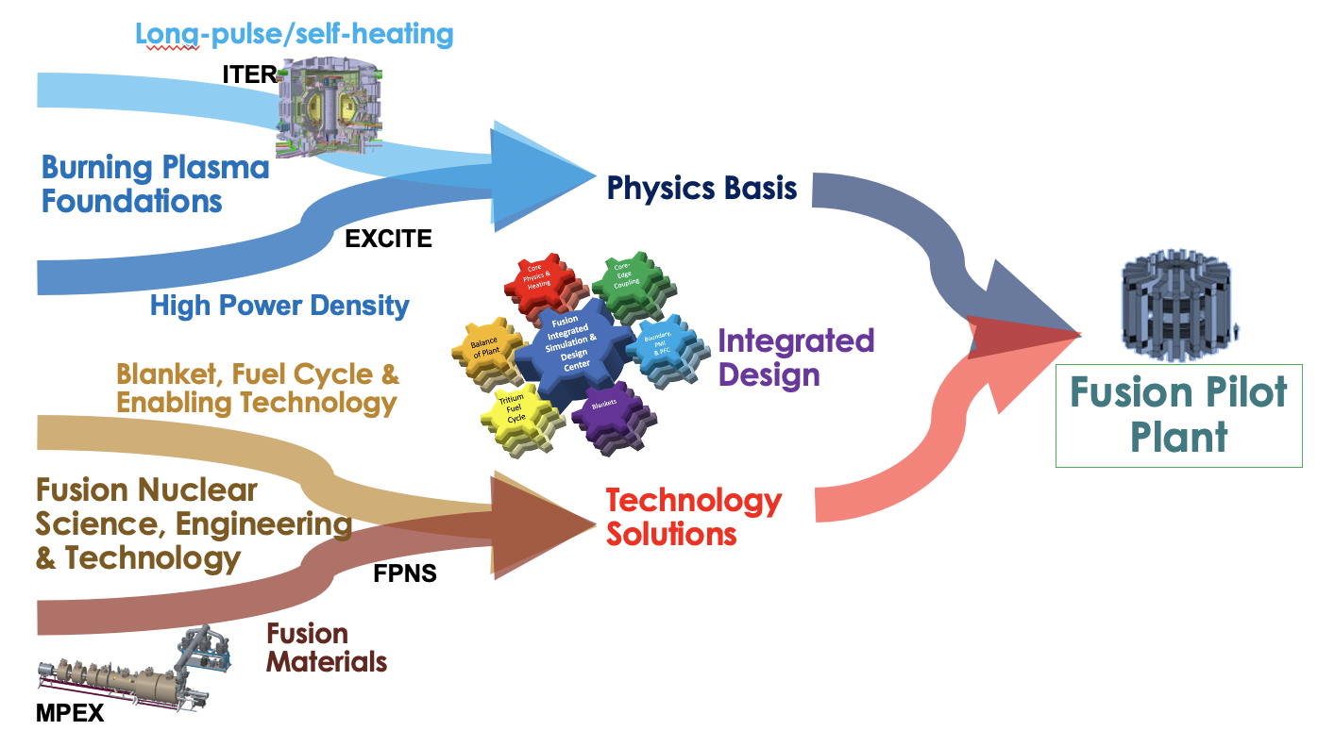
ORNL Fusion Program’s Vision and Mission
Vision: Fusion energy – the clean electricity source of choice for this generation and beyond
Mission: In partnership with public and private fusion efforts worldwide, establish the technical basis for burning plasma physics, next-generation materials, and fusion nuclear technology critical to the integrated design of a fusion pilot plant
Overriding Principle: Pursue pathways that have the potential to deliver early fusion energy through targeted R&D to resolve technical challenges that threaten mission success, timeliness, and cost

Slide 3
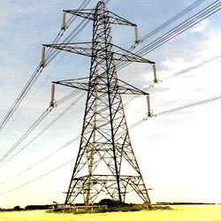
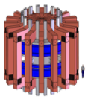
Generating Electricity from Fusion Energy Requires Resolution of Three Scientific/Technological Challenges
Creating and Sustaining a Fusion Power Source
Approximate Technical Readiness Today
Materials to Survive in the Fusion Environment
Fusion Electricity
Fuel Self-Sufficiency & Harnessing Fusion Power
Technical Readiness Level (TRL)
Imaginable
Plausible
Feasible
Practical
1
2
3
4
5
6
7
8
9

Slide 4
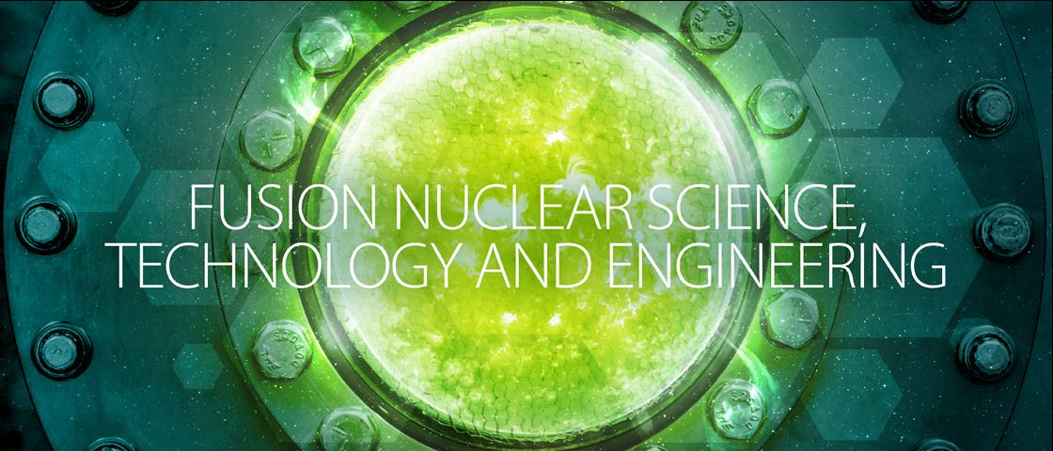


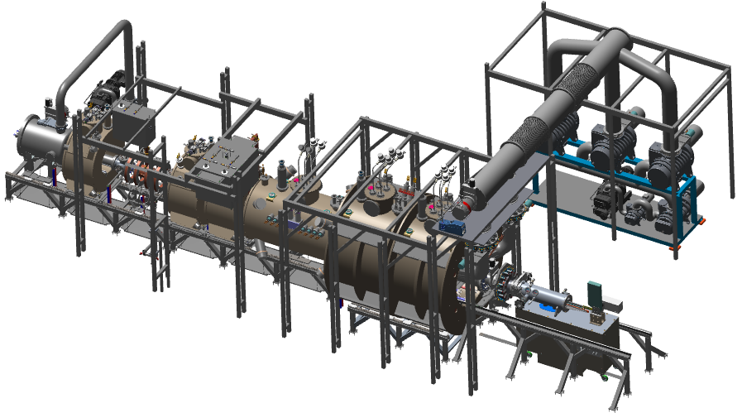
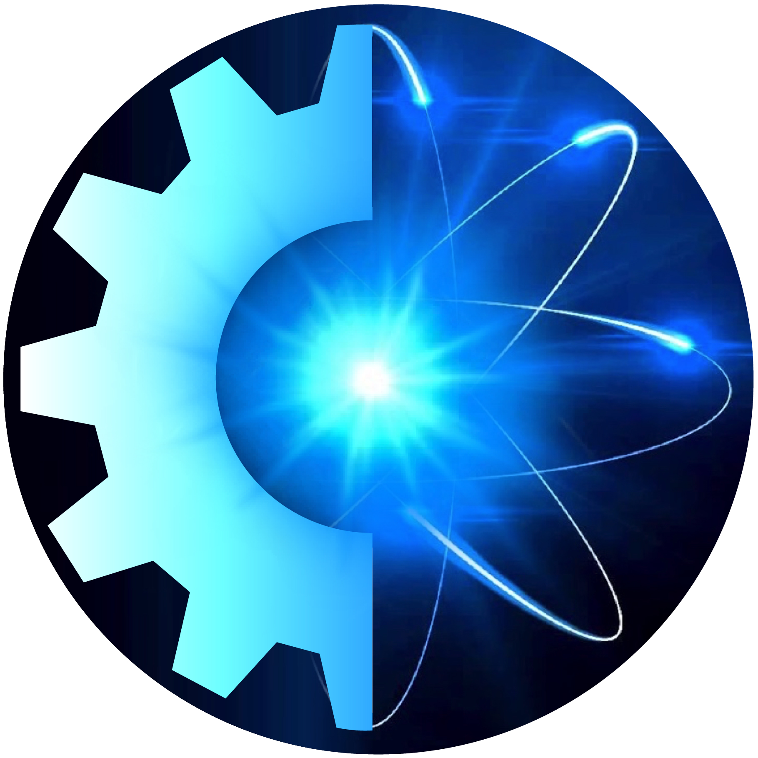
ORNL Fusion Program Is Fully Aligned with Priorities Identified in Community Plan
Integrated Fusion Systems
ORNL FUSION ENERGY DIVISION
Public and Private Partnerships
PR-A: (FPP)
PR-C: (Public-Private Partnerships)
Plasma Material Interactions Science
MPEX
PR-B: (ITER)
SO-A: (PFCs)
SO-B: (Materials)
Blanket & Fuel Cycle
Fusion Technology
Fusion Engineering
Remote Systems
Power Exhaust & Particle Control
Advanced Tokamak Physics
Plasma Theory & Modeling
Diagnostics & Controls
SO-C: (Blankets/ Tritium)
SO-F: (Innovate Technology)
PR-A
SO-A: (PFCs)
SO-G: (Licensing, Power Plant Technology)
SO-A: (PFCs)
SO-D: (Tokamak Physics)
PR-D: (Modeling)
PR-E: (Diagnostics)
Community Plan priorities

Slide 5
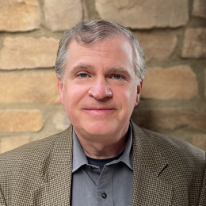
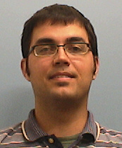
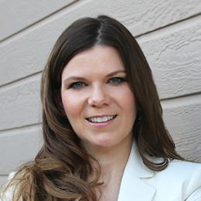
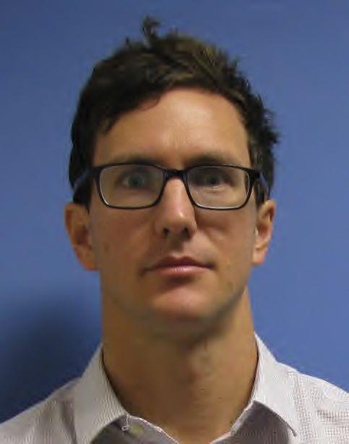
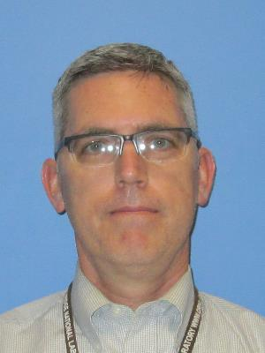
ORNL – Building the Foundations for Burning Plasma Operation
Integrated Fusion Systems
ORNL FUSION ENERGY DIVISION
Public and Private Partnerships
Leverage existing experiments to resolve urgent physics issues needed for ITER and FPP
Power exhaust and particle control solutions
Integrated scenarios combining core performance with exhaust management
Transients: disruption mitigation physics, ELM control
Development and validation of theory and simulation woven throughout
Deliver physics basis for high-power density confinement solutions called for in NASEM and community reports
Plasma Material Interactions Science
MPEX
Phil Snyder
Blanket & Fuel Cycle
Fusion Technology
Fusion Engineering
Remote Systems
Power Exhaust & Particle Control
Advanced Tokamak Physics
Plasma Theory & Modeling
Diagnostics & Controls
Zeke Unterberg
Cami Collins
David Green
Ted Biewer

Slide 6
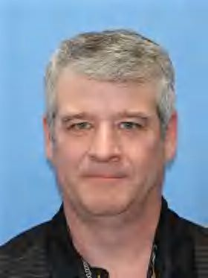
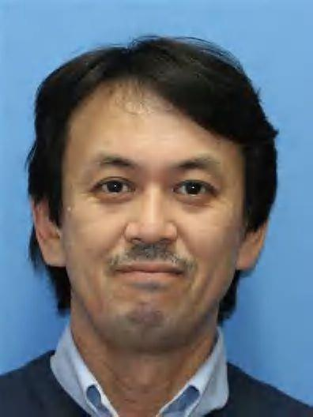
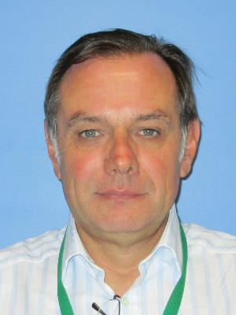
ORNL – Delivering Materials for the Extreme Fusion Environment
Integrated Fusion Systems
ORNL FUSION ENERGY DIVISION
Public and Private Partnerships
Deliver MPEX project on time, on budget, and on spec
Establish world leadership in fusion PMI science
Leverage collaborative network to develop foundational basis for in-situ material erosion, migration, and impact
Play key role in construction of a Fusion Prototypic Neutron Source
Establish world leadership in fusion neutron effects
Deliver new materials that meet the stringent requirements of fusion systems and the science important to the performance of those materials
Plasma facing materials/components, structural materials, thermal/electrical insulators, magnet conductors, fusion-tolerant sensors, ….
Plasma Material Interactions Science
MPEX
Phil Ferguson
Blanket & Fuel Cycle
Fusion Technology
Fusion Engineering
Remote Systems
Power Exhaust & Particle Control
Advanced Tokamak Physics
Plasma Theory & Modeling
Diagnostics & Controls
Yutai Kato
Juergen Rapp

Slide 7
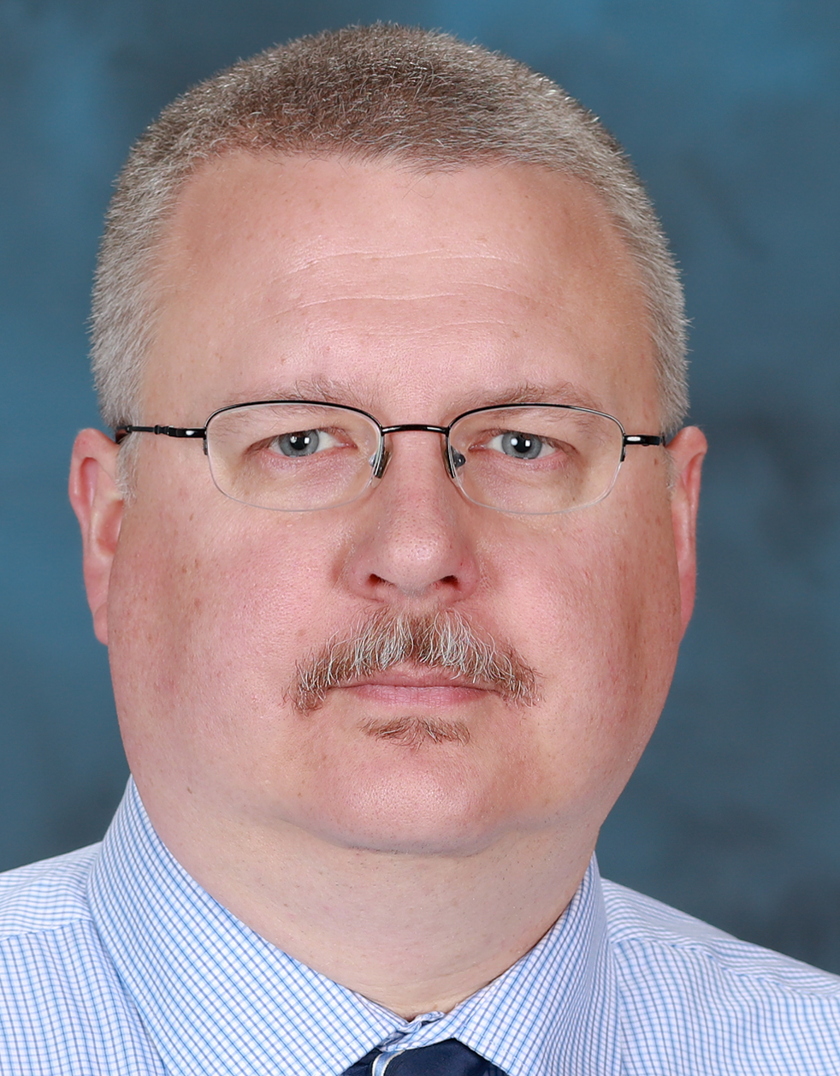
ORNL – Providing Fusion Technology Solutions for an FPP
Integrated Fusion Systems
ORNL FUSION ENERGY DIVISION
Public and Private Partnerships
Establish basis for high-pressure helium cooling (He Flow Loop)
Lead development of steady-state fueling and fusion fuel cycle
Pursue enabling technology for RF, magnets, remote systems, fusion nuclear diagnostics
Pursue technology-enabling facilities:
Blanket Component Test Facility (BCTF)
High Heat Flux Facility (HHF)
Chuck
Kessel
Plasma Material Interactions Science
MPEX
Blanket & Fuel Cycle
Fusion Technology
Fusion Engineering
Remote Systems
Power Exhaust & Particle Control
Advanced Tokamak Physics
Plasma Theory & Modeling
Diagnostics & Controls
Larry Baylor
Robert Duckworth
Arnold Lumsdaine
Venu Varma

Slide 8
ORNL – Engaging Fusion Private Industry to Accelerate Fusion Development
Integrated Fusion Systems
ORNL FUSION ENERGY DIVISION
Public and Private Partnerships
Our Pilot Plant vision: public-private venture that leverages capabilities of both sectors to deliver timely completion at acceptable risk
For 2040s delivery, build out of infrastructure will need to begin in the 2020s
ORNL is establishing a streamlined policy for private firms to site fusion activities on the ORNL reservation
Akin to INL procedure for fission facilities
Draft policy has been developed – now working with Lab and DOE Site Office to finalize
Plasma Material Interactions Science
MPEX
Blanket & Fuel Cycle
Fusion Technology
Fusion Engineering
Remote Systems
Power Exhaust & Particle Control
Advanced Tokamak Physics
Plasma Theory & Modeling
Diagnostics & Controls

Slide 9
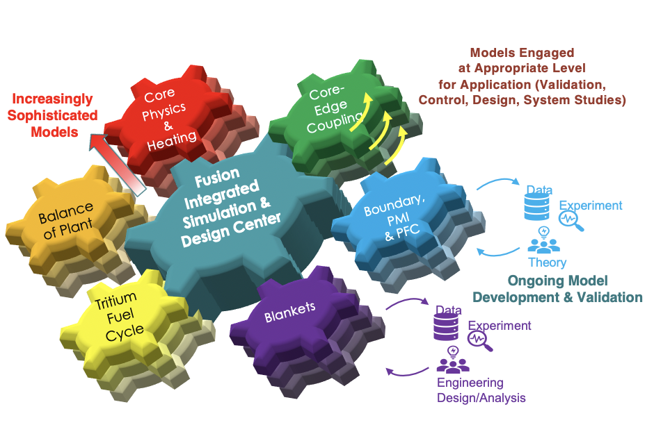
ORNL – Advancing Integrated Simulation/Design for Fusion
Integrated Fusion Systems
ORNL FUSION ENERGY DIVISION
Public and Private Partnerships
Fusion Integrated Simulation for Design Center (FISDC)
Translate fundamental knowledge into workable designs
Leverage enhanced computation for ITER operation and FPP/EXCITE design
Engages community widely
National: Physics and engineering design teams → optimized design
Institutional: Module development and validation → improved basis
Public/Private: State-of-the-art tools for designing and evaluating new concepts/ideas
Plasma Material Interactions Science
MPEX
Blanket & Fuel Cycle
Fusion Technology
Fusion Engineering
Remote Systems
Power Exhaust & Particle Control
Advanced Tokamak Physics
Plasma Theory & Modeling
Diagnostics & Controls

Slide 10
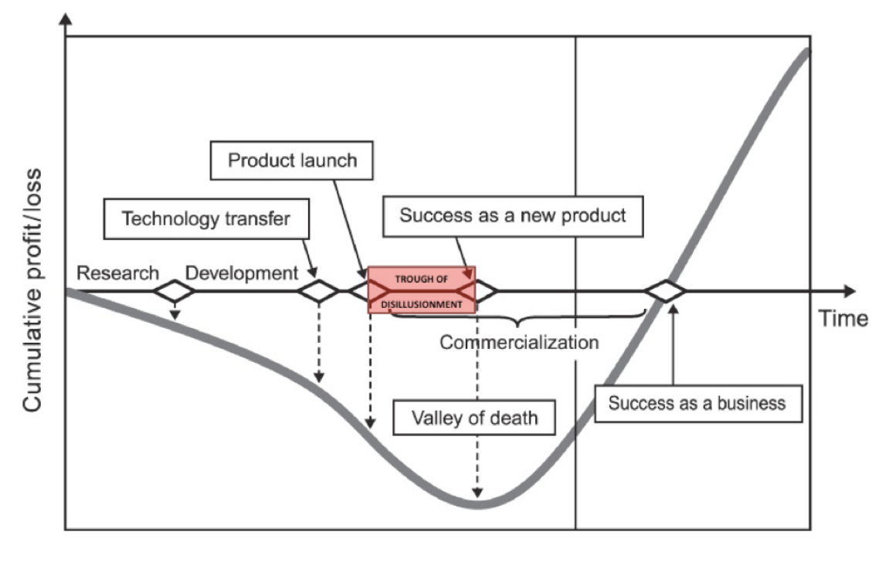
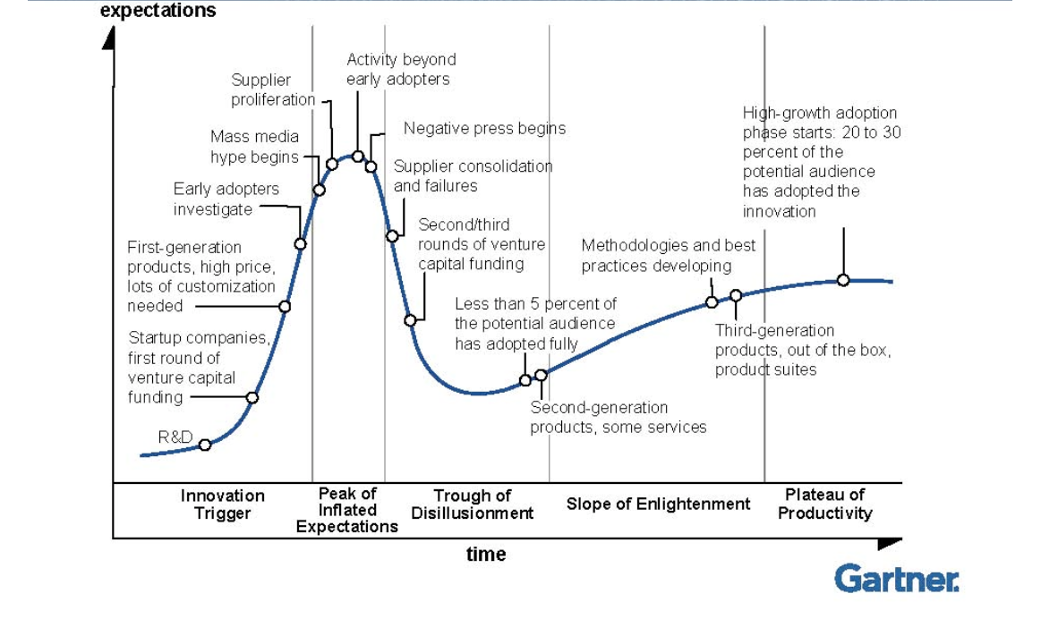
Public Program Essential in Assisting Private Firms in Maintaining Positive Investor Expectations While Reducing Cumulative Investment Requirements
Expectations generally overestimate near-term potential / underestimate long-term potential
Profit/Loss ”Valley of Death” typically coincides with lowest point in expectations
Publicly supported program important in:
Delivering cost-attractive technical approaches with potential to limit depth of “Valley of Death”
Maintaining positive expectations for fusion through continued improvements in performance capabilities of the end-product

Slide 11
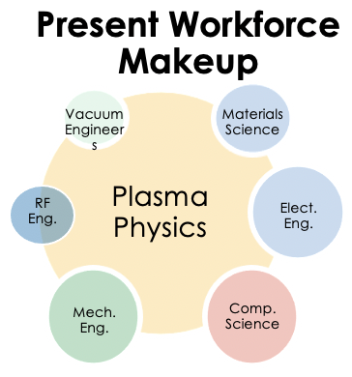
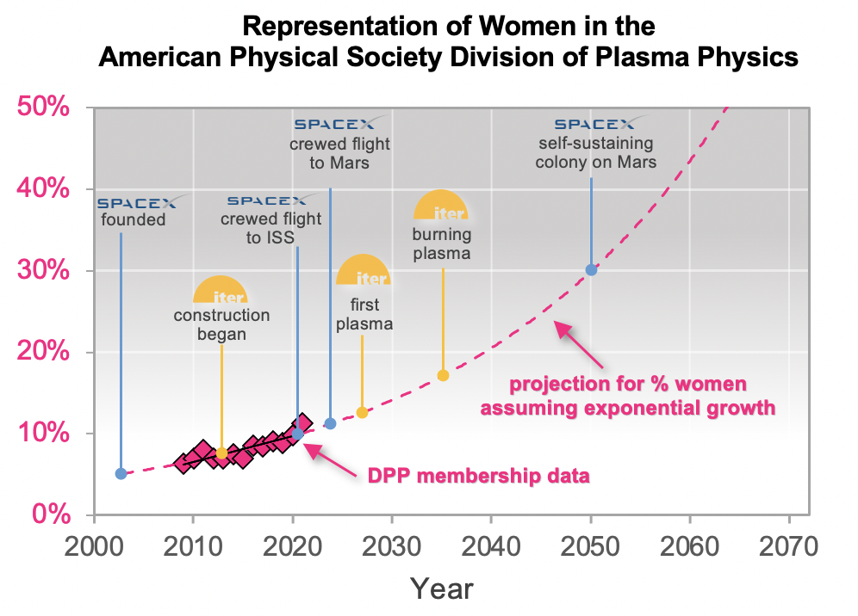
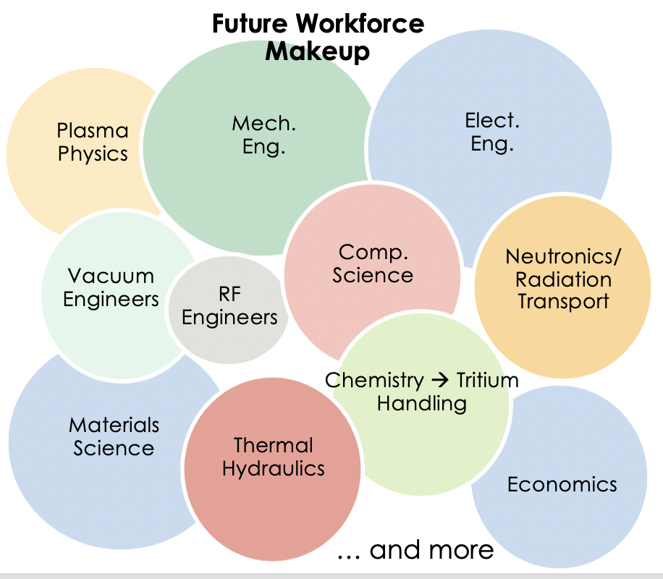
Aggressive Development of Fusion Will Require Rapid Diversification of Expertise Base
Must Diversify
Technically
Only possible if we aggressively pursue a culture that fosters gender/ethnic diversity in attracting, retaining, and promoting experts from a wide range of fields

Slide 12
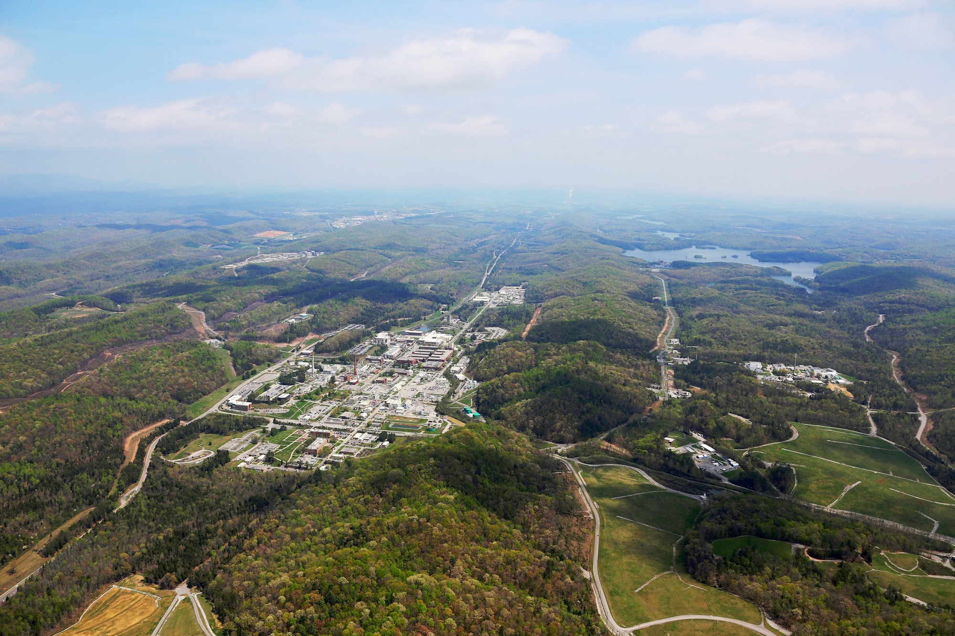
ORNL Has the Capabilities and Interest to Host a Future Fusion Pilot Plant and Demonstration Facilities
Our Vision: Fusion energy – the clean electricity source of choice for this generation and beyond
Our Capabilities:
Multiple siting options with access to required water and electricity needs
Demonstrated capability to host major projects
Broad range of technical capabilities important to pilot plant success
Aerial view of ORNL

