Slide 1
ICF Research at the University of Rochester’s Laboratory for Laser Energetics
Dr. Mike Campbell, Director
42nd Annual Meeting of Fusion Power Associates
December 15⎼16, 2021

Slide 2
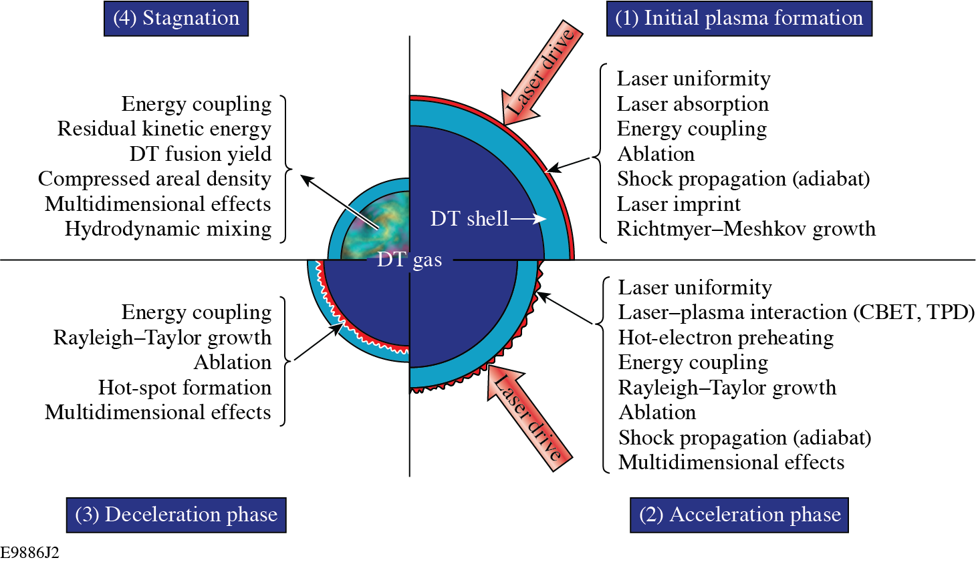
Research in laser direct drive (LDD) includes multidiscipline expertise, multiple facilities, and integration of broad areas of science and technology
Positive Features of LDD
  Efficient coupling of laser energy to target
    Lower pressure for ignition
      (P_{ig})^{th} ~(E_{hs})^{-1/2}
      Lower convergence (~20-25)
      Higher adiabat
    Higher potential gain
    Innovative approaches
      Shock ignition
      Magnetic fields
    Diagnostic access (3-D)
Challenges for LDD
  Hydrodynamic instabilities
    Laser imprinting
    Electron driven ablation
      Higher RT growth rates
      Thin shells
  Laser plasma instabilities
    Cross beam energy transport (CBET)
    2 ω_{pe} , stimulated Raman scattering (SRS)
OMEGA
Omega, NIF,NIKE
OMEGA
Omega, NIF

Slide 3
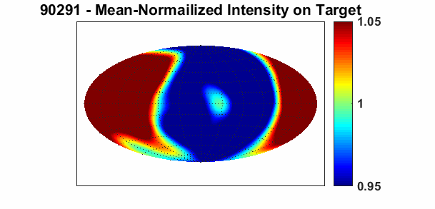
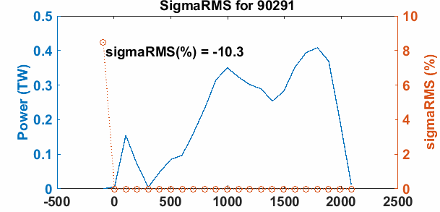
The on-target laser drive uniformity of OMEGA is being improved and quantitively diagnosed
On-target, overlapped intensity (100 ps avg)
based on laser power measurement
Normalized signal
90921
Time histories of ave. laser power per beam and σ_{RMS} for overlapped, on-target intensity
90921
(100 ps bins)
Time (ps)
Full-beam In-tank (FBIT) measurements inside the target chamber have begun.

Slide 4
Experiments and “first principle modeling of plasma formation”¹ are underway to quantitatively understand laser imprint and develop mitigation strategies
The ≈20 fs, 450 nm probe pulse propagates through the region of the sample exposed to the 355 nm, ≈100 ps pulse
Images captured using the fs pulse as “strobe illumination” measure the plasma-induced absorption through the forming plasma region
Vacuum chamber
20 fs
90 ps
Ablator material
Experiment-modeling comparison
objective
camera
¹ Collaboration with CELIA

Slide 5
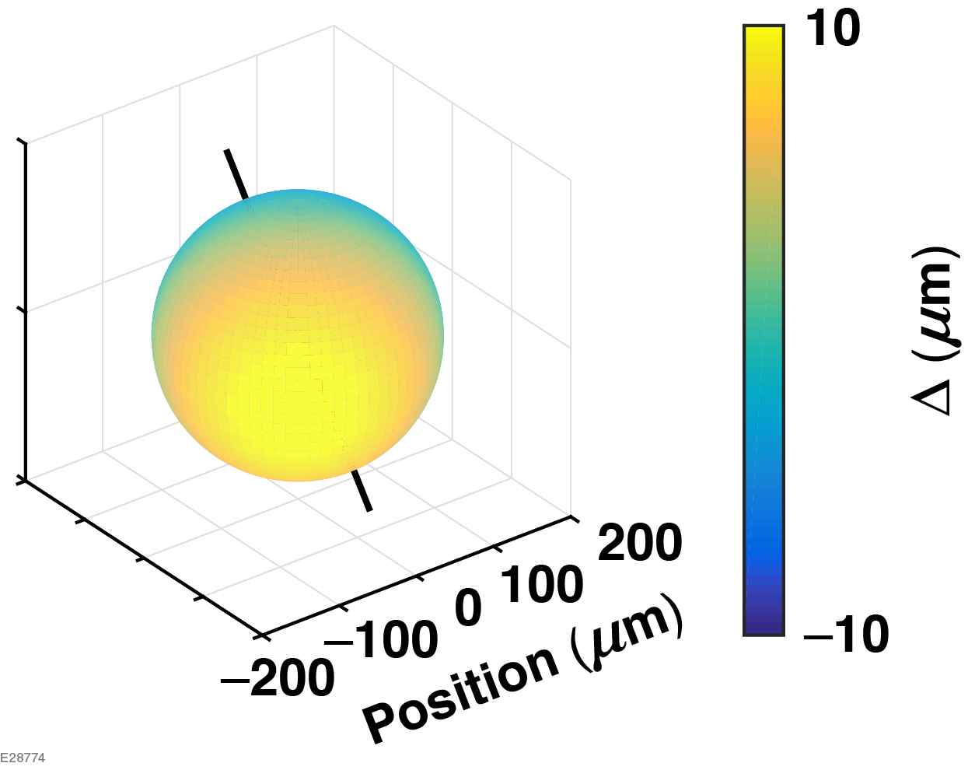
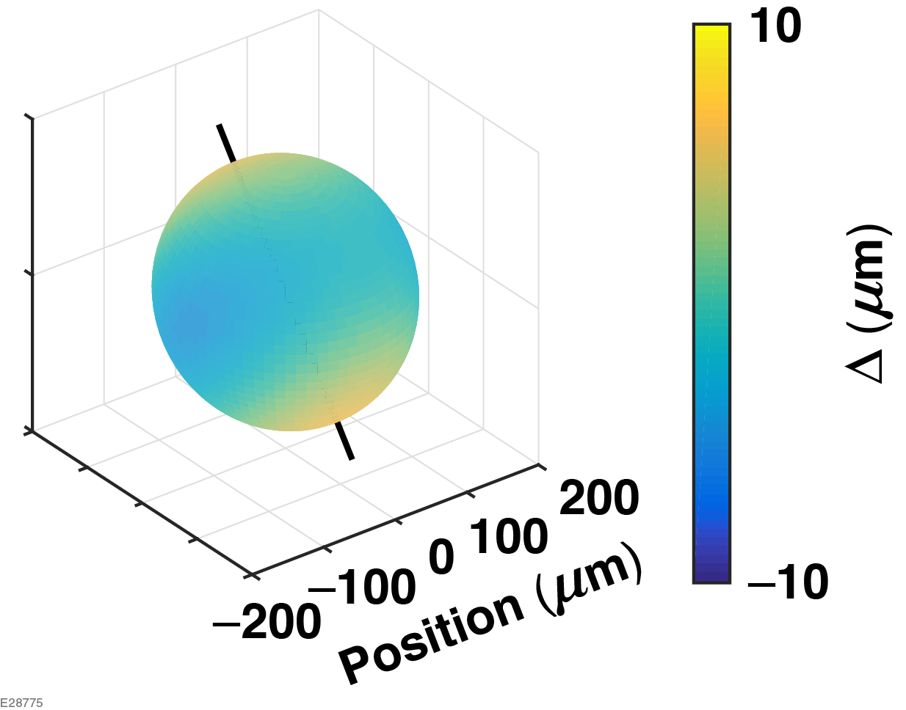
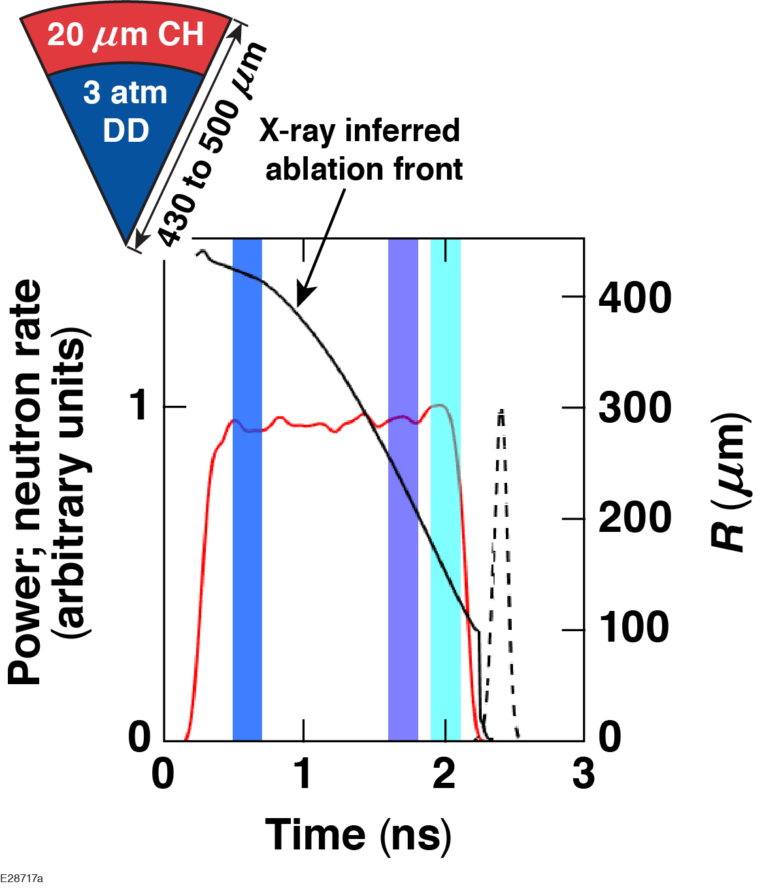
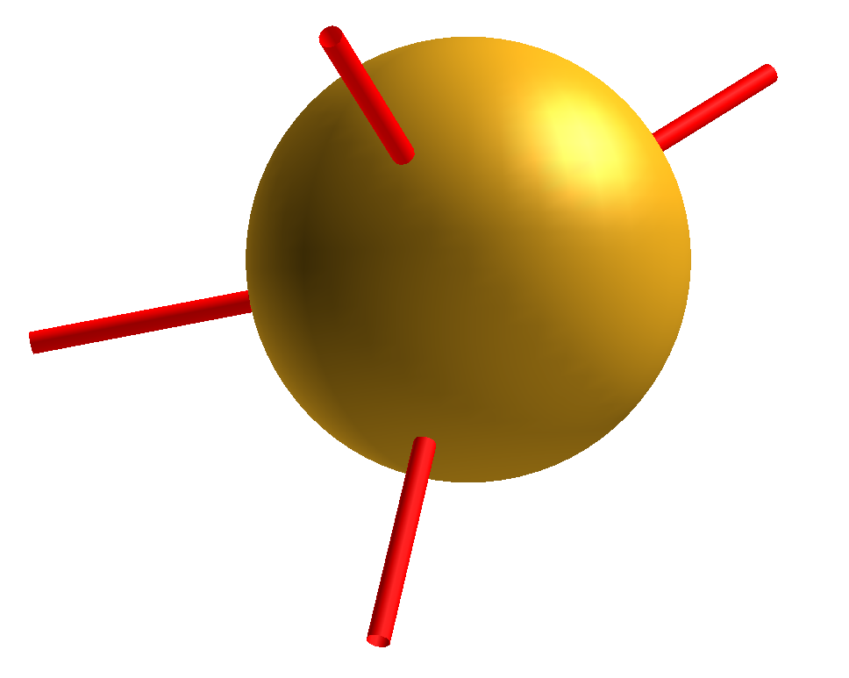
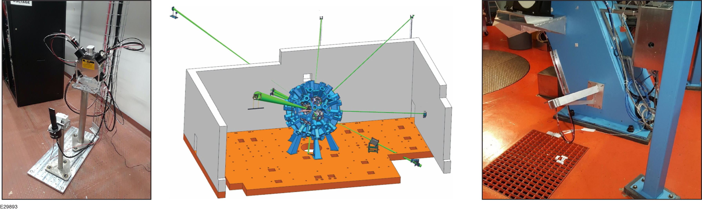
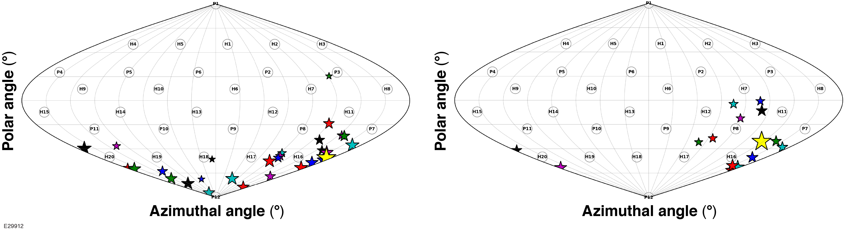


“3-Dimensional” measurements are required to understand implosion performance
Multiple LOS x-ray imagers
3-D in flight (CR ~ 3)
In flight
Drive uniformity
Radial location of ablation surface showing residual $ℓ$ = 1 mode
Radial location of ablation surface showing residual $ℓ$ = 2 mode
Multiple LOS Neutron time of flight
DT cryogenic target implosions
DT gas-fill plastic shell implosions
Stagnation (residual kinetic Energy)
Average direction (𝜽,𝝓) = (142°,171°)
Average direction (𝜽,𝝓) = (128°,133°)

Slide 6

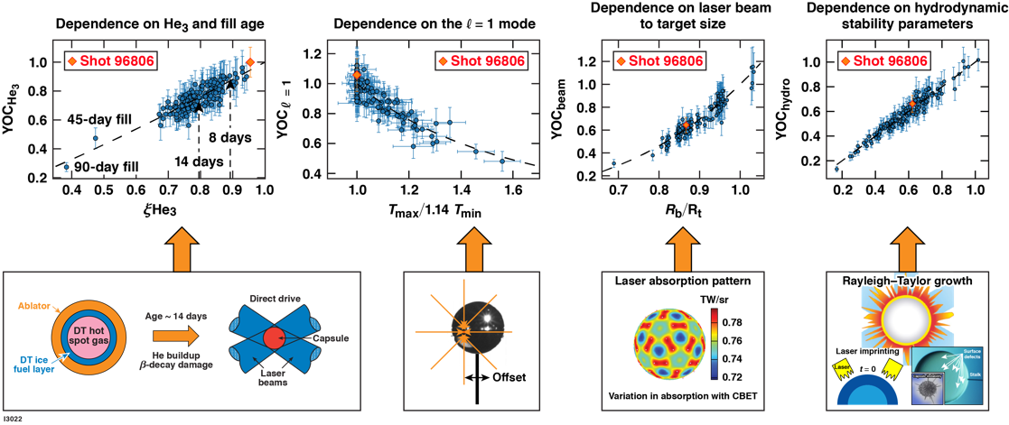
Statistical modeling of systematic OMEGA experiments, 3-D diagnostics and simulations have successfully improved performance and developed an understanding of implosion degradation mechanisms
$$α^{0.8}{\hat{T}}_{rel}^{2.6}{\hat{T}}_{c}$$
Experiments on “Present day” NIF to study laser–plasma coupling in ignition scale plasmas to date have been encouraging, increase understanding, and exercise modeling/simulation tools.

Slide 7
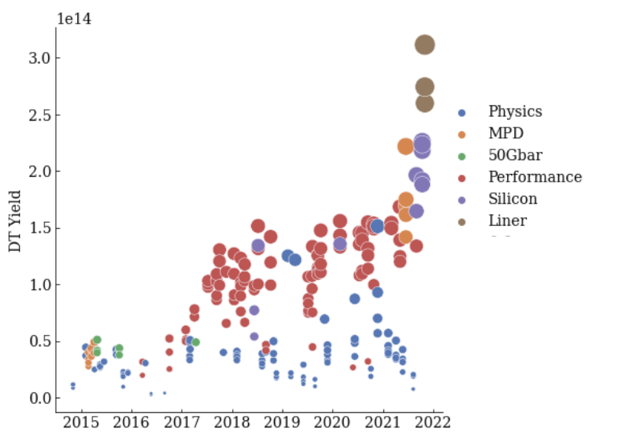
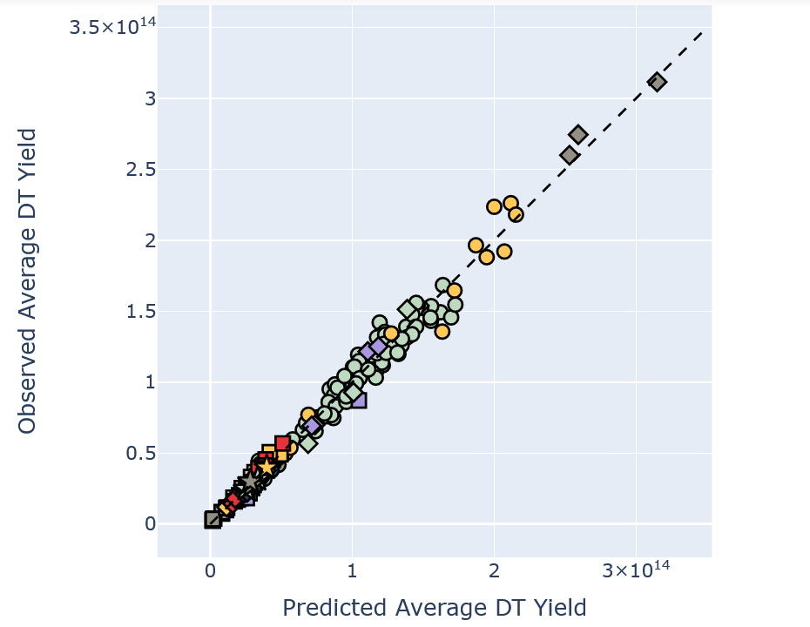
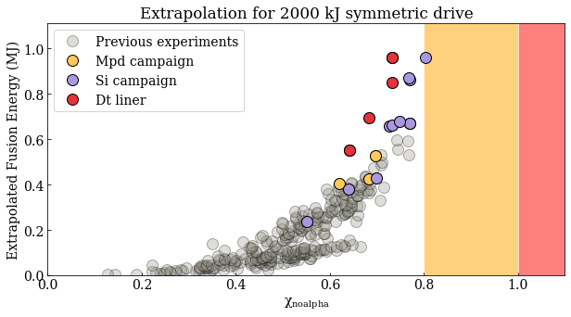
Recent OMEGA DT cryogenic implosion campaigns produced the highest yields (3.1 E14 DT) and highest scaled (NIF energies) Generalized Lawson Criteria (GLC) ~0.8 and fusion yield/shell kinetic energy ~0.9 (targets: convergence ~18, adiabat >4)
Measured neutron yield vs. time
Statistical modeling (SM) predictions*
vs. Measured neutron yield
Extrapolated fusion yield
vs. GLC (χ_{no-α})
Burning Plasma
Ignition
The improved performance is based on using the insights from the SM to reduce the impact of degradation mechanisms** (LPI, ,low mode drive asymmetry, hydro, beta decay) through innovative target designs.
_______________
*V. Gopalaswamy et al., “Tripled Yield in Direct–Drive Laser Fusion Through Statistical Modelling,” Nature 565 (7741), 581-586 (2019).
**A. Lees et al., “Experimentally Inferred Fusion Yield Dependencies of OMEGA Inertial Confinement Fusion Implosions,” Phys. Rev Lett. 127, 105001 (2021).

Slide 8
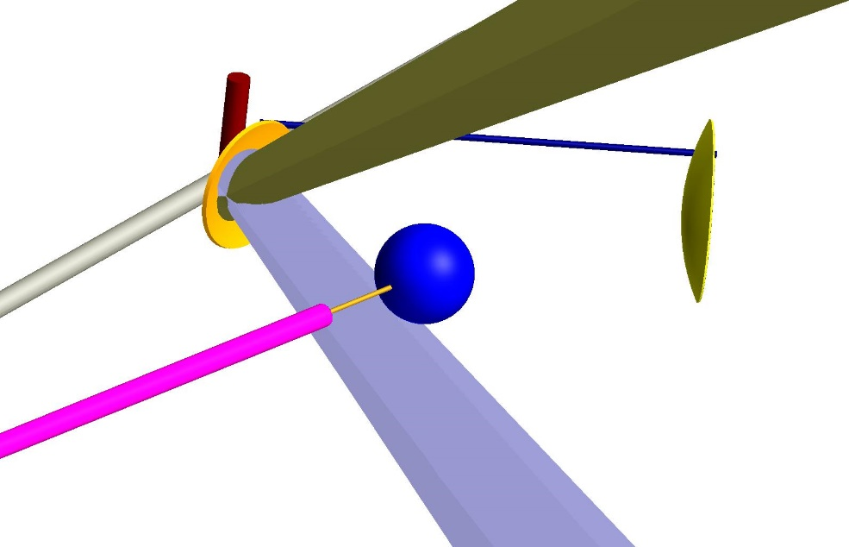
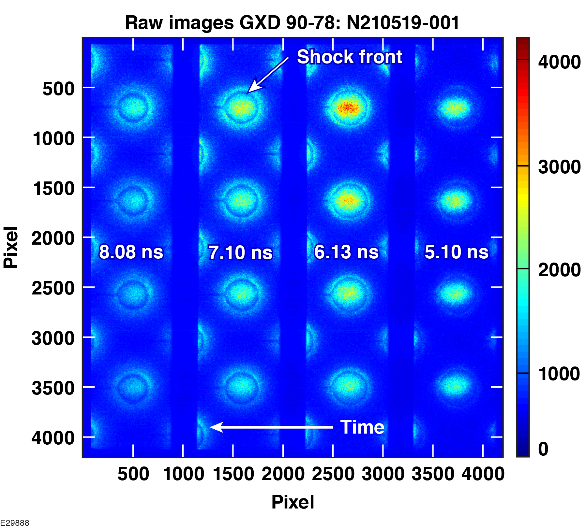
Energy-coupling experiments relevant to LDD ignition-target designs are being conducted on the NIF using a spherical, solid-plastic target
4 beams
Time-gated x-ray radiographs of converging shock
Cu backlighter foil
Au shield for DIM-90-124
Solid CH sphere (2.1-mm diameter) driven by 184 beams
4 beams
Solid spheres offer the advantage of quantifying energy coupling without the challenges from hydrodynamic instabilities of thin-shell implosions

Slide 9
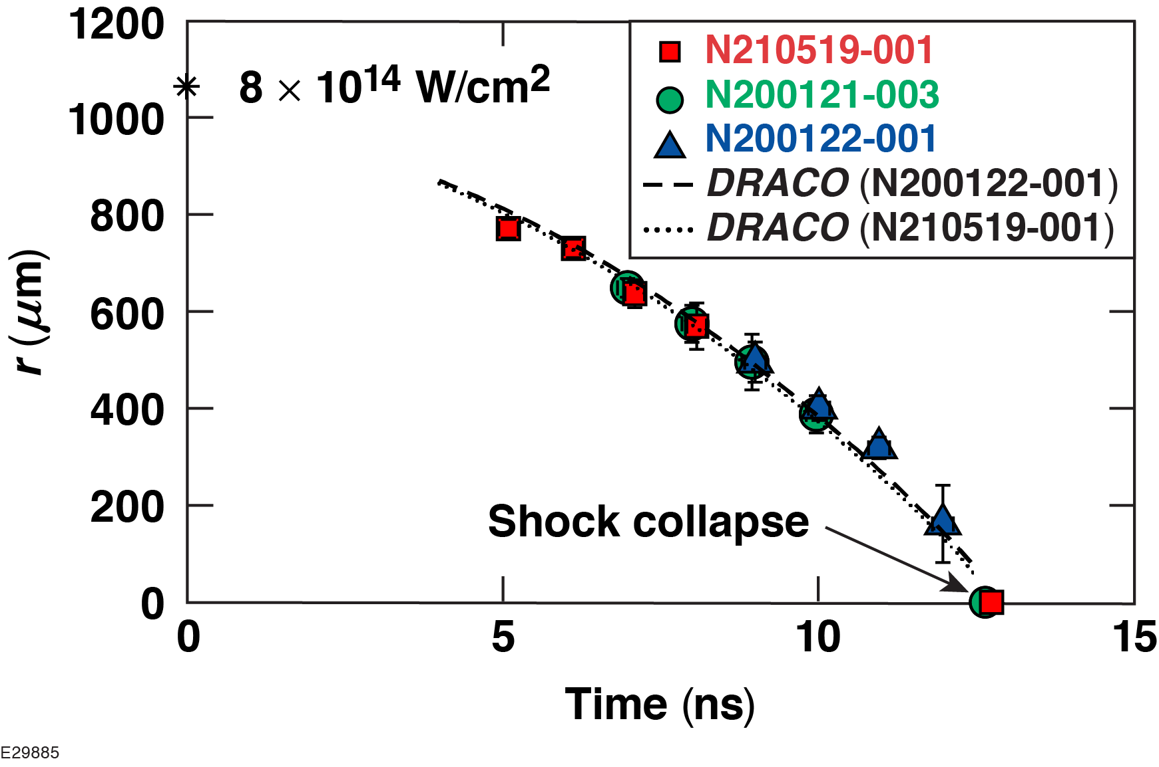
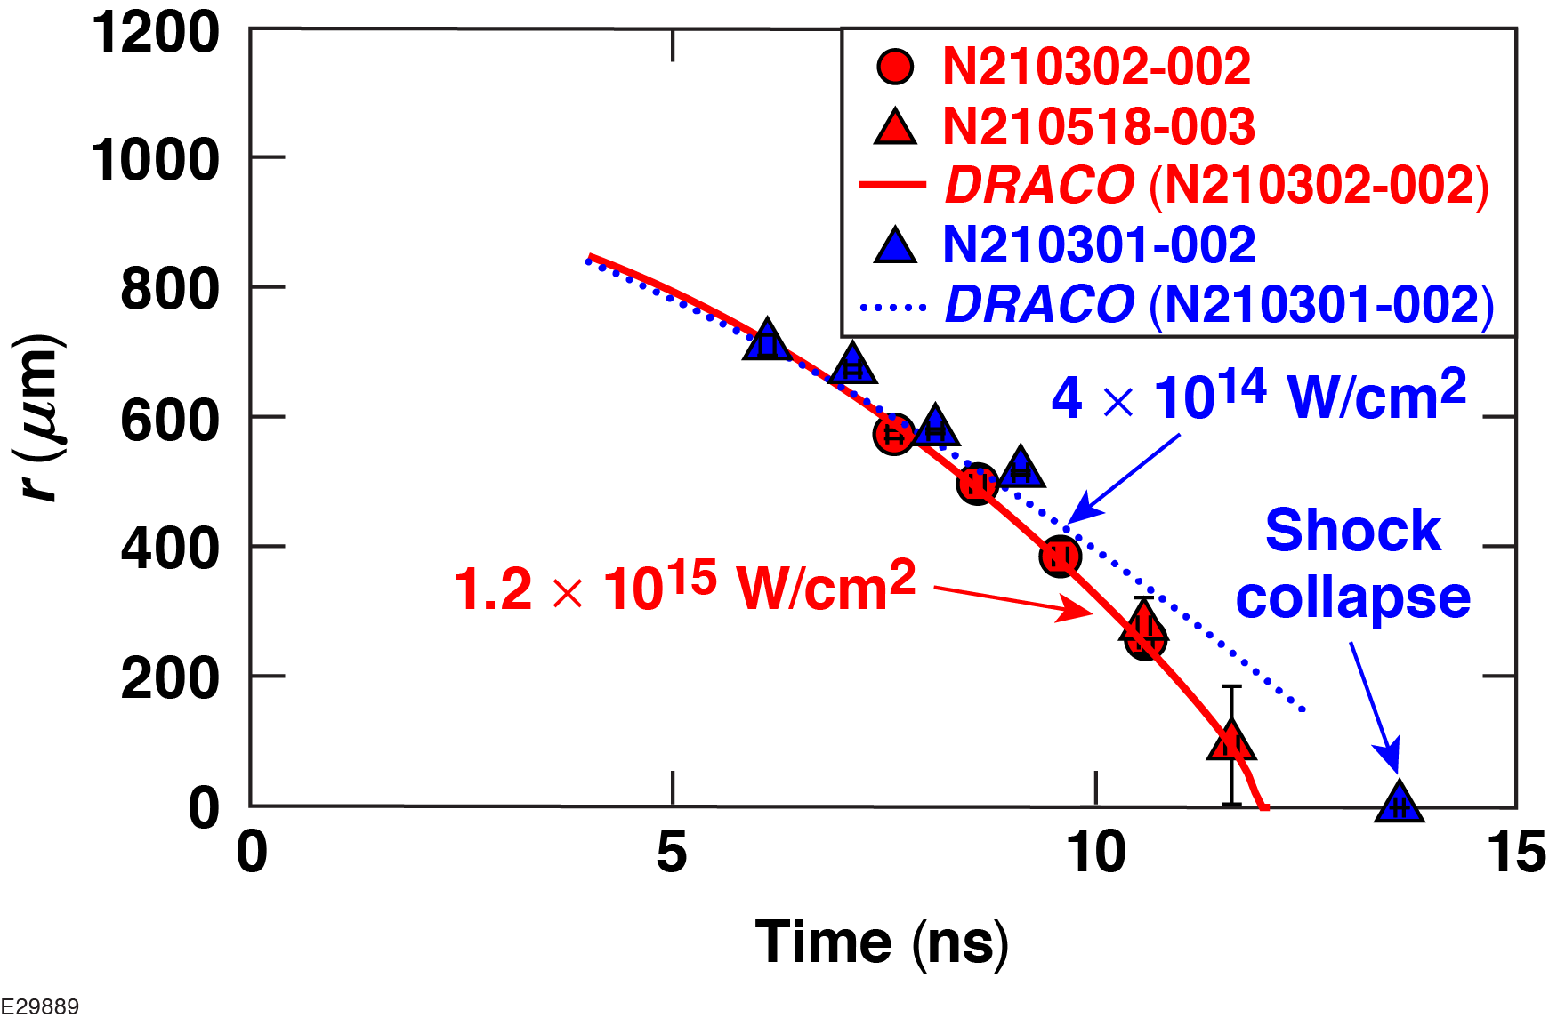
2-D DRACO simulations using CBET and nonlocal heat-transport models predict accurately the energy coupling diagnosed with shock-trajectory measurements at different intensities
Ongoing experiments will diagnose energy coupling through trajectory of multiple shocks and scattered light measurements* and use laser pulses where shock trajectory is more sensitive to CBET
*M. J. Rosenberg et al. Rev. Sci. Instrum. 92, 033511 (2021)

Slide 10
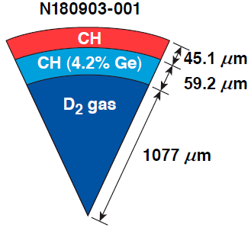
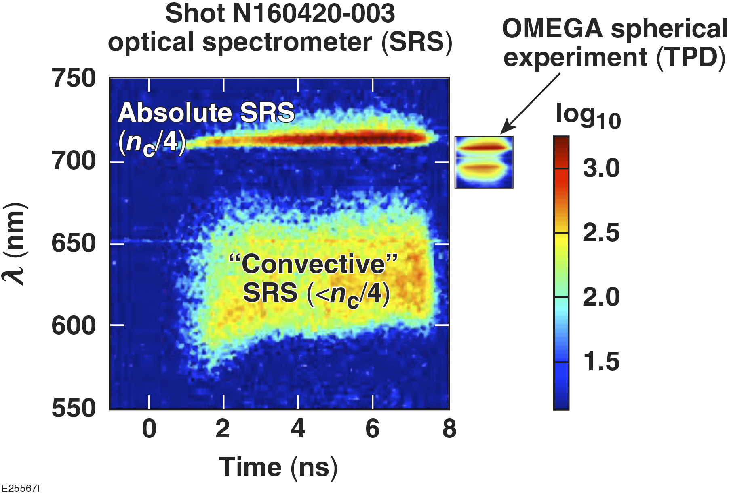
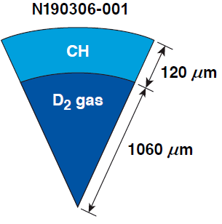
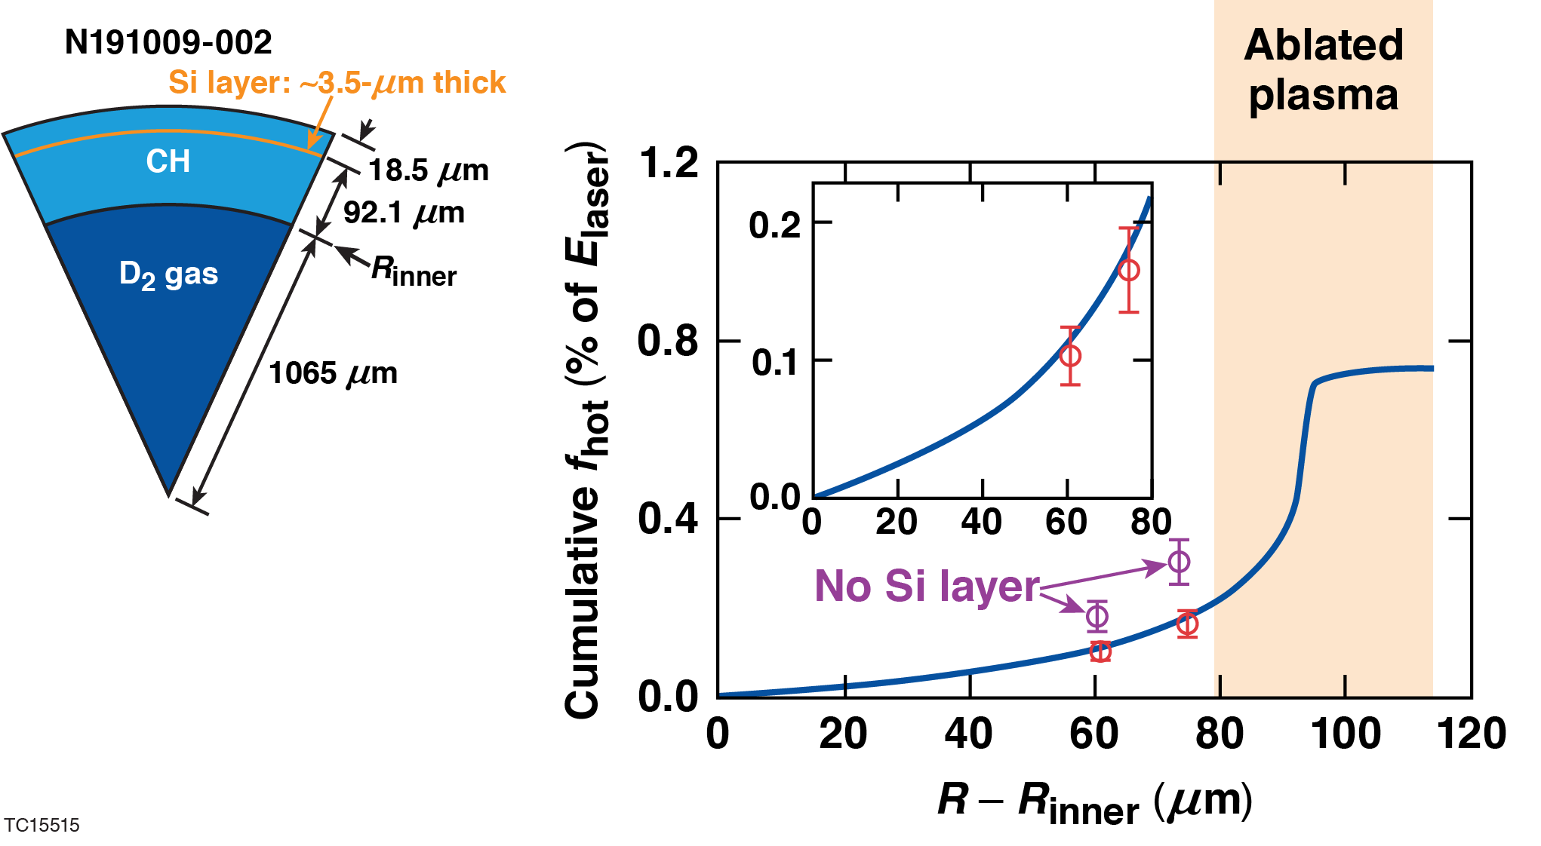
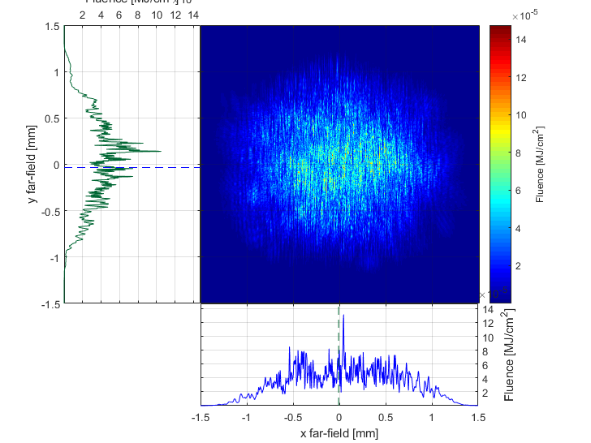
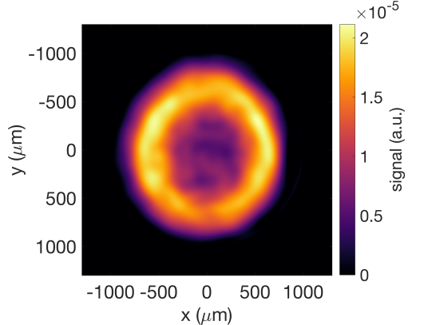
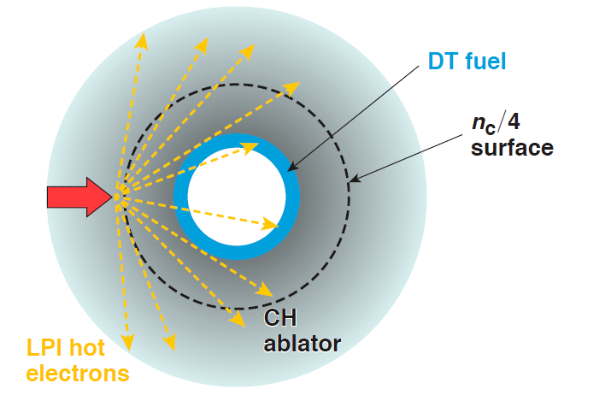
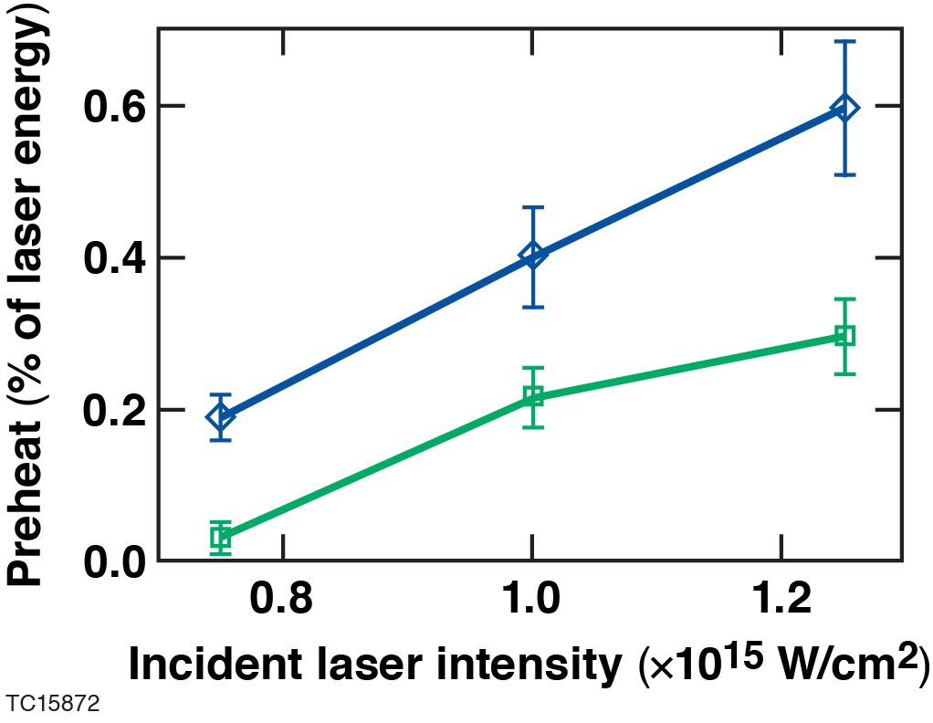
Energetic electron and transport; Hot electron preheat has been diagnosed in NIF PDD and OMEGA SDD implosions and demonstrate that target modifications using mid-Z layers can mitigate preheat
CH ablator
~50 keV x-ray image
CH ablator with a Si layer
NIF Beam quality makes this “worse case”

Slide 11
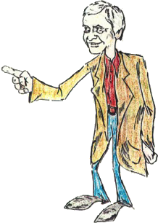
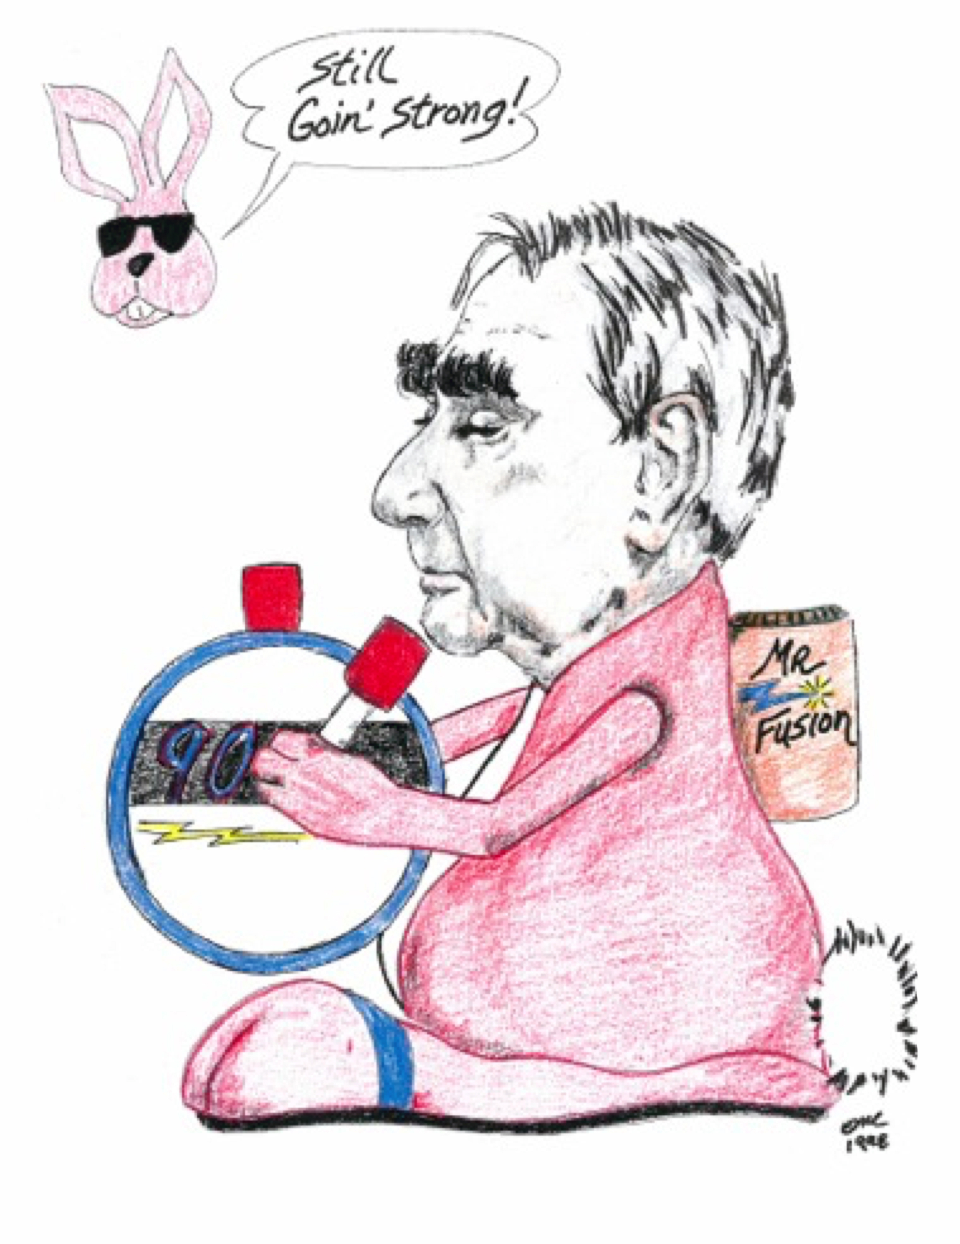
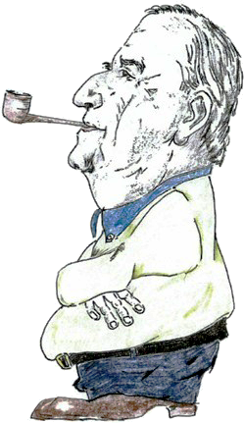
A conversation at LLNL in 1960
Edward, I think we can do fusion with this new invention, lasers!
Not if plasma physics gets in the way!
You should
be worried!
John Nuckolls
(“father of ICF”)
Edward Teller

Slide 12

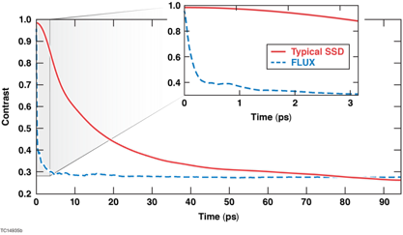
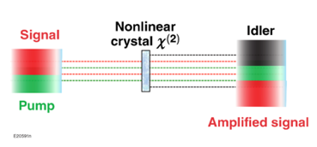
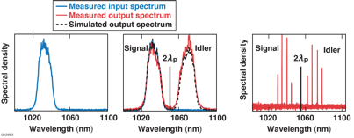
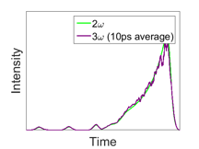
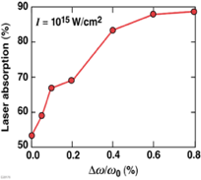
LLE is developing Broadband (>10 THz) UV lasers (FLUX) with flexible temporal formats to suppress LPI and laser imprint to expand parameter space for ICF and HEDP
Imprint reduction: ~picosecond beam smoothing
DKDP
Broadband input
Compensation gratings
Frequency conversion
Physics
Narrowband, temporally shaped 530-nm pump
Increased absorption (reduced CBET)
CH ablators
OMEGA
Bandwidth and spectral shaping
Temporal pulse shaping

Slide 13
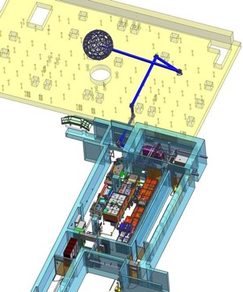
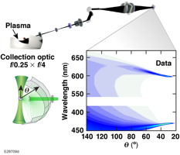
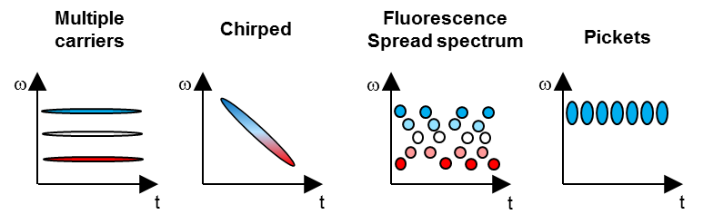
4th generation Laser experimental platform;
FLUX will be transported to OMEGA to provide independent plasma control, “coupling” beams, and extensive diagnostics
FLUX (Fourth-generation Laser for Ultrabroadband eXperiments)
Physics requirement | Specification
Central wavelength | 351 nm (3$ω$)
Fractional bandwidth Δ$ω$/$ω0$ | 1.5%
Pulse duration/shape | 1.5 ns/flat in time
Energy | 150 J
On-target power | 0.1 TW
Far-field size | Focusable to 100 $μ$m (with distributed phase plates)
On-target intensity | 10¹⁵ W/cm²
Multi-angle (120°) Thomson scattering
And……
Bandwidth formats
Stud-like

Slide 14
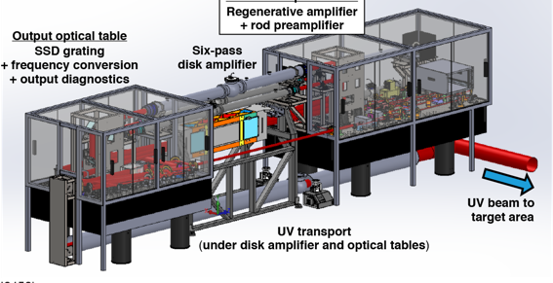
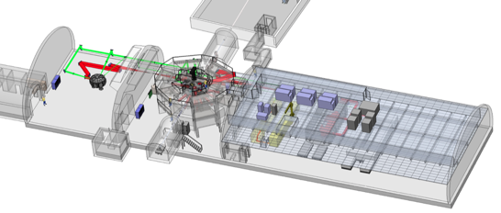
Building on our laser technology and expertise, LLE designs and builds high-power lasers for the HEDP community
LLE delivered a precision 0.1 kJ UV laser to Argonne National Laboratory and WSU
LLE will deliver a 1kJ green laser to SLAC as part of the Matter at Extreme Condition Upgrade (MEC-U) station at the xFEL
In addition to lasers, LLE has world class expertise in “all things optical”: coatings, gratings, laser damage, non-linear optics (frequency conversion, optical parametric amplification)

Slide 15
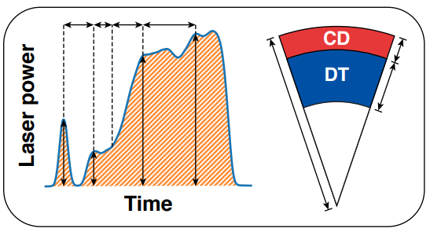
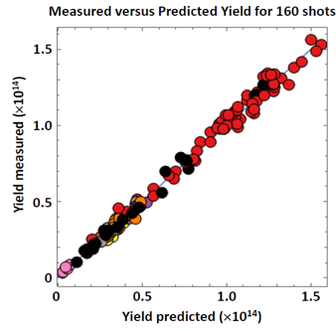
Looking to the future: ICF/HEDP research is data starvedimpacting the ability to exploit modern machine learning tools for improving fusion performance, exploring novel concepts, and increasing the quality and accuracy of HEDP
Data Driven Machine learning optimization (160 implosions over several years!)
Experimental input
Measured yield predicted from 1-D LILAC
parameters¹ (for 160 shots)
Future facilities must be designed with increased rep-rate but with values determined by the challenge/complexity of the experiment.

Slide 16
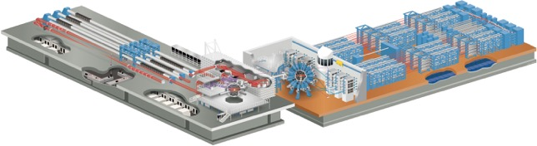
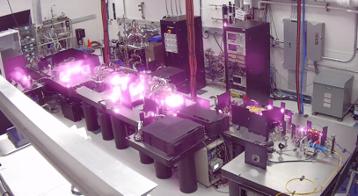
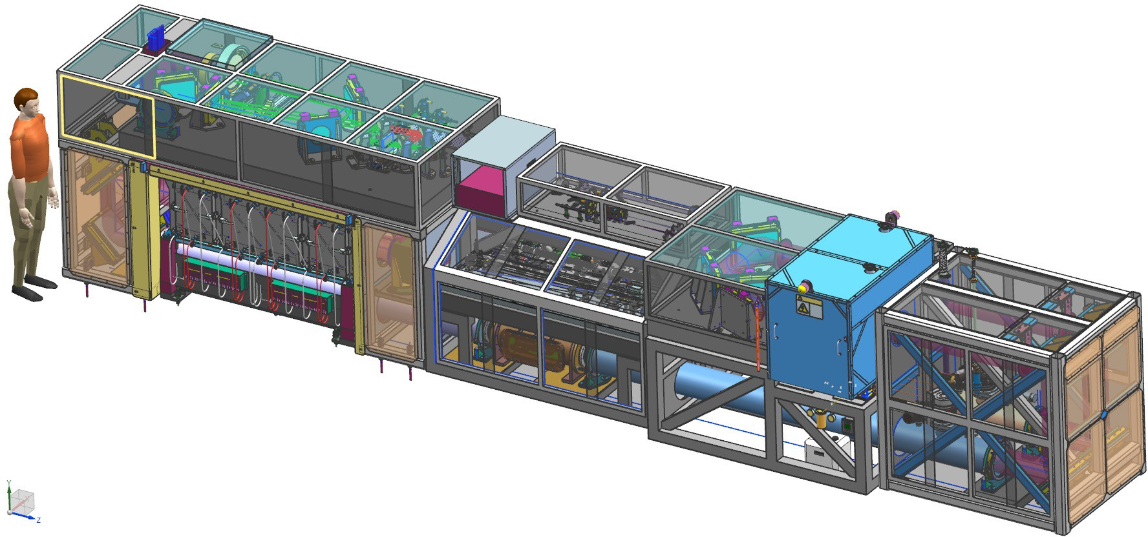
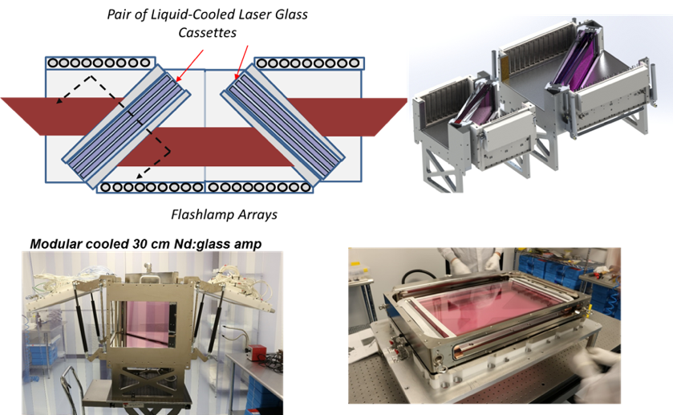
Looking to the future: Address the issue of “Data Starved” ICF/HED:
Today:
Omega facilities are HED workhorses (~2300 shots/yr) based on late 20th century laser S&T
5 to 10 Joules/beamline @10Hz (>1000s/day)
30-50 kJ total UV (“LPI free”) Beamlines ~ 100 to 1000 @~5 to10 minutes) >100/day
2030s:
+
Major improvements in operation technology/strategy, diagnostics, target fabrication will be required.

