Slide 1




Staged Z-pinch
(A Target for Fusion Energy)
Hafiz Ur Rahman
Magneto-Inertial Fusion Technology Inc. (MIFTI)
Tustin, CA, 92780
FUSION POWER ASSOCIATES
Magneto-Inertial Fusion Technology In.
University of California
San Diego
University of Nevada
Reno
Cornell University
Ithaca NY
Lawrence Livermore
National Lab
Lab for laser Energetics
University of Rochester
Prepared by LLNL Contract DE-AC52-07NA27344

Slide 2
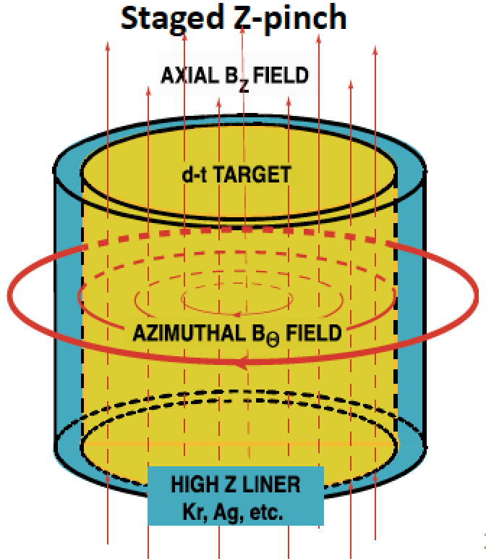
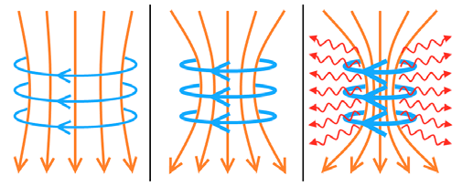
Staged Z--pinch Fusion Concept
Implosion of a Z-pinch
time
High-Z plasma liner Ar, Kr or Xe Implodes on a DD or DT target.
Stagnation of shock waves at interface creates secondary piston that compresses the target.
Shock waves also preheat the target plasma.
Target plasma remains stable during implosion.
This leads to a stable high energy density plasma relevant to fusion conditions.

Slide 3
Overview of the Staged Z-pinch
Implosion of a liner plasma onto a target plasma
Must have a high Z (radiative) driver
Control and mitigation of the RT-instability
Pre-Shock heating and adiabatic compression
Formation of high-energy-density, stable plasma
Real prospect for high net gain fusion-energy production
1. Rahman, et. al., Phys. Rev. Lett. 74, 714(1995)
2. Rahman, et. 1l., Physics of Plasmas, 58, 367 (1997)
4. Rahman, et al., Physics of Plasmas, 11, 5595 (2004)
5. Rahman, et. al., J. Plasma Physics, 75, 749 (2009)
6.Rahman, et. al., Astrophys. Space Sci. 323: 51-55 (2009)
7. Rahman, et. al., Physics of plasma, 19, 122701 (2012)
8. Rahman, et. al., Physics of Plasmas, 26, 052706 (2019)
9. Conti, et. al., Physics of Plasmas, 27,012702 (2020)
10.Ruskov, et. al., Physics of Plasmas, 27,042709 (2020)
11. Ruskov et. al, Physics of Plasmas, 28, 112701 (2021)

Slide 4
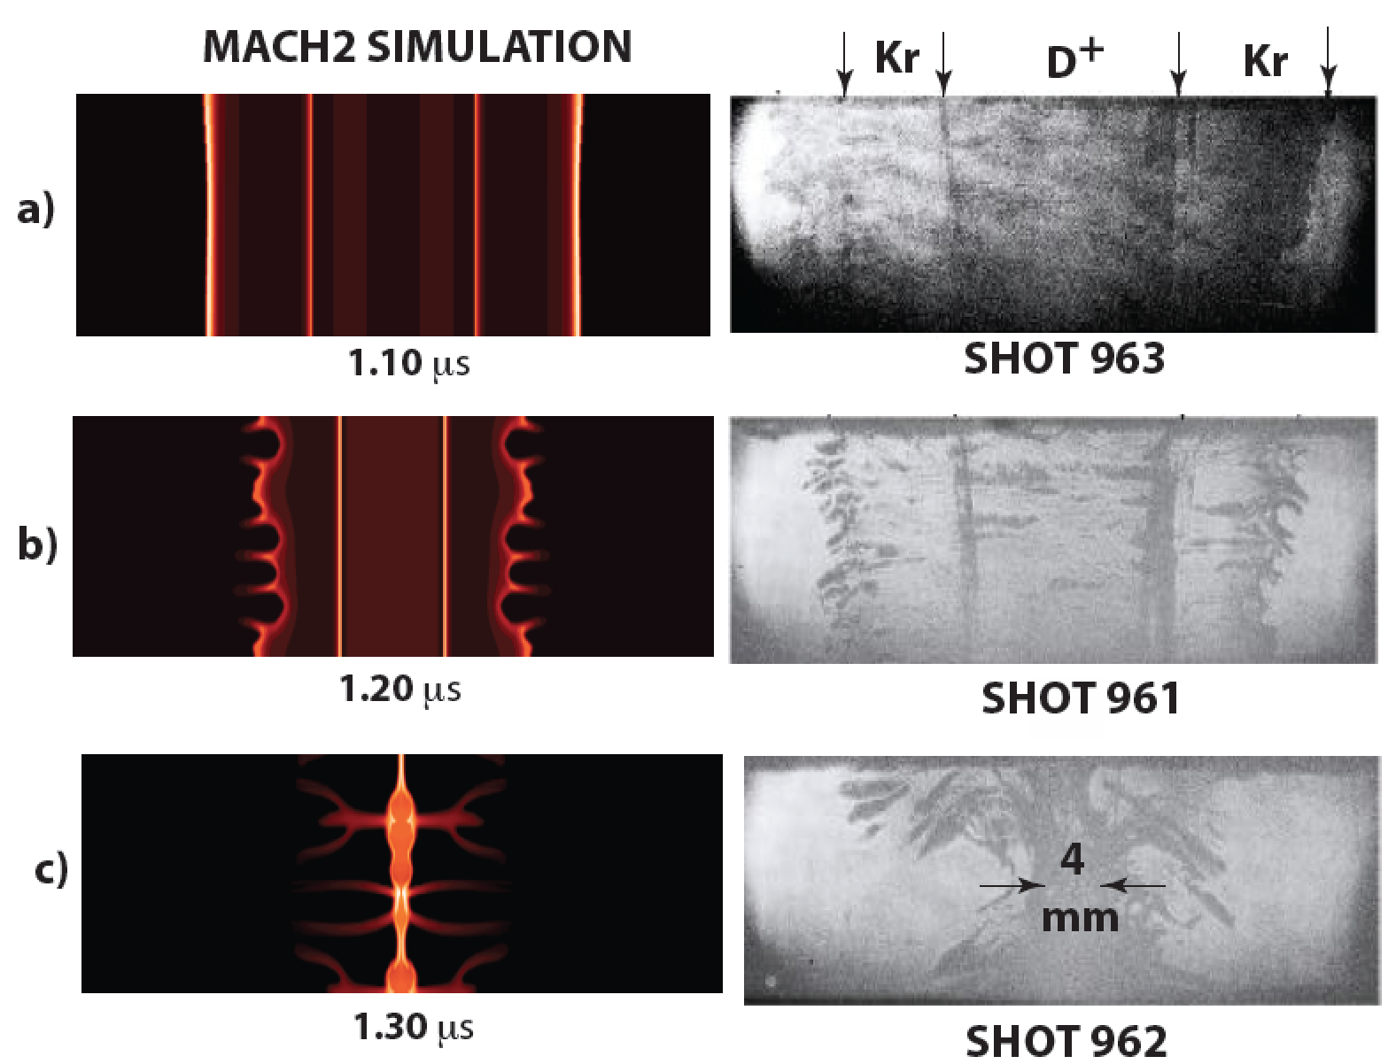
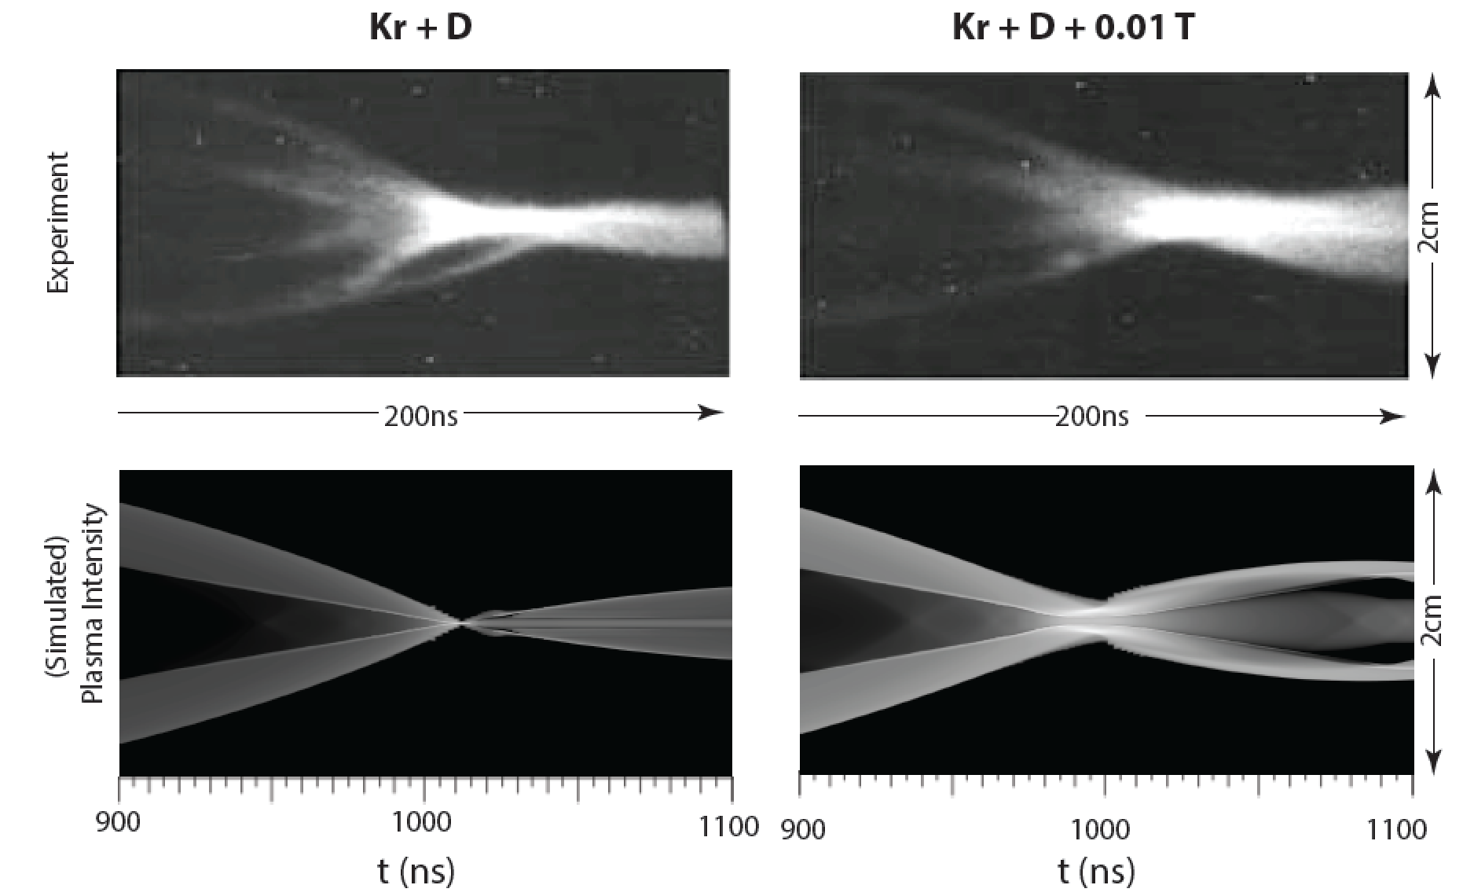
Staged Z-pinch Experiment on 1MA UCI Z-pinch (90’s)
Laser Shadowgraphs
Streak images
Liner shows surface instabilities due to MRT
Target remains stable during implosion

Slide 5
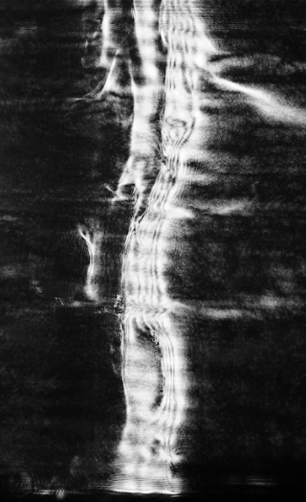
Shadowgraphs of Staged Z-pinch on four different machines
Kr on D
Kr on D
Target Plasma remains stable; although the MRT instability grows on the outer surface of the liner
Kr on D
Kr on H
CESZAR 2021
5

Slide 6
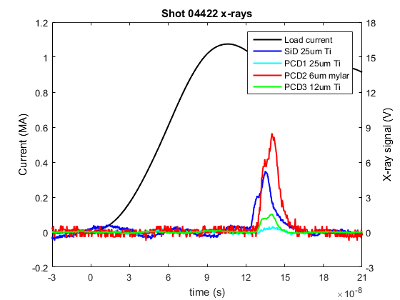
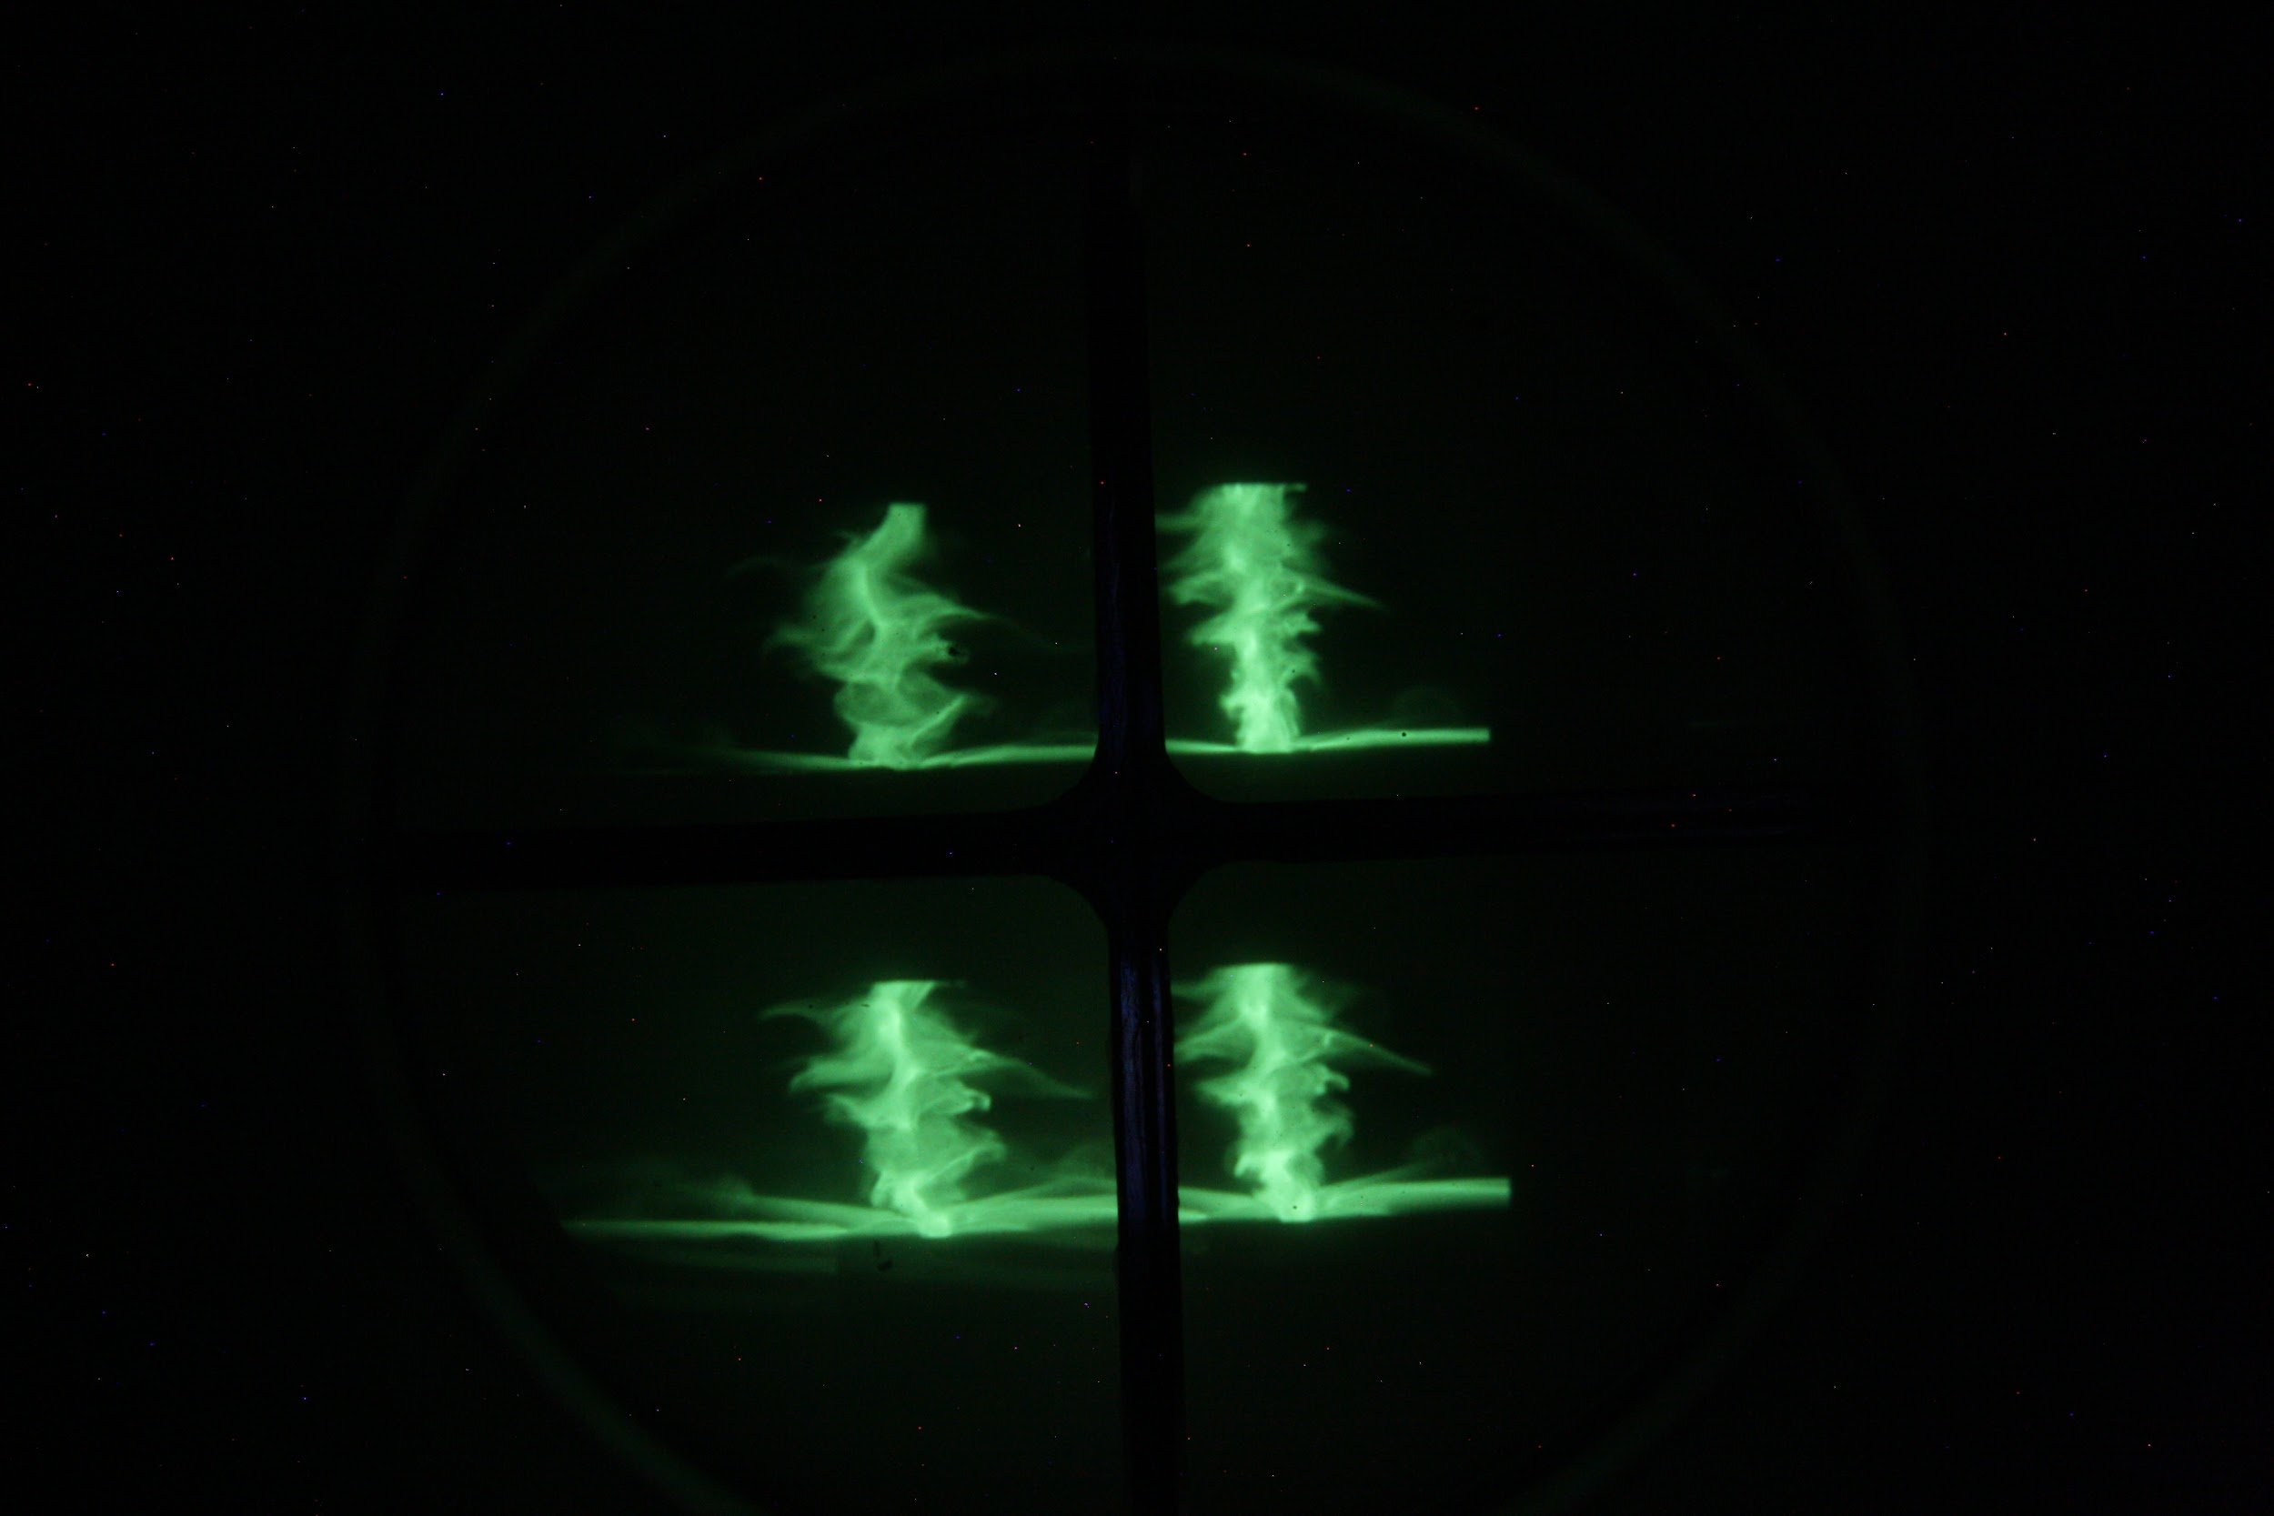
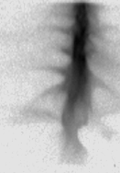
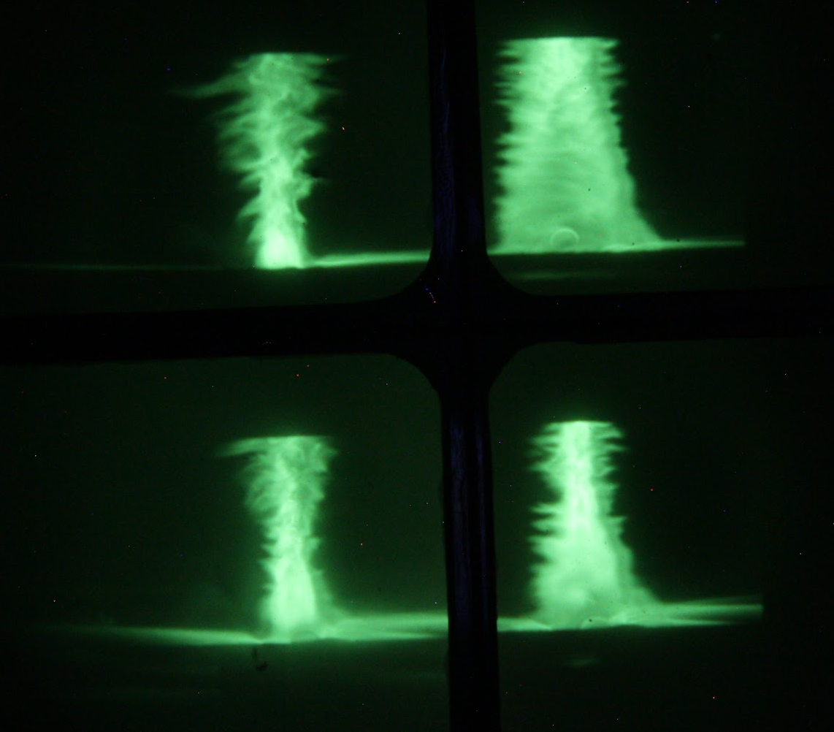
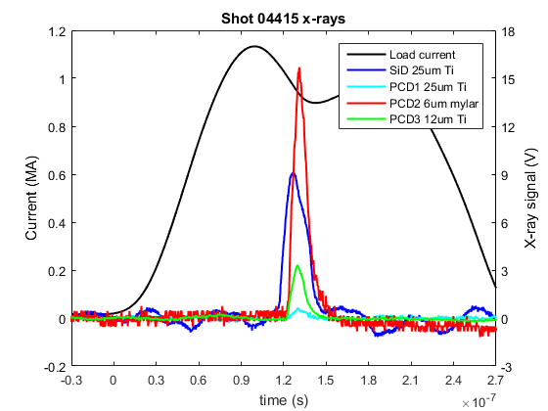
Comparison of simple pinch with staged Z-pinch at Cornell Cobra Facility
Liner: Ar, p= 2.1 psia, t= -500 μs, n_{Ar} ≈ 3x10¹⁶ cm⁻³, B_{z} = 2.4 kG
136ns
106ns
Under similar conditions
staged Z-pinch is stable
produces hotter plasma
Simple Z-Pinch
No Target
126ns
116ns
138ns
108ns
X-ray
Pinhole image
Staged Z-Pinch
with H₂ Target
128ns
118ns
6

Slide 7
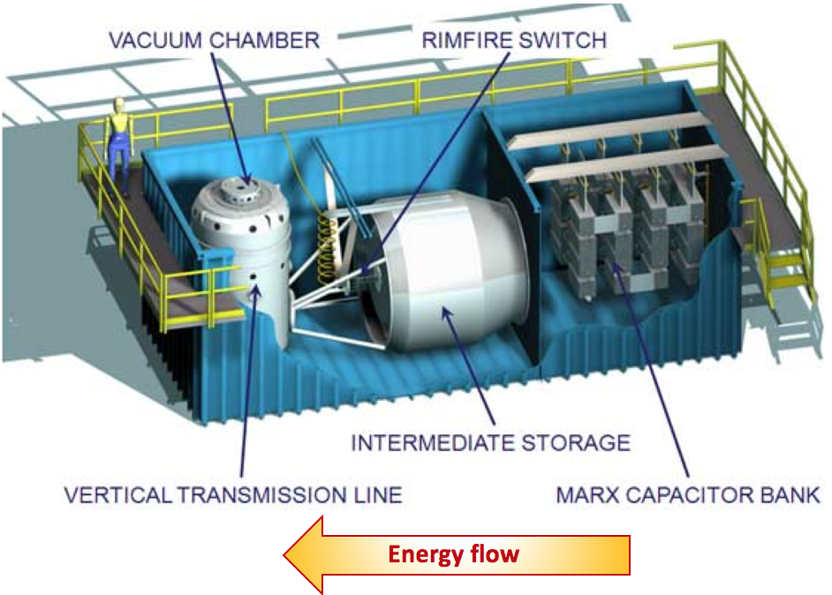
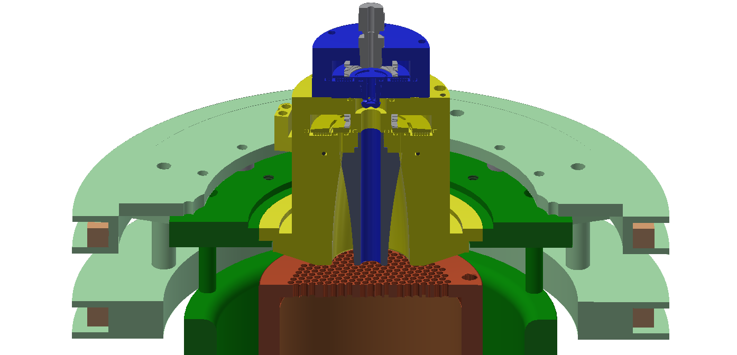
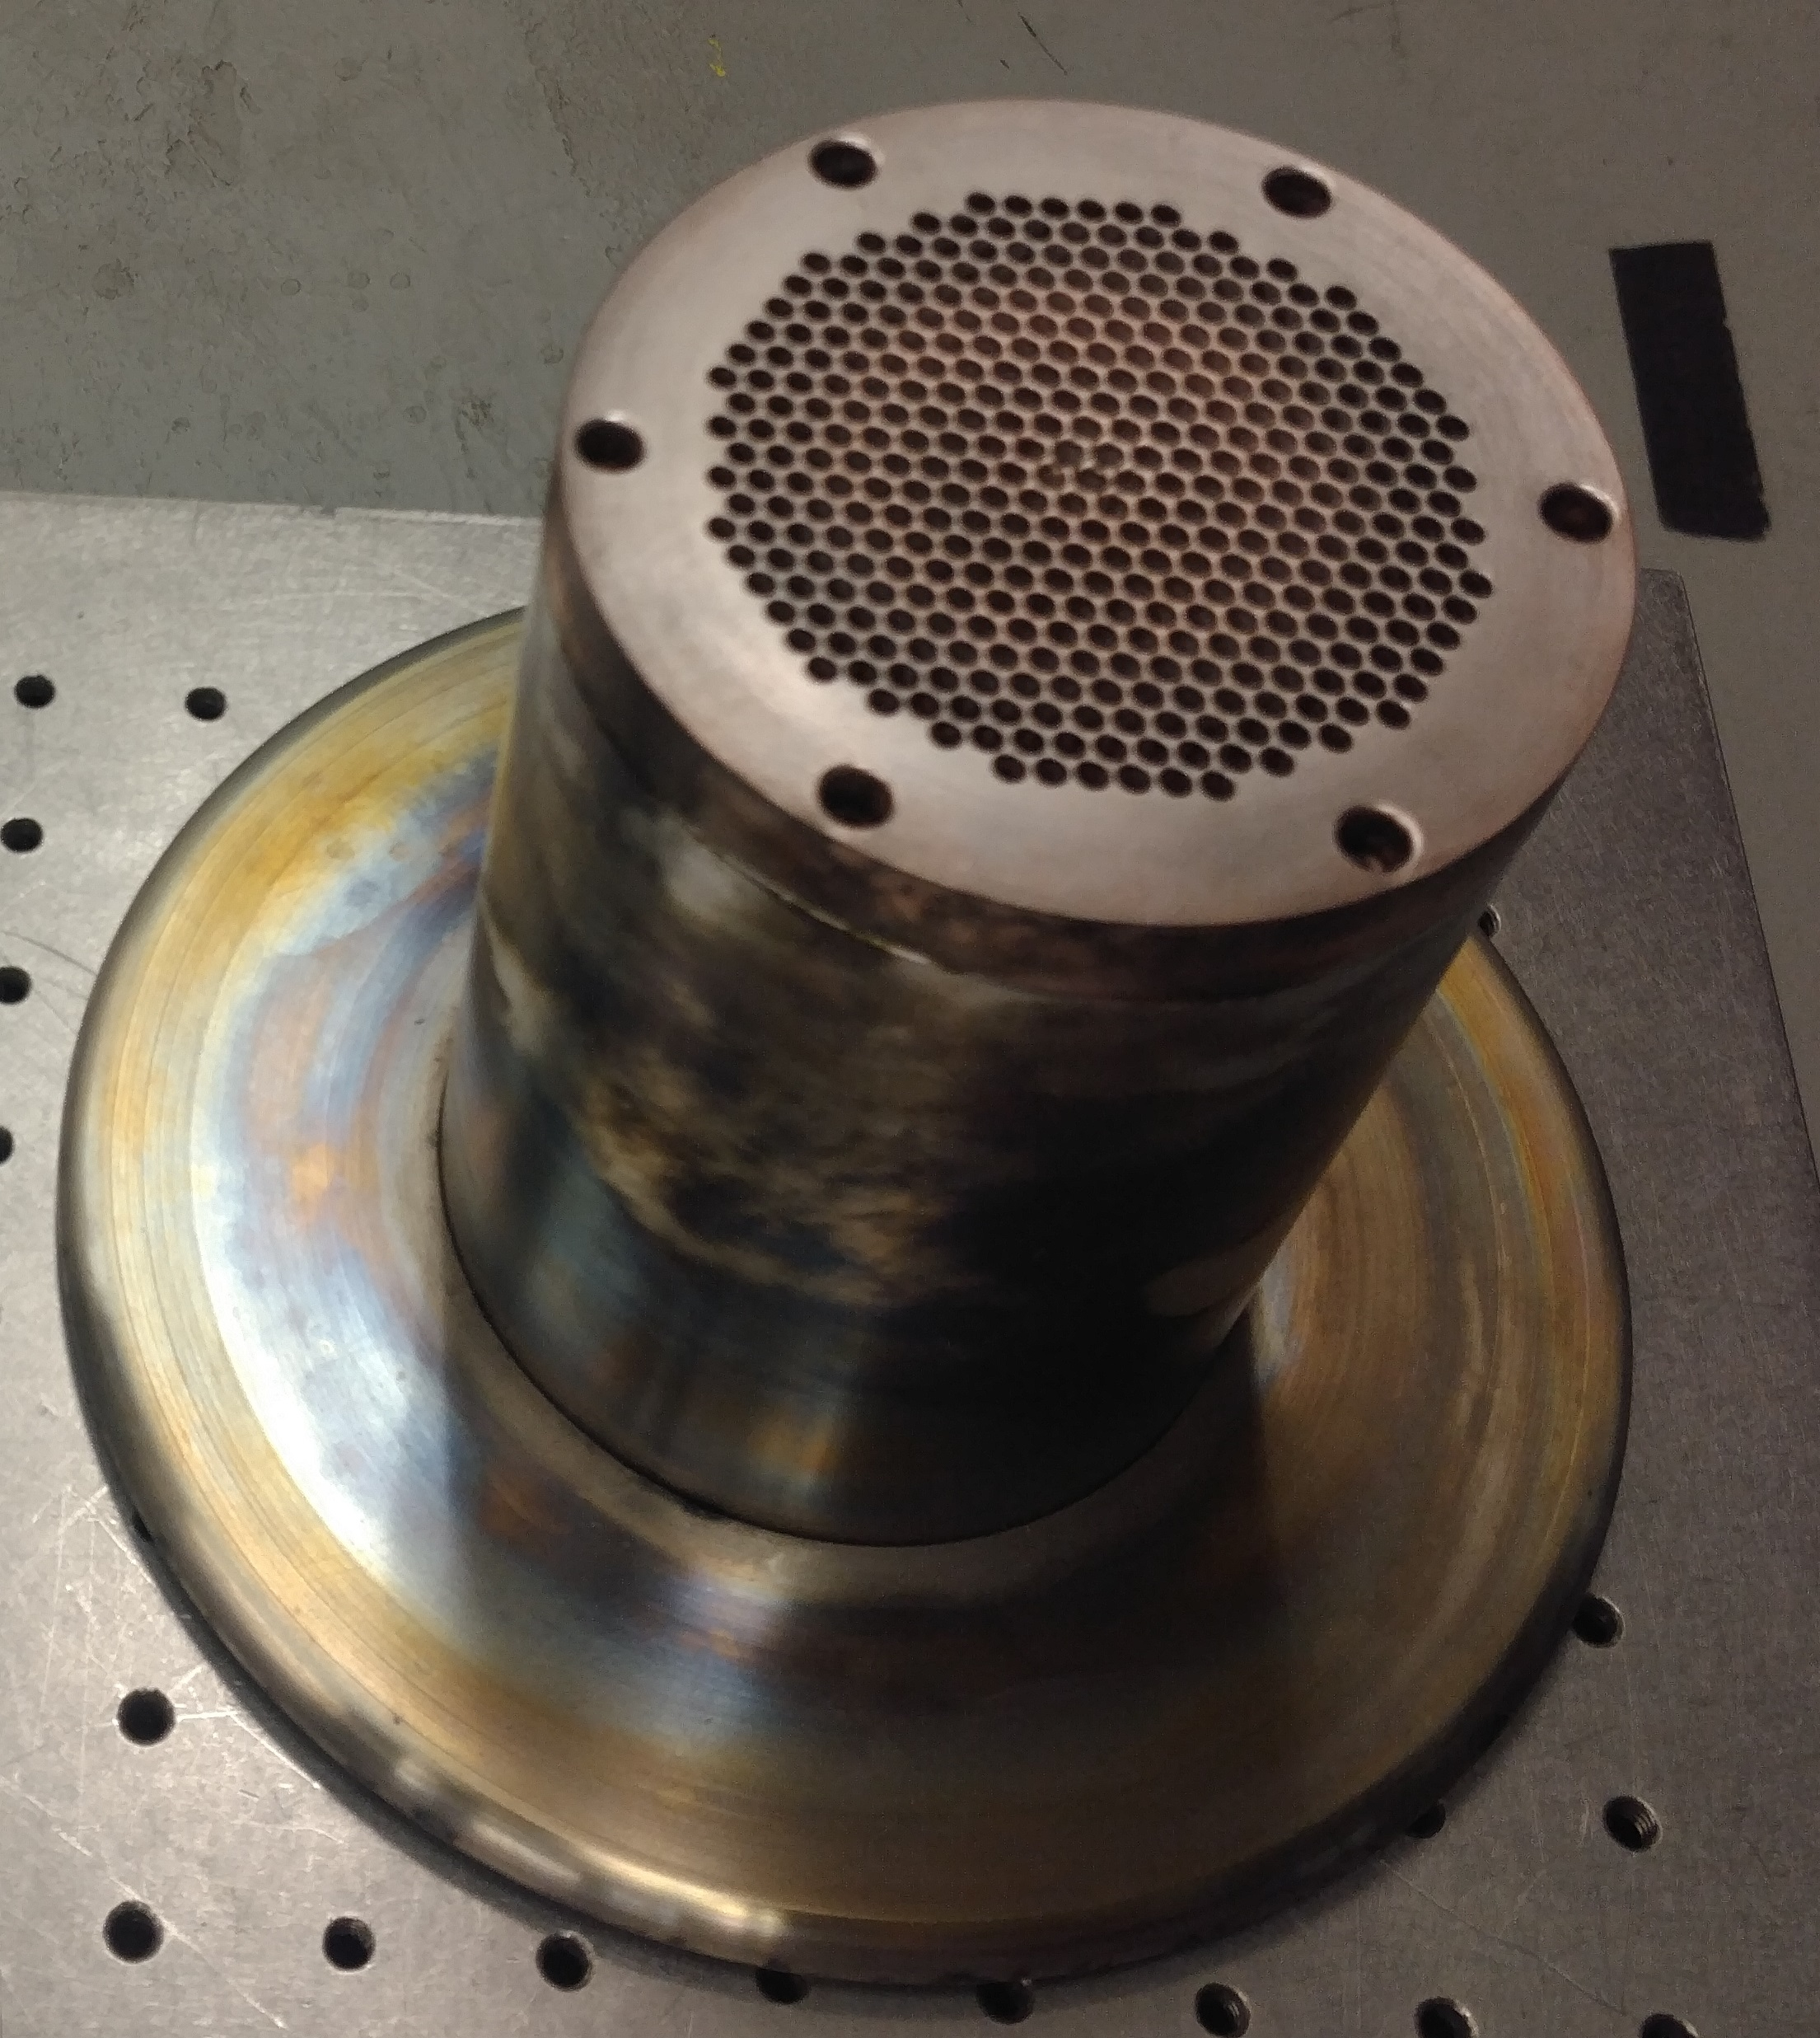
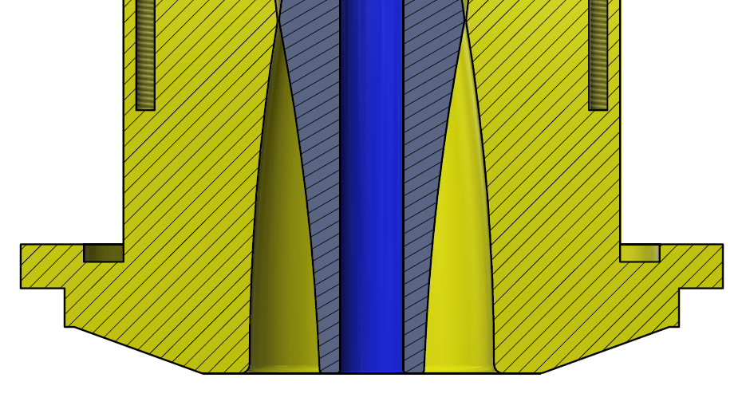

Experiments at Nevada National Terawatt Facility
Zebra: 2 TW, 1 MA, 100 ns
Mega-ampere currents.
Multiple experiments using Ar and Kr liners.
2 cm
B_{z} coils
anode
Kr
Cathode
D₂
Lineout
Cathode
Double gas shell injector
Load region
Electrodes made from Cu/W survive multiple shots >50 tested

Slide 8
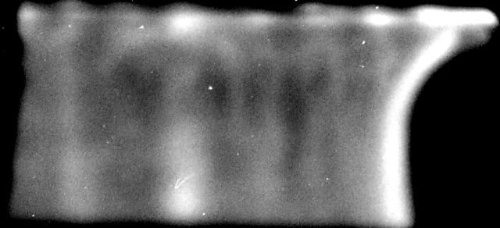
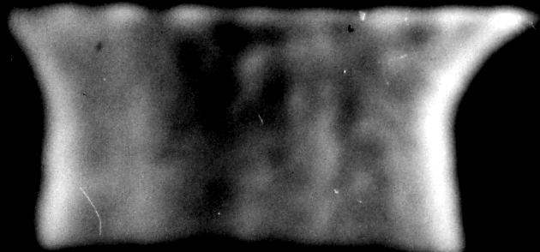
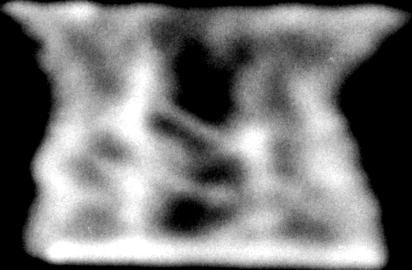
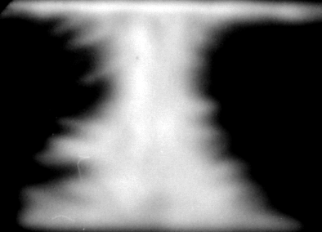
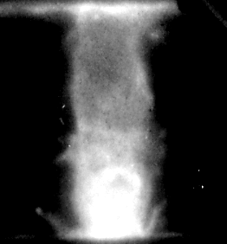
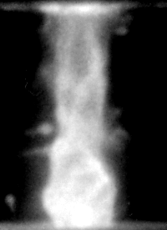
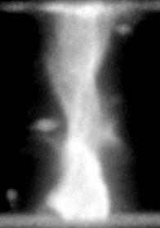
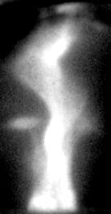
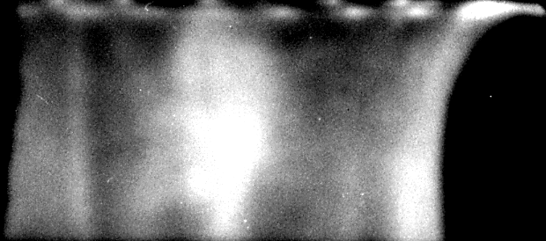
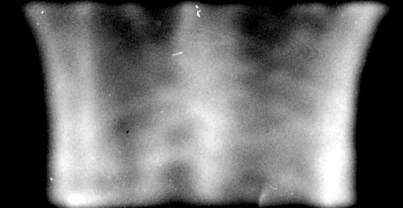
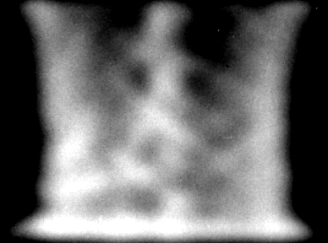
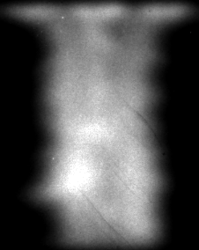
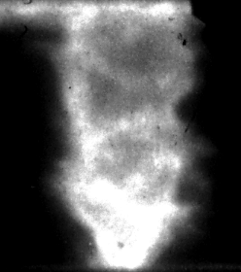
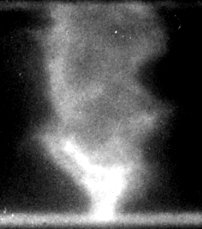
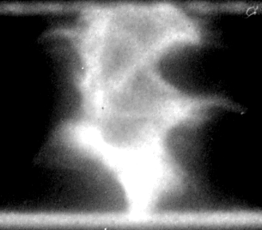
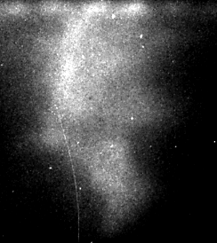
Stability of staged Z-pinch (Kr Vs. Ar liners)
XUV pinhole camera images 8frams
Shot #5230
Kr Liner on D
(B_{Z} = 1.0KG)
t = 67.7 ns
t = 77.7 ns
t = 87.7 ns
t = 97.7 ns
Kr liner imploding on D target shows more stability than Ar liner
t = 101.4 ns
t = 106.4 ns
t = 111.4 ns
t = 116.4 ns
Shot #5246
Ar liner
(B_{Z} = 1.5KG)
t = 75.2 ns
t = 85.2 ns
t = 95.2 ns
t = 105.2 ns
t = 109.9 ns
t = 115.4 ns
t = 119.9 ns
t = 125.4 ns

Slide 9
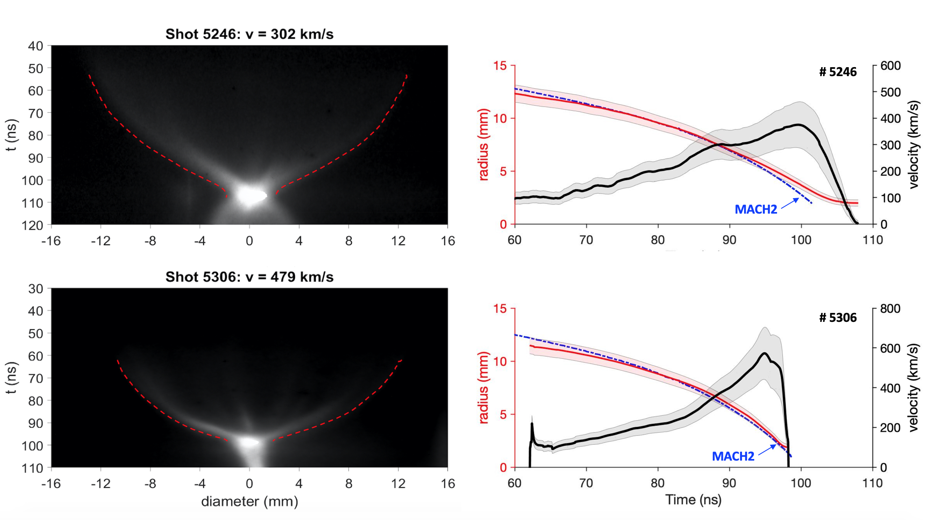
Streak Images of Ar, and Kr Liner on D Target
Ar liner on D
Streak images help to measure pinch radius, implosion velocity & acceleration.
Kr-pinches on D have higher acceleration than Ar on D.
Also Kr-pinch reaches to higher terminal velocities (~600km/s) than Ar-pinch (~400km/s)
Kr liner on D

Slide 10
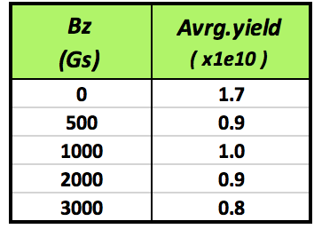
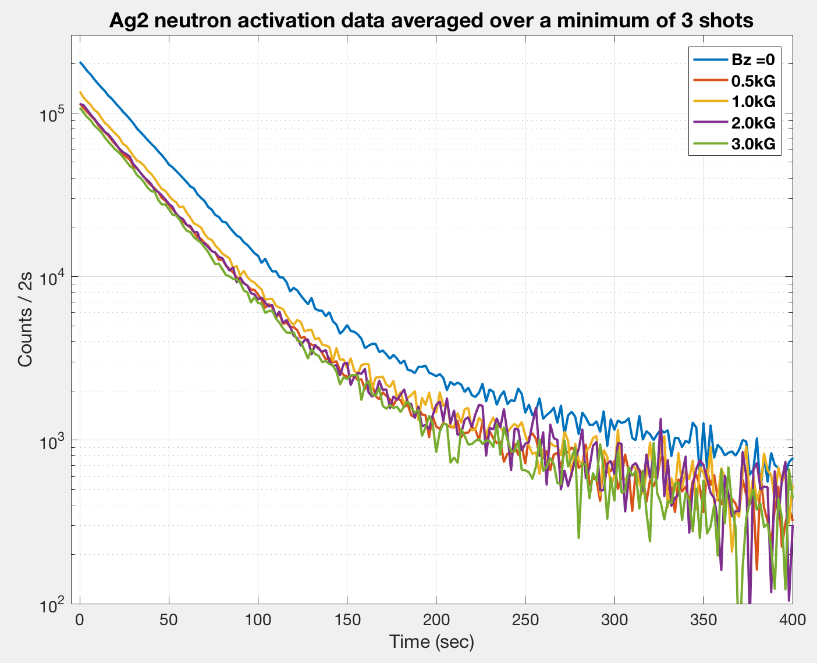
Average Neutron Yield as a Function of B_{z} for Kr on D
Kr Liner imploding on the D target using 1MA Zebra Current
Signal from Ag activation detector
The yield is higher without axial magnetic field
With 0.5 to 3 KG axial field the yield is consistently reproducible
Highest neutron yield 2.3x10¹⁰

Slide 11
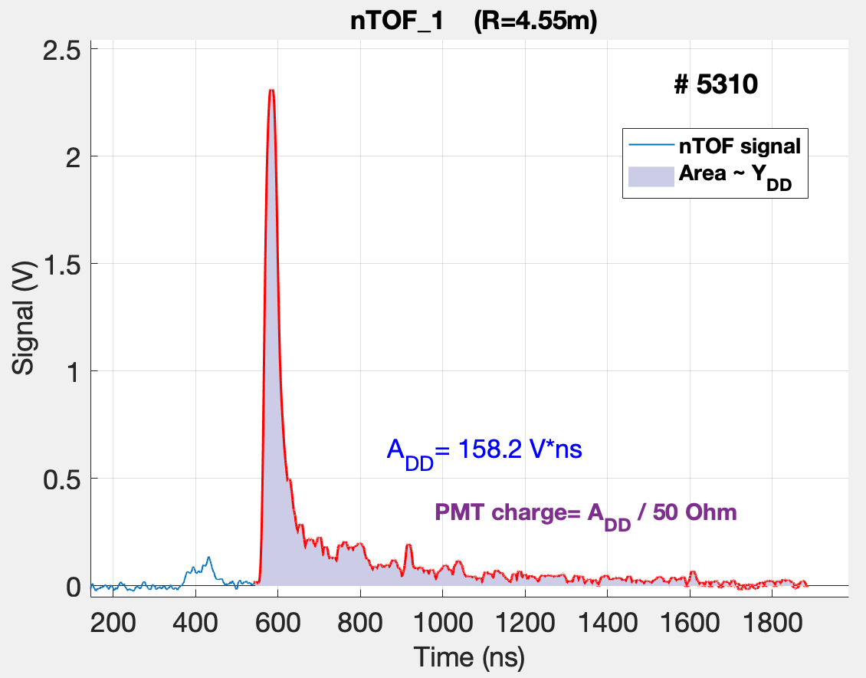
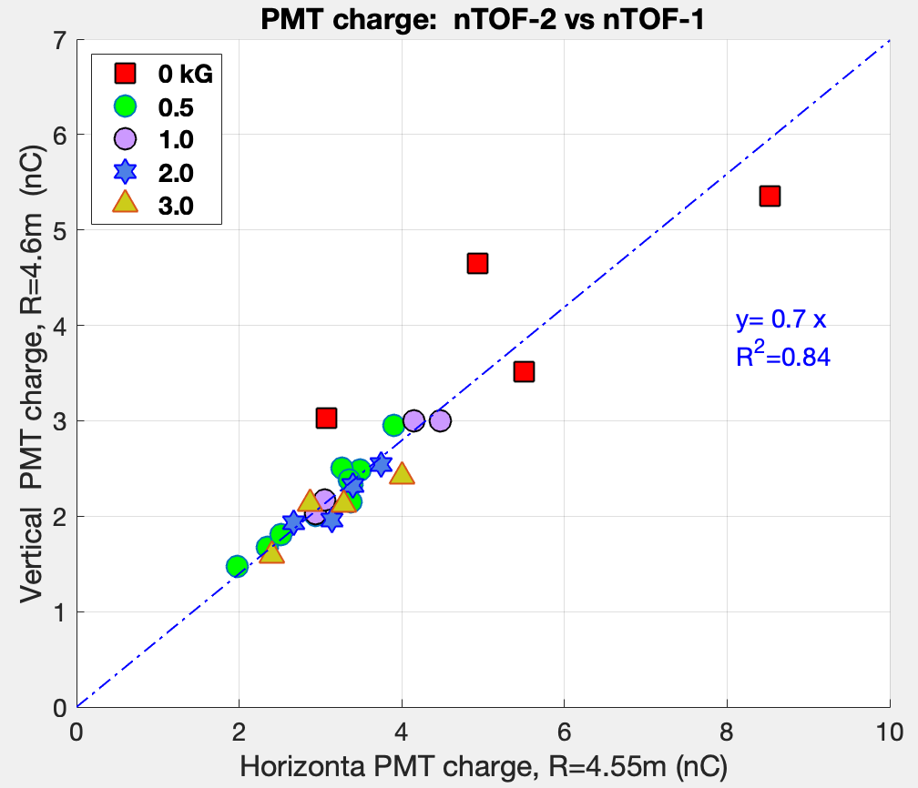
Neutron emission is isotropic for B_{z} > 500Gs
DD signal
Area under the DD signal is proportional to the neutron flux captured by the nTOF.
Linear correlation between the neutron flux captured by the vertical and horizontal nTOF detectors suggests isotropic, thermonuclear neutron emission.

Slide 12
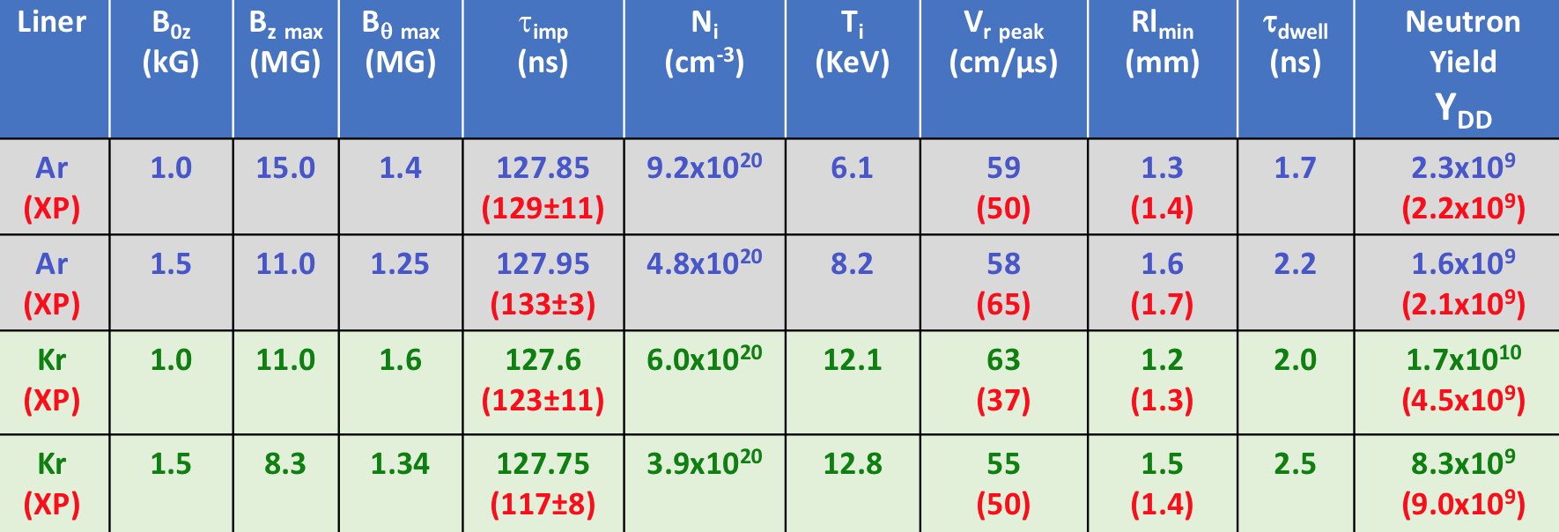
MACH2 Code Simulation close to Experimental Parameters
(8.0)
(1.0x10¹⁰)
2 cm
(8.0)
(1.0x10¹⁰)
Measureable parameters match closely with 2D mach2 simulation:
Implosion time from B-dot probe
Implosion velocity from Streak image
Plasma Temperature from NTOF detector.
minimum radius from XUV images
Lawson’s Triple product n.T.τ ~10¹⁸ (Kev.s.m³)

Slide 13
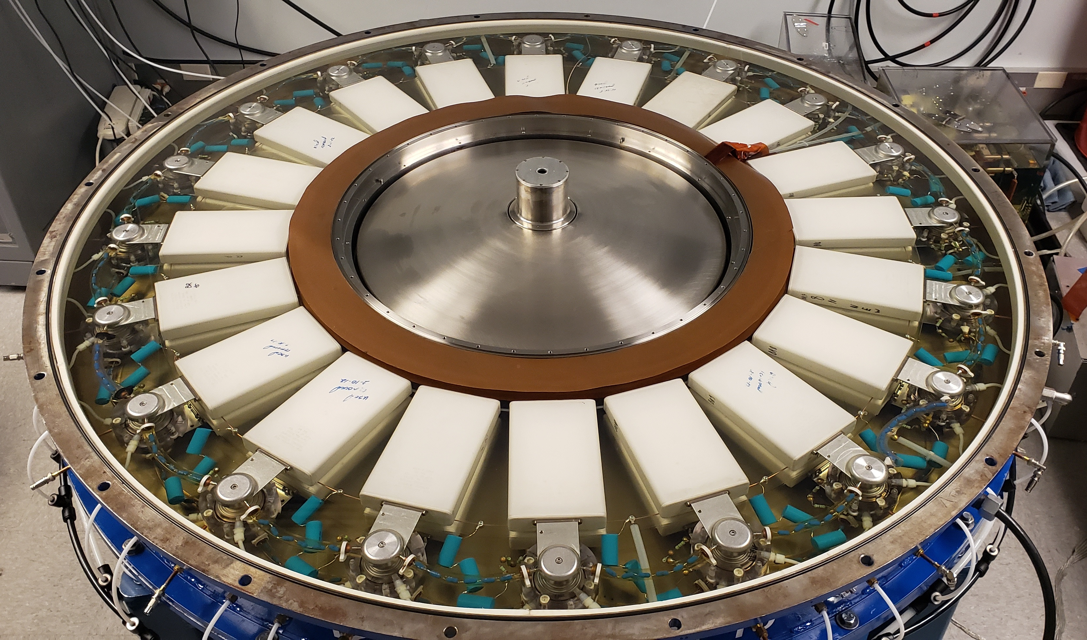
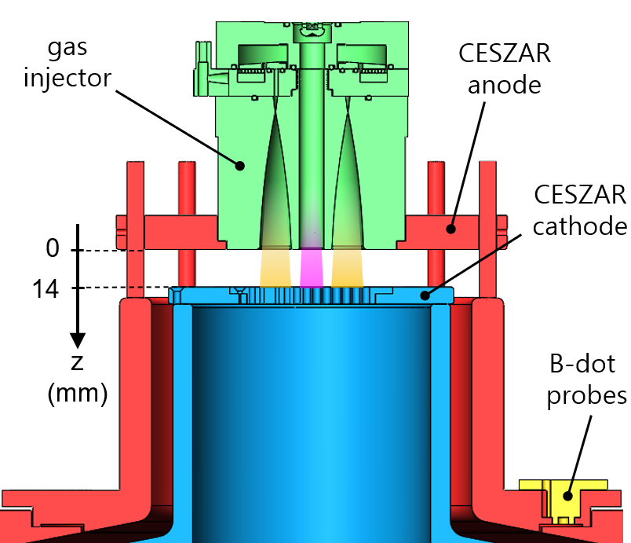
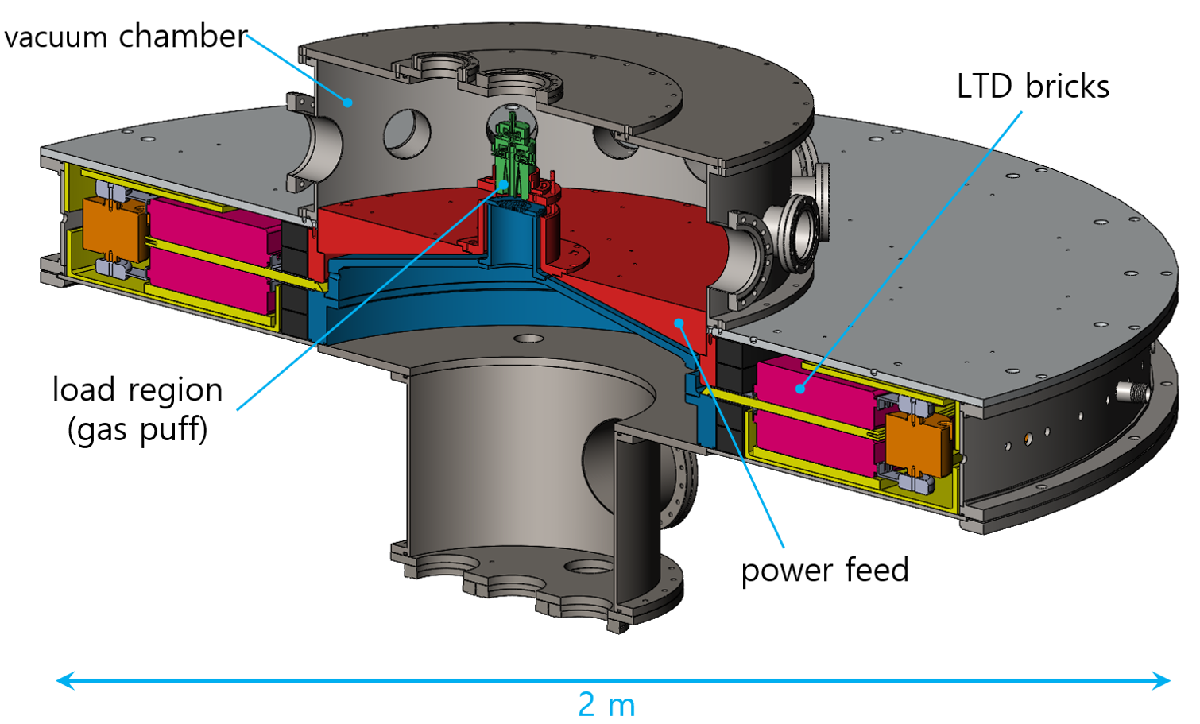
Staged Z-pinch Experiments with CESZAR LTD Generator
CESZAR is a compact machine at UC San Diego, based on new Linear Transformer Driver (LTD) generator technology.
4 kJ stored energy, 0.5 mega-ampere current, 200 ns rise time
Experiments using various liner gases (Ne, Ar, Kr) on deuterium target
2 cm
Lineout

Slide 14



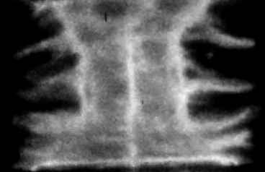
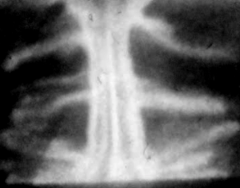
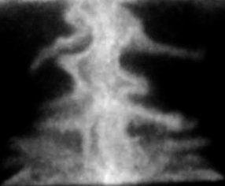
XUV images of Kr & Ar liner on D target at CESZAR
Staged Z-pinch of Kr liner on D target
Shot#478
MRT instability develops on the pinch surface
Target remains stable during the implosion
Shot to shot reproducibility remains quite good
A dense plasma layer develops at the liner-target interface
High ram pressure compresses the target to high energy density plasma
1cm
231ns
251ns
271ns
Staged Z-pinch of Ar liner on D target
Shot#876
1cm
151ns
171ns
191ns

Slide 15
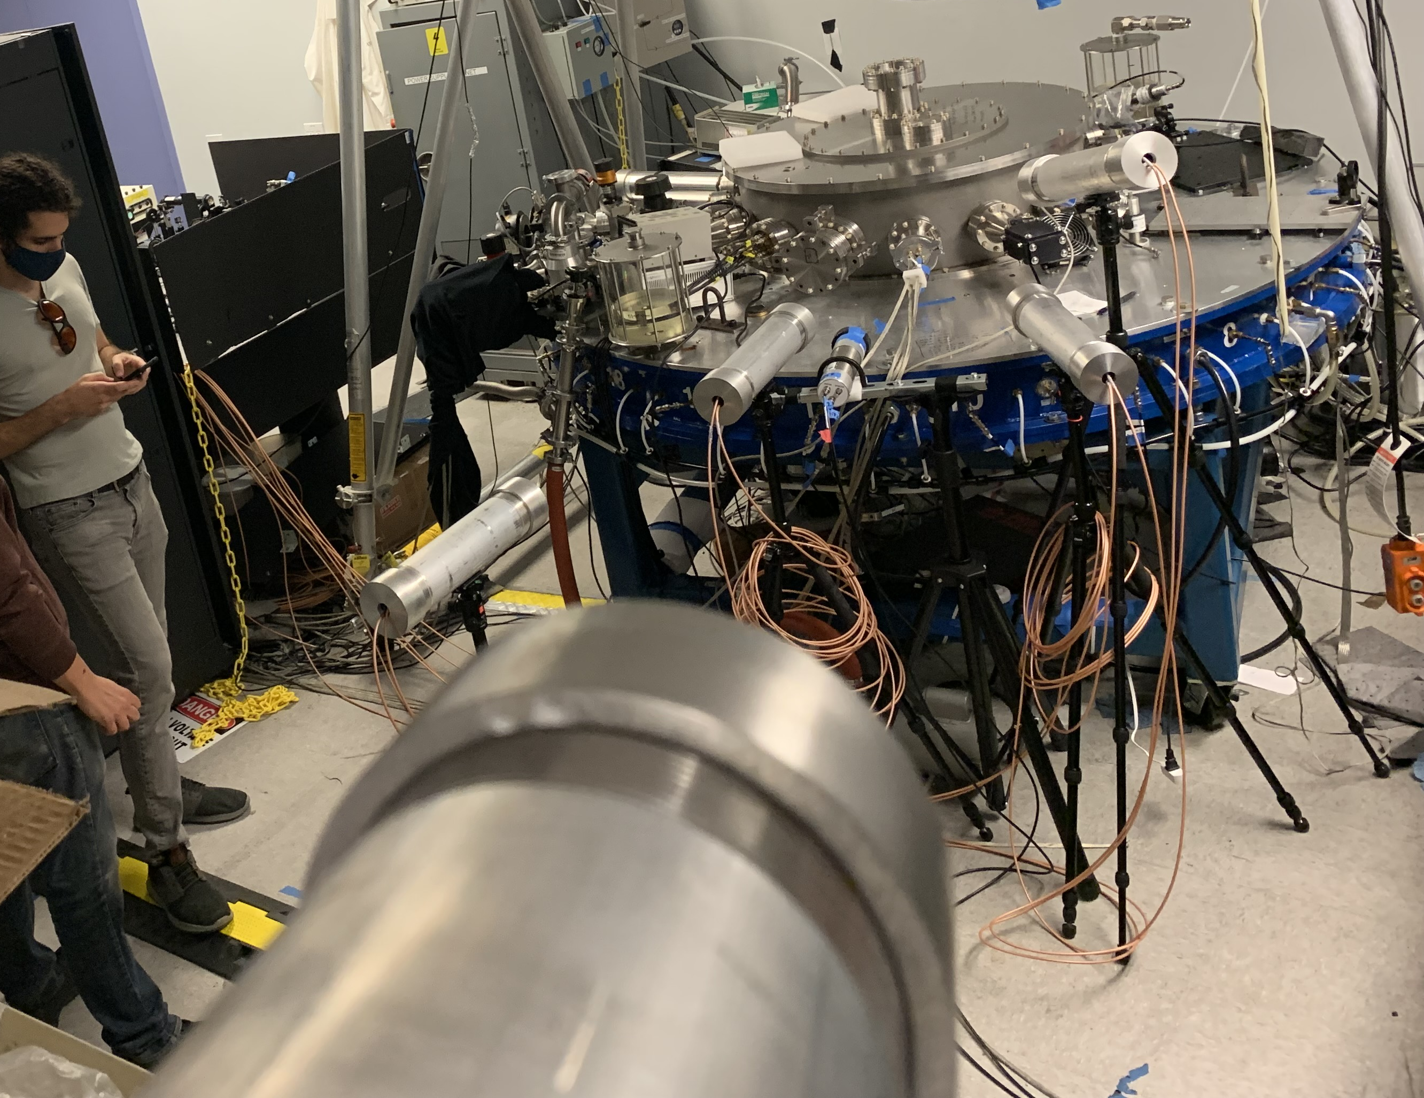
S/PMT Neutron Detectors in PANDA Setup (LLNL)
Detectors placed
  at different distances to measure neutron energy using TOF
  At different angles to measure anisotropy
LTD Experimental setup at UCSD
4
7
CESZAR emission region
1
2
4.75 m
6
4.5 m
4
3
S/PMTs
30°
14°
1 m
5
4.5 m
3 & 8
1 & 2
2.5 m
1 m
6
1.13 m
Floor

Slide 16
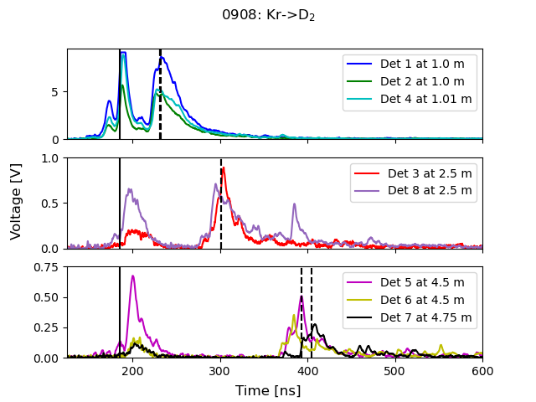
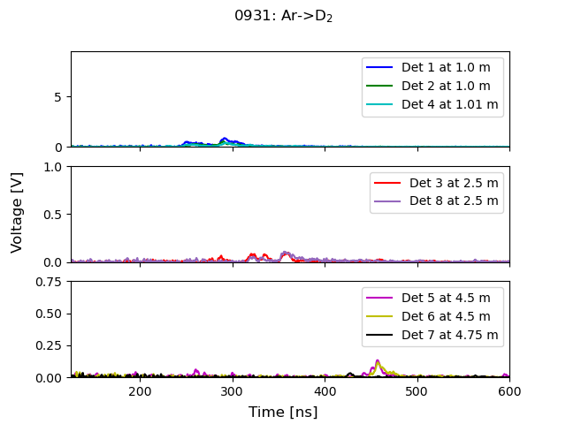
X-ray and neutron signals were measured for Ar & Kr liner on D target
Dashed line indicates TOF of 2.45 MeV neutron
Solid line indicates T0 (determined by x-ray signals)

Slide 17
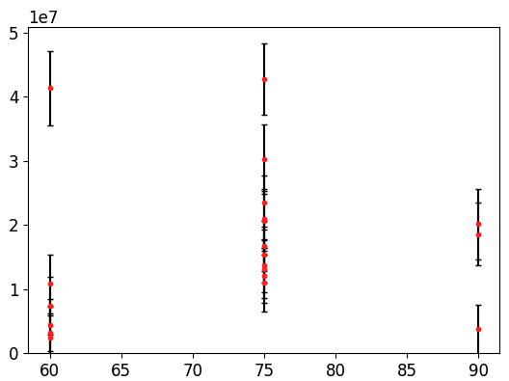
LaBr Activation Records Calibrated Neutron Yields
LaBr detects neutrons via (n, n’) reactions.
Neutron Yield
~4-5x10⁷
Neutron Yield
Fit to signal
The signal and background are fit with time multi-channel analyzer.
This allows robust uncertainty analysis and background subtraction.
Inner Gas D₂ Pressure (psia)
Measurement
The LaBr diagnostic was absolutely calibrated at LLNL.
It provides automated yields in <3 minutes to allow parameters such as gas pressure to be optimized.
Fit to background
Time (s)

Slide 18
Scaling for the Higher Current Machine, Breakeven and Beyond

Slide 19
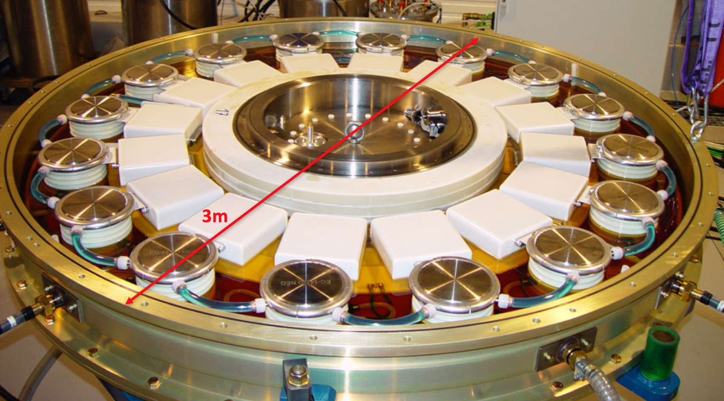
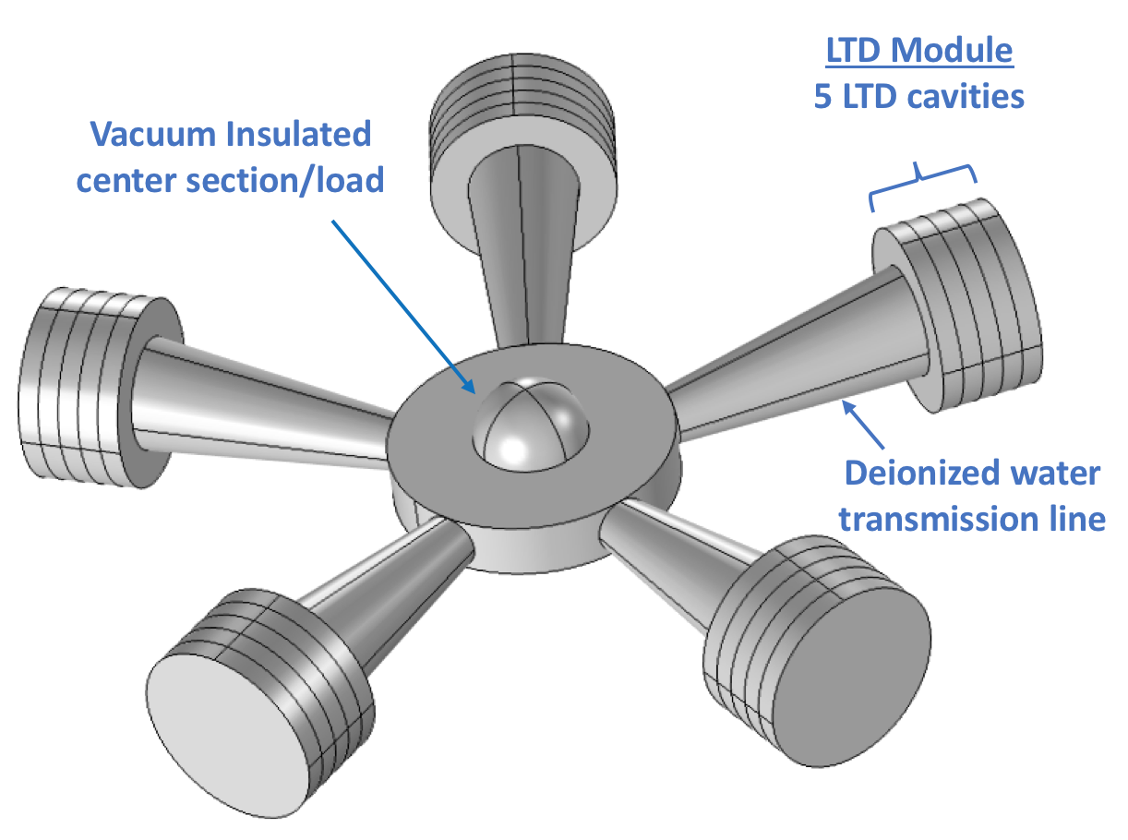
Conceptual design for 10MA machine to study the scaling
1MA Single Cavity
LTD brick
Configuration
5 Linear Transformer Driver (LTD) modules with 5 LTD cavities each
Each cavity contains 20 capacitor-switch units called “bricks”
Current is transmitted from the LTD modules to a central vacuum section and load
Generator is impedance matched to maximize energy delivery
- Total stored energy is 800 kJ
- Diameter is ~10 meters
10MA LTDX

Slide 20
Current/Energy vs. time for SZP load (Trac-II)
Current and Energy delivered to Z-pinch load
Implosion of Kr/DT staged Z-pinch load
8.6 MA peak current
250 kJ delivered to the load
170 ns rise time
31% energy efficiency
44 cm/μs implosion velocity
160 nF capacitors charged to ±100 kV
E_{CAP}=800 kJ
Z=0.09 Ω
180 ns rise time
𝜏_{IMP}=232 ns
30% energy efficiency

Slide 21
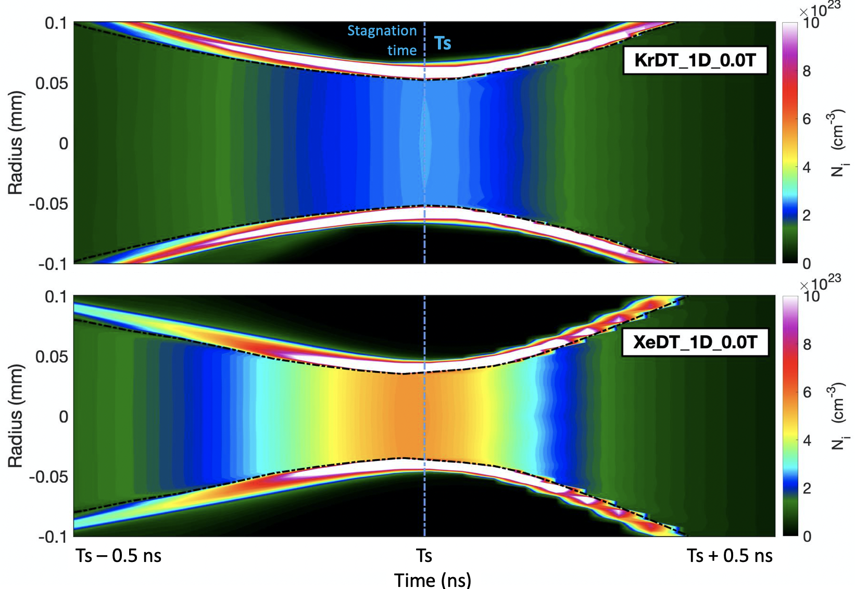
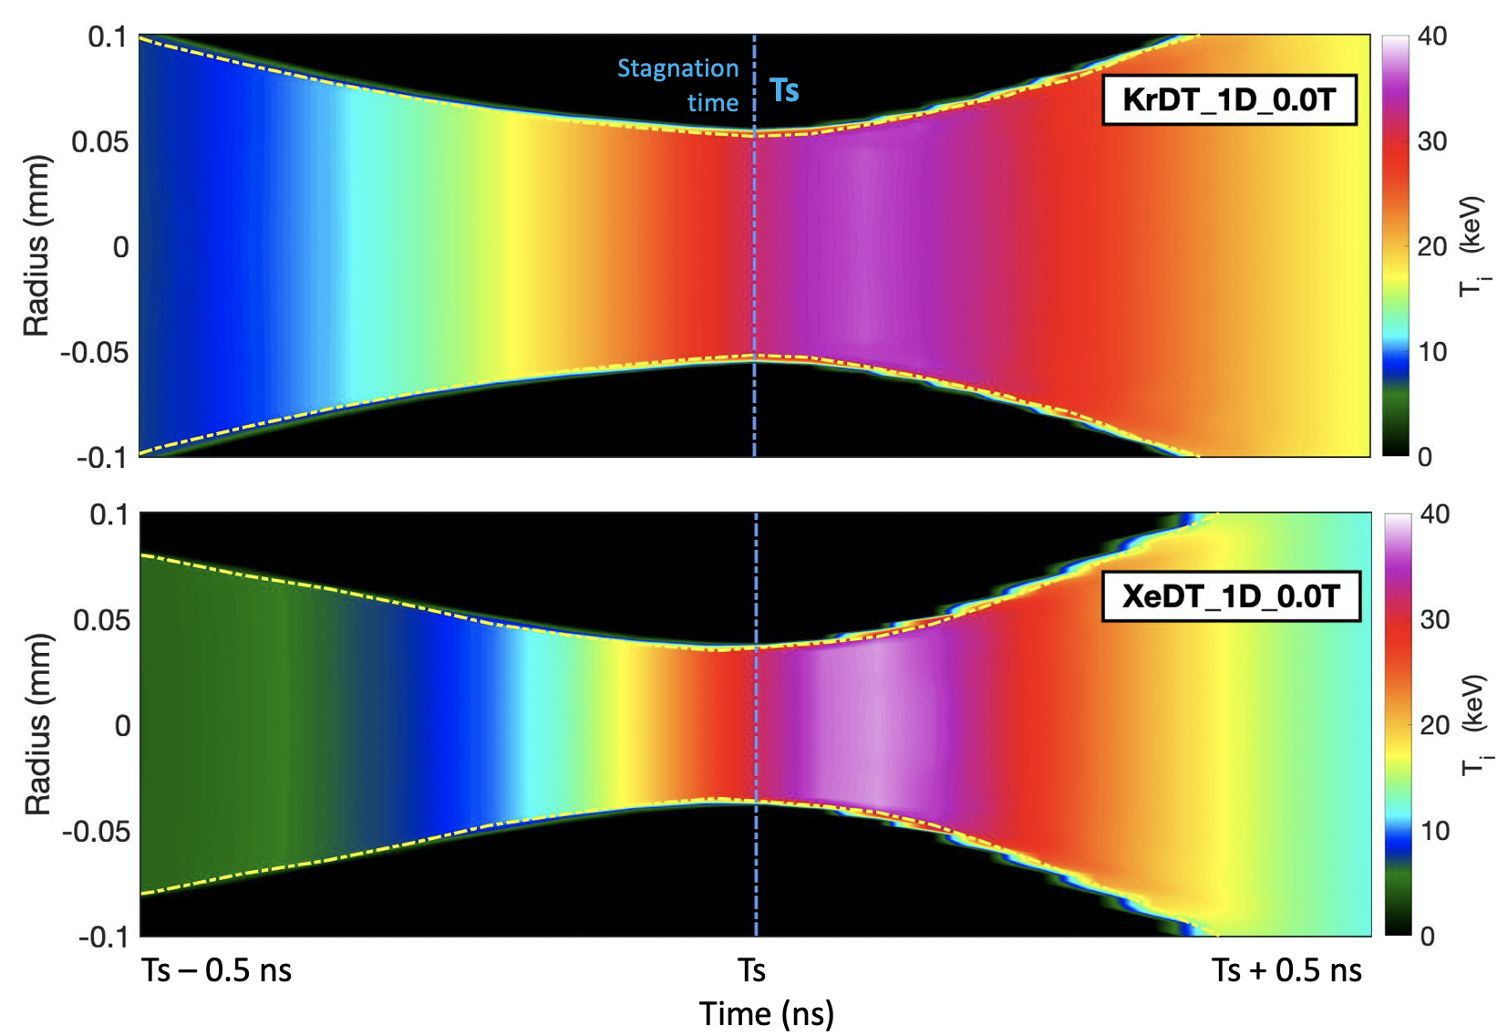
Comparison plasma parameters for 10MA LTDX machine near peak implosion
Plasma Density
Ion Temperature
A thin magnetized high density layer of liner plasma develops at the interface.
The ram pressure is almost twice for Xe liner as compared to Kr liner.
This thin layer compresses the preheated target adiabatically.
The ion temperature at stagnation is around 25KeV for both Kr & Xe liner.
Plasma density of target plasma reaches twice for Xe Liner than Kr liner.

Slide 22




10 MA LTDX machine current yield with Kr vs. Xe liner on DT (MACH2)
Currents
Energies
Input Energies
Stored energy= 0.8 MJ
Energy from circuit =0.48 MJ
Fusion Energy
KrDT_1D_0.0T: 1.28. MJ
XeDT_1D_0.0T: 1.85 MJ
Xe Liner imploding on DT target produces almost 50% higher fusion energy than Kr Liner Imploding on DT.
Breakeven may be possible
Fusion Energy
Energies

Slide 23
Summary
Staged Z-pinch is based on flux-compression experiments started 30 years ago at UCI
Liner-on-target (Ar, Kr -> H2, D2 or DT) produces stable Z-pinch
Higher-Z liner provides better compression and stability
A modest axial magnetic field improves the pinch uniformity and further insulate the hot target plasma from the cold liner plasma
Implosion velocity, V_{r} ~ 30 – 50 cm/μs and Ion temperature, T_{i} ~ 5 – 10 KeV
Measured DD neutron yield is isotropic => thermonuclear yield
DT neutrons also being detected => high compression of Bz field
Maximum yield of 2.3x10¹⁰ is measured at ZEBRA
Our plan is to study extensively on the current 500KA LTD machine at UCSD and upgrade to 1MA to obtain results similar to ZEBRA
LTDX 10MA machine predicts promising results for breakeven and beyond

Slide 24
Thanks
Any Question?

