Slide 1
State Of The Art ICRF Transmitters
Dr. Marcel P.J. Gaudreau, PE
President
Diversified Technologies, Inc.
December 16th, 2021
Diversified Technologies, Inc., Bedford, MA USA

Slide 2
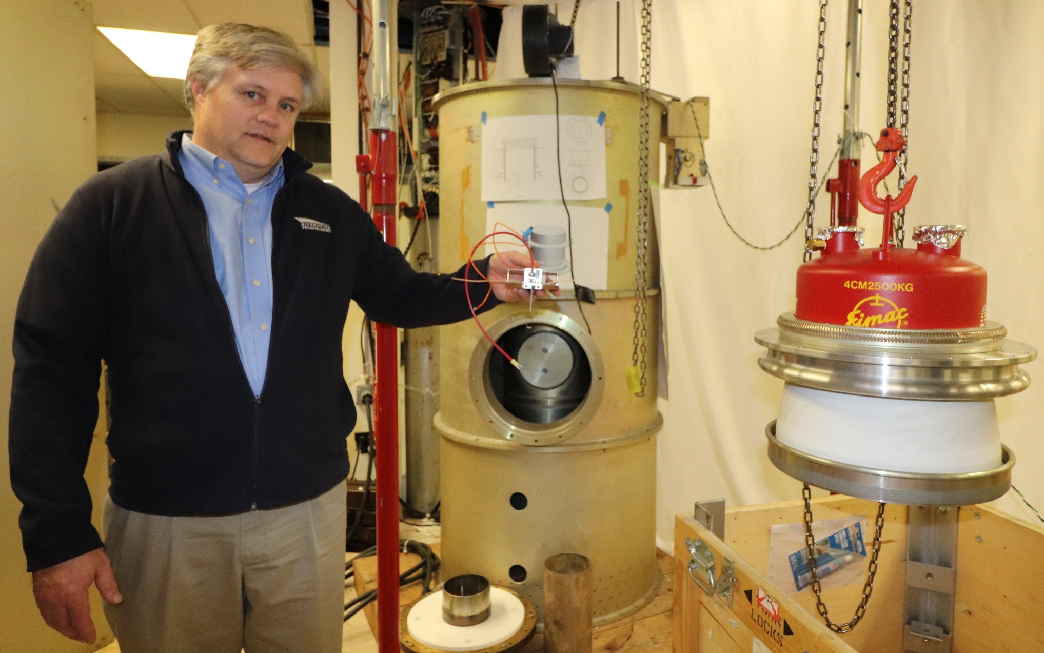
Options: Solid State vs. Tetrode
4kW solid state module 2.5 MW tetrode

Slide 3
Diversified Technologies, Inc.
DTI, founded in 1987, is a direct descendant of MIT Plasma Fusion Center
Major Markets
Radar Transmitters
High Voltage Modulators
Power Conversion
Sponsored R&D
Over 100 employees
60,000 sq ft R&D / Production Space
Sales ~ $30M in 2020
DTI 2020 Sales
R&D
Modulators
Radar
Transmitters
Power Conversion
R&D

Slide 4
Solid State Switching
Series String of High Power Transistors
All Operate Synchronously
Patented Design
Very High Voltage & Current Systems
Up to 500 kV
Up to 900 kA
Extremely Uniform & Reliable Pulses
Sub-Microsecond Switching
Arbitrary Pulsewidth & Frequency
1 ns – CW;
> 300 kHz Continuous
DTI’s PowerMod™ Model

Slide 5
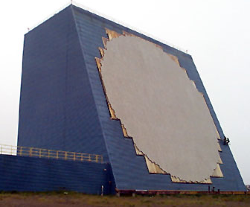
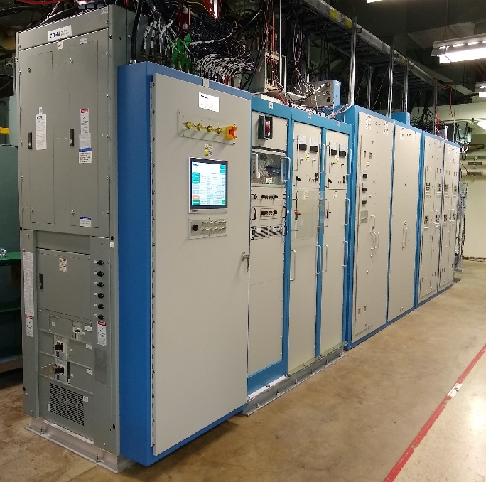
Radar Transmitters - Cobra Dane
High Power Radar in Alaska
96 Large TWTs (Traveling Wave Tube, 12 Groups of 8)
Initial Operations in 1977
DTI Selected By USAF to Upgrade Transmitters ($70M Prime Contract)
Prototype Group Installed in 2019
Remaining 11 Groups On Contract
Installation in 2022 – 2025
Increase Reliability & Performance
Numerous other examples of large DTI Transmitters for Military, Energy, and commercial applications
Similar scale and cost to a fusion pilot plant ICRF system

Slide 6

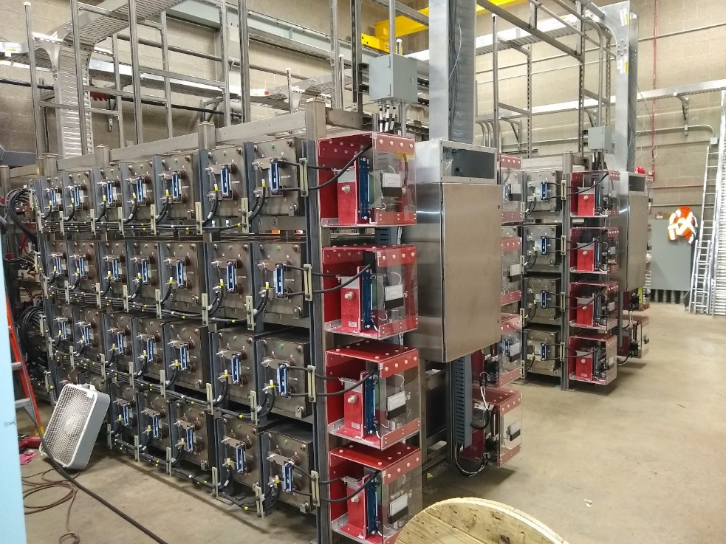
High Power Application Example
Invasive Asian Carp could cause Great Lakes environmental disaster
Carp could swim up the Chicago Canal between the Mississippi River and Lake Michigan
An electric fence within the waterway is an effective barrier
DTI is installing two electric fences
Awarded by US Army Corps of Engineers
First fence complete (2020)
Second fence awarded to DTI for 2022 installation
6 kV
30 kA
180 MW
Comparable to state of the art fusion magnet power systems

Slide 7
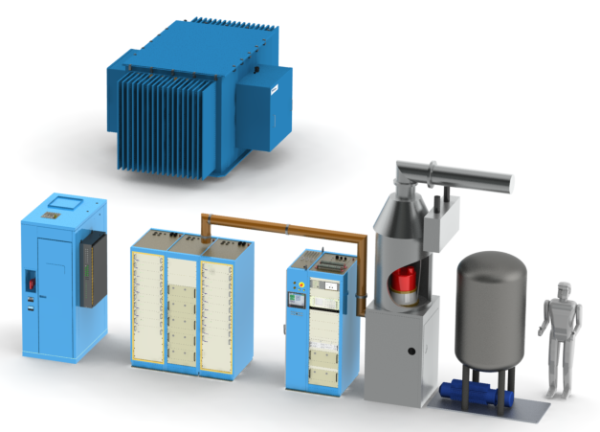
Tetrode-based ICRF System
DTI’s fast high voltage solid-state switches allow:
Elimination of mercury-filled ignitrons
Modern controls and interface
Improved tube protection
Reliable operation at greater power
Rapid tube-arc fault recovery allows the Tokomak plasma pulse to continue without shutdown or disruption

Slide 8
Solid State Direct Cavity Combiner (DCC)
DTI’s Solid State Direct Cavity Combiner (DCC) transmitter capable of delivering up to 1.5 MW of RF power
Array of advanced, solid state RF power modules with unique feedback circuitry to prevent device oscillation
Drastic reduction in footprint
Efficiency >75%,
Cost <$2/W,
Soft Failure, MTTF > 20 years
120 MHz, 1.5 MW solid state direct cavity combiner (DCC) transmitter.

Slide 9
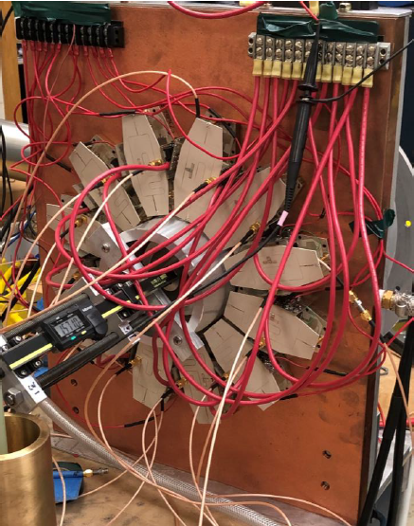
Solid State DCC
DCC transmitter. Coaxial resonant cavity is tuned mechanically via various frequencies for ICRF heating including H(D) minority heating for various magnetic fields.
DOE SBIR, 650 MHz 50 kW-class DCC

Slide 10
Conclusions
DTI supports both Tetrode and Solid State approaches to produce 60-120 MHz RF for heating and/or current drive
Proven transmitters for Tetrode systems
Immediate application
Low risk
Modular DCC transmitters have been demonstrated
Favorable technical characteristics
Reduced Footprint
Reduced Life Cycle Cost
Greater Efficiency
Greater Reliability
Greater technical risk
Best plan, least risk is to develop both technologies in parallel-they can be mixed on the next machine

Slide 11
Thank You
Diversified Technologies, Inc.
35 Wiggins Avenue
Bedford, MA 01730
(781)-275-9444
gaudreau@divtecs.com
www.divtecs.com

