Slide 1
Fusion Fuel Cycle R&D
Fusion Power Associates 43rd Annual Meeting
Brenda Garcia-Diaz and Dave Babineau
Savannah River National Lab
SRNL-RP-2022-01196
12/8/2022

Slide 2
The Fusion Fuel Cycle, Public-Private Partnerships, and Fusion Commercialization
Dec 2020 FESAC Report – “Powering the Future Fusion & Plasmas”
Recommendation: Significantly expand blanket and tritium research and development programs
Recommendation: Expand existing and establish new public-private partnership programs to leverage capabilities, reduce cost, and accelerate the commercialization of fusion power and plasma technologies.
Mar 2021 NASEM Report – “Bringing Fusion to the US Grid”
Recommendation: The Department of Energy should establish and demonstrate efficient tritium processing technologies at relevant rates and processing conditions before operation of a pilot plant.
Recommendation: The Department of Energy should move forward now to foster the creation of national teams, including public-private partnerships, that will develop conceptual pilot plant designs and technology roadmaps and lead to an engineering design of a pilot plant that will bring fusion to commercial viability.
Fuel Cycle Challenges and Questions
The reports recognize the need for investment in the fuel cycle to meet needs for fusion commercialization, but do not provide details about how to get there
How should the fusion community work to advance the fuel cycle in a push towards commercialization?
What are areas where companies should be collaborating and what are areas where it should be anticipated that there is more competition?
How do we wrap in public safety, regulation, and workforce development aspects of the fuel cycle where tritium provides a significant radiological hazards that needs to be addressed within fusion systems
How do we proactively plan for deactivation and decommissioning (D&D) activities where tritium content in components is likely to be a significant challenge in waste disposal?
How should the fusion community be coordinating on all aspects of the fuel cycle in a public-private partnership framework?

Slide 3

SRNL Recommended Fuel Cycle Development and Demonstration Plan
Fusion Pilot Plant D-T Fuel Cycle
TECHNOLOGY DEVELOPMENT
FACILITIES
SYSTEM DESIGN/ ENGINEERING
Non-rad Demonstration(s)
Integrated demonstrations of sub-systems required to work together at fixed processing rates
Scale of needed demonstrations to be determined by technology readiness assessments in system planning
Facilities for performing integrated demonstrations will likely need specialized infrastructure
Non-rad facility preferably in a relatively low security restricted location (e.g. PPA)
Utilize facilities to help with workforce development
Rad Demonstration
Need fully integrated demonstration roughly at scale that demonstrates feasibility of plant operations
Scale of needed demonstrations to be determined by discussions with industry, funding agencies, regulators, and other stake holders
Needs to be in a secured location that is able to handle appropriate quantities of tritium and deuterium
Leverage investments from other agencies where possible
Component Development
Improve component technologies and unit operations to increase the TRL level and scale of gas processing
Intensify processes to both increase throughput and reduce inventory through innovative design
Develop novel processing and inventory methods that can move from batch processing or aggregation inventory to online processes
Model performance of novel processes
Materials Development
Synthesize, characterize, and model novel materials or coatings that can improve tritium processing
Develop novel and improved tritium processing methods that are based around novel materials
Characterize tritium effects on materials and estimate materials durability and lifetime in an FPP environment
Technology Baselining
Determine approximate tritium processing criteria for a FPP system
Develop a current description of a system with high TRL that can meet the processing volumes
Quantify gaps in system size, cost, tritium inventory, and other critical parameters from targets
TRL Technology Assessments
Assess the TRL level for tritium technologies in development
Determine technology gaps and challenges for each unit operation and cross-cutting areas (e.g. materials)
System Modeling
Develop a modeling framework using ASPEN or other appropriate software to assist in integration decisions
Develop baseline modeling and key alternative configurations

Slide 4
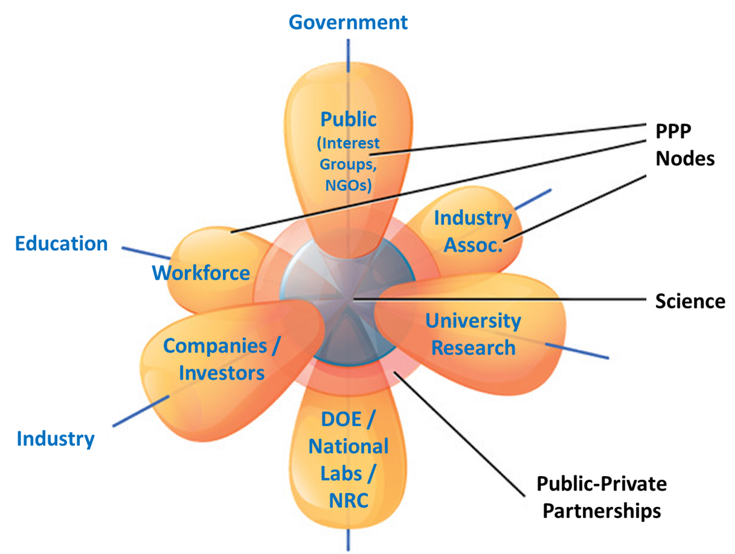
SRNL Focused on Enabling Successful Public-Private Partnerships for Fusion
SRNL Fusion Program Efforts
Leveraging expertise gained from NNSA, ITER, and programs to help industry
Licensing of fusion-relevant technologies to industry and supporting commercialization
Public-Private Partnership Projects
  DOE FES INFUSE Program
  Fixed-price Milestone Programs –Like NASA COTS (Enabled by HR-133 Sec. 2008)
DOE FES Efforts to Define/Support an FPP
  Blanket & Fuel Cycle Working Group Mtg
  Fusion Energy System Studies
  Milestone FPP FOA
ARPA-e GAMOW Technology Development
  HyPOR Loop Development
  Direct LiT Electrolysis
DOE FES Technology Development

Slide 5
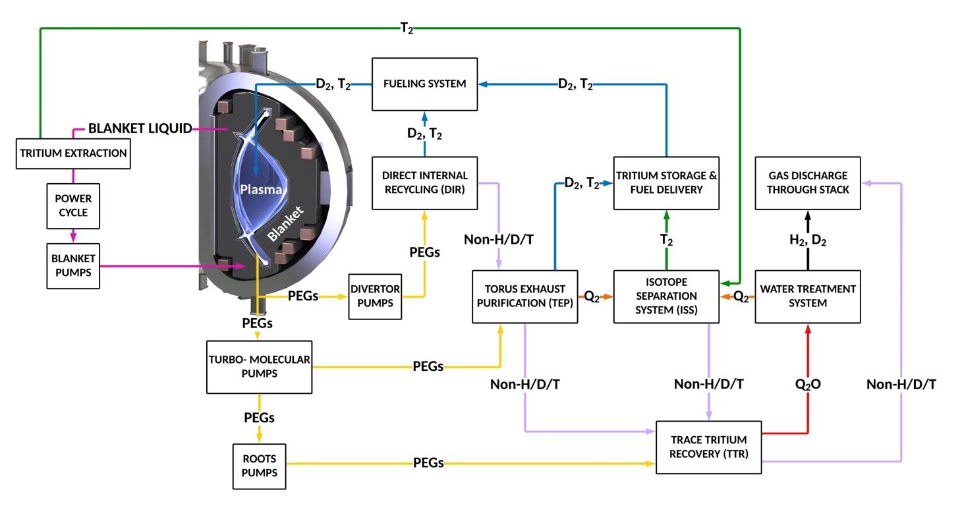
2023 Fuel Cycle Workshop
Conducting workshop with community on fuel cycle needs
Request for Information conducted
  Sent out in October 2022
  Responses received in November 2022
Planning a virtual introductory session followed by an in-person workshop
Workshop will be similar to FPNS, IFE, and Blanket workshops
  Define infrastructure needs for the fuel cycle
  Define critical technology needs to be addressed
  Identify enduring scientific missions for facilities after fusion pilot plant operation
SRNL is co-hosting workshop with community members
  Industry: CFS, Realta Fusion, Type One Energy
  Education: MIT
Figure 1: Preliminary block diagram of an FPP-class tritium handling system (utilizing the ARC power plant being developed by CFS as an example to start discussion).
Please contact SRNL if you are interested in participating in either the virtual or in-person workshop

Slide 6
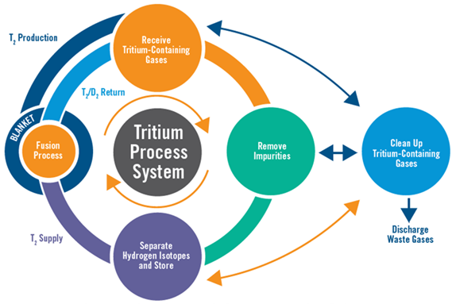
Five Tritium Research Topics to Enable Fusion Energy
Process Modeling, Process Control, & Simulation – Define models to advance & optimize system design, monitor operation, control the process and simulate performance during normal and off-normal operation
Tritium Inventory Reduction & Improved Process Technologies – Improve tritium processing to reduce the inventory needed and lower the radioactive source term. This includes developing advanced designs such as direct internal recycling
Isotope Supply, Tritium Breeding, and Tritium Extraction– Define tritium/isotope supply source and processing, ensure tritium breeding ratio can be achieved, and minimize captive inventory
Tritium Confinement to Reduce Emissions and Support Safety Basis – Develop advanced tritium wetted materials and confinement barriers, understand and mitigate tritium effects on plasma facing components, and improve tritium removal and recovery from secondary/tertiary confinements and effluent streams
Tritium Accountability and Tritium Analytical/Diagnostic Capabilities – Develop rapid, high-accuracy/precise accountability measurement instruments and techniques to measure tritium and account for it in different parts of the system

Slide 7


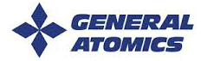
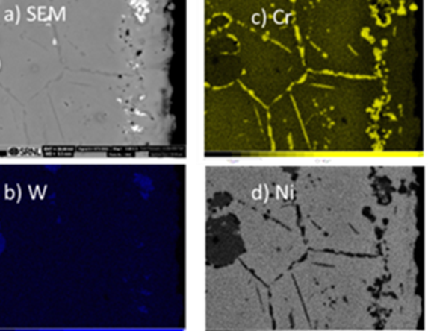
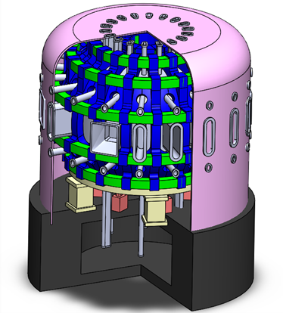


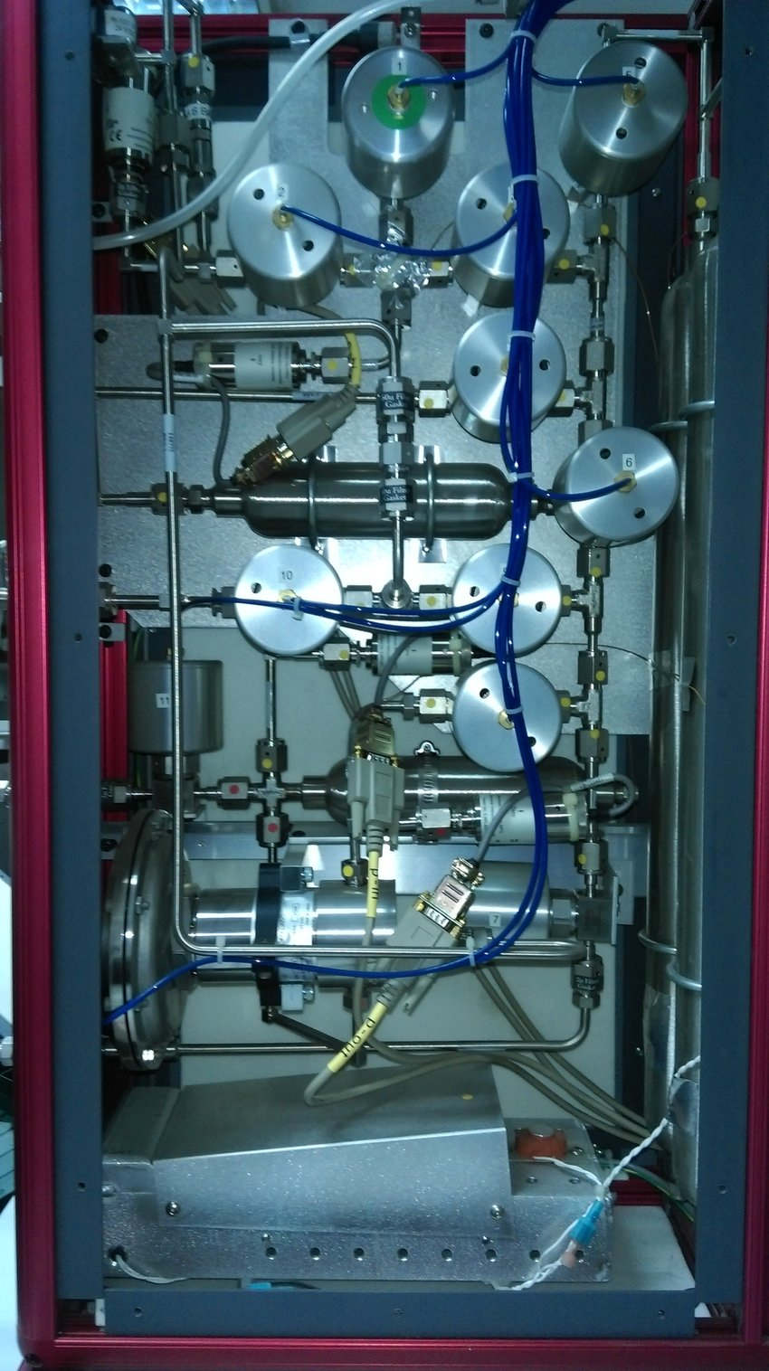
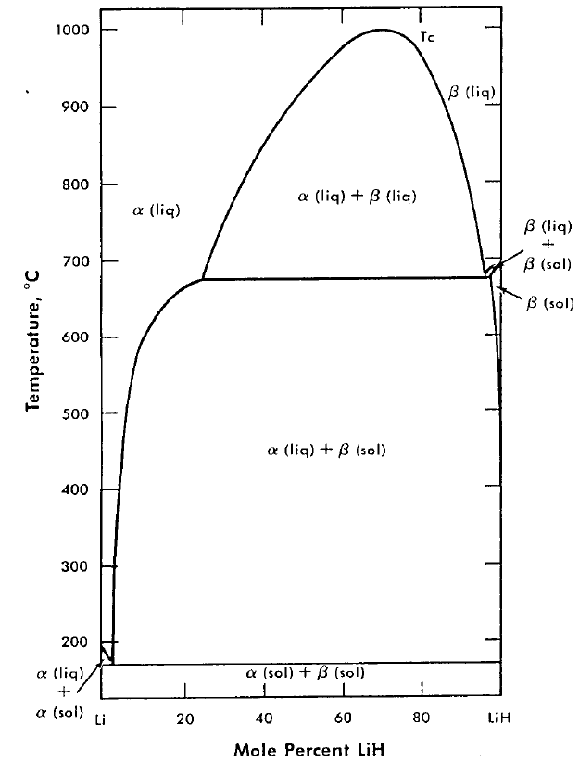
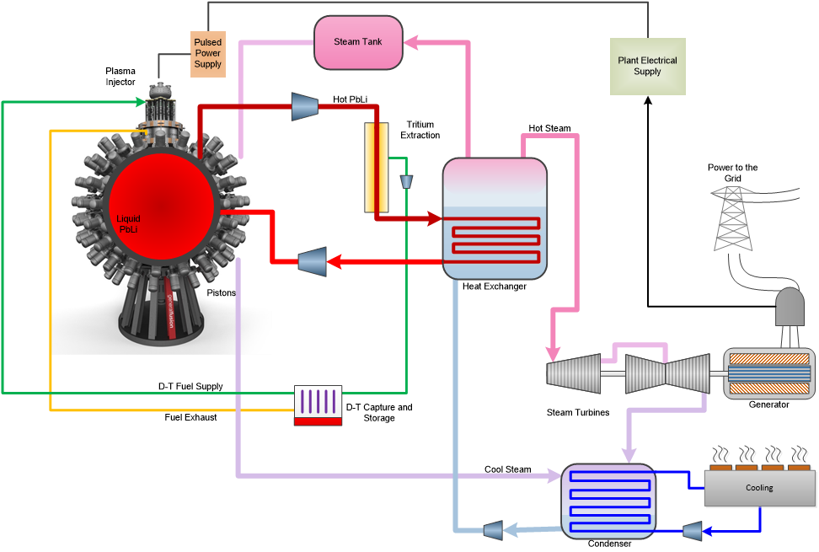
Partnering with Industry through INFUSE CRADA projects
Active Redox Control of Molten Salts For Fusion Blankets
Fuel Cycle and Tritium Plant Model for Fusion Pilot Plant
Demonstrate corrosion mitigation using redox control coupled with electrochemical potential measurements
Brandon Sorbum – CFS PI
Brenda Garcia-Diaz – SRNL PI
Develop reduced and detailed models form a fusion pilot plant fuel cycle that can be utilized for integration into overall fusion pilot plant models
David Weisberg – General Atomics PI
Holly Flynn – SRNL PI
Phase Diagram of Li-LiH,D,(T) Mixtures and Implications for Tritium Retention and Extraction
Tritium Fuel Cycle Modelling and Optimization to Enable Fusion Pilot Plant Development
Measure phase diagrams for tritium extraction with LiH & LiD mixed with Li to allow extrapolation to LiT
Francesco Volpe – Renaissance PI
George Larsen – SRNL PI
Quantify and streamline tritium processing in a commercial pilot plant to enable fusion pilot plant development to deliver clean, safe, and on-demand fusion power at industrial scale
Matt Miles – General Fusion PI
George Larsen – SRNL PI

Slide 8



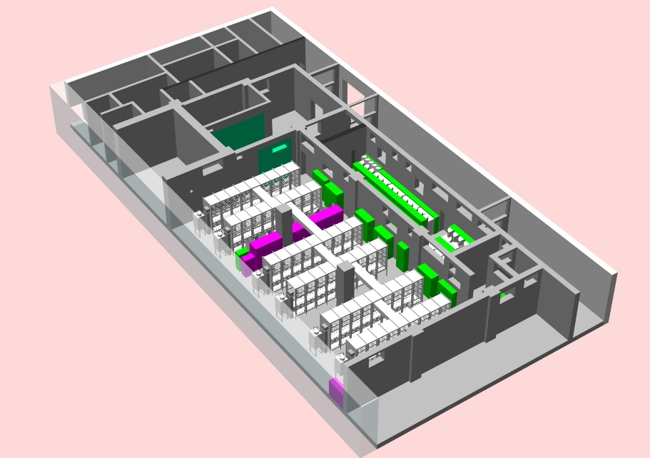
ITER Tokamak Exhaust Processing (TEP)
SRNL is Leading the Design, Procurement, and Fabrication of the TEP System
SP-1 Scope is Completion of Final Design of the US Hardware for TEP
Develop specifications and procure prototype components for risk mitigation
  Design TEP System including gloveboxes, equipment, instruments and controls
  Develop design substantiation documentation, models, and plans
SP-2 Scope is the Procurement, Fabrication, Factory Acceptance Test, and Delivery of all TEP Hardware to ITER

Slide 9
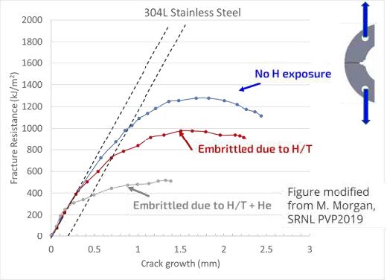
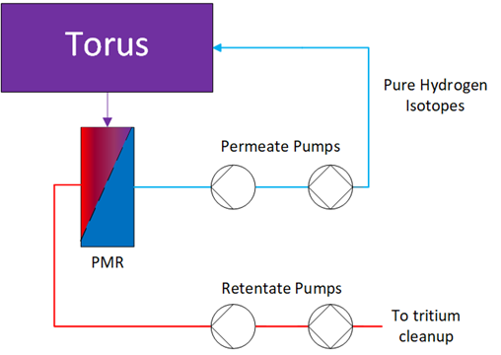
Leveraging FES Program Funding to Advance Technologies and Materials
Advanced Pd Alloys for Impurity Reaction & Removal
Advanced Getters for Tritium Removal from Coolant Loops
Characterizing and Mitigating Tritium Retention and Permeation
Fusion Nuclear Science Program
Fusion Nuclear Science Program
Fusion Materials Program
Develop, characterize, and test novel alloys for palladium membrane reactors (PMRs) that can react impurities and separate hydrogen isotopes for internal recycling
Lucas Angelette – PI
Characterize the use of advanced getter materials for the removal of tritium from secondary He cooling loops that can prevent unwanted release of tritium from the fuel cycle
George Larsen – PI
Characterize tritium and He degradation of structural materials for fusion and develop tritium permeation barriers and application methods for process components
Dale Hitchcock – PI

Slide 10
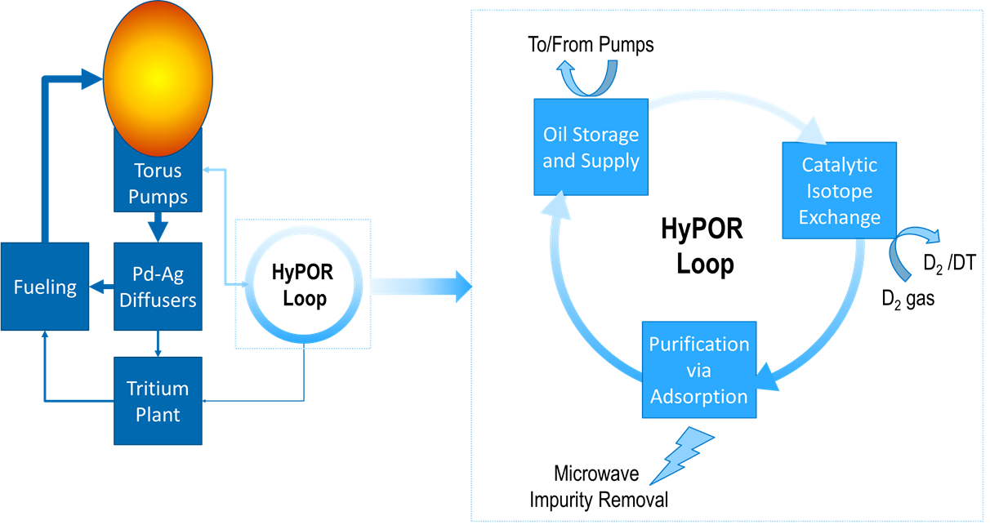
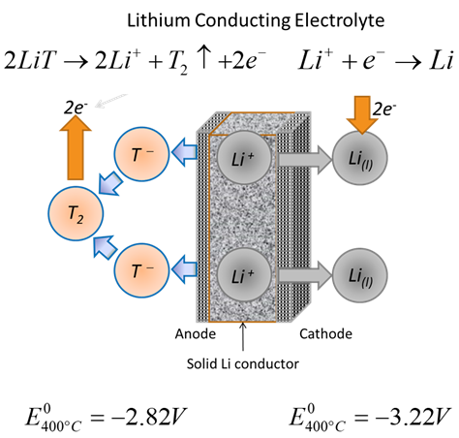
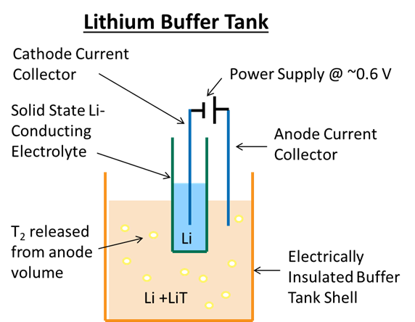


Technology Development with ARPA-e GAMOW and FES
Direct LiT Electrolysis
Goal: Develop method to electrochemically extract tritium directly from a PbLi blanket for reduction of tritium concentrations below vacuum extraction
  >50% reduction in capital cost compared to Maroni process
  Develop durable electrolytes and electrodes
  Scale-up demonstration to 1 kg/hr processing rate
Hydrocarbon Pump Oil Recycling (HyPOR) Loop
Goal: Selectively remove heavier H₂ isotopes from pump oil while also purifying the oil of radiation-induced damage
  >4x reduction in tritium inventory
  >10x reduction in pump electrical consumption
  >50x reduction in costs

Slide 11
SRNL Supporting FES Efforts to Advance the Fuel Cycle through the National Blanket Program
Develop and implement models as part of a multi-laboratory program to provide technical knowledge and guidance of the Deuterium-Tritium (DT) fusion fuel cycle.
  full functioning Discrete Time Fuel Cycle model
  And Kalman Filter Prediction Algorithm
  Aspen process models
Demonstrated the capability of the Kalman Filter for real-time accountancy
  Simulated sensor measurements and processed through Kalman Filter
  Sensor measurement error was reduced from 60% to near 0.001%
Investigated In-Process Tritium Inventory Reduction using the discrete time model
  Simulated improvements and changes to the fuel cycle by adjusting the processing time and fractional flows of sub-systems.
  Continuous pumping, Direct Internal Recycling (DIR), and improvement in Isotope Separation
  In-process inventory was shown to be reduced > 50% with a maximum reduction of ~71%.
1.) Flynn, H. B., and George Larsen. "Investigating the application of Kalman Filters for real-time accountancy in fusion fuel cycles." Fusion Engineering and Design 176 (2022): 113037.
2.) (Accepted) “Fusion Fuel Cycle Inventory Reduction Studies using a Processing Time based Discrete-Time Interval Model” in a Special Edition of Fusion Science and Technology, Young Investigators of Fusion

Slide 12
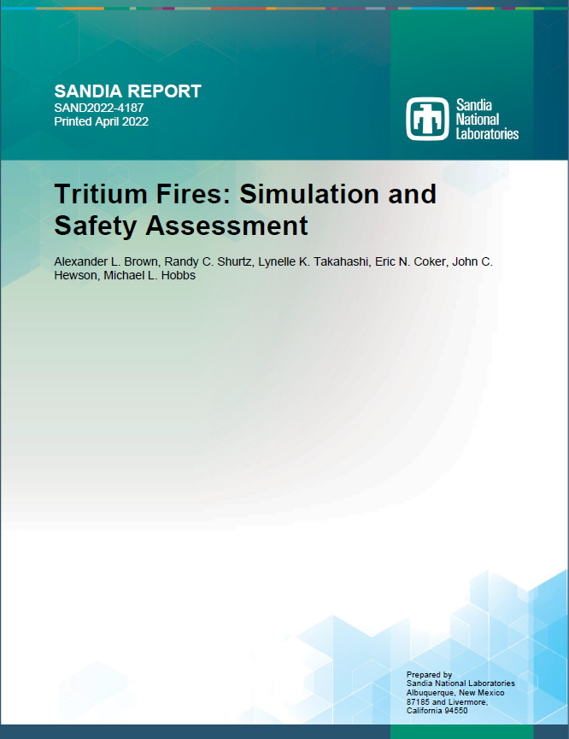
Working with DOE and NRC on Tritium Subject Matter Experts for Fusion Regulation and D&D
Tritium is Unique among Radionuclides
  Tritium is an exception to DOE-STD-1027 in terms of regulation
    “At the recommendation of the Tritium Focus Group, the [hazard facility class] tritium threshold values were provided by the Tritium Focus Group (TFG) and are not calculated using the methodology in this Standard.” [Brown et al., Sandia2022-4187]
  Tritium has many unique properties
    Permeates solid metals
    Isotopically exchanges with protium or deuterium atoms in other materials
    Can be present as a gas (elemental or oxide), liquid (oxide or organic), or solid (hydride or organic) within the same facility
    Autocatalytic – spontaneously, but not necessarily quickly, reacts with other species
Form of Tritium in Accident Scenarios is Critical
  Dose Coefficient (DC) for tritiated water (HTO) 10,000 times higher than the DC for tritium gas (HT) and the DC for an insoluble tritiated particle can be about ~14x that of HTO per DOE-STD-1129 (depends on particle size)
  Accident scenarios involving fires near tritium sources are often the limiting cases in accident analysis
    “Since the DC for tritiated water vapor is much greater than for T₂ gas, facility-wide accidents involving fires or explosions are generally the default scenarios of greatest concern for overall facility hazard categorization.” [Brown et al., Sandia2022-4187]

Slide 13
Energy Justice Considerations and The Tritium Fuel Cycle
Tritium Emissions
Fuel cycle will have most energy/environmental justice considerations
No cladding to contain all nuclear material
Avogadro’s Number and emissions
  6.022 x 10²³ molecules/mole
  ppm: 6.022 x 10¹⁷ molecules / ppm
  ppb: 6.022 x 10¹⁴ molecules / ppb
FPP will exhaust ~10s of moles of He/day
Tritium can be detected at low concentrations
The community where a fusion plant is located will likely be able to measure that tritium is being emitted
Are companies committed to transparency of posting tritium emissions?
Are designs being developed and improved to reduce emissions?

Slide 14
Questions?

