Slide 1
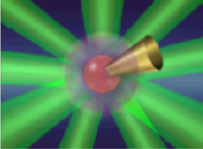

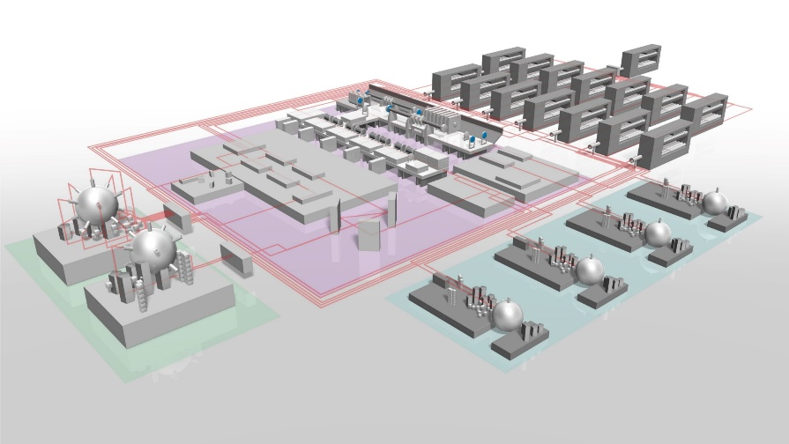


43rd Annual Meeting and Symposium of FUSION POWER ASSOCIATES, December 8, 2022 @ Washington DC
Plan of a new generation of a large laser facility in Japan, relevant to the laser fusion research
Recent actives on laser fusion research
Power Laser Facility to open the door to new possibilities : J-EPoCH project
High energy density science revolutionized by the High-repetition & High-power Laser Facility.
Summary
Ryosuke KODAMA
Institute of Laser Engineering, Osaka University
1

Slide 2
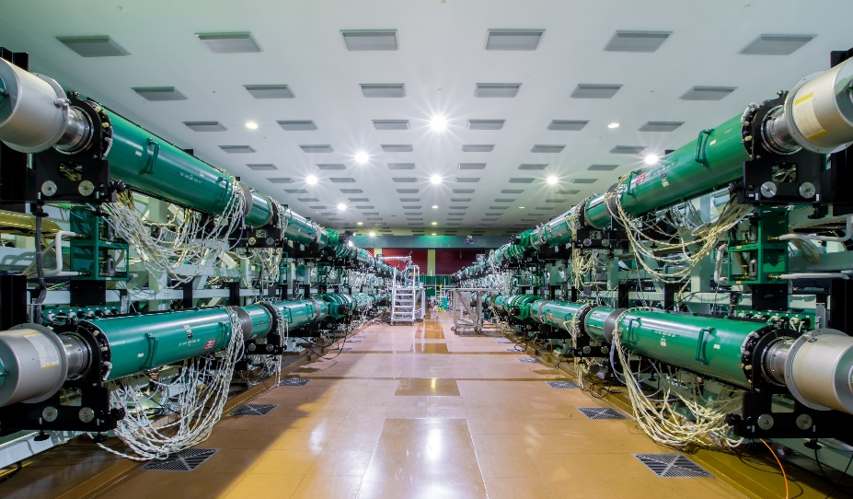
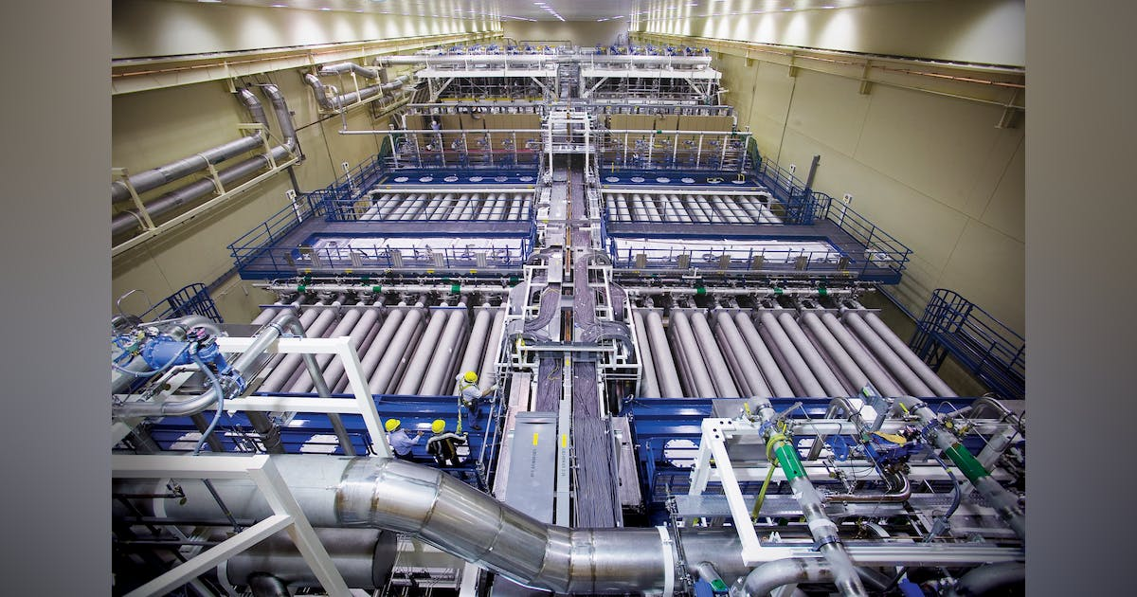

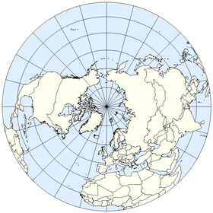
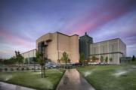


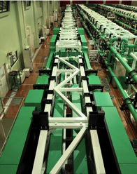
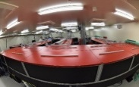
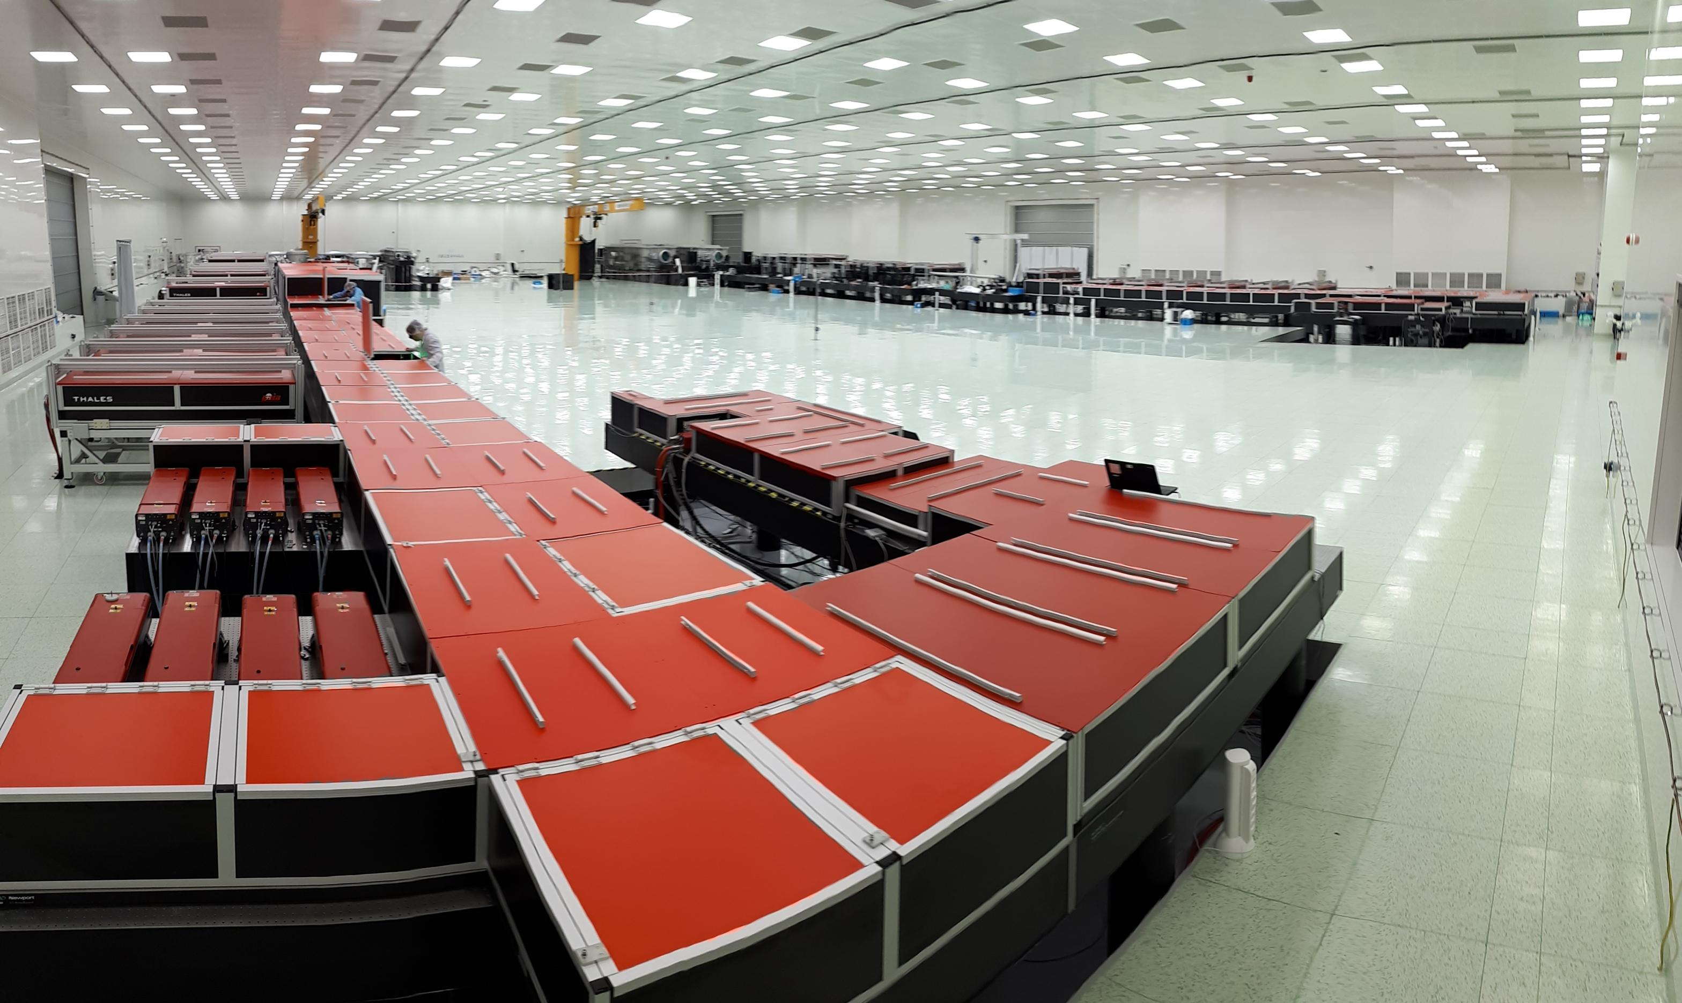

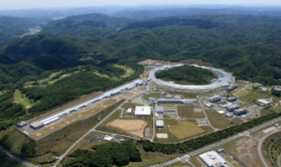
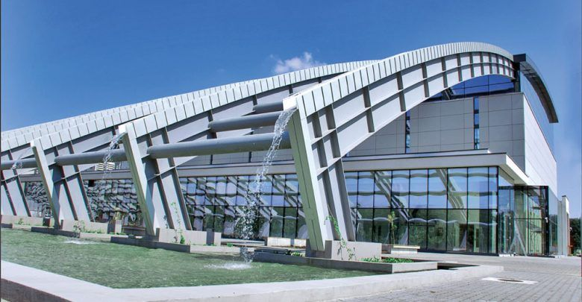
Activities at the Osaka University's Power Laser Facility are useful in conducting efficient collaborations with larger facilities in the world.
GEKKO XII
LFEX
HERMES@XFEL
we have now a laser facility GEKKO/LFEX, consisted of kJ long pulse lasers and kJ-PW short pulse laser, which is quite useful for laser fusion research especially for the Fast ignition scheme. We have also a laser facility at the Japanese XFEL facility SACLA in RIKEN, which is also important for HED science.

Slide 3

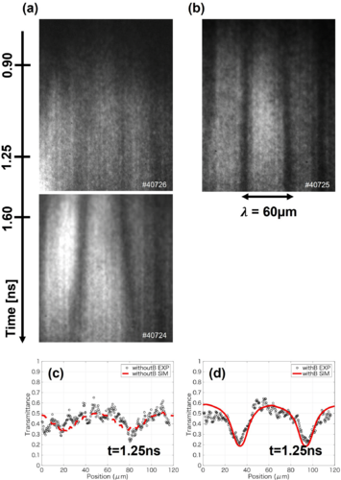
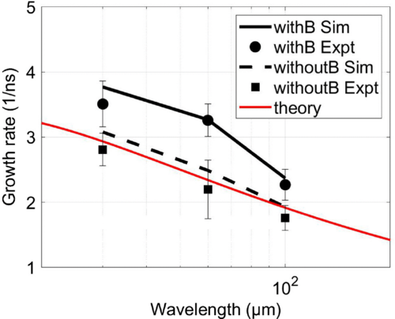
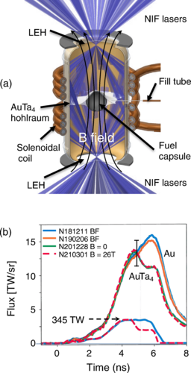
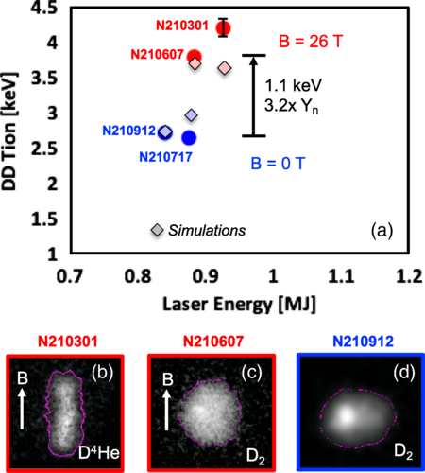
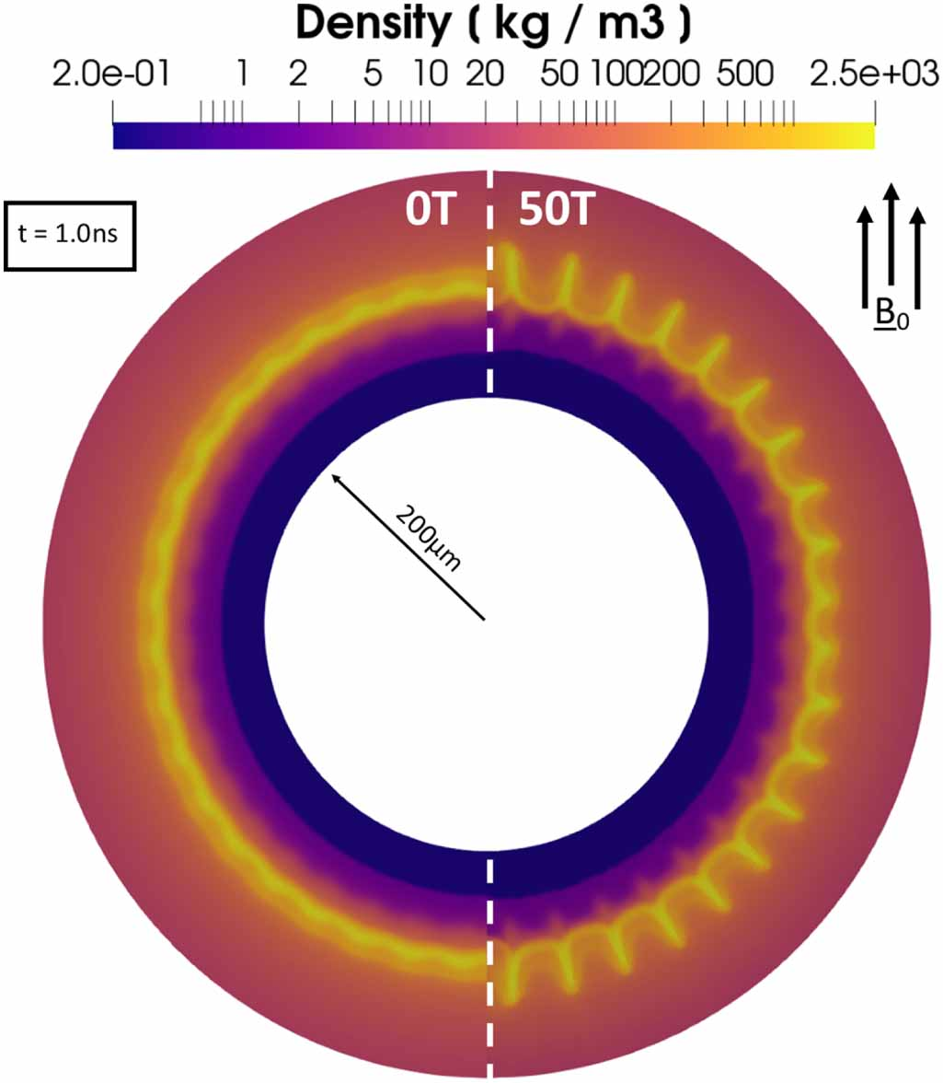
Combination of IFE and B-field
External magnetic fields increase the growth of hydrodynamic instabilities, but confine more heat in the hot spot, enhancing neutron yield..
Experimental observation of enhanced growth of RT instability in external magnetic field.
Integrated implosion experiment of external B-field assisted ICF concept on NIF
K. Matsuo, T. Sano, H. Nagatomo, ..., S. Fujioka et al., PRL 127, 165001 (2021).
J. D. Moody, B. B. Pollock, H. Sio, ..., S. Fujioka et al., PRL 129, 195002 (2022).
Reference: C. Walsh et al., PPCF (2020).

Slide 4
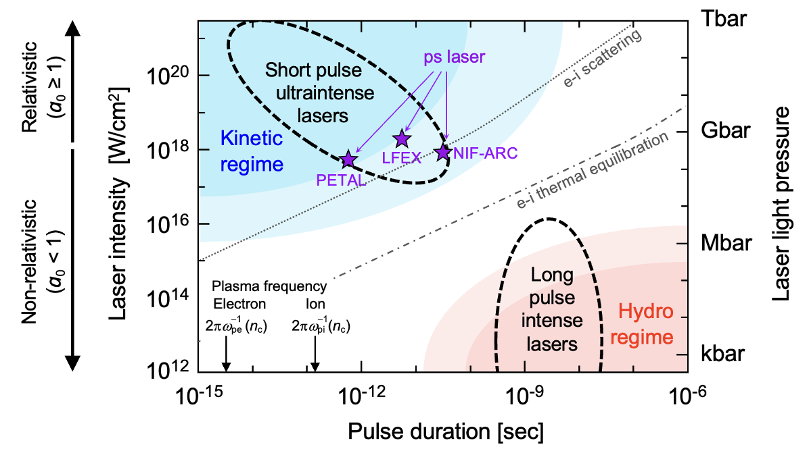
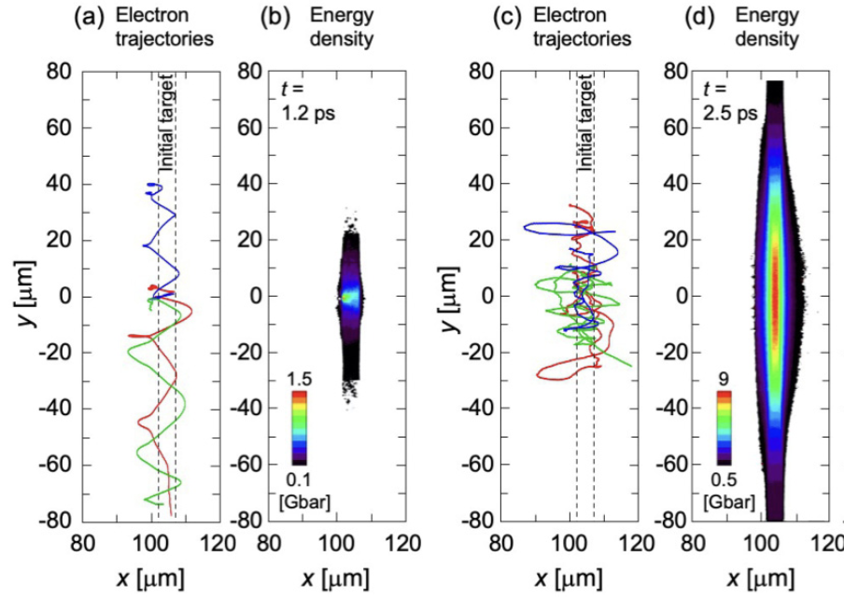
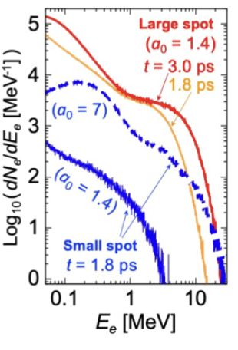
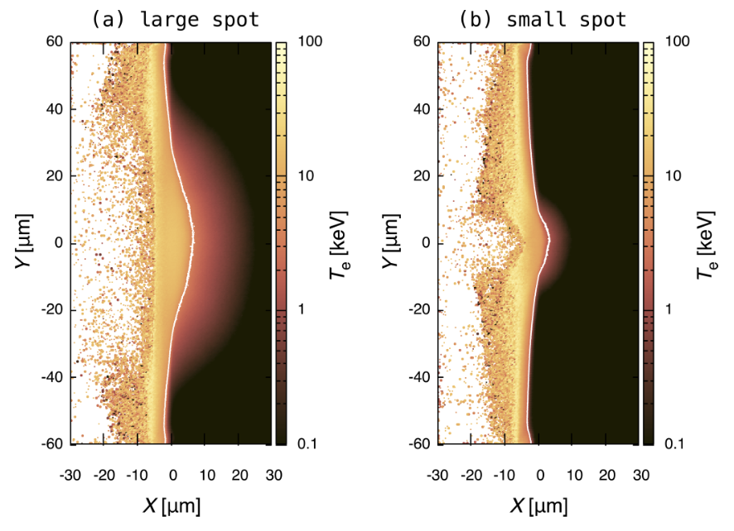
kJ petawatt laser light
Relativistic laser light with large focal spot has an advantage both for fast isochoric heating and ion acceleration
Small spot
Large spot
Large focal spot laser boosts electron energy
lateral
confinement
of fast e-
Large spot
Small spot
A kJ petawatt laser is in a new regime and it can heat a dense plasma over keV efficiently by diffusive heating.
Electron acceleration is also enhanced by the lateral confinement due to a geometrical effect of large focal spot and thus ion acceleration will be boosted.
→ proposal is accepted in NIF Discovery Science for 2023-2024
diffusive
heating
less
heating
[1] N. Higashi, N. Iwata et al., “Isochoric heating of solid-density plasmas beyond keV temperature by fast thermal diffusion with relativistic picosecond laser light”, Phys. Rev. E 105, 055202 (2022).
[2] N. Iwata, A. J. Kemp, S. C. Wilks et al., “Lateral confinement of fast electrons and its impact on laser ion acceleration”,
Phys. Rev. Res. 3, 023193 (2021).

Slide 5
A new role and possibilities in international collaboration on HED science with a new facility
GEKKO XII
J-EPoCH:
Japan Establishment for a Power-laser Community Harvest
LFEX
HERMES@XFEL
The present facilities in Japan are useful to make progress of international collaboration on laser fusion research. A proposing new type of the large laser facility with a high repetition and high power corresponding to more than 100kW averaged power. will have a new role and possibilities in international collaboration on HED science.

Slide 6
High-repetition, high-power laser facility: J-EPoCH, proposed for multiple purposes in HED science, including laser fusion research in Japan.
6

Slide 7
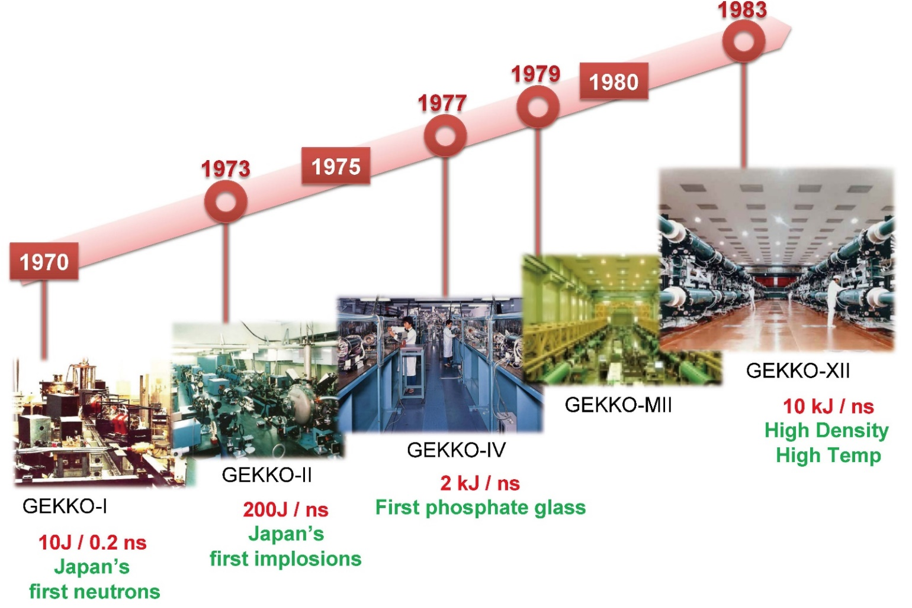
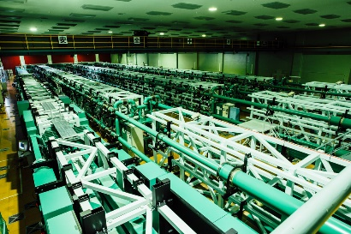

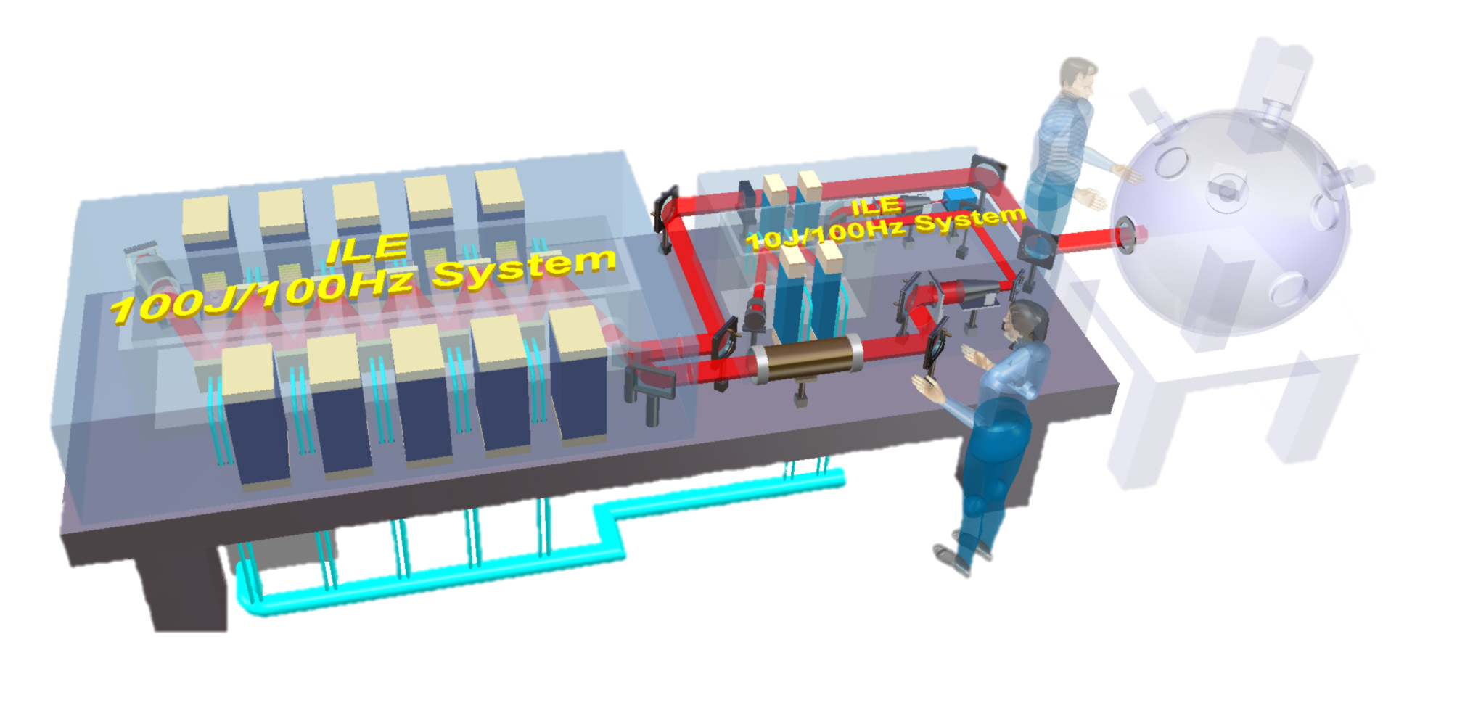
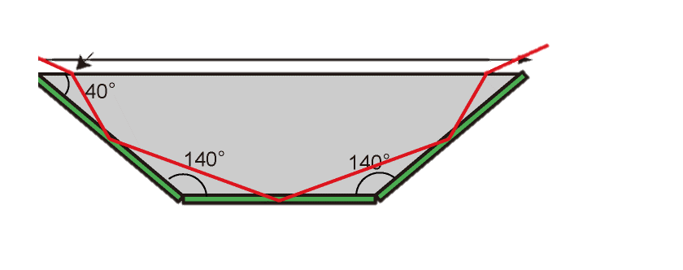
Progress and Prospect of Development of the Large-Scale High-repetition High-power Laser Systems
Single-shot glass lasers
2009
High Repetition and High Power Laser
Laser Fusion Reactor
Beam
aperture
35cmx35cm
0.0001Hz
HYPERION
LFEX
J-EPoCH
2 PW/2kJ/1ps
0.5MJ/2Hz/MW
for Clean H2 generation
2028
160 beams×
100 J×100Hz
JM-10
J-EPoCH Module 10 beams
We are here!!
Accelerate development of key technologies
Deepen understanding fusion plasma
Development of human resources
Active-Mirror
2022
2020
2022 FY Budget
100 Hz DPSSL
with Cryogenically cooled Yb:YAG
2015
10 J×100Hz
1 J×100Hz
10cm
35cm
・・
100J/10kW
1kJ/100kW
10kJ/MW
Integration of Advanced Tech.
New Ceramic
Smaller size, higher efficiency (room temperature operation)
7

Slide 8
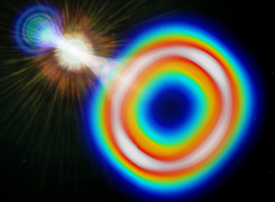
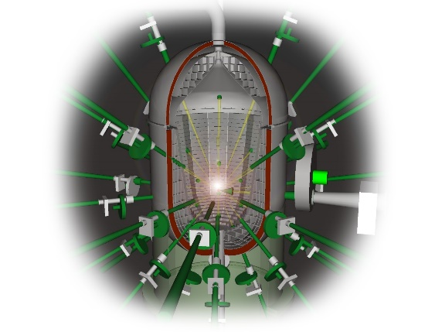
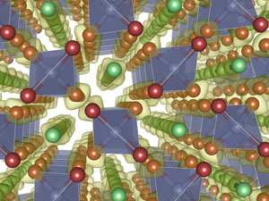
The J-EPoCH will open the Door to New Possibilities in HED science including IFE development.
10PW/10Hz：Quantum Vacuum Physics
Necessity: Data accumulation and statistical processing
Addition: Much higher EM fields will be expected by plasma photonic devices
Related fields： Quantum Physics, High Energy Physics, Astrophysics
8kJ/>10Hz: Laser Fusion Energy Science
Necessity: Data driven analysis of fusion plasmas for the optimization and repetitive-fusion-reaction technology development
Addition: Laser-fusion sub-critical power reactor engineering will.
Related fields： Fusion Reactor Engineering, Plasma Physics, Material Science
kJ/10-100Hz: High-Pressure Quantum Material Science
Necessity: Isentropic compression with an extremely precise-pulse controlled >kJ
laser with through the high repetition
Addition: Extremely low entropy compression will creates new Quantum Materials.
Related fields： Solid State Physics, High-pressure Physics and Chemist, Material
      Science, Planetary Science
8

Slide 9
Laser fusion research plan using the J-EPoCH
Deepening our understanding of fusion plasma with big data
Laser Plasma interaction
Deep-Understanding of Nonlinear process and instability in the laser-plasma interactions.
Optimization of laser-plasma interactions
Realization of stable and efficient laser fusion and deepening understanding of plasma physics
Implosion process
Deep-Understanding of fluid Instability of imploded plasmas
Seeking for the possibilities of Avoidance and Suppression of the instability
Heating process in the fast ignition scheme
Optimization of the heating efficiency
Start of laser fusion reactor engineering
Fusion reactor engineering with subcritical reactor (miniature reactor)
Establishment of energy conversion technology for pulsed fusion and contribution to fusion reactor engineering
Proof of Principle for Power Generation and Hydrogen Generation (Laser)
Reactor material development (Laser & Magnetic)
Tritium breeding (Laser & Magnetic)
Diverter heat load test (Magnetic)
9

Slide 10
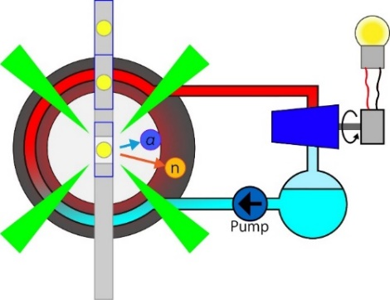
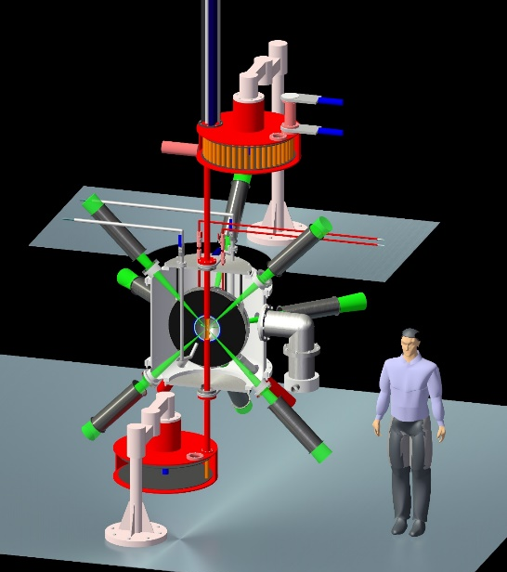
Laser fusion subcritical power of the J-EPoCH,
realized in the experimental area with symmetrical laser irradiation of 8kJ/>10Hz
Demonstration of power generation and hydrogen production proof-of-principle
using a simple target based on past experiences, rather than a special target,
8kJ/1～10 Hz
→ thermal energy 14 ～ 140 W→ electric power: >a few W
Fusion reactor material technology
1～10Hz/8kJ
→ 10¹³～10¹⁴ n/sec； 6.6 x 10¹³ ～ 10¹⁴ n/m² sec @10cm
as a Neutron production of 10¹³ /shot
Tritium Breeder Technology, a Fusion Fuel
Tritium Breeding Ratio ：6.8 x 10⁻⁶ （3.8 x 10¹¹ /5.6 x 10¹⁶）
as a Tritium product of 3.8 x 10¹³ /100 shots; with Radioactivity of 6.8 x 10⁴ Bq
various applications other than the demonstrations not only for IFE but also for MFE
A. Iwamoto and R. Kodama, Nucl. Fusion 61, 116075 (2021)
10

Slide 11
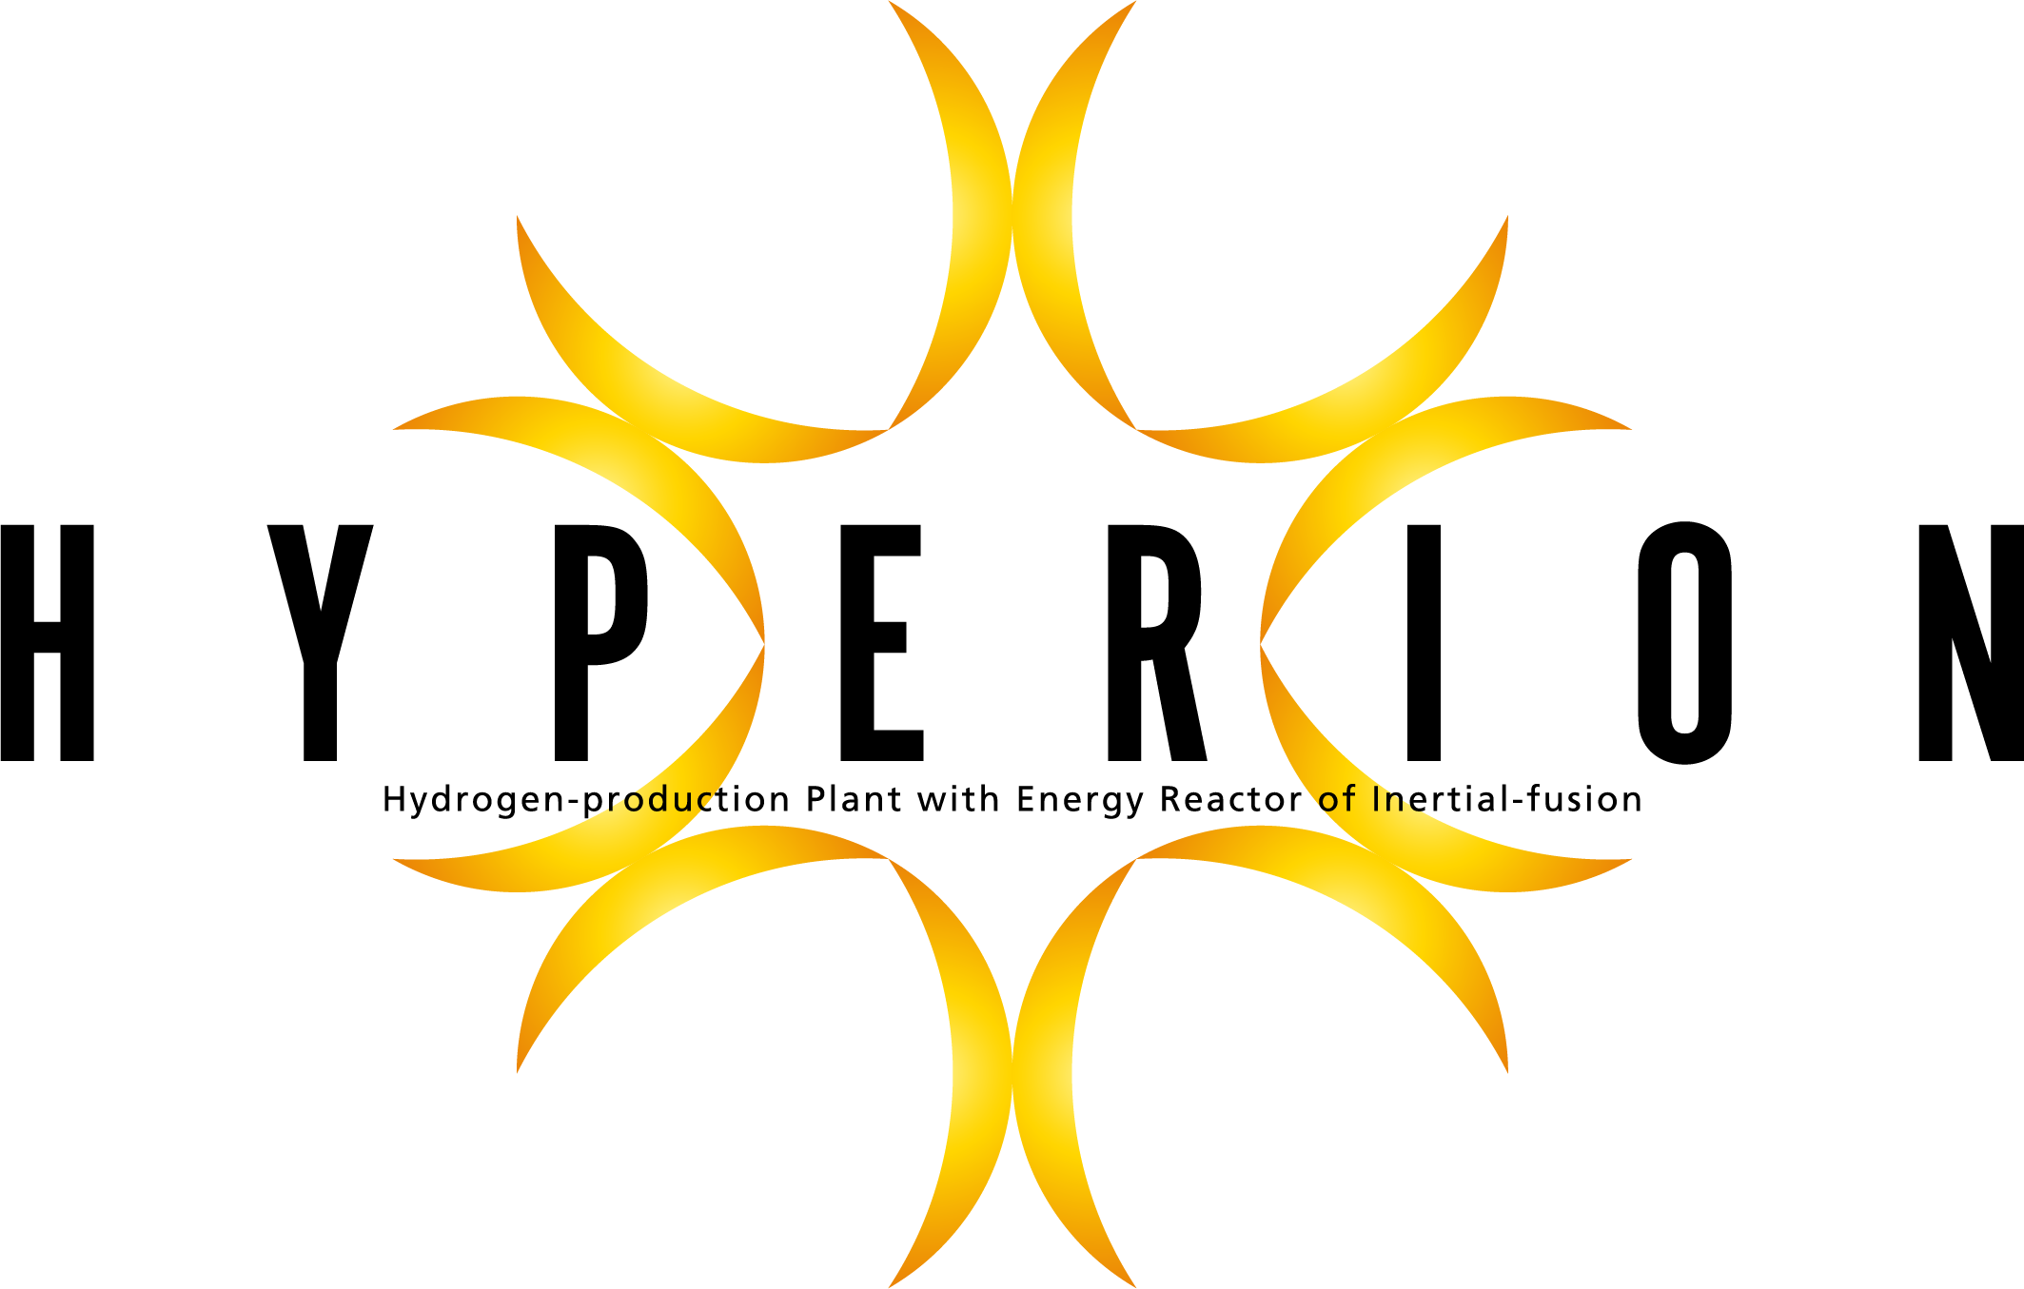

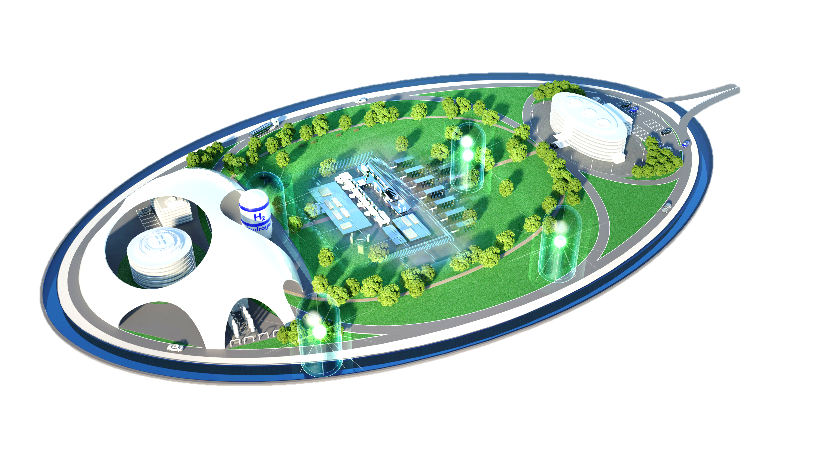


Challenge for Laser Fusion Reactor by 2050 based on the J-EPoCH project in Japan
2021-2022
2030
２０４０～2050
SENJU
J-EPoCH
HYPERION
（Test reactor –
Commercial Reactor）
(module）
（Multi purpose）
Challenge a laser fusion reactor
compact fusion reactor
2022 FY Budget
100Hz/10０J Laser
Test facility of the high repetition laser
1-100Hz/10kJ Laser
Sub-critical reactor
Demonstration of Generation of Electric Power and Clean H2
Data-base of Laser fusion plasma for optimization
MW laser
Consumer
HYPERION : Hydrogen-production Plant with Energy Reactor of Inertial-fusion
Single-shot base achievements
both a test reactor for power generation and a commercial reactor for clean hydrogen production, taking into account the difficulties of actual grid connection
Accelerate the development of key technologies and human resources
Demonstration of highly efficient fusion based on a fast ignition system
International collaborations
11

Slide 12
Summary:
HED science revolutionized by High-repetition & High-power Laser Facility
Multi-purpose, high-repetition and high-power laser facility: J-EPoCH is proposed as a new generation of a large-scale laser facility for HED science in Japan.
The J-EPoCH is based on 160 beams of the 100J/100Hz laser module: SENJU. The prototype of the SENJU has been budgeted in 2022FY.
The J-EPoCH will open the Door to New Possibilities in HED science including IFE development.
3 grand challenges : Quantum Vacuum Physics, Laser Fusion Energy Science and High-Pressure Quantum Material Science
deep diving of HED science including laser fusion plasma physics through data-drive science with the high repetition system.
A lot of emerging technologies in material science and life science
The J-EPoCH activities are necessary for the IFE development.
Accelerate the advanced technology development for the IFE reactor
Development of human resources for the IFE program
12

