Slide 1
ORNL Perspectives on Maximizing Fusion Pilot Plant Success
Mickey Wade for the ORNL Team
Oak Ridge National Laboratory
Fusion Power Associates Annual Meeting
Dec. 7, 2022

Slide 2
ORNL approach to an FPP program: Fundamental Values
Fusion energy is hard, no single institution can do it all

Slide 3
ORNL approach to an FPP program: Fundamental Values
Fusion energy is hard, no single institution can do it all
Fusion should utilize all resources
  Data/information: include critical lessons learned and data from ITER, nuclear/fusion industry, and other domestic and international facilities
  People: a lot of people want to help, they shouldn’t have to switch institution, or start their own company to contribute their talent

Slide 4
ORNL approach to an FPP program: Fundamental Values
Fusion energy is hard, no single institution can do it all
Fusion should utilize all resources
  Data/information: include critical lessons learned and data from ITER, nuclear/fusion industry, and other domestic and international facilities
  People: a lot of people want to help, they shouldn’t have to switch institution, or start their own company to contribute their talent
Public and private sectors both have important roles to play in accelerating progress
  Public → advancing the understanding of common challenges and dispersing knowledge, technology, and experience
  Private → rapidly capitalizing on emerging capabilities and advancing new products/approaches

Slide 5


ORNL Perspective: Public sector effort should be structured to enable near-term and intermediate-term private roadmaps
Private Enterprise
Public
Sector
Public
Reference
Designs
FPP Concept
Design-to-Build
What needs to be done now to demonstrate viability of concept?
What needs to be put in place now to be in position to meet future milestones of range of concepts?
Near-term
focus on
concept
Intermediate-term
focus on
common needs
Milestone 1
Milestone 3
Milestone 5
Milestone 7
Milestone 9
Concept
Development
Timeline
Decision to
Construct
Milestone 2
Milestone 4
Milestone 6
Milestone 8
Milestone 10

Slide 6
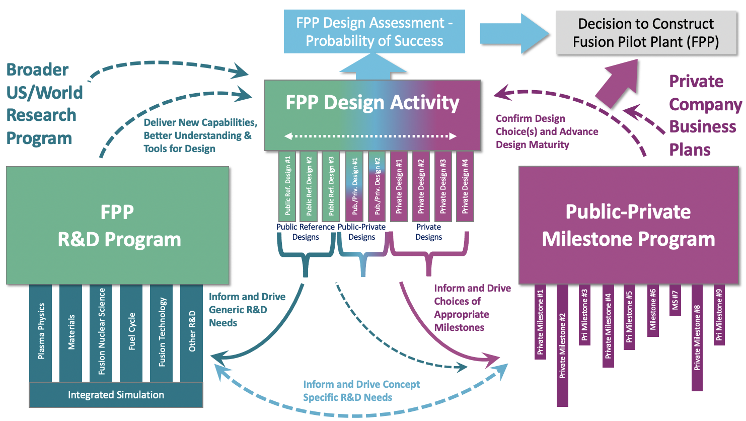

A Successful Fusion Pilot Plant Development Program Will Require Three Strongly Linked Elements

Slide 7
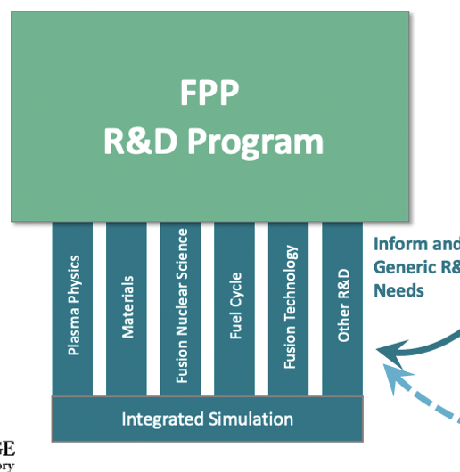
Publicly Supported Fusion Pilot Plant R&D Program Targets New Capabilities, Better Understanding, and Advanced Design Tools
Broad R&D program driving knowledge development in critical science/technology areas
Objectives:
  Provide broad and deep technical foundation for wide range of concepts
  Advance technical readiness levels of technologies needed by all concepts
  Leverage enormous intellectual capital in public sector
  Provide opportunities to assess integration challenges at range of scale (from proof-of-concept to industrial)

Slide 8
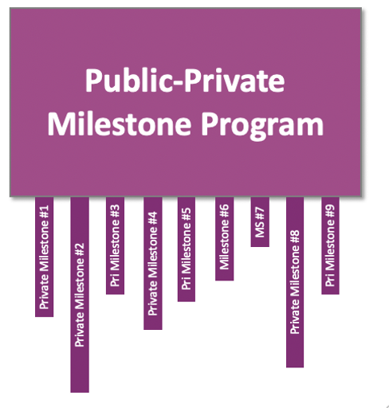
Milestone Program Critically Needed to Advance Technical Readiness of Most Promising Approaches
Milestone Program is meant to:
  Confirm design choices and advance design maturity
  Be open but competitive
  Rapidly advance technical readiness levels of trailing technologies
Key features:
  Down-select approaches as needed to maintain aggressive posture on most promising concepts
  Be privately driven with public support and evaluation

Slide 9
Design Activity Needed to Provide Direction/Impulse; Both Private and Public Efforts Needed
Private designs:
  Design-to-build
  Driven by private company capabilities and business plan
  Private staff supported by public sector expertise
Public Reference Designs:
  Conceptual design
  Open to all including private staff
  Allow assessment of integration issues and the potential impact of focused R&D
  Put options on the table that improve range of concepts
  Create the expertise that private companies will need in addressing downstream challenges
  Provide entry pathway for all public sector staff into FPP design

Slide 10
Without Public Reference Designs, the Linkages between the Elements are Much Weaker

Slide 11
Our Conclusion: A Public Reference Design Effort Will Likely Prove to Be a Critical Piece of this Puzzle

Slide 12
What is ORNL doing?
milestone FOA submission
FPP* pre-conceptual design and technology roadmap
FPP preliminary design review
2022 | 2023 | 2024 | 2025 | 2026 | 2027 | 2028 | 2029
ORNL aims to maximize the probability of timely credible design(s) that projects to commercial viability (leveraging private interest/capabilities) by:
  playing a central role in FPP design by providing integrated toolset
  foundational R&D needed for low-TRL, longer term milestones
  development and demonstration of technology components

Slide 13
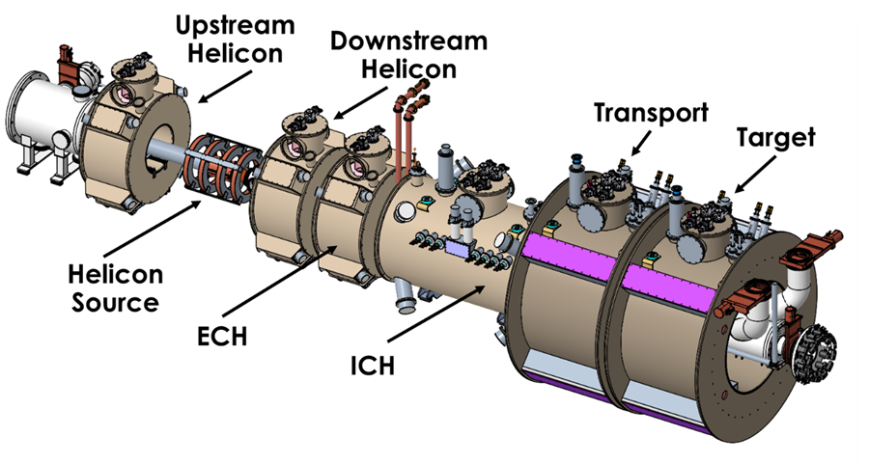
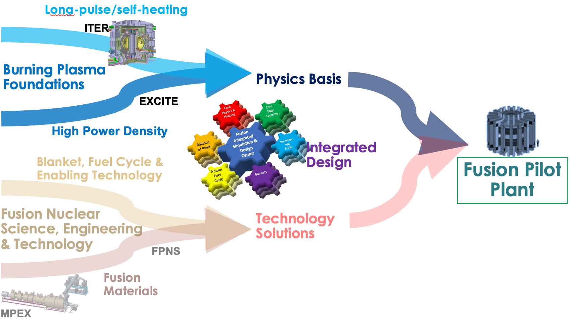
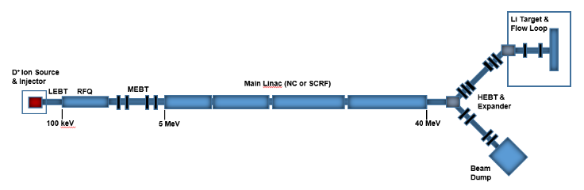
ORNL Role in FPP Development in the 2020s is Three-Fold
Solution Provider
Integrator
Enabler
Maintain and expand R&D portfolio focused on fusion’s most challenging problems
Leverage broad discipline expertise to deliver/inform promising FPP designs…
Deliver facilities central to fusion development…
…while working with private companies to advance their technical readiness
BCTF
Surface Heating
Magnets
Test Blanket Component
MPEX
Vacuum Enclosure
He Coolant
PbLi breeder/coolant
FPNS
…embodied in a comprehensive physics/ engineering toolkit for simulation and design
Notes:
\

Slide 14
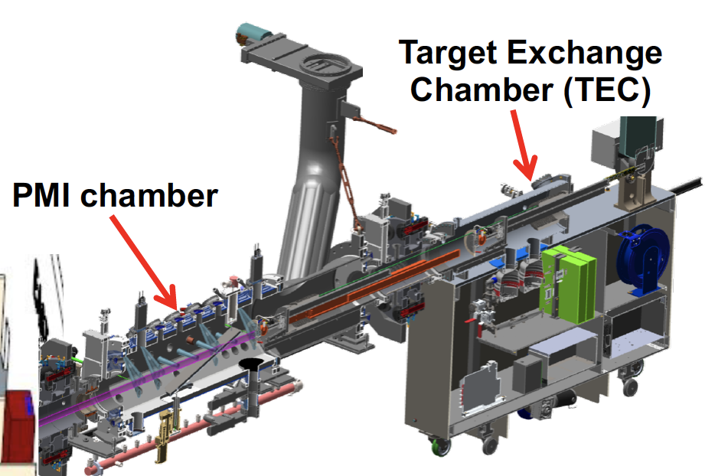
MPEX will be a platform to test and advance understanding of plasma material interactions in a FPP-relevant environment
MPEX capable of lifetime exposures of materials in 2 weeks of operation
Separate heating systems for control of parameters at target
  Helicon (Electron density), EBW/ECH (Electron temperature), ICRF (Ion Temperature)
Interchangeable target with capability of
10 MW/m² and exposing irradiated materials and liquid metals (small amounts)
W erosion at 10 eV
Fusion Power Plant
MPEX
C-mod
JT60-SA
ITER
DIII-D
JET
EAST
Planned project completion in Q2FY28
(early completion March 2026)

Slide 15
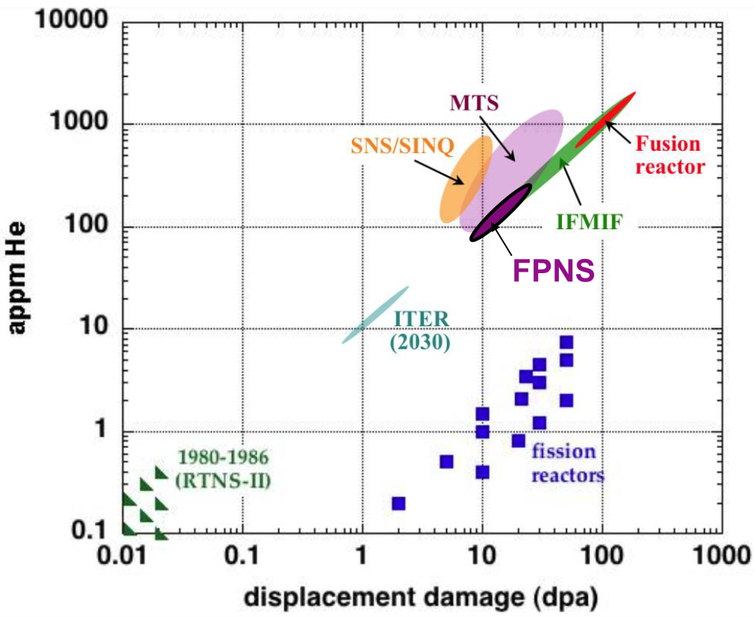
EPRI-led Workshop Revisited Fusion Prototypic Neutron Source (FPNS) Goals
2018 workshop: To address this gap, we propose to build a near-term, moderate cost neutron source to advance the scientific understanding of materials under simulated D-T neutron irradiation
2022 workshop largely upheld previous workshop findings, but…:
  A timeframe was added to the requirements (by 2028 or earlier)
  Requirements were also added for an upgraded FPNS (by 2032 achieve 15 dpa/yr in Fe in a volume of ≥ 300 cc)
Figure adapted from FESAC Report DOE/SC-0149, February 2012.

Slide 16
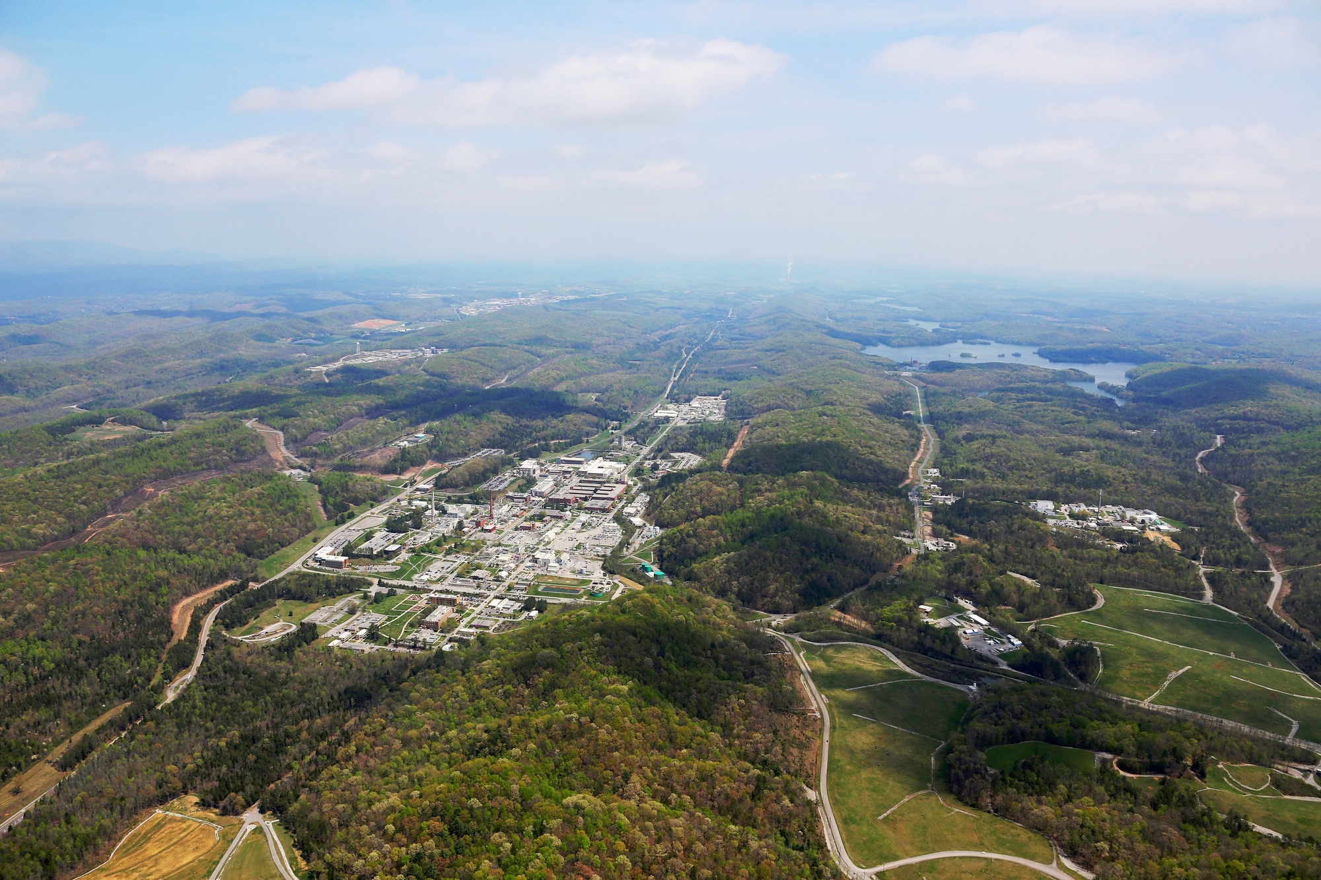
ORNL Has the Capabilities and Interest to Host a Future Fusion Pilot Plant and Demonstration Facilities
Our Capabilities:
  Multiple siting options with access to required water and electricity needs
  Demonstrated capability to host major projects consisting of national teams
  Broad range of technical capabilities important to pilot plant success
Currently working with DOE to establish siting policy for private facilities
Aerial view of ORNL

Slide 17
Summary
ORNL is committed to FPP success, addressing the key issues with highest leverage on performance and cost
Public sector strength is ability to look ahead
A public reference design effort is needed to assess the fully integrated system and anticipate downstream issues that may not be readily apparent

