Slide 1
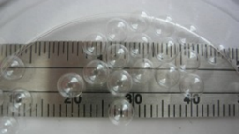
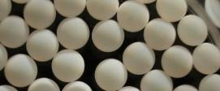
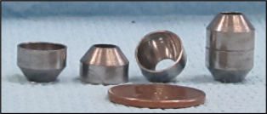
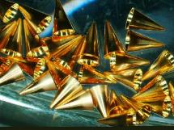
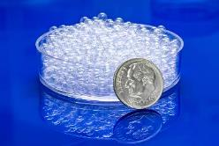
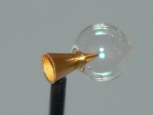

Wetted Foam Targets for Inertial Fusion Power Plants
By
Neil Alexander
Director of Inertial Fusion Energy
Shell/capsule
Foam Shell
Hohlraum
Presented to
Fusion Power Associates
Cone-in-shell
Washington DC,
December 19-20, 2023

Slide 2
Inertial fusion energy (IFE) power plant have a number key R&D needs
A proven, robust, (fabricable/affordable) target design
A long-life, affordable, high shot-rate, driver
Affordable, precise, mass-production of targets
A long-life, reliable target injector
Accurately hitting the targets on-the-fly
Survival of cryogenic target fuel to chamber heat flux
Debris/target waste removal/chamber reset strategy
Long-life final ‘optics’
An affordable target chamber survival strategy
Long-life blanket (tritium breeding and heat transport to power conversion)
Efficient tritium recovery and purification
GA IFE Group’s Emphasis
Injected targets
Tritium Processing
Many items directly or indirectly involve the target

Slide 3
There are many potential IFE target types
Several of the many IFE target types:
New target designs may appear
Targets are <~~1cm in size
Each target design can be the core of an IFE plant
At a single driver facility many target designs can be tested
Capsule with IR reflective coat
Capsule with IR reflective coat
(a)
(b)
(c)
(d)
Hollow cone
Sealed capsule with IR reflective coat
Hohlraum (High Z interior)
Tamper
Propellent
Pusher
P2 Shield (High Z)
Thin film windows and supports
(f)
(e)
(g)
Distributed radiators (metal foams)
Many target design utilize a spherical foam shell
Solid pure DT layer
Solid DT in foam
Cylindrical liner
(low Z)
Liquid DT in foam
Nano-wire forest
“Wetted Foam”
(h)
(i)

Slide 4

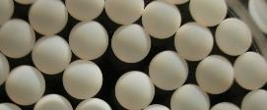
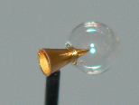
Inertial fusion energy (IFE) reactors use many targets
Goals for target factory mass production:
Low cost targets
Small fraction of energy value of target’s yield
~10’s cents laser and ion drive
~$2 pulse power
High production rate
~1 to 10 Hz laser and ion drive,
~0.1 Hz pulse power drive
High precision: ~10 µm
Components and assembly
Smooth surfaces: up to ~10’s to 100’s nm
Spherical shells, “cylinders”, cones, foams
Each target design has its own tolerances
The target needs to be fueled
Cryogenic DT, usually “layered”
Shell/capsule
Foam Shell
Hohlraum
Cone-in-shell
Foam density for
“Wetted Foam” ~5 - 50mg/cc

Slide 5





Studies have shown the feasibility of a cost-effective IFE target supply for energy
% of Energy Value
Goodin, D.T., et al, “A cost-effective target supply for inertial fusion energy”, Nuclear Fusion 44 (2004).
Direct Drive Laser Fusion
Heavy Ion Fusion
Z-Pinch IFE (ZFE)
Laser Inertial Fusion Engine (LIFE)
1-10 μm CH Overcoat
Thin (300-1200 Å)
High Z coating
Foam + DT
DT
DT Vapor
~ 2.3 mm rad
~1 cm
Foam layer:
0.18 mm thickness Divinyl Benzene (DVB) or Resorcinol-Formaldehyde (RF)
If the selected process meets precision, targets should be affordable

Slide 6
Our estimates for direct drive target production costs are encouraging
Chemical engineering approach to Target Fabrication Facility (TFF)
Costing is done for an “nth-of-a-kind” plant
Major Parameters
500,000 targets per day
25% reject rate
Installed capital of $97M
Annual operating cost of $19M
Cost per injected target estimated at 16.6 cents
Conceptual layout for NRL high gain target production
Each contactor:
ID 50cm x 50cm long
26 gallon (98 L)
~6% filled with targets
8 hours of targets at 6 Hz
Nuclear Fusion, 44, (2004), 254-265
Full Presentation - HAPL April 4/5, 2002
(http://aries.ucsd.edu/HAPL/MEETINGS/0204-HAPL/program.html)

Slide 7
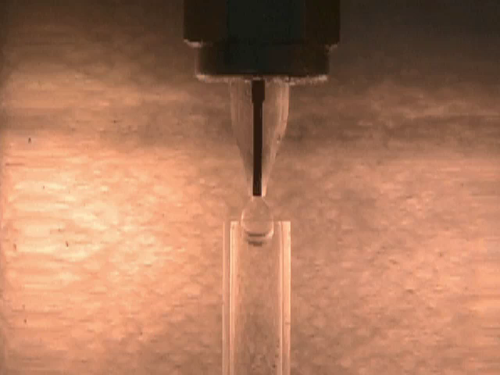

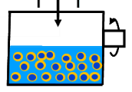
Polymer or foam capsules can be made at IFE rates by blowing “bubbles” in solution (aka micro-encapsulation)
Polymer solution
Plain solution
Droplet generator produces at ~1Hz
Achieving high yield of centered capsules is the challenge
DVB Foam capsules, 4.6 mm dia. X 180 µm wall
FOAM CAPSULES (100mg/cc) FROM HAPL ERA
Pumping solutions forms bubbles
Yield, %
PAMS Capsules, 4.0 mm dia. x 35 µm wall
Agitation and heat to center and cure bubble into capsules
Solvent exchange and critical point drying
SPEC
Non-Concentriicity, %
Today’s wetted foam target concepts will want lower foam density

Slide 8
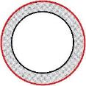
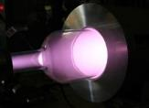
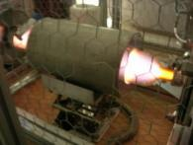

Mass production methods to over-coat foam shells were developed during the HAPL program
Seal large pores of foam with polyvinylphenol (PVP via interfacial condensation)
Reinforce with GDP layer (Glow Discharge Polymer)
Sputter coat an IR reflective layer on top (Au:Pd)
Overcoats
A) Interfacial reaction
The rotary horizontal GDP coater scales to mass production – arbitrary length
B) GDP coating
Au/Pd alloys coated on shells for reflection of thermal heat load in reactor; hydrogen permeable
Interfacial Condensation
Solvent A with reactant C
C) Sputter coating of metal (Au/Pd)
Solvent B with reactant D
A & B immiscible, so C & D react at capsule surface to form layer

Slide 9
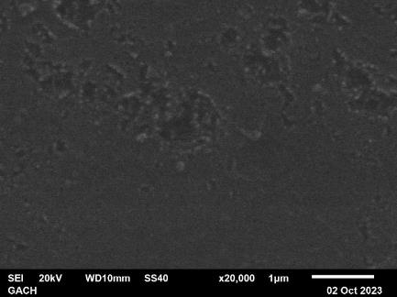
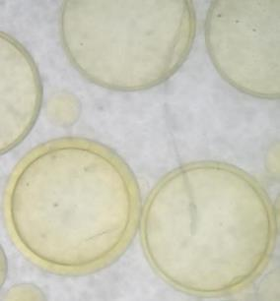
NEW – GA’s GACH foam chemistry adjusted for micro-encapsulation in droplet generators
Overcoats well (from foam billets)
Surface GACH micro-encapsulated bead, 25 mg/cc
First GACH foam compound droplets have been formed (25mg/cc nom.)
Low density (2 – 200 mg/cc billets made), small pore size
Pure CH, no oxygen
Deuterated feed stock available for pure CD

Slide 10
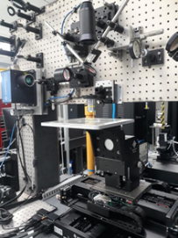
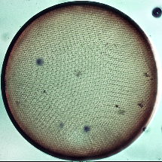
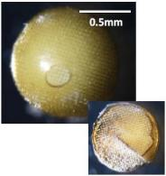
GA has built its own, open architecture, 2 photon polymerization (2PP) additive manufacturing (AM) systems – Printing WF targets and foam inside of capsules demonstrated
Arbitrary structure printed inside of PAMS capsule
2PP-AM graded density foam
Foam printed inside of GDP capsule still in resin
Energy 1 Photon (1PP)
Energy 2 Photon (2PP)
2PP System at GA
2PP printed shell with foam interior
Polymerization Threshold α Ι
Polymerization Threshold α Ι²
Conduction Band
Conduction Band
0.5mm
λ = 400nm
λ = 800 nm
800 nm
Flexible output, sub-micron resolution
Determined structures, even foam structure
There are many strategies for increasing throughput (e.g. multiplexing 2PP laser; MHz)
e⁻
e⁻
Objective Lens
Objective Lens
800 nm
Valence Band
Valence Band
Speed increase needed for IFE

Slide 11
Schemes to speed up additive manufacturing
Use area projection rather than scanning points voxels
Use chemistry that turns into foam, instead of scanning foam struts
4060 projections (1um) vs 2 billion voxel (1um)³ scan moves
Scan multiple capsules at once
Each target is small, ~4mm
Many will fit onto a single scanning stage
66²=4356 on (30 cm)² stage
24hr/4356= = ~20 sec
Short pulse lasers have energy to support many simultaneous printing spots
2000 demonstrated (W. Ouyang, Nature Comm. 2023)
Scan voxels
Project cross-sections
One pattern/laser in
Multiple patterns/lasers out

Slide 12
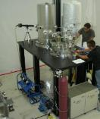
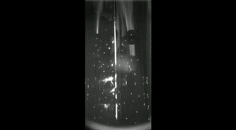
GA developed a cryogenic fluidized bed for layering the DT/D2 solid fuel layers
E-folding time of DT material migration is
H_{s}*ρ_{s}/q_{s} = 26 minutes
q_{s} volumetric heating DT 5.02e-2 W/cm³
Hs heat of sublimation of DT 1580 J/mol
ρ_{s} density of solid DT 5.03e-2 mol/cm³
Layering cavity for one target
LAYERING
Heat from beta decay (DT) or imposed IR D2 cause surface of DT/D2 to move until isothermal
Thicker regions are hotter, higher vapor pressure, condense preferentially on thinner colder regions
In one target experiments, the capsule is placed in the center of a spherical cavity of a copper block to force a concentric spherical isotherm
In the cryogenic fluidized bed, the random spinning and circulation provides a time averaged spherical isotherm determined by the sphericity of the capsule
Provide spinning is much faster than layering time constant (~1/2 hour for beta layering)
Fluidized Bed
Frit
11K bed Video, 1/17th normal speed, Empty capsules
Cryogenic Gas Flow

Slide 13
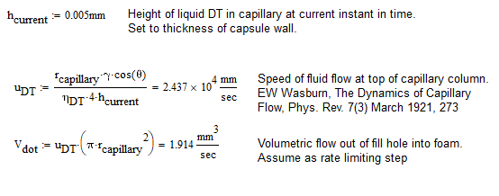
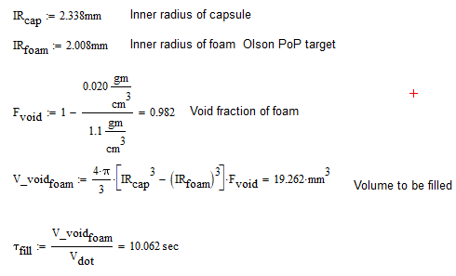
Wetted foam target concept - Filling via wicking into foam layer can be rapid
r_{capillary} := 0.005mm
Capsule Wall
Fill Hole (Capillary)
Foam layer
10 second fill time possible
Filling and layering occur simultaneously
Will lead to much lower tritium inventory than permeation filling
Liquid DT

Slide 14
For LDD target, tritium inventory can be low for wetted foam target systems
DT gas in
? DT
Fill and Layering Station
DT recovery System from Blanket (vacuum disengager)
? DT in TPS
Blanket
Cup
? DT in blanket
Liquid DT in condenser/HX/dispensing 1.14 gm T (1.9gm DT)
Equivalent to 1 m x 0.13” ID line
Capsule
Tritium Purification System
Mid-point
chamber
Vacuum Pumps/disengagers
<<1 targets worth DT at shot time
R 3.343mm
DT gas in Line 0.016 gm Tritium.
Line 25m x 0.13” ID;
T=300K; <P> = 0.61 atm
6 cups for filling
60 cups for wicking into foam capsule
Liquid DT in cups 0.62 gm T (1.03 gm DT)
Target Injector
Fill and Layering Station
Queue for Injector
1 targets worth DT
Target to queue for injector
1 cup for target removal
For a DT mass multiply by 3/5 for tritium mass
Target DT mass 4.43 milligram (Olson et al PoP 2021 wetted foam target design; yield 62MJ)
Shot frequency 6 Hz (372MW_{thermal})
3 targets worth DT
59 cups for adjusting capsule fill
Rough estimate, at least 1.8 gm Tritium needed for target systems
Does not include DT adsorbed on walls or permeated into reactor surfaces
Does not include reserve DT or reserve filled targets

Slide 15
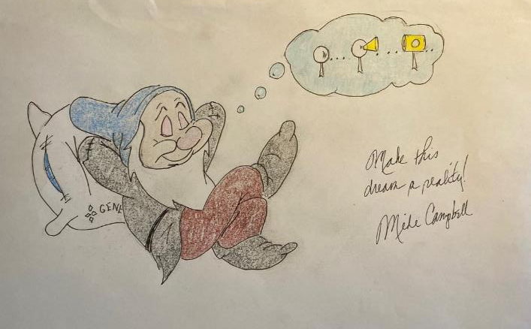

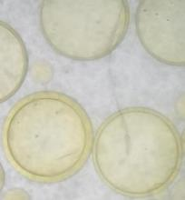
Plenty of target R&D to do in IFE
Questions?
First GACH foam compound droplets have been formed (25mg/cc nom.)

Slide 16
Outside-in construction would coat interior of capsules with foam using random rotation
Micro-encapsulate capsules
Laser drill hole in capsules
Rotary slip joint
Fill capsules with foam forming solution
Rotating, varying pitch, spiral cure tube
Long spiral rotating curing tube would allow foam layer to coated inside of capsules in a continuous flow of capsules

