Slide 1



A talk by…
EUR ING Jack Astbury
Chief Engineer – Fusion Pilot Plant
Fusion Power Associates
Washington DC, 12/19/23

Slide 2



Our Technology Advantage
+
=
Spherical Tokamak
*
HTS Magnets
Efficient Fusion
High efficiency
Advanced simulation
50% less magnet materials*
Quench proof
Stable plasma control
Robust design
* Versus conventional tokamak
* High Temperature Superconducting
Notes:
1 slide summary of Tokamak Energy’s approach.
Improved physics performance inherent in the ST. – Unlocked by HTS magnet technology.

Slide 3
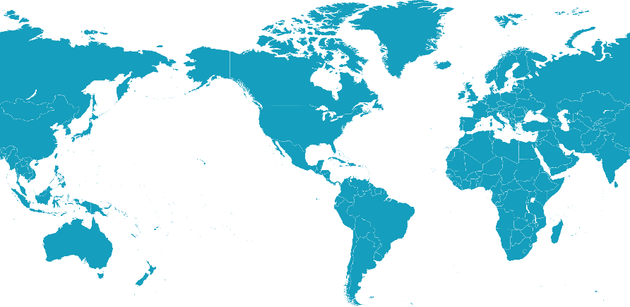





About Tokamak Energy
250+ people
UK Headquarters
(Oxford Fusion Cluster)
World-class scientists, engineers and commercial specialists
60 PhD, 75 MSc
US subsidiary
With strong research and
commercial partnerships
$250+M raised to date
Financial backing from private capital and government grants
Japan & Asia-Pacific
Priority for supply chain
and market entry
Collaboration
Governments
National laboratories
Strategic partners
Strategic partnerships, MOU’s and research agreements worldwide
Notes:
Started as spinout from Culham but now grown into one of the largest private fusion companies.
Global network with major collaboration and strategic partnerships beyond the UK – Japan, Australia, Europe and of the course the US. Our modus operandi is to move with pace and agility making rapid innovation and progress at low TRL while simultaneously building relationships with industrial partners, research organisations, and strategic market entrants to keep up technology development momentum at increased scale.
One such collaboration we were excited

Slide 4


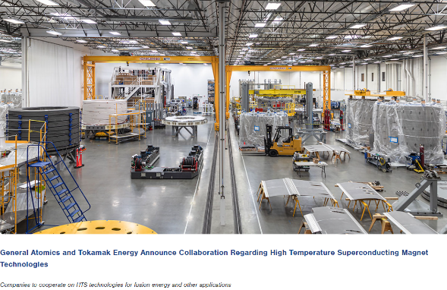
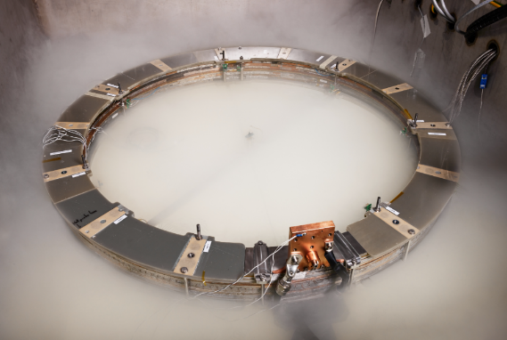
A Prime Example of Global Collaboration in Action
“GA has significant experience, knowledge and facilities to produce large superconducting magnets at scale. Tokamak Energy has been developing HTS technologies for fusion for over a decade. The integration of these complementary capabilities promises to accelerate the development and production of HTS technologies in additional fields, such as aviation, naval, space and medical applications.” – Warrick Matthews, CEO, Tokamak Energy (May 30 2023)
Notes:
(As you heard this morning from Wayne Solomon) One such example of a collaboration partnership in 2023 was an agreement between Tokamak Energy and General Atomics to partner in taking Tokamak Energy’s R&D of HTS magnet and scaling that up to increased scale using General Atomic’s capability from the ITER program in large magnet manufacture.
The left image here is GA’s facility in California, and the image on the right is a small PF coil produced in-house at Tokamak Energy using patented IP.
As you can read from the quote on screen, the integration of these two capabilities allows us to move at pace and focus Tokamak Energy’s effort where they can have the greatest impact: namely innovative technologies, early R&D of breakthrough ideas, and technical integration of systems into a fusion pilot plant.

Slide 5

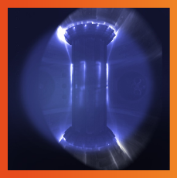






Record of Achievement
2022
Highest plasma ‘triple product’ of any
private fusion company
2022
First private fusion company to achieve
100M°C plasma ion temperature in a tokamak
2021
Robust, scaleable, quench-protected HTS magnet precisely validating our simulations
2020
World-record 24 Tesla field at 20 K with patented HTS magnet technology
2017
Designed, built and operate the world’s highest-magnetic field spherical tokamak (ST40)
2015
First HTS tokamak sustained pulse for >24 hours (ST25 HTS)
Notes:
This slide shows some highlights of Tokamak Energy’s achievements leading up to this year – from the first all HTS tokamak that ran for 29 hours in 2015, to building world record performance small prototype magnet systems, and the record of being the first private fusion company to achieve 100 million Kelvin thermal ion temperature in a tokamak with to date the highest nTtau triple product in the private fusion field

Slide 6
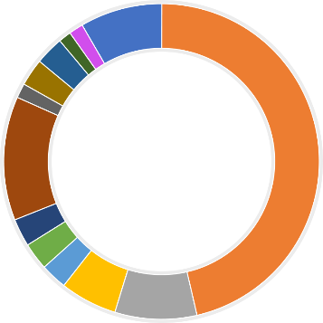

IP Generation and Protection
2022
Highest plasma ‘triple product’ of any
private fusion company.
Magnet
Technology
Spherical Tokamak Design
2022
First private fusion company to achieve
100M°C plasma ion temperature in a tokamak.
Plasma Control
6
Fuel Cycles
2021
Robust, scaleable, quench-protected HTS magnet precisely validating our simulations
2
Breeder Blankets
2
Reactor Maintenance
>75 Patent
Families
Reactor Control
2020
World-record 24 Tesla field at 20 K with patented HTS magnet technology.
35
9
Plasma Facing Components
2
Power Supply and Cryogenics
2017
Designed, built and operate the world’s highest-magnetic field spherical tokamak (ST40).
2
Plasma Initiation and Ramp
2
4
Neutron Tolerant Materials
6
Mechanical
2015
First HTS tokamak sustained pulse for >24 hours (ST25 HTS).
Radiation Shielding
Notes:
I show this slide not just because of the slide transition but also because it gives some indication of the depth and breadth of Tokamak Energy’s IP position; while magnet technologies are the foremost patent area, we do have developed ideas in a number of other technology families – some of which I’ve been involved in.

Slide 7

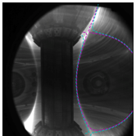





Continuing to lead…
2024
ST40 preparing…for the gyrotron
2024
Secure STX funding & global delivery partners
2024
JV STEP Engineering Consortium and FFP work
2023
Achieved a diverted plasma with higher currents, sustained for longer durations
2023
U.S. Department of Energy award as part of its bold decadal vision.
2023
A world-first set of new generation HTS magnets
Notes:
This plot is the achievement timeline you saw before but updated to show major accomplishments from this year, and what we are looking forward to in 2024.
We made major progress on the manufacture of HTS magnets for the DEMO4 magnet system – and I will have more to saw about that in a few moments.
We returned ST40 to operations and achieved diverted plasma with a plasma current around half a MA sustained during the flat-top.
And we secured a place on the US Department of Energy’s Milestone-Based Fusion Development Program, which we are thrilled to be a part of and look forward to many more successes on that Program to deliver a Fusion Pilot Plant to the US. I will also have more to say about that shortly.
But looking ahead to 2024, as we announced at the SOFE conference in July, we are looking forward with excitement to the next phase of UKAEA’s STEP program. Tokamak Energy is unique in the fusion engineering landscape given the heritage on both spherical tokamaks and high temperature superconducting magnets, so we want to work with UKAEA to move STEP forward. We are looking forward to the tendering process next year.
STX, which is our proposed follow-on device to ST40, passed its CDR in September of this year, and in 2024 we are moving forward with securing specific financing for that project working with strategic partners to make that happen.
Lastly, we will have yet more upgrades for ST40 – in 2024 we will start work to make ST40 ready for its gyrotron upgrade further increasing performance and investing non-inductive start-up.

Slide 8

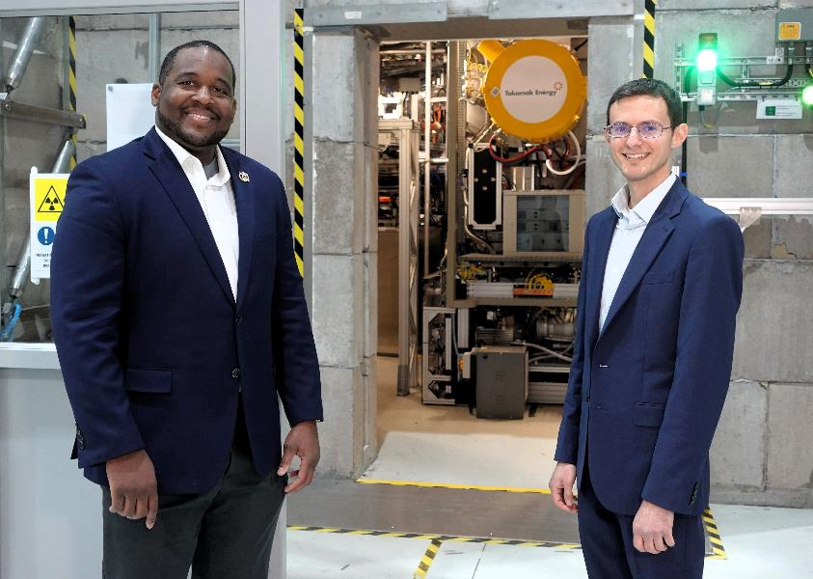

Introducing Tokamak Energy Inc.’s New Leadership
Working alongside Prof. Mark Koepke at TE Inc. (USA) and TE Ltd.’s 250+ team (UK)
Left:
Dr Aaron Washington PMP Technical Project Manager
TE Inc.
Right:
Dr Michael Ginsberg EngScD President
TE Inc.
Bold Decadal Vision:
“The objective of achieving net-zero global carbon emissions has made the acceleration of fusion energy a national priority.”
Notes:
I mentioned two things earlier: 1) that Tokamak Energy is now a genuinely fully globally networked fusion player; and 2) that we were delighted to have won a place on DOE’s Milestone Program. We have long held aspirations to be a central presence to the US fusion ecosystem. We have recently taken the next step in that journey by making the first two full time hires for our US subsidiary, Tokamak Energy, Inc. Please allow me to introduce you to Aaron Washington and Michael Ginsberg who will be based in the U.S. and working on our public private partnerships on the Milestone Program, on INFUSE projects, and other PPP opportunities moving forward. We are extremely thrilled to have Aaron and Michael on board. They are pictured here on their last visit to Tokamak Energy in the UK just outside the bio-shield with ST40 behind them.
As a side note, before I became Chief Engineer, my background is in Nuclear Engineering and I led the functional design of that bio-shield. I know that the FPA is not supposed to be a technical talk, but I could not help mentioning that project, and I extend the invitation to any past, present or future nuclear engineers or those with an interest in neutronics to come find me; it was a fascinating project. Or see my slides from the ANS conference in Seattle last year; I think they are still available online.

Slide 9
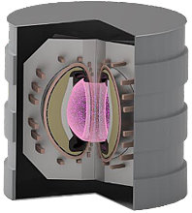
The Path to a Pilot Plant
An (extremely!) abridged version
ST physics basis
Fusion Pilot Plant
Burning plasma scenarios and control
RF plasma start-up and ramp-up
Plasma facing components
Tritium breeding blankets
Technology challenges
HTS magnet technology
Deuterium-Tritium fuel cycle
Fusion relevant materials
Fusion compatible diagnostic systems
Tokamak maintenance strategy
Advanced radiation shielding
Notes:
Moving onward, I want to introduce some of the technological challenges Tokamak Energy is working on to close the gap to a Fusion Pilot Plant. We sometimes colloquially refer to them as fusion building blocks, so if you hear me slip into that vernacular, then these are the challenges I am referring to.

Slide 10
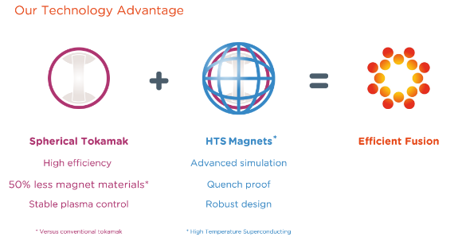
The Path to a Pilot Plant
An (extremely!) abridged version
ST physics basis
Fusion Pilot Plant
Burning plasma scenarios and control
RF plasma start-up and ramp-up
Plasma facing components
Tritium breeding blankets
Technology challenges
HTS magnet technology
Deuterium-Tritium fuel cycle
Fusion relevant materials
Fusion compatible diagnostic systems
Tokamak maintenance strategy
Advanced radiation shielding
Notes:
Clearly I do not have enough time to go over all of these in any level of detail, but I will say a few words about two of these. Why these two?
[CLICK]
Well if you recall the earlier slide, I mentioned that the two key elements on our technology advantages lie in developing and operating spherical tokamaks and gaining new insights into their physics, and in using HTS magnet technology to access the massive advantages that ST’s have and turn that into a commercial fusion plant. So it makes sense that I talk to you today about these two – as much as I’d like to stay on the home turf of nuclear engineers and talk about breeding blankets and radiation shielding

Slide 11
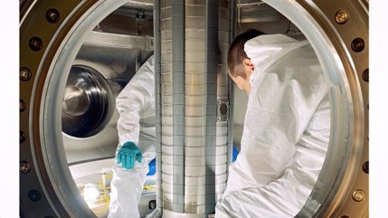
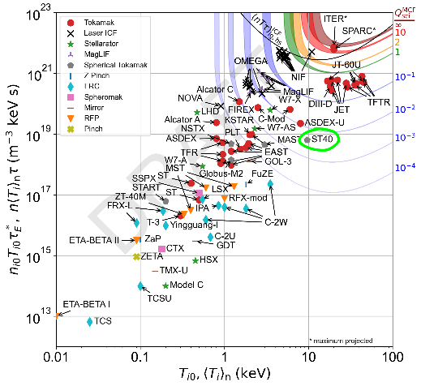


The Path to a Pilot Plant
ST40 – record triple product and <Ti> for a ST; upgraded in 2023
ST physics basis
Burning plasma scenarios and control
RF plasma start-up and ramp-up
Plasma facing components
Tritium breeding blankets
Technology challenges
HTS magnet technology
Deuterium-Tritium fuel cycle
Fusion relevant materials
Fusion compatible diagnostic systems
Tokamak maintenance strategy
Advanced radiation shielding
Notes:
So, ST40. You can see on the plot where ST40 occupies on the NtTau universe. But the real achievement is that it occupies the record nTtau and temperature for a Spherical Tokamak but does so in a much smaller device, at a fraction of the cost and in much shorter timescales than other devices of a similar performance.
Of course, we are very much looking forward to our friends and collaborators at PPPL getting NSTX-U operating again in the near future and beating ST40’s record. We very much hope that happens.
If you have good eye-sight you can see some of the diagnostics data from one of the high performance shots on ST40, and inside the vessel during a recent upgrade

Slide 12
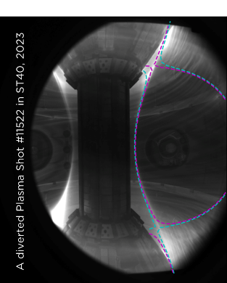
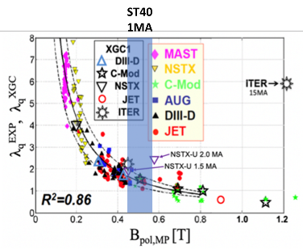
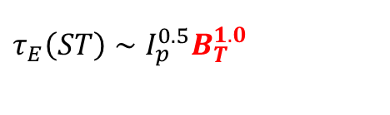
ST40: Expanding the high field ST physics basis
Confinement & stability at high field
  Strong scaling of confinement observed on others STs with increasing toroidal field
Solenoid-free start-up schemes
  Merging compression and RF driven start-up
High performance reactor relevant operating scenarios
  High bootstrap, high performance regimes with dominant RF H&CD
Characterise divertor performance
  Scrape-off layer width scaling at high poloidal and toroidal fields
$$τ_{E}\left(ST\right)∼I_{p}^{0.5}B_{T}^{1.0}$$
Kurskiev, G. S., et al. 2021 Nucl. Fus .62.
.
Chang, C. S., et al. 2021 PoP 28
© 2023 Tokamak Energy Private and Confidential
Notes:
Moving forward with ST40, we plan to further prove the expected very strong correlation of energy confinement scaling with toroidal field on ST’s – providing more evidence that we are on the right line with HTS and Spherical Tokamaks.
I mentioned that we want to investigate non-inductive start-up techniques, as well as accessing higher plasma performance.
We have also installed and commissioned some IR camera diagnostics to measure the scrape off width at the divertor, which supports our INFUSE collaboration with CS Chang at PPPL. We already have some data from that, and we plan to produce much more. The SOL width of course is a very important parameter for Spherical Tokamaks, especially on the inboard divertor leg.

Slide 13
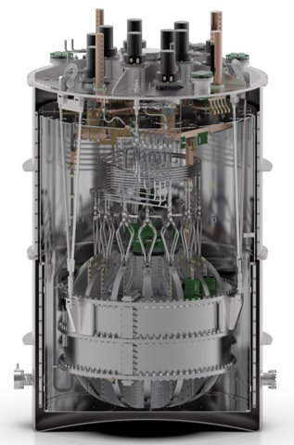
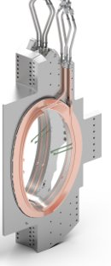
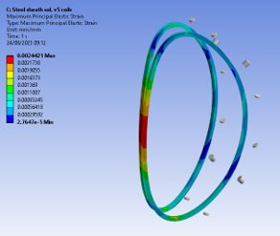
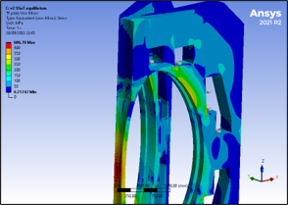
The Path to a Pilot Plant
Leading HTS Magnets Technology – Testing and Modelling
ST physics basis
Burning plasma scenarios and control
RF plasma start-up and ramp-up
Plasma facing components
Tritium breeding blankets
Technology challenges
HTS magnet technology
Deuterium-Tritium fuel cycle
Fusion relevant materials
Fusion compatible diagnostic systems
Tokamak maintenance strategy
Advanced radiation shielding
Notes:
On Magnets, I have already mentioned our collaboration with General Atomics, but we are making progress on advanced dynamic modelling as well as the DEMO4 assembly.

Slide 14
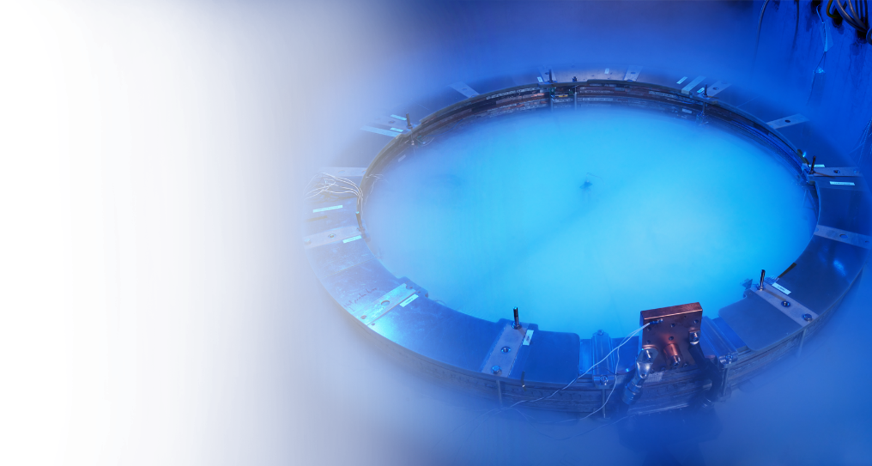


HTS Magnet Achievements at Tokamak Energy
2023
Gamma irradiation system under test at Sandia National Lab
2021
HTS magnet quench protection scheme demonstrated
2019
World-record 24 Tesla field at 20 K with patented HTS magnet technology
2015
First HTS tokamak sustained pulse
for >24 hours (ST25 HTS)
Notes:
You have seen 3 of these points from earlier on in the presentation, but it is another excuse to show the PF coil test in the liquid nirogen bath – this time in a nice blue hue. But it is also an opportunity to say a word about the GAMMA experiment at Sandia. This year, we finished the design and build of a cryogenic test rig which allows us to take HTS tape stacks to operating temperature and energise them so they are at a field in-situ while they are being irradiated by gamma rays and live performance diagnostics data of the tapes are being taken. This allows us to predict whether HTS tapes are sensitive to gamma irradiation, as some studies have claimed, and if so which tapes are sensitive. Those tapes are being irradiated as I speak and producing reams of data.

Slide 15
© 2023 Tokamak Energy
Notes:
Here is DEMO4. It is a busy slide so I won’t speak to all of it, but I’ll say a few words while you read the highlights. It is an ambitious project to build a full all-HTS magnet set and operate it in high-field - using patented tape winding and coil fabrication techniques. This is essentially to understand coil-on-coil interactions and improve our in-silica models for the interaction as well as demonstrating engineering performance of the assembly. Coil manufacture and assembly of the DEMO4 lab are well underway.

Slide 16


The Path to a Pilot Plant
The US Milestone-Based Fusion Development Program will be used to close technology gaps on all fronts
ST physics basis
Fusion Pilot Plant
Burning plasma scenarios and control
RF plasma start-up and ramp-up
Plasma facing components
Tritium breeding blankets
Technology challenges
HTS magnet technology
Deuterium-Tritium fuel cycle
Fusion relevant materials
Fusion compatible diagnostic systems
Engineering Consortium is commercialisation vehicle
Tokamak maintenance strategy
Advanced radiation shielding
Notes:
Of course, all of these building block challenges are required to be closed out to lead to a pilot plant. We have developed plans to address these areas.
[CLICK] To do that we are working with our partners in the US on the Milestone Program to close out these issues – as this slide’s animation attempts to illustrate.

Slide 17
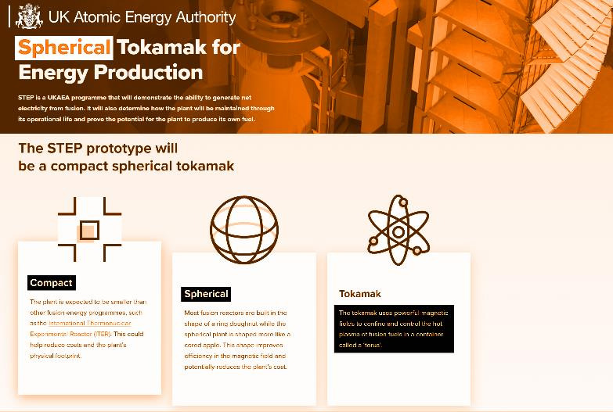
STEP Consortium
UKAEA STEP Program
Public/private collaboration
£20B govt. funding (20 years)
IP vests with private partners
Tokamak Energy
The ONLY private spherical tokamak company in the world
The leader in HTS magnet technology
Key partner in the Engineering Consortium to deliver STEP
Notes:
I want to finish with a last word on STEP, the UK Government’s prototype fusion power plant.
I get asked a lot about whether STEP is a competitor, and the answer is certainly ‘no’ – it is great to see UKAEA following the HTS Spherical Tokamak approach to commercialise fusion power, and a fantastic endorsement. As I said earlier, we very much would like to contribute to STEP as an engineering partner; and this absolutely complements rather than competes with what we are doing on this side of the Atlantic on the DOE’s Milestone Program; especially in light of the recent UK/US Fusion Collaboration Agreement. We very much want STEP to be a roaring success, and we applaud UKAEA’s initiative to making that happen.

Slide 18




Contact us:
Jack Astbury
Chief engineer – fusion pilot plant
jack.astbury@tokamakenergy.com
www.tokamakenergy.com
Thank you
Tokamak Energy Ltd
173 Brook Drive
Milton Park
Oxfordshire OX14 4SD
United Kingdom
Notes:
With that, I thank you for your time. I will happily take any questions.

