Slide 1
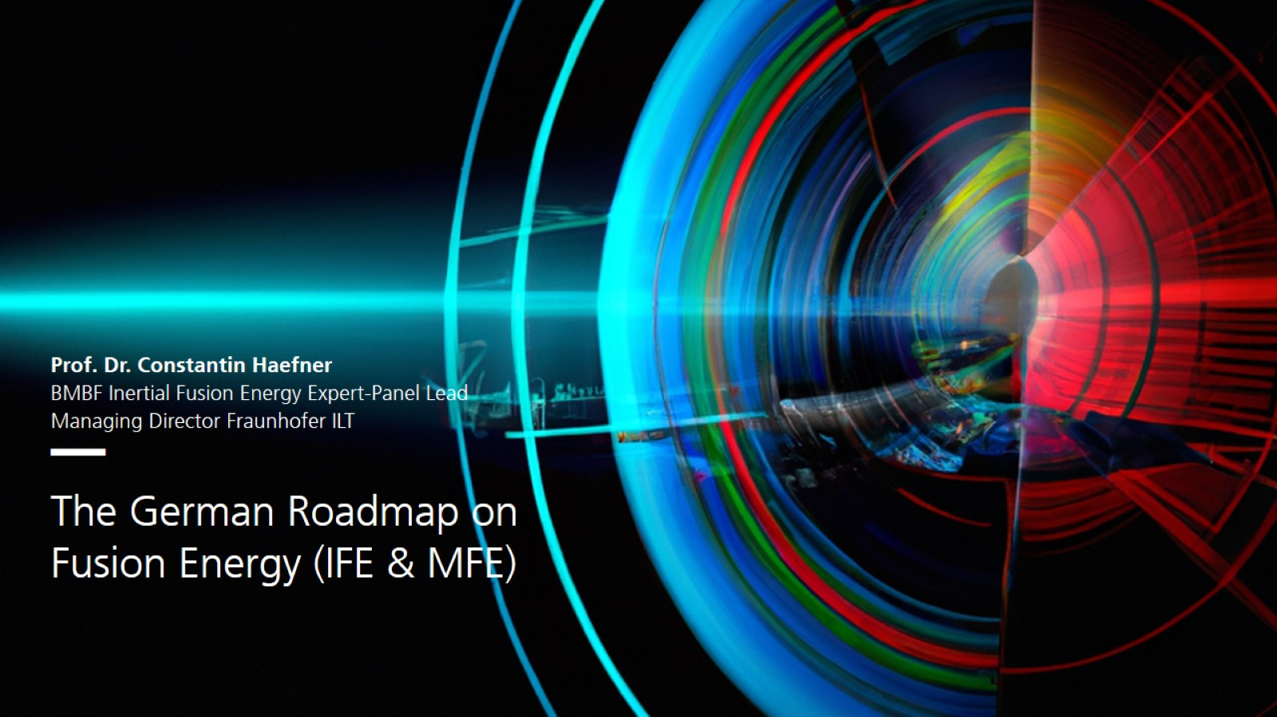

Slide 2
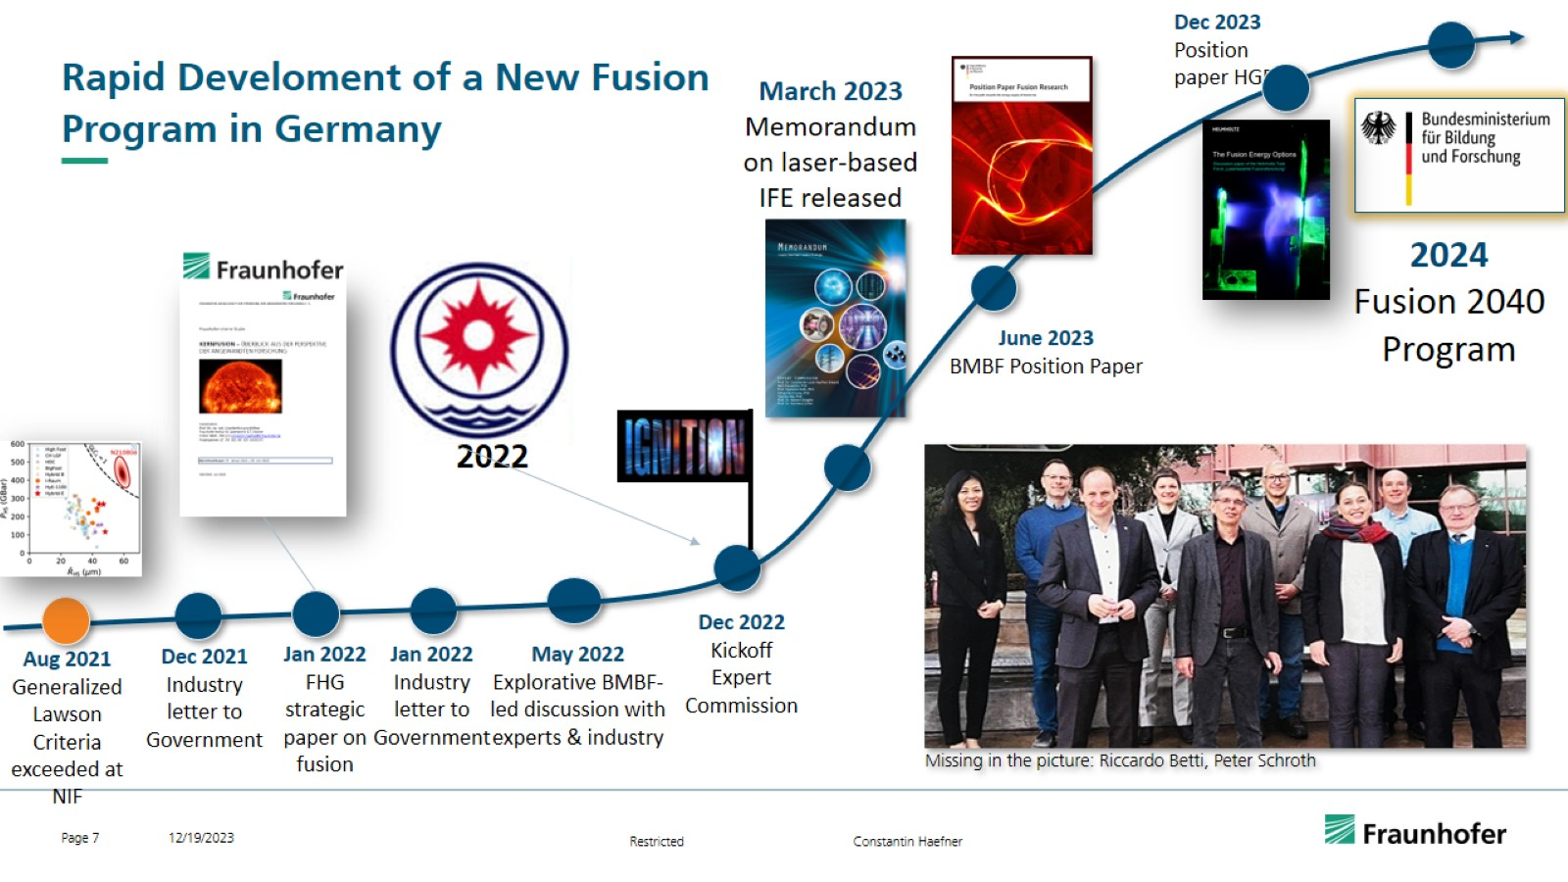
Rapid Develoment of a New Fusion Program in Germany

Slide 3
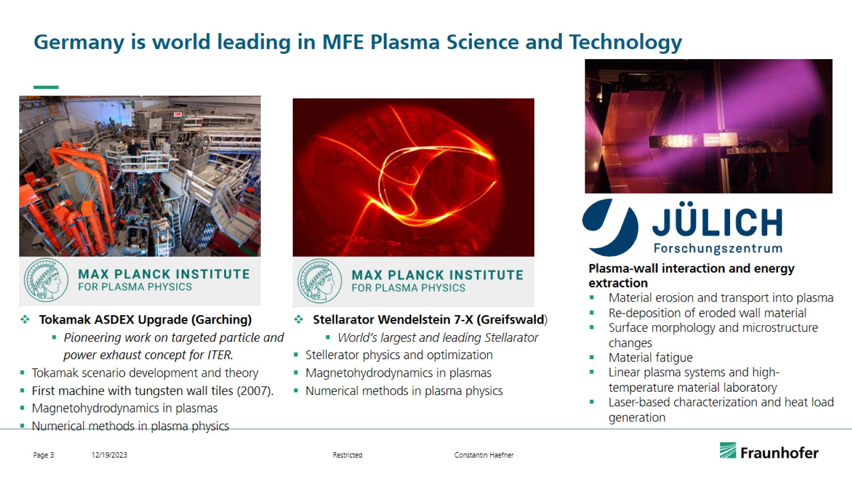
Germany is world leading in MFE Plasma Science and Technology

Slide 4
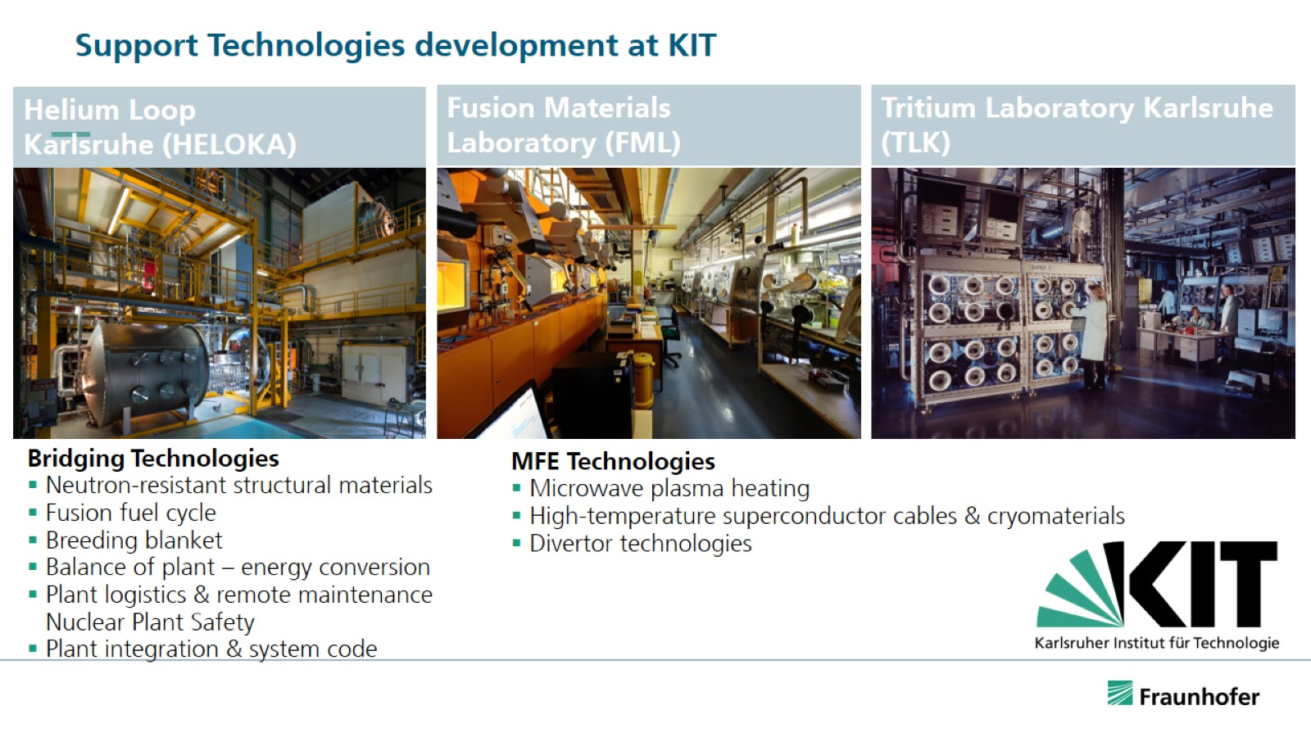
Support Technologies development at KIT

Slide 5
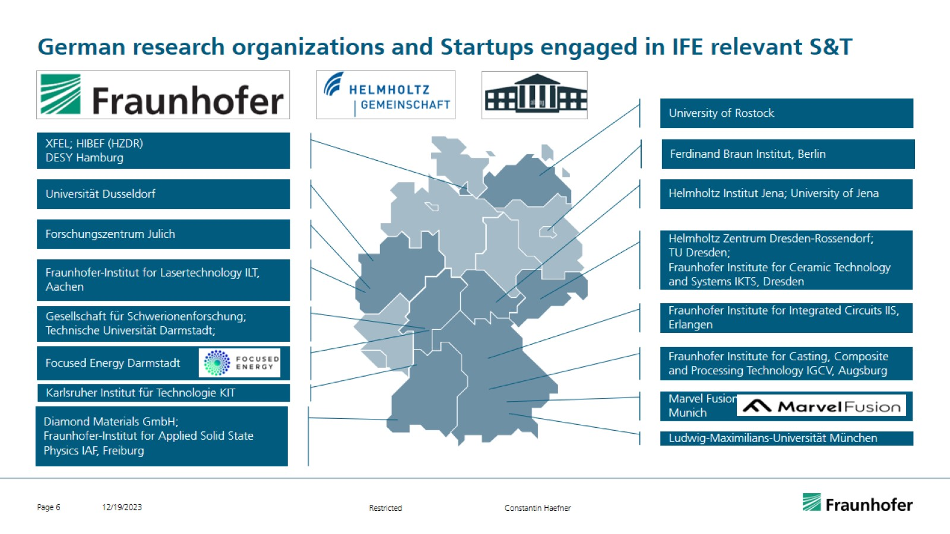
German research organizations and Startups engaged in IFE relevant S&T

Slide 6
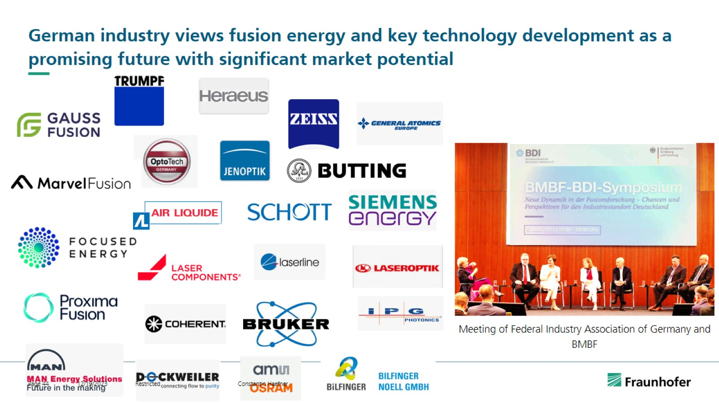
German industry views fusion energy and key technology development as a promising future with significant market potential

Slide 7
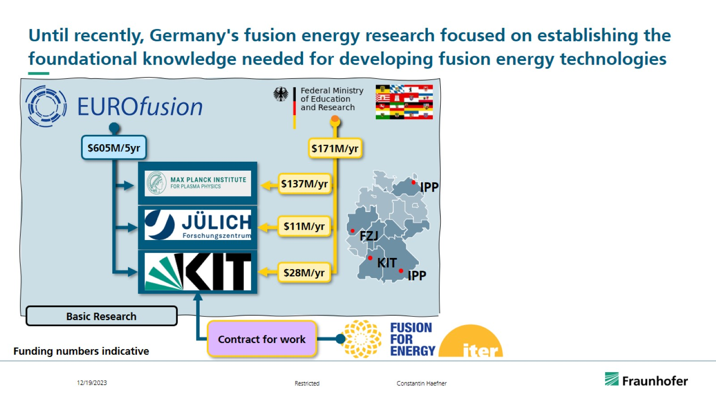
Until recently, Germany's fusion energy research focused on establishing the foundational knowledge needed for developing fusion energy technologies

Slide 8
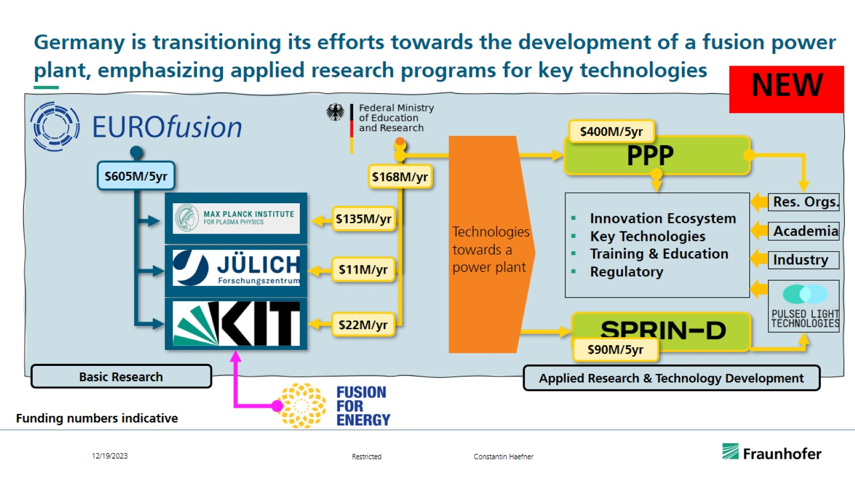
Germany is transitioning its efforts towards the development of a fusion power plant, emphasizing applied research programs for key technologies

Slide 9
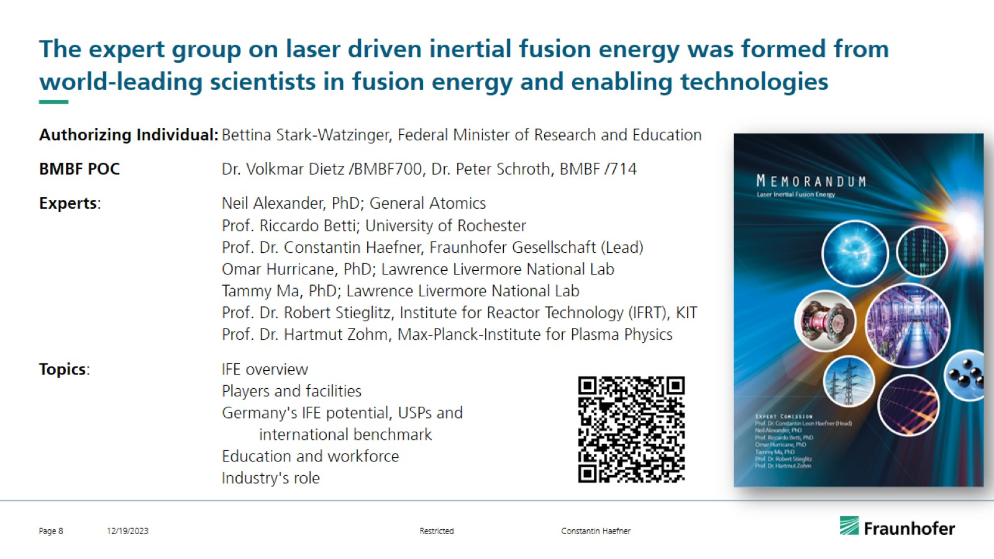
The expert group on laser driven inertial fusion energy was formed from world-leading scientists in fusion energy and enabling technologies

Slide 10
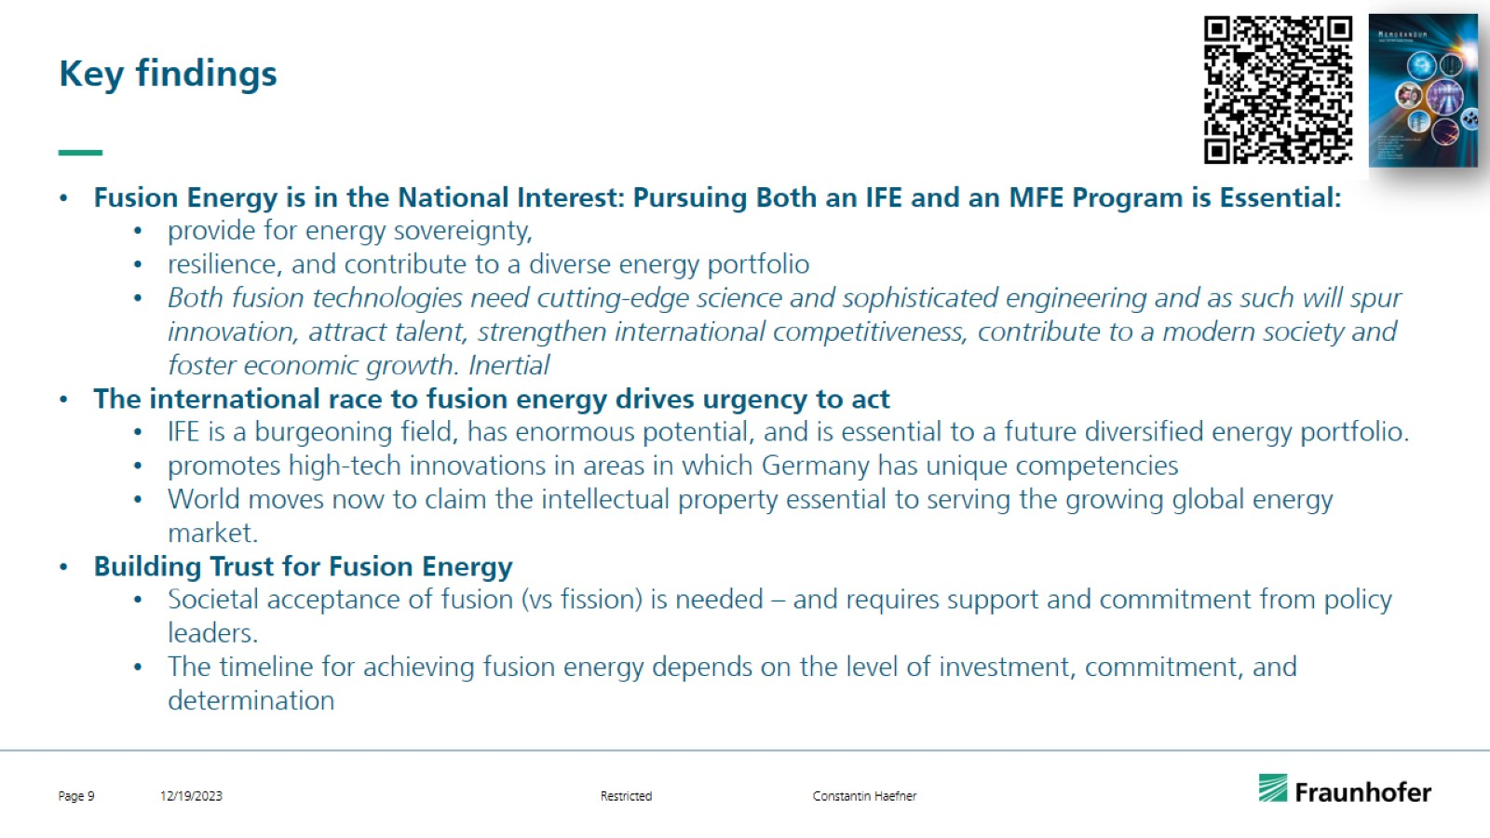
Key findings

Slide 11
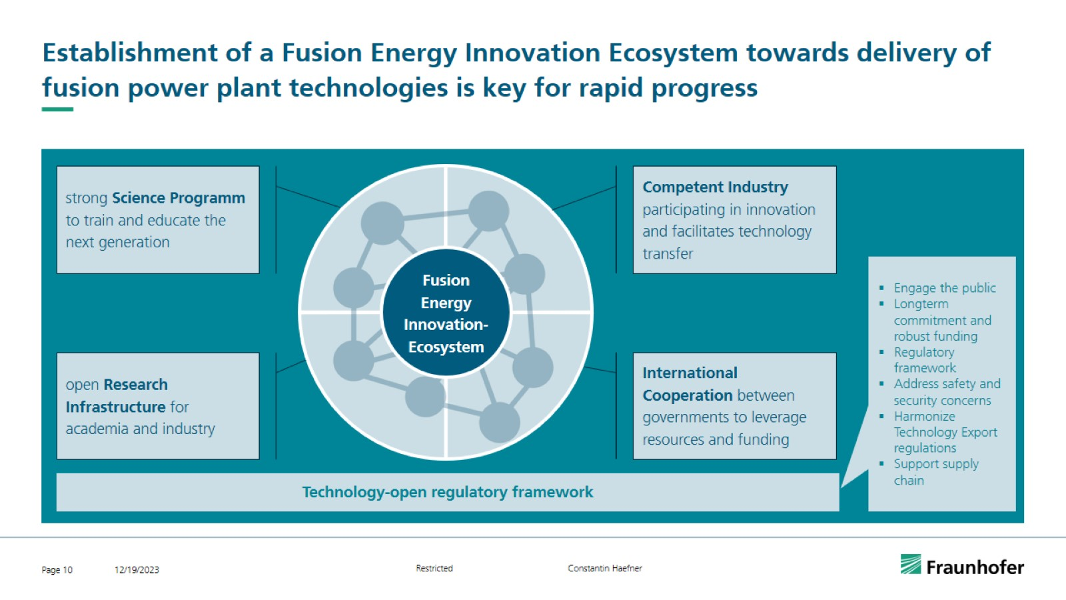
Establishment of a Fusion Energy Innovation Ecosystem towards delivery of fusion power plant technologies is key for rapid progress

Slide 12
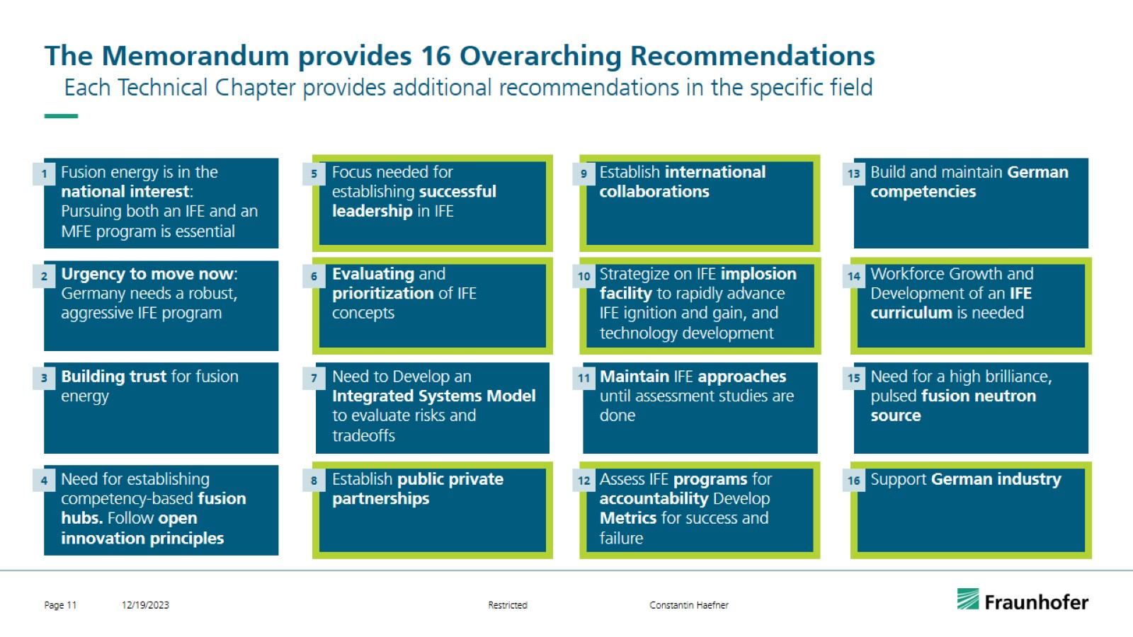
The Memorandum provides 16 Overarching Recommendations

Slide 13
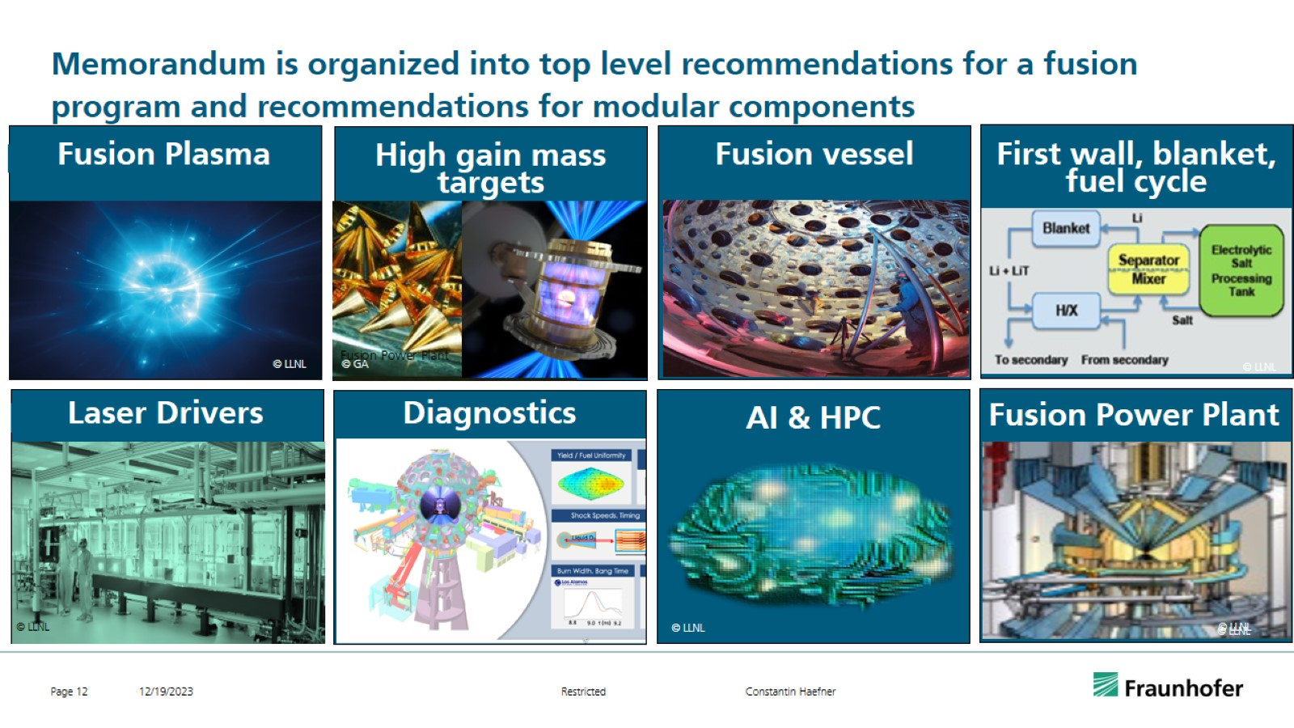
Memorandum is organized into top level recommendations for a fusion program and recommendations for modular components

Slide 14
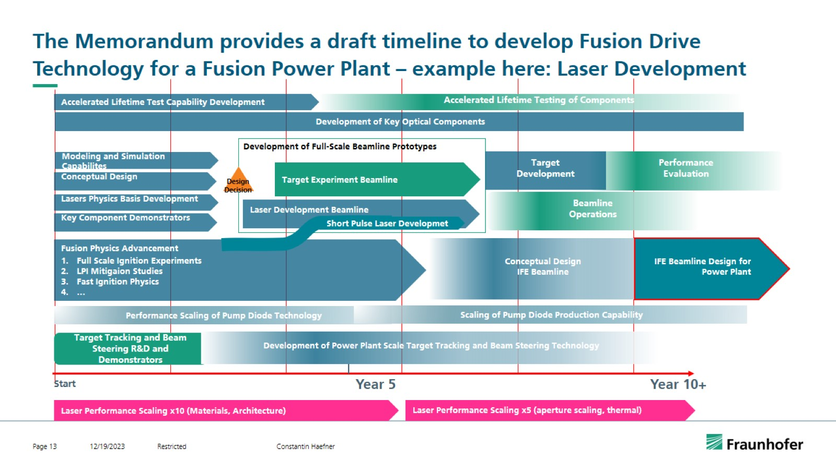
The Memorandum provides a draft timeline to develop Fusion Drive Technology for a Fusion Power Plant – example here: Laser Development

Slide 15
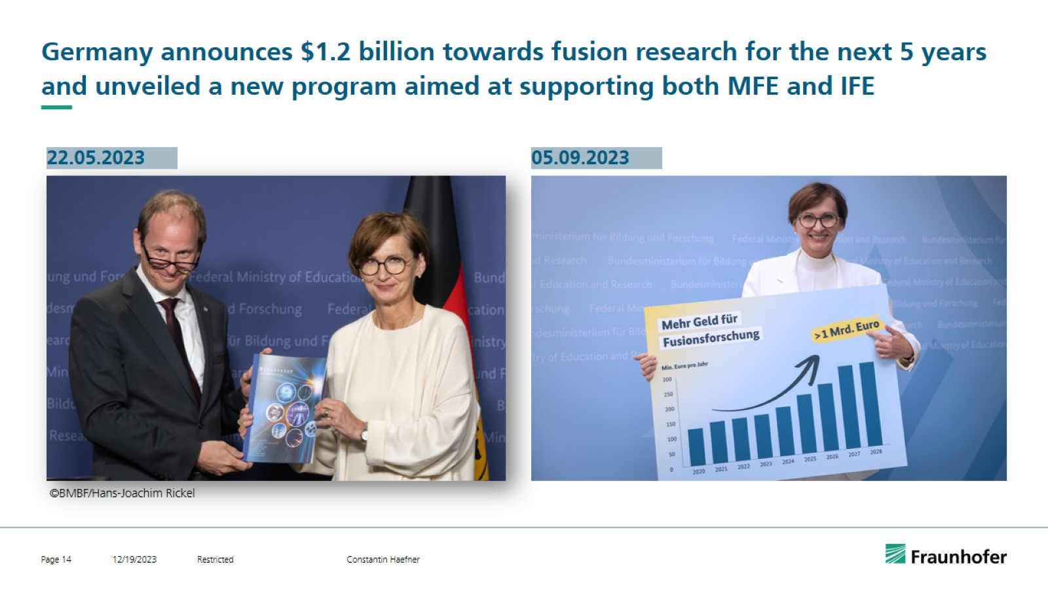
Germany announces $1.2 billion towards fusion research for the next 5 years and unveiled a new program aimed at supporting both MFE and IFE

Slide 16
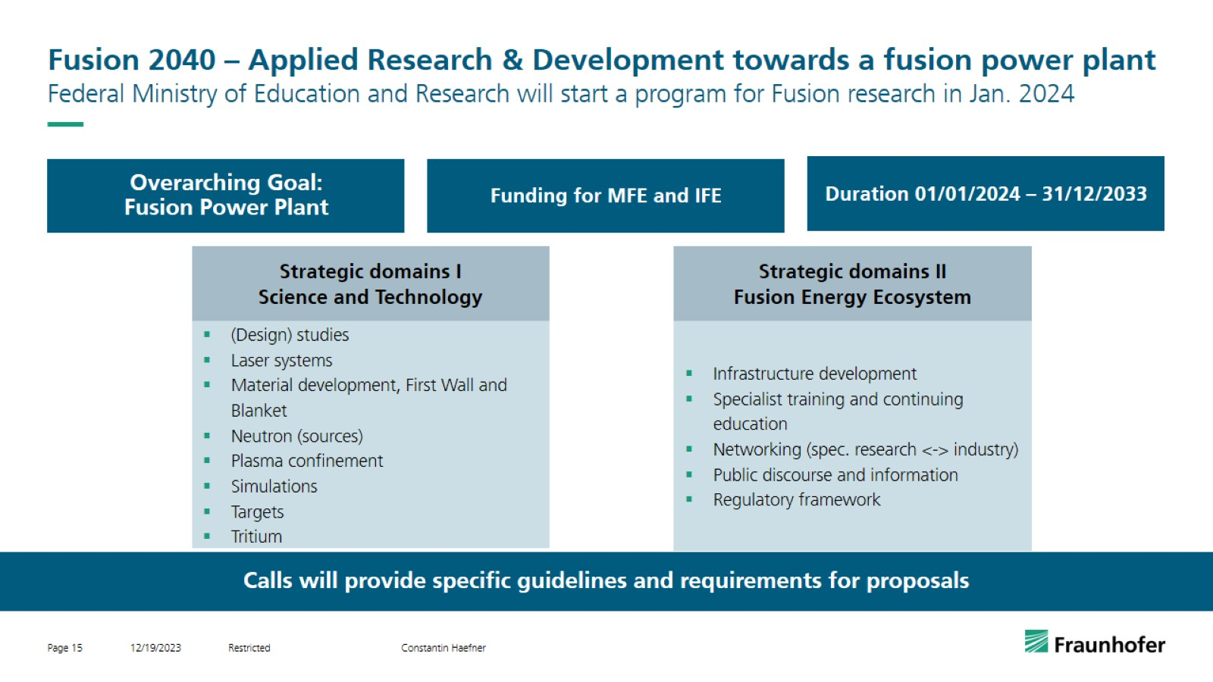
Fusion 2040 – Applied Research & Development towards a fusion power plant

Slide 17
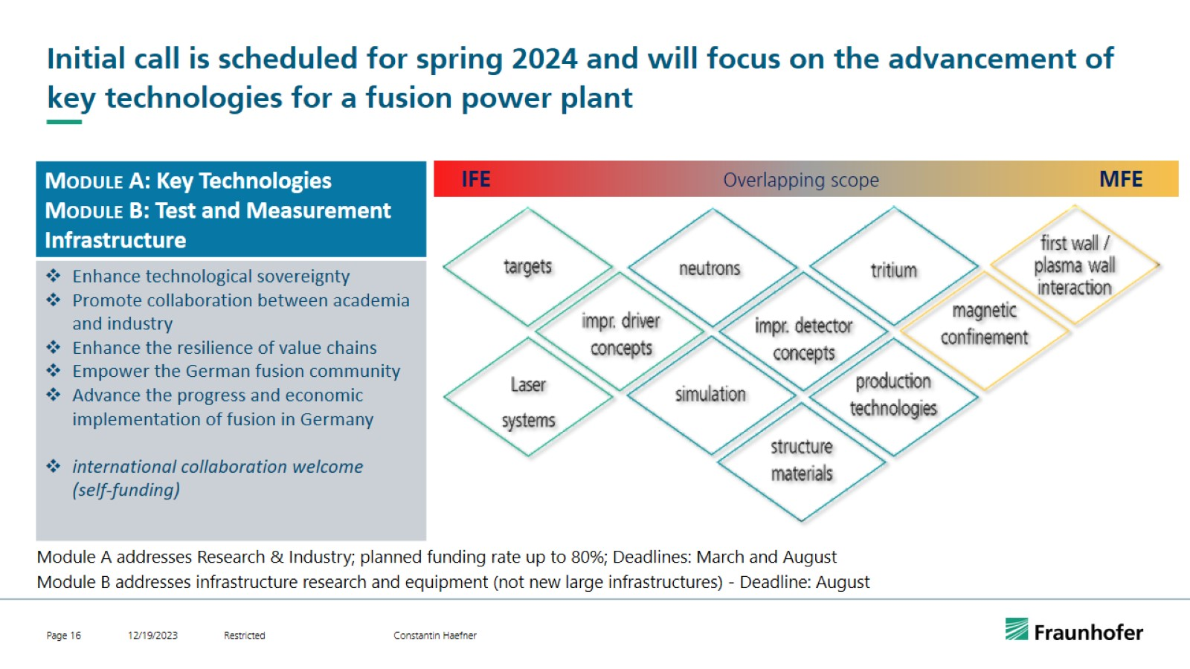
Initial call is scheduled for spring 2024 and will focus on the advancement of key technologies for a fusion power plant

Slide 18
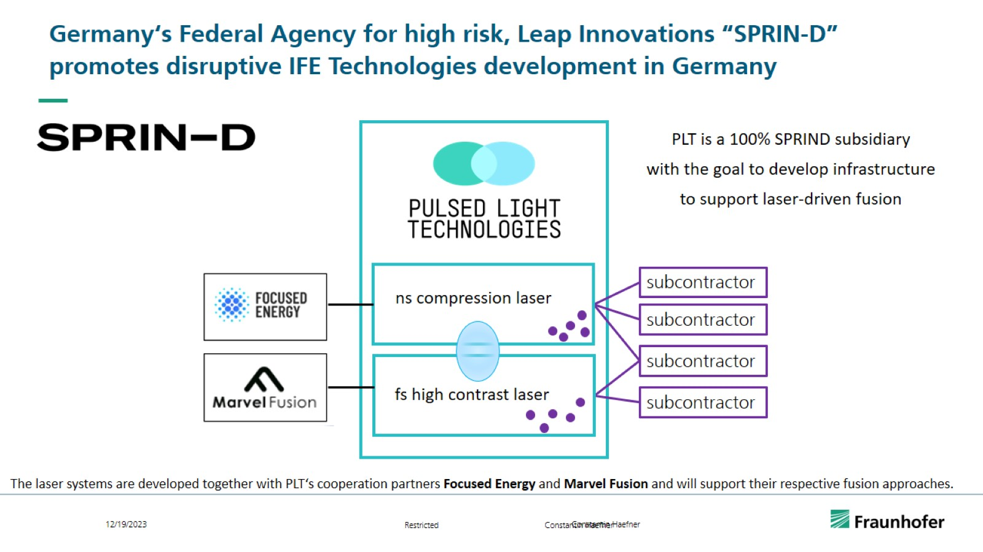
Germany‘s Federal Agency for high risk, Leap Innovations “SPRIN-D” promotes disruptive IFE Technologies development in Germany

Slide 19
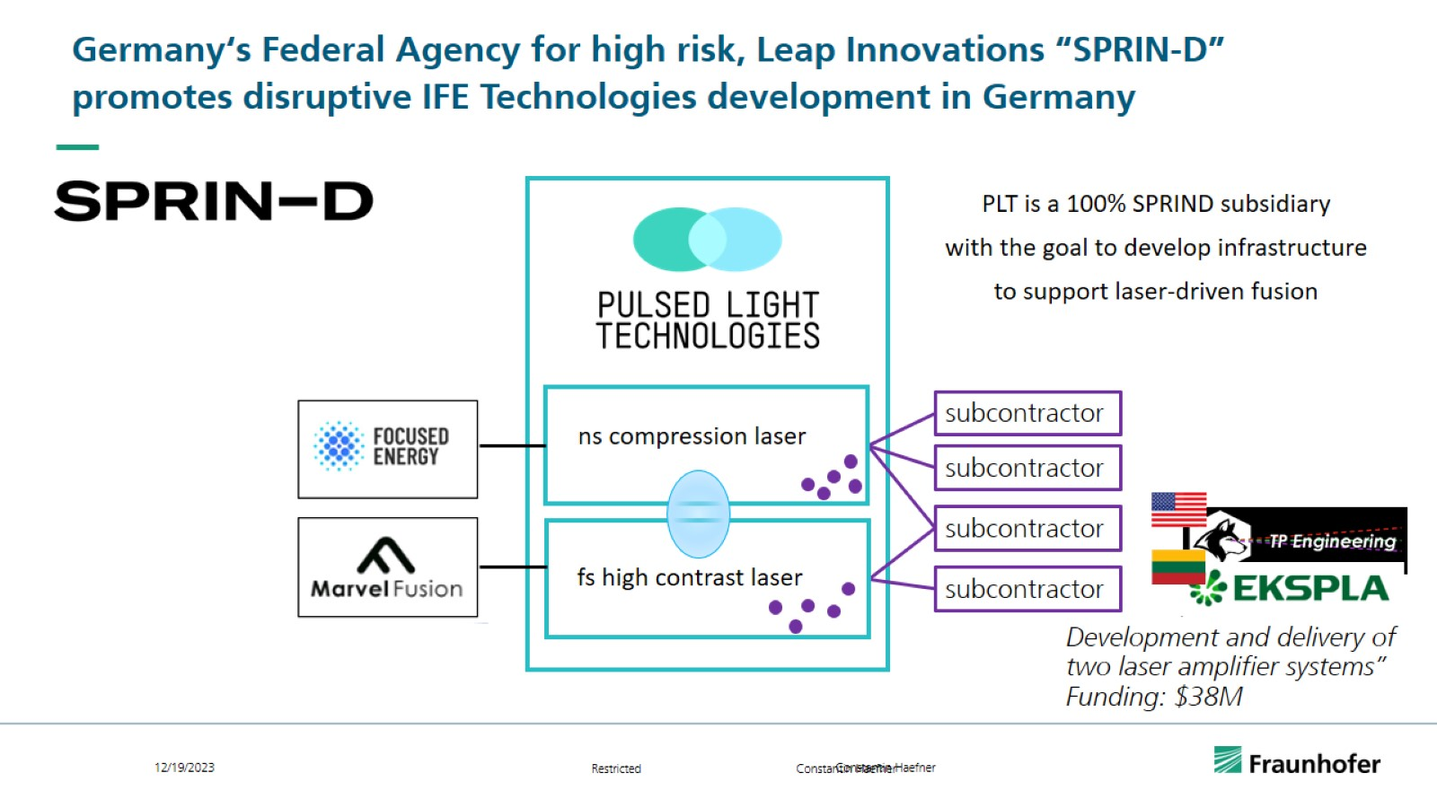
Germany‘s Federal Agency for high risk, Leap Innovations “SPRIN-D” promotes disruptive IFE Technologies development in Germany

Slide 20
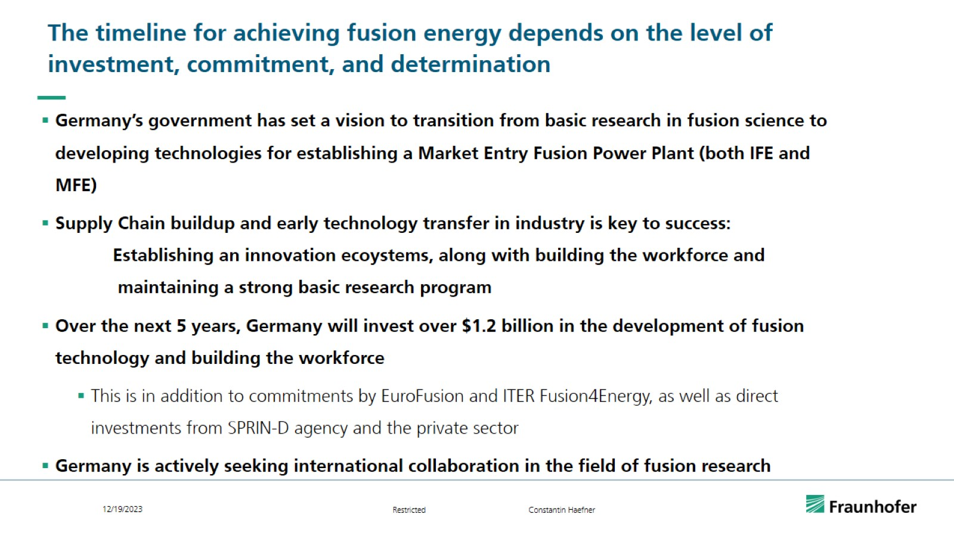
The timeline for achieving fusion energy depends on the level of investment, commitment, and determination

Slide 21
