Slide 1


Focused Energy
Pravesh Patel
Chief Technology Officer
Fusion Power Assoicates Meeting
Washington, DC
December 19, 2023

Slide 2
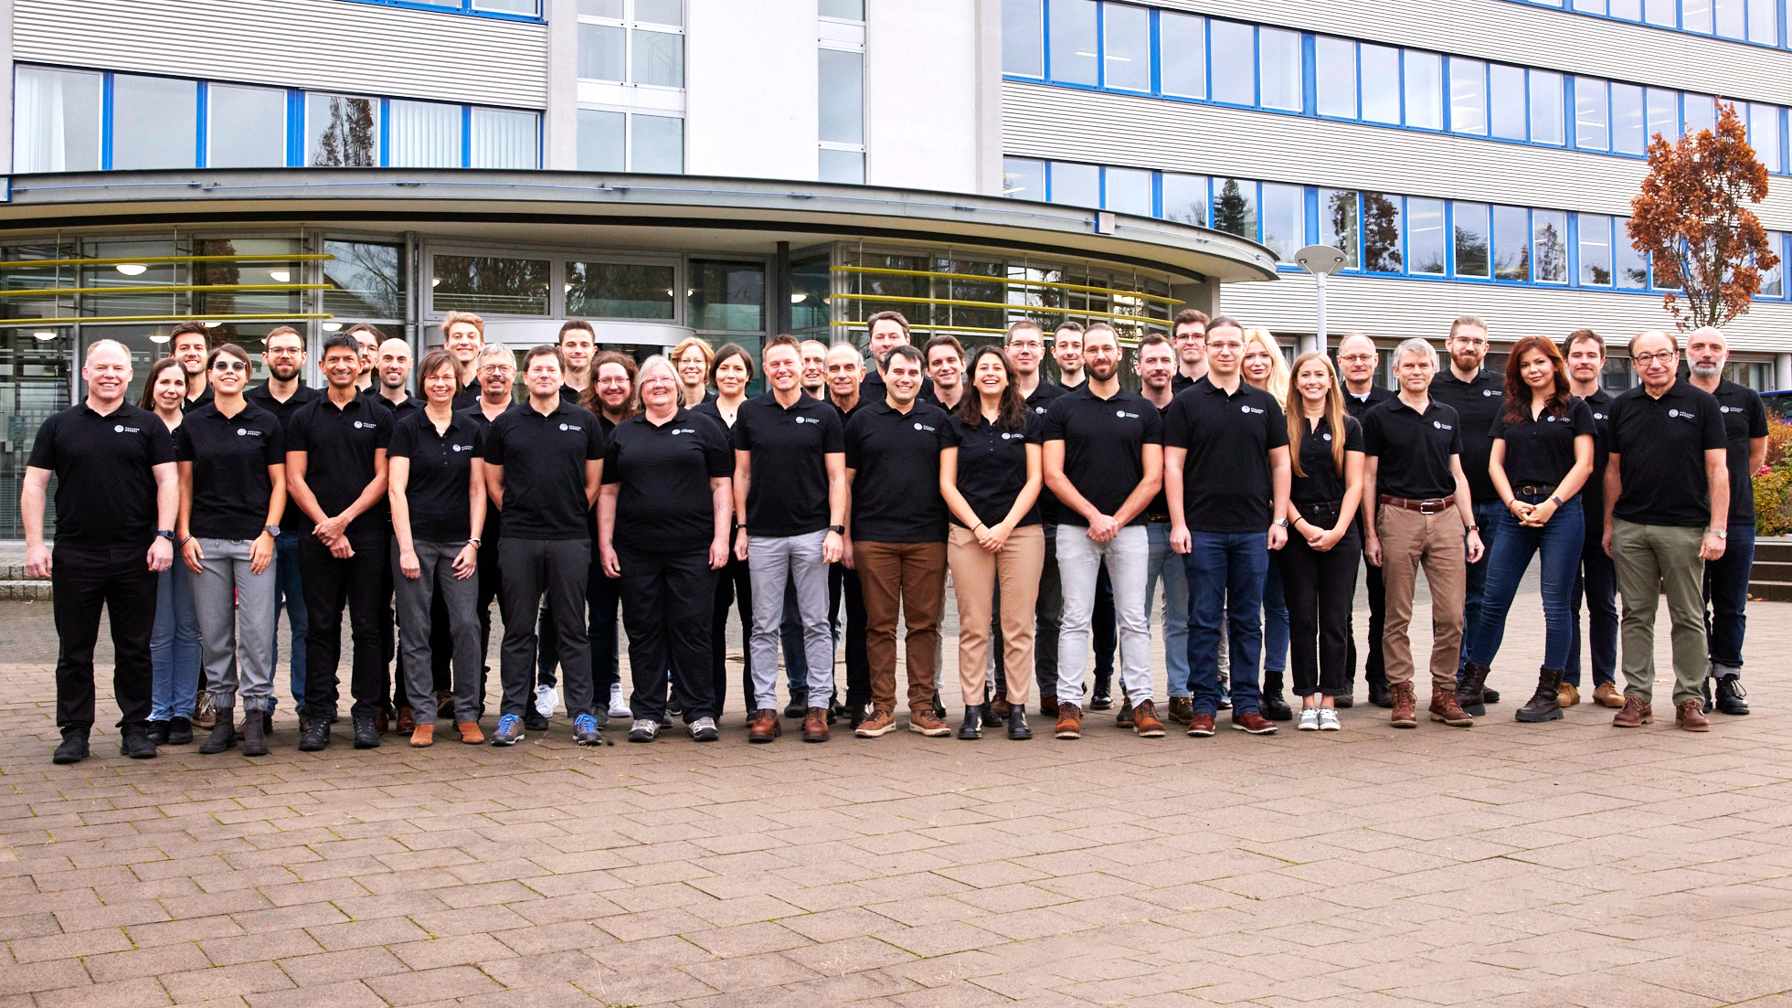











Notes:
Focused Energy was founded 2 years ago. We’re based in the U.S. and Germany
We’ve rapidly grown to a team of 50 people with core expertise in inertial fusion science, laser technology, and targetry
We’re developing partnerships with national labs, universities, and industry to build a national and international consortium to develop and commercialize IFE

Slide 3
IFE Science
Laser Technology
Target Technology
Building on ICF and NIF ignition—exploring advanced schemes to achieve high gain and robust performance
Mature driver technology—diode-pumped solid-state lasers (DPSSL)
Target fabrication technologies scalable to mass production and automation

Slide 4


In ICF we need to compress and heat DT fuel to high density and high temperature
Central Hotspot Ignition
Fast Ignition
fuel
High ρ &T simulataneously
High velocity, high convergence implosion
High ρ with a low velocity implosion
High T with a separate heating source
hot
spot
fuel
hot
spot
Hydro-instablity $⟹$ stress on target quality
Symmetry $⟹$ stress on laser & target
Low fuel mass $⟹$ limited gain
Hydro-stability $⟹$ relaxed target quality
Asymmetric $⟹$ relaxed laser requirements
High fuel mass $⟹$ high gain
Fast Ignition has the potential for high gain and robustness
M. Tabak et al., Phys. Plasmas 1, 1626 (1994)

Slide 5
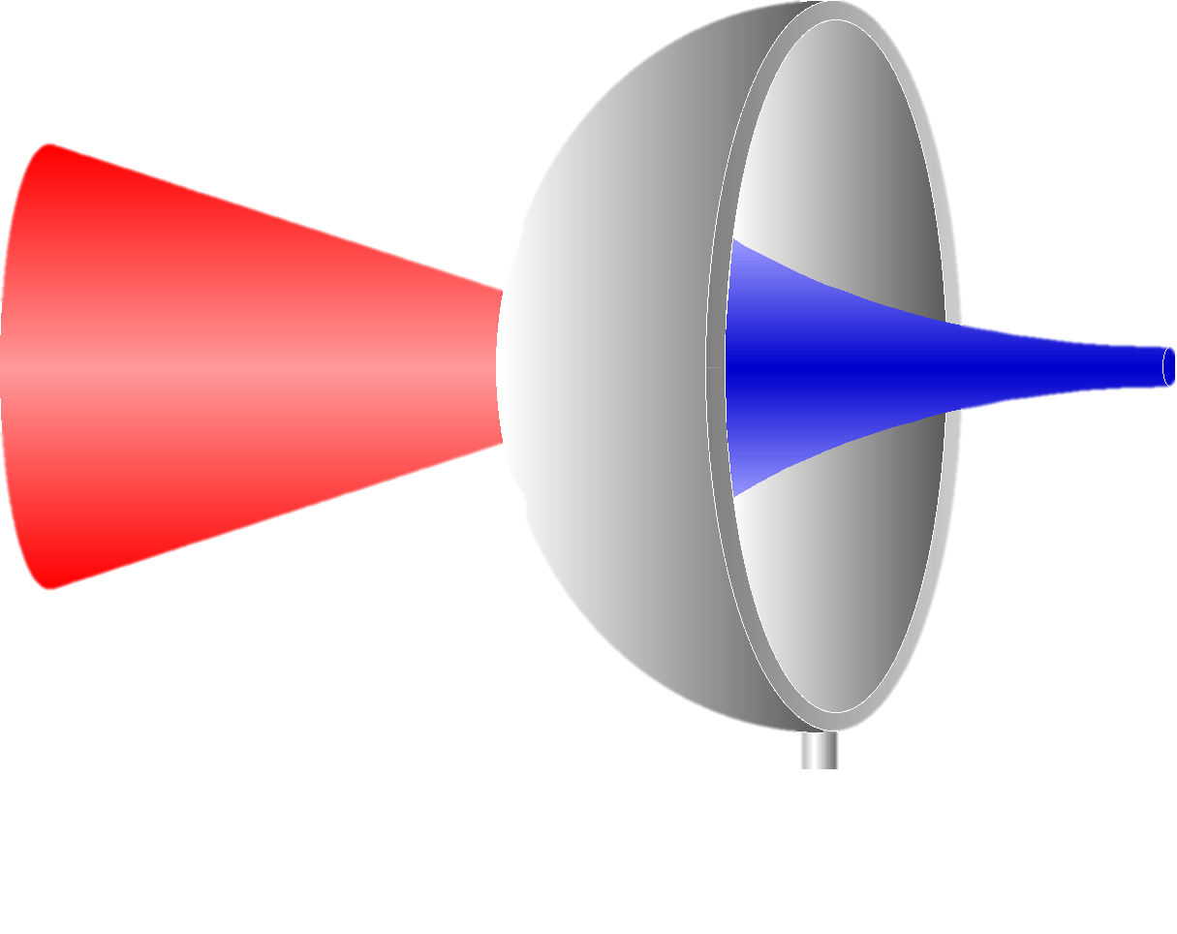

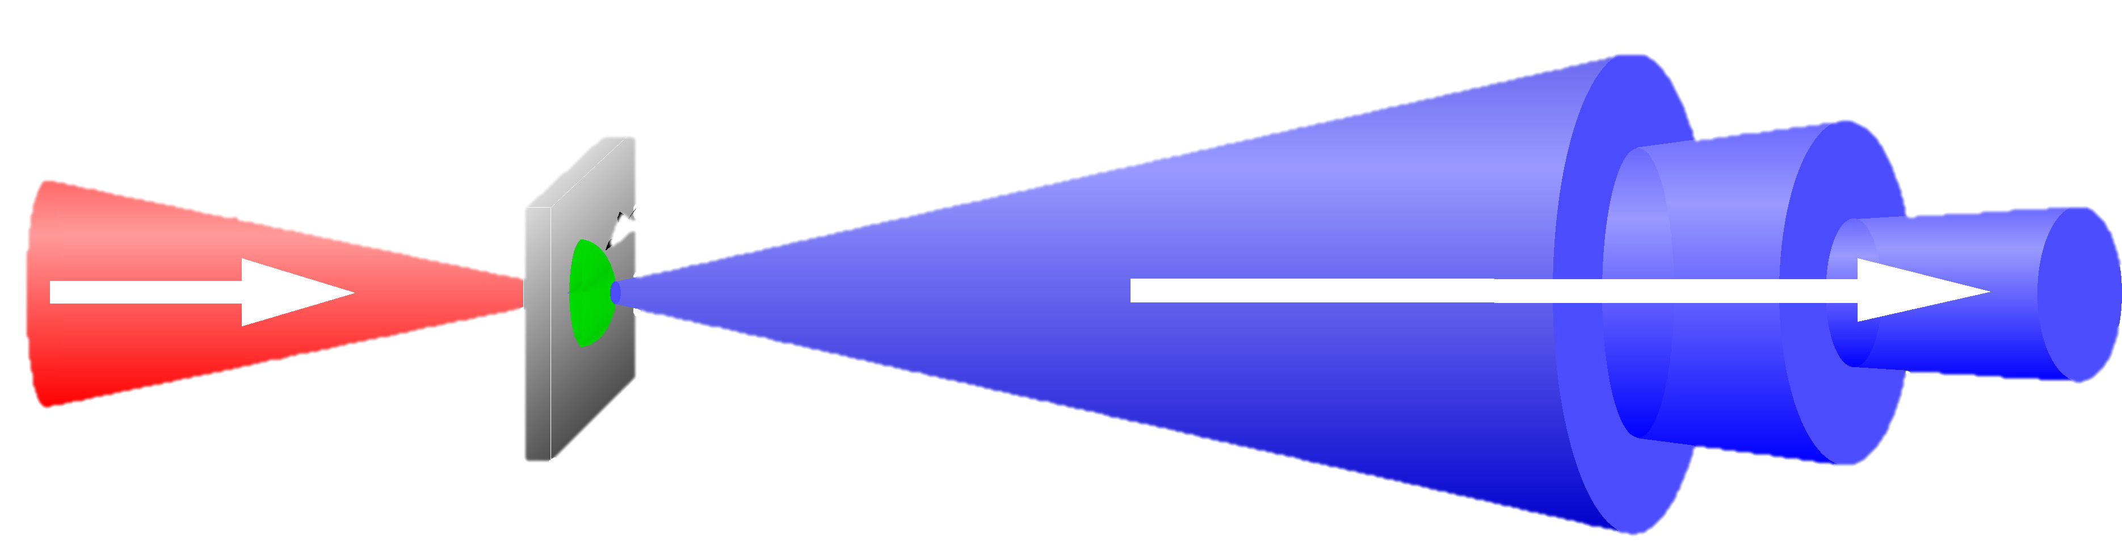
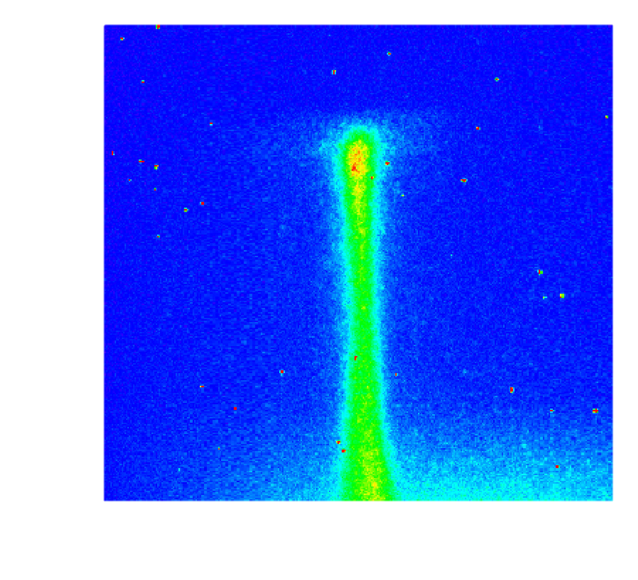
In the 2000’s it was discovered that short-pulse lasers could generate intense beams of protons
High-intensity laser
Electrostatic sheath field
10-100’s eV
temperatures
50µm
Highly collimated, high energy, short-pulse proton beam
Time
Distance
R. Snavely, et al, PRL, 85, 14, 2945 (2000); P. K. Patel, et al, PRL, 91, 125004 (2003); M. Roth et al., PRL 86, 436 (2001)

Slide 6


Proton Fast Ignition
Shell
Coated CH
Ablation layer
Seals, protects fuel
Long-pulse lasers
Spherically illuminate shell, compressing DT fuel to high density
DT wetted foam
Low density CH foam supporting 3 mg DT
Cone
Protects foil
Guides protons
Short-pulse lasers
Accelerate protons from hemispherical foil
Hemispherical foil
Metallic foil with hydrogen-rich layer
Focuses protons

Slide 7

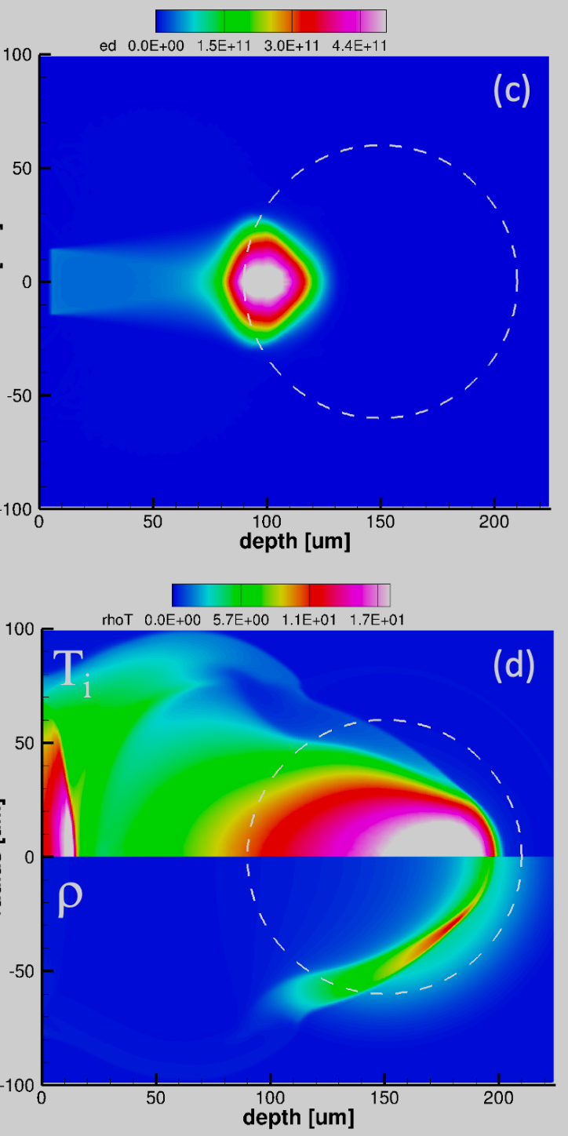

Our current designs indicate that we can achieve target gains >100 with 2 MJ laser energy
Fusion gain
Solid DT 363 µm
150
E_{L} = 1.7 MJ (2ω)
m_{DT} = 2.7 mg
v_{imp} = 200 km/s
ρ_{max} = 400 g/cm³
ρR = 2.8 g/cm²
DT gas
1341 µm
125
PFI (ideal)
1D design
100
Gain
75
2D core heating simulations
Proton energy dep
Temperature
50
25
NIF (2023)
0
0
0.5
1
1.5
2
2.5
3
Laser Energy (MJ)
Density

Slide 8
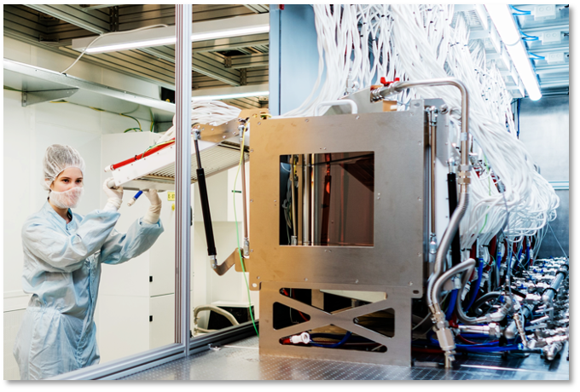
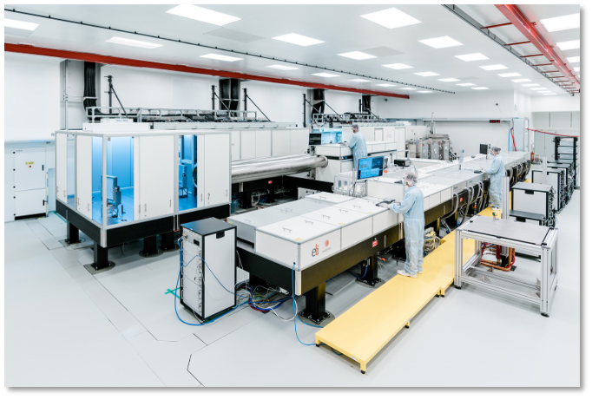
Laser Technology: we have already developed and deployed the technology for our first kJ-class laser system
Large aperture liquid-cooled amplifier technology
2 kJ @ shot/min beamline
operational at ELI Beamlines
We are designing a 1 kJ, 10 Hz laser that will be the unit building block of an IFE FPP

Slide 9
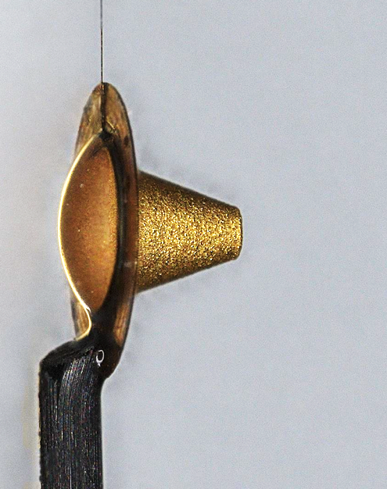
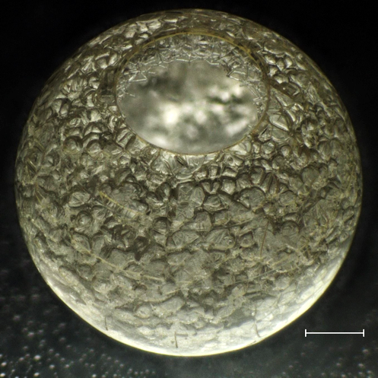
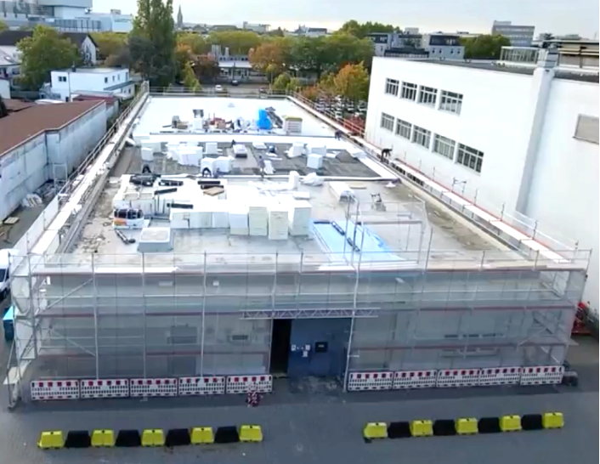

Target Technology: we’re developing fabrication methods for low cost, mass manufacturing of IFE targets
$$300 μm$$
Fabrication techniques for capsule shell, foam, and cone that scale to 10 Hz mass manufacturing
15,000 sq.ft. facility operational in 2024

Slide 10
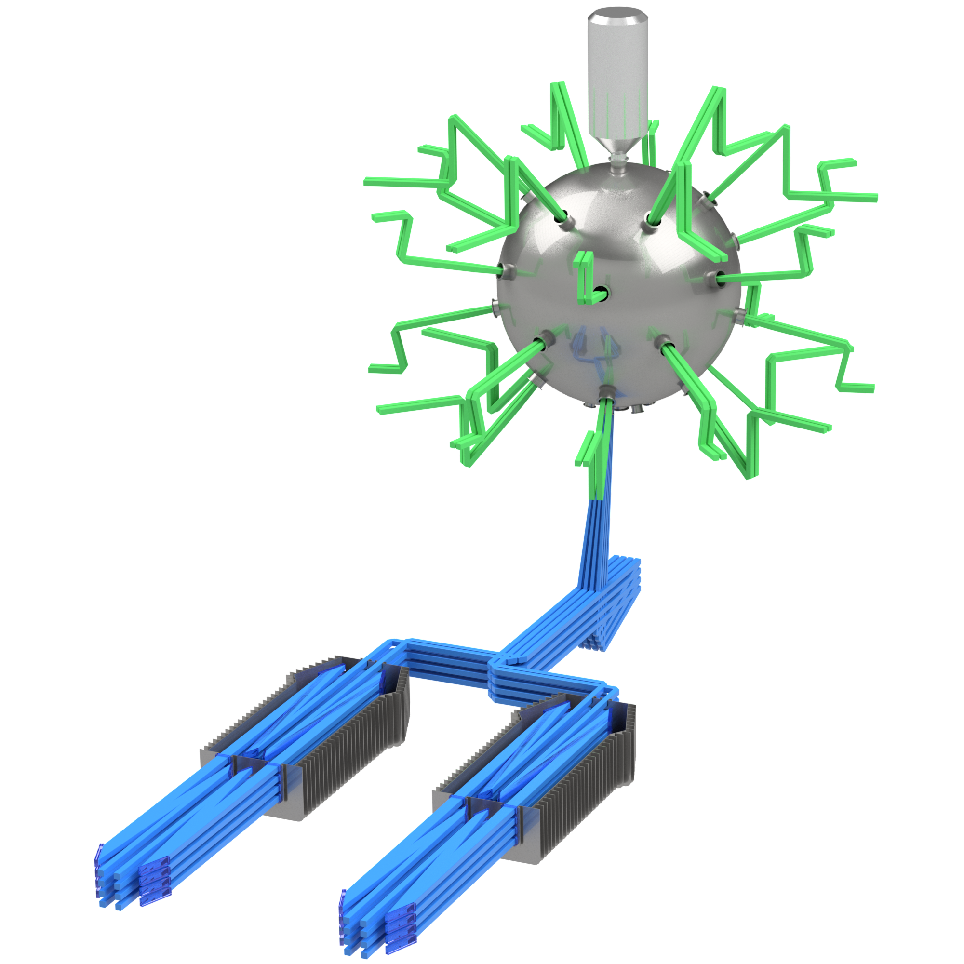
The key for both science & technology risk-reduction is a sub-scale, high rep-rate IFE implosion facility
1/3 spatial scale (1/30 energy scale) of FPP
48 LP + 8 SP beams (60 kJ total energy)
Dedicated IFE facility with spherically symmetric illumination geometry, capable of studying both direct-drive central hot spot and fast ignition schemes

Slide 11
The key for both science & technology risk-reduction is a sub-scale, high rep-rate IFE implosion facility
Phase I
Flashlamp-pumed lasers (shot/3 min)
DT wetted foam targets
Capability for 100+ shots/day giving very high data return for experimental optimization of parameter space
Requires significant level of automization (target production, delivery, and alignment, laser alignment and operations, data acquisition and processing)

Slide 12
The key for both science & technology risk-reduction is a sub-scale, high rep-rate IFE implosion facility
Phase II
Install diode-pumped beamlines (10 Hz)
Add target injection and tracking capability for 10 Hz operation
Upgrade diagnostics to 10 Hz operation
Fully integrated systems testing (at sub-scale) of laser, targetry, control systems, and implosion performance at 10 Hz operation

Slide 13
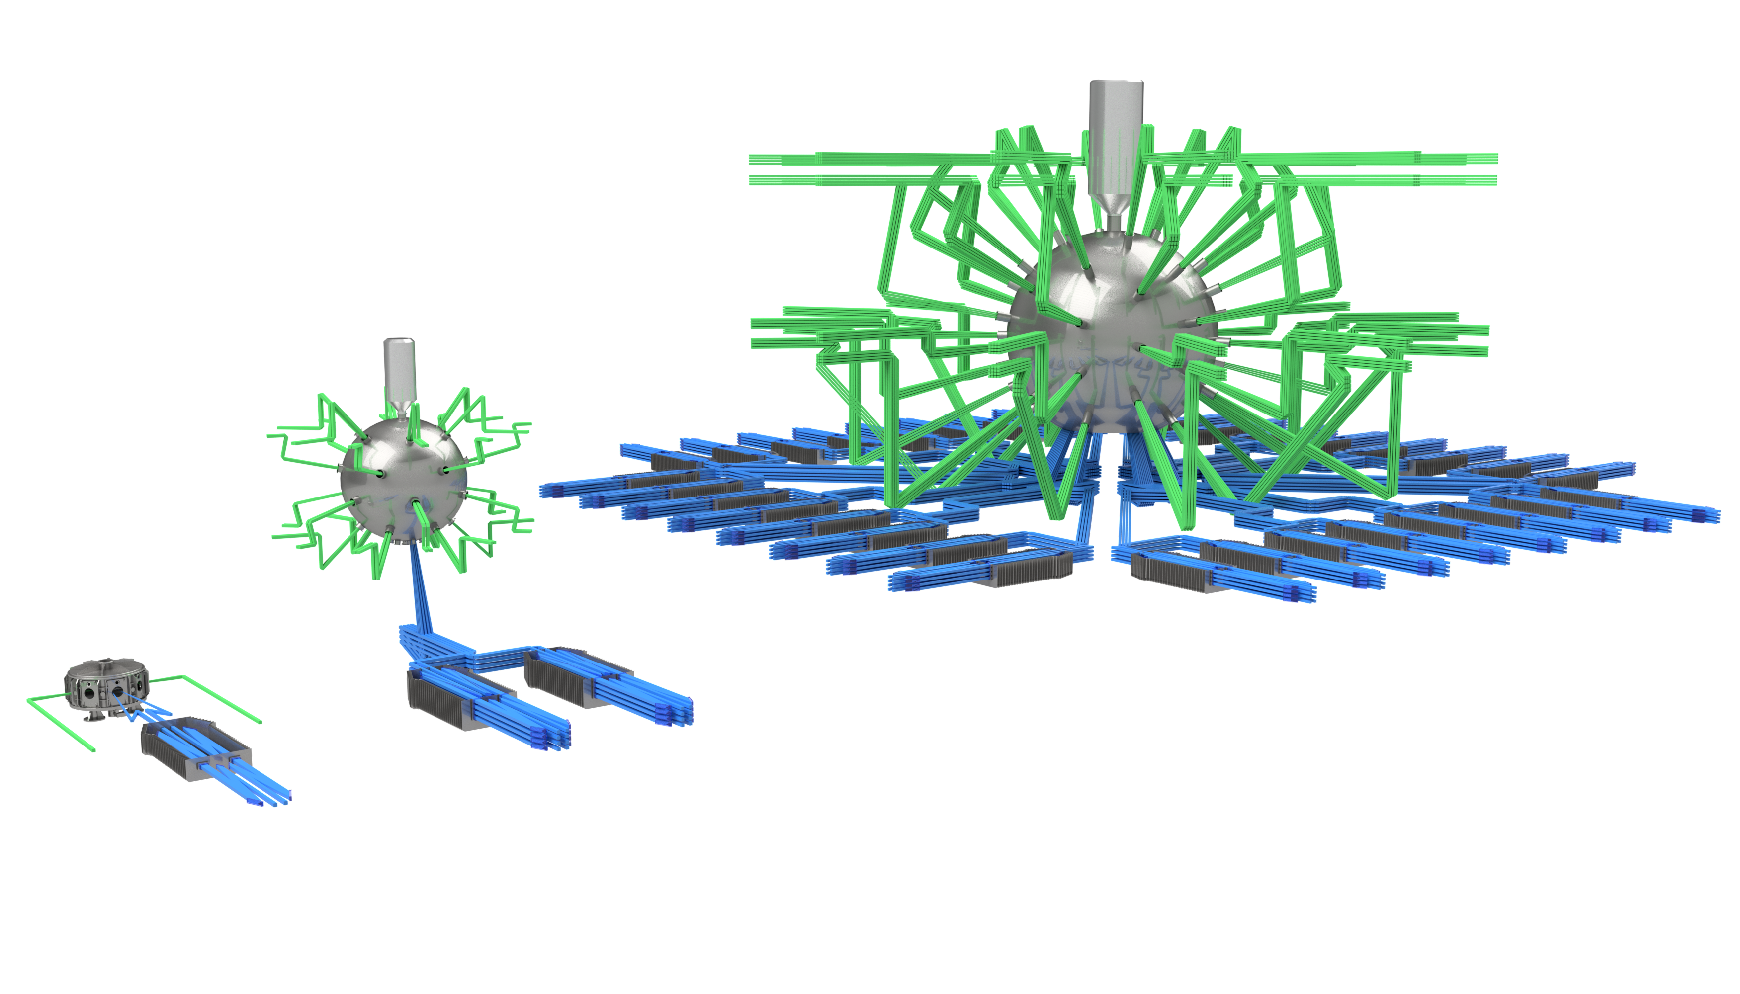
This facility will provide the technical basis and confidence to then scale up to a high-gain FPP
50 kJ LP + 10 kJ SP
shot/3 min, 10 Hz
3x spatial
1750 kJ LP + 250 kJ SP
G>100, 10 Hz
30x energy

Slide 14

Pravesh Patel
CTO, Focused Energy
pravesh.patel@focused-energy.world
Notes:
We

