Slide 1
Thoughts on maturing pulsed-power based paths to Inertial Fusion Energy
Daniel Sinars
Sandia Program Executive, Office of Experimental Sciences
Director, Pulsed Power Sciences Center
Fusion Power Associates Meeting
December 19-20, 2023
SAND2023-XXXX C

Slide 2
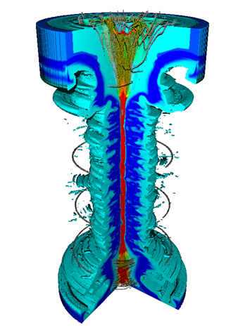
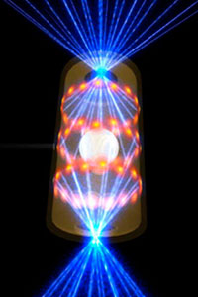
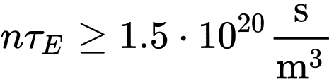
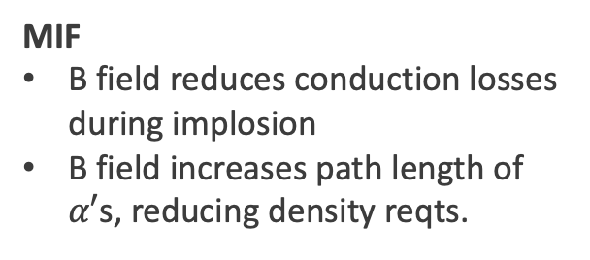
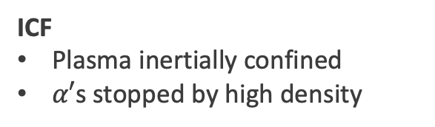
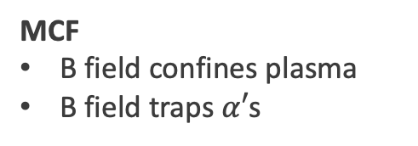
Magnetic inertial fusion (MIF) bridges the gap between magnetic confinement fusion (MCF) and inertial confinement fusion (ICF).¹
MCF (e.g. ITER)
MIF (e.g. MagLIF)
ICF (e.g. NIF)
MCF
B field confines plasma
B field traps $α′$s
MIF
B field reduces conduction losses during implosion
B field increases path length of $α′$s, reducing density reqts.
ICF
Plasma inertially confined
$α′$s stopped by high density
 | MCF | MagLIF | ICF
Density | 1 x 10²⁰ m⁻³ | 1 x 10²⁹ m⁻³ | 2-20 x 10³¹ m⁻³
Duration | 300-500 s | 1-2 x 10⁻⁹ s | 5-10 x 10⁻¹¹ s
Volume | 8 x 10² m³ | 8 x 10⁻¹¹ m³ | 6 x 10⁻¹⁴ m³
Magnetic field | 100 kG | 50-100 MG* | 0 kG
Lawson criterion (DT)
*Achieved by flux compression
[1] Richard Siemon et al., “Why Magnetized Target Fusion Offers A Low-Cost Development Path for Fusion Energy?” Comments on Plasma Physics and Controlled Fusion, December, 1997
Notes:
There are 3 main approaches to assemble thermonuclear plasmas.
Magnetic confinement fusion (MCF) holds a large plasma at low density for a long duration.
Neutral beams and RF waves externally heat plasmas.
Confinement is done by external magnetic fields
Fuel densities are limited by Bremsstrahlung emission.
Large magnetic-field -- inner-radius product is needed to trap alpha particles.
Inertial Confinement Fusion (ICF) creates a high-density plasma over small volume and for a short duration.
Laser-driven imploding shells produce PdV work on fuel to heat it.
Confinement is done by fuel inertia (small $τ)$
High densities and pressures are required to surpass the Lawson criterion.
High areal density rho-R is need to confine $α$’s.
Magneto-Inertial Fusion (MIF) bridges the gap between magnetic confinement fusion (MCF) and inertial confinement fusion (ICF).
Imploding shells heat the fuel via pdV work.
Confinement is done by shell inertia (medium $τ)$.
Medium densities and pressures are needed to surpass Lawson.
Magnetic fields are embedded in the fuel to
Reduce thermal conduction losses and
Trap alpha particles within the plasma column.
I stress that MCF and MIF both use magnetic fields for different purposes. The high magnetic-fields required for MagLIF are achieved via flux compression of the implosion itself.

Slide 3
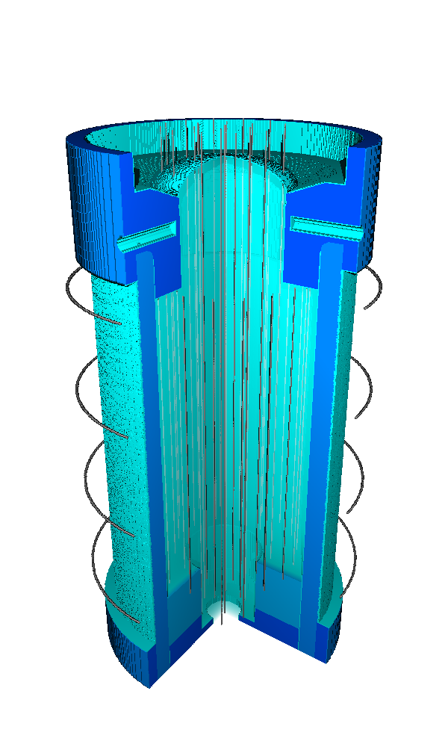
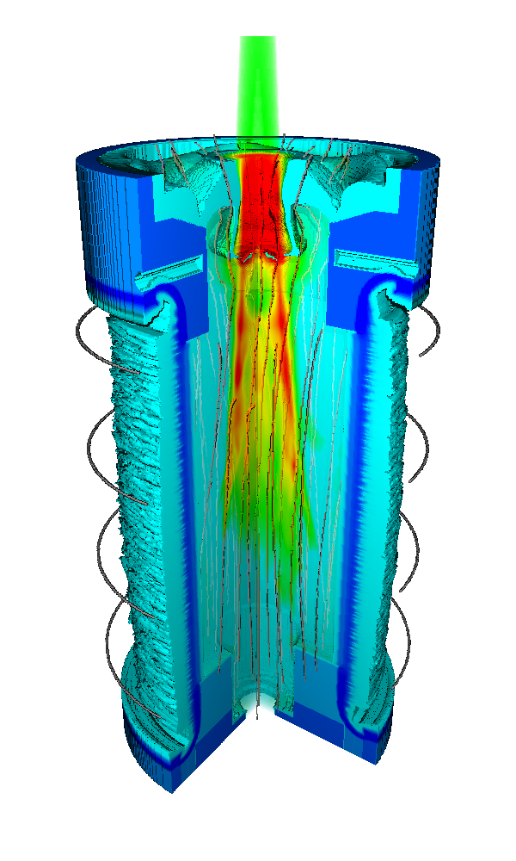
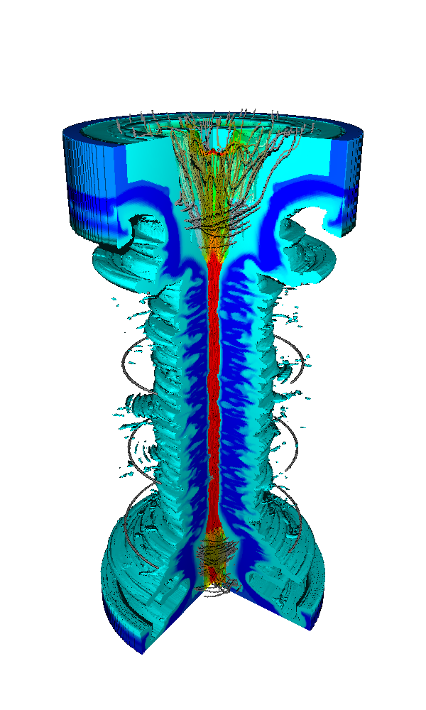
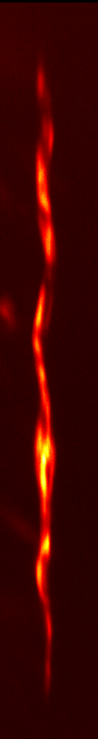
Magnetized Liner Inertial Fusion (MagLIF) is a fusion concept combining external axial magnetic fields, laser preheat, and z-pinch implosions.^{2,3,4}
Laser preheat
Pulsed-power driven implosion
Be liner
6-8 mm
Gaseous
D₂ fuel
~125 ns
External B Field
Preheat
Implosion
Thermonuclear stagnation column
[2] S. A. Slutz, M. C. Herrmann, R. A Vesey, et al., Phys. Plasmas 17, 056303 (2010).
[3] M. R. Gomez, S. A. Slutz, A. B. Sefkow, et al., Phys. Rev. Lett. 113, 155003 (2014).
[4] D.A. Yager-Elorriaga et al., Nuclear Fusion (2022).
3
Notes:
Magnetized Liner Inertial Fusion is a fusion concept that combines external axial magnetic fields, laser preheat, and z-pinch driven implosions. When successfully combining all three elements of the platform, we can achieve thermonuclear-relevant plasmas. In the following slides, I shall give you further details about each of these ingredients.

Slide 4
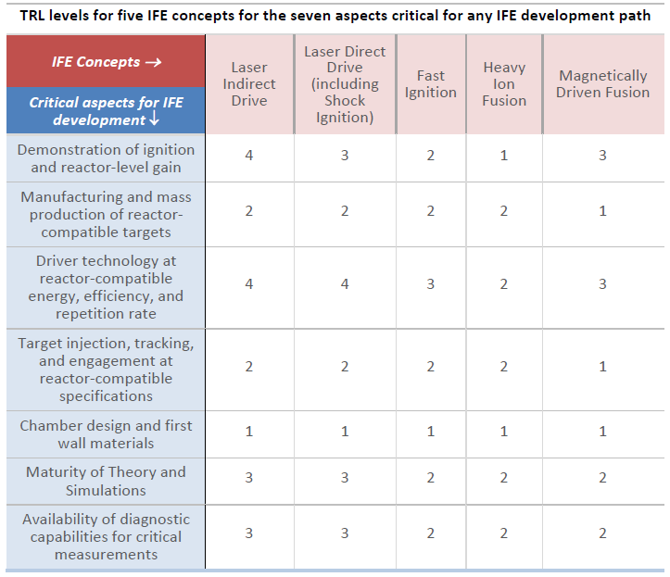
We are working to address perceived shortcomings to magnetically driven fusion highlighted in the recent Basic Research Needs report
  We are looking at how to best establish quantitative systemwide requirements for a magnetically driven IFE system
    Substantial work was done ~20 years ago using LDRD, but with wire array targets that do not include the benefits of using much more robust MDD targets.
  The demonstration of ignition and reactor-level gain will require a facility beyond Z today
    NNSA is considering a Next-Generation Pulsed Power project that would provide about 6-9 MJ to fusion targets, which we predict should be capable of ignition and >100 MJ yields.
  Manufacturing and production of reactor-compatible targets
    Sandia is actively researching the seeds for magneto-Rayleigh-Taylor implosion instabilities (electro-thermal instability and Hall effect). Surface roughness requirements are far more tolerant than in spherical capsule implosions.
    Self-magnetizing targets are highlighted as an important
    development path for MagLIF and are being developed.
  IFE-relevant driver-target coupling technologies
    Recyclable transmission lines, target insertion and
    engagement, and debris mitigation are areas that need
    further development for magnetic drive

Slide 5
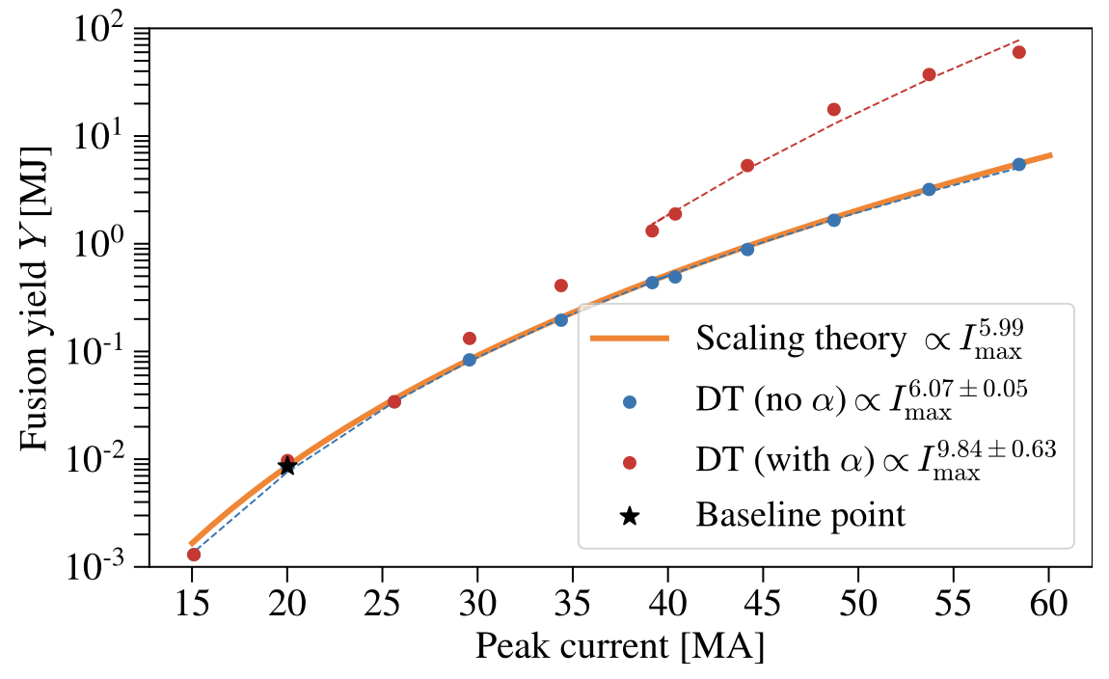
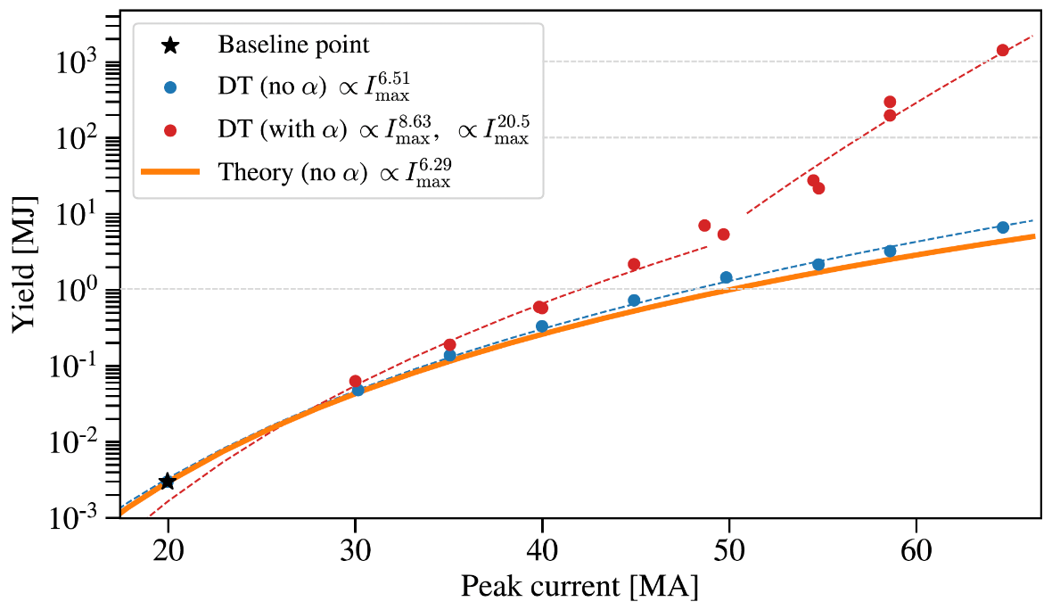
We are actively validating paths to ~100 MJ yields on future facilities with magnetic direct drive fusion targets^{5,6}
Ice-burning MagLIF targets might substantially increase fusion yields
Scaling of gas-burning MagLIF targets
NGPP
NGPP
Self-heating
Hydra modeling & analytic theory
of MagLIF with cryo fuel layer
Daniel Ruiz, NGPP High Yield Workshop
Z
[5] P.F. Schmit & D.E. Ruiz, Phys. Plasmas (2020).
[6] D. E. Ruiz, et al., “Exploring the parameter space of MagLIF implosions using similarity scaling. II. Current scaling”, Phys. Plasmas (2023).

Slide 6
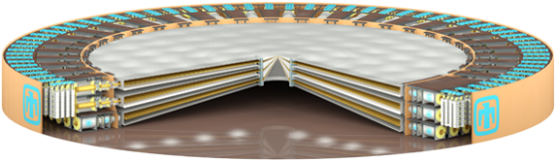
Sandia is working with the NNSA on a Next Generation Pulsed Power (NGPP) project to address important HED capability gaps and provide needed agility and flexibility for the next phase of stockpile modernization/replacement
NGPP will:
Be the world’s most powerful warm x-ray source
Support fusion yields up to ~100 MJ
Provide advanced capability for high energy density physics (e.g., dynamic materials)
Advance the state-of-the-art for fast pulsed power technology
Provide a venue for scientific and technical innovation for national security
One example concept that would deliver 50-70 MA of electrical current depending on target
Parameter | Z | Ex. NGPP Option
Diameter | 108’ | 300’
Marxes | 36 @ 600 kJ (22 MJ) | 75 @ 2400 kJ (180 MJ)
Capacitors | 2,160 @ 2.65 µF | 13,500 @ 2.95 µF
Power at Stack | 85 TW | 602 TW
Forward Energy at Stack | 6 MJ (short pulse) | 54 MJ (short pulse)
Energy to target | 1-2 MJ | 9-18 MJ
Mission need and requirements finalized in 2023
We are looking for CD-0 approval in 2024
We expect to take 5+ years to reach CD-1
Project completion in the 2030s

Slide 7
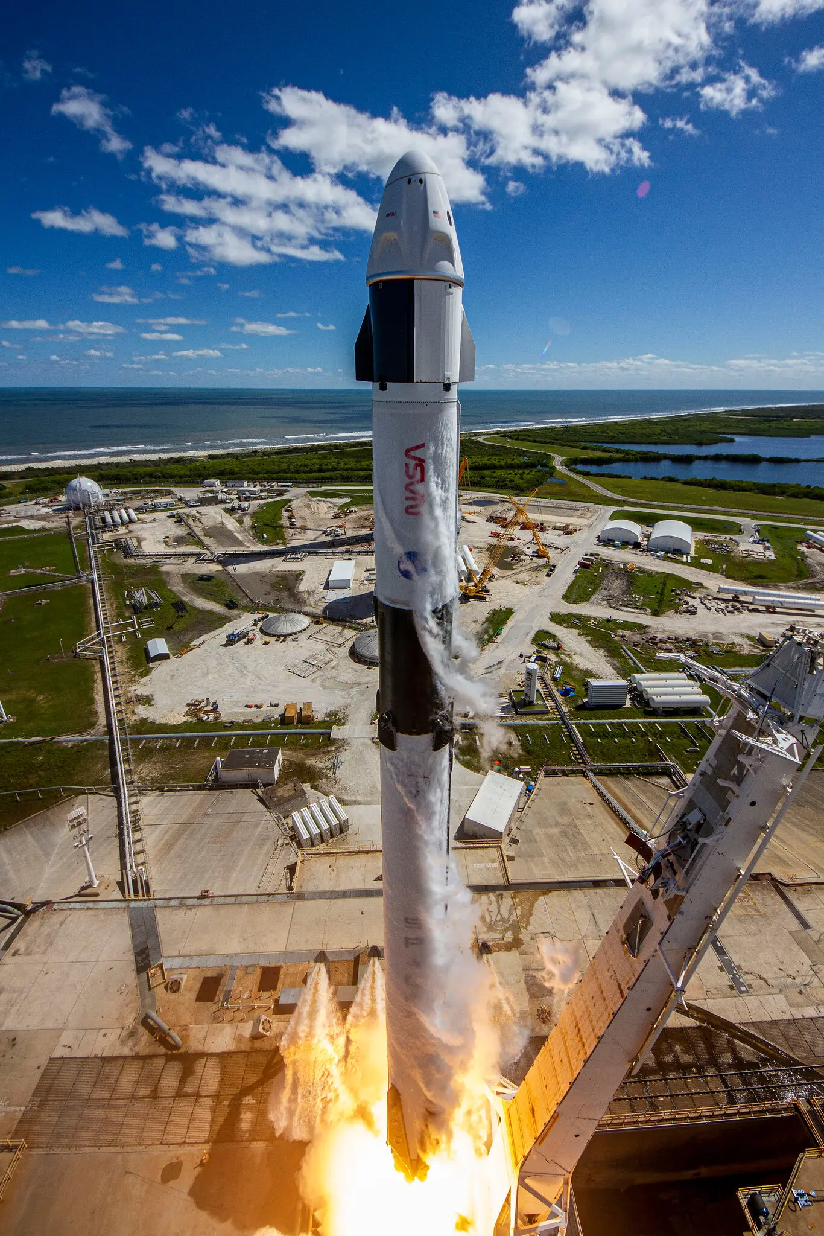
We are exploring options and solutions that may allow us to more readily achieve NGPP in partnership with private industry and others
Partnerships
NASA “COTS”-like approach may enable an NGPP capability to be realized more quickly, with much lower risk, and at a fraction of the cost
Unique opportunities exist now to partner with multiple private fusion companies on pulsed power technology maturation activities
UK/AWE International partnerships also an option for both IFE and weapons
Fixed Cost Target Approaches
Fixed cost target is inherent to NASA “COTS”-like approach
Regardless of partnerships, develop fixed cost target early in 413.3b with scope reduction plan – formal approval at CD-1
Urgency for CD-0 decision
Due to current landscape of private investment, some of the partnership options may have only a short window to take advantage of
Impacts plans and strategy for Z going forward
Image Credit: SpaceX

Slide 8
A public-private capability development partnership could enable an NGPP capability for significantly less cost, less risk, and in less time
The approach enables industry to develop the needed capability as a transaction with NNSA instead of pursuing a traditional capital acquisition. Essentially, an alternative approach to procurement that enables private industry to contribute to government programs while still moving at the speed of startups.
NASA’s Commercial Orbital Transportation Services (COTS), and later the Commercial Resupply Services (CRS), could be a model for NGPP.
NASA invested $788M and private companies invested $1B to provide NASA access to two separate options for cargo delivery to the ISS from U.S. soil.
In comparison, NASA’s conventionally procured Space Launch System, currently in development, has cost the agency $20 billion and has not yet flown.
What made COTS different and successful?
Legally structured as “other transactions” allows for partnerships that are not considered procurements (subject to the FARs) or cooperative agreements (subject to the Chiles Act)
The program contained minimal overhead as it relied on goal-driven evaluations and fixed-price payments after milestone-completion.
Leveraged commercialization interests of industry

Slide 9
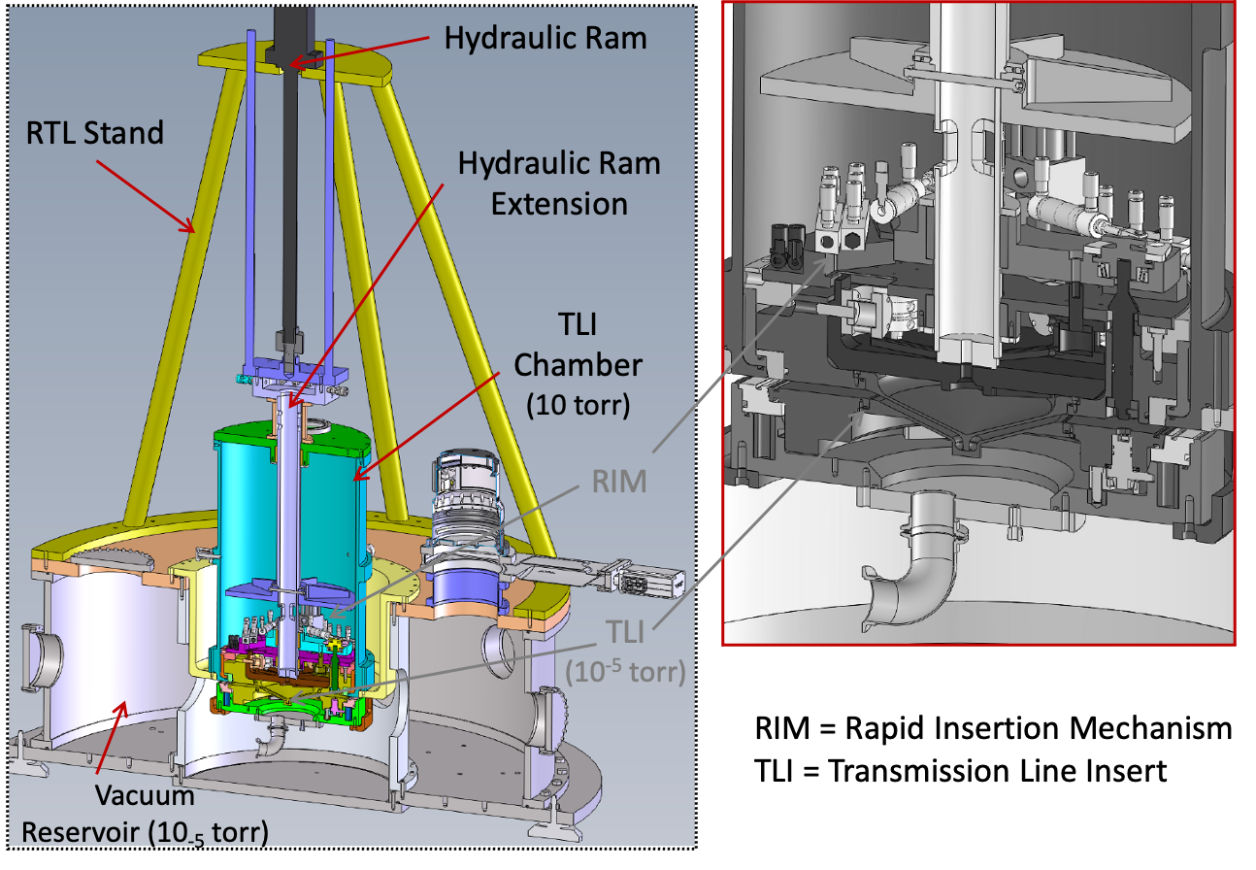
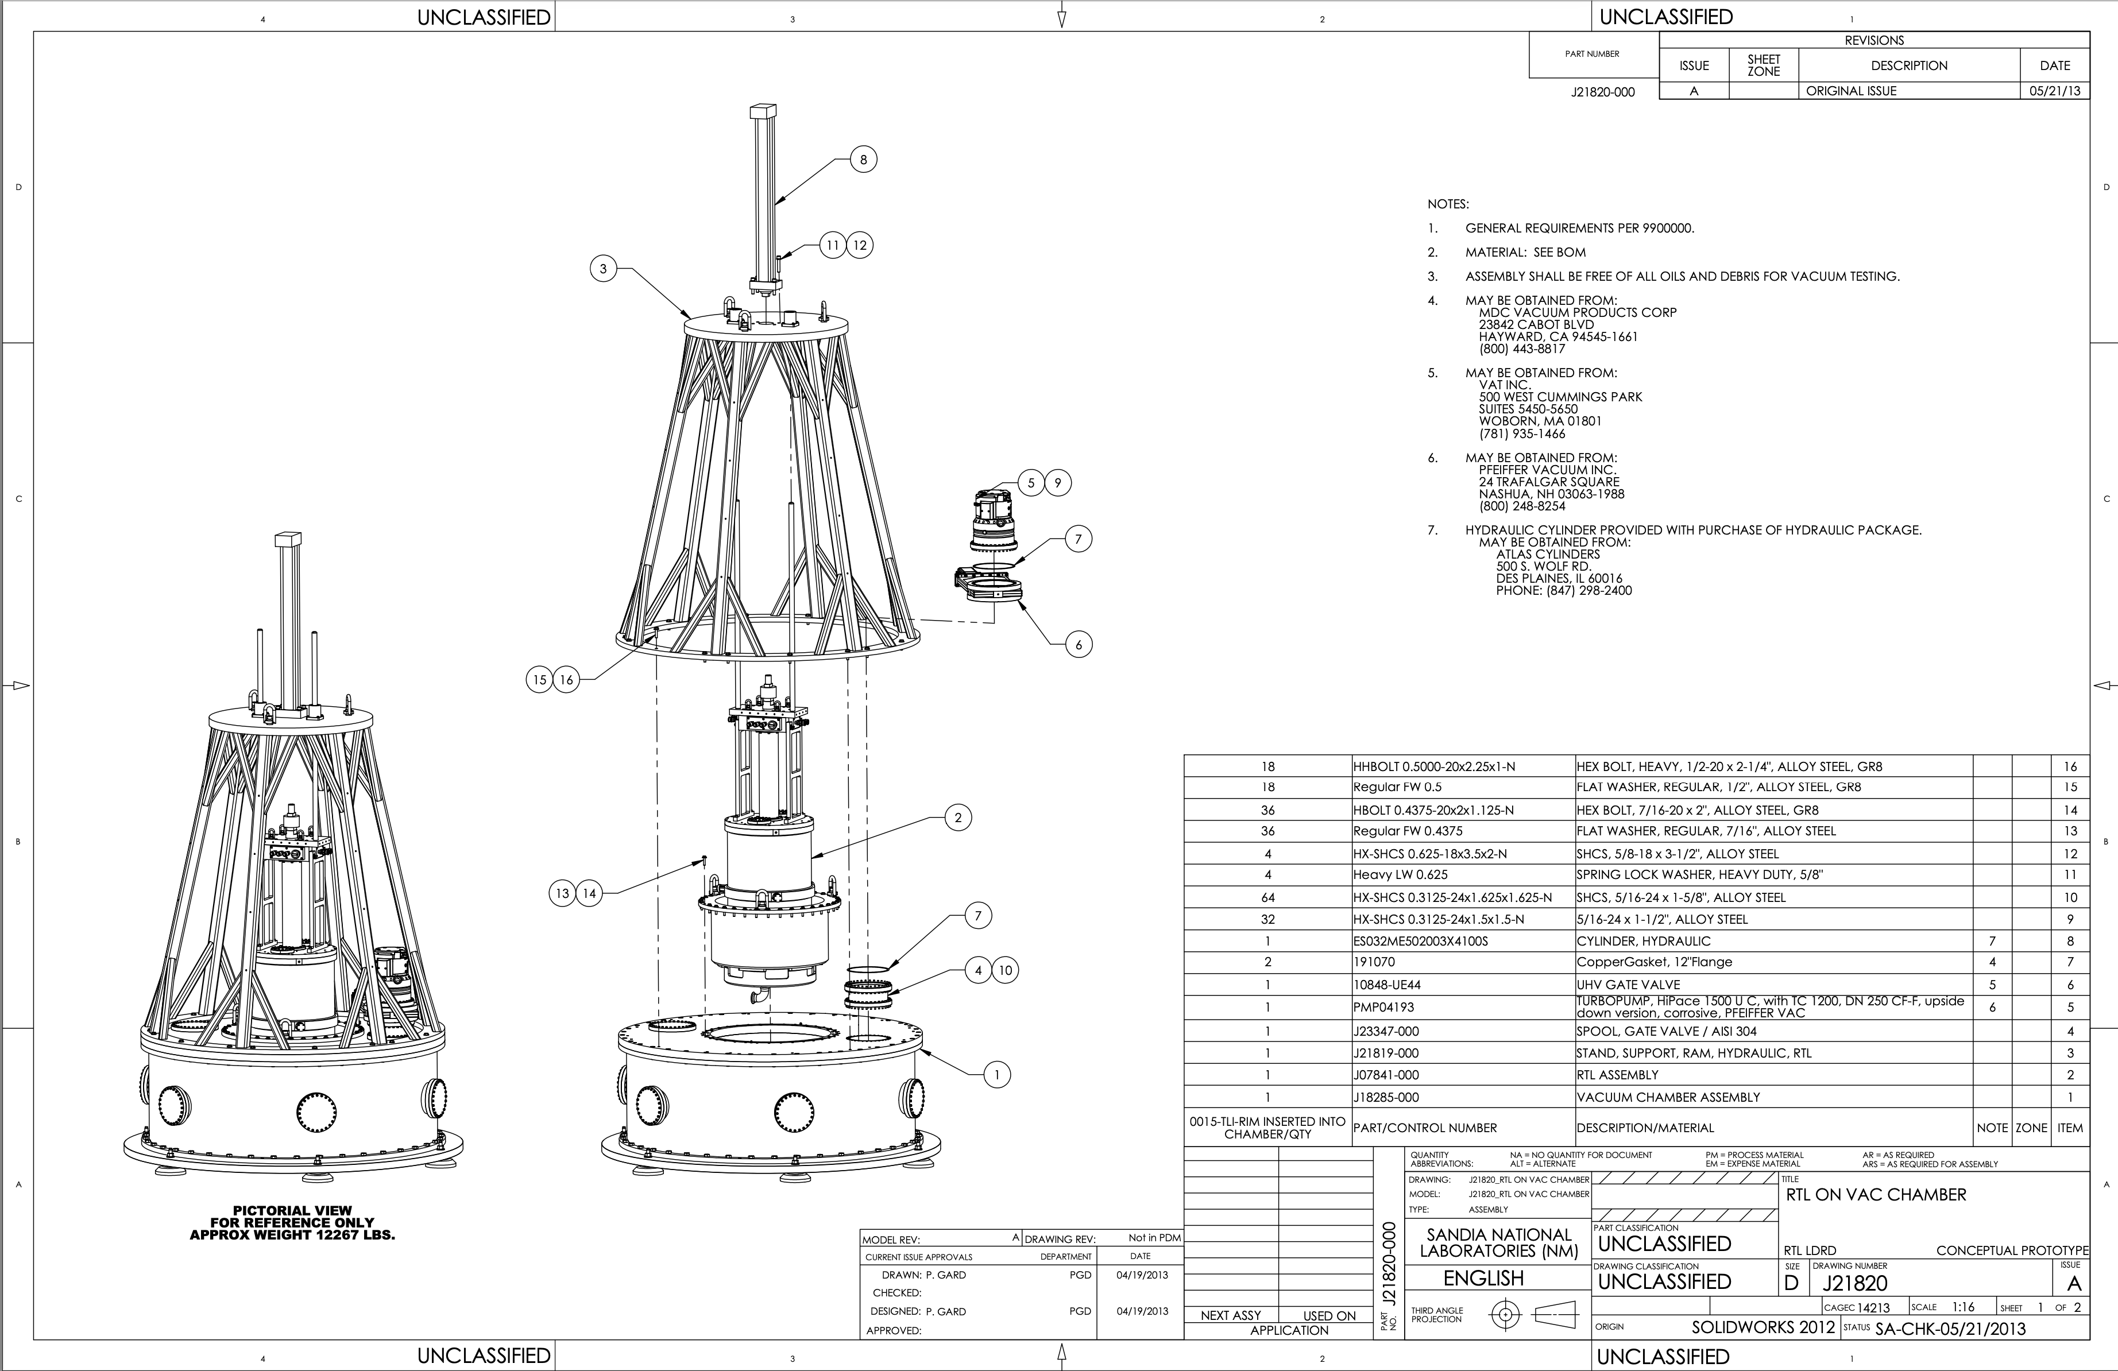
Prior LDRD research⁷ designed a fully engineered prototype Recyclable Transmission Line (RTL) intended to demonstrate solutions to challenges
Report included detailed print drawings to fabricate (but it was never built)
Intended to operate at ~0.1 Hz and >10,000 cycles
Provides current path to target
Pre-pumped MITLs
Extended transmission lines or fast closure valves for standoff.
[7] T.J. Awe et al., “New Strategies for Pulsed Power Transmission Lines: From Repetitive to Replaceable to Recyclable,” Sandia Report, SAND2013-8382 (2013).

Slide 10
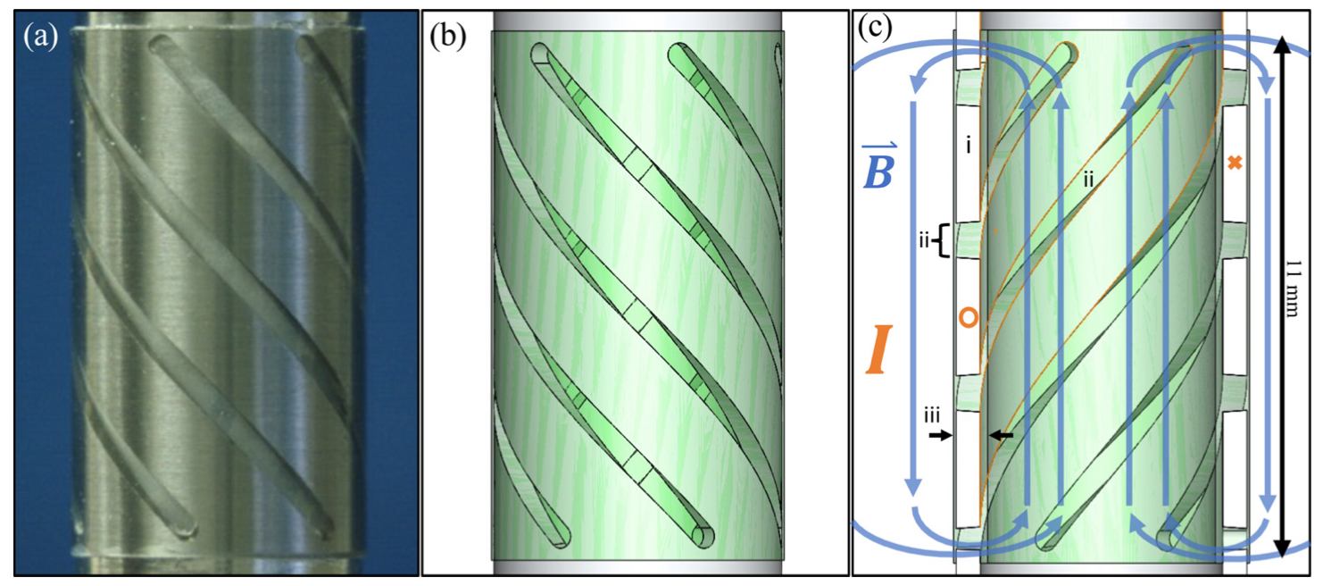
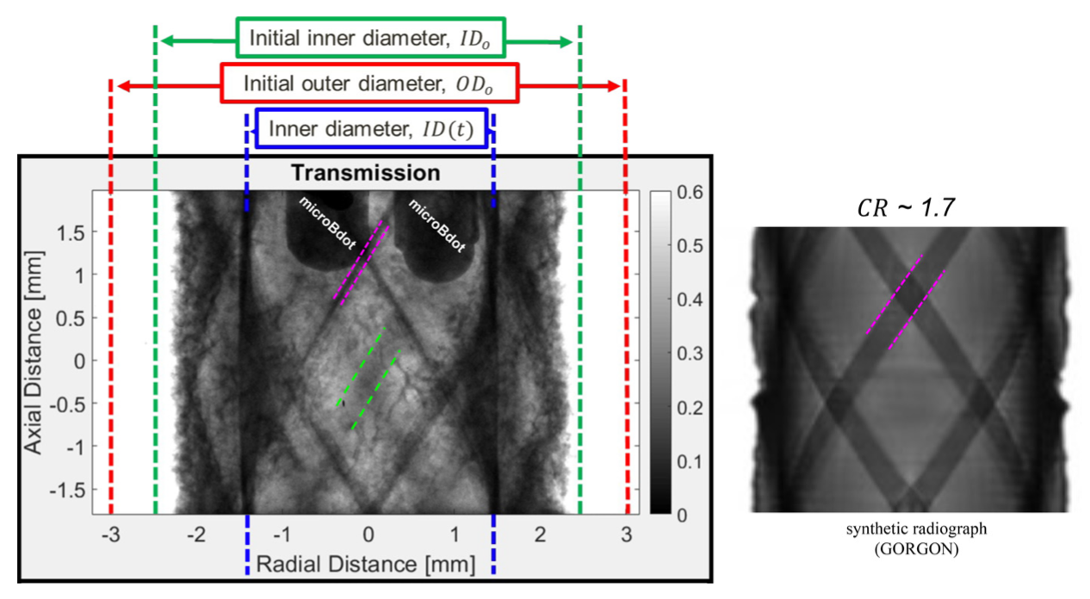
“Auto-Mag”^{[8]} is one approach we have studied on Z and smaller scale facilities to demonstrate axial magnetization without using field coils
[8] G.A. Shipley and T.J. Awe, Phys. Plasmas 30, 102707 (2023).

Slide 11
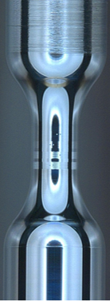
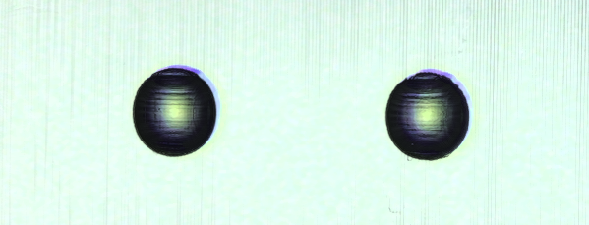
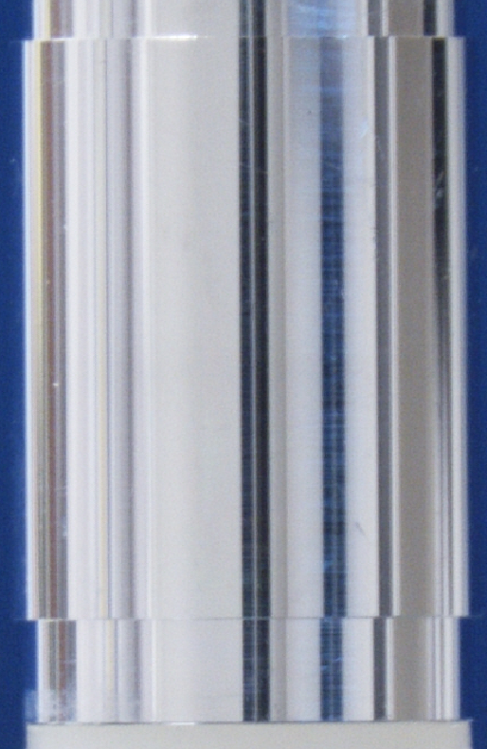
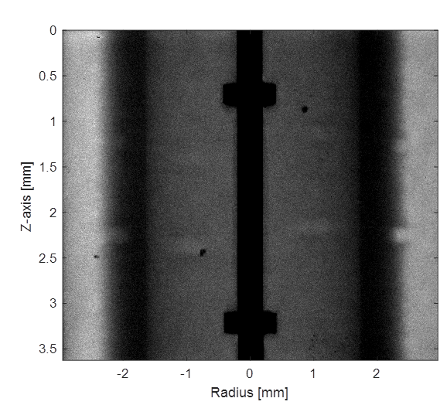
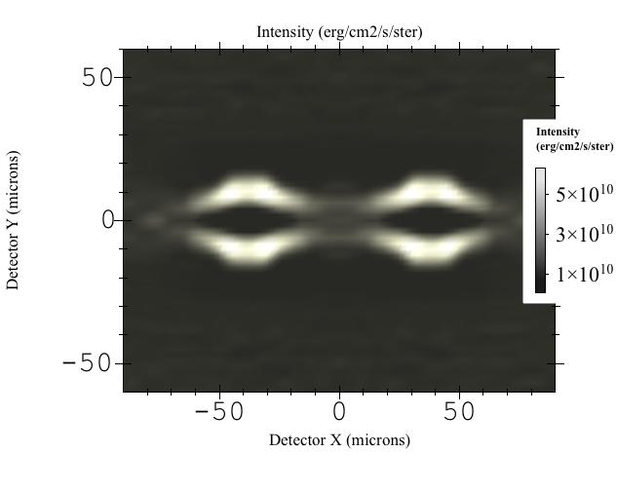
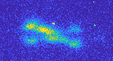
We are using Z and other facilities to quantify the growth and synchronization of instabilities to understand mass production requirements^{[9]}
24 𝜇m pits
100 𝜇m holes (not to scale)
j
Experimental radiograph
R~2.3 mm
simulated visible self-emission
On-axis rod
triplet pattern
triplet pattern
1 mm
experimental visible self-emission
Similar to 1 MA, pair merges
Pair dominates MRT growth at this time
(Courtesy M. Hatch)
[9] T.J. Awe, E.P. Yu, M.W. Hatch et al., Phys Plasmas (2021); M.W. Hatch (to be published).
Notes:
Ensight:11.81

Slide 12
We are working to address perceived shortcomings to magnetically driven fusion highlighted in the recent Basic Research Needs report
  We are looking at how to best establish quantitative systemwide requirements for a magnetically driven IFE system
    Substantial work was done ~20 years ago using LDRD, but with wire array targets that do not include the benefits of using much more robust MDD targets.
  The demonstration of ignition and reactor-level gain will require a facility beyond Z today
    NNSA is considering a Next-Generation Pulsed Power project that would provide about 6-9 MJ to fusion targets, which we predict should be capable of ignition and >100 MJ yields.
  Manufacturing and production of reactor-compatible targets
    Sandia is actively researching the seeds for magneto-Rayleigh-Taylor implosion instabilities (electro-thermal instability and Hall effect). Surface roughness requirements are far more tolerant than in spherical capsule implosions.
    Self-magnetizing targets are highlighted as an important
    development path for MagLIF and are being developed.
  IFE-relevant driver-target coupling technologies
    Recyclable transmission lines, target insertion and
    engagement, and debris mitigation are areas that need
    further development for magnetic drive

Slide 14
Large gaps in weapon high energy density (HED) testing capabilities have existed since the cessation of underground nuclear tests. The need to fill those gaps for the next phase of stockpile stewardship is growing.
Gap
Stockpile Need & Impact
  Inability to experimentally assess nuclear dominated weapon processes and weapon relevant radiation flow
  Inability to test large objects and experimentally simulate high-fidelity warm x-ray and energetic neutron environments
  Inability to experimentally measure properties of strategic materials at certain weapon conditions
  Inability to achieve robust thermonuclear burn and high gain
  Improves confidence and risk tolerance in Nuclear Explosive Package (NEP) assessments and design
  Provides important qualification evidence to assure survivability of evolving weapon systems and environments
  Data needed to support high consequence stockpile decisions, address nuclear counterterrorism concerns, and maximize effectiveness of subcritical experiments
  Enables experimental access to operating weapon conditions (temperatures, pressures) in weapon relevant volumes with real weapon material

