Slide 1

Transforming How We Energize the World
December 2023
Proprietary and Confidential. Do Not Distribute.

Slide 2


General Fusion will transform the world’s energy supply with the fastest and most practical path to commercial fusion energy —
Magnetized Target Fusion (MTF)

Slide 3
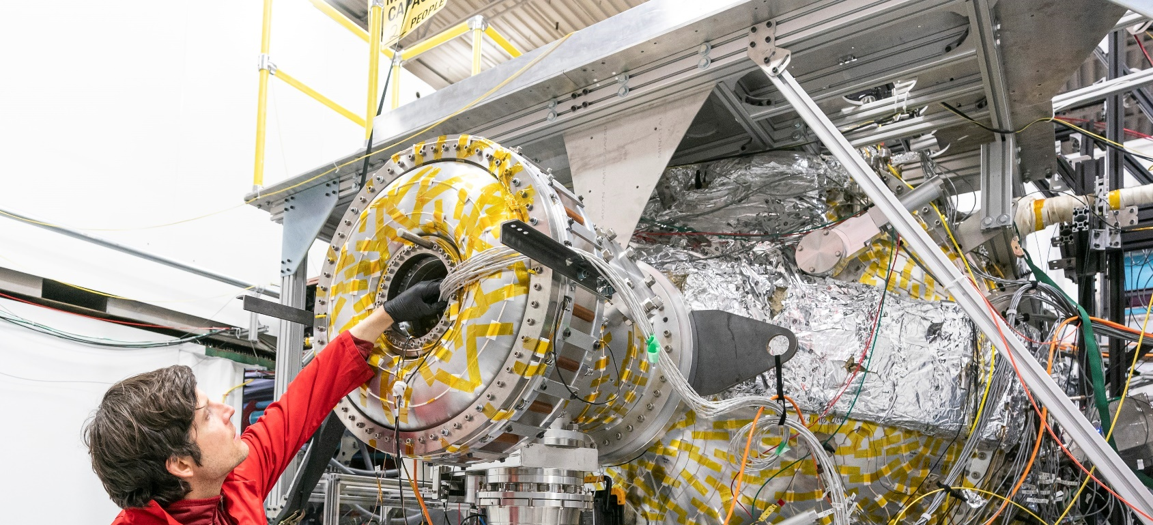


General Fusion Overview
General Fusion has the surest, fastest pathway to commercial fusion
Company
General Fusion Strategy
Founded in
Headquartered in Vancouver, Canada
2002
Pursue the fastest, lowest-risk path to commercial fusion with practical Magnetized Target Fusion technology (“MTF”)
MTF uniquely solves hurdles to commercialization
Core technologies in
place and tested
Next milestone is compression of magnetized plasma to fusion conditions
New, state of the art fusion campus, with ~100,000 sq ft spanning 3 facilities
~150 employees
>170 patents¹
Backed by a global syndicate of leading investors and government support
~US$325 million raised to-date²
General Fusion’s two decades of technology development put commercial fusion within reach

Slide 4
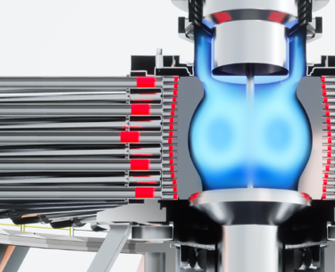

A Balanced Approach – Proprietary Fusion Technology that is Uniquely Practical
General Fusion’s technology optimizes advantages of magnetic confinement and inertial compression for commercialization
Magnetized Target Fusion
Magnetic Confinement Fusion
Inertial Confinement Fusion
All-Confinement Pathway All-Compression Pathway
General Fusion’s Superior Approach
Durable Fusion Machine
Sufficient Fuel Production
Simple Energy Extraction & Conversion
Economical Fusion Power
Prohibitively expensive magnets
Scarce, consumable fuels
Material issues due to neutron damage
Heat extraction challenges
Expensive high-power lasers and/or targets
Scarce, consumable fuels
Efficiency, structure and control issues
Heat extraction challenges

Slide 5
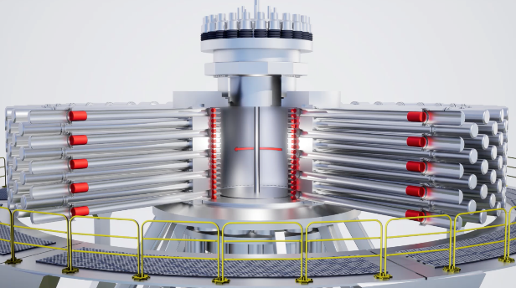
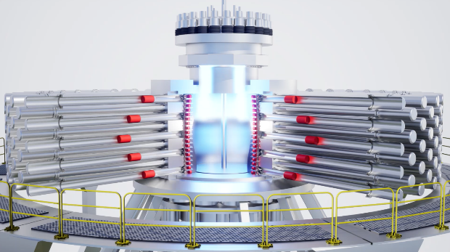
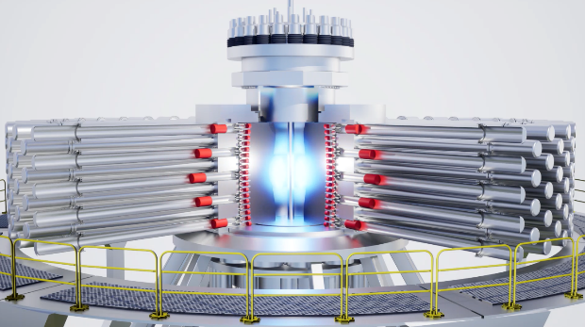
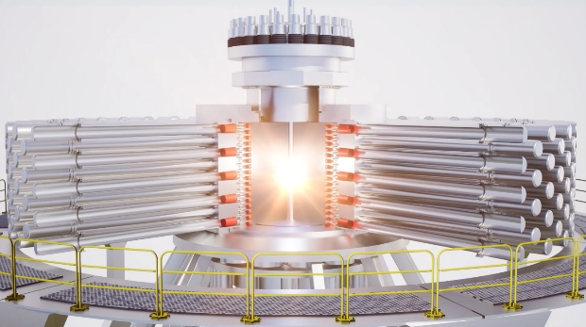

General Fusion’s Magnetized Target Fusion Approach
Commercial fusion machine basics
Form liquid metal cavity inside fusion vessel
Inject magnetized plasma¹ into liquid metal cavity
Compress plasma with liquid metal using mechanical drivers
Fusion and energy extraction, conversion and recovery
Plasma injector
Liquid metal
Pistons
Fusion
Repeat
Magnetized plasma compressed fluid-mechanically to fusion conditions
1. General Fusion’s plasma injectors form spherical tokamak plasma targets using a 100% coaxial helicity injection (CHI) process. Targets are formed into a chamber with solid metal walls. There is no active feedback; plasma position and stabilization is accomplished entirely through the metal walls acting as a flux conserver.
5

Slide 6

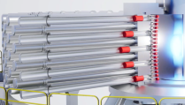

General Fusion’s Unique Approach Solves the Four Long-Standing Barriers to Commercial Fusion
1
2
3
4
Material Degradation
Fuel Production
Energy Capture
Cost
Neutrons emitted from fusion reaction damage unshielded machine structures
Difficult technological path for creating a self-sustaining fuel source
The path to extract and convert fusion energy into a heat source and electricity is still experimental
Steady-state fusion needs costly superconducting magnets, while inertial confinement relies on pricey high-power lasers and/or targets
General Fusion Addresses the Barriers to Commercial Fusion
Plasma Injector
Hot Metal
Tritium Extraction
Heat Exchanger
Deuterium-Tritium
Capture and Storage
Deuterium-Tritium Fuel Supply
Durable Fusion
Machine
Sufficient Fuel
Production
Simple Energy Extraction and Conversion
Economical Fusion Power
Liquid metal wall compression technology absorbs neutrons and protects machine from fusion damage
Liquid metal wall surrounding fusion plasma produces tritium fuel with a sustainable breeding ratio
Liquid metal wall surrounding fusion absorbs neutrons and heat for simple conversion to electricity via steam turbine
Mechanical compression with liquid metal avoids the need for expensive magnets or targets, high-power lasers and exotic/unavailable materials

Slide 7
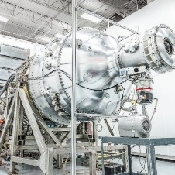


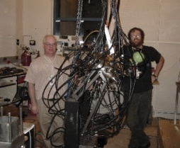
General Fusion's Achievements
In the past 20 years, General Fusion has achieved significant milestones on its mission to deliver practical fusion energy
Proven success scaling individual technologies, creating the pathway for General Fusion to integrate, deploy and commercialize fusion energy
2021-2023
2016-2020
2021
Plasma performance sufficient to achieve fusion conditions at scale¹
Compressed liquid cavity with symmetry and controlled shape sufficient to achieve fusion conditions
2022
Market Development Advisory Committee formed
Exceeded core technology performance targets with plasma and compression prototypes
2023
Symmetrical compression results from LM26 test ring compression test bed
2002-2005
2006-2015
2010
First plasma injector properly confined plasma
2012
Liquid metal compression tests validated engineering of liquid metal approach and synchronization of pistons
2013
Sufficient plasma performance to heat when compressed
2017
Stable compression of plasma
2018
Heating and increased neutron yield during plasma compression
2019
Plasma lifetime maintained within liquid metal wall cavity
2002
Founded
2005
First fusion reaction to produce neutrons
Fusion Process Stability
Plasma Performance
Liquid Compression Performance
7

Slide 8
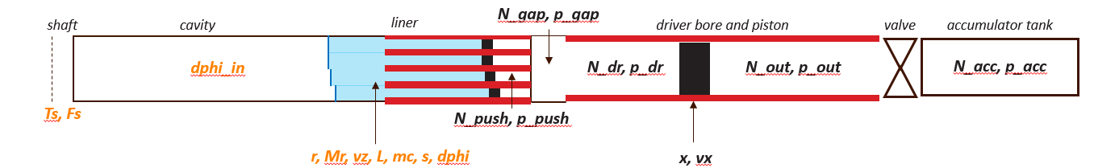
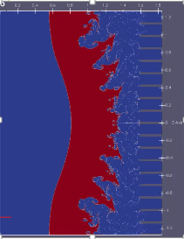


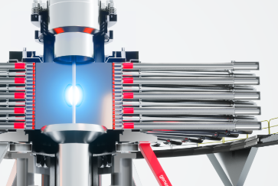
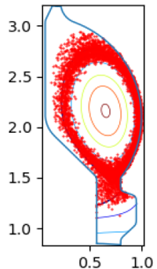
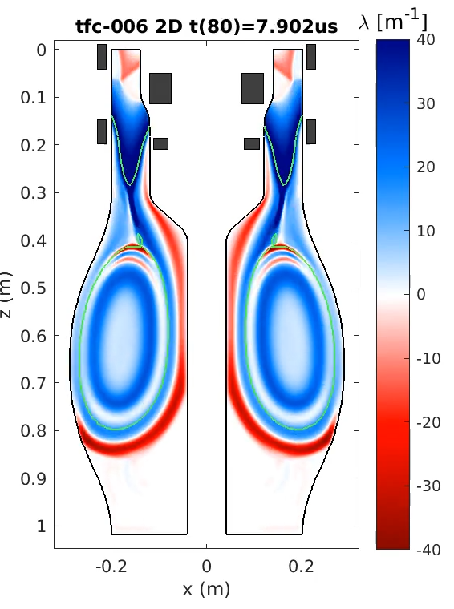

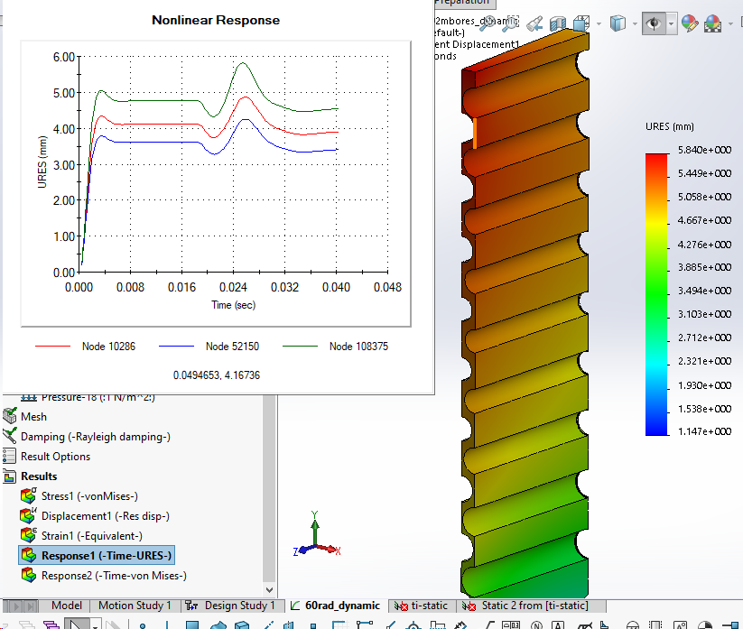

Simulation and Modelling – Applied physics is combined with rapid development of testbeds and large prototypes
Integrated Model
Simple, 1D, 2D model of entire system
Used to explore and optimize in a wide space of parameters (size, speed, cavity shape, plasma)
Plasma Stability
DCON
Stability of plasma to resonant modes
Liquid Metal Dynamics
OpenFOAM
CFD-MHD code to predict the shape of liquid metal cavity, including effect of plasma forces.
Plasma Boundary
Interactions between plasma and liquid wall
Plasma Dynamics
VAC MHD code
Simulate plasma formation, evolution and compression
Dynamic FEA
ANSYS Structural
Analyze solid component stresses
Thermal Transport
TGYRO, CGYRO
Gyrokinetic thermal transport

Slide 9
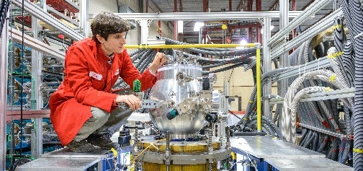
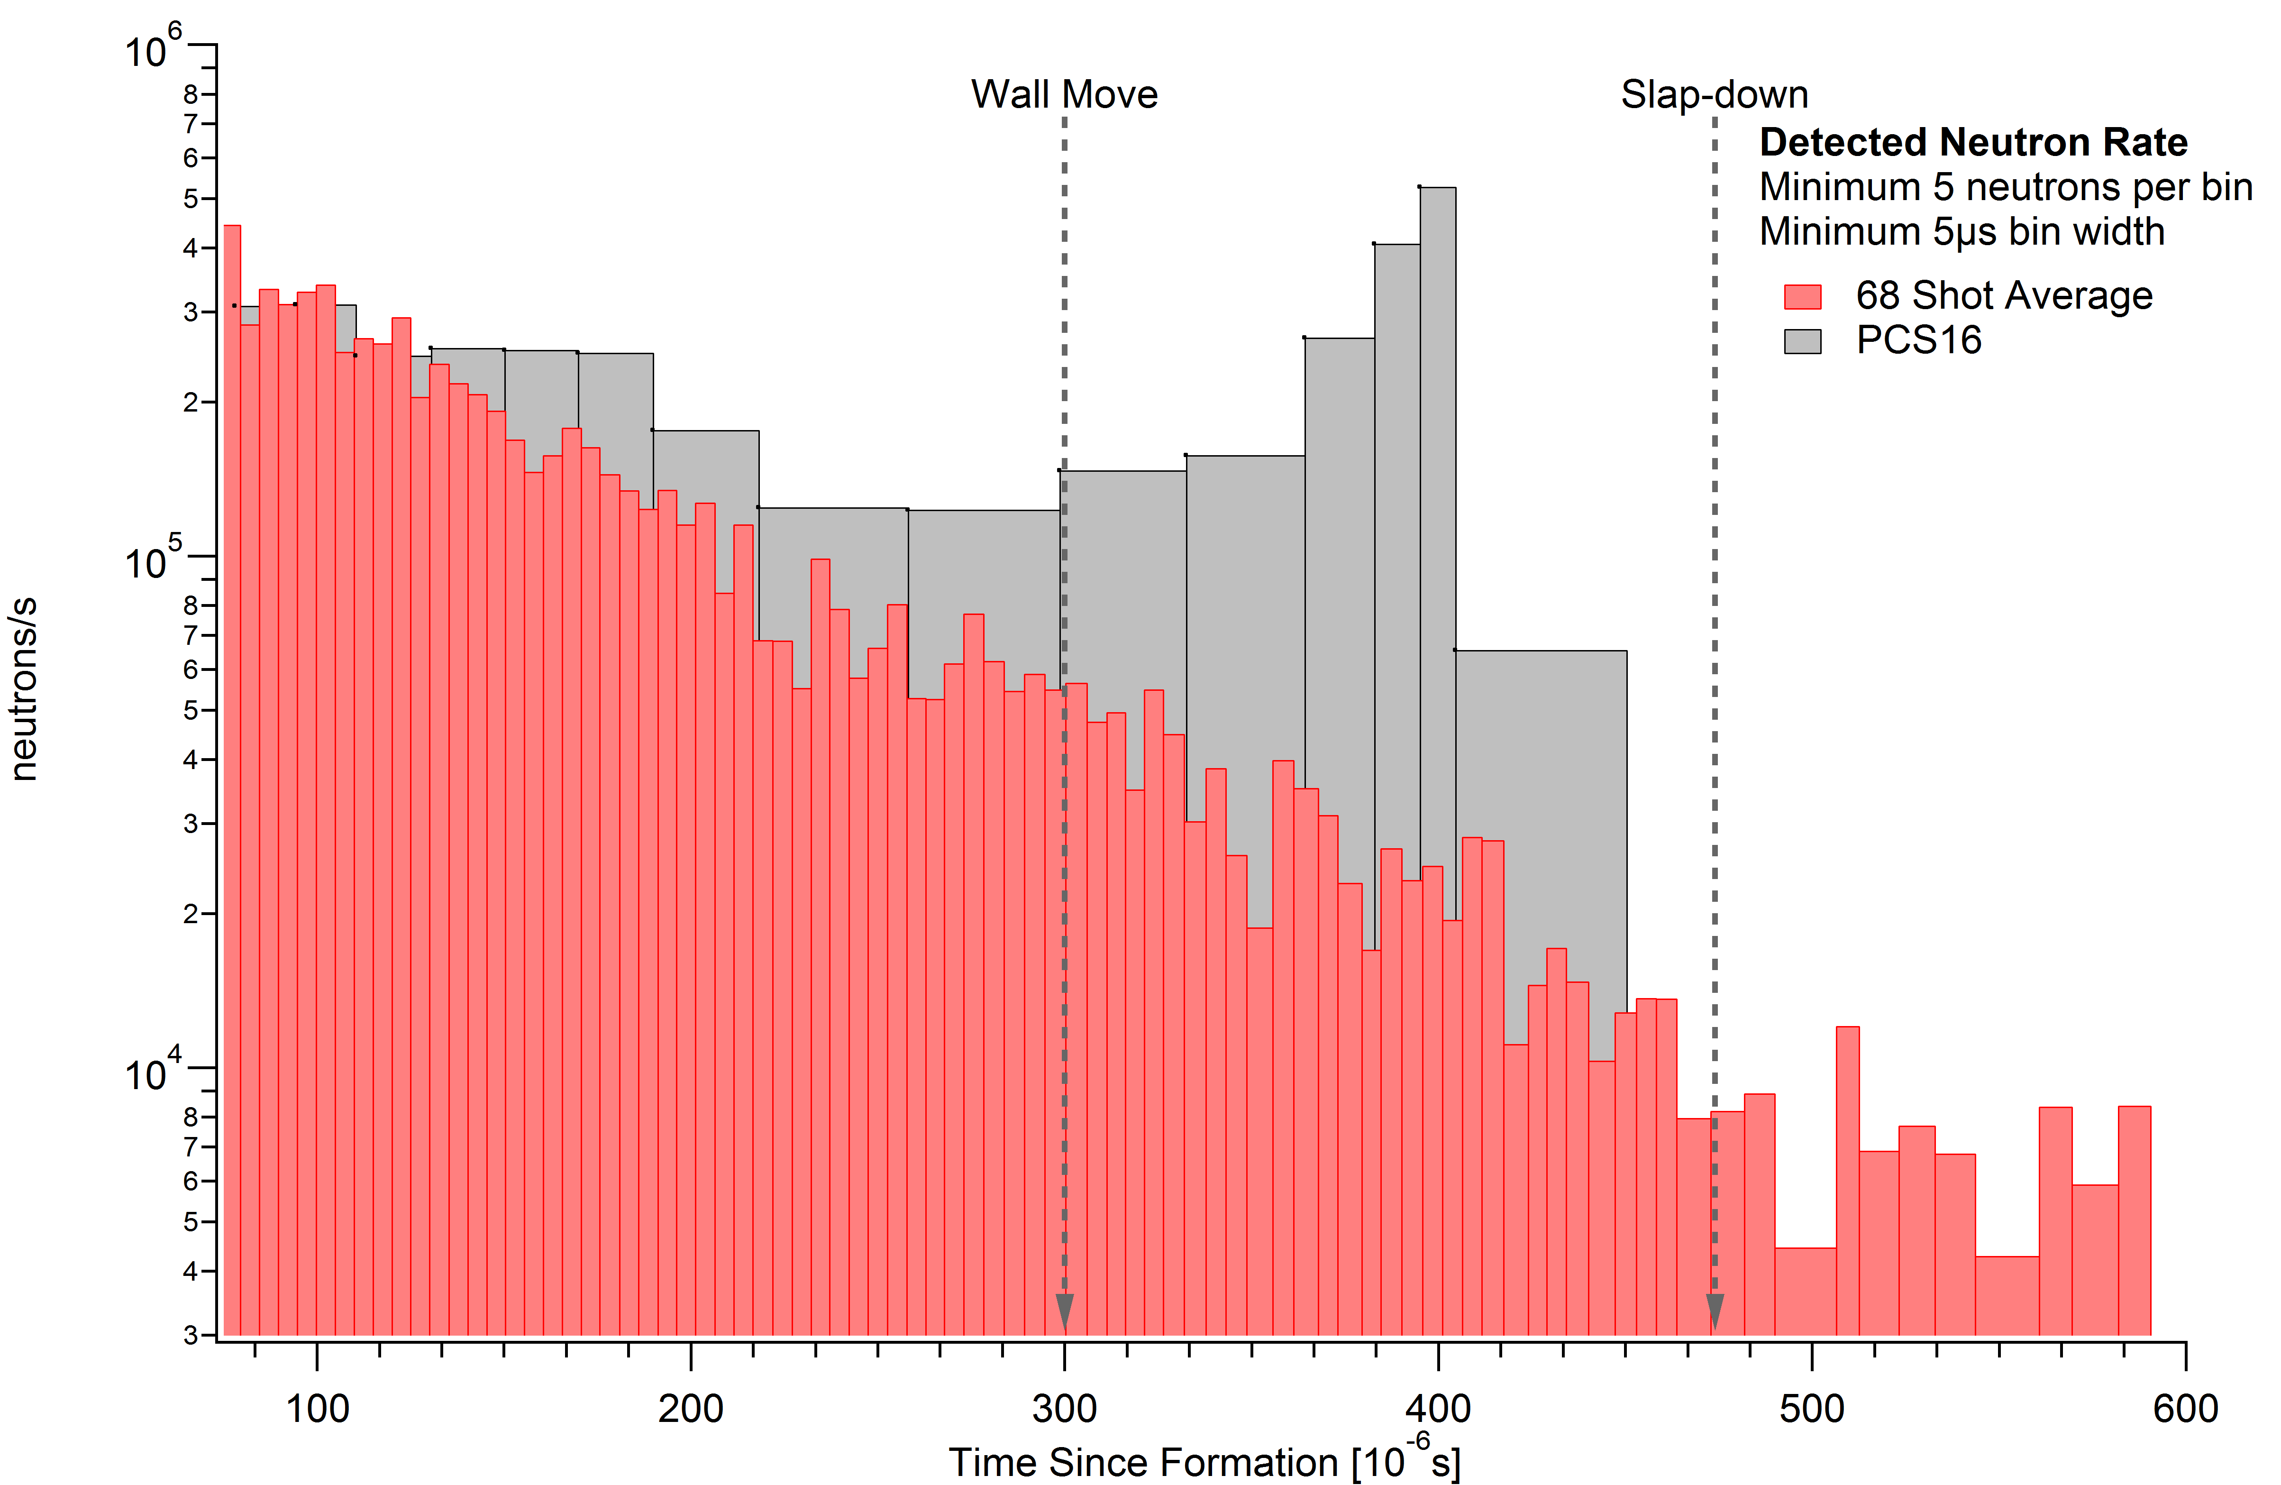
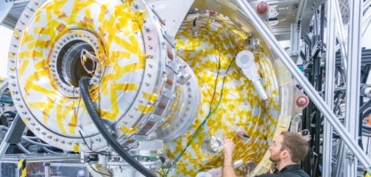
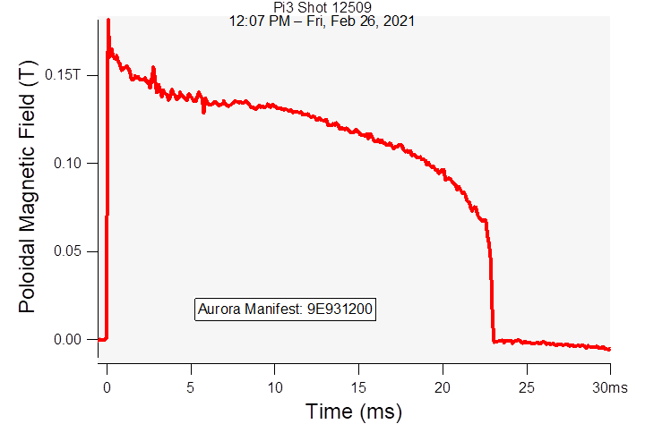
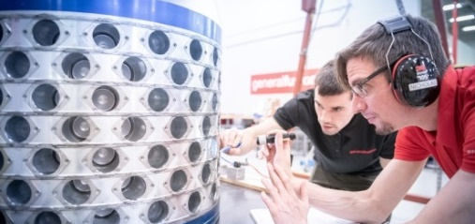
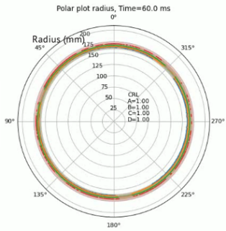
20 Years of Practical Development and Demonstration
Core technology capabilities developed and successfully tested
`
Fusion Process Stability Under Compression
Sub-scale science program provides understanding of plasma behavior and neutron yield under compression as well as plasma behavior in liquid metal systems
Plasma Performance
24 prototypes and over 200,000 plasma experiments have culminated in the world’s largest and most powerful operational fusion plasma injector for LM26
~10 ms τ
Compression window
Liquid Compression Performance
Testbeds demonstrate compression technology necessary for smooth, rapid and symmetric compression of a liquid cavity
Next Up: LM26 – Integrated demonstration of Magnetized Target Fusion to achieve fusion conditions (10 keV) with potential for breakeven¹
9

Slide 10
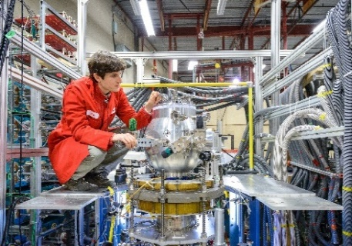
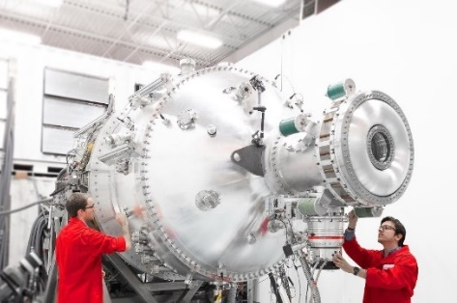
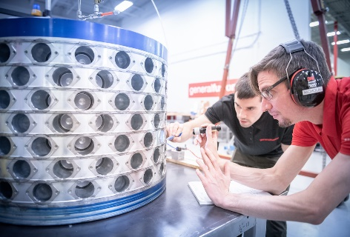
LM26 Demonstration Program
General Fusion Milestones Completed
Three Core Technology Milestones Achieved, Leveraging Large Scale Prototype Systems
Fusion Process Stability
Plasma Performance
Liquid Compression Performance
Next Milestones
LM26 Demonstration Program
Commercialization Program
2021 – 2023
2025
2026
2026 Onward
Near commercial fusion machine with liquid lithium compression system, followed by first commercial plant putting electricity on the grid
Demonstration of LM26 Plasma Injector Performance: Plasma injector¹ achieved pre-compression plasma performance sufficient to achieve fusion conditions (10 keV) when compressed
Demonstration of LM26 Plasma Compression to 10 keV: Addition of solid lithium liner compression system to LM26 plasma injector to achieve fusion conditions (10 keV) through compression of magnetized plasma
LM26 modification to increase plasma performance to target breakeven²

Slide 11
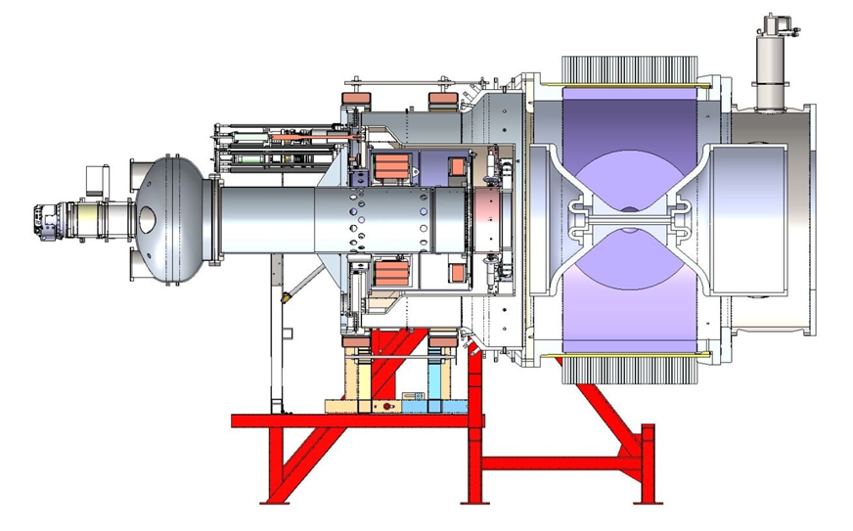
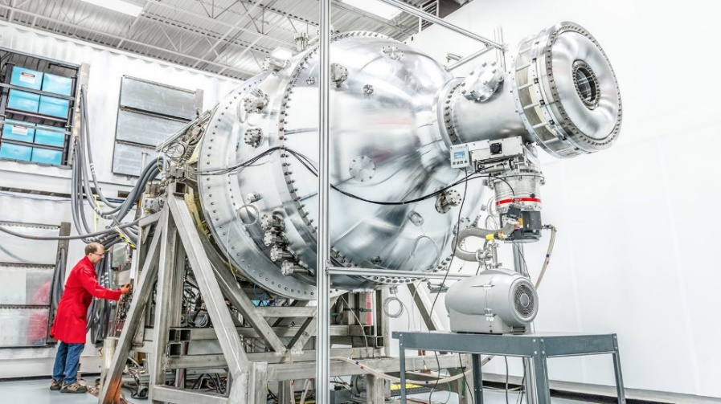
Lawson Machine 26 (“LM26”)
General Fusion’s LM26 machine will compress General Fusion’s world-leading plasmas using a lithium liner
LM26 Demonstration Program in Progress
Liner Pre-Compression
Liner Post-Compression
+
Plasma Injector
Fiberglass Vessel
Coils
1. Plasma Injector Operating
2. Next Step: Compression System Integration
Plasma lifetime and density sufficient to create fusion conditions (10 keV) when compressed
Compression system will compress plasma using electromagnetic acceleration of a solid lithium liner
The LM26 machine aims to reach 10 keV in 2025 with increasing progress toward breakeven¹ demonstration in 2026
General Fusion’s goal is to achieve scientific breakeven¹ (100% Lawson) in 2026

Slide 12
General Fusion’s Practical Commercial Power Plant
General Fusion’s MTF technology is ideally suited for traditional steam plant applications and repowering old power plants
Fusion Island
Balance of Plant
Conventional Island
Pulsed
Power
Supply
Steam Tank
Plant Electricity Supply
Hot
Metal
Hot Steam
Plasma Injector
Tritium Extraction
Power to
the Grid
Heat Exchanger
Deuterium-Tritium Fuel Supply
Steam Turbines
Generator
Fuel Exhaust
Deuterium-Tritium
Capture and Storage
Cool Steam
Cooling
Condenser

Slide 13
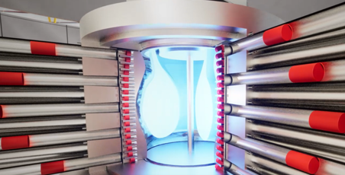
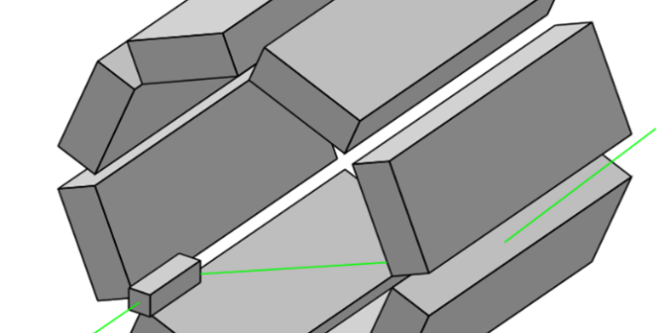

















A Wide Spectrum of Partnerships
General Fusion has partnerships with industry leaders to accelerate its path to commercial deployment
Fusion Technology Development
Diagnostic
Development
Support for Future Near Commercial Machine and Related Systems
Collaboration agreement with UKAEA propels General Fusion’s technology and commercialization plans forward
Current UKAEA Collaboration Projects:
Neutronics Model Development and Simulation
Qualifying Class 3 Steel for Vacuum
Supply of Thompson Scattering Polychromators
Magnetic Profile Reconstruction Validation
Polarimeter and Interferometer Consulting
STEP²-GF Supply Chain Development
Thermal Transport Analysis Training
Build sustained value around proprietary MTF fusion technology
Leverage experience to build diagnostic tools
Cornerstone partners to support commercialization
Potential Site For
Near Commercial Machine
JET Facility
Technology Development Partner
Diagnostics and Code
Project & Future Location Partner
Plasma Stability and Compression
Neutron Spectrometer
Engineering and Construction
MHD Simulation
Magnetic Probes
Architect
Hydrodynamic Stability
Neutron Diagnostics
Building Engineering
Edge Plasma Modeling
Ion Doppler
Project Management
Thermal Transport
Forging and Materials
Tritium Extraction
Liquid Lithium
Tritium Inventory
Commercial Rotor
3-D Additive Manufacturing Specialist
Example: 3-D Printing
Example: Plasma Science

Slide 14
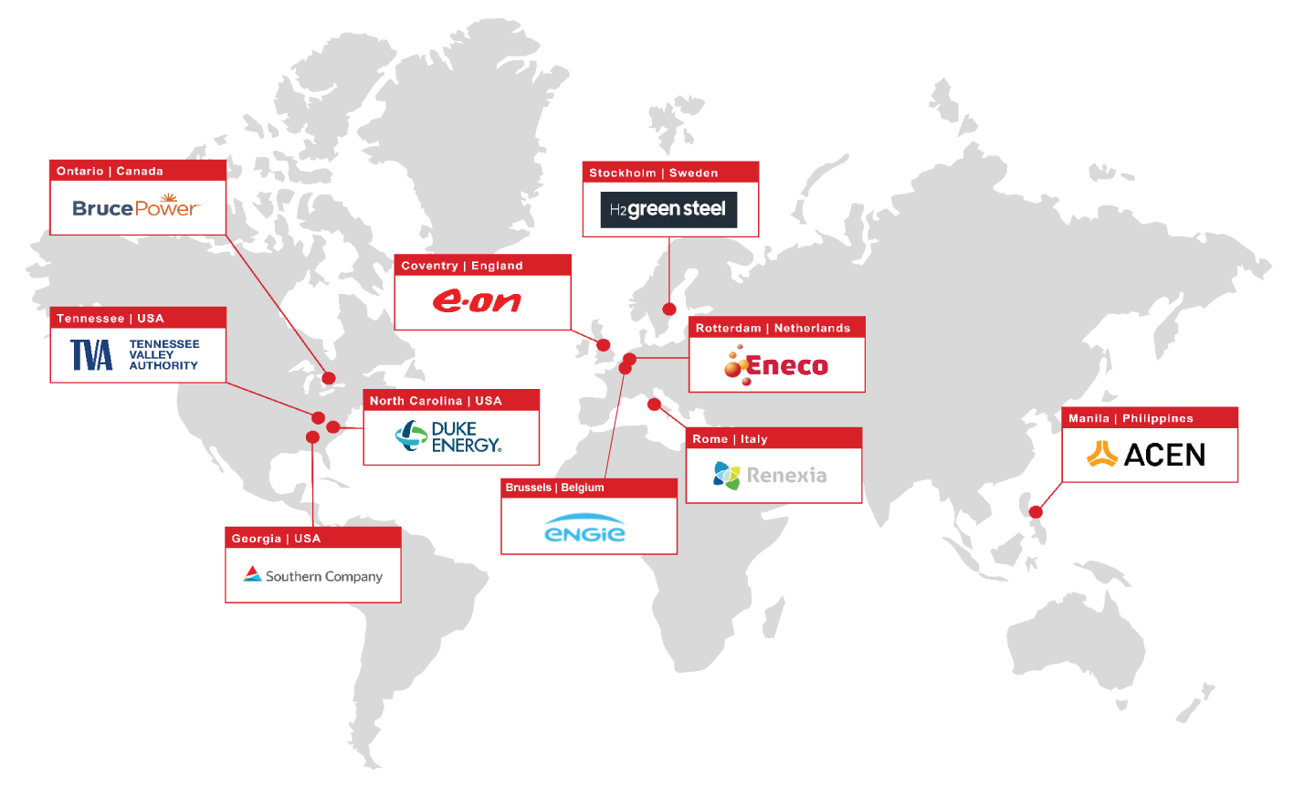
Building Potential Launch Customer Portfolio for Early Adopters
Focus on key prospective markets and customers with Market Development Advisory Committee (“MDAC”)
Purpose of the General Fusion MDAC
Current Members of the General Fusion MDAC
Develop early adopters for commercial power plant
Apply end-user input to commercial power plant design
Support formation of regulatory framework for fusion
Participate in energy policy and market design
Regulatory Engagement
The United Kingdom set precedent as the first country to propose a fit-for-purpose, technology-appropriate, fusion regulatory framework in 2021
In 2023 The United States Nuclear Regulatory Commission voted to regulate fusion energy separately from the regime that regulates nuclear fission
Fission and fusion require different technology-appropriate regulatory regimes. Fusion requires no special nuclear material
Notes:
Fission and fusion require different technology-appropriate regulatory regimes; Fusion requires no special nuclear material

Slide 15




TM
Clean Energy. Everywhere. Forever.
Website
generalfusion.com
Twitter
@generalfusion
Instagram
@generalfusion
LinkedIn
general-fusion

